Slide 1
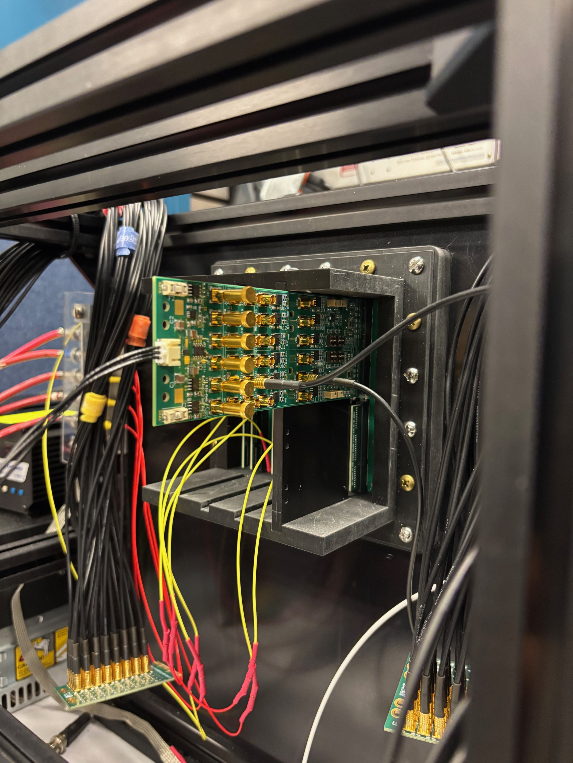
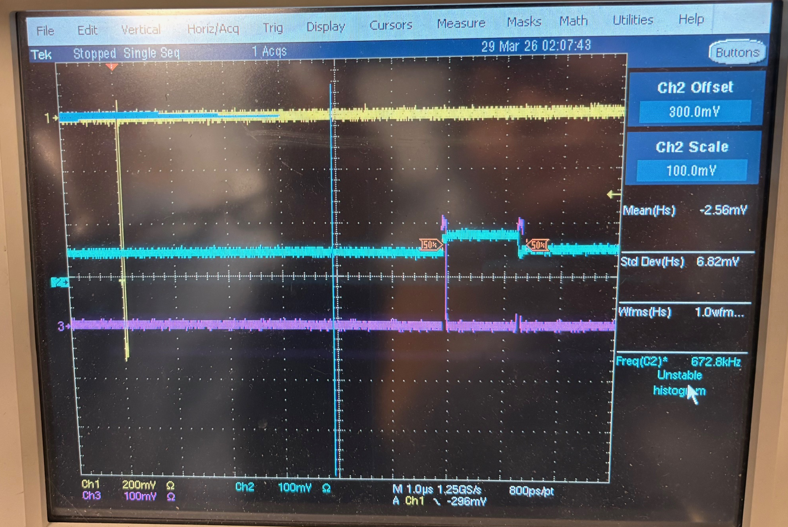
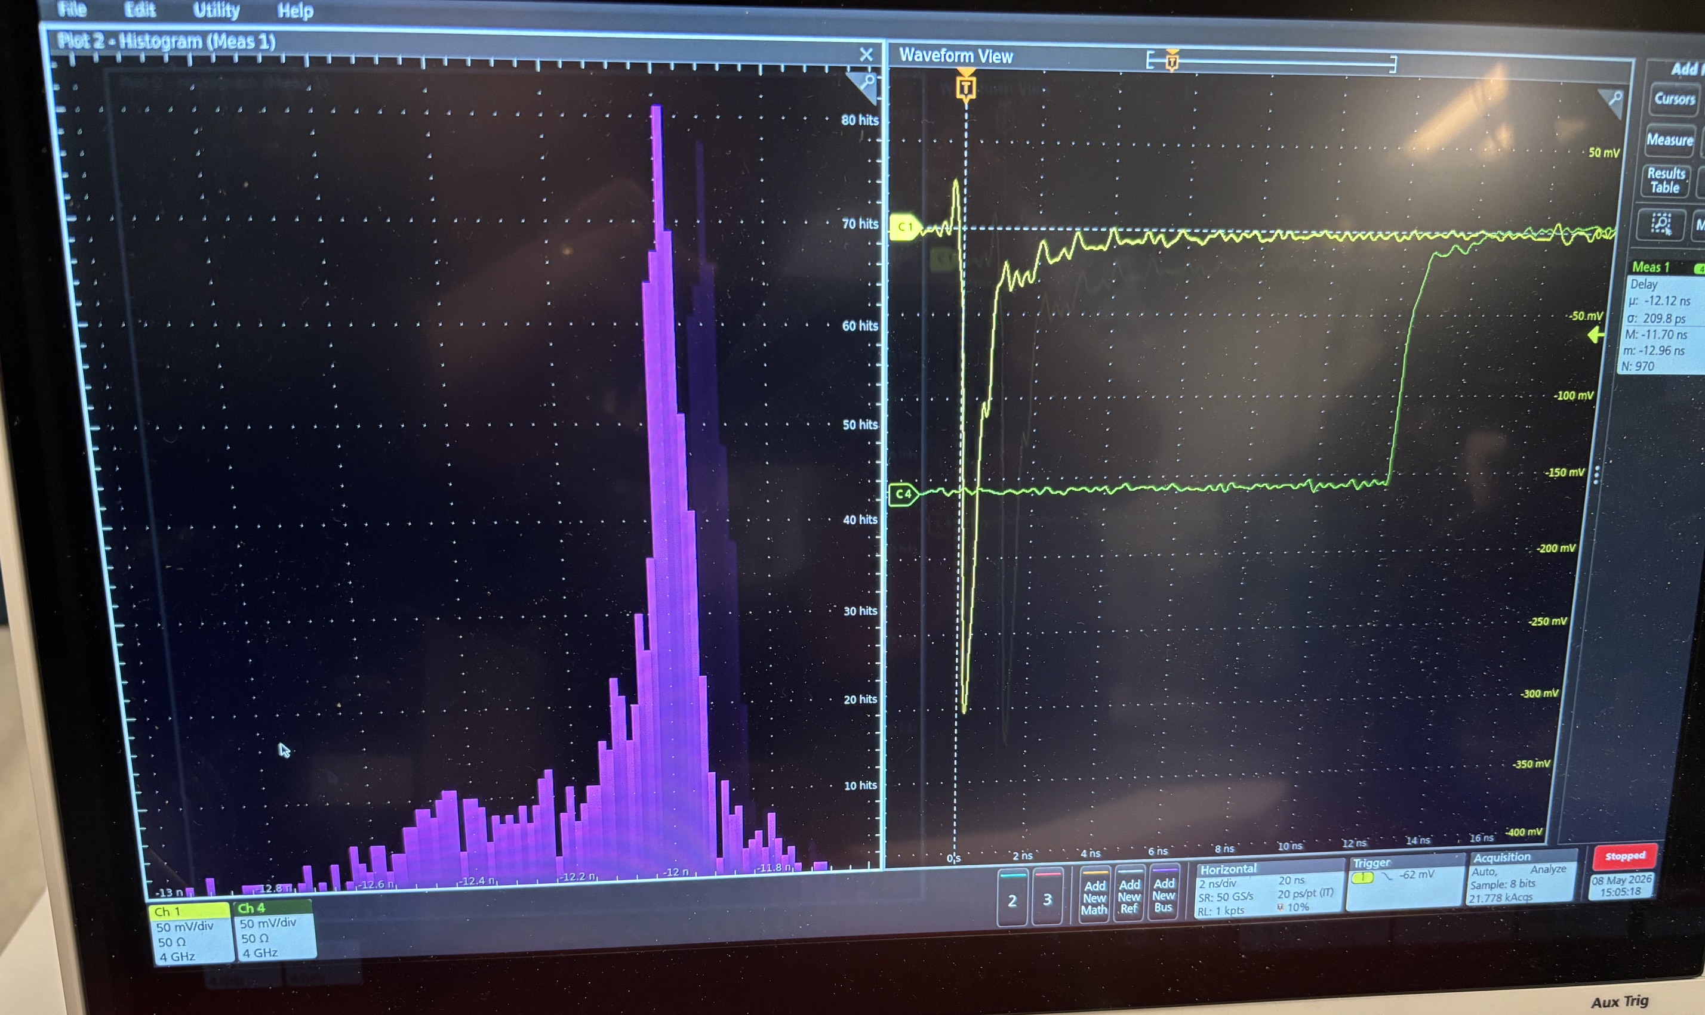
FCFD evaluation card test status
Takao Sakaguchi, BNL on May 14, 2026
Initial smoke test passed (Apr 13). Removed a 66.5 Ohm resister placed at the input (Raymond’s suggestion).
  Found input/output channel mapping issue.
  Big noise due to the “on-the-fly” pulse injection system
Connected to HRPPD on May 8 again.
Alexander measured timing jitter for FCFD discriminator.
  FWHM of the narrow peak is around 60-70psec? -> maybe 30psec in sigma
Sent one card to Raymond (on Tuesday)
(1) Input pulse
(2) Analog output
(3) Discr. output

Slide 2
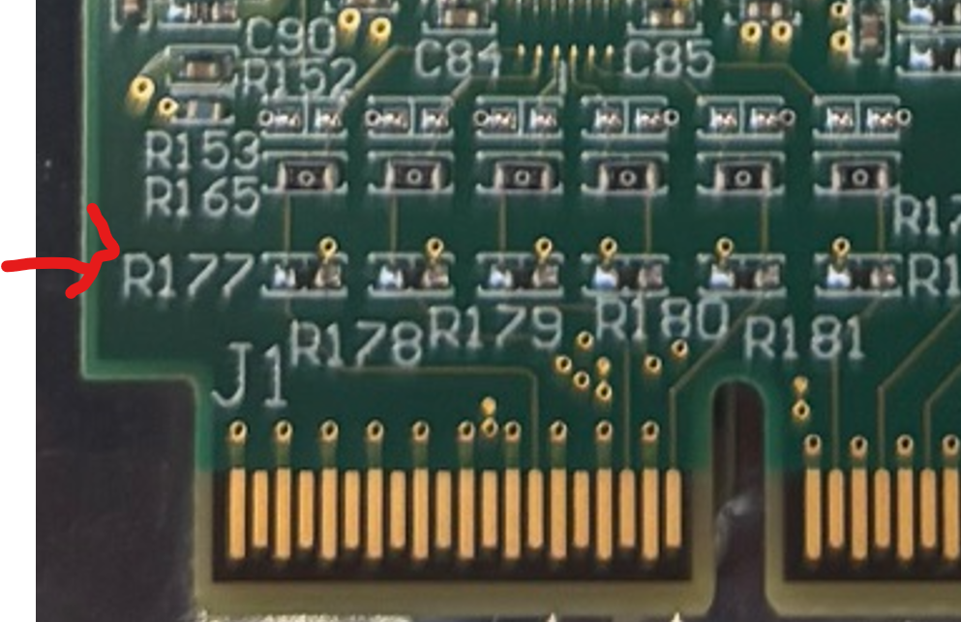
Issue and next step
Issue
  The engineer who worked on wire-bonding is away until the memorial day weekend. I will ask Don to finish the rest three cards.
Next step.
  One more card has been modified (66 Ohm removal and GND patch) for spare for CERN test. Will be passed to Alexander today.
We will have FCFD review on May 20.
  We got an idea on power consumption of FCFD on May 11, already. See next two slides.
  No update on input impedance info.

Slide 3
Backup

Slide 4
