Slide 1
LV power consumption and readout scheme update
Takao Sakaguchi

Slide 2
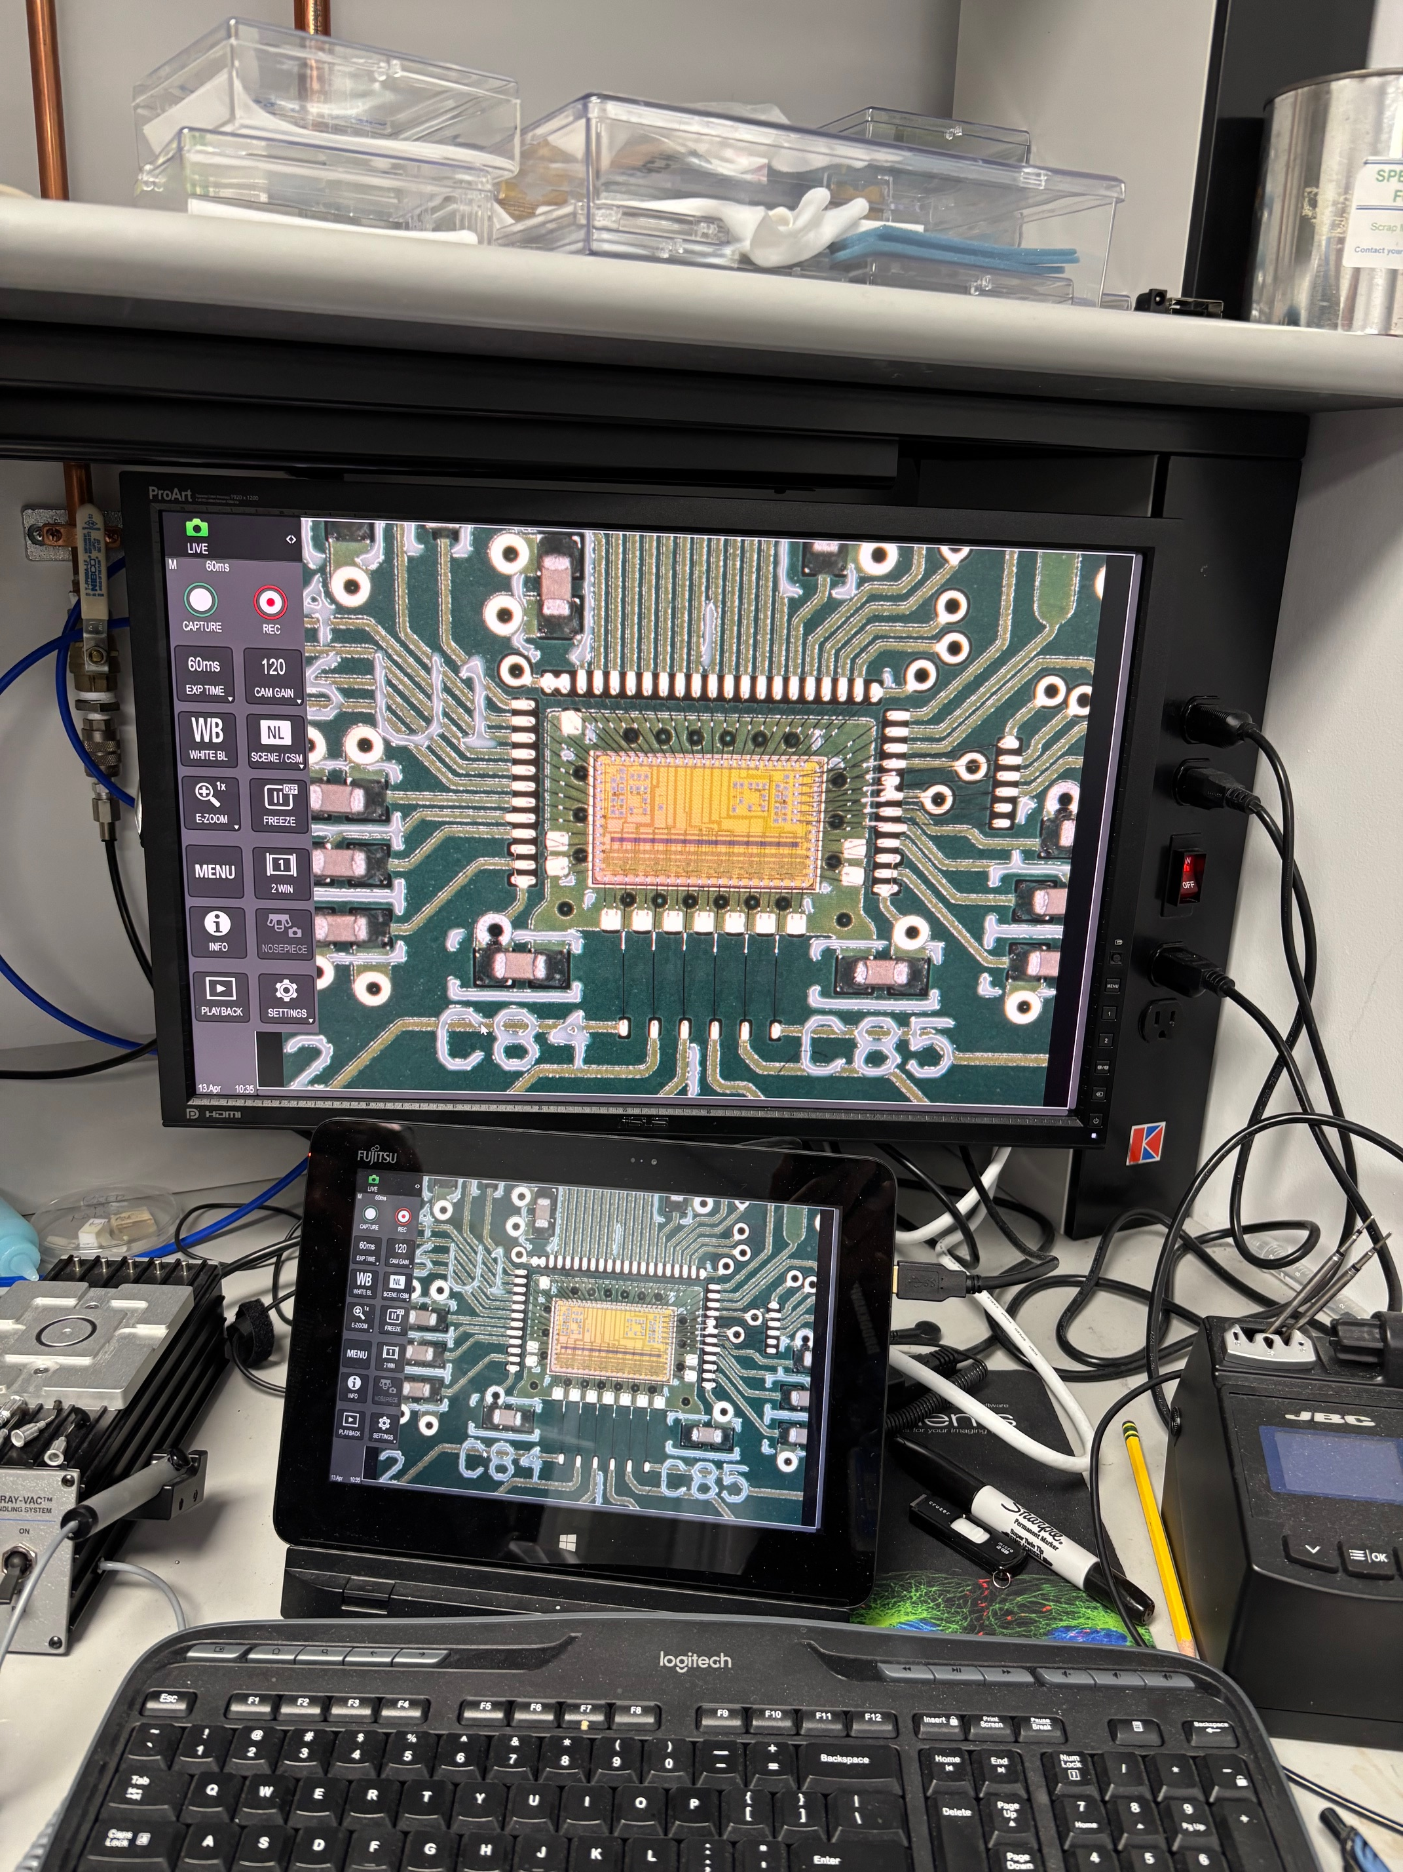
Power consumption of a 32ch-FCFD
FCFD now goes for 32ch/chip.
Previous number:
Estimated from the table for 128ch.
Analog 32ch: 3.8mW * 32 = 120mW
TDC+ADC 32ch: 0.2mW *32 = 6.4mW
Supporting Circuitry 32ch: 6.4mW
Global circuitry: 1per chip = 200mW
Total power per chip will be: 330mW
New number:
As presented at the TIC meeting
Analog 32ch: 3.6mW * 32= 116.2mW
TDC+ADC 32ch: 0.2mW*32= 6.4mW
Supporting Circuitry 32ch: ?
Global circuitry: 1 per chip = 78mW
Total power per chip: 200mW.
Table presented by Artur at ePIC coll meeting on Jul 16, 2025
Table presented by Artur at TIC meeting on May 11, 2026
From Artur’s slide

Slide 3
Readout scheme and LV power consumption
Average data rate (incl background):
Based on hit rate provided by Brian
5bit ADC/TDC + ~20% hdr =12 bit/hit/pad.
15Mbps per HRPPD
1Gbps from pfRICH as whole
Bandwidth of lpGBT + VTRX+
Max bandwidth for lpGBT with FEC10 encoding is 7.68Gbps. (10.24Gbps mode)
Whole pfRICH data could fit to this.
Conceptual readout scheme.
Four (tentative) FCFDs per FEB.
FCFD output bandwidth: 320Mbps/chip
A Father board (FB) (a set of lpGBT and VTRX+) handles eight FEBs.
FB can handle multiple HRPPDs, but we should carefully design conn. diagram.
Power: 1.1*8+1.6 = 10.4 W/HRPPD.
707W for whole pfRICH. If we collect all data to one lpGBT+VTRX, we save 100W.
bPOL48 (DC-DC) eff. is assumed to be 70% in average (can be better).
Parts | Per unit | QTY
FCFD | 200mW | 4
bPOL48 | ~70% eff | 1 per line
Total | ~1.1W | per FEB
Parts | Per unit | QTY
lpGBT | 750mW | 1
VTRX+ | 300mW | 1
bPOL48 | ~70% eff | 1 per line
Total | ~1.6W | Per FB
FEBs, 8 per HRPPD
HRPPD backplane
0-16V, 10A/ch max,
100W/ch max
LVPS
Wiener MPV4016I ?
FCFD
bPOL 48: 2.5V
bPOL48: 1.2V
RDO
FELIX
FCFD
bPOL48: 1.2V
VTRX+
FCFD
bPOL48: 2.5, 1.2V
RDO
FCFD
lpGBT
Slow control, Clock, trigger, digitized data

