Slide 1
EIC Project News
E.C. Aschenauer (BNL), R. Ent (JLab)
Co-Associate Directors for the EIC Experimental Program
ePIC Bi-Weekly General Meeting
June 5th, 2026

Slide 2
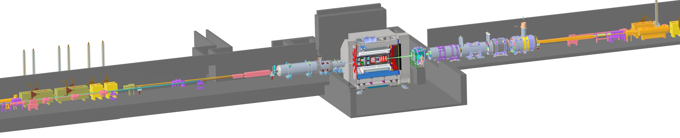

ePIC – The EIC State-of-the-Art General-Purpose Detector
26 subsystems over ± 40 m to measure particle momenta, energy and type
2T Solenoid (⌀ 2.84 m)
3 hadronic calorimeters (also serve as flux return)
3 electromagnetic calorimeters
1 DIRC + 2 RICH detectors + barrel and forward time-of-flight detectors
Various Silicon and Micro-pattern gas tracking detectors
Backward
p/A beam
electron beam
Forward
7 Auxiliary detectors integrated in the accelerator lattice
fully streaming readout electronics and DAQ (integrate AI/ML capabilities from the start)
electron (IR-6 and RCS) and hadron (IR-4 & IR-6) polarimetry
Integration, Installation and Infrastructure
Non-Beam Commissioning
Barrel HCal
Backward HCal
Magnet
forward HCal
DIRC
Barrel ECal
forward ECal
Barrel ToF
dRICH
backward
ECal
pfRICH
forward ToF
8 world first technologies:
4 in micro-electronics
4 in detector technologies
Zero Degree Calorimeter
electron beam
Luminosity
System
p/A beam
Low-Q2 Taggers
Roman Pots (RPs) and
Off-Momentum Detectors (OMDs)
B0 Magnet
Spectrometer
2

Slide 3
Update on Reviews – Path to Baselining CD-2
Preliminary Design Reviews (60% design maturity equivalent, called PDR, PDR2 or PDR3, pending the subsystem)
  PDR2: Silicon Tracking Detectors (6.03.01.02.01) – Jan. 27-28, 2026
  PDR2: Polarimetry (6.03.01.11) – February 18, 2026
  Peer Review: DAQ-Slow Controls (6.03.01.08.02) – Summer 2026 – Slow controls integration separated from electronics/DAQ to ensure integration in collider common platform; the controls rely on scope in various areas
  PDR3: IR Integration and Auxiliary Detectors (6.03.01.10) – April 20, 2026 – Low-Q2, ZDC, includes 6.10.14 lumi detector
  PDR3: IR Integration and Auxiliary Detectors (6.03.01.10) – July (?) 2026 – B0, RPs, OMDs – Exact Dates TBD pending when IR design more mature
  PDR2: AC-LGAD-based Particle Identification Detectors (6.10.04; BTOF, FTOF, common systems) – June 3-4, 2026
  Peer Review: Detector Infrastructure and Utilities Integration – June 2026 – overall utilities needs, couple review to the off-project portfolio scope
Final Design Reviews (FDR):
  FDR: Backward EM Calorimetry (6.03.01.04.01) – May 26, 2026
  More FDRs planning ongoing – next slide
Project Reviews:
  Detector Baseline Readiness Review Feb 3 – 5, 2026
  BNL Director’s Review – Comprehensive, Mar. 9-12, 2026
  PAC review – acts as Director’s Review, August 18-19, 2026
  DOE OPA Status Review / IPR April 28-May 1, 2026 → September 15-18, 2026 (ICR may not be needed, INF and CD-3C scope both below $100M)
  DAC – Summer/Fall 2026 – act as next comprehensive review of the ePIC detector status: has progress since the June 2025 comprehensive design review of the DAC been satisfactory, have all recommendations that are relevant for detector CD-2 baselining been addressed, and to give advice for the ePIC detector CD-3 production phase.
Other Meetings:
  7th RRB Meeting: June 9-10, 2026 – MEXT, Tokyo
  Annual Joint ePIC/EICUG Meeting, July 13-17 – Glasgow, https://indico.bnl.gov/event/31808/
  ePIC Software and Computing Review: October 13-14, 2026 – BNL
@Present foreseen scope of DOE IPR Comprehensive Review on Sept. 15-18 is: planning for baselining. start of first EIC subproject (Infrastructure) and CD-3C.
(CD-2 for DET may slip to coincide with CD-3 given risk in large in-kind contributions for DET without signed agreements (yet). To keep momentum, a large share of CD-3C may be related to DET.)

Slide 4
Detector Advisory Committee
DAC founded in 2020; Per the charter, 1/3 of the committee replaced every year
  2024: transition from Ed Kinney to Andy White as Chair
2024
2025
2026
Andrew White | U. Texas Arlington
Edward Kinney | Boulder CO
Ken Wyllie | CERN
Petra Merkel | FNAL
Antonis Papanestis | Rutherford Appleton Laboratory
Peter Krizan | U Ljubljana
Ana Amelia Machado | Campinas State U, Brazil
Cecilia Gerber | UIC
Brigitte Vachon | McGill
Stefano Miscetti | INFN Frascati
Roman Poeschl | IJCLab
Eraldo Oliveri | CERN
Andrew White | U. Texas Arlington
Edward Kinney | Boulder CO
Ken Wyllie | CERN
Petra Merkel | FNAL
Antonis Papanestis | Rutherford Appleton Laboratory
Peter Krizan | U Ljubljana
Ana Amelia Machado | Campinas State U, Brazil
Brigitte Vachon | McGill
Stefano Miscetti | INFN Frascati
Roman Poeschl | IJCLab
Eraldo Oliveri | CERN
Andy White | U. Texas Arlington
Filippo Costa | CERN
Szymon Kulis | CERN
Petra Merkel | FNAL
Antonis Papanestis | Rutherford Appleton Laboratory
Peter Krizan | U Ljubljana
Floris Keizer | CERN
Anna Macchiolo | TU Zurich
Lorenzo Rota | SLAC
Stefano Miscetti | INFN Frascati
Roman Poeschl | IJCLab
Eraldo Oliveri | CERN
DAC-Meetings 2024-2026:
June 21, 2024: 8th DAC meeting - strategic advice on the planning for the construction phase of the ePIC detector
  “Congratulations on enormous progress on developing realistic designs and starting active design review cycles on different systems”
August 28-29, 2024: 9th DAC meeting - Annual advice on detector R&D status and FY25 completion needs
June 11-13, 2025: 10th DAC meeting - Comprehensive look of DAC to design status and readiness for CD-2.
  “Overall, the DAC found that the ePIC detector design is well established and prepared to address the broad range of the EIC physics program. The R&D phase is converging well to a conclusion and the transition to a PED phase is occurring.”
Fall 2026 (planned): 11th DAC meeting - act as next comprehensive review of the ePIC detector status: has progress since the June 2025 comprehensive design review of the DAC been satisfactory, have all recommendations that are relevant for detector CD-2 baselining been addressed, and to give advice for the ePIC detector CD-3 production phase.

Slide 5
Update on Reviews – Planning for CD-3
Final Design Reviews (FDR):
  FDR 6.03.04.01: Backward EM Calorimetry – May 26, 2026
Planning for Final Design Reviews before CD-3: (dates/months as in P6 now)
  FDR 6.03.02.01: MPGDs – March 2027
  FDR 6.03.02.02: SVTs – August 2027
  FDR 6.03.03.01-03: hpDIRC, dRICH, pfRICH → hpDIRC, dRICH and pfRICH – February 2027
  FDR 6.03.03.04: TOF – June 2027
  FDR 6.03.04.02: Barrel EM Calorimetry – September 2026
  FDR 6.03.04.03: Forward EM Calorimetry – September 2026 → combine with Barrel HCAL and LFHCAL
  FDR 6.03.05.02-03: Barrel HCAL & LFHCAL – September 2026, combine with Forward EMCal
  FDR 6.03.06: Magnet Cryo – link to integral review with accelerator/cryo, July 2026
  FDR 6.03.07 & 6.03.08: Electronics & DAQ/Computing – September 2026 → will be a few months later to close open design items
  FDR 6.03.09: I3 Barrel Detector Structures – February 2027
  FDR 6.03.09: I3 Detector Infrastructure and Utilities Integration – July 2027
  FDR 6.03.09: I3 Installation (includes also Magnet Installation) – November 2027
  FDR 6.03.10.01-02: Auxiliary Detectors, B0 and RP/OMD – July 2027
  FDR 6.03.10.03-05: Auxiliary Detectors, ZDC, Low-Q2, Lumi – April 2027
  FDR 6.03.11.01-02: Electron and Hadron Polarimetry – May 2027
  Peer Review 6.03.12: Non-Beam Commissioning – November 2027
  FDR: HRPPDs – August 2026 (high-priority CD-3C candidate)
  FDR: Mirrors & Aerogel – September 2026 (possible CD-3C candidate)
Assumption: DET CD-3 in Q1/FY28
→ DOE Review ~ October 2027
FDRs need completion ~ July 2027

Slide 6
Detector Technical Readiness for Baselining
Detector has been technically baselined since Spring 2024
Project Detector R&D has been fully completed
June 11-13, 2025: Comprehensive Design Review by DAC
Detector Baseline Readiness Review Feb 3 – 5, 2026
BNL Director’s Review – Comprehensive, Mar. 9-12, 2026
DOE OPA Status Review September 15-18, 2026
Subsystem | PDR Completed | PDR Scheduled | CD-3A,B FDR Completed | Subsystem FDR Completed
Tracking | 40% & 60% Si, 40% & 60% MPGD
PID | 40% & 60% hpDIRC, pfRICH, dRICH ToF 40% & TOF Peer review, 60% |  | DIRC Bar refurbishment
ECals | 60% bECal, BECal, fECal |  | SiPM & SciFi fECal, BEcal SiPM & PbW04 bECal | backward ECal
HCals | 40% & 60% BHCal & fHCal 40% & 50% bHCal |  | SiPM bHcal & fHcal Lead blocks fHCal
Solenoid | 60% PDR Cryogenics |  | Magnet, Conductor and Power Supply
Electronics | 40%, 50% & 60% |  | VTRX+ & lpGBT
DAQ | 40%, 50% & 60%
Integration- Installation - infrastructure | 60% Inner and outer Barrel support-structures |  | electron and hadron endcap support structures
Auxiliary Detectors | 40% & 50% RP, B0, ZDC, Low Q2-Tagger, Lumi, 60% ZDC, Low Q2-Tagger, Lumi | 60% B0, RP/OMD: aim for July 2026
Polarimetry | 40% & 60% RCS & ESR Compton Polarimeter & HSR Polarimeters

Slide 7
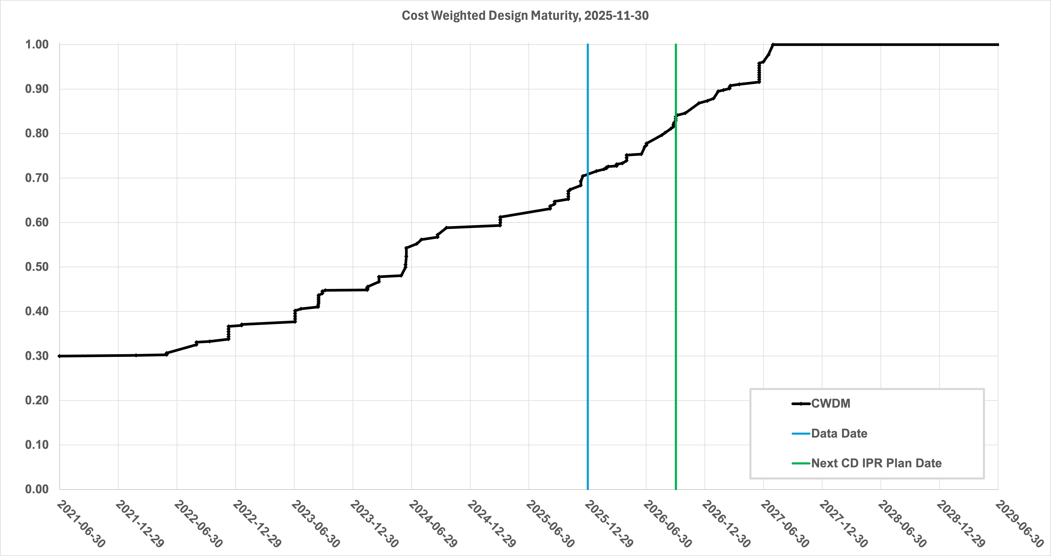
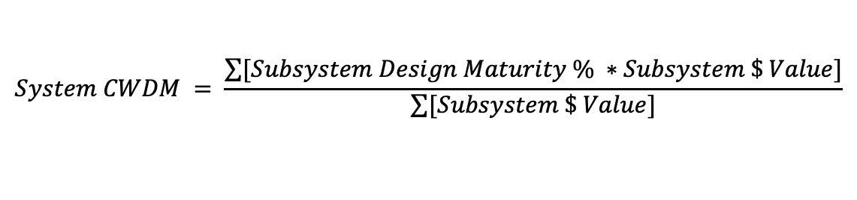
Path to Baseline – Design Maturity
$$System CWDM = \frac{\sum{[Subsystem Design Maturity \% ∗Subsystem \$ Value]}}{\sum{[Subsystem \$ Value]}}$$
Cost-weighted design maturity:
Present design maturity >75%
Projected >80% in September 2026
All 26 subsystems have already received at least one PDR
June 2026: only 1 subsystem needs a final PDR, planned for 07/26 but relies on mature IR design.
10 FDRs completed for CD-3A and 3B items
1 FDR completed for entire sub-system (05/26/26)
Until CD-2/3 (Q1FY28): +16 FDR

Slide 8
CD-3A Status and CD-3B Scope
CD | Scope | Status
CD-3A | Lead Tungstate Crystals for the Detector Backward Electro-Magnetic (EM) Calorimeter (1069 of 2899 crystals) | Contract awarded 3/5/2025 (CRYTUR) – 1069 (!) crystals delivered – quality tests completed, all passed specifications → completed
 | Scintillating Fibers for the Detector Barrel (1125 km of 4900 km) and Forward EM Calorimeters (750 km of 3000 km) | Barrel SciFi: Contract awarded 12/19/2025 (Kuraray) → 357km of 1125km delivered Forward SciFi: Contract awarded 3/12/2025 (Luxium) → iterated with Luxium to fulfill requirements, 386km of 1000km delivered and accepted
 | Silicon Photomultipliers for the Detector Forward Hadronic Calorimeter (341k of 540k) | Contract awarded 11/25/2024 (Hamamatsu) → All 341k SiPMs delivered to BNL → testing done at Yale → no quality issues. → completed
 | Steel towers for the Detector Forward Hadronic Calorimeter (650 towers of 1500) | The Acquisition Plan and RFP have been approved by BHSO. RFPs have been received. Need a different procurement strategy cost was 2.2 higher.
 | Detector Solenoid Magnet Design and Fabrication and Conductor | Solenoid: becomes In-Kind. Tender process starting in Spring 2026 led by Italy Conductor: contract awarded 09/23/2025 (Luvata), Vendor has acquired all materials.
CD-3B | Lead Tungstate Crystals for the Detector Backward Electro-Magnetic (EM) Calorimeter (1000 pieces cont. CD-3A) | All options in CD-3A contracts issued
 | Scintillating Fibers for the Detector Barrel (1264 km cont. CD-3A ) and Forward EM Calorimeters (1065 km cont. CD-3A )
 | Steel towers for the Detector Forward Hadronic Calorimeter (200 towers cont. CD-3A )
 | Detector Solenoid Magnet Power Supply | 3 quotes received, vendor selected on the technical basis, procurement team is working with the technical team to finalize the vendor and send the documents to DOE.
 | Flux Return Steel for the Electron and Hadron Endcap Structures (50% of needed steel → first phase hadron endcap) | SOW, technical specifications and drawings are signed, APP close to final, PRR planned after floor loading assessment has been finalized.
 | VTRx+: Versatile Link Plus Transceivers (5500 pieces ) and lpGBT: Low Power GigaBit Transceivers (1500 pieces) | Planning with CERN, procurement going through DOE for approval → CERN bought components; assembly will happen after HL-LHC components are done.
 | DIRC Bar Refurbishment – work-to-go related to reuse of components | 2 (of 8) ex-BABAR DIRC bar boxes opened and disassembled in short bars, 6 bar boxes are CD-3B: 3rd DIRC bar box opened in February after CD-3B authorization.
DET: $33M DOE scope (38%)
DET: $12M DOE scope (25%)

Slide 9
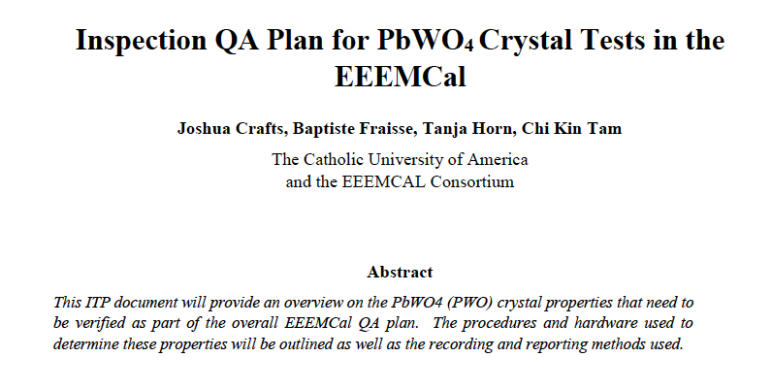
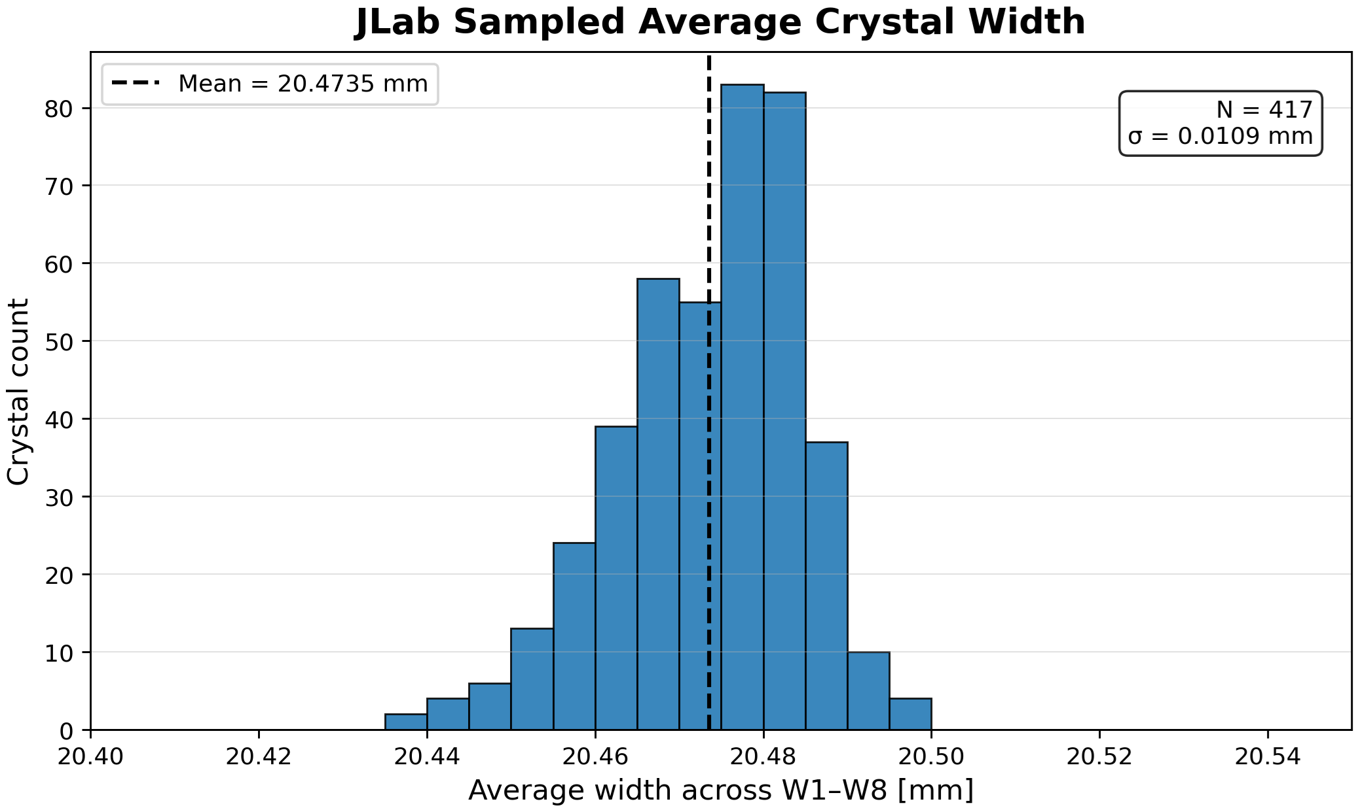
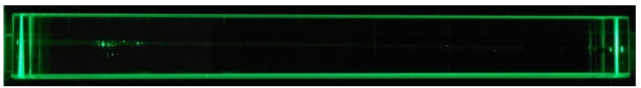
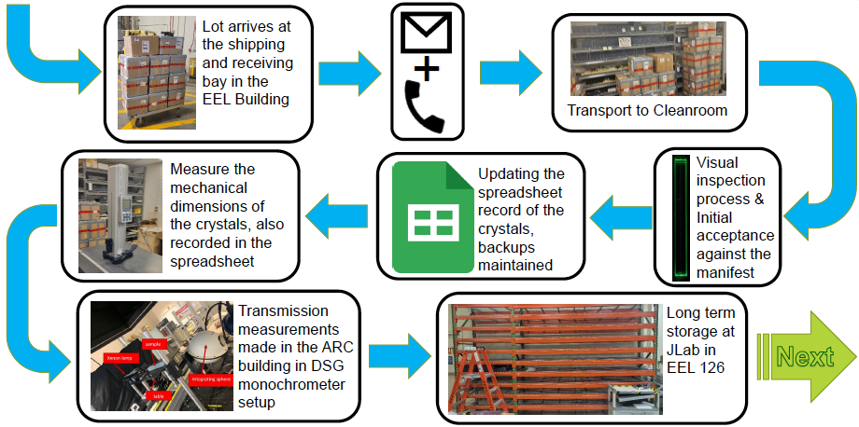
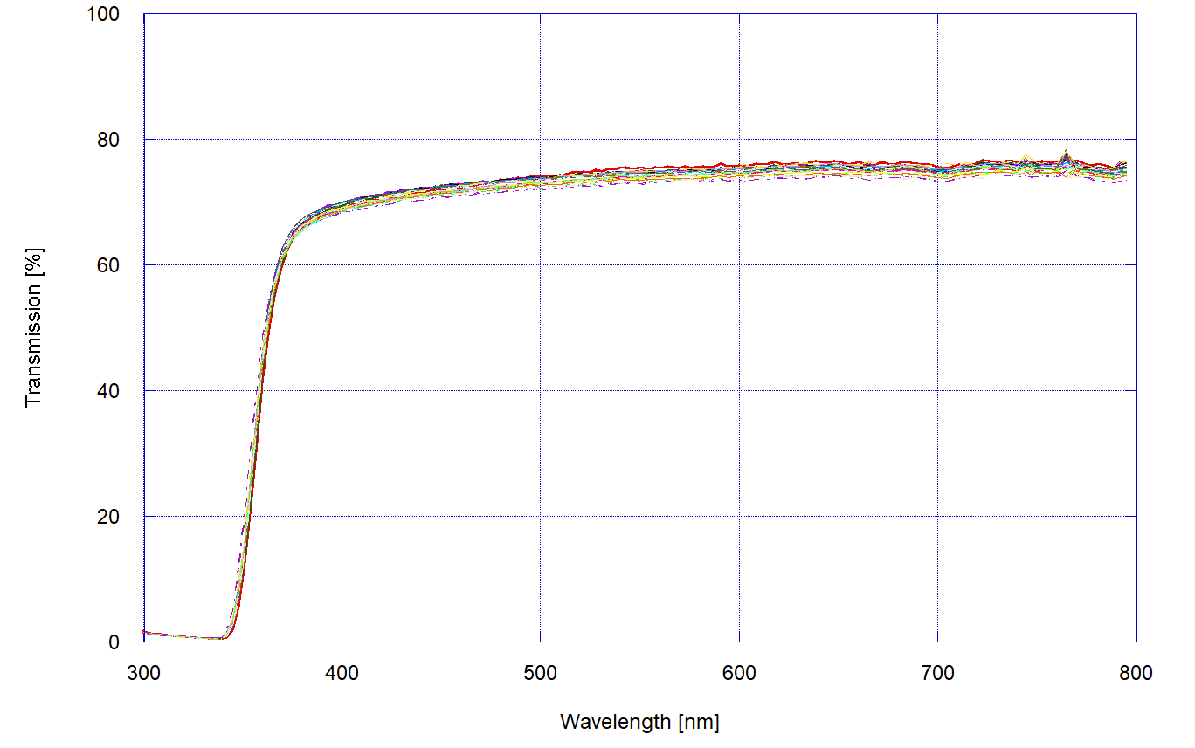
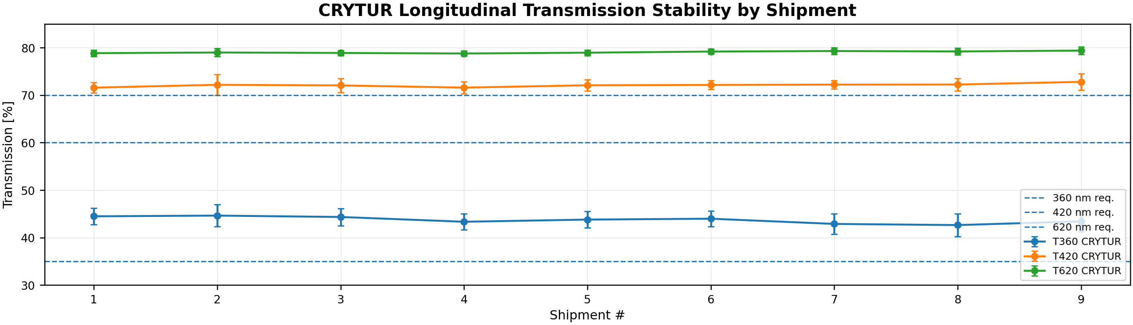
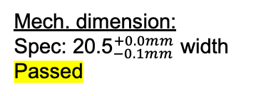
Quality Assurance: PbWO4 crystals for EEEMCAL
Mech. dimension:
${\text{Spec}\text{: 20.5}}_{−0.1mm}^{+0.0mm}$ width
Passed
Visual test (also with laser):
No Scratches, no surface pitting, no internal bubbles
Passed
360 nm
420 nm
620 nm
vs 𝝀
vs shipment #
Optical transmission:
Spec: >35% at 360nm, >60% at 420nm and >70% at 620nm
Passed

Slide 10
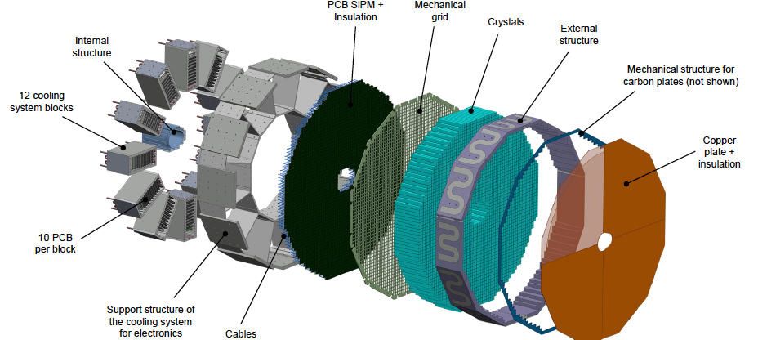
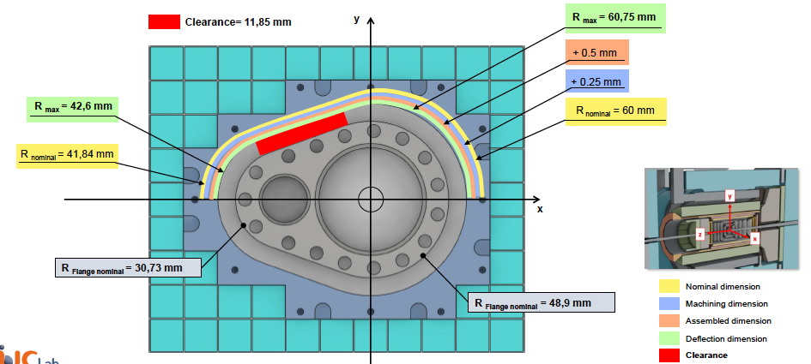
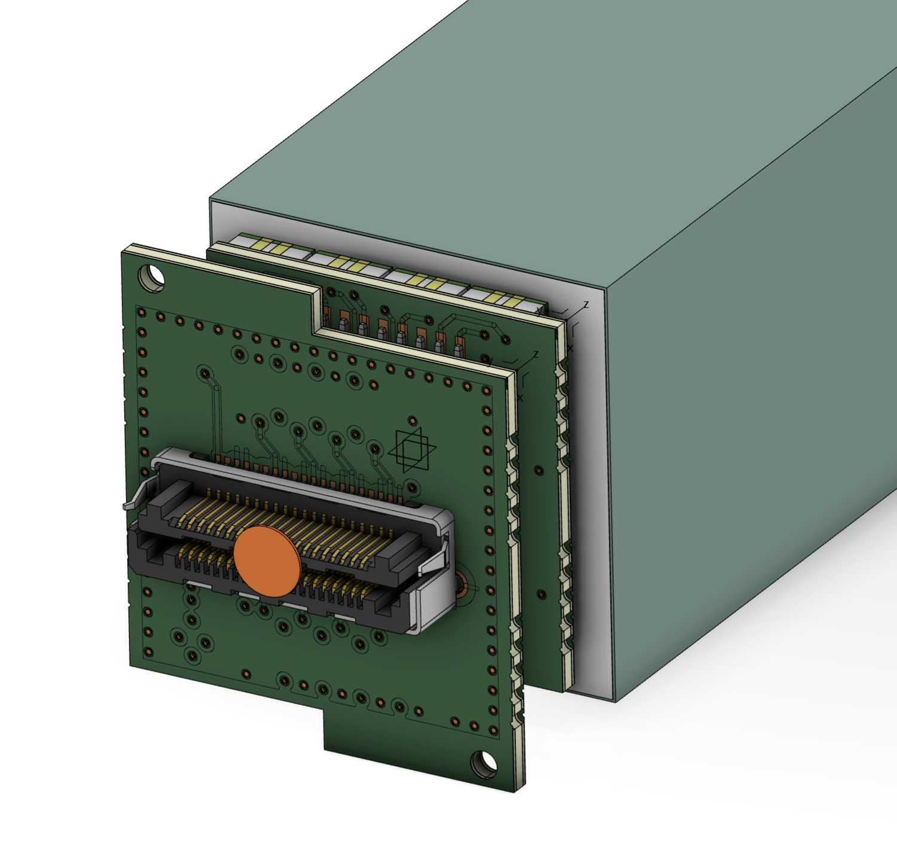
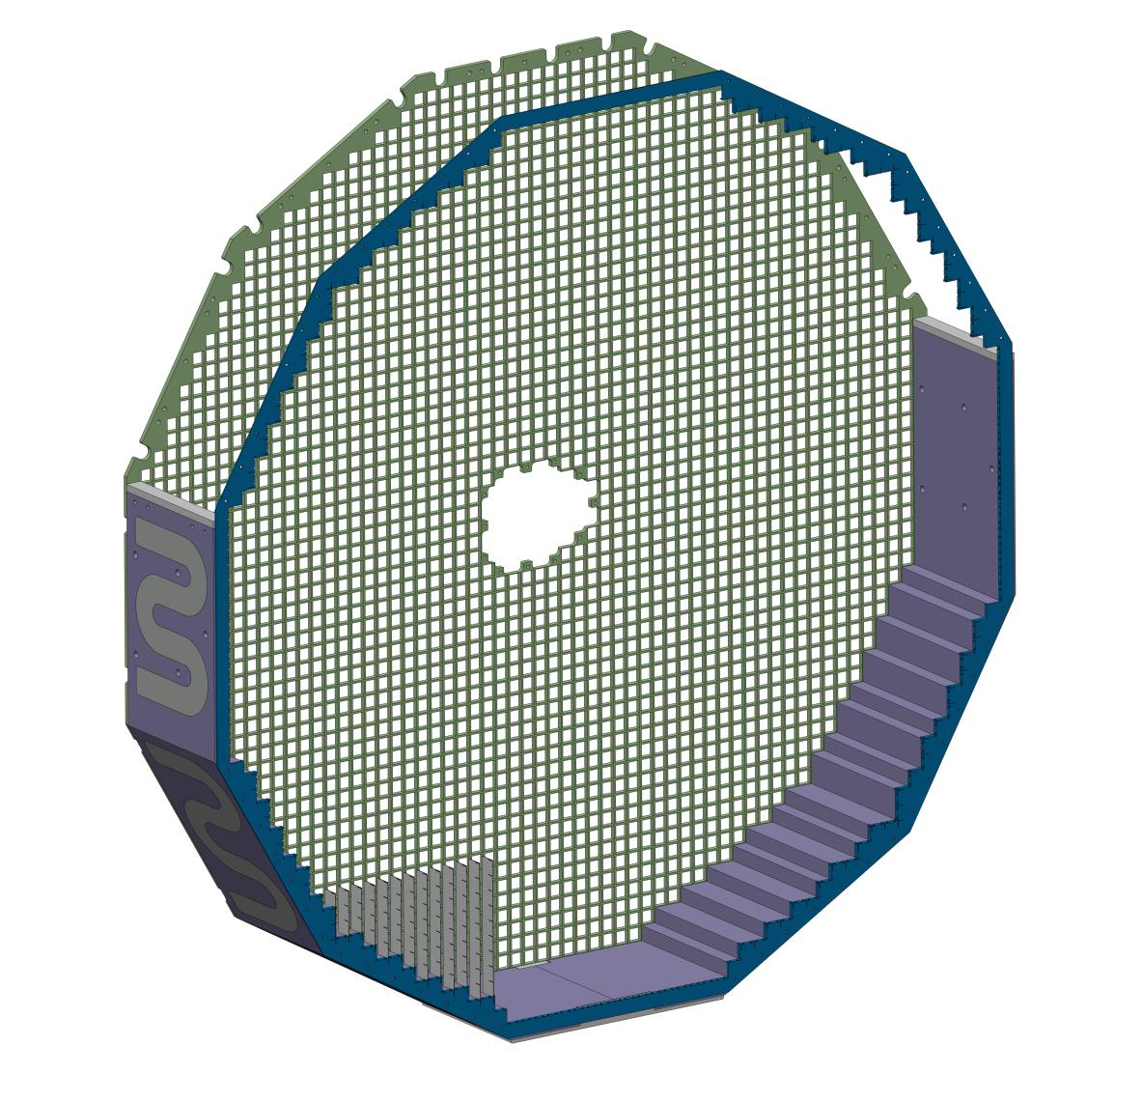
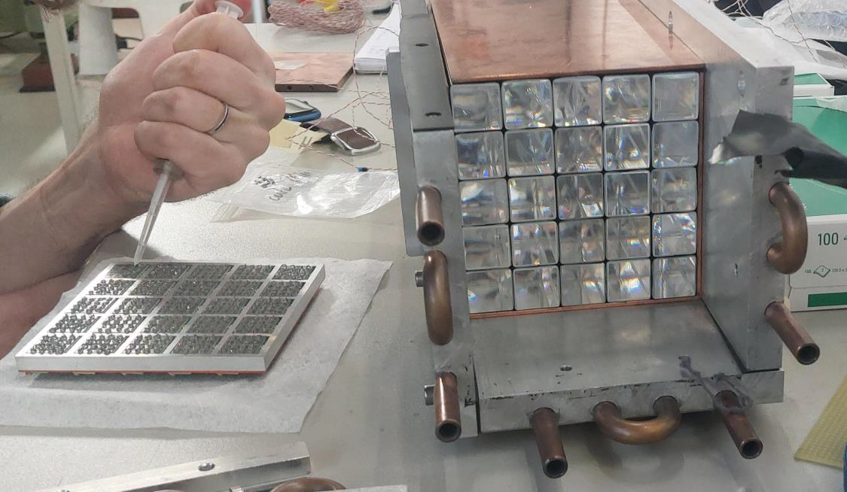
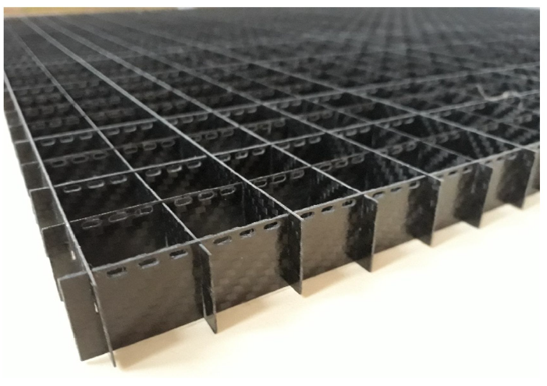
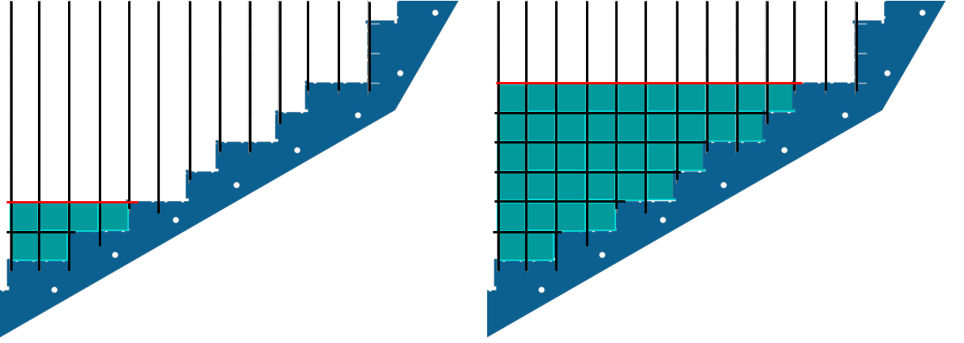
EEEMCAL FDR, May 26, 2026
Review Committee:
Liping Gan (UNC Wilmington)
Lars Schmitt (GSI Darmstadt)
Timothy Whitlatch (Jefferson Lab)
PWO crystal FDR: July 21, 2023
Photosensor FDR: Sep 14, 2023
Mech. Structure FDR: This Review
Overall mechanical Design
Electronics Integration
Integration with beam pipe
PCB SiPM
PCB adapter
Cooling Prototyping
Assembly
Conclusion:
We congratulate the Backward EEEMCal team for the remarkable achievements.
We thank the team for the excellent quality of the presentations and the constructive discussions in the Q&A.
We are looking forward to further progress towards CD2 and the realization of the project.
Carbon Structure

Slide 11
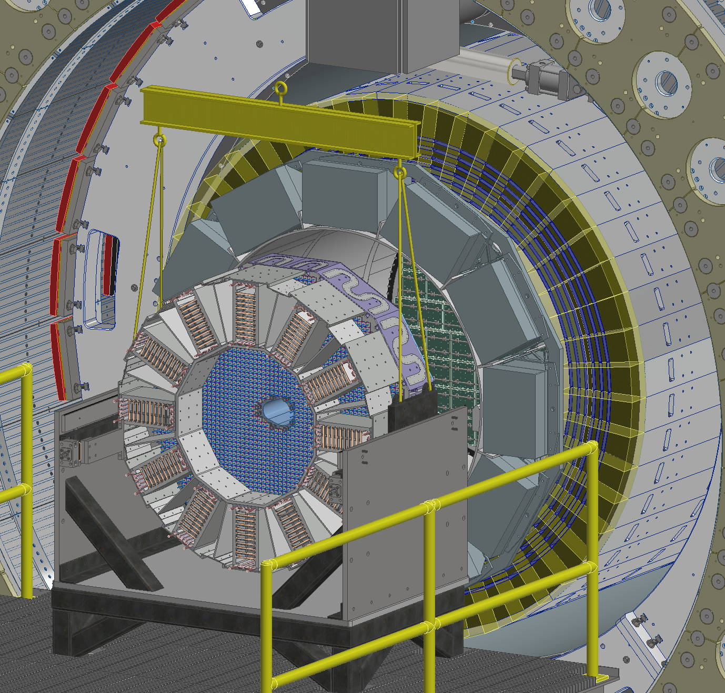
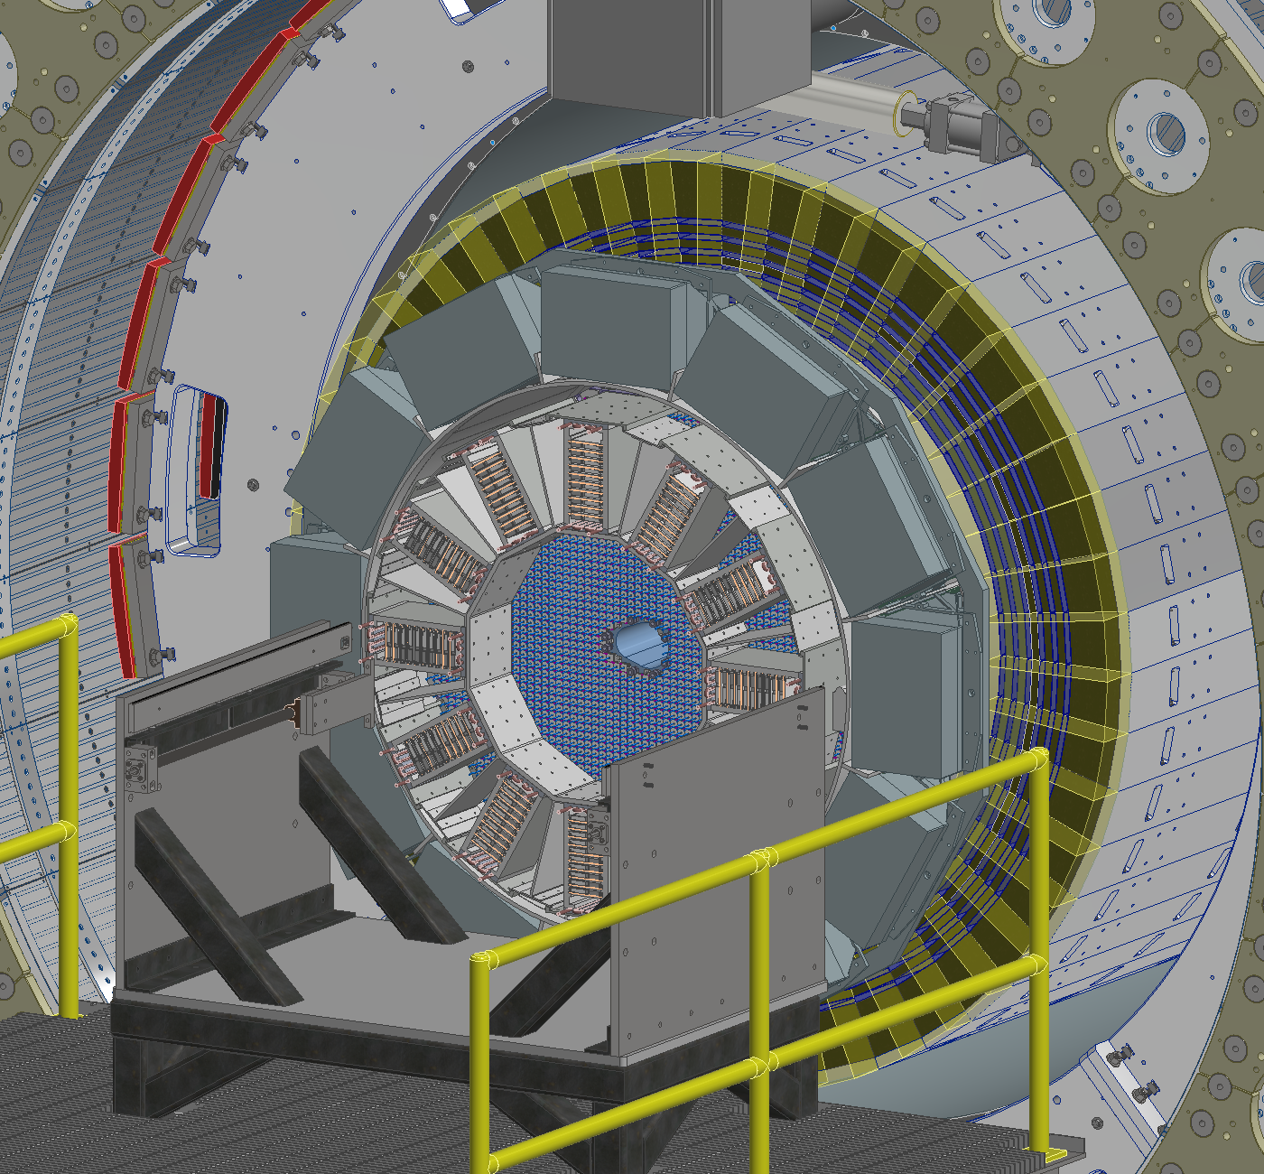
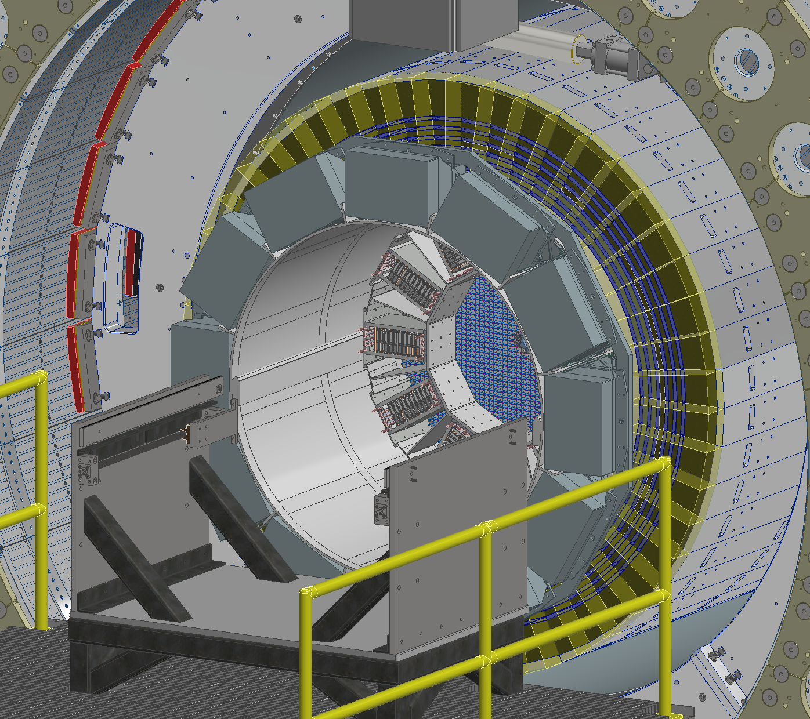
EEEMCal Installation in Experimental Hall
Task | Time
pfRICH & EEEMCal Platform Installation | 4 days
pfRICH Detector | 5 days
EEEMCal Detector | 5 days
pfRICH & EEEMCal Cabling & Cooling | 30 days
pfRICH & EEEMCal Testing | 10 days
pfRICH & EEEMCal Platform Removal | 2 days
Within engineering group: much attention to installation and installation tooling, and how to allow serviceability of detectors.

Slide 12
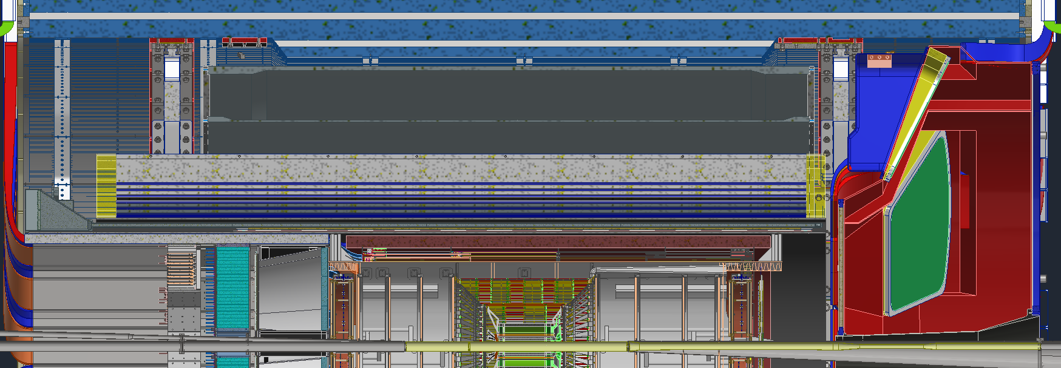
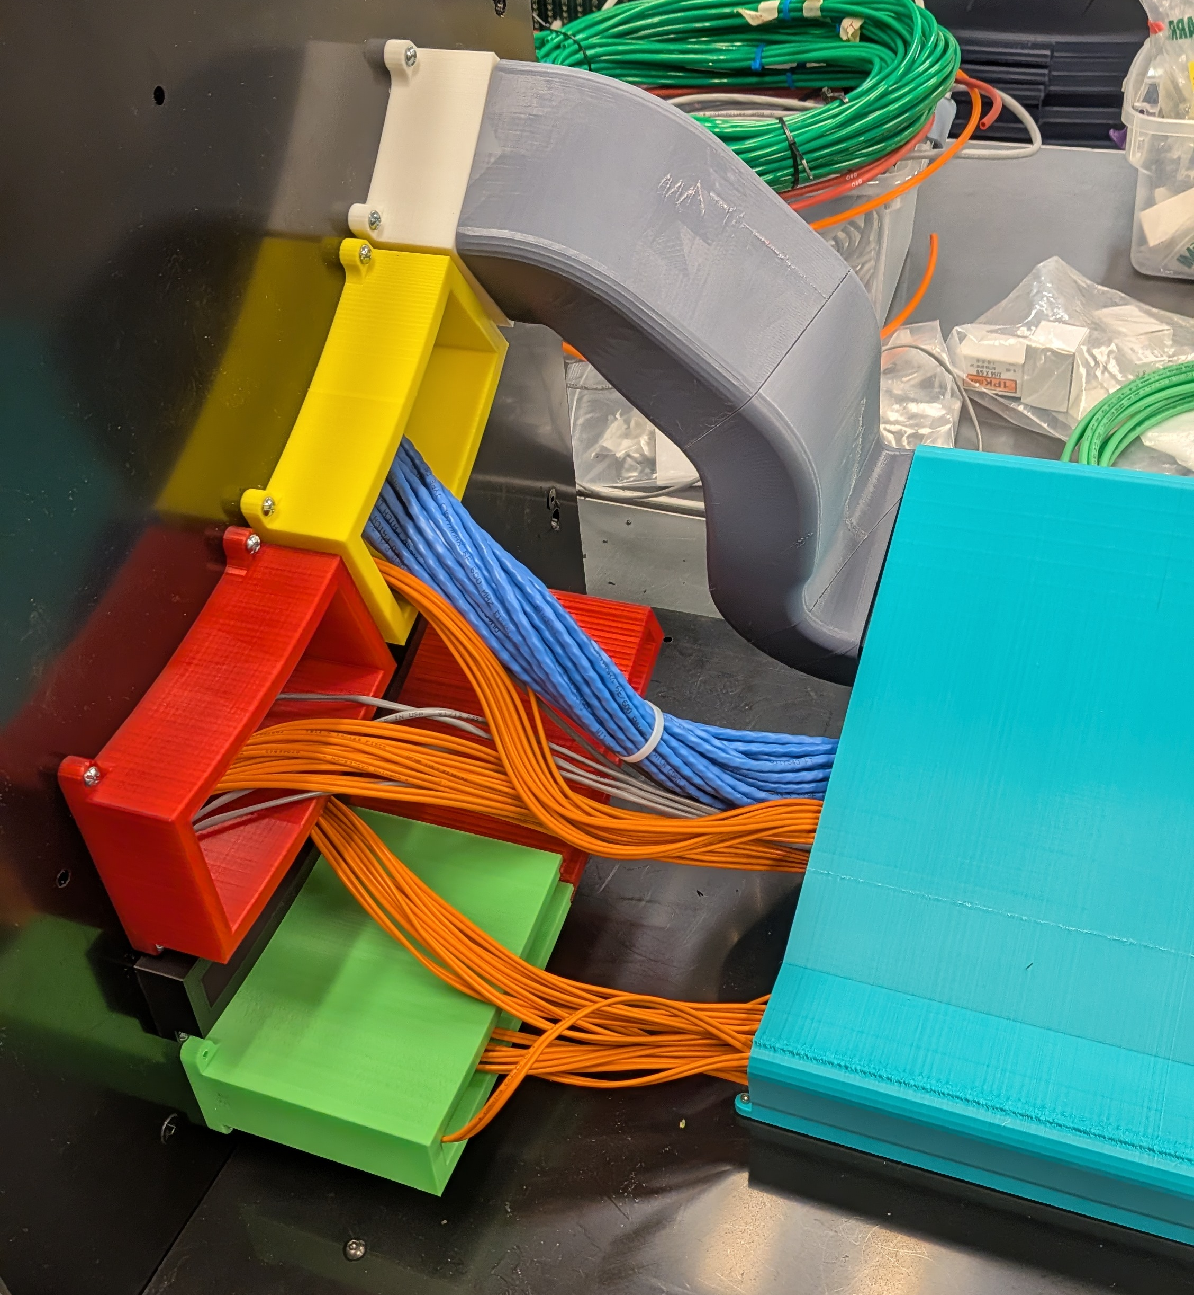
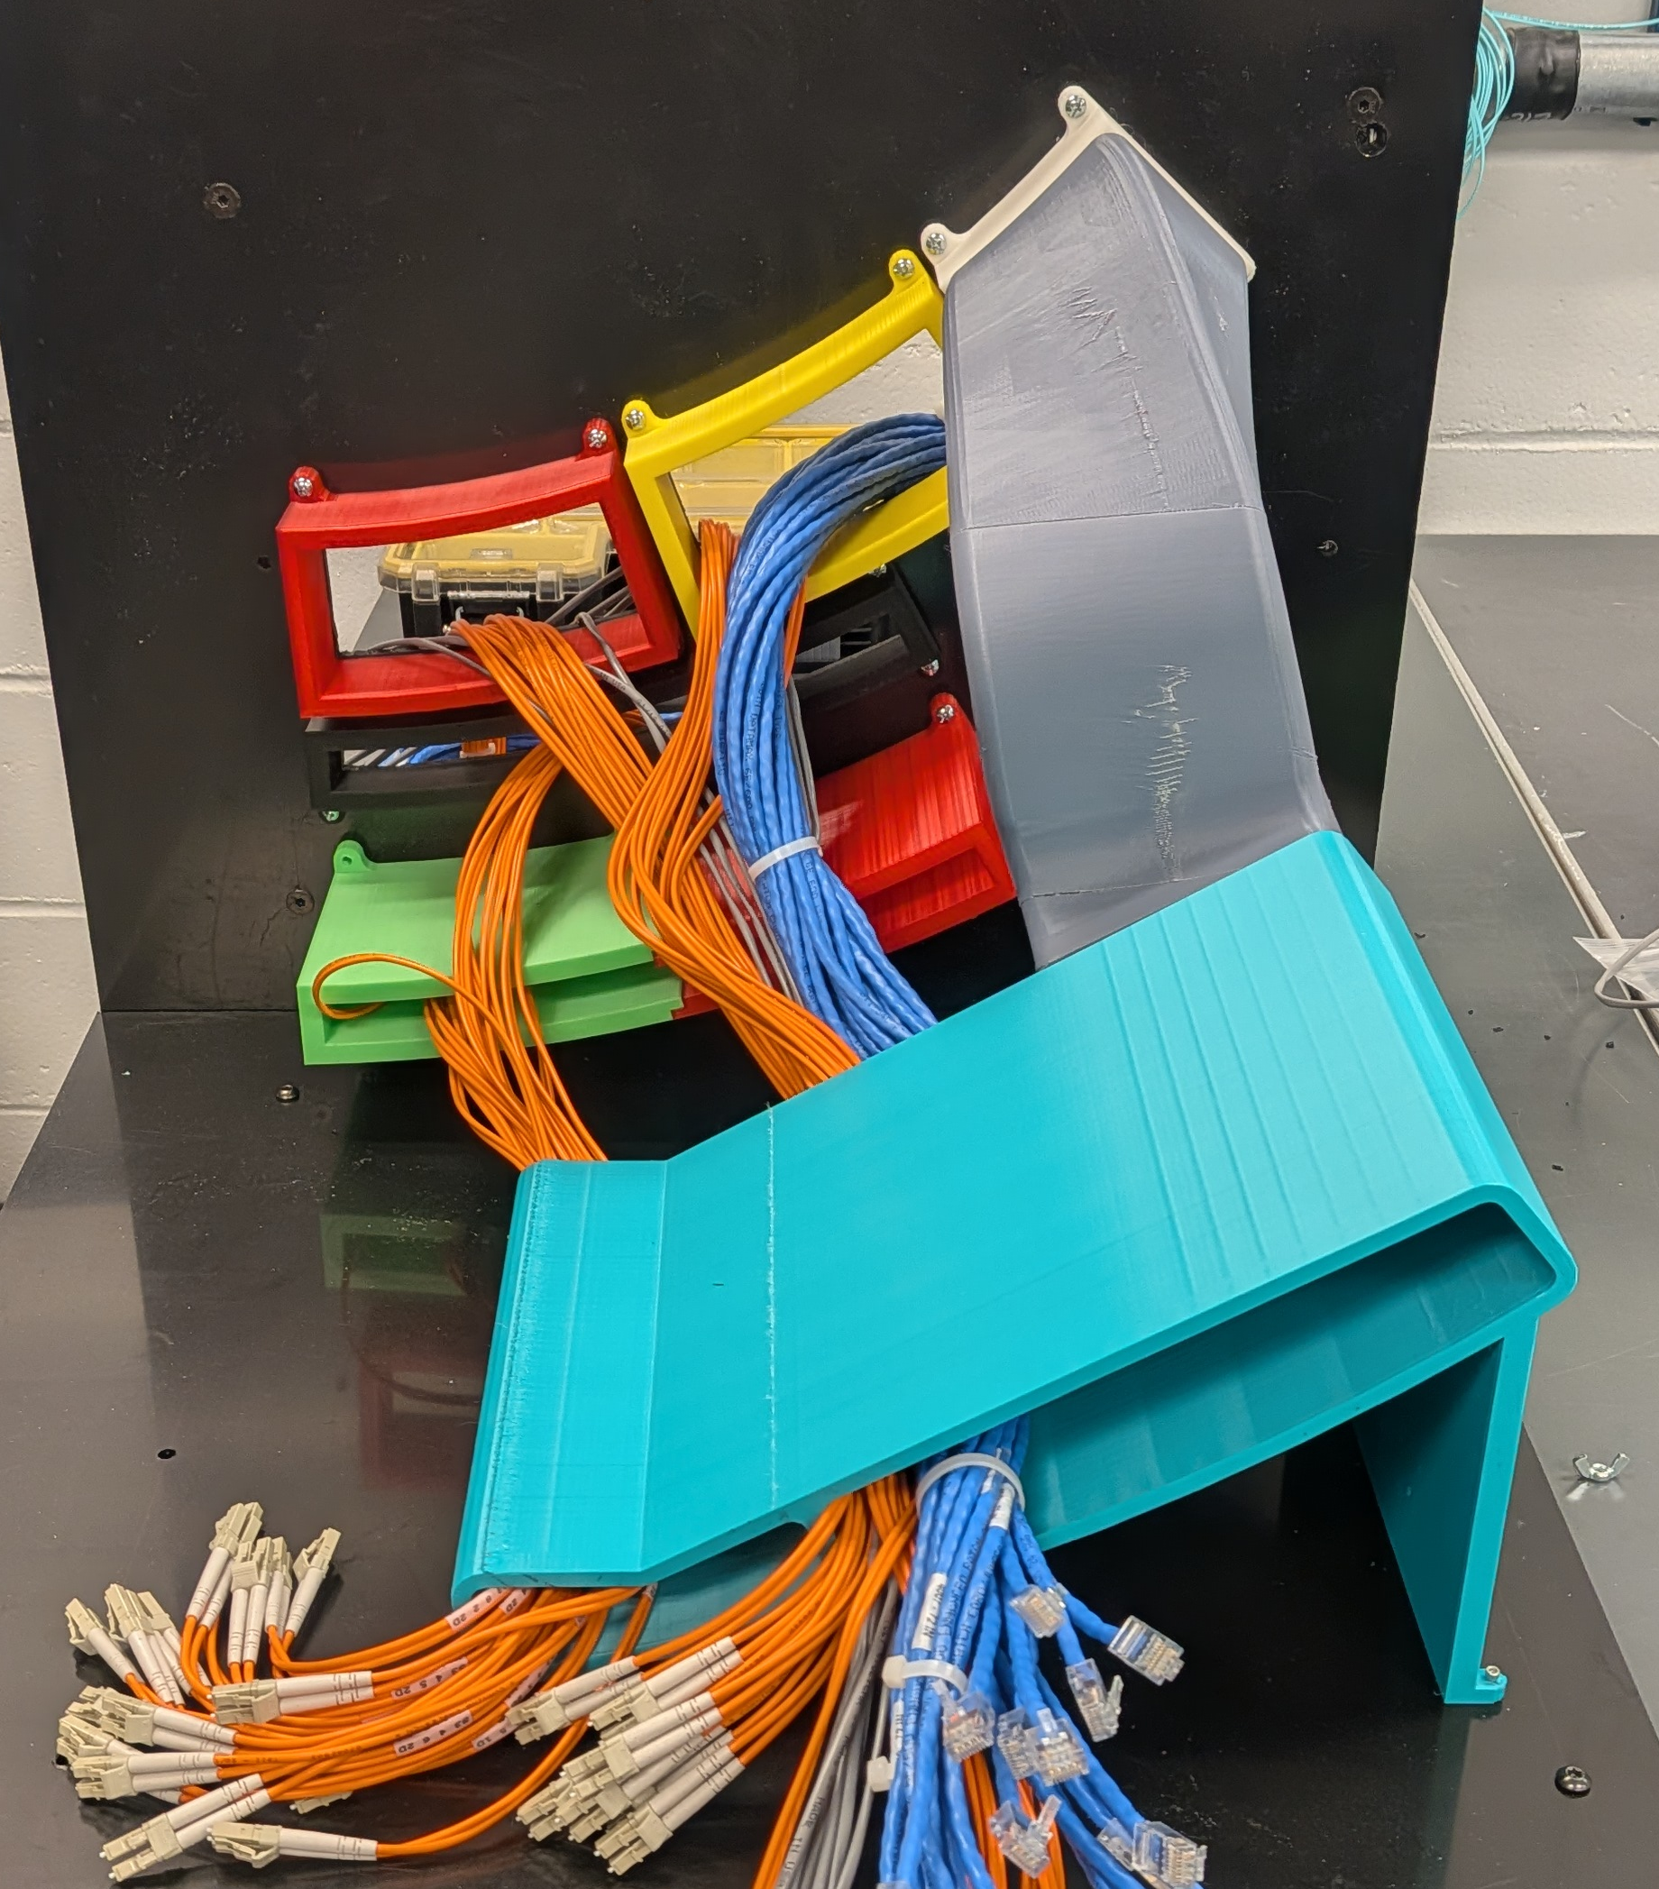
Backward Services Mock-Up
We mocked up 1/12th of the region between the backward end of the PST, the pfRICH, CYMBAL, and barrel ToF
We 3d printed the ends of the relevant detectors along with the services trays which will be used to guide services out past the EEEMCal. We also printed a mock SVT exhaust air duct.
Using cables from previous experiments, we are checking to see if the spaces we have allocated are adequate
Additionally, we want to see if we can maintain acceptable bend radii for all the fibers
SVT Exhaust air duct
End of PST
End of CYMBAL
End of ToF
Service Trays

Slide 13
Planning for CD-3C Package – DET
Subproject | WBS | Long Lead Procurement Description | $M | FDR
DET | 6.03 | Lead tungstate crystals (cont. CD-3A/B) – 830 remaining | 2.3 | Done
DET | 6.03 | fECal Scintillating Fibers (cont. CD-3A/B) – 1185 km remaining; Barrel SciFi → Korea In-Kind | 1.0 | Done
DET | 6.03 | SiPMs (cont. CD-3A/B) – 220 k remaining | 2.1 | Done
DET | 6.03 | Steel towers for forward HCal (cont. CD-3A/B) – 650 towers remaining | 1.7 | Done
DET | 6.03 | Flux return steal rear endcap | 3.4 | Done
DET | 6.03 | High-Rate Picosecond PhotoDetectors (HRPPDs) | 6.8 | 08/2026
DET | 6.03 | SiPMs for all the other subsystems and mounting on the SiPMs on boards | 3.4 | Done
DET | 6.03 | Aerogel for pfRICH and dRICH (Ring Imaging Cherenkov (RICH) | 0.6 | 09/2026
DET | 6.03 | Mirrors for dRICH | 1.8 | 09/2026
DET | 6.03 | Forward HCal towers due to large assembly time (incl. SiPMs and Steel towers) | 8.2 | 09/2026
DET | 6.03 | Forward ECal due to large assembly time (excl. SciFi) | 7.0 | 09/2026
DET | 6.03 | Barrel Imaging Calorimeter to assemble sampling calorimeter modules (excl. SciFi) | 4.3 | 09/2026
 |  | Total | 42.6
$21M for the high priority items (without contingency)

Slide 14


Slide 15
EIC Present Planning Dates
Milestone |  | Milestone
DOE Independent Project Review (IPR) | Jan 7-9, 2025 | Assessments of Baseline Readiness for SPs | Nov’ 25 – June ’26
Start Developing Scope of Subprojects | January 10, 2025 | Interaction Region (IR) | Nov. 18-20, 2025
IR SC Magnet Steering Group Meetings - Monthly | January 17, 2025 | Accelerator Storage Rings (ASR) | Jan. 14-16, 2026
Project Advisory Committee Meeting | February 11, 2025 | Detector (DET) (Rescheduled from Nov. 12-14) | Feb. 3-5, 2026
Detector Advisory Committee Meeting | June 11-13, 2025 | Project and Integrated Performance (IP) | Mar. 9-12, 2026
EIC Advisory Board Meeting | June 17, 2025 | Electron Injector (EIN) (follow-up to Apr ‘25 Review) | June 3-5, 2026
DOE CD-3B ESAAB Approval | January 28, 2026 | EIC Project Advisory Committee | Dec. 2, 2025
DOE IPR Focused Status Review | August 5-7, 2025 | EIC Project Strategy Workshop - Stakeholders | Dec. 4, 2025
DOE RHIC R&R/Injector Operations Review | Sept 8-10, 2025 | RHIC Operations Concludes, R&R Starts | February 6, 2026
Machine Advisory Committee Meeting | Sept. 16-18, 2025 | BNL Director’s Review – Comprehensive | Mar. 9-12, 2026
Infrastructure Construction Advisory Committee | October 1-2, 2025 | Project Advisory Committee Review | Aug. 18-19, 2026
EIC Advisory Board Meeting | October 10, 2025 | DOE IPR Comprehensive Review | Sep.15-18, 2026
Resource Review Board Meeting (BNL) | Nov 4-5, 2025 | DOE CD ESAAB Approvals | Late CY2026
@Present foreseen scope of DOE IPR Comprehensive Review on Sept. 15-18 is: planning for baselining. start of first EIC subproject (Infrastructure) and CD-3C.
(CD-2 for DET may slip to coincide with CD-3 given risk in large in-kind contributions for DET without signed agreements (yet). To keep momentum, a large share of CD-3C may be related to DET.)

