Slide 1

Collaboration News
John Lajoie, Silvia Dalla Torre
June 5, 2026

Slide 2
Hey John, start the recording….

Slide 3
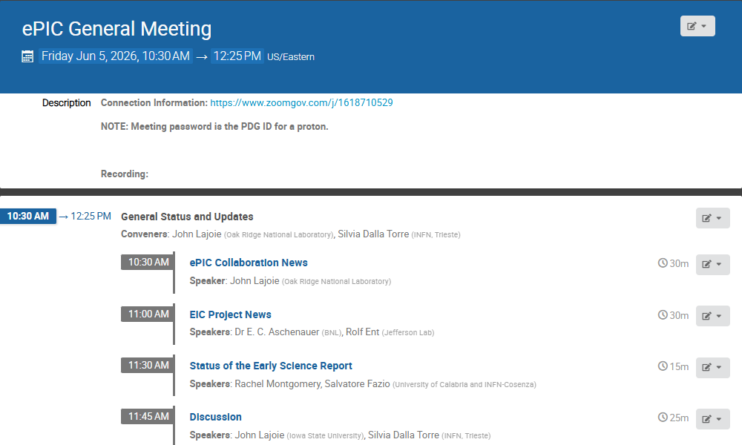
Agenda
Collaboration and Project News
Report from PACs on Early Science Report
Our last General Meeting was April 24th !

Slide 4


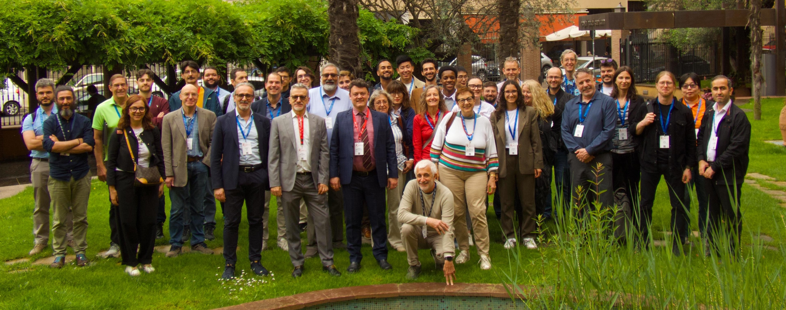
@
Ongoing Development in a Proximity-Focusing RICH Detector for ePIC at the Electron-Ion Collider | Jihee Kim
Preliminary cooling tests for the ePIC Silicon Vertex Tracker Inner Barrel | Sabrina Ciarlantini
Design and development status of Silicon Vertex Tracker for ePIC experiment | Domenico Colella
ePIC PID Performance in SIDIS Processes | Lorenzo Polizzi
The G-RWELL Endcap Tracker of the ePIC Experiment | Stefano Gramigna
Forward Particle Identification at the EIC with the ePIC dRICH Detector | Simone Vallarino
The ePIC dRICH Streaming Readout System | Sandro Geminiani
Simulation based performance of the ePIC-dRICH for Forward PID at the Electron Ion Collider | Ramandeep Kumar
Particle physics at the BNL electron-ion collider | Allesandro Tricoli
Inclusive electron-proton measurement prospects in the Electron-Ion Collider early science stage | Stephen Maple
Heavy-Flavor Studies with the ePIC Experiment at the Electron–Ion Collider | Domenico Elia
Projected High Precision Measurements on the Spin Structure g1 for the Proton and the Neutron at EIC | Win Lin
The EIC: Physics, Status and Perspectives | John Lajoie
Bologna, Italy
Thirteen contributions from ePIC collaborators!

Slide 5
News from the TC Office
Slides courtesy of Silvia Dalla Torre

Slide 6
Beam Background Challenges for the ePIC Subsystems
Motivations:
Background studies needed for pre TDR (subsystems and physics studies)
The project needs a feedback about the current scheme of collimation and shielding
Kick-off : TIC meeting on February 23Rd, 2026
Studies must address: occupancy and data rates, radiation and fluences, performance
Initial progress reports based on the current simulation campaign:
TIC meetings on March 30th and April 13th
Update on the background studies: TIC meetings on May 18th and June 1st
Current status:
Very diversified achievement status by the DSCs
  To be considered:
    Overlap with testbeam periods
    Prioritization choices in DCS
    Available workforce
    Some missing ingredients (f.i. the implementation of geometry of the backward beamline, dedicated simulation samples, the progress of the collimation design for realistic beam halo)
Dedication by all DSCs expected in the short term view the key goals of this effort
One of the 2026 Priority actions identified at the January 2026 Collaboration meeting !
Some examples of advanced progress in the next slides

Slide 7
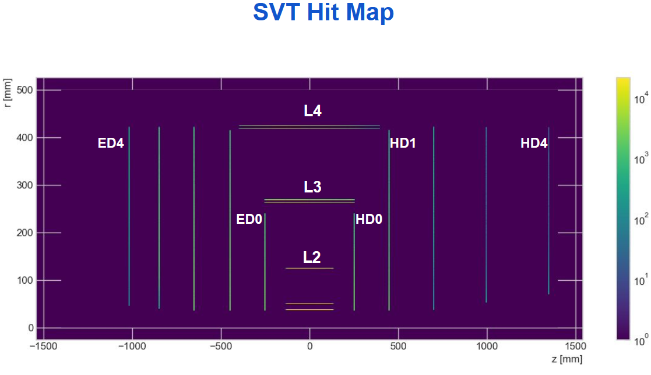
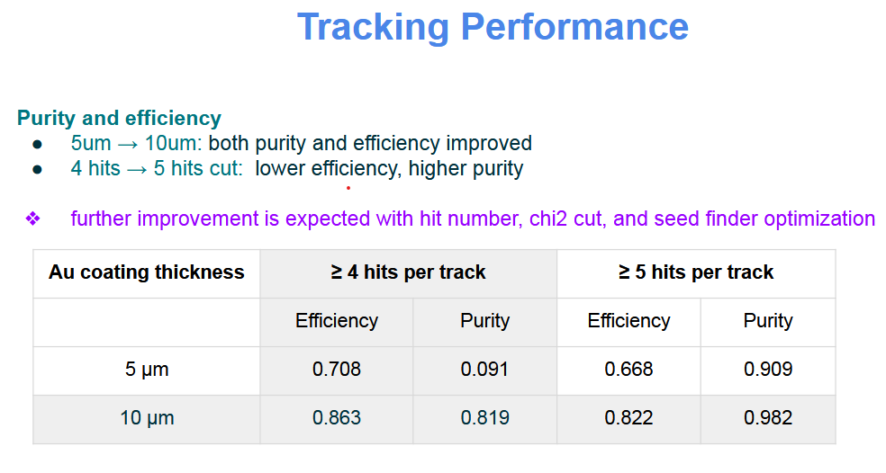
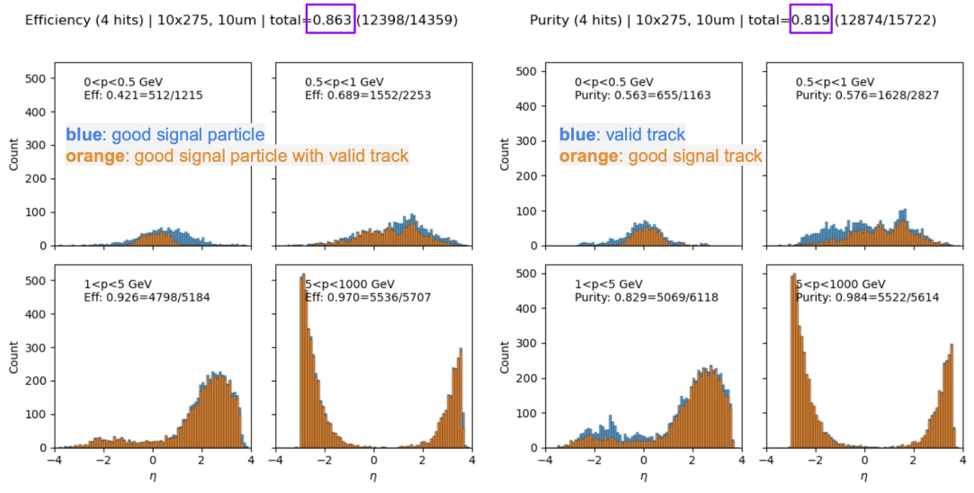
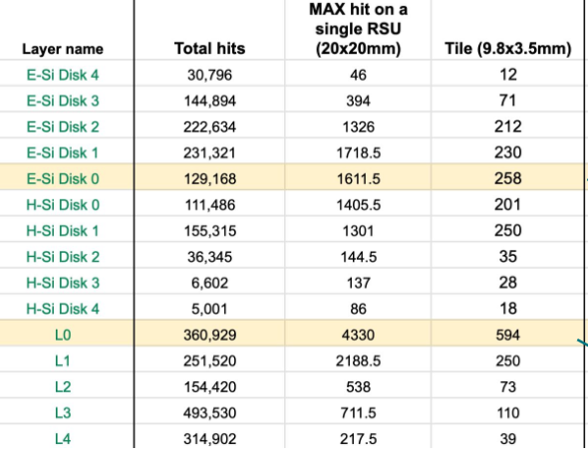
Inner tracking and synchrotron radiation
Synchrotron radiation mainly affects elements of the tracking systems.
Moderated by 10μm Au coating of the beam pipe in the IR
All background sources included; SR is prevalent.
Adequate tiling allows for
manageable band width
7

Slide 8
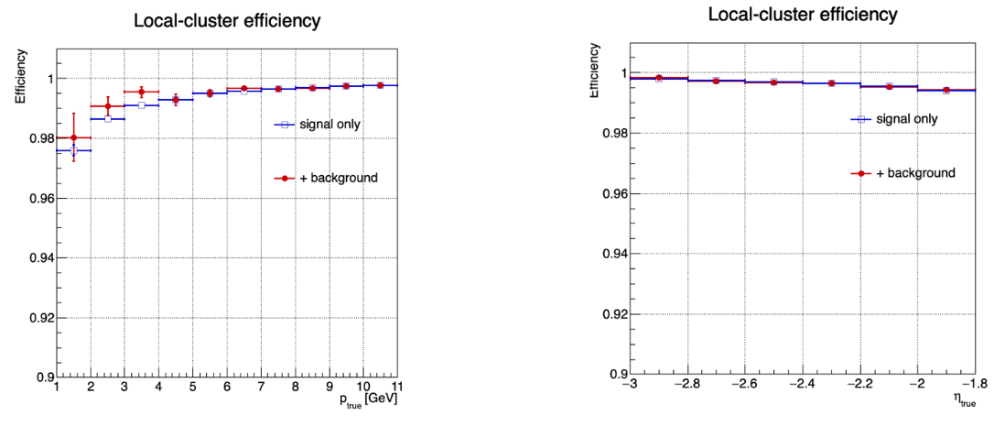
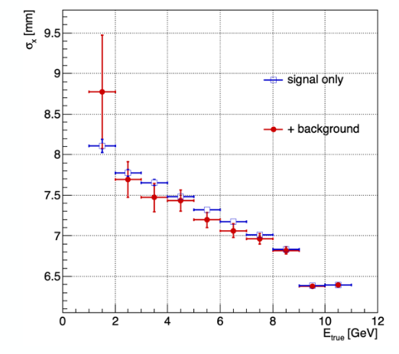
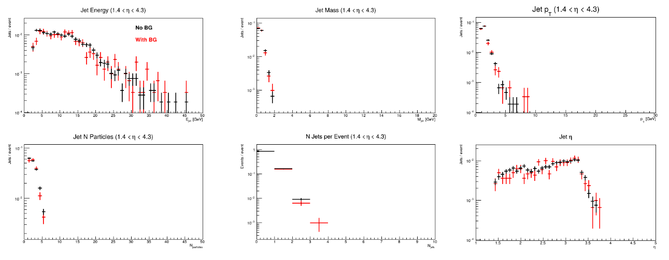
Impact of the background on EMCAL performance
EEEMCAL
FEMCAL

Slide 9
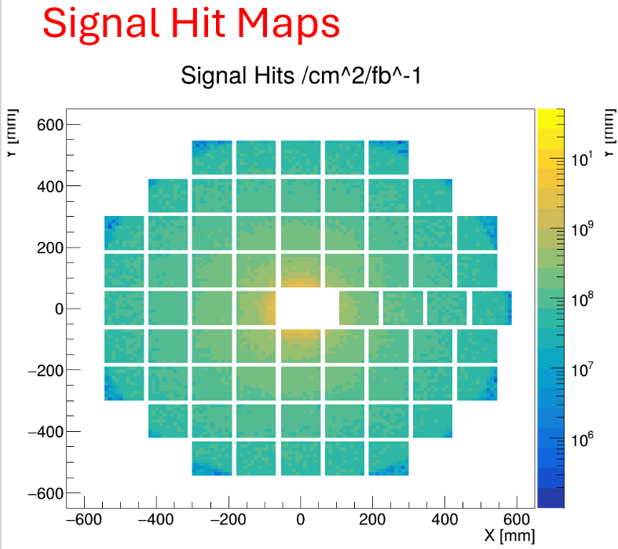
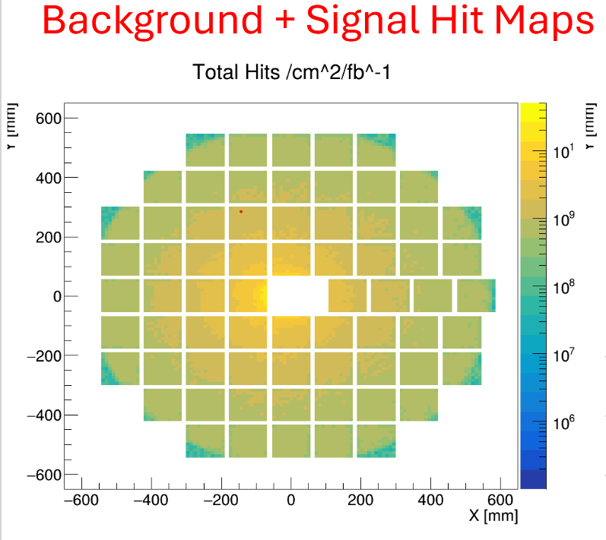
Background and Photosensor Ageing
The pfRICH case
Background impact:
~ 1 order of magnitude increase in hit rate
Hit rates can be translated in accumulated charge over operation time and compared with the ongoing ageing studies to confirm the choice of the HRPPD photosensors
Current estimates depending on operative gain:
0.05 – 0.5 C/cm²/year
Resulting in a negligible QE decrease over 10ys of operation according to the preliminary ageing studies

Slide 10
Coordination of Testbeam Activities
Worldwide crisis of hadron testbeam availability starting in Fall 2026:
FNAL without near perspectives
CERN shutdown moving to Hi-Lumi → global pressure for CERN testbeams in 2026
ePIC in front of strategic needs:
Completing engineering design → validation in hadron testbeam strategy !
ePIC applied for various beamtests in 2026:
Strategy: coordination, enhance synergies and have a single ePIC interface
All needs could be satisfied !
dRICH, pfRICH, BIC, MPGDs, LFHCAL, AC-LGADs
The added value of
Coordination within ePIC !
2 periods, synergistic usage
SPS 5/27-6/3
PS 6/11-24
PS 8/28-9/3
SPS 7/15-29 (in parallel with ATLAS LGADs)
PS 4/8-15
SPS: 5/13-20
SPS 7/15-29 (as part of DRD1)
10

Slide 11
How to register a team at CERN for
The starting point is the CERN secretariat (info.recognized-experiments@cern.ch), tell them that you want to establish a new team under RE47 (ePIC).
They will send you a form that requires signatures from a team leader and deputy team leader, and a representative from your institution’s administration.
Send the signed form to the Spokesperson for a signature
Once the completed form is registered with the secretariat, your team is formed, and the team leader can add team members, etc.

Slide 12
News from Software and Computing
Slides courtesy of Markus Diefenthaler, Dmitry Kalinkin, Holly Szumila Vance, Torre Wenaus

Slide 13
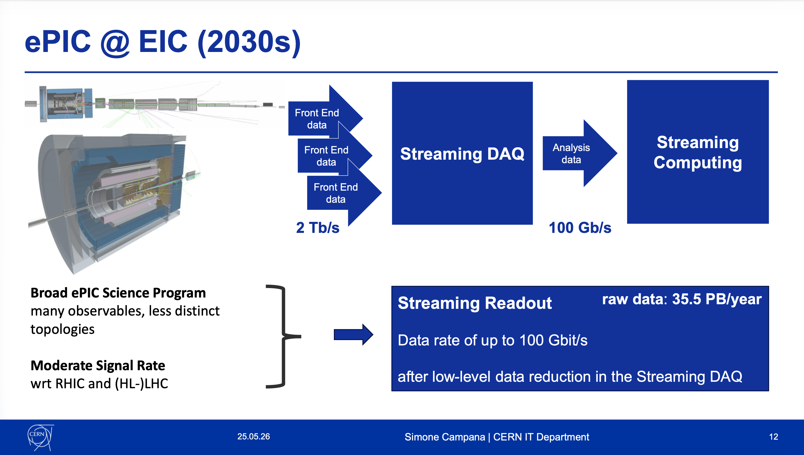
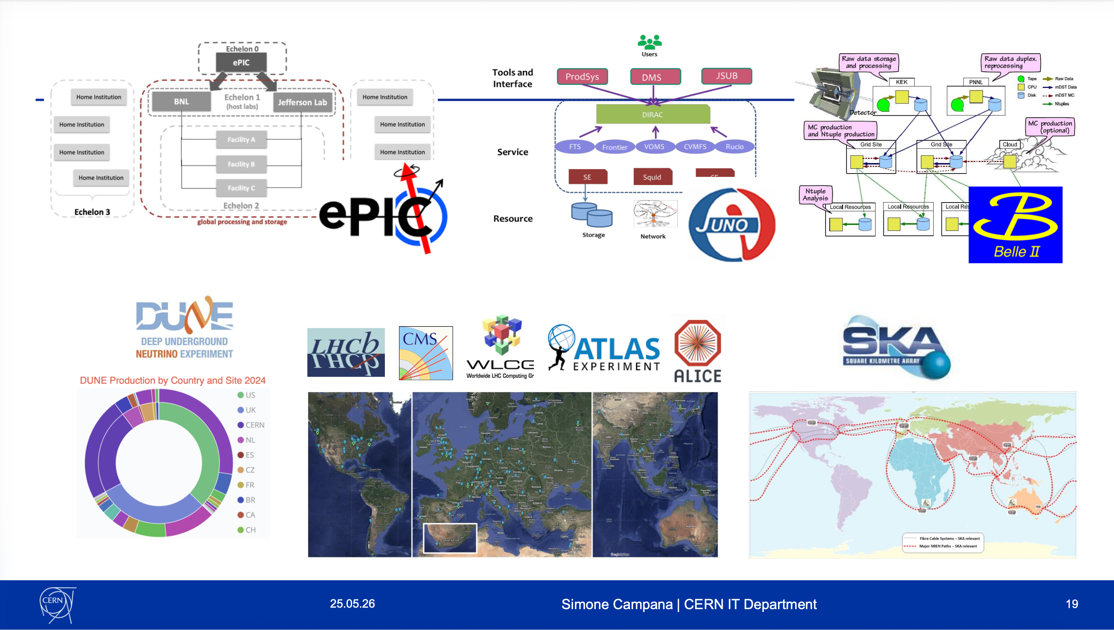
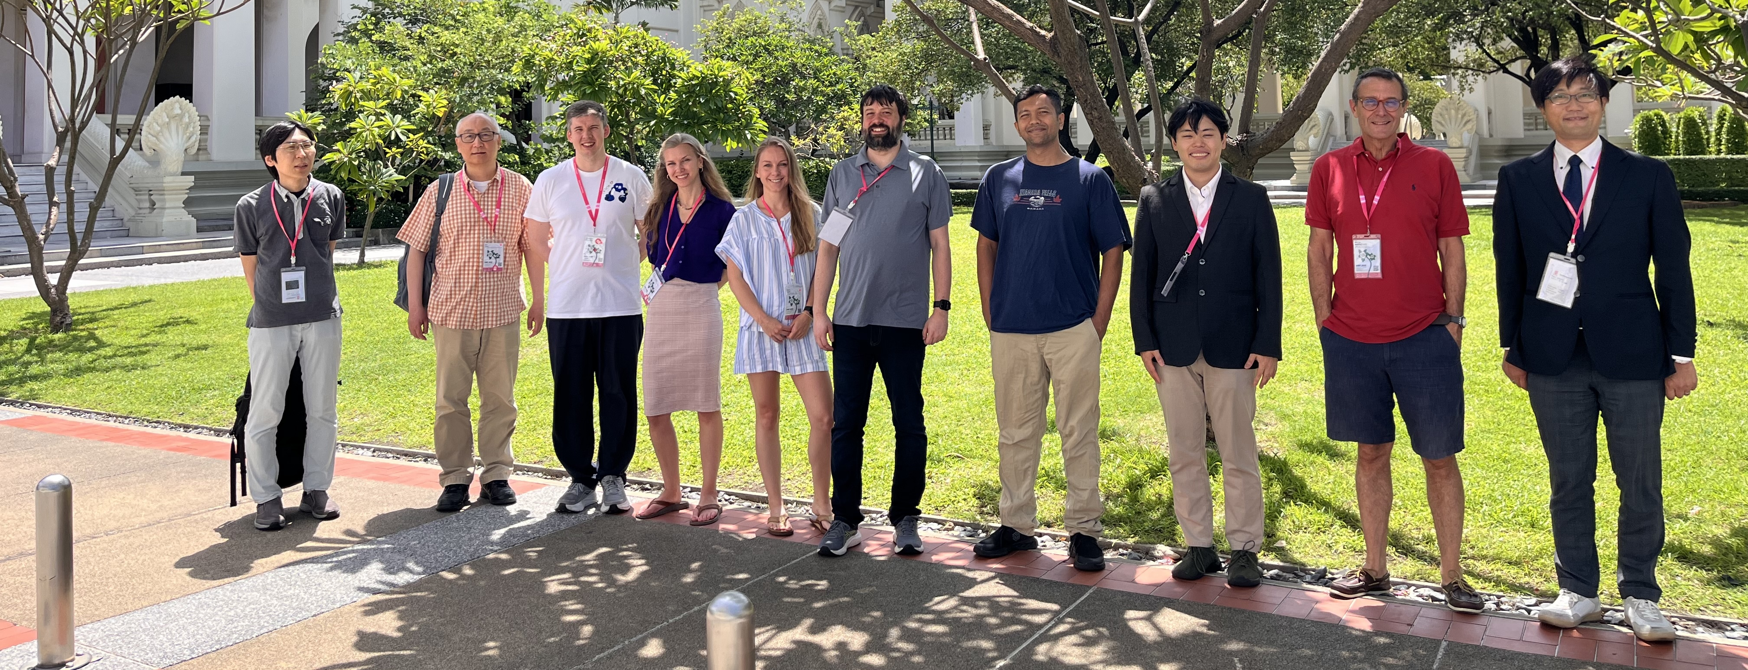

ePIC Representation at CHEP 2026 (May 25–29, Bangkok, Thailand)
ePIC was well-represented, including in Simone Campana’s keynote
ePIC Contributions
Takuya Kumaoka – Development of Streaming Data Reconstruction for ePIC Experiment at EIC
Sakib Rahman – Scaling ePIC Simulation Production: Distributed Workflow and Data Management
Holly Szumila – The ePIC Streaming Computing Model
Sakib Rahman – Exploring Potential Pathways to Accelerated ePIC Detector Simulations
Sasha Prozorov – ePIC User Learning Training and Documentation Strategies

Slide 14
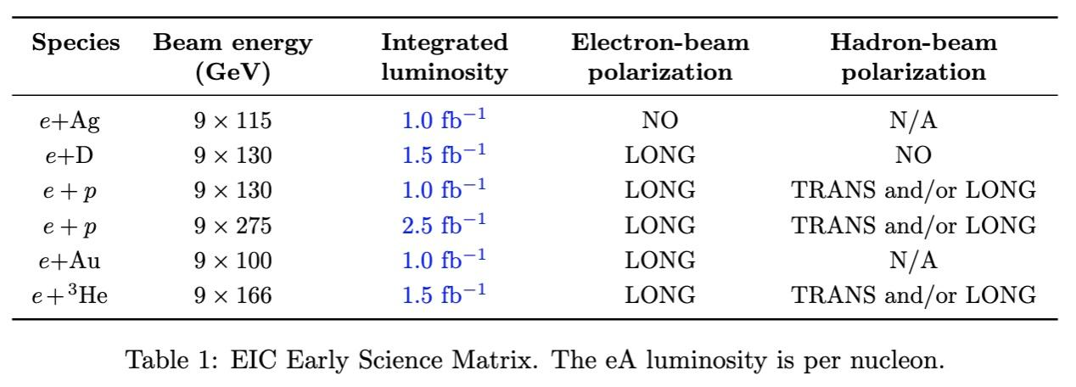
Purpose of the July Campaign
Earlier in May, we received updated estimates from the EIC Project for the collected luminosities associated with different beam energies and species during the Early Science period.
Decisions
Early Science Report: Use the April campaign with the original settings, with the luminosities in the Early Science studies rescaled accordingly.
NIM-A Special Issue: Use simulation productions based on the revised beam energies and species. Target: July.

Slide 15
Preparations for the July Campaign
Software stack was updated to provide capability to simulate and process 9 GeV electron samples in late April.
Production WG has contacted PWGs regarding requests and updated input files.
Automated production workflows will be presented at the collaboration meeting, with a preview at the ePIC Software & Computing meeting on June 24.
Until then, we will continue using the existing workflow:
  Coordinate with your PWG and the PACs.
  Generate MC input following our guidelines.
  Submit requests through the request form once the input file is available.
  Clarification: Requests should be submitted through the Google Sheet, not via PRs.
The collection of new data files is progressing well. The only known issues are with BeAGLE and are being addressed by the Physics Analysis Coordinators.

Slide 16
Campaign Dataset Catalogue and Verification Tools
Dataset Catalogue https://eic.github.io/epic-prod/documentation/default_datasets.html
It is based on the Overview Tracking Spreadsheet but includes a much more detailed provenance record.
Verification Tools (inside eic-shell)
Check Campaign Availability: Run this snippet to check the availability of specific samples in a given campaign month: https://github.com/eic/snippets/blob/campaign_info/SimulationProduction/check_campaign.py
List Files by DID: Run this snippet to write out the individual files available under a particular Rucio DID: https://github.com/eic/snippets/blob/campaign_info/SimulationProduction/check_storage.py

Slide 17
Collaboration Survey
Survey opened May 11th, closed May 25th
184 responses in total
  Substantial variation in the number of responses for each question, between ~30 to ~160
Survey responses read, digested and discussed by SP and CC Offices
  Also provided data to Coordinators
Thomas gave an overview for the Collaboration Council in the
May 29th CC Meeting
AI Summary is used in following slides

Slide 18
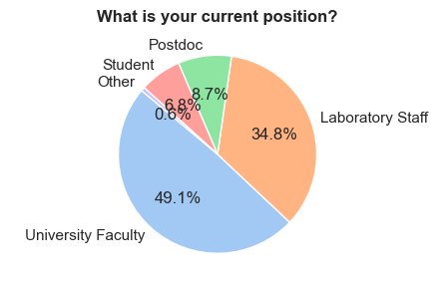
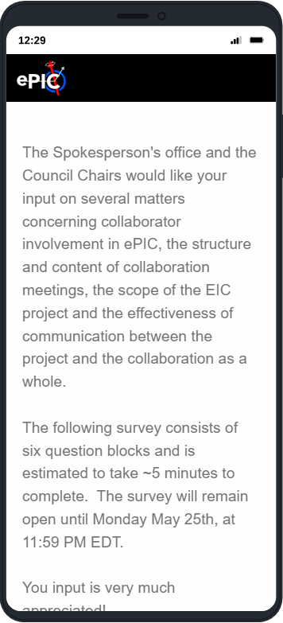
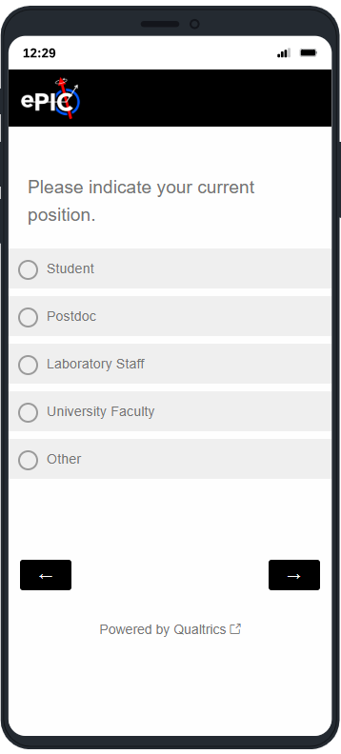
Question 1
Intro, and demographic information
Interpretation
The survey was dominated by senior collaboration members (faculty and laboratory staff), with more limited representation from postdocs and students.
(From the phone book, students and postdocs make up 23% of ePIC collaborators.)

Slide 19
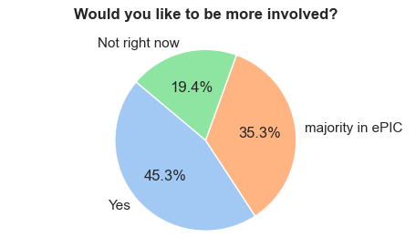
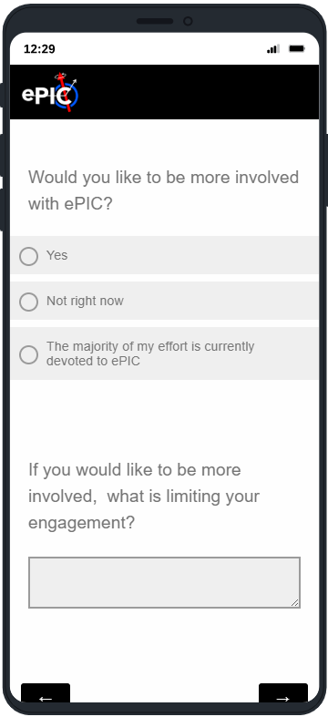
Question 2
Engagement
Main Constraints on Engagement
The most common themes in free-text responses were:
Lack of time / competing commitments
Teaching responsibilities
Overlap with CERN/LHC commitments
Funding limitations
Geographic constraints and travel burden
Uncertainty about project timelines and priorities
Representative Comments
“Time. Other projects. Teaching.”
“Difficulty attending meetings because of heavy overlap with teaching and CERN-related meetings.”
“Support to spend significant time near BNL or one of the ePIC institutions.”
Interpretation
There is substantial willingness for increased engagement, but collaboration members frequently feel constrained by bandwidth, scheduling conflicts, funding, and uncertainty about project direction.

Slide 20
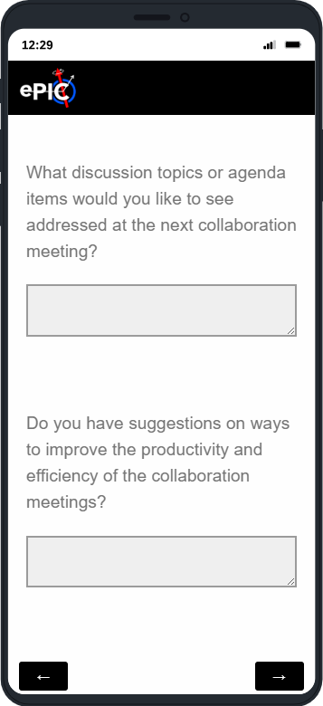
Question 3a
Most requested agenda topics included:
Accelerator schedule and implementation planning
In-kind contributions and project responsibilities
Streaming readout and software discussions
Detector integration and PID strategy
Early science planning
New member onboarding
Young researcher opportunities
Interpretation
Respondents want:
More strategic/project-level information
More practical implementation details
Better visibility into detector and software coordination
More support for junior members and remote contributors
Collaboration meeting topics and agenda items

Slide 21
Question 3b
Reduce Meeting Overload / Improve Efficiency
Respondents noted:
Too many meetings
Repetition of the same speakers
Need for better time management
Desire for more structured discussion sessions
Increase Inclusion and Participation
Suggestions included:
Better onboarding for new members
More opportunities for junior researchers
Greater participation from quieter members
More small-group interaction
Improve Remote and Hybrid Participation
Several comments emphasized:
Better hybrid meeting support
Faster posting of recordings
Asynchronous communication tools
Better accommodation for different time zones
Improve efficiency and productivity of collaboration meetings

Slide 22
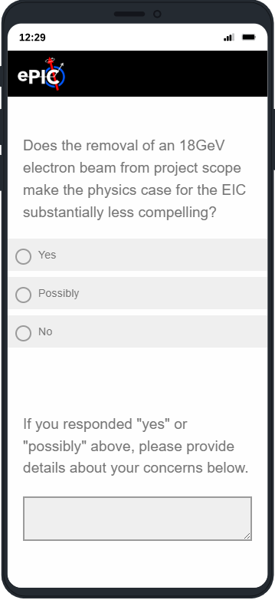
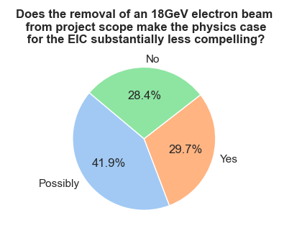
Question 4
Interpretation
A mixed response representing concerns focused primarily on:
Reduced kinematic reach
Saturation physics sensitivity
Access to high-Q² processes
Loss of discovery potential
Common Scientific Concerns
Respondents repeatedly referenced:
Reduced phase space
Lower saturation reach
Reduced precision or statistics
Less compelling physics relative to other facilities
Representative comments:
“A key motivation for EIC was the search for saturation.”
“Significant loss in phase space.”
“The upper energy is already constraining the physics output.”
Minority View
Some respondents argued that:
Higher luminosity may compensate for lower energy
Early operation at reduced energy is acceptable
Detector commissioning and gradual ramp-up are expected anyway
18 GeV electron beam.

Slide 23
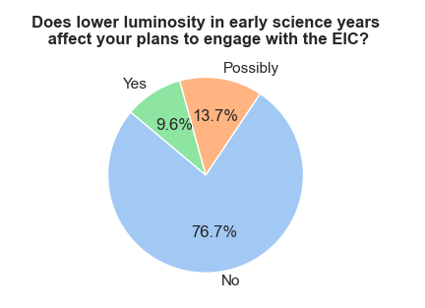
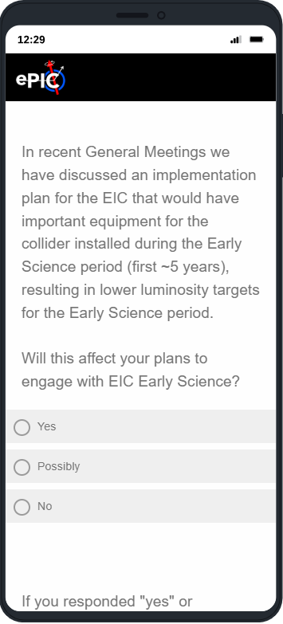
Question 5
Early Science
Interpretation
Most respondents indicated that reduced luminosity during the Early Science phase would not substantially alter their engagement.
However, the comments reveal nuanced concerns:
Competition with LHC Run 4 priorities
Concern about weakening the overall physics case
Worry about delayed flagship measurements
Anxiety about long-term momentum and recruitment
Representative comments:
“Luminosity is everything if EIC is to have the most possible impact.”
“Anything that hurts the EIC physics case relative to other experiments will result in a redistribution of analysis resources.”

Slide 24
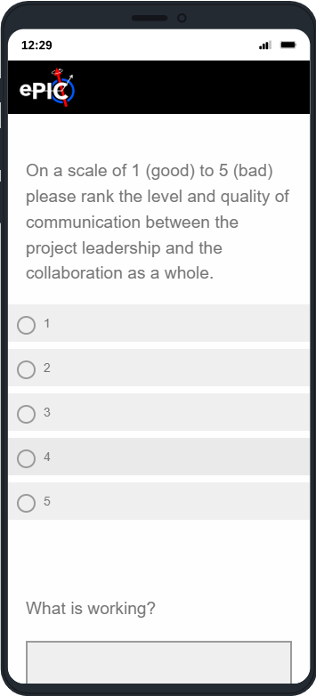
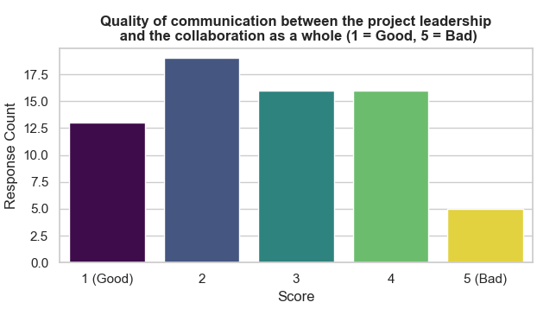
Question 6
What Could Be Improved?
Recurring theme emerged:
More Transparency About Accelerator and Project Planning
Many respondents specifically requested:
More realistic schedule information
More accelerator updates
Better discussion of risks and uncertainties
Clearer distinction between official plans and realistic expectations
Representative comments:
“We seem to be missing what is actually happening in project planning, particularly for the accelerator.”
“More updates on what's going on with the machine.”
Collaboration-Project communication.
Note the “collaboration as a whole” phrase.

Slide 25
Overall Survey Assessment
The survey indicates a collaboration that is:
  Scientifically committed,
  Operationally active,
  Increasingly concerned about transparency, realism in planning, and preservation of the full physics potential of the EIC.
The strongest positive signal is continued enthusiasm and willingness to engage.
The strongest concern is that repeated reductions in machine capability or uncertainty in planning could gradually erode scientific momentum.

Slide 26

Upcoming RRB Meeting
7th RRB Meeting at MEXT headquarters in Tokyo June 9-10th
  https://indico.bnl.gov/event/32211/
  Continuing discussions on project and collaboration status, in-kind contributions, computing, and common funds
  More in Project News

Slide 27

(Following the 7th RRB June 9-10th at MEXT)
https://indico2.riken.jp/event/5568/
Registration now open!

Slide 28
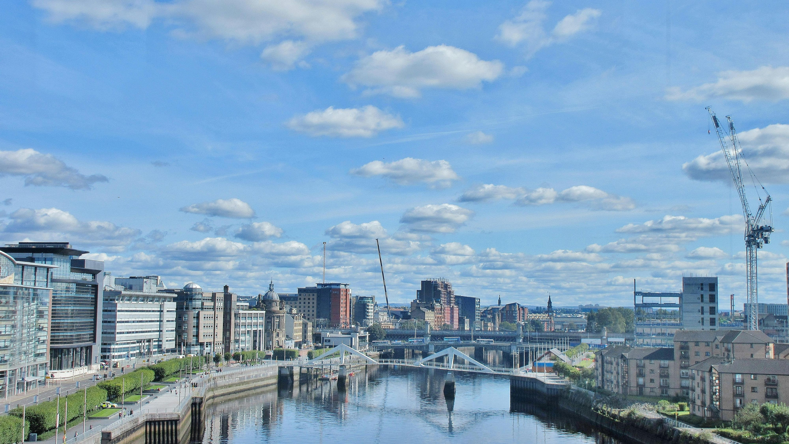
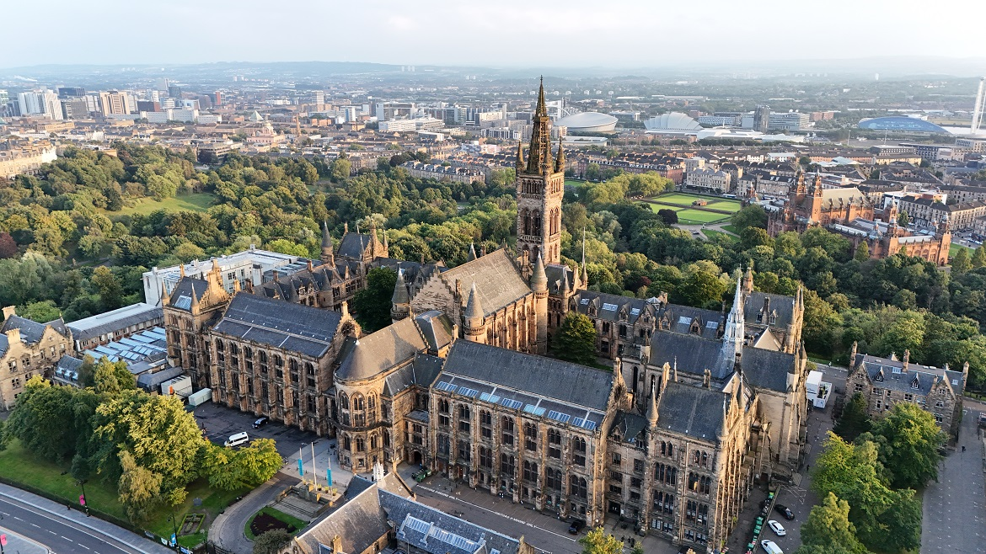
Summer 2026 Joint EICUG/ePIC Meeting
The Summer 2026 joint EICUG/ePIC meeting will be held at the University of Glasgow July 13-17th , 2026.
ECR event July 11-12th (organized by EICUG) – looking for contributions!
Indico w/information and Registration:
https://indico.bnl.gov/event/31808/
Registration Now Open!
Deadline June 22nd: This is the deadline for the early bird price of the registration fee. However June 22 also has to be the deadline for signing up to the optional conference dinner, whisky tasting and excursion events. This is also linked to our internal deadline for catering numbers. It will be possible to register after June 22 for an increase of fee to £400 (from £300) but we cannot guarantee any of the optional events beyond this date.

Slide 29
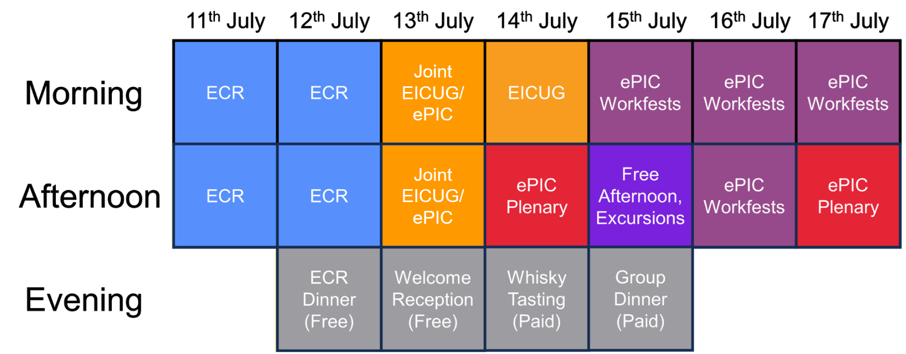
July Collaboration Meeting Block Structure
Waiting for survey feedback to finalize ePIC allocated time.

Slide 30
DRAFT Workfest Proposals and Tutorials
AI Workfest
  Discussing multiple proposals
  1-2 sessions
Excl., Diff and Tagging
  Stephen Kay, Garth Huber, Kong Tu
  Prefer Afternoon
Tracking
  Barak, Shujie and Barbara
  One session, avoid PWG overlap, afternoon a must
Electronics, RO + Streaming WG
  Jeff, Fernando, Dave, Taku, Marco, Torre, Markus
  2 sessions
AC-LGAD Sensors and ASICS
  Alex, Satoshi
  Prefer Afternoon
  2 sessions
EPIOS (TBC)
  Richard Milner
Physics, Software and Computing
  Open issues in software/simulations/computing
  Solicit contributions (?)
Tutorials:
ECR – track + cluster matching, PODIO analysis
AI – MCP for physics analysis (TBC)
Workfest schedule to be finalized after discussion with coordinators.
Updates to ePIC portion of agenda coming in the next week!

Slide 31
Conferences Needing ePIC Speakers
ICNFP 2026:
  https://indico.cern.ch/event/1571736/overview
  Seeking ePIC highlight talk, other talks and posters
  Deadline past with no known applicants.
Diffraction and Low-x Conference:
  https://indico.cern.ch/event/1632252/overview
  ePIC Overview, soliciting additional contributions as well
  No formal abstract deadline but requested talks by June 17.
ISMD 2026:
  https://indico.cern.ch/event/1593982
  Open and soliciting speaker for ePIC overview talk
Contact the Conference and Talks Committee (CTC) with nominations (incl. self nominations):
Brian Page: bpage@bnl.gov
Daniel Brandenburg: brandenburg.89@osu.edu

Slide 32
Call for Nominations: Vice-chairs of Collaboration Council, Membership Committee, and Conference & Talks Committee
Dear Colleagues,
The ePIC Election Committee is seeking nominations for the following ePIC leadership positions:
Collaboration Council Vice-Chair (Replaces Renee, as she becomes chair. The candidate(s) have to be CC members.)
Membership Committee Vice-Chair (Replaces Carlos, who becomes chair)
Conference and Talks Committee Vice-Chair (Replaces Daniel, who becomes chair)
More info on the Collaboration Council and Standing Committees:
https://www.epic-eic.org/collaboration/council.html
https://www.epic-eic.org/collaboration/committees.html
Nominate your colleagues. Self-nominations are welcome and encouraged. The call for nominations will be open for 2 weeks, until June 9. Please send your nominations to the Election Committee (email addresses in the cc). Elections will then take place using ranked ordered voting.
Best regards,
Ken for the ePIC Election Committee

Slide 33
Survey on ePIC Analysis Formats and Tools
Dear all,
To prepare for a discussion with the ROOT team, we have prepared a brief survey on I/O formats and analysis tools used within ePIC:
https://docs.google.com/forms/d/e/1FAIpQLSffmr7S2qGDECnp6_SjDEF2cd30Vgey4IxY0kv90CIlQ5rN0w/viewform?usp=sharing&ouid=117756119943977751147
The survey has seven questions and should take only a few minutes to complete. Your responses will help us understand current usage and provide useful feedback on how to take advantage of developments in ROOT I/O and analysis tools to better support ePIC workflows.
This survey is limited in scope and is intended to support the upcoming discussion with the ROOT team. It will also help prepare for a broader discussion of analysis models, tools, and workflows within ePIC.
Best regards,
Dmitry, Holly, Markus, and Torre

Slide 34
Upcoming Events 2026
hPDIRC Annual Meeting – June 4-10th
EIC RRB & EIC-Asia Meeting, Tokyo, June 9th – 13th
5th BIC In-Person Workshop – June 16-18th
Next General Meeting – June 26th
EIC Early Science Whitepaper Due – July
EICUG Early Career Meeting July 11-12th @ University of Glasgow
Collaboration Meeting July 13-17th @ University of Glasgow
EIC Project Director’s Review Aug. 18-19th
DOE OPA review of the EIC Project Sept. 15-18th
ePIC NIM-A Special Issue Submissions – Oct
ePIC Software and Computing Review – Oct 13-14th
Plus: Numerous PDR/FDR reviews – see Project News

Slide 35
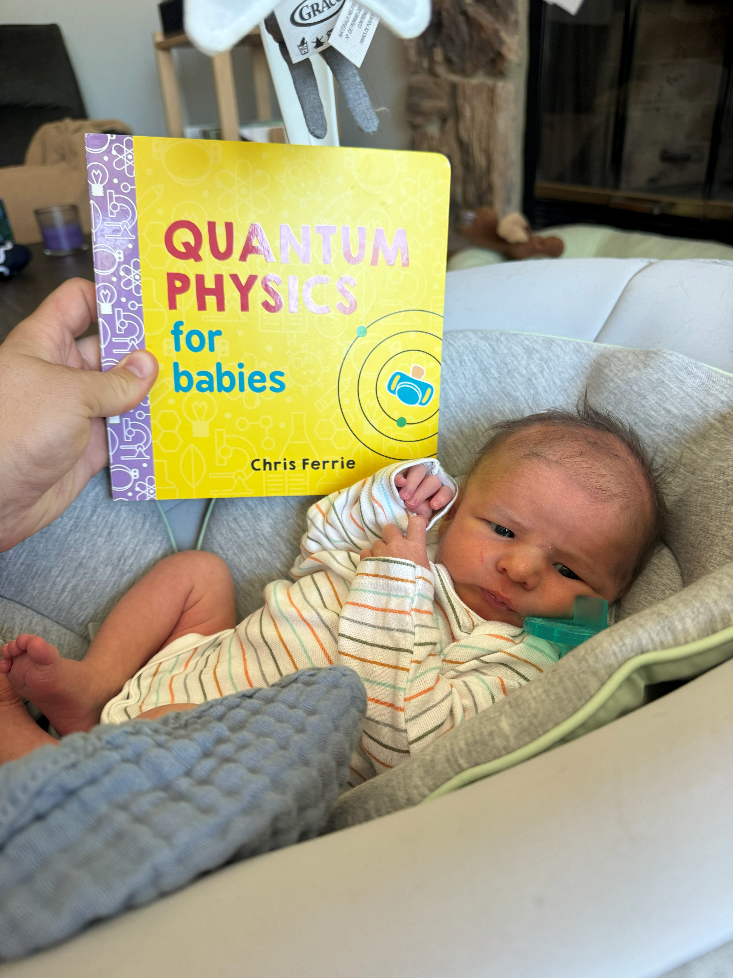
Pondering QCD
Rowan Stephen Lajoie
Born: May 3rd, 2026

Slide 36


Slide 37
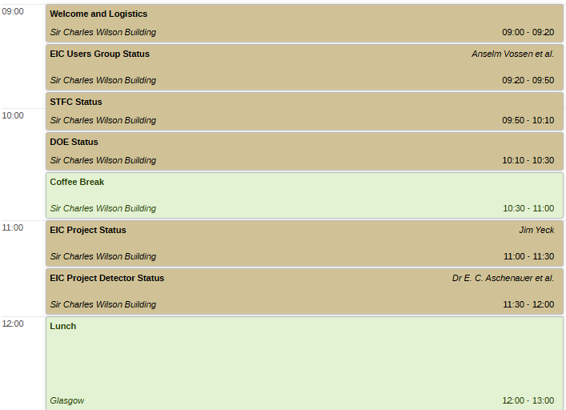
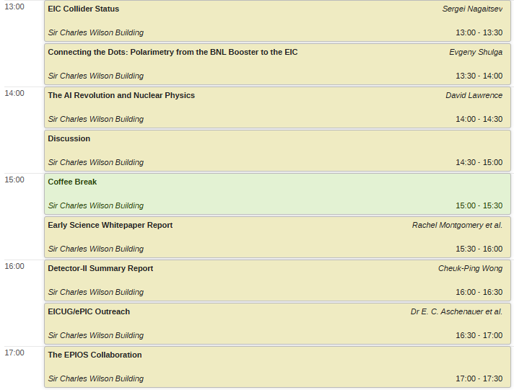
Joint EICUG/ePIC Plenary Session DRAFT

Slide 38
Collaboration Goals for the first half of 2026
Support the EIC project and ePIC Technical Design:
  Close the design loop with ePIC simulations
  Advance the pTDR in preparation for CD-2
    Respond to review recommendations
Complete the Early Science whitepaper
Progress in developing a multi-year plan for ePIC Software and Computing
Begin submissions to the NIMA Special Issue
At the upcoming collaboration meeting, we will take stock of our progress on these priorities and set the priorities for the next half of 2026.

Slide 39
Suggested Action Items (AI)
Communication and Transparency
Provide regular accelerator/project-status briefings
Share realistic timelines and risks explicitly
Improve communication around strategic decisions
Increase direct interaction between collaboration and accelerator leadership
Meeting Improvements
Reduce repetitive presentations
Expand moderated discussion sessions
Improve hybrid participation tools
Post recordings and slides quickly
Use asynchronous discussion channels where appropriate
Inclusion and Engagement
Create structured onboarding pathways
Increase opportunities for students/postdocs
Encourage broader participation beyond established senior voices
Support cross-working-group collaboration
Scientific Strategy
Clearly communicate the scientific impact of energy/luminosity tradeoffs
Provide comparative studies showing mitigation strategies
Emphasize compelling early-science opportunities

Slide 40
ePIC Resources
Public Website - https://www.bnl.gov/eic/epic.php
Mailing Lists – https://lists.bnl.gov/mailman/listinfo
Indico Agenda - https://indico.bnl.gov/category/402/
  ePIC Software and Computing: https://indico.bnl.gov/category/435/
Wiki - https://wiki.bnl.gov/EPIC
ePIC Software Training:
  Landing Page: https://eic.github.io/documentation/landingpage.html
  Tutorials: https://eic.github.io/documentation/tutorials.html
Mattermost: https://chat.epic-eic.org
ePIC Zenodo Community: https://zenodo.org/communities/epic

Slide 41


EICUG Membership
The EICUG is a vital organization to promote the interests of the EIC community!
  Without the EICUG we would never have gotten far enough to form ePIC!
Please register your institution!
Check with your EICUG IB representative to get registered as a member
https://www.eicug.org/content/join.html

Slide 42
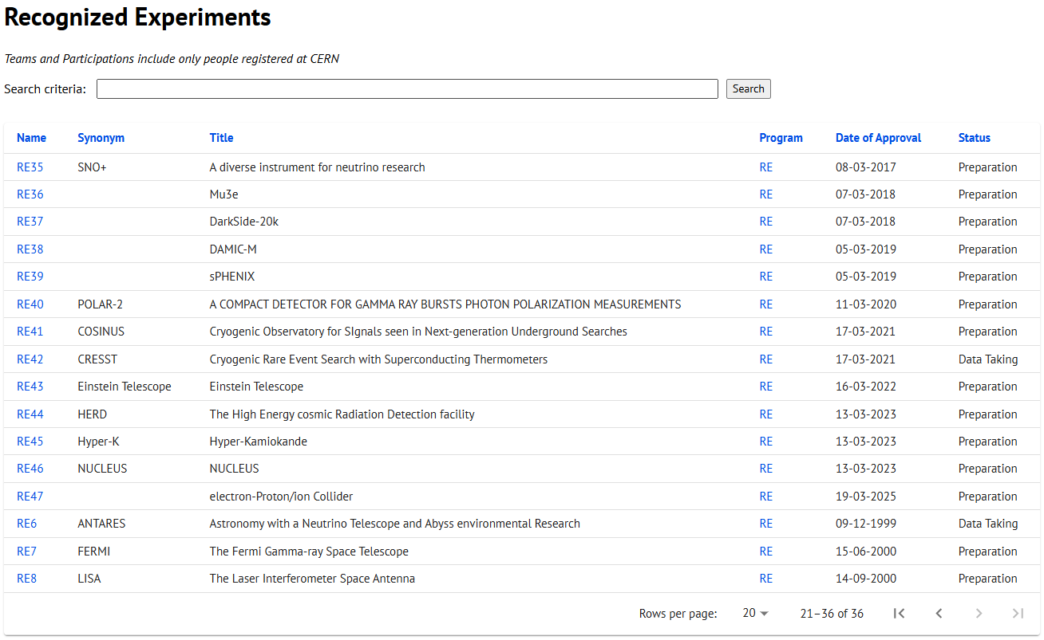
CERN Recognized Experiment Status: RE47
ePIC now appears in the CERN Grey Book database as RE47:
https://greybook.cern.ch/experiment/recognized
Two steps to get ePIC Collaborators registered at CERN:
CC Representative needs to register as team leader with
CERN Users Office:
  https://usersoffice.web.cern.ch/
  https://usersoffice.web.cern.ch/team-leaders-corner
  Users.Office@cern.ch
CC member can then certify registrations of team members
Contact us if you run into problems!

