Slide 1

Collaboration News
John Lajoie, Silvia Dalla Torre
June 26, 2026

Slide 2
Hey John, start the recording….

Slide 3
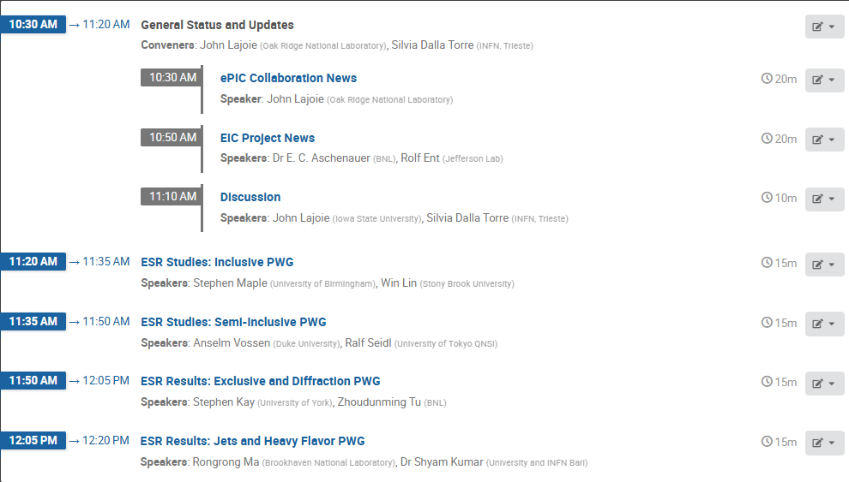
Agenda
Collaboration and Project News
Report from PWG’s on Early Science Report Studies
Our last General Meeting was June 5th !

Slide 4




New Institutions!
Trento Institute for Fundamental Physics and Applications
Justus-Liebig-Universität Gießen
Vrije Universiteit Brussel (VUB)
Welcome to ePIC!

Slide 5
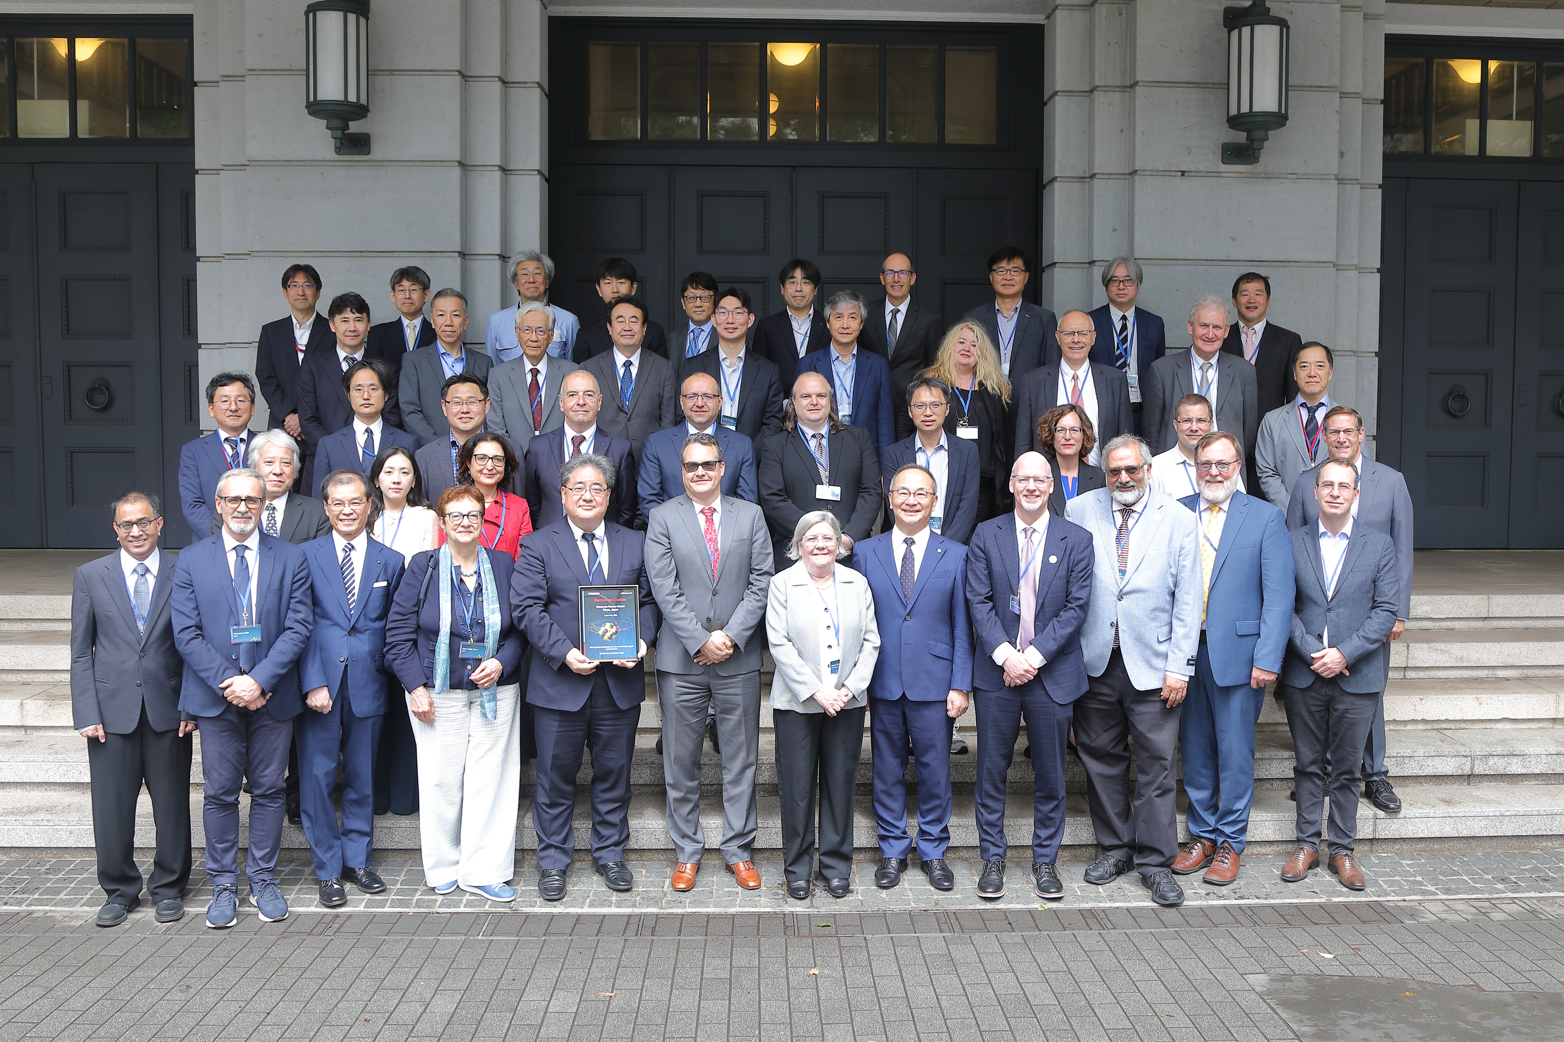
7th RRB Meeting
Held at MEXT headquarters in Tokyo June 9-10th
  https://indico.bnl.gov/event/32211/
  Continuing discussions on
  project and collaboration
  status, in-kind contributions,
  computing, and
  common funds
  More in Project News

Slide 6

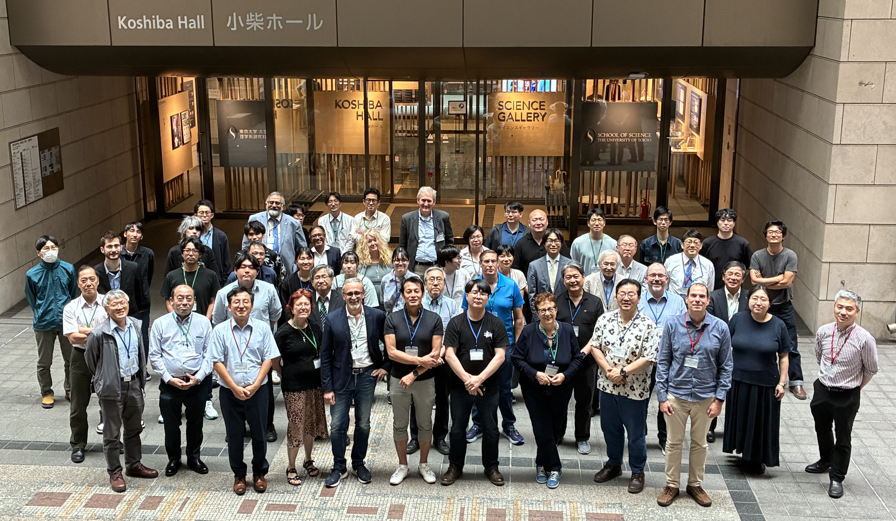
5th EIC-Asia Workshop
June 11-13th
https://indico2.riken.jp/event/5568/

Slide 7
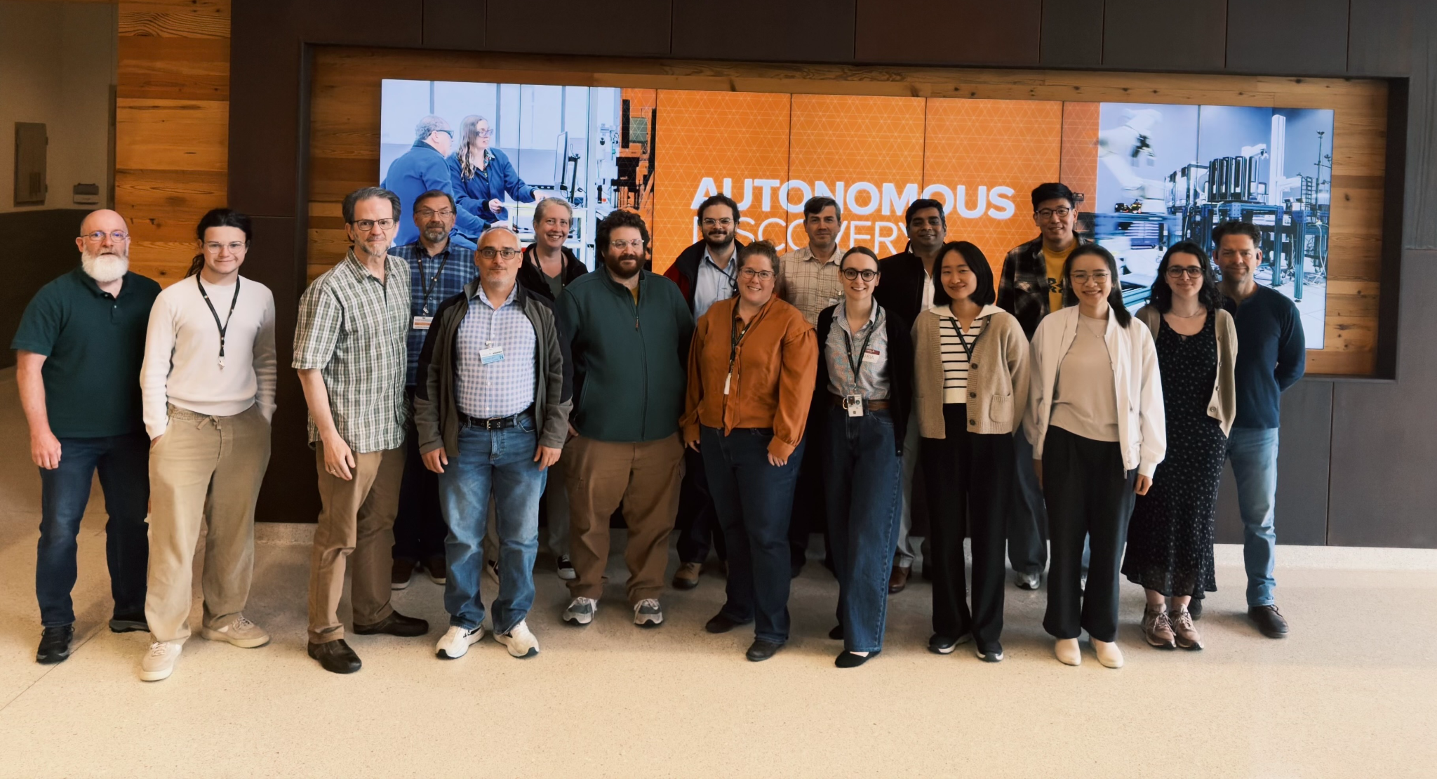
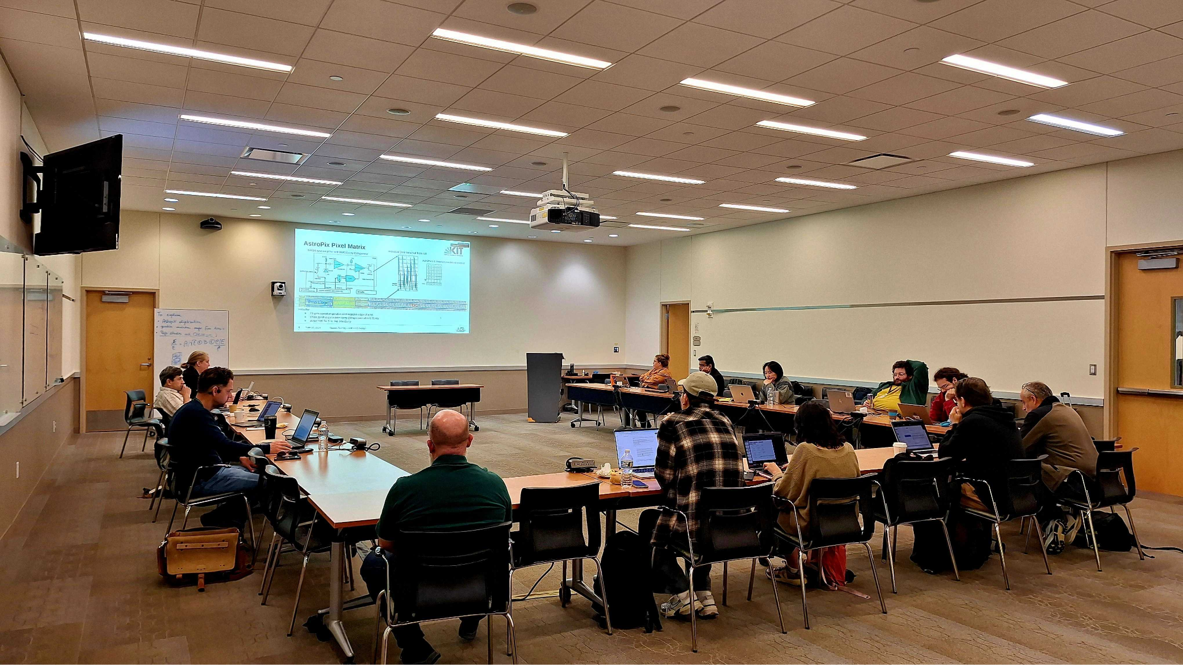
BIC Workshop at Argonne National Laboratory
June 15: BIC management day
June 16-18: BIC Workshop
https://indico.bnl.gov/event/31519/timetable/#20260616
25 in-person participants, ~15 online
16 sessions including:
  On-location BIC Sector Planning in production space and SiPM Simmung boards tests
  Planning and discussion sessions on ESB, Mechanics, Modules and Wafers, and System Testing
  QC Document writing session

Slide 8

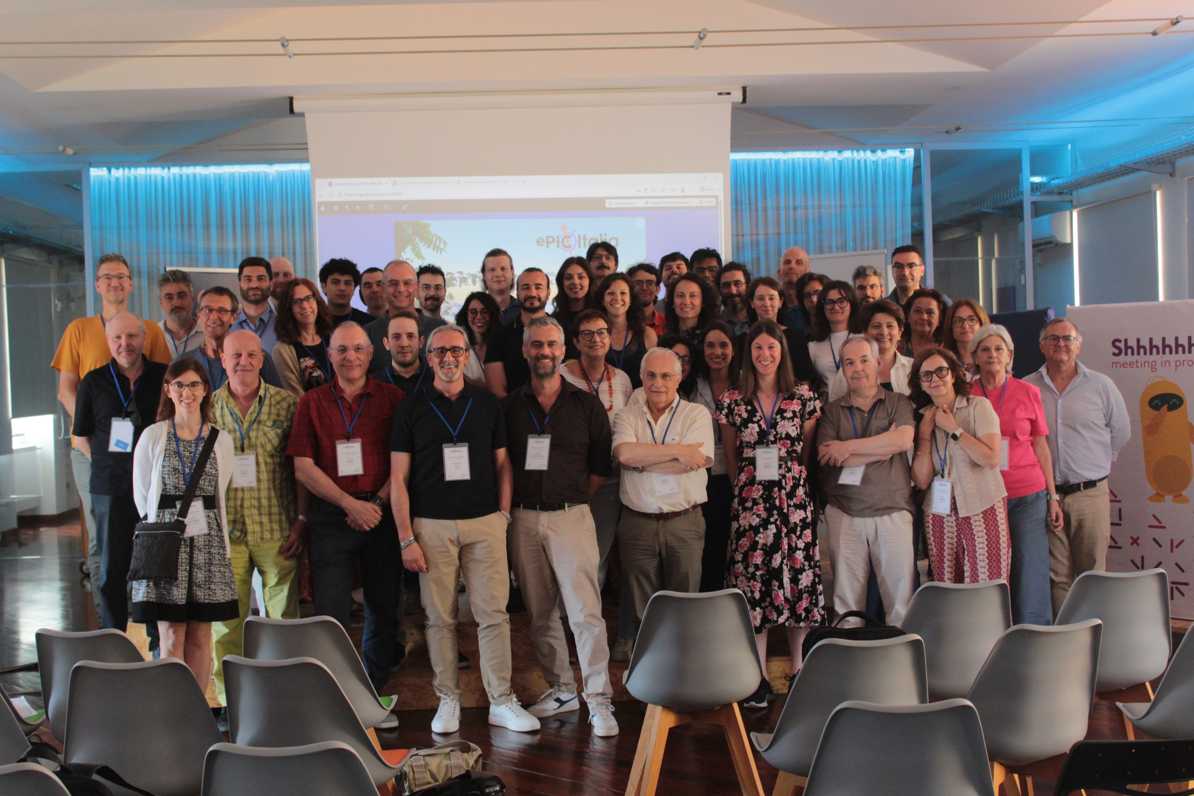
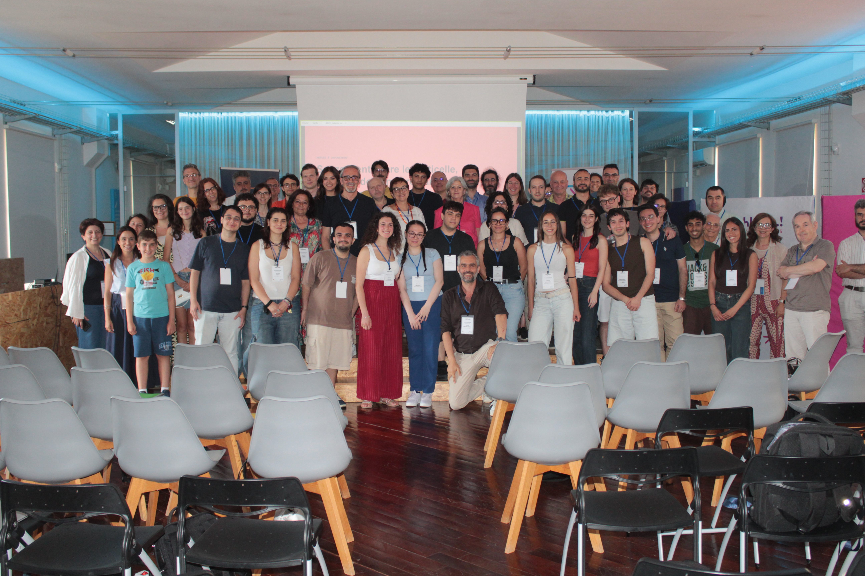
ePIC Italia
https://agenda.infn.it/event/50095/overview

Slide 9
News from the TC Office
Slides courtesy of Silvia Dalla Torre

Slide 10
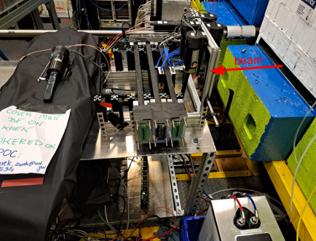
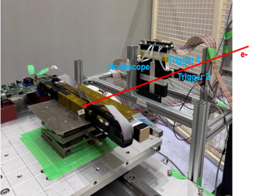
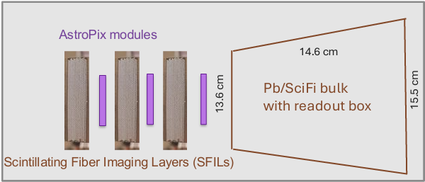
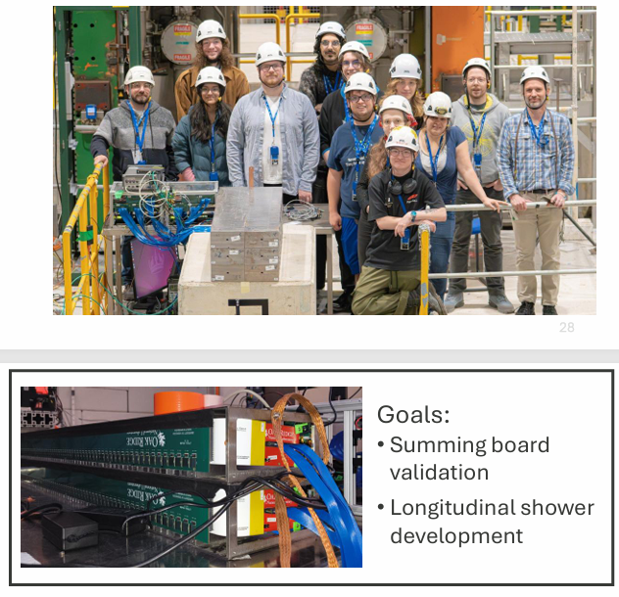
Beam Background Challenges and Test Beam Coordination
Motivations:
Background studies needed for pre TDR (subsystems and physics studies)
The project needs a feedback about the current scheme of collimation and shielding
Status and planning: summarized in a table uploaded to the TIC meeting June 22 agenda
( https://indico.bnl.gov/event/33334/attachments/70962/121603/Background_Challenges_DSCs.xlsx )
DSLs and DSTCs, are kindly asked to check and send feedback/comments/corrections by Monday June 29th
The table to insert data rates/hit occupancy is available prepared by Jeff Landgraf:
https://brookhavenlab.sharepoint.com/:x:/s/EICPublicSharingDocs/IQB-kLhwyLvuSpfzxCNyxGDOAZRAjAheMUOrajAzU52MJ1s?e=Hhc0ig
DSLs and DSTCs, are kindly asked to populate the table as soon as the information becomes available thanks to the ongoing background studies
Feedback from recent test beams:
  BIC at the TIC meeting June 8th
  LFHCAL at the TIC meeting June 22th
NEW !
NEW !
CERN, Aug. 2026,
in preparation
Parasitic at Jlab,
April and May 2026
BIC
NEW !
At KEK, May 2026
LFHCAL

Slide 11
TC Office priorities in second half of 2026
Completion of the background studies, ongoing
Update the preTDR to include the results of the background studies
  Obviously correlated with (i) to be started in parallel with the completion of (i) Coordination of the NIM-a Papers, DSC sector
Coordination of the NIM-A Papers, DSC sector
  In parallel with preTDR update
Status / perspectives/ encouragements for “full chain studies”:
  Sensor & FEE ASIC + FEB & RDO & DAM + FBDC & DAQ
  Of course, progressing step by step starting by coupling sensor and FEE (first step)
  This first step is also key to confirm the sensor performance: in terms of performance sensor and FEE are a fully integrated system

Slide 12
News from Software and Computing
Slides courtesy of Markus Diefenthaler, Dmitry Kalinkin, Holly Szumila Vance, Torre Wenaus

Slide 13
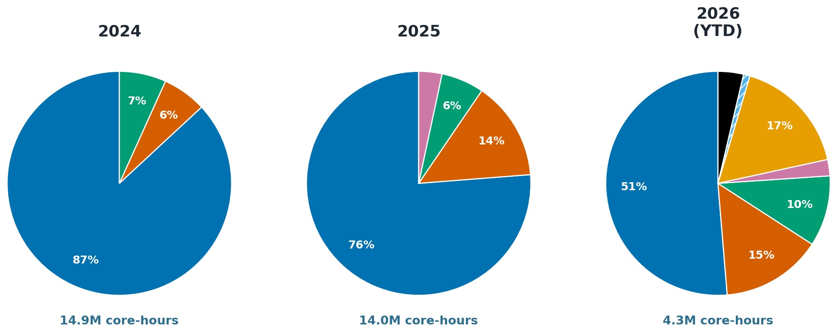
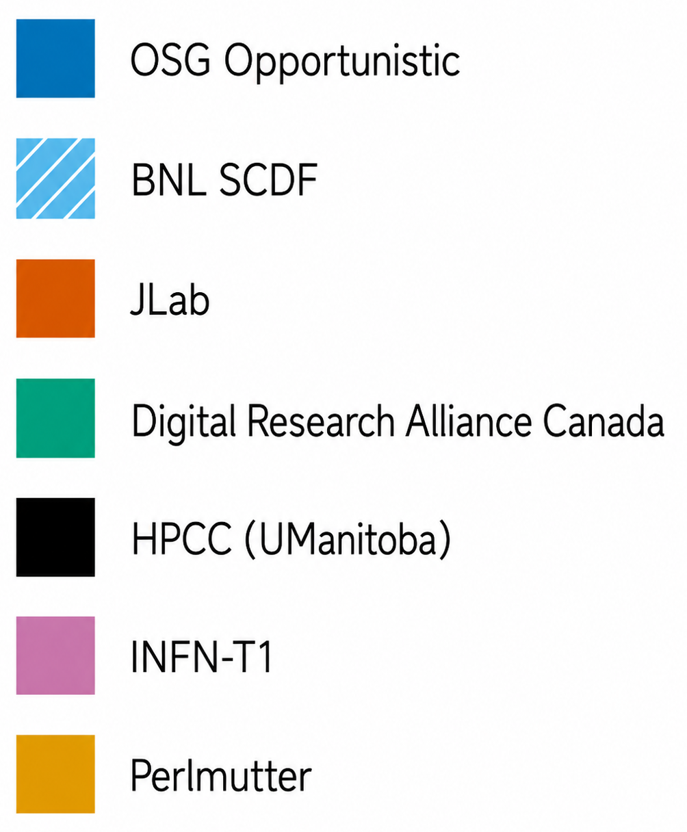







Distributed Computing and Storage: Status
Monthly simulation campaigns for preTDR and CD-2 preparations:
Compute Capacity
Storage Capacity
750 TB
BNL
NEW
Academia Sinica Grid Computing Centre (ASGC)
500 TB
500 TB
500 TB
JLab
+ 500 TB
ePIC is building its distributed compute and storage fabric now, with ongoing discussions about additional international contributions.
Notes:
2025: Italy 3%,
2026: BNL SDCF 1%, HPPC 4%, Italy 2%

Slide 14
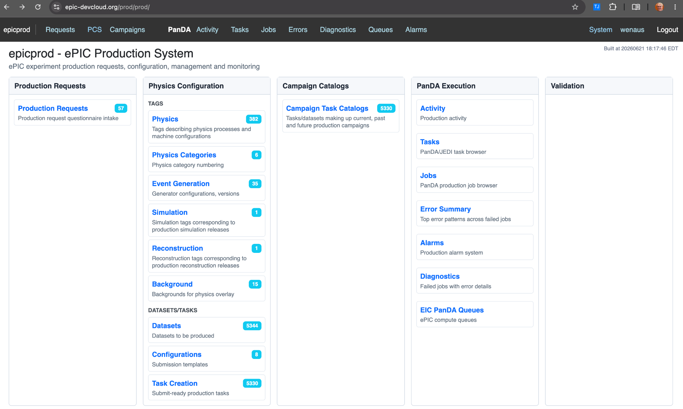
Automated Productions: Status and Plans Discussion on June 24
Openly accessible mirror: https://epic-devcloud.org/prod/
Validation using detector and physics benchmarks and Hydra work in progress.
Everyone can have a look at the open mirror, no login required.
Any input on what you see is highly welcome!
We are shifting from manual campaign coordination to an automated workflow using PanDA and AI agents. epicprod will make simulation production more accessible and scalable for ePIC, starting with the July campaign. More details at the collaboration meeting.

Slide 15
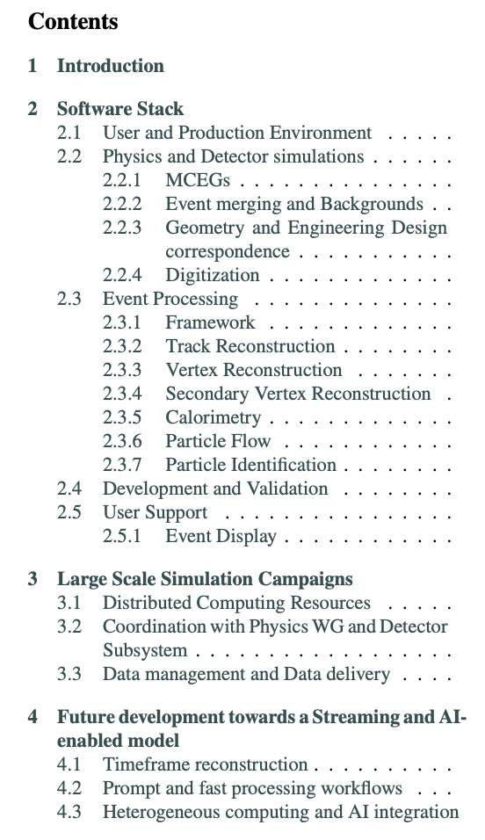
ePIC Software and Simulations Paper: Motivation and Scope
Need for a Software and Simulation Paper for NIM-A Special Issue
A major collaborative effort that deserves documentation
A reference for simulation efforts by DSCs and PWGs
Suggested by DSCs during a TIC meeting
Purpose: Document the full process of campaign delivery and processing:
How the software is developed
How simulation and reconstruction are processed
How simulation campaigns are carried out
How data analysis is performed
How the overall framework connects to future developments and ongoing testbed efforts
The TIC reviewed the outline on June 22.

Slide 16
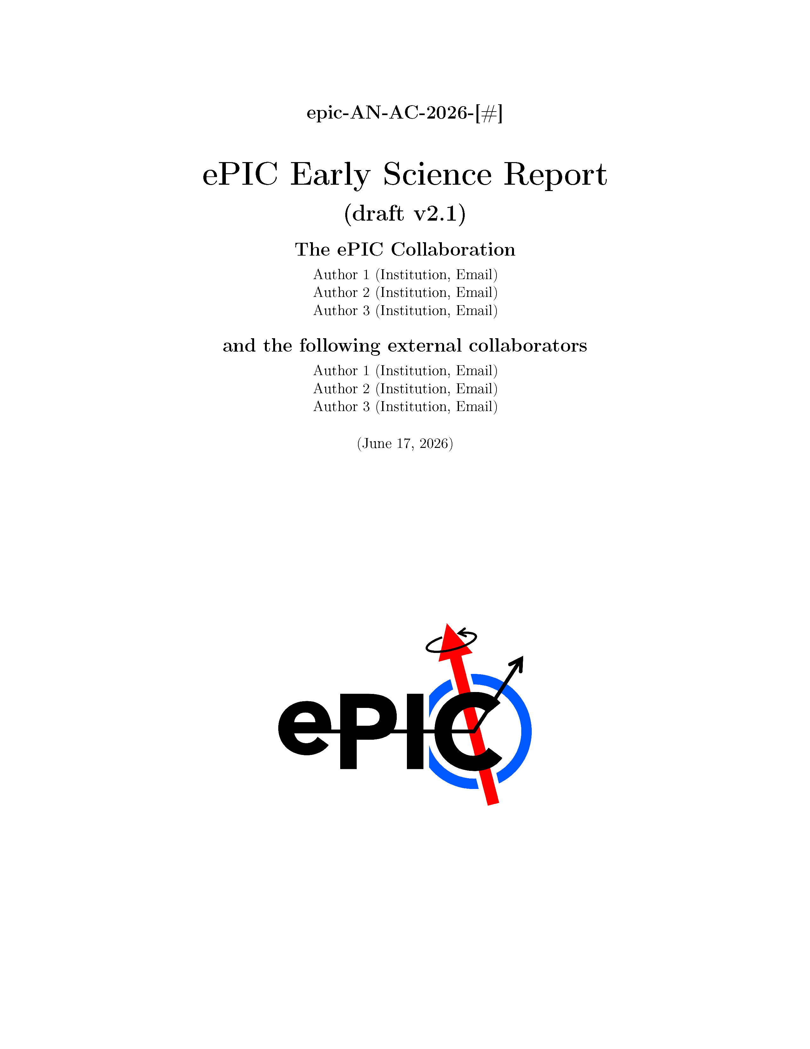
Early Science Report - Endgame
Comments solicited from Collaboration
  Due June 23rd
PACs++ at work revising document
Call out to CC representatives to review draft author list
  SP, CC Office will meet with Membership and Publication committee chairs to revise author list June 30th
  Includes request for acknowledgements
PACs submit to SP/CC ~July 1st,
final read
Send to Lab ALD’s by July collaboration meeting.
Submit to arXiv following collaboration meeting.
  Working with BNL graphic design on a cover

Slide 17
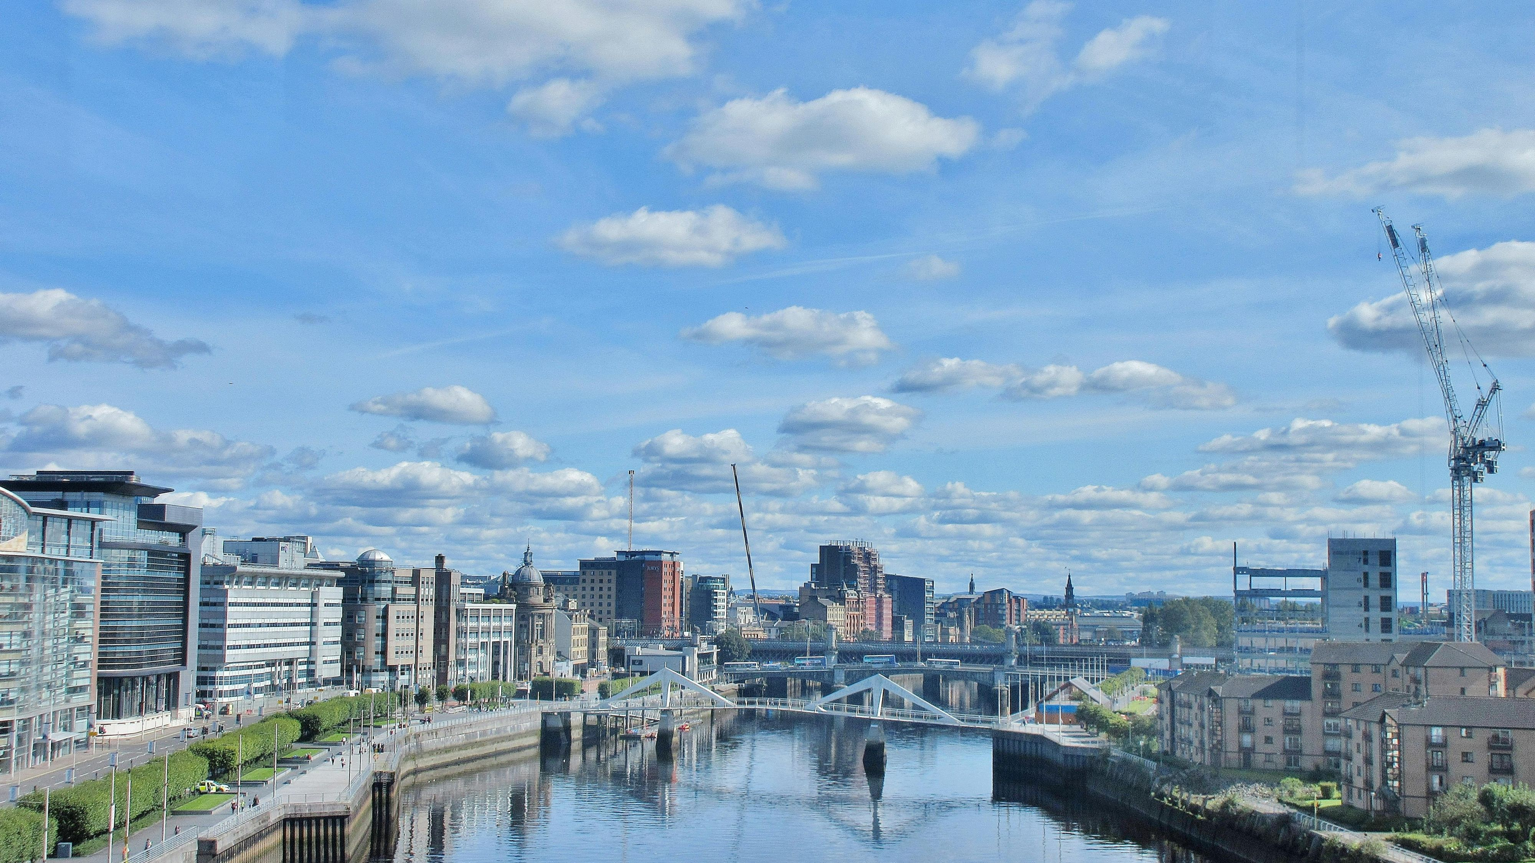
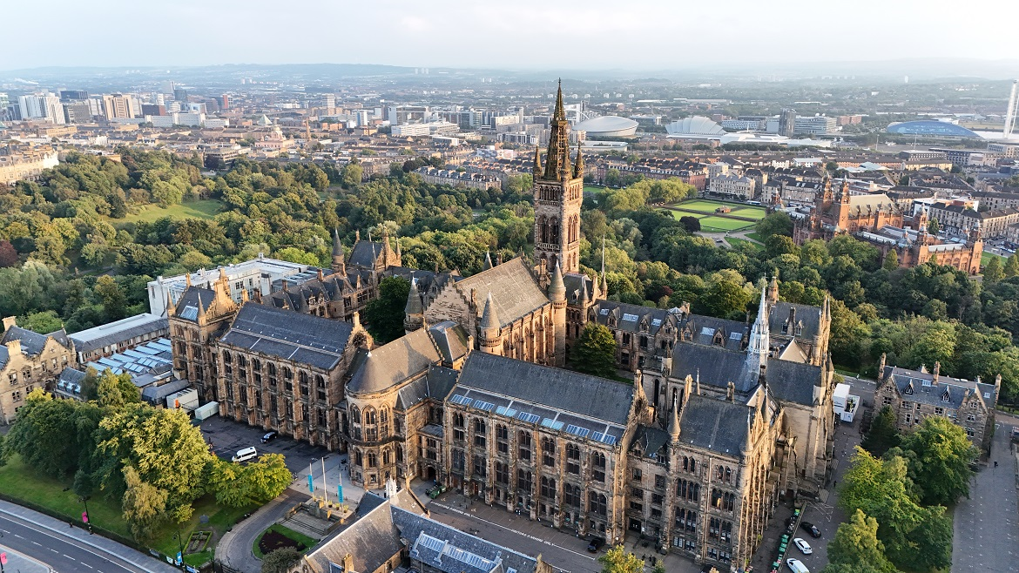
Summer 2026 Joint EICUG/ePIC Meeting
The Summer 2026 joint EICUG/ePIC meeting will be held at the University of Glasgow July 13-17th , 2026.
ECR event July 11-12th (organized by EICUG)
https://indico.bnl.gov/event/31808/
184 Registered, 102 In-Person
REMINDERS:
If you have registered for the dinner, please select menu choices ASAP:
https://indico.bnl.gov/event/31808/page/739-group-dinner
Excursions prices now fixed, payment links going out soon:
  Stirling Castle : £40
  Loch Lomond : £40
  Clydeside Distillery: £25
  Tennents Brewery: £25
  Whisky Tasting: £25
  Group Dinner: £75

Slide 18
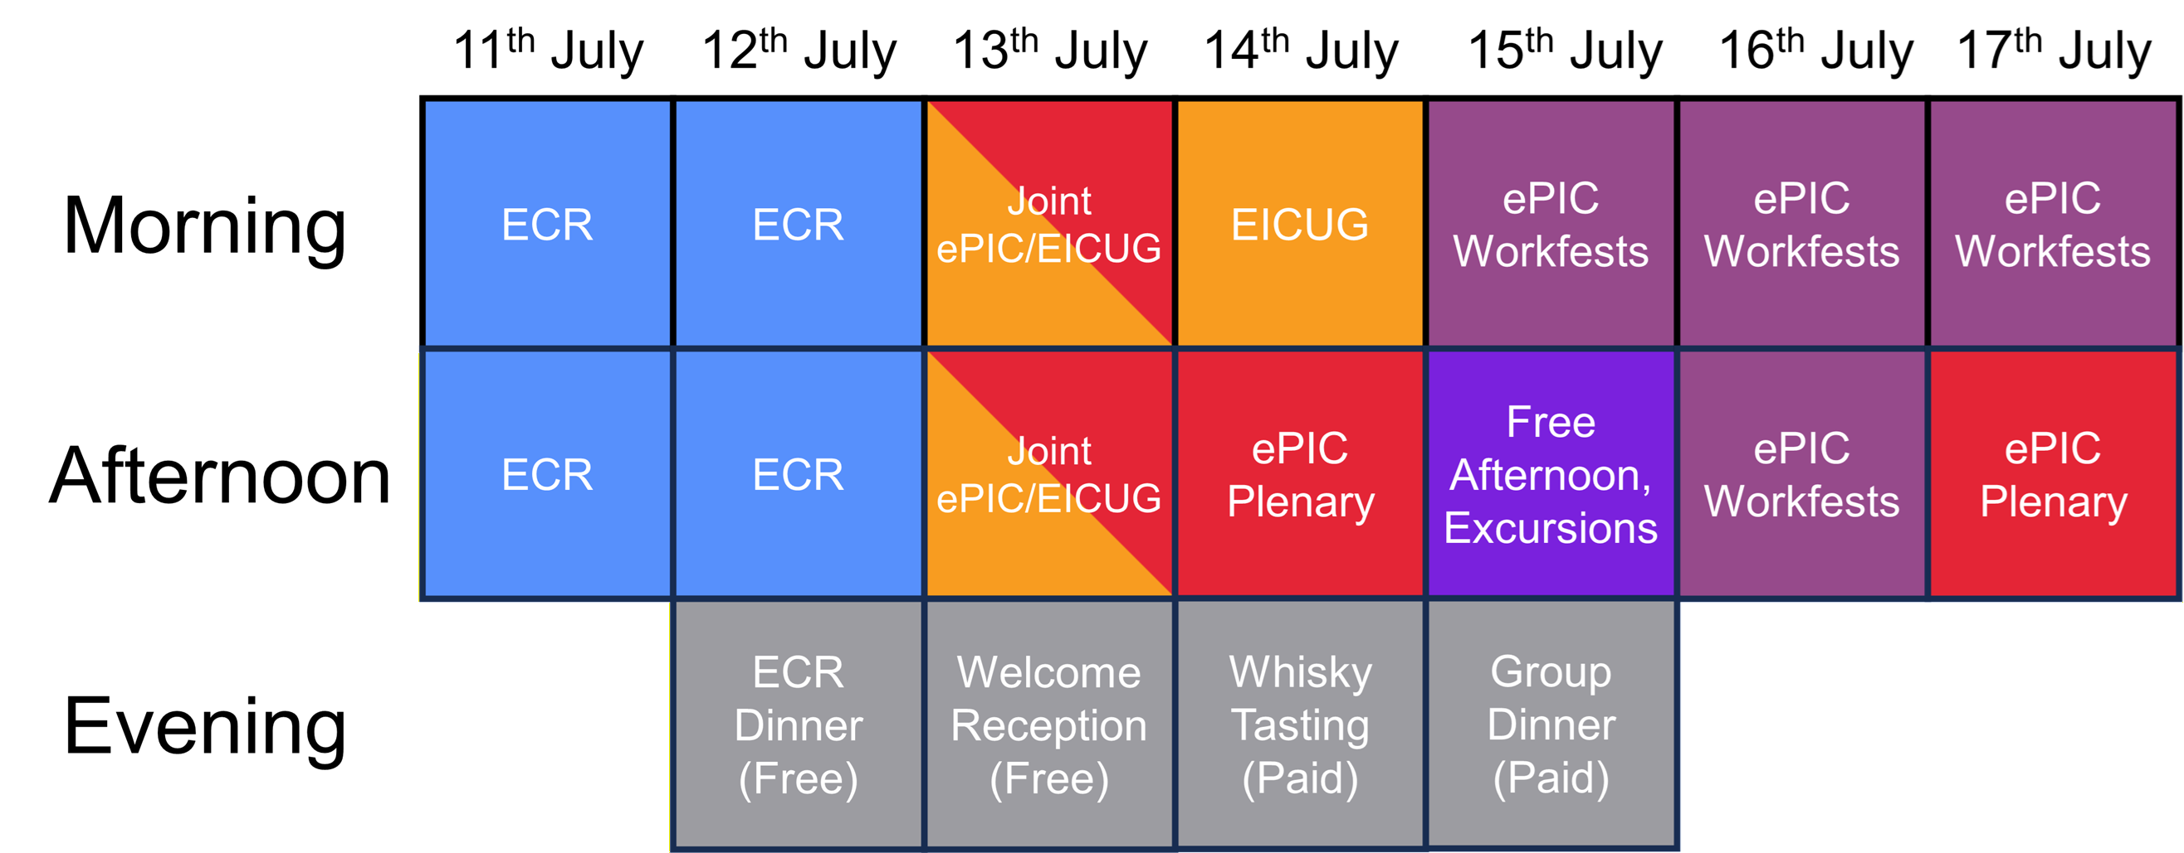
Meeting Structure
https://indico.bnl.gov/event/31808/

Slide 19
Workfest Organization
Wed 7/15
Thurs 7/16
Fri 7/17
Excl. Diff. & Tagging
Electr. + RO/DAQ + Streaming
AI
Electr. + RO/DAQ + Streaming
TOF Mechanics
AI
Morning
Free Afternoon
Tracking
AC-LGAD Sensors+ASICS
Closing Plenary
Afternoon
Workfest agendas and information available at: https://indico.bnl.gov/event/31808/timetable/

Slide 20
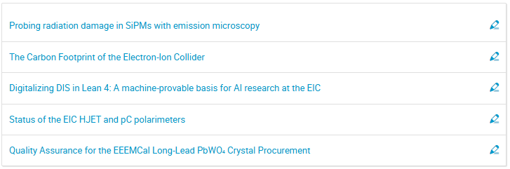
Collaborator Contributions
Time allocated Friday afternoon July 17th for collaborator contributions:
  Open call, in-person or virtual
  12+3 minute presentations
  This is your opportunity to showcase your work to the collaboration!
  Email the SP for a spot
  on the agenda!

Slide 21
Conferences Needing ePIC Speakers
ISMD 2026:
  https://indico.cern.ch/event/1593982
  Open and soliciting speaker for ePIC overview talk
Contact the Conference and Talks Committee (CTC) with nominations (incl. self nominations):
Brian Page: bpage@bnl.gov
Daniel Brandenburg: brandenburg.89@osu.edu

Slide 22

Deadline for abstract submission is July 21st!

Slide 23
Upcoming Events 2026
hPDIRC Annual Meeting – June 4-10th
EIC RRB & EIC-Asia Meeting, Tokyo, June 9th – 13th
5th BIC In-Person Workshop – June 16-18th
Next General Meeting – June 26th
EIC Early Science Whitepaper Due – July
EICUG Early Career Meeting July 11-12th @ University of Glasgow
Collaboration Meeting July 13-17th @ University of Glasgow
EIC Project Director’s Review Aug. 18-19th
DOE OPA review of the EIC Project Sept. 15-18th
ePIC NIM-A Special Issue Submissions – Oct
ePIC Software and Computing Review – Oct 13-14th
Plus: Numerous PDR/FDR reviews – see Project News

Slide 24


Slide 25
Collaboration Goals for the first half of 2026
Support the EIC project and ePIC Technical Design:
  Close the design loop with ePIC simulations
  Advance the pTDR in preparation for CD-2
    Respond to review recommendations
Complete the Early Science whitepaper
Progress in developing a multi-year plan for ePIC Software and Computing
Begin submissions to the NIMA Special Issue
At the upcoming collaboration meeting, we will take stock of our progress on these priorities and set the priorities for the next half of 2026.

Slide 26
ePIC Resources
Public Website - https://www.bnl.gov/eic/epic.php
Mailing Lists – https://lists.bnl.gov/mailman/listinfo
Indico Agenda - https://indico.bnl.gov/category/402/
  ePIC Software and Computing: https://indico.bnl.gov/category/435/
Wiki - https://wiki.bnl.gov/EPIC
ePIC Software Training:
  Landing Page: https://eic.github.io/documentation/landingpage.html
  Tutorials: https://eic.github.io/documentation/tutorials.html
Mattermost: https://chat.epic-eic.org
ePIC Zenodo Community: https://zenodo.org/communities/epic

Slide 27


EICUG Membership
The EICUG is a vital organization to promote the interests of the EIC community!
  Without the EICUG we would never have gotten far enough to form ePIC!
Please register your institution!
Check with your EICUG IB representative to get registered as a member
https://www.eicug.org/content/join.html

Slide 28
How to register a team at CERN for
The starting point is the CERN secretariat (info.recognized-experiments@cern.ch), tell them that you want to establish a new team under RE47 (ePIC).
They will send you a form that requires signatures from a team leader and deputy team leader, and a representative from your institution’s administration.
Send the signed form to the Spokesperson for a signature
Once the completed form is registered with the secretariat, your team is formed, and the team leader can add team members, etc.

