Slide 1
EIC Project News
E.C. Aschenauer (BNL), R. Ent (JLab)
Co-Associate Directors for the EIC Experimental Program
ePIC Bi-Weekly General Meeting
June 26th, 2026

Slide 2
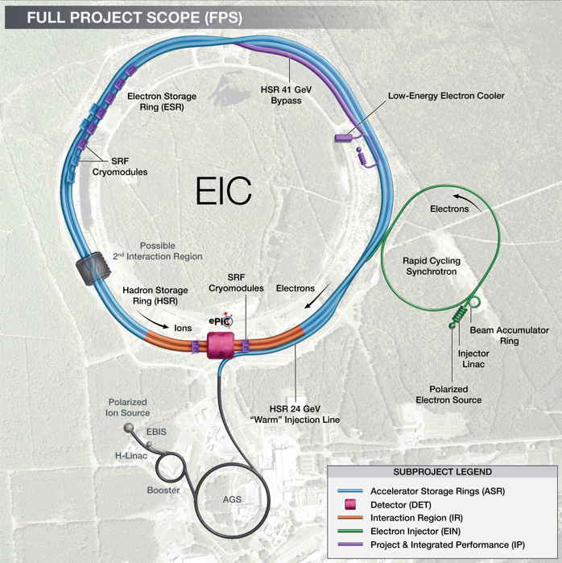
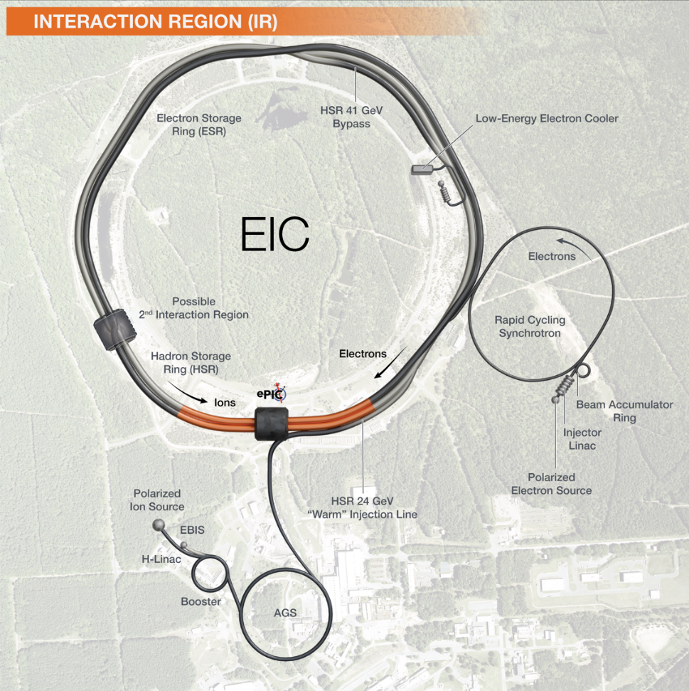
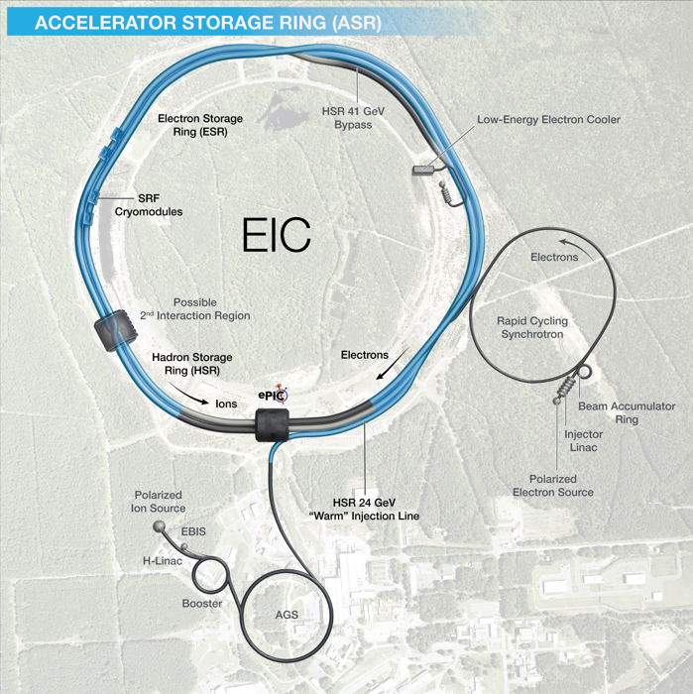

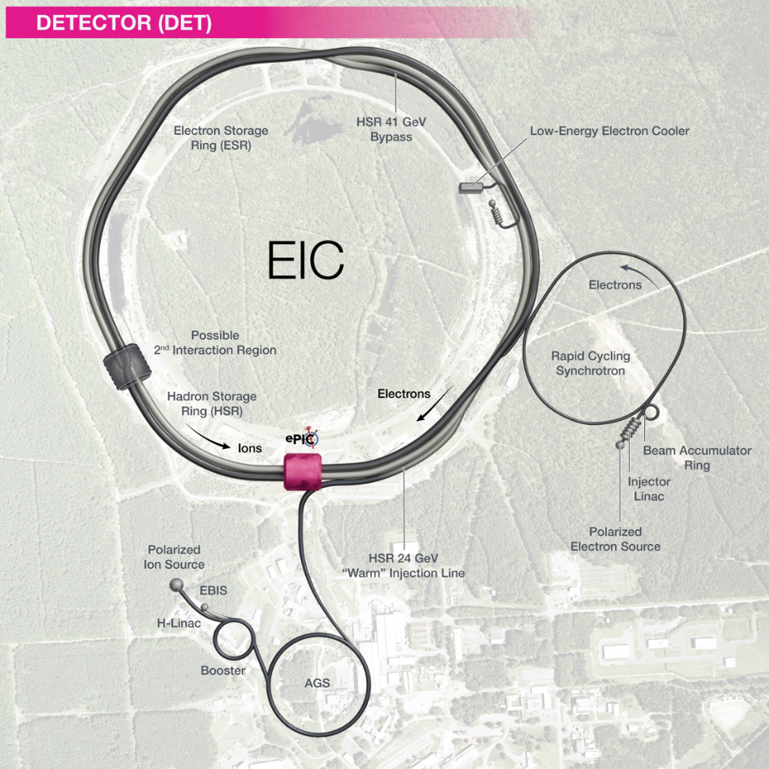
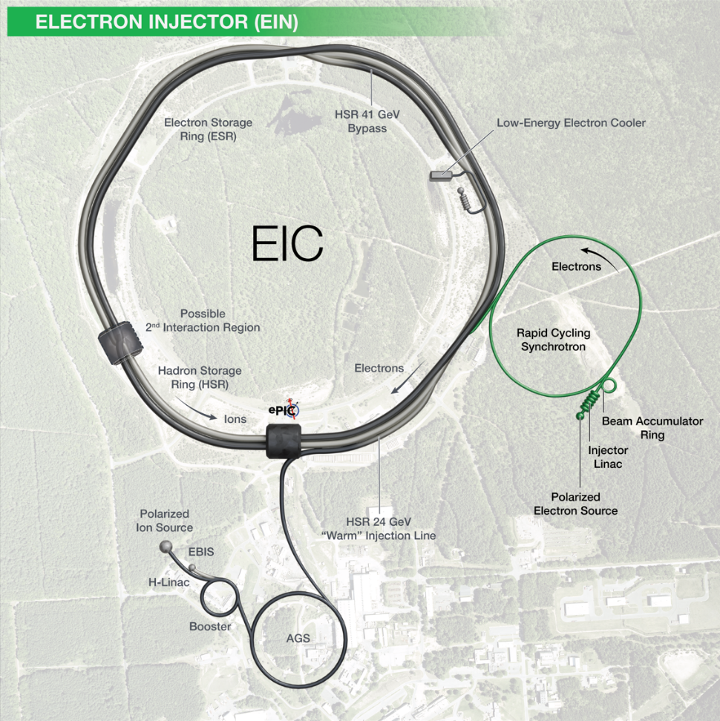
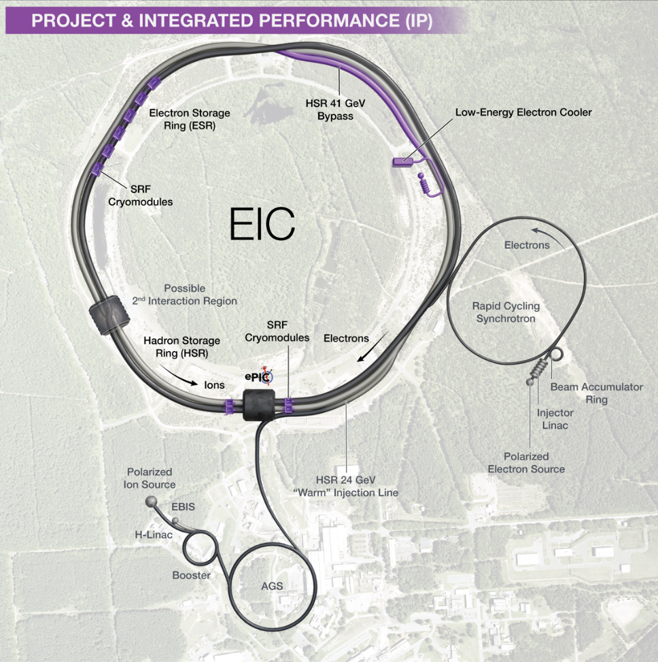
EIC Scope
EIC Scope
A single integrated line-item construction project.
Scope includes well-defined deliverables, interfaces, and draft KPPs.
EIC Line-Item Project Scope:
Infrastructure
Accelerator Storage Rings (ASR)
Interaction Region (IR)
Electron Injector (EIN)
Detector (DET)
EIC Portfolio (Off-Project Scope)
NP operations scope, including initial EIC ops
Host Laboratory Infrastructure
COLLIDER
ACCELERATOR

Slide 3
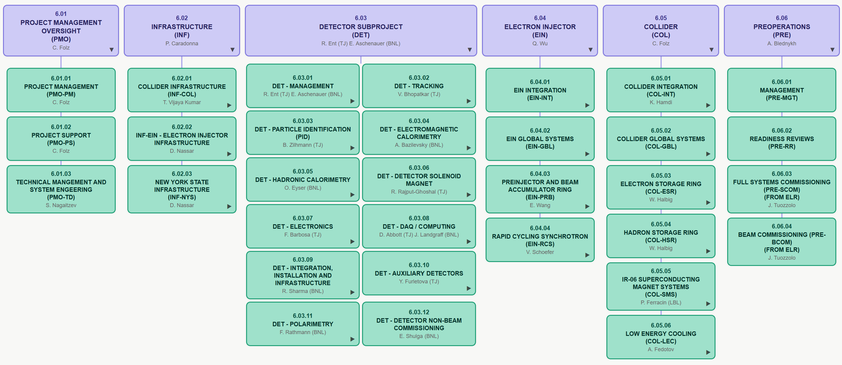
Proposed New EIC Work Breakdown Structure
Accelerator
NOT the Organizational Breakdown Structure

Slide 4
DOE Independent Project Review of the EIC
Originally planned for the end of April, the review is now scheduled for September 15–18, 2026 to allow adequate time to address the results of the Director’s Review, develop an integrated, resource-loaded preliminary baseline, and implement significant cost management options.
The review will assess:
  Execution of long-lead procurements (CD-3A and CD-3B)
  Development of a preliminary baseline
  Justification for a long-lead procurement Critical Decision (CD-3C)
  Readiness for CD-2/3 approval for conventional facilities infrastructure funded by New York State
  Assess progress towards a future CD-2 for the ePIC detector
DOE prepared the final charge
EIC Project Advisory Committee "Director's Review" August 18-19, 2026

Slide 5
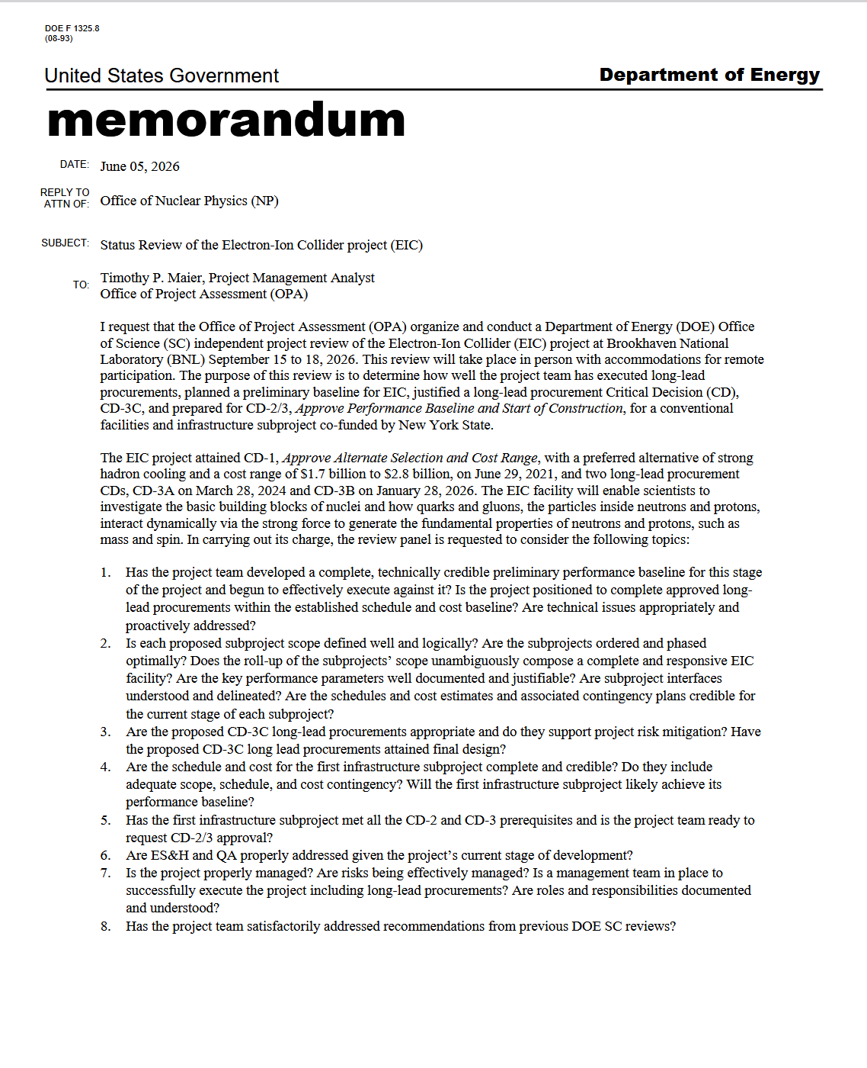
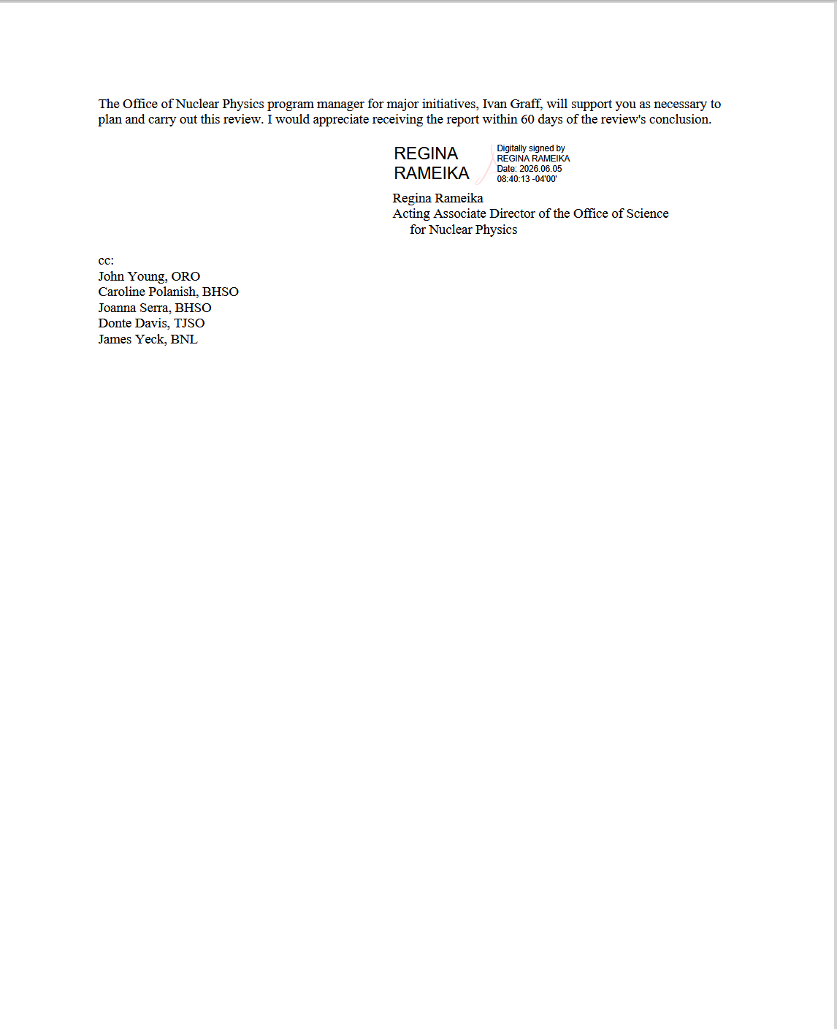
September 15-18 DOE OPA Review - Charge

Slide 6
CD-3C Preliminary Package - DET
Subproject | WBS | Long Lead Procurement Description | $M | FDR
DET | 6.03 | Lead tungstate crystals (cont. CD-3A/B) – 830 remaining | 2.3 | Done
DET | 6.03 | fECal Scintillating Fibers (cont. CD-3A/B) – 1185 km remaining; Barrel SciFi → Korea In-Kind | 1.0 | Done
DET | 6.03 | Steel towers for forward HCal (cont. CD-3A/B) – 288 towers remaining | 1.7 | Done
DET | 6.03 | Flux return steal rear endcap | 3.4 | Done
DET | 6.03 | High-Rate Picosecond PhotoDetectors (HRPPDs) | 6.8 | 08/2026*
DET | 6.03 | SiPMs for all the other subsystems and mounting on the SiPMs boards & QA | 6.5 | Done
 |  | Total | 21.7
(without contingency)
CD-3C will complete:
the PbWO4 crystal procurement
the fiber procurement of the fECAL
the steel towers for the lfHCal
the flux return steel for the electron and hadron endcap
all the HRPPDS for the pfRICH and the DIRC
all SiPMs for the bEcal, the Barrel-ECAL, the fECal, the Barrel Hcal, the fHCal and all the auxiliary detectors
*we are looking into the Sept. 1-4 period for this

Slide 7

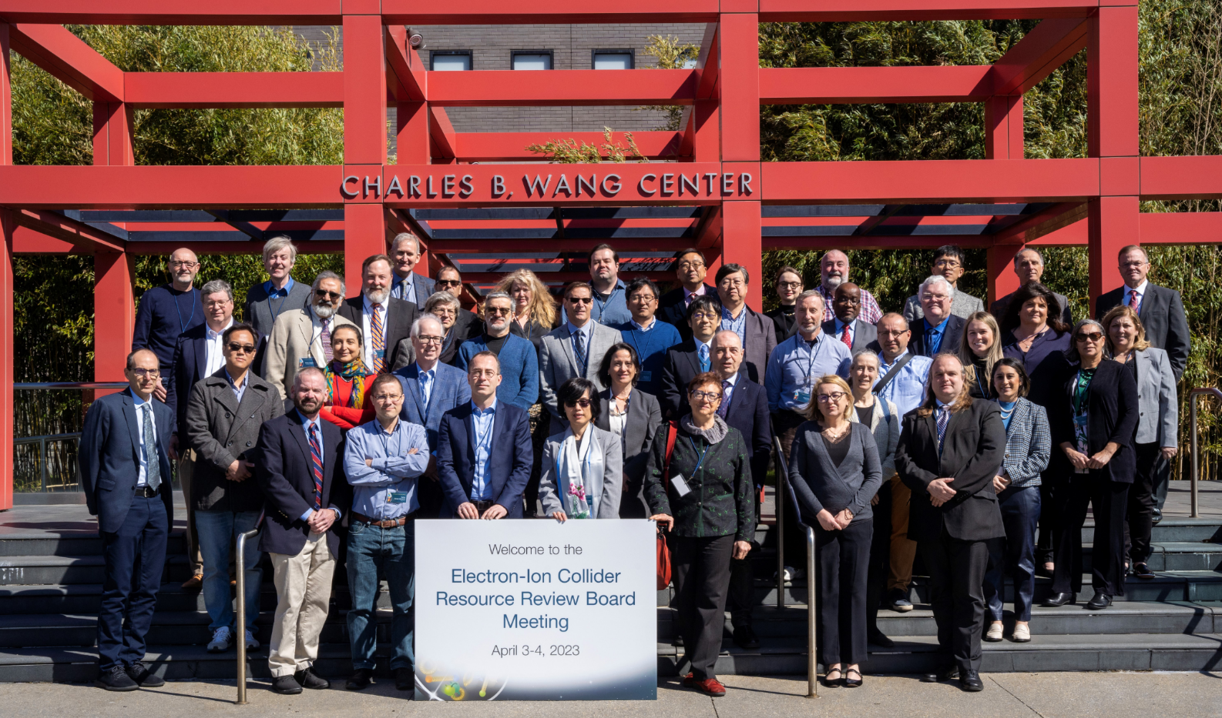
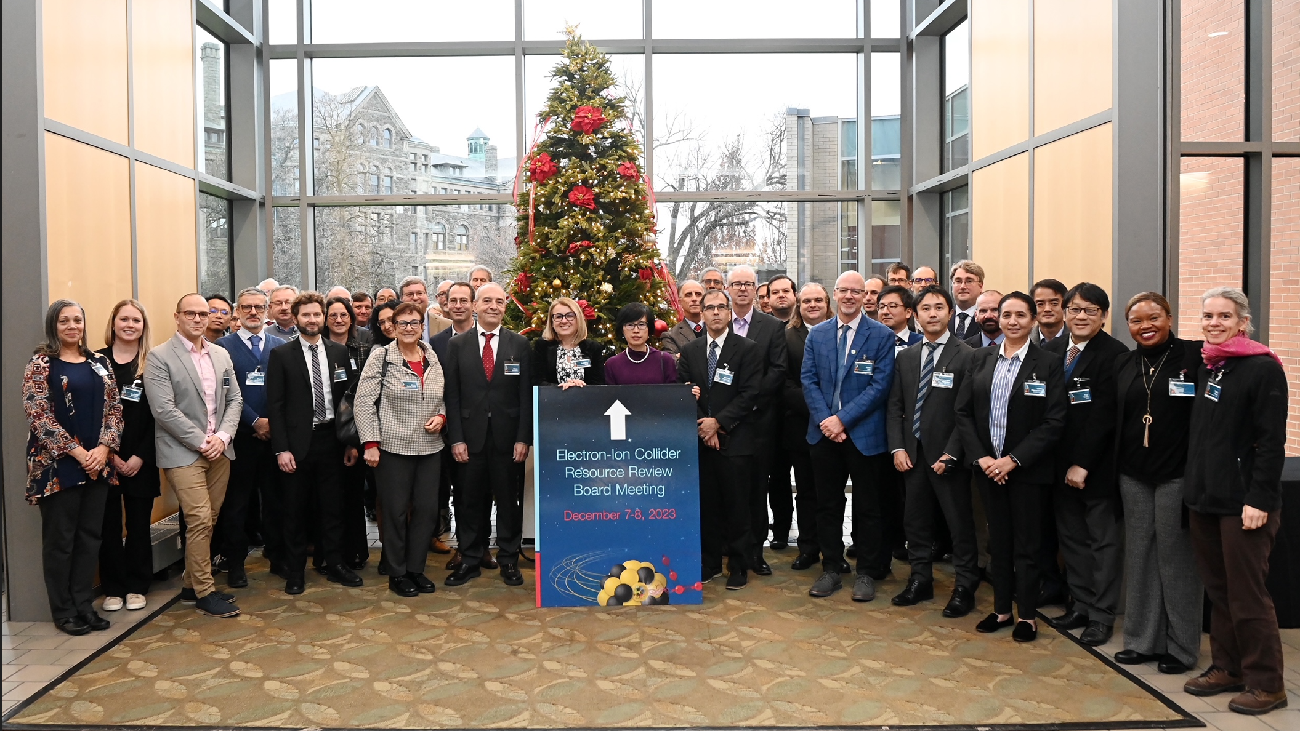
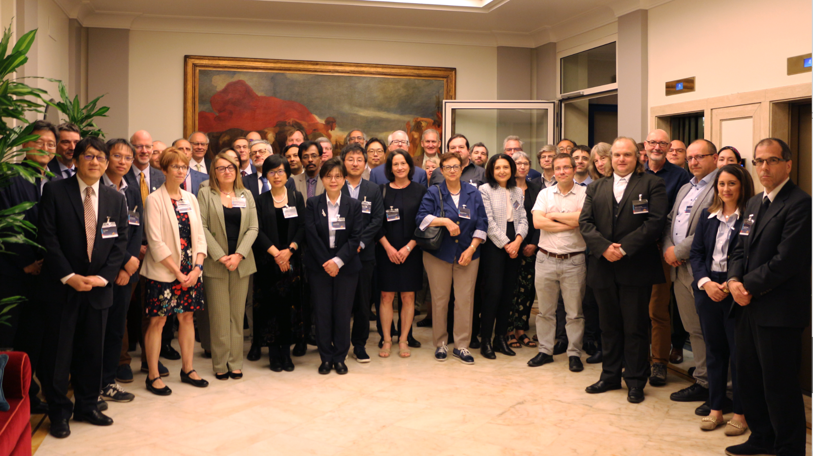
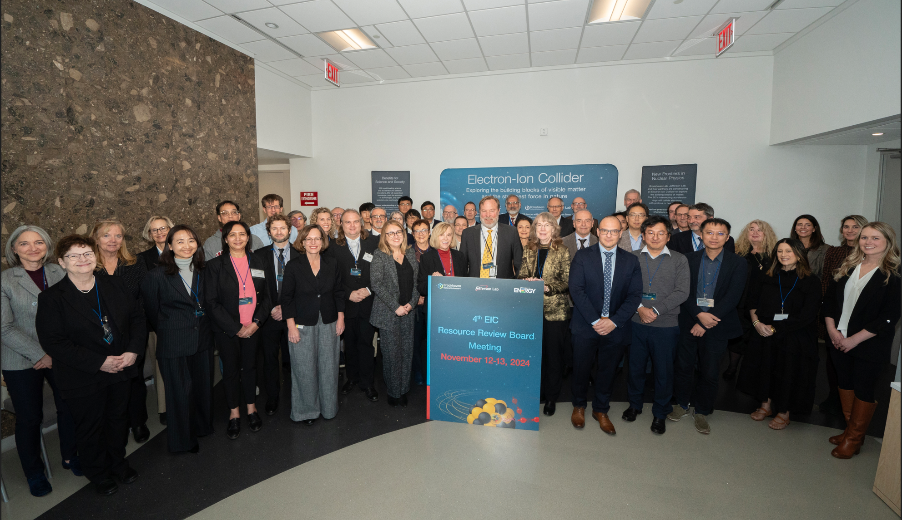
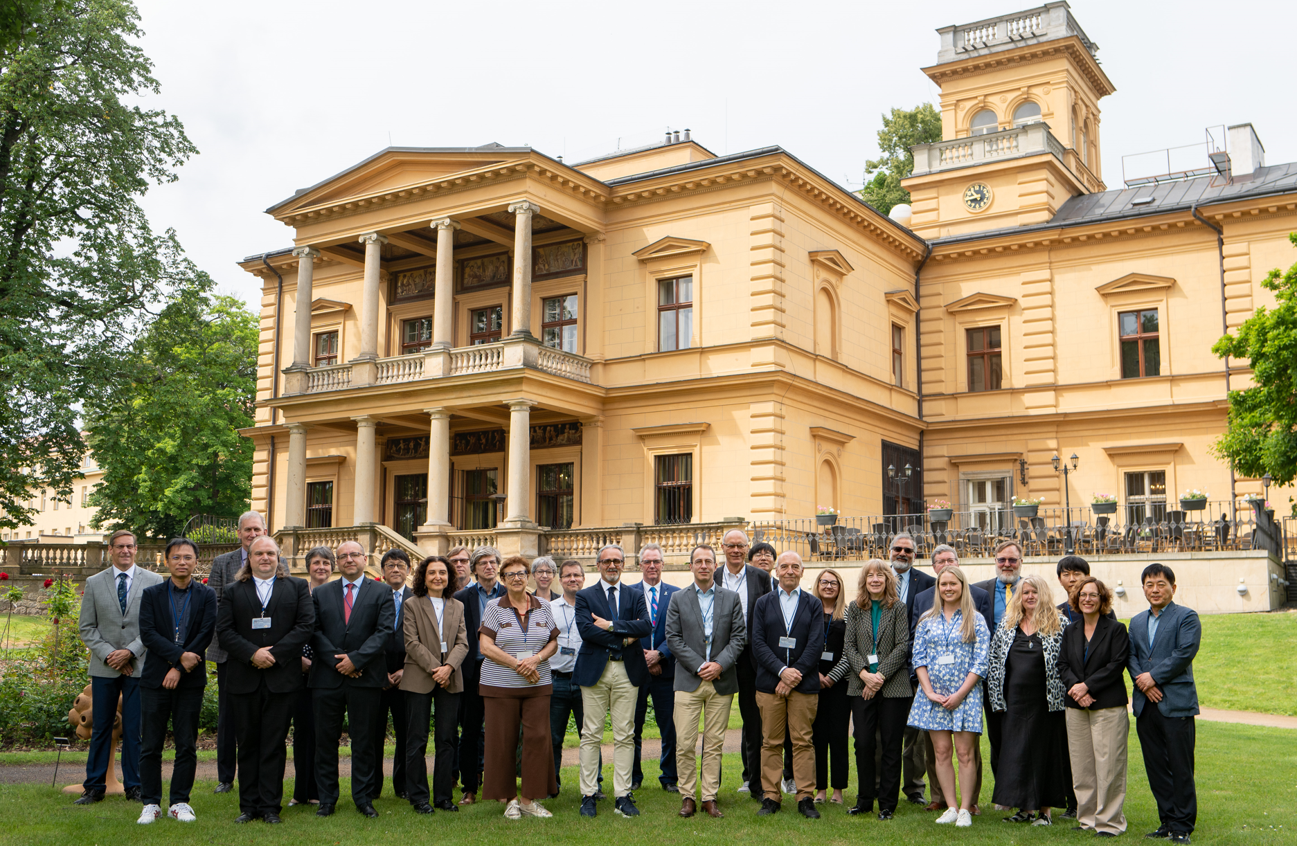
Resource Review Board (RRB) Meetings
DOE and the host labs promote the EIC as a facility “fully international in character.”
Initial RRB Co-Chairs:
Haiyan Gao (BNL) transitioned to Abhay Deshpande (BNL)
Diego Bettoni (INFN) transitioned to Franck Sabatie (Saclay)
David Dean as JLab CRO is ex-officio transitioned to Eric Brown (JLab)
https://www.bnl.gov/eic-rrbmeeting/
1st RRB meeting on April 3-4 2023 at Stony Brook University.
2nd RRB meeting on December 7-8 2023 at Catholic University of America.
3rd RRB meeting on May 6-7 2024 hosted by INFN/Italy in Rome
4th RRB meeting on November 7-8 2024 at BNL
5th RRB meeting on June 5-6 2025 in Prague
6th RRB meeting on November 4-5 2025 at BNL
7th RRB meeting on June 9-10 2026 at MEXT, Tokyo, Japan
Future: 8th RRB meeting November 16-17 2026 – remote (mornings EST)
9th RRB meeting May/June 2027 - Interest from Taiwan & France
The EIC-RRB provides coordination among the different funding partners during both the detector development and construction phase of the project and during the future operations of the experiments
The EIC-RRB shall provide oversight of resources utilized for detector construction and planning, which is the ePIC detector in the EIC project scope
The EIC-RRB will function as the body that reaches agreement on scope entailed in common projects, as appropriate, which shall be funded by members of the EIC-RRB

Slide 8
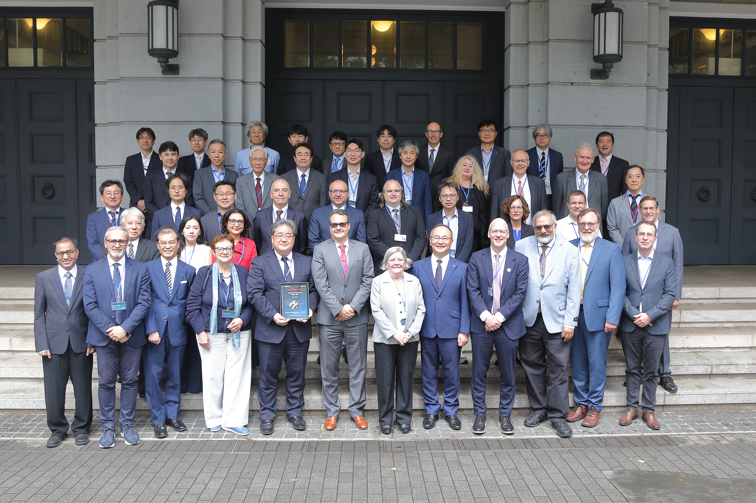
7th EIC Resource Review Board Meeting
Very successful EIC Resource Review Board Meeting June 9th -10th @ MEXT in Tokyo
The meeting brought together approximately 60 participants, including representatives from the U.S. Department of Energy (DOE), BNL, JLab and research institutions and funding agencies from
Canada (remote), Czech Republic, France (CEA & IN2P3), Italy, Japan, South Korea, Taiwan, and UK (remote)

Slide 9
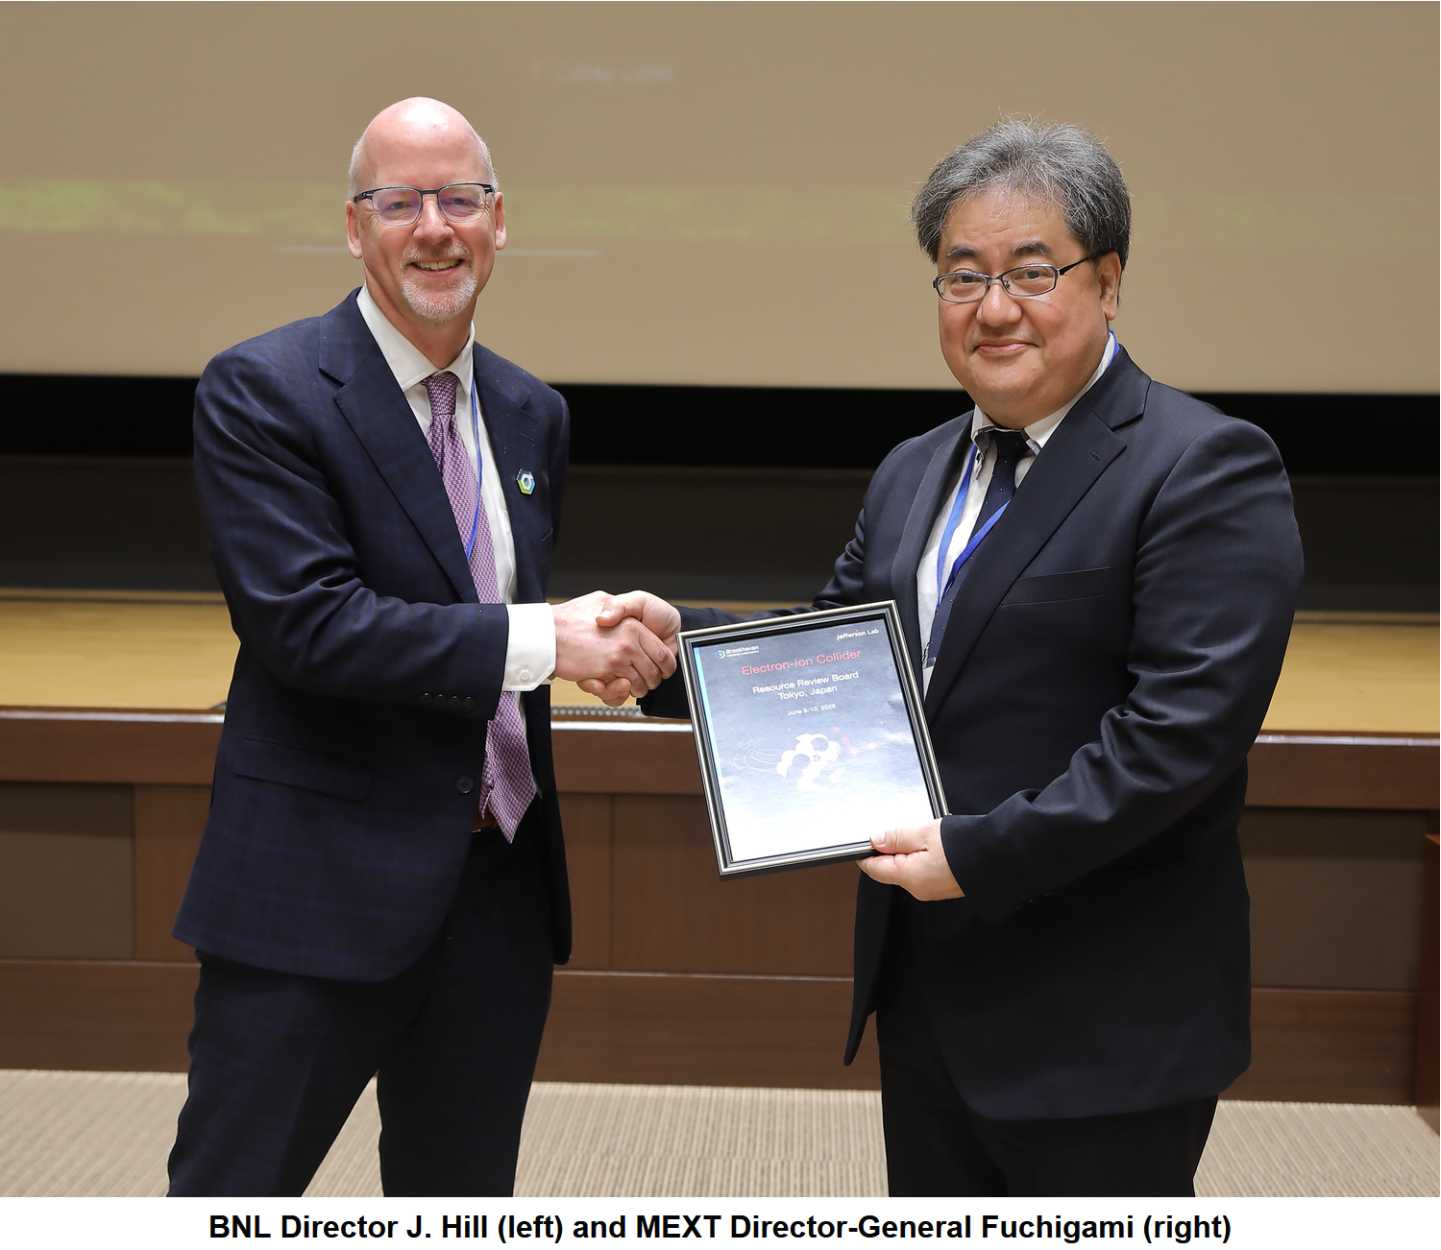
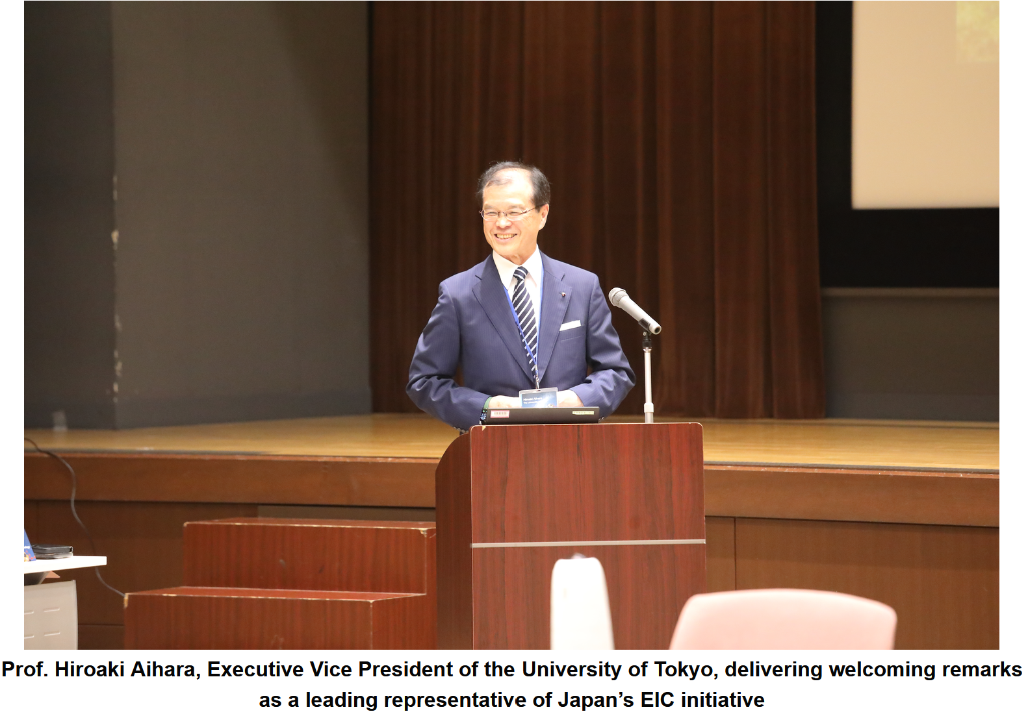
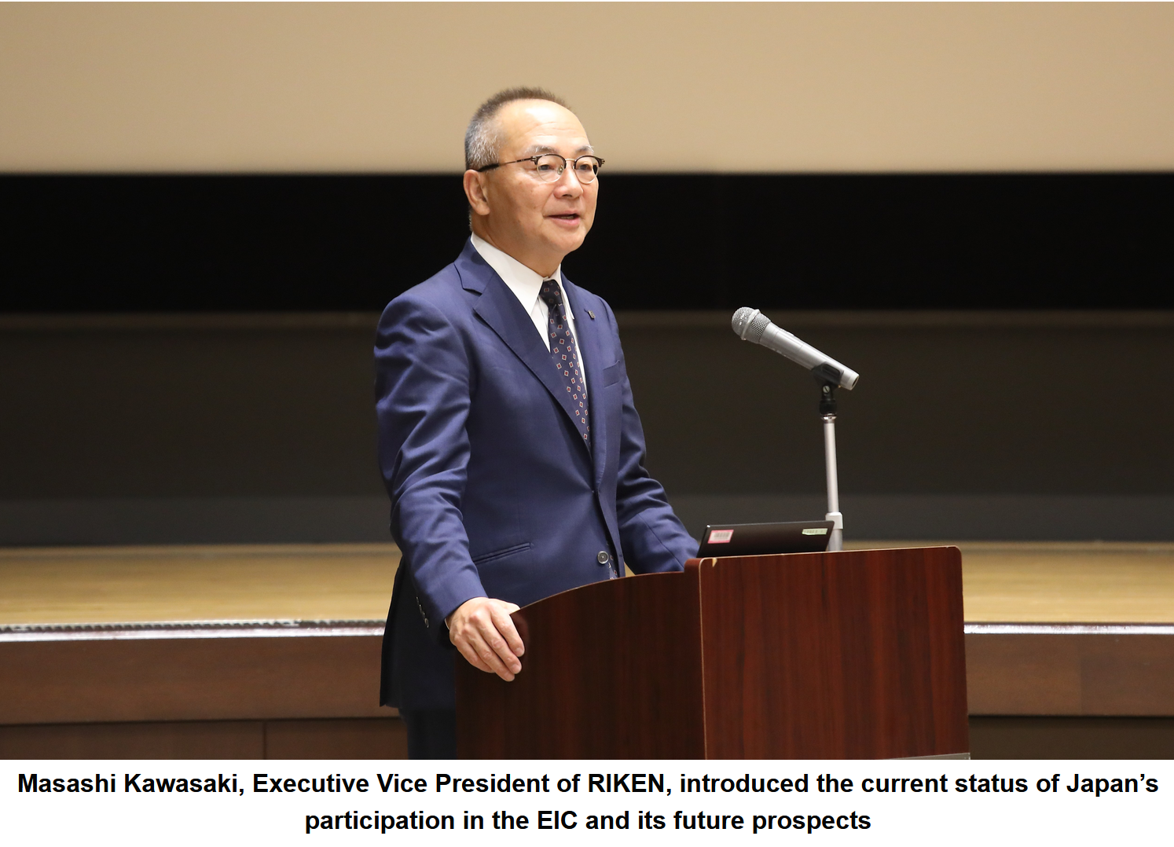
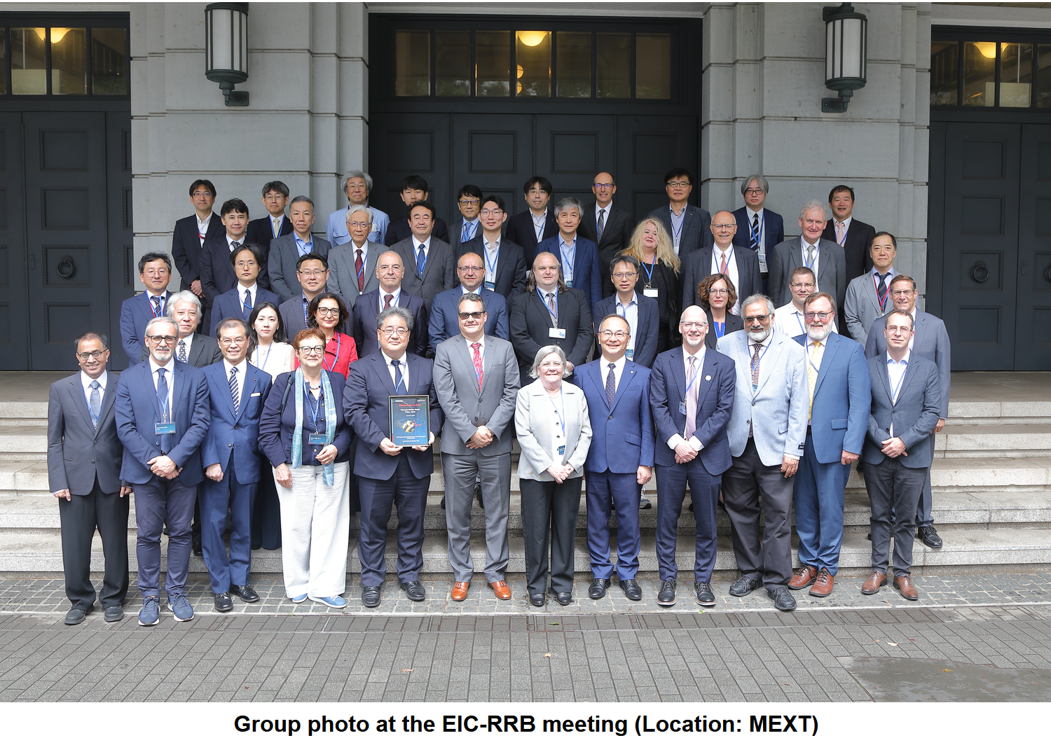
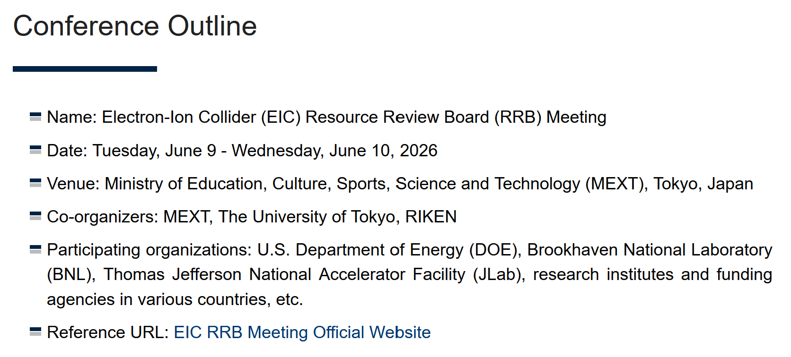
7th EIC Resource Review Board Meeting - Photos

Slide 10

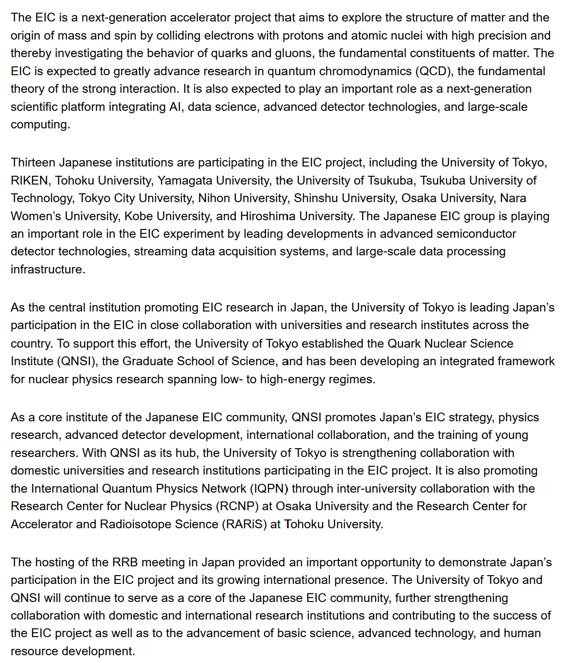
7th EIC Resource Review Board Meeting – Press Summary

Slide 11
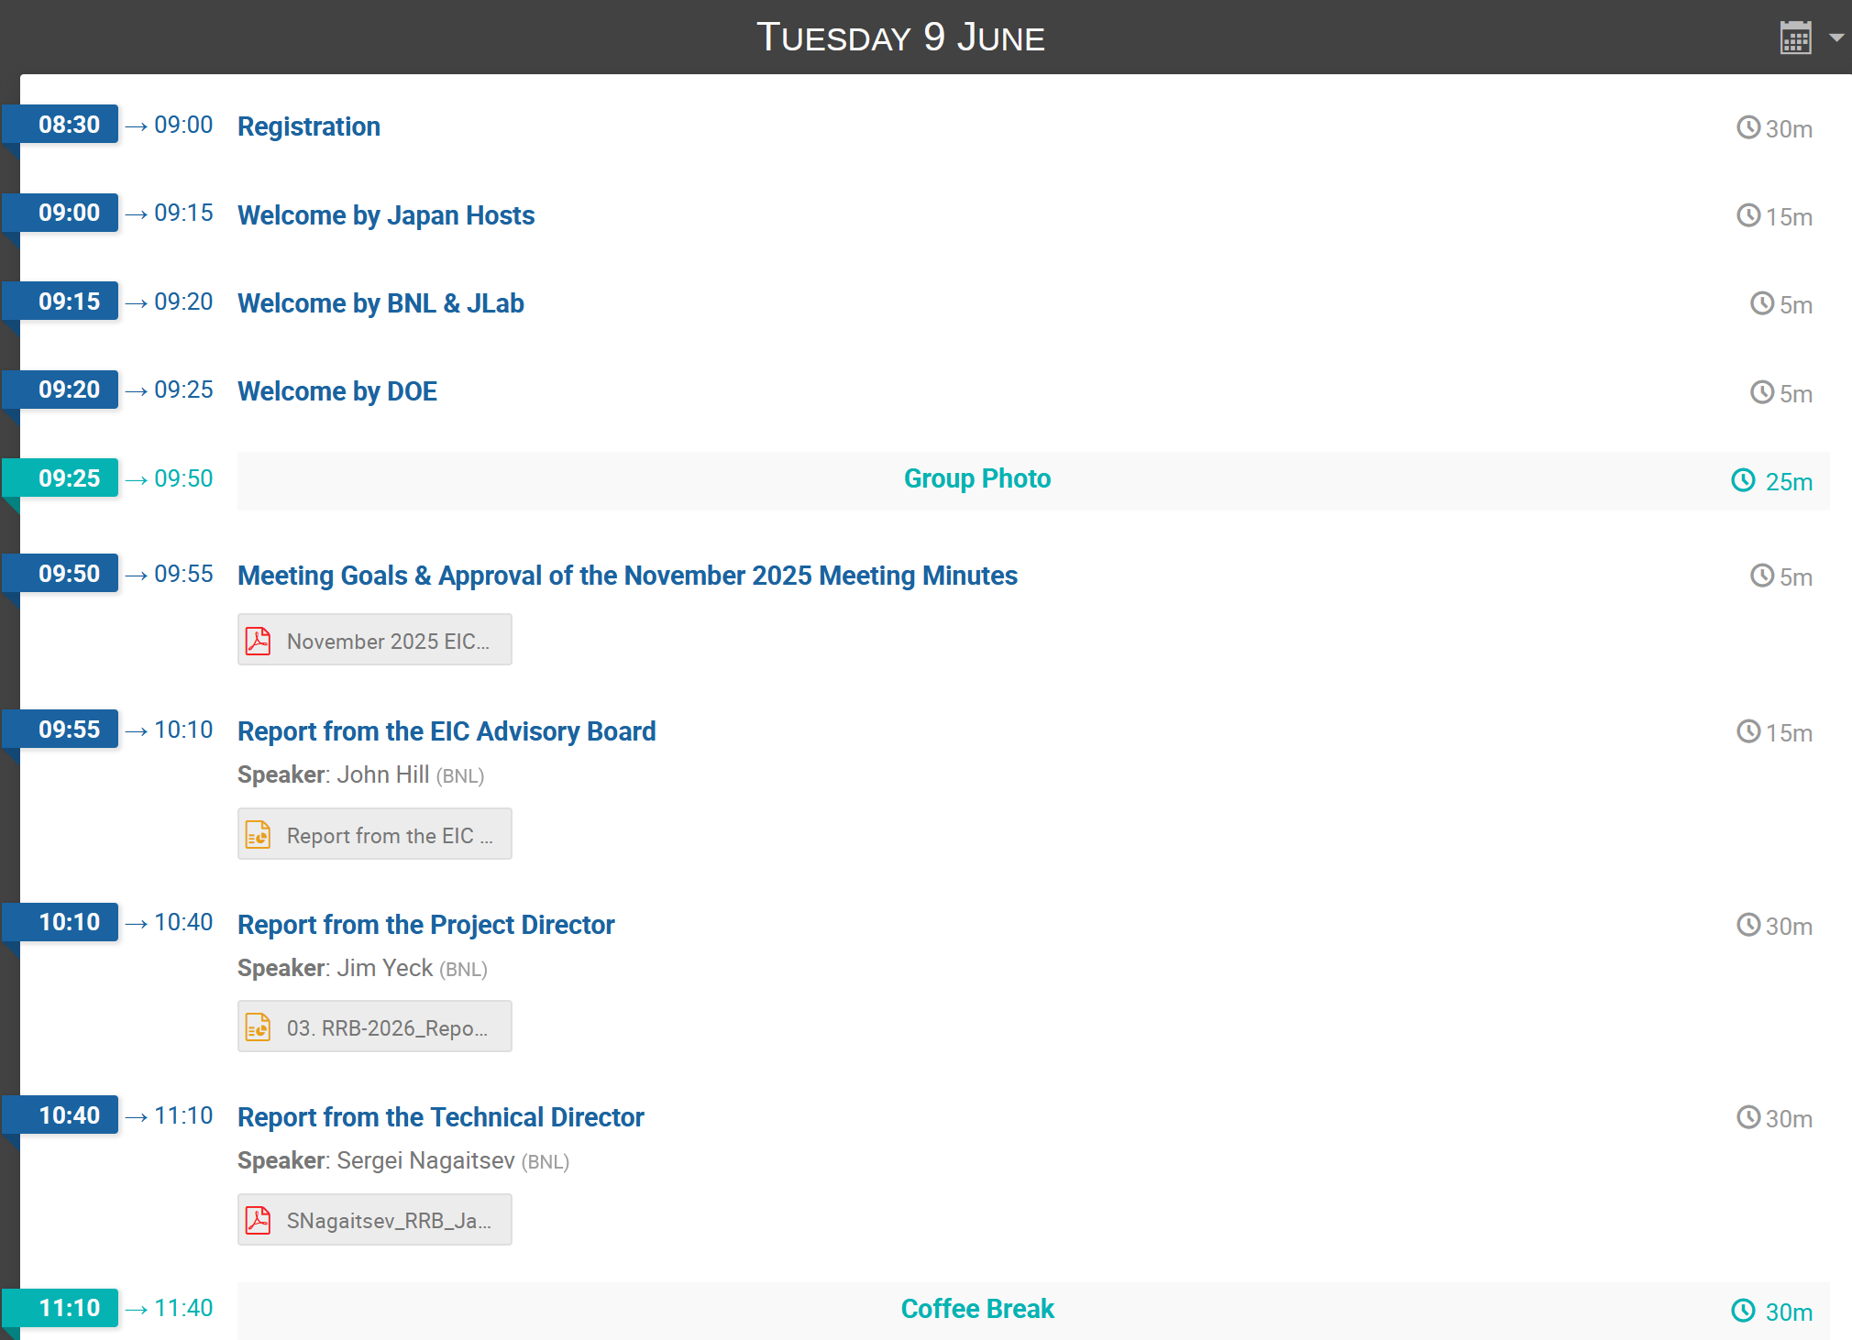
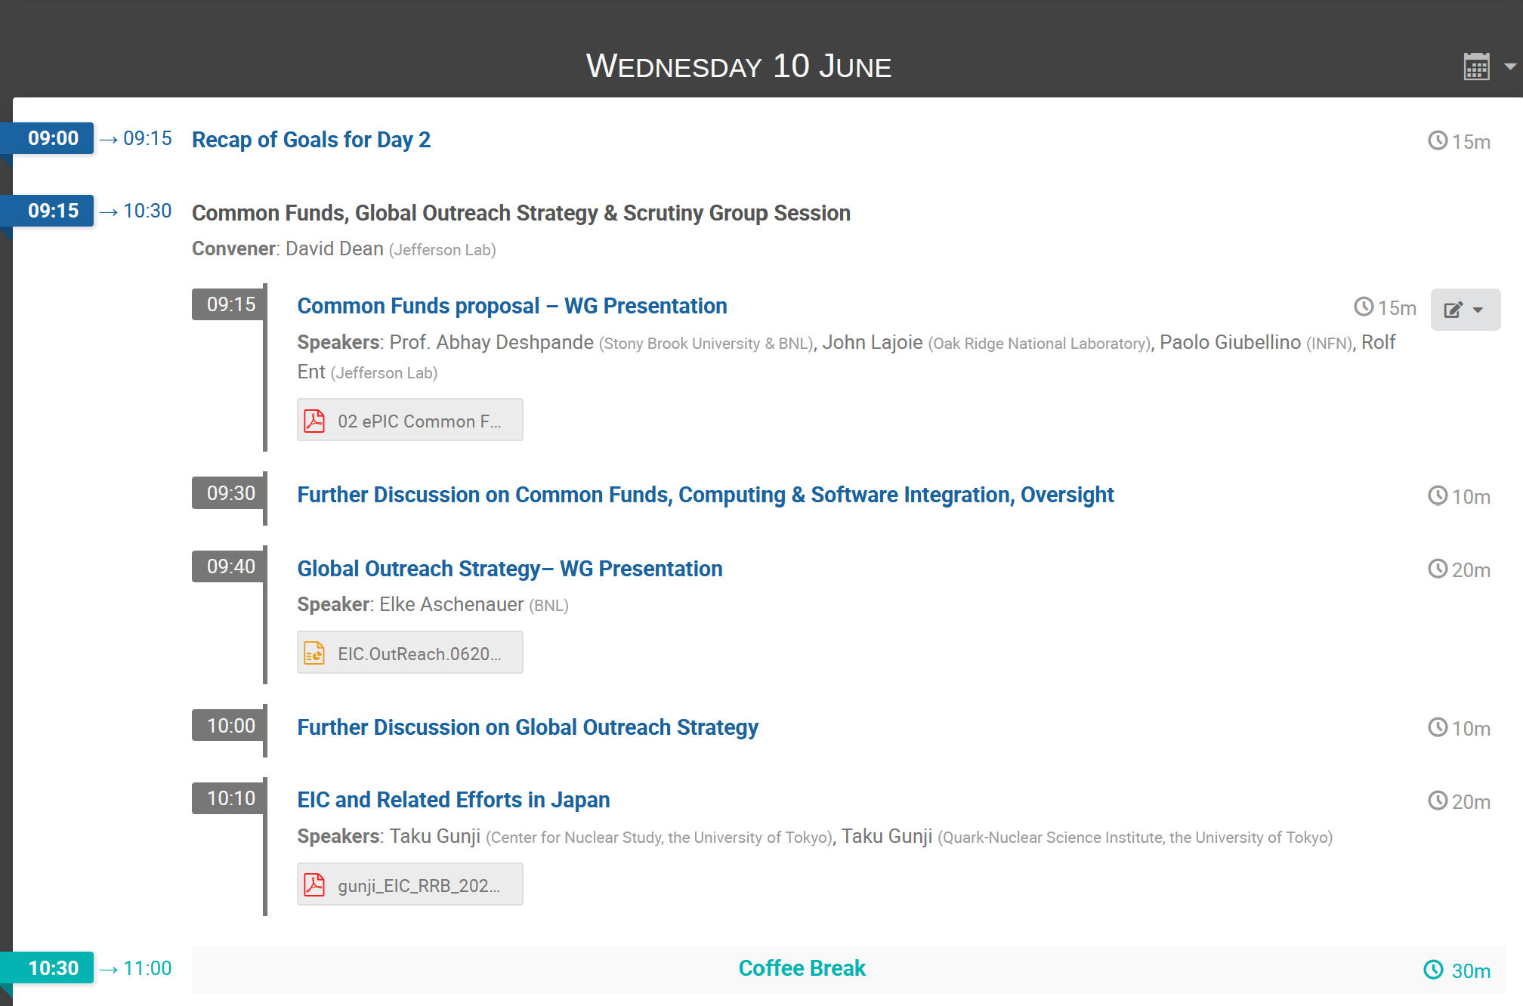
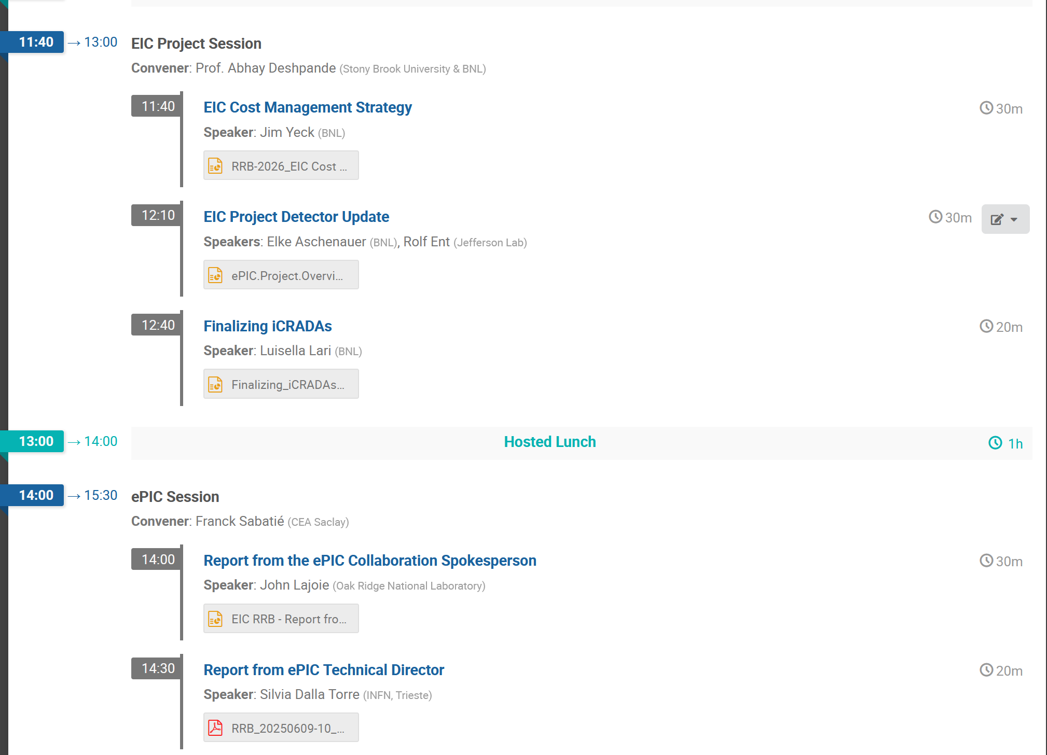
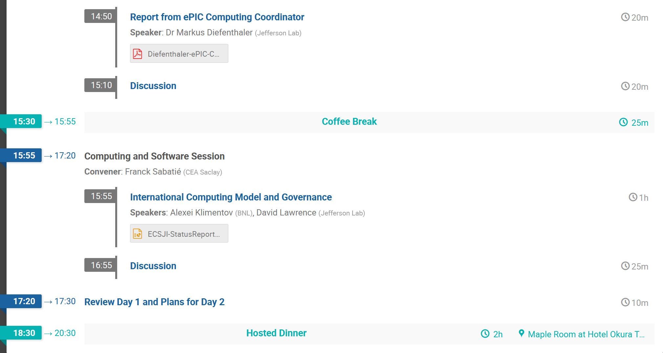
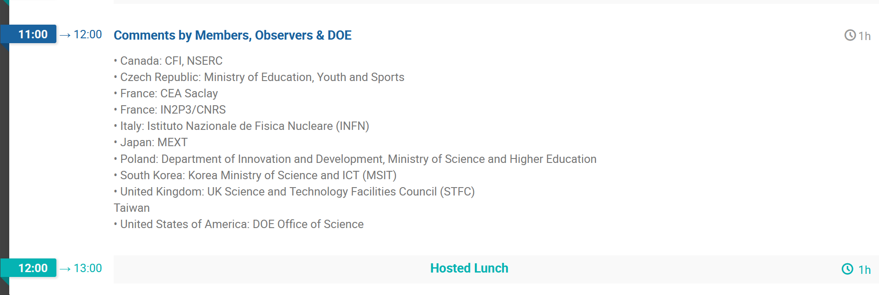
EIC Resource Review Board June 9-10, 2026

Slide 12


