Slide 1


SIDIS Studies for the ESR
Anselm Vossen, Ralf Seidl (QNSI Tokyo)
Gabriel Garcia (BNL)
Research Supported by

Slide 2
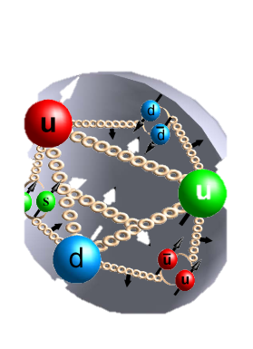
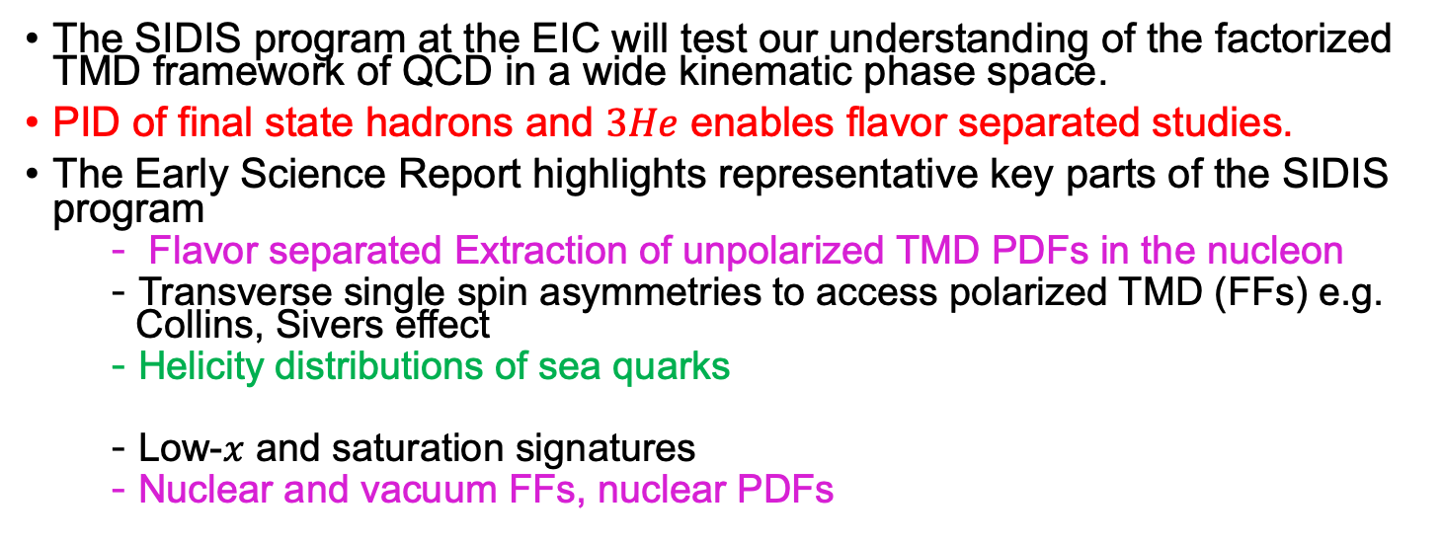
Overview
h
q
(n)FF_{q}
σ
(n)PDF
X’
The SIDIS program at the EIC will test our understanding of the factorized TMD framework of QCD in a wide kinematic phase space.
PID of final state hadrons and $3He$ enables flavor separated studies.
The Early Science Report highlights representative key parts of the SIDIS program
  Flavor separated Extraction of unpolarized TMD PDFs in the nucleon
  Transverse single spin asymmetries to access polarized TMD (FFs) e.g. Collins, Sivers effect
  Helicity distributions of sea quarks
  Low-$x$ and saturation signatures
  Nuclear and vacuum FFs, nuclear PDFs

Slide 3
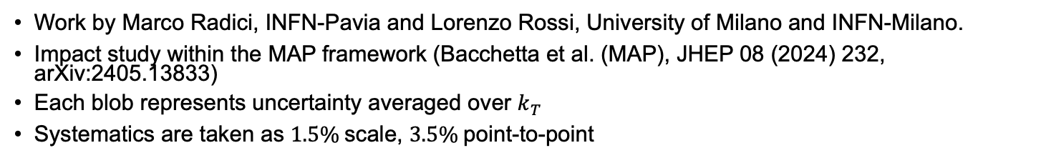
Unpolarized TMD PDFs
Color indicates
Quark Flavor of
distribution impacted
most by the data
Work by Marco Radici, INFN-Pavia and Lorenzo Rossi, University of Milano and INFN-Milano.
Impact study within the MAP framework (Bacchetta et al. (MAP), JHEP 08 (2024) 232, arXiv:2405.13833)
Each blob represents uncertainty averaged over $k_{T}$
Systematics are taken as $1.5\%$scale, $3.5\%$point-to-point

Slide 4

Transverse Single Spin Asymmetries
Here: Extraction of Sivers $f_{1T}^{⊥}(x)$ and transversity/tensor charge
Tensor charge: JAM3D-22/JAM3D* (Phys.Rev.D 109 (2024) 3, 034024) Phys.Rev.D 106 (2022) 3, 034014, provided by D. Pitonyak (LVC), A. Prokudin (PSU Berks), simulations produced by Ralf Seidl
Extractions of Sivers impact: ART by A. Vladimirov (UCM)

Slide 5
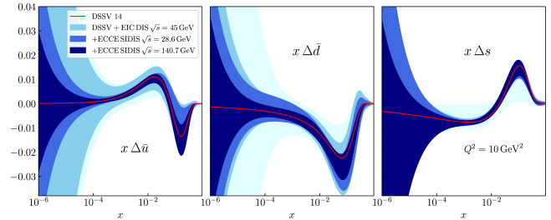
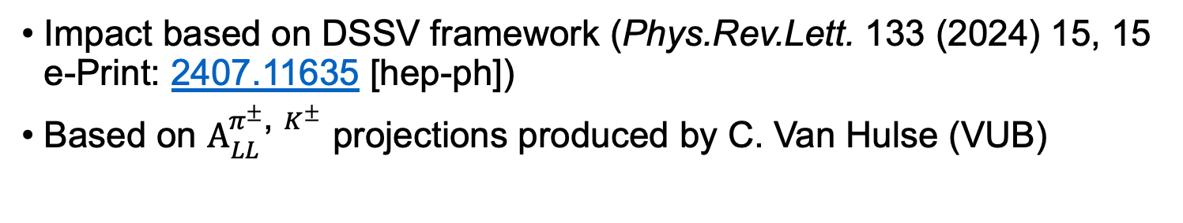
(sea) quark helicities
Example: To be replaced by final plot
Impact based on DSSV framework (Phys.Rev.Lett. 133 (2024) 15, 15 e-Print: 2407.11635 [hep-ph])
Based on $A_{LL}^{π^{±}\text{, }K^{±}}$ projections produced by C. Van Hulse (VUB)

Slide 6
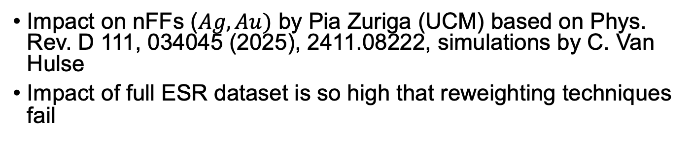
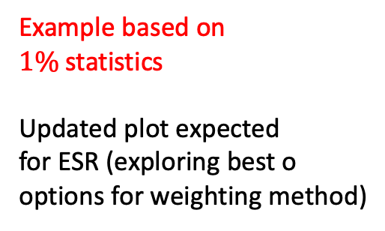
(n)FFs, PDFs
Example based on
$1\%$statistics
Updated plot expected
for ESR (exploring best o
options for weighting method)
Impact on nFFs ($Ag, Au)$ by Pia Zuriga (UCM) based on Phys. Rev. D 111, 034045 (2025), 2411.08222, simulations by C. Van Hulse
Impact of full ESR dataset is so high that reweighting techniques fail

Slide 7
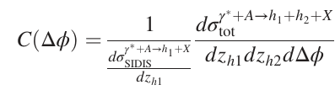
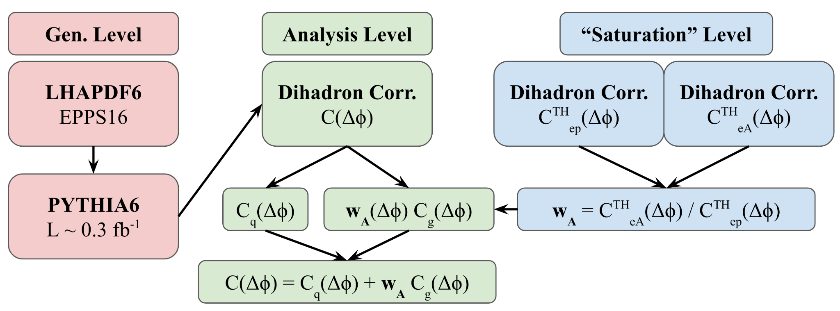
Di-hadron impact study: Method
e+p (0.25 fb⁻¹), e+Ag (0.38 fb⁻¹), e+Au (0.40 fb⁻¹) at 10⨉100 GeV² → Projected to 1.0 fb⁻¹
Di-hadron correlation analysis with event-level re-weighting method
Coincidence probability across phase-space (Q², x, z_{h1}, z_{h2})

Slide 8
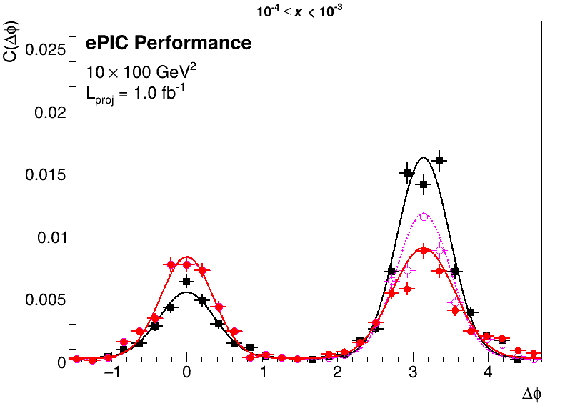
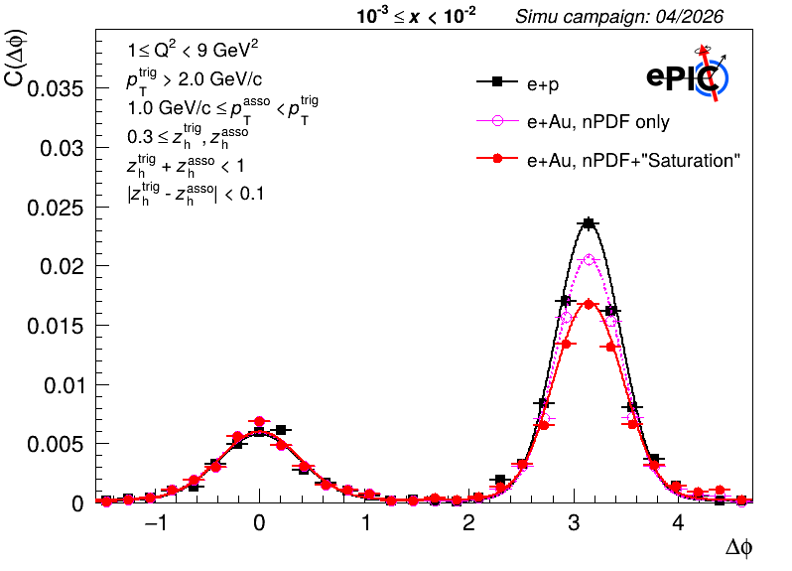
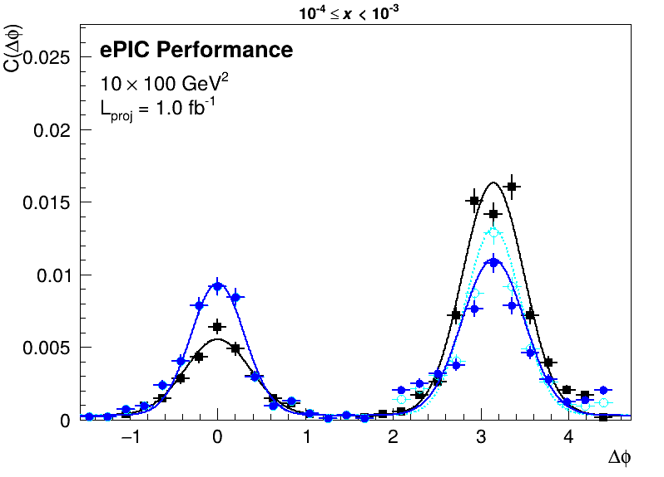
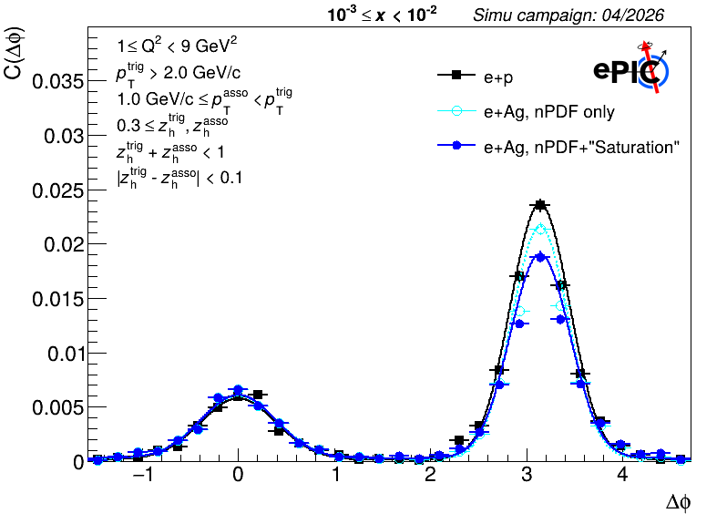
Di-hadron impact study: Results
Suppression of away-side peak observed in e+A vs e+p
Lower x more suppressed
Difference between Ag and Au reflects nuclear size dependence
Away-side area suppression ~40% in lowest x bin of e+Au relative to e+p

Slide 9
Conclusion
Early science data already has significant impact on high priority SIDIS observables
We expect additional impact that is harder to quantify due to exploring kinematic phase space not covered by previous experiments, examples: TMD evolution, model dependence of extractions.
Additional channels and more sophisticated analyses can be pursued in a longer paper.
Many thanks to ePIC and theory collaborators who worked hard till the deadline!

