Slide 1
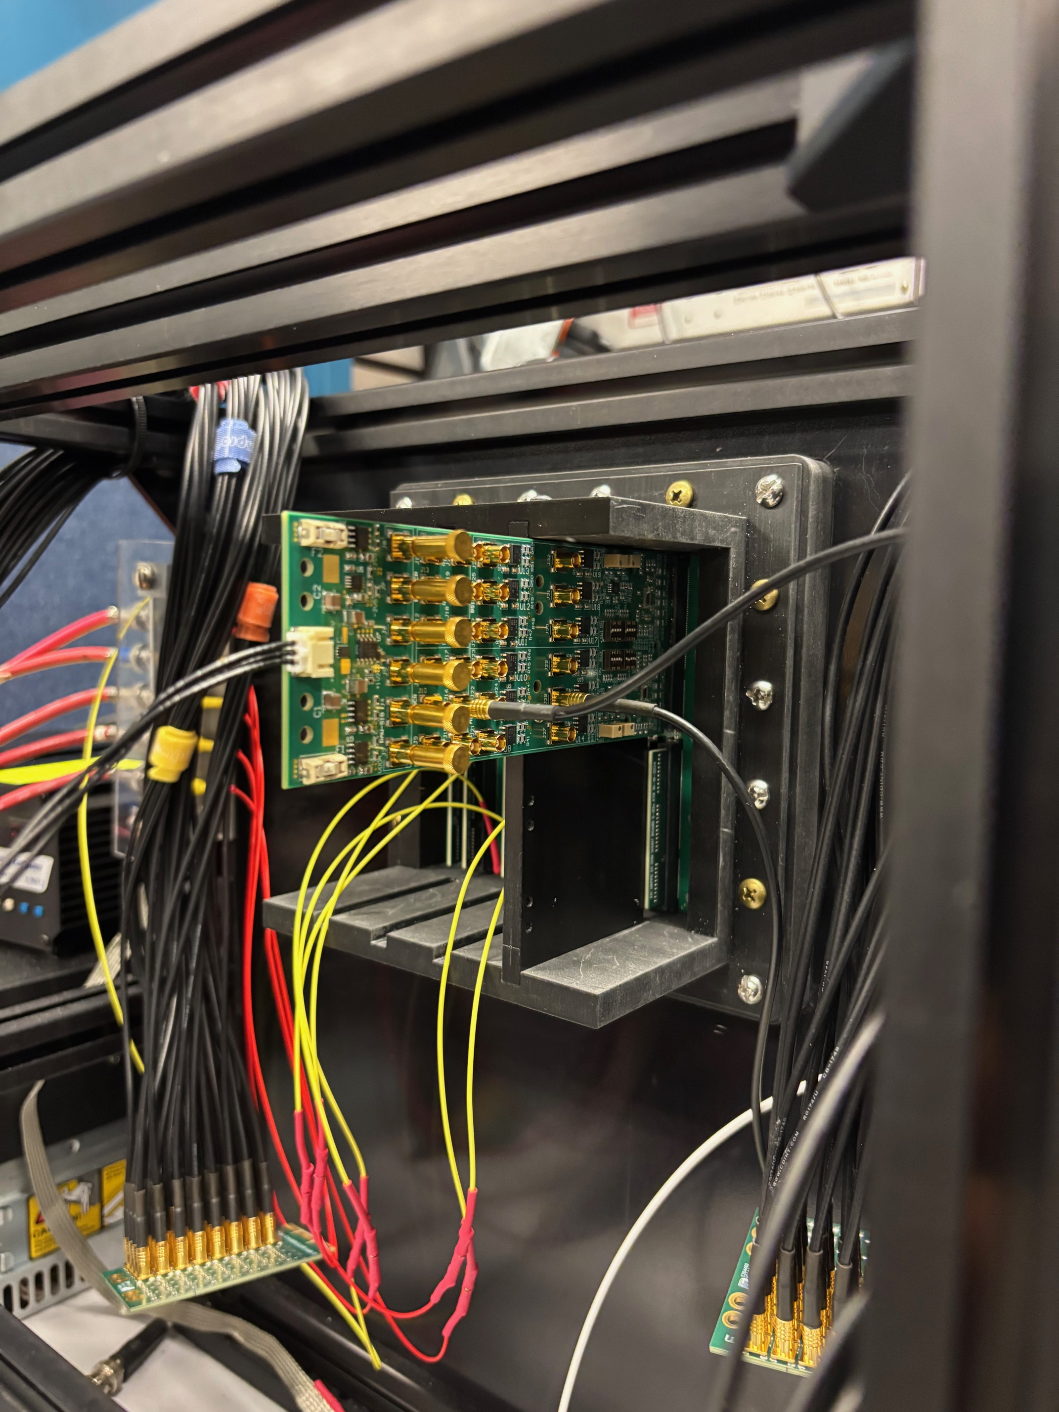
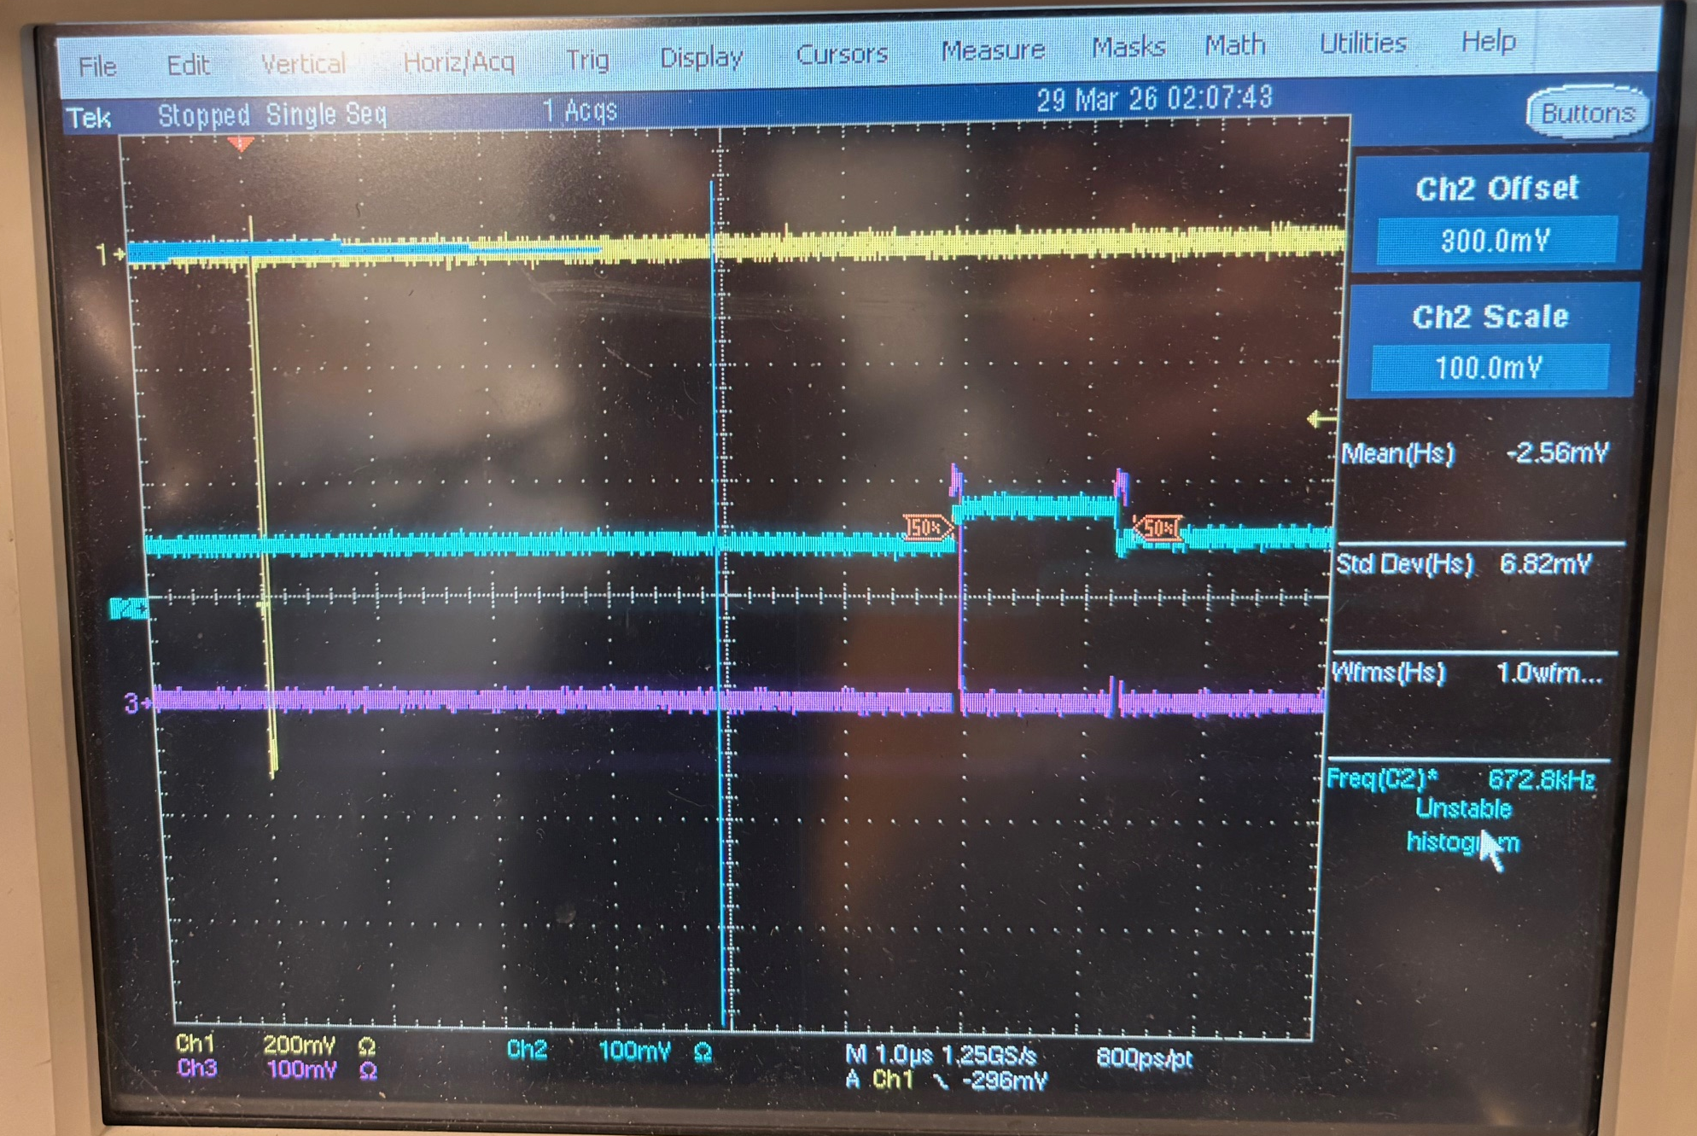
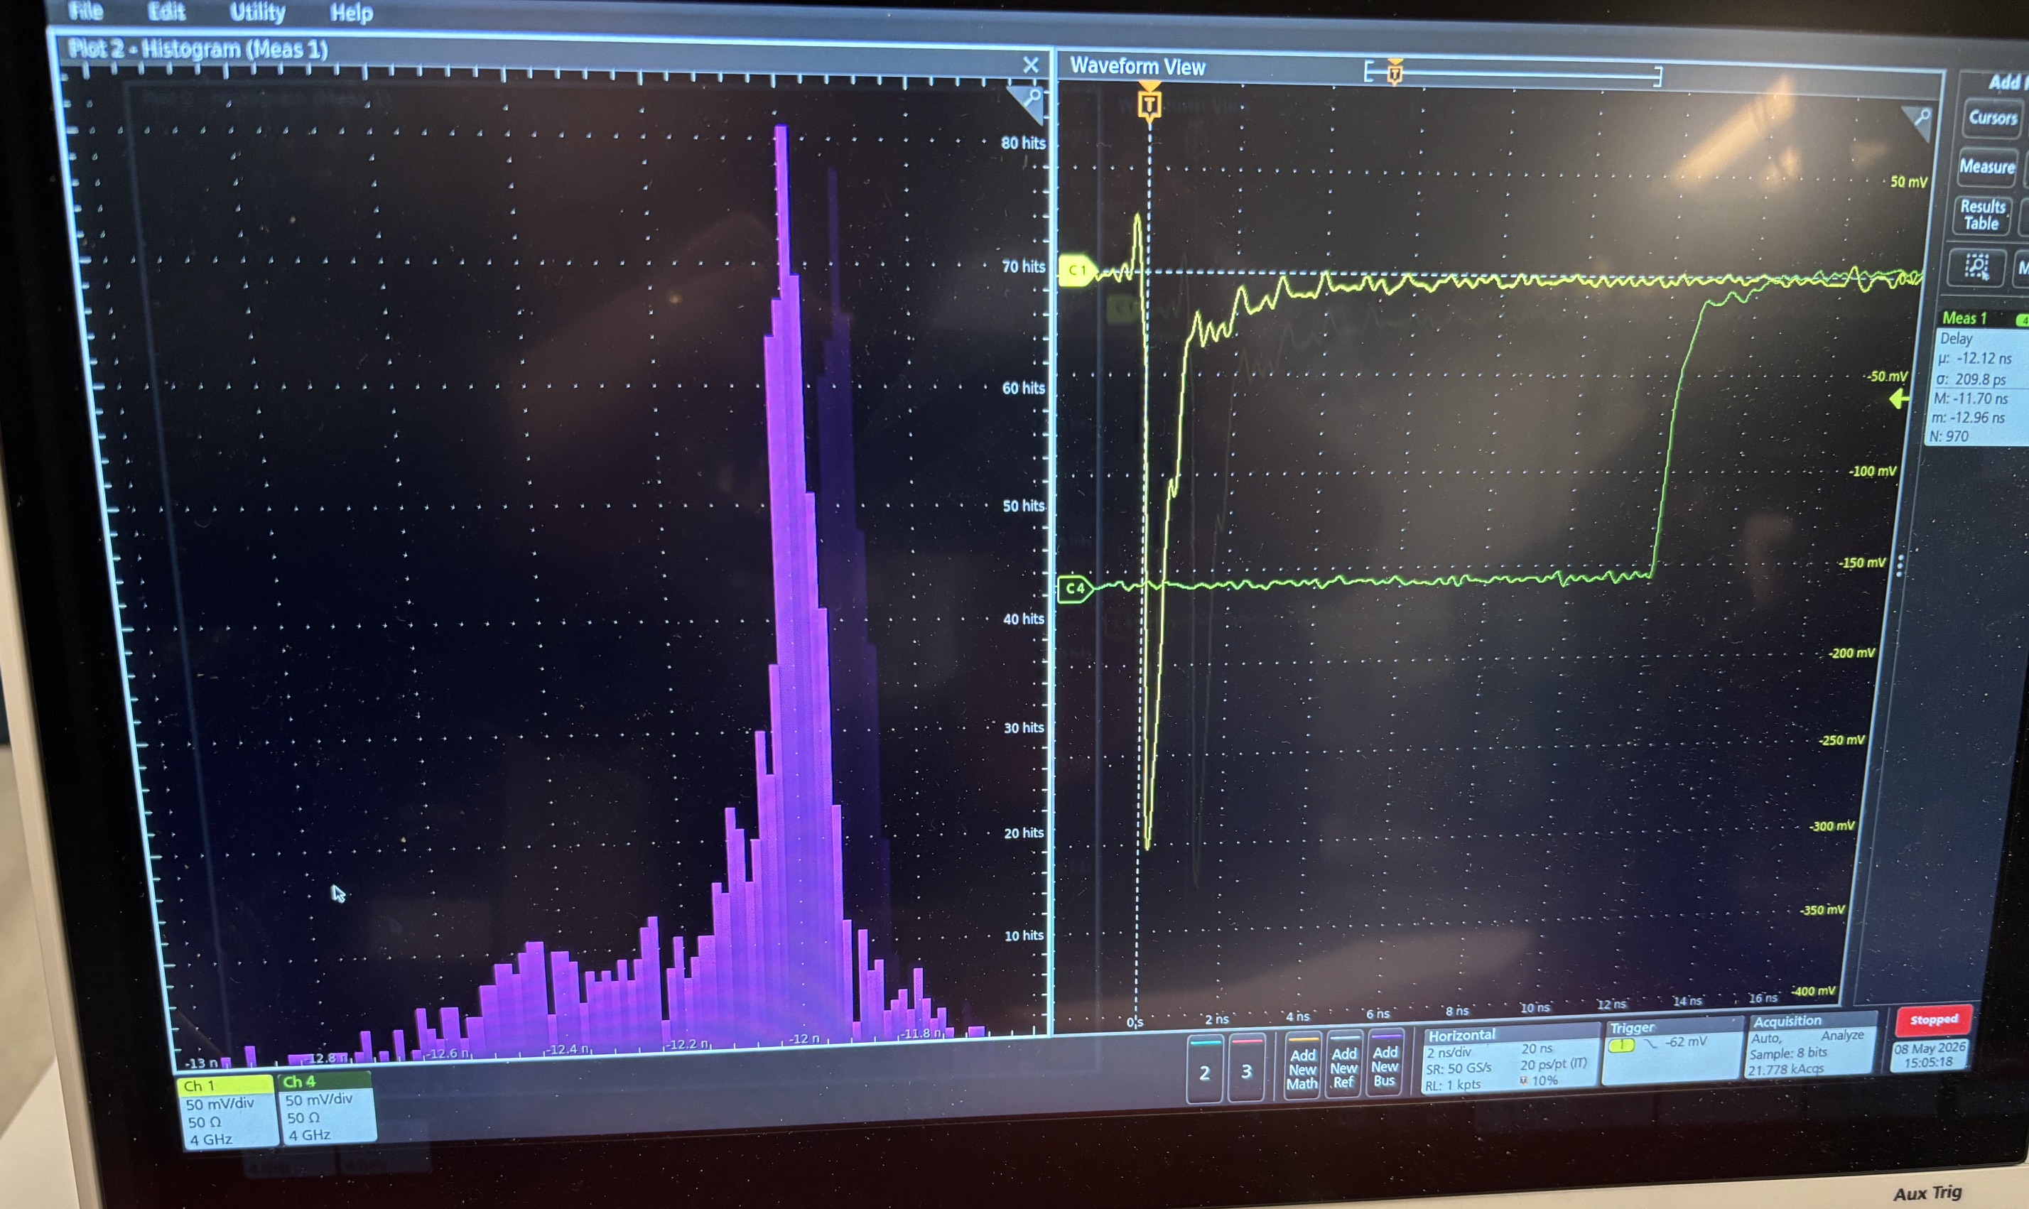
FCFD evaluation card status
Takao Sakaguchi, BNL on May 21, 2026
Initial smoke test passed (Apr 13). Removed a 66.5 Ohm resisters.
Found input/output channel mapping issue.
Measured timing jitter on HRPPD on May 8 again.
Wire-bonding work completed on Friday last week.
Passed two cards to Alexander, one card to Raymond.
Rest three cards are sitting in TS’s office.
No more issue/action item for now.
(1) Input pulse
(2) Analog output
(3) Discr. output

