Slide 1
Data rate update based on FCFD review talk
Takao Sakaguchi

Slide 2
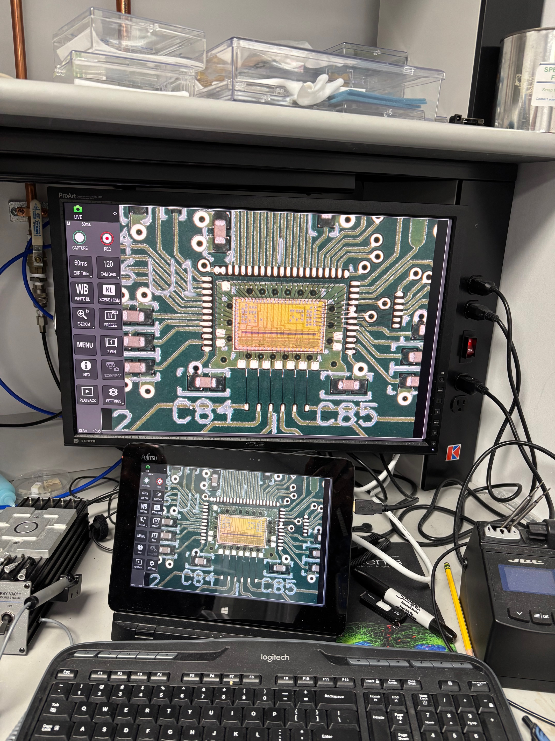
FCFD power (same as last week)
FCFD now goes for 32ch/chip.
Previous number:
Estimated from the table for 128ch.
Analog 32ch: 3.8mW * 32 = 120mW
TDC+ADC 32ch: 0.2mW *32 = 6.4mW
Supporting Circuitry 32ch: 6.4mW
Global circuitry: 1per chip = 200mW
Total power per chip will be: 330mW
New number:
As presented at the TIC meeting
Analog 32ch: 3.6mW * 32= 116.2mW
TDC+ADC 32ch: 0.2mW*32= 6.4mW
Supporting Circuitry 32ch: ?
Global circuitry: 1 per chip = 78mW
Total power per chip: 200mW.
Table presented by Artur at ePIC coll meeting on Jul 16, 2025
Table presented by Artur at TIC meeting on May 11, 2026
From Artur’s slide

Slide 3
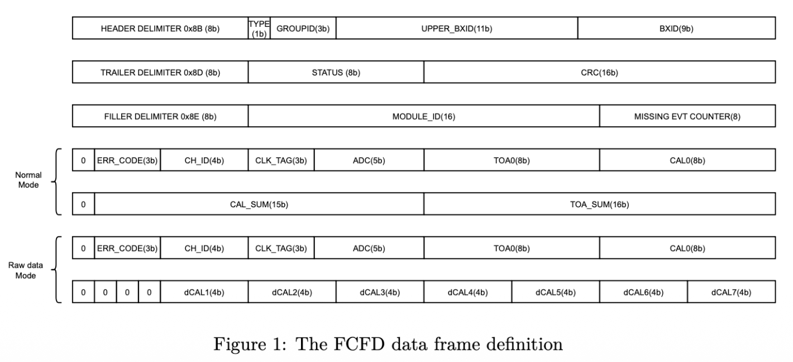
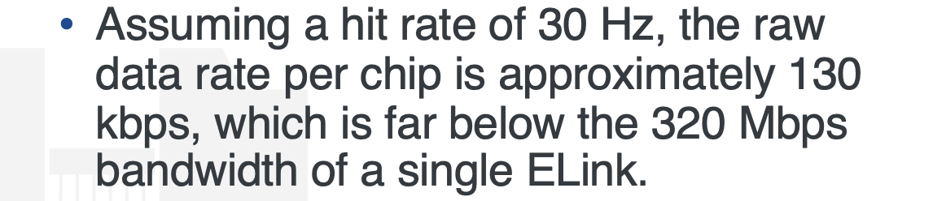
Data format and rate from 32ch-FCFD
Data format was presented for the first time.
My previous estimate: 12bit/hit
5 bit ADC + 5 bit TDC + 20% header
(semi-)official number: 160 bits/hit (max)
5 bit ADC + 8bit TDC + other info = 64 bits/ch
Header(H) + trailer(T) + filler (F) = 96 bits/ch
H+T+F may be merged for channels hit at same time.
Number is consistent with statement also presented.
130kbps / (30[Hz] * 32 [ch]) = ~135 bits
Using Brian’s average hit rate, it means:
200Mbps per HRPPD, 13.3Gbps from pfRICH as whole.
Will need at least two sets of lpGBT+VTRX+.
Max rate from a pad is 20kHz → 3.2Mbps/pad → 102Mbps/32ch.
It still fits to FCFD data bandwidth of 320Mbps/chip
Power estimate won’t change.
To be checked: Can the FCFD analog part handle 20KHz pulse rate? They assume 100Hz per channel…
Bandwidth of lpGBT + VTRX+ with FEC10 encoding is 7.68Gbps. (10.24Gbps mode)

