Slide 1

TOF
Satoshi YANO
Hiroshima University & RIKEN

Slide 2
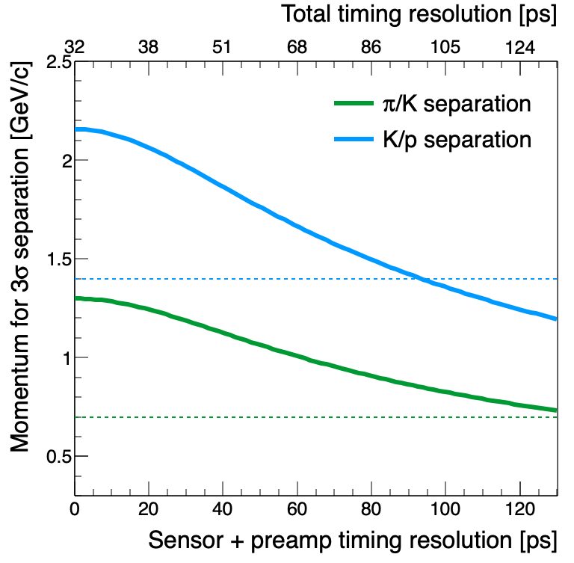
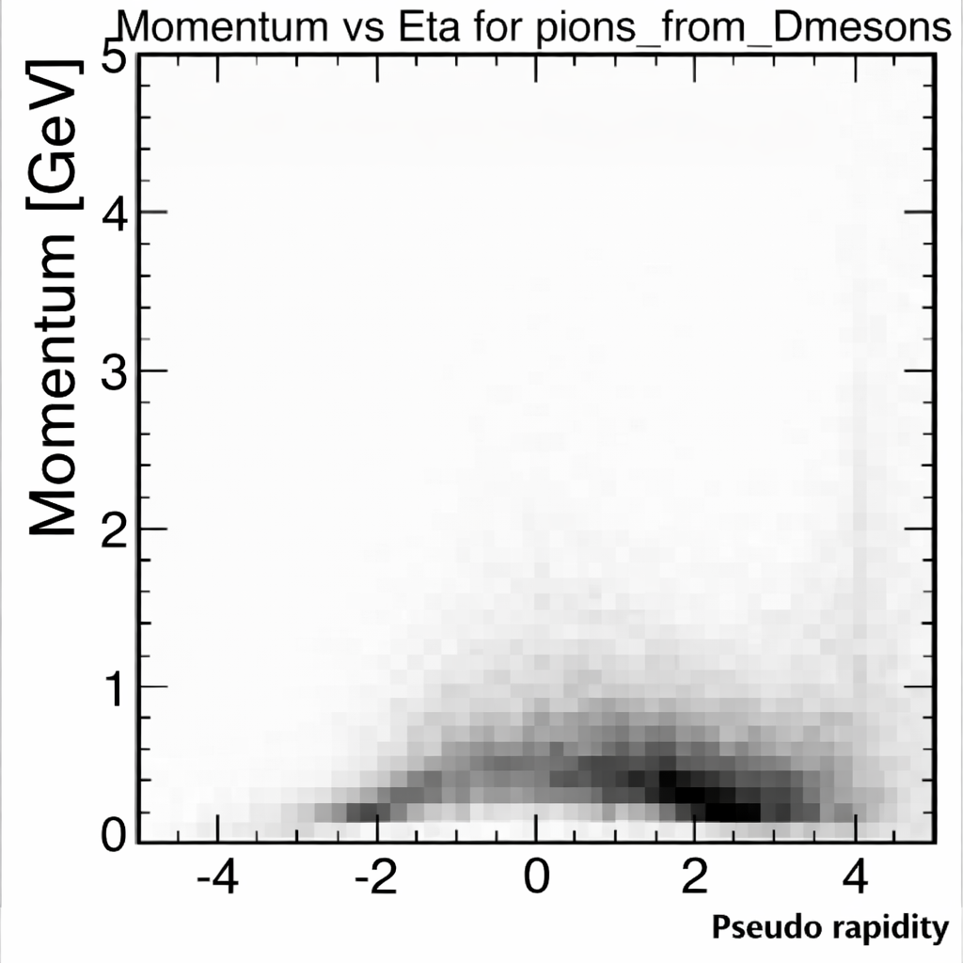
Impact on the ePIC PID Performance
Charge #1
The BTOF PID focuses on low-momentum particles at mid-rapidity
Continuous PID coverage requires seamless operation in conjunction with other PID detectors, avoiding PID gaps
Minimum timing required for the sensor to eliminate the PID gap is ~95 ps
A stretch goal of sensor ~40 ps would provide substantial overlap (Δp ≈ 0.5 GeV/c) for robust cross-calibration
To achieve the stretch goal, < 30 μm positioning resolution is desired
σ_{elec} = 20ps
σ_{T0} = 25ps
hpDIRC
dRICH
pfRICH
Overlap
~ 0.5 GeV/c
Overlap disappear
point
hpDIRC limit
Overlap
~ 0.5 GeV/c
FTOF
BTOF
hpDIRC limit
HRPPD
~95 ps
Decay products from D-meson in ep DIS @ √s = 141 GeV

Slide 3
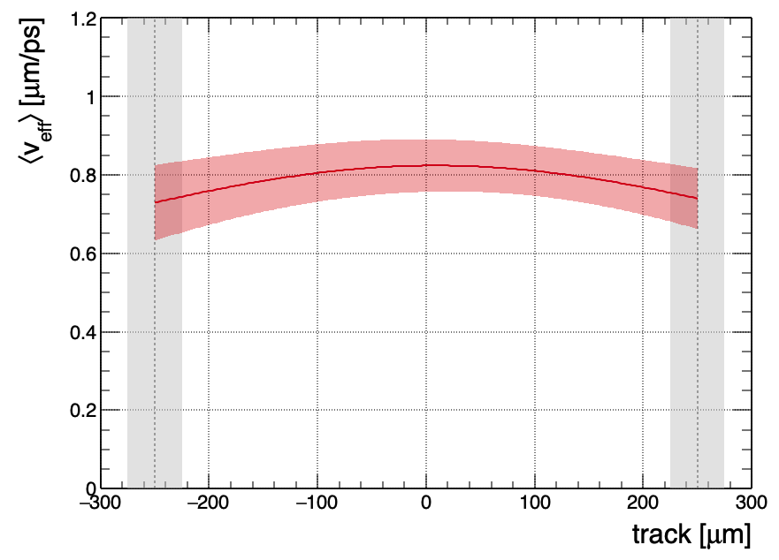
Required Positioning Resolution
Charge #1
Charge #3
Nonnegligible signal propagation time has been observed
Propagation speed is approximately 0.8 μm/ps
<30 μm positioning resolution is required to reach 30~40 ps timing resolution
Strip#1
Strip#2
Δt₁
Δt₂
Hit time t₀
T_{s1} = t_{hit} + Δt₁
T_{s2} = t_{hit} + Δt₂
Nonnegligible propagation time

Slide 4
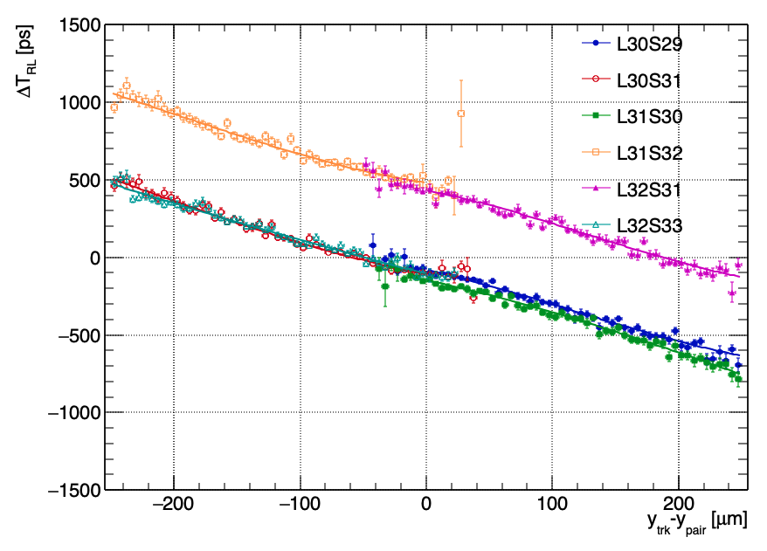
Position v.s. ΔT_{RL} (=T_{R} - T_{L})
S_{L}
d₀
S_{R}
Example: DUT1 COL1
u
d₀-u
d₀+u
Hit time t₀
T_{R}(u)= t₀ + (d₀ + u)/v_{eff} + a_{R}
T_{L}(u)= t₀ + (d₀ - u) /v_{eff} + a_{L}
ΔT(u)=T_{R}(u)- T_{L}(u) = 2u/v_{eff} + (a_{R} - a_{L})
d{ΔT(u)}/du = 2/v_{eff}
v_{eff} = 2{dΔT(u)/du}

Slide 5
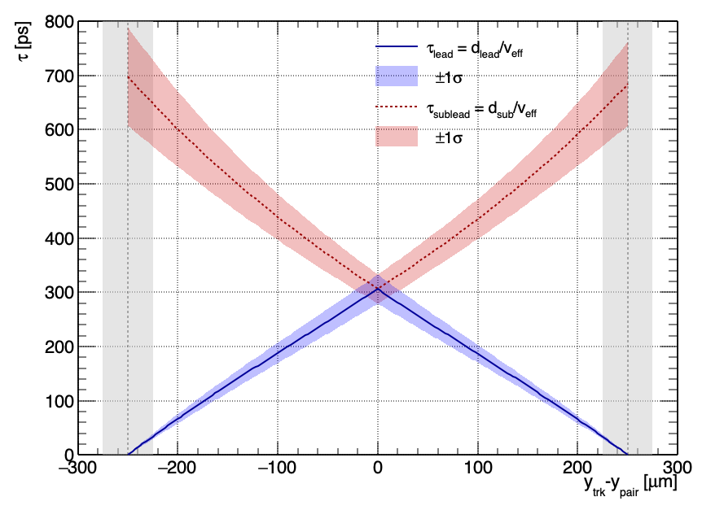
Propagation Time Correction

Slide 6
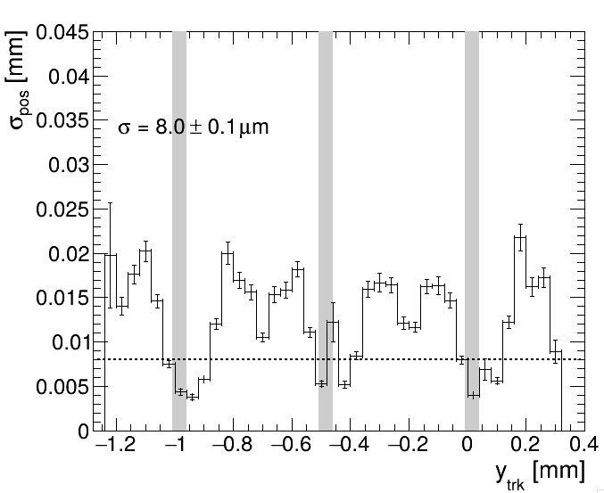
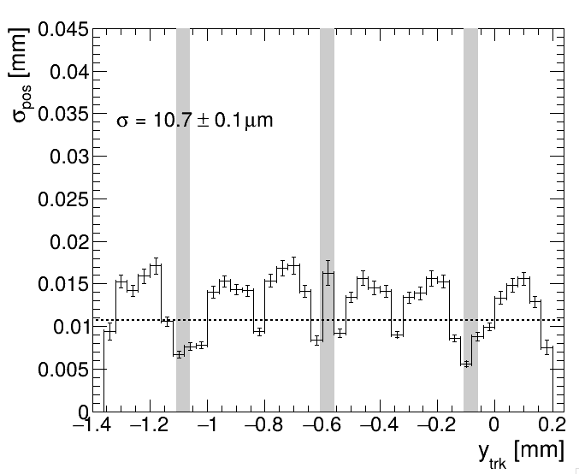
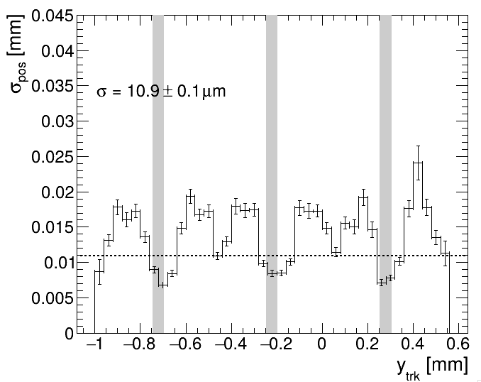
Positioning Resolution
Charge #3
Positioning resolution achieves σ ~ 10 μm
Sensor: S0
Sensor: S1
Sensor: S2

Slide 7
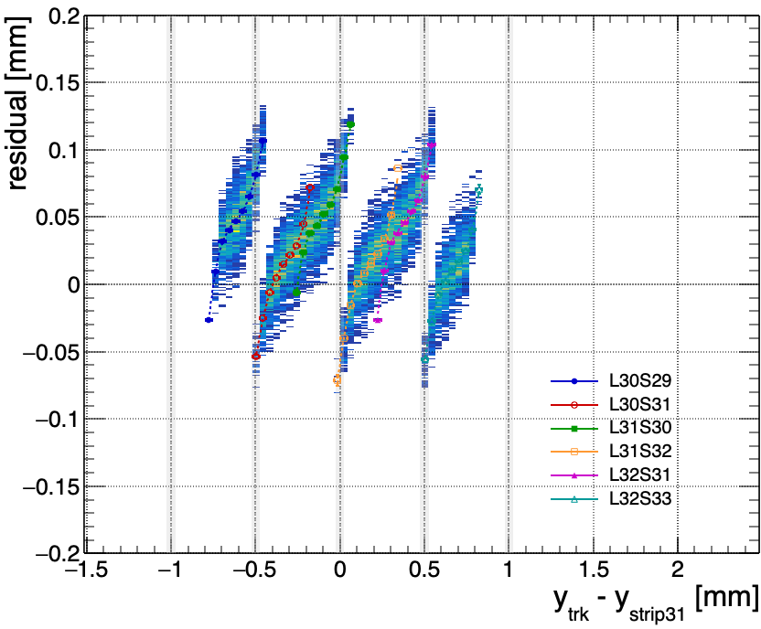
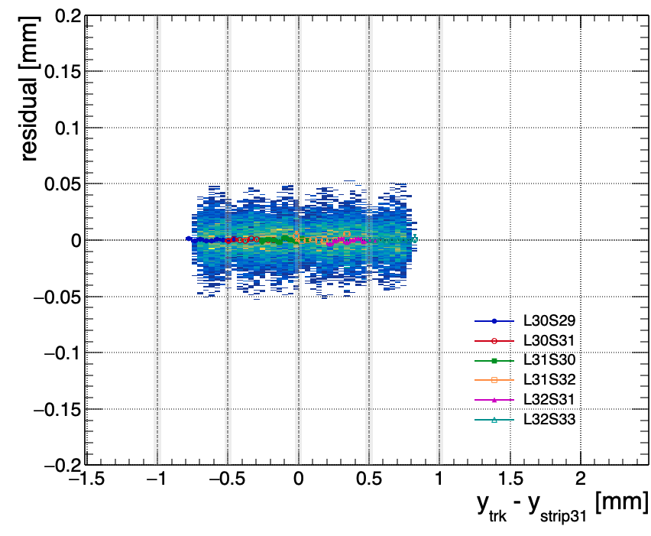
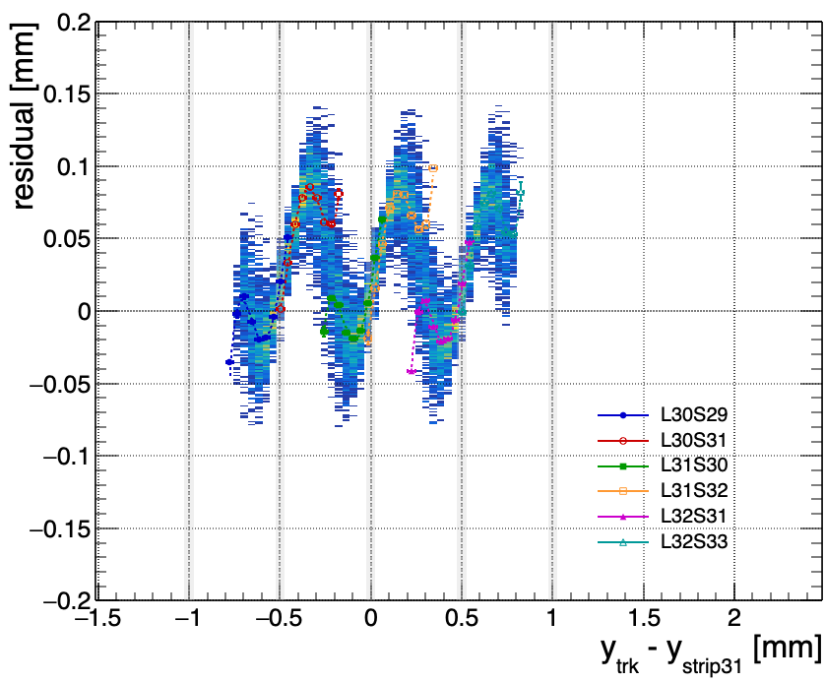
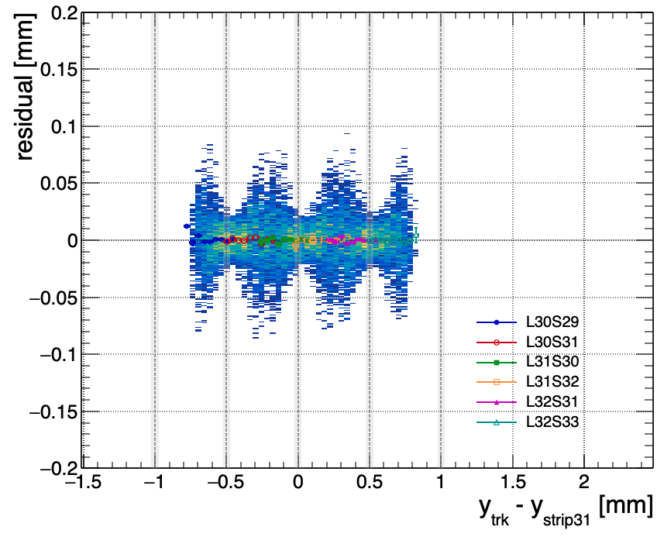
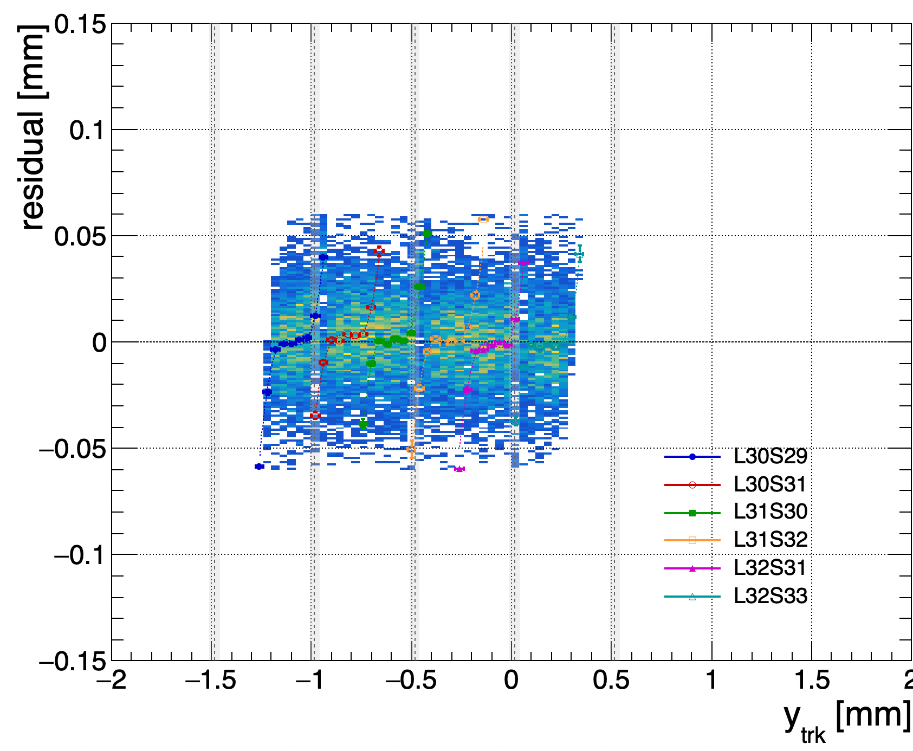

Position Reconstruction
Weighted method (ampw), squared weighted method (sqw) and tracked-base eta correction (etac) method are compared
Bending residual can be seen in ”raw” of ampw and sqw reconstructed position
However, this can be corrected by simple method
ampw method
sqw method
etac method

Slide 8
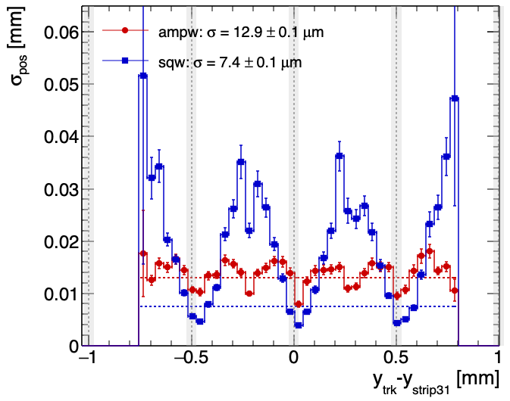
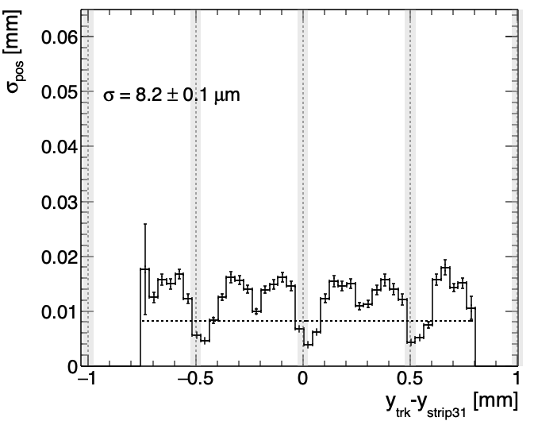
Positioning Resolution
”Resolution” point of view, ampw and sqw are better than eta-correction
Which resolution—ampw or sqw—is better depends on the distance from the strip
The best positioning resolution is ampw and sqw combined results
Eta = Q_{L}/(Q_{L}+Q_{R}) is a key tool to switch ampw and sqw

Slide 9
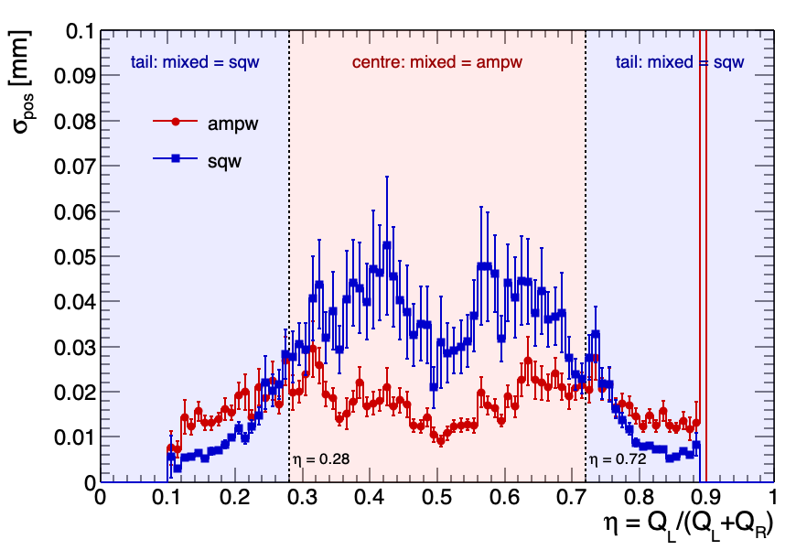
Positioning Resolution v.s. Eta

