Slide 1

Collaborative Tools
John Lajoie
ePIC Spokesperson
Oak Ridge National Laboratory

Slide 2
ePIC Collaborative Tools Approach
ePIC is a relatively new international collaboration, planning on first physics data in ~10 years
That being said, ePIC is >1100 collaborators and has well-defined membership criteria and policies
  These require tools for tracking, approval workflows, etc.
ePIC has collaborative tools needs specific to the design and construction periods
ePIC can foresee new needs for the future that previous experiments have not had to deal with
The EIC has multiple host laboratories
  ECSJI is our interface for computing and collaborative tools
Our approach has been to adopt collaborative tools when:
  We have an identified need and can articulate requirements
  Avoid adopting technical debt for the future:
    Modular approach – take on only what we need when we need it, interconnect tools with specific purposes.
    Large, monolithic approaches disfavored.
Access is vitally important:
  All ePIC collaborators need access, regardless of member institution or country

Slide 3
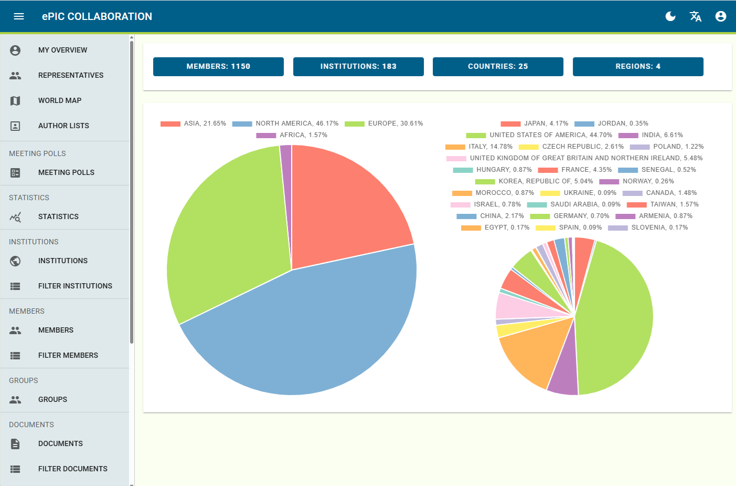
ePIC Collaboration Database
ePIC has adopted a collaboration database (“phone book”) supported by BNL
Federated login with COmanage
Managed by CC Chair and Membership Committee Chairs
  With admin support from BNL
Works well overall
Incorporates a Workflow process for approvals

Slide 4
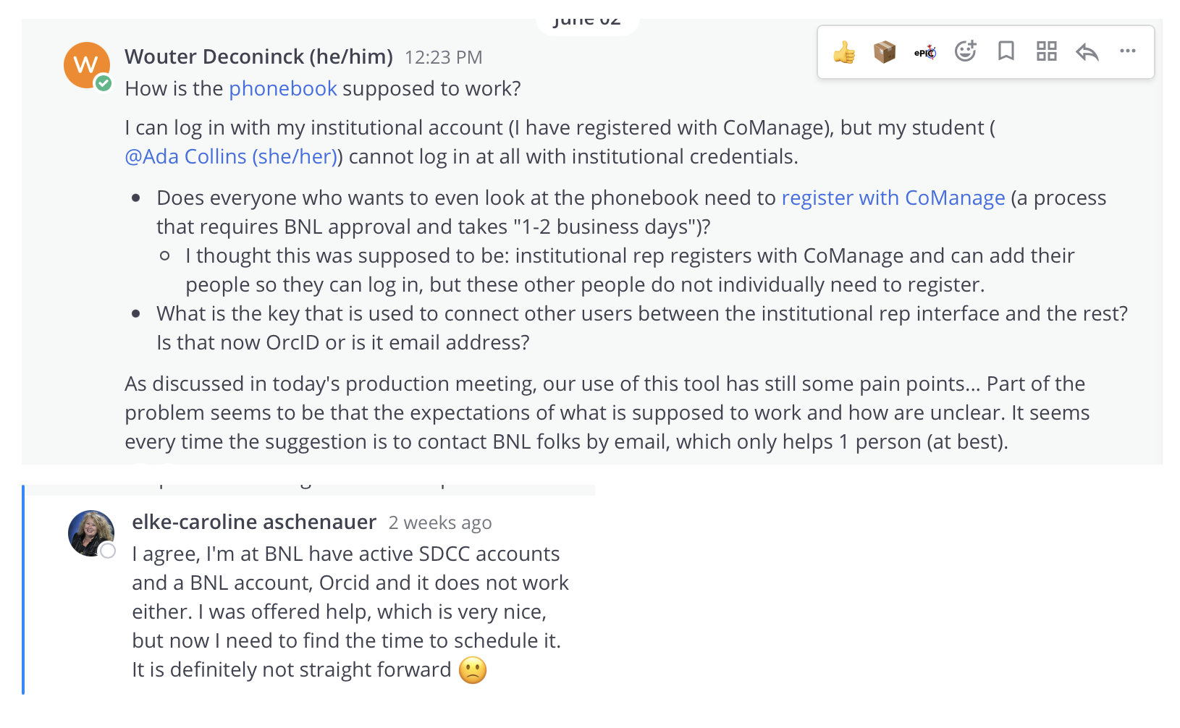
Issues with Federated Login/COManage
Still some issues with access to phonebook.
Edge cases can be complicated and require support to debug and fix.

Slide 5
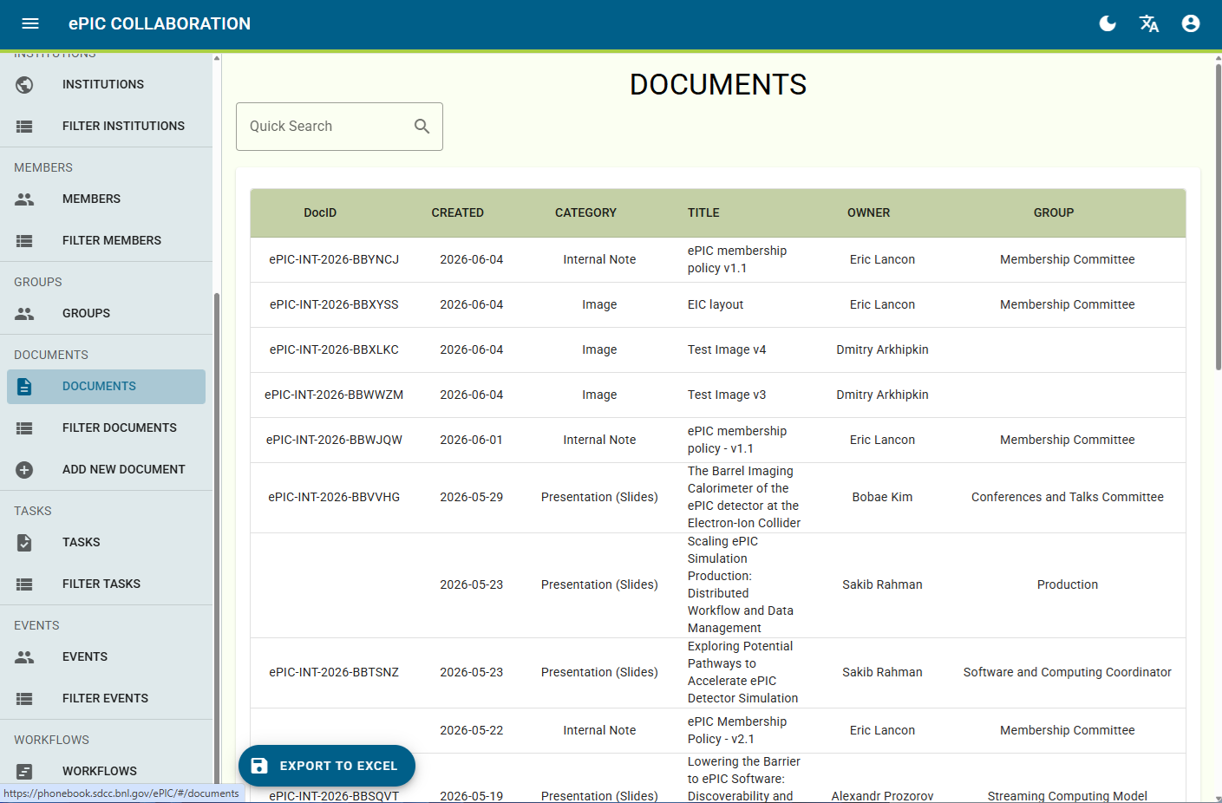
Document Approval Workflow
Conference and Talks Committee has been testing a workflow system integrated into the phone book.
  Link to document database
  Stores comments and discussions
  Workflow approval steps automated
Led by CTC chairs
Testing by collaboration

Slide 6
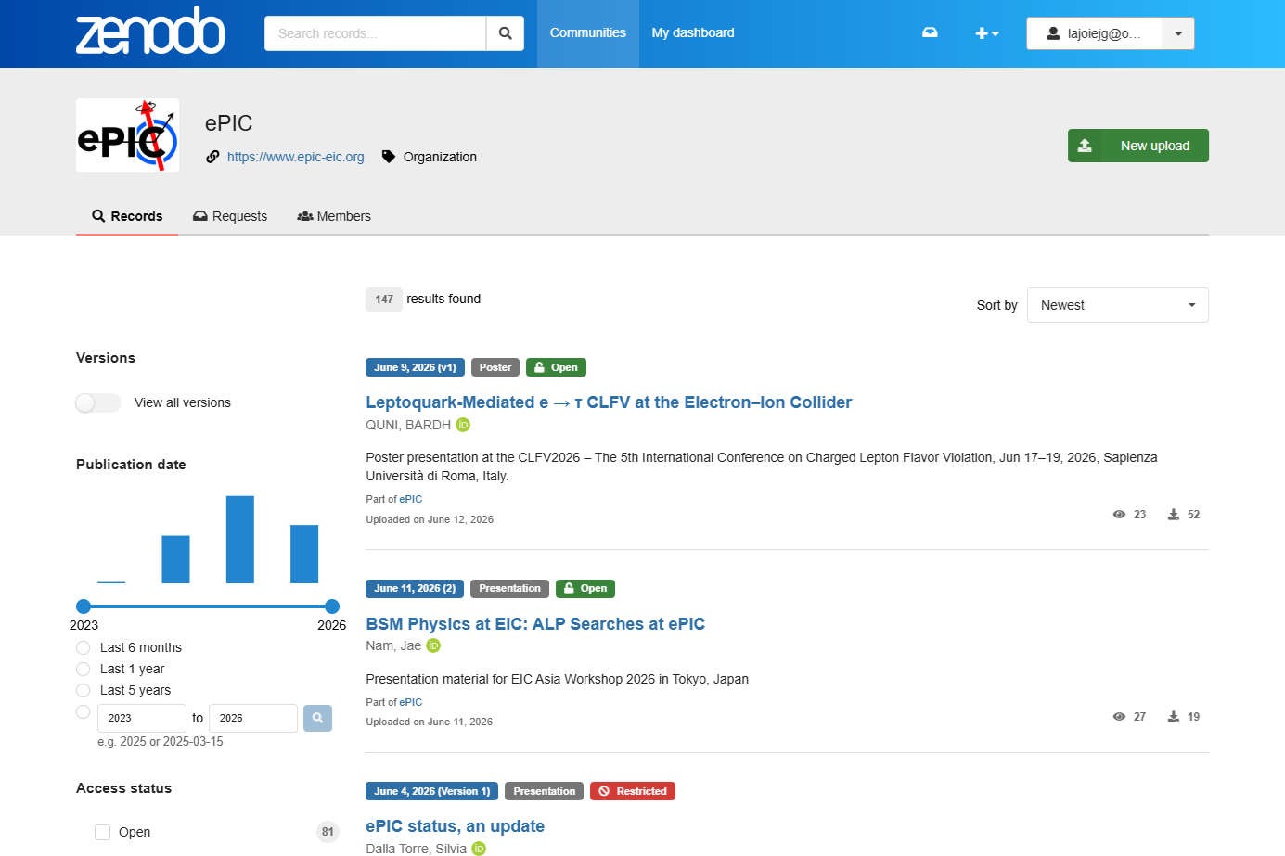
Document Database (Zenodo)
Using Zenodo as a document database
  Maxim has a separate talk on this later in the meeting
No phone book integration so requires manual intervention to add collaborators to ePIC community

Slide 7
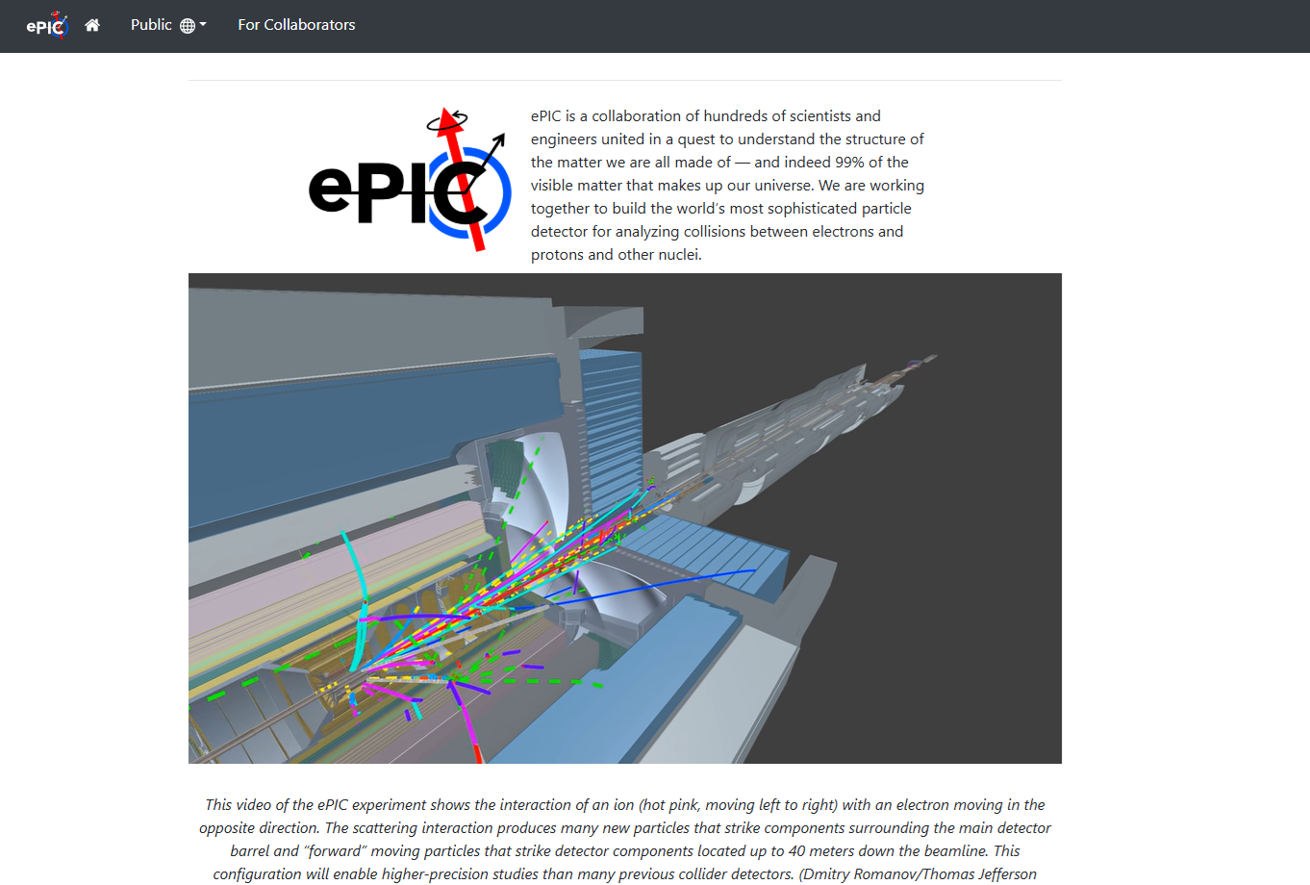
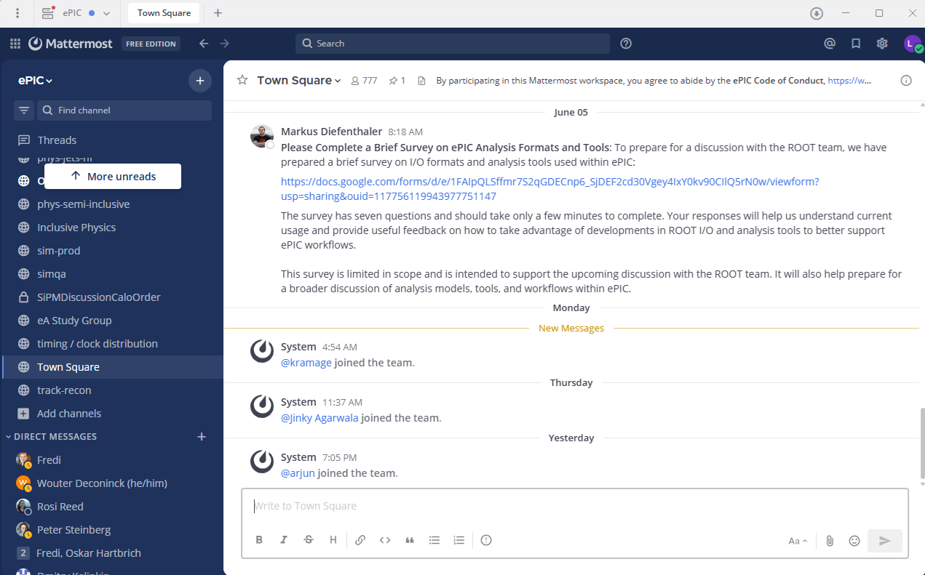
Other Tools
BNL Supported:
  Mailing lists
  Indico (integrated with phone book)
ePIC Supported:
  EIC Software in GitHub
  The ePIC website is hosted by GitHub pages
    Website managed in Markdown
    Flexible and allows many to contribute
    No hosting for large files (video, etc.)
    Meets need for now, but will not scale
  The ePIC Mattermost is hosted by ePIC
    Google Cloud server supported by collaborator
    ePIC internally supports Mattermost server administration

Slide 8
Detector Component Database (CDB)
The CDB is a tool to assist in documenting, organizing, and tracking components used in construction of complex systems, originally developed ca. 2015 for use in accelerator system upgrade at Argonne National Lab. The BNL CAD Controls Group created a test instance of this platform at BNL for evaluation and possible deployment in production.
Investigating use of a database solution developed by ANL - same solution to be used by the EIC project
  Support from Maxim for evaluation
  TOF has developed test case (Grigory Nigmatkulov)
Initial round of testing of its features and interfaces at BNL has been completed.
Not clear if a separate database instance is needed by the collaboration, or if we can have a separate set of tables within the EIC project database
  External access by collaborators at other sites is required.
  Will likely need some BNL support.
  Need becoming urgent
  Ready for discussions on production instance

Slide 9
AI Tools and Resources
The use of AI agents is growing rapidly in many aspects of what the collaboration does:
  Personal Workflow Agents
  Support Agents (incl. agentic workflows)
  Coding Agents
Access to AI tools at the moment is typically funded by individual collaborators
What will the lab support for collaborations?
  AI Policy?
  Agents supported?
  AI token pools/quotas?
    Resource usage varies widely by use cases
    Does that lab control allocations by user, or does the collaboration control and allocate a pool of resources?
Planning in an AI policy discussion in the July collaboration meeting.

Slide 10
Automated Simulation Production Workflows
Automated workflows are critical to support the simulation production needs of the collaboration with limited workforce
More details in the Software and Computing Meeting on June 24th
Likely to be our first “special case” need for ePIC
By the July collaboration meeting, we want to have a plan for a server running an agentic workflow at the host labs that supports the automated production workflows and a timeline.
Will pursue discussions through ECSJI.

Slide 11
Summary of Collaborative Tools and Services Usage & Plans
Service Pillar | Current Status | Details & Expertise | Future Plans
Phonebook [Membership Database] | Production | Integrated with Indico Phonebook data is maintained by the collaboration | Production instance at BNL but need sustainable support, integration with future tools
Invenio RDM | To Be Evaluated | Have example with Zenodo imported. Some experience with workflow tools. | Workflow tools are an identified need (Conference and Talks)
Zenodo | Production | Current ePIC document management system | Requirements evolving, including software citation and data cards (dataset registration)
Automated Simulation Production Workflow | Ready for deployment |  | Server(s) running at host labs
CDB | Testing | Same soln. as EIC project, meets requirements | Needs support, user access
AI Support | Discussions (AI policy, requirements) |  | Needs discussions with lab

Slide 12


Slide 13
Capabilities of the CDB
Core capabilities:
  Captures documentation for all components, and logs component history
  Maintains a repository for inspection & measurement data
  Supports the concept of ownership and location
  Supports the concept of the assembly (aggregation of components)
  Supports generation of the Bill of Materials
Additional capabilities:
  QR code, mobile app (*)
  Input templates based on Excel spreadsheets, export to same format
Interfaces:
  Web Portal
  REST API for external applications
  Import from Excel-compatible spreadsheets
  Export to spreadsheets and PDF

Slide 14
The three domains of the CDB
Component Catalog
Types, descriptions, documentation
Component Inventory
Physical instances of components
System Designs
Assemblies of inventory items

Slide 15
Domains Detail
Component Catalog
Component Inventory
System Designs
What type of component is it?
Which specific units do we have?
Where does it go in the (sub) system?
▸ One entry per unique component type or design
▸ Each physical item procured or fabricated
▸ Placeholders for components at specific locations
▸ Covers both custom-fabricated and COTS items (can be complex by design)
▸ Every instance gets a unique ID code
▸ References inventory items (unit installed). The Inventory item installed at a location will change as components fail or age
▸ Stores: name, project, owner, owner group – at a minimum
▸ Tracks location: building, room etc
▸ Supports hierarchical designs
▸ May (and should) include model, description, vendor sources, images, and optional “properties”
▸ Refers to its Catalog entry
▸ Enables Bill of Materials generation
▸ Stores inspection, testing, and maintenance data
▸ Think of it like an online store catalog

Slide 16
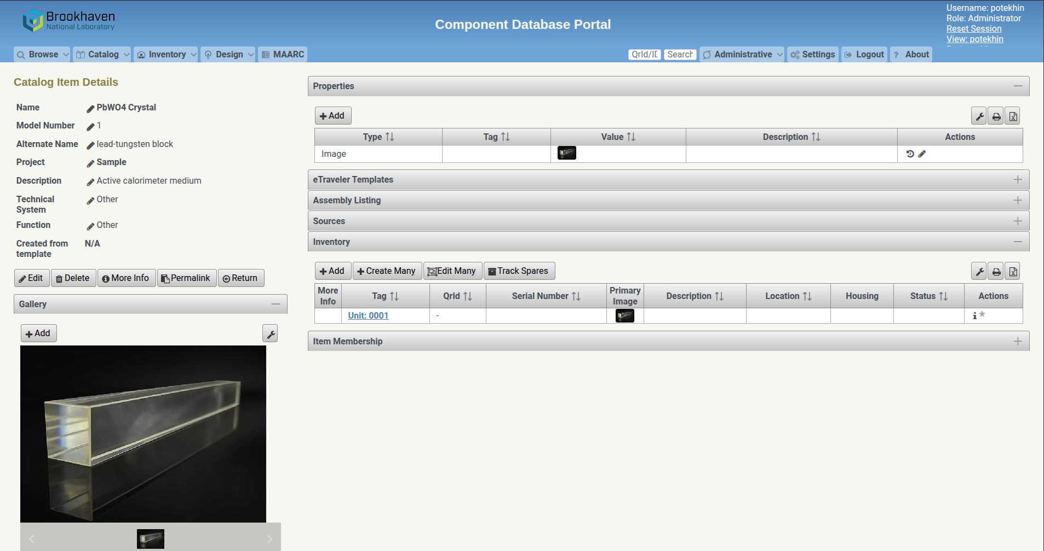
Test example: the ePIC BEMC PbWO4 crystal

Slide 17
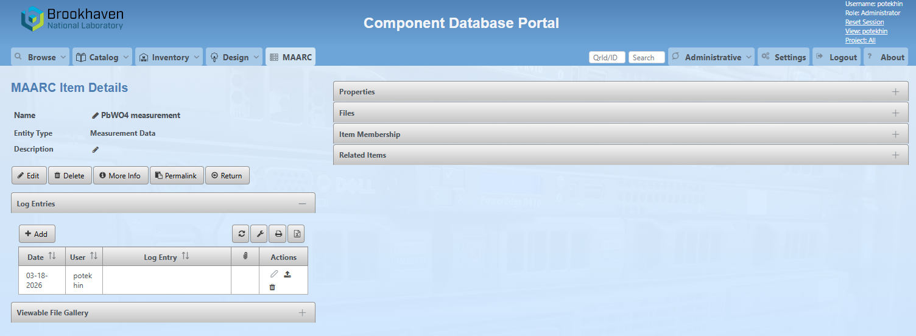
MAARC – Measurement and Analysis Archive
This functionality allows for consistent management of a variety of materials documenting the measured and other characteristics of an inventory item
The information can be exported as a spreadsheet etc

Slide 18
Access to the CDB
Currently access to the CDB portal via the browser is only possible within the BNL perimeter, and accounts are created by the CDB administrators on demand. One possibility is to use a SSH tunnel through cssh.rhic.bnl.gov
Once inside the perimeter, the user can access the portal at https://cdb.eic.bnl.gov/cdb
Going forward, we’ll need to ensure the least cumbersome way of accessing the data at least in the read-only mode. Opening the portal to the world will require the BNL Cyber Security audit, which is tough.

Slide 19
CDB Status and Plans
The CDB meets a variety of requirements, including ones listed in https://zenodo.org/records/13924160 for ePIC.
Initial testing of the CDB has been performed utilizing the BNL instance (components, inventory, initial test of the design/assembly) – the latter needs more work to evaluate. Work is ongoing, a few adjustments needed (templates fixes for the inventory, e-travelers etc)
Plan: use the BEMC crystal batch as the first use case, with potential addition of the BTOF subsystem later
Ensure the full component template and traveler functionality
Investigate network APIs that would be required to integrate external systems (like test setups in labs)

