Slide 1
Endcaps Structure and Floor Modifications
Dan Cacace (BNL)
Contributions from the triple I Group
June 2nd, 2026

Slide 2
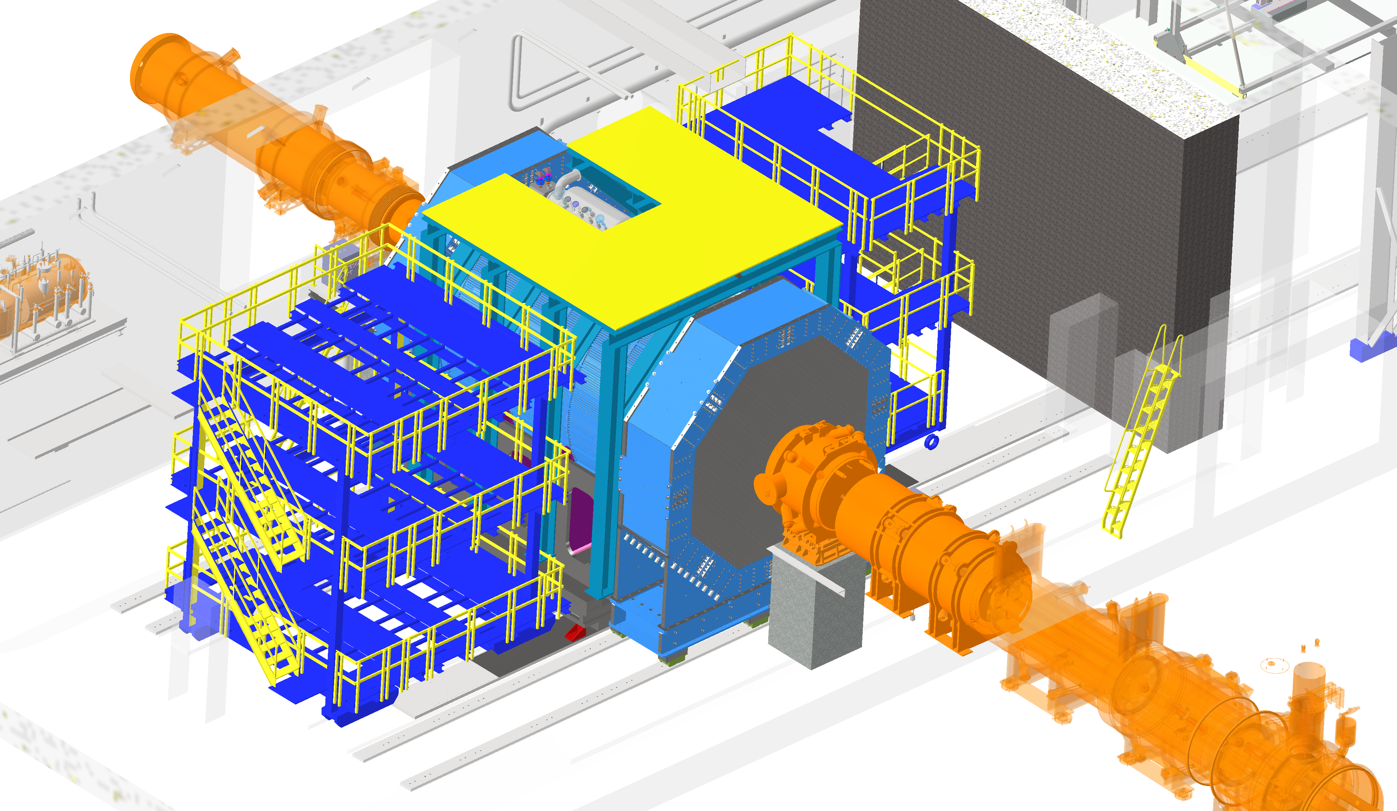
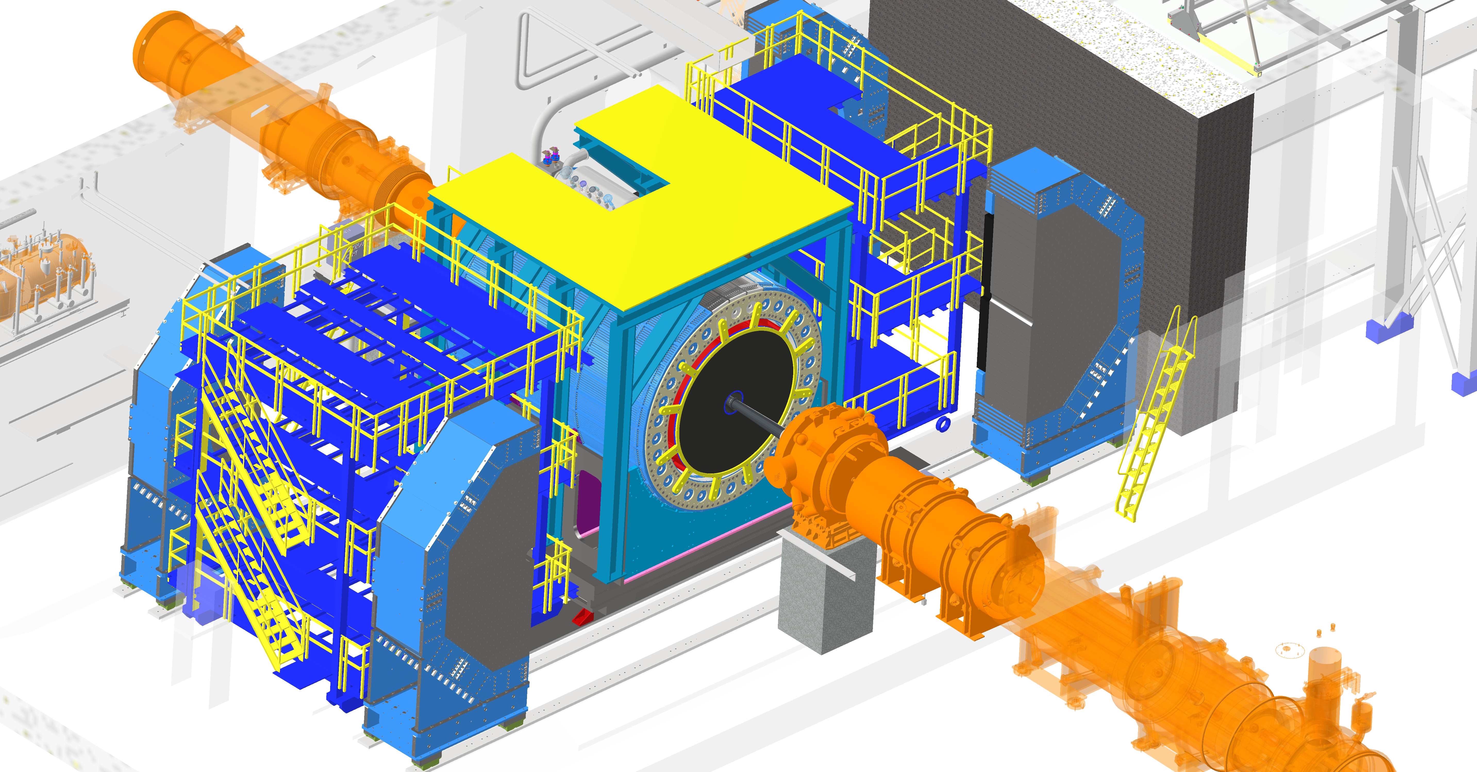
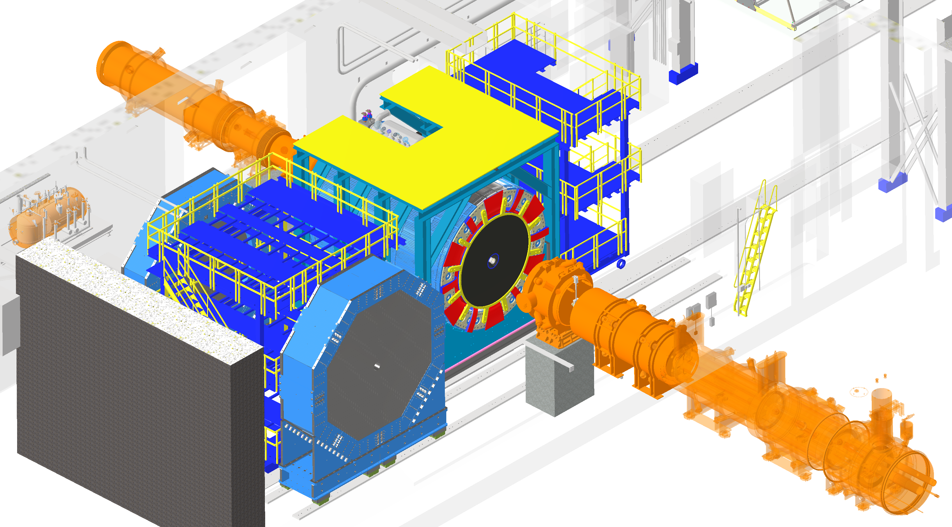
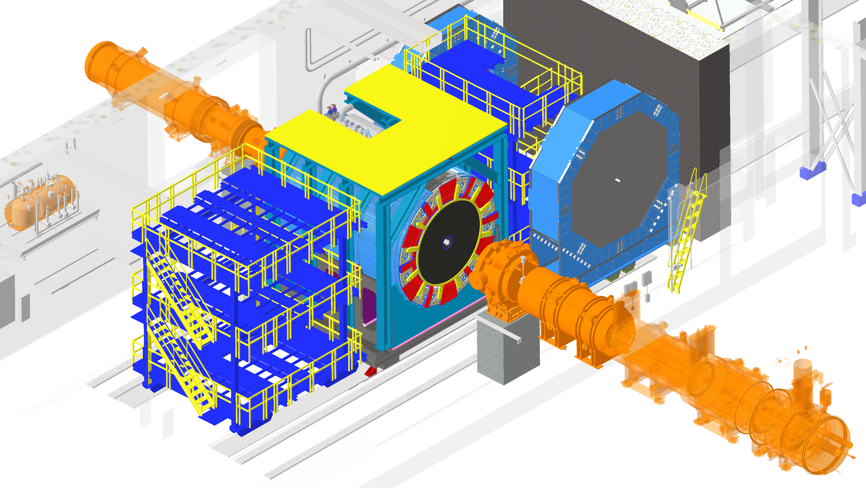
Endcap Choreography
Nominal Operating Position
The maximum extent of the positions needed for installation, integration and maintenance
Making all options viable gives us significant flexibility
Allows for beam pipe bake-out, inner detector removal and endcap maintenance.
Platforms need to be trimmed to allow endcaps to move past them
Services laid out for endcap and central barrel detector to make sure they can pass each other smoothly without damage
Typical Maintenance Position
Typical Rollout Position
Atypical Maintenance Position

Slide 3
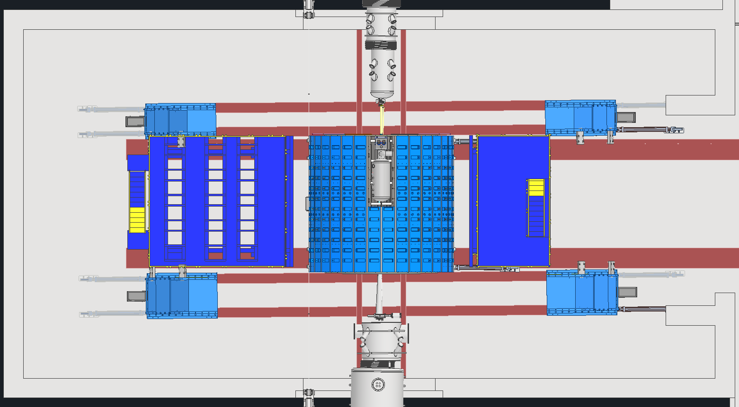
Endcap Rails
Central barrel has a 0.5deg rotation with respect to rails
Repercussions of this need to be fully reconciled (doesn’t affect steel)
Endcap rails will be tilted to accommodate (doesn’t affect steel)
STAR platforms trimmed to fit between endcaps
Floor analysis complete with full detector weight finalized, setting up contract for design
BE South
BE North
South Platform
Central Barrel
North Platform
FE South
FE North

Slide 4
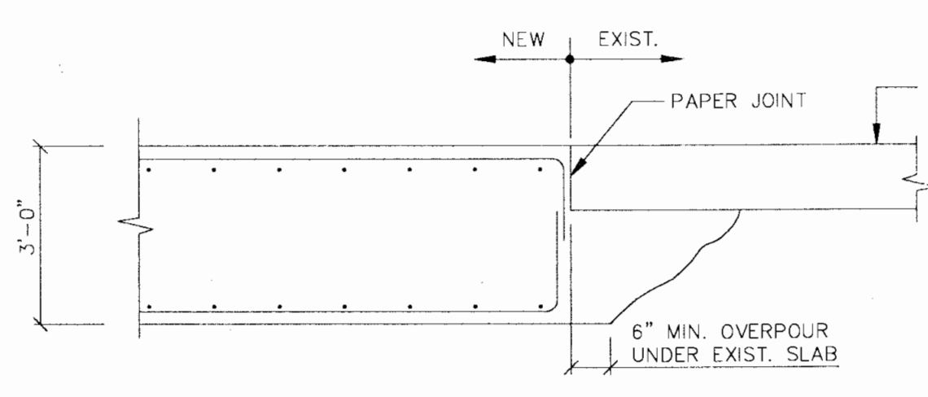
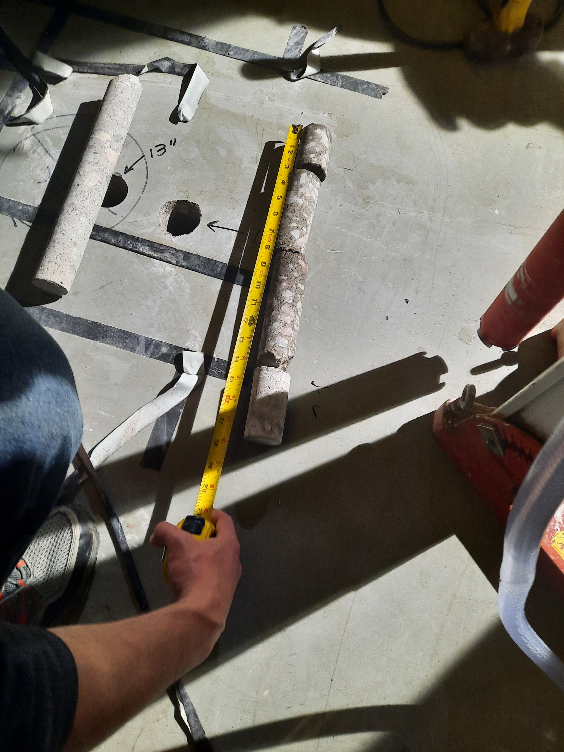
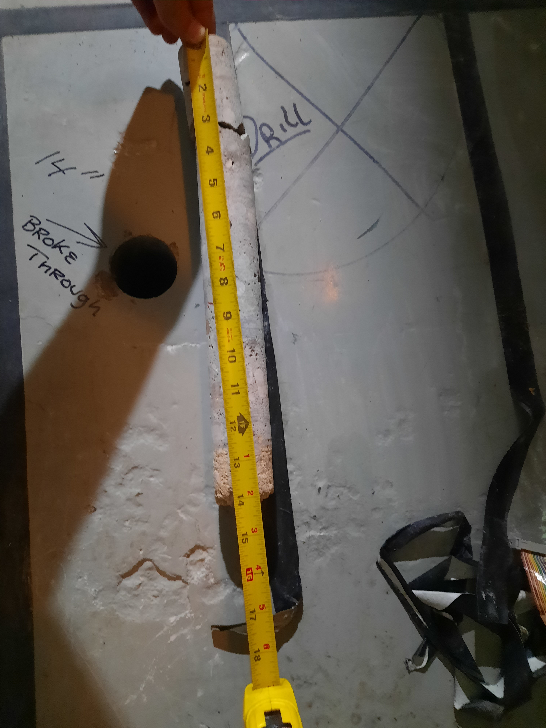
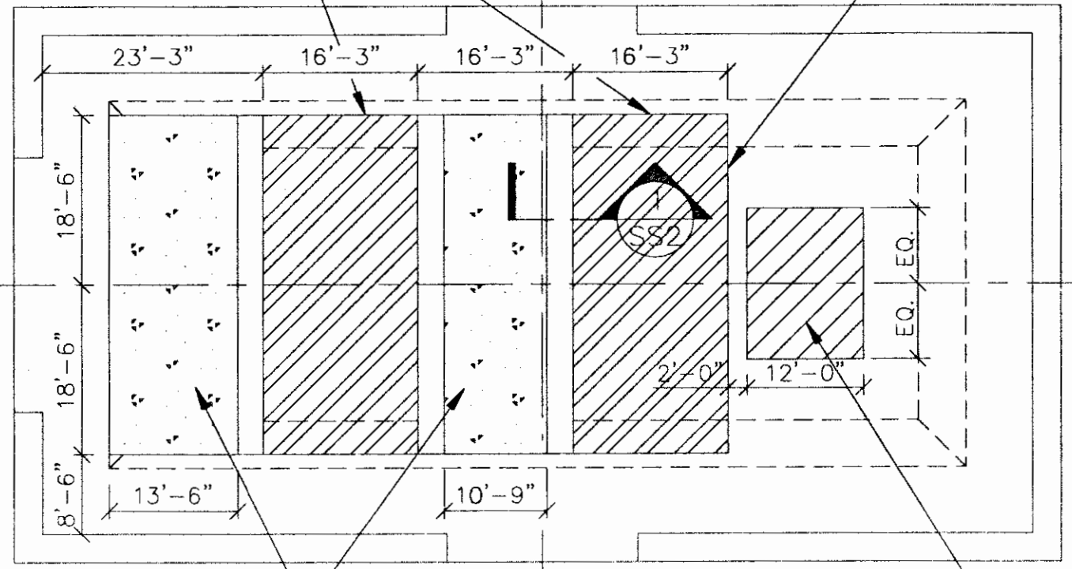
ePIC vs. STAR Loads on Floor
STAR weight: 1200 tons
ePIC weight: Central Barrel: 1100 tons or less, FE: 360 tons, BE: 225 tons
Although ePIC is distributed over greater area, the higher overall load requires further concrete analysis
  Central Barrel area: 6.5sqft (rollers), 540sqft (STAR) 460sqft (ePIC) (area)
  Endcaps area: 3.25sqft (rollers), 66sqft (FE) 52sqft (BE) (area) per endcap
Previous concrete strengthening work over several sections of the wide-angle hall substantiated with two core samples
3ft Thick
1ft Thick

Slide 5
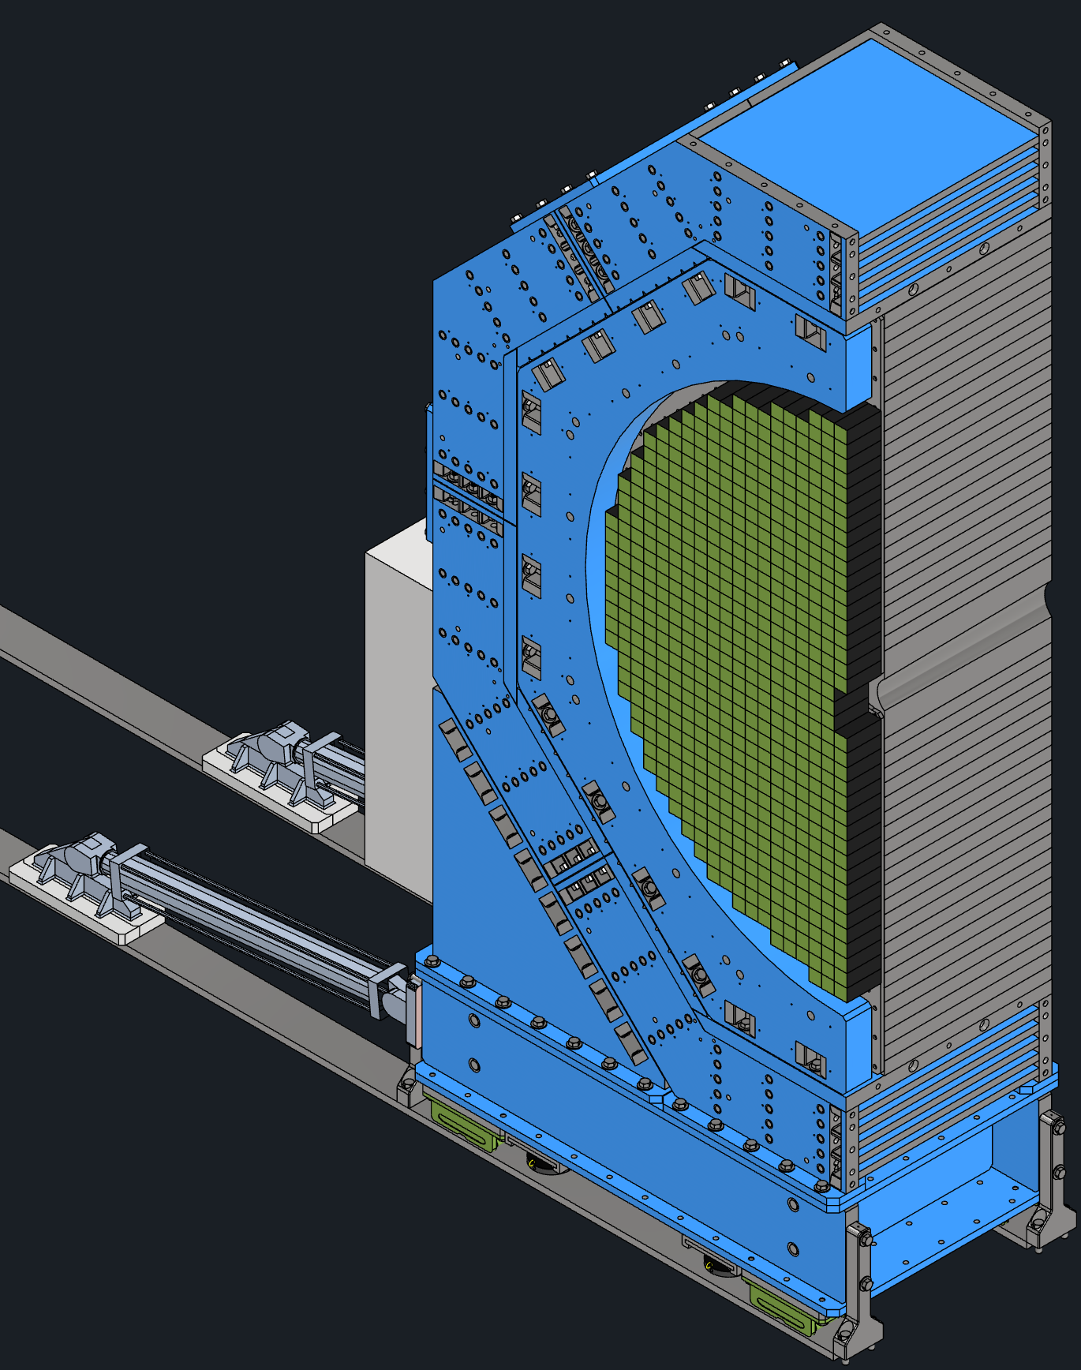
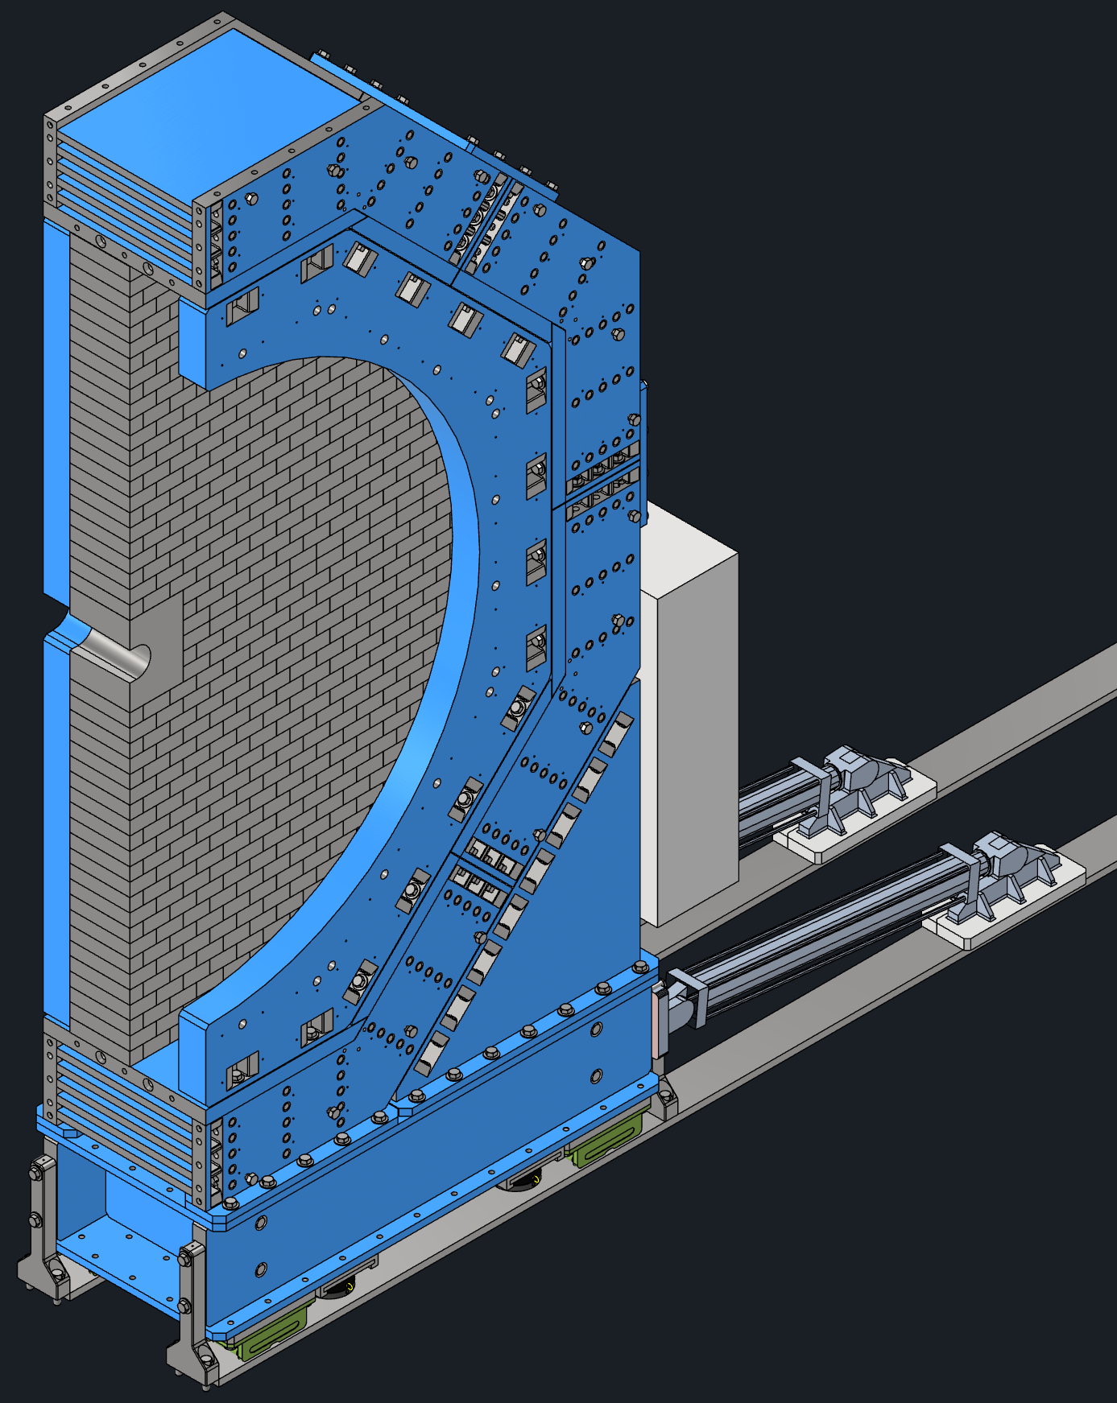
Endcap Structure
Forward Endcap (FE)
11’x6’x25’, 200ton
Backward Endcap (BE)
11’x4’x25’, 125ton
Description
HCal
EMCal
HCal and EMCal are end cap detectors
Seismic restraints attach the end caps to the central barrel
Anchor bolts tie down the end caps when the central barrel isn’t available
Hydraulic rams push the end caps on Hilman rollers
Hydraulic jacks lift the detector for alignment
Flux return minimize the fringe field and balance the magnetic forces
HCal
Seismic Restraints
Seismic Restraints
Flux Return
Flux Return
Hydraulic
Rams
Hydraulic
Rams
Rack
Rack
Hydraulic Jacks
Hydraulic Jacks
Hilman Rollers
Anchor Bolts
Anchor Bolts
Hilman Rollers

Slide 6
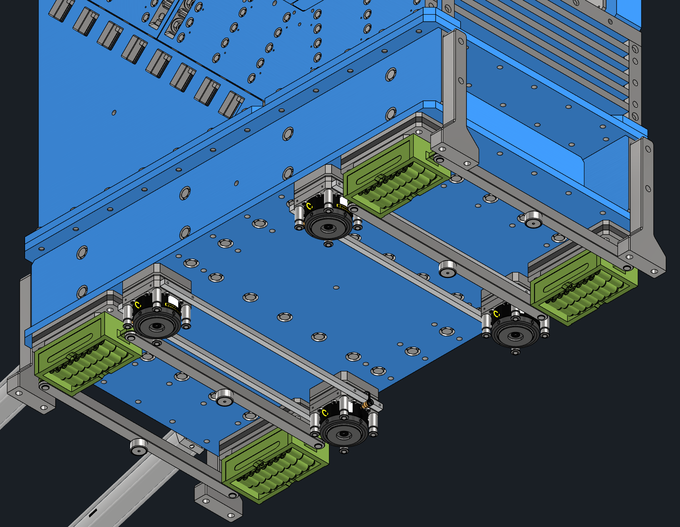
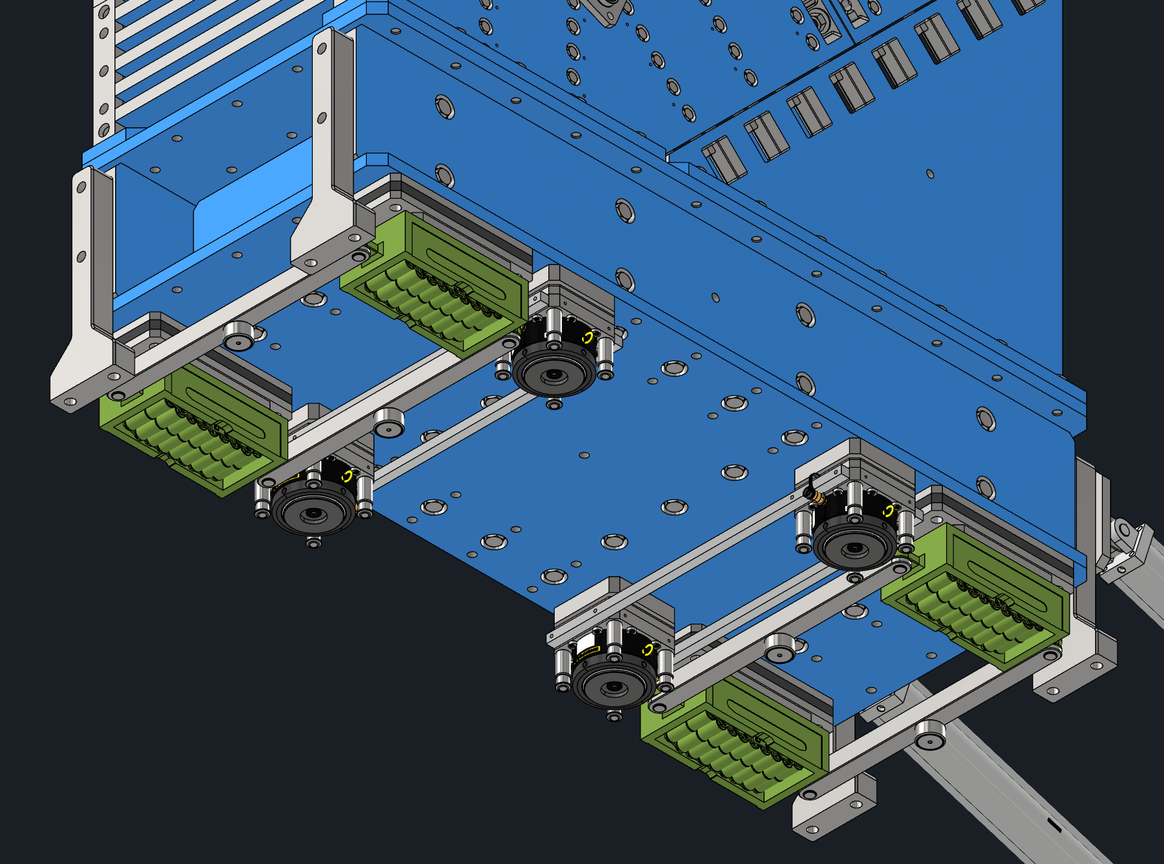
Endcap Moving Mechanisms
Forward Endcap (FE) – Base
Backward Endcap (BE) – Base
Hilman Rollers
Hydraulic Jacks
Use synchronous lifting system controller for all movements to 1mm
Four 200ton Hilman rollers, with cam followers
Four 250ton 2” stroke Enerpac hydraulic locknut jacks
Shim between the rollers and base, leaving the endcaps on the rollers
Jacks could be removable and reused for all endcaps

Slide 7
BACKUP

Slide 8
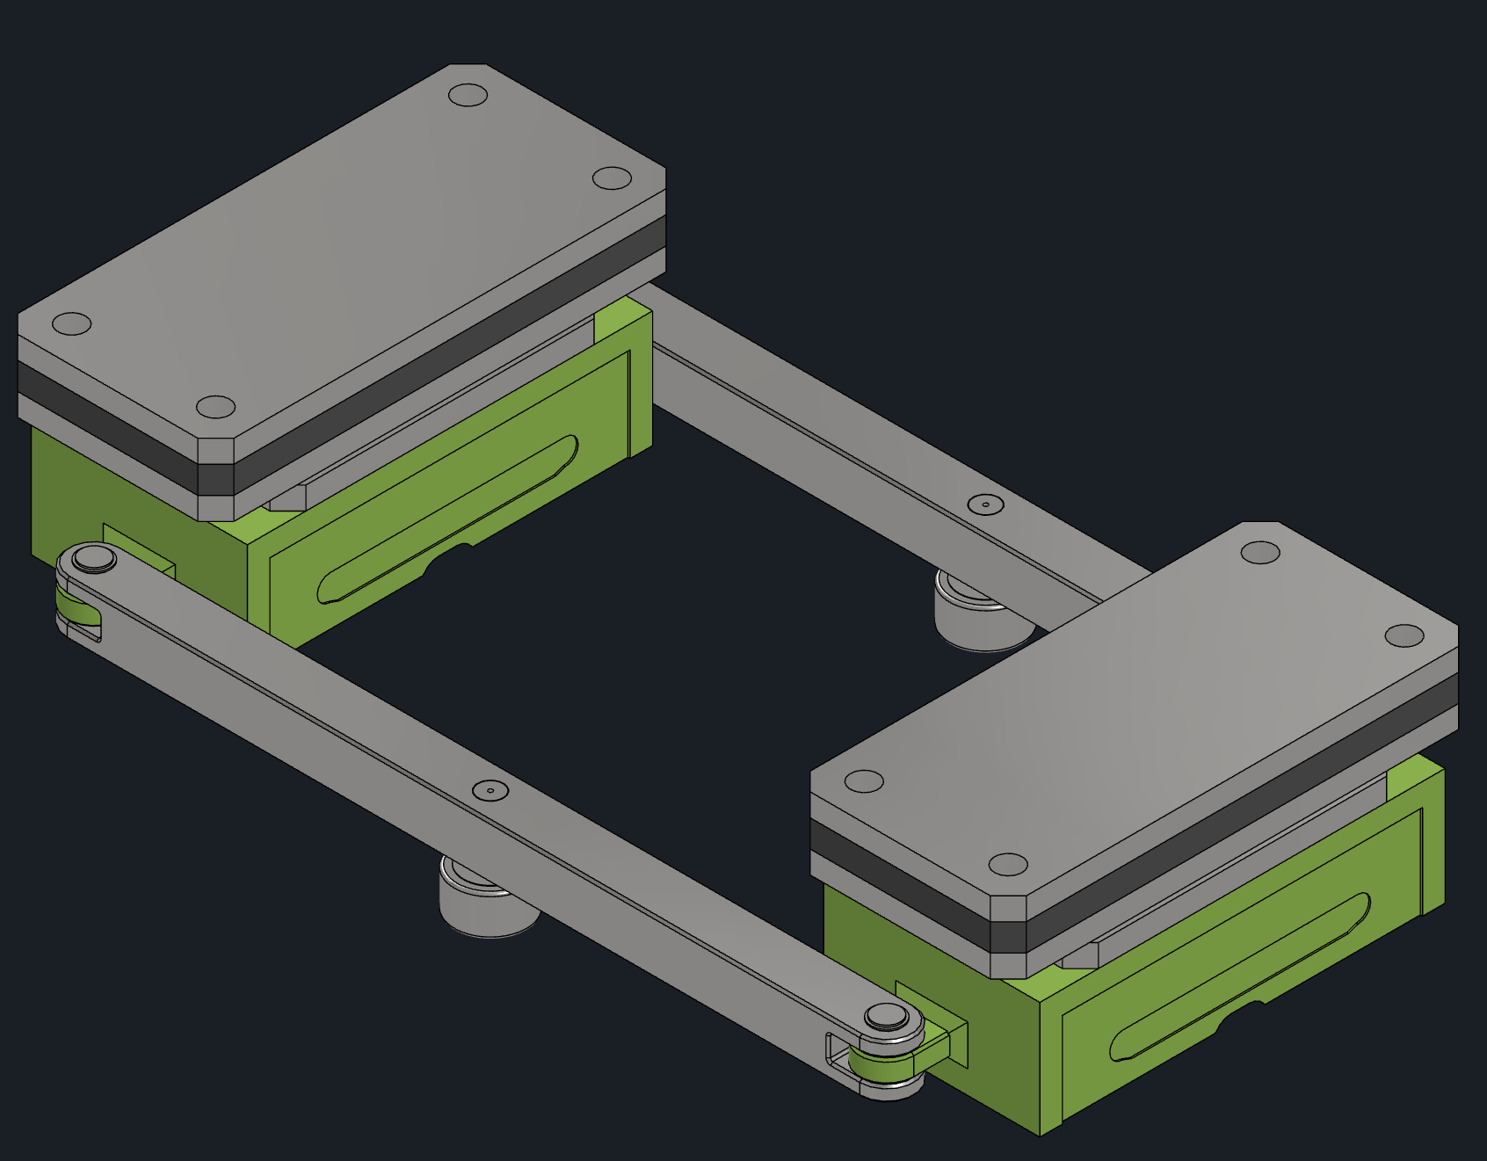
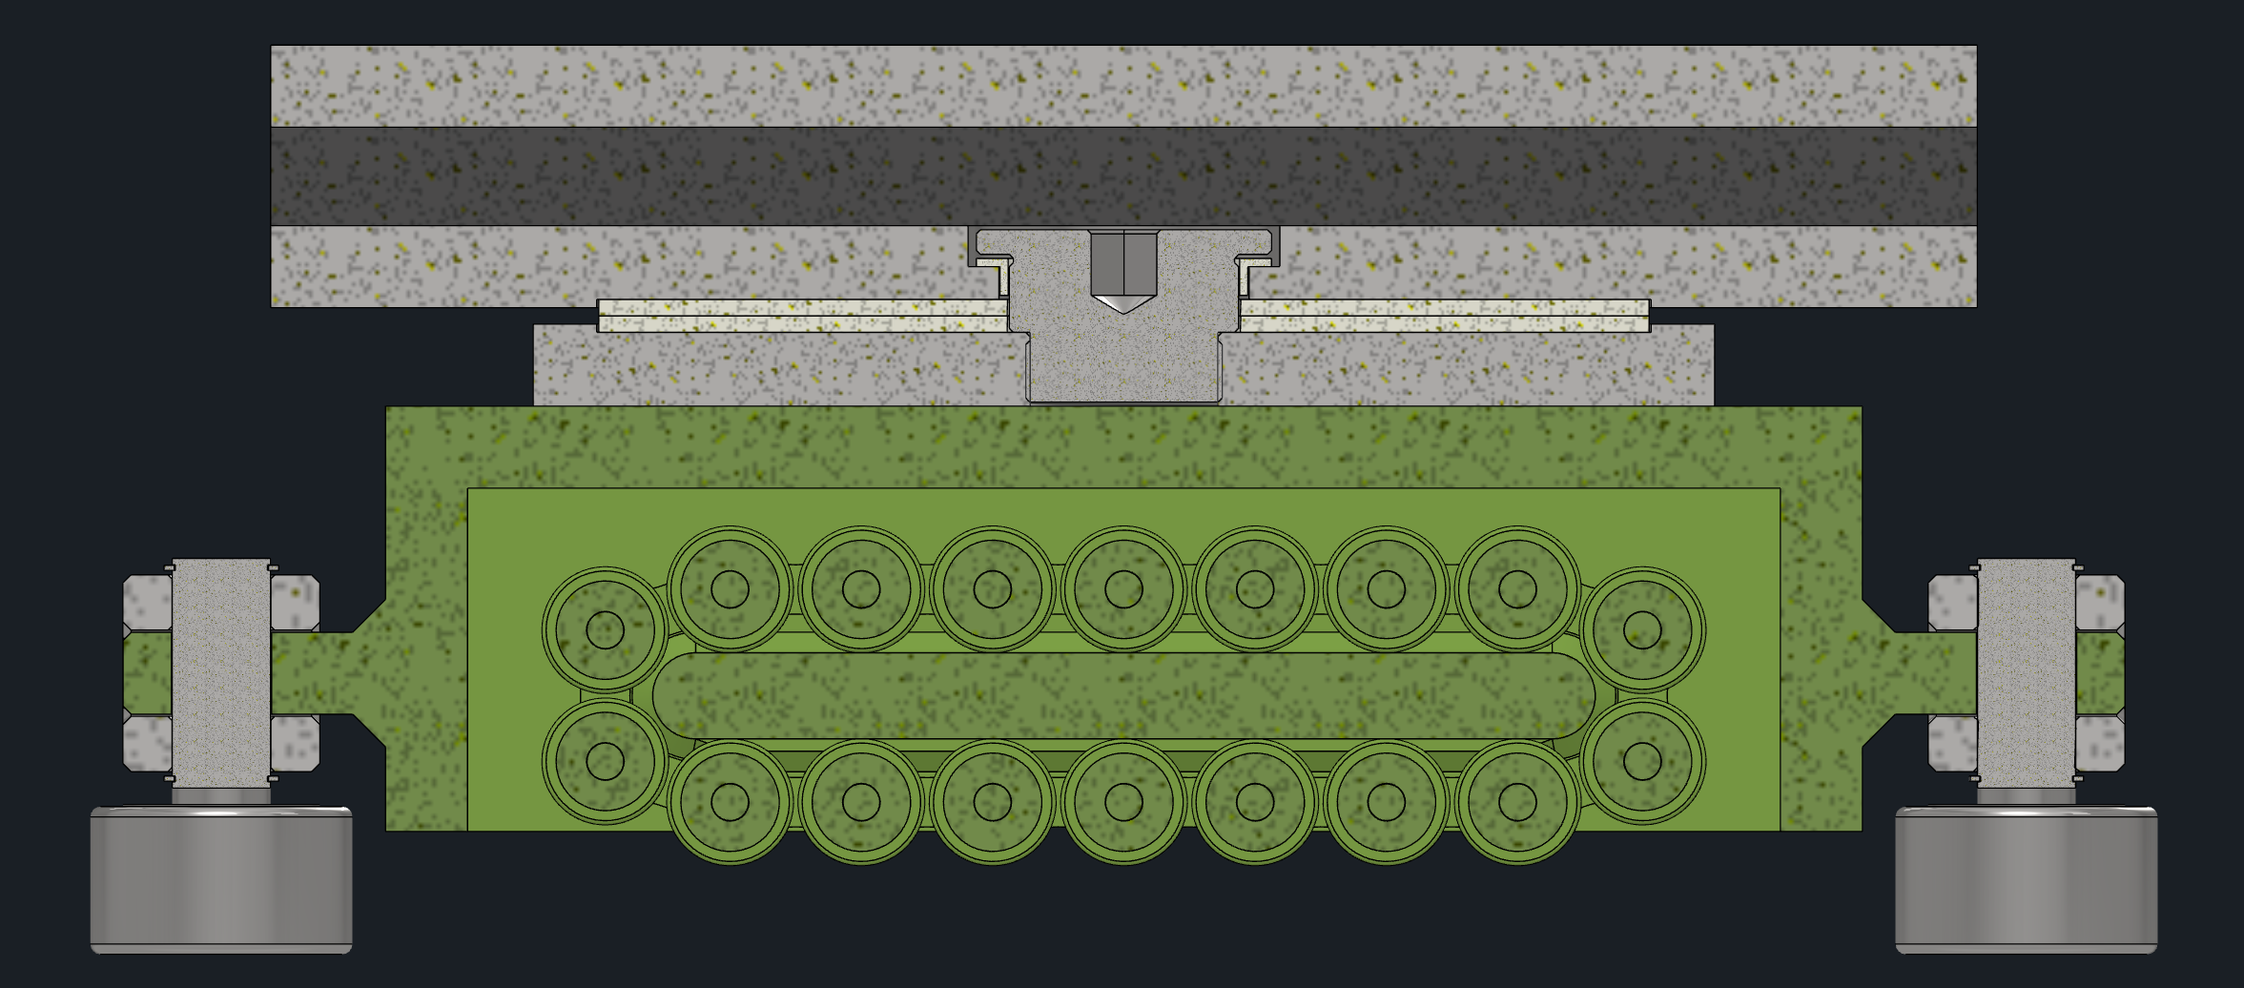
Rollers
1
Capacity of Hilman rollers is 200 tons each
Coefficient of friction for Hilman rollers is 0.03–0.05, 6-10 tons load
Side load capacity 5-10% of static vertical load, or 10-20 tons each
Rigging Pad
PTFE Plate
The rollers roll on 1 ft wide A36 steel plate.
Rollers attached in pairs via two bar linkages
At the center of the linkages are cam followers.
The followers sit in an AR300 steel channel grouted in the concreate floor.
Eccentric cams can aid in alignment.
On top of the roller is a pair of fiberglass reinforced PTFE plates resting in pockets.
There is a shaft in the center of these plates constraining the PTFE plates to only rotation.
The PTFE also provides electrical isolation.
Above the PTFE is a thick rigging pad to accommodate uneven loading over the roller.
Top plate is a replaceable shim for +/-1in.

Slide 9
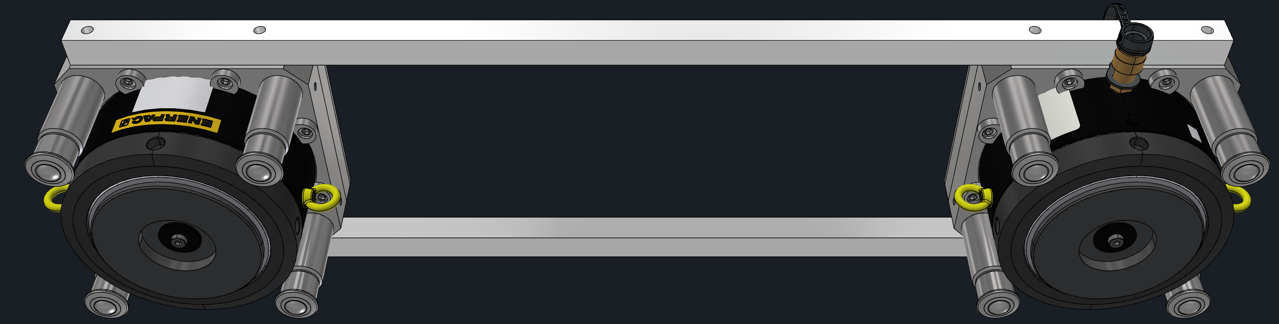
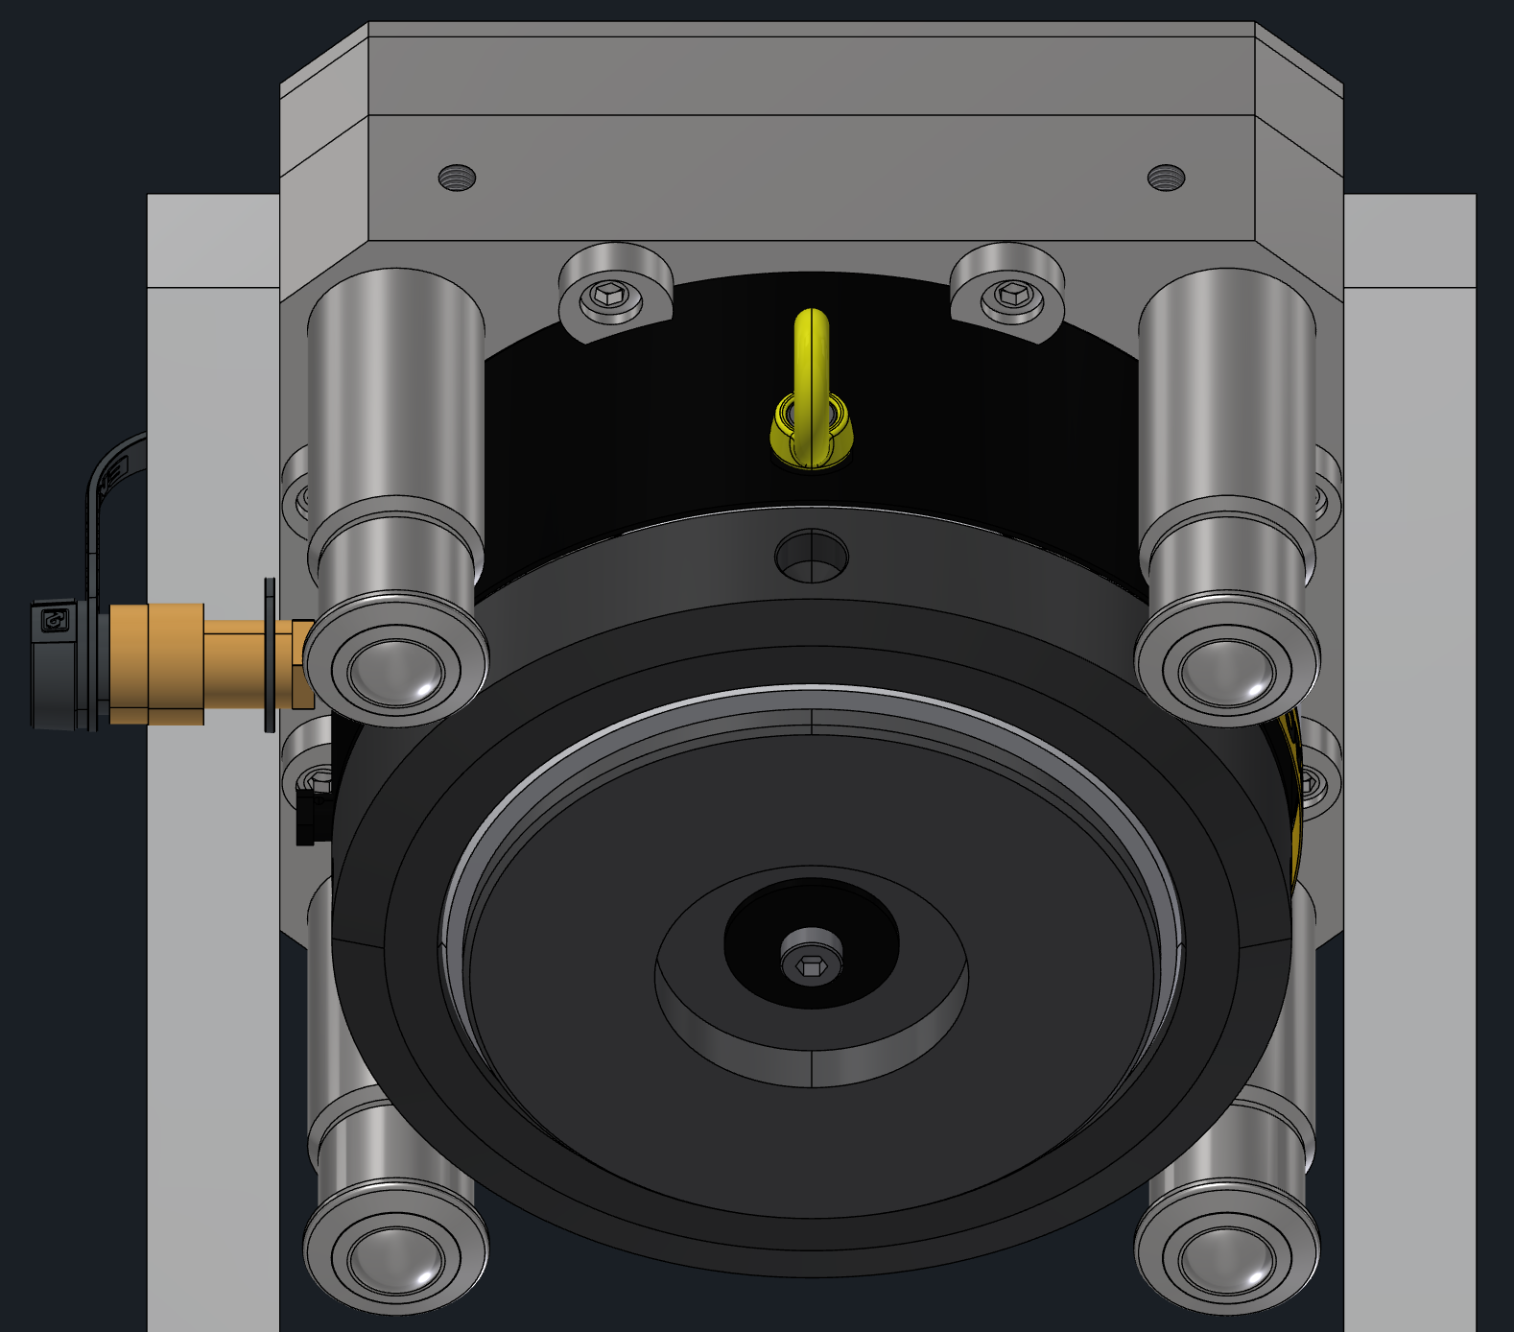
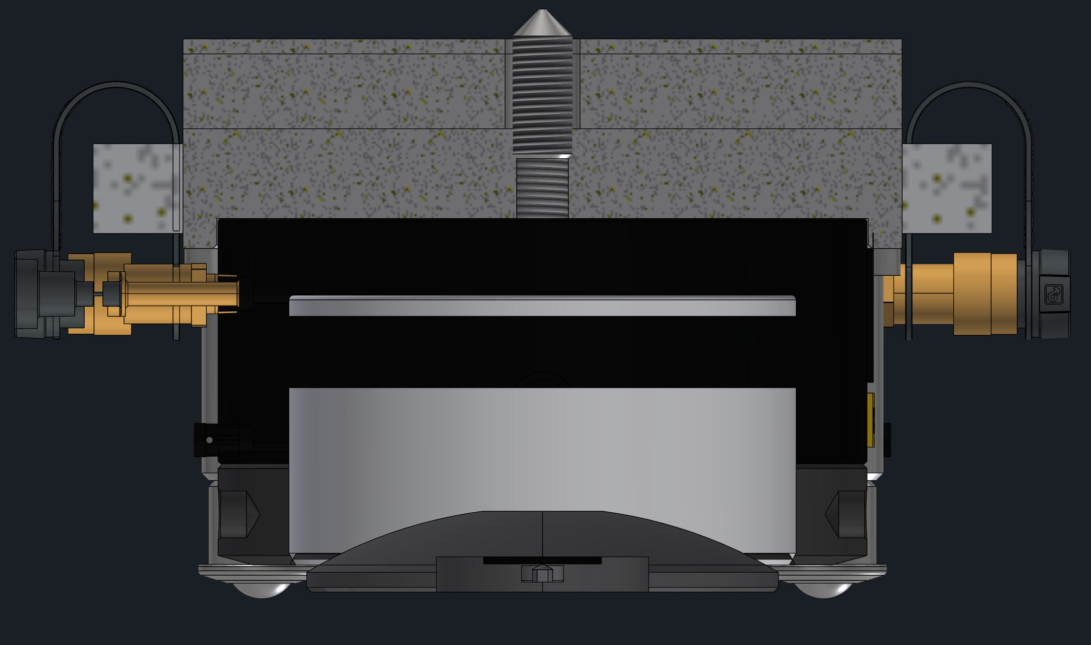
Vertical Hydraulics – Dolly
1
Enerpac Jacks: LPL2502 Low-Height Cylinder
1.75” (45 mm) stroke, 250 tons Capacity
Sideload resistance 5% of maximum capacity
Single-acting, 5deg integrated tilt saddle
Hydraulics attached in pairs via two bars.
Four ball rollers allow hydraulics to easily be moved around under endcaps.
Endcaps are only lifted vertically for initial alignment, settling over time to re-shim rollers or if the rollers get jammed.
Two pairs of two can be used for all endcaps.
8 eccentric screws clamp the hydraulic to the mounting plate, which attaches all other components.
On top of the mounting plate is a replaceable shim plate for +/-1in adjustment.
A pointed setscrew protrudes out the top of the assembly to align the plate on the bottom of the endcap.

Slide 10
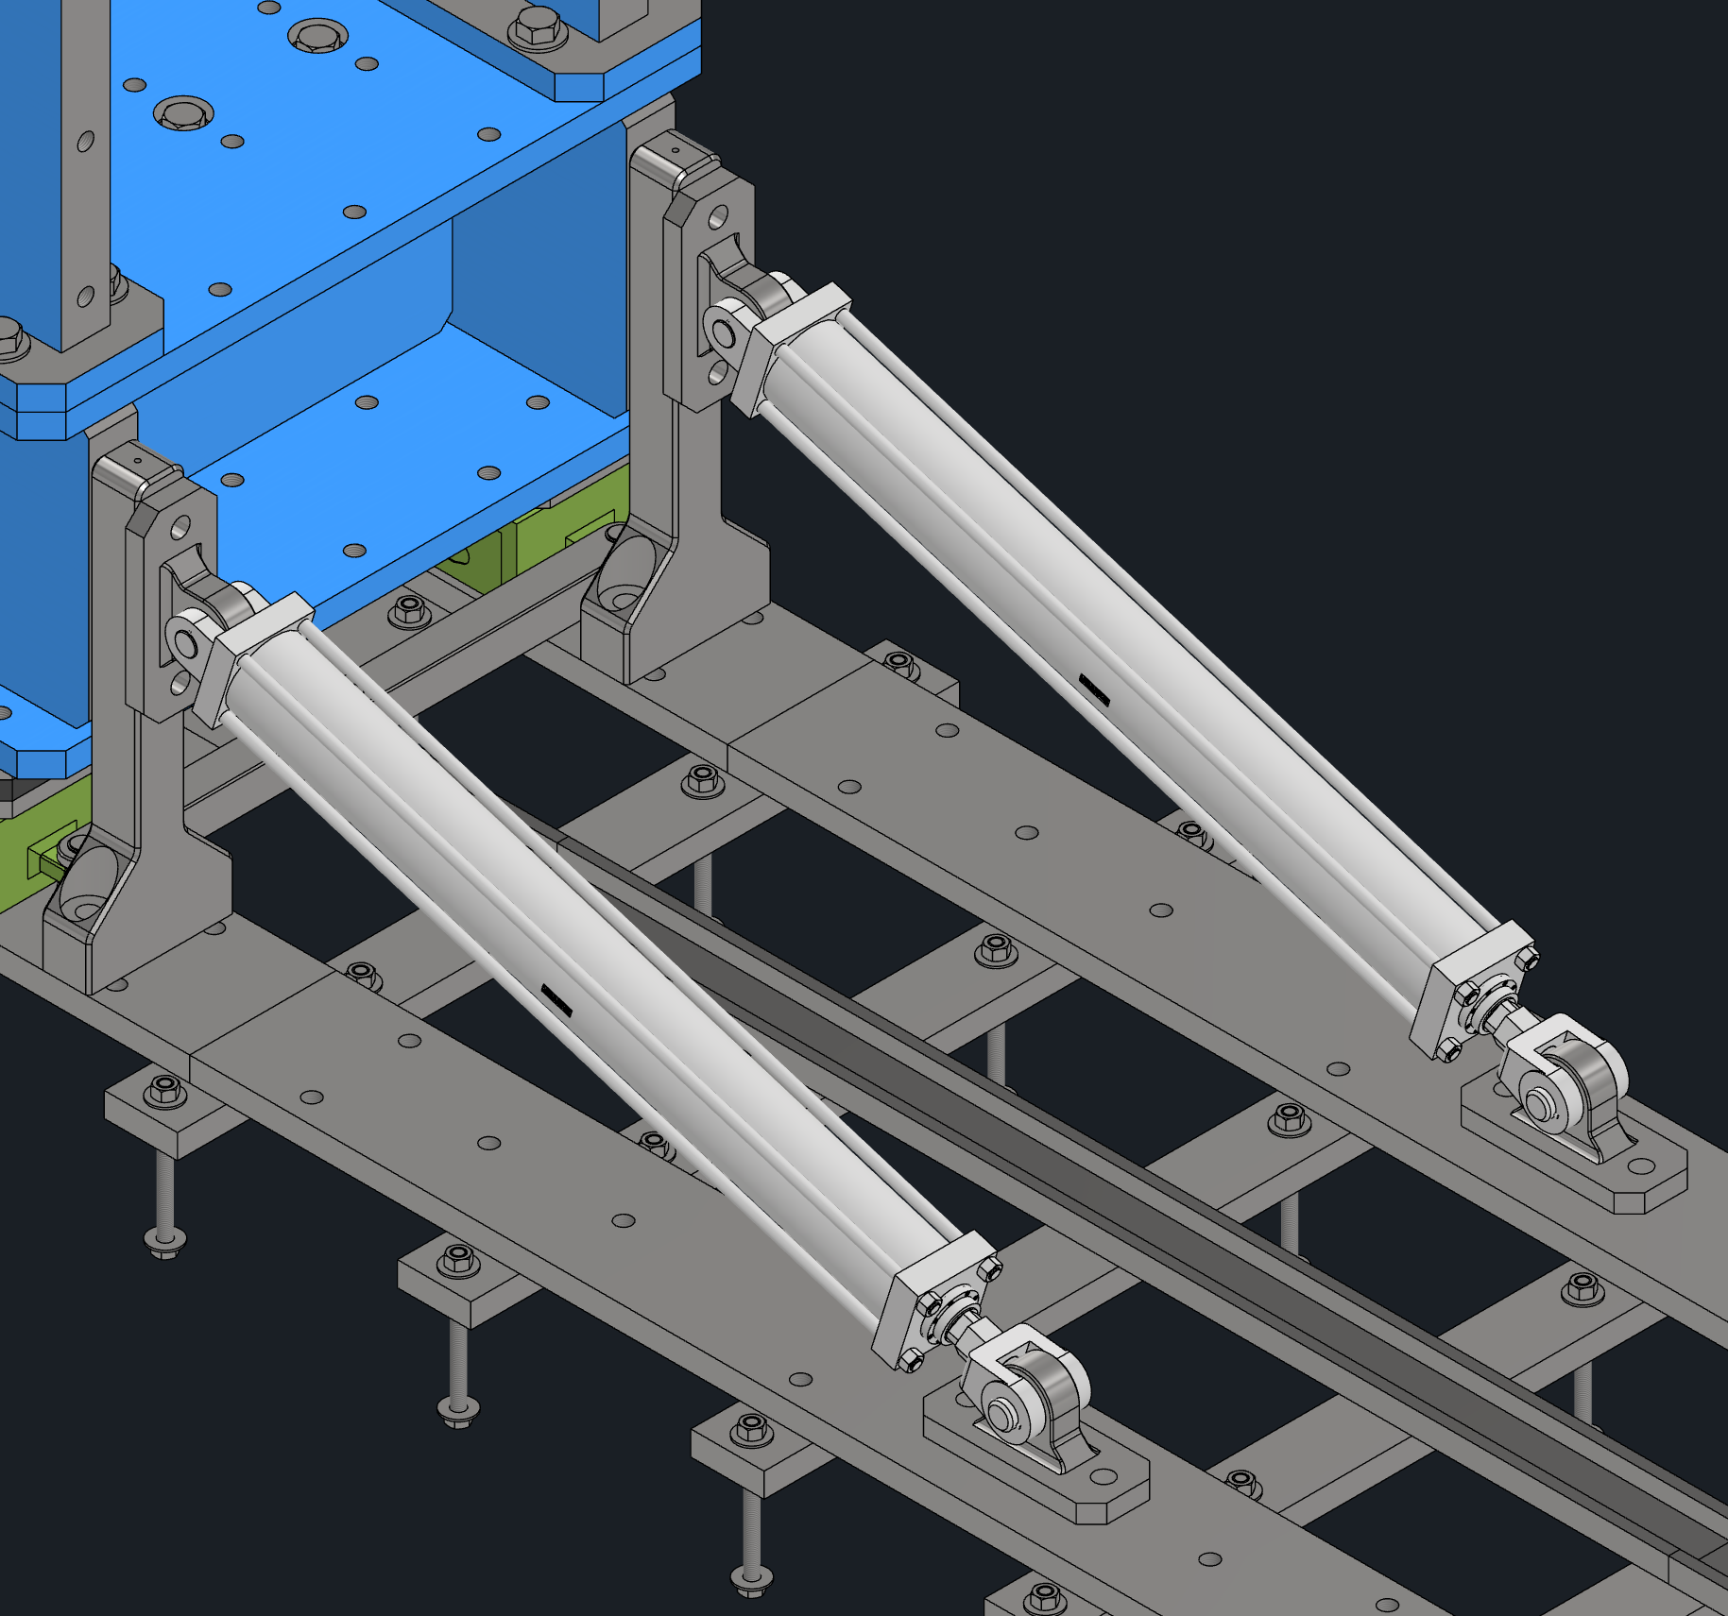
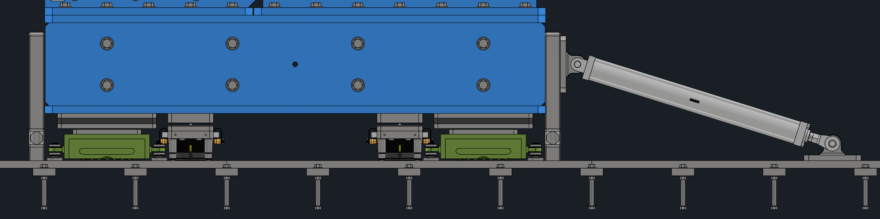
Horizontal Hydraulics
1
A pair of dule acting hydraulic rams push/pull the endcaps along the rails with tapped holes.
Each with a 25ton capacity.
The rams are 4.5’ long allowing them to reach two mounting points on the 8’ rail sections at any time.
The rams can be flipped up or removed for storage if needed.
Use force gauges and pressure gauges to ensure even and consistent movement.

Slide 11
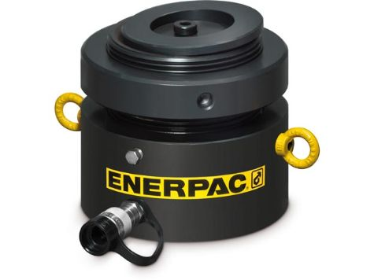
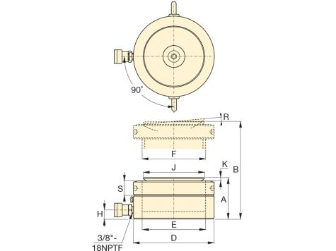
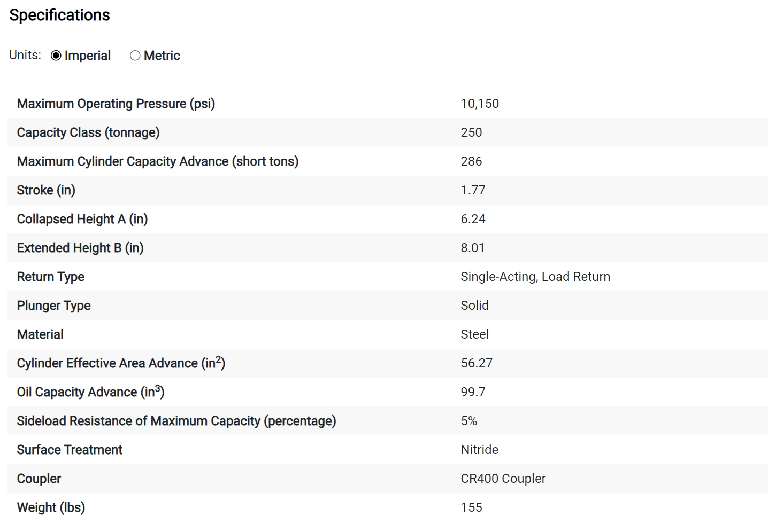
ENERPAC Lock Nut Hydraulic Cylinder
1
Model: LPL2502 | ECCN: EAR99 | Harmonization: 8412210075 Series: LPL | Product Line: Industrial Tools
LPL-Series hydraulic cylinders are ideal for heavy-duty applications where clearance space is restricted. The lock nut provides the reassurance of mechanical load holding for extended periods, helping to ensure safety on the job site.
LPL-Series Low-Height Cylinders have a longer stroke of up to 1.97” (50 mm) as compared with our CUSP and CULP pancake cylinders, and the tilt saddle allows for up to 5 degrees of misalignment. All are finished with a nitrocarburized coating for enhanced durability and corrosion protection in harsh working environments.
Lock nut provides mechanical load holding for a safe work environment
Integrated tilt saddle allows for up to 5 degrees of misalignment
Extreme low-height for use in confined areas
5% side-load resistance of maximum capacity
Overflow port as stroke limiter to prevent plunger blow-out
Single-acting, gravity-return

Slide 12
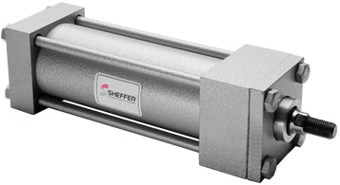
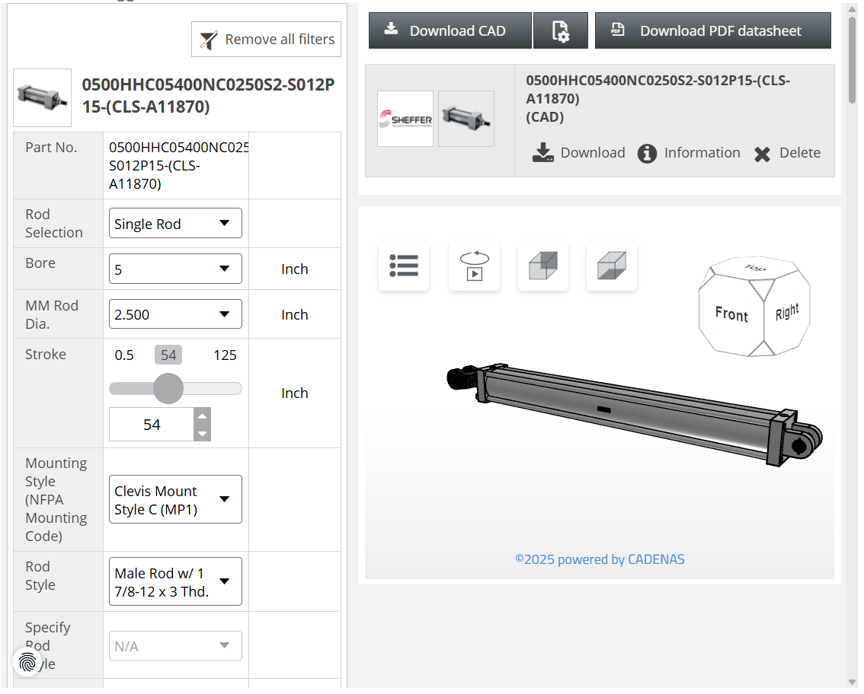
SHEFFER Hydraulic Cylinder
Bore: 1-1/8″ thru 24″ cataloged standards, up to 50″ custom
Rating: 3,000 PSI working pressure, 5,000 PSI shock pressure, higher as custom
Mountings: 22 cataloged mounts; specials available
ANSI, NFPA, JIC interchangeable dimensions
Hydrodynamic in-board rod bearing for low friction and long life
Unique slipper seal piston for low friction, breakaway and long life
Abrasion resistant rod seal and wiper
Studded rod end – 4 wrench flats
Adjustable cushions available

Slide 13
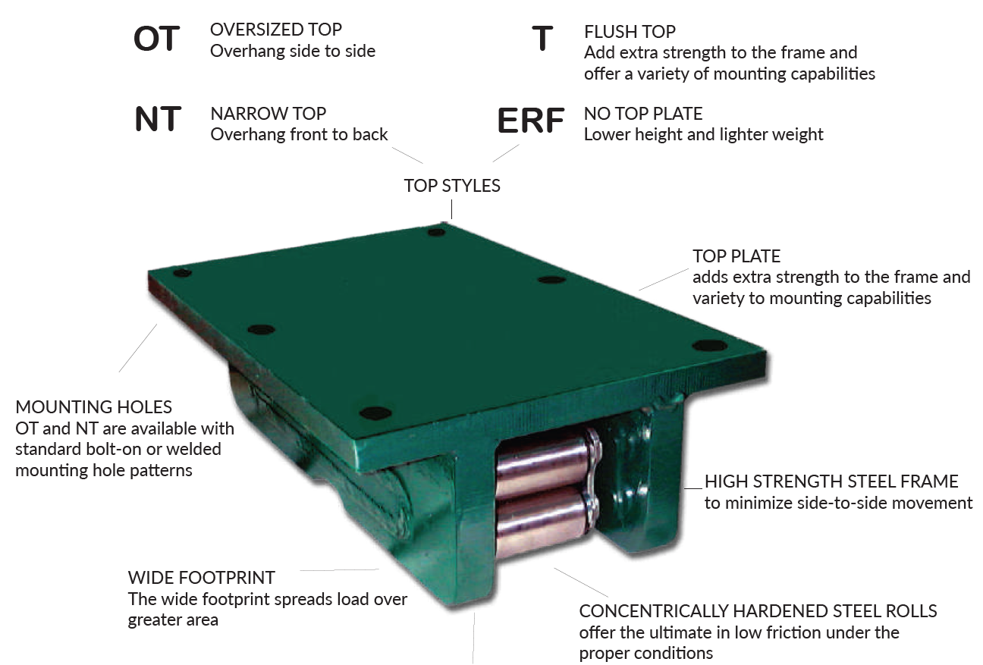
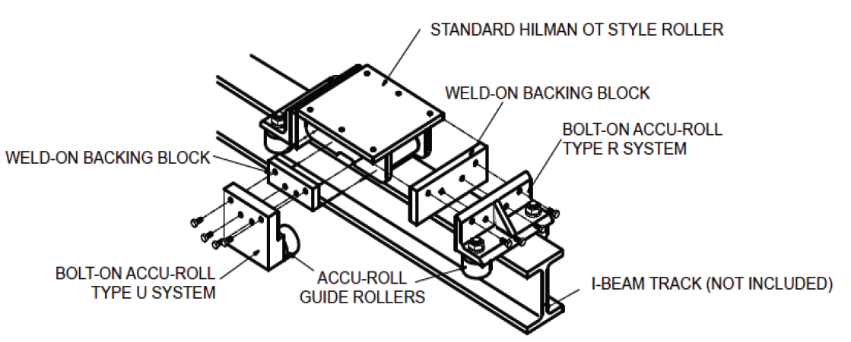
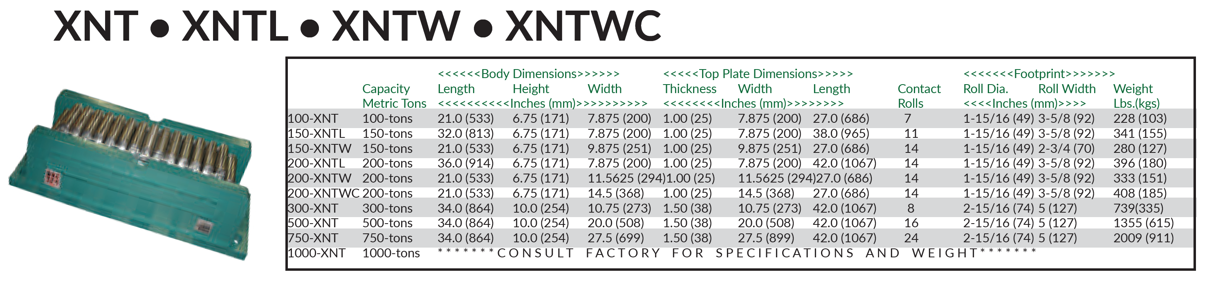
Hilman Rollers
1

Slide 14
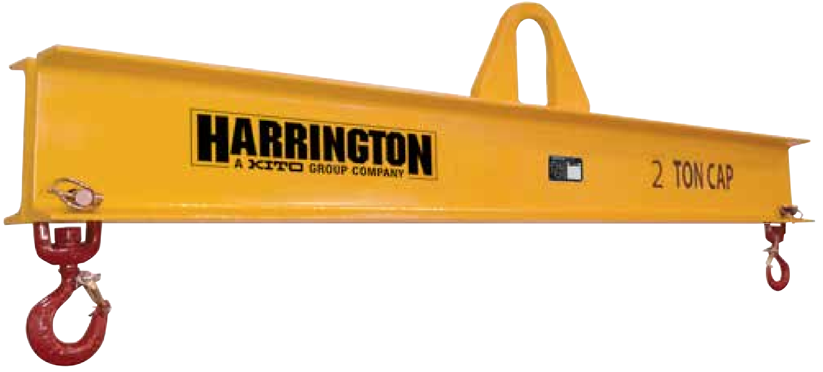
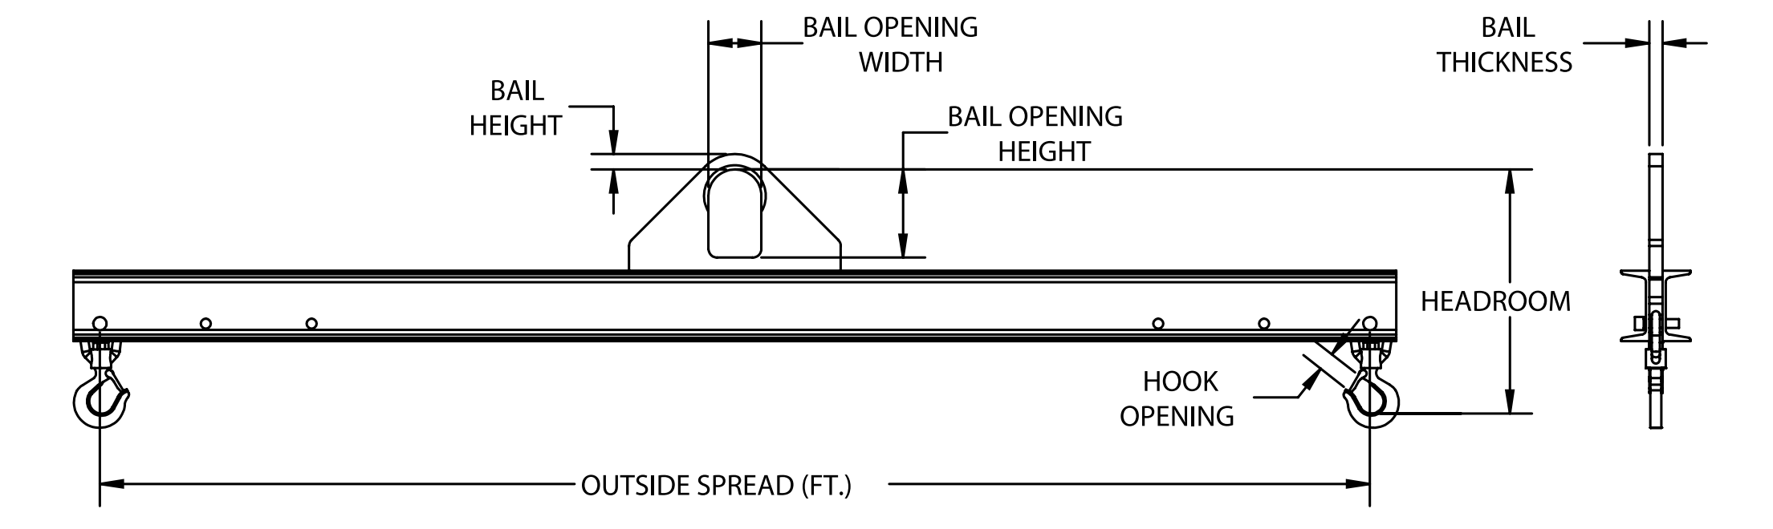
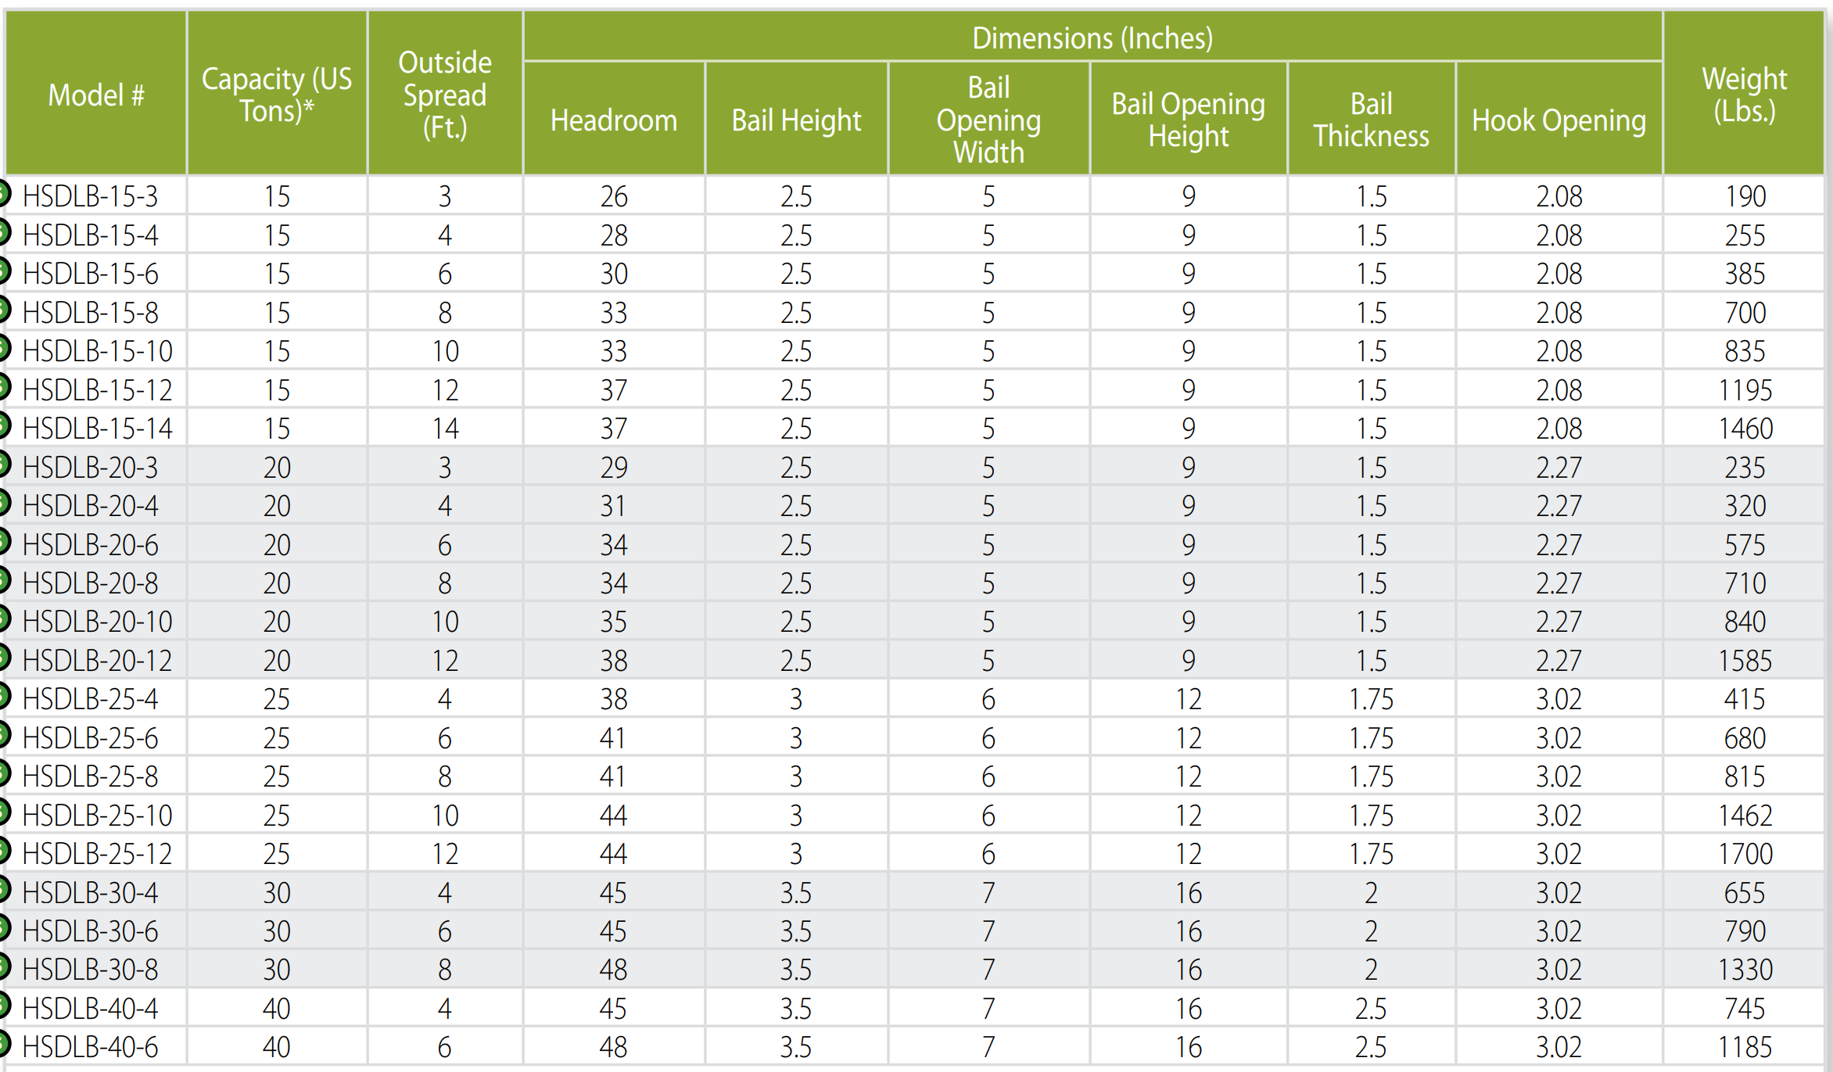
Lifting Beam
This style of lifting beam can be utilized where headroom is limited and comes with a pair of swivel hooks and three standard spreads (3’ and 4’ beams have two standard spreads).
Three standard lift points for load adjustment: outside lift point, middle lift point (outside less 1’), inside lift point (middle less 1’).
Engineered and manufactured to ASME B30.20 & BTH-1 Design Category B Service Class 2.
100% of ALL Harrington Lifting Beams are proof-tested to 125% capacity and certificates supplied at no additional charge.
Made in USA.

