Slide 1

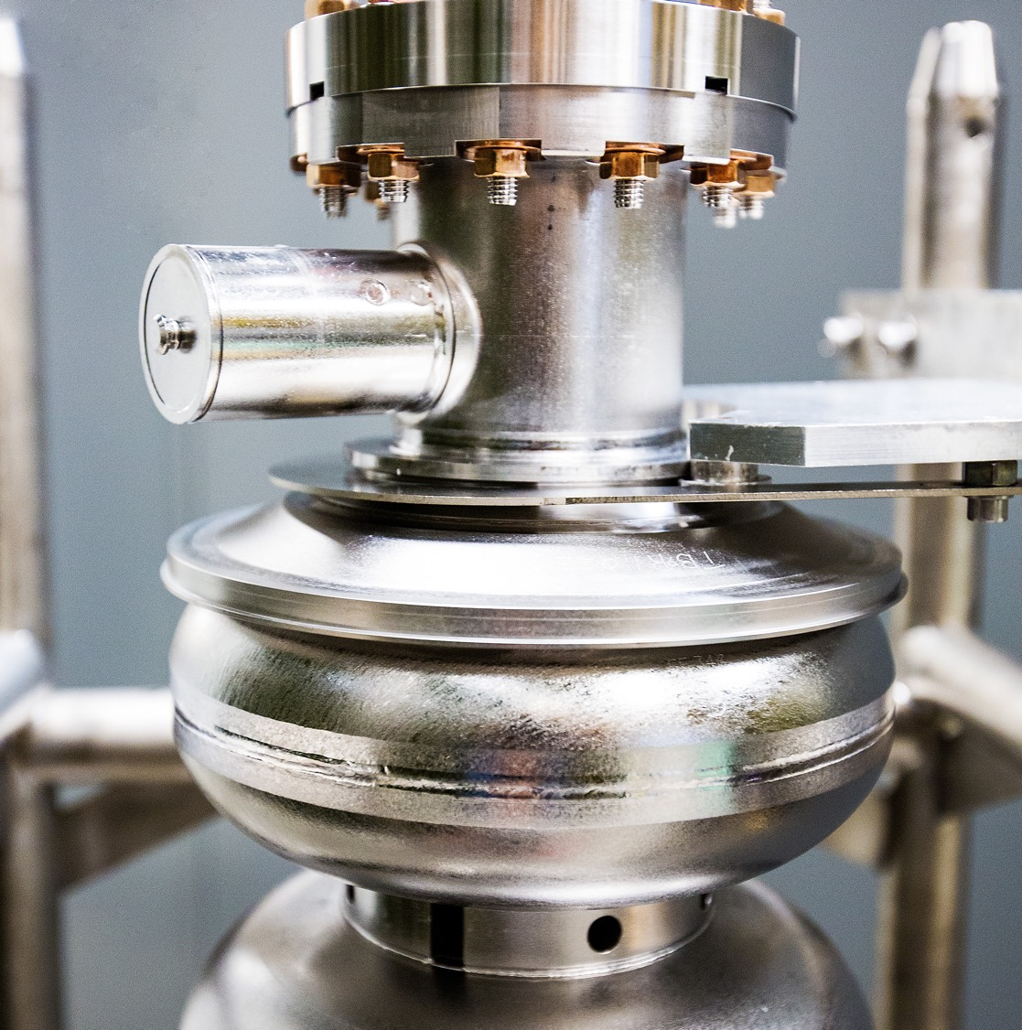
FCFD Variant Update
DIRC@EIC Annual Meeting
Sensors and Readout
2026-06-08
Raymond Dawson
Notes:
Tip: Keep titles under 60 characters for readability
To change the photo: Right-click on photo and select change photo

Slide 2
Background
Raymond Dawson – Electronics Engineer at Jefferson Lab
Responsible for electrical design of HRPPD sensor, and front-end electronics and ASIC integration in pfRICH and hpDIRC
  Primarily been working on pfRICH
Agenda
  FEB status
  Preliminary testing results of the HRPPD with the FCFD
  Detector specifications for FCFD
  Concept and power consumption
  Data format
  Next steps
  hpDIRC discussion

Slide 3
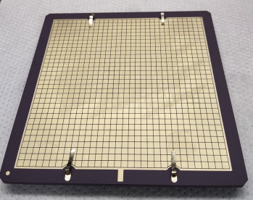
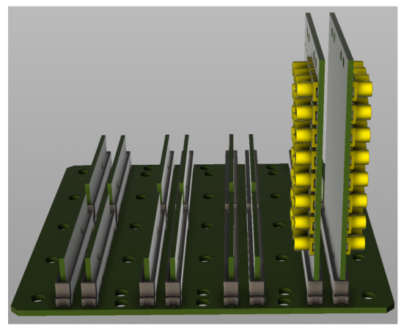
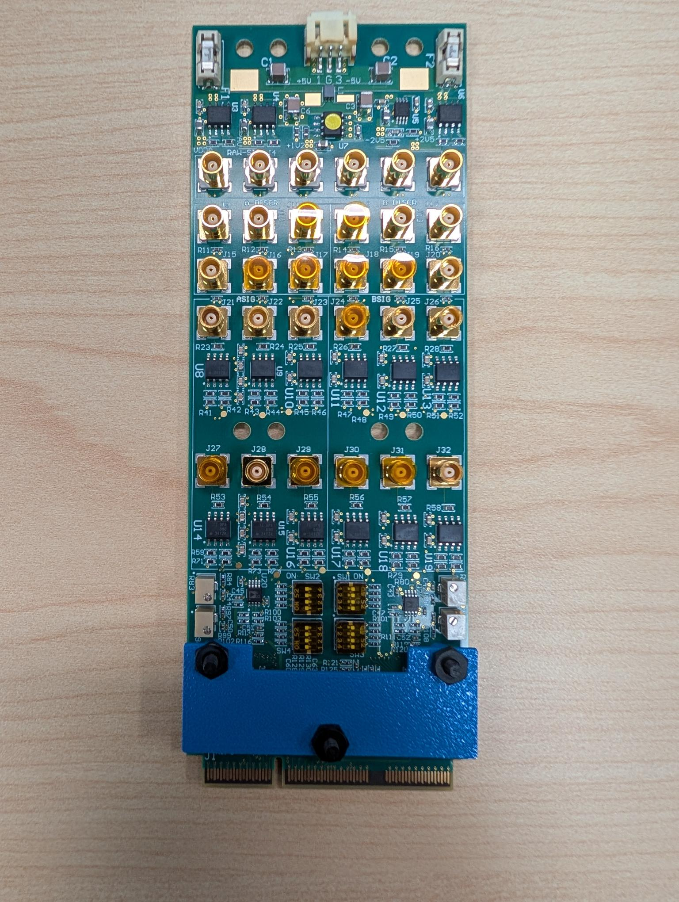
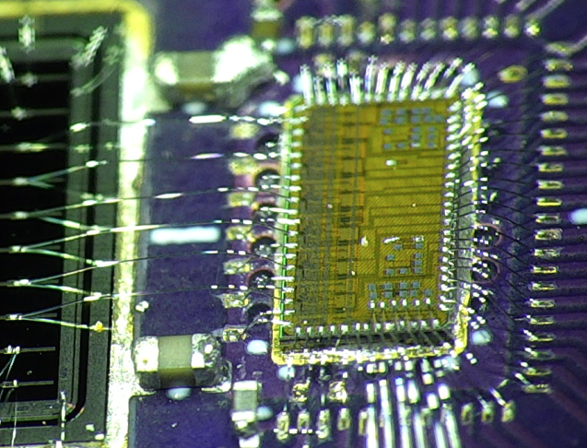
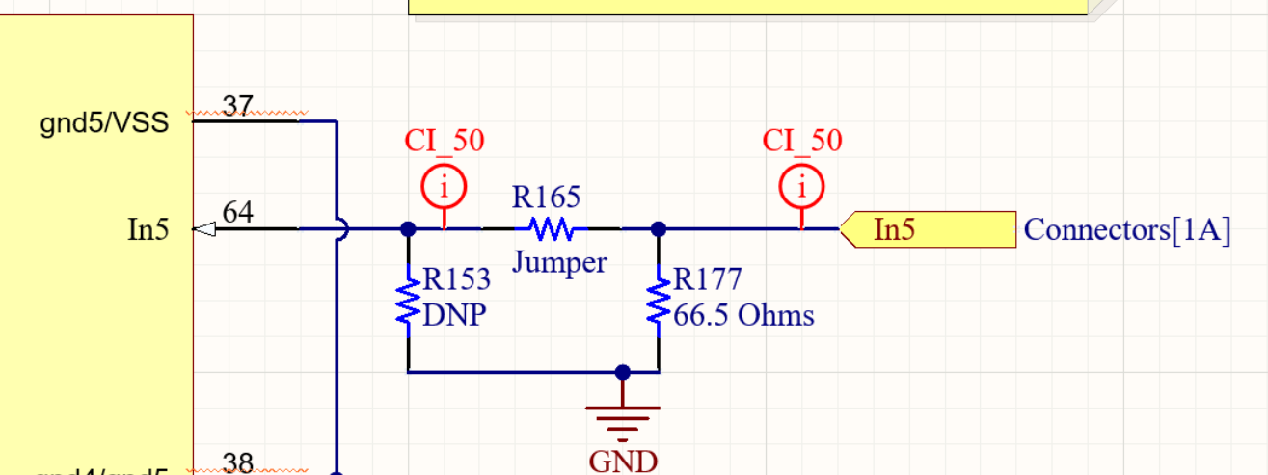
FCFD Front End Board Status
HRPPD and Front-End Electronics
All 6 boards are wirebonded as of late May
  1-2 boards with Alexander at CERN
  1 board at JLab
  Remaining boards at BNL
Assembly issues
  Wrong power IC – 2.5V regulators populated with wrong part
  Impedance matching
    Issue: The boards would not detect any charge with the termination resistors installed, but upon removal the chip worked as expected
      The termination resistors on each FCFD input are directly ground referenced
      The FCFD inputs are DC biased, and most likely the resistors are impacting this bias
      Solution: Need AC termination to prevent reflections if they appear as an issue during testing
  Unused inputs on the FEB were not grounded
    Design mistake
    Required creative grounding to prevent charge buildup on ungrounded pads
  HRPPDs at CERN – sensors were shipped to CERN for beam testing
FCFDv1.1
FCFD Variant FEB
Termination resistor

Slide 4
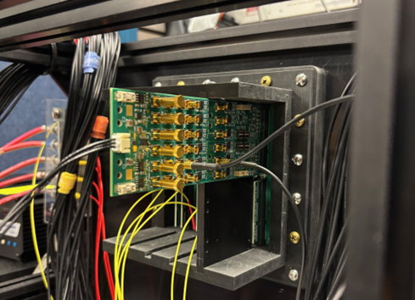
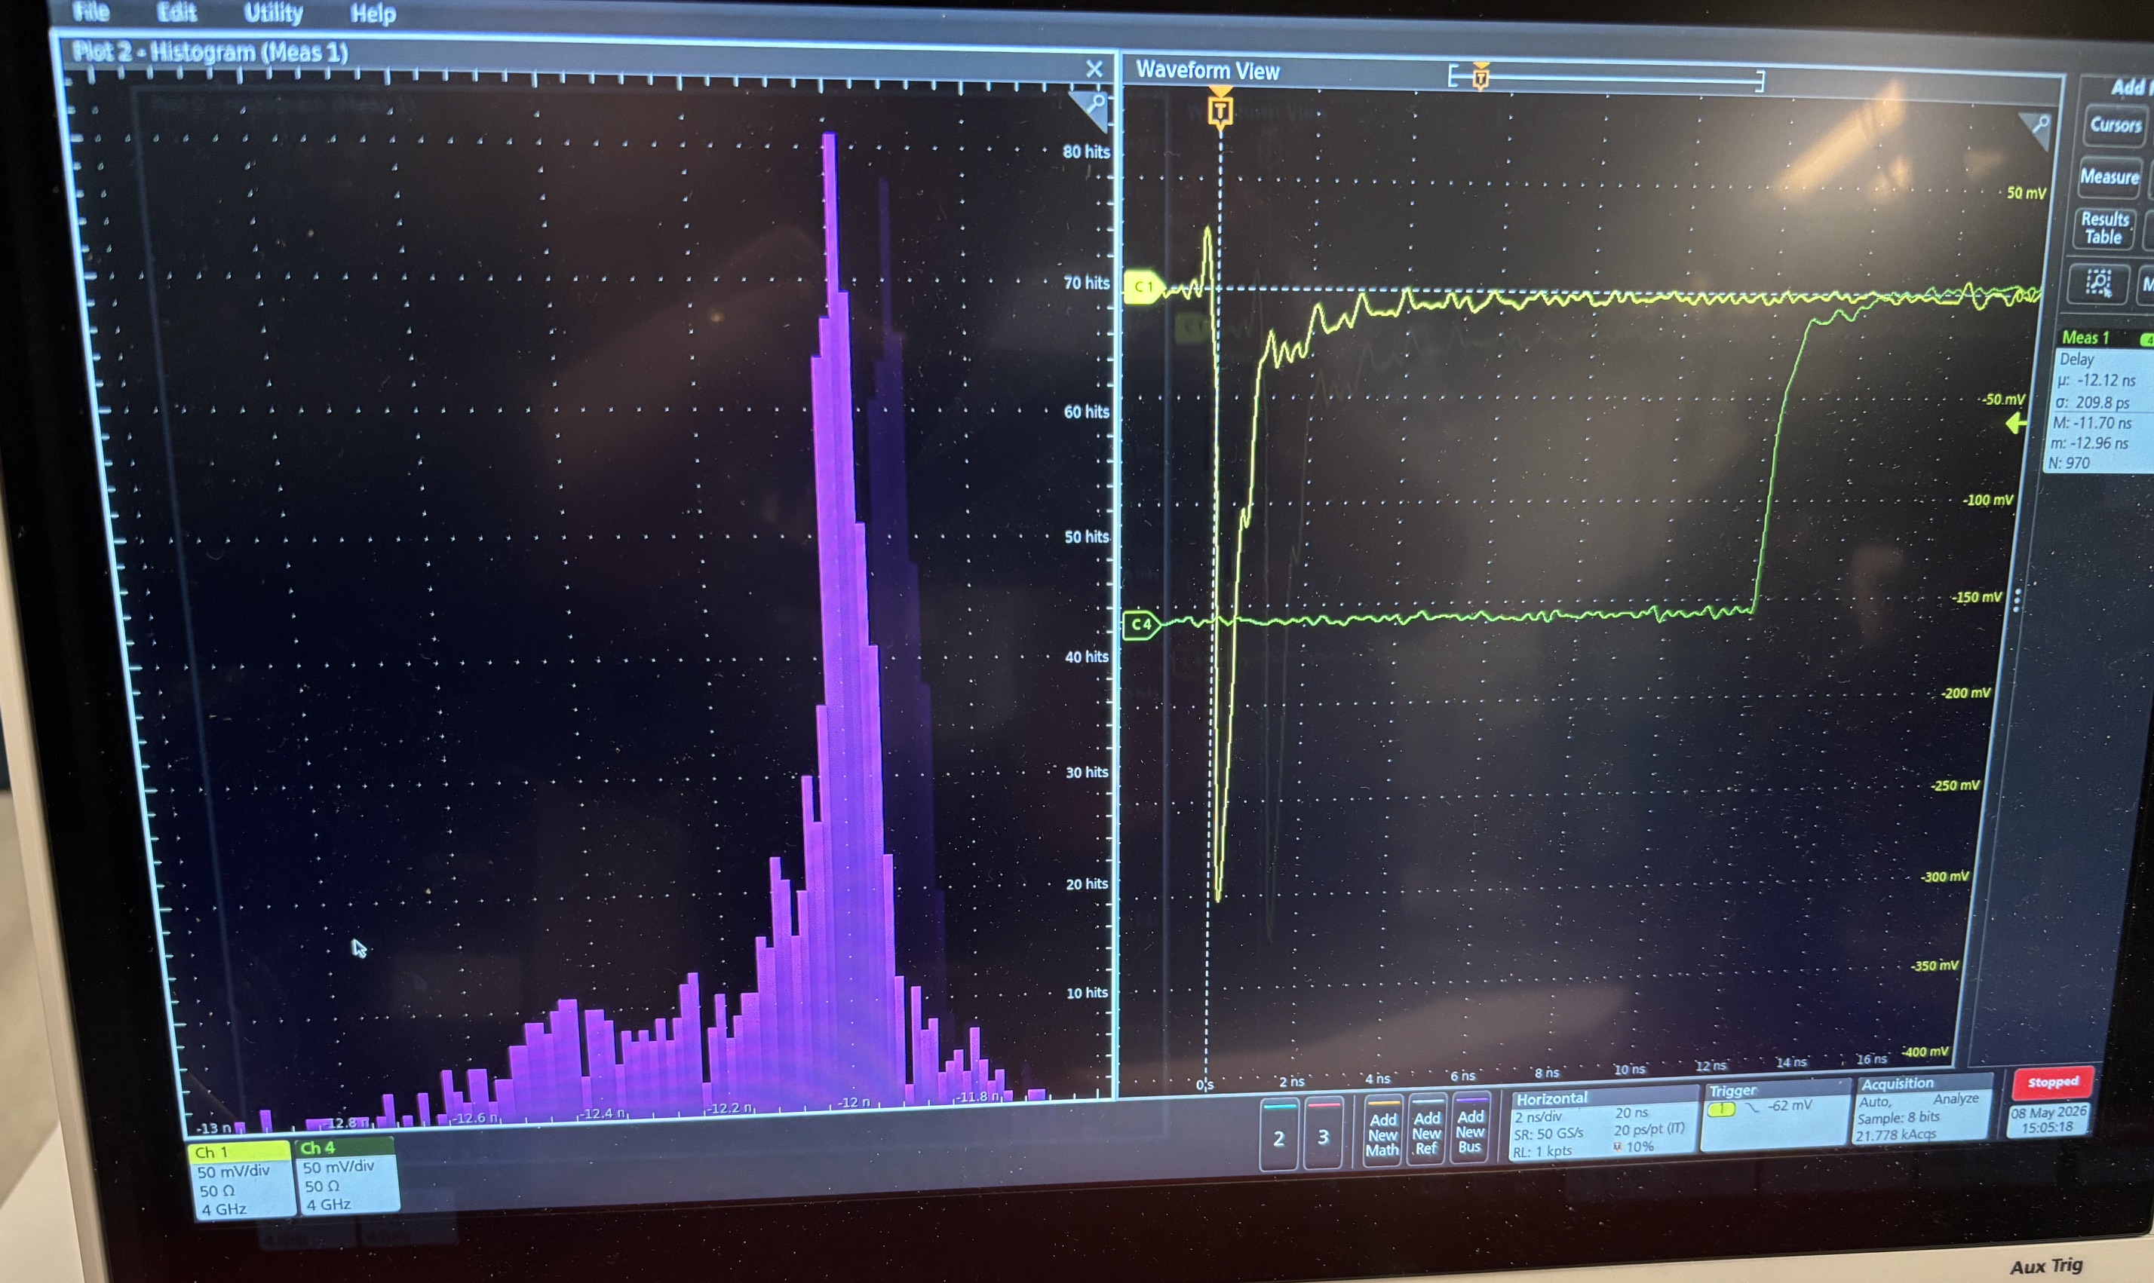
Laser Testing with HRPPD
Test setup:
  True timing response of laser measured with fast photodiode and HRPPD
  Laser was diffused over area, not exactly centered on pixel
    Gain was low 10⁵
  Yellow is photodiode response
  Green is CFD output of ASIC
  Lead and tail ends could be charge sharing, small signals, noise, dark pulses
  Histogram records response time difference of photodiode from CFD
Results
  FWHM = 80 ps
    6 bins above FWHM line
    Each bin is 13.3 ps, 3 bins per division
    Each division is 40 ps
  Std dev = ± 35 ps
Seems promising as a first run but obviously much more testing is required
  Need to assess gain and noise impacts
Edge-edge measurement
±35 ps jitter
FWHM = 80 ps

Slide 5
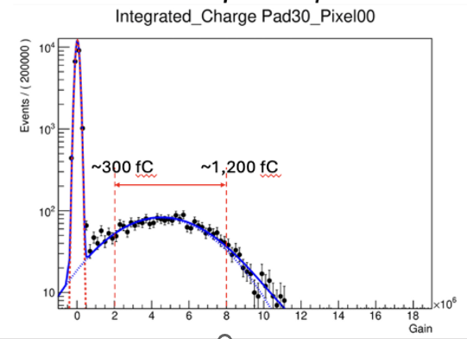
FCFD Specifications (Tentative)
Detector | Channel Capacitance | Channel Rate | Time resolution | Time and Charge Measurement Dynamic Range | “Over” Charge Threshold | Charge Measurement Resolution
pfRICH | ~10-15 pF * | ~20 kHz | ~40 ps @ 100 fC | 100 - 1,200 fC [10^{6]} (50 - 600 fC [10⁵]) | TBD ** (2000 – 3000 fC?) | TBD
hpDIRC |  | ~10 kHz | ~40 ps @ 100 fC | 100 - 1,200 fC | ? | TBD
Assumptions
Gain of 10⁵ corresponds to 16fC
pfRICH region of operation defined within pictured area
Low end of 100/50 fC to account for x3 pixel-pixel gain variations
Notes
Updates highlighted with black outline
  Maybe we can evaluate hpDIRC during meeting
Dynamic range dependent on selected gain (TBD)
* Depends on if same backplane and FEBs are used for hpDIRC
** Precise measurement not needed at high values
pfRICH Region of Operation

Slide 6
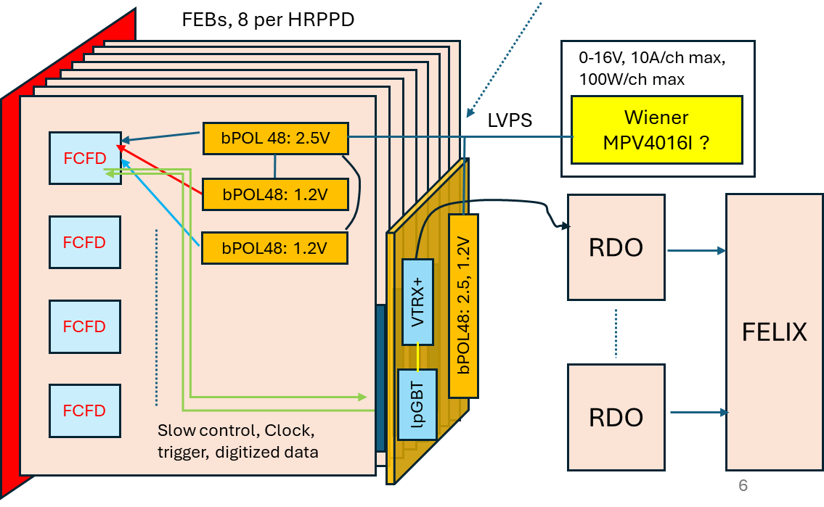
Readout and Power Consumption
Conceptual readout scheme
  Four (tentative) FCFDs per FEB
  Eight FEBs per HRPPD
  FCFD output bandwidth: 320Mbps/chip
  A father board with 2+ sets of lpGBT and VTRX+ handles eight FEBs
Power per HRPPD: 12 W
  8 FEBs * 1.1W + 3.2W = 12 W
  816 W for whole pfRICH (68 units)
Parts | Per unit | QTY
lpGBT | 750mW | 2
VTRX+ | 300mW | 2
bPOL48 | ~70% eff | 1 per line
Total | ~3.2W | Per FB
Parts | Per unit | QTY
FCFD | 200mW | 4
bPOL48 | ~70% eff | 1 per line
Total | ~1.1W | per FEB

Slide 7
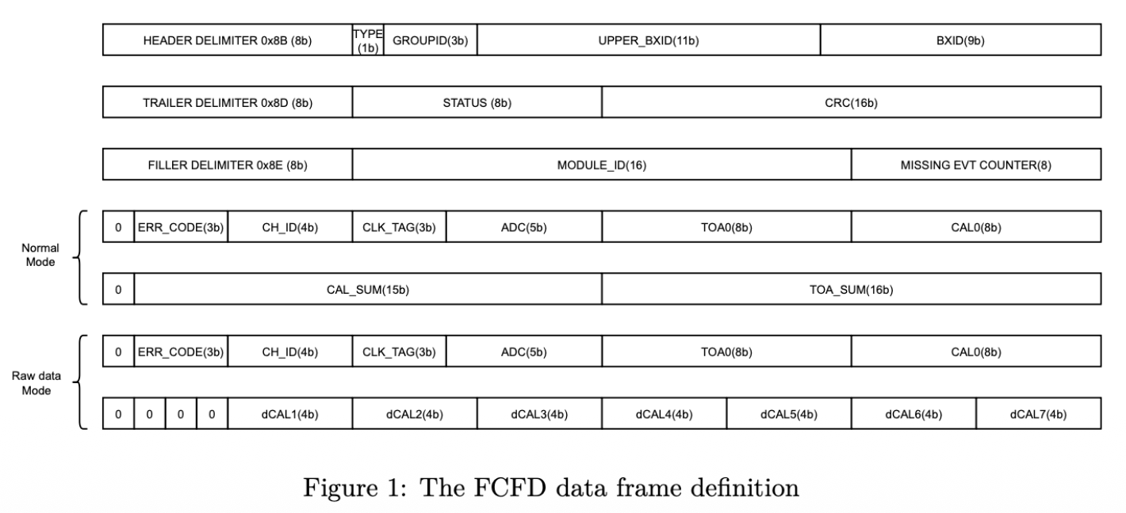
Data format from 32ch-FCFD
Semi-official number: 160 bits/hit (max)
  5-bit ADC + 8bit TDC + other info = 64 bits/ch
  Header(H) + trailer(T) + filler (F) = 96 bits/ch
  H+T+F may be merged for channels hit at same time.
FCFD analog front-end CAN handle 20kHz hit rate for pfRICH

Slide 8
Next Steps
Timing testing will resume in July
  Continuing to vary gain and other parameters
  While waiting, charge injection test board will be used to measure parameters once manufactured
Discussed wish list with FNAL
  Increase dynamic range and threshold
  Alternate packaging and assembly to wirebonding
    pfRICH - ~2200 ASICs, hpDIRC - ~2300 ASICs
  Investigate need to modify input impedance profile
Next steps for FNAL
  Waiting on budget approval
  Will require sign-off on specs (for v1.2)
    Ray will put together document

Slide 9
hpDIRC Discussion
Can electrical requirements be updated?
  Are signals 1 or two photon?
  Will gain be the same as pfRICH?
  Any other differences?
What are mechanical constraints surrounding front-end electronics?
Detector | Channel Capacitance | Channel Rate | Time resolution | Time and Charge Measurement Dynamic Range | “Over” Charge Threshold | Charge Measurement Resolution
pfRICH | ~10-15 pF * | ~20 kHz | ~40 ps @ 100 fC | 100 - 1,200 fC [10^{6]} (50 - 600 fC [10⁵]) | TBD ** (2000 – 3000 fC?) | TBD
hpDIRC |  | ~10 kHz | ~40 ps @ 100 fC | 100 - 1,200 fC | ? | TBD

Slide 10
QUESTIONS?
Notes:
Before sharing your presentation, confirm:
Fonts are consistent
Images meet quality standards
Charts use template colors
Footer information is current
Spell check completed
Links are working
File size is optimized

Slide 11
Appendix

Slide 12
hpDIRC
Signals are mostly one or two photon
Signals on detector may vary due to gain variations and non-uniformity of the PMT

Slide 13
pfRICH
Two groups of signals
  Single photons for Cherenkov ring imaging from aerogel
  Cherenkov hits from direct hits in the PMT window
For category 1:
Single photon per pad: signal in ~ 10 pads per event per particle
Resolution about 30-40 ps for single photons
Gain may be 10⁵ or 10⁶, still need to be determined (Once the gain is selected, it will be the same for all devices)
The readout chip needs to handle gain variations of ~x2-3 due to MCP and field variations
For category 2:
  Localized within ~10 pads
  Some pads will see signal an order of magnitude higher than Category 1

Slide 14
Specifications for pfRICH and hpDIRC
Detector | Channel Capacitance | Channel Rate | Time Resolution | Time Measurement Dynamic Range | Charge Measurement Dynamic Range | Charge Measurement Resolution
pfRICH | ~10 pF | ~10 kHz | ~40 ps @ 100 fC | 100-1,200 fC | 100-10,000 fC | TBD
hpDIRC | ~10 pF | ~10 kHz | ~40 ps @ 100 fC | 100-1,200 fC | 100-1,200 fC | TBD
Assumptions that went into this table
  Gain of 10⁵ corresponds to 16 fC
  pfRICH region of operation defined with RED arrow below.
  Low end of 100 fC to account for x3 gain variations
We circulated the above proposal to the detector experts
  Next steps would be to test with the upcoming prototypes and see how well the CFD approach works for these detectors
  Modified version will be needed to accommodate for MCP signals

Slide 15
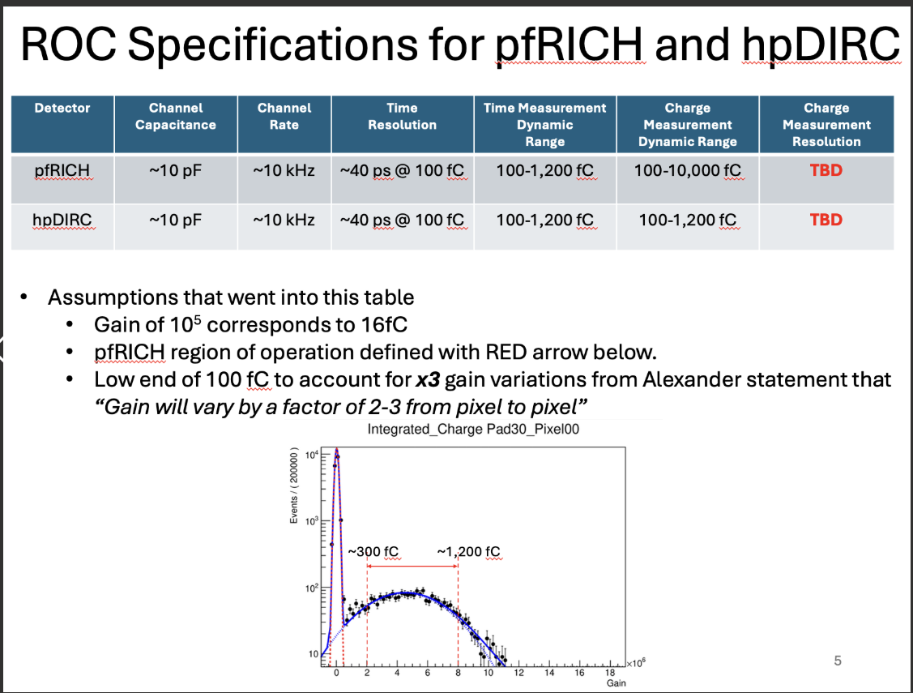
Requirements/Specifications – 21 April 2025
Latest - From meeting on 11 April 2025 with pfRICH and hpDIRC.

Slide 16
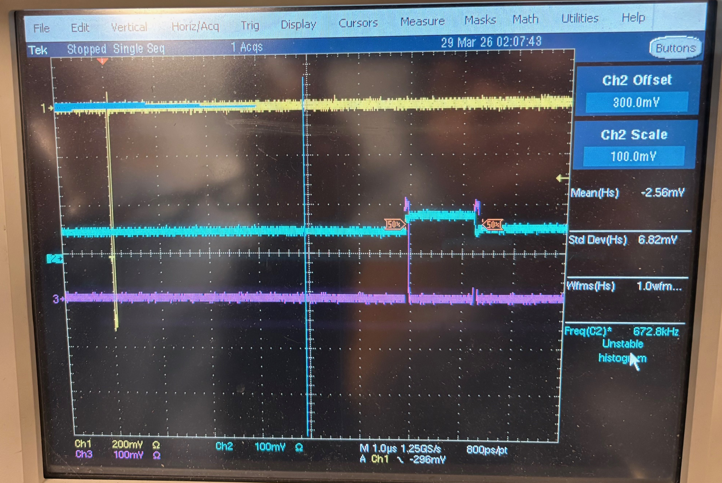
Current testing status
  Initial outputs from FCFD looked OK, although timing may be off due to the test setup
  BNL was able to run 1 test of the discriminator before packing up HRPPDs
  Testing will not resume until July
  BNL/JLab will perform charge injection testing while waitinf for HRPPDs once boards complete
(1) Input pulse
(2) Analog output
(3) Discr. output

Slide 17
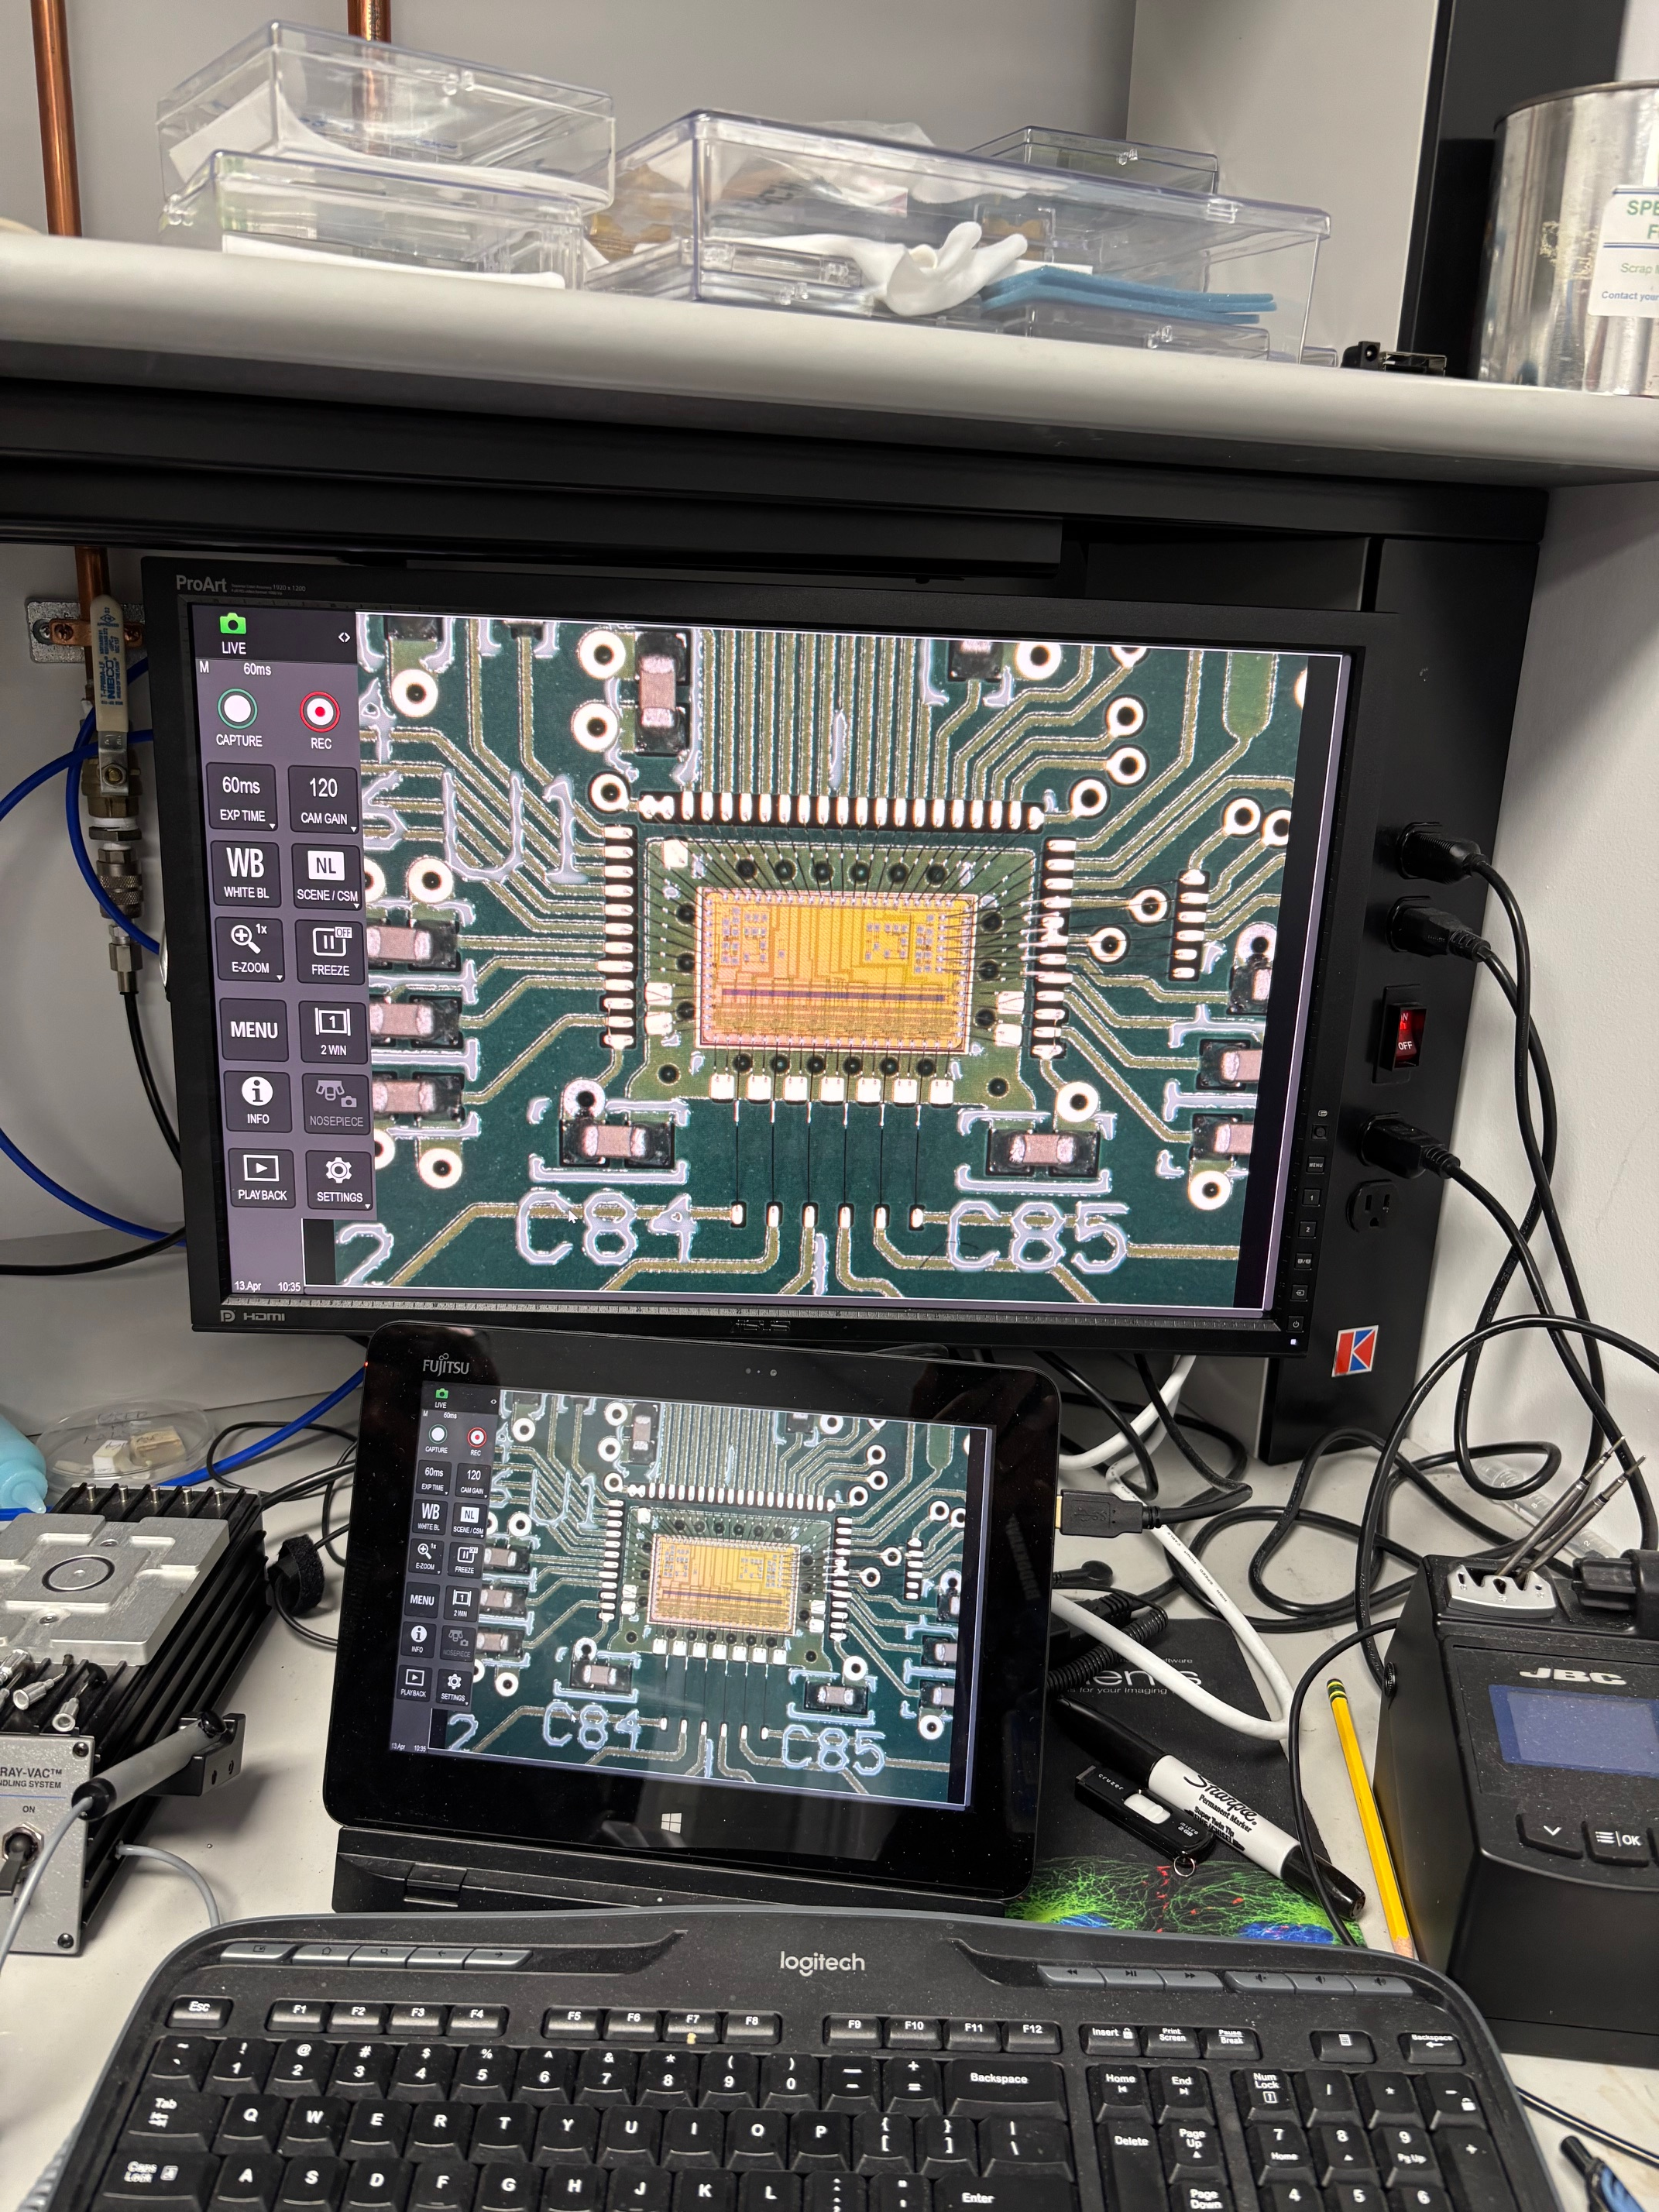
6/8/2026
Power consumption of a 32ch-FCFD
FCFD now goes for 32ch/chip.
Previous number:
  Estimated from the table for 128ch.
  Analog 32ch: 3.8mW * 32 = 120mW
  TDC+ADC 32ch: 0.2mW *32 = 6.4mW
  Supporting Circuitry 32ch: 6.4mW
  Global circuitry: 1per chip = 200mW
  Total power per chip will be: 330mW
New number:
  As presented at the TIC meeting
  Analog 32ch: 3.6mW * 32= 116.2mW
  TDC+ADC 32ch: 0.2mW*32= 6.4mW
  Supporting Circuitry 32ch: ?
  Global circuitry: 1 per chip = 78mW
  Total power per chip: 200mW.
Table presented by Artur at ePIC coll meeting on Jul 16, 2025
Table presented by Artur at TIC meeting on May 11, 2026
From Artur’s slide
17

Slide 18
6/8/2026
Readout scheme and LV power consumption
Conceptual readout scheme.
  Four (tentative) FCFDs per FEB.
  FCFD output bandwidth: 320Mbps/chip
  A Father board (FB) (a set of lpGBT and VTRX+) handles eight FEBs.
Power: 1.1*8+3.2 = 12 W/HRPPD.
  816W for whole pfRICH.
  bPOL48 (DC-DC) eff. is assumed to be 70% in average (can be better).
Parts | Per unit | QTY
FCFD | 200mW | 4
bPOL48 | ~70% eff | 1 per line
Total | ~1.1W | per FEB
Parts | Per unit | QTY
lpGBT | 750mW | 2
VTRX+ | 300mW | 2
bPOL48 | ~70% eff | 1 per line
Total | ~3.2W | Per FB
FEBs, 8 per HRPPD
HRPPD backplane
0-16V, 10A/ch max,
100W/ch max
LVPS
Wiener MPV4016I ?
FCFD
bPOL 48: 2.5V
bPOL48: 1.2V
RDO
FELIX
FCFD
bPOL48: 1.2V
VTRX+
FCFD
bPOL48: 2.5, 1.2V
RDO
FCFD
lpGBT
Slow control, Clock, trigger, digitized data
18

Slide 19
Data format and rate from 32ch-FCFD
Semi-official number: 160 bits/hit (max)
  5-bit ADC + 8bit TDC + other info = 64 bits/ch
  Header(H) + trailer(T) + filler (F) = 96 bits/ch
  H+T+F may be merged for channels hit at same time.
Using Brian’s average hit rate, it means:
  200Mbps per HRPPD, 13.3Gbps from pfRICH as whole.
  Will need at least two sets of lpGBT+VTRX+.
  Max rate from a pad is 20kHz → 3.2Mbps/pad → 102Mbps/32ch.
  It still fits to FCFD data bandwidth of 320Mbps/chip
FCFD analog front-end CAN handle 20kHz hit rate
Bandwidth of lpGBT + VTRX+ with FEC10 encoding is 7.68Gbps. (10.24Gbps mode)

