Slide 1
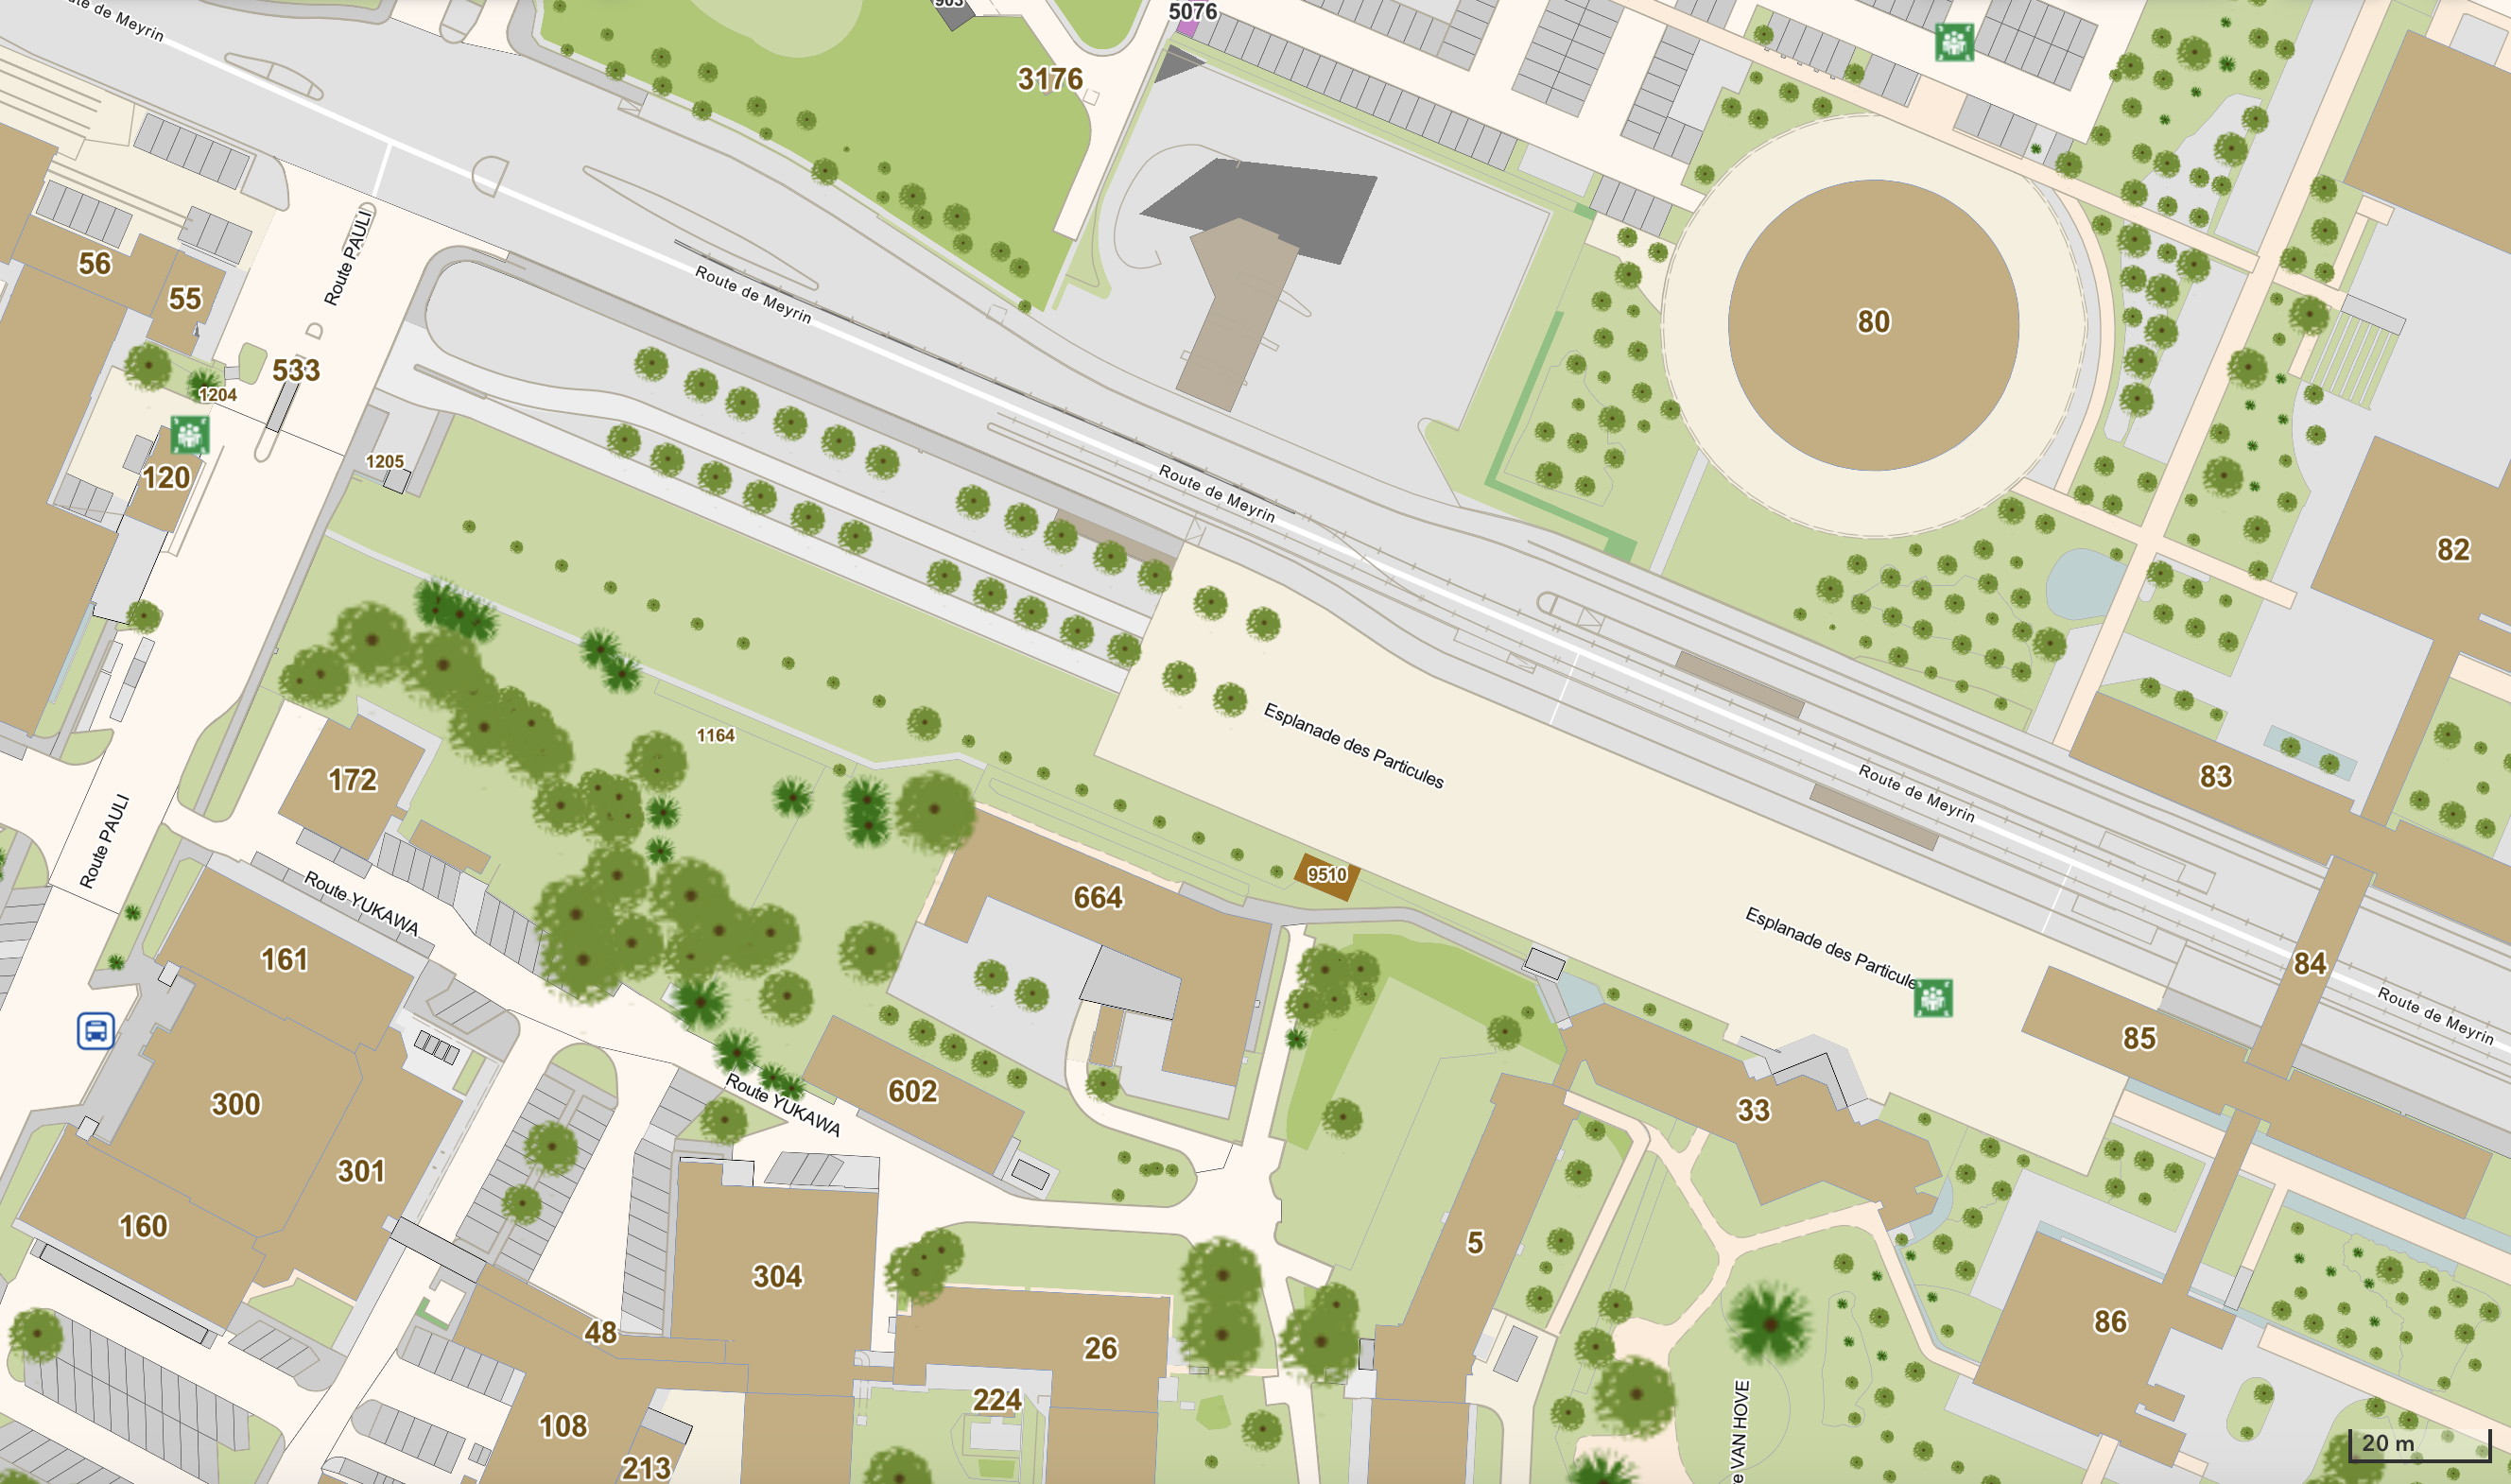
Day 1: Accessing the CERN Site
Weekdays (7:00 AM – 6:30 PM)
Collect a Day Pass at *CCSC in Building 33
Evenings & Weekends
Present your CERN Hostel booking confirmation to the gate guards
Gate
Cern Tram Station
Building 33
*CERN Community Support Center (CCSC)
JIHEE KIM

Slide 2
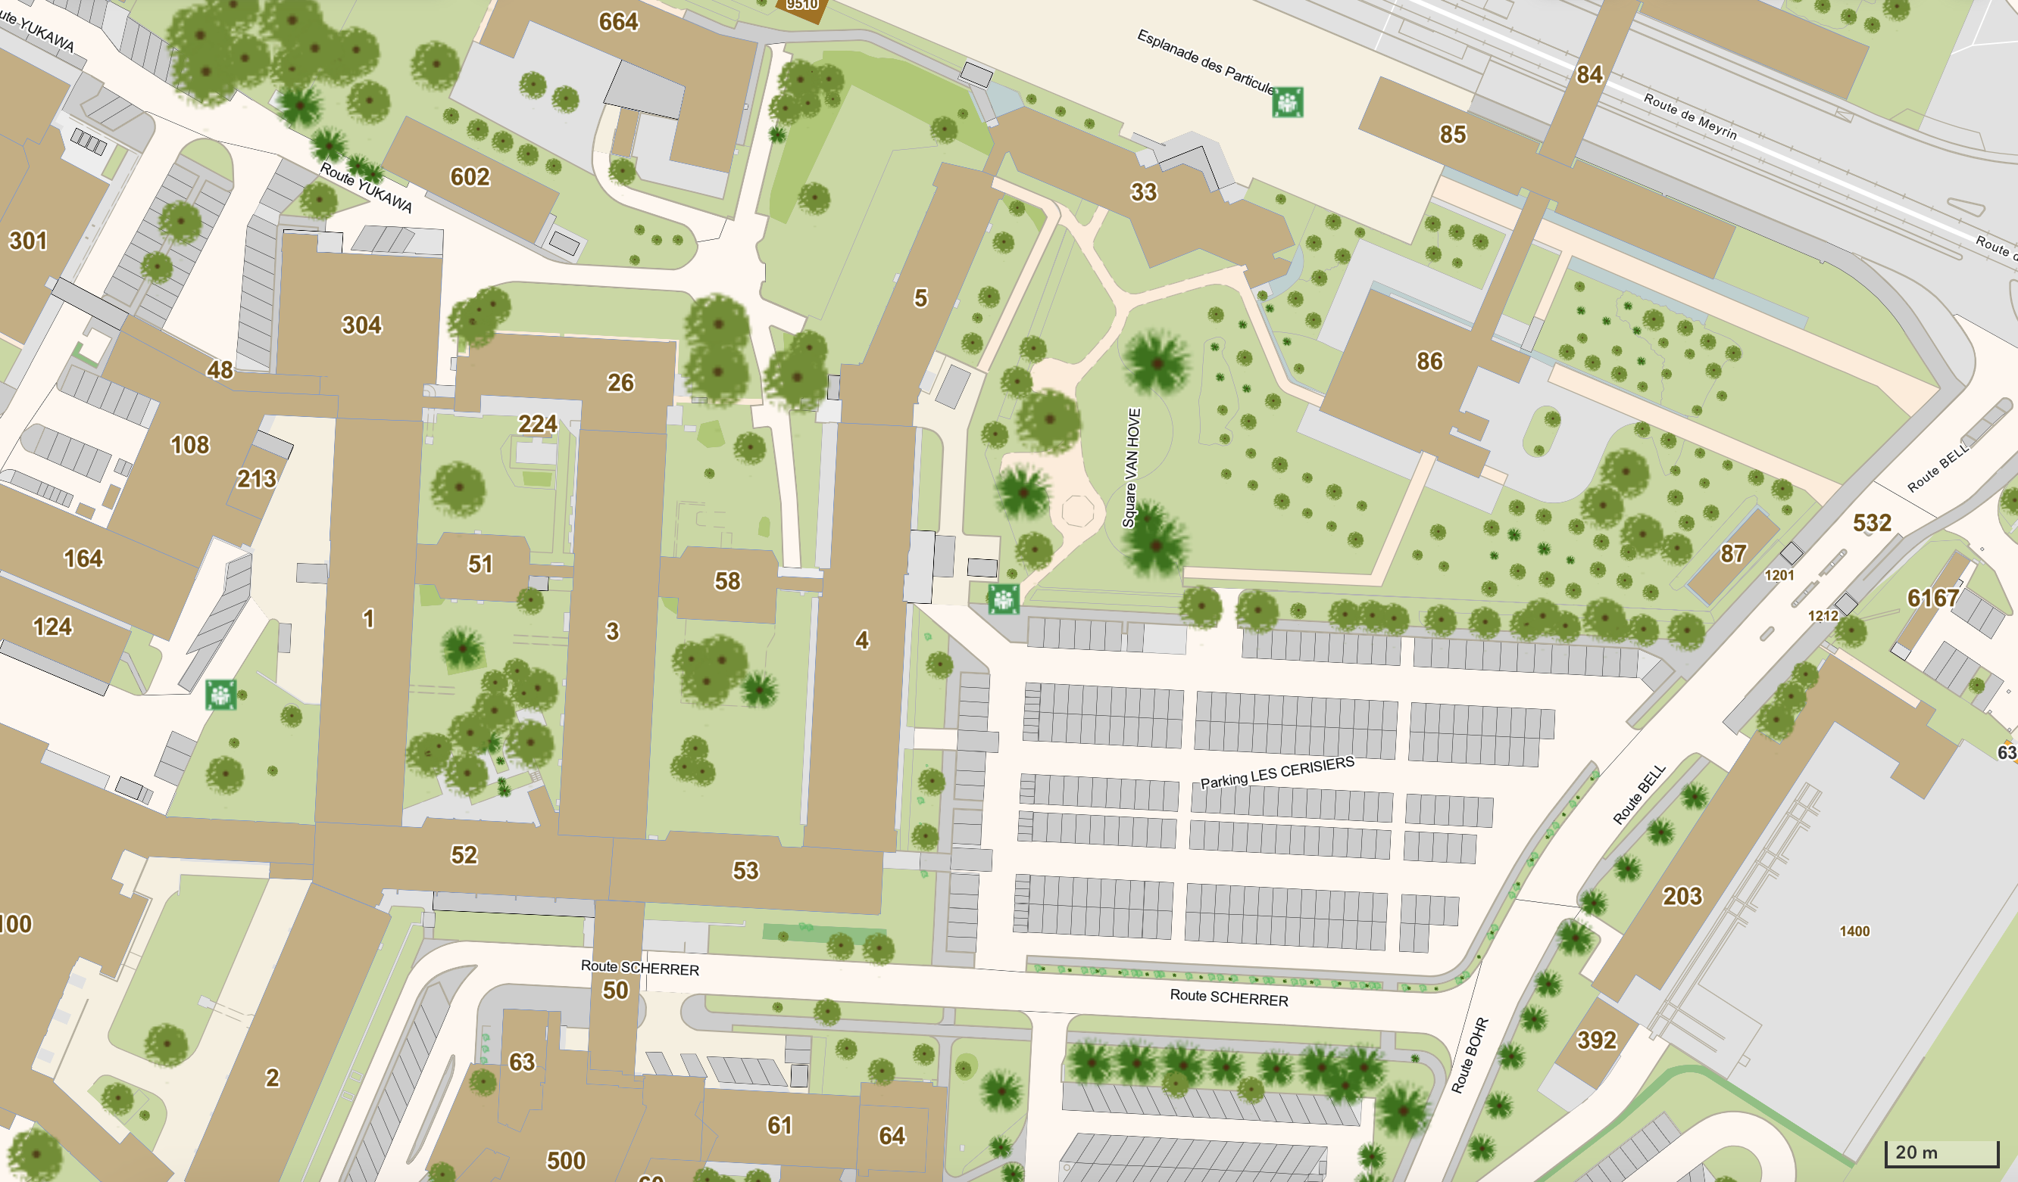
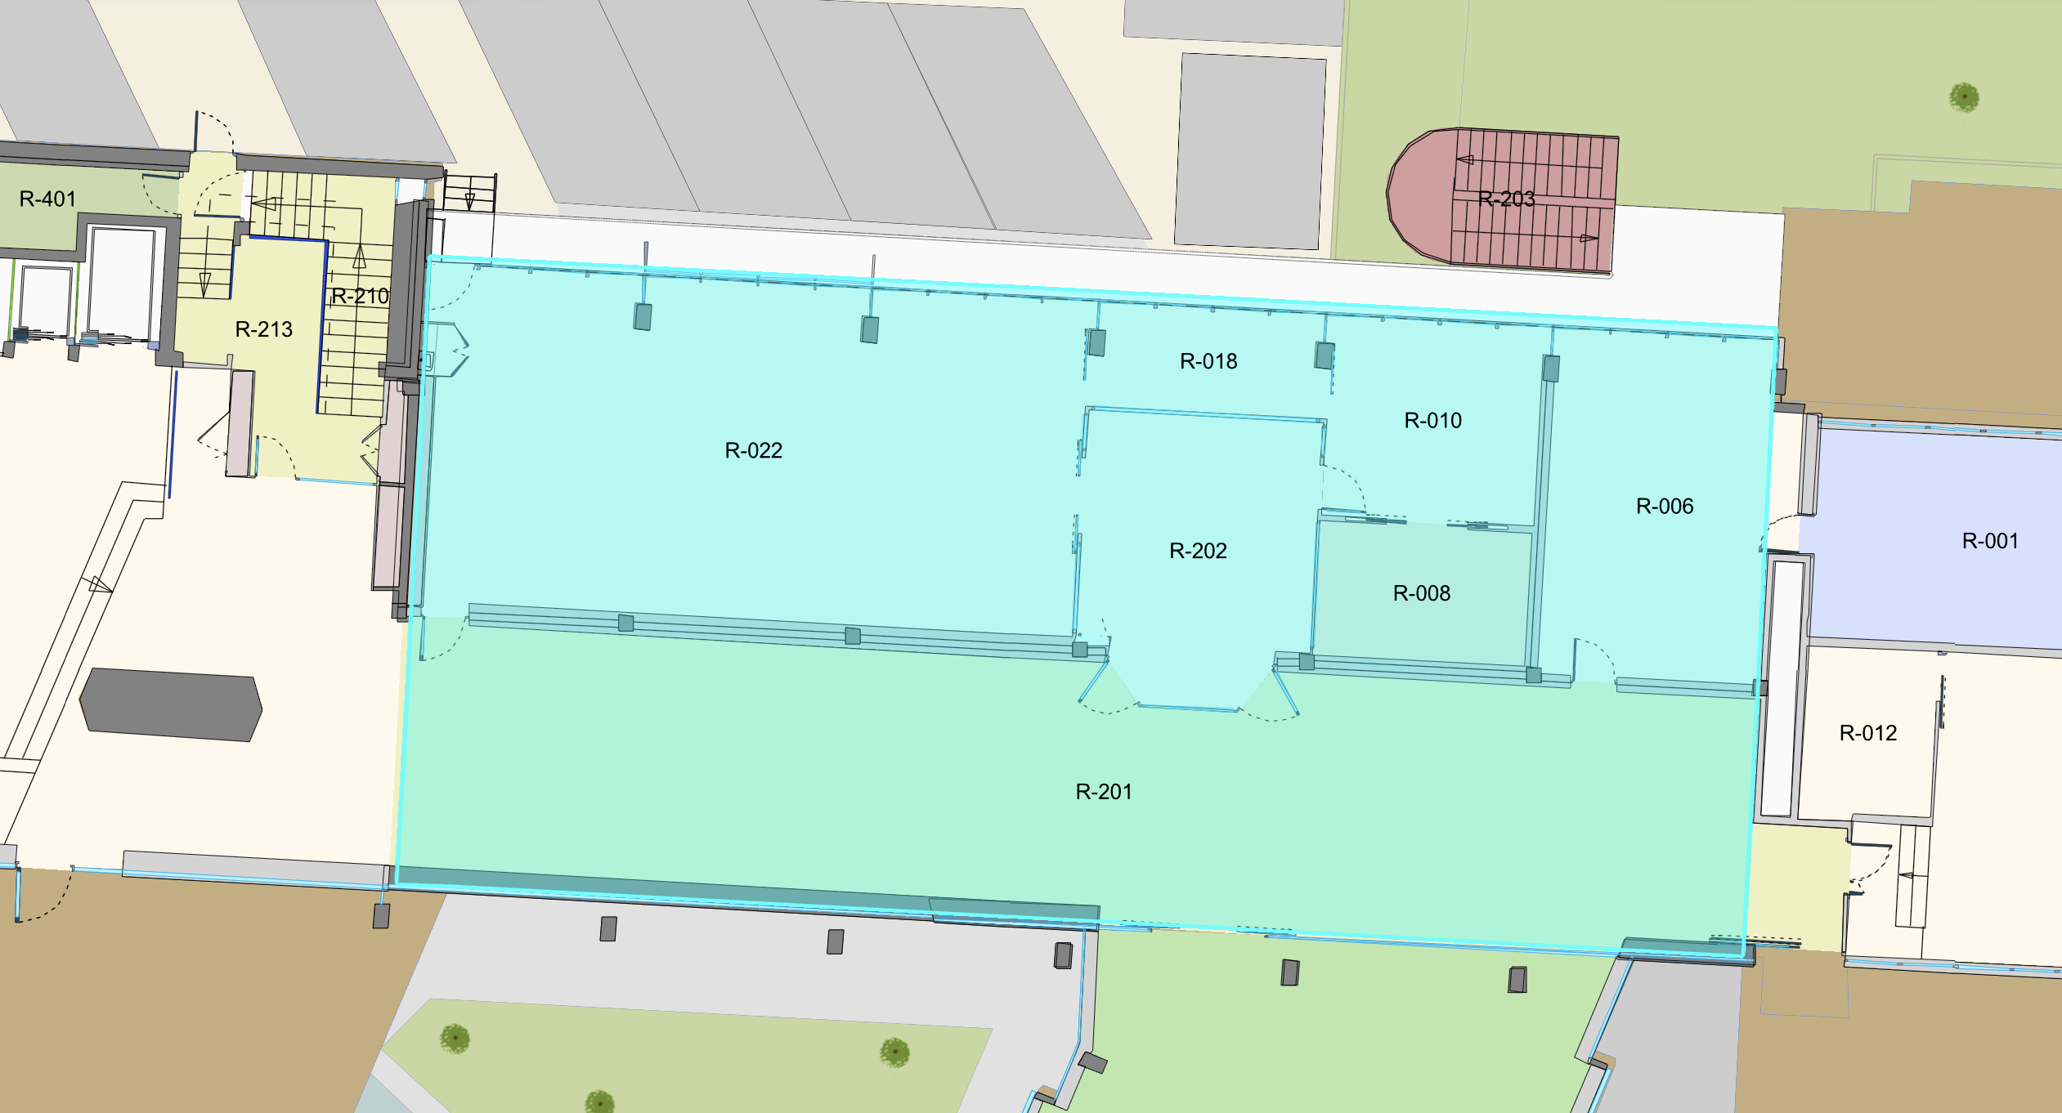
Day 1: Finalizing Registration for Users
Go to Users Office in Building 61
to finalize your registration and sign your contract
08:30 AM – 12:30 PM 02:00 PM – 04:00 PM
Cern Tram Station
Building 33
Building 61
Users Office (R-010)
Building 61
Building 501 – Restaurant 1
JIHEE KIM

Slide 3
Day 1: Collecting Badge and Dosimeter
Go to the CCSC in Building 33 (open weekdays, 7:00 AM – 6:30 PM).
Take a queue ticket and wait for your number to be called.
Present your passport.
Have your photo taken for your badge.
Complete an iris scan for your dosimeter.
JIHEE KIM

Slide 4
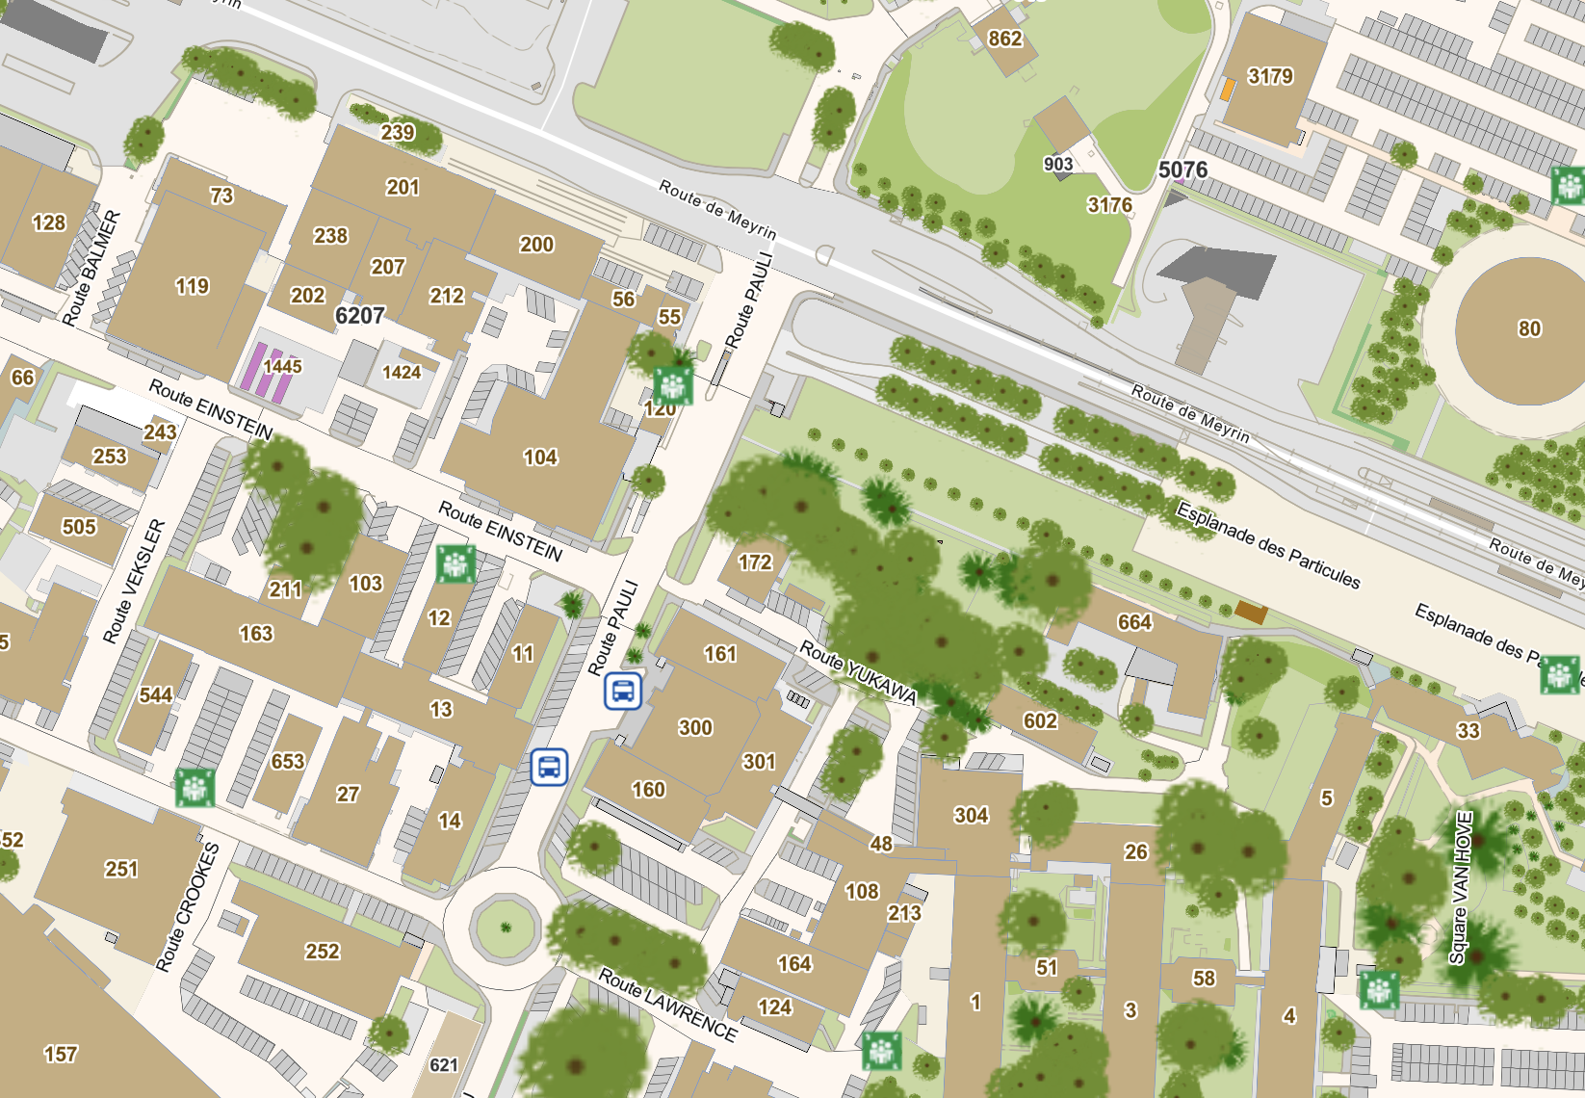
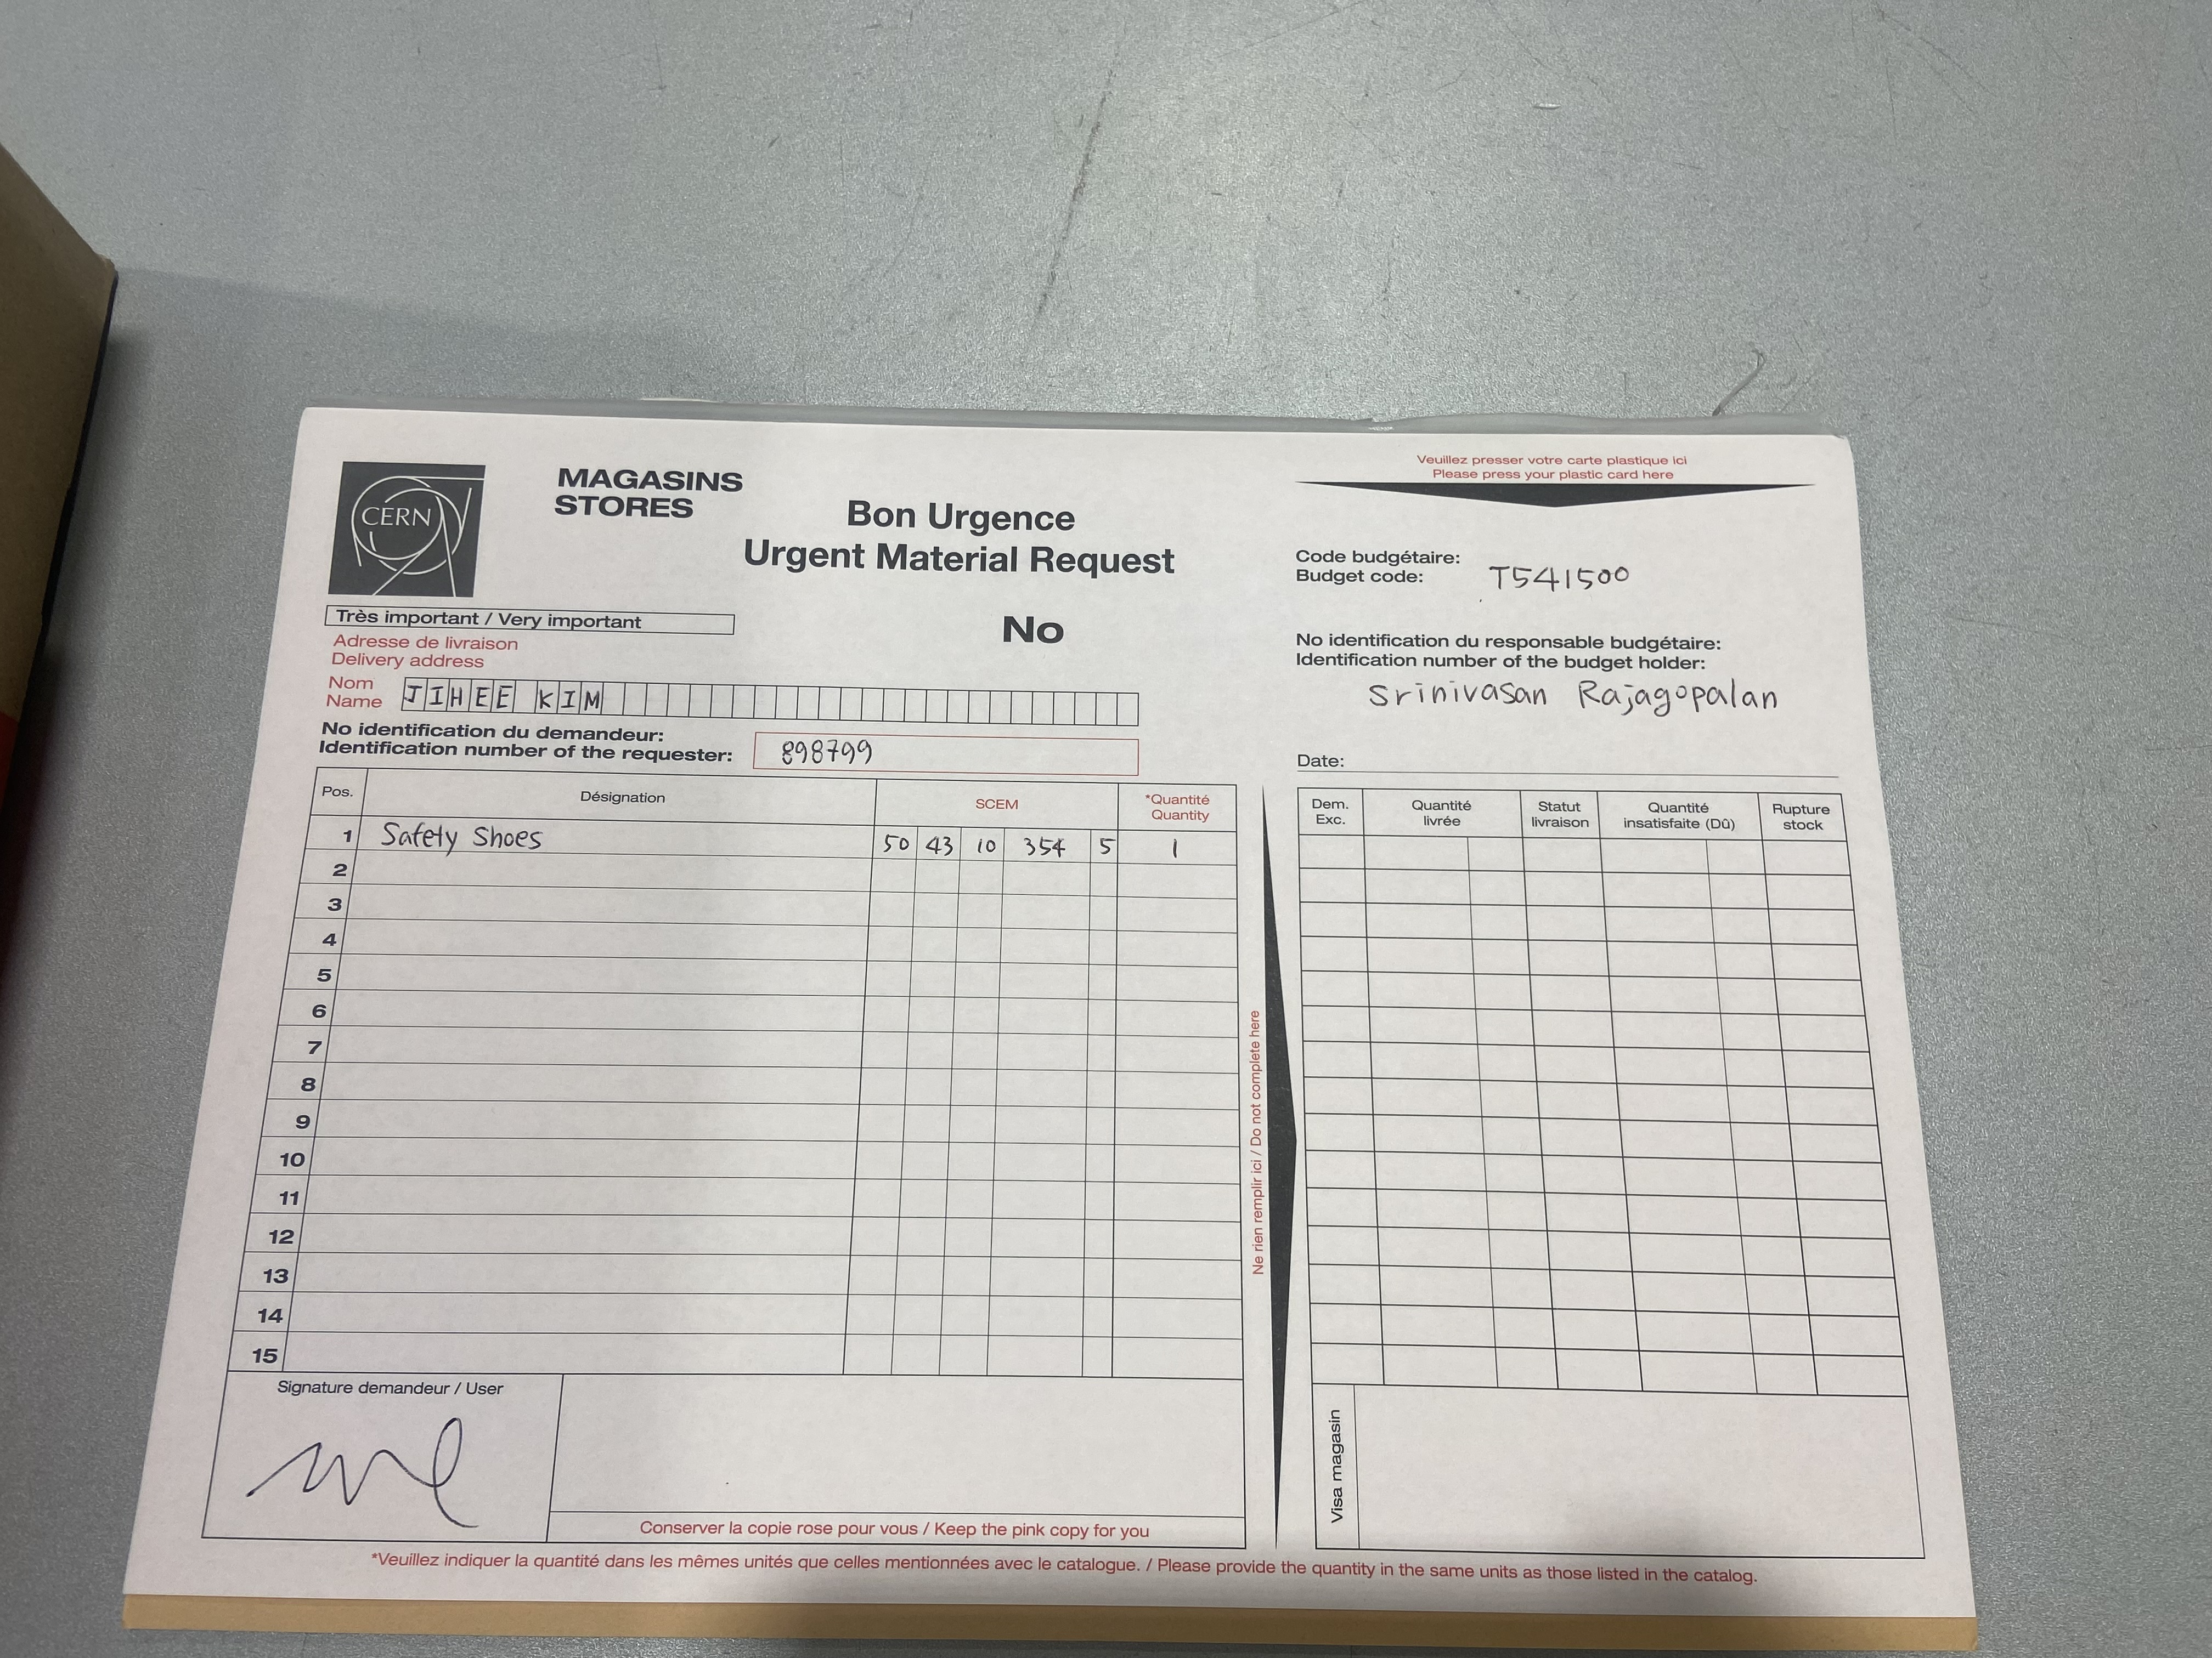
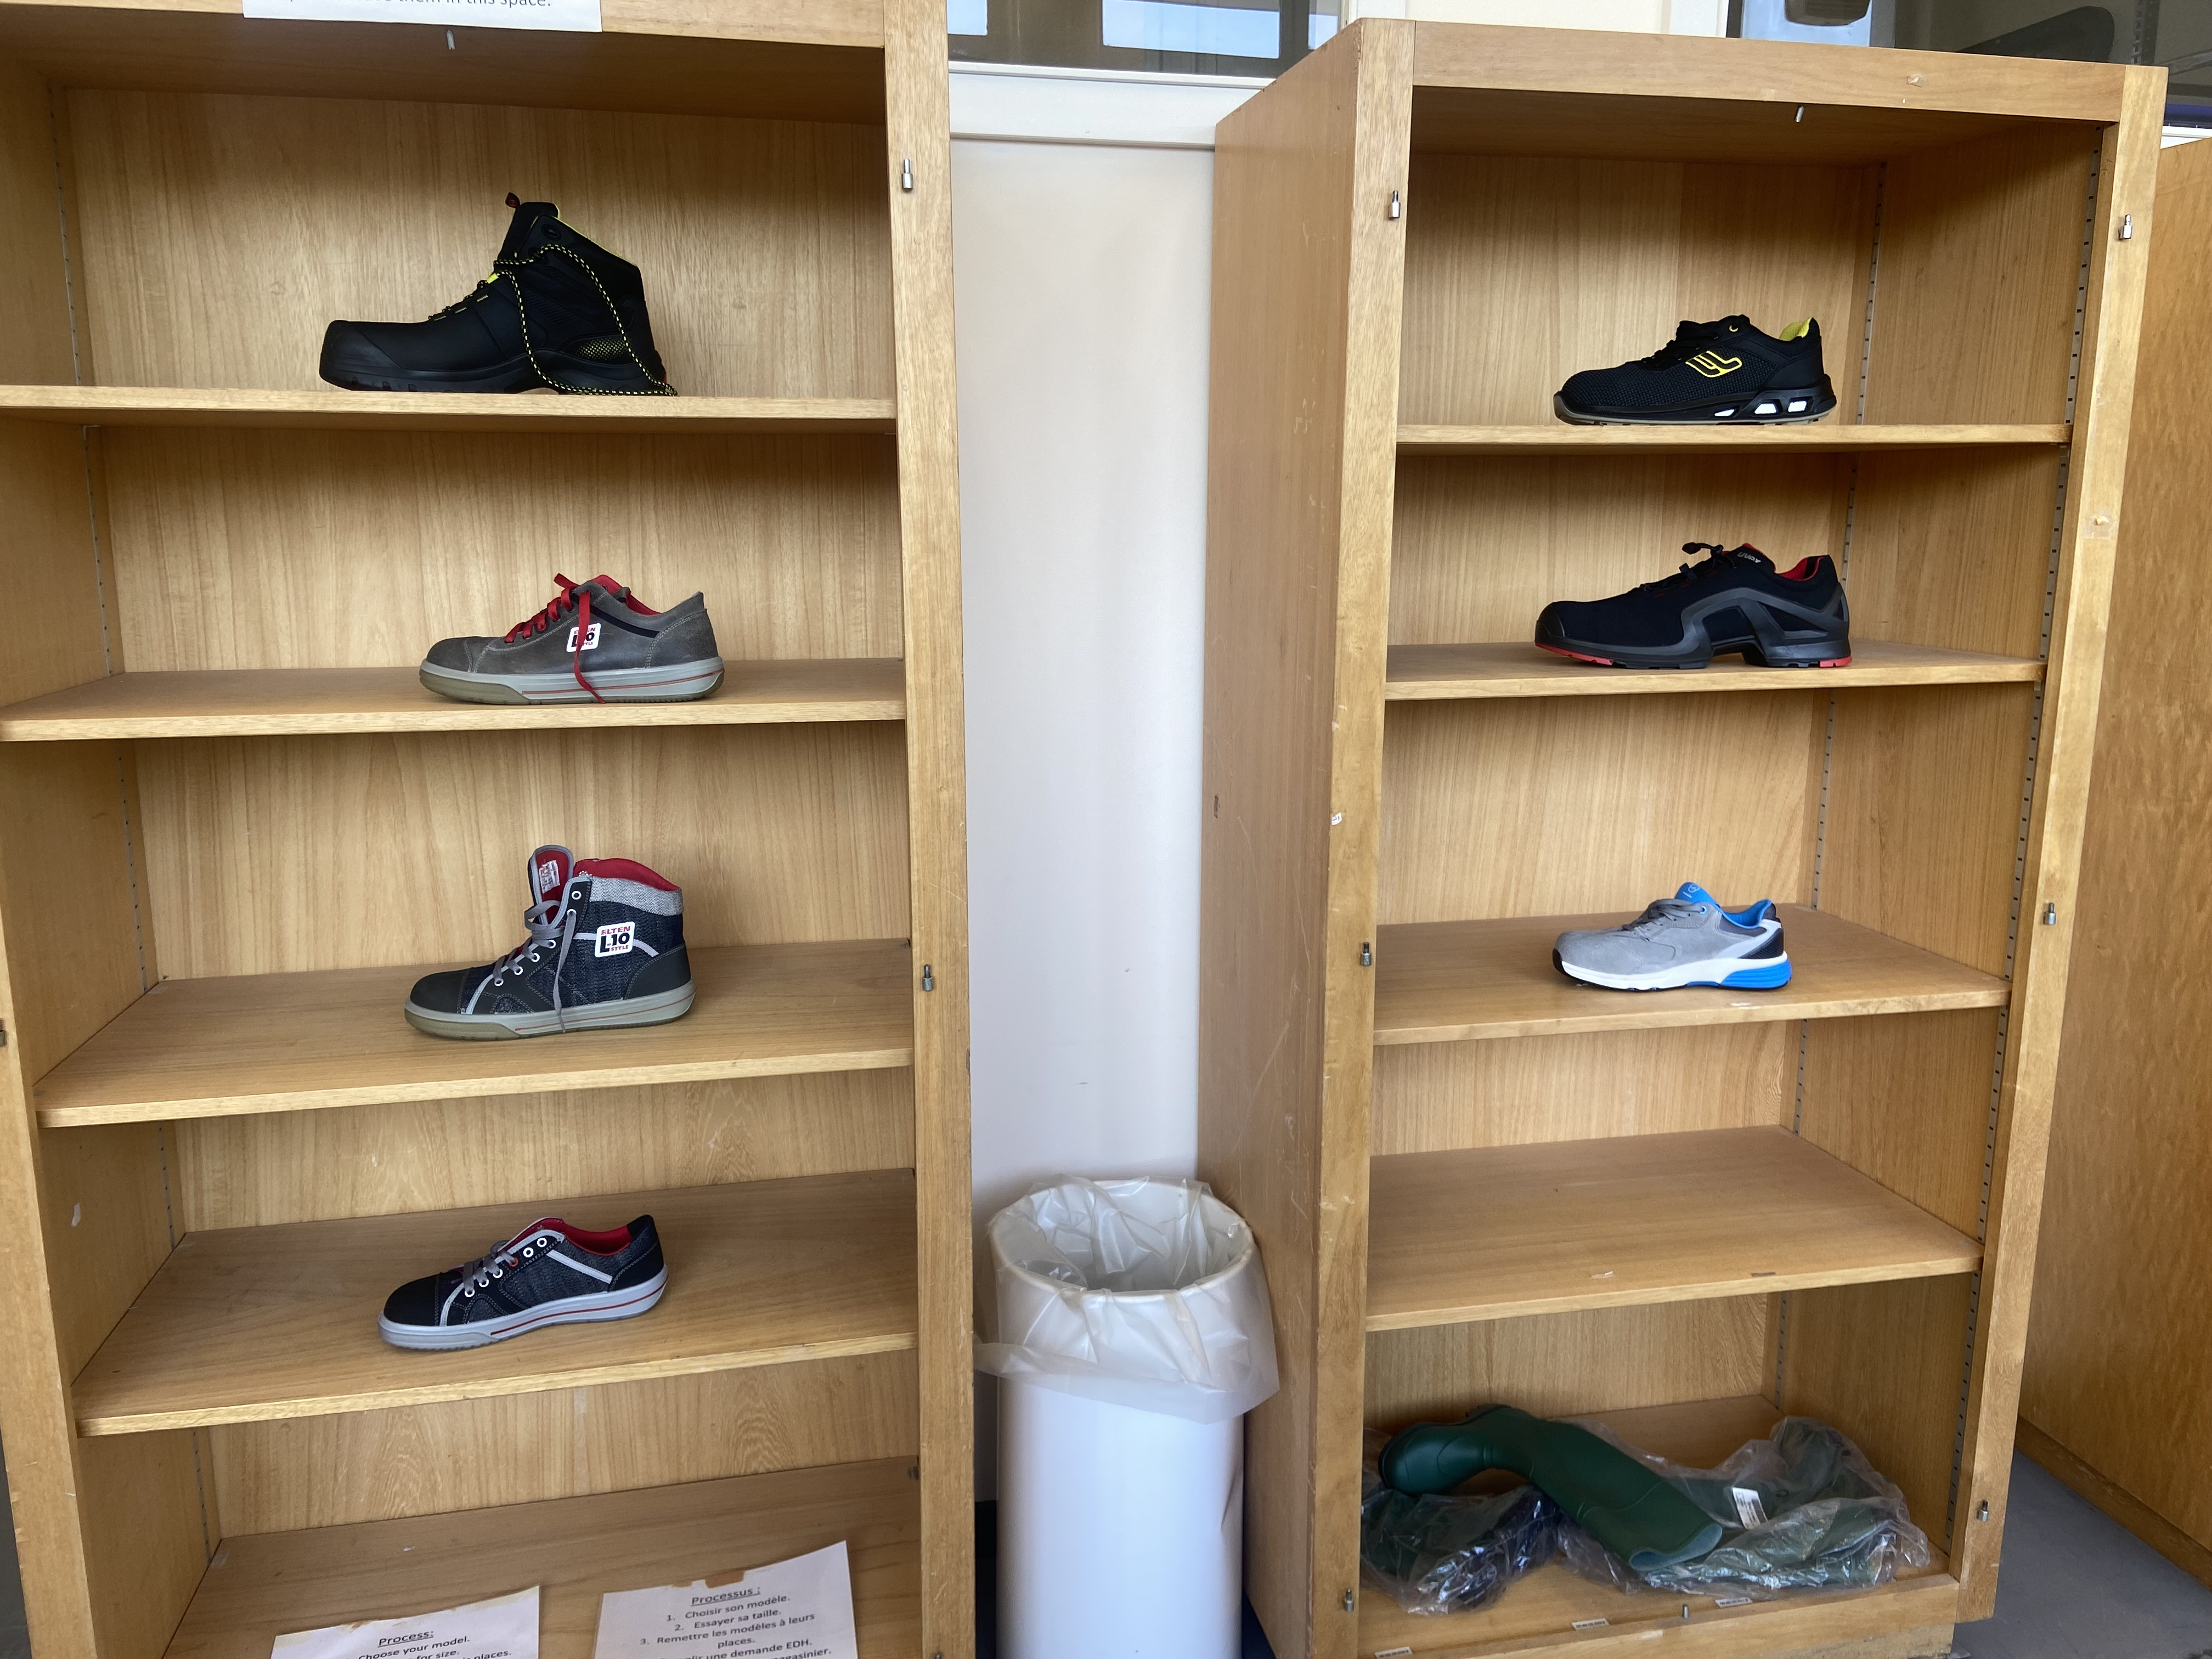
Day 1: Buying PPE
Building 73
Cern Tram Station
Visit the central store (0th floor in building 73) during opening hours (7:30 – 11:50 AM and 1:00 – 4:20 PM).
Head to the Showroom on the left.
Try on the safety shoes for fit.
Provide the store staff with your chosen model and size.
Fill out the required paperwork using *budget code and name.
Building 33
*Ask Brian and Alexander about details on budget code
JIHEE KIM

Slide 5
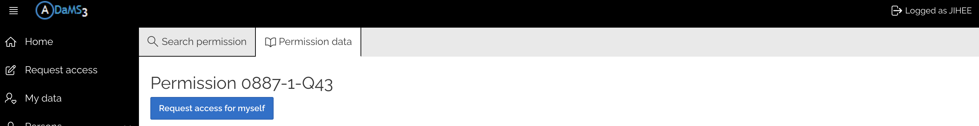
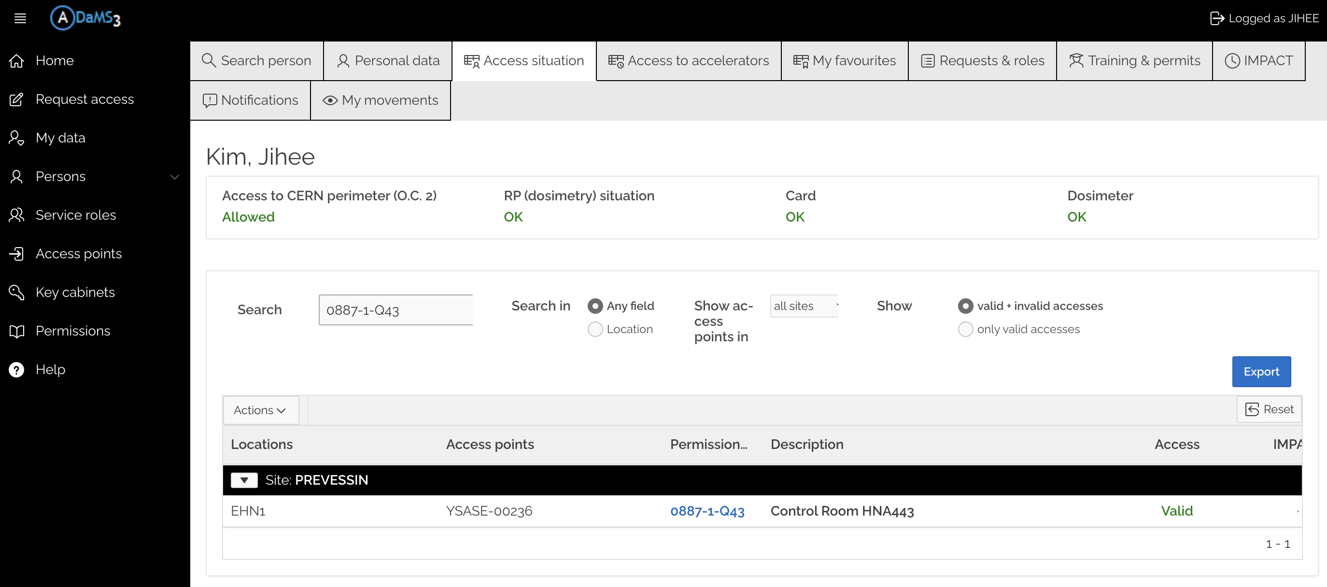
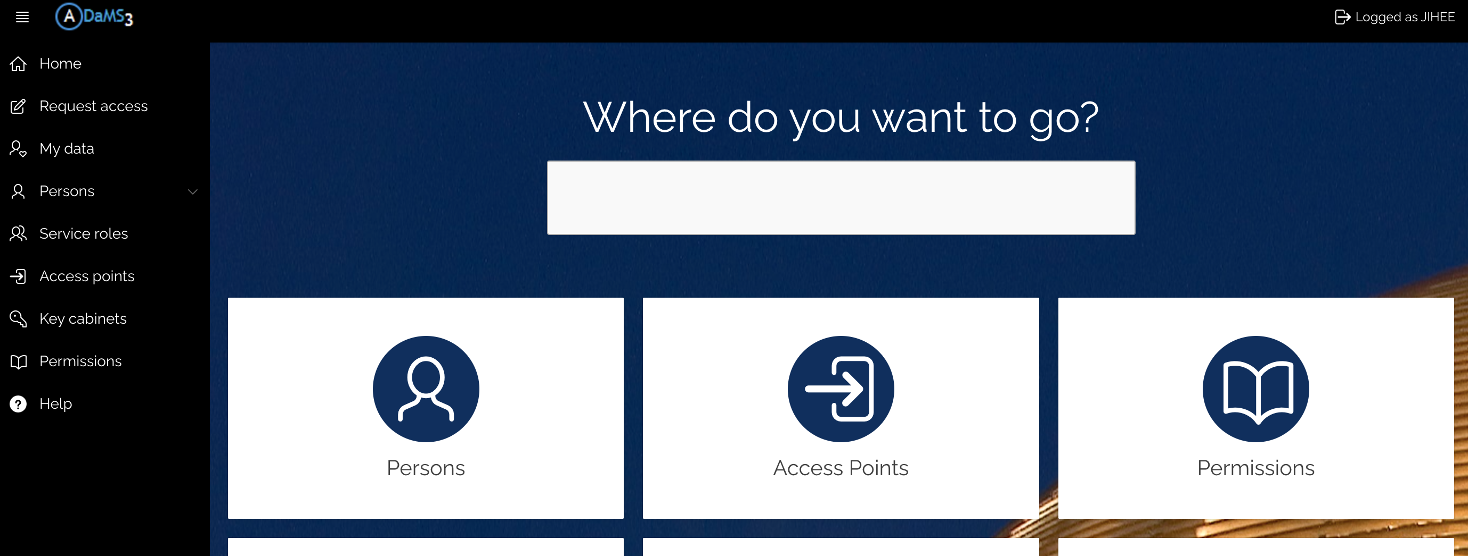
Day 1: Activate Access Card to Control Rm
Go to https://apex-sso.cern.ch/pls/htmldb_edmsdb/f?p=404:1:11418813765156::::: or Google for “CERN Adams”.
Search for "1-Q43" (the SPS control room).
Select the first option: "0887-1-Q43 : Control Room HNA443".
Click the blue "0887-1-Q43" button under the Permission column.
Fill out the required blank fields.
Click "Request access for myself" to finish.
Wait for approval (usually very quick).
Final step: When entering test beam facility, tap the second scanner for your badge to update access card
1-Q43
JIHEE KIM

Slide 6
Day 1: Activate Access Card to Control Rm
Go to https://apex-sso.cern.ch/pls/htmldb_edmsdb/f?p=404:1:11418813765156::::: or Google for “CERN Adams”.
Search for ”157-R-C21" (the PS control room).
Select the first option: "0157-R-C21 : T10 Control room".
Click the blue ”0157-R-C21" button under the Permission column.
Fill out the required blank fields.
Click "Request access for myself" to finish.
Wait for approval (usually very quick).
Final step: When entering test beam facility, tap the second scanner for your badge to update access card
1-Q43
JIHEE KIM

Slide 7
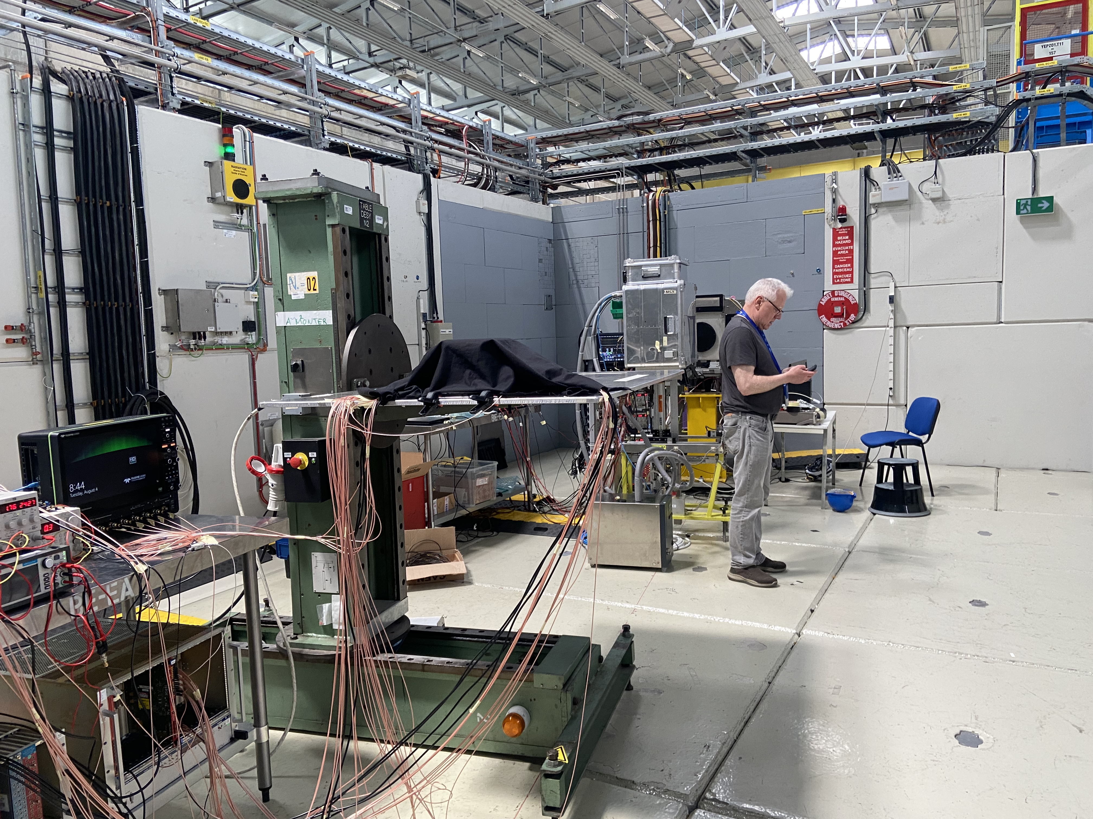
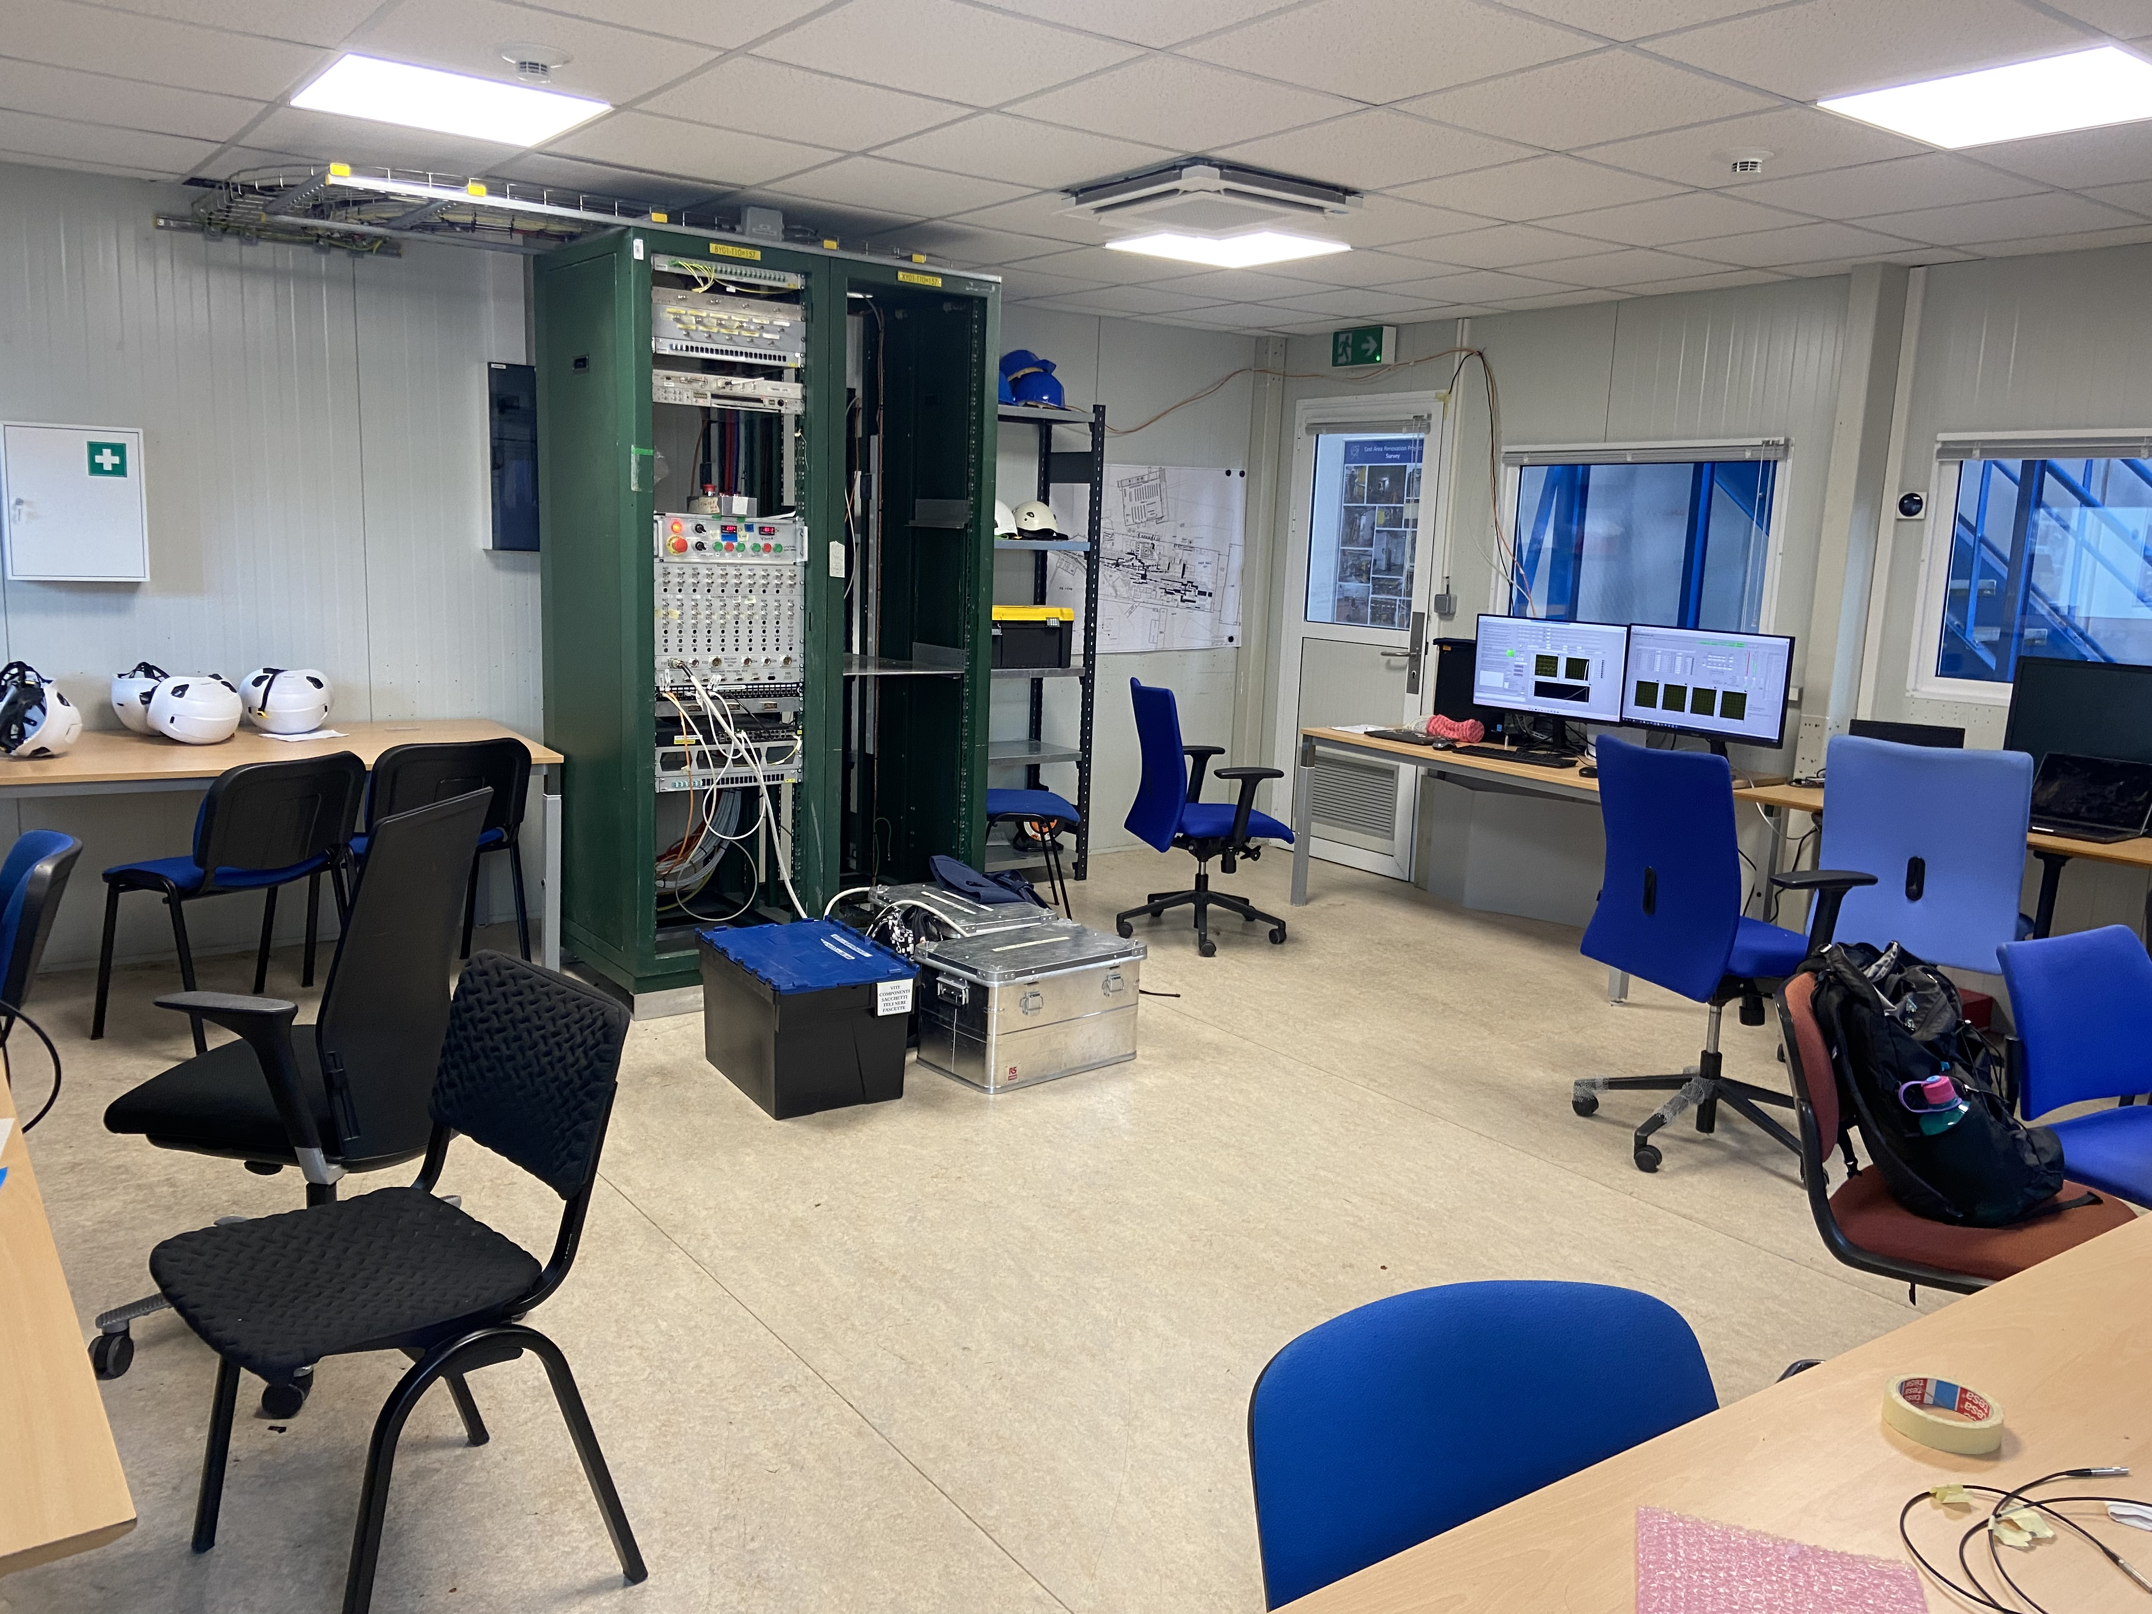
PS Run: T10 Experimental Hall/Control Rm
T10 Experimental Hall
T10 Control Room
Beam
dRICH
DESY Table for pfRICH
Beam dump
JIHEE KIM

Slide 8
Day 1: Network Registration (Wifi)
Connect to the CERN-Campus-Register Wi-Fi network.
Register your device using one of the following links:
  https://wifi.web.cern.ch/CERN-Campus/#device-registration
  https://landb.cern.ch/portal/devices/register
Save the username and password provided upon successful registration.
Connect to your preferred network (CERN-Campus, CERN, or eduroam) using those credentials.
JIHEE KIM

Slide 9
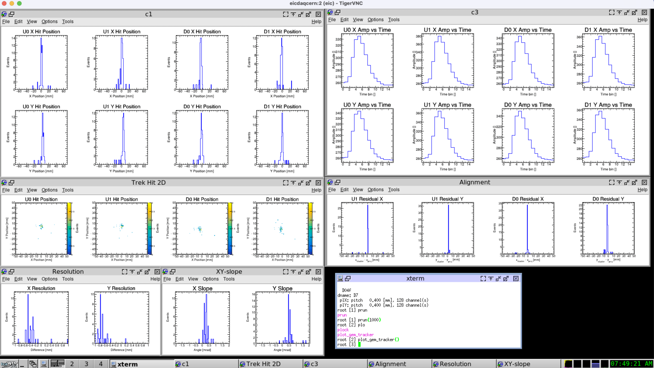
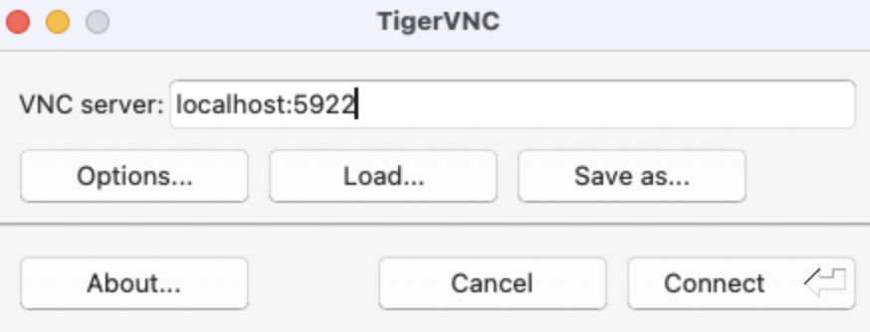
Remote Laptop: VNC Viewer
Launch and interact with graphical applications on remote machines
1) Download: TigerVNC
  https://sourceforge.net/projects/tigervnc/files/stable/1.16.2/
2) Install (macOS): Mount .dmg → Move to Applications → Launch
3) Connect: Set up SSH tunnel → Enter localhost:5922
JIHEE KIM

Slide 10
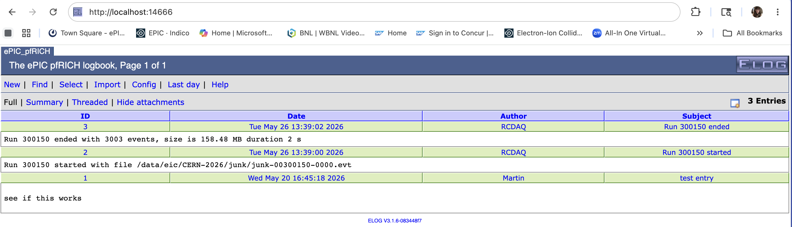
ELog and Google Spreadsheet
With the tunnels in place, you can open ELog:
Started on
https://docs.google.com/spreadsheets/d/1GRvyhwN7_BqvVkQwJNSKuNiKdquypuXQGfnWgZJ7rUs/edit?usp=sharing
JIHEE KIM

Slide 11
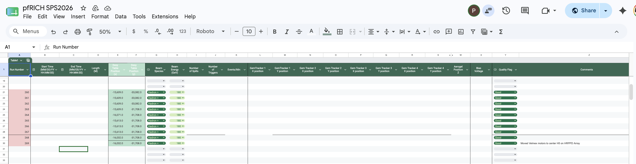
Log: Google Spreadsheet
Started on Google Spreadsheet
https://docs.google.com/spreadsheets/d/1GRvyhwN7_BqvVkQwJNSKuNiKdquypuXQGfnWgZJ7rUs/edit?usp=sharing
JIHEE KIM

Slide 12
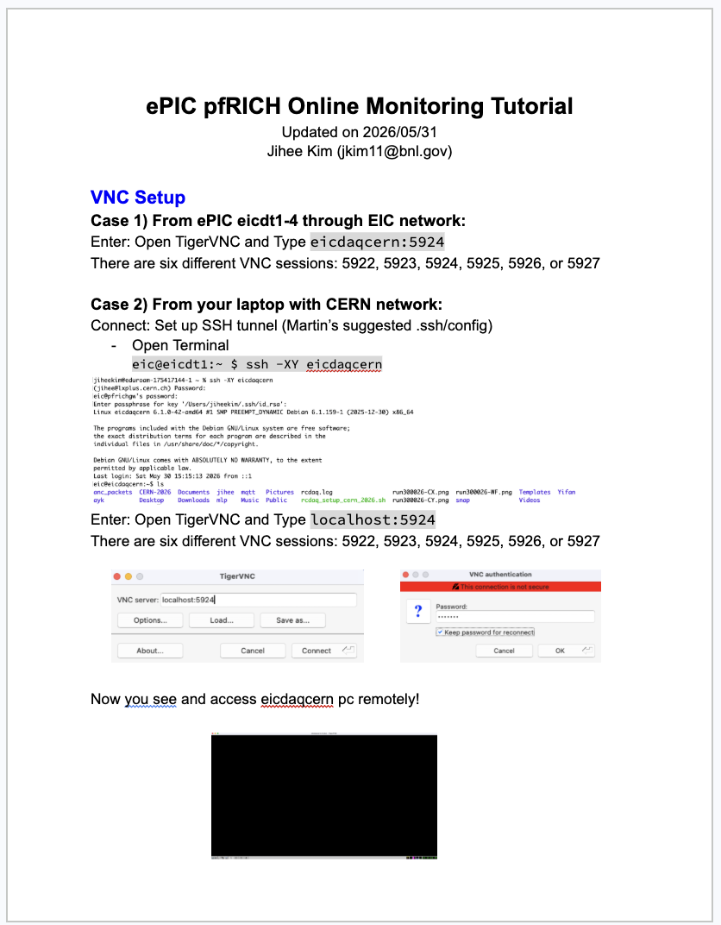
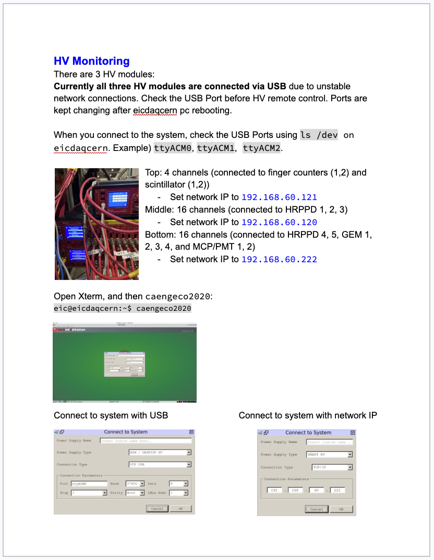
Online Monitoring Tutorial
Started on Google Doc
https://docs.google.com/document/d/1iDnQdxj9nmGScwmvc_SMk_DZoHpSfwROQFhvetEdNsg/edit?usp=sharing
VNC setup for monitoring desktops and personal laptop
HV remote control
JIHEE KIM

Slide 13
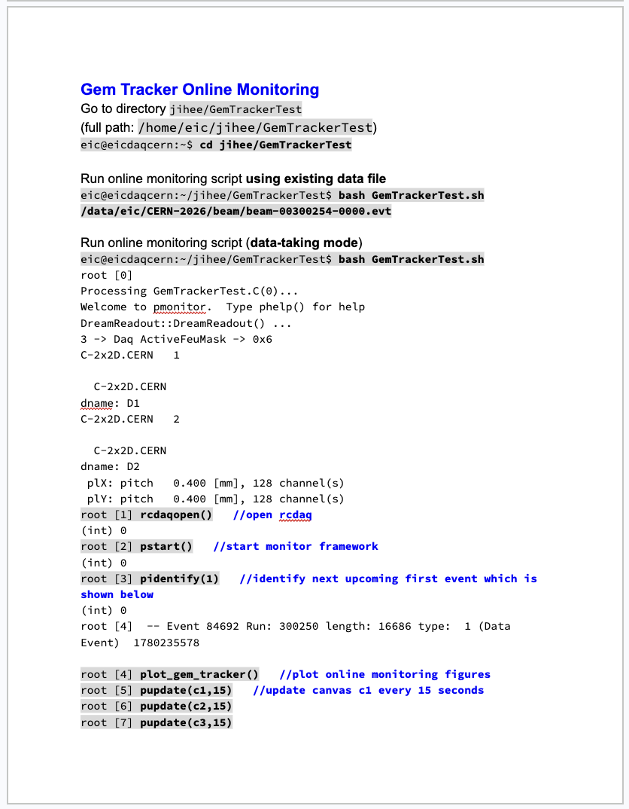
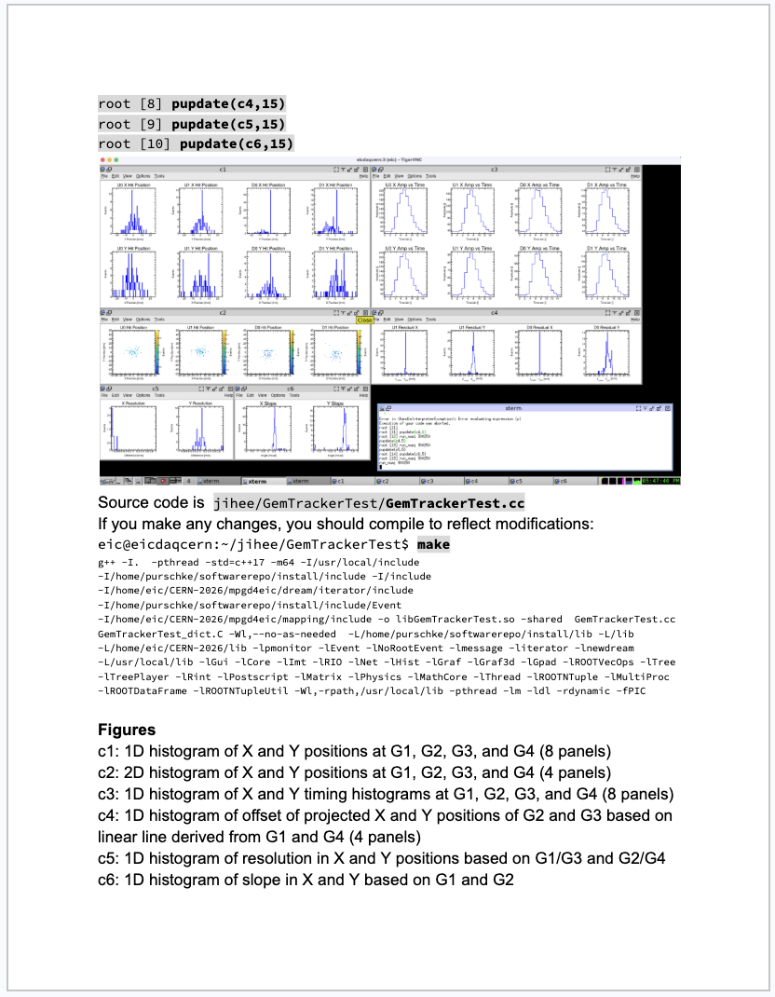
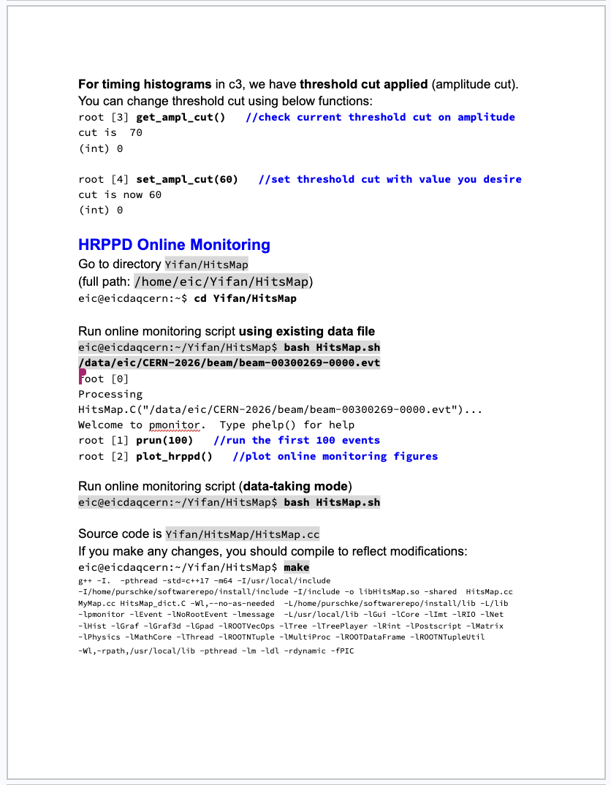
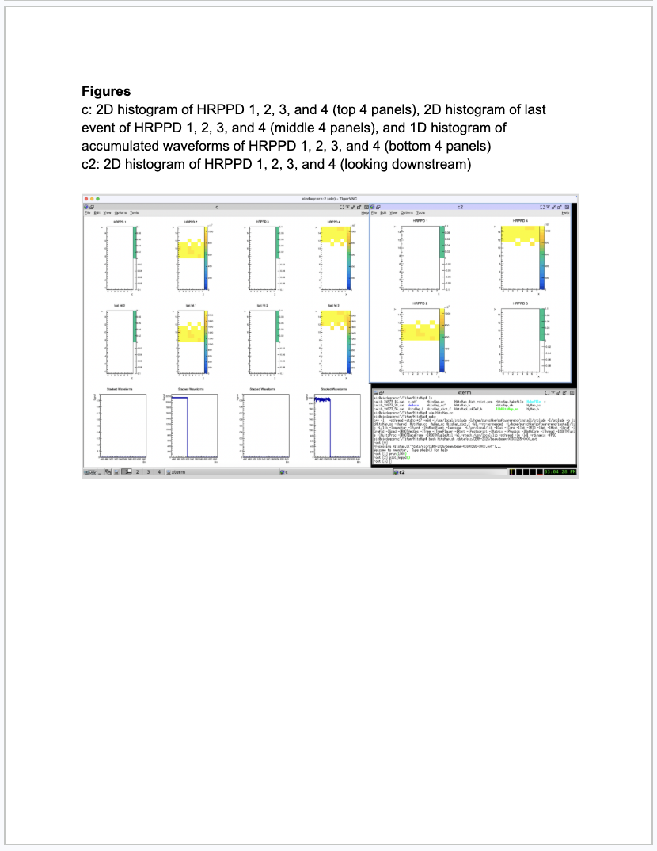
Online Monitoring Tutorial
Started on Google Doc
https://docs.google.com/document/d/1iDnQdxj9nmGScwmvc_SMk_DZoHpSfwROQFhvetEdNsg/edit?usp=sharing
Gem tracker and HRPPD online monitoring (data-taking mode as well as looking at existing file)
JIHEE KIM

Slide 14
Backup Slides
JIHEE KIM

Slide 15
Slide Header
Body Text
  Bullet Tier 1
    Bullet Tier 2
JIHEE KIM

Slide 16
Slide Header
JIHEE KIM

Slide 17
Print-friendly Section Break
Subtitle
JIHEE KIM

