Slide 1
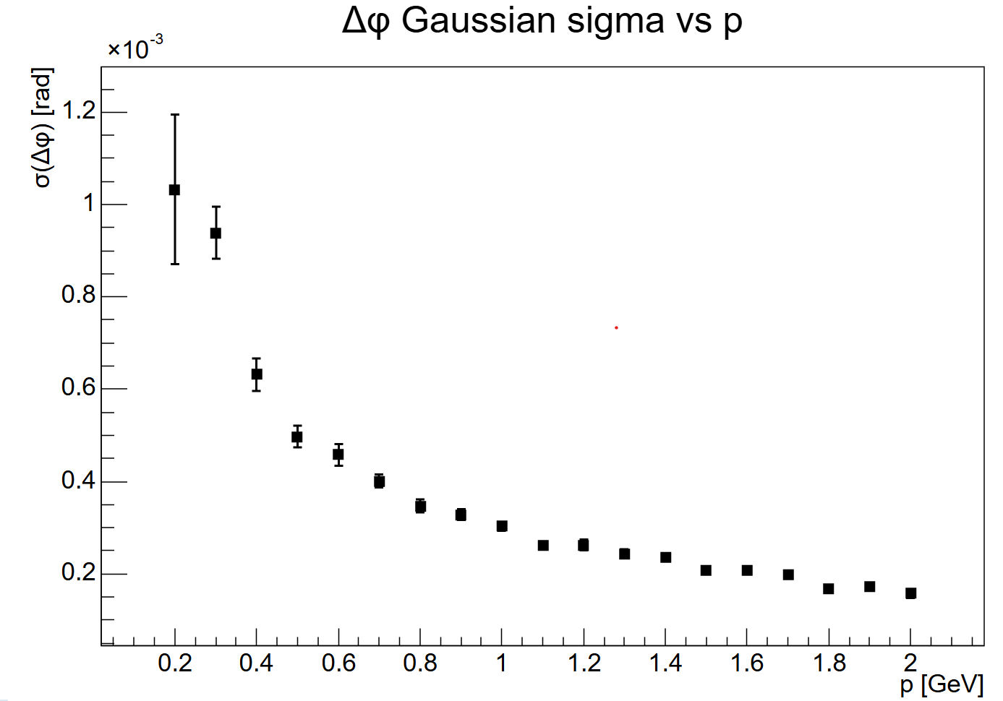
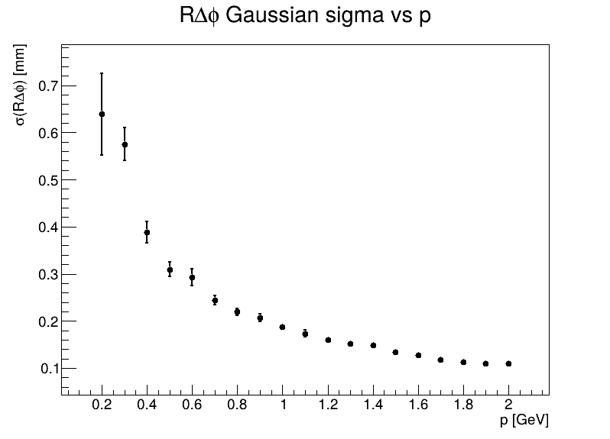
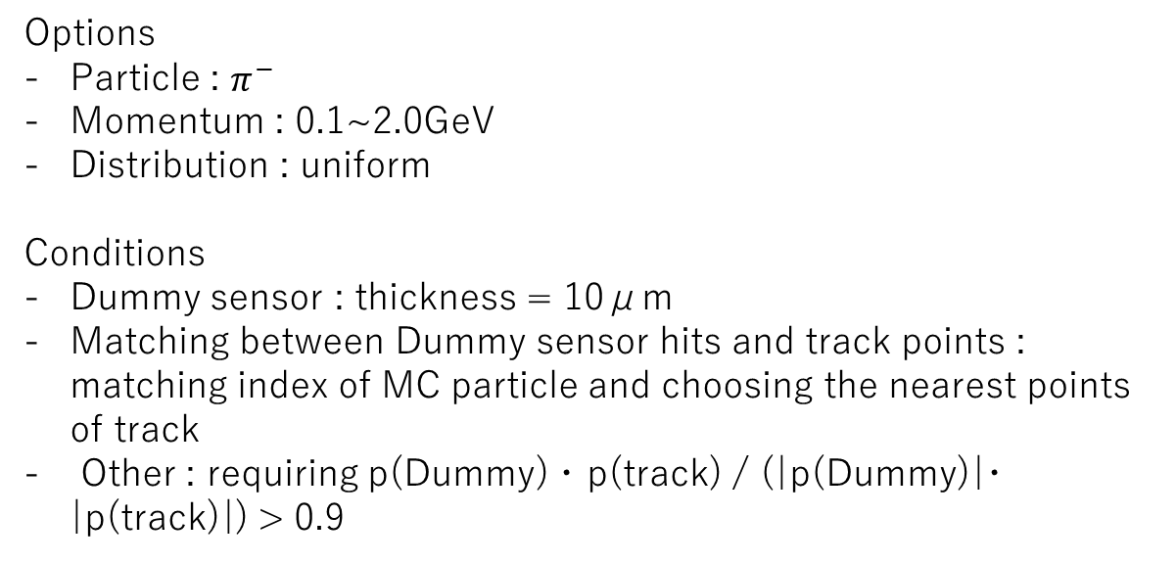
Tracking resolution on BTOF
Options
Particle : $π^{−}$
Momentum : 0.1~2.0GeV
Distribution : uniform
Conditions
Dummy sensor : thickness = 10μm
Matching between Dummy sensor hits and track points : matching index of MC particle and choosing the nearest points of track
Other : requiring p(Dummy) ･ p(track) / (|p(Dummy)|･|p(track)|) > 0.9

