Slide 1
bPOL48/EPCS4001 based power modules

Slide 2
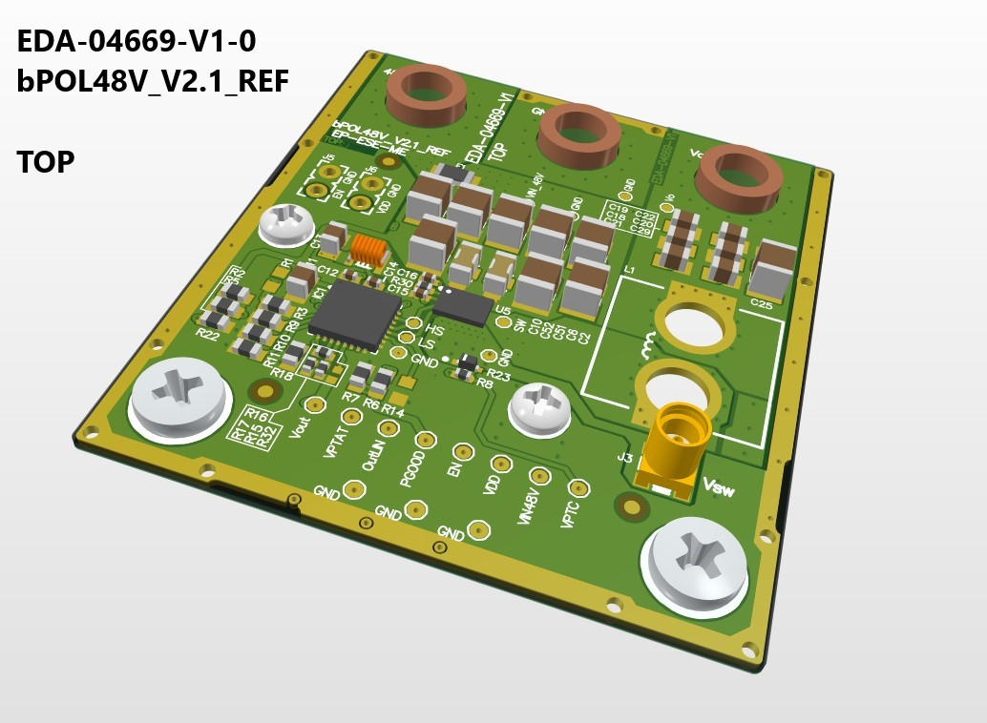
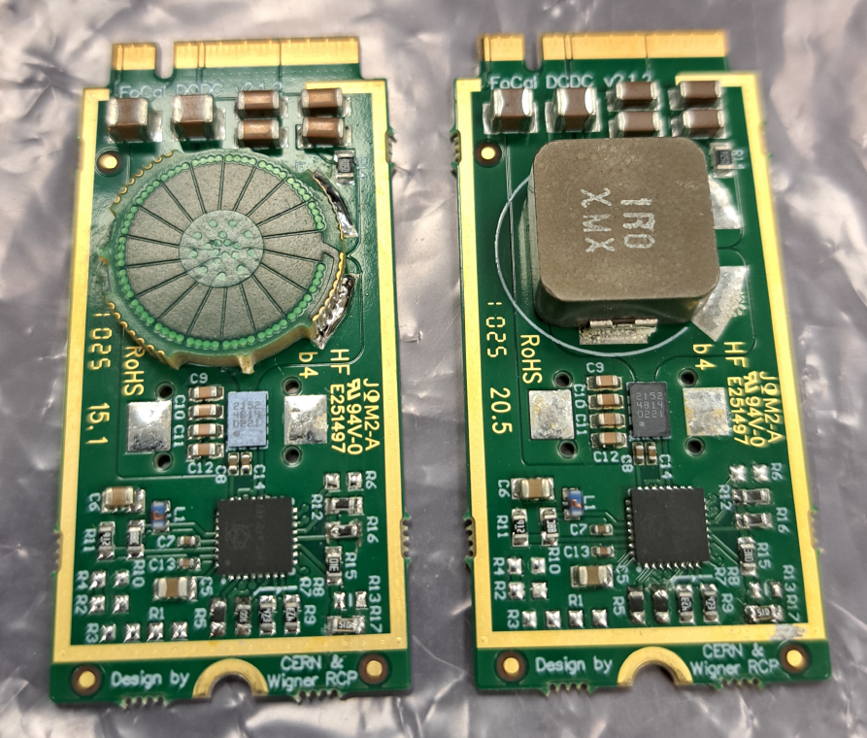
bPOL48 reference design and modules (V2.1)
EDA-04866 with a PCB and ferrite inductor
https://indico.cern.ch/event/1516886/contributions/6383422/attachments/3044485/5379055/bPOL48V-DRD7-4-Apr25.pdf

Slide 3
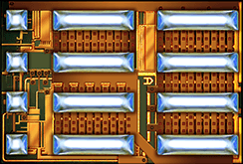
EPC2152, GaN Half bridge
10mΩ, 60V_{DC}, 3MHz…
2.59 x 3.85mm
RadHard
https://epc-co.com/epc/products/gan-fets-and-ics/epc2152

Slide 4
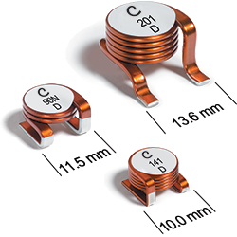
CoilCraft’s air-core power inductors
257nH, ~25A, DCR_{max}= 2.2mΩ, Q = 200 @50MHz
Open magnetic field
High force in magnetic field..
https://www.coilcraft.com/en-us/products/rf/air-core-inductors/high-current-flatwire/1010vs-1212vs-2014vs/2014vs-251/

Slide 5
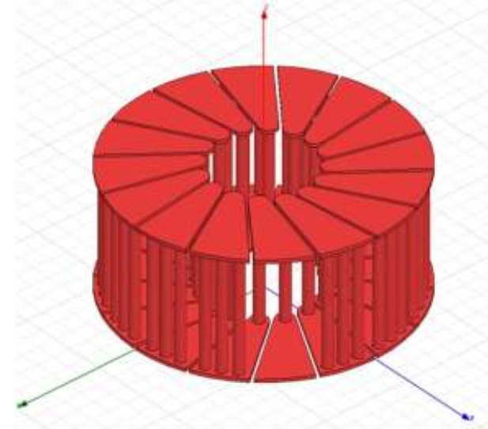
PCB based air core (toroid)coil
small field emission
prone to mechanical vibration
easy to manufacture
good power density
high self resonance
https://scispace.com/pdf/optimization-of-shielded-pcb-air-core-toroids-for-high-5d27fr6u5k.pdf

Slide 6
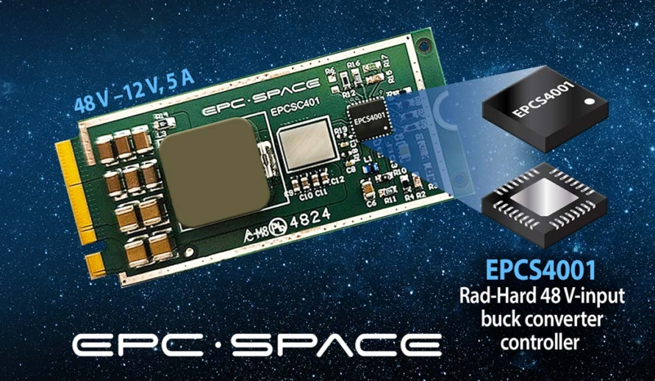
EPCS4001 (2025-04)
New GaN half-bridge (14mΩ)
(EPC7011L7SH, 60V_{DC}, 10A)
Up to 3MHz operation
Space tolerant package
→ bit higher channel resitance
(than EPC2152)
https://epc.space/products/demonstration-boards/epcsc401/

Slide 7
LMG3100R017 (single FET with driver)
Integrated 1.7mΩ (LMG3100R017) or 4.4mΩ (LMG3100R044) GaN FET and driver
100V continuous, 120V pulsed voltage rating
Interated high-side level shift and bootstrap
Two LMG3100 can form a half-bridge – No external level shifter needed
5V external bias power supply
Supports 3.3V and 5V input logic levels
High slew rate switching with low ringing
Gate driver capable of up to 10MHz switching
NO RAD-HARD
https://www.ti.com/lit/ds/symlink/lmg3100r017.pdf

Slide 8
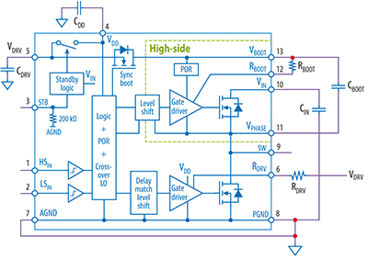
EPC23104 (half-bridge with driver)
100V, 15A, 1MHz, 8.7mΩ, 3.5x3.5mm
NO RAD-HARD
https://epc-co.com/epc/products/gan-fets-and-ics/epc23104

Slide 9
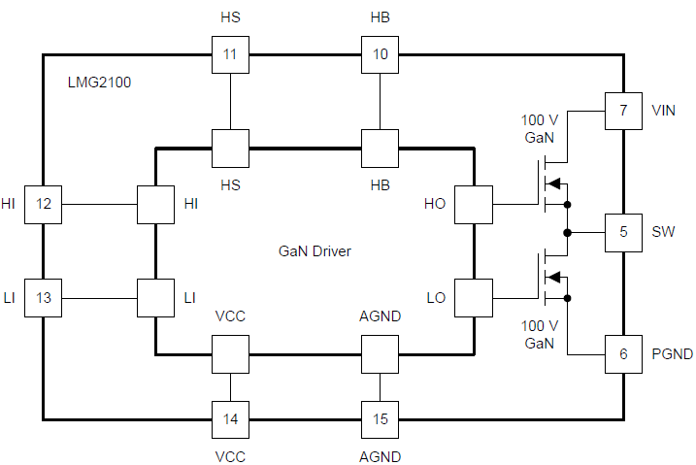
LMG2100R026 (half-bridge with driver)
Integrated half-bridge GaN FETs and driver
93V continuous, 100V pulsed voltage rating
High slew rate switching with low ringing
5V external bias power supply
Supports 3.3V and 5V input logic levels
Gate driver capable of up to 10MHz switching
2.7mΩ High side, 2.6mΩ Low side GaN FET resistance
NO RAD-HARD
https://www.ti.com/lit/ds/symlink/lmg1210.pdf?ts=1781007561856

Slide 10
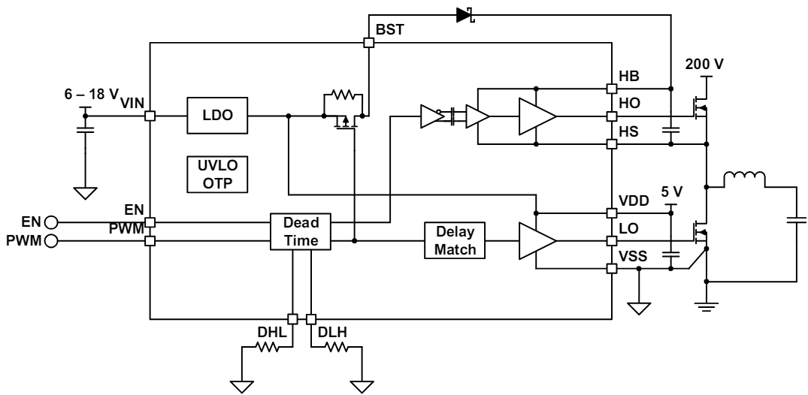
LMG1210 + EPC2366 (single FET + driver IC)
LMG1210 is a 200V half-bridge GaN driver, with max 10MHz operation
EPC2366’s serial resistance is 0.84mΩ (40V)…
NO RAD-HARD
https://www.analog.com/en/products/lt8418.html
https://epc-co.com/epc/products/gan-fets-and-ics/epc2366

Slide 11
Conclusion
Because we need a rad-hard modules, we have no option in component selection → bPOL48/ECPS4001 + EPC2152
Cooling need to be solved →
  AlN PCB material?
  Copper filled VIAs?
  Bottom-up PCB design? (all component on bottom side, full plain on top side)
  Heavy copper layers, or copper core?
Coil design is critical for efficiency (and noise immunity) →
  Try out different topology to increase air core coil inductance (to reduce switching frequency)
  Reduce coil DC resistance (heavy copper PCB, copper filled VIAs, Litz/multi strand tracing, PCB finishing…)
  Compare shielding and toroid designs
Size reduction is needed?

