Slide 1
LUME VA/DT Tutorial
Ryan Roussel
rroussel@slac.stanford.edu

Slide 2
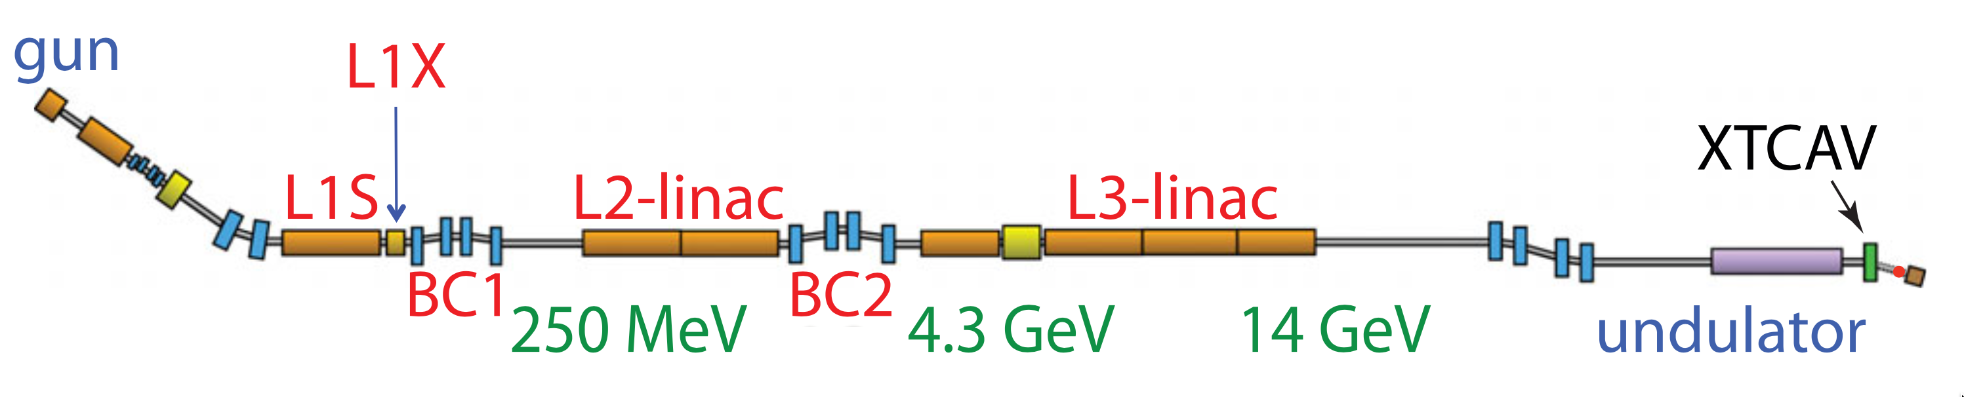
Nomenclature
EPICS
Virtual accelerator
Various interfaces (EPICS, python, etc.)
Users
Applications
Digital twin
Various interfaces (EPICS, python, etc.)
Live machine readings / archived states

Slide 3
Applications of Virtual Accelerators / Digital Twins
Virtual diagnostics (VA / DT)
Online control (DT)
Model calibration (VA / DT)
Accelerator design / operating routines (VA)
Controls software testing / continuous integration (VA / DT)
Operator / algorithm training (VA / DT)

Slide 4
Current State of Affairs
“Simulators”
Python wrappers
IOC serving (i.e. EPICS)
Beam dynamics codes
LUME-Impact,
PyTao, ad-hoc
Analytical calculations
PCASpy
Surrogate models
LUME-Torch
Implementation barriers (custom/ad hoc implementations per use case)
IOC read/write

Slide 5
Implementation Goals
Create a standardized Python API / toolset for arbitrary simulators w/ multiple entry points
Simulator 1
LUME-pva
LUME-Model
Simulator
Simulator
Simulator 2
Simulator
Simulator
Simulator 3
Simulator API
(LUME-Impact, PyTao)
Standardized LUME-Model API
(dicts, IOC names / units)
IOC Interface
(EPICS)

Slide 6
LUMEModel Structure
LUME-Base
LUMEModel
set
Set control variables by name and run the sim/model, then update the model’s state
get
Read back model state by variable name
any simulator can implement these methods
reset
Restore model to initial state
supported_variables
Dictionary of named variables that the model supports

Slide 7
LUMEModel Structure
LUME-Base
LUMEModel
set
Set control variables by name and run the sim/model, then update the model’s state
Variables define types, units, read/write permissions for model inputs and outputs + validate inputs / outputs
ScalarVariable: float-like scalar variables (individual parameters, etc)
NDVariable: array-like multi-dimensional variables (screens, wire scans, etc)
ParticleGroupVariable: openpmd-beamphysics ParticleGroup variables
TorchScalarVariable: torch version of ScalarVariable
TorchNDVariable: torch version of NDVariable
get
Read back model state by variable name
any simulator can implement these methods
reset
Restore model to initial state
supported_variables
Dictionary of named variables that the model supports

Slide 8
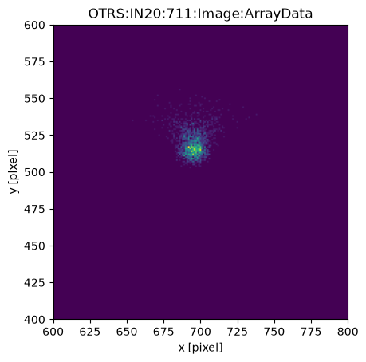

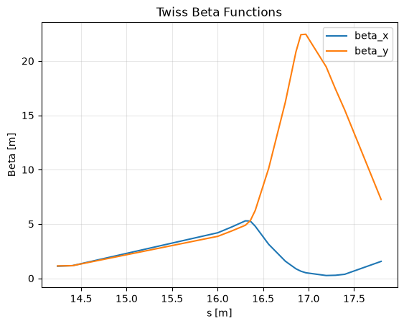
Example Interactions via Python API
Once a LUMEModel instance is defined, users interact with it via set(), get() methods in control/model name parlance and/or object properties
Initialize model
Set model parameters via PV name/units
Get model parameters via PV name/units
Get model parameters provided by simulation

Slide 9
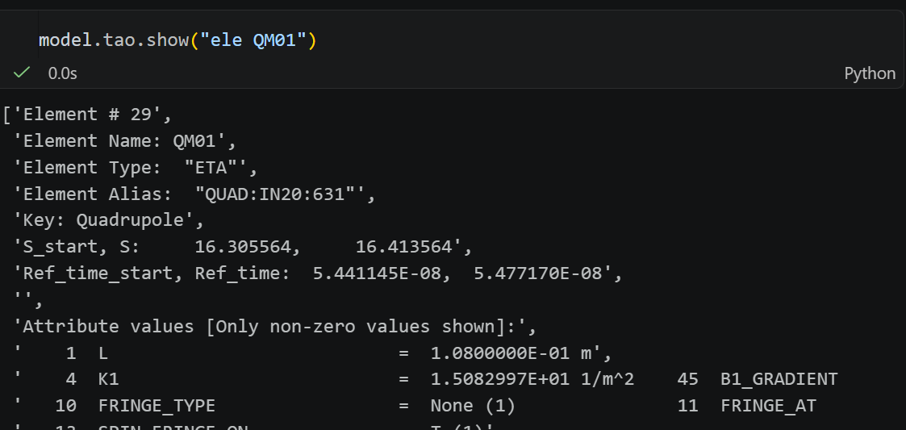
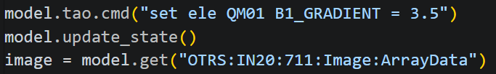
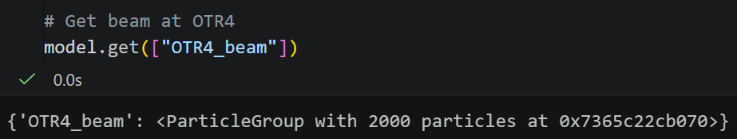
Example Interactions via Python API
Once a LUMEModel instance is defined, users interact with it via set(), get() methods in control/model name parlance and/or object properties
Interact with underlying simulator
Interact with underlying simulator + PV
Get beam distribution
(openPMD-beamphysics ParticleGroup)

Slide 10
LUME Package Structure for Simulation Codes
LUME-Base
LUMEModel
StagedModel(LUMEModel)
Simulator agnostic
LUME-pva
EPICS PV serving
Facility agnostic
LUME-Cheetah
LumeCheetahModel(LumeModel)
LUME-Impact
LumeImpactModel(LumeModel)
LUME-Torch
LumeTorchModel(LumeModel)
LUME-Bmad
LumeBmadModel(LumeModel)
LUME-Genesis
LumeGenesisModel(LumeModel)
(under development)
Facility specific
LCLSCuHxrModel(StagedModel)
CUInjector
CULinac
HXRUndulator

Slide 11
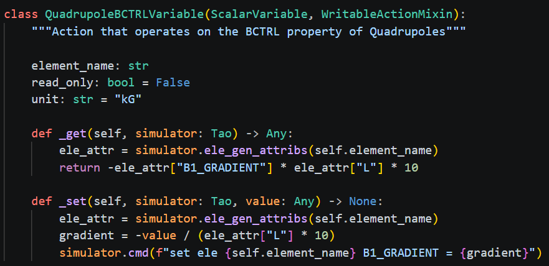
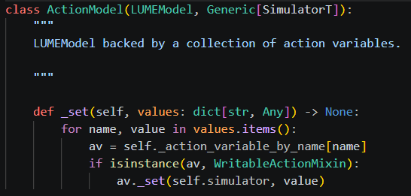
LUME Actions
LUME Actions enhances LUME variables with set() and get() methods that act on simulators
Good place for facility specific conversion logic
Stack actions to build large-scale virtual accelerators inside LUMEActionModel subclass

Slide 12
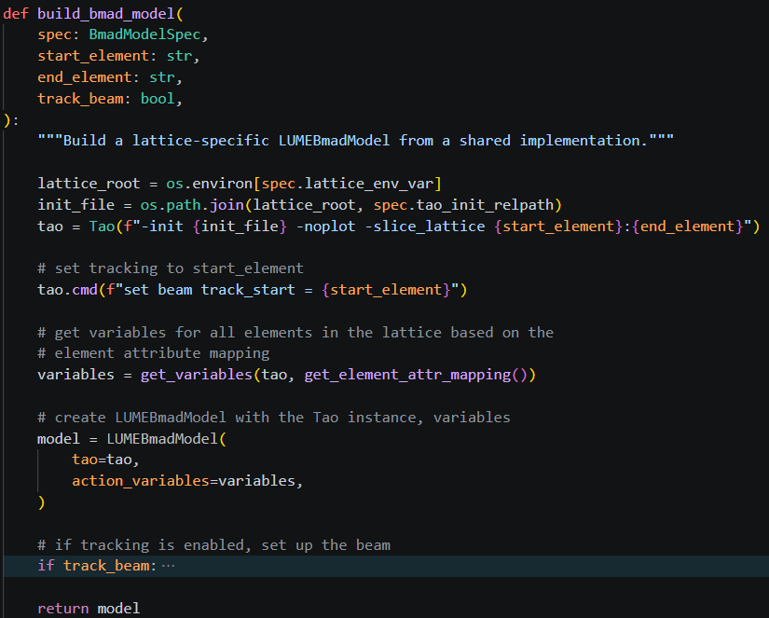
Example Implementation: LCLS CU HXR (Bmad)
PyTao initialization + lattice slicing

Slide 13
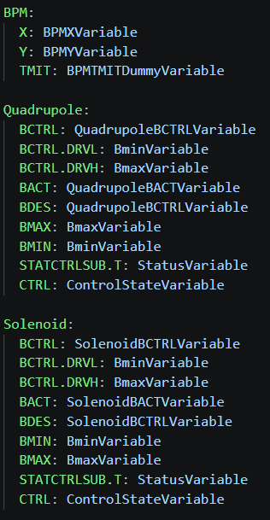
Example Implementation: LCLS CU HXR (Bmad)
Generate action variables based on lattice

Slide 14
Example Implementation: LCLS CU HXR (Bmad)
Create LUMEModel instance

Slide 15
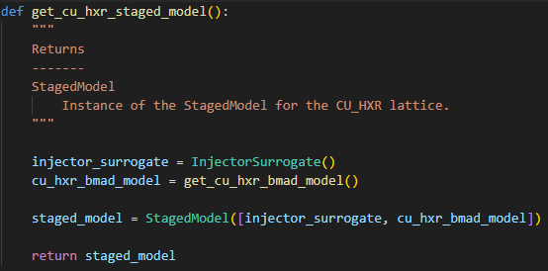
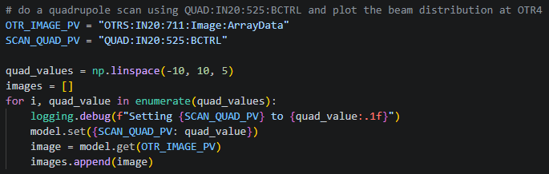
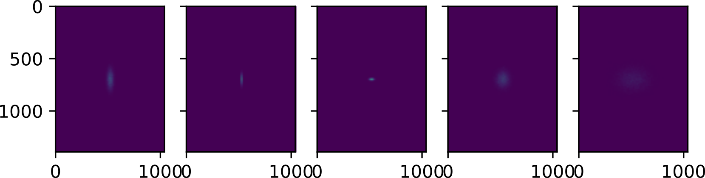
Example Implementation: Staged Model
LUMETorchModel
LUMEBmadModel
ParticleGroupVariable
LCLSCuHxrModel(StagedModel)
PyTorch
PyTao
Set PV in injector NN surrogate
Read screen PV in linac Bmad sim

Slide 16

Example: Running in EPICS w/ LUME-pva
Subclasses of LUME-Model can immediately be used to create an EPICS PV server by using the LUME-pva Runner class
Utilizes LUME-Variable types to create PVs
Multi-threaded collection of PV commands and simulation running
Could be subclassed / extended to other IOC systems (DOOCS, etc.)

Slide 17
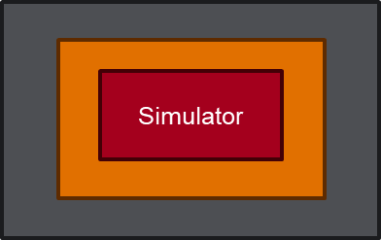
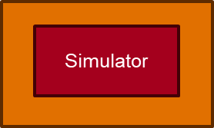
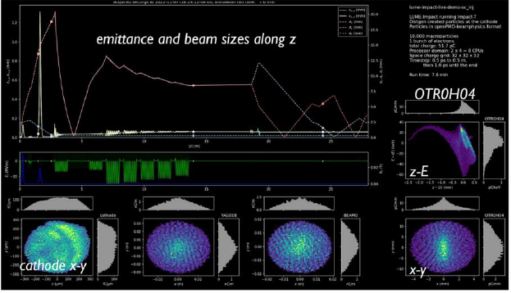
Virtual Accelerator / Digital Twin Interactions
Virtual accelerator in python
Virtual accelerator in container
Container instance
Python instance
User
Python
User
EPICS
Digital twin in container
Machine snapshot
Digital twin in global server
Machine snapshot
Machine snapshot
Machine snapshot
Container instance
Visualization
User
EPICS

Slide 18
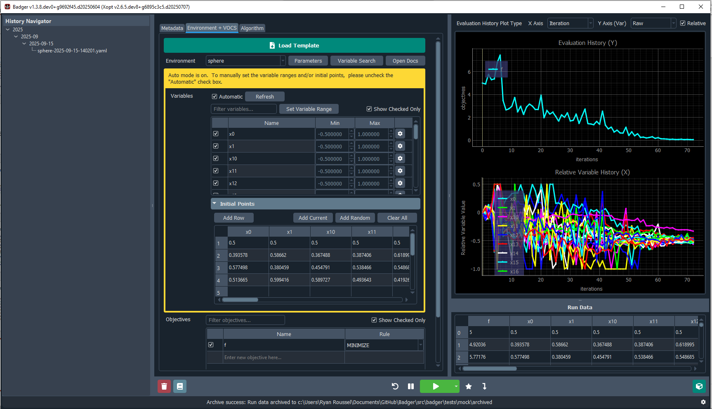

Badger Environment Testing / Continuous Integration
Use VA to perform nightly testing / validation of code used to interact with the machine
Badger GUI
LCLS Badger Environment class
Nightly testing workflow
Class instance
Testing report
EPICS
EPICS
not available for software testing
LCLS Machine
LCLS Virtual Accelerator

Slide 19
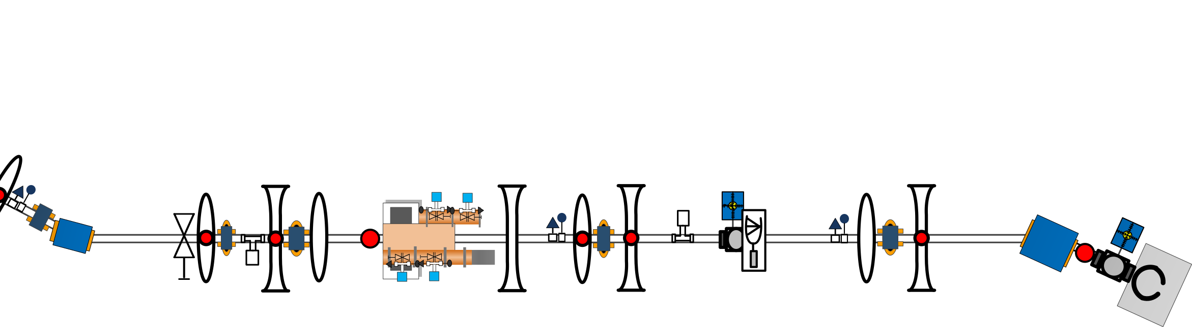
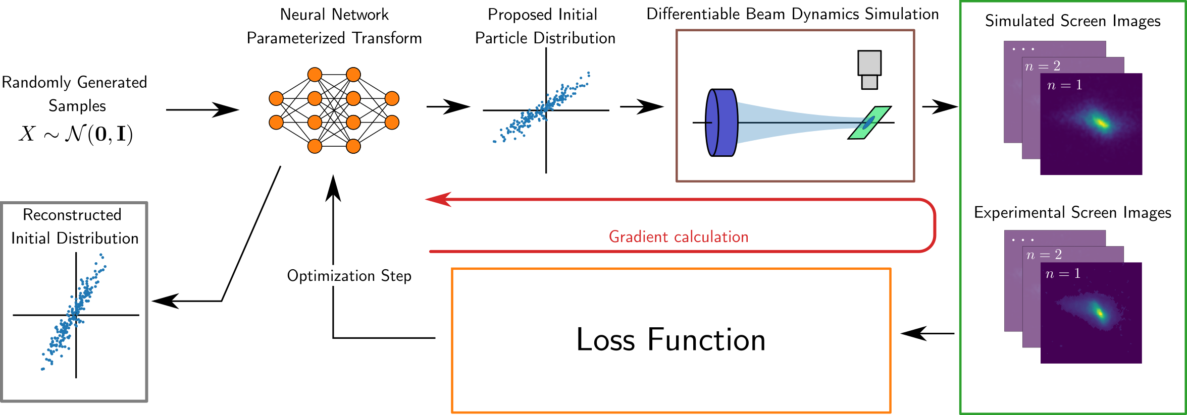
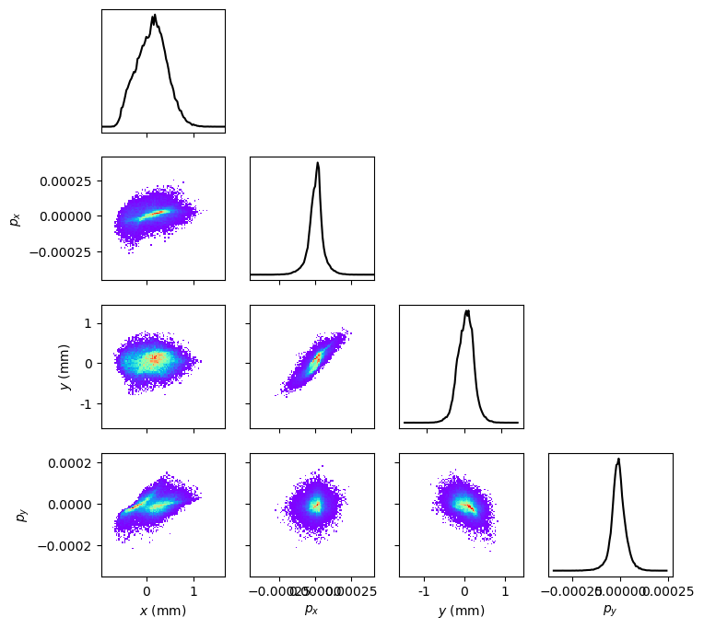
VA for Model Calibration / Phase Space Meas.
Black-box (Impact / Bmad) and differentiable simulators (Cheetah, surrogates) can be used inside VAs to perform model calibration, phase space reconstruction
Improved VA
Experimental measurements
Ex: LCLS-II DIAG0 beamline
Loss function
Machine state
LUME-Model
Predicted meas.
Simulator
Reconstructed beam distribution
Simulator
Update internal simulator
Post-optimization

Slide 20
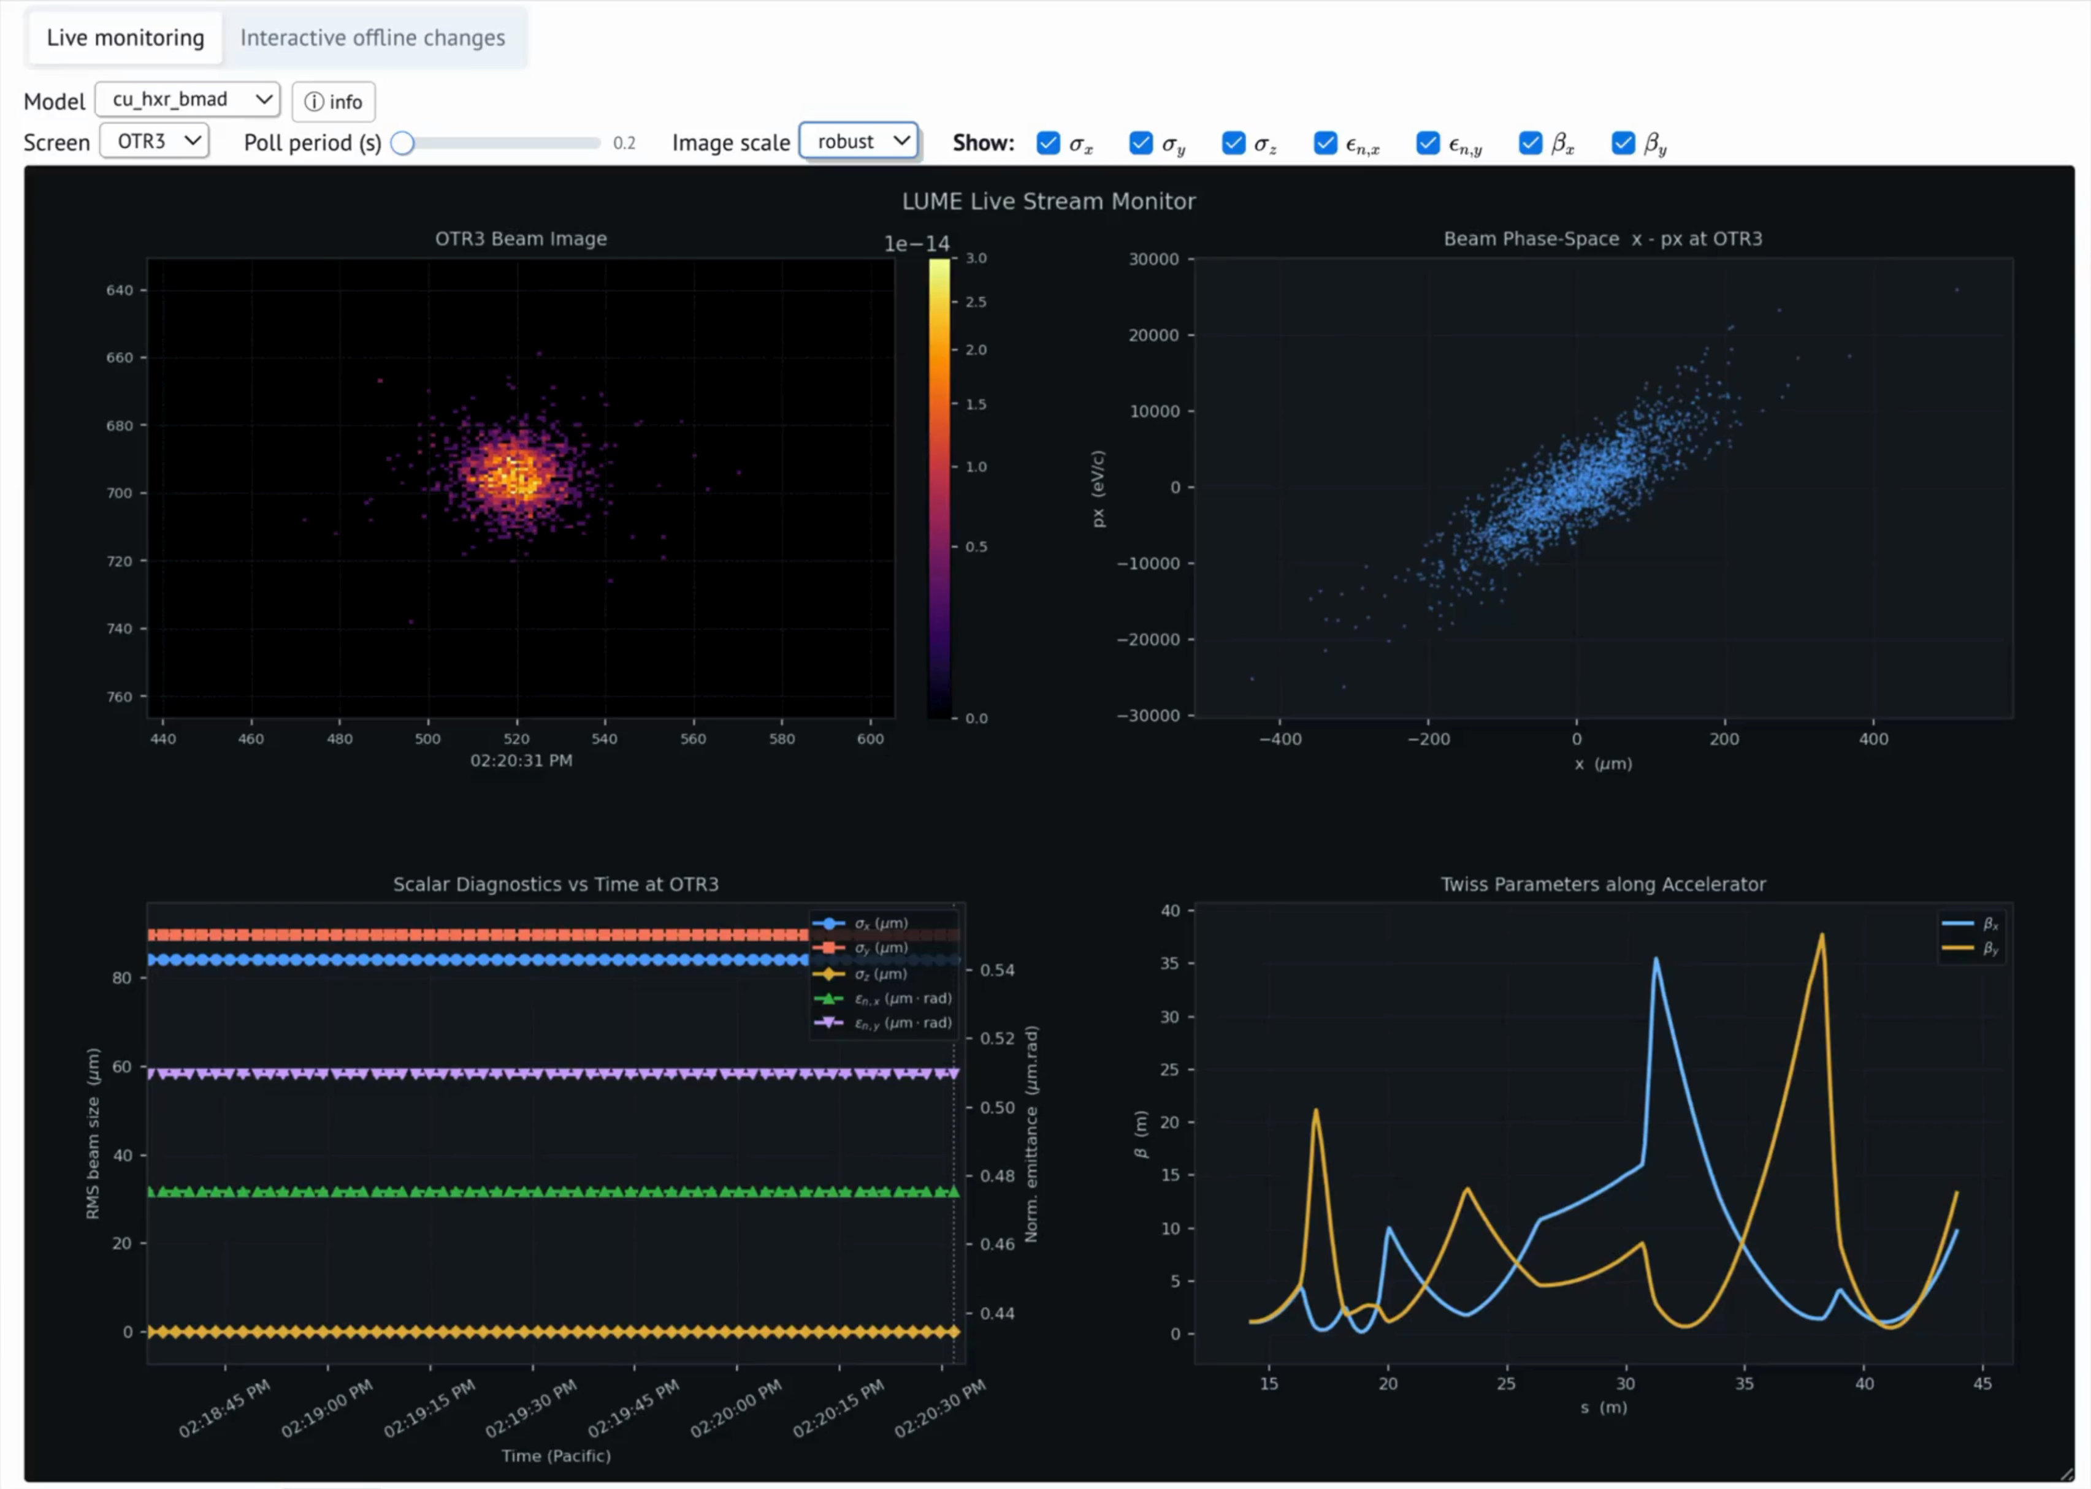
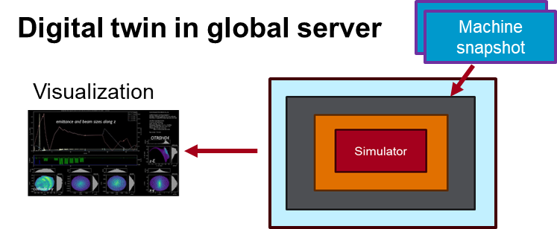
Digital Twin Live Deployment
https://ard-modeling-service.slac.stanford.edu/live-monitor/w3/
Slide from Sara M.

Slide 21
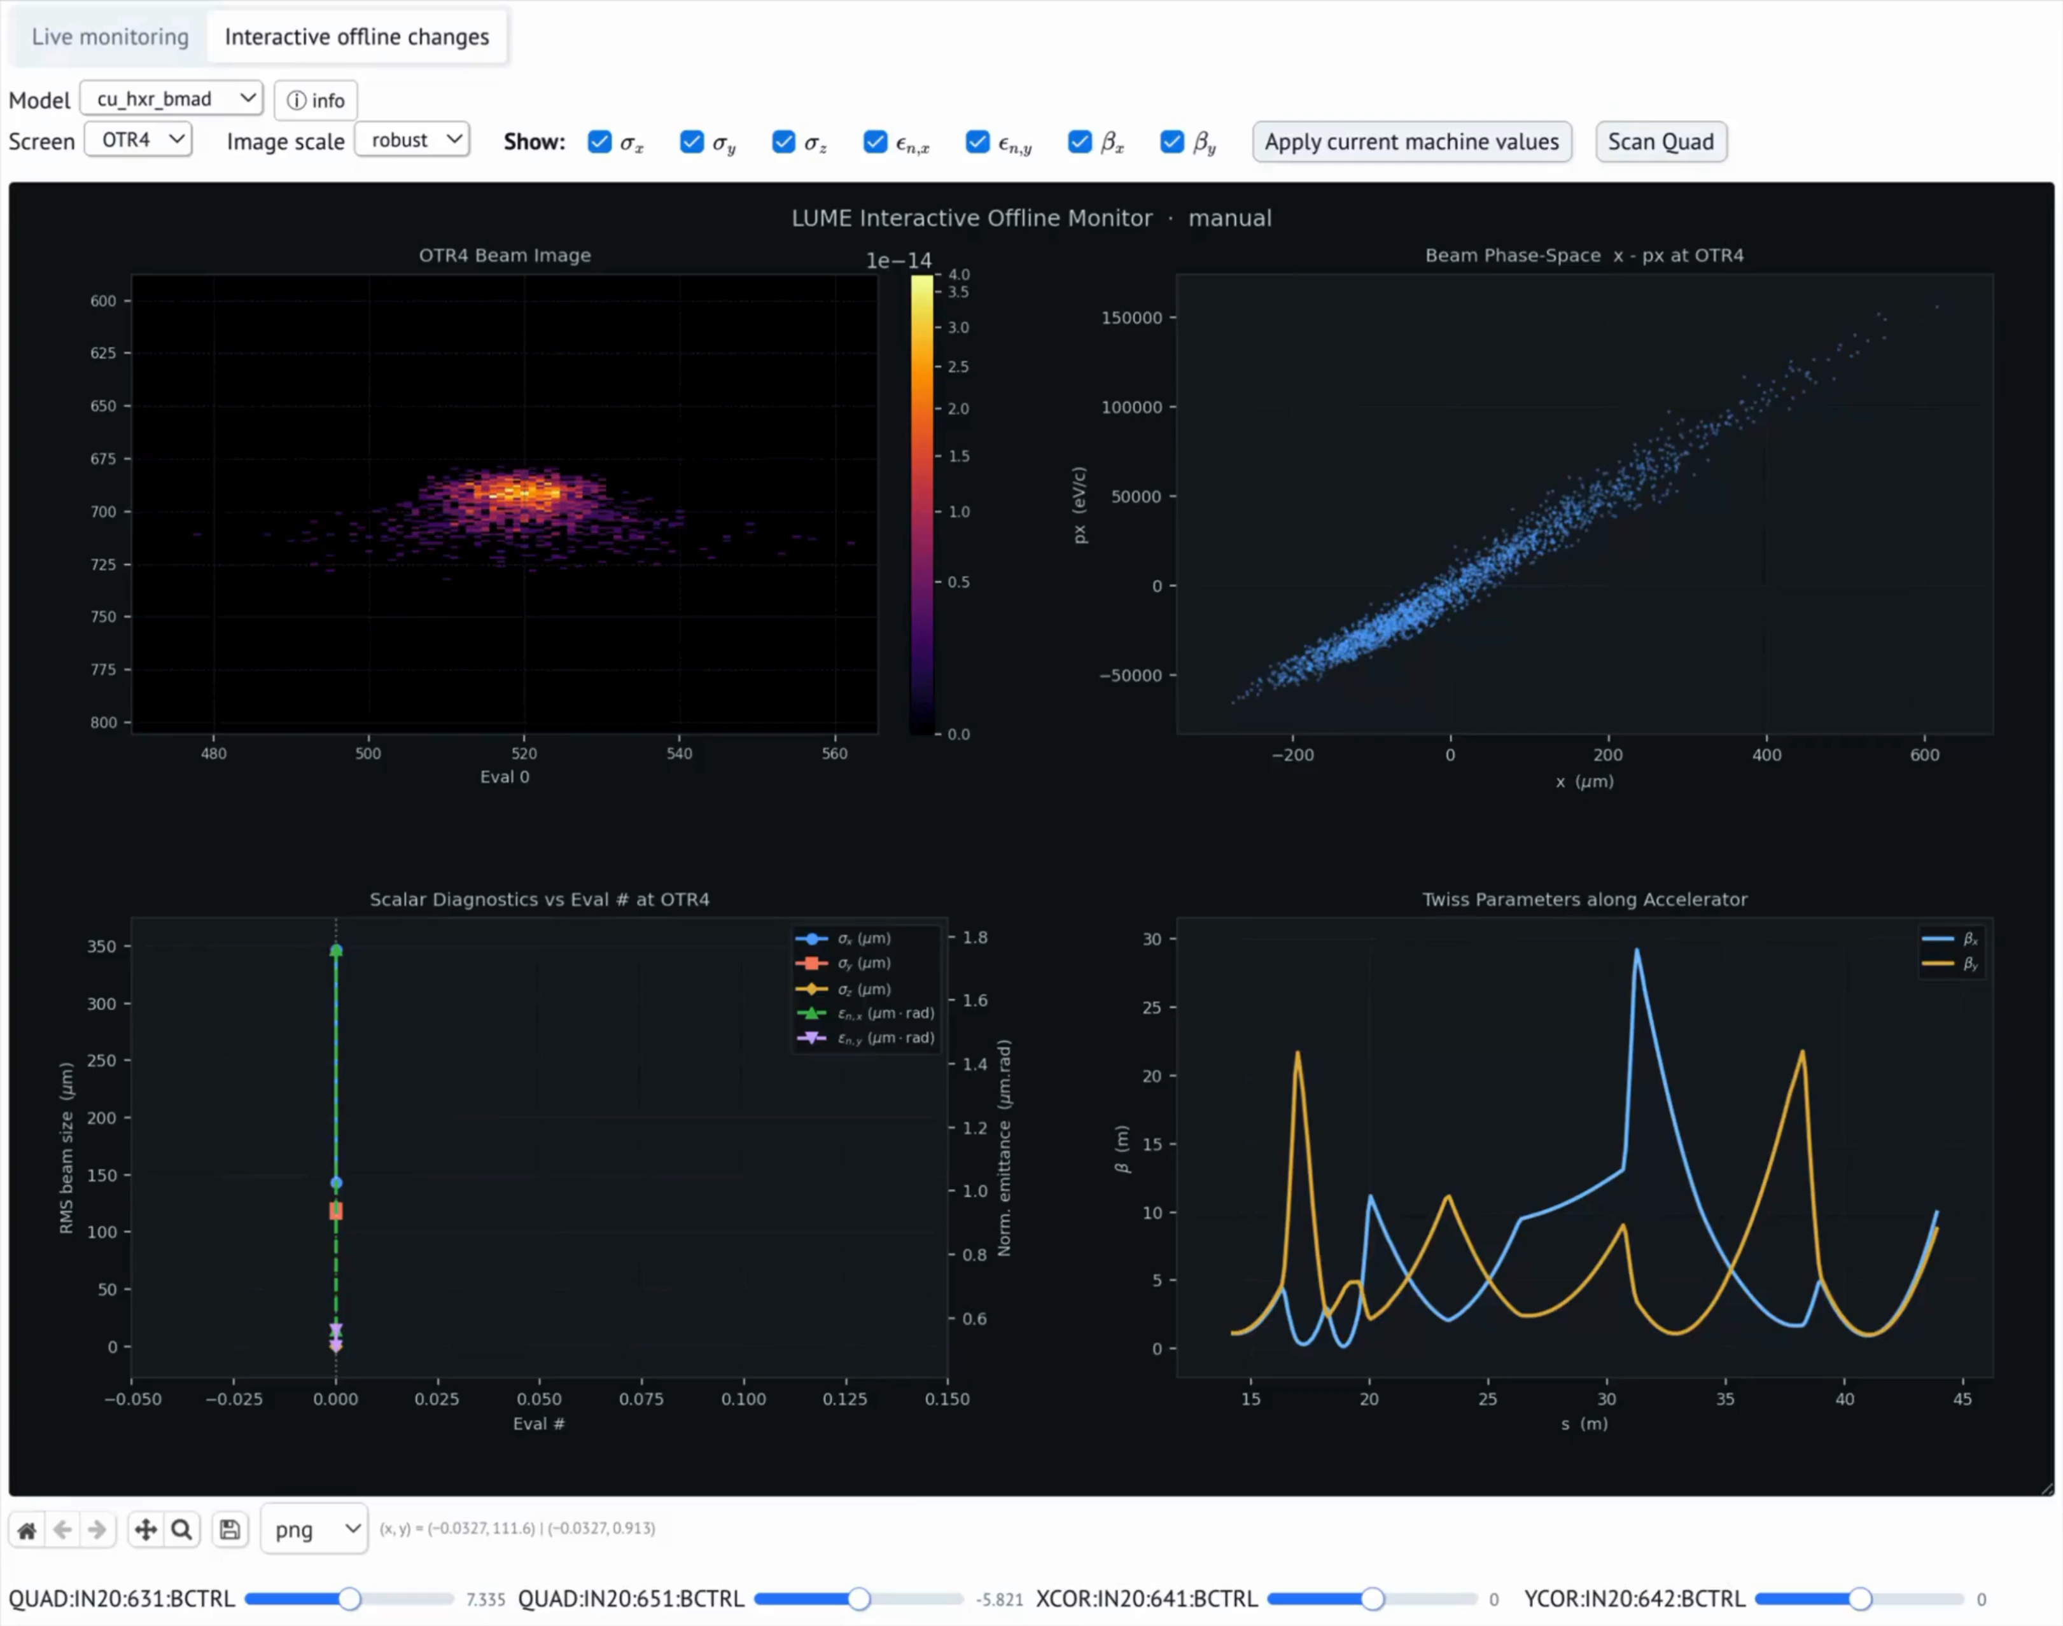
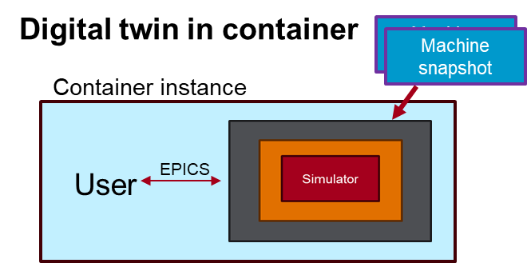
Interactive VA Mode from Live State
Slide from Sara M.

Slide 22
Online applications of VA/DT
Badger training tool:
https://ard-modeling-service.slac.stanford.edu/badger/
Live accelerator VA/DT
https://ard-modeling-service.slac.stanford.edu/live-monitor/

Slide 23
Conclusion
LUMEModel, and subclasses provides a standardized, extendable way to run virtual accelerators with realistic IOC names / units
Modular approach allows both interactions via python API and with LUME-pva, IOC serving (necessary for satisfying multiple use-cases)

Slide 24
Tutorial Link
https://colab.research.google.com/drive/1H-yOSBj3mmbEOqK7-zSloEFnINVEDjfl?usp=sharing

Slide 25
Backup

Slide 26
A Note On PALS
Ultimately PALS will aim to handle a lot of this, future LUME-PALS may look like:
LUME-Impact
LUME-Bmad
LUME-Cheetah
LUME-Base
LUMEModel
LUME-PALS
LUMEPalsModel(LUMEModel)
LUME-Pals allows for the selection of different simulator backends

Slide 27
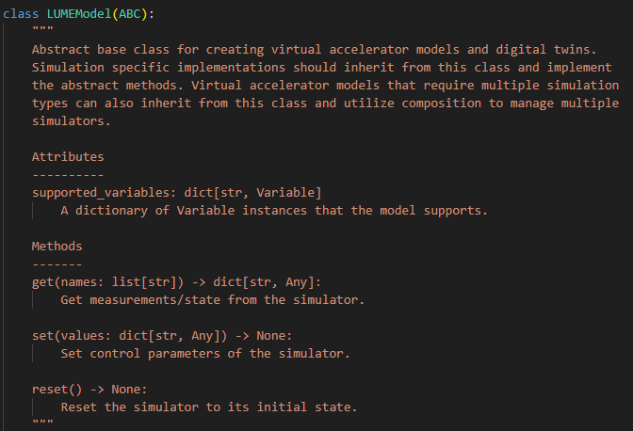
LUME-Model Class
Defines fixed Python API for IOC (and other parameters)
get(list[str])
set(dict(str,Any))
reset()
supported_variables defines dict of IOC names that are supported by the model

Slide 28
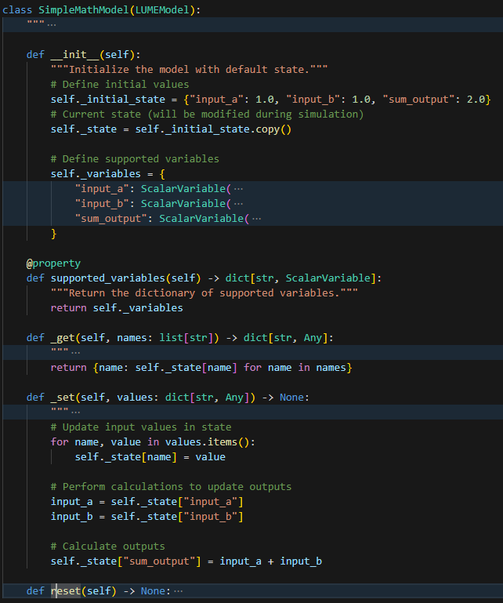
Basic LUME-Model Implementation
Agnostic to simulations / EPICS etc. → useful for software dev / testing, CI, etc.

Slide 29
Considerations for Simulator-Specific LUME-Model Subclasses
Some observations
  Each code has a specific way for running, modifying, extracting data from simulations – LUME-Model subclasses serve as an abstraction layer to unify this
  Each facility has a different way of defining control names, units, custom behavior
Where we are headed:
Each facility will map their unique infrastructure to PALS
LUME can provide abstraction logic to run / modify simulations based on PALS info
Current: Each connection is unique
Bmad
SLAC IOC
Bmad
LUME-Bmad
SLAC-mapping
SLAC IOC
PALS
Impact
BNL IOC
Impact
BNL IOC
LUME-Impact
BNL-mapping
Parallel Strategy: Implement facility-specific transformers with common patterns for each code, then transition to PALS-based transformers for each code type, LUME-Model subclasses remain the same

