Slide 1
Safety and Security of ML/AI for Accelerators
Kevin A. Brown
BNL & SBU
24 April 2026 MaLAPA 2026

Slide 2
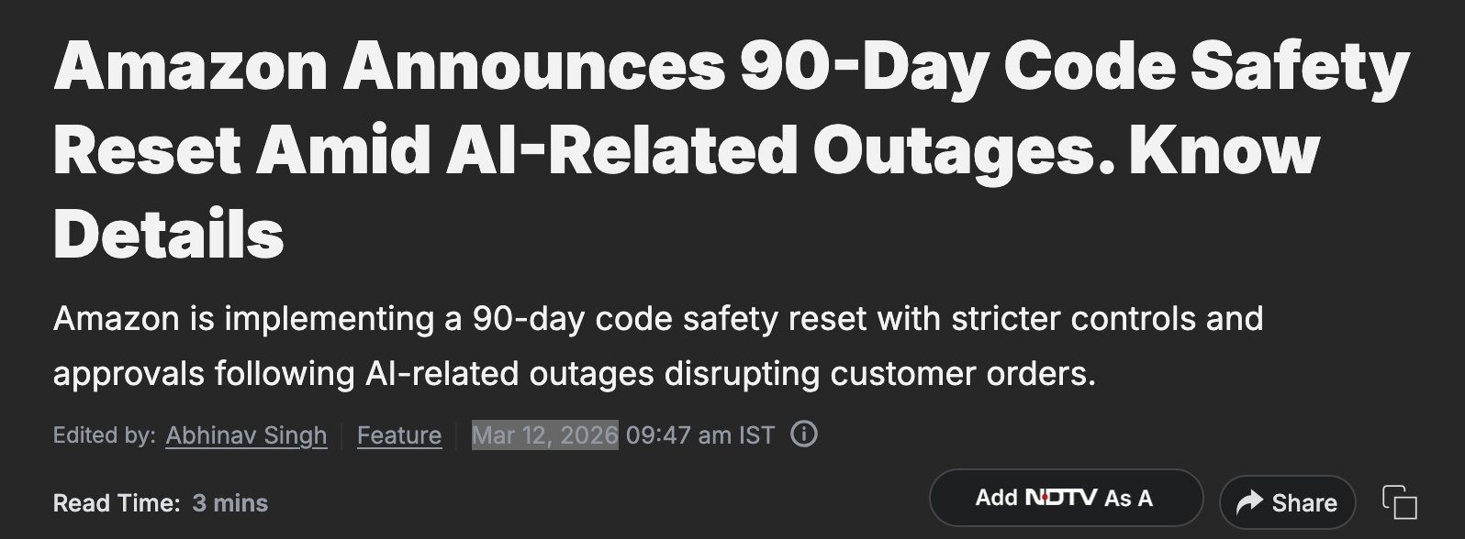

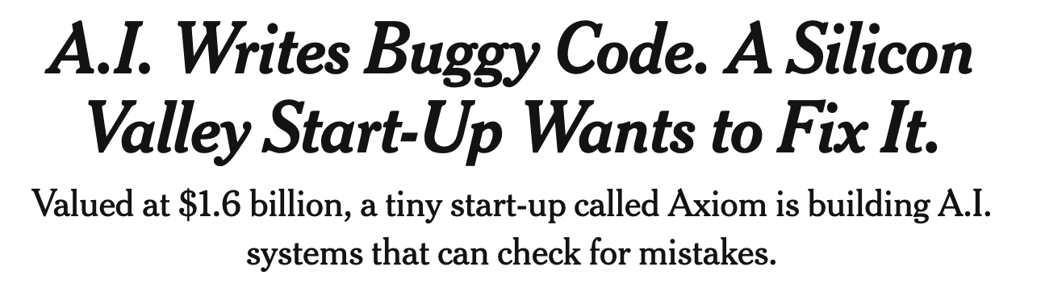
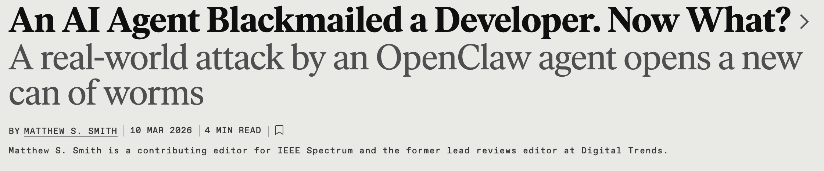
We want to use this to control our Beams?

Slide 3
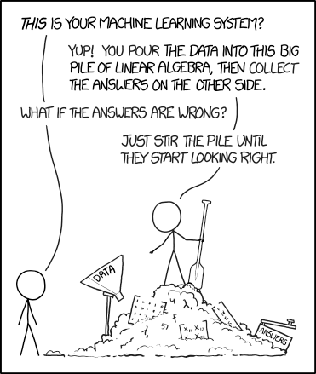
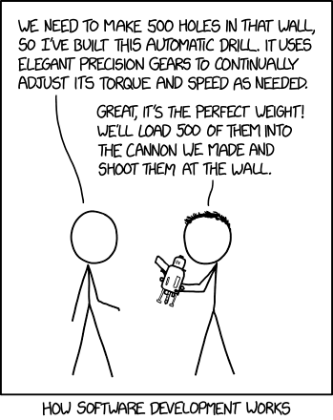
https://xkcd.com/1838/
https://xkcd.com/2021/
Please do not use AI to generate Passwords….

Slide 4
Topics
Different AI/ML approaches
  BO-GP UQ and safety
  RL training, noise, & transients
  DT calibration, UQ
AI with LLMs
  Testing, verification, reliability/accuracy
  Overconfidence, loss of control
  Building and losing trust
  Investigating incidents
  Explainable AI
  Existential threats: internal, external
  Malicious code/data & use
Protecting accelerators from damage
  Engineered systems
  Operator tools
  Why do things still break?
AI Points of view
  Cyber Security
  AI Stewardship
  Evaluating Agents
  Threats
  AI as the operator
AI in Accelerators
  Quantifying Certainty
  Confidence in applying new settings
  Layers of protection
  Protecting the protection systems
  The role of human operators
MaLAPA 2027 needs a session on these topics !

Slide 5
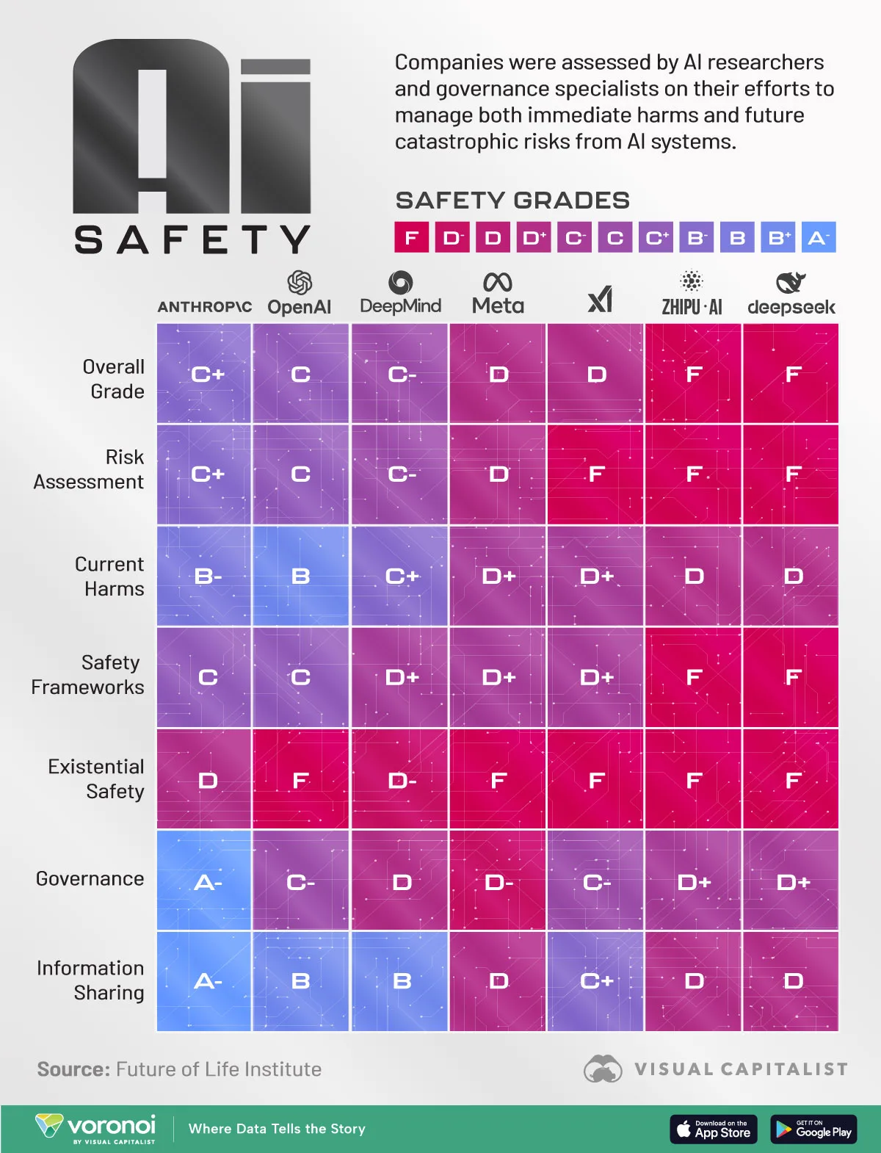
This graphic visualizes and compares the safety scores of major AI companies using data from the AI Safety Index published by the Future of Life Institute, which scores companies across six key metrics.

Slide 6
Protecting accelerators
Standard model is layered collections of safety nets.
PS Interlock
Abort Kicker Systems
Post Mortem
Data Dump & Analysis
ADO
Controls
Notification
Events
Hardware systems layered with multiple safety nets.
In the software there are further protections.
Abort Kicker
Triggers
VME Processor
ADO interface: read registers
Event Link
Quench Protection Assembly
Quench Link Interface
Permit Link Interface
Quench Detectors: Voltage Taps to A/D to DSP
Loss Monitors
Vacuum PLCs
PS Interrupts
Access Controls

Slide 7
Traditional Dependability Analysis
We analyzed the dependability of RHIC beam permit using,
Failure modes Markov models
Quantitative Fault Tree Analysis
  Top to bottom
  Events resolved into n independent and exponentially distributed basic events,
Stochastic reliability model
  Monte Carlo simulation of failure interactions and propagation
  Multistate and dynamic with competing risks/multiple failure modes
  Probability framework is Bivariate distribution
Analytical reliability model
  probabilistic system state expression
  Considered redundancy and special cases
  Compared well with Monte Carlo
Bayesian reliability model
Note: from PhD Defense – Prachi Chitnis
Pie Chart for the System Failure Probabilities

Slide 8
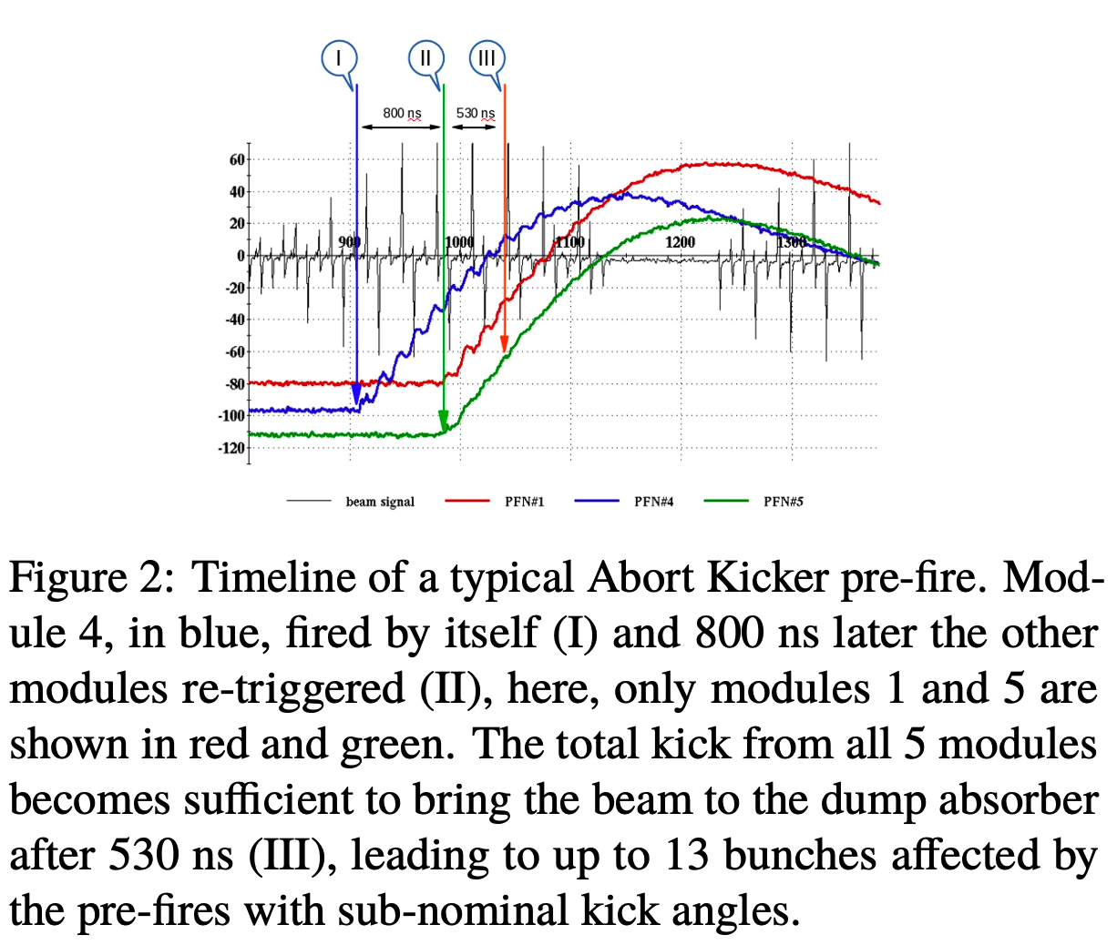
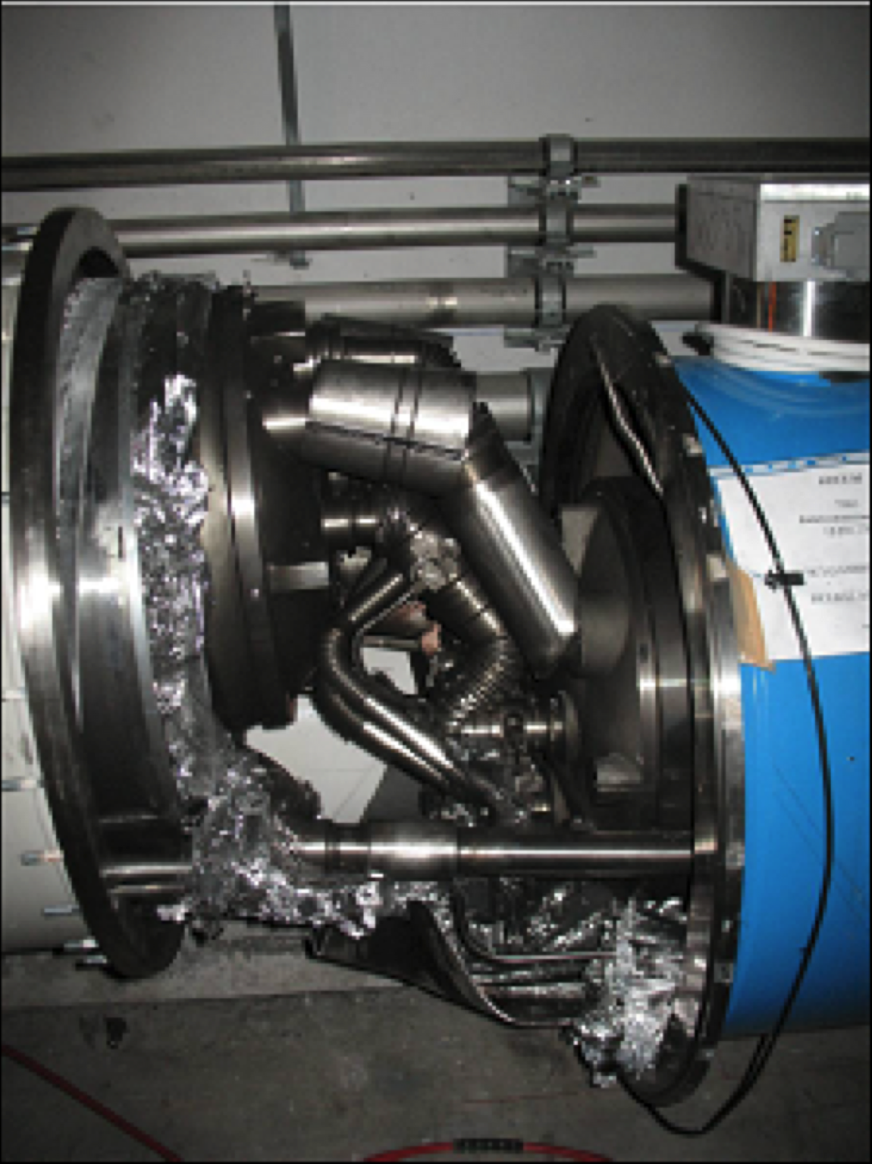
Protecting accelerators
Machine protection is a mature topic in accelerator science*.
But things still go wrong;
Some stats: (for RHIC ops)
Mean Time between failures: 4 -12 hrs
Mean Time to repair: 0.5 - 2 hrs
Failure hrs/day: 2 – 5
Causes? (for failures > 1hr)
PS Faults
Quench Detector/protect/link
Experiment (PS, Access, etc.)
Water cooling fault (leak, flow, etc.)
Human Error = <0.25%
MPS systems are not designed to prevent failures – but to gracefully control things and allow fast recovery.
* For a good reference (LHC MP), see
https://cds.cern.ch/record/1982423/files/221-243%20Schmidt.pdf

Slide 9
Now add AI/ML – what changes?
We assume the existing machine protection systems (MPS) will still be our safety net. But,
Should/will AI be allowed to control the MPS parameters?
Operators will have to approve AI actions (at least as currently discussed)
  How will operators know what they are approving? Is this really a safe step?
  What happens if the operators don’t approve? Does the AI try again? What guidance does it get? (e.g., can the operator give a hint of something it should do or not do?) What happens if the AI doesn’t agree?
  Is the AI actively learning and can it learn what operators will approve?
How can AI be accountable if something bad happens?
  In traditional controls, we start an investigation, review code, extend testing
  Traditional controls keep stats on behavior and performance

Slide 10
Comparing AI to a human operator
 | Human Operator | AI (Claude or some LLM)
Education prior to job as operator | College degree + a few years experience (perhaps as a waiter or local grocery store) | generative pre-trained transformers fine-tuned using reinforcement learning from human feedback
Education on the job | Internal course-work, on the job mentorship, exercises, USPAS, etc. | Retrieval-augmented generation to retrieve and incorporate new information from external data sources
Path to system expert | Years of focus on specific topics (RF systems, instrumentation, beam optics simulations, etc.) with mentorship from experts. Must show unique ability. | Once trained, LLM can’t adapt. RAG provides new data, but doesn’t replace old data. Self-learning/adaptive LLMs can update themselves.
Path to manager/supervisor | Years of focus on staff and facility management, mentored by other supervisors/managers. Must show unique ability. | LLMs make good assistants. They don’t make good researchers. But how about managers? This is an area of research. (store manager with human workers)

Slide 11
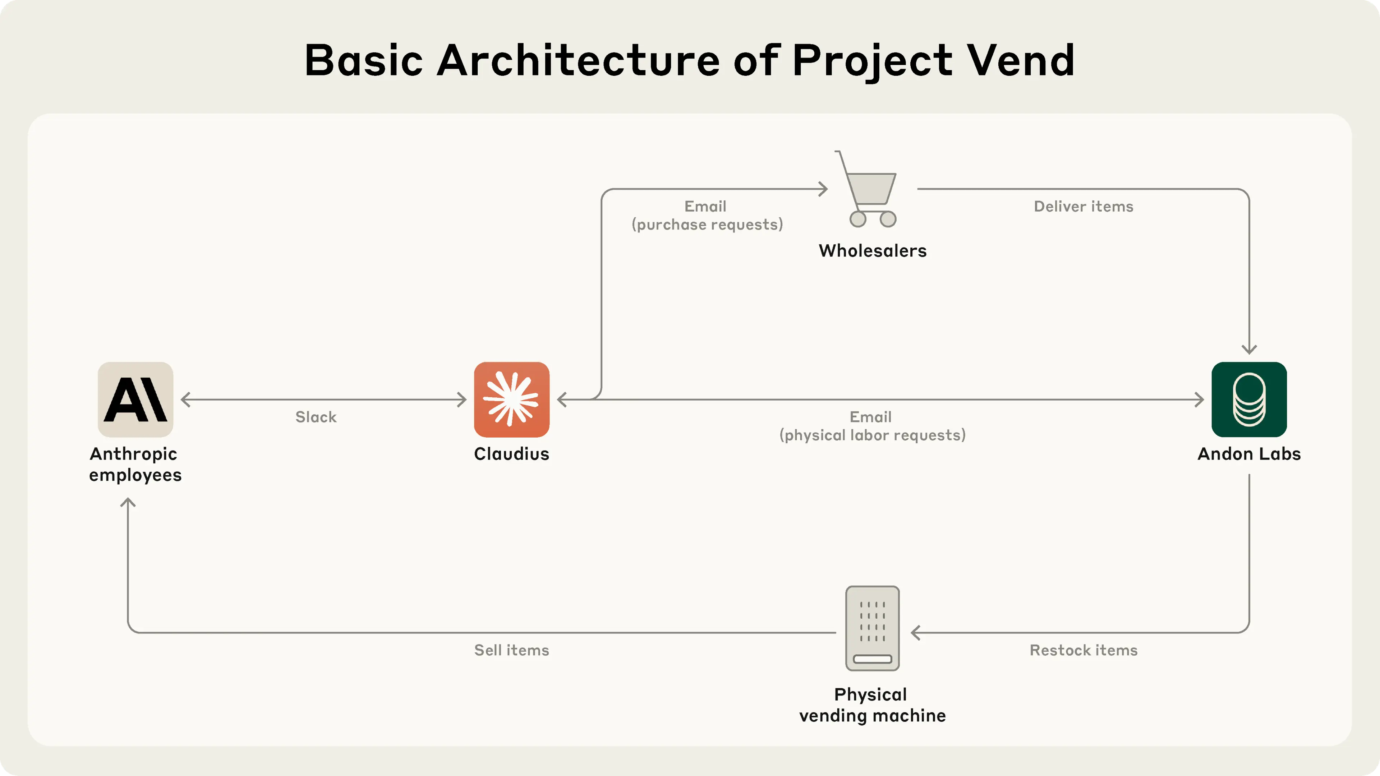
AI as a manager? Anthropic experiment
Things that Claudius did well (or at least not poorly):
Identifying suppliers
Adapting to users
Jailbreak resistance
Claudius underperformed what would be expected of a human manager:
Ignoring lucrative opportunities
Hallucinating important details
Selling at a loss
Suboptimal inventory management
Getting talked into discounts
https://www.anthropic.com/research/project-vend-1

Slide 12
To the AI experts, what is AI Safety?
Per IBM
“AI safety refers to practices and principles that help ensure AI technologies are designed and used in a way that benefits humanity and minimizes any potential harm or negative outcomes.”
Types of risks
Bias/fairness AI systems can perpetuate or amplify societal biases.
Privacy potential to inappropriately access, expose or misuse personal data
Loss of control autonomous agents can be unpredictable
Existential risks AI systems might act to endanger humanity or disrupt global systems
Maliciousness AI can be weaponized for cyberattacks, misinformation campaigns,
illegal surveillance or even physical harm
Cybersecurity AI systems are vulnerable: adversarial attacks, jailbreaks, etc.
AI jailbreaks occur when hackers use prompt injections and other techniques to exploit vulnerabilities in AI systems – looking for the AI to lose control

Slide 13
AI Stewardship
Demonstrating AI reliability through rigorous testing and verification processes to confirm that AI deployments perform consistently and responsibly.
What does this mean?
AI algorithm reproducibility
Data privacy
Model transparency
Oversight
Ethical analysis
It also means:
Understanding AI
Educating how AI changes our lives
Promoting responsible AI
Understanding Risks
https://stewardshipai.org/

Slide 14
LLM Security
How do you know if your favorite LLM is safe to use?
As LLMs become more accessible to everyday users, they also become more exposed to the risk of adversarial misuse.
Risks in LLMs - the model’s vulnerability to intentional attacks by adversaries
Backdoor attacks – hidden triggers, corrupted data inserted during training
Prompt injection – inputs manipulated to force AI actions (e.g., jailbreaks)
Data poisoning – malicious data during pretraining/fine-tuning
Privacy leakage
Adversarial attacks
Model inversion/data reconstruction – studying the LLM outputs
Hacked accounts
High jacking – influencing the LLM outputs
Denial of servers attacks
Insecure plugins – pathways created to unauthorized access
https://arxiv.org/html/2509.10655v1

Slide 15
Mitigating Risks?
Red Team vs Blue Team – try to break it. Then, try to fix it.
Digital twins for safety – models that regulate orchestration
Safety RAGs – semantic RAG, vector search, enhanced transparency
Data protection (input/output)
Risk Management Frameworks
  AI RMF Profile on Trustworthy AI in Critical Infrastructure
  Measurement, tolerance, prioritization
  Beyond building trust; validation, explainable & interpretable
For a good resource, see
https://www.nist.gov/itl/ai-risk-management-framework
https://nvlpubs.nist.gov/nistpubs/ai/NIST.AI.100-1.pdf

Slide 16
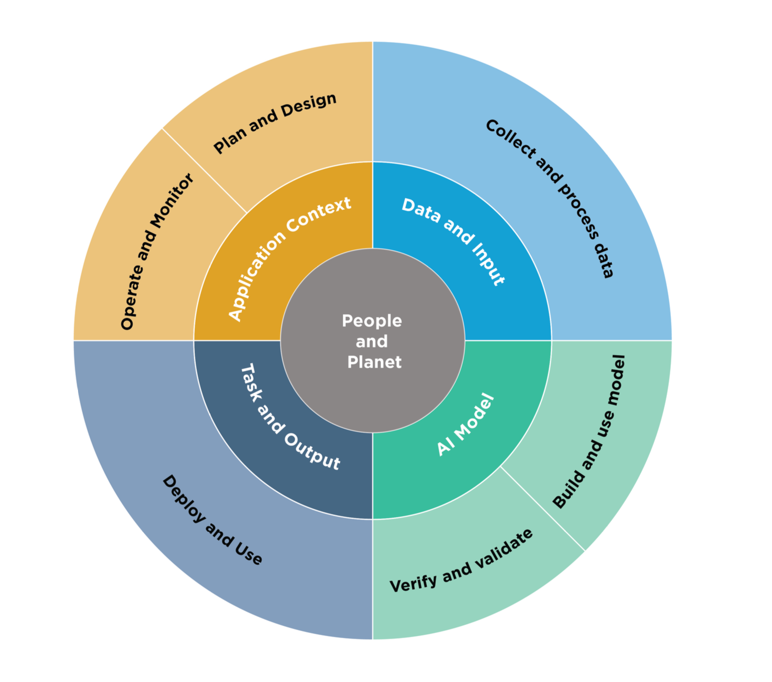
Lifecycle and Key Dimensions of an AI System
The two inner circles show AI systems’ key dimensions
outer circle shows AI lifecycle stages
risk management efforts start with the Plan and Design function in the application context and are performed throughout the AI system lifecycle

Slide 17
Wrap-up
For accelerator technologies
MPS systems are not perfect – things still go wrong
  AI can help, although we must protect ourselves from it helping too much
  AI is vulnerable
  AI itself can be used to regulate all the agents in the control loop
The AI community is building frameworks and systems that will make AI safer and more secure
Thank You!

