Slide 1
OED for BtA and for AGS injection
Eiad Hamwi
4th EIC-BeamAI Collaboration Meeting
September 1st – 3rd, 2026

Slide 2
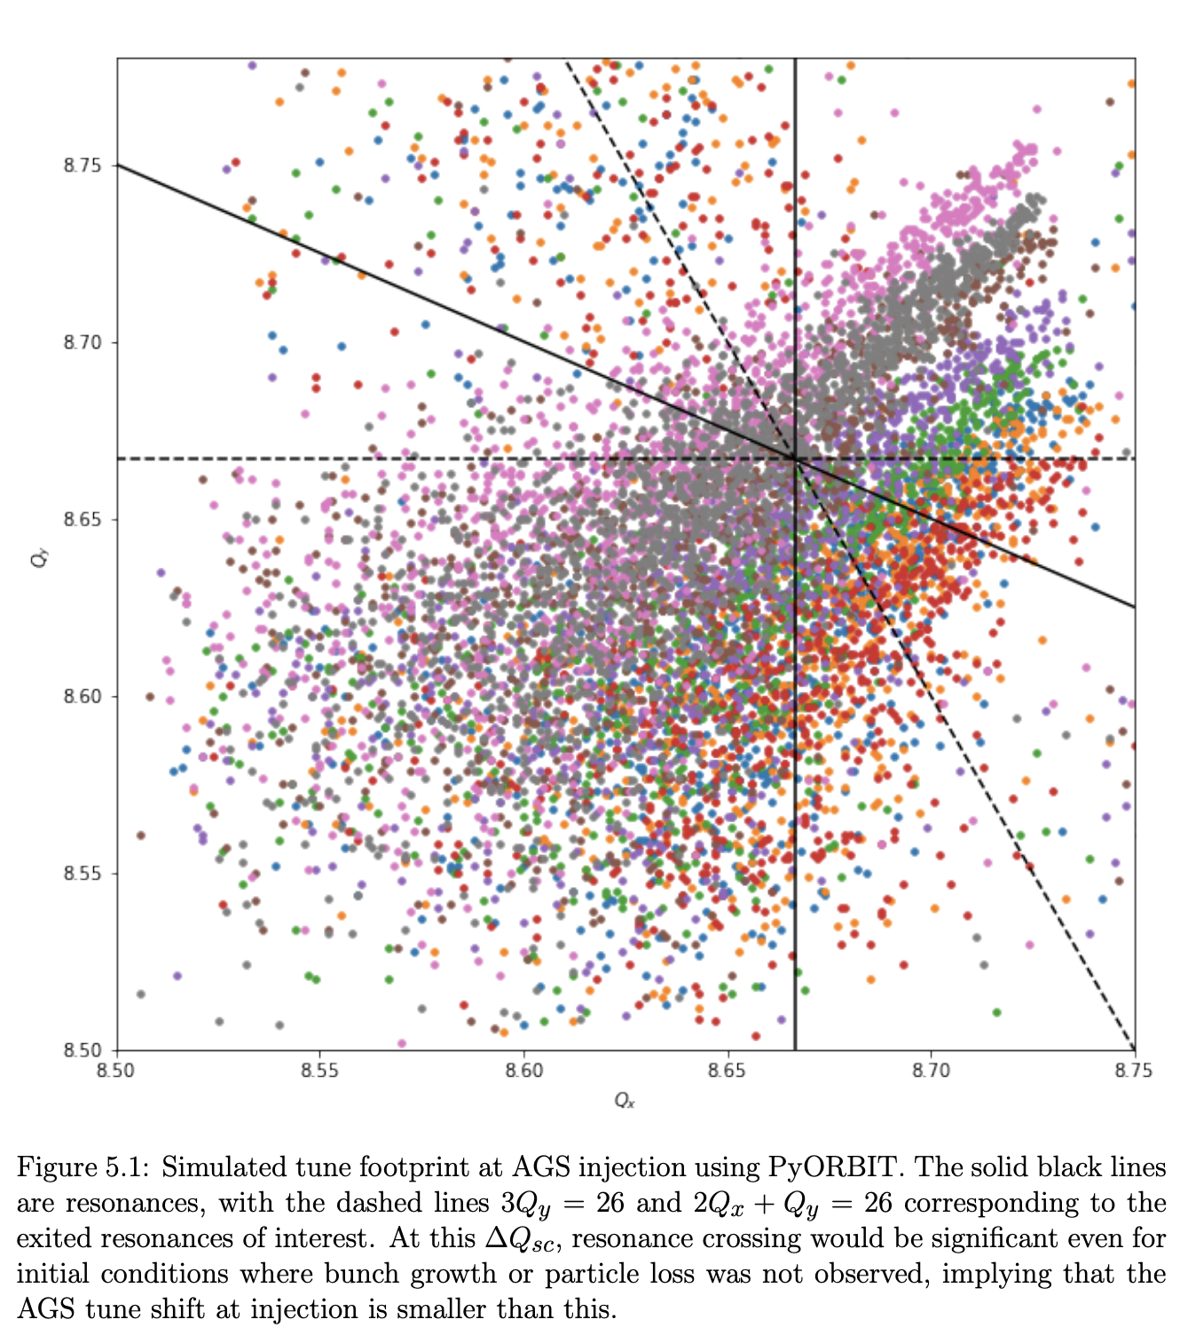
Objectives
Figures of merit for the AGS
  Intensity
  Emittance (Brightness)
  Polarization
Contributing processes
  Beam threading
  Optics matching
  Scattering
  Space-charge resonances
  Spin resonances
  Etc…
Michael Balcewicz, PhD Dissertation 2023
4th EIC-BeamAI Collaboration Meeting
Eiad Hamwi

Slide 3
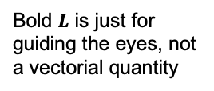
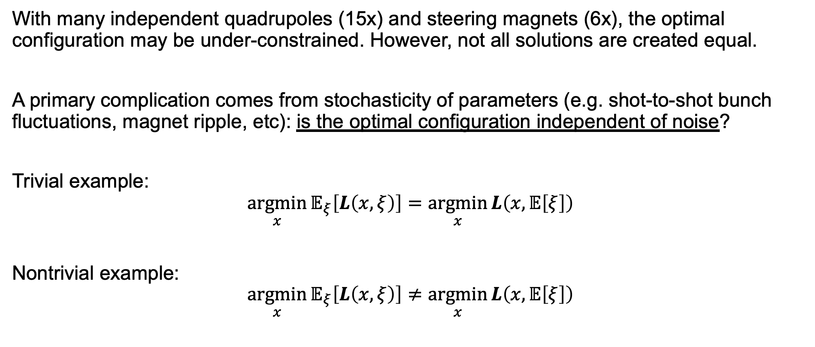
Controllability
With many independent quadrupoles (15x) and steering magnets (6x), the optimal configuration may be under-constrained. However, not all solutions are created equal.
A primary complication comes from stochasticity of parameters (e.g. shot-to-shot bunch fluctuations, magnet ripple, etc): is the optimal configuration independent of noise?
Trivial example:
$$\underset{x}{argmin}{𝔼_{ξ}\left[L\left(x,ξ\right)\right]}=\underset{x}{argmin}{L\left(x,𝔼\left[ξ\right]\right)}$$
Nontrivial example:
$$\underset{x}{argmin}{𝔼_{ξ}\left[L\left(x,ξ\right)\right]}≠\underset{x}{argmin}{L\left(x,𝔼\left[ξ\right]\right)}$$
Bold $L$ is just for guiding the eyes, not a vectorial quantity
4th EIC-BeamAI Collaboration Meeting
Eiad Hamwi

Slide 4
Controllability
Hard apertures provide an excellent example of certainty inequivalent controls.
Even for zero-mean centroid fluctuations (🔵,🟢,🟠), we can see how asymmetric clipping can favors a shifted optimum.
In the presence of errors, we can find a tradeoff between orbital threading and optical matching. This tradeoff can then be balanced at an optimal point under stochastic/noisy fluctuations.
4th EIC-BeamAI Collaboration Meeting
Eiad Hamwi

Slide 5
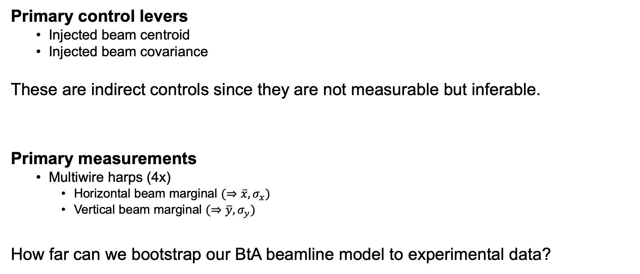
Observability
Primary control levers
  Injected beam centroid
  Injected beam covariance
These are indirect controls since they are not measurable but inferable.
Primary measurements
  Multiwire harps (4x)
    Horizontal beam marginal $(⇒\overline{x}, σ_{x})$
    Vertical beam marginal $(⇒\overline{y}, σ_{y})$
How far can we bootstrap our BtA beamline model to experimental data?
4th EIC-BeamAI Collaboration Meeting
Eiad Hamwi

Slide 6
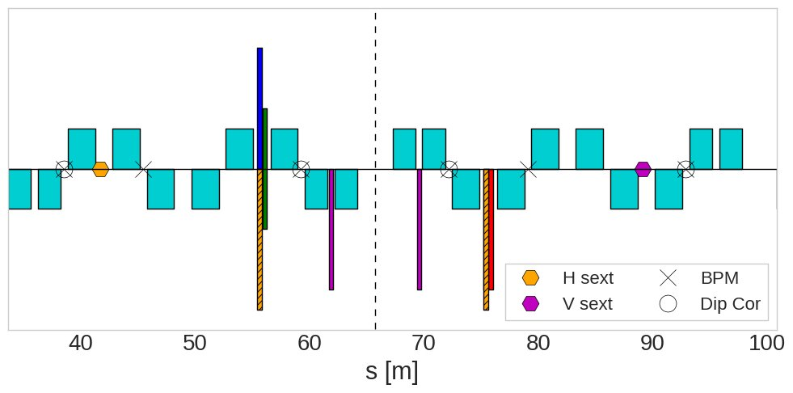
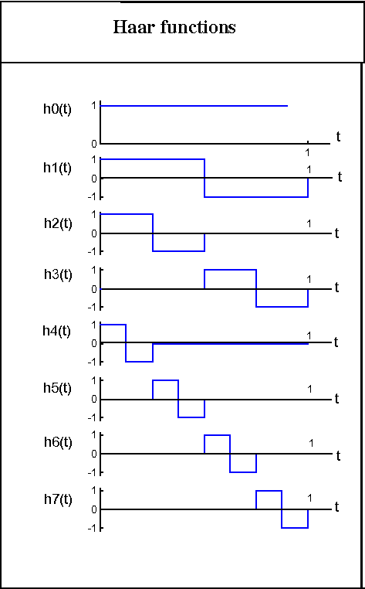
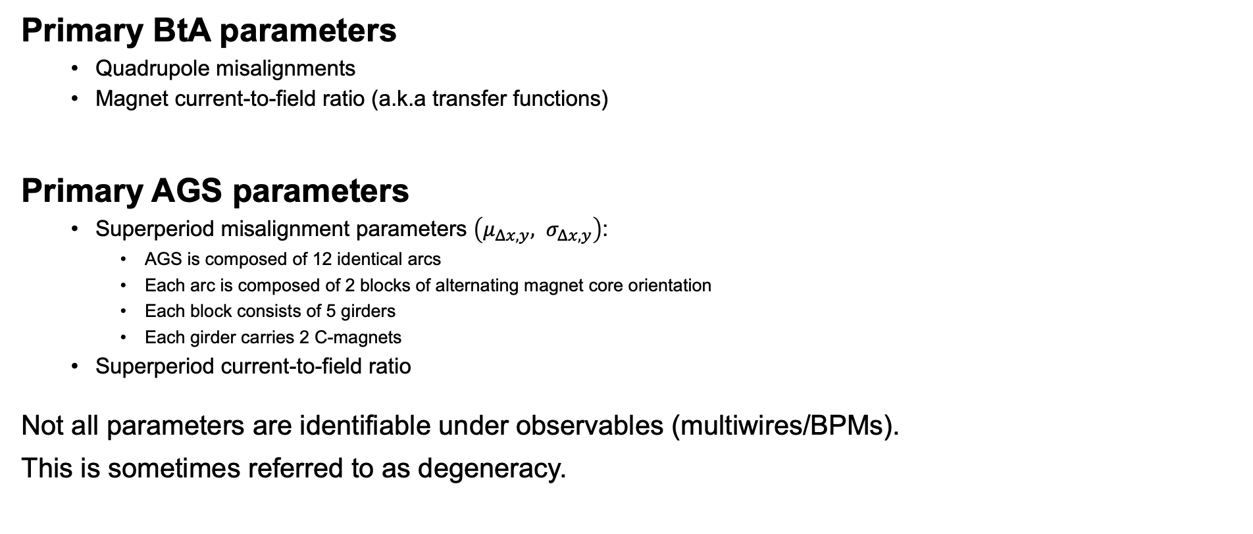
Identifiability
Primary BtA parameters
  Quadrupole misalignments
  Magnet current-to-field ratio (a.k.a transfer functions)
Primary AGS parameters
  Superperiod misalignment parameters $\left(μ_{Δx,y}, σ_{Δx,y}\right)$:
    AGS is composed of 12 identical arcs
    Each arc is composed of 2 blocks of alternating magnet core orientation
    Each block consists of 5 girders
    Each girder carries 2 C-magnets
  Superperiod current-to-field ratio
Not all parameters are identifiable under observables (multiwires/BPMs).
This is sometimes referred to as degeneracy.
4th EIC-BeamAI Collaboration Meeting
Eiad Hamwi

Slide 7
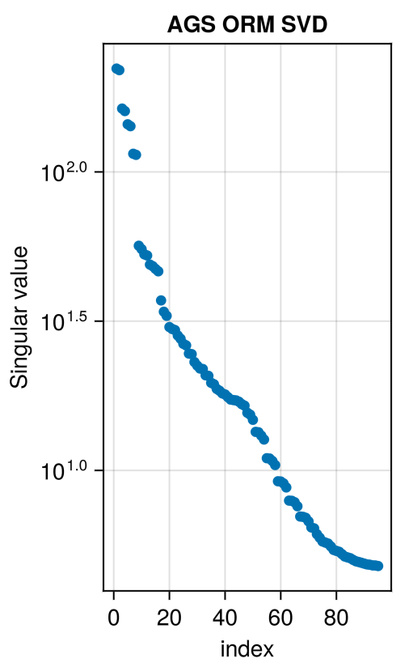
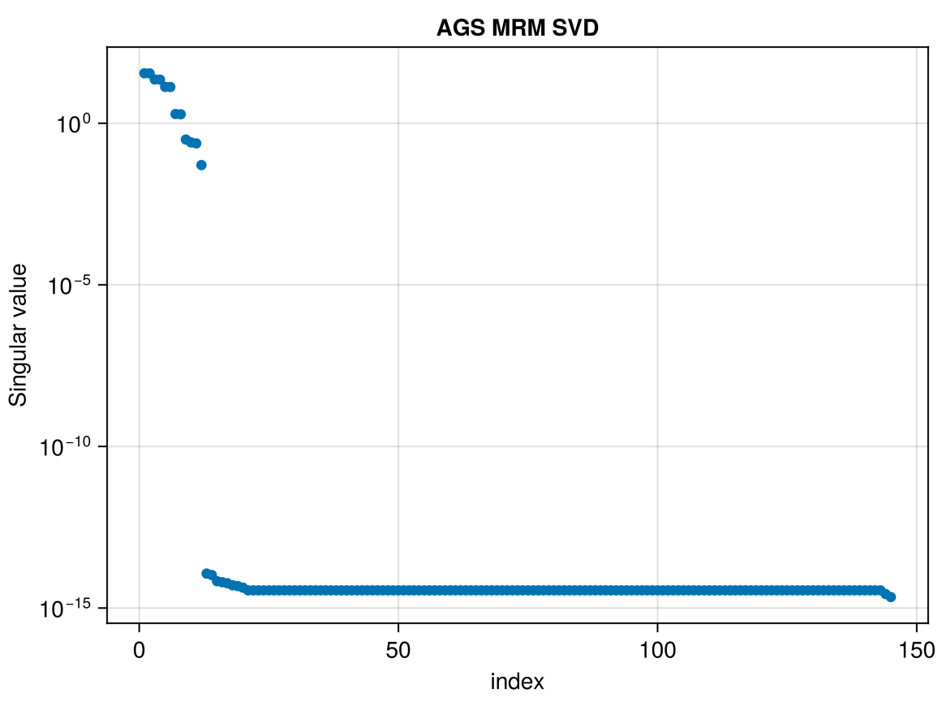
Experimental Design
Diagnostics are used to confirm dynamics and establish baselines.
Given a causal (physics) model, UQ enables parameter inference.
Not all parameters contribute equally to figures-of-merit:
  Usually there is a hierarchy of parameter effects
  Some parameters (or combinations) are transparent
Given controllable actions in the physical model, experimental design targets relevant parameters by expected information gain.
Optimal experimental design targets maximal information with minimal data.
4th EIC-BeamAI Collaboration Meeting
Eiad Hamwi

Slide 8
Optimal Experimental Design
BtA beam-based alignment / quad scan
  UQ on beam (underlying state)
  UQ on quadrupole centers (machine params)
  UQ on effective apertures (machine params)
AGS beam threading (assuming TbT data)
  UQ on injection orbit bump
  UQ on effective misalignments (e.g. effective superperiod params)
  MPC for beam threading
Empirical tradeoff between injection efficiency and equilibrium intensity
  Simultaneous variation of BtA and AGS, steering and optics
  UQ on aperture-driven beam loss
  MPC on stochastic-optimal configuration
4th EIC-BeamAI Collaboration Meeting
Eiad Hamwi

Slide 9
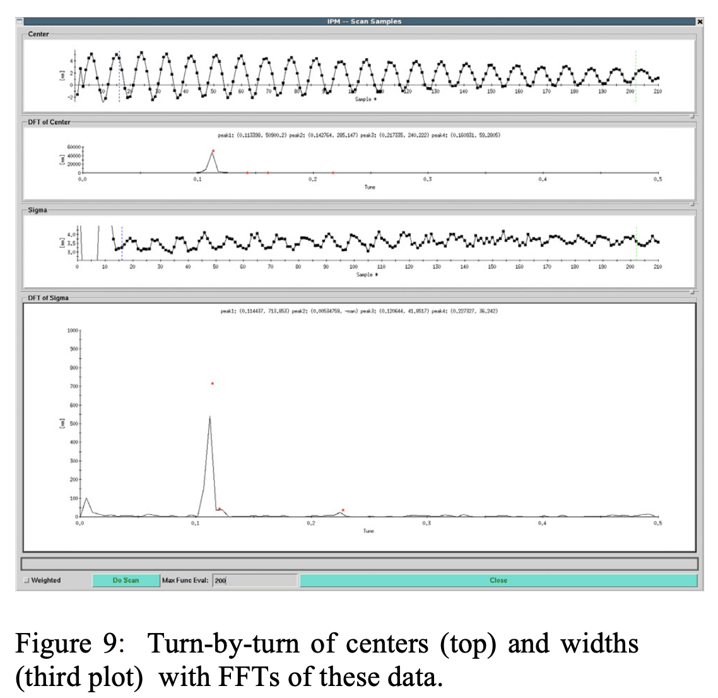
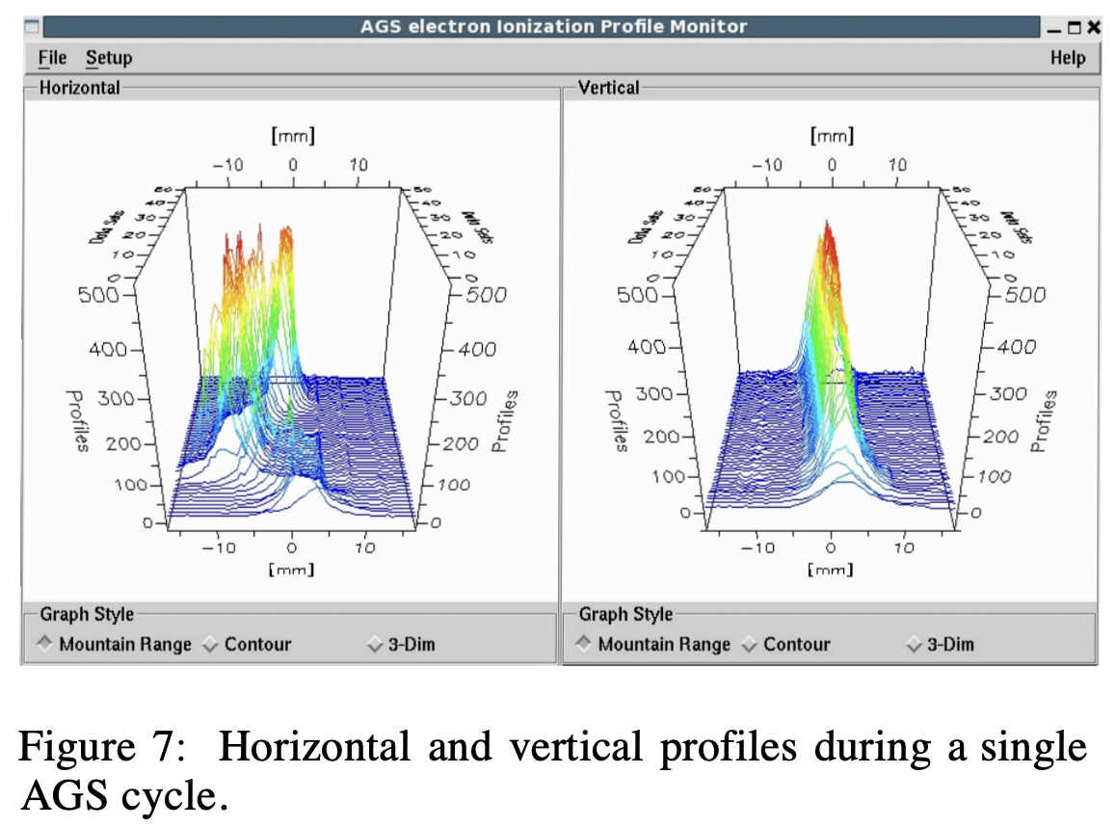
AGS ramping and discussion
Beyond injection, strong space chare-driven dynamical effects (resonances) are excited and muddy the simulation
R. Connolly et al., “RHIC-Style IPMs in the Brookhaven AGS”, in Proc. IBIC'14
4th EIC-BeamAI Collaboration Meeting
Eiad Hamwi

