Slide 1
Genesis Proposal BNL:
AI-Driven, Self-Learning Digital Twins for Robust Operation of Particle Accelerators
Kevin Brown, BNL
2 September 2026 EIC-BeamAI Collaboration Meeting

Slide 3
Project Objectives
The Phase I effort will demonstrate the feasibility of a closed-loop AI and digital twin (DT) framework for accelerator operations under uncertainty using representative BNL accelerator systems, with the AGS Booster serving as the primary proof-of-concept environment.
The goal is to establish AI as the core operational intelligence in a self-learning DT workflow that integrates simulation, measurement, uncertainty quantification (UQ), and decision support.
Objective 1: Autonomous Sim2Real Digital Twin Workflows with UQ
Objective 2: AI-Driven Operational Decision-Making

Slide 4
Actual start: August 19
Currently working on:
Develop and benchmark the SciBmad model of the AGS Booster as the primary DT engine and begin development of a physics-informed AI.
DT/OED Workflow and UQ methodology
NARAD & PALS infrastructure

Slide 5
Genesis Mission Resources
Genesis Mission Consortium
https://www.genesismissionconsortium.org/
Genesis Mission Partnership Exchange
https://partnerships.genesismissionconsortium.org/user/login
(Your account at Genesis Mission Partnership Exchange has been activated.)
Have had meetings with: Nvidia and Accenture
Been contacted by: Databricks, Ansys/Synopsys, + others

Slide 6
Support Infrastructure at BNL
Subtitle

Slide 7
The Brookhaven AI Inference (BRAIN) Platform
Secure, On-Premise AI for Scientific Computing and Operations
Meifeng Lin
Computational Science Department, CDS
Updated: 08-31-2026

Slide 8
Vision and Objectives
Primary Goal: Deploy secure, locally hosted Large Language Models (LLMs) to support Brookhaven's research and administrative workflows without compromising data privacy.
Key Drivers:
  Data Security: Keep sensitive research data strictly on-premise.
  Customizability: Fine-tune models for specific scientific domains and augment retrieval using internal BNL documentation.
  Accessibility: Lower the barrier to entry for AI integration across various lab departments and scientific projects.
  Cost: Rising costs with commercial AI models and platforms.

Slide 9
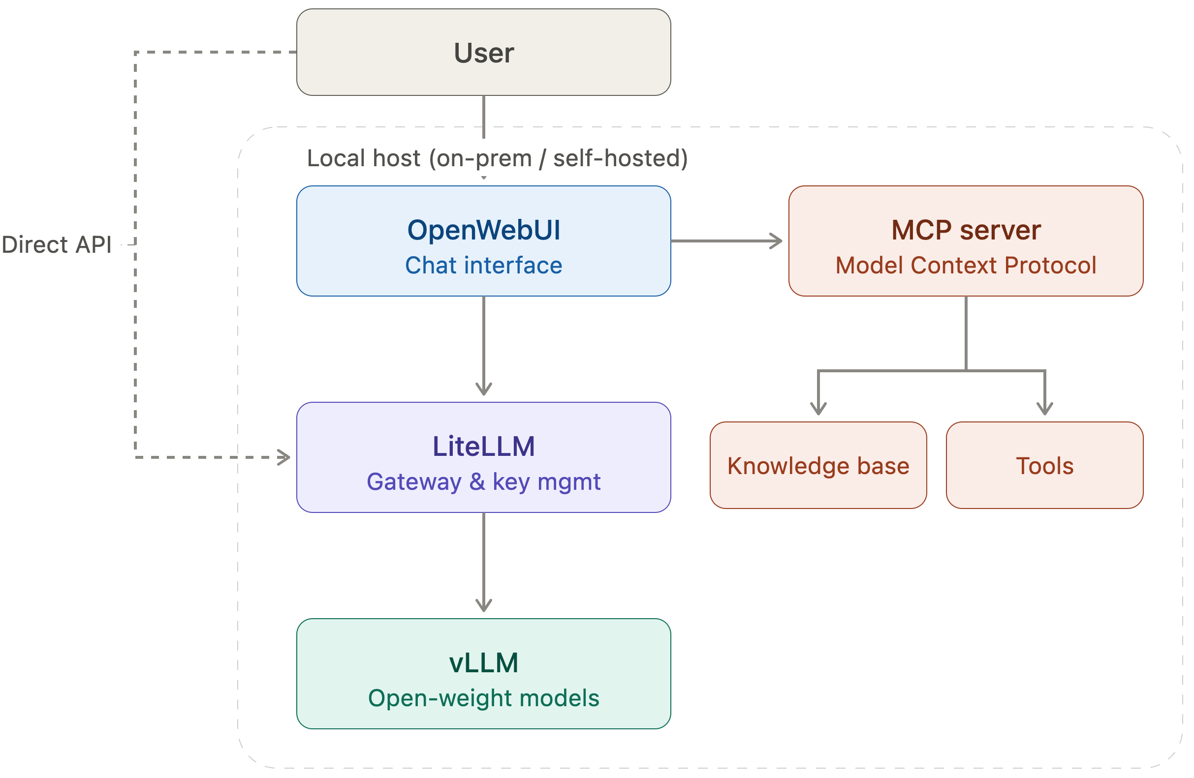
Services Provided
1. Internal Chat Interface: A secure, web-based UI for general inquiries, drafting emails, and coding assistance. Inclusion of image generation capabilities through Flux.1.
2. API Access: RESTful APIs for researchers to integrate LLM capabilities directly into their scientific workflows or AI agents.
3. Document Retrieval (RAG): "Chat with your data" capabilities to securely search and summarize large volumes of internal PDFs, reports, and technical manuals.
4. MCP Server: Hosting internal knowledge base and specialized tools
BRAIN Architecture

Slide 10
Models Currently Hosted (US Models Only)
Model | Provider | Practical best uses | Context window / prompt limit | Modalities | Reasoning / generation features
Muse Glimmer-30B (Replacing Llama4-Scout) | Meta | Local agentic assistants, MCP/tool agents, coding, deep-search/RAG, multimodal document analysis, autonomous task completion | 131K+ tokens | Text + image → text/code | Multi-step reasoning; reliable tool use; failure recovery; controllable reasoning effort; trained for end-to-end agentic tasks; multilingual across 100+ languages
Gemma 4 26B-A4B | Google | Efficient general-purpose assistant, coding, scientific assistance, multimodal RAG, moderate-scale agents | Up to 256K tokens | Text + image → text/code | Configurable thinking, native function calling, coding, reasoning, system-role support
GPT-OSS-120B | OpenAI | Deep reasoning, scientific problem solving, difficult coding, structured outputs, tool-driven agents | Up to 131,072 tokens | Text → text/code | Configurable reasoning effort, native function calling, tool use, structured output, fine-tuning
Nemotron 3 Super 120B-A12B | NVIDIA | Production agentic AI, multi-agent systems, coding, RAG, tool orchestration, high-throughput reasoning | Up to 1M tokens | Text → text/code | Reasoning-budget control, tool calling, planning, long-running and collaborative-agent optimization
Nemotron 3 Ultra 550B-A55B (Preview) | NVIDIA | Highest-accuracy reasoning, complex scientific/code reasoning, mission-critical multi-step agents, deep planning, high-stakes RAG, very long-context analysis | Up to 1M tokens (limited to 512K tokens in current deployment) | Text → text/code | Configurable reasoning mode/budget, tool use, complex agentic workflows; native speculative decoding via MTP; trained with SFT, RL and multi-teacher on-policy distillation
FLUX.1 image-generation | Black Forest Labs | Text-to-image generation, scientific illustrations, presentation graphics, outreach, UI assets, concept art | Up to 512 input tokens | Text → image | Strong prompt adherence, typography, style diversity, variable resolutions/aspect ratios.
Modified from a summary generated with ChatGPT 5.6

Slide 11
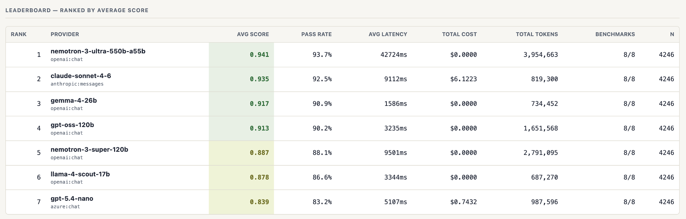
How Good Are These Models?
Muse-glimmer-30b results pending
Benchmark | Capability Tested | Format | Questions | Status
OpenBookQA | Multi-step science reasoning + common sense | 4-way MCQ | 500 | Complete
SciQ | Physics, chemistry, biology knowledge | 4-way MCQ | 1,000 | Complete
CoLA | Linguistic acceptability / grammar | Binary MCQ | 500 | Complete
MMLU | Broad knowledge across 57 subjects | 4-way MCQ | 500 | Complete
RACE | Reading comprehension | 4-way MCQ | 500 | Complete
HumanEval | Python code correctness (execution-graded) | Pass/fail | 164 | Complete
IFEval | Instruction-following compliance (deterministic) | Verifiable checks | 541 | Complete

Slide 12
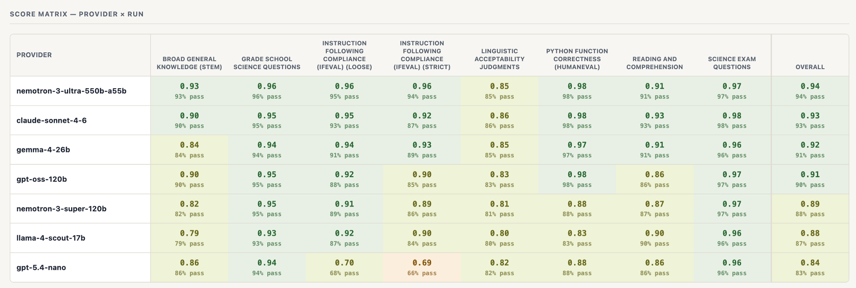
Detailed Scores
Muse-glimmer-30b results pending
Top Model Performance Summary
Leader: nemotron-3-ultra-550b (0.94 overall) — Exceptional instruction following and science proficiency.
Top-Tier: gemma-4-26b (0.92) — Highly balanced performance across reasoning and science.
Key Strengths: Universal high performance in Python (HumanEval) and Science (SciQ) across all top models.
Primary Weakness: All top models show a relative dip in Linguistic Acceptability (CoLA).

Slide 13
Rollout Schedule & Timeline
Phase 1: Proof of Concept and Beta Launch (Q4 FY2026)
  Deploy initial hardware infrastructure.
  Test Chat UI and API access with selected groups of users (scientists and ops staff).
  Gather feedback on latency, model accuracy, features and workflow integration.
Phase 2: General Availability (Q1 FY2027)
  Lab-wide rollout of LLM services, utilizing new hardware procured.
Phase 3: Ongoing Optimization and Scale-up (Q2 FY2027 & Beyond)
  Scale hardware, update to newer model architectures, and expand integration with broader BNL resources.
  Introduce domain-specific fine-tuning options for individual departments.

Slide 14
Acknowledgments
Core Technical Team:
  Mohammad Atif – MCP Server, BNL knowledge integration
  Costin Caramarcu – Initial prototypes of Open WebUI, vLLM/LiteLLM
  Kriti Chopra – Model performance benchmarking
  Zhihua Dong – Deployment, hardware infrastructure
  Mikhail Titov – Web pages, user guide, GitHub
  Tianle Wang – Computational performance benchmarking, optimization
Advisors:
  Nick D’Imperio
  Tony Wong
  Shinjae Yoo
We thank ITD for their prompt support of the changing service requirements!

