Slide 1
    AI-Enabled Digital Twin for Scalable Injector Optimization and Control
Monika Yadav
School of Data Science,
Department of Physics,
Old Dominion University, VA, USA
4th EIC-Beam AI Collaboration Meeting, Sep 3, 2026

Slide 2
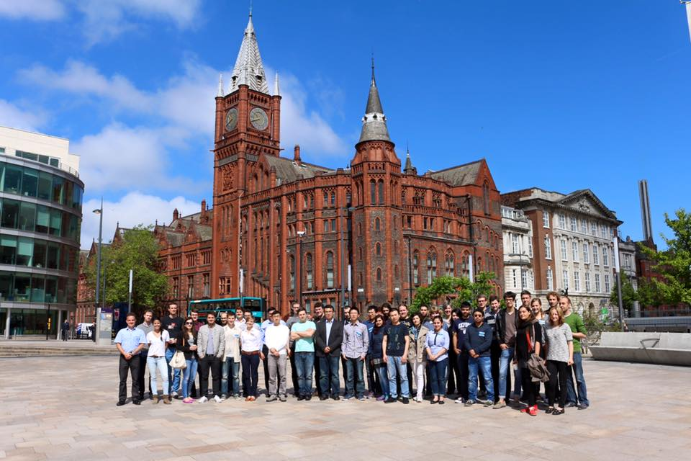

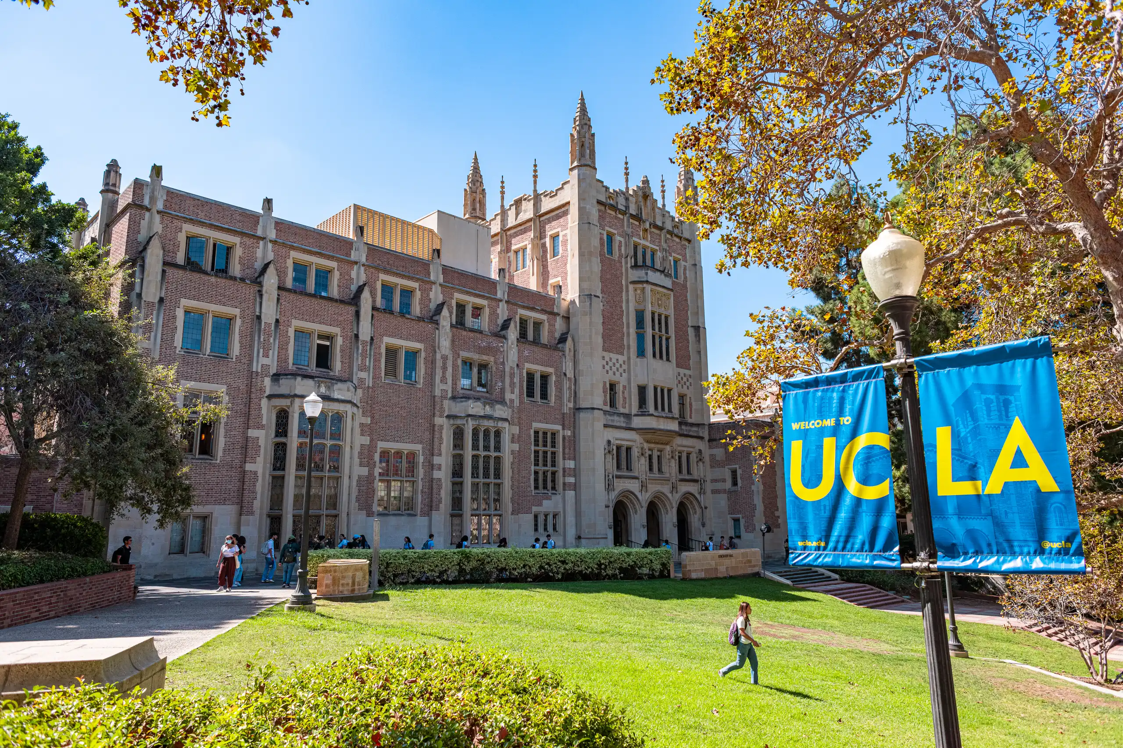

About me
  Ph.D. Thesis: Betatron radiation from underdense plasma for FACET-II beamline at Stanford National accelerator center (SLAC).
  Postdoc: Continuation of Ph.D. work at UCLA
  Assistant professor at ODU in the school of Data Science and Physics
  Genesis Mission Accepted proposals (ODU led)
    AI-Enabled Digital Twin for Scalable Injector Optimization and Control
    Real-Time Attack Detection and Adaptive
    Mitigation for AI-Driven Scientific Workflows
University of Liverpool
University of California Los Angeles
ODU

Slide 3
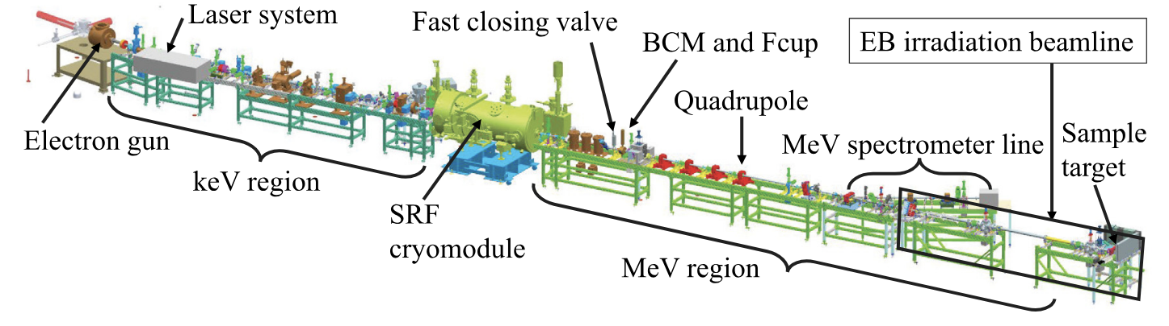
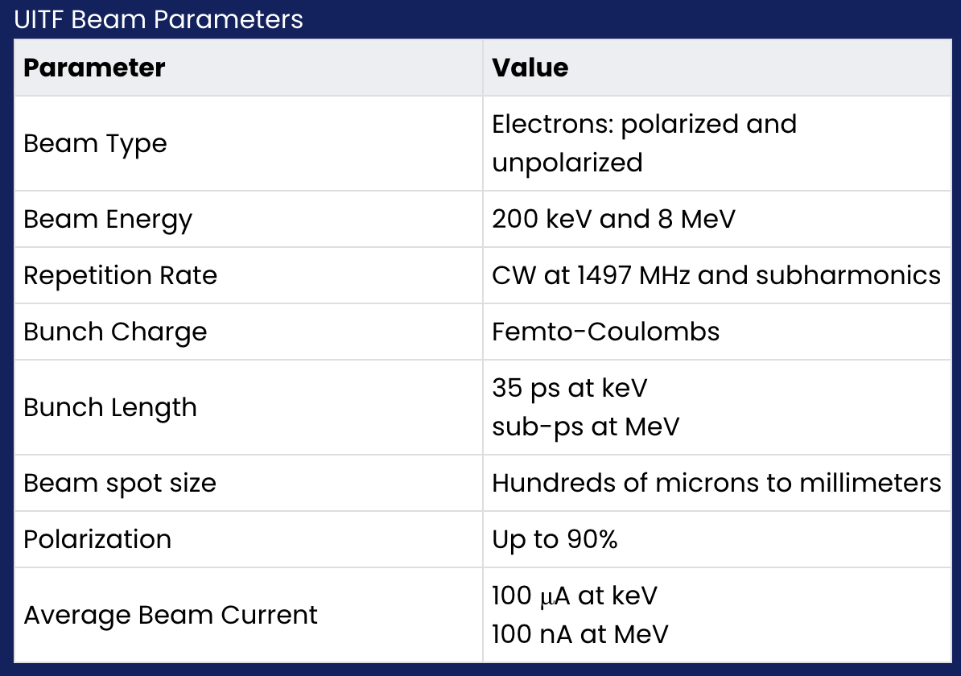
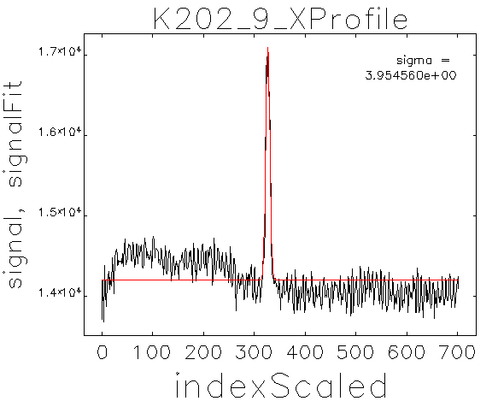
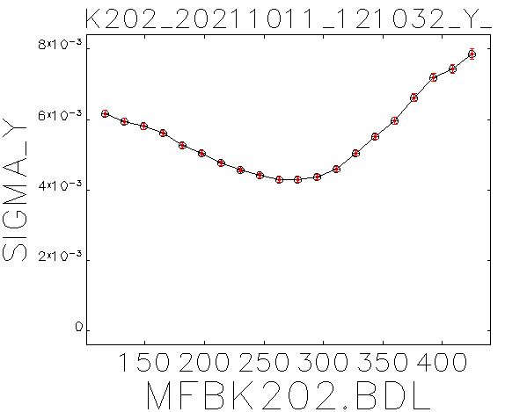
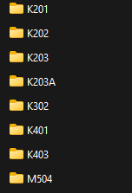
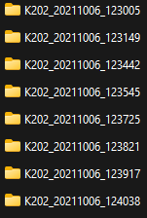
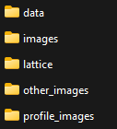
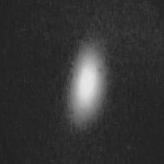
Upgraded Injector Test Facility (UITF)
UITF at Jefferson Lab for testing new algorithms and framework including the ability of these models to transfer between facilities.
6/10/2021
K202
Example of navigating through data architecture. Middle: Gaussian fit of pixel vs. intensity from beam radiation. Right: Spread of beam position data in y)

Slide 4
Project Objectives
The specific Phase I objectives are to:
build a unified digital representation of the UITF injector by integrating models of the source, RF cavities, magnetic elements, solenoids, and diagnostics such as viewer screens;
reduce simulation-to-experiment mismatch through ML based sim2real calibration trained on archived and validated on live machine data;
incorporate machine learning, computer vision, and auxiliary signals to enhance observability, virtual diagnostics, and beam-loss detection;
demonstrate AI-assisted optimization that recommends improved operating points and reduces injector setup effort; and
establish the technical basis for transferring the framework from UITF to CEBAF injector operation in Phase II.

Slide 5
Injector tuning is a partially observed, high-dimensional problem
Many controls magnet strengths, phases, set points, etc..
Few diagnostics screens and monitors observe only projections
Expensive evaluation machine time and high-fidelity tracking are limited
Changing machine component errors and drift create sim2real mismatch
Turn sparse measurements into a calibrated state estimate and actionable tuning guidance.
UITF beamline drawing

Slide 6
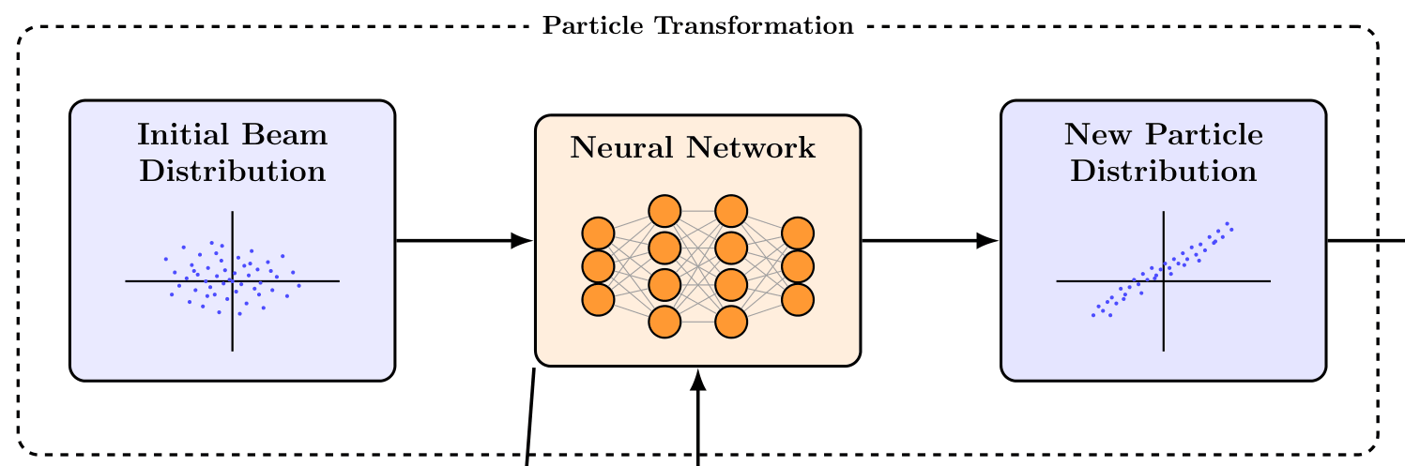
Proposed Initial Beam and Neural Network Transformation
UITF RUNS
September
Develop DAF
Simulation Workflow
UITF data
from Archiver
Unified Accelerator Management: A central Accelerator object manages all devices and maintains the machine’s complete operating state through a consistent programming interface.
Digital-Twin Control Room: The Digital Accelerator Framework (DAF) enables users to configure machine parameters, control data acquisition, inspect settings, and operate the virtual accelerator like a physical machine.
Flexible Simulation Integration: The DAF generates and analyzes beam data while supporting comparison across different backend simulation engines, allowing new engines to be integrated as needed.
Get beam data
BPM data
Run digital twin
Using UITF data from Archiver
Compare beams
(sim2real)

Slide 7
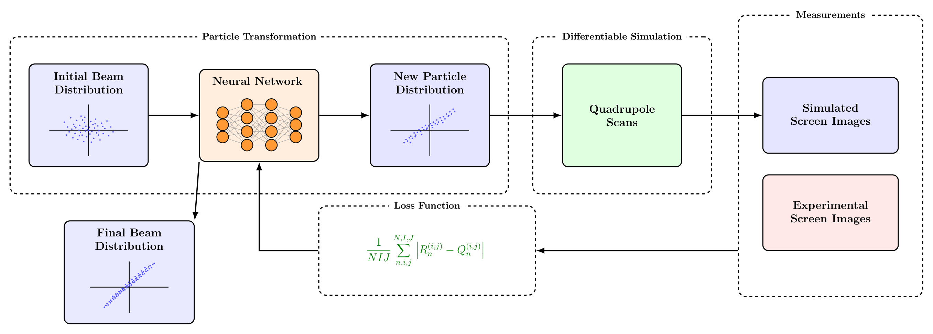
Phase-space reconstruction is the first inverse problem
Phase Space Reconstruction
Infer the upstream beam distribution based on the downstream transverse measurements
Central part to understanding beam dynamics & improving performance
ML and Differentiable Simulations
Quadrupole scans give a means of emittance measurements
Differentiable simulations supply gradient information to machine learning algorithms
Roussel, et al. Phys. Rev. Lett 130, 145001, 2023
Different component errors can produce similar downstream observations; calibration must report uncertainty and degeneracy, a best fit.

Slide 8
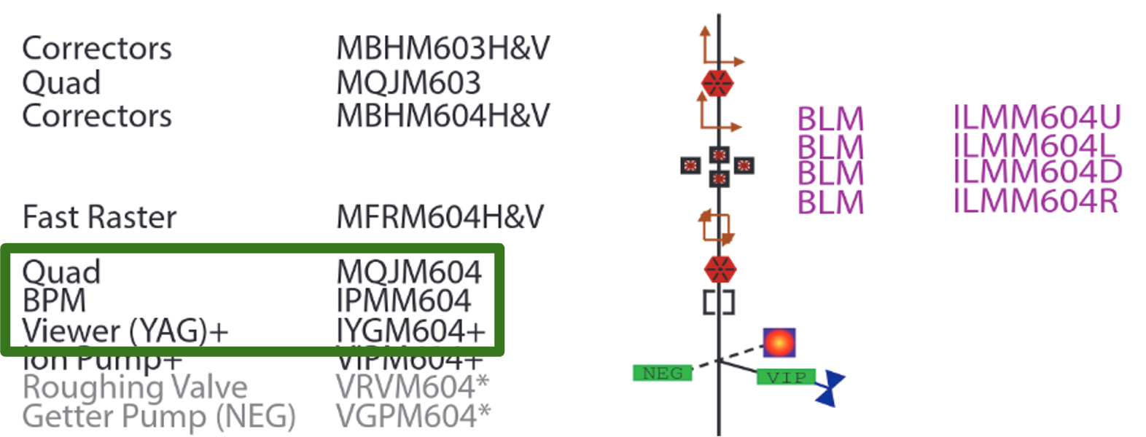
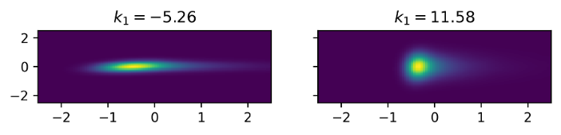
Quadrupole scans make the inverse problem observable
Dataset is from multiple simulated quadrupole strengths of the Upgraded Injector Test Facility (UITF) beamline MeV region (MQJM604 to IYGM604)
Quad scanning for 20 measurements over the range of [-20,20]
Transverse beam measurements (x/y) collected on a screen following a drift section
Dataset is split 50/50 for training and testing sets
Each magnet setting creates a new projection; together, the scan supplies complementary constraints on the latent beam state.

Slide 9
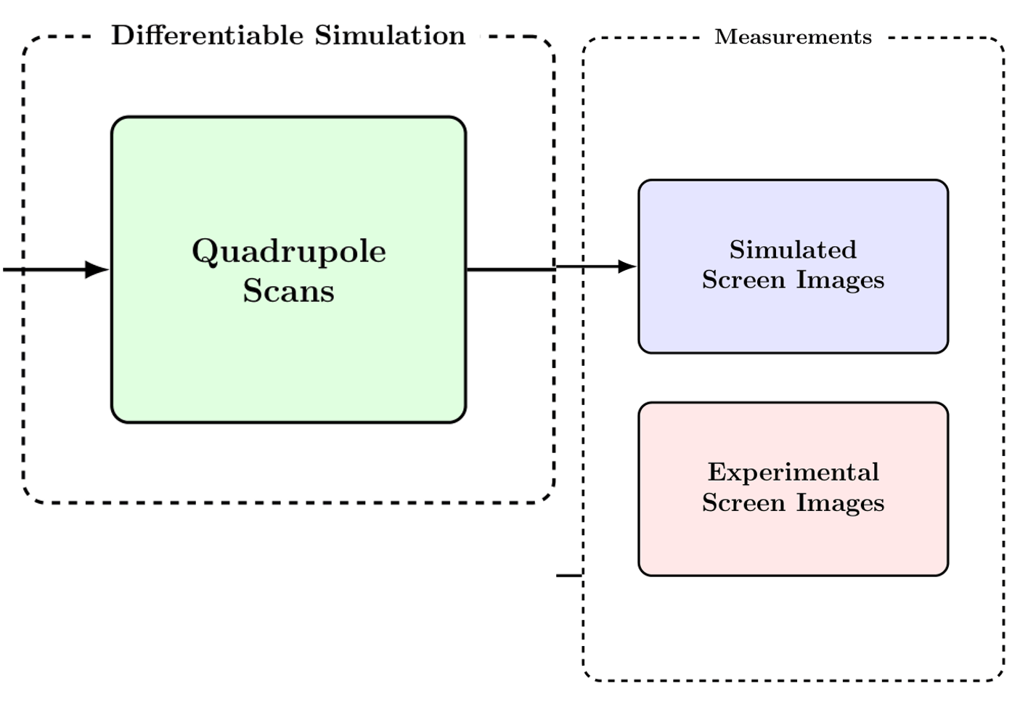
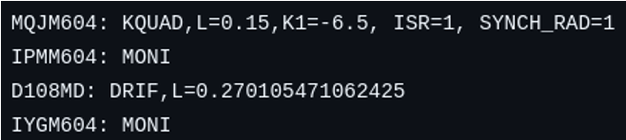
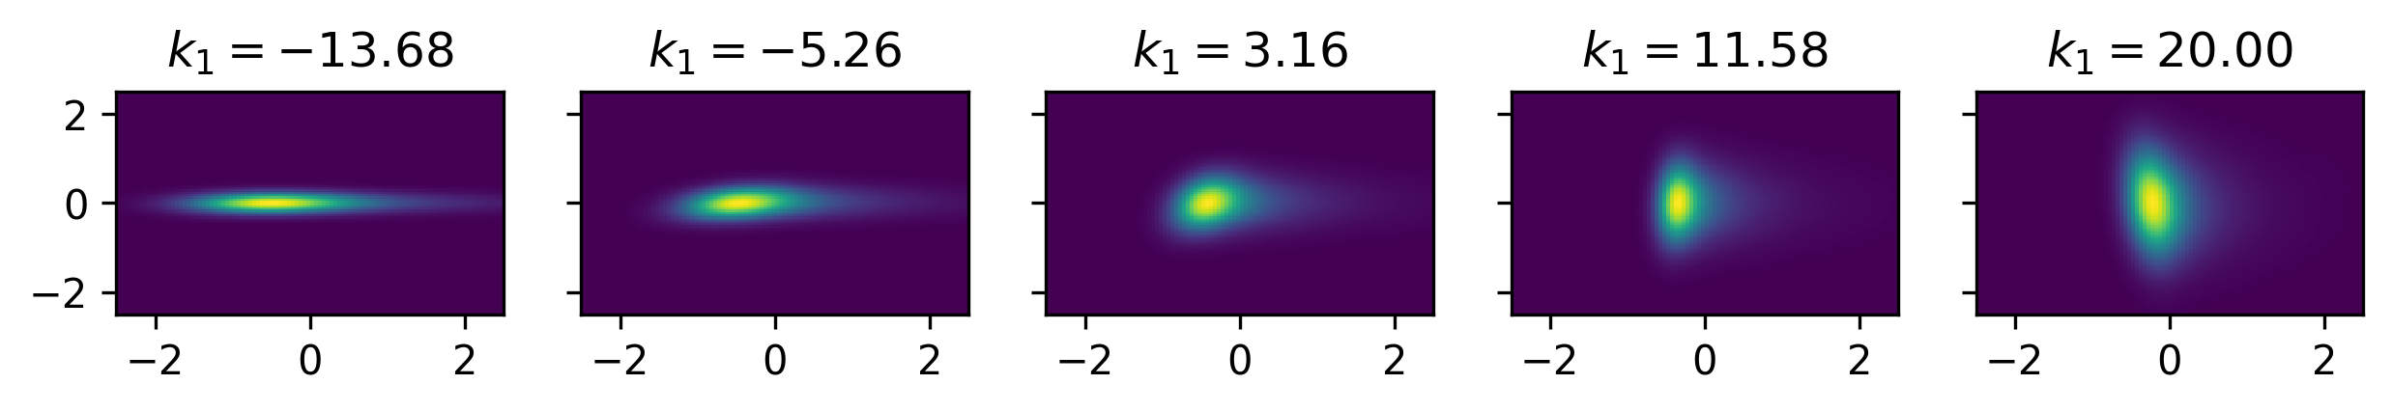
Lattice - Quadrupole Scanning in Differentiable Simulation
Targeted quadrupole region is implemented using Cheetah, the differentiable particle tracker
As each new proposed initial beam is created, it is run through this simulation to generate new measurements
Every element in the simulation is differentiable!

Slide 10
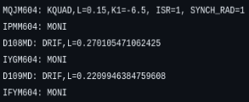
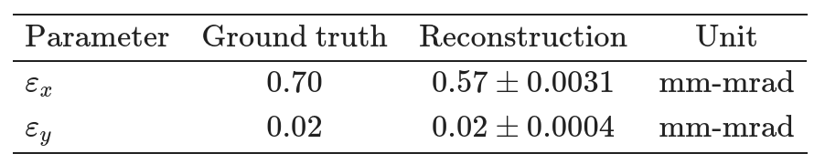
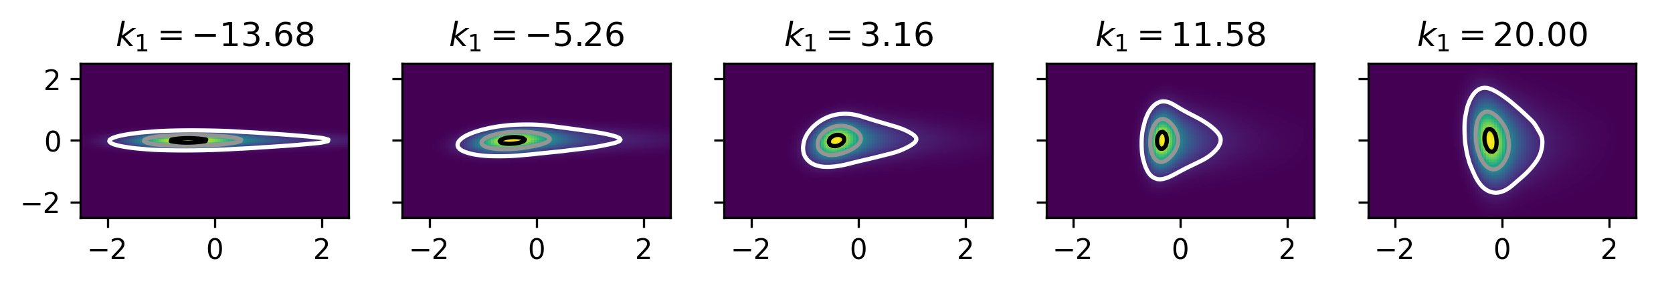
MQJM604 to IFYM604 (MeV region)
Testing Dataset
Resulting Downstream Predictions
Particles: 100,000
Model: MLP with 2 layers of 20 nodes
Epochs: 10,000 with 5,000 set for burn-in

Slide 11
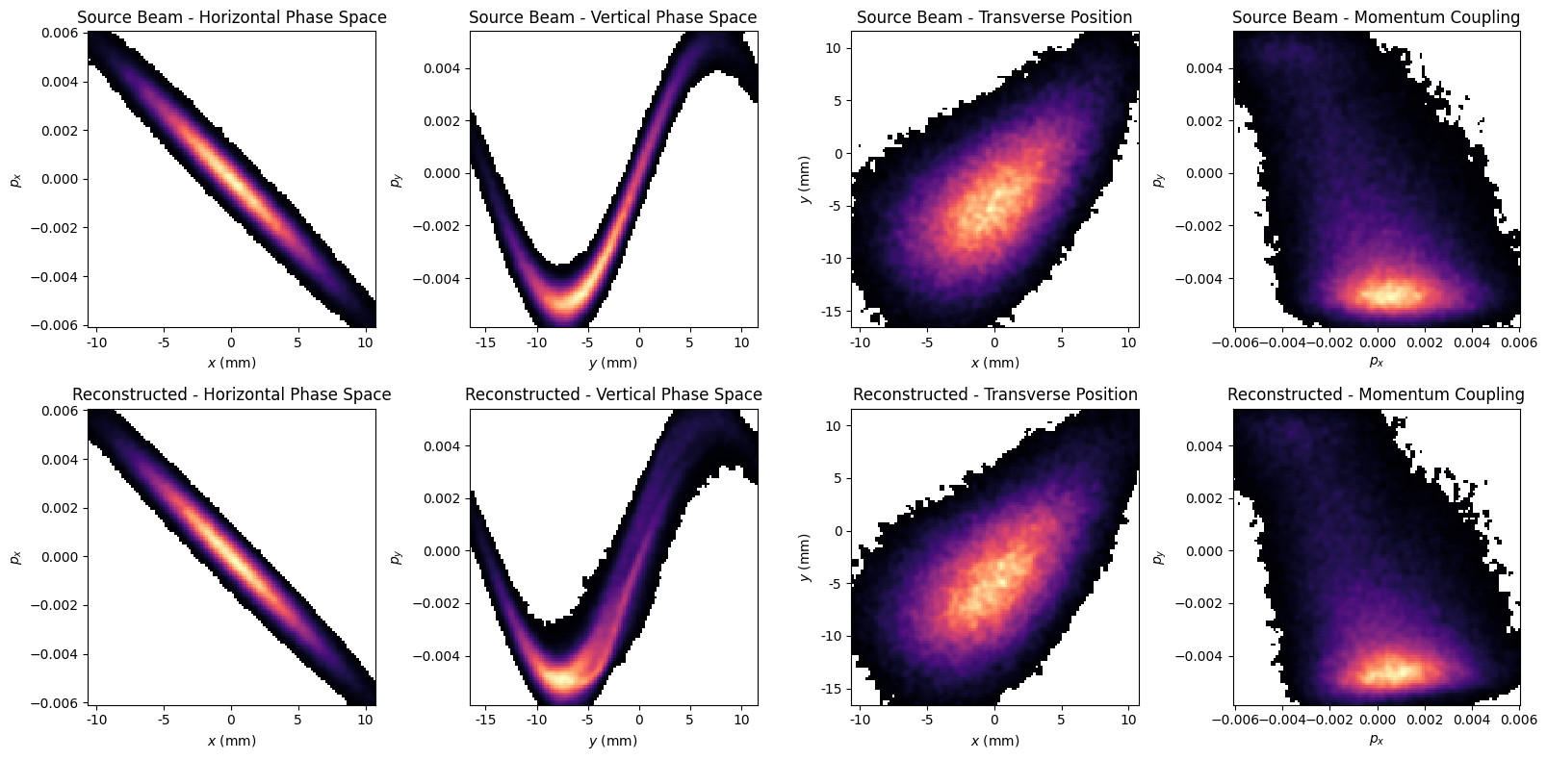
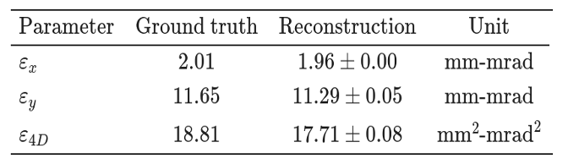
Simulation study recovers held-out downstream projections
Predicted Upstream Beam vs. Ground Truth
Example beam ripped right from the reference paper (Roussel 2023)
Simply an illustrative attempt to show method on more complicated beam distribution
Ensemble Epochs: Snapshot saved every 500 epochs
LR Scheduler: Cosine Annealing

Slide 12
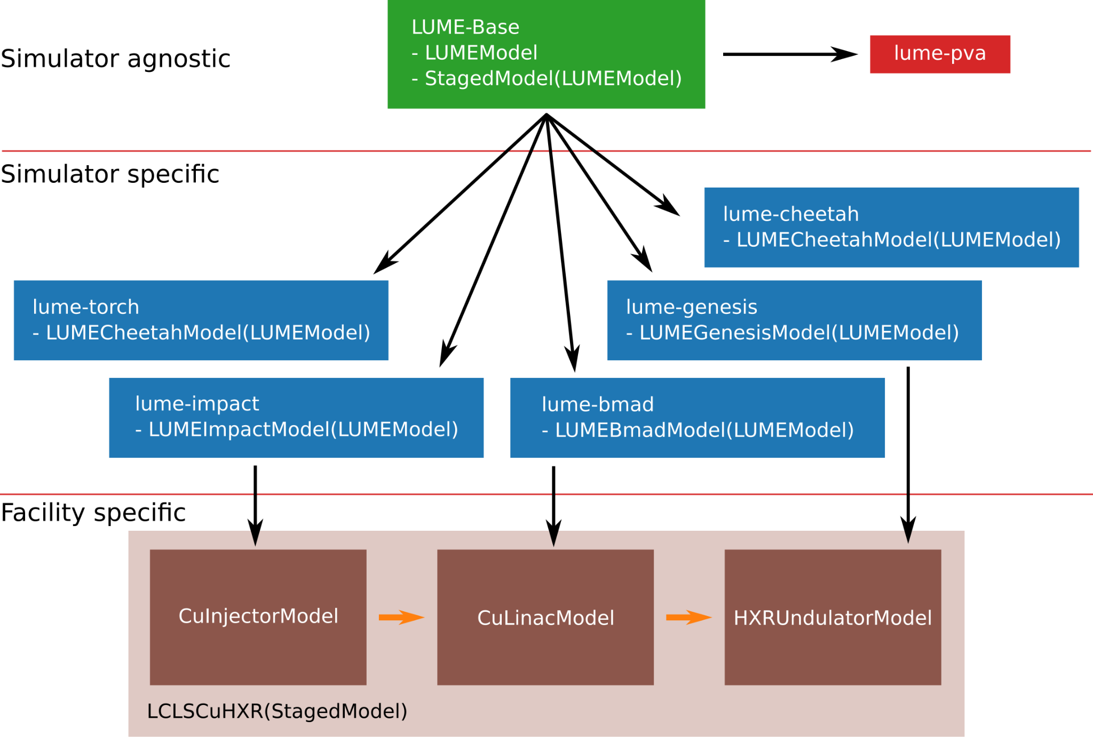

LUME’s Overall Framework
Why LUME for the Digital Twin?
Unified interface for Impact, GPT, Astra, Genesis, Bmad, and Cheetah
Best simulation engine selected for each UITF beamline region
PyTorch surrogate models for fast predictions
Lume-PVA connection for live control-room beam data
Transferable framework for deployment across accelerator facilities
UITF keV
UITF MeV
more…
https://www.lume.science/
Modularity is what makes the DT maintainable and what makes transfer to another accelerator plausible.

Slide 13
The twin operates as a continuous evidence loop
Machine definition
Lume workflow
Physics engines
Synthetic data
Compare to UITF
Infer & update
Lattice
Field maps
Settings
etc..
Common execution, data interfaces, and reproducible runs
Impact/Impact-T
BMAD / SciBMAD
ASTRA / GPT
Parameter scans
Phase-space outputs
Surrogate training
BPMs
Screens
Phase-space and scan data
Incoming beam
Element offsets
RF / field-map errors
Iterate until the mismatch is small, stable, and identifiable across multiple diagnostics
Strong space charge / low-energy dynamics
Optics, tracking, CSR / collective effects
Impact, Impact-T, ASTRA, or GPT validated for the section and fidelity required.
BMAD or SciBMAD, with effect coverage and conventions checked explicitly.
Notes:
Explain figure 1

Slide 14
AI/ML and UQ for a digital twin
Confidence estimates
Report both aleatoric and epistemic uncertainty.
Separate measurement noise, model uncertainty, and simulation uncertainty.
Calibrate what can be calibrated; treat the rest as error.
Model UQ and data drift
Start with deep ensembles: train multiple models and report predictions for different horizons.
Develop a Bayesian approach such as variational inference.
For Phase II, quantify data drift using environmental measurements.
Fast models and inverse problems
Use physics-informed surrogates; the speed–precision trade-off still needs to be understood.
Reconstruct measurements to control parameters using neural networks plus differentiable simulation or at least very fast forward models.
Safe control and roadmap
Contain control decisions in a safety envelope. Compare continuous beam control using model-predictive control with injector-parameter optimization.
Phase I evaluates transferability to a different facility; Phase II examines bottlenecks and scaling with more compute, data, and model detail.
Notes:
Explain figure 1

Slide 15
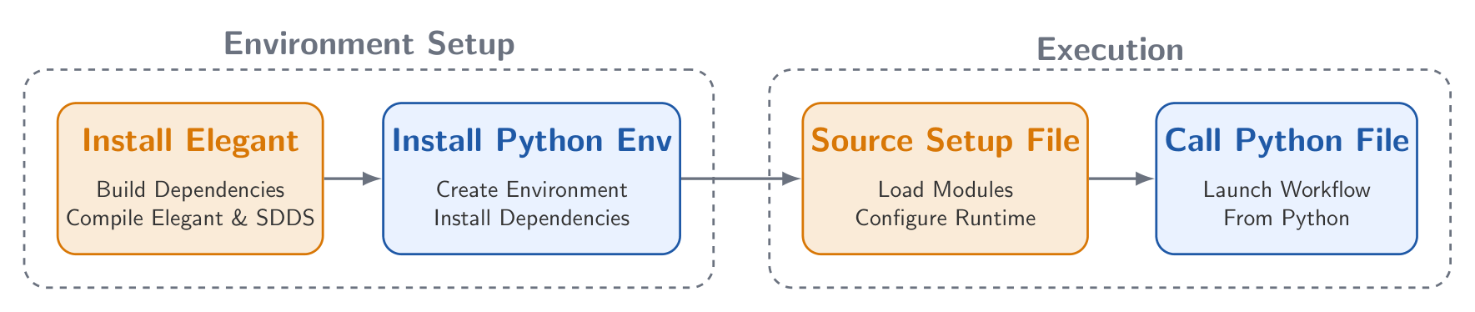
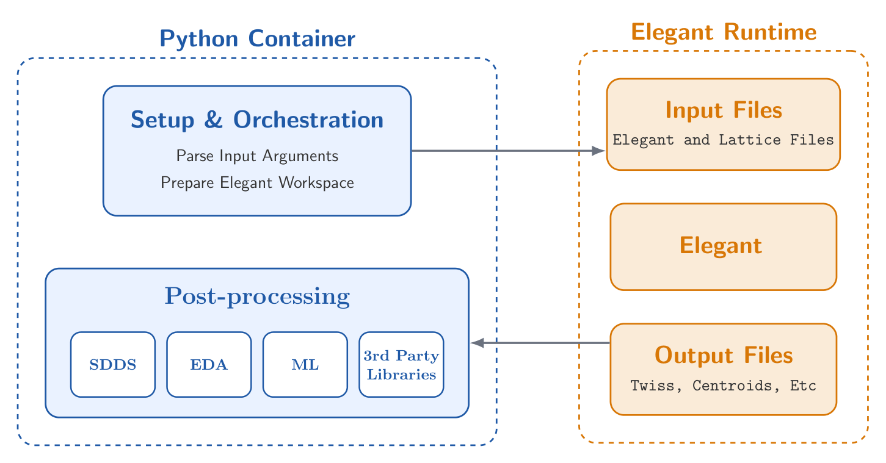
Elegant & SDDS on the HPC through Python
Setup & Configuration
Compiling dependency libraries, Elegant, and SDDS
Establish Python version and libraries
Execution
Source required setup files for shell executions
Launch the Python-based workflow
Future workflow will allow for full setup and post-processing in Python

Slide 16
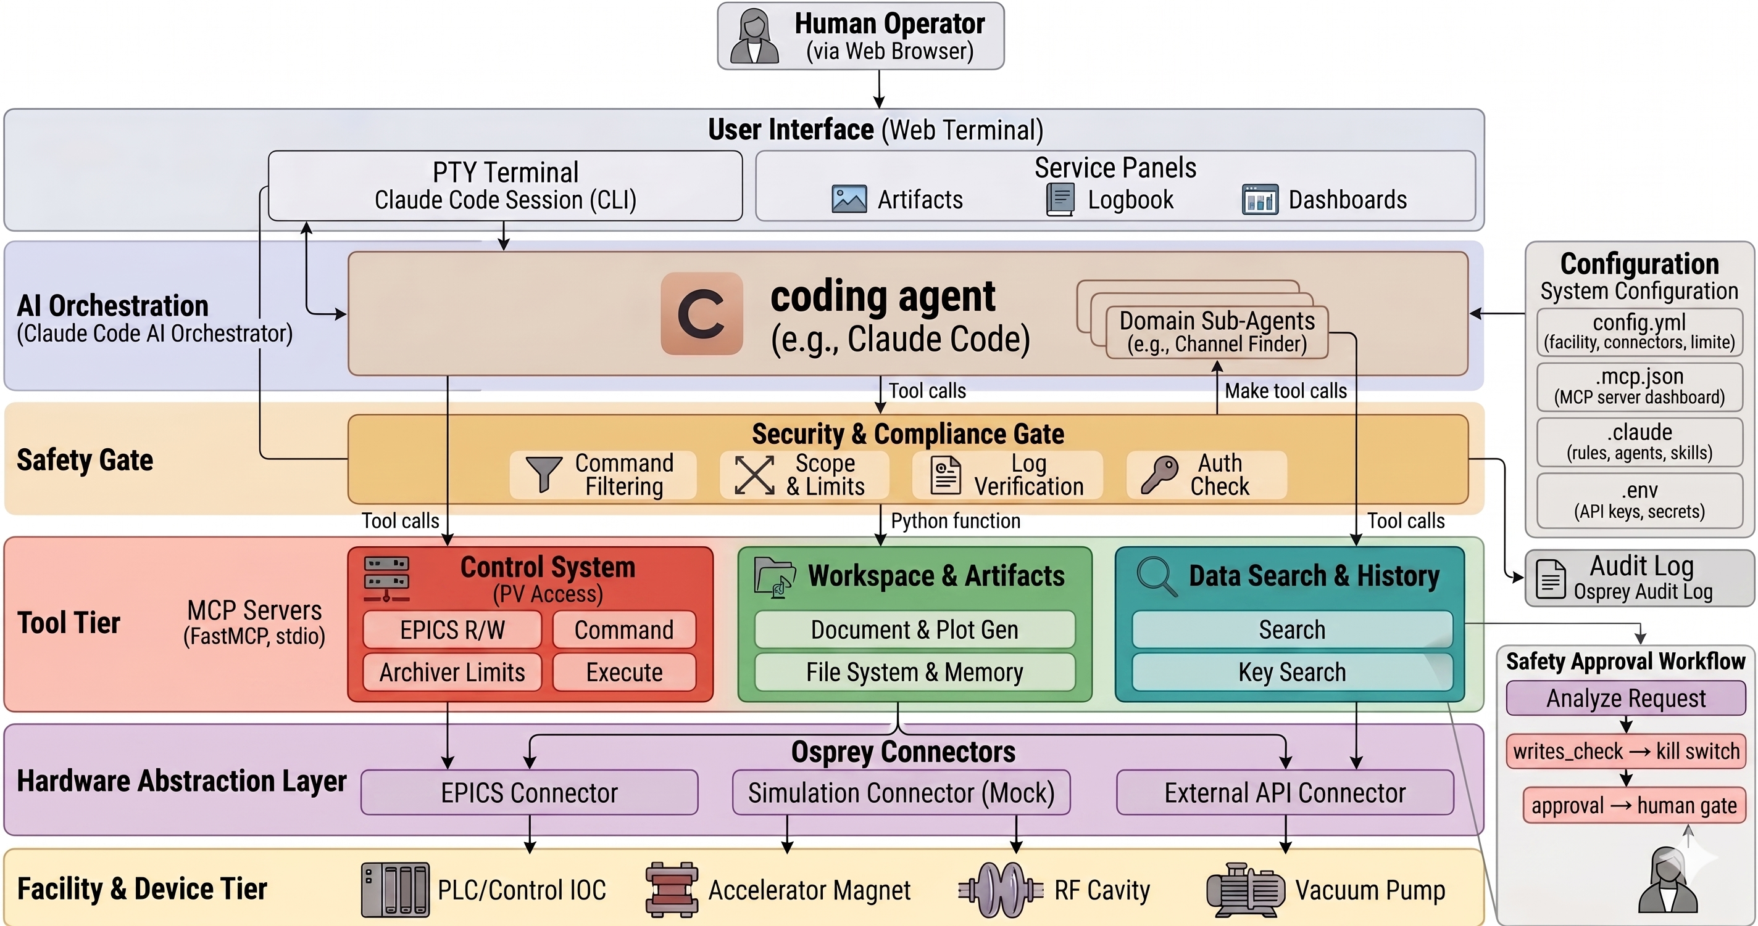
Osprey: Production-Ready Agentic AI for Safety-Critical Control Systems
Development, deployment, and extension of the agentic framework
Reduce time-to-solution and improve reliability of simulation/control workflows.
Bridge operator's goals, software tools, and safe execution.
Adding new features that leverage LLMs and agent-based workflows.
Repository:https://github.com/als-apg/osprey
Osprey system architecture from operator to facility, with the safety gate and approval workflow in-line.

Slide 17
Logbook Retrieval using Osprey
Osprey Query
Any recent beam loss events and what caused them
Ranking + Retrieval
Filter by time, category, Severity
Rank by keyword and semantic similarity
Cited logs
Log #142
RF fluctuation - WARN
Log #137
Beam loss - ERROR
LLM Assisted Report
Summary generated exclusively from cited logs and generated into PDF report for reference
FAQs
How does retrieval work?
Two-stage: filtering -> ranking
Ranking combines keyword matching + semantic similarity
What model is used?
Sentence-transformers for embeddings, LLM used for summarization only
How are results grounded?
Top-k logs returned with timestamps + IDs, Summary is generated only from retrieved logs
How does it scale?
Embeddings precomputed and cached, Retrieval operates on filtered subsets
Can be extended with vector indexing (FAISS)
What are current limitations?
Dependent on log quality / completeness, No query rewriting yet
Logbook Retrieval for Particle Accelerator Experiments
Taking operator queries against thousands of logs and returning cited reports using semantic search and Large Language Models.
Operators ask questions in natural language allowing the application to retrieve relevant logbook entries using filtering and ranking.
Top logs are returned to the user with grounded AI summaries of the relationship between their queries and the retrieved logs.

Slide 18
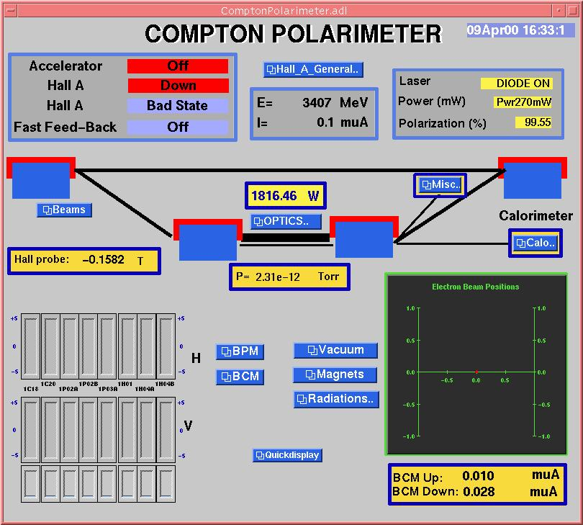
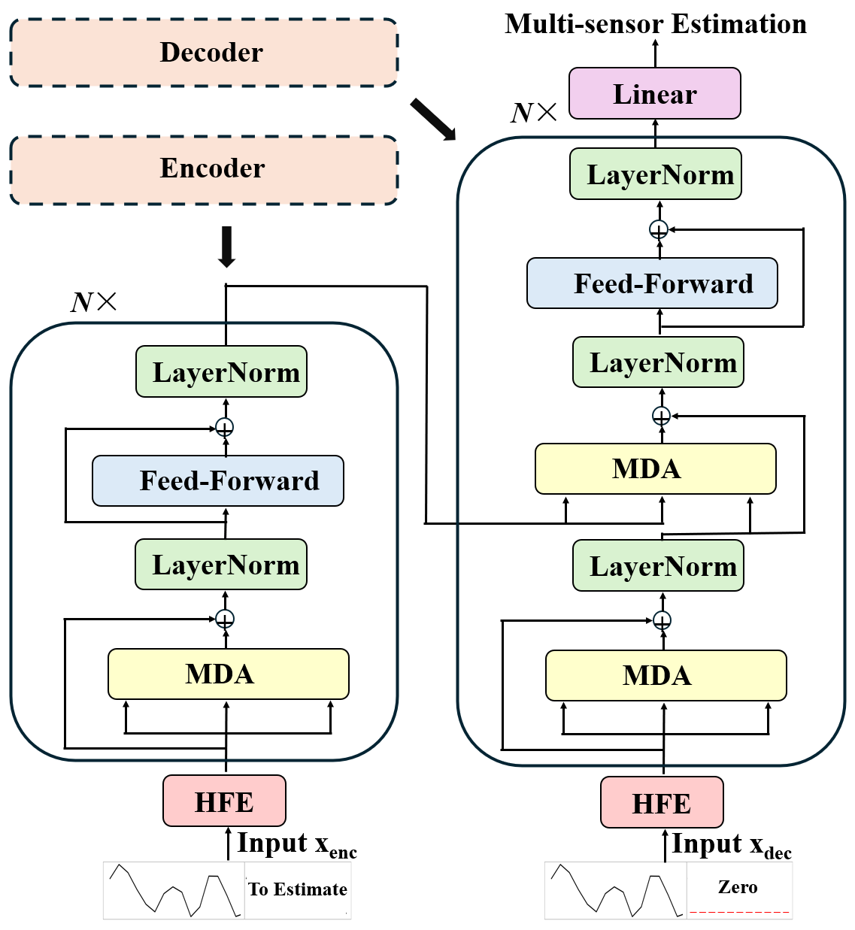
EPICS-Driven Radiation Monitoring at JLab
EPICS streams real-time, time-series data from radiation sensors across the JLab campus.
Sequence-based AI models analyze the sensor data:
  Multi-Task Transformer (MTL-TX)
  Long Short-Term Memory (LSTM) networks
The models estimate radiation levels at multiple locations.
The workflow demonstrates how AI can interpret complex, physically connected sensor data in real time.
EPICS menu screen example.
MTL TX model

Slide 19
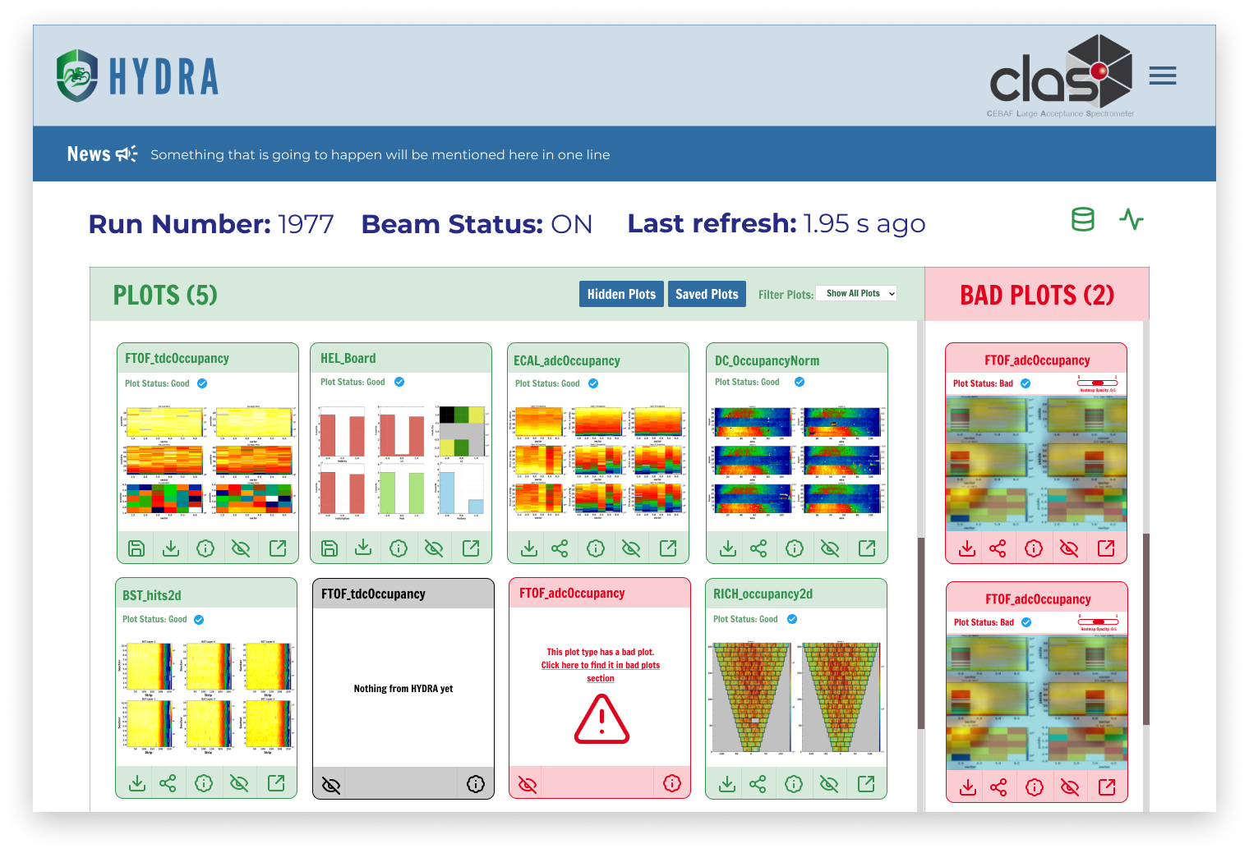
AI-Driven Scientific Workflows at Jefferson Lab
JLab increasingly uses real-time AI workflows to support nuclear physics experiments.
The Hydra monitoring system performs near-real-time data-quality assessment.
The system identifies potential problems affecting detector or accelerator health.
Results are displayed through an interactive run interface.
Operators can rapidly review data quality and respond to abnormal conditions.
Hydra Run page example from Hall B.

Slide 20
EPICS connects the physical accelerator to the digital twin
Accelerator
EPICS
Digital twin
Decision workflow
Sensors, magnets, RF, diagnostics and equipment state
IOCs publish named process variables with values, timestamps, alarms and limits
Estimate the beam state, run physics or surrogate models, and quantify uncertainty
Compare prediction with measurement; recommend, approve or reject a setting
Measurements calibrate the twin • approved setpoints return through EPICS
EPICS is the communication layer
The digital twin is the reasoning layer
Acquire, timestamp, distribute and when authorized write machine values.
Reconstruct, simulate, calibrate, predict and optimize before touching hardware.

Slide 21
Plan for building a Digital Twin
Develop a UITF digital twin using LUME for synthetic data generation and simulation-to-experiment comparisons.
Apply differentiable physics, AI/ML, and surrogate models to calibrate simulations and reduce sim2real mismatch.
Use generative phase-space reconstruction and normalizing flows to predict particle distributions and infer upstream machine errors.
Develop reinforcement-learning controllers for accelerator optimization and control.
Resolve ambiguous machine errors such as magnet misalignment versus incorrect beam angle using targeted magnet scans, diagnostic data, and phase-space analysis.
Two ways of identifying errors in an accelerator model:
Per-device approach: Adjust and calibrate one component at a time
Combined approach: Estimate errors in several components simultaneously
A degenerate solution occurs when different combinations of errors produce nearly the same diagnostic output.
Combined inference
Similar beam-position changes can have different causes, requiring targeted diagnostic scans and phase-space analysis to identify the true machine error.
Notes:
Explain figure 1

Slide 22
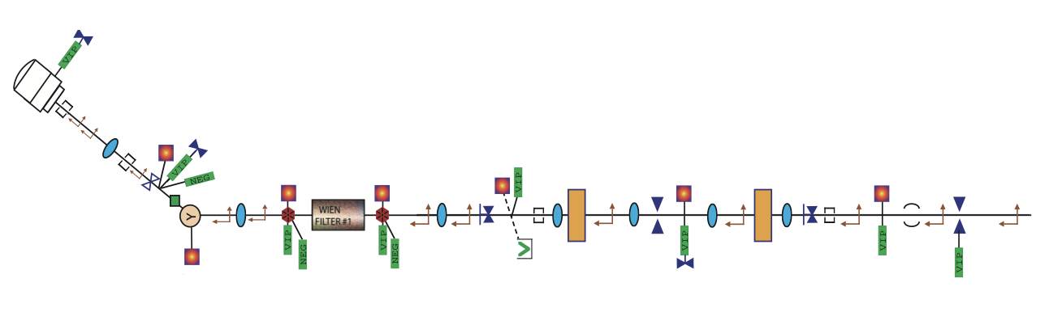
Goal: A digital twin for the UITF beamline
PHYSICAL SYSTEM
DATA PIPELINES
DIGITAL-TWIN CORE
COMPUTE + MEMORY
UITF beamline
LIVE GATEWAY
ONLINE MODELING
EPICS +
Lume-PVA
INPUT
Physics baseline
LOCAL / HPC COMPUTE
validate units
align timestamps
check bounds
LUME orchestration • IMPACT-T / ASTRA / Elegant
CPU • GPU
physics ensembles
model training and inference
SETTINGS
Calibrated ML surrogate
Setpoints
+ readbacks
Residual learning • uncertainty intervals • status
STATE
MEASURED
ARCHIVE + REGISTRY
Timestamps
alarms + limits
CHARACTERIZATION + OPTIMIZATION
process images
flag invalid beam
synchronize runs
raw → processed
measurements + predictions
models • metrics
Characterize
Recommend
OPERATOR GUI
Compare model and held-out diagnostics
Optimize within bounds; operator approves
Versioned and auditable
HUMAN-IN-THE-LOOP • approved settings → EPICS • decisions → archive

Slide 23
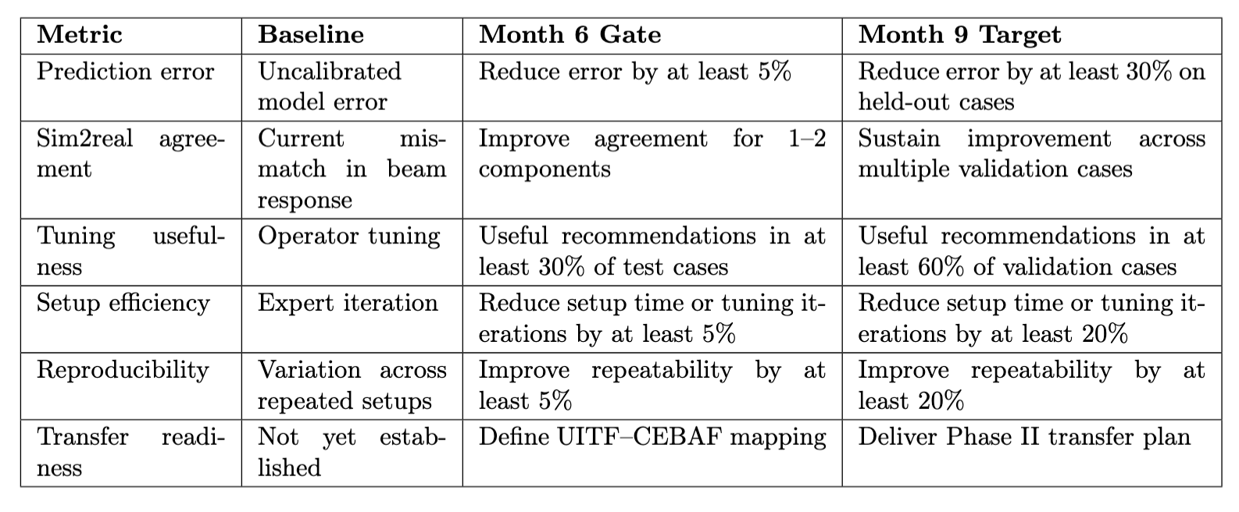
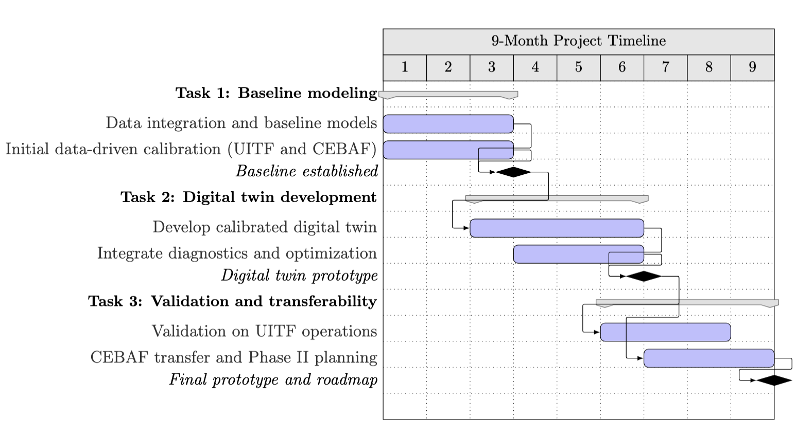
A staged roadmap
M1–2
M2–4
M4–6
M6–8
M8–9
Baseline
Build
Evaluate
Validate
Transfer
Data integration
calibrated physics model
Reconstruction
digital twin workflow
Held-out tests
tuning usefulness
Machine cases
uncertainty and drift
CEBAF mapping
And Phase II plan
Decision gate metrics
Gantt chart for proposed research

Slide 24
Our Team
Old Dominion University
Monika Yadav (PI)
Qianqian Su
Léon Van Riesen-Haupt
Balša Terzić
Jean Delayen
Frank Liu
Matt Grau
Subashini De Silva
Masha Sosonkina
Jefferson Lab
Todd Satogata (co-PI)
He Zhang
Steven Goldenberg
Kishansingh Rajput
Christopher Tennant
Matthew Poelker
PNNL
Jan Strube (co-PI)
Milan Jain
Natalie Isenberg
LBNL
Jean-Luc Vay
SLAC
Auralee Edelen
Graduate students
Karen Makino
Jacob Bird
Kazi Ridwan Ahmed
Muhammad Faisal Sattar
Owen A Gerdes
Pengyu Li
Master Students
Tony Griffin
Kamelia Marchand Vaudrin
Jim Ryan

Slide 25










\
Existing and Potential Partnerships
International and national collaborations
  UCLA
  SLAC National Accelerator Lab (FACET-II)
  Argonne Wakefield Accelerator (AWA)
  University of Liverpool, Cockcroft Institute, CLARA facility
  INFN lab Frascati
Funding sources
  STaR grant ODU
  CCI grant 2026
  Two Genesis Mission DOE grants
I have actively collaborated with and gained experience in
  NSF, DARPA, Industry and national lab partnership, and more …

Slide 26
Questions?
Thank you!

