Slide 1


Machine Learning Approaches to Improved Ion Profile Monitor Measurements
Chris Hall
Boulder, Colorado USA | radiasoft.net

Slide 2
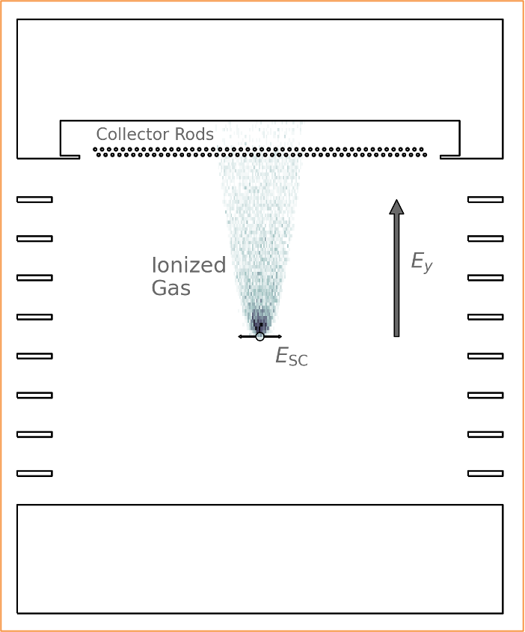
Ion Profile Monitors
Non-destructive measurement of transverse bunch size
Operation:
  Passing beam (going into page) ionizes background gas
  lons are collected, their profile provides information on the beam distribution
  Space charge from the bunch will spread the observed profile out relative to the true distribution
If the Twiss β and dispersion are known at the lPM then emittance can be calculated

Slide 3
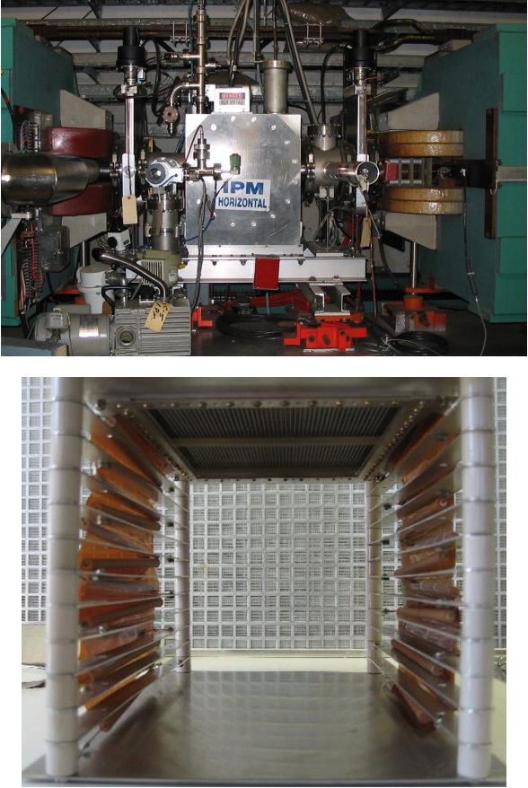
Why look at applying ML to IPMs?
Ion IPM are the main emittance measurement tool in the AGS
  Electron gathering IPMs are also present
    Measurements less sensitive to intensity
    Faster collection
    Operation has been very limited
More generally:
  Test ML-based approaches to correct for intrinsic aberrations, signal noise, and random errors
  Want to improve both measurement accuracy and reliability

Slide 4
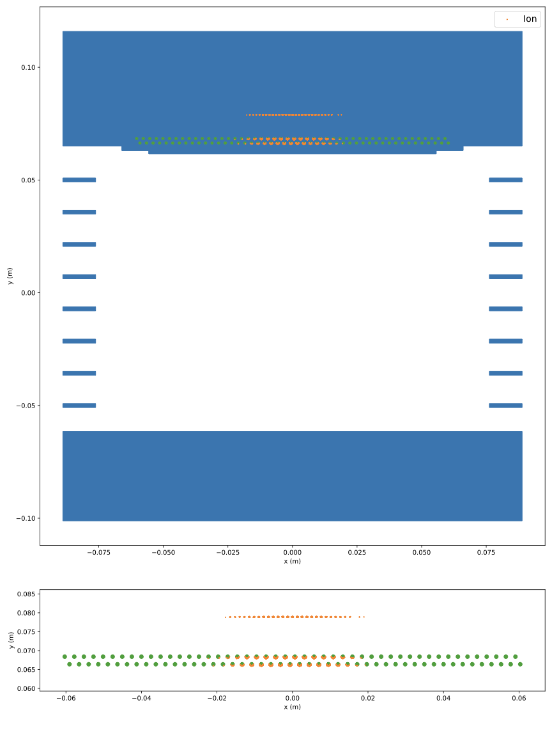
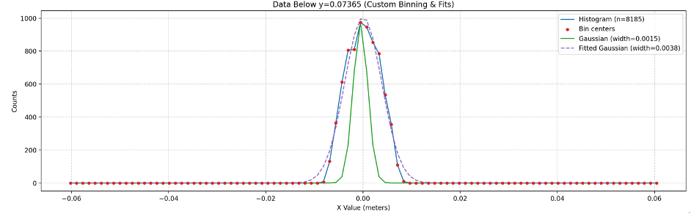
IPM Simulations
Built using the code Warp, a multi-species, three-dimensional particle-in-cell (PIC) application specializing in the simulation of intense beams of charged particles
Provides:
  Field solve
  Embedded boundaries
  Electric field of the collector assembly
  Accurate particle scraping on collector wires
  Monte Carlo ionization models

Slide 5
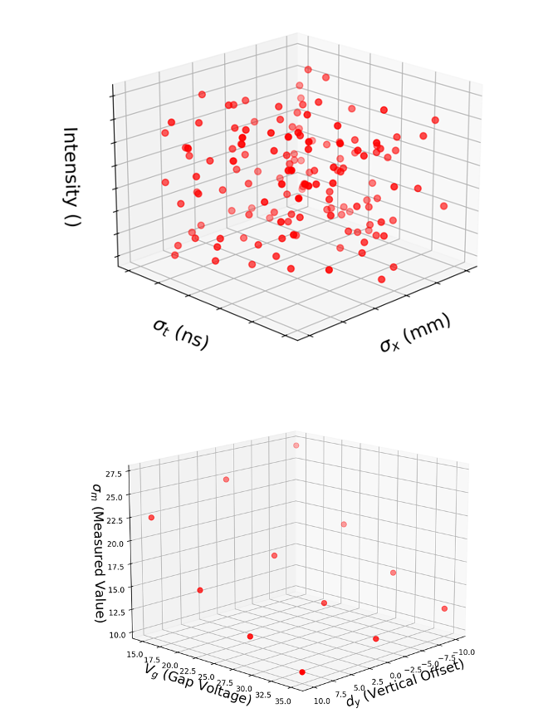
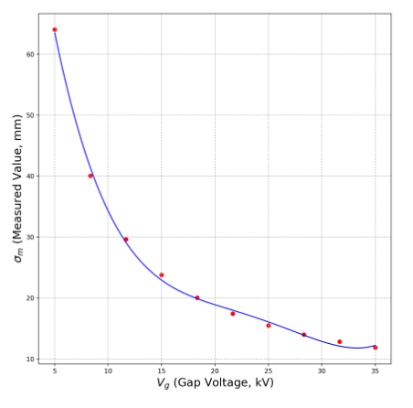
Training a Regressor Model from Simulations
Provides a means to quickly determine true beam parameters even with noisy/imperfect measurements
Training data generation:
Simulation dataset with Latin hypercube sampling of:
  Beam size (x & y)
  Number of protons in bunch
  Bunch length
Fixed values for:
  Collection species: N2
  Circulating beam energy: 10 GeV
  Bunch spacing: 200 ns
For each parameterization of the beam run scan over
  Collector voltage
  Vertical offset of bunch centroid from collector
Train models to predict true beam size from scan – without direct knowledge of other beam parameters

Slide 6
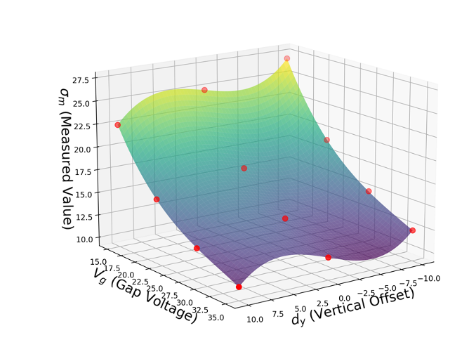
Measurement types
Three different model types are trained, distinguished by the type of scan data they take in:
Voltage-fit: A 4th order polynomial is fit to a voltage scan of 12 points. The polynomial coefficients are used as inputs to the regressor.
Surface-fit: A 4th order polynomial surface is fit to the scan data. The polynomial coefficients are used as inputs to the regressor.
Point-by-point: The regressor models are trained using the individual data points from the scan, plus intensity. Should have insufficient information to uniquely determine beam parameters, intended as a reference case.

Slide 7
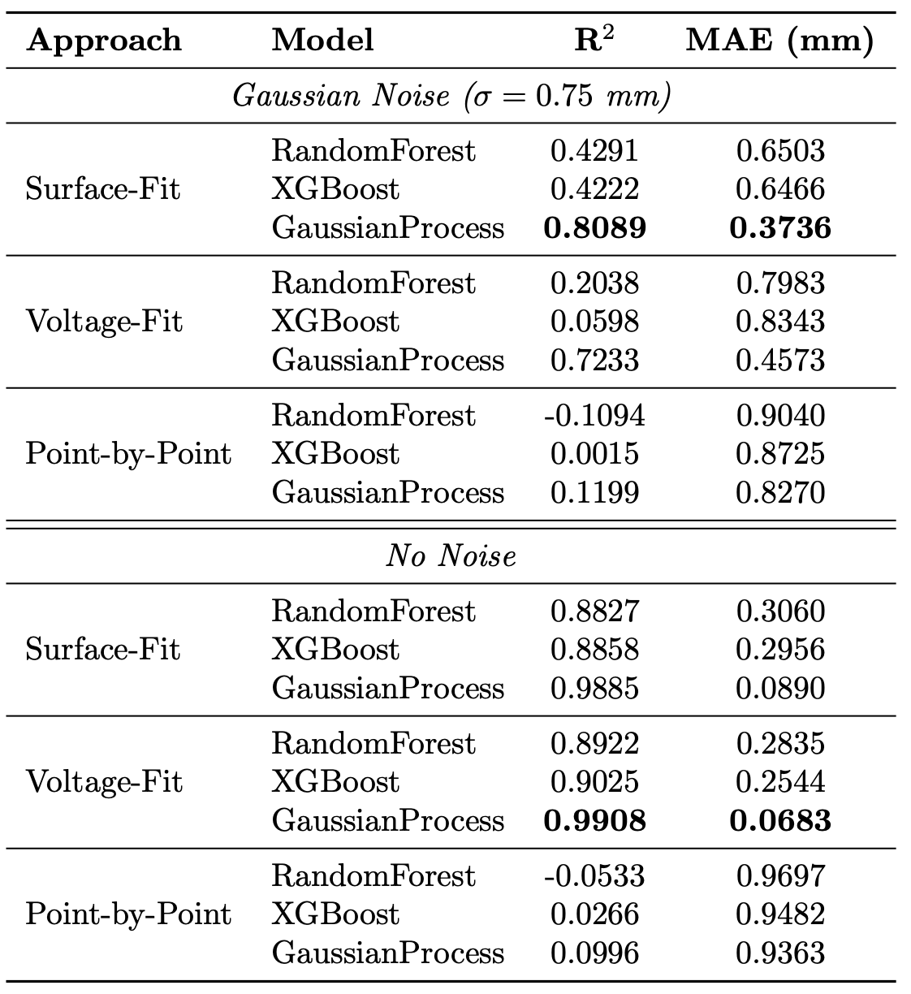
Model Performance
Compares 3 model methods for each measurement approach
“Gaussian noise” case adds in random errors to the measured beam size sampled from a Gaussian
GP is always the clear best performer
Using the surface-fit offers some benefit, over voltage-fit, for noisy measurements
  Slightly more involved, need to displace the beam systematically to alter trajectory through IPM

Slide 8
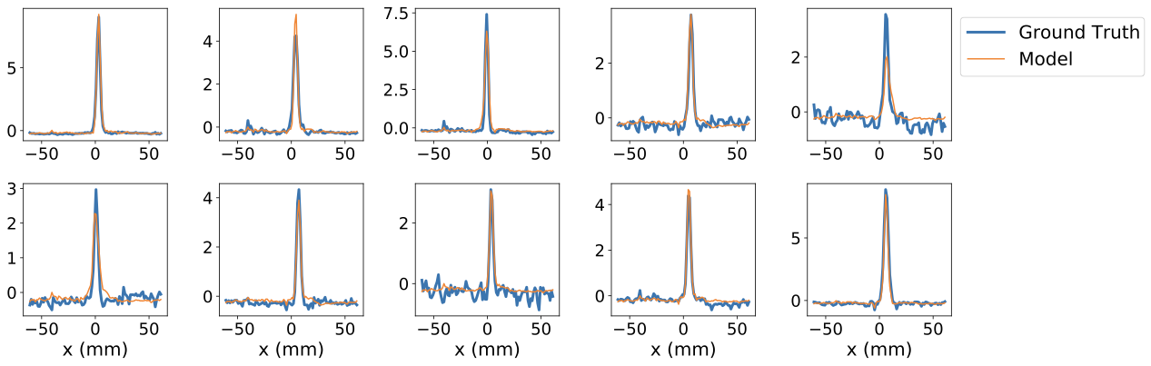
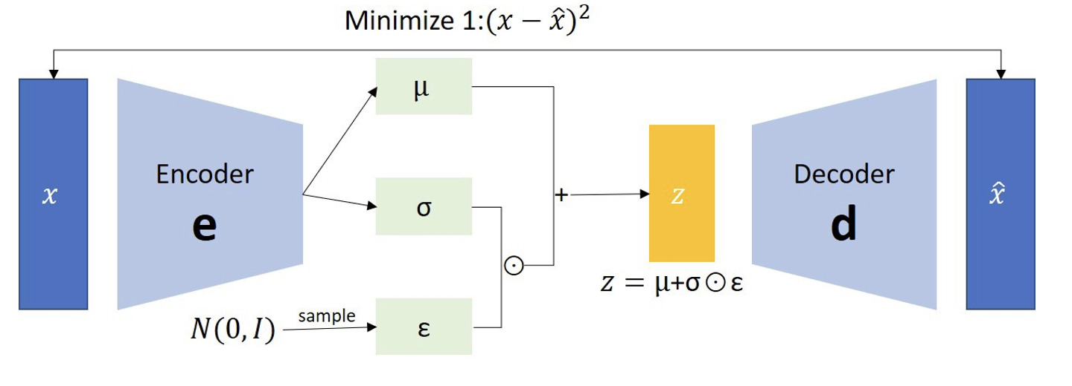
Signal Denoising
Variational autoencoders can be very effective at removing random noise while preserving the main signal*
A VAE is trained to reproduce input profiles
1D convolutional networks used for the encoder and decoder
*Henderson, M., et al. Journal of Instrumentation 19.11 (2024): P11015.

Slide 9
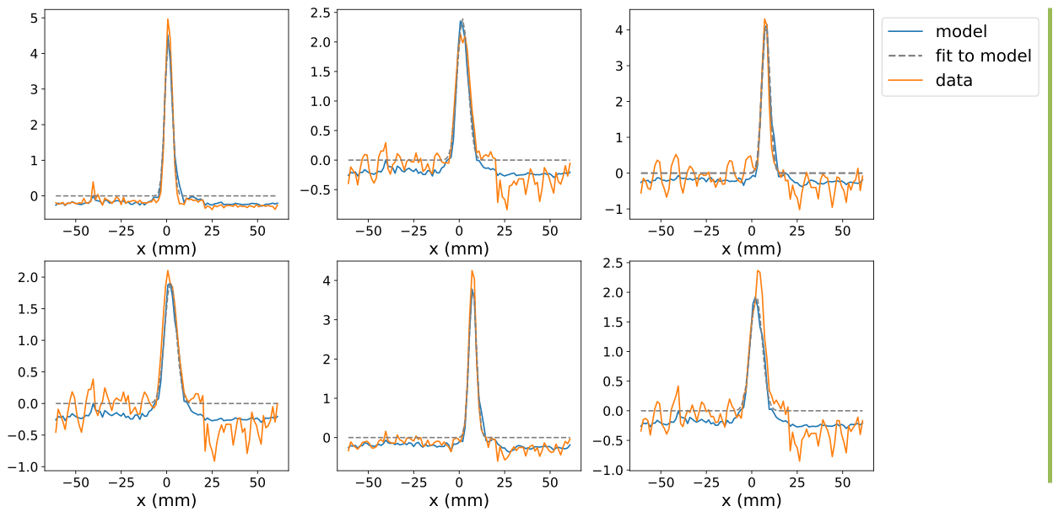
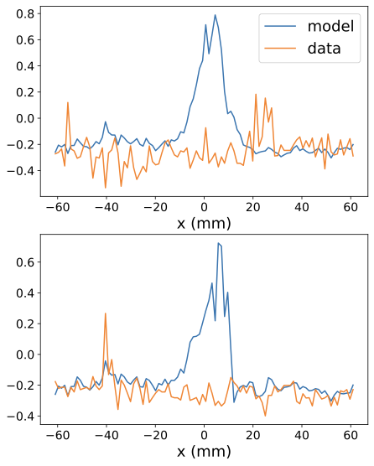
Denoising VAEs
Denoising enables the fitting routine to converge in cases that previously failed
However, VAE is prone to hallucinating signals from pure-noise profiles. Motivates the use of classifiers to remove bad signals ahead of denoising.

Slide 10
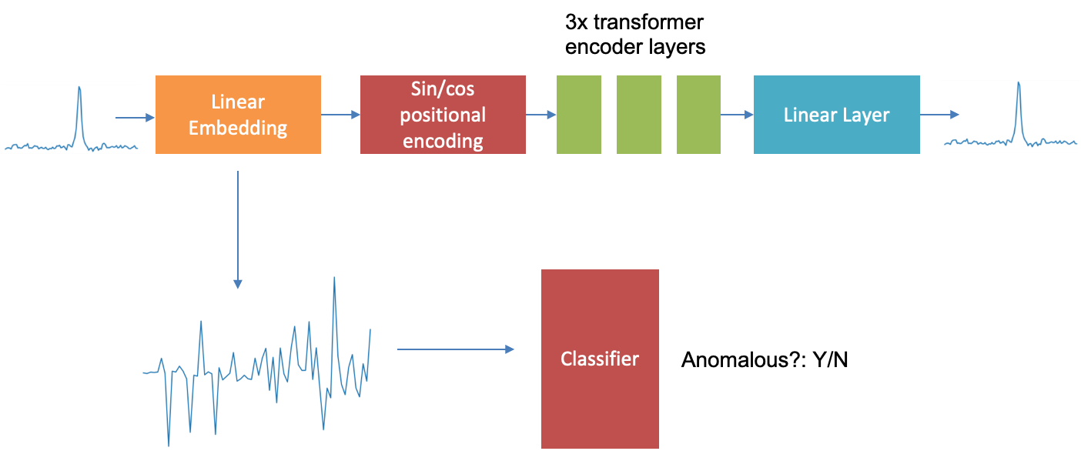
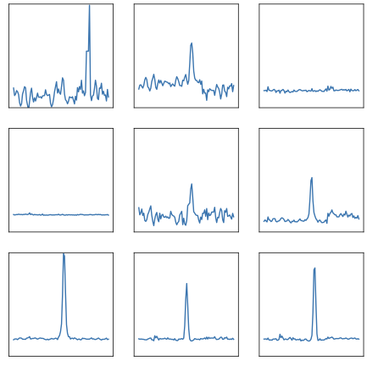
Unsupervised Anomaly Detection
Train a simple transformer encoder to reproduce IPM profiles
Goal is not denoising, the transformer will generally reproduce any noise in the signal, but to use the embedding
The embedding is averaged over all input tokens and passed to an unsupervised classifier
Anomalous
Good

Slide 11

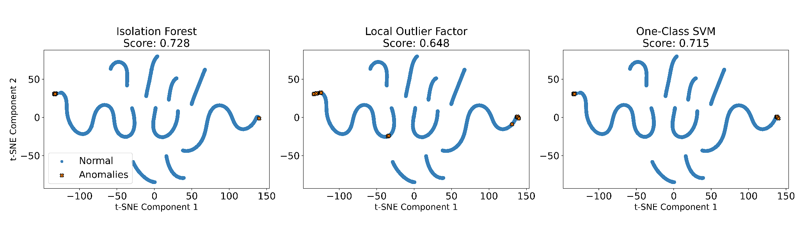

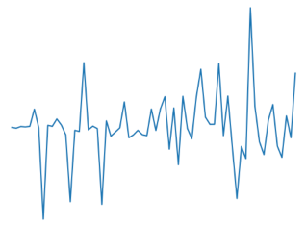
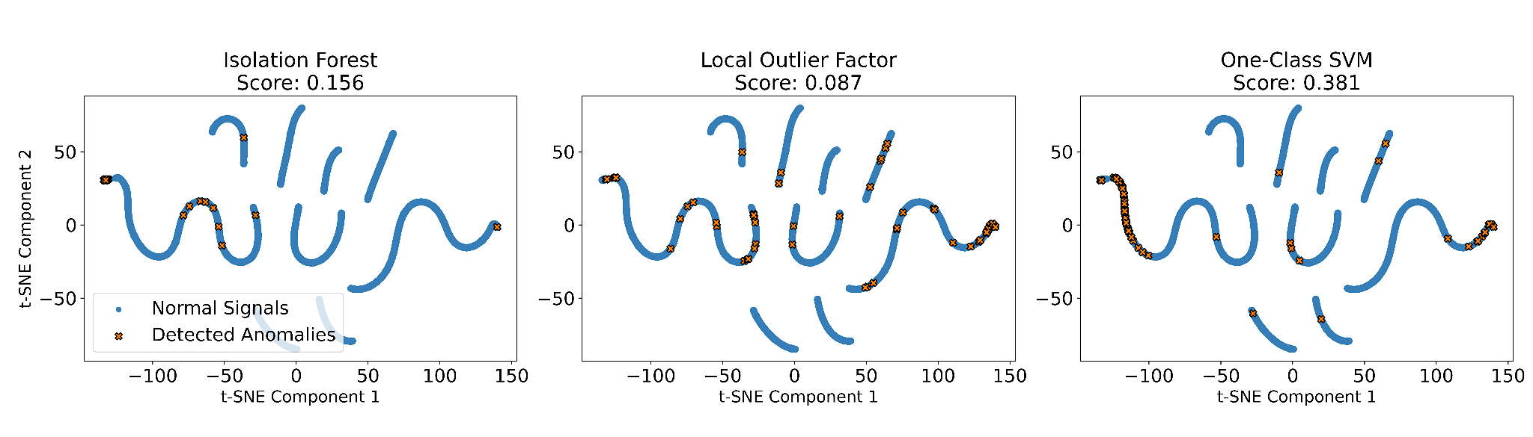
Unsupervised Classifier Performance
Performance is compared via spot checks, silhouette scores and clustering of points in clustering of data in a t-SNE representation.
For all 3 classifier models considered the use of the linear embedding to pre-process the signal greatly enhances classifier accuracy compared to raw IPM signals

Slide 12
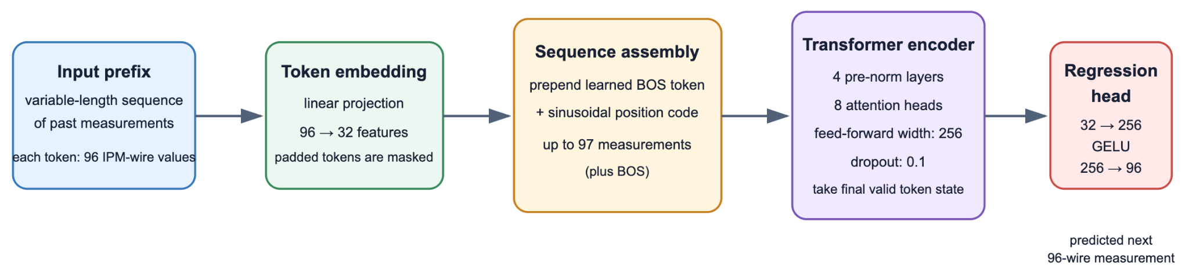
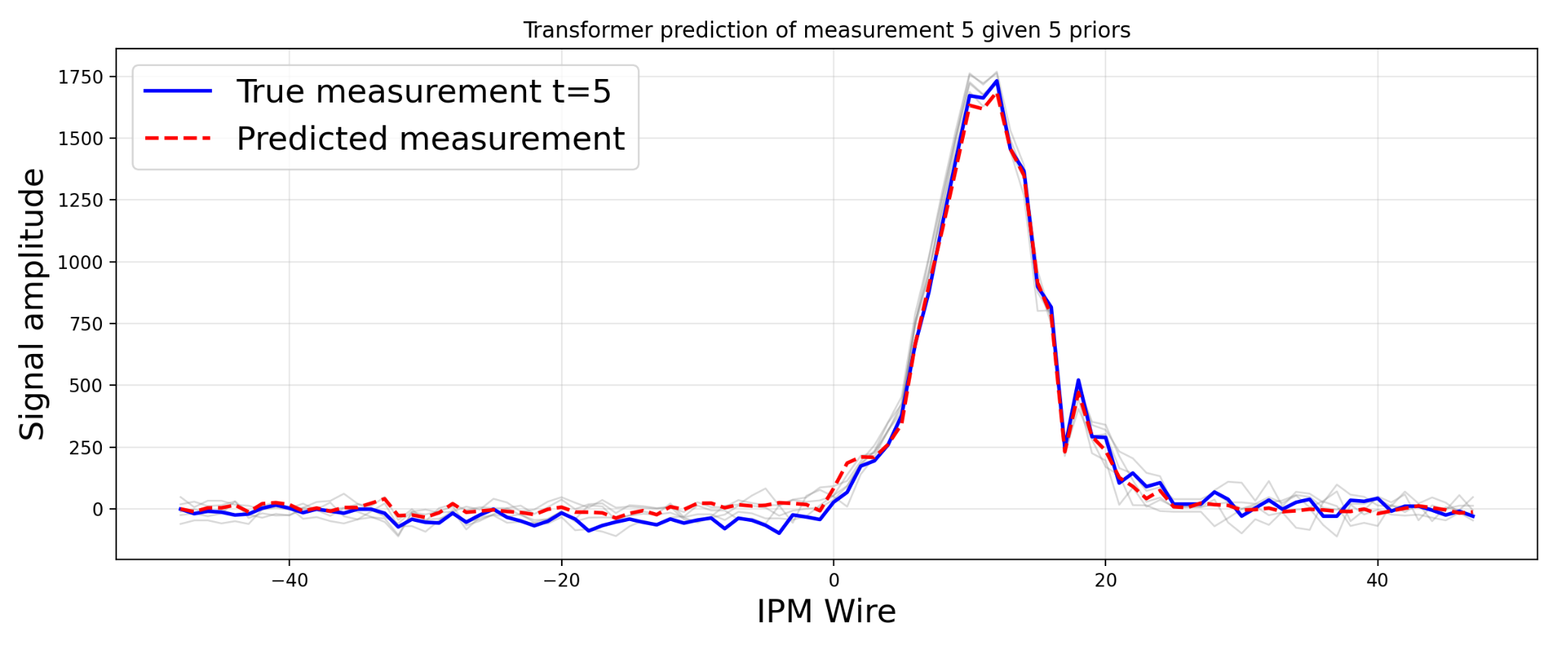
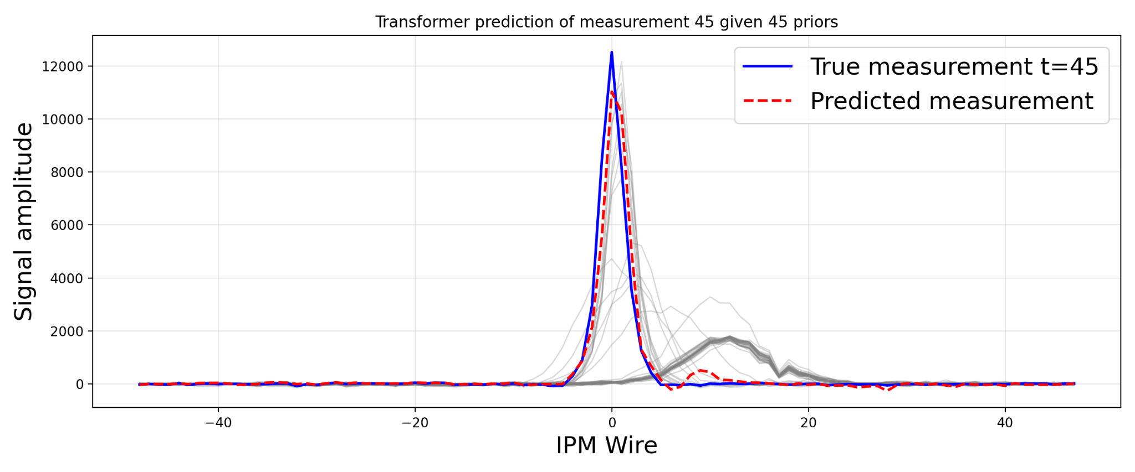
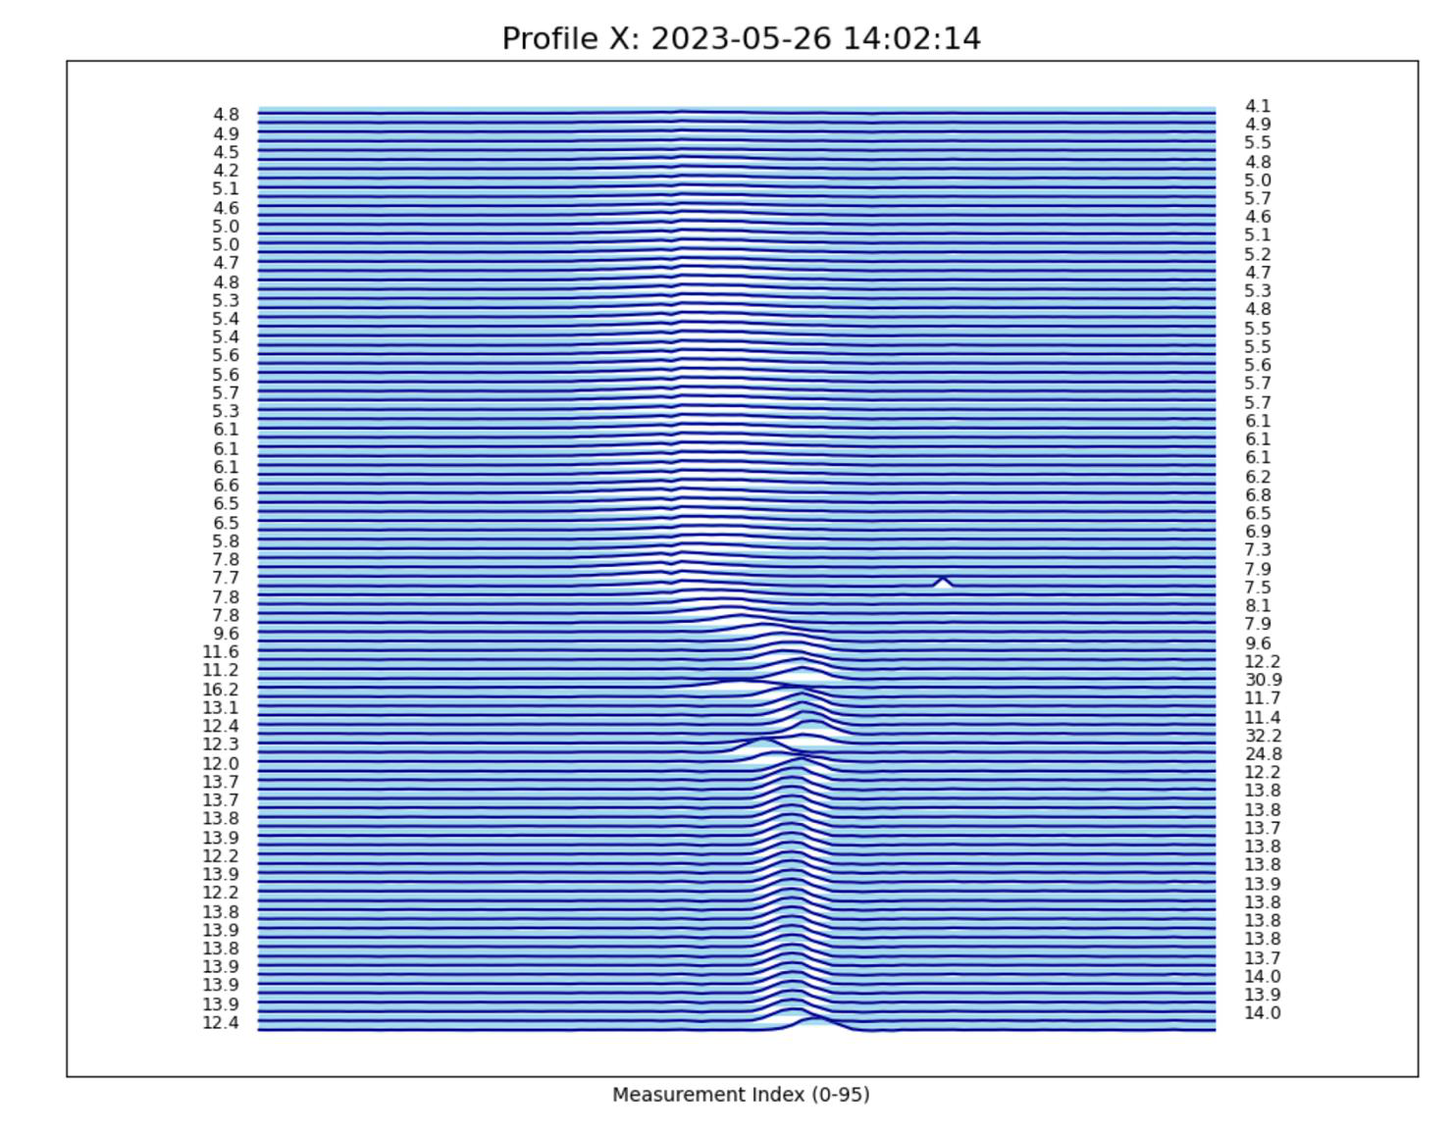
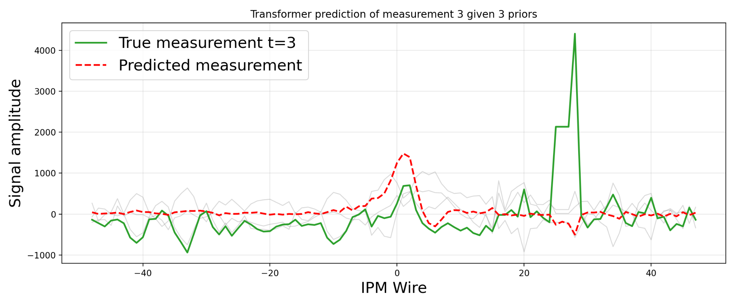
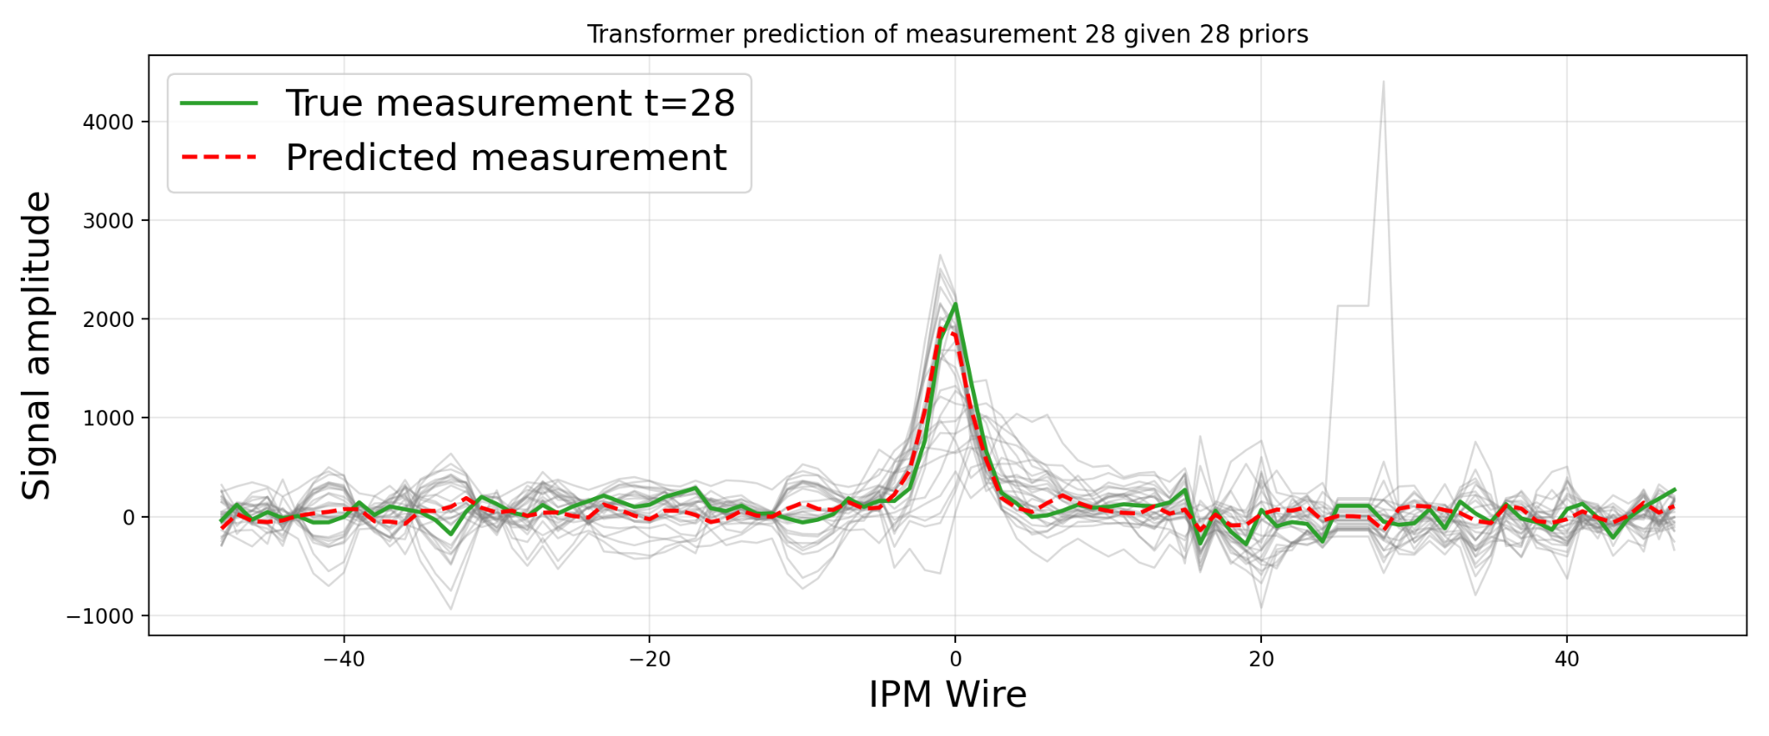
Forecasting IPM Measurements
Transformer architecture is used again but input is a sequence of n IPM measurements during 1 cycle, goal is to predict n+1
Prediction is not autoregressive. Transformer gets the true, previous n measurements each time, not its previous predictions
From Test Dataset
Out of distribution dataset
Notes:
Prediction is not autoregressive. Transformer gets the true, previous n measurements each time, not its previous predictions

Slide 13
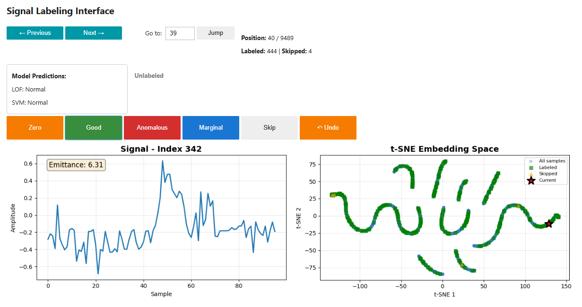
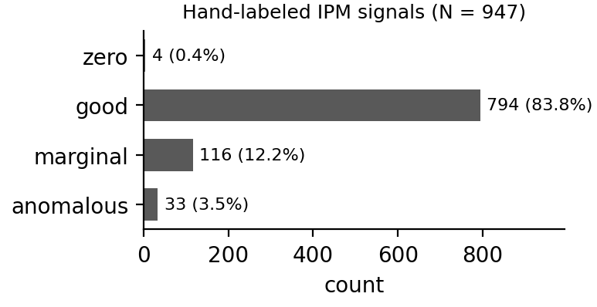
Training Supervised Classifiers
Labeling interface and dataset convention to store labels against raw data and embedding presentations
Currently labeled about 10% of 9800 signal dataset taken from portions of 1 month of operation
Dataset had been cleaned to remove some bad data so labels are quite imalanced

Slide 14
Conclusion / Summary
Developed Warp simulations of the ion-collecting IPMs, capable of including all major relevant physics
  Used to demonstrate a possible method for using parameter sweeps of the IPM to take self-consistent measurements of true beam size
Investigating several avenues for using ML to improve usability and accuracy of IPM measurements in post-processing
  VAEs for unsupervised signal denoising
  Unsupervised anomaly detection on raw IPM signals of using a linear embedding from a transformer trained on an autoencoder task
  Use of a transformer to make one-step-ahead predictions from previous measurement sequences
  Started work on creating a labeled dataset for supervised anomaly detection and numerical validation of previous unsupervised methods

