Slide 1
OB stave prototyping

Slide 2
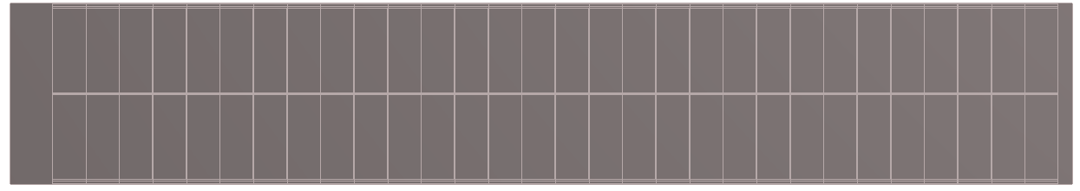
EIC-LAS thermal specifications
2 power scenarios: typical/max
  Chip design still evolving
  Power depends on temperature
 |  | Typical | Max
LEC | Power [mW] | 160 | 208
 | P density [mW/cm²] | 182 | 236
per RSU | Power [mW] | 146 | 208
 | P density [mW/cm²] | 34 | 48
5-RSU LAS (L4) [mW] |  | 890 | 1246
6-RSU LAS (L3) [mW] |  | 1036 | 1454
AncASIC |  | 35% of LAS | 45% of LAS
FPC |  | 20% of LAS | 30% of LAS
L3 Stave (8×6-RSU LAS) [W] |  | 12.8 | 16.9
L4 Stave (16×5-RSU LAS) [W] |  | 22.1 | 34.9
114.330
19.564
LEC
RSU
RSU
RSU
RSU
RSU
4.500
4.5
Temperature requirements
Requirement | LEC | RSU | AncASIC
Maximum T [◦C] | 65 | 40 | 80
Maximum T variation [◦C] | 10 | 1 over 3 mm 10 over full length | 10

Slide 3
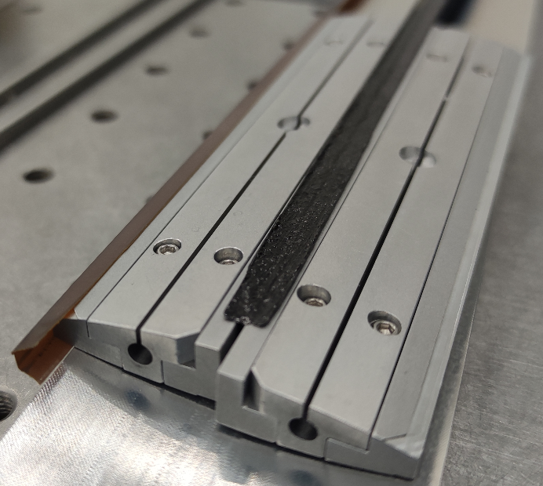
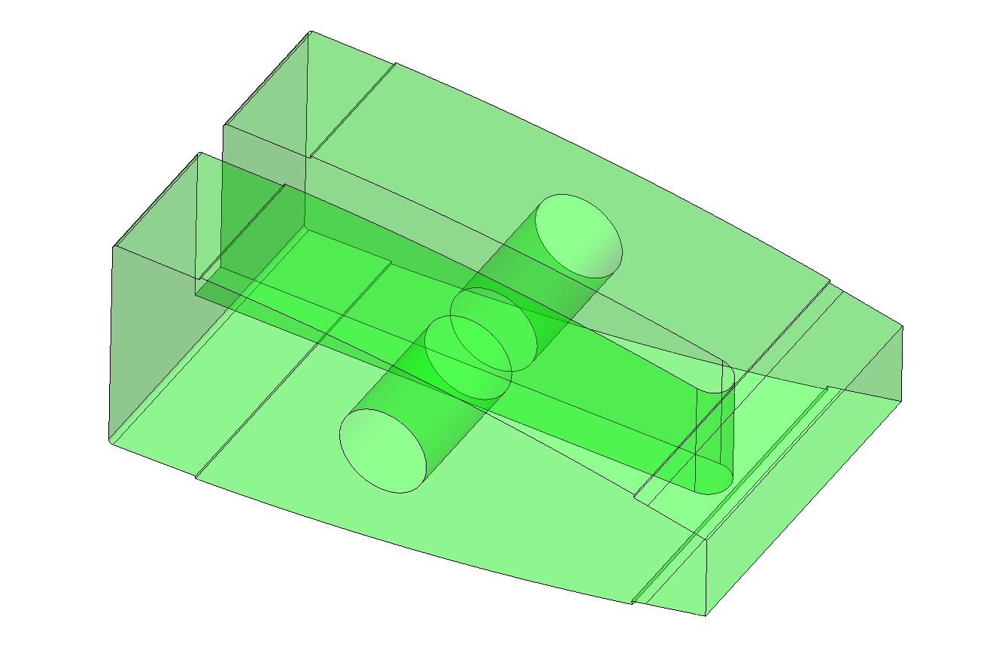
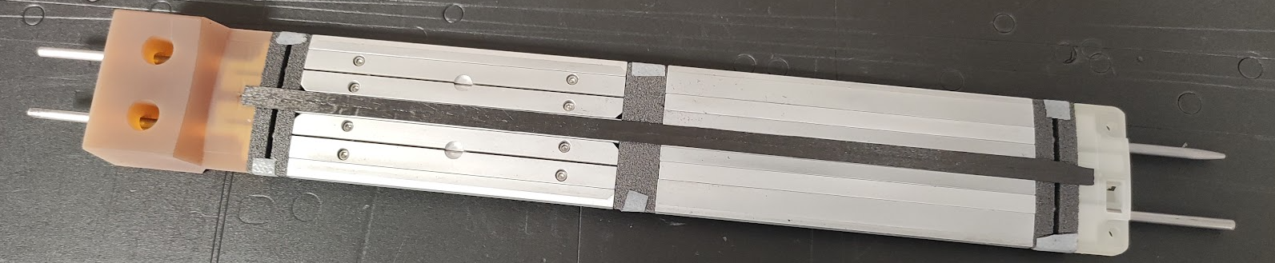
Stave manufacture – internal mould
Pre-cure the central I-beam
Assemble internal parts on internal mould parts
  Internal mould for less challenging tolerances and assembly
  Moulds are segmented into two halves with 3 parts each (wire-EDM)
    Clamp around the central I-beam
    Skewered onto two silver steel rods for straightness
Add FPCs on the sides (positioned by dowel pins)
Cover with pre-cut CF pre-preg (K13C2U/EX1515 0/90
Cover with release film, breather and vacuum bag for autoclave cure
K9 foam heatsink
⌀ 3 mm Silver Steel rods

Slide 4
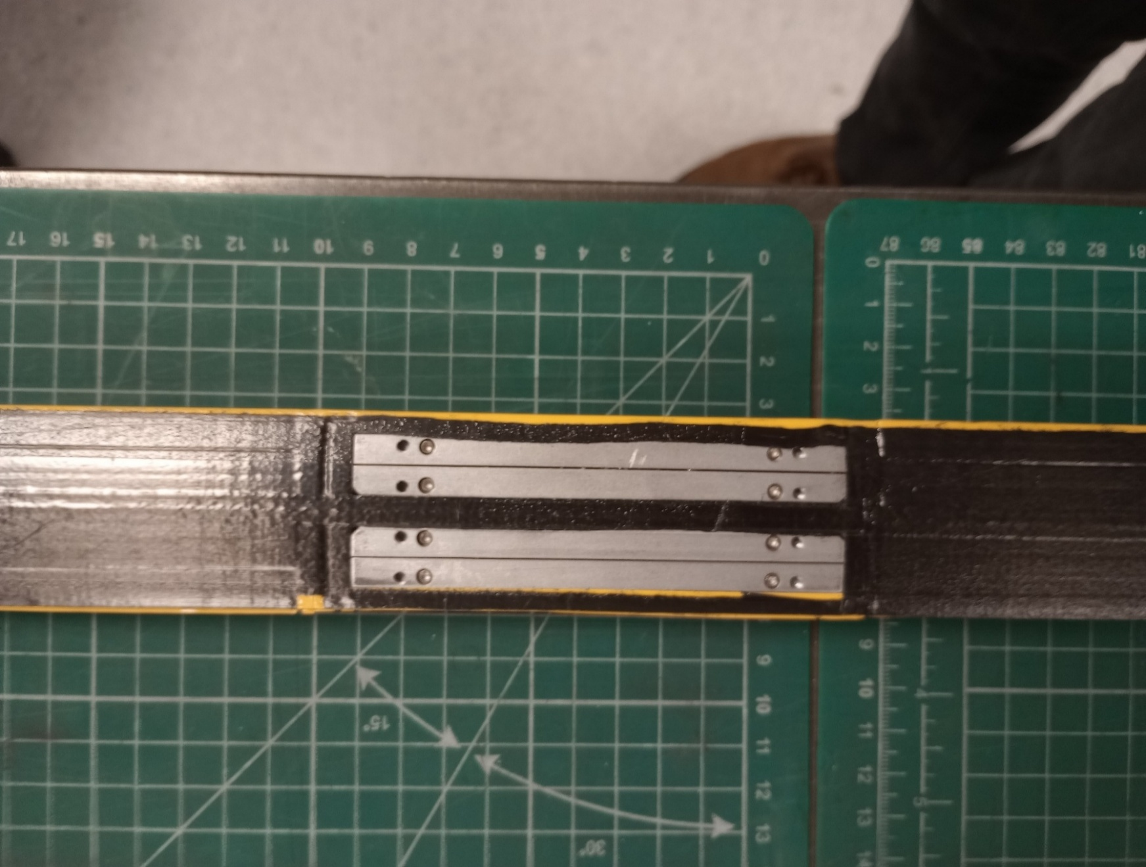
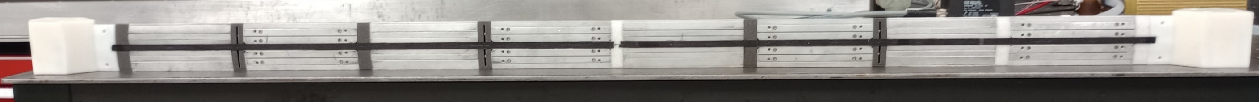
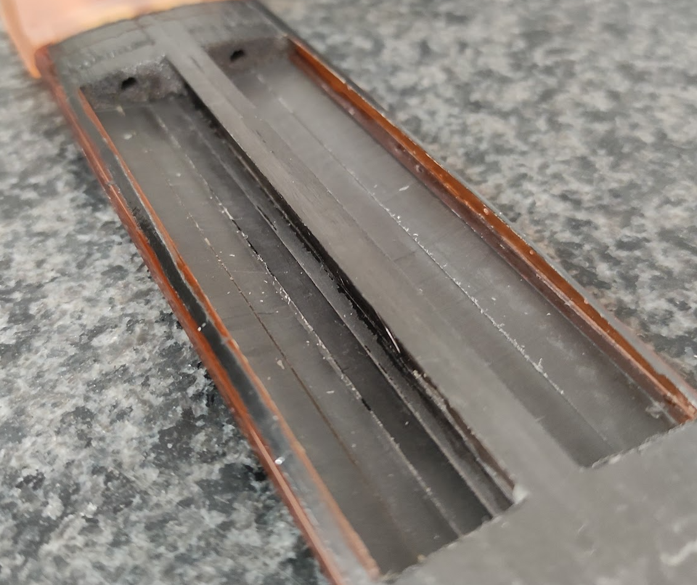
L4 prototype manufacture – issues encountered
We used expired CF pre-preg left over from other projects
  Reduced tackiness caused movement of narrow sections during cure
  Bond between I-beams and facesheet detached – tried to
  fix with Araldite, but not clear how reliable
We did not have enough K9 for all cross-ribs so used foam with poor thermal conductivity for M1 and M2
Resin seepage into the gaps between the mould parts
  This made removal, especially of the outer parts, difficult and some
  damage to the thin facesheet was incurred – this was repaired by
  gluing 25 µm Kapton over the damage
All these caused weaknesses of the structure, resulting in leaks that were
patched with 25 µm Kapton glued on with Araldite
  In particular, the poor adhesion of some I-beam sections resulted in bulging out of
  facesheets under pressure with subsequent bursting
M8
M6
M4
M2
LEC
LEC
LEC
LEC
M5
LEC
M3
LEC
LEC
M1
LEC
M7
K9 cross-ribs
Non-conductive cross-ribs

Slide 5
Dummy heater modules
Use dummy modules made of 50 µm steel shim stock, covered with Kapton/Cu heater circuits
Heater circuits have three different areas to replicate AncASIC, LEC and RSUs with their different power densities
Dimensionally similar to modules (2×5-RSU LAS + 2×AncASIC), but steel has larger CTE and higher modulus than silicon
Power density ratio inspired by LAS but not exact (LEC/RSU: heater 17.4, final typical 4.9)
121 mm (for 5-RSU LAS + AncASIC)
Full dummy module | AncASIC | LEC | RSUs
R [Ω] | 0.88 | 0.90 | 1.53
A [mm²] | 112 | 132 | 3959
R/A [mW/mm²A²] | 7.86 | 6.79 | 0.39
AncASIC
RSUs
LEC
40 mm (2 LAS)

Slide 6
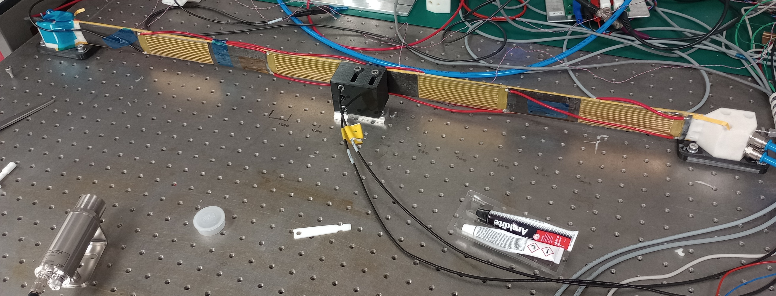
Test setup
Air out (to atmosphere)
4 more heaters on backside
(interleaved)
LEC
M7
fixed
constraint
heater
M5
LEC
heater
M3
LEC
heater
M1
Air
in
heater
LEC
capacitive
displacement
sensors
fixed
constraint
TI camera
Fixed-fixed support conditions

Slide 7
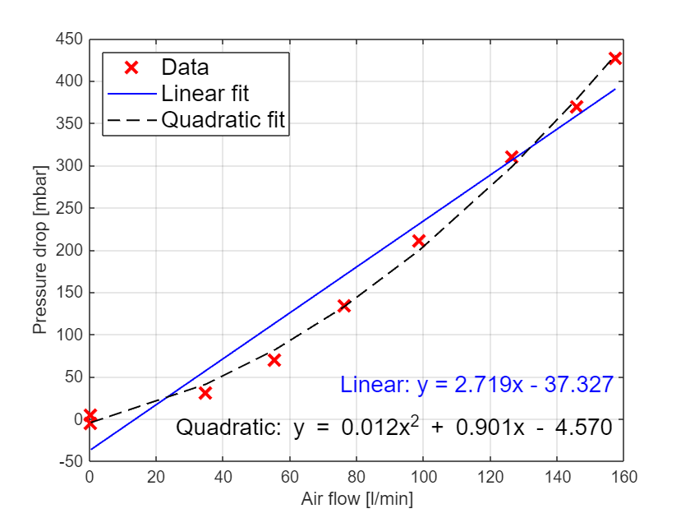
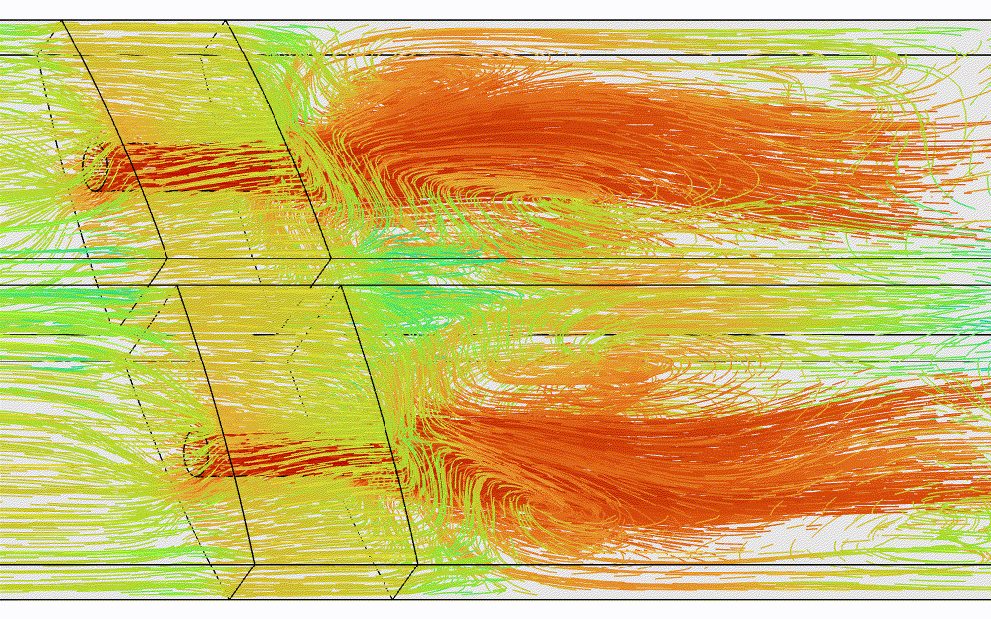
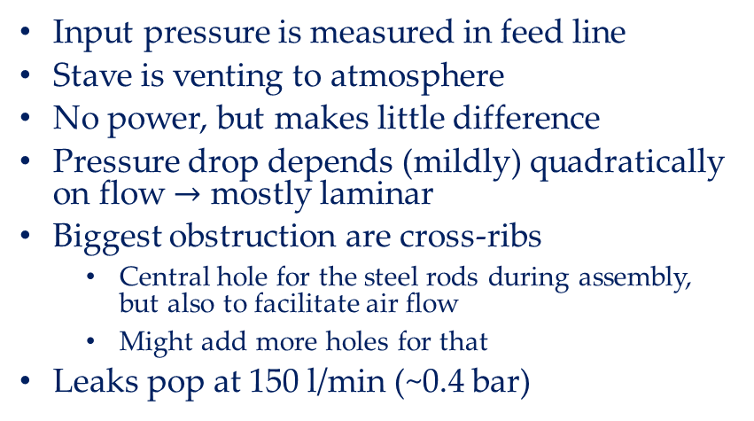
Pressure drop vs air flow
Input pressure is measured in feed line
Stave is venting to atmosphere
No power, but makes little difference
Pressure drop depends (mildly) quadratically on flow $→$ mostly laminar
Biggest obstruction are cross-ribs
  Central hole for the steel rods during assembly, but also to facilitate air flow
  Might add more holes for that
Leaks pop at 150 l/min (~0.4 bar)

Slide 8
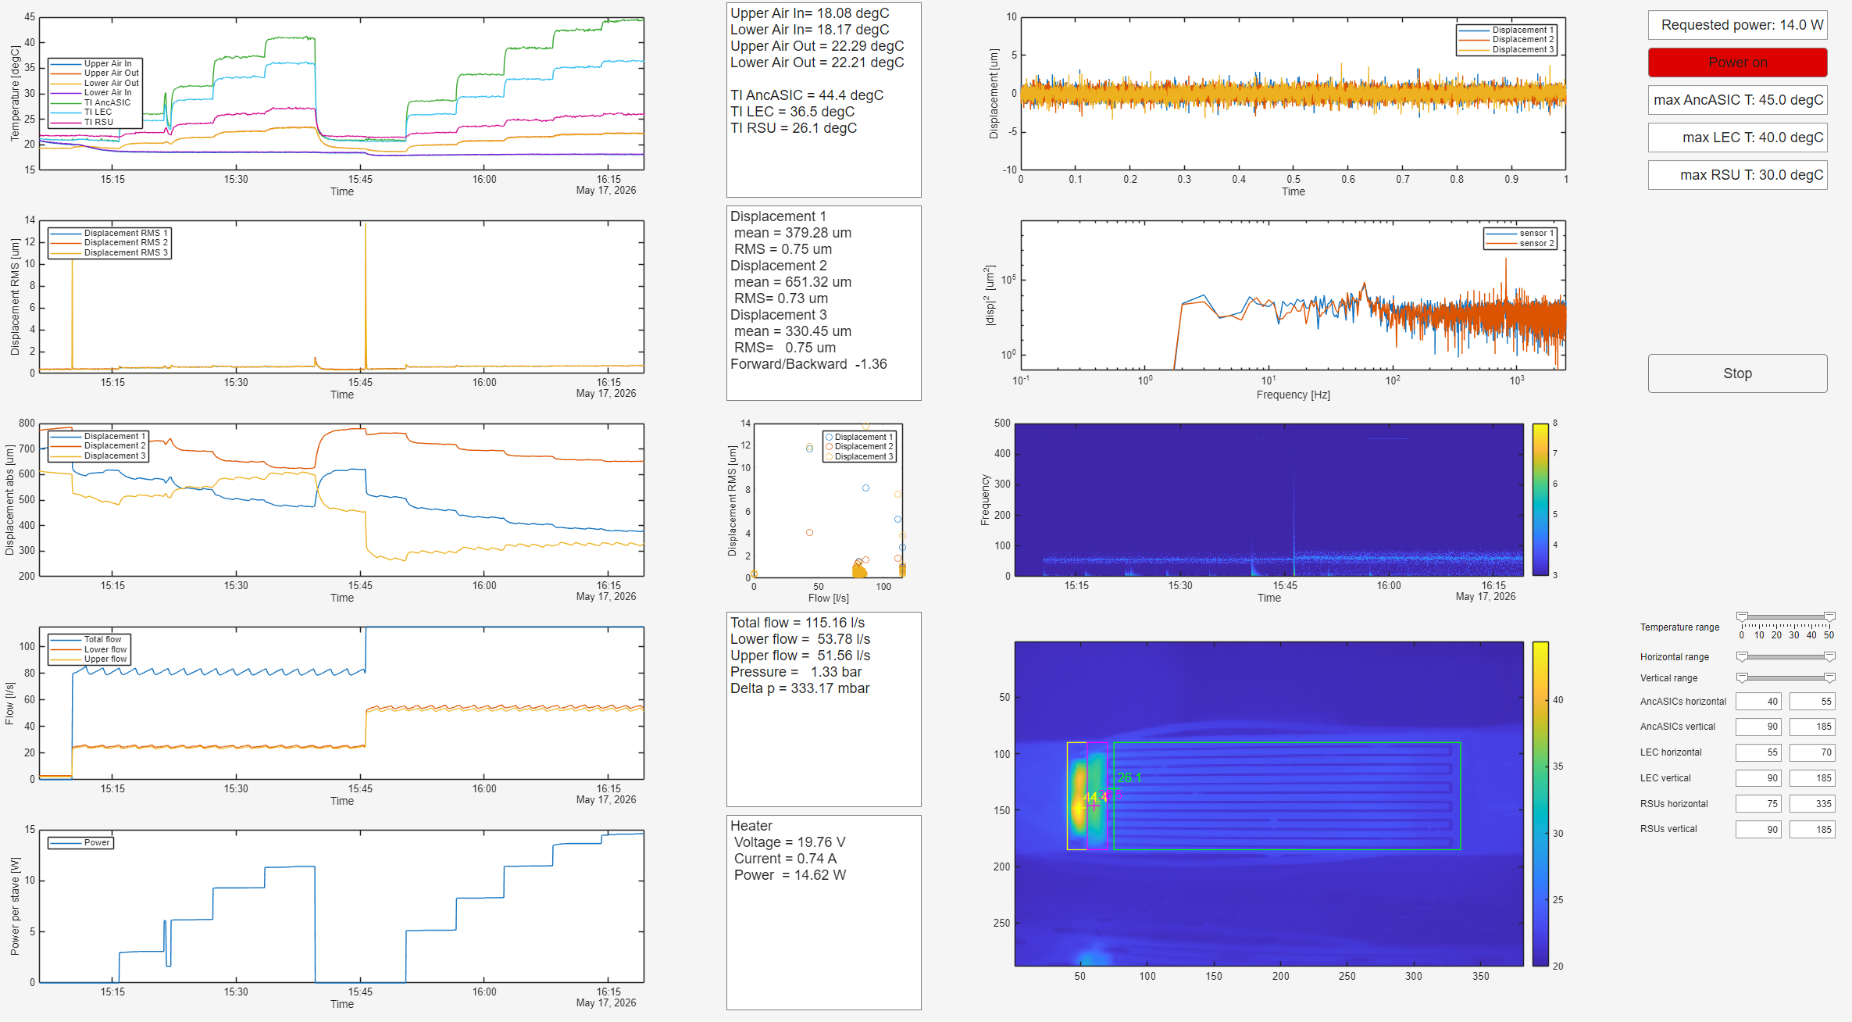
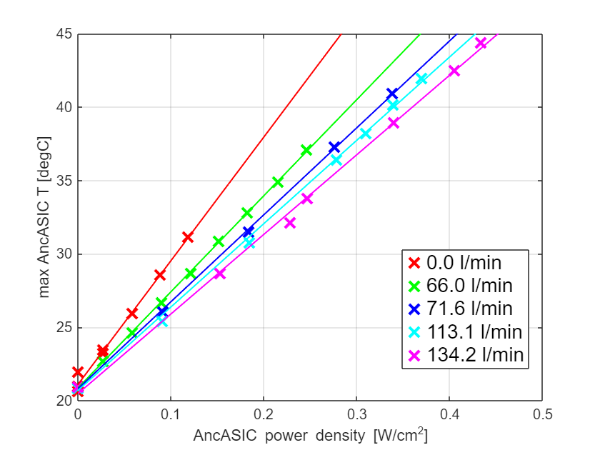
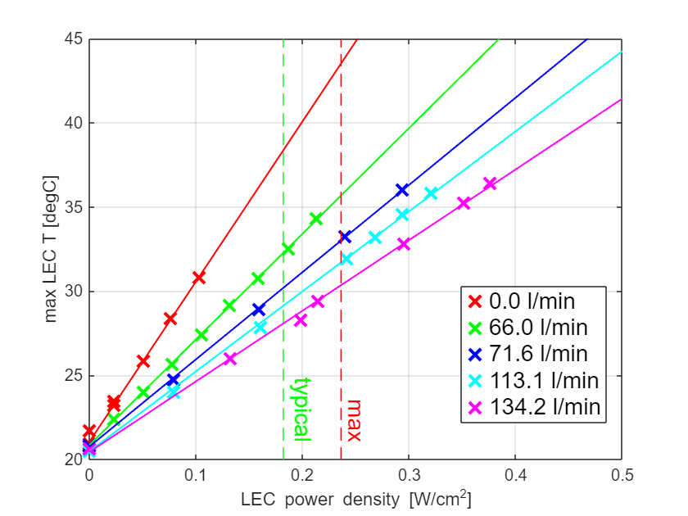
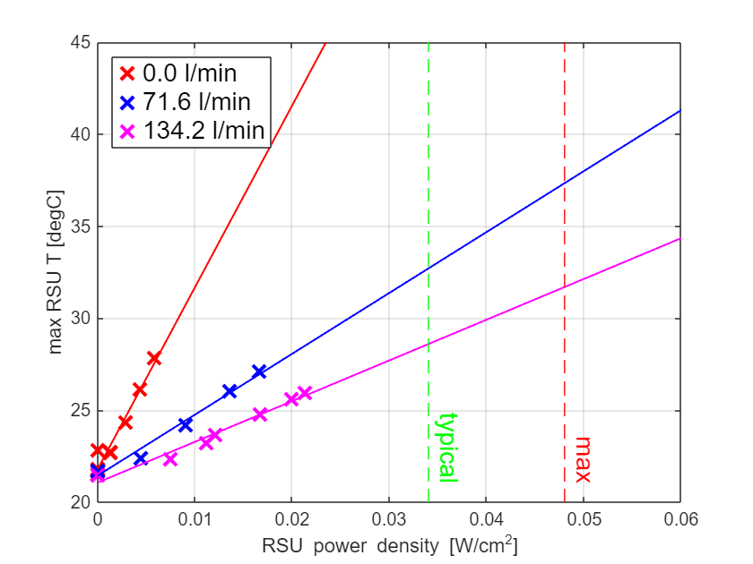
Module temperatures – Module 7
Parallel flow from module 1 end
Module temperature measured with thermal imaging camera
  AncASIC, LEC and RSU temperature quoted is hottest temperature in component area
Affected by natural convection and proximity
  For example, hottest point on RSU is always close to LEC
T [°C]

Slide 9
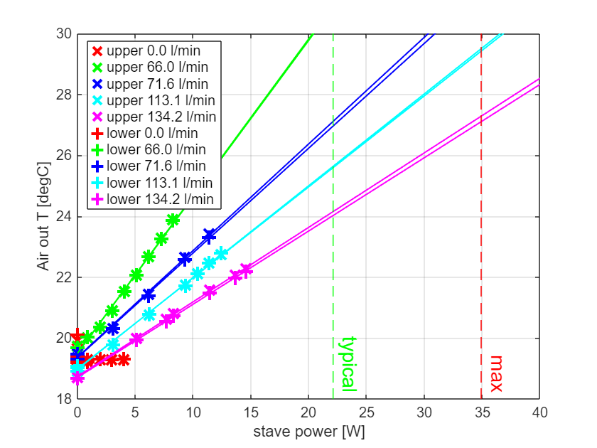
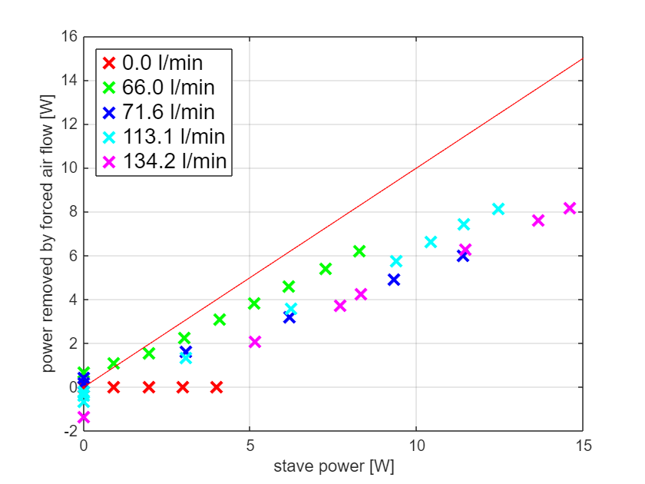

Output air temperatures
Air out temperature is measured by TC in exhaust line
Significant difference (~factor 1.5) between power supplied to stave and power removed by air flow (heat capacity of air $c_{p}=1.005$ J/kg/K, density $ρ=$1.2 kg/m³)
  $→$ must have gone to natural convection
Surprising: Higher airflow (which keeps stave colder) results in higher fraction removed by natural convection?...

Slide 10
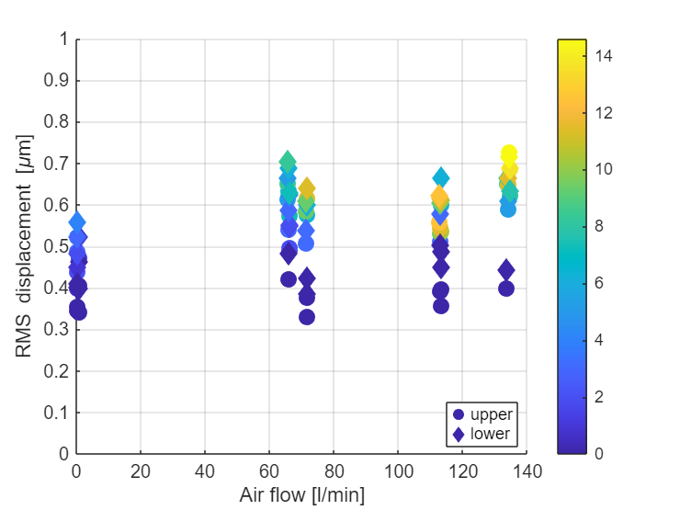
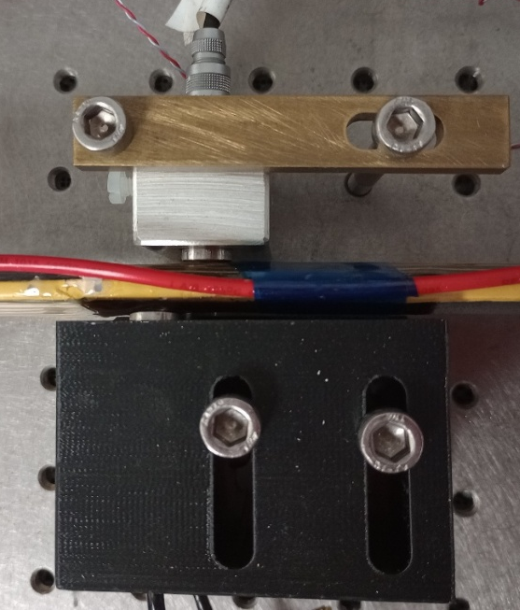
Displacements
Displacements measured with capacitive sensors at centre of stave
Sampled in 1 s windows at 5 kHz
RMS displacements smaller than expected
  Little variation with flow
  RMS is dominated by macroscopic deformations
  due to
    Internal air pressure
    Temperature (power)
Top view
Sensor 3
Sensor 1 & 2
Front view
Sensor 1
Sensor 3
Sensor 2

Slide 11
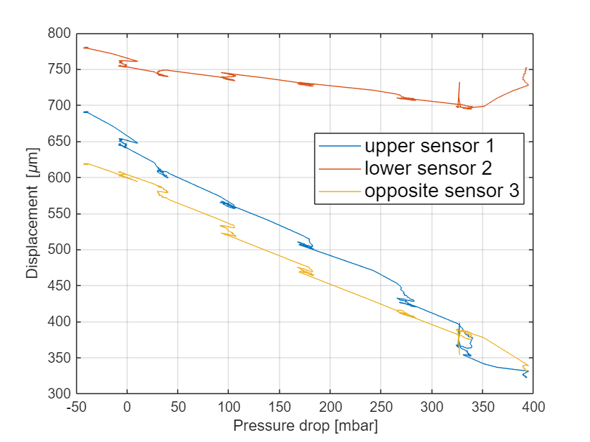
Gradual deformations - pressure
No power
All sensors move in the same direction (out)
Stave core expands with pressure
This could be enhanced due to poor bonding of facesheet with I-beam

Slide 12
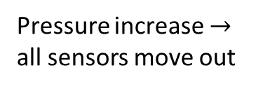
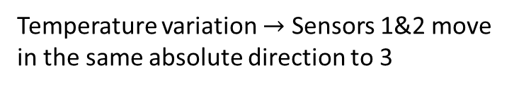
Gradual deformations – temperature
We do expect some temperature-dependent deformations due to CTE mismatch
Expect this to be much smaller for silicon modules
  Steel CTE ~12 µm/m°C, E ~200 GPa
  Silicon CTE ~2.6 µm/m°C, E ~160 GPa
Observe about 30 µm/3 °C variation of the LEC temperature
This is in the centre of the stave, could be larger locally
  Future investigations
Pressure increase $→$ all sensors move out
Temperature variation $→$ Sensors 1&2 move in the same absolute direction to 3

Slide 13
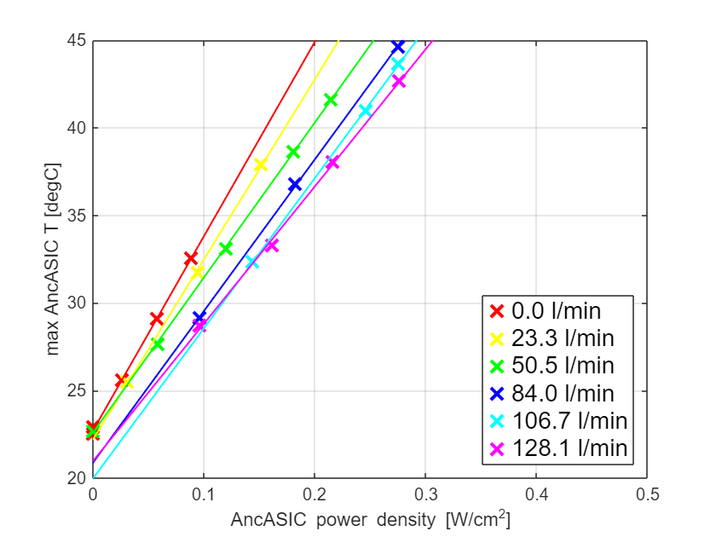
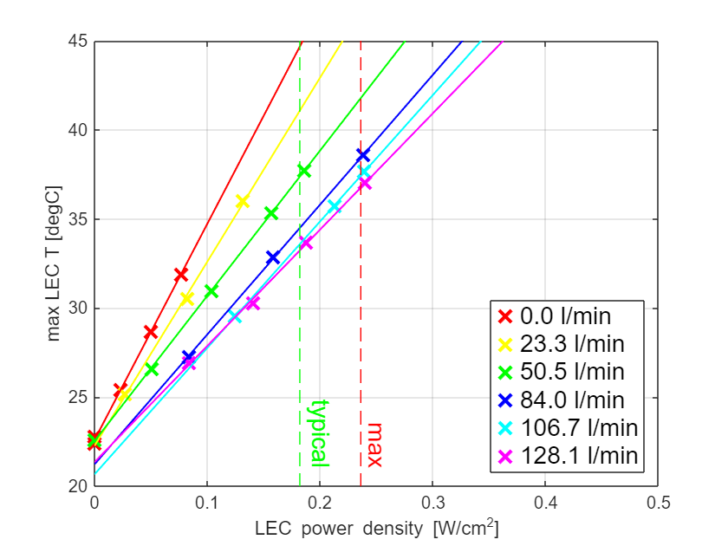
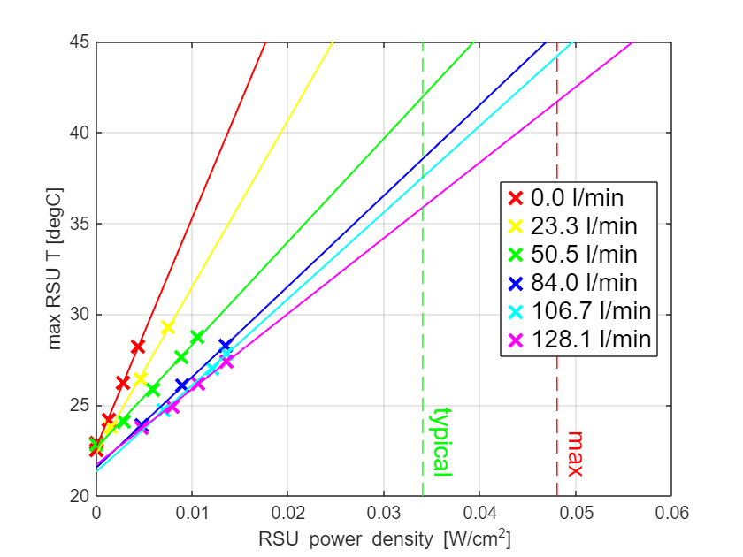
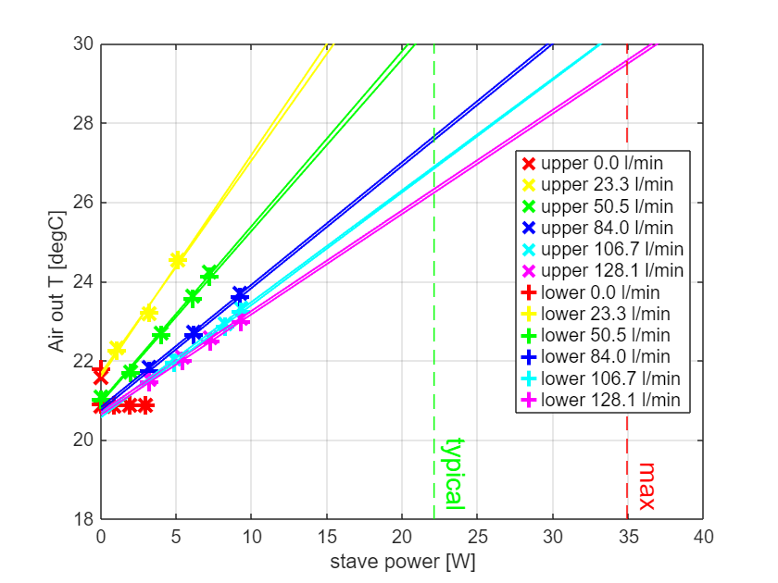
Module temperatures – Module 5
Heat removal capability (ΔT/P) worse than M7
  Still within specs (T_{LEC} < 65°C, T_{RSU} < 40°C) at 150 l/min
  Possibly more significant internal damage
Interestingly also higher ΔT/P for air out temperature

Slide 14
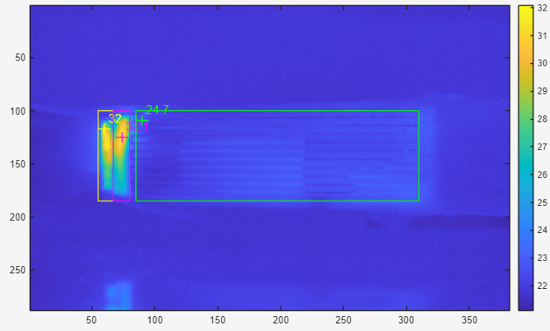
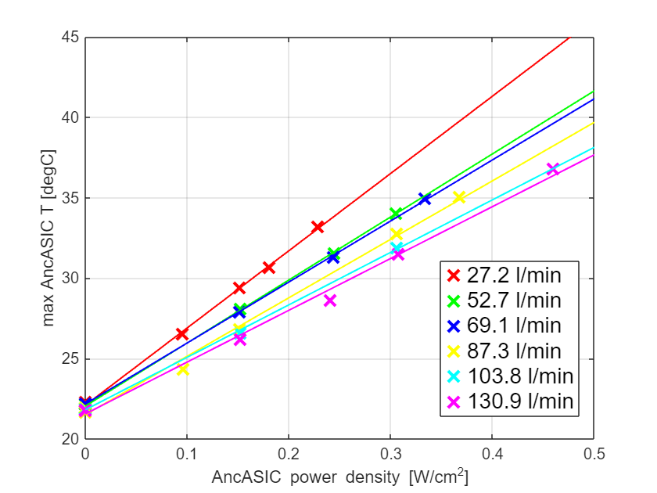
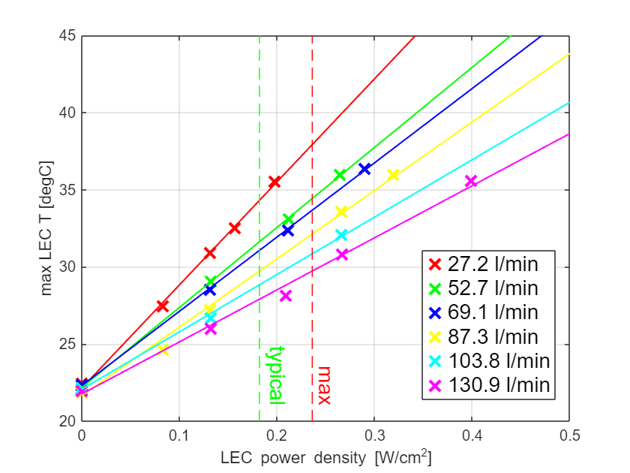
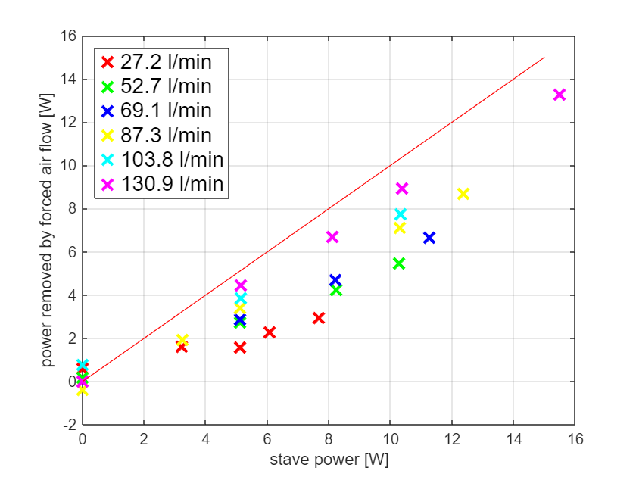
Module temperatures – Module 2
Moved stave with all instrumentation to allow access from rear
M2 does not have a K9 cross-rib
  So we expected to do worse than M5/7 in the AncASIC/LEC area
  We see the opposite
  RSUs have been so cold that temperature data were dominated by reflections from the environment
It appears from the TI that the two halves of the module saw different cooling
Air flow cooling power vs input power looks more sensible and much better than for the runs for M7
  But: this data is not module-specific (relies on stave power and air outlet temperature)???

Slide 15
Counterflow measurements
We wanted to investigate counter-flow of air
  But we were concerned whether the central I beam still acts as a barrier
  So, we connected air flow to one half of the stave and measured flow in and out, and indeed the flow out was only a small fraction, so counterflow likely would turn around immediately
  So, we gave up on this – will investigate with future stave

Slide 16
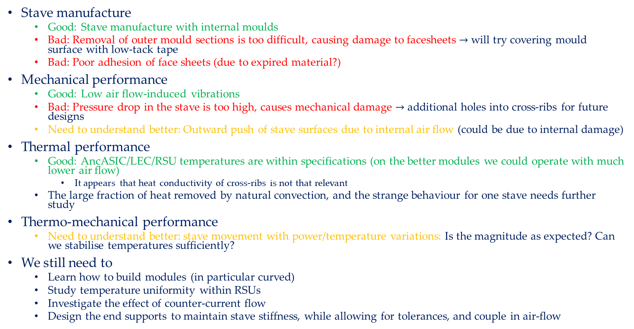
Conclusions
Stave manufacture
  Good: Stave manufacture with internal moulds
  Bad: Removal of outer mould sections is too difficult, causing damage to facesheets $→$ will try covering mould surface with low-tack tape
  Bad: Poor adhesion of face sheets (due to expired material?)
Mechanical performance
  Good: Low air flow-induced vibrations
  Bad: Pressure drop in the stave is too high, causes mechanical damage $→$ additional holes into cross-ribs for future designs
  Need to understand better: Outward push of stave surfaces due to internal air flow (could be due to internal damage)
Thermal performance
  Good: AncASIC/LEC/RSU temperatures are within specifications (on the better modules we could operate with much lower air flow)
    It appears that heat conductivity of cross-ribs is not that relevant
  The large fraction of heat removed by natural convection, and the strange behaviour for one stave needs further study
Thermo-mechanical performance
  Need to understand better: stave movement with power/temperature variations: Is the magnitude as expected? Can we stabilise temperatures sufficiently?
We still need to
  Learn how to build modules (in particular curved)
  Study temperature uniformity within RSUs
  Investigate the effect of counter-current flow
  Design the end supports to maintain stave stiffness, while allowing for tolerances, and couple in air-flow

Slide 17
Further material

Slide 18
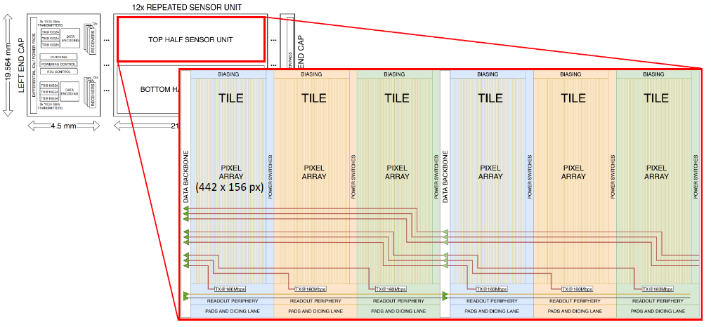
MOSAIX/EIC-LAS

Slide 19
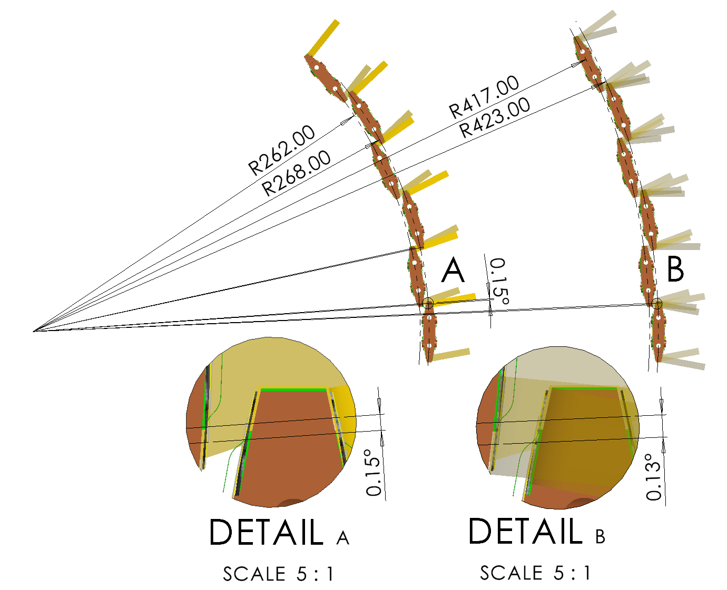
OB layout parameters
Layer | radius [mm] |  | length [mm] |  | # of staves | target X/X₀
 | nominal | design | nominal | design
L3 | 270 | 262/268 | 540 | Overall 550 (active 503) | 44 | 0.25%
L4 | 420 | 417/423 | 820 | Overall 840 (active 793) | 70 | 0.55%
Baseline is castellated layout
Nominal is original SVT specification, design is optimised for sensor size, overlaps, overall integration (disks)
19

Slide 20
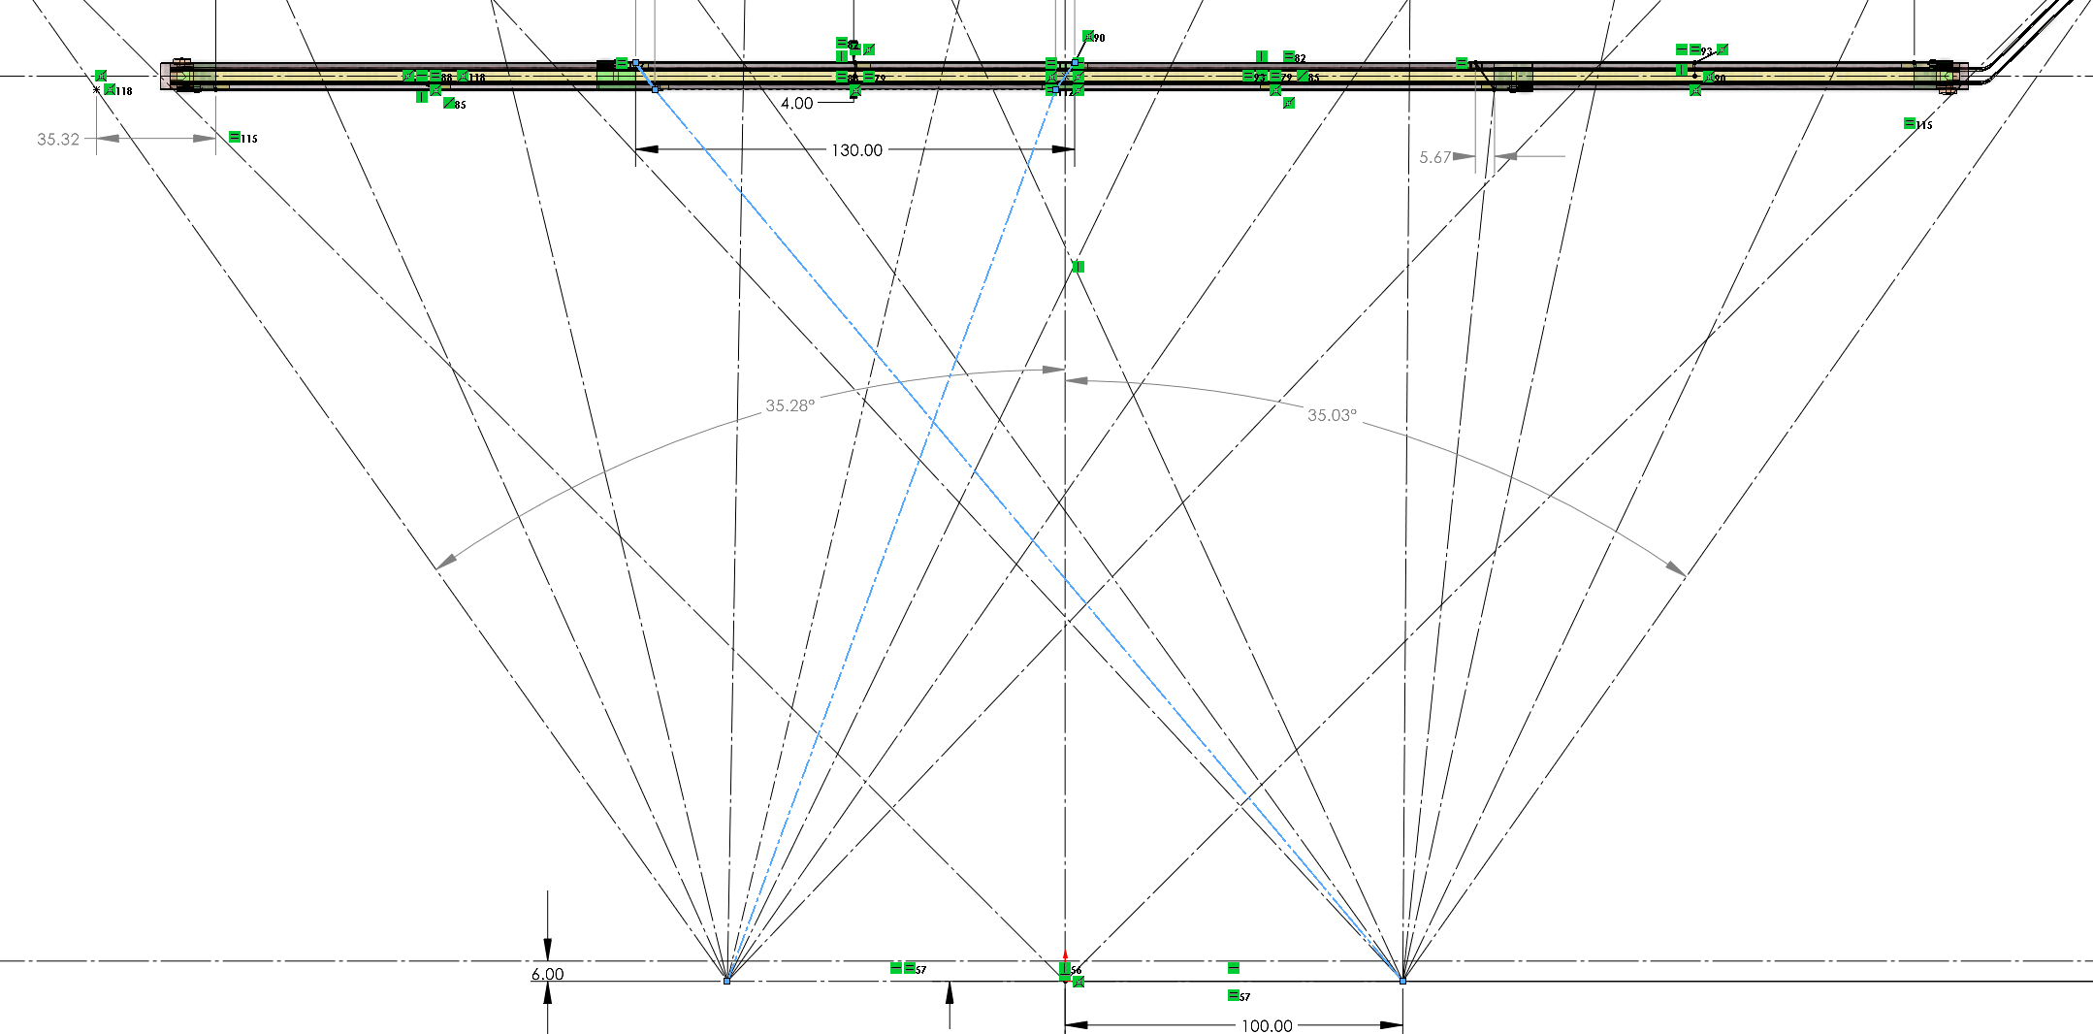
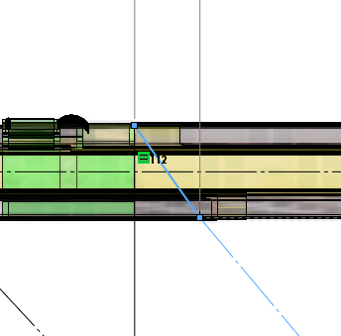
OB layout

Slide 21
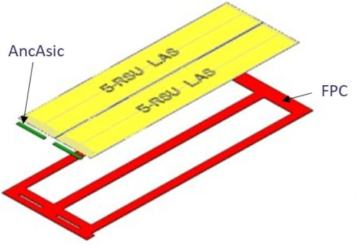
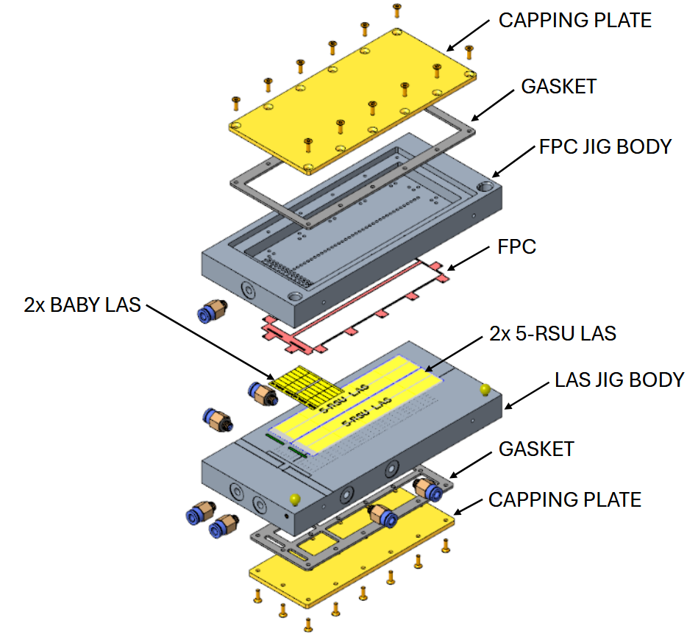
Modules are small units that can be tested before integration into staves
2 EIC-LAS + 2 AncASICs
Glued to Kapton module carrier
  Contains trace layers to allow to act as bridge FPC
EIC-LAS and AncASIC connections wire-bonded to bridge FPC
Modules need to be assembled on jig and stay on there for protection until they get glued onto stave
  Jigs will be used during transport from module production to module loading site
Currently prototyping flat modules as a first step
  Curved modules will require assembly on a curved jig
  Challenge for curved modules will be bonding
    Sensor will be curved, AncASIC flat

Slide 22
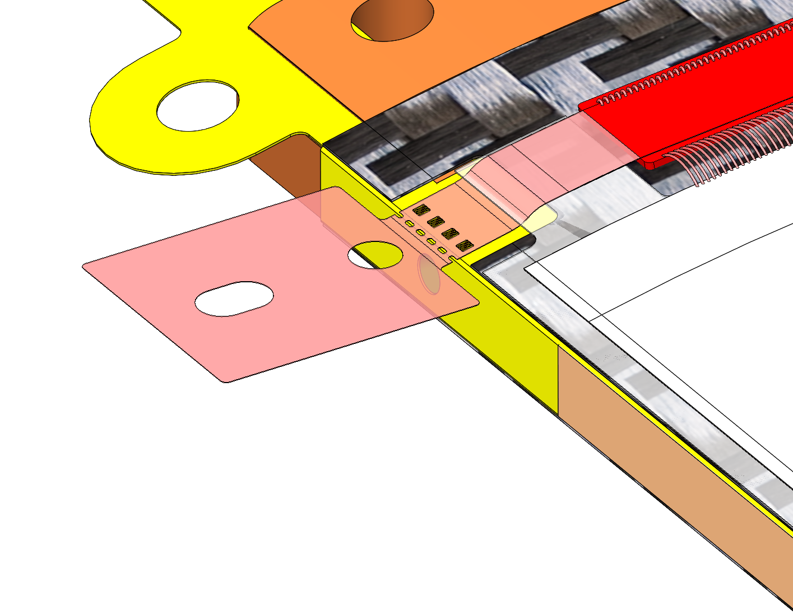
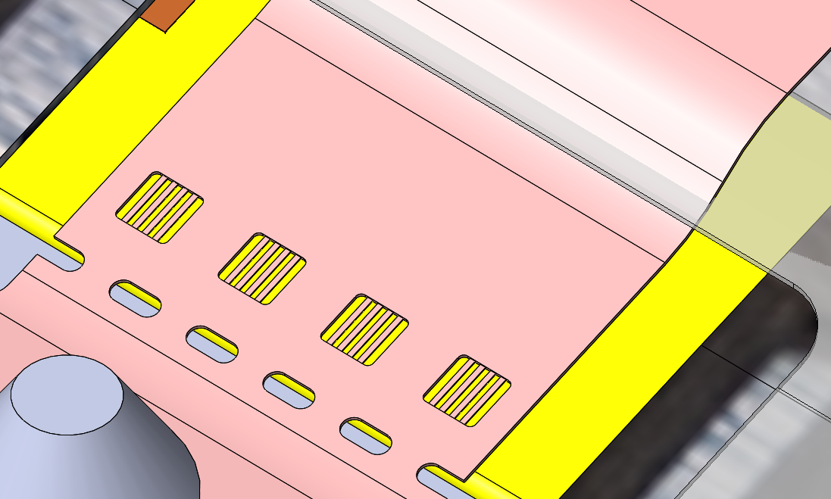
Module – FPC electrical interface
Modules will be glued
to the stave core to
close the air channel
and contribute to the
stave stiffness
Electrical connections between
the module and the stave FPC
will be made using sp-TAB
  Requires stave FPC to bridge FPC alignment of ±0.025 mm
  Module will be aligned based on local reference features on the
  FPC instead of a global module alignment
Bridge FPC
Stave FPC

Slide 23
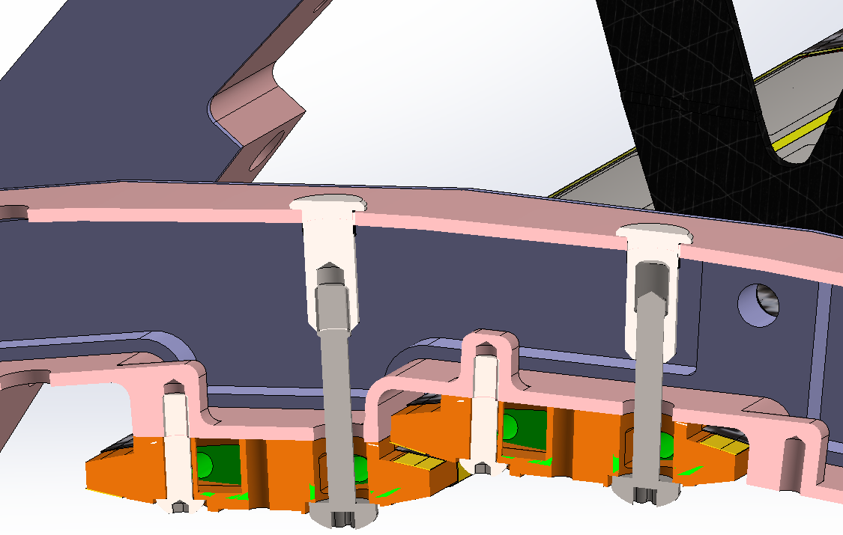
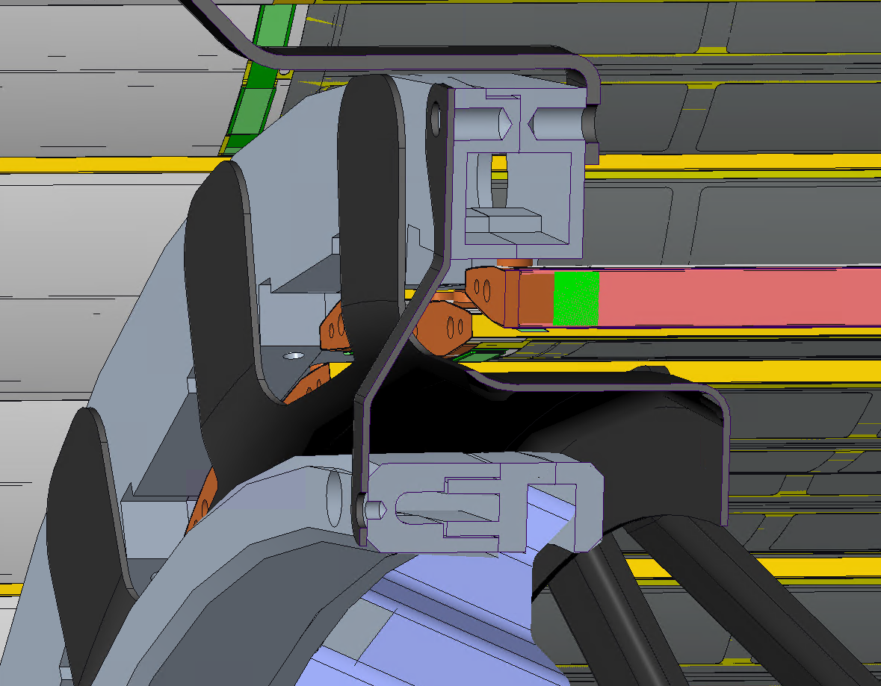
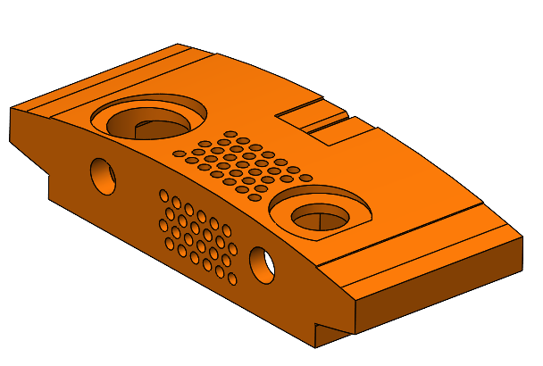
Stave mounting
Support off L4
Air supply duct
L3 stave
Inlet
Support D0
Inlet CSA of 30 mm² (equivalent to ⌀6 mm)
  Flow velocity at inlet will be approx. 4× internal flow velocity
Support IB
Diffused Outlet

Slide 24
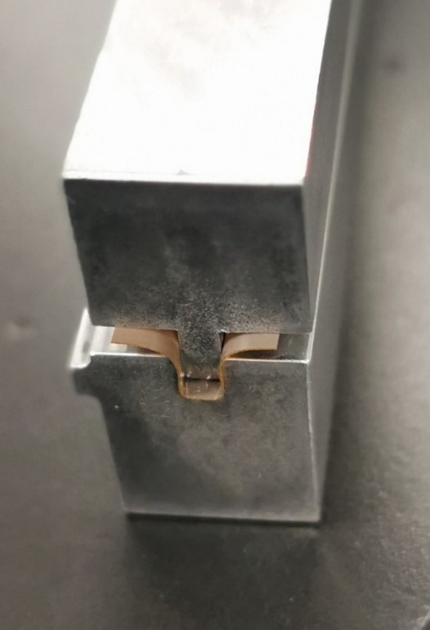
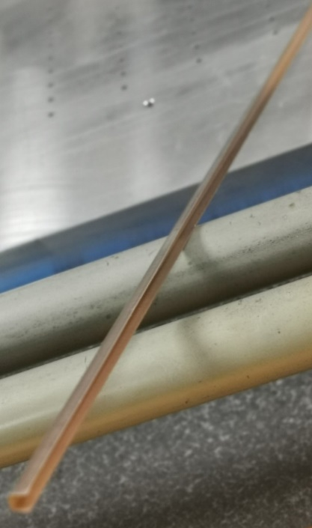
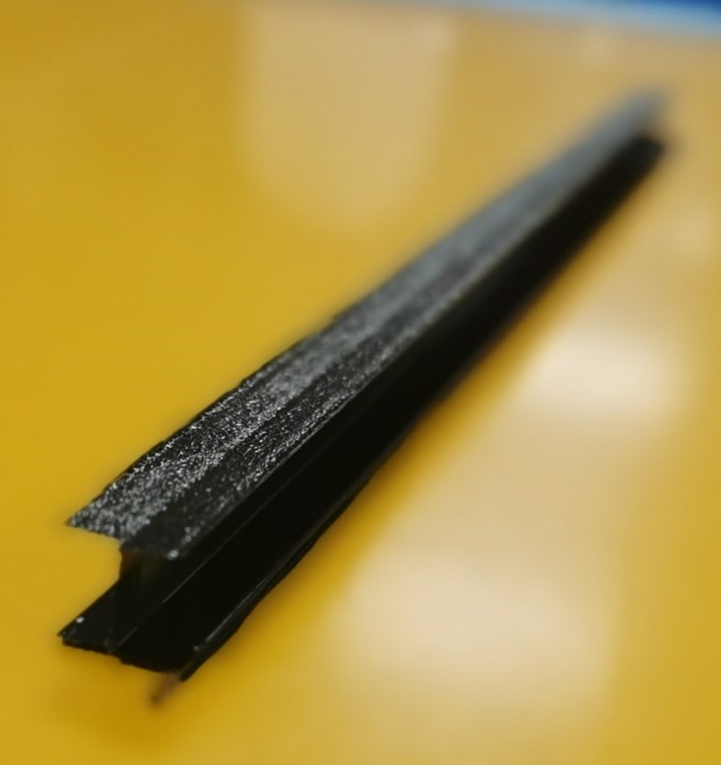
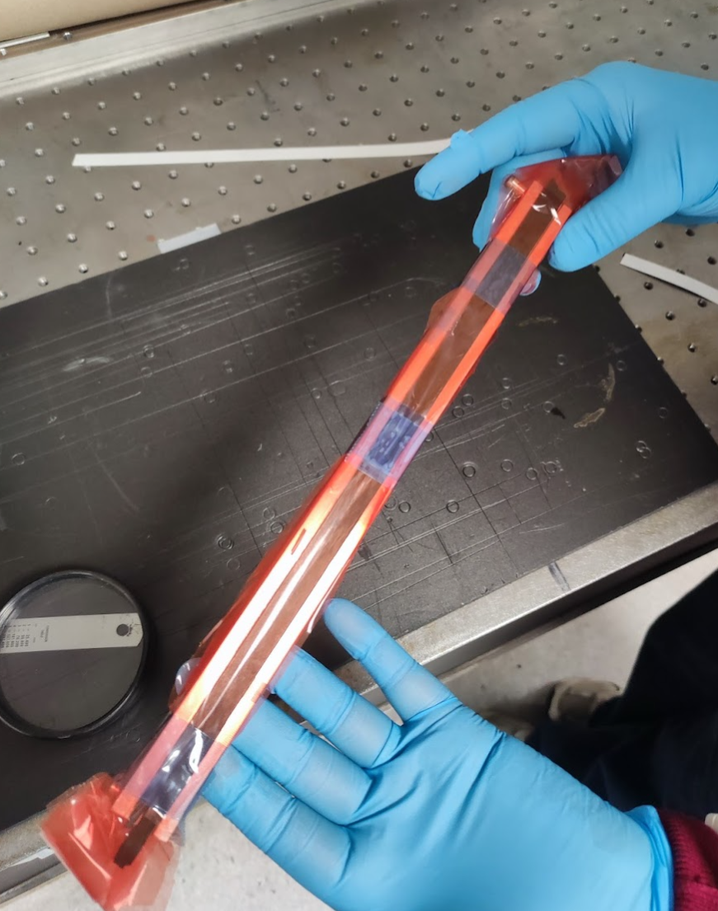
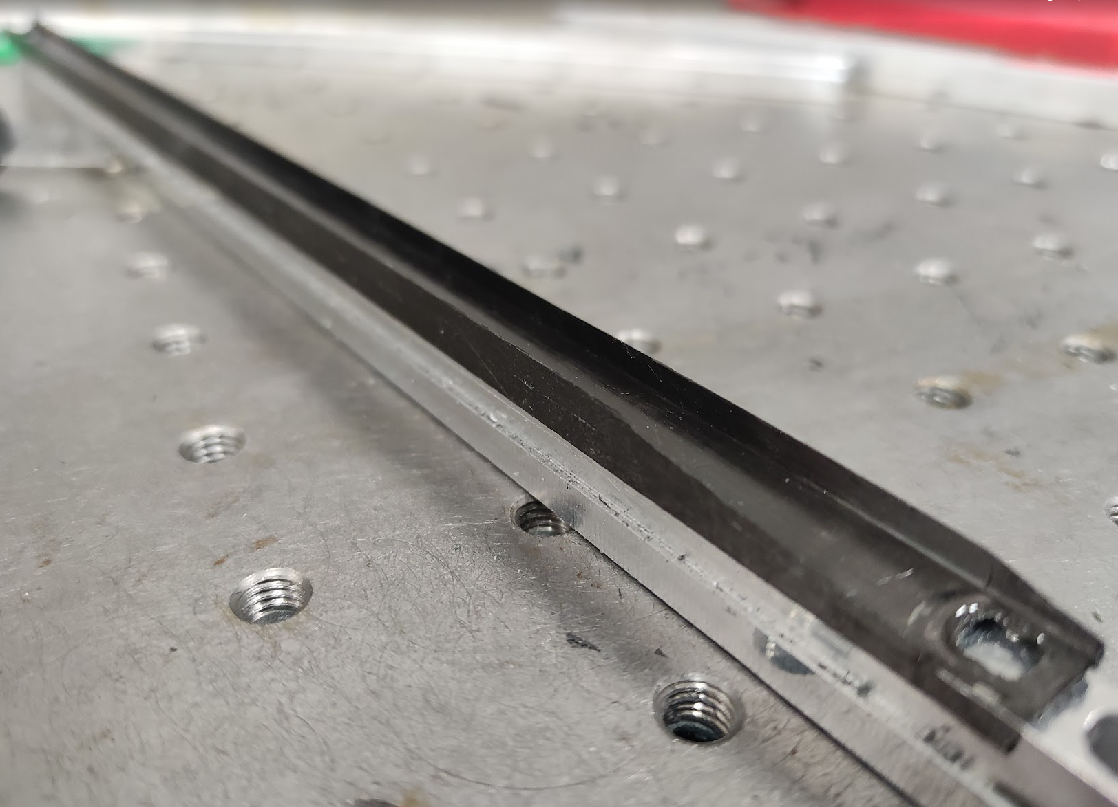
Preformed components
  Carbon Fibre I-beam pre-cured in a 2-part mould
  Flexible Printed Circuits (FPC) preformed (with heat and pressure) into C channel

Slide 25
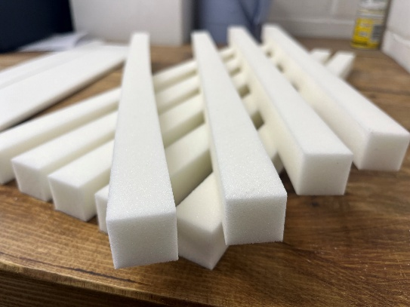
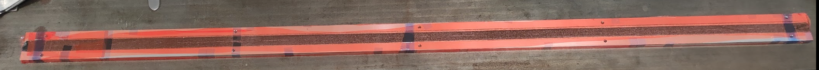




Based on old geometry with minimum overlap between modules
  Up to date L4 stave would be shorter (by approx. 50 mm)
New tooling for FPC & I-beam manufacture tested
  Kapton thermal forming tooling works well, alignment holes are very effective
  I-beam tooling may need refinement, very difficult to remove
6 of 18 K9 foam blocks replaced with Rohacell 110
  Low thermal conductivity, closed cell foam, holes added to allow airflow
Redesigned stave ends for vibration & flow testing
CF Trimming Tool
Kapton FPC Forming Tooling
Stave End Supports

Slide 26









L4 prototype co-curing
End pieces with optimised air flow
K9 cross-ribs
Non-conductive cross-ribs

Slide 27


Post-Cured Stave Assembly (quarterstave)

