Slide 1
ParticleCNNTransformer
Hierarchical CNN–Transformer for 3D Hadronic Shower Momentum Regression
Tamás Menyhárt, Róbert Lakatos, Dr. András Hajdu
Architecture
Input
Task
CNN + 3-Stage Transformer
64³ Voxel Energy Grid
Proton Momentum Regression
Performance
MAE = 1.085 GeV
RMSE = 1.843 GeV
2.16 M
Mean Absolute Error
Root Mean Square Error
A few trainable Parameters
Calorimeter Reconstruction • Deep Learning • Particle Physics

Slide 2
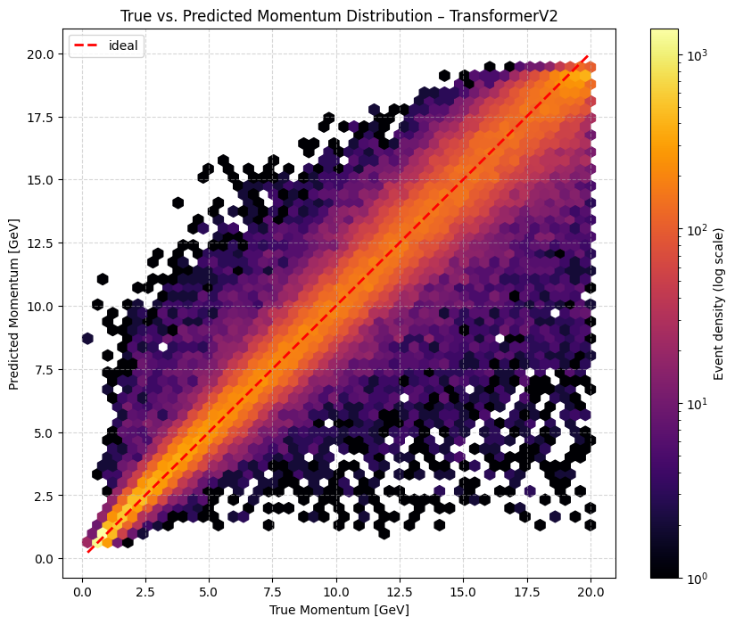
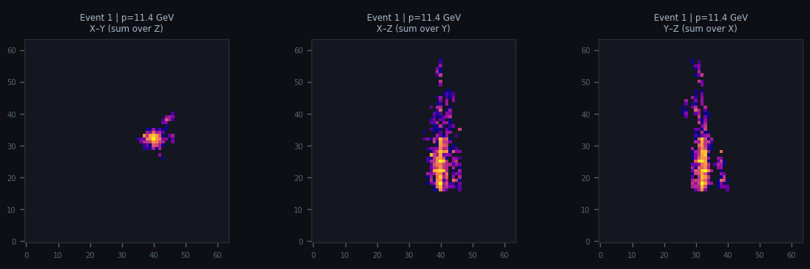
Problem statement
Why 3 levels of self-attention and CNN are important?
The Physics Problem
Why This Architecture?
• Hadronic calorimeters measure particle showers deposited as 3D energy patterns
• Incoming proton momentum (1–20 GeV) must be inferred from the shower topology
• Traditional methods: calibration curves, linear weighting — limited for complex showers
• High-energy showers produce diffuse, multi-scale structures hard to characterise analytically
• The model lacks geometric awareness and the latent space is highly sparse.
• Convolutional nets capture local features but struggle with long-range correlations
• Plain transformers on 64³ = 262,144 tokens: prohibitive O(N²) attention cost
• Multi-scale processing naturally matches the hierarchical structure of particle showers
• Attention mechanisms can learn which spatial regions drive the momentum estimate
Density is LOGARITHMIC ! MAE=1.0851|RMSE=1.8426
Sample Input Events — 3-Axis Energy Projections

Slide 3
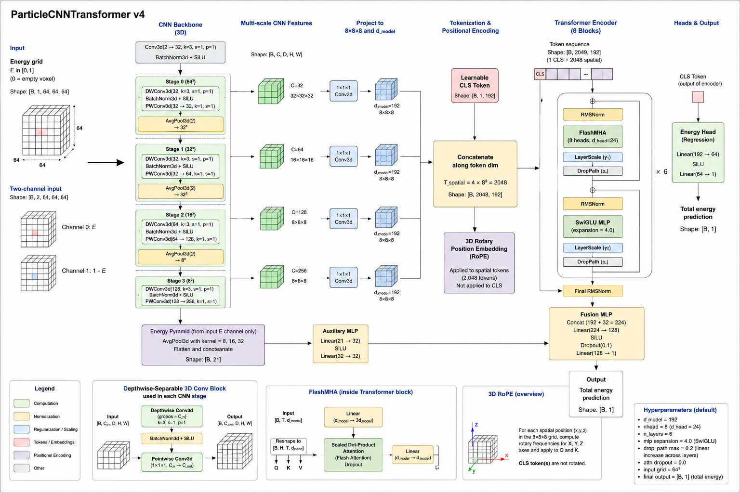
Model Architecture
ParticleCNNTransformer — full pipeline overview
Input tensor construction
  Two-channel input: energy + complement (1 − energy)
  Improves stability and representation richness
Hierarchical CNN levels (L0–L3)
  Progressive downsampling: 64³ → 32³ → 16³ → 8³
IntraSpatialAttn
  Splits each scale into spatial blocks (CLS token per block)
  Capture local geometric patterns
CrossScaleAttn (multi-scale fusion)
  CLS token aggregates scale-wise information
InterBlockAttn (global aggregation)
O(N²) attention cost now reduced with 3-level aggregation.

Slide 4
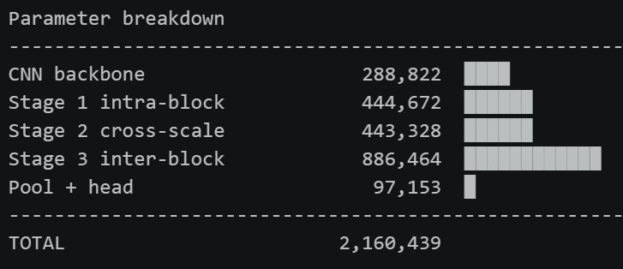
Model Efficiency & Parameters
2.16M parameters — transformer stages dominate; CNN backbone is lightweight
Parameter Distribution
CNN Backbone
289K (13.4%)
Stage 1 Intra
445K (20.6%)
Stage 2 Cross
443K (20.5%)
Stage 3 Inter
886K (41.0%)
Pool + Head
97K (4.5%)
Regularisation & Training Techniques
• LayerScale (init 1e-4): residual paths open gradually — prevents early instability
• DropPath / Stochastic Depth: drops entire residual paths per sample — stronger than Dropout
• RMSNorm instead of LayerNorm: faster, no mean subtraction, matches LLaMA/Gemma design
• AdamW with differential weight decay: LayerScale params exempt — prevents them being shrunk to zero
• Linear warmup + cosine decay learning rate schedule

Slide 5
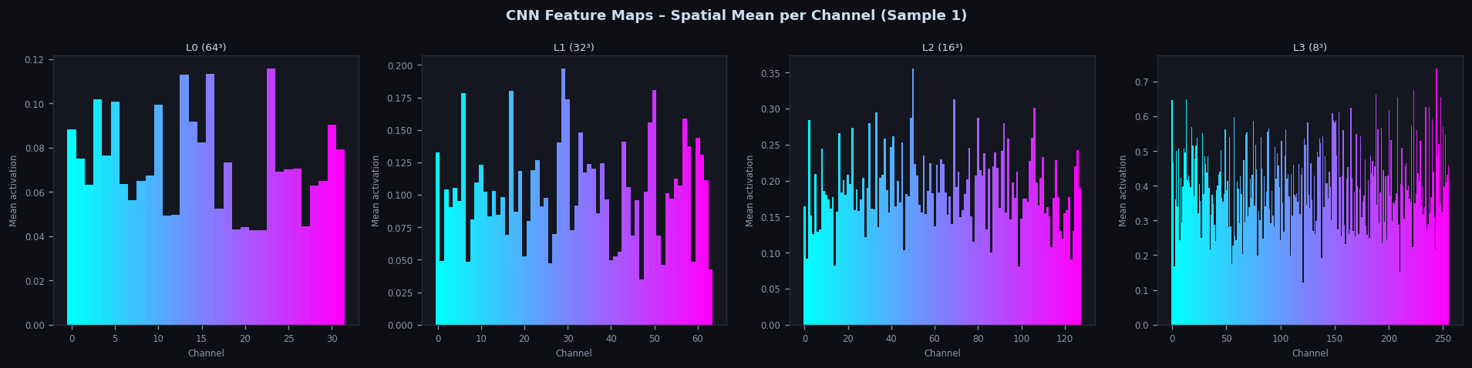
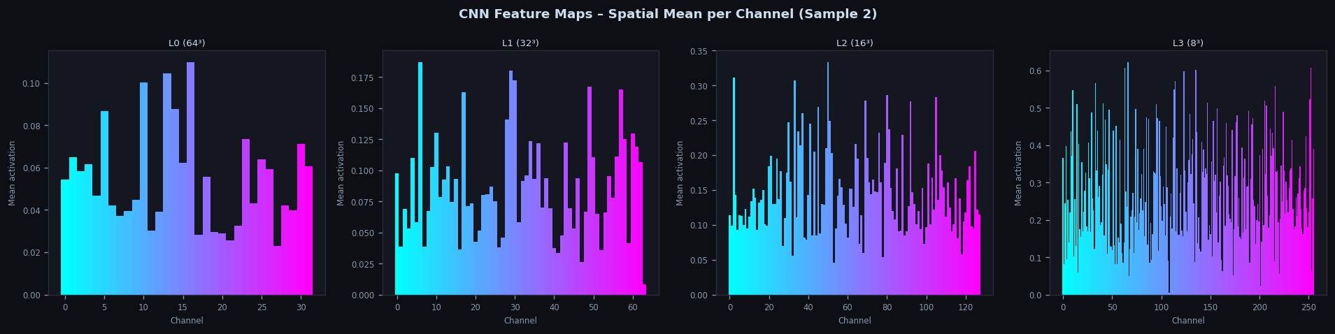
CNN Backbone
Depthwise-separable 3D convolutions across 4 resolution scales
L0 64³
L1 32³
L2 16³
L3 8³
→
→
→
32 ch
64 ch
128 ch
256 ch
Highest activations
→ All projected to 8³ × d_model=192 for transformer input
CNN Feature Maps — Spatial Mean Activation per Channel (Sample 1 and 2). Highest values: 0.1, 0.175, 0.35, 0.6

Slide 6
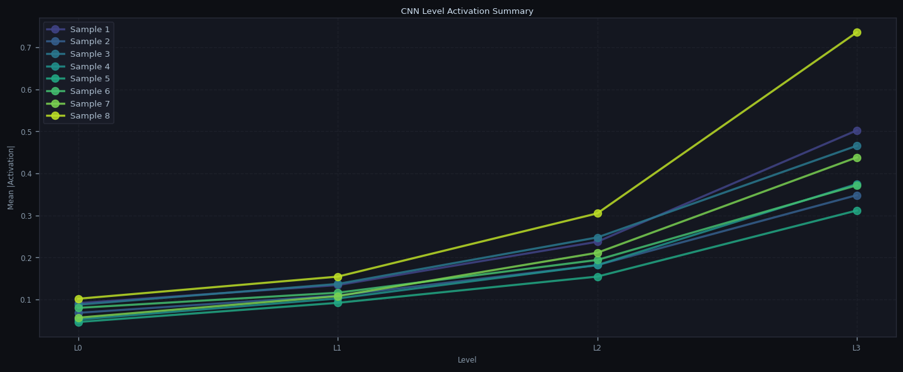
CNN Backbone
Depthwise-separable 3D convolutions across 4 resolution scales
L0 64³
L1 32³
L2 16³
L3 8³
→
→
→
32 ch
64 ch
128 ch
256 ch
Activation grows with depth — L3 captures most abstract, high-energy features. Features that describe the whole figure are more important than small details. (Possible noise?)
→ All projected to 8³ × d_model=192 for transformer input

Slide 7
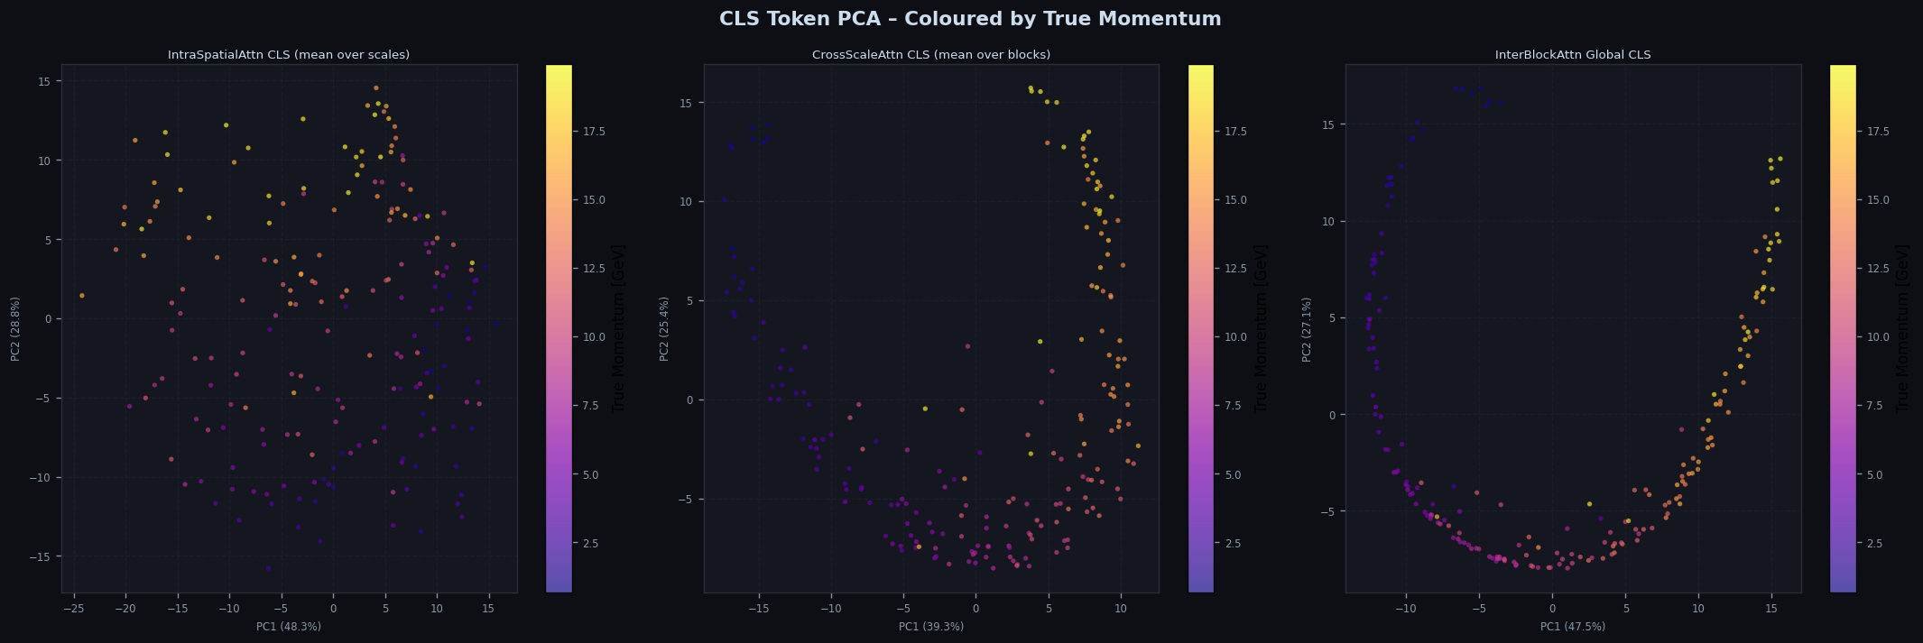
Three-Stage Transformer Encoder
Hierarchical attention from local to global — O(N²) cost reduced ×7.8
Stage 1
Stage 2
Stage 3
IntraSpatialAttn
CrossScaleAttn
InterBlockAttn
• 8 spatial blocks, each 4³=64 tokens
• Full self-attention per block + CLS token
• 3D RoPE positional encoding (relative distances)
• Output: 8 block CLS tokens per scale
• Flat attention: 512² → 8×65² (×7.8 faster)
• Per block: attends across 4 scale CLS tokens
• Sequence length: only 5 tokens (S+1)
• No RoPE — scale index is not spatial
• Output: 8 fused block CLS tokens
• Learns which resolution is most informative
• Single global CLS token + 8 block tokens
• 9 tokens total — negligible cost
• 2 transformer layers for global reasoning
• Output: 1 global representation vector
• Learns which blocks drive the prediction
→
→

Slide 8
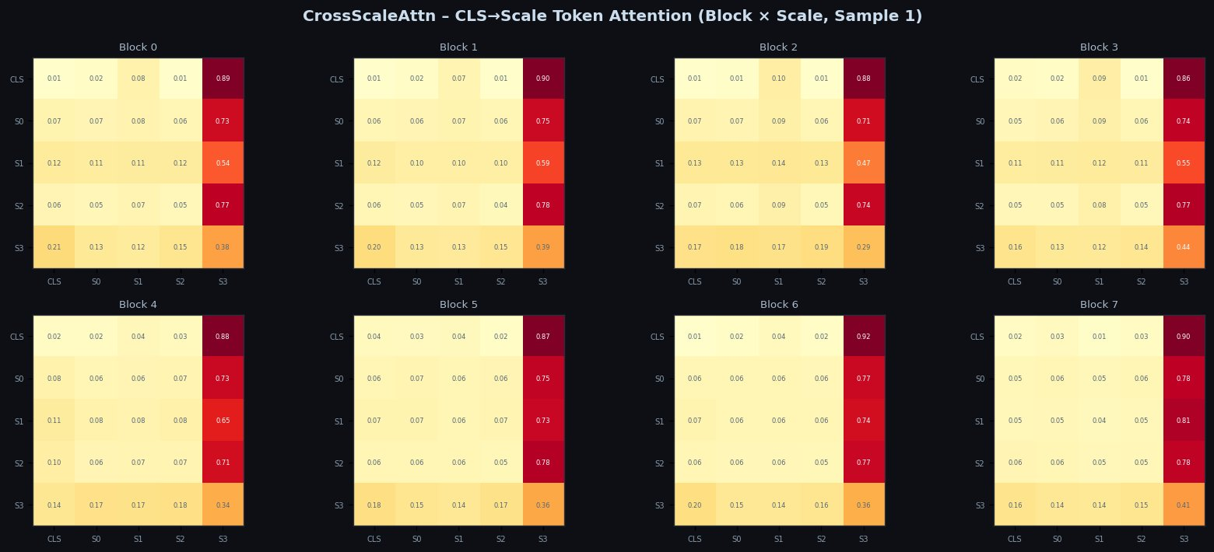
CrossScaleAttn — Multi-Resolution Fusion
Each spatial block independently learns which CNN scale to trust most
Key Observations
• S3 (8³ native resolution) consistently dominates attention weight across all 8 blocks
• CLS row shows highest attention to S3 (~0.88–0.92) — coarse scale is most informative
• S1 (32³) receives least weight, suggesting intermediate resolution adds least value
• Weight pattern is consistent across blocks, indicating stable learned scale preference
• S3 dominance aligns with physics: coarse shower topology drives momentum more than fine detail
Attention Matrix Structure
Row = query token
Column = key token
Value = attention weight
(head-averaged softmax)

Slide 9
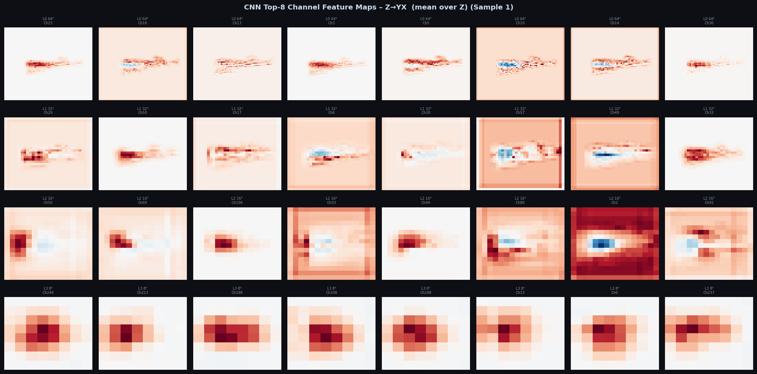
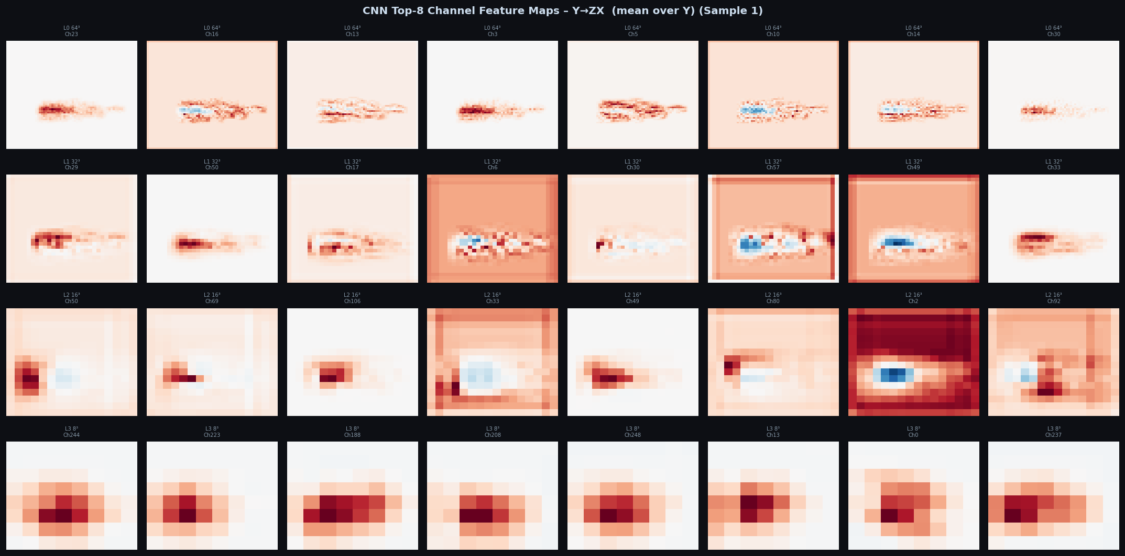
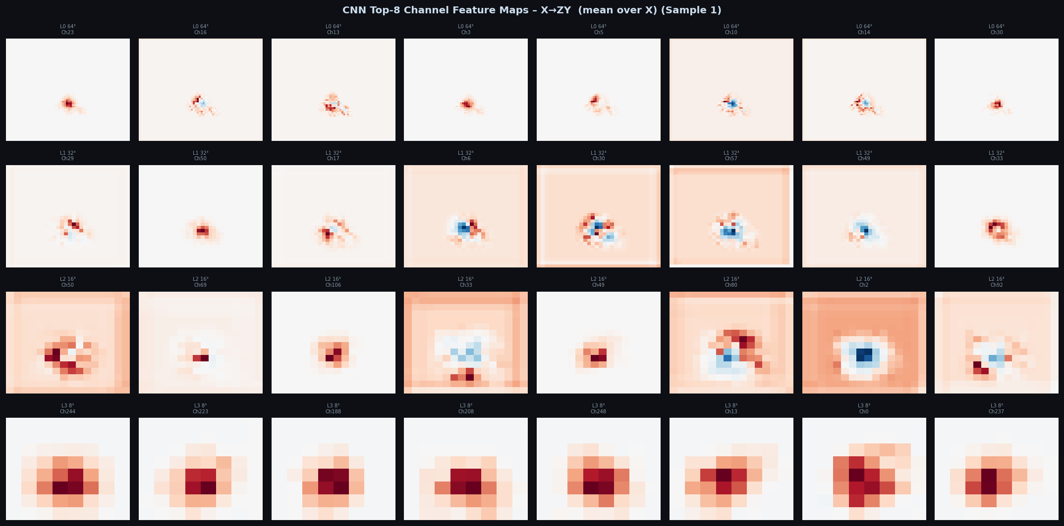
CNN Feature Map Analysis
Top-8 channel activations across L0–L3, projected along Z axis
Observations
• L0 (64³): fine-grained elongated shower core clearly resolved — RdBu diverging scale shows gradient structure
• L1–L2 (32³–16³): intermediate structure, increasing abstraction, shower boundaries visible
• L3 (8³): all channels show symmetric blob — coarse energy centroid captured
• Blue regions indicate inhibitory responses (boundary detection / contrast enhancement)
• Channel specialisation increases with depth — more diverse filter responses at L3

Slide 10
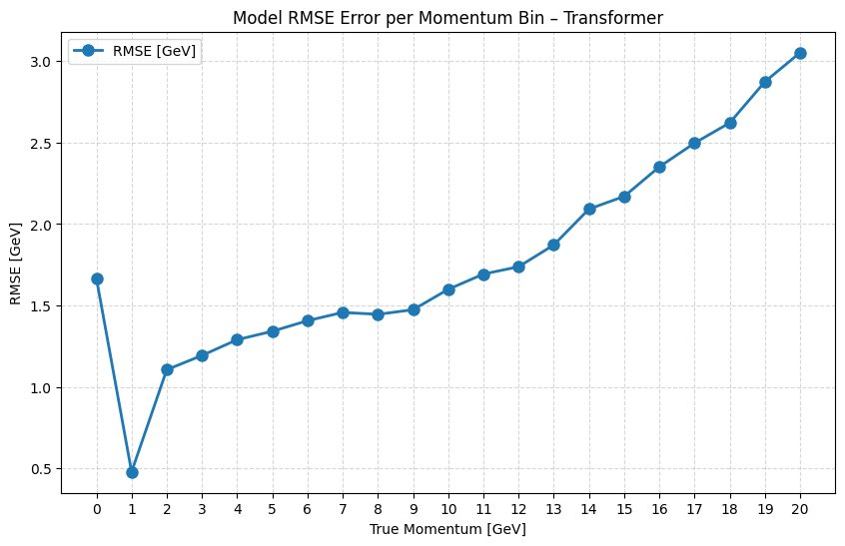
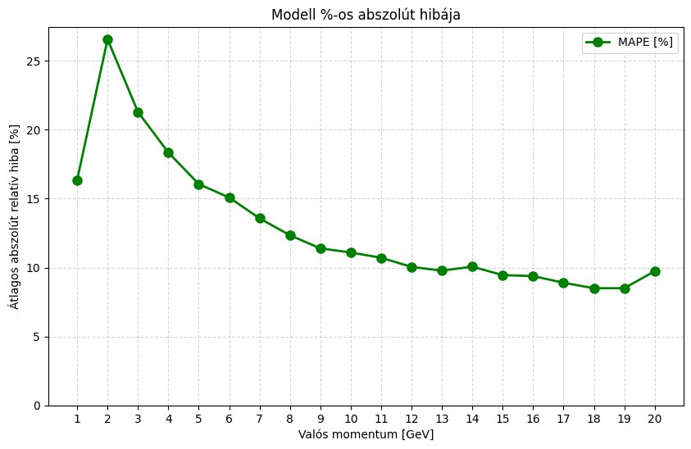
Regression Performance
RMSE and MAPE across the full 1–20 GeV momentum range
MAE = 1.085 GeV
RMSE = 1.843 GeV
~10% MAPE
2.16 M
Global mean absolute error
Global root mean square error
At high momentum (10–20 GeV)
Trainable parameters
RMSE per Momentum Bin
MAPE per Momentum Bin
Key Insight:
RMSE grows roughly linearly with true momentum — consistent with calorimeter stochastic resolution (σ/E ∝ 1/√E). MAPE converges to ~10% above 8 GeV, indicating stable relative performance at high energies. The elevated error at 1–2 GeV likely reflects shower containment effects at low energies.

Slide 11
Regression Performance
RMSE and MAPE across the full 1–20 GeV momentum range
MAE = 1.085 GeV
2.16 M
Global mean absolute error
Trainable parameters
RMSE = 1.843 GeV
~10% MAPE
Global root mean square error
At high momentum (10–20 GeV)

Slide 12
Conclusions & Outlook
Hierarchical CNN–Transformer proves effective for 3D shower momentum regression
Key Conclusions
Future Directions
• 3-stage hierarchical attention reduces O(N²) complexity by ×7.8 vs flat transformer
• Multi-scale CNN features + CLS token aggregation captures local and global shower structure
• PCA of final CLS tokens shows a clean 1D momentum manifold — model internalised the physics
• CrossScaleAttn consistently prioritises the coarsest scale (S3), matching physical intuition
• MAE ~1.1 GeV and MAPE ~10% above 8 GeV — competitive for a 2M parameter model
• Extend to multi-particle events and mixed hadron species (pion)
• Compare against graph neural networks (GNN) on the same dataset
• Investigate attention rollout for shower core localisation
• Scale to full calorimeter geometry (non-cubic, irregular segmentation)
• Explore uncertainty quantification for physics analyses
Architecture Pipeline
64³ Energy Grid
→
CNN (4 scales)
→
IntraSpatialAttn
→
CrossScaleAttn
→
InterBlockAttn
→
Regression Head

Slide 13
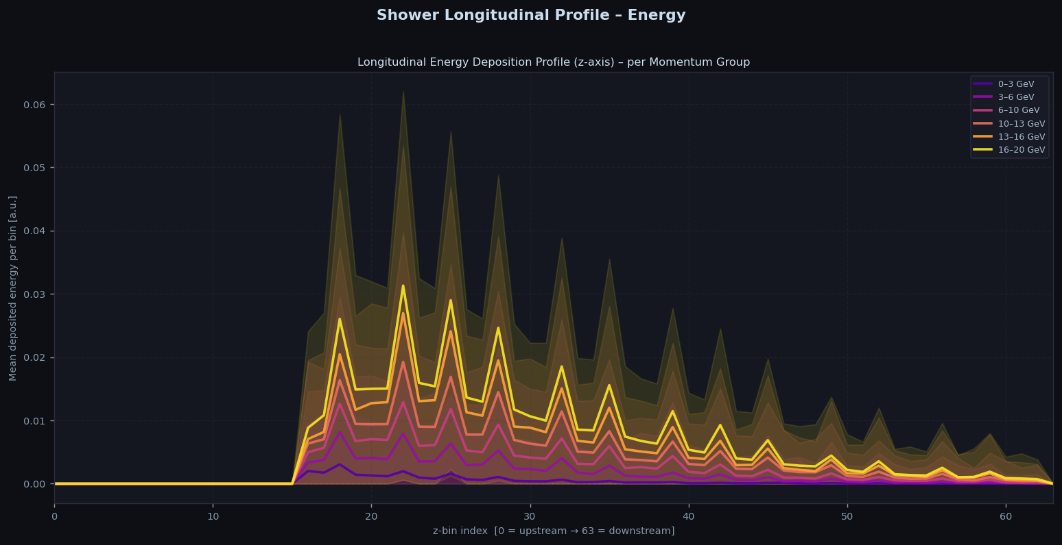
Longitudinal Energy Deposition Profile
Hadronic showers initiate at z≈18 and exhibit characteristic fluctuating profiles. Higher momentum groups deposit more energy but show similar longitudinal shape, consistent with nuclear cascade dynamics.

Slide 14
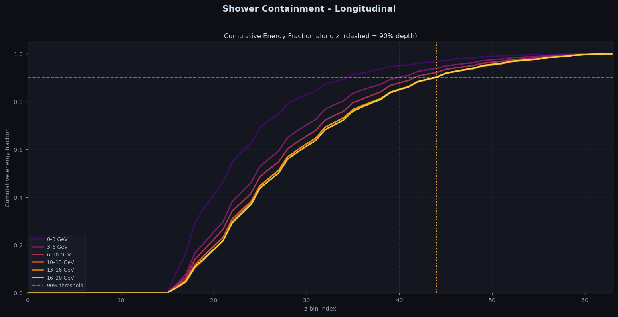
Shower Containment
90% of shower energy is contained within z≈41–44 across all momentum groups. Higher-energy showers extend slightly deeper, but the difference is small (~3 bins), confirming adequate longitudinal detector coverage.

Slide 15
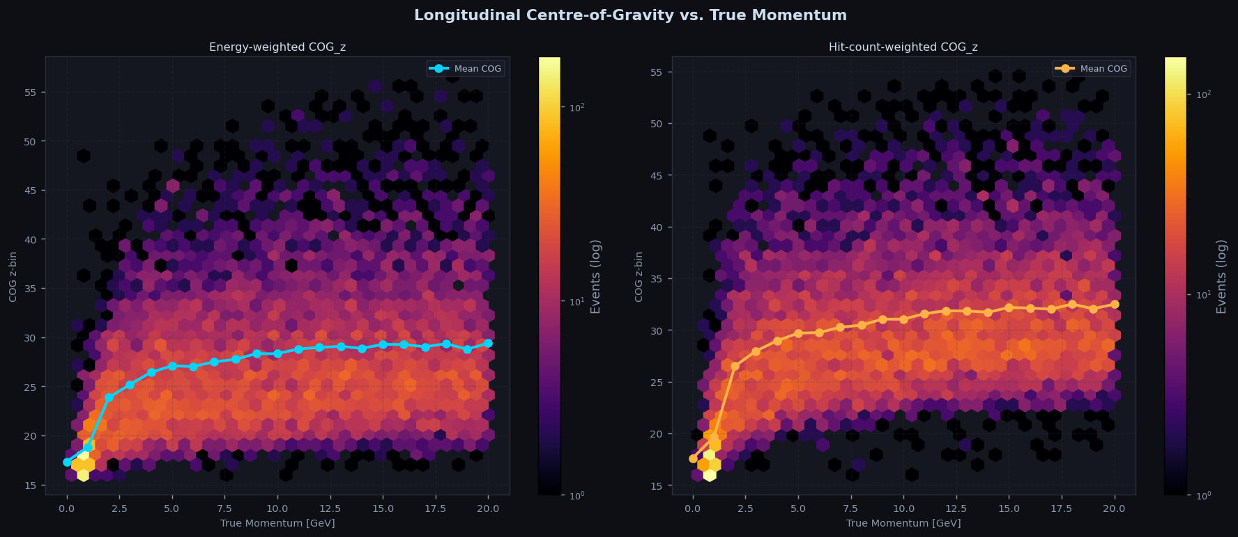
Longitudinal Centre-of-Gravity
Energy-weighted COG saturates at z≈29, while hit-count-weighted COG sits ~3 bins deeper, revealing a low-energy secondary particle tail in the shower's downstream region. Both metrics plateau above ~5 GeV.

Slide 16
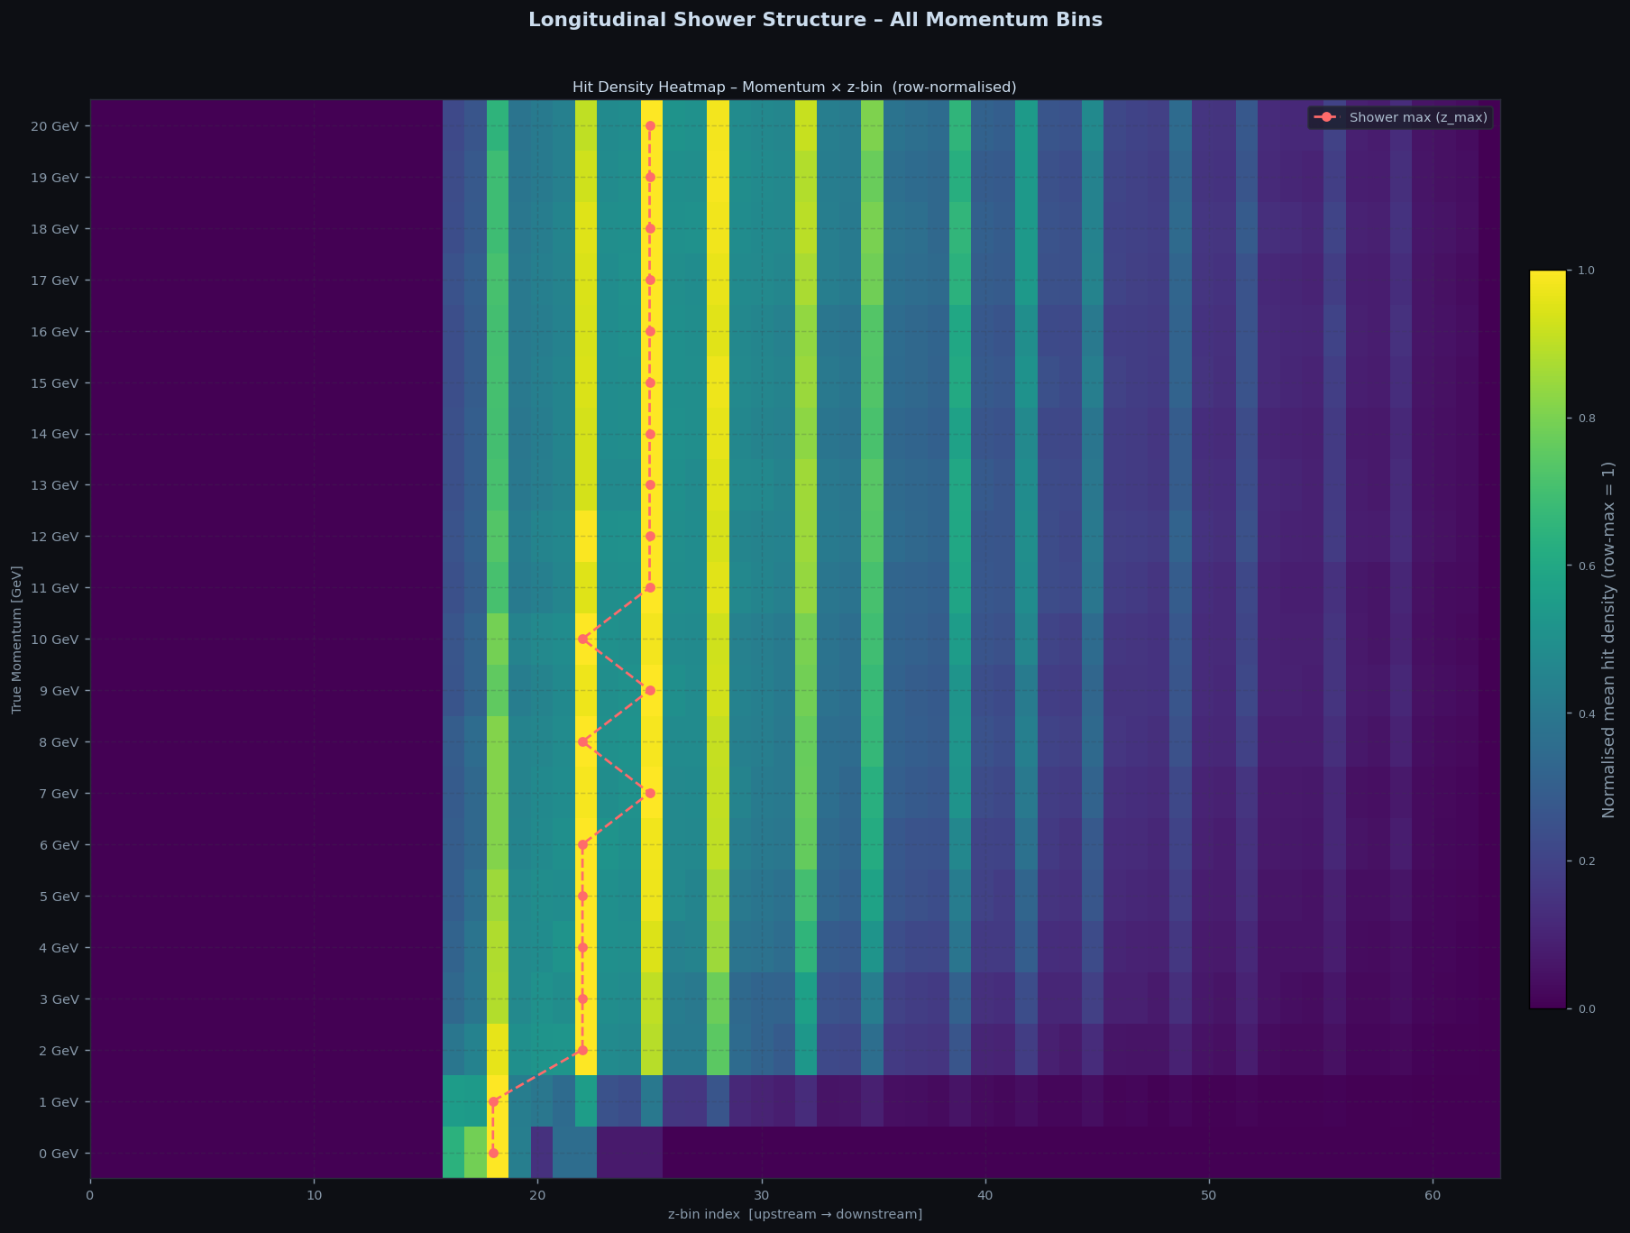
Hit Density Heatmap
Vertical bands reflect the sandwich calorimeter's absorber-active layer structure. The shower maximum (dashed line) shifts from z≈18 at low momenta to z≈26 above 5 GeV, then remains stable — validating the longitudinal shower model.

