Slide 1
sPHENIX Director’s Review
OUTER HCAL DETECTOR
ANATOLI GORDEEV
August 2-4, 2017
BNL

Slide 2
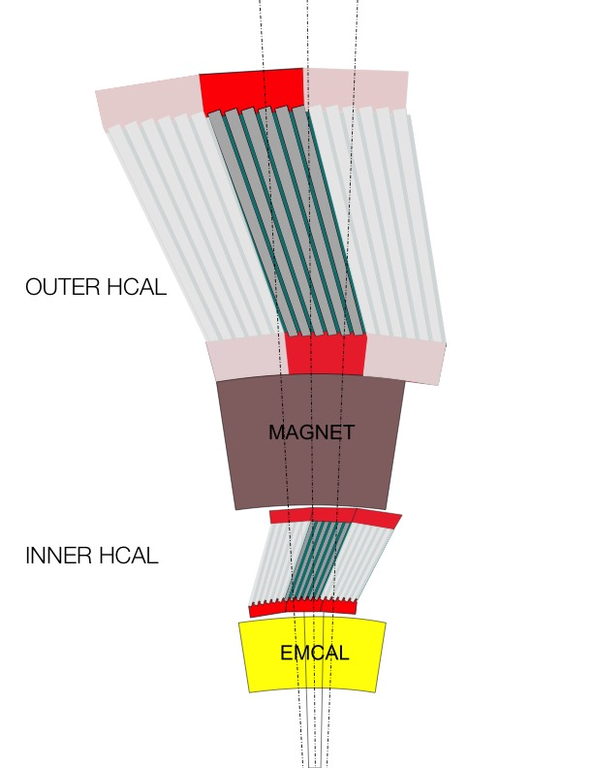
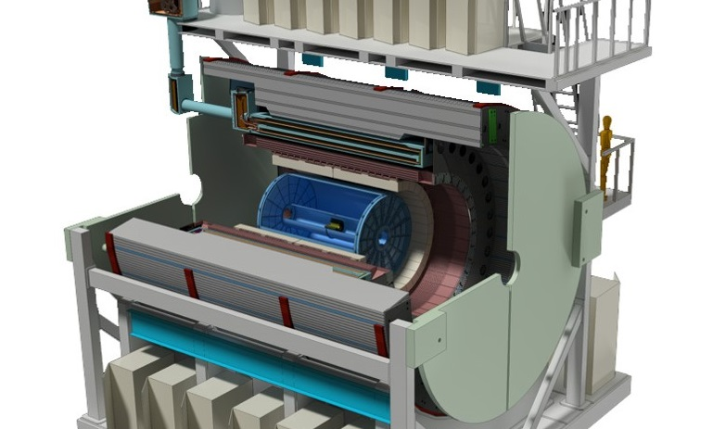
sPHENIX OUTER HCAL Description
HCAL steel-
HCAL ABSORBER STEEL
MAGNET FLUX RETURN
STRUCTURAL SUPPPORT FOR INNER DETECTORS AND MAGNET
Scintillating tiles with wavelength shifting fiber
SiPM Readout

Slide 3
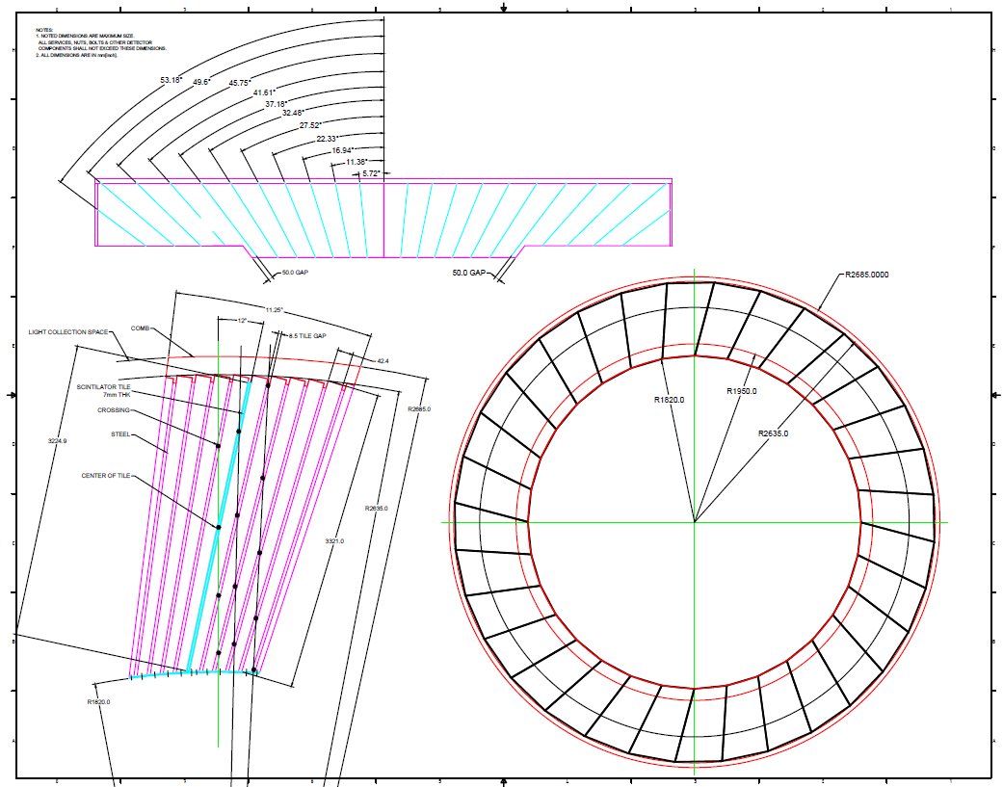
The Subsystem Technical Overview
32 MODULES
INNER RADIUS 1.9m
OUTER RADIUS 2.6m
10 GAPS of 7mm Scint Tiles
24 Tiles in each row.
~26.1mm - ~42.4mm
Tapered 1006 Steel Plates

Slide 4
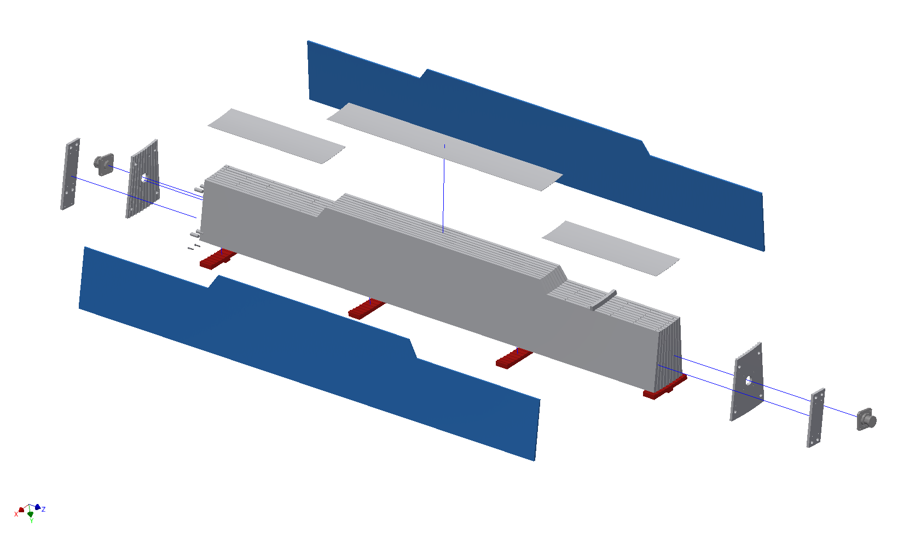
OUTER HCAL SECTOR- LOWER
SUPPORT ENDPLATE
MAGNET STEAL
ABSORBER PLATE
SPLICE PLATE
SUPPORT RING
BRACKET LOCATION
MAGNET STEEL
HALF PLATE
LIFTING/ROTATING TRUNION

Slide 5
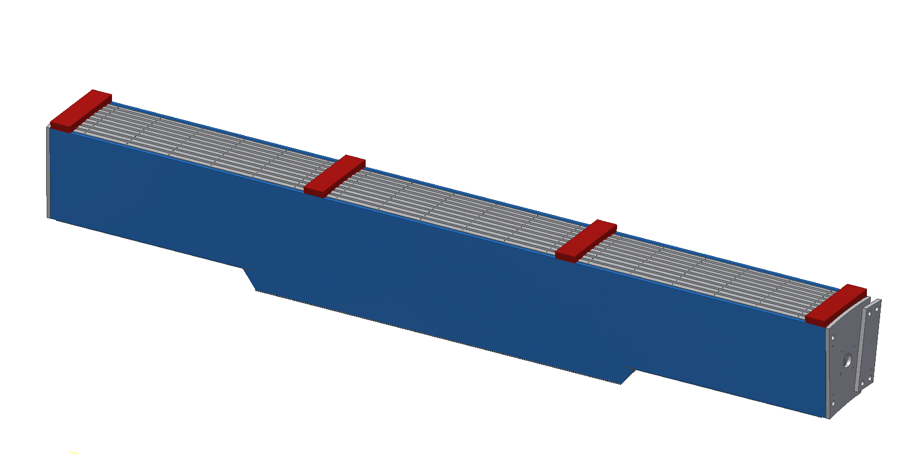
OUTER HCAL MODULE
COMPLETED MODULE
6.3m LG
13.5 TONS
LIGHT TIGHT
COVERS/PROTECTOR
INSTALLED BEFORE INSTALLATION
SUPPORT COMB
READY FOR INSTALLATION IN IR

Slide 6
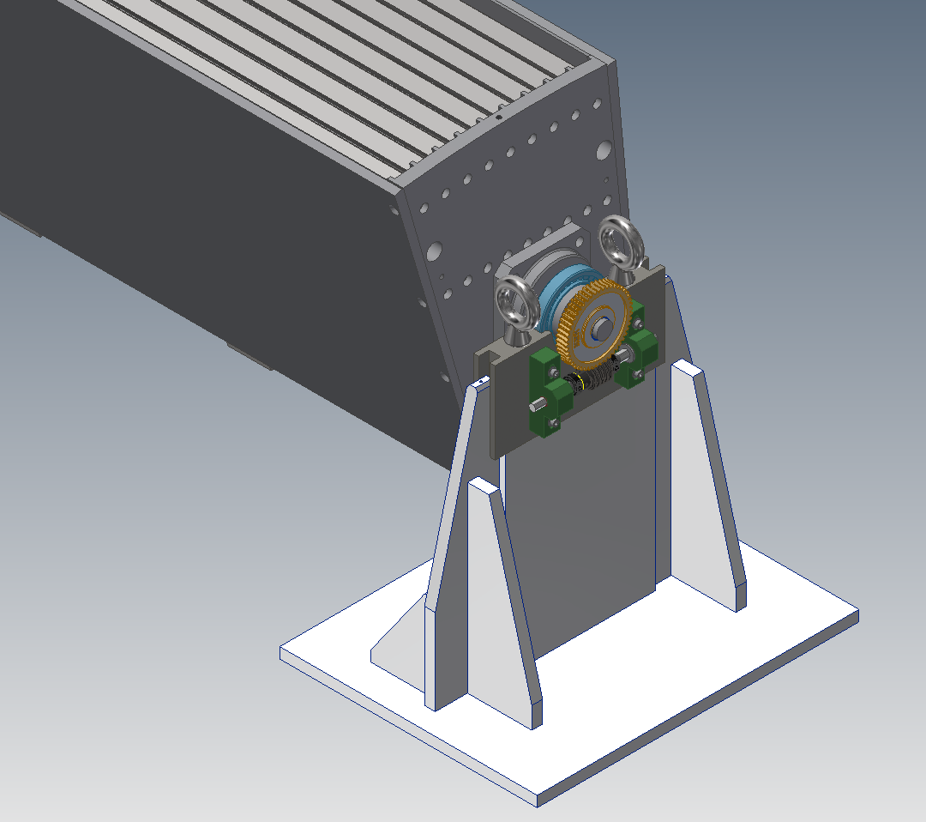
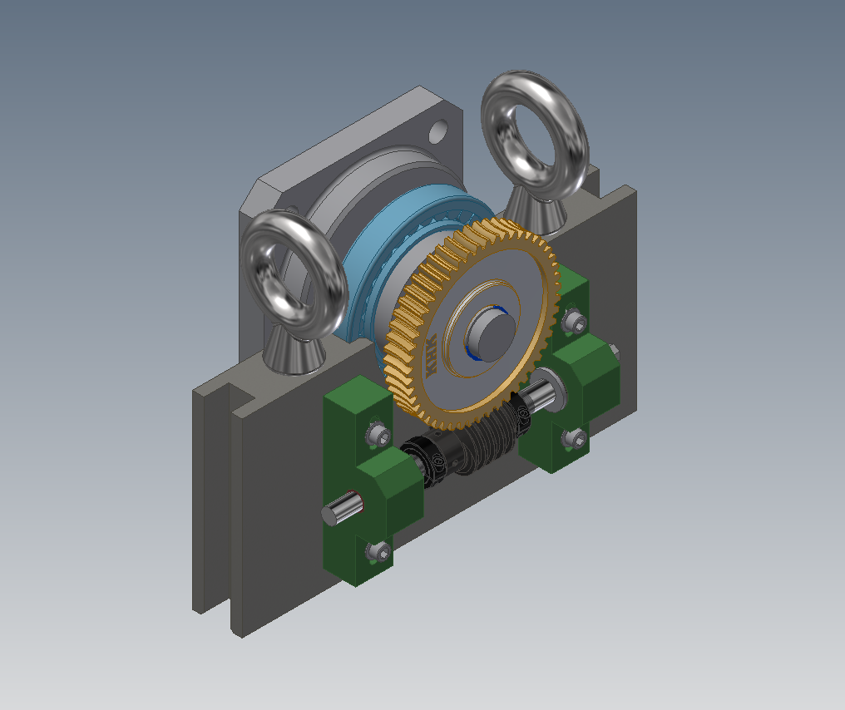
OUTER HCAL HANDLING FIXTURES
OUTER HCAL SECTOR
LIFTING FIXTURE
SECTOR ROTATION ATTACHMENT (WORM GEAR)
HOLDING FIXTURE (BASE STAND)
CLOSER VIEW OF LIFTING FIXTURE WITH ROTATION GEARS

Slide 7
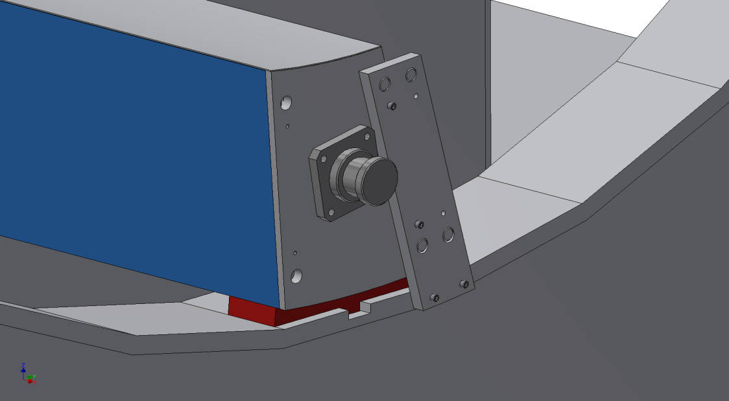
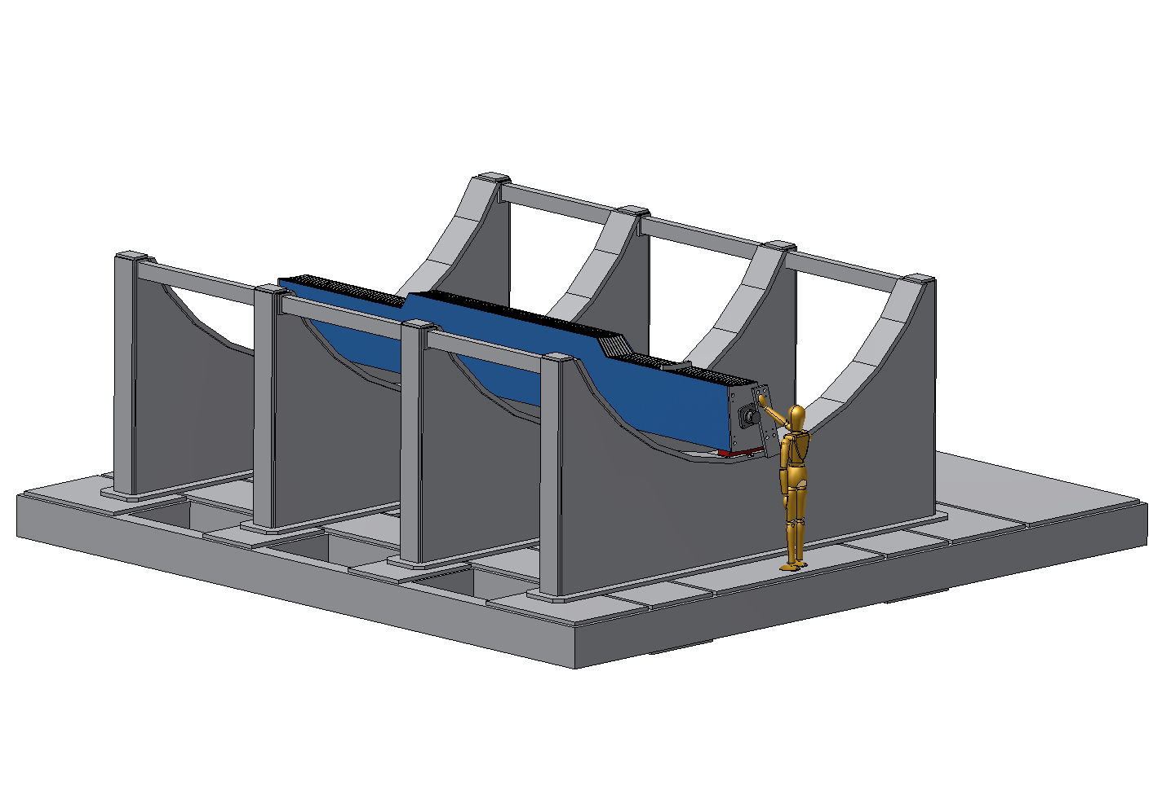
1ST HCAL MODULE INSTALLATION
PINNED TO
NEXT
MODULE
LIFTING/ROTATING TRUNION
1ST MODULE SHIMMED/SURVEYED
AND KEYED IN PLACE
BOLTED TO
ENDPLATES
SHIM HERE
OUTER HCAL SERVES AS THE
SUPPORT STRUCTURE FOR THE DETECTOR
AND MAGNET FLUX RETURN
BOLTED TO
CRADLE
ONE SIDE
CRADLE CARRIAGE WELDMENT

Slide 8
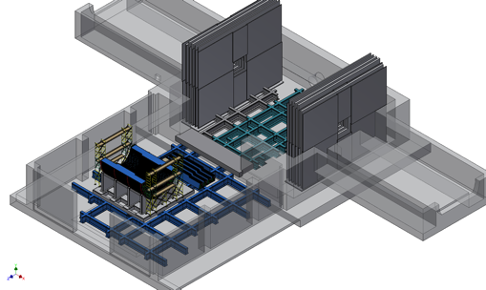
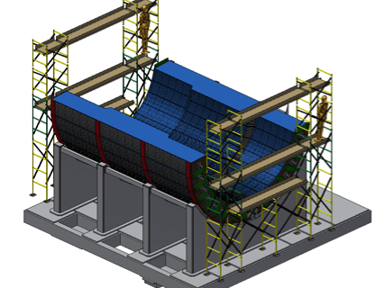
OUTER HCAL LOWER HALF INSTALLATION
ACCESS SCAFFOLDING

Slide 9
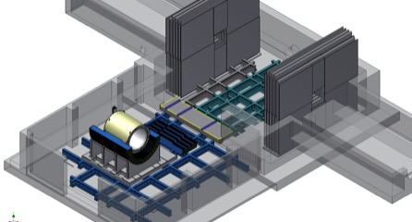
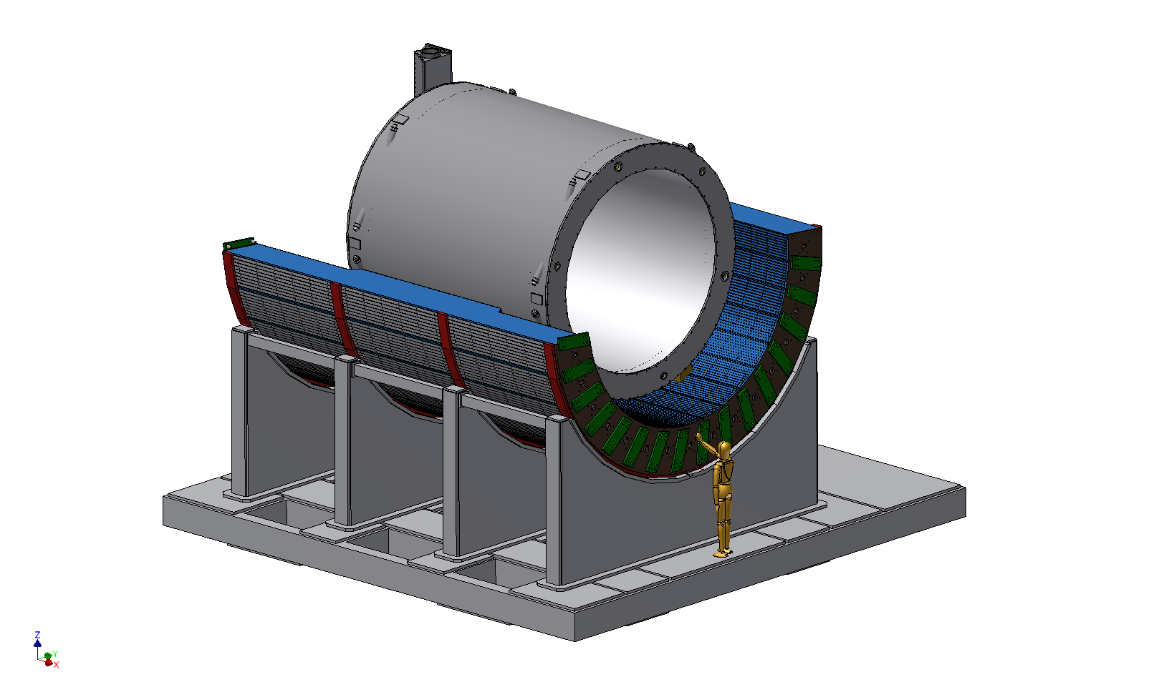
SC MAGNET INSTALLATION
MAGNET IS SUPPORTED
BY THE OUTER HCAL

Slide 10
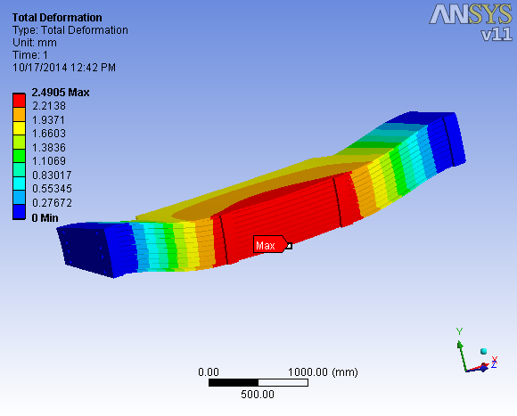
OUTER HCAL SECTOR ANALASYS
SUPPORT COMB
WORST CASE SCENARIO – HORIZONTAL LIFT
TOTAL DEFORMATION
WITHOUT SUPPORT COMBS 4.6mm
TOTAL DEFORMATION
WITH 5 SUPPORT COMBS ON TOP
7 COMBS ON BOTTOM 2.5mm

Slide 11
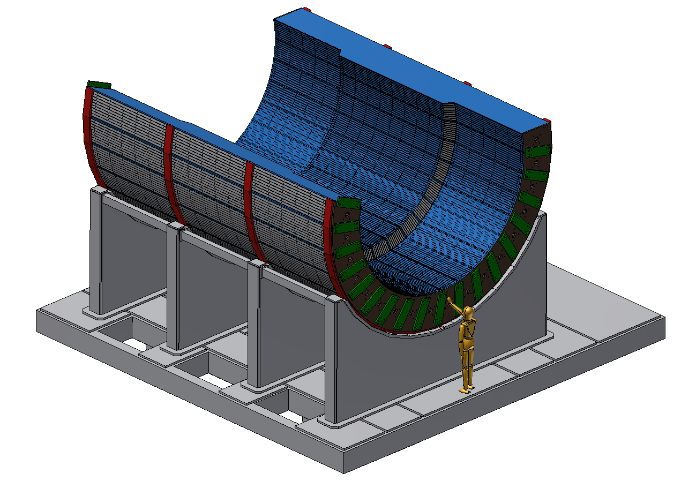
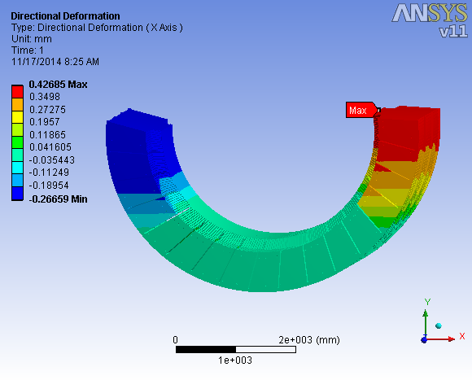
~180 deg OUTER HCAL ASSEMBLED
120 DEGREE OR MORE
BOTTOM SUPPORT
WILL BE SUFFICIENT
TOTAL DEFORMATION IS 0.4mm MAX

Slide 12
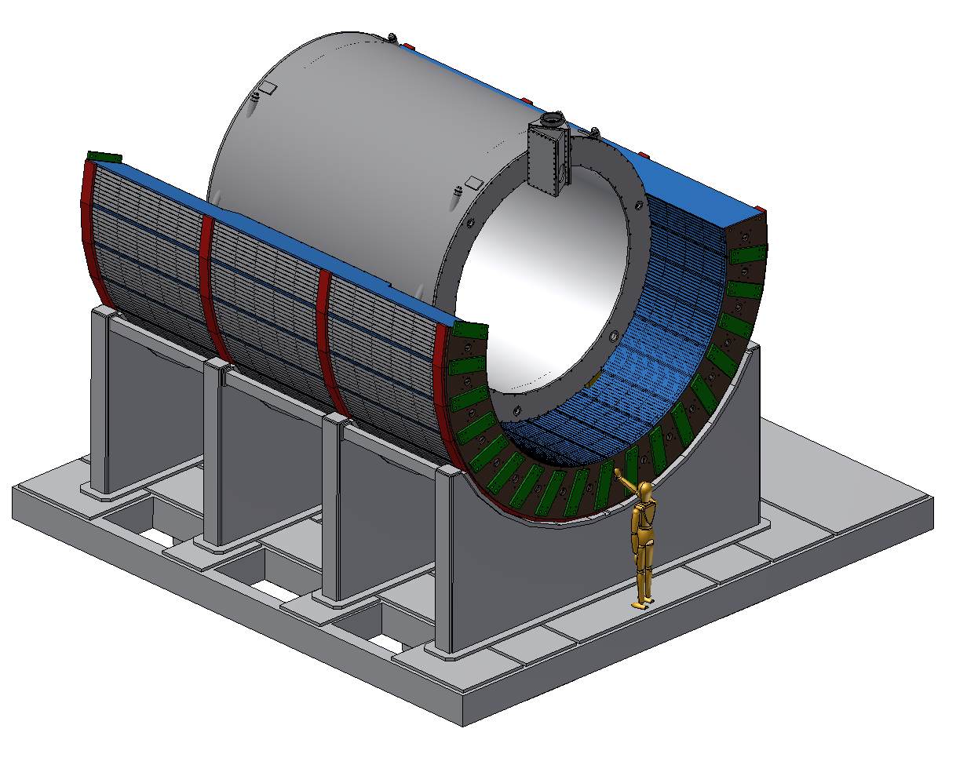
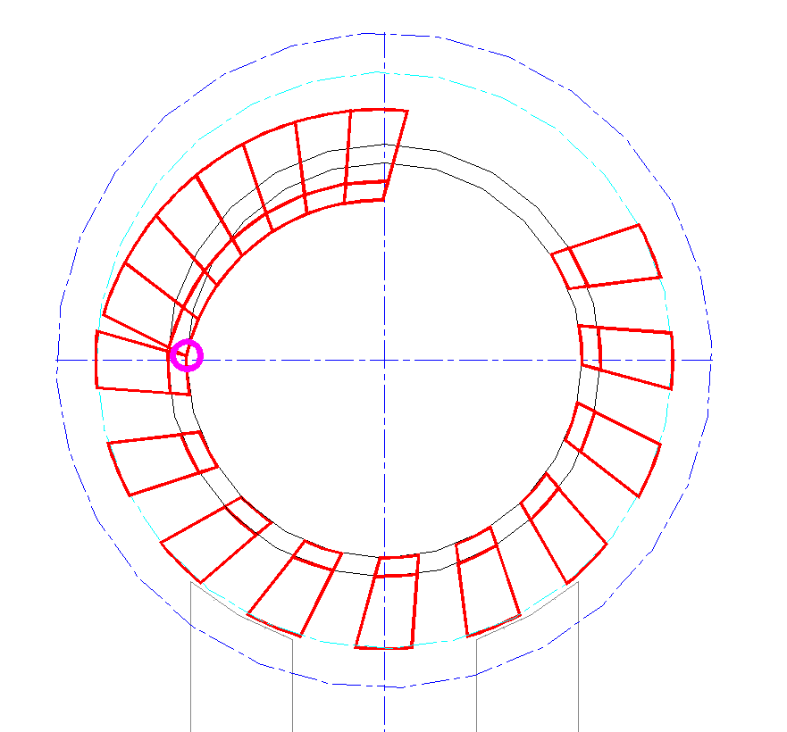
ASSEMBLE UPPER QUADRANT
BOLTED SECTOR CONNECTION –FRICTION CONNECTION.
TOP MODULE SECTION CAN ROTATE AND
MAKE ASSEMBLY IMPOSSIBLE
AFTER MAGNET IS INSTALLED
REMAINING SECTORS ARE INSTALLED
MOMENT

Slide 13
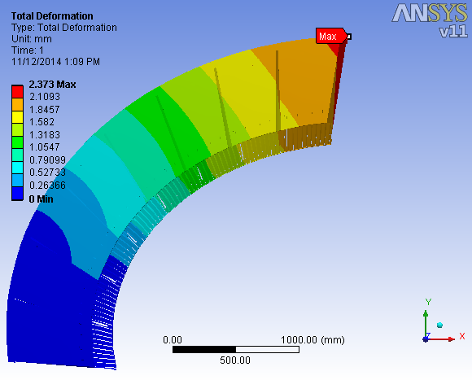
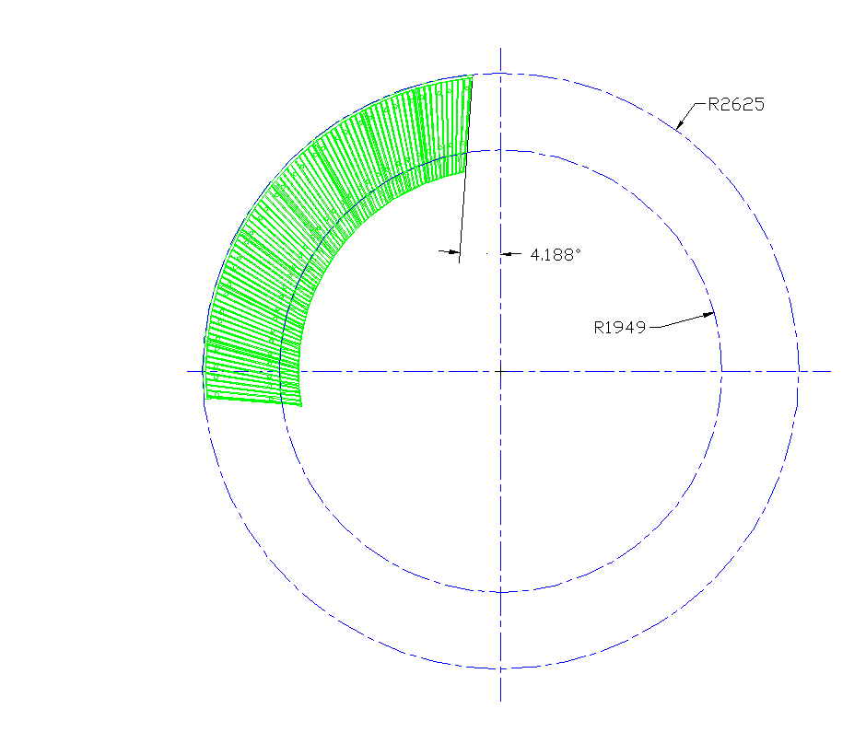
ASSEMBLY DEFORMATION
2.3mm DEFORMATION
8 MODULES
DEFORMATION IS TOO GREAT
FOR INSTALLATION OF REMAINING
SECTORS WITHOUT ADDITIONAL TEMPORARY SUPPORT
FIXED SUPPORTS

Slide 14
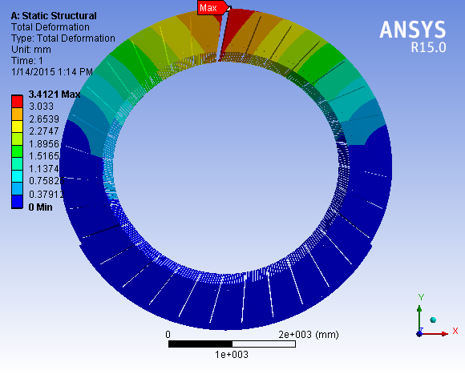
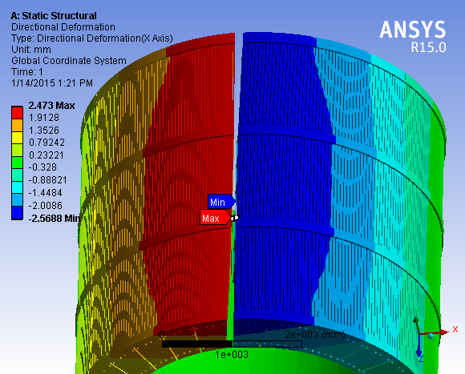
ASSEMBLY DEFORMATION
AN EXTERNAL SUPPORT IS REQUIRED
FOR REMAINING MODULES TO BE INSTALLED

Slide 15
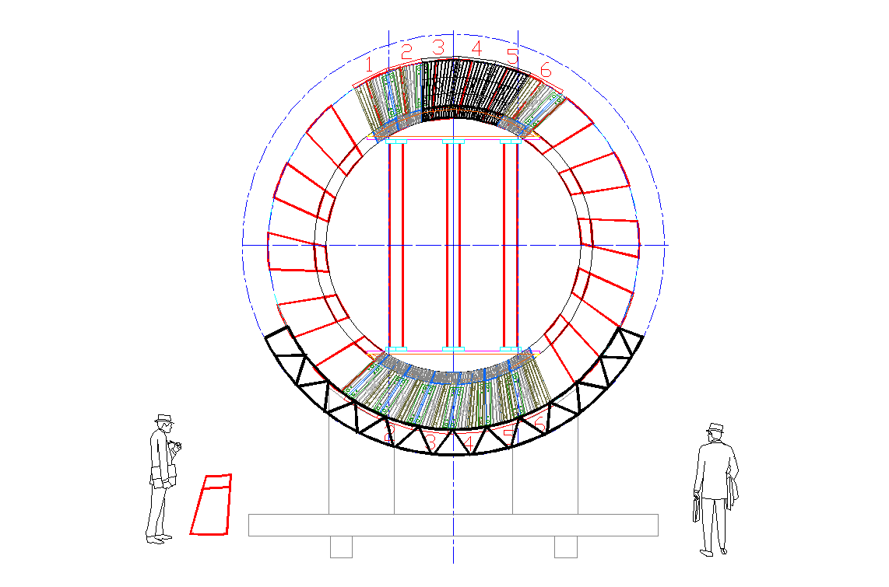
TEMPORARY SUPPORT FOR TOP SECTOR INSTALLATION
FRONT AND BACK SUPPORT COLUMNS
ONE POSSIBLE SOLUTION SHOWN. OTHER OPTIONS INCLUDE USING HYDRAULIC PISTONS BETWEEN SECTOR TRUNIONS TO ACHIEVE ADEQUATE SEPARATION FOR INSTALLATION
TOP AND BOTTOM
FRAME SUPPORTS

Slide 16
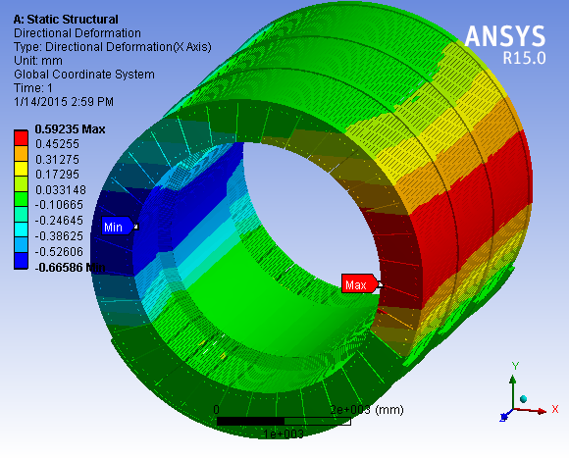
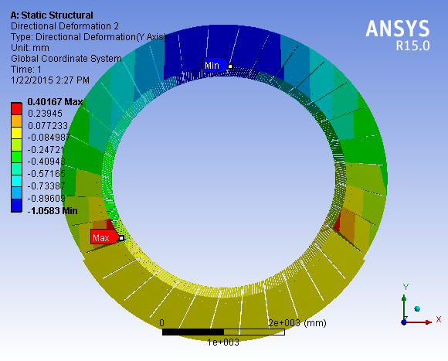
COMPLETED ASSEMBLY ANALYSYS
Y DEFORMATION 1mm MAX
X DEFORMATION +/- 0.6mm
FINAL ASSEMBLY DEFORMATION IS WITHIN TOLERANCE AFTER
REMOVAL OF TEMPORARY SUPPORTS

Slide 17
Status and Highlights
Analyses are continuing (near completion)
Outer HCal to Cradle carriage
Adding SC Magnet, Inner HCal and EMCAl support loads to model
Splice Plate and Pin stresses
Modified sectors (with cut out for SC Magnet Chimney extension)
Lifting fixture design (including rotation attachment) nearly complete
Design to be submitted to BNL lifting safety committee this month
Tile/electronics assembly stands detailed awaiting final approval for fabrication
Full scale prototype sector in production at vendor. Delivery this month.
Validate and qualify lifting and handling fixtures/tools
Evaluate tile holding features and alignment
Evaluate cable management
Partial instrumentation to validate operational characteristics with cosmic rays
Evaluate light tightness design
Test structural integrity in all installed orientations

Slide 18
Summary
Design is maturing rapidly
Analyses indicate acceptable structural integrity
Full scale prototype sector (near final design) in production
Design drawing package nearly complete
Interfaces with Cradle Carriage and other detectors under development
Assembly area at BNL to be identified shortly (candidates identified, negotiating availability)
Cost and production schedules being validated with full scale prototype sector

Slide 19
Back Up

Slide 20
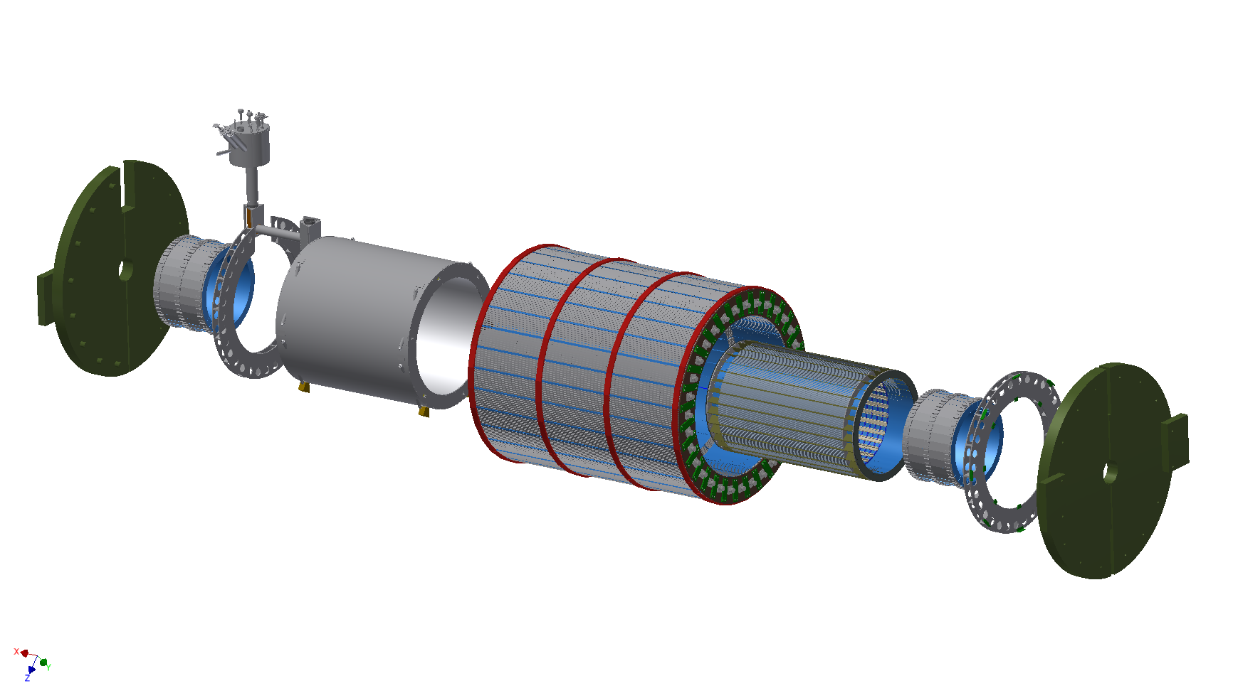

SPHENIX EXPLODED VIEW
SOUTH ENDCAP
(FLUX RETURN)
COIL CHIMNEY
CRYOSTAT/SC COIL
OUTER HCAL
INNER HCAL
NORTH ENDCAP
(FLUX RETURN)
SOUTH EMCAL
SOUTH SUPPORT RING
NORTH EMCAL
NORTH SUPPORT RING

Slide 21
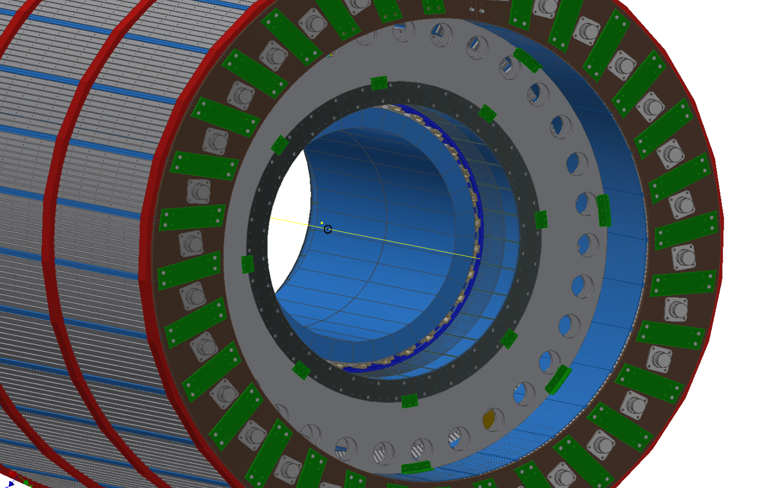
INNER HCAL ATTACHMENTS
EMCAL
OUTER
HCAL
INNER
HCAL END
RING
LOAD TRANSFER
SUPPORT RING
(INNER HCAL TO
OUTER HCAL)
PLATE
L-BRACKET
21

Slide 22
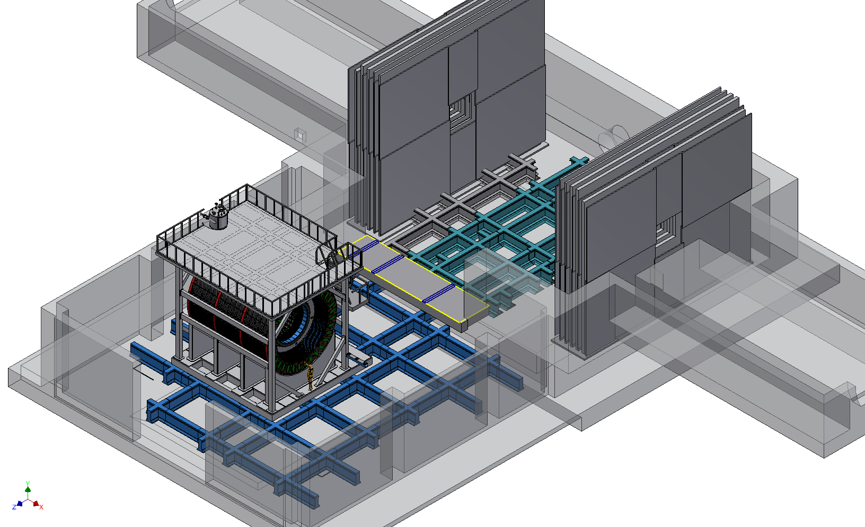
COMPLETED HCAL INSTALLATION
22

Slide 23
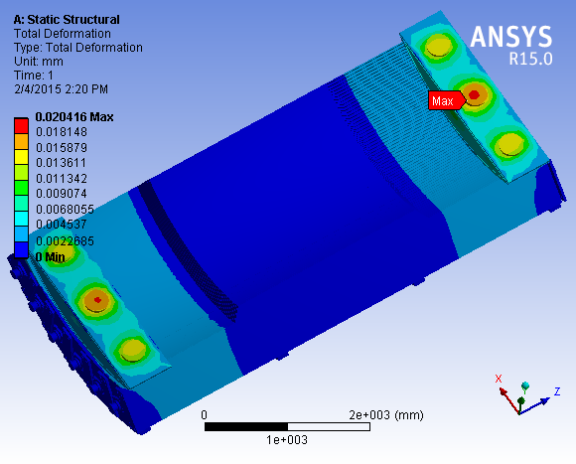
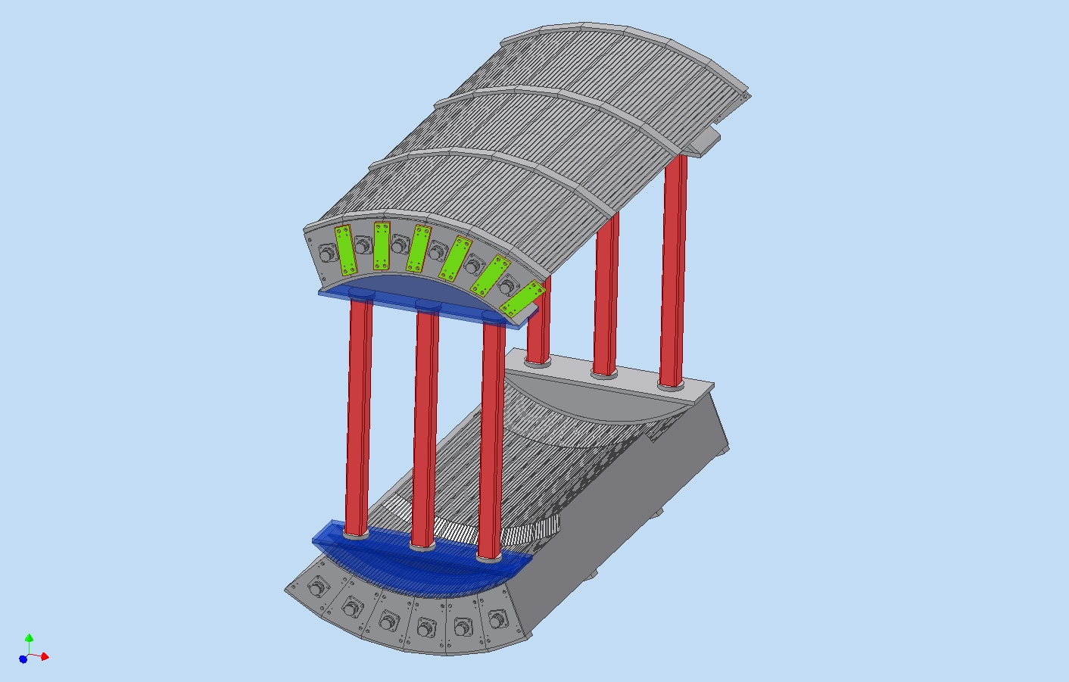
TEMPORARY SUPPORT FOR
TOP MODULE INSTALLATION
FRAME SUPPORT DEFORMATION IS ONLY 0.02mm
TOP MODULES
SUPPORT COLUMNS
HYDRAULIC JACKS
FRAME SUPPORT
BOTTOM MODULES
DEFORMATION DOES NOT EFFECT LOWER HCAL MODULES INTERNAL STRUCTURE
BNL, D. Lynch, R.Ruggiero, A. Gordeev
23

Slide 24
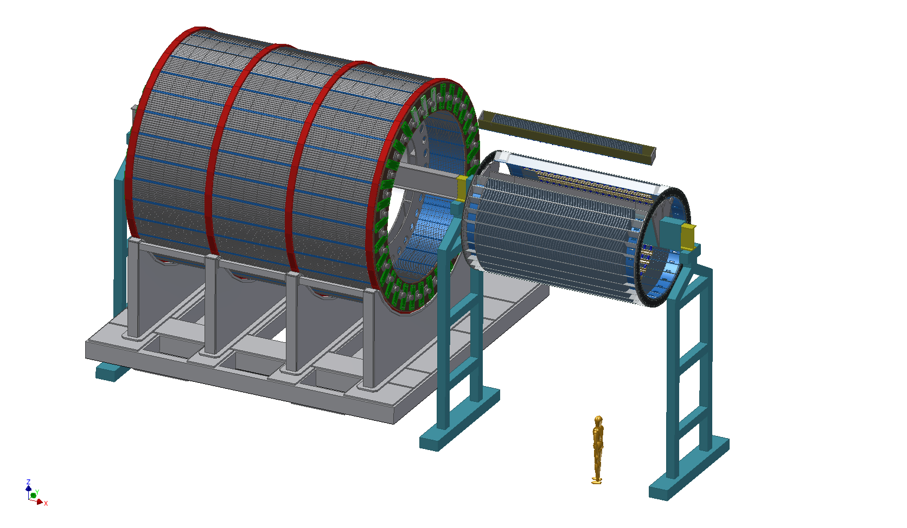
xPHENIX OUTER H-cal MODULE VERSION. PRELIMINARY STUDY . ASSEMBLY POSSIBLE SCENARIO. TEMPORARY SUPPORT
INNER HCAL INSTALLATION
SUPPORT RING
INNER HCAL MODULE
INNER HCAL
ASSEMBLY FIXTURE
I-BEAM
SUPPORT
SHORT I-BEAM
I-BEAM
SUPPORT
I-BEAM EXTENSION
C3PO
BNL, D. Lynch, R.Ruggiero, A. Gordeev
24

Slide 25
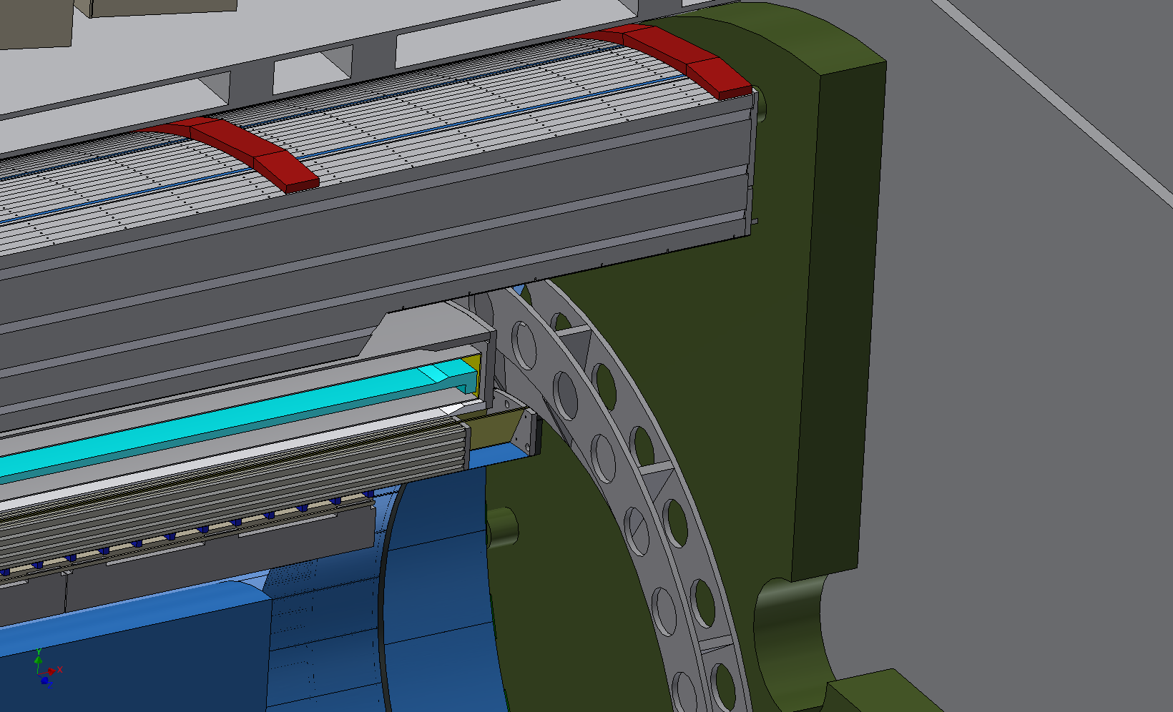
CUT AWAY VIEW
OUTER HCAL
MAGNET
SUPPORT RING
EMCAL
INNER HCAL

Slide 26
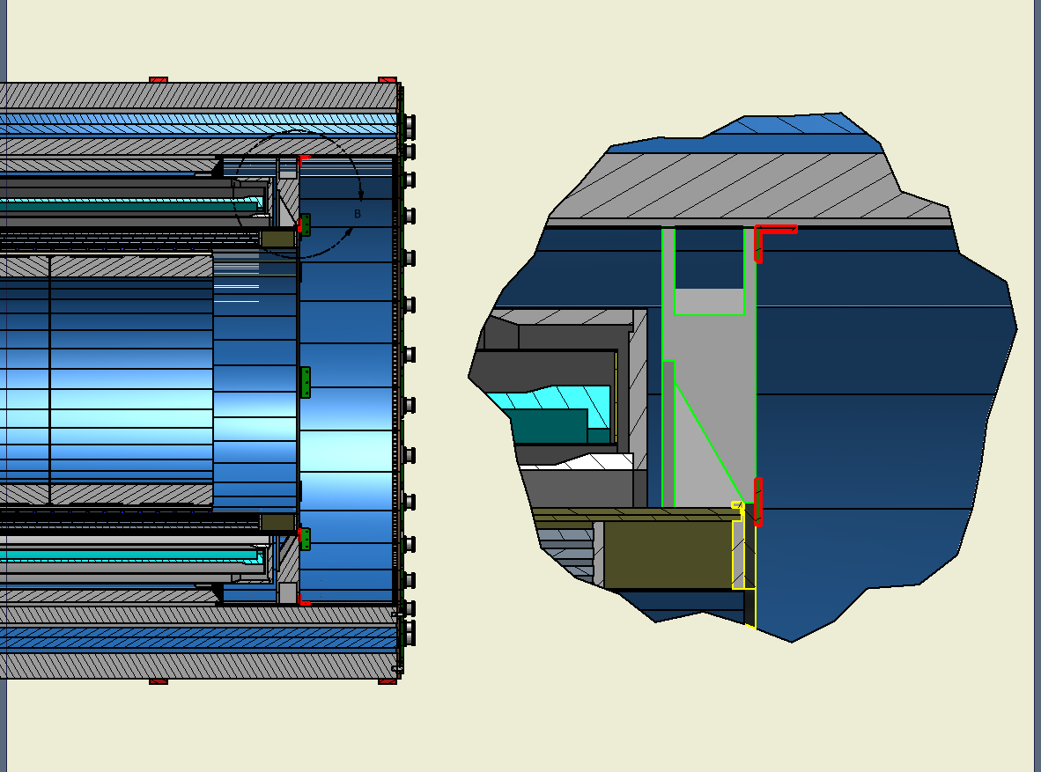
SUPPORT RING CROSS SECTION
SUPPORT RING
L-BRACKET
InnerHCAL ENDPLATE
SPLICE PLATE
Inner HCAL SUPPORT END RING

Slide 27
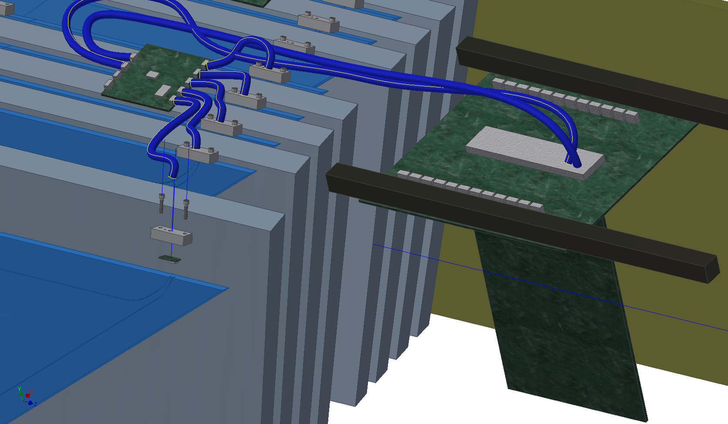
TOWER BOARD
HCAL ELECTRONICS & CABLE ROUTING
PC BOARD
PC Board Brace
SiPM PC Board
SiPM Holder
SiPM PC Board

Slide 28
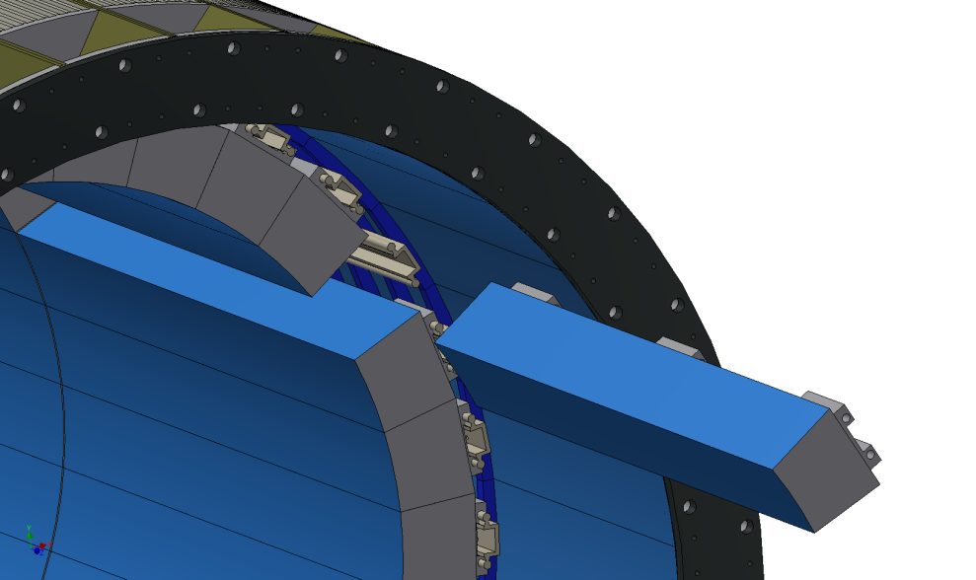
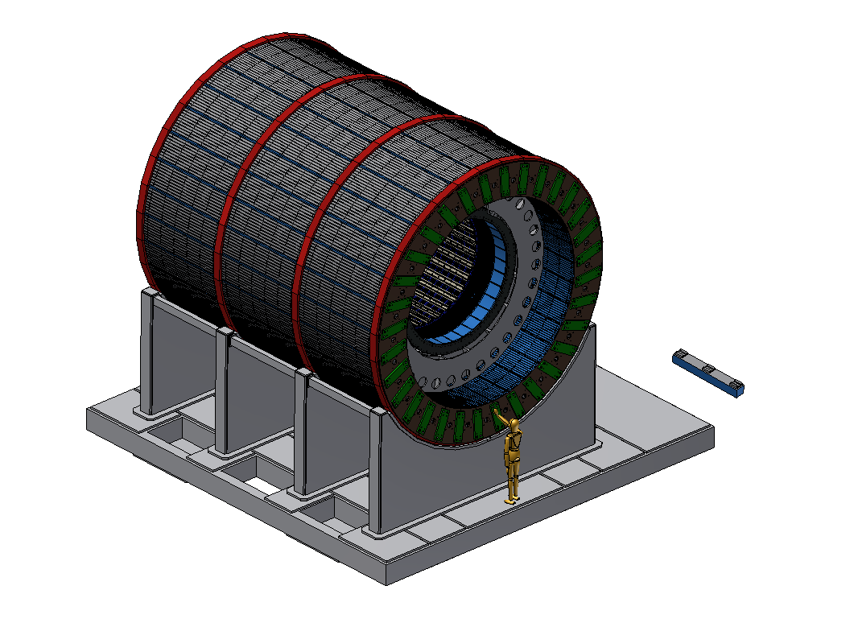
EMCAL MODULES ATTACHED TO INNER HCAL
LINEAR RAILS
CARRIAGE

Slide 29
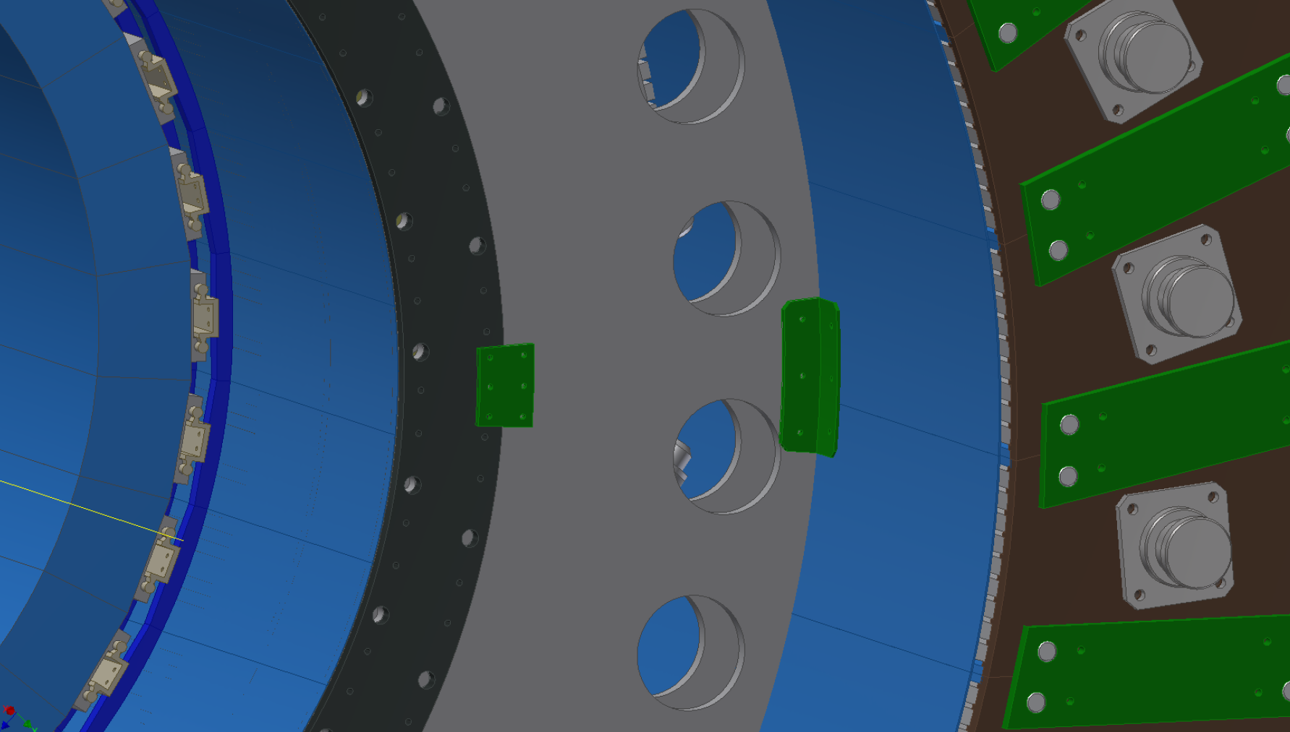
SUPPORT RING ATTACHMENTS
L-BRACKET
SPLICE PLATE

