Slide 1
sPHENIX Director’s Review Calorimeter Digitizer
C-Y Chi
August 2-4, 2017
BNL

Slide 2
The Subsystem
The calorimeter digitizer system
Off detector ADC system for both EM and Hadronic calorimeter.
Received the amplified signal from on-detector amplify through cables
Digitize the signal at 6x beam crossing rate, ~ 60 MHz, with 14 bits ADC
Offset the baseline to use most of the ADC range.
Provide at least 40 beam crossing of data buffers to cover L1 trigger latency
Provide Level 1 trigger primitives.
have at least 4 Level 1 events buffer.
Maximum 31 ADC samples per channel per events, 16 samples planned.
Up to 15 KHz Level 1 trigger rate.
Send Level 1 trigger events to the DAQ system.

Slide 3
The Subsystem Technical Overview
Crate based system.
Signals are cable from the on-detector electronics.
Digitized with 14 bit ADC.
Receive timing information the SPHENIX Granule Timing Module (GTM)
Generate L1 trigger primitives
(not in the reference design)
Receive L1 trigger and send out L1 triggered event data to Data Collection Module II (DCMII).
Provide buffer for both the 40 beam crossing L1 delay buffer and 4 L1 triggered events
Clock are fanout point to
point through the backplane
Trigger
out
crate
Trigger
out
Slow control/readback
bus, L0, L1 trigger
Token passing
dataway
Token passing
dataway
Controller
ADC
ADC
XMIT
3 ADC → XMIT
(rack based)
detector
clockmaster
3Gbit/sec
optical link
1.6Gbit/sec
optical link
Slow control/readback
Beam clock,
L0, L1 trigger
GTM
JSEB II
DCM II
PC
SPHENIX DAQ System

Slide 4
Scope
The sub-system consists of
432 ADC boards
64 channel per board
EMCAL 24576 Channels, HCAL 3072 channels.
144 XMIT modules
36 crates
Power supplies
Up to 36 clock master modules

Slide 5
Subsystem Collaborators
Currently we have only Columbia University handle this project.
BNL is helping integration and DAQ test.
Other groups can help us when the time ready for production or further long term testing.
This is the 3rd ADC system we have done in the last 10 years.
The PHENIX HBD 60 MHz 12 bits ADC (48 channel per board).
The MicroBooNe PMT readout, 64 MHZ 12 bits system.
The difference for this ADC system are ADC baseline shifting, serial backplane pathway, trigger primitive generators and more channel in the same space

Slide 6
Schedule Drivers
The ADC system prototype works
Low Noise
ADC data unpack
Data buffering & trigger data readout
Trigger primitive path
The electronics is off detector
Little detector mechanical constraint.
If the testing with detector continues to be successful, we have not much schedule constraint.

Slide 7
Cost Drivers
The cost drivers are on the ADC board.
The 8 channel Analog Device ADC AD9257
64 channel board → 8 ADCs per board
The Altera Arria 5 FPGA
receive the ADC data and data manipulation, L1 delay, 5 events buffer and generating trigger primitives.
The differential receiver, AD8132
Receiver the differential signals from the cable. One per channel.
The PCB board
The PCB assembly.

Slide 8
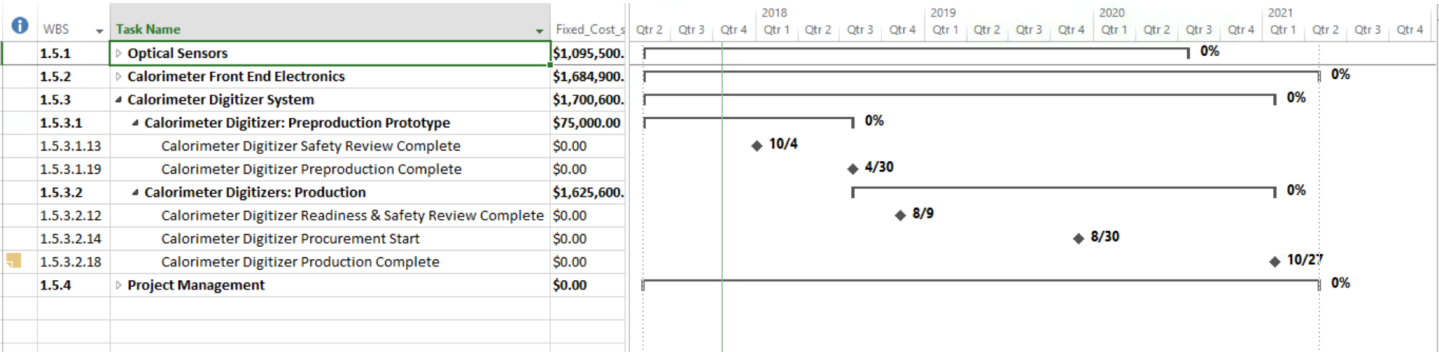
Basis of Estimate and Resource-Loaded Schedule

Slide 9
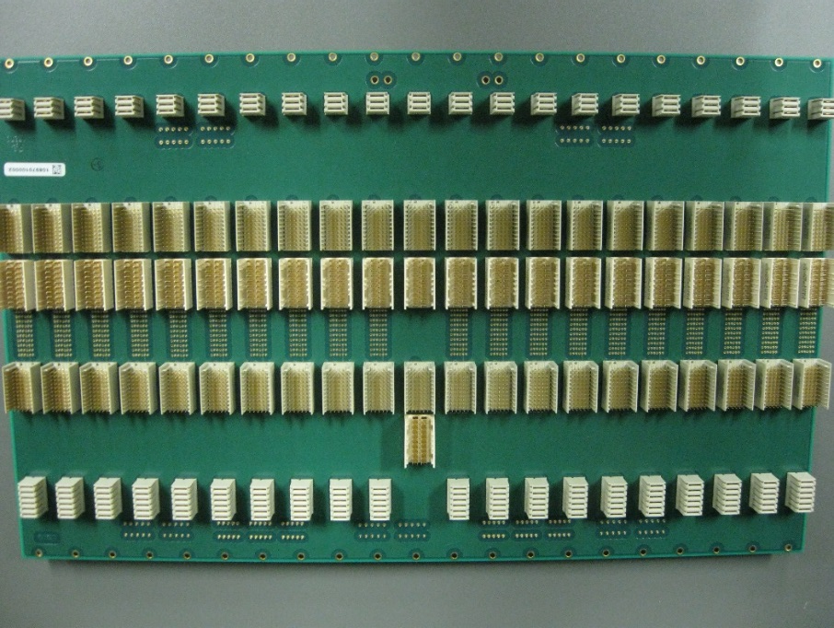
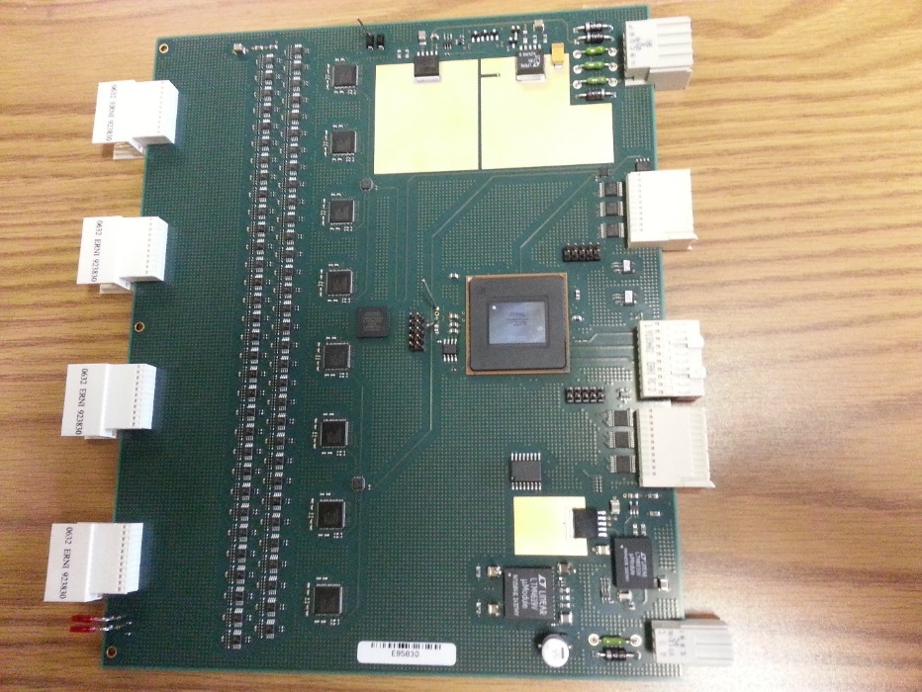
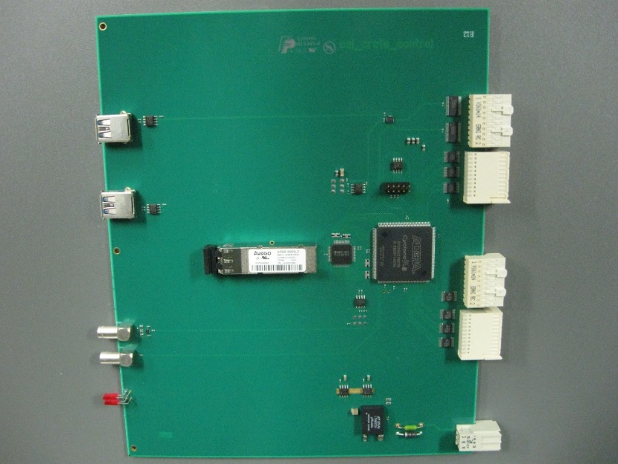
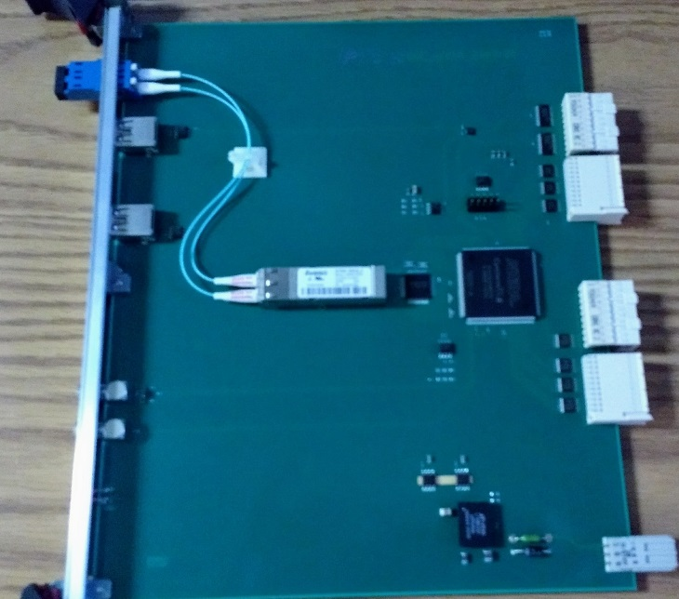
Status and Highlights
ADC board
Custom ADC system backplane
ADC XMIT board
ADC crate controller

Slide 10
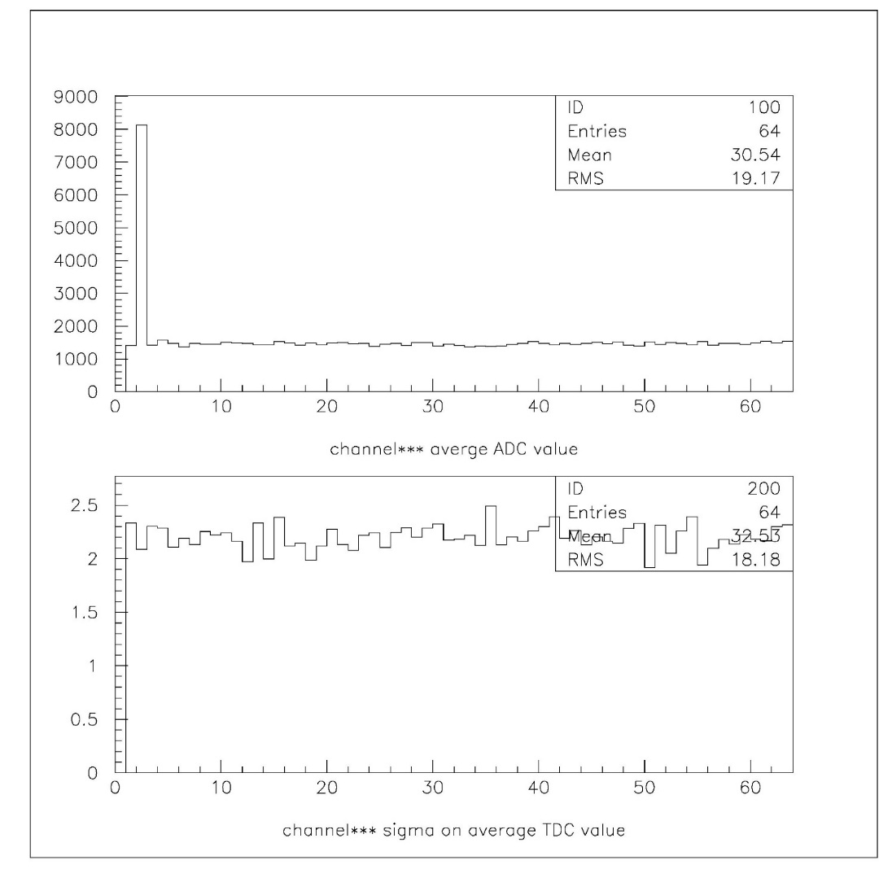
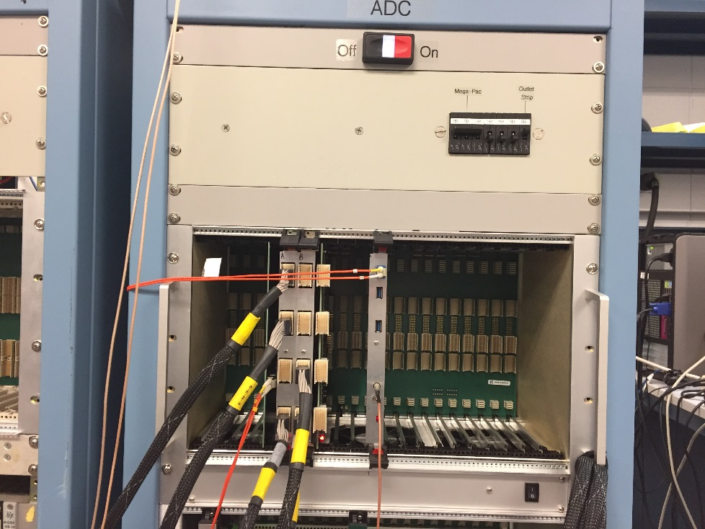
Status and Highlights
ADC baseline histogram (without signal cables)
14 bits ADC system (16384 ADC counts)
Without baseline shifting
Test stand in BNL
3 ADCs boards
Average
ADC counts
channel
ADC counts
Sigma
channel

Slide 11
Summary
We have construct first round of the digitizer system.
All first round prototype boards works so far.
ADC board has low analog noise.
Digital logics work so far
Trigger daughter card seems to work.
Some modification may be necessary when interface with sphenix timing system
Just affect the crate controller.
BNL test stands ongoing
Going reasonable well.
Fine tune tests will be done.

Slide 12
Back Up

Slide 13
sPHENIX ADC Module Block Diagram
RHIC beam clock 9.6MHz
Analog
Device
AD9257
8 channel
14bits
65 MHz
ADC
7X ADC clock
+- 3.5V, -2.5V
Differential
receiver power
+1.8V analog
ADC power
+1.8V digital
ADC power
+4V, -3.5V, +2.5V
Power
F
R
A
M
E
Differential
receiver
Serialized ADC DATA
ALTERA Arria V GX
BB1D4F35
1152 pins FPGA
6x beam clock
Beam phase,
init, L1
De-serializer
D
P
U
2 mm
Hard Metric
or mini-SAS
Connector
Token
Passing
Data
two transceivers
64 channel
ADC board
6 X beam
clock
Clock
Fanout
Serial
command
L1
Delay
Buffer
5 L1
Accepted
Event
buffer
Serialized
Token
Passing
two transceivers
2 mm
Hard Metric
or min-SAS
Connector
L1 trigger primitives
transceiver out
De-serializer
command/
offline data read
F
R
A
M
E
Differential
receiver
Serialized ADC DATA
Bused command
Serial data
Analog
Device
AD9257
8 channel
14 bits
65 MHz
ADC
3.3V
LDO
3.3V
LDO
DC/DC
switch regulator
4V
+12V
Power
7X ADC clock
2.5V FPGA I/O
DC/DC
switch regulator
1.5V
LDO
1.1V
core

Slide 14
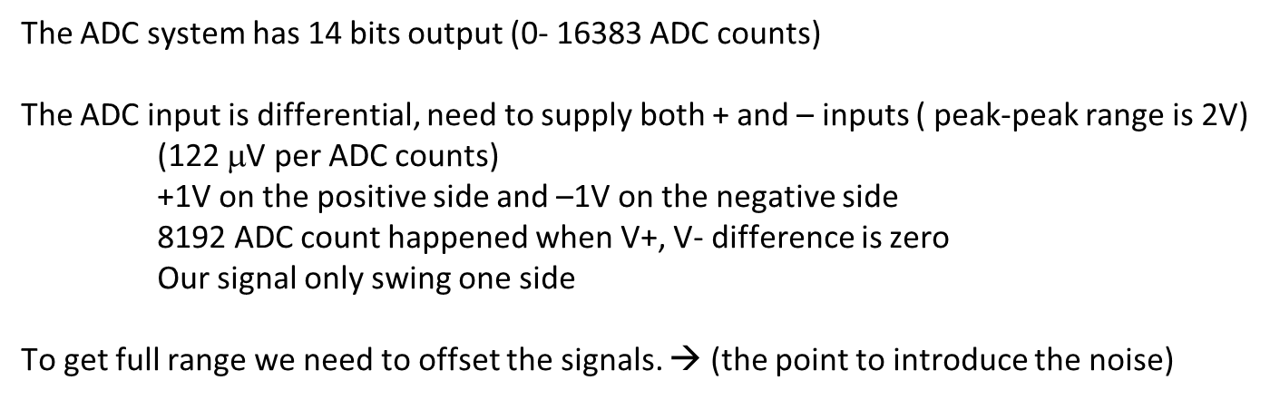
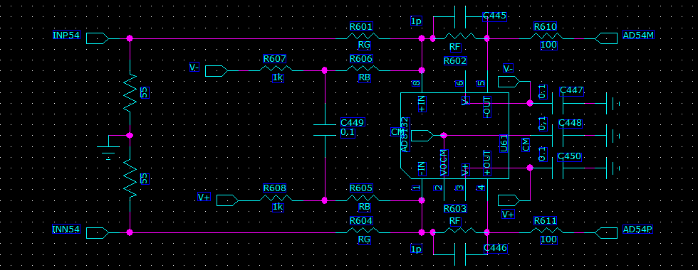

Slide 15
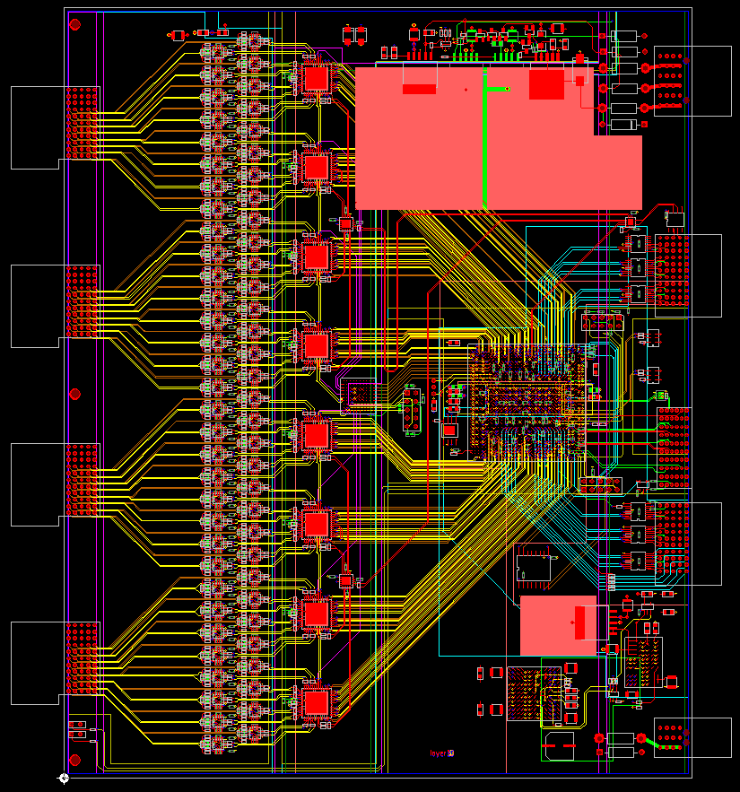
SPHENIX ADC board
Analog
Power
64 channel inputs
2mm HM connectors
160mm by 190mm (6U board)
The 8 channel 14 bits ADC will be running at 6x beam crossing rate ~ 60 MHz
Altera Arria 5GX FPGA de-serialize data, provide 5 events buffer, 40 beam crossing L1 delay, token passing data, L1 trigger primitives output
2mm HM
Input
connector
Clock in
L0/L1
Serial
Command
output
Differential
receivers
Trigger
Primitives
output
Token
Passing
Data
In/out
Analog
Device
AD9257
14 bits
ADC
Serial
Command
input
ALTERA
Arria 5GX
FPGA
Digital
Power

Slide 16
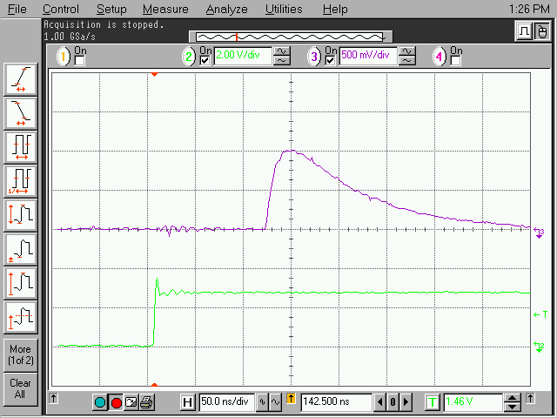
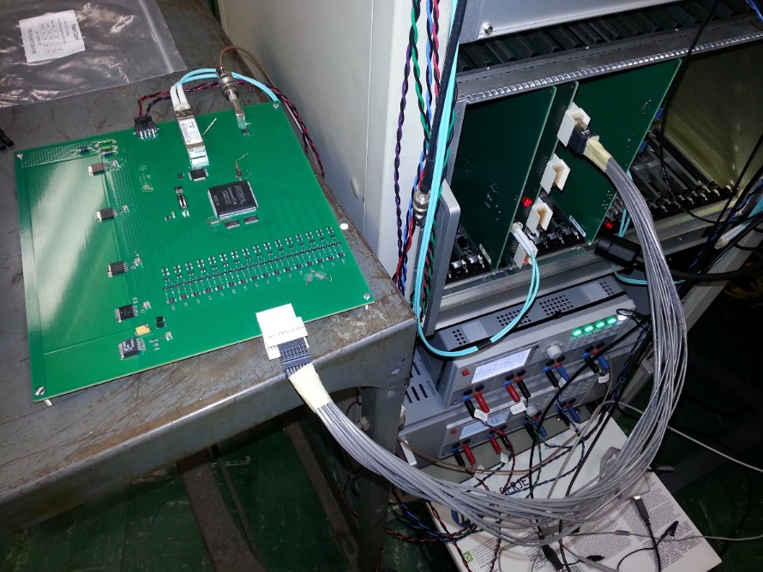
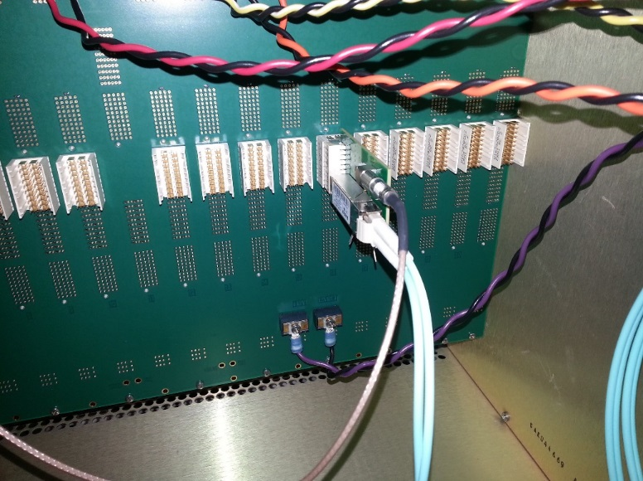

Slide 17
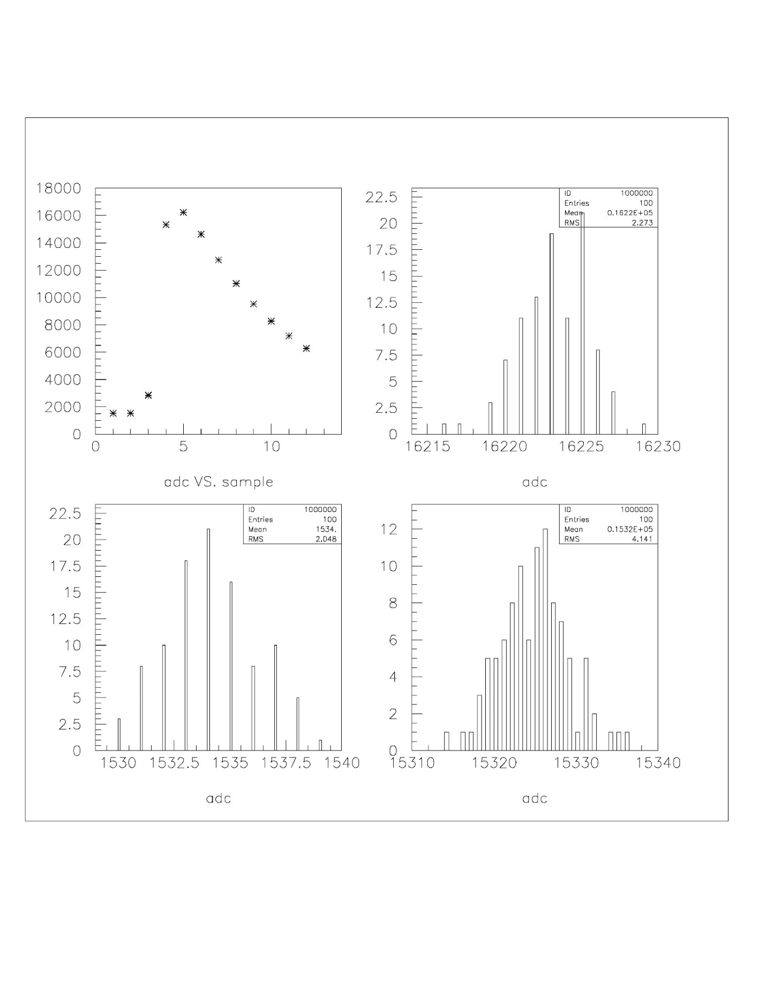
Pulse shape channel 40
rms
ADC
Sample number
ADC
ADC
ADC

