Slide 1
sPHENIX Director’s Review
1.2.1 TPC Mechanics
Klaus Dehmelt, Stony Brook University
August 2-4, 2017
BNL

Slide 2
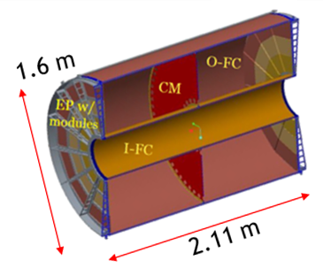
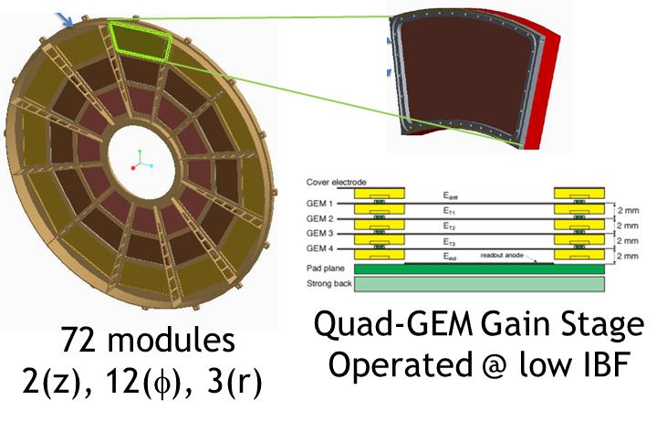
The Subsystem
WBS 1.2.1 - TPC Mechanics → Field Cage with full azimuthal coverage and |η| < 1.1
Modules based on Quad-GEMs for continuous readout and low Ion Back Flow IBF
Present gas choice provides drift time of ~ 18 μs, single spatial point resolution < 250 μm, low IBF
  Central Membrane CM
  Endplates EP, 2 in z
  Modules, 12 in φ, 3 in r
  Outer Field Cage O-FC, R = 78 cm, L = 211 cm
  Inner Field Cage I-FC, R = 20 cm , L = 211 cm

Slide 3
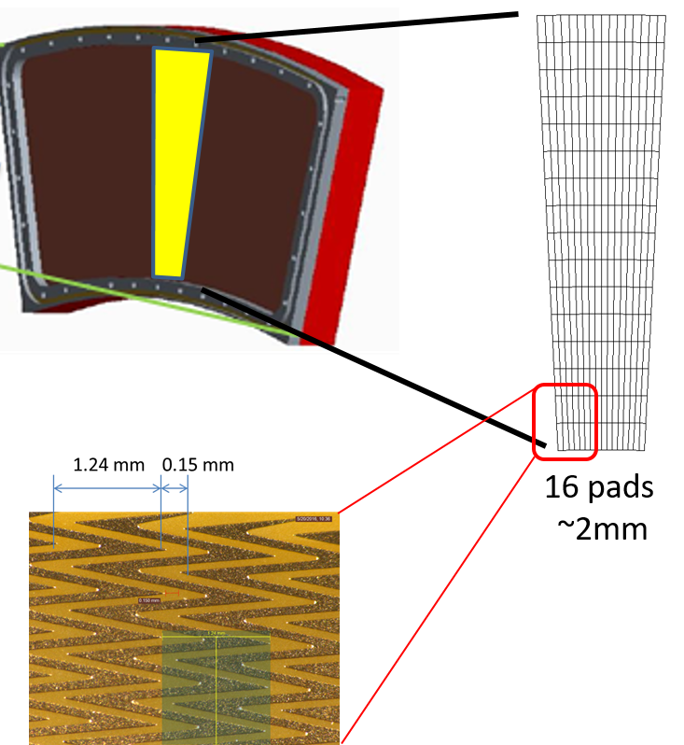
The Subsystem Technical Overview
Dimensions and designs dictated by
  Inner/outer radius → magnet and inner/outer detector design
  Length → pseudorapidity
  Design of field cages → minimum space
  and maximum stability
  Design endplates → minimum material
  budget, maximum stability
  Design modules → maximum integrity, least
  producibility, maximum performance

Slide 4
Scope
WBS 1.2.1 contains all elements that lead to the successful assembly of the TPC mechanics (WBS 1.2.1.8) and eventually make the TPC ready to install
TPC v1 Field Cage Prototype
TPC v2 Field Cage
TPC Final Field Cage
TPC v1 Modules
TPC v1 Module Gas Enclosure
TPC v1 Module Common Mechanics
TPC v1a Module Prototype
TPC v1b Module Prototype
TPC v2 Modules
TPC v2 Module Gas Enclosure
TPC v2 Module Common Mechanics
TPC v2a Module Prototype
TPC Production GEM Acquisition
TPC High Voltage System
TPC Assembly

Slide 5
Subsystem Collaborators
CAM WBS 1.2.1 TPC Mechanics: Klaus Dehmelt (Stony Brook University)
  Research Scientist
  Since 1999: HEP/HI Experiments: HERA-B (DESY-HERA), COMPASS (CERN-SPS), L3 (CERN-LEP), PHENIX (BNL-RHIC). Detector Systems: HERA-B Outer Tracker System (installation/commissioning), COMPASS-GEM Small Area Tracker (SAT) (design/construction/installation/commissioning), DESY-Large Prototype of a TPC (LC-TPC collaboration) (design/construction/installation/commissioning, management), PHENIX-Detector Council Member (Drift Chamber subsystem, 2011 – 2016), R&D: CsI-GEM RICH, large area GEM chambers, TPC Ion Back Flow
L2 Manager WBS 1.2 TPC: Thomas K. Hemmick (Stony Brook University)
  Distinguished Teaching Professor
  Since 1988: Heavy Ion Experiments: E814 (BNL-AGS), E877 (BNL-AGS), PHENIX (BNL-RHIC). Detector Systems: E814 drift/pad chambers (construction), E877 MWPC chambers (design/construction/management), PHENIX RICH (design/construction/management), PHENIX drift chambers (design/construction/management), PHENIX hadron blind detector (design/construction/management), PHENIX MPC-EX (construction). R&D: CsI-GEM HBD, CsI-GEM RICH, W-Si preshower, large area GEM chambers, TPC-Cherenkov hybrid, TPC Ion Back Flow
John Cozzolino (CAD BNL)
  Senior engineer
  25+ years involved in numerous aspects of the design development and construction of superconducting accelerator magnets. Specialized in computer-aided engineering analyses critical to the R&D, design and manufacture of such magnets primarily for RHIC at BNL and the LHC at CERN
Steven Bellavia (CAD BNL)
  Senior engineer
  25+ years performing mechanical analysis, design and fabrication of detectors, for PHENIX (1992-1995), RHIC (1998-present), NSRL (1999-2003) and LSST (2013-present)

Slide 6
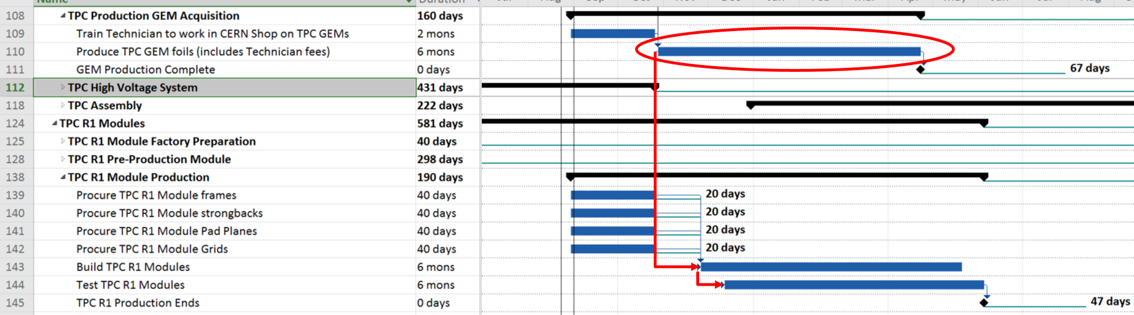
Schedule Drivers
WBS 1.2.1.6 TPC Production GEM Acquisition
Factory production follows a Start-Start relationship to GEM production
Module assembly takes less time than GEM production (PHENIX HBD experience)
GEM schedule drives module production schedule and TPC overall schedule

Slide 7
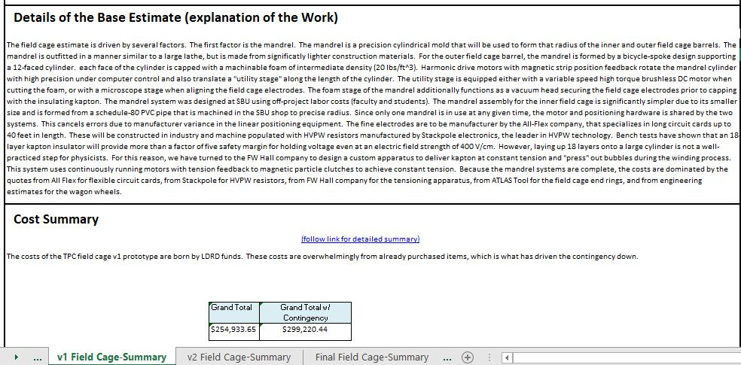
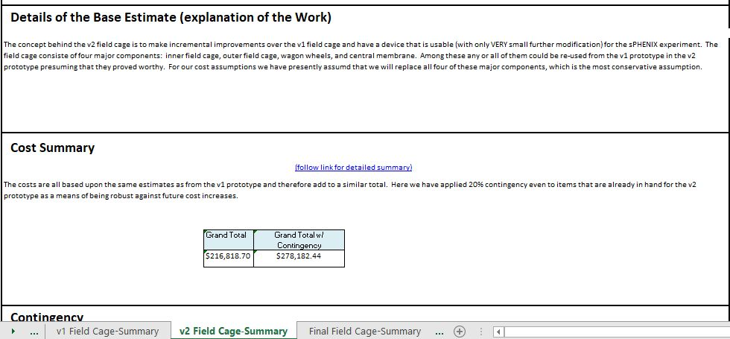
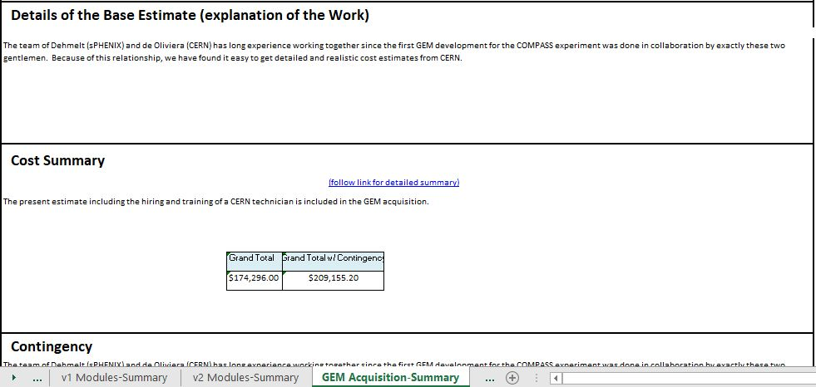
Cost Drivers
Latest bottom-up cost estimate reveals the cost drivers to be
  WBS 1.2.1.1 TPC v1 Field Cage Prototype
  WBS 1.2.1.2 TPC v2 Field Cage
  WBS 1.2.1.6 TPC Production GEM
  Acquisition
  Contingency at purchase-by-purchase level → weighted contingency
Grand Total | Grand Total w/ Contingency
$254,933.65 | $299,220.44
Grand Total | Grand Total w/ Contingency
$216,818.70 | $278,182.44
Grand Total | Grand Total w/ Contingency
$174,296.00 | $209,155.20

Slide 8
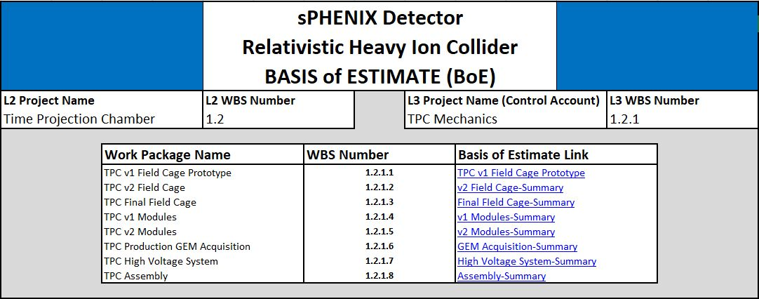
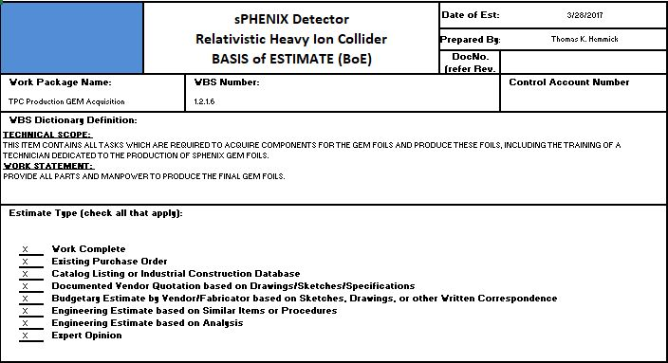
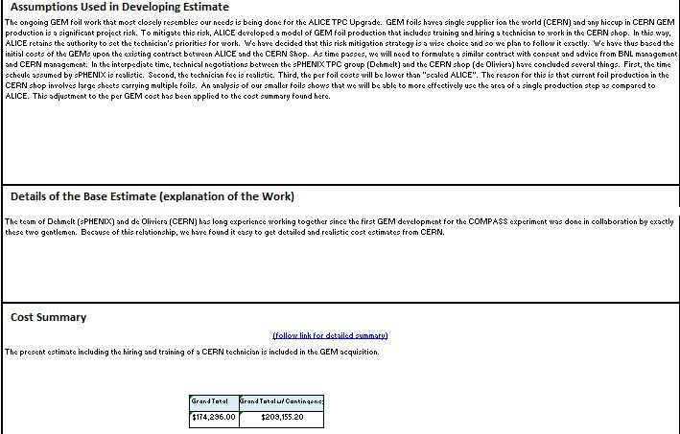
Basis of Estimate and Resource-Loaded Schedule
WBS 1.2.1 contains 8 work packages
Each work package is linked from the Title Page
e.g.:
Within each file 2 pages per L4 item:
  Summary page explains BoE Details and Assumptions.
  Intended to be readable without additional documents open and at the ready.
Link to detailed cost summary

Slide 9
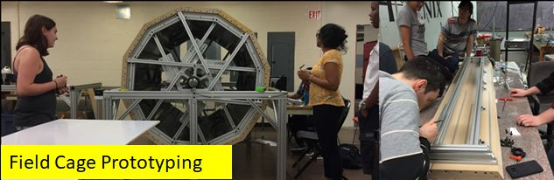
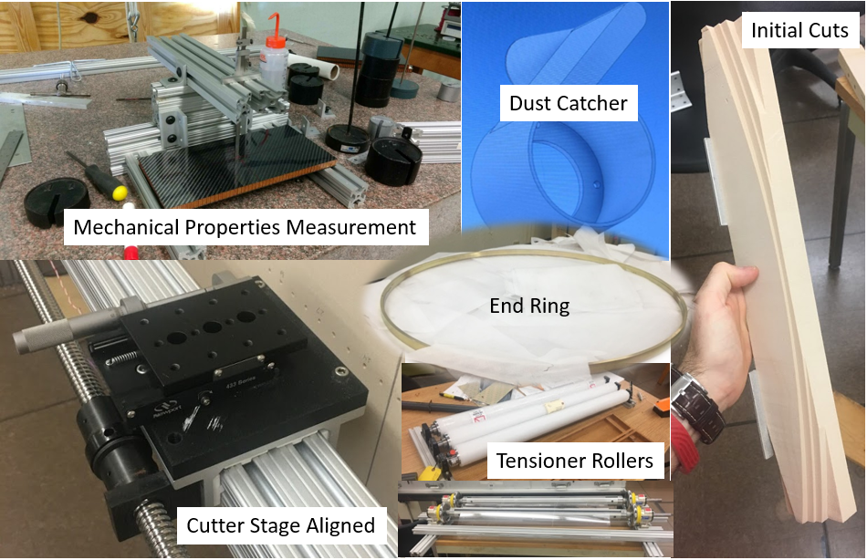
Status and Highlights
Outer Field Cage v1 prototype
  Mandrel finalized
  Field cage in production

Slide 10
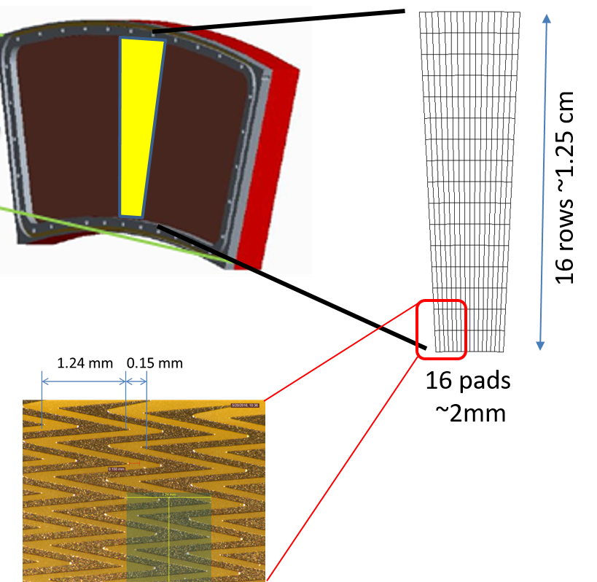
Status and Highlights
TPC v1 modules
  Common mechanics designed → submit to SBU workshop
  TPC v1a module prototype: GEM design finalized → submit to CERN workshop
  Readout board with zig-zag shaped pads designed -> submit to provider

Slide 11
Issues and Concerns or Summary
Issues and concerns
  GEM production exclusively at CERN
  Mitigated by hiring technician exclusively for sPHENIX production
  Big GEM production (ALICE TPC, CMS) completed in 2017/2018
Summary
  All WBS items in BoE well understood
    Purchases, quotes, contracts, analysis, experience
  All WBS items have contingencies on a very mature level
  Risk items on a very low level
  Tasks are well progressing
    TPC O-FC v1 prototype nearly completed
    TPC Modules v1 well on track

Slide 12
Back Up

