Slide 1
sPHENIX Director’s Review Calorimeter Simulations
Jin Huang (BNL)
August 2-4, 2017
BNL

Slide 2
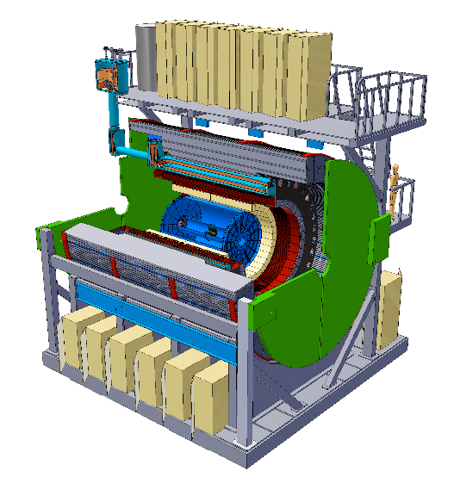
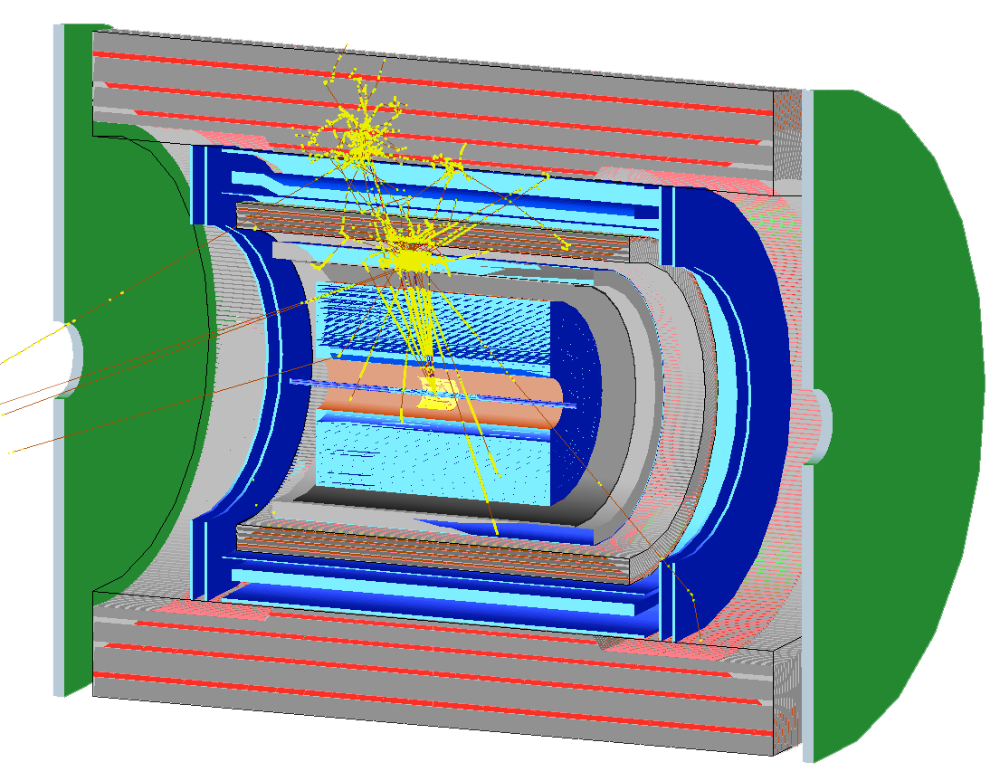

sPHENIX Calorimeters in Simulation
EM calorimeter (EMCal) : 18 X₀ W-SPACAL
Inner hadron calorimeter (Inner HCal) : 1 λ₀ SS-Scint. sampling
sPHENIX coil and cryostat. (Magnet): 1.4 X₀ Coil & Cryostat
Outer hadron calorimeter (Outer HCal) : 4 λ₀ SS-Scint. sampling
Outer HCal
Magnet
Inner HCal
Geant4 Land
EMCal
Open source @
https://github.com/sPHENIX-Collaboration/
IP

Slide 3
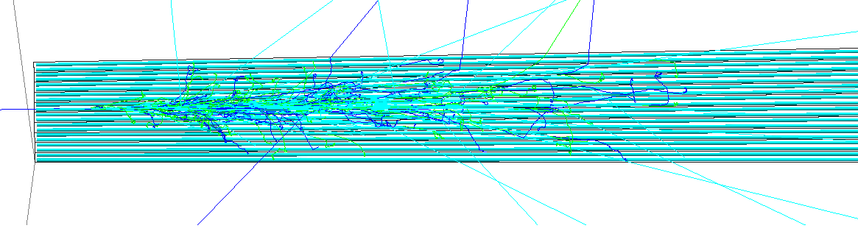
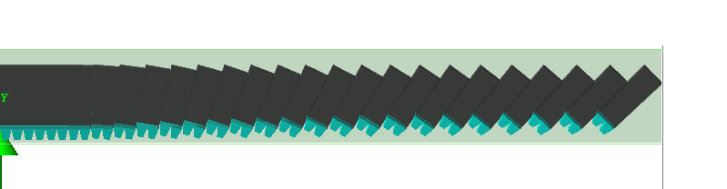
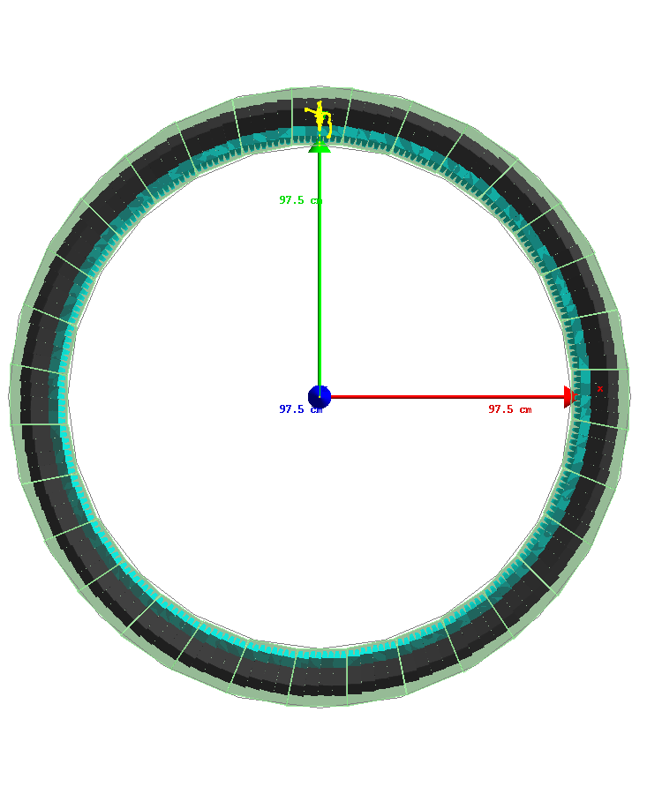
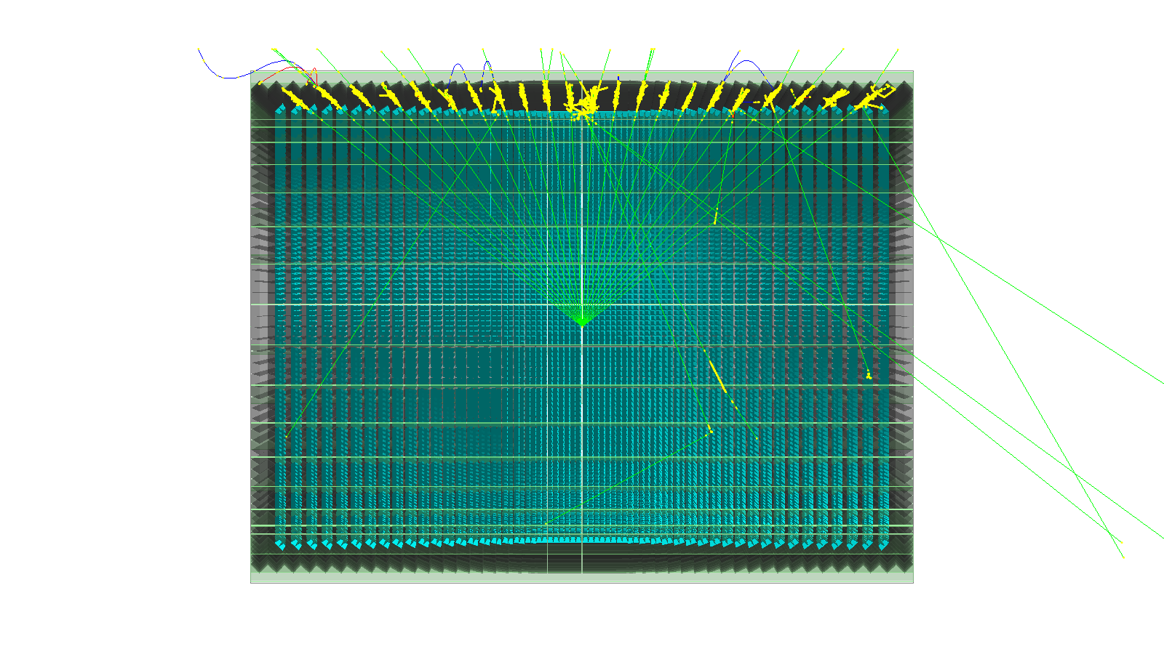
Simulation Setup: EMCal
2 cm
10GeV, e+
SPACAL Tower w/ fibers displayed
EMCal Half Sector
(fibers simulated but hidden from display)
8 GeV photons in full EMCal
Side view/beam view

Slide 4
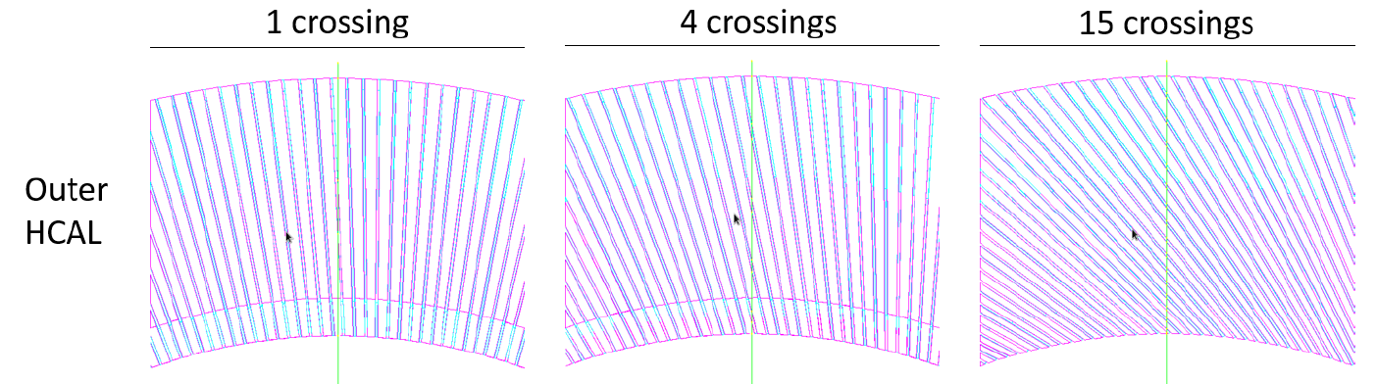
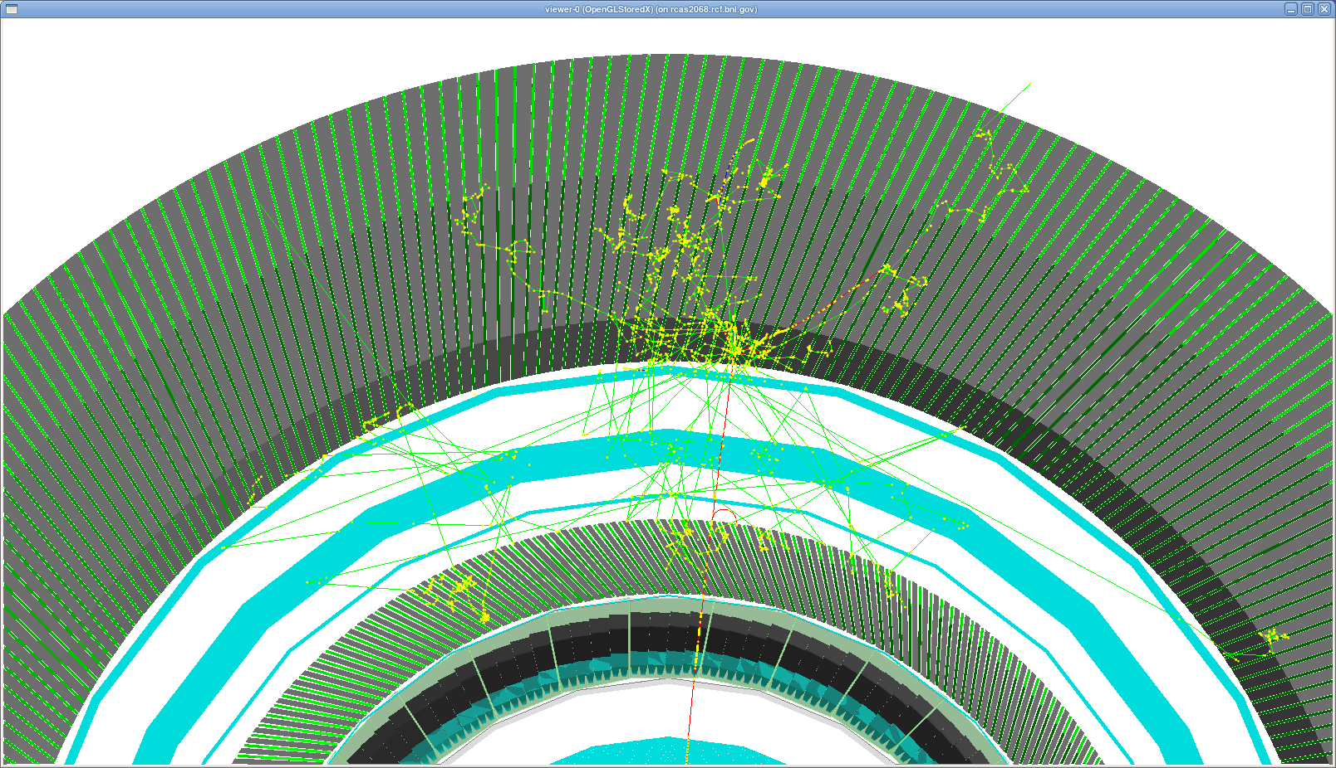
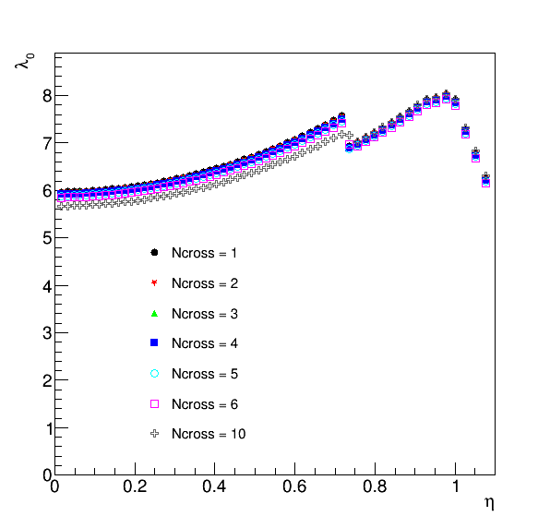
Simulation Setup: HCal
Beam view of full calorimeters
Outer HCal
Magnet
Baseline design
Inner HCal
EMCal
24-GeV pion shower
Calorimeter simulation & analysis chain: GEANT4 hit → Scintillation light model → Light collection model → Tower readout → Digitization → Calibrated tower energy → Clustering/Track matching/Jet finding

Slide 5
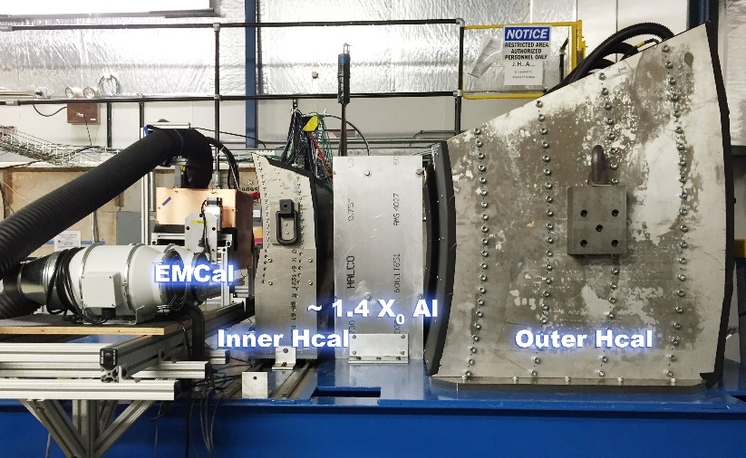
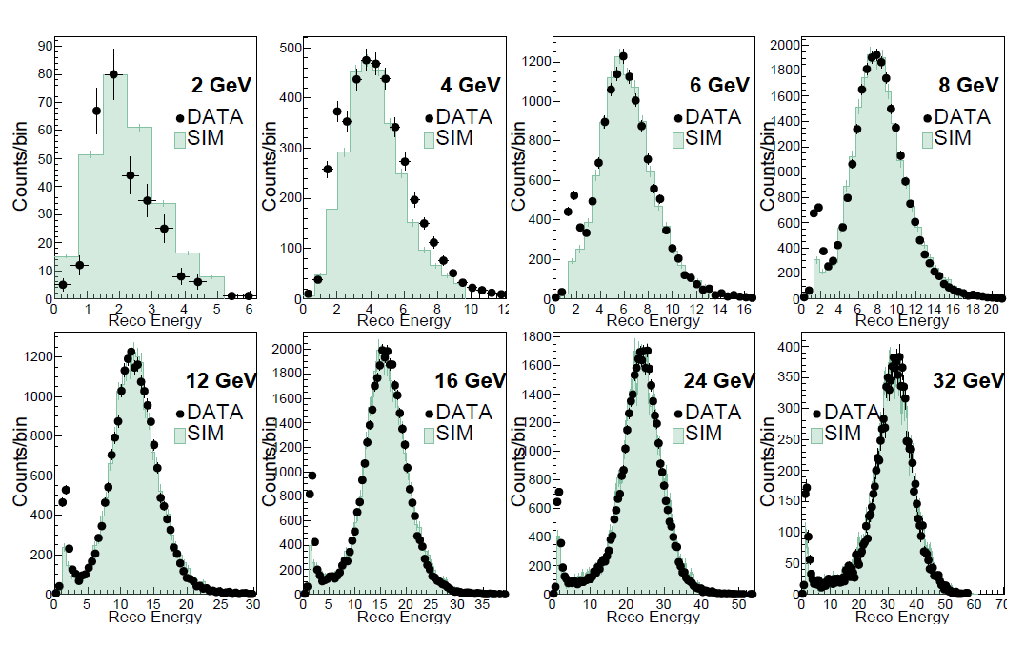
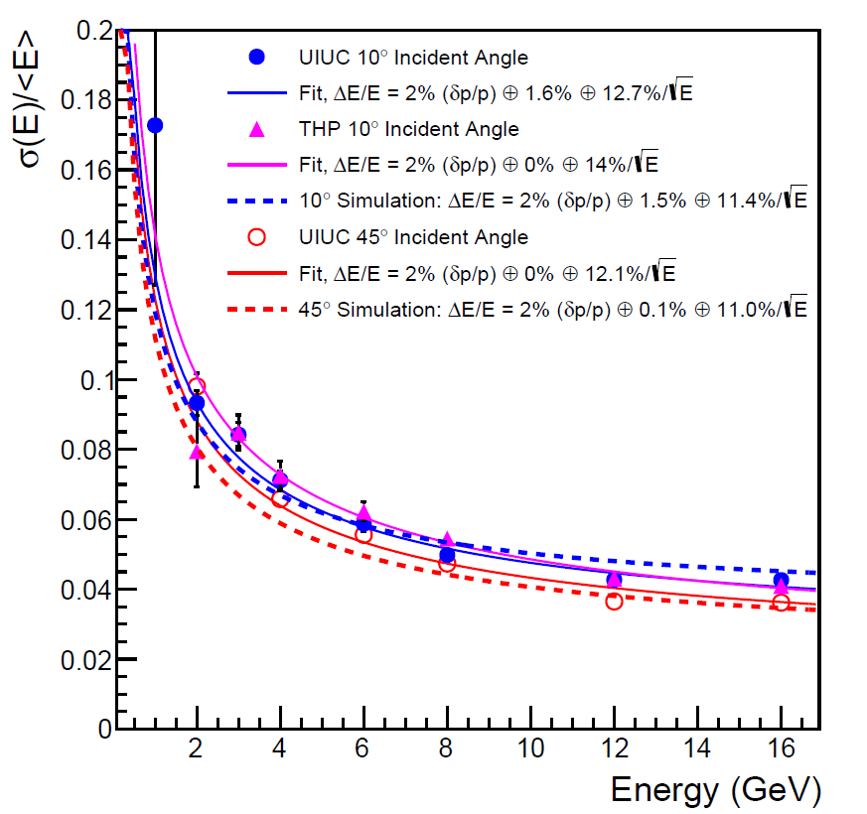
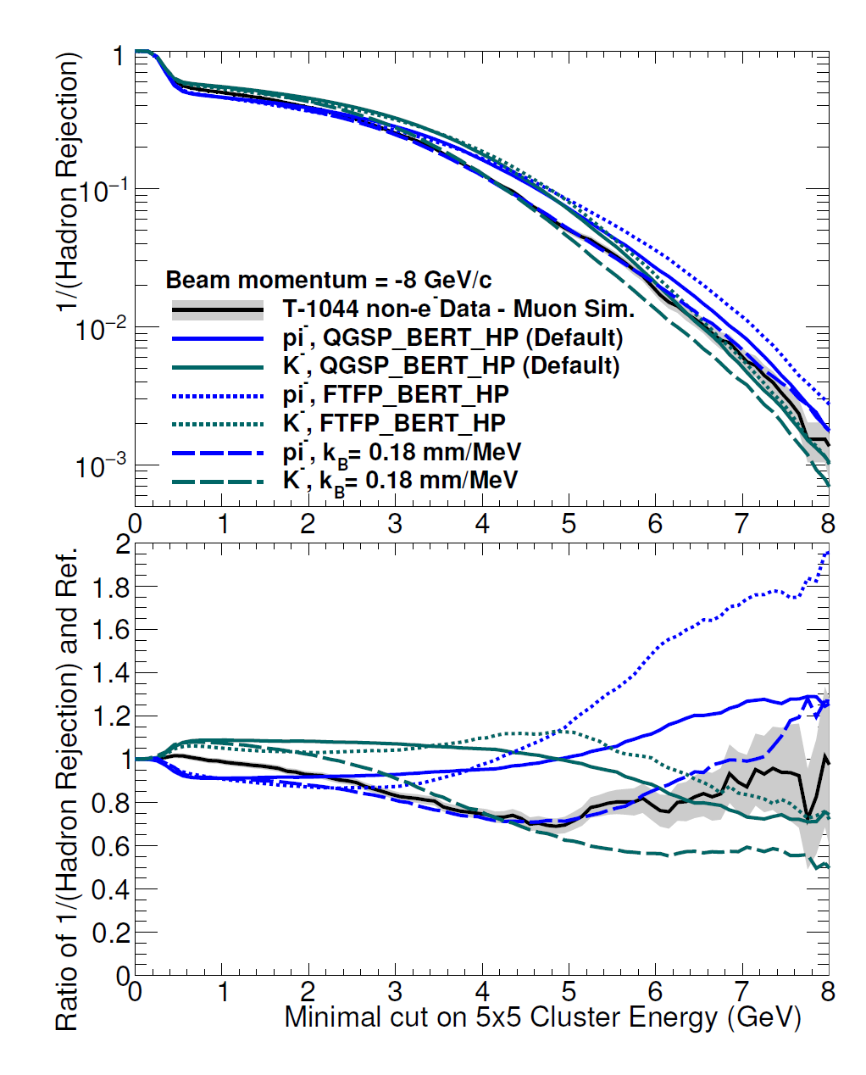
Test Beam Verification [arXiv:1704.01461]
Geant4 World
EMCal energy resolution for EM shower in tower center
EMCal rejection for pion-
HCal energy response for pion-
sPHENIX beam test data
sPHENIX beam test data

Slide 6
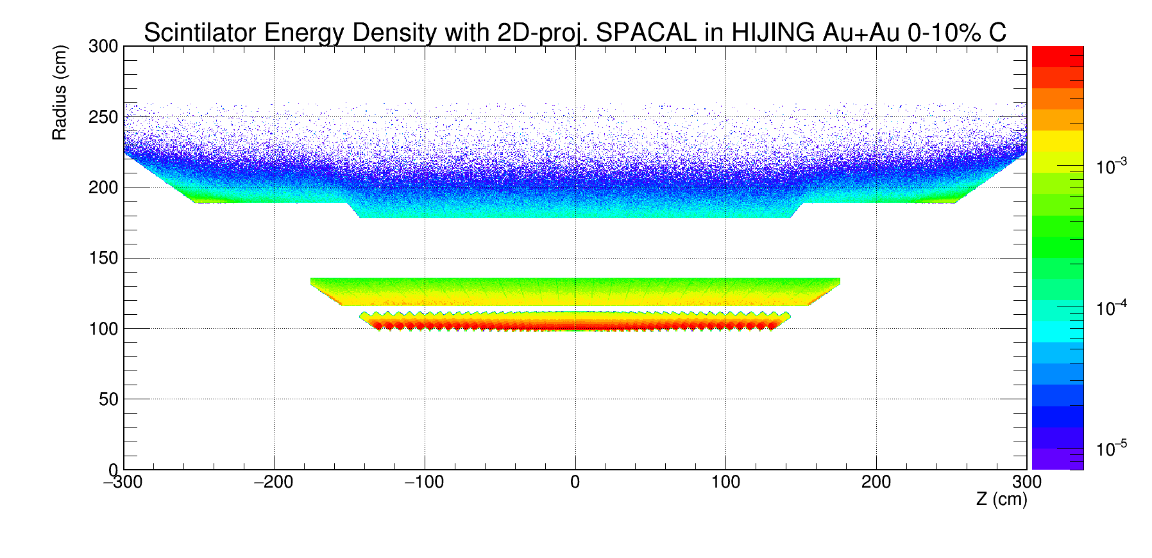
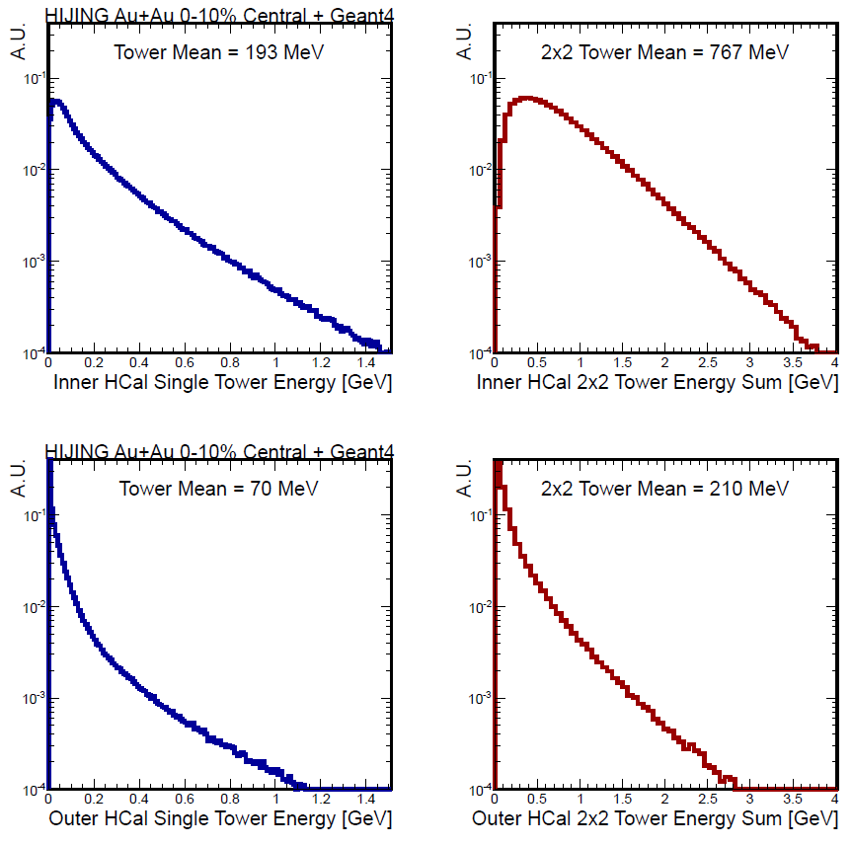
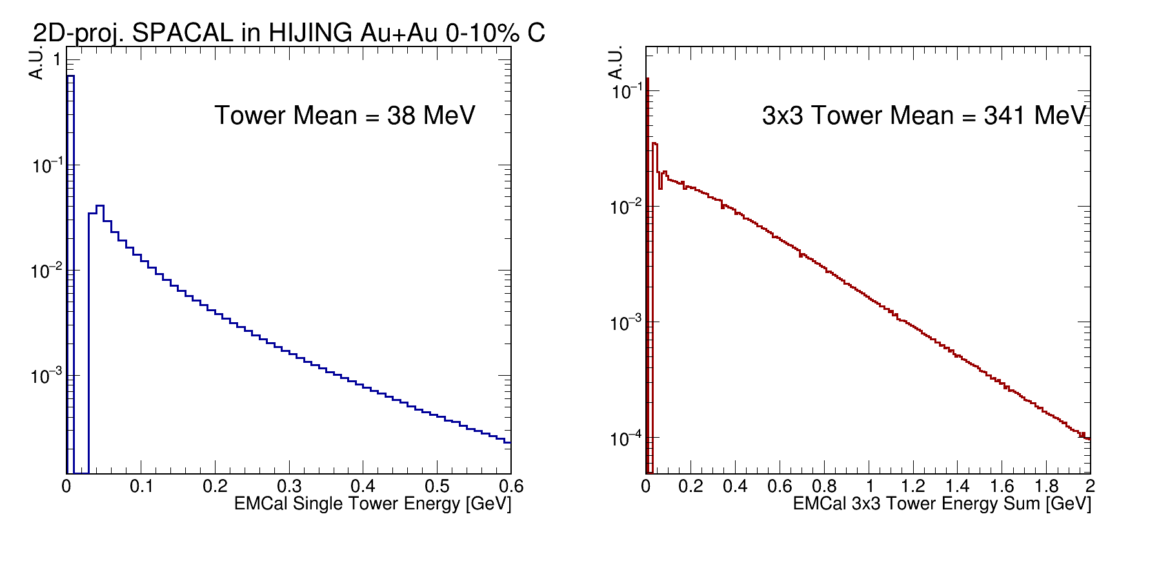
Occupancy in Central Au+Au Events
sPHENIX is designed to handle large background environment of central AuAu collisions
Such background is simulated with HIJING → full detector in Geant4 → full analysis chain
Taken into account for electron ID and jet performance via embedding
Outer HCal
Inner HCal
Inner HCal
EMCal
EMCal
Outer HCal

Slide 7
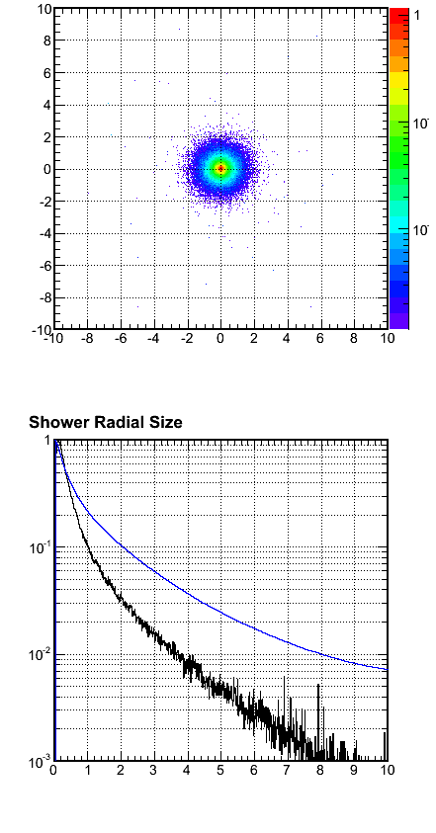
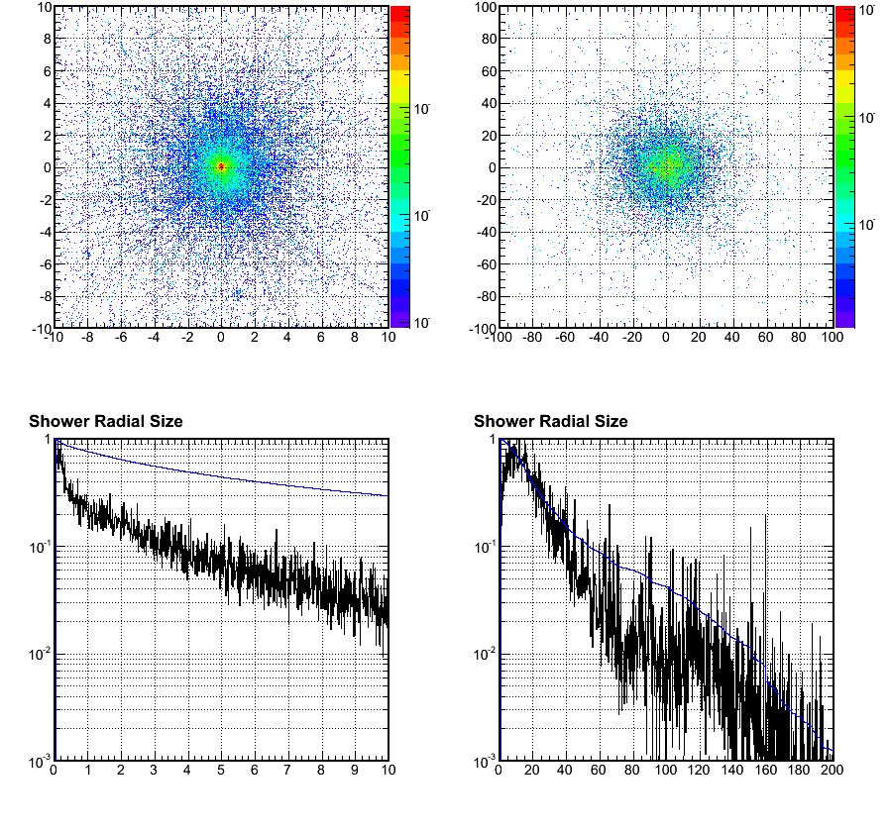
Spatial responses
EMCal design has a tight Moliere radius of 2 cm → Reduce background in Au+Au
4 GeV Electrons
4 GeV Pions, that passed E/p electron-ID cut
EMCal
EMCal
Inner HCal
EMCal Y (cm)
EMCal Y (cm)
Inner Hcal Y (cm)
EMCal X (cm)
EMCal X (cm)
Inner HCal X (cm)
― Energy deposition (A.U.)
― Percentage outside radius
A.U./Leakage Ratio
← Moliere radius, 2cm
A.U./Leakage Ratio
A.U./Leakage Ratio
← 3x3 tower
95% containment
← 3x3 tower
50% containment
← ~3x3 tower
60% containment
EMCal radius (cm)
EMCal radius (cm)
Inner HCal radius (cm)

Slide 8
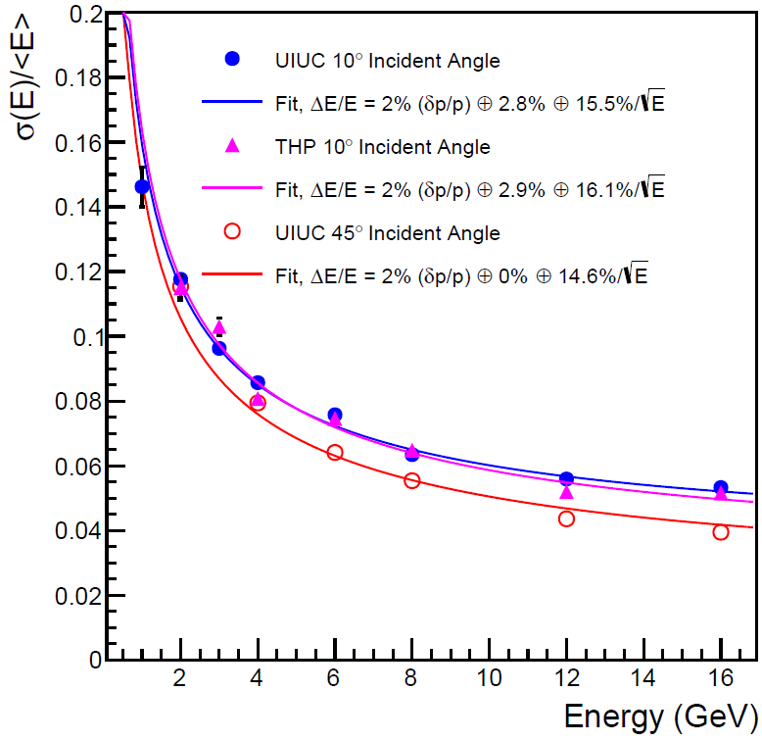
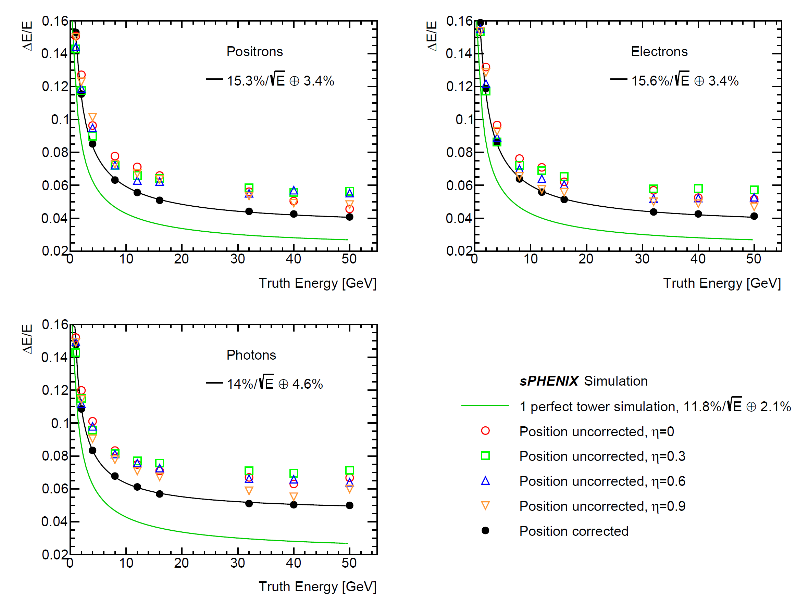
Performance : Single EM Showers
Applied cluster-position-based non-uniformity correction as used in test beam analysis
dE/E ~ 15%/ √(E) + 4% (meets sPHENIX goal)
Beam test [arXiv:1704.01461] Full sPHENIX detector simulation
sPHENIX beam test data

Slide 9
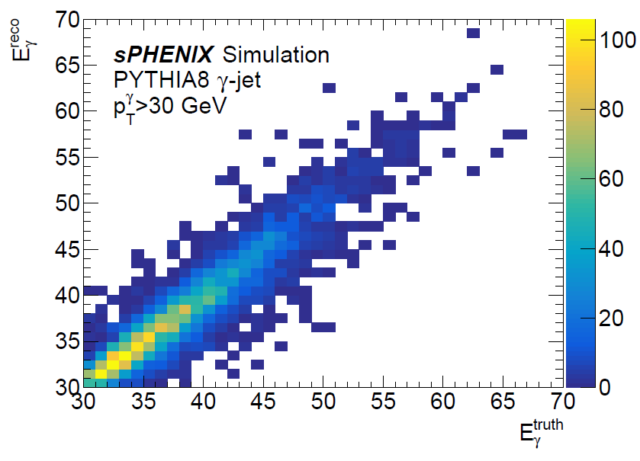
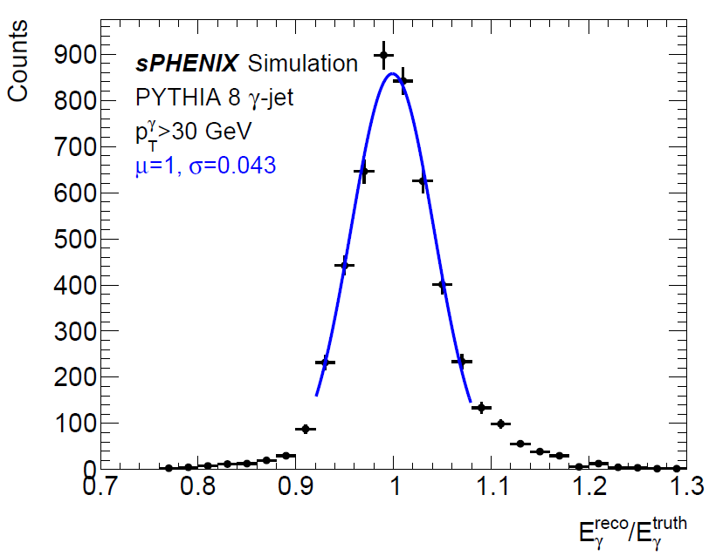
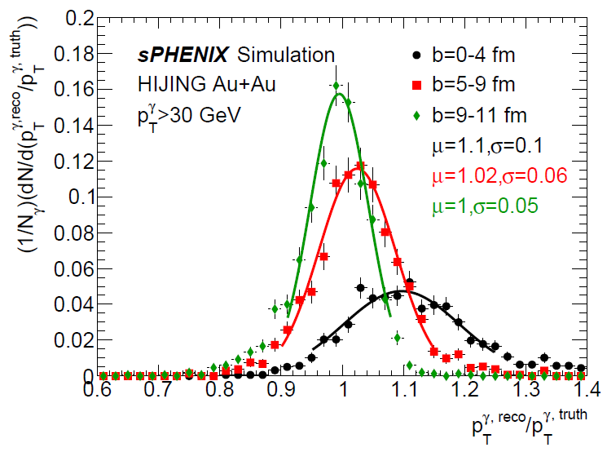
Performance : Photon in Full Event
Good linearity up to photon kinematic limit of sPHENIX
Good photon response shown in full gamma-jet event simulations
In progress: improving clustering algorithm to minimize background pickup in central Au+Au collisions.
Nevertheless, jet energy resolution dominates precision for gamma-jet momentum balance measurements

Slide 10
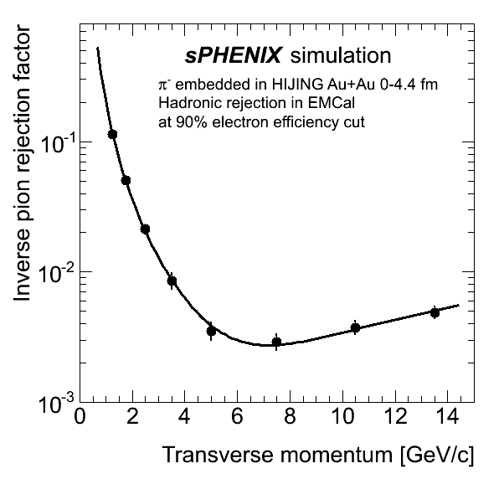
Physics Performance : Electron-ID
Critical driving factor for EMCal design: Upsilon electron ID
Satisfied detector requirement (>90:1-pion rejection @ p_{T}=4 GeV/c in central Au+Au collisions at 70% efficiency)
Updating Upsilon background and R_{AA} projections
Pion rejection @ (improved) 90% efficiency
Upsilon R_{AA} projections in sPHENIX proposal
Assuming 100:1 pion rejection @ 70% e-eff.
Updating ...
arXiv:1501.06197

Slide 11
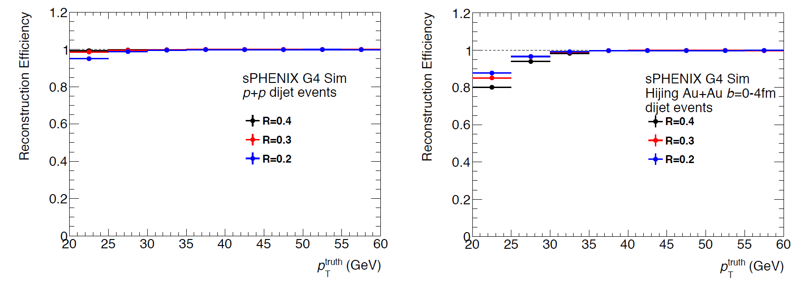
Performance : Jet Finding
Jets in p+p and central Au+Au collisions are also studied in full detector simulations
Jet finding followed by iterative background subtraction [10.1103/PhysRevC.86.024908]
Study are in progress updating the jet performance plots as in sPHENIX proposal
Preliminary results show good efficiency (>80% for p_{T}>20 GeV/c jet in central Au+Au collisions)
Further improving underlying event subtraction and fake-jet rejection algorithm based on RHIC and LHC experiences

Slide 12
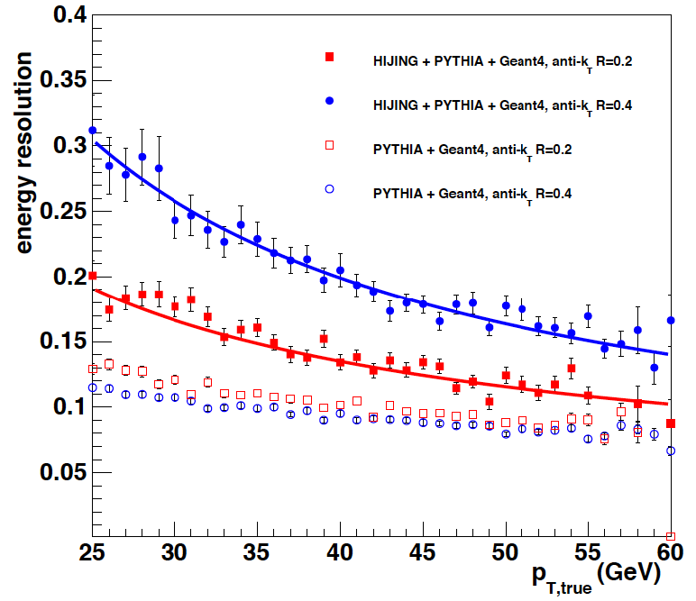
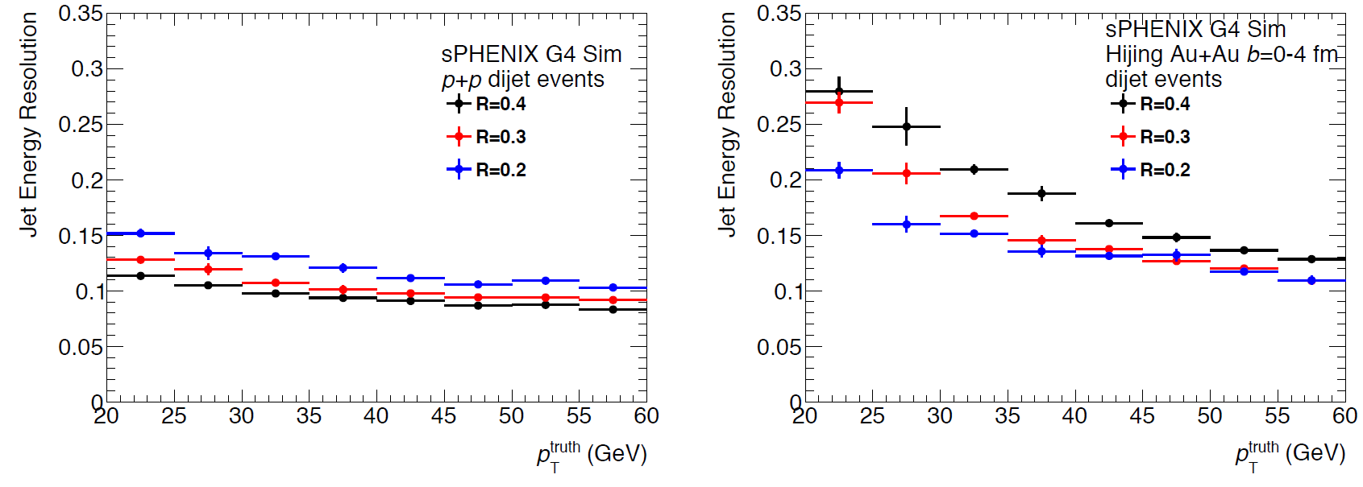
Performance : Jet Energy Resolution
sPHENIX proposal [arXiv:1501.06197]
Detector simulations has been updated with detailed engineering design and beam test tunings
Study are in progress, results are still preliminary
Preliminary energy resolution was found consistent with simulation study as in sPHENIX proposal [arXiv:1501.06197]
Full detector simulation with the current design

Slide 13
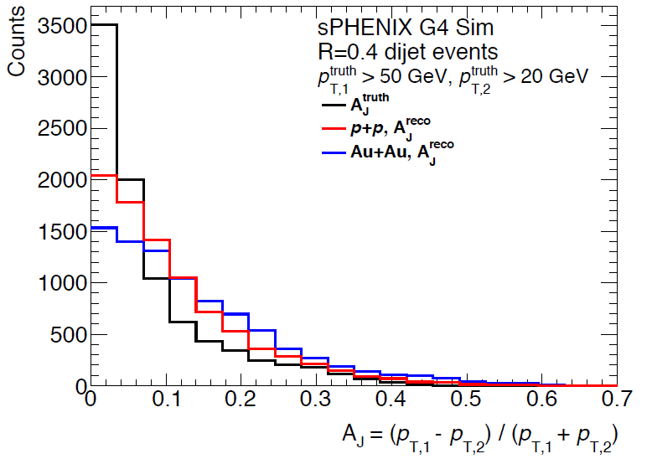
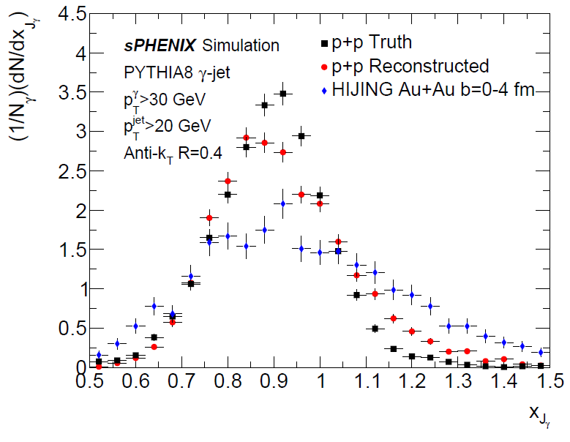
Physics Performance : Jet Observables
Jet-balance/imbalance observables simulated in full detector events: day-1 measurement, resolution under control
On-going effort in understanding the details of the jet simulations and unfolding studies.
Expanding jet observables studied with the updated design and simulations
Di-jet transverse momentum asymmetry
γ-jet transverse momentum balance

Slide 14
Summary
A detailed model of the sPHENIX calorimeter has been implemented in GEANT4 and used for design and performance studies
Good agreement with test beam data
Calorimeter performance achieves the scientific goals
Work in progress to update reconstruction algorithms and the physics performance plots with refined detector design and simulation

Slide 15
Extra information

Slide 16
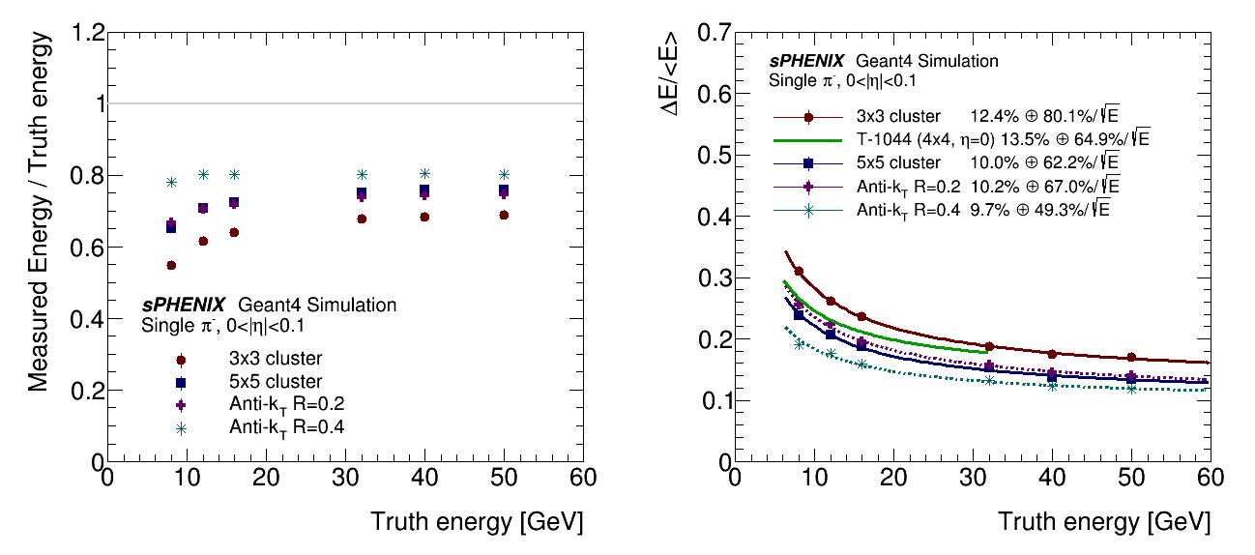
HCal simulation verification
HCal prototype @ eta = 0 energy response for pion-
T-1044 test beam and simulation
arXiv:1704.01461
Full sPHENIX energy response for pion-

Slide 17
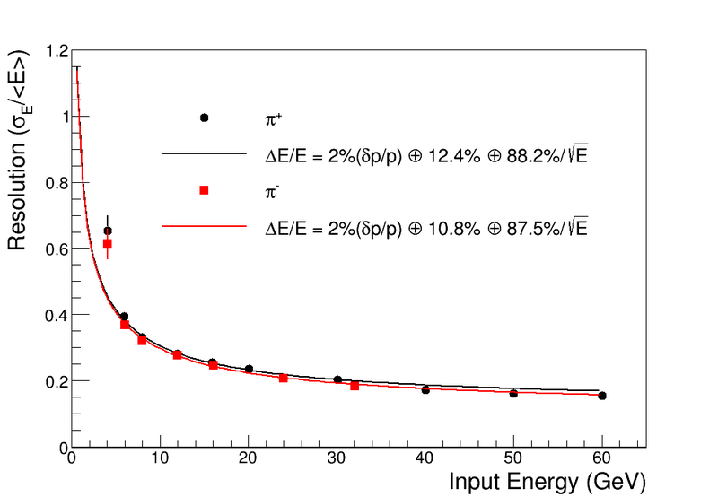
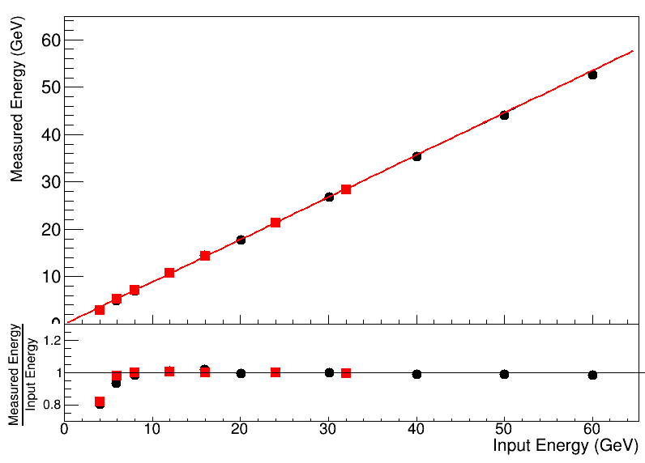
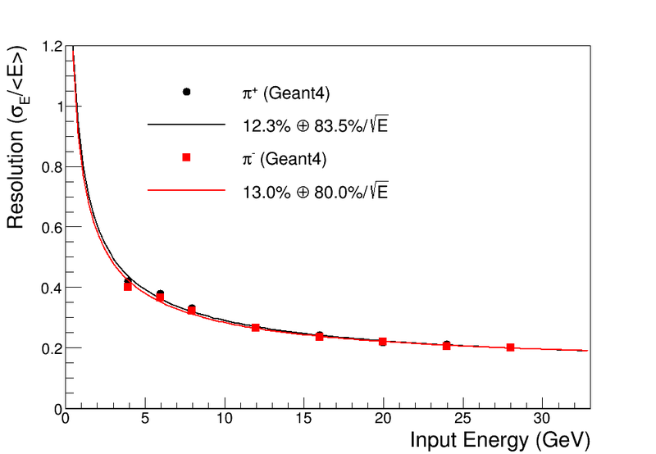
HCal prototype 3 @ η = 1
sPHENIX beam test data, Inner + Outer HCal
sPHENIX beam test data, Inner + Outer HCal
sPHENIX beam test simulation, Inner + Outer HCal

Slide 18
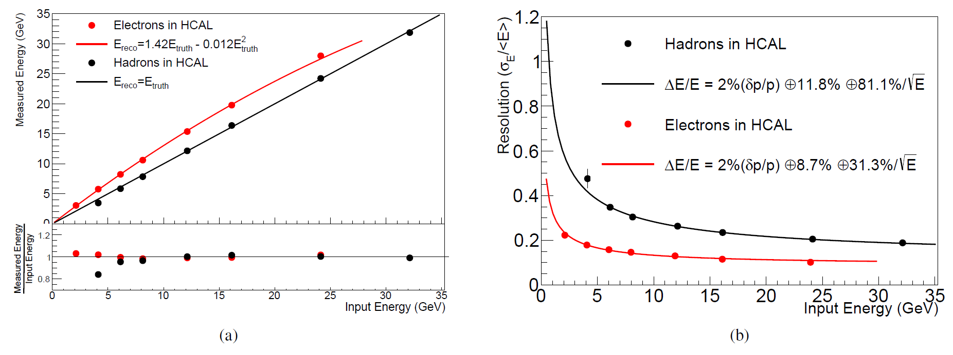
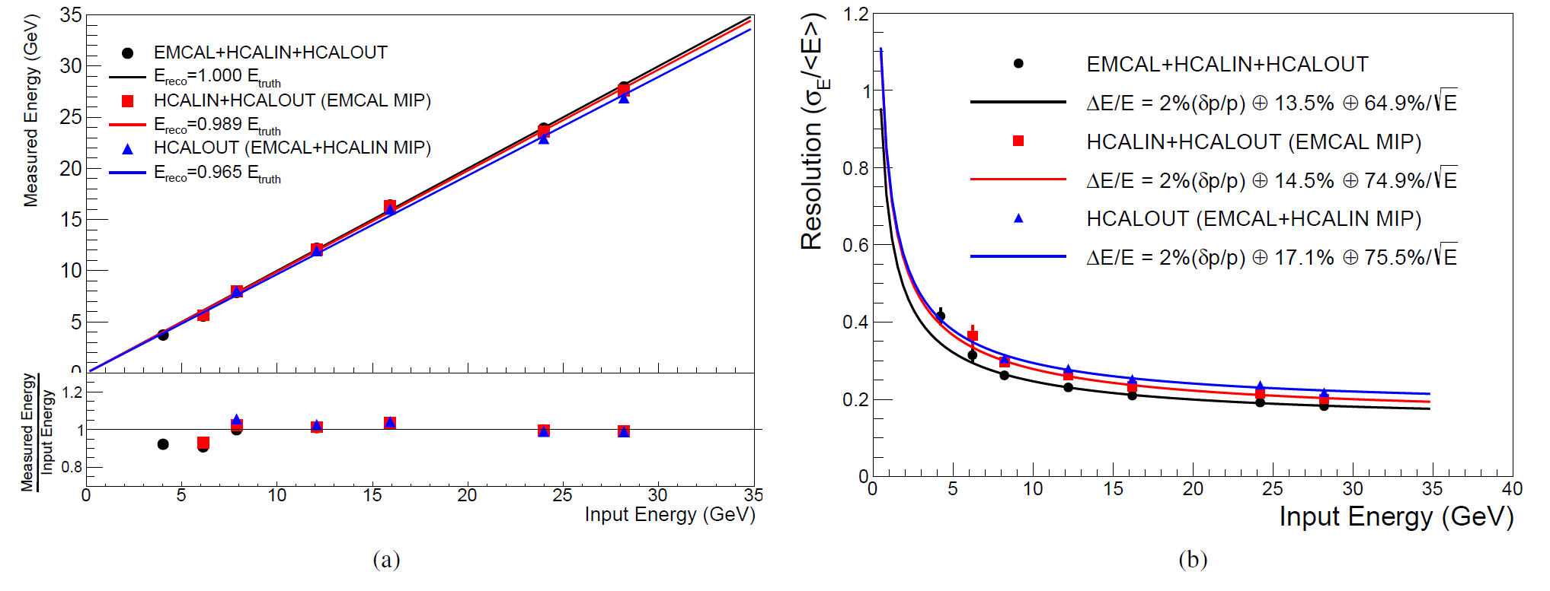
HCal prototype 2 @ η = 0

Slide 19

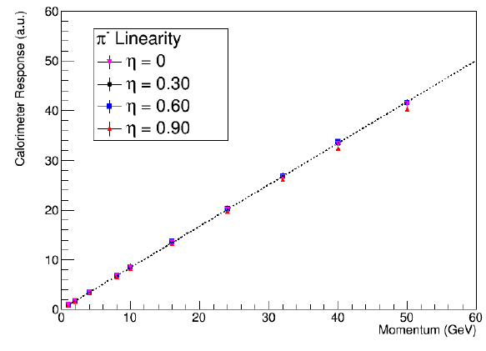
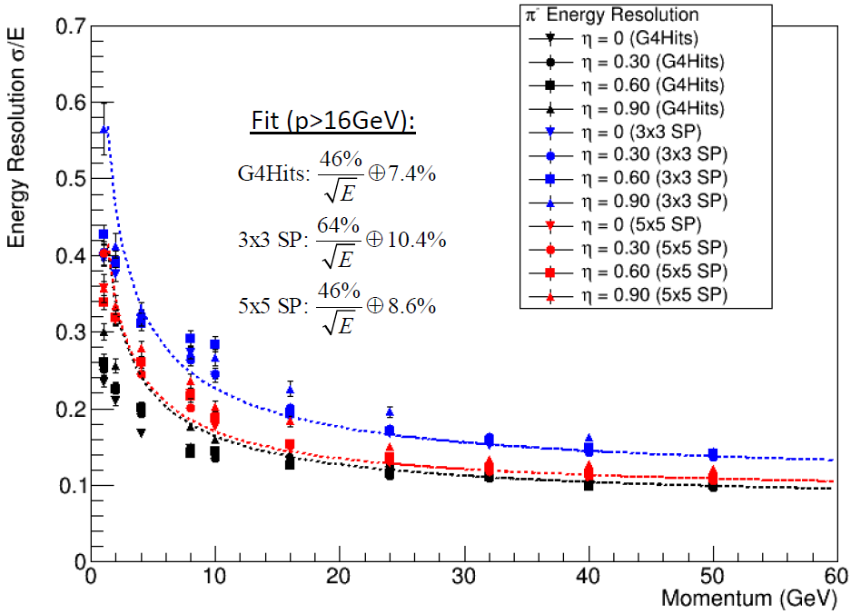
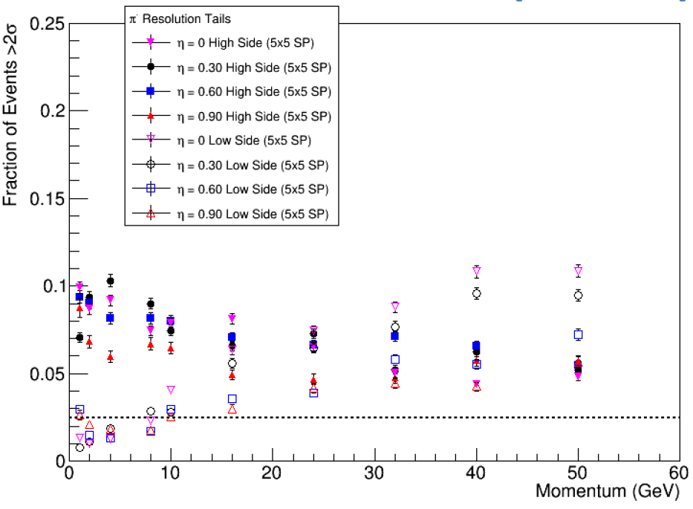
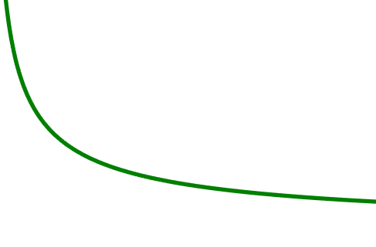
Performance : Single Hadron showers
Single pion shower studied with clusters of digitized towers (3x3 and 5x5 clusters), which is compared with ideal sum of Geant4 hit in scintillator (label G4Hits)
Energy resolution satisfied design goal. Tails <= 10%
Linearity
Energy resolution
Single-side tail
10% stat. in each tail
Requirement: 100%/√E ⊕ 10%
2.5% stat. in tails as expected from Gauss shape

Slide 20
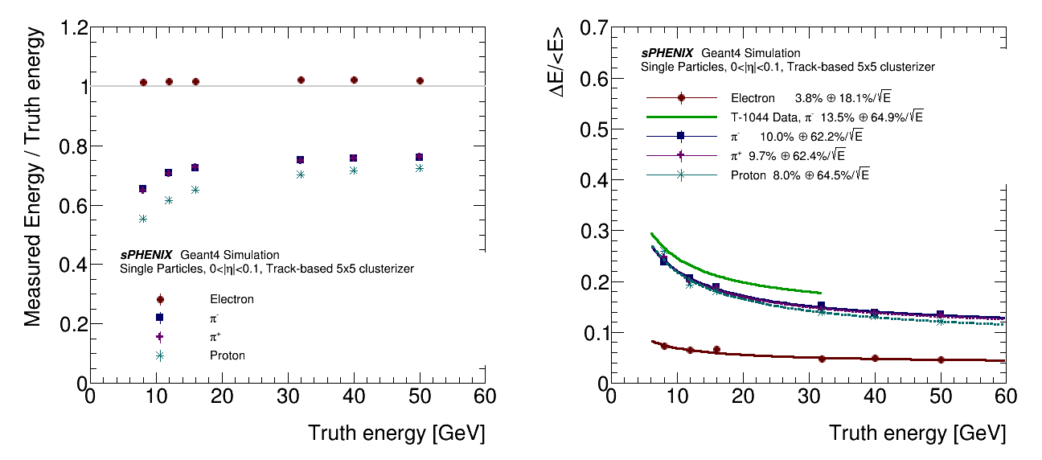
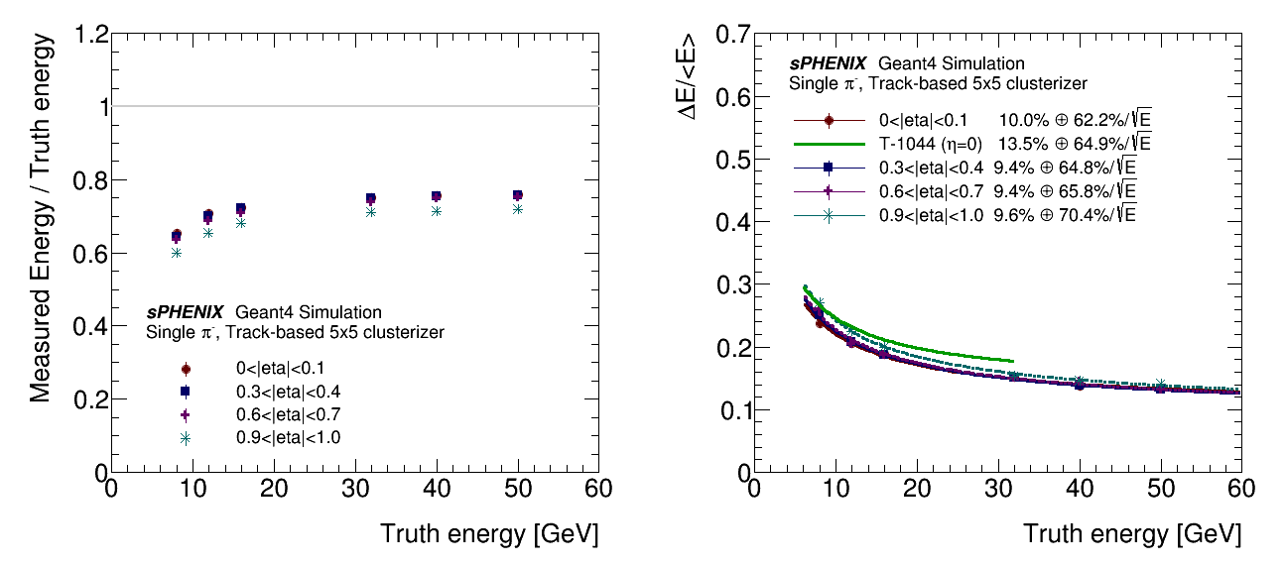
Performance : Single Hadron showers

Slide 21
Jet energy response and scale
Fig 5

Slide 22
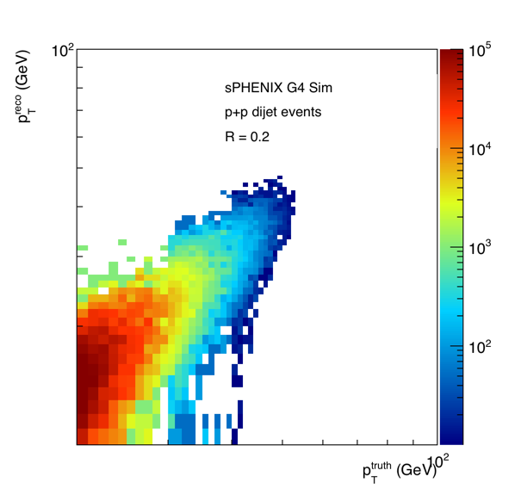
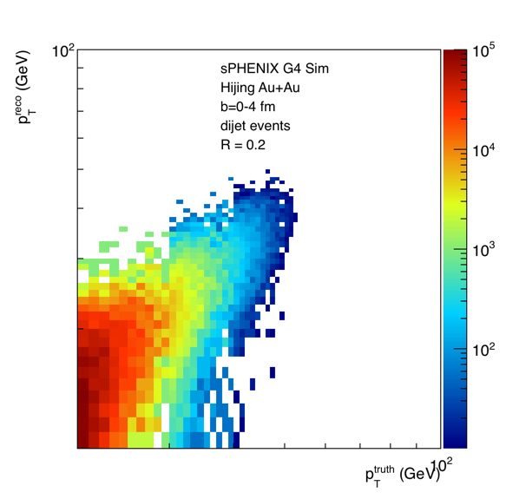
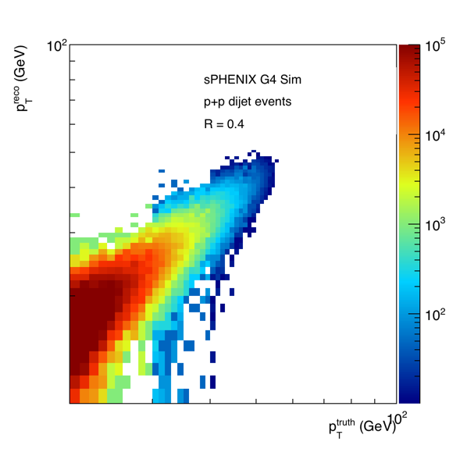
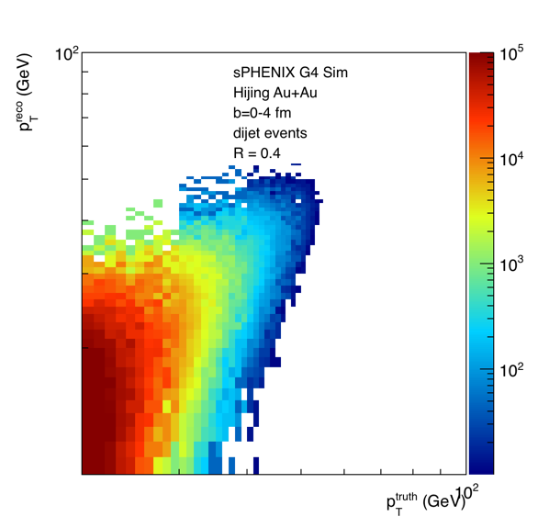
Jet and di-jet response

Slide 23
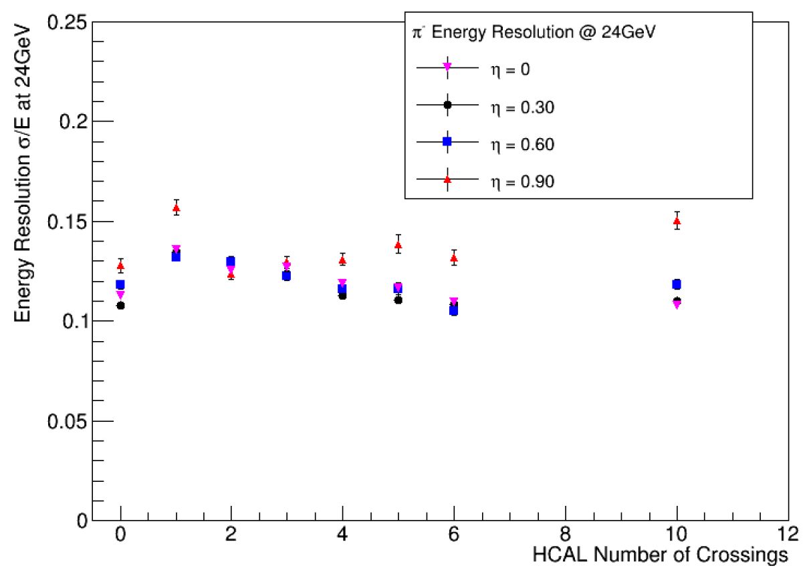
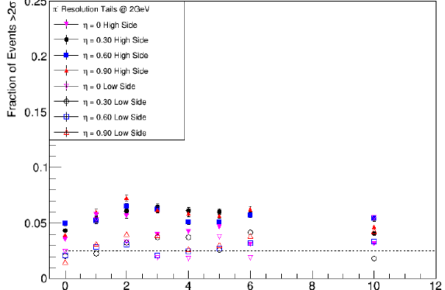
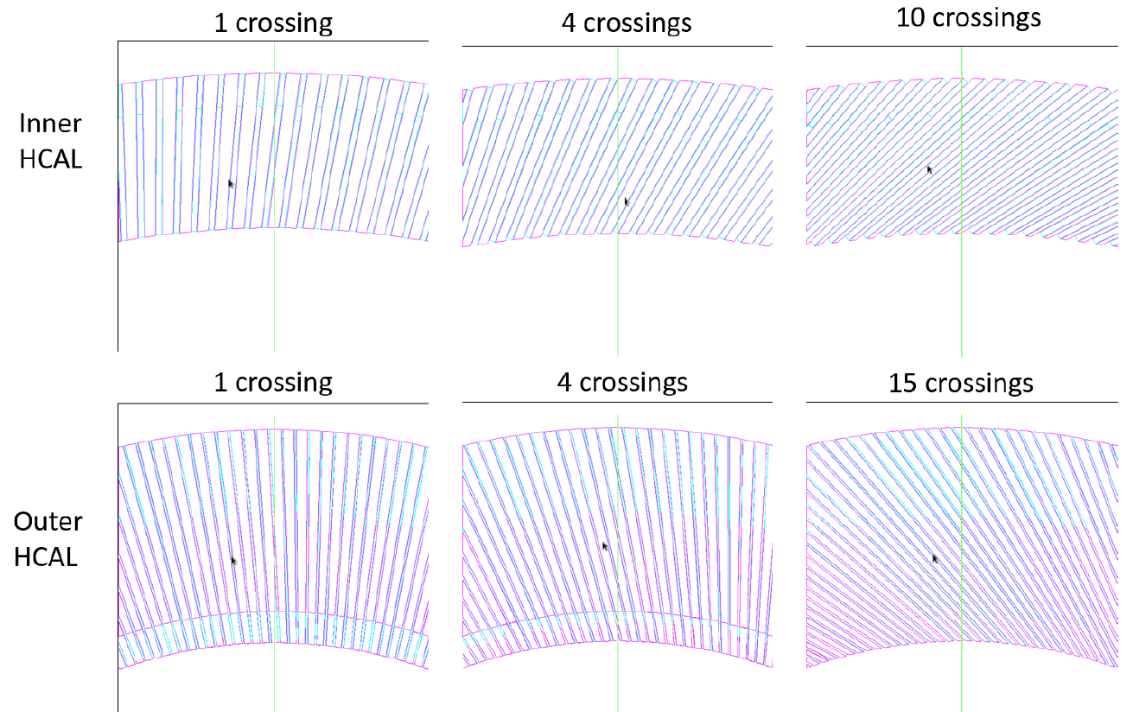
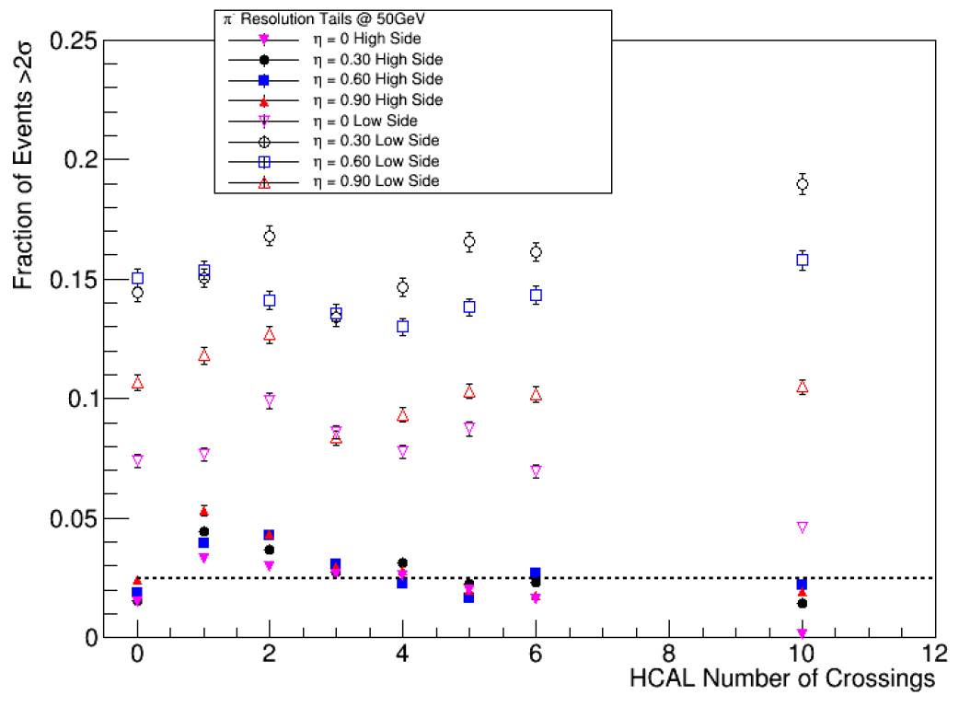
Tilt angle optimization
Performance not a strong function of tilt angle of Hcal iron plates
Baseline design (4-crossing tilt angle) is a reasonable choice
24GeV π⁻ ΔE/E
2GeV π⁻ tail
Baseline design
Reasonable Range
Baseline design
50GeV π⁻ tail
Hcal #-of-crossing

Slide 24
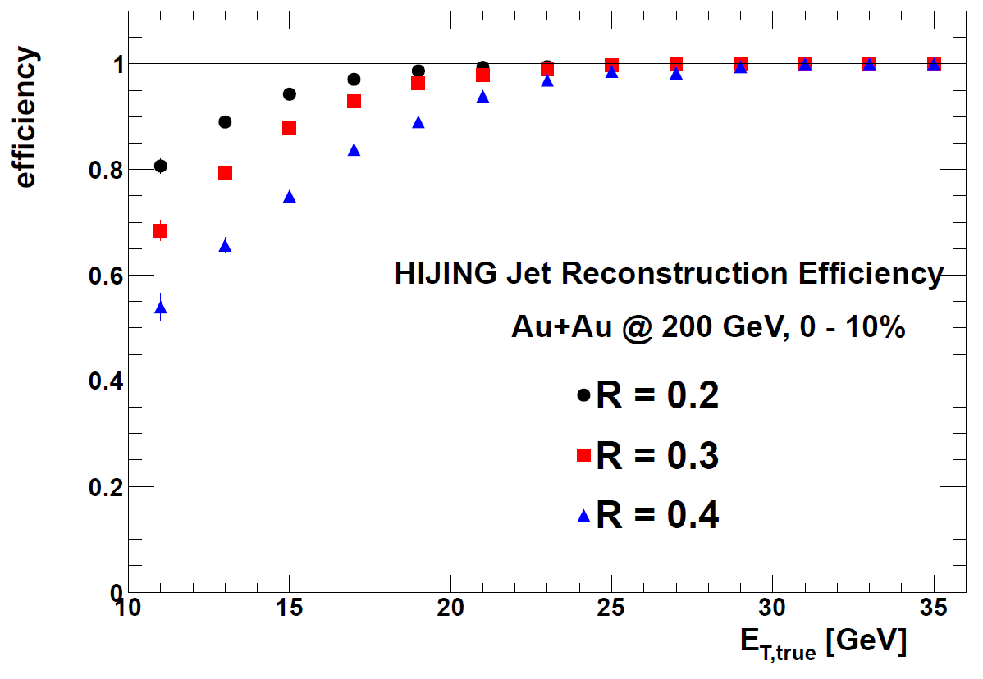



Fast simulation for Jets in central Au+Au
Algorithm developed based on ATLAS and CMS heavy ion experience
Good efficiency and purity
Resolution/tails fit for unfolding jet spectrum
Need to keep updated as detector design/performance evolves
p_{T} (GeV)

