Slide 1
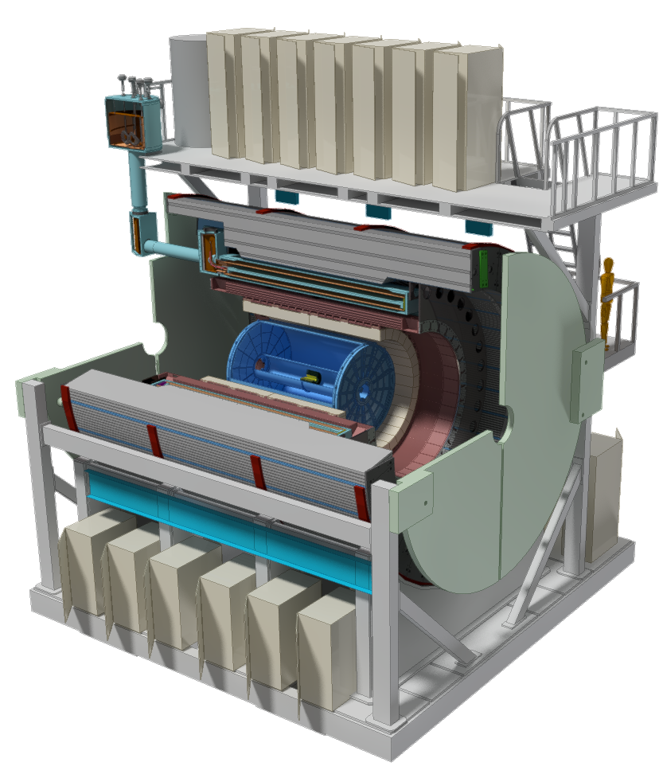
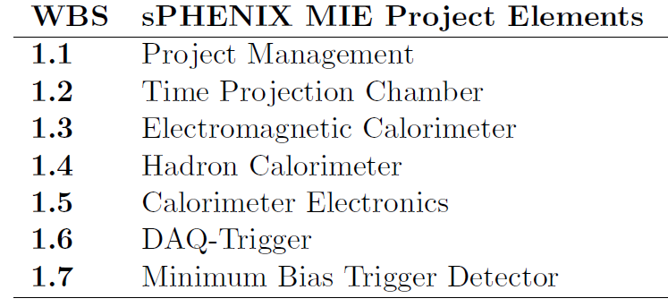
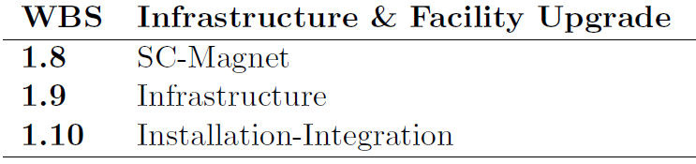
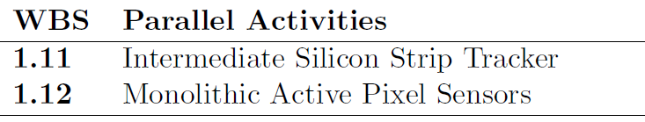

Inner HCAL WBS 1.4.2
(inner)
John Lajoie
Iowa State University

Slide 2
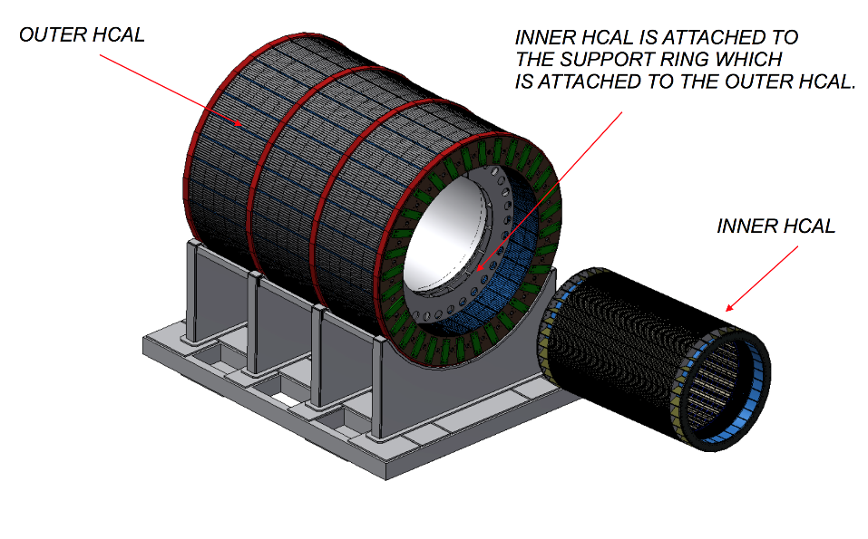
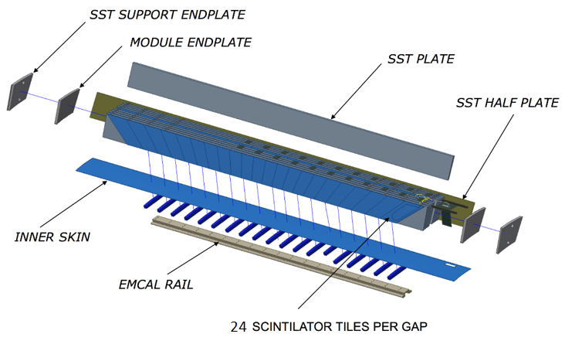
Inner HCAL
DELIVERABLE:
32 sectors - 1.16m inner radius, 1.37m outer radius
8 rows of 7mm scintillator tiles (24 tiles per row)
32º tilt angle, flat stainless steel plates ~10.2mm - ~14.7mm
Completed sector is 4.3m long, weighs ~ 1 ton
Flat SS310 steel plates
Half plates on sides
4 scintillators/tower
48 towers per module
32 modules; 1536 channels
(6144 SiPMs)

Slide 3
HCAL Performance Specifications
HCAL performance driven by jet physics in HI collisions
Uniform fiducial acceptance -1<η<1 and 0<φ<2π
Extended coverage -1.1<η<-1.1 to account for jet cone
Absorb >95% of energy from a 70 GeV jet
Requires 5.5 nuclear interaction length depth
Hadronic energy resolution of combined calorimetry:
with constant term <15%
Gaussian response (limited tails)
Performance optimized/demonstrated in three test beams
Inner HCAL is inside superconducting solenoid
Must be made of non-magnetic material

Slide 4
Design Drivers
Why an inner and outer HCAL segment?
Size limitations set by existing interaction hall
Set by radius of BaBar solenoid, the design of the mechanical support for the detector, and overall cost effectiveness
Why a tilted plate design?
A tilted plate design can provide a uniform acceptance, adequate energy resolution and simplified construction
How are the tilt angles chosen?
Chosen to avoid channeling (tails in resolution function)
Why Δη x Δφ ≈ 0.1 x 0.1?
Driven by occupancy in Heavy Ion collisions
Good match to scale of hadronic jets

Slide 5
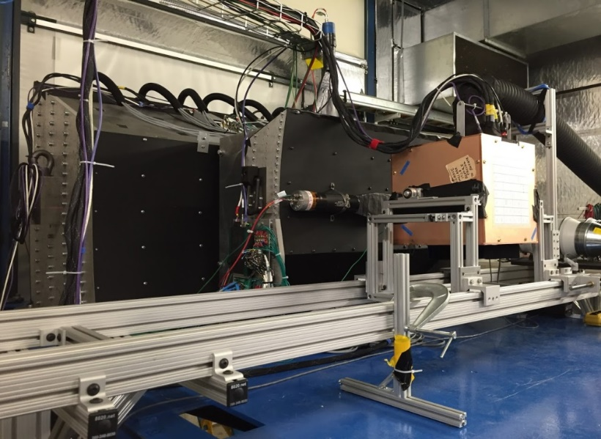
Test Beam Performance
Simulated Magnet
Three test beams (2014/15/16):
EMCAL
IHCAL
Beam
OHCAL
In all cases, the combined system meets the sPHENIX spec!

Slide 6
Personnel
BNL
Edward Kistenev (scientist)
Don Lynch (engineer)
Rich Ruggiero (designer)
Anatoli Gordeev (engineer, OHCAL L3)
ISU
J. Lajoie (L2 Manager/IHCAL L3)
Colorado (tile testing)
J. Nagle (faculty)
GSU (tile testing, outer HCAL)
Megan Connors (faculty)
Xiaochun He (faculty)
WSU
Bill Llope (faculty)
Joern Putschke (faculty)
ACU
Rusty Towell (faculty)
Rutgers
Sevil Salur (faculty)
In discussions with Russian institutions (MEPHI/IHEP/Kurchatov)
BNL engineering has decades of experience with PHENIX.
ISU was responsible for the PHENIX LL1 trigger and MPC-EX.
WSU has a wide range of experience in building detectors.
ACU worked on the PHENIX MuTR chambers.

Slide 7
Schedule Drivers
Sector Mechanical Prototypes: 3-9/2017
Prototype v2.1 Test Beam: 2/2018 – 3/2018
Inner HCAL Production: 11/2019 – 7/2021 (CD3b)
Mechanical sectors produced every 15 working days
University assembly (scintillator/electronics/testing) keeps pace
Shipped in groups of four to BNL; sectors retested
Production schedule integrates availability of electronics/SiPMs
(WBS 1.5).
Schedule slip in assembly can be addressed by adding additional University labor.
24

Slide 8
Resources/Cost Drivers
SS310 steel is essentially a commodity material but precision machining is expensive
Cost dominated by production of sector mechanicals
Scintillator tile production
Surface flatness over long distances a key specification
Wrapped tile thickness < 7.5mm, Uniplast can meet this spec.
Uniplast (T2K, PHENIX)
FNAL/Elgen also investigated, Uniplast most economical for complete tile assemblies
Module Assembly and QA
Assemble inner HCAL at multiple university sites
Make use of university labor and facilities
Deliver assembled, cosmics tested sectors to BNL

Slide 9
Basis of Estimate
The Inner HCAL will be assembled at two (or more) University sites.
ISU, WSU and ACU have expressed interest
Rutgers may provide some machined parts
Sector assemblies provided by local vendors, populated with scintillator and electronics by University labor
Shipped to BNL, tested after shipping and stored.
IHEP Protovino investigating construction alternatives
Costs in BoE are based on:
Experience with test beam prototypes
Experience with sector prototypes
Quotations
Engineering estimates (Inner HCAL End Ring)

Slide 10
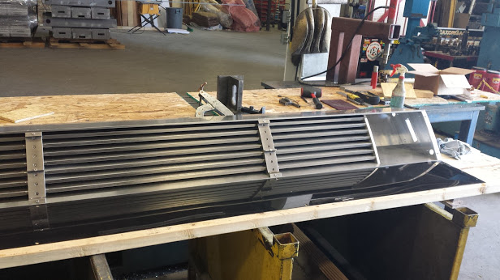
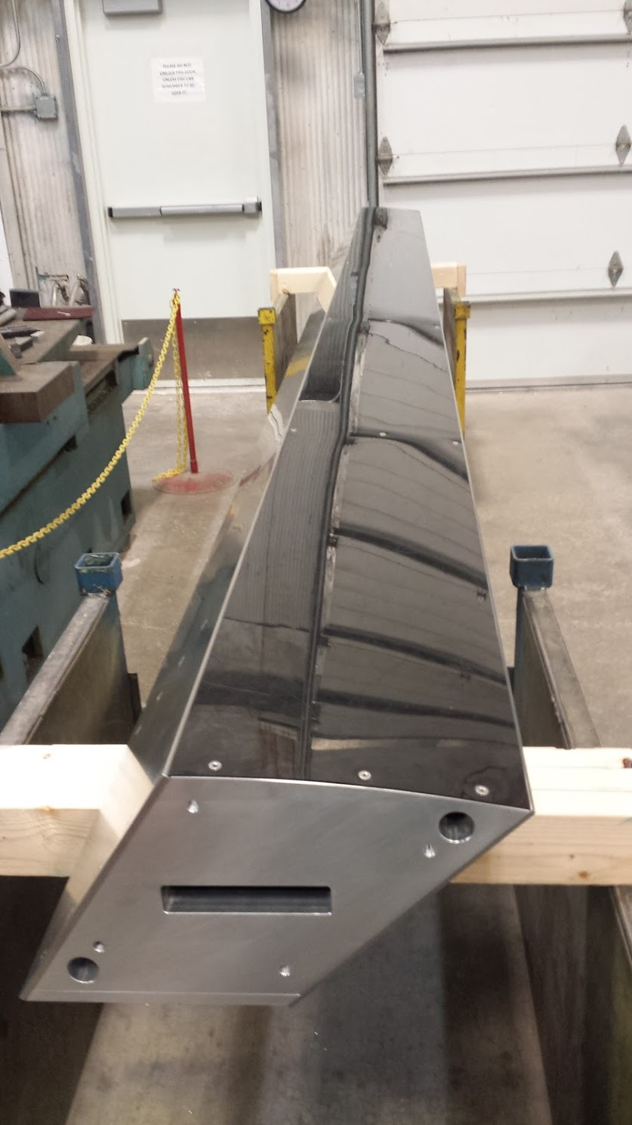
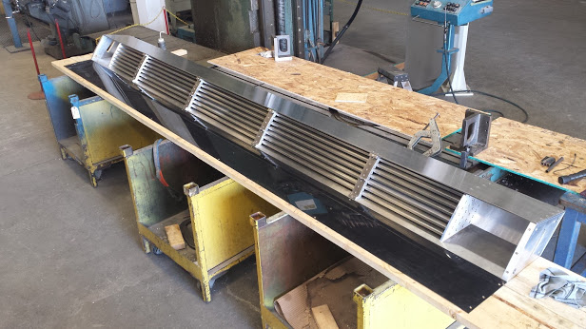
Sector Prototype
Light cover (reflection)

Slide 11
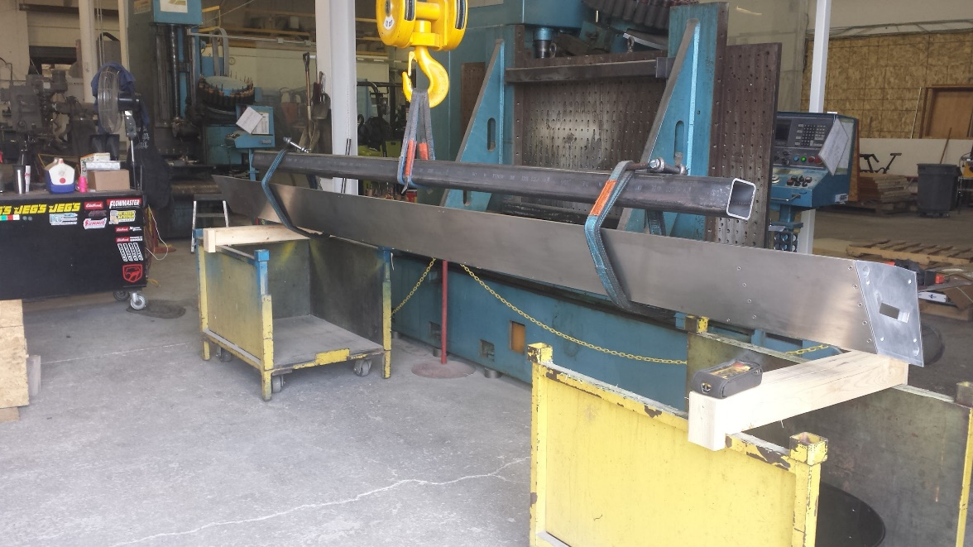
Assembled Sector Measurements
In lifting fixture
Assembled sector moved to mill table, supported on ends (4 blocks). Twist and sag in middle measured @ 70ºF.
“Back” sags more than front when unsupported (CG shifted towards back). Supported measurements show not all sag is due to weight, some could be taken out by assembling on mill table.
Similar results at 90ºF.
front
Bot. view
back
Very little twist!

Slide 12
Risk Registry/Issues and Concerns
Risk registry currently includes three major items, two of which are rated at moderate risk (all three relevant to inner HCAL).

Slide 13
Back Up

Slide 14
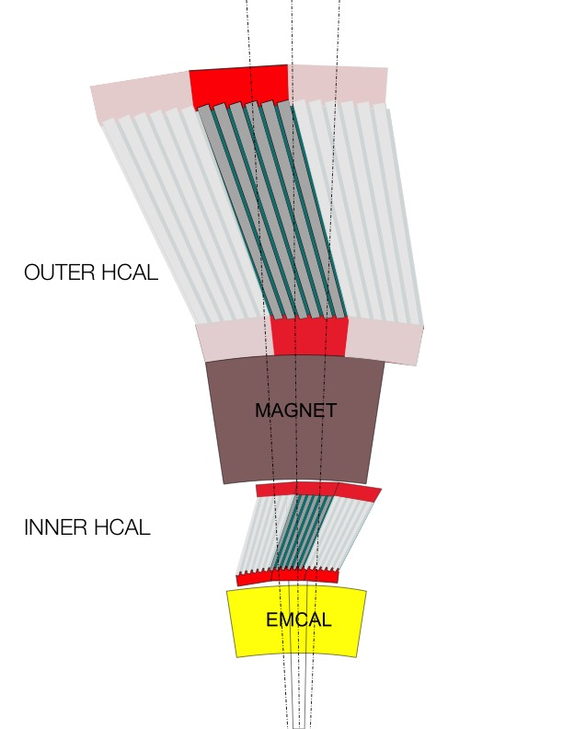
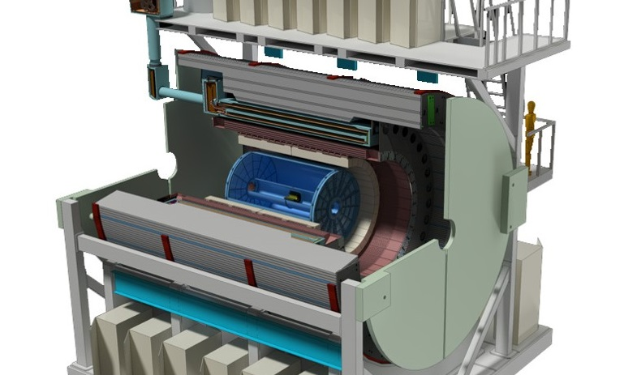
sPHENIX HCAL Description
HCAL steel and scintillating tiles with wavelength shifting fiber
2 longitudinal segments.
An Inner HCal inside the solenoid.
An Outer HCal outside the solenoid.
Δη x Δφ ≈ 0.1 x 0.1
3,072 readout channels
σ_{E}/E < 100%/√E (single particle)
SiPM Readout
Outer HCAL ≈3.5λ_{I}
Magnet ≈1.4X₀
Inner HCAL ≈1λ_{I}
EMCAL ≈18X₀≈1λ_{I}

Slide 15
Why a Sector Prototype?
Need to verify sector cost estimate ($43.6k)
Are the estimated machining times/effort reasonable?
Are there any unforeseen difficulties?
Can the manufacturing process be optimized?
Sector prototype produced by TSI in Ames, IA (contract from Iowa State)
All machining done by TSI (Jeremy Johnston), with exception of combs, which were sent out for wire EDM machining
Absorber plates were ordered ground to thickness to reduce bowing/maintain flatness

Slide 16
Sector Prototype Drawing
Baseplate and “endcaps” are Al; everything else is S310.
Note that baseplate bolts tapped at an angle

Slide 17
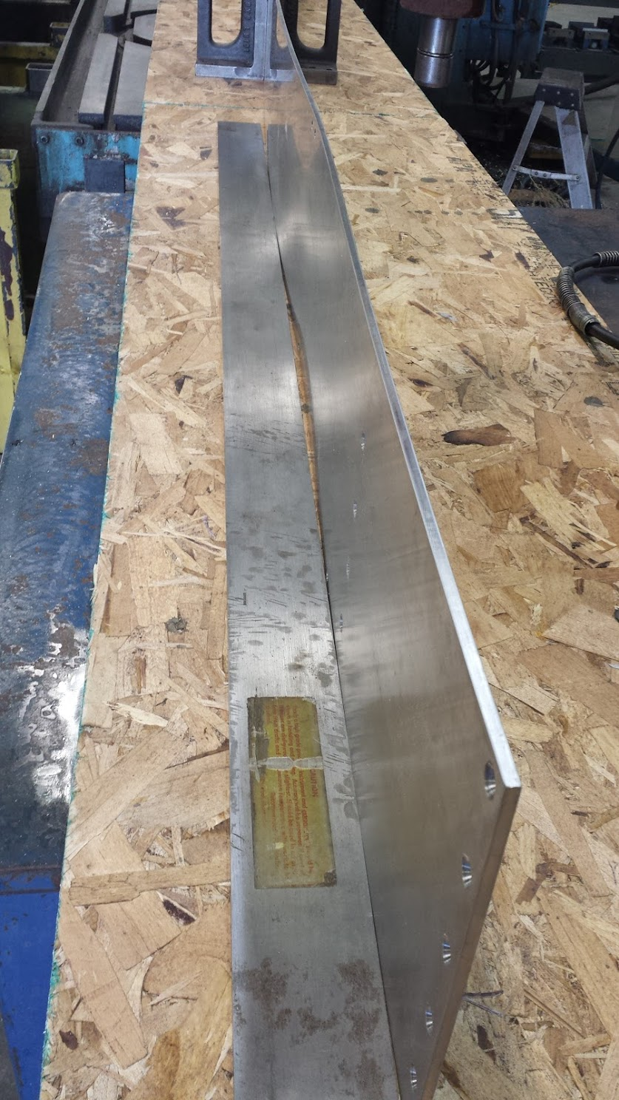
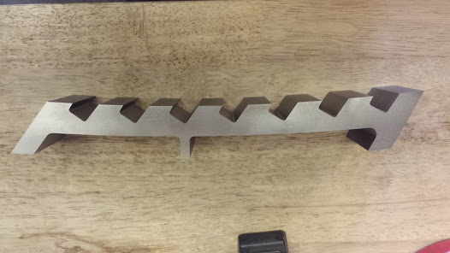
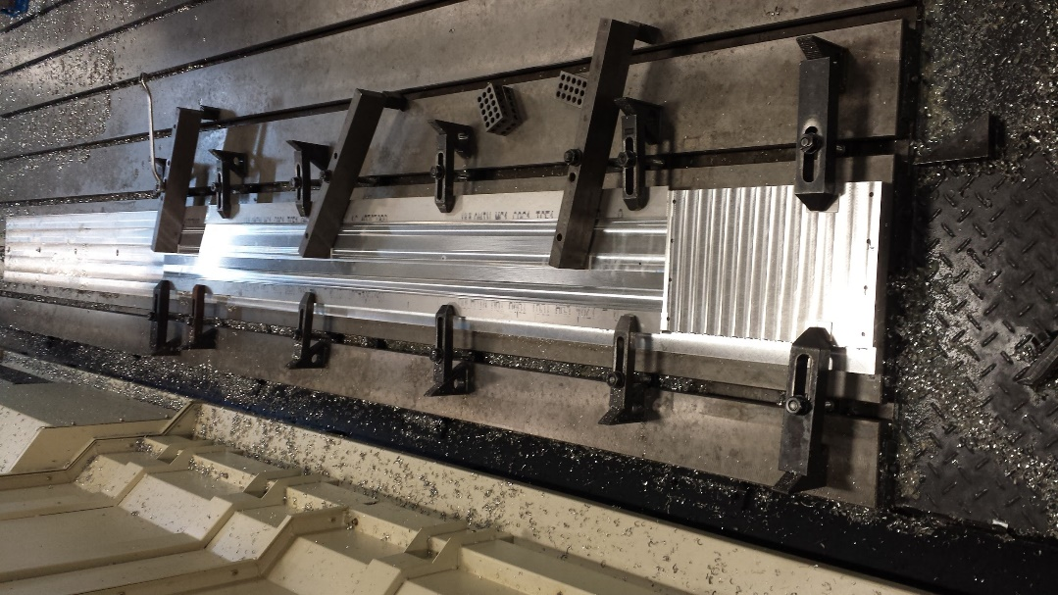
Some Pictures
Comb (wire EDM)
Example of bowing in thin absorber plate (sides), had to be manually straightened.
Al baseplate machining

Slide 18
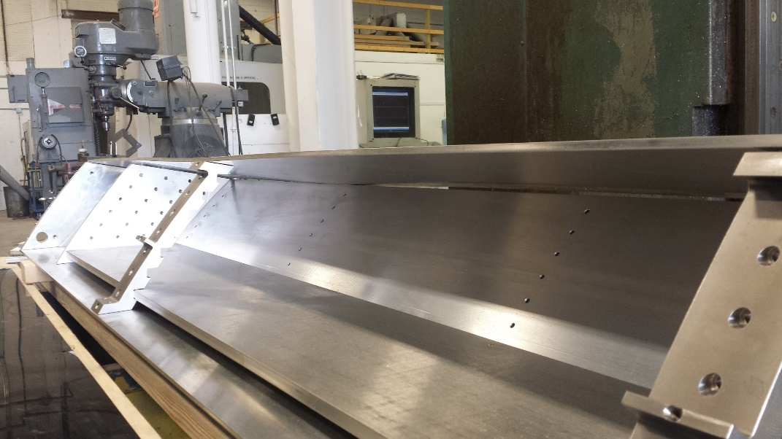
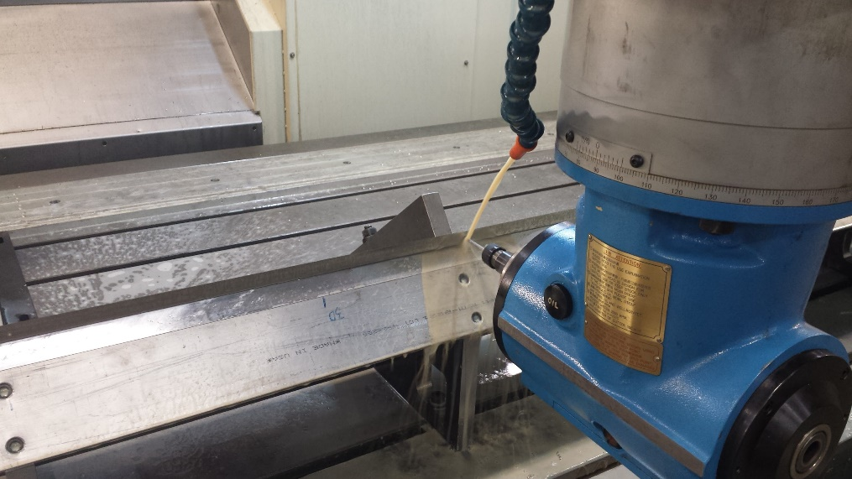
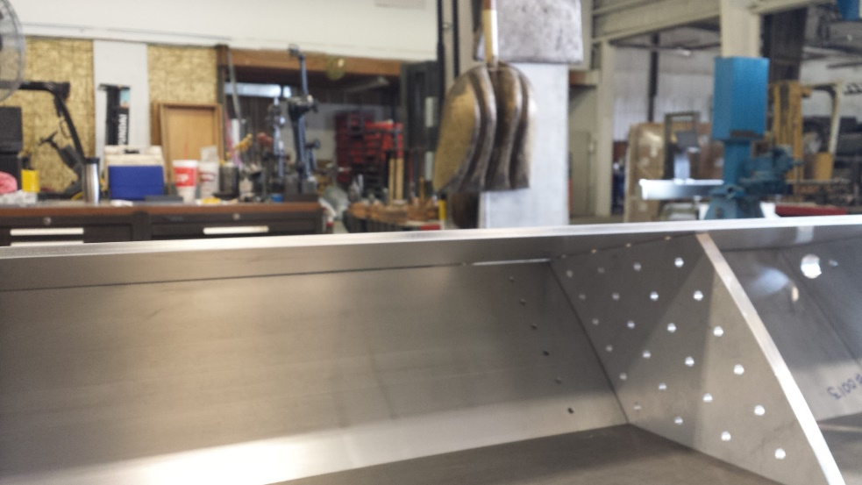
More Pictures
Machining baseplate mounting holes in absorber
Test fit of end plates, baseplate and side plates – gap due to bowing in outer plate.

Slide 19
Finished Product
Light cover (reflection)

Slide 20
Assembled Sector Measurements
In lifting fixture
Assembled sector moved to mill table, supported on ends (4 blocks). Twist and sag in middle measured @ 70ºF.
“Back” sags more than front when unsupported (CG shifted towards back). Supported measurements show not all sag is due to weight, some could be taken out by assembling on mill table.
Similar results at 90ºF.
front
Bot. view
back
Very little twist!

Slide 21
Sector Sag
front
Bot. view
back
 | Unsupported | Supported
Front Mill Jack | 78 mils | 48 mils
Back Mill Jack | 105 mils | 33 mils
@ 70ºF :
 | Unsupported | Supported
Front Mill Jack | 72 mils | 45 mils
Back Mill Jack | 98 mils | 34 mils
@ 90ºF :

Slide 22
HCAL Budget Profile

Slide 23
HCAL Staffing
FTE Profile by Category
FTE Profile by Fiscal Year
WBS Level | Org Sort | Group | FY 17 | FY 18 | FY 19 | FY 20 | FY 21 | FY 22
1.4 | BNL | Purchased Services | 0.00 | 0.00 | 0.18 | 0.46 | 0.12 | 0.00
 |  | Scientific | 0.60 | 0.36 | 0.16 | 0.37 | 0.00 | 0.00
 |  | Technical | 0.74 | 0.31 | 1.29 | 1.87 | 0.51 | 0.00
 |  | Professional | 0.38 | 0.47 | 0.23 | 0.91 | 0.75 | 0.00
 | BNL Sum |  | 1.71 | 1.13 | 1.87 | 3.61 | 1.38 | 0.00
 | Non-BNL | Student | 0.08 | 0.23 | 1.35 | 9.50 | 5.97 | 0.00
 |  | Technical | 0.00 | 0.00 | 0.38 | 1.27 | 1.76 | 0.00
 |  | Professional | 0.00 | 0.00 | 0.00 | 0.12 | 0.10 | 0.00
 |  | Postdoc | 0.00 | 0.00 | 0.82 | 1.46 | 1.61 | 0.00
 | Non-BNL Sum |  | 0.08 | 0.23 | 2.55 | 12.34 | 9.43 | 0.00
Grand Total |  |  | 1.79 | 1.36 | 4.42 | 15.95 | 10.81 | 0.00

Slide 24
Quality of Estimate

