Slide 1
sPHENIX Director’s Review
August 2-4, 2017
BNL

Slide 2
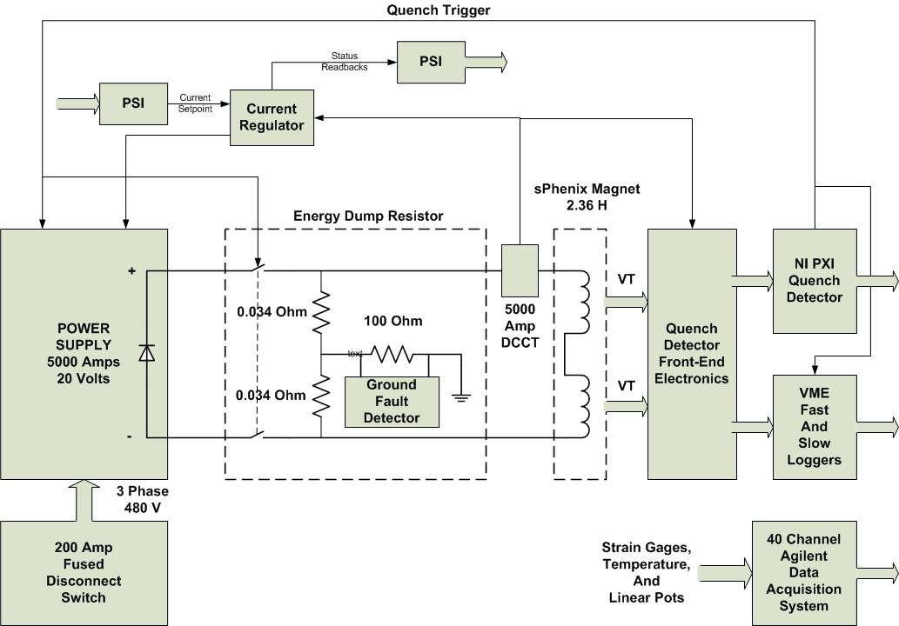
Magnet System Block Diagram

Slide 3
Magnet Power Supply
Power Supply
Performance Specifications
Nominal Magnet Operating Current is 4596 Amps
PS Max Current 5000 Amps
Magnet Voltage for ramping is approximately 8 Volts
PS Max Voltage 20 Volts
100 ppM Current Regulation
12 pulse SCR Phase Controlled Power Converter
Analog PID Current Regulator

Slide 4
Quench Detector
Quench Detector
22 Voltage Tap Channels
4 Dual Gain Channels
1 Magnet Current Channel
Two Quench Detector Algorithms for Super-Conducting Coils
Vmeas – L * di/dt
Half Coil Comparison
Fixed Thresholds for Gas-Cooled Leads, Flex Joints, and Super-Conducting Bus
Front-End Electronics
Provide isolation to ground of 2500 Vrms
Provide differential voltage sensing
Gain appropriate for the channel
Anti-aliasing filters

Slide 5
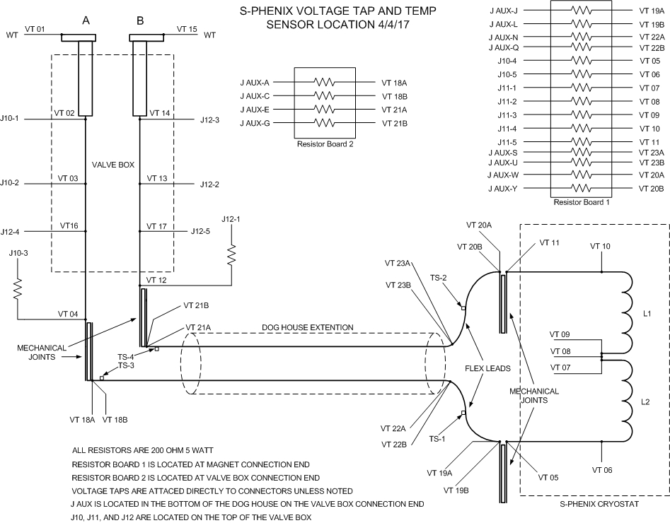
Voltage Tap Locations

Slide 6
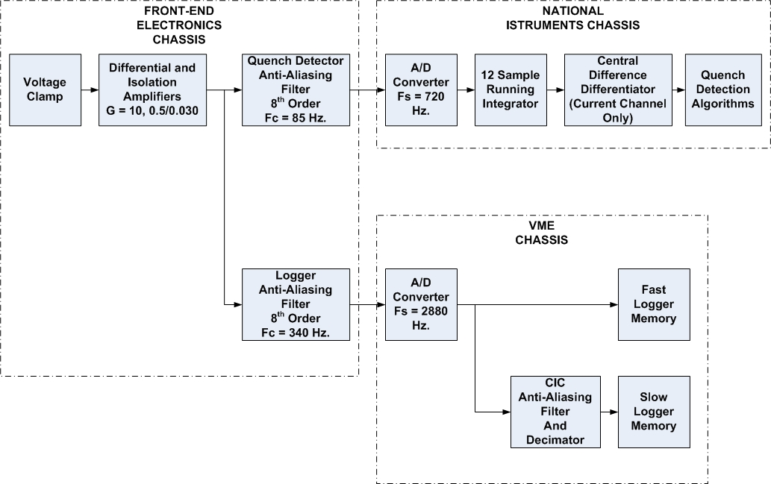
Quench Detector Signal Processing

Slide 7
Subsystem Collaborators
Zeynep Altinbas BNL
Quench Detector Software
Winston Pekrul BNL
Loggers Software
Strain Gage and Linear Pots Software
Control System Interface Software
Pablo Rosas BNL
Power Supply and Energy Extraction Resistor
Carl Schultheiss BNL
Quench Detector Front-End Electronics
System Integration

Slide 8
Schedule Drivers
WBS 1.8.4 Power Supply and Quench Detection Systems
High Field Test
Power Supply, Energy Dump Resistor, and Quench Detector must all be operational.
Mid September 2017

Slide 9
Cost Drivers
Power Supply was provided by SLAC.
Replaced electrolytic capacitors
Replaced PLC
Energy Dump Resistor was also provided by SLAC.
Replaced DC contactor
Power Cables
$10.00/ft.

Slide 10
Basis of Estimate and Resource-Loaded Schedule
Basis of Estimate
Catalog prices
Engineering Estimates
Resource-Loaded Schedule
Engineering Estimates
Experience

Slide 11
Status and Highlights
Power Supply
Tested to 2600 Amps .
Tested with PSI generating ramp.
Quench Detector
Front-End Electronics Boards in house and under test.
Quench Detector Software being written.
Fast and Slow Loggers Software complete.
Strain Gage Software is complete.

