Slide 1
sPHENIX Director’s Review
Project Overview
Edward O’Brien
August 2-4, 2017
BNL

Slide 2
What is sPHENIX ?PHENIX?
sPHENIX is a major upgrade to the PHENIX detector. It is a large-acceptance, high-rate detector for Heavy Ion physics that repurposes >$20M in existing PHENIX equipment, infrastructure and support facilities
The detector is optimized to measure jet and heavy quark physics by incorporating a Tracker, full EM and Hadronic calorimeter coverage at |η| < 1.1, and a 1.5 T solenoidal magnetic field.
It will utilize much of the infrastructure already existing in the PHENIX detector complex and the BaBar SC-magnet. The Min Bias Trigger Detector is the reused PHENIX Beam Beam Counter with upgraded electronics.
A bottom-up resource-loaded project plan has sPHENIX assembled, commissioned and ready to take data in January 2023 based on the DOE-ONP guidance for the Critical Decision from earlier this year.

Slide 3
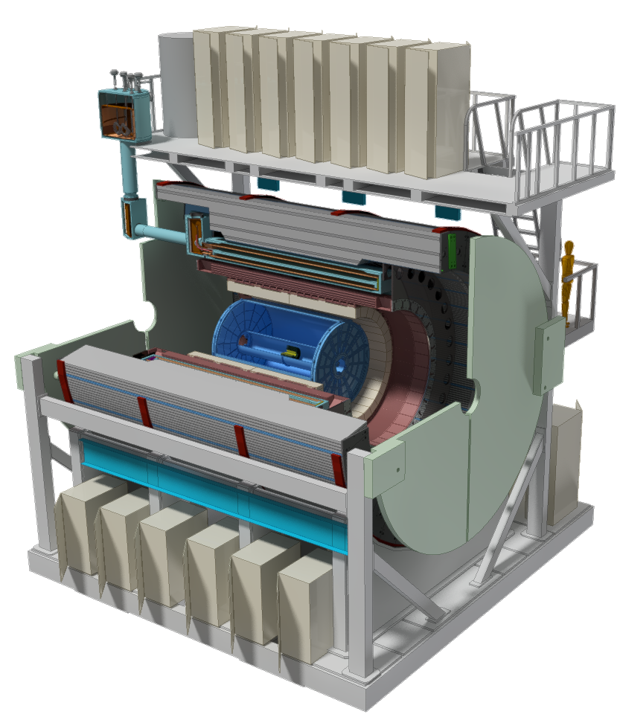
sPHENIX Conceptual Design
Uniform fiducial acceptance -1<η<1 and 0<φ<2π
Superconducting solenoid enabling high resolution tracking
Hadronic calorimeter doubling as flux return
Compact electromagnetic calorimeter to allowing fine segmentation at a small radius
Solid state photodetectors that work in a magnetic field, have low cost, do not require high voltage
Common readout electronics in the calorimeters
High rate 15 kHz in AA allows for large unbiased MB data sample
Utilization of existing PHENIX exp Infrastructure
Compact TPC 250 mm hit res & continuous readout
4 Intermediate silicon strip tracking layers (Japanese funds)
3 layer – 2π MAPS-based vertex det (DOE-Upgrade)
Not part of this review
Most Detector components are at an advanced state of R&D

Slide 4
The Three Parts of sPHENIX
MIE Cost range is $29-35M DOE funded & Managed
Upgrade Support is ~$20M BNL Funded & Managed
Infrastructure/Facility Upgrade ~$20M BNL Funded & Managed
  sPHENIX MIE Upgrade covering the detector (Project Management, TPC, EMCal, HCal, Calorimeter Electronics, DAQ/Trigger, Min Bias Detector). Dominated by M&S costs. The MIE carries labor for Project Management and ~$1M in paid University labor for building things.
  Upgrade Support is 100% BNL labor that supports the sPHENIX MIE upgrade. Primarily the Phys Dept PHENIX/sPHENIX technical support group augmented by CAD, Magnet Div and Instrumentation Div.
  Infrastructure and Facility Upgrade of the 1008 complex . Combination of M&S and Labor. Purpose is the upgrade of 1008 to modern standards. Enables cryo operations in 1008 and provides a facility optimized for the operation of a modern detector.

Slide 5
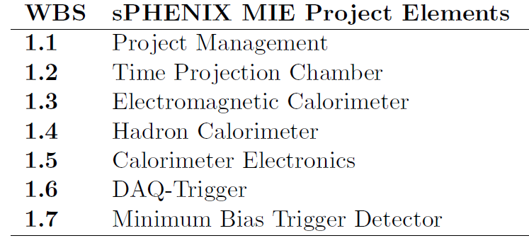
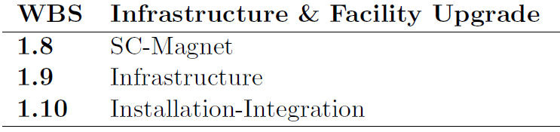
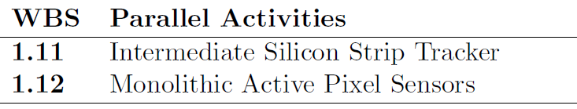
WBS of sPHENIX MIE & Support Effort
MIE
Support Activities managed by the sPHENIX Project team
Parallel Activities funded from other sources

Slide 6
sPHENIX Schedule
sPHENIX passes DOE Science Review Apr 2015
CD-0 Mission Need Approved Sep 2016
BNL Director’s pre CD-1 Review Sep 2017
OPA-CD-1/CD-3a Review Spring 2018
CD-1/CD-3a authorization (?) Dec 2018
Fabrication (orders) of long lead time components begins Dec 2018
All Preproduction R&D and Design complete Spring 2019
OPA- CD-2/CD-3b review Spring 2019
CD-2/CD-3b authorization (?) Aug 2019
All fabrication (orders) begin Aug 2019
sPHENIX installation begins in 1008 Facility Apr 2021
MIE deliverables complete Dec 2021
sPHENIX Installed, cabled, ready to commission Jul 2022
Initial commissioning complete Sep 2022
First RHIC beam for sPHENIX Jan 2023
CD-4 Approval Jan 2024
The Resource-loaded Schedule contains 6 months of float to Jan 2023 first beam @ RHIC
The MIE has 24 months of float to CD-4

Slide 7
CD-1 Documents Available to the Committee
Project Team Organization
WBS (WBS Dictionary)
Basis of Estimate documents
Contingency Risk/Analysis
Project Schedule
Critical Milestones
Proposed Funding Profile
Proposed Labor Profile
Preliminary Hazard Analysis Report
NEPA form
Integrated Safety Management Plan
Conceptual Design/Conceptual Design Report-
Acquisition Strategy
Preliminary Project Execution Plan
Preliminary Risk Assessment and Risk Registry
Security Vulnerability Assessments (Equipment protection & cyber security)
Alternate Analysis

Slide 8
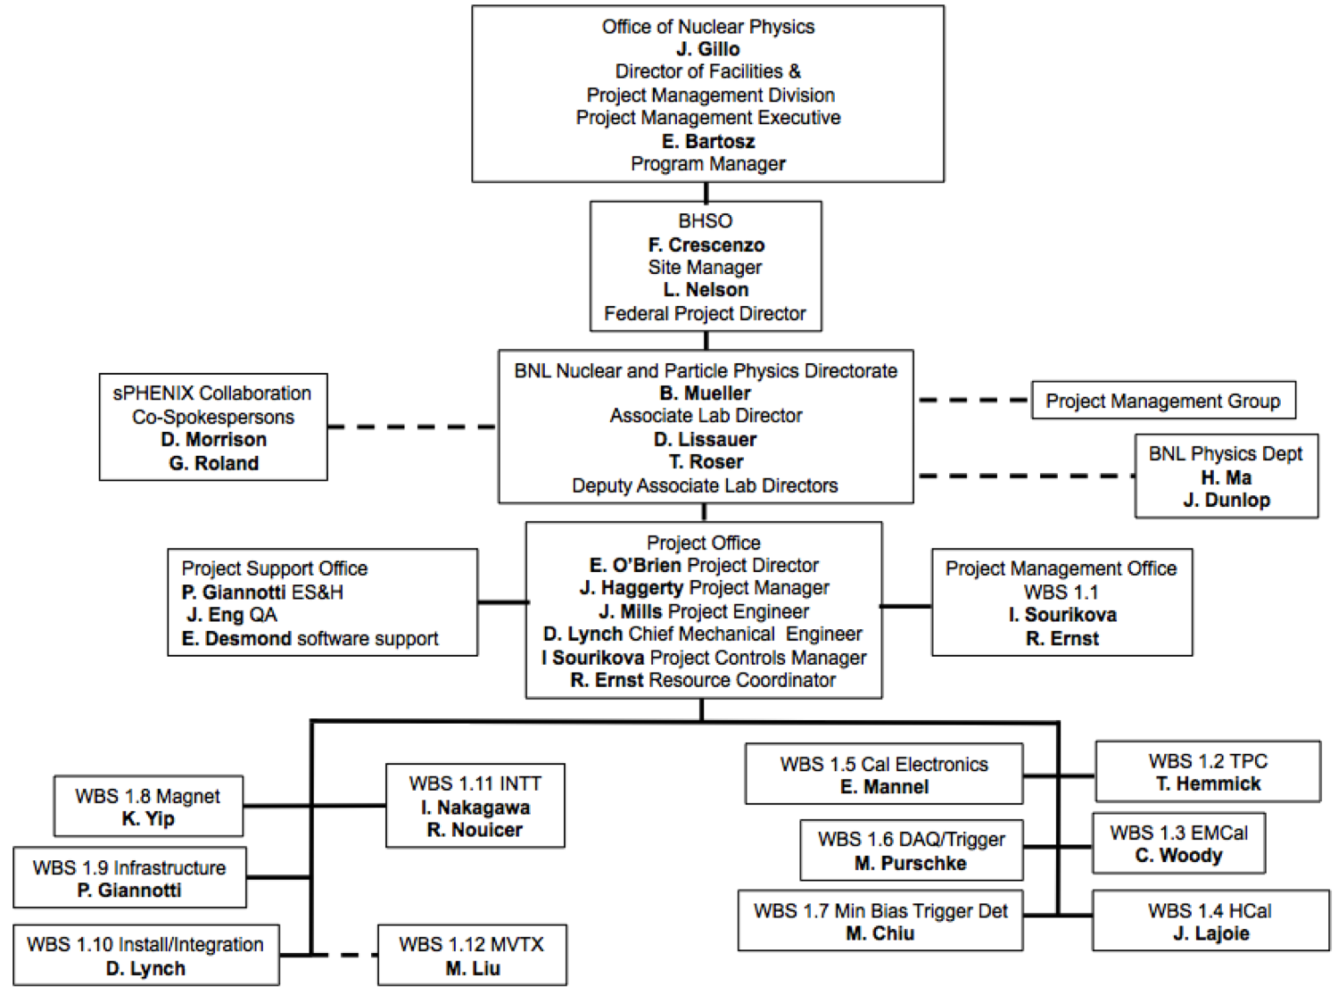
Project Organization
https://docdb.sphenix.bnl.gov/0001/000104/001/sPHENIX-Bios.docx.pdf

Slide 9
Project Organization
MIE
Infrastructure & Facility

Slide 10
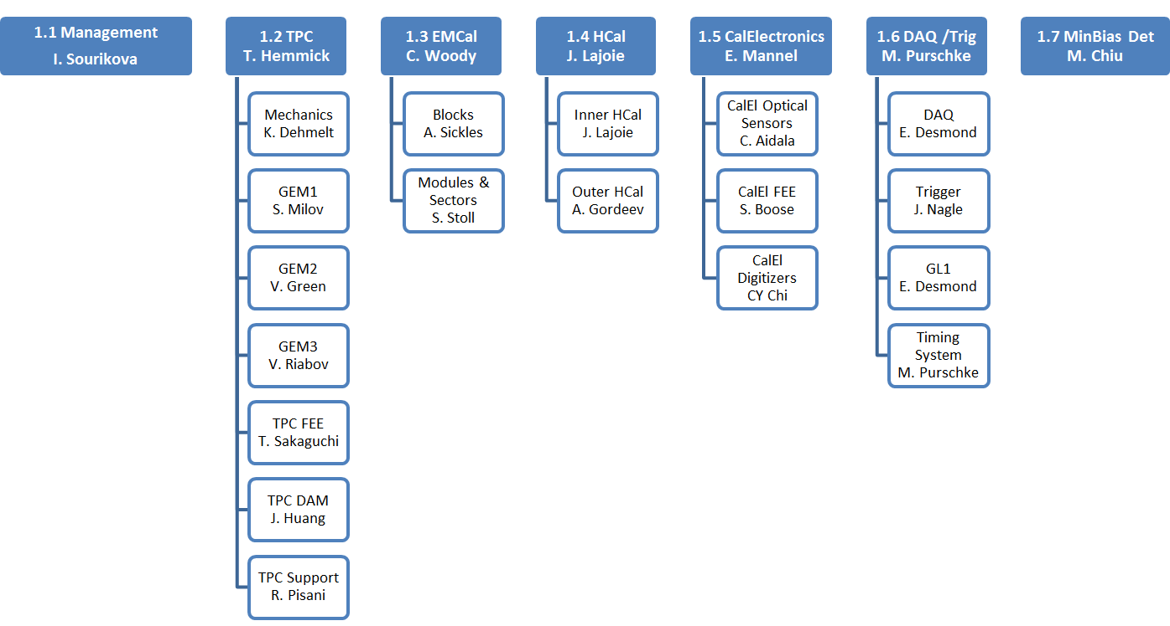
L2 and CAM Structure of MIE
Key:
L2 Managers
CAMs

Slide 11
L2 Managers & Control Account Managers
L2 Managers:
1.1 Project Management Irina Sourikova(BNL-Project Controls)
1.2 TPC Tom Hemmick (SBU)
1.3 EMCal Craig Woody (BNL)
1.4 HCal John Lajoie (ISU)
1.5 Calorimeter Electronics Eric Mannel (BNL)
1.6 DAQ/Trigger Martin Purschke (BNL)
1.7 Min Bias Trigger Detector Mickey Chiu (BNL)
Control Account Managers
Project Managmt Irina Sourikova (BNL)
TPC Detector Klaus Dehmelt (SBU)
GEM r1 Sasha Milov (WIS)
GEM r2 Vicki Greene (Vandblt)
GEM r3 Victor Riabov (PNPI)
TPC FEE Takao Sakaguchi (BNL)
TPC DAM Jin Huang (BNL)
EMC Blocks Anne Sickles (UIUC)
EMC Module/Sector Sean Stoll (BNL)
Inner HCal John Lajoie (ISU)
Outer HCal Anatoli Gordeev (BNL)
CalE SiPMs Christine Aidala (UM)
CalE Preamps Steve Boose (BNL)
CalE Digitizer CY Chi (Columbia)
DAQ Ed Desmond (BNL)
Trigger J. Nagle(UColorado)
Timing Sys TBD (If necessary)
MB Trig Det Mickey Chiu (BNL)

Slide 12
Resource-Loaded Schedule Status
We are finishing a bottom-up revision to the Resource-loaded schedule
  6 month effort of ~40 - 50 people.
  1800+ activities over 11 WBS L2 categories. All in MS-Project
  The MIE Activities were integrated with the Magnet, Infrastructure, Installation/integration.
  Merged the INTT with the rest of the project files
  Consultant migrating the files to P6 in process. No review yet by L2’s or CAMs. Ready for primetime early Sept
RLS and BOE Procedure:
BOE of Cost and Duration based on Vendor bids or quotes, catalog prices, engineering estimates or previous experience
L2s/CAMs Bottom-up contingency based on uncertainty(risk) table
Use BNL Labor bands, BNL Extraordinary OH rates, university rates where applicable.
Non-BNL labor availability estimates came from collaborating institutions
No RFP’s on MIE. 1 RFP in SC-Magnet (cryo bypass)
The CERN GEM order involves only vendor that doesn’t take payment in $.
  No significant foreign exchange issues.
Labor resources not available from BNL Phys Dept will come from CAD, Mag Div, Instrumentation Div, or collaborating Institutions

Slide 13
sPHENIX BOE Contingency Guidelines
Materials Bottom-Up Contingency
Uniformly Graded Approach to Risk Across All Subsystems
There is a similar table for Labor contingency estimates
Code | Type of Estimate | Contingency % | Description
M1 | Existing Purchase order | 0% | Items have been completed or obligated. (Note: Contact Change Orders are considered a Risk and should not be included )
M2 | Procurement for LOE/Oversight work | 0%-20% | M&S items such as travel, software purchases and upgrades, computers, etc. estimated to support LOE efforts and other work activities.
M3 | Advanced | 10%-25% | Items for which there is a catalog price or recent vendor quote based on a completed or nearly completed design or an existing design with little or no modifications and for which the costs are documented.
M4 | Preliminary | 25%-40% | Items that can be readily estimated from a reasonably detailed but not completed design; items adapted from existing designs but with moderate modifications, which have documented costs from past projects. A recent vendor survey (e.g., budgetary quote, vendor RFI response) based on a preliminary design belongs here.
M5 | Conceptual | 40%-60% | Items with a documented conceptual level of design; items adapted from existing designs but with extensive modifications, which have documented costs from past projects.
M6 | Pre-conceptual - Common work | 60%-80% | Items that do not have a documented conceptual design, but do have documented costs from past projects. Use of this estimate type indicates little confidence in the estimate. Its use should be minimized when completing the final estimate.
M7 | Pre-conceptual - Uncommon work | 80%-100% | Items that do not have a documented conceptual design, and have no documented costs from past projects. Its use should be minimized when completing the final estimate.
M8 | Beyond state of the art | > 100% | Items that do not have a documented conceptual design, and have no documented costs from past projects. Technical requirements are beyond the state of the art.

Slide 14
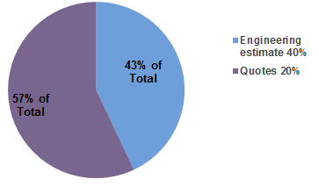
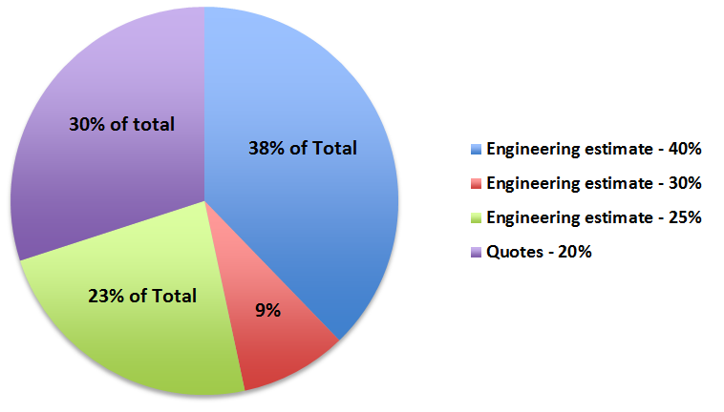
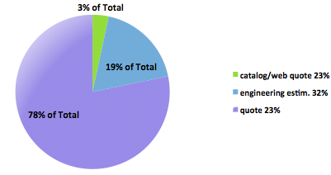
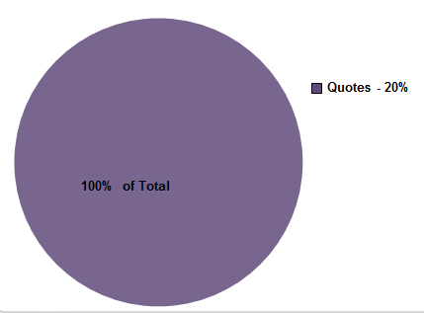
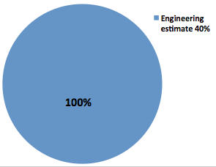
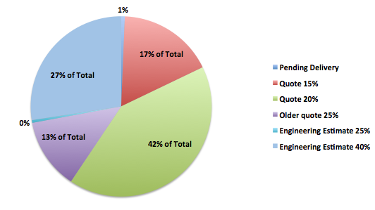
Basis of Estimate
Calorimeter Electronics
Net contingency 30%
HCal
Net Contingency 29%
EMCal
Net Contingency 25%
DAQ/Trigger
Net contingency 20%
TPC
Net Contingency 25%
MBD
Net Contingency 40%

Slide 15
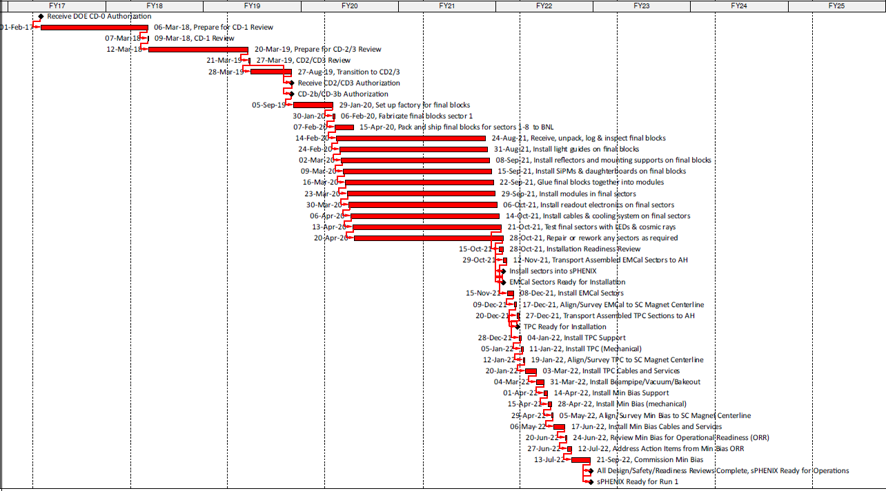
sPHENIX Critical Path Calculated in P6
sPHENIX MS-Project and P6 give essentially the same critical path

Slide 16
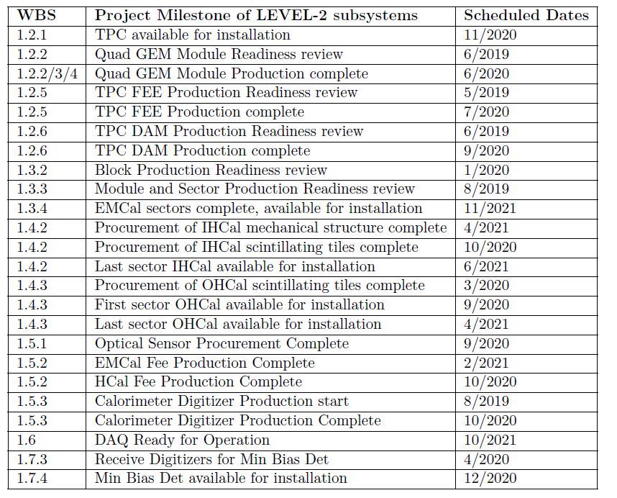
Major Project Milestones for L2 Subsystems

Slide 17
The MIE Part of sPHENIX
MIE Cost range is $29-35M DOE Funded & Managed
The full MIE scope exceeds the cost range by ~3.5 M AY$ (contingency included)
All documents including the RLS, BOEs, labor profiles etc. assume the full scope
We have two descope options that fall within the budget range but the detailed science impact has yet to be evaluated by the collaboration.
The intention is to build the full scope by reducing costs through scrubbing and value engineering, while also pursuing additional funds from International and other sources.
The Project is working with the collaboration and BNL to devise a plan to get back within the cost range.

Slide 18
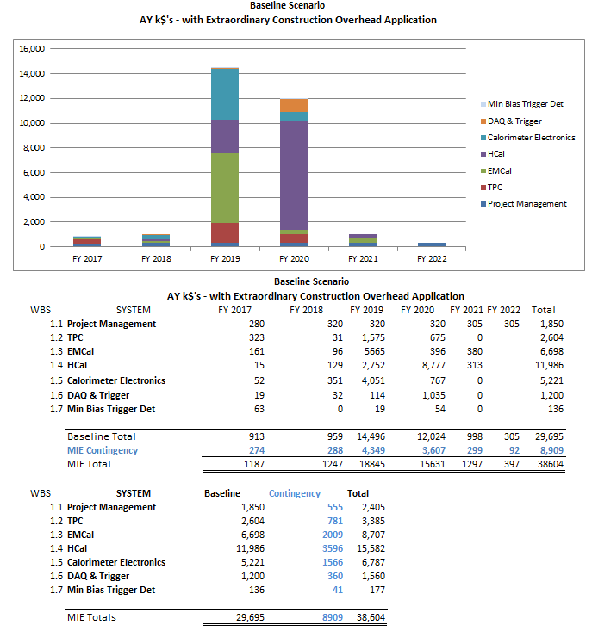
sPHENIX Cost Estimate – Full Scope

Slide 19
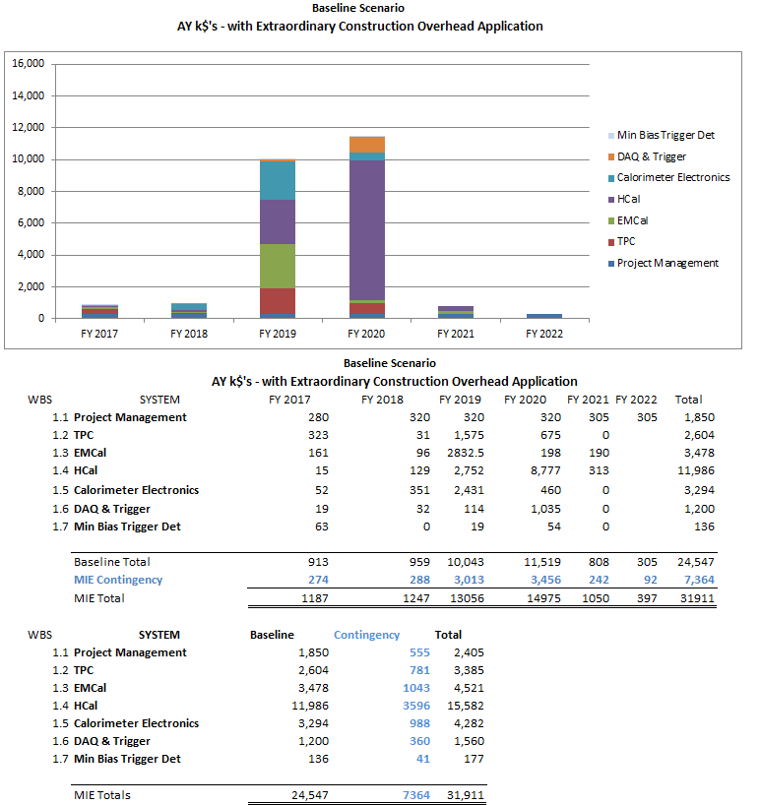
sPHENIX Descope Scenario -1, 50% EMCal

Slide 20
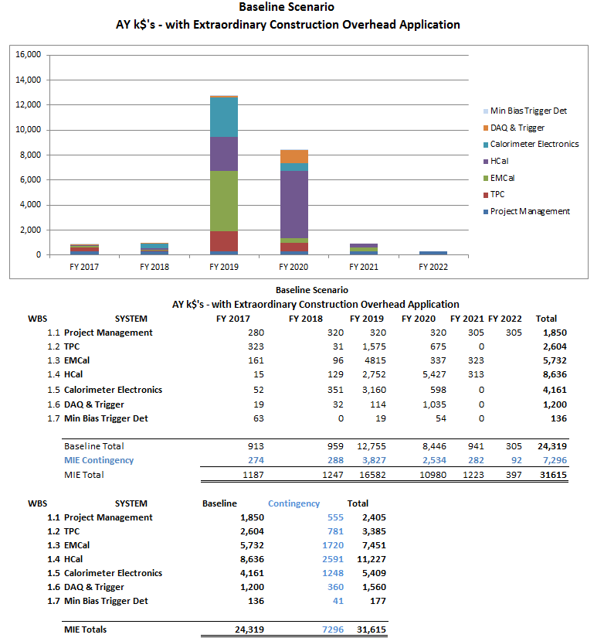
sPHENIX Descope Scenario -2, No IHCal, 85% EMCal

Slide 21
Impacts of the De-scope Options
Building ½ the EMCal will reduce our acceptance for Upsilons by almost a factor of four. In addition we lose γ+jet statistics, direct γ statistics and our ability to look at jets over a full range of R values due the restrictions on the acceptance. The other physics capabilities of the detector are preserved.
Building No IHCal will reduce our e/h separation due to leakage out the back of the EMCal which in turn creates a bigger combinatorics background for the upsilon through hadron misidentification as an electron.
The collaboration has agreed to study the physics impact of these issues in detail and recommend a de-scope option. In the mean time institutions involved with the EMCal (UIUC+UM) and IHCal (ISU&WSU) are investigating the possibility of an NSF MRI proposal or proposals to fund components of these subsystems. Initial talks with Garcia-Solis and Opper of NSF were promising but incipient.
International funding is also being pursued with IHEP-Protvino as a possible contributor to the IHCal. Other endeavors such as Saclay contributing to the TPC would free up funds that could be directed to restore parts of our de-scoped subsystems. Recent discussions with new potential Chinese collaborators for work on the EMCal also are promising.

Slide 22
Long Lead-Time Items for Letter or Authorization or CD-3a
Two options for Long Lead procurements: Letter of Authorization from the Project Management Executive (J. Gillo), or CD-3a authorization.
SiPMs for EMCal and HCal $1.0M
Outer HCal Steel $5.3M
Scintillating Tiles for HCal $1.8M
Scintillating Fibers for EMCal (1/2 order) $0.7M
Each items has a long production time, long queue time or both. All are for detectors on or near the critical path.
Procure of those long-lead “items” through authorization from the PME in advance of CD-2 would be carried out via a tailoring strategy (Letter of Authorization)
Justification:
1. Reduce overall project risk
2. Materials will be needed regardless of . . .
3. Contract option already in placed to be executed with excellent price
4. Reduce project schedule
5. Reduce overall cost to project (estimated to be . . . )

Slide 23
Labor Supporting for sPHENIX MIE
WBS 1.1 through 1.7
FTE Profile
WBS Level | Group | FY 17 | FY 18 | FY 19 | FY 20 | FY 21 | FY 22
BNL | Purchased Services | 0.00 | 0.00 | 0.18 | 0.48 | 0.12 | 0.00
 | Scientific | 2.65 | 3.65 | 2.40 | 4.02 | 2.79 | 0.32
 | Technical | 4.70 | 2.15 | 2.40 | 10.79 | 5.47 | 0.11
 | Professional | 6.10 | 6.03 | 4.38 | 8.73 | 6.23 | 0.55
 | Administrative | 0.40 | 0.59 | 0.59 | 0.59 | 0.57 | 0.09
BNL Sum |  | 13.84 | 12.41 | 9.96 | 24.61 | 15.18 | 1.08
Non-BNL | Scientific | 2.24 | 1.12 | 1.21 | 3.68 | 0.20 | 0.00
 | Student | 1.96 | 3.29 | 6.05 | 36.16 | 19.43 | 0.27
 | Technical | 1.80 | 1.28 | 0.56 | 6.01 | 3.42 | 0.00
 | Professional | 0.15 | 0.23 | 0.46 | 0.71 | 0.10 | 0.00
 | Postdoc | 0.00 | 0.00 | 0.82 | 1.46 | 1.61 | 0.00
Non-BNL Sum |  | 6.15 | 5.93 | 9.10 | 48.01 | 24.75 | 0.27
Grand Total |  | 20.00 | 18.34 | 19.06 | 72.63 | 39.94 | 1.34
The student contribution is commensurate with past student contributions from the same institutions on similar detector projects
We will secure the non-BNL labor contributions with Memoranda of Agreement between Institutions.
No FTE contingency shown in plots
or spreadsheet

Slide 24
Labor Supporting MIE+Infra/Facility Upgrade +INTT
WBS 1.1 – 1.11
FTE Profile by Category
FTE Profile by Fiscal Year
WBS Level | Group | FY 17 | FY 18 | FY 19 | FY 20 | FY 21 | FY 22
BNL | Purchased Services | 0.05 | 0.22 | 0.26 | 1.04 | 0.37 | 1.47
 | Scientific | 3.29 | 4.39 | 3.03 | 4.64 | 3.21 | 1.94
 | Technical | 8.35 | 4.59 | 5.28 | 14.71 | 6.93 | 5.58
 | Professional | 11.64 | 9.12 | 6.62 | 12.75 | 7.20 | 1.94
 | Administrative | 0.40 | 0.59 | 0.59 | 0.59 | 0.57 | 0.09
BNL Sum |  | 23.73 | 18.90 | 15.78 | 33.73 | 18.29 | 11.02
Non-BNL | Scientific | 2.31 | 1.13 | 1.21 | 3.68 | 0.20 | 0.00
 | Student | 1.96 | 3.29 | 6.05 | 36.16 | 19.43 | 6.27
 | Technical | 1.80 | 1.28 | 0.56 | 6.01 | 3.42 | 0.00
 | Professional | 0.15 | 0.23 | 0.46 | 0.71 | 0.10 | 0.00
 | Postdoc | 0.00 | 0.00 | 0.82 | 1.46 | 1.61 | 0.00
Non-BNL Sum |  | 6.23 | 5.94 | 9.10 | 48.01 | 24.75 | 6.27
Grand Total |  | 29.95 | 24.84 | 24.88 | 81.75 | 43.04 | 17.29
No FTE contingency shown in plots
or spreadsheet

Slide 25
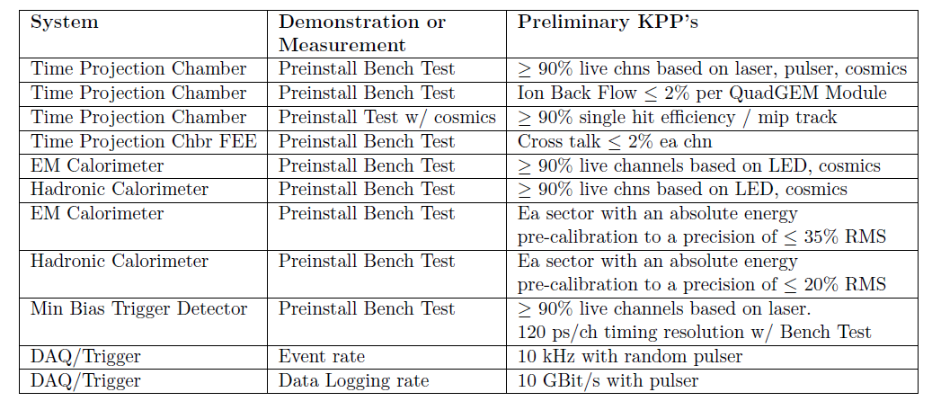
Proposed Key Performance Parameters
Installation is NOT part of the MIE and not a deliverable. Beam collisions are not needed to satisfy the KPP’s.
Preliminary KPP’s listed in the PPEP. They are under Discussion with DOE-ONP

Slide 26
Oversight and Project Meetings
Oversight
Biweekly sPHENIX meeting with DOE BHSO
Monthly sPHENIX meeting with DOE-ONP
Monthly PHENIX R&R(decommissioning) meeting with DOE-ONP
Biweekly meeting with BNL ALD’s Project Management Group
8 internal BNL reviews of the subsystems
2 BNL Director’s reviews with external committees.
Project Meetings
Weekly Management meeting
Weekly simulations meeting
Biweekly meetings for each MIE subsystems
Biweekly meetings for SC-magnet
Biweekly sPHENIX engineering meeting
Biweekly Tracking meeting
Biweekly L2 Managers meeting
In addition there is a biweekly General Meeting for the whole collaboration at which the Project reports and a biannual Collaboration meeting.
We’ve held 900 sPHENIX meetings over the last 3 years. It is a very active collaboration.

Slide 27
Summary
sPHENIX is a major upgrade to the PHENIX experiment that will utilize >$20M in existing equipment. The sPHENIX scientific collaboration is a new organization that was formed 1.5 years ago.
The sPHENIX Project team is established and has been working together for 3 years.
  The Project Organization including L2’s and CAMs is established.
We have releases or advanced draft of the documents for required for CD-1 including a CDR(300 pages, 200 figures) and a preliminary PEP.
  They are available on the review web site.
There is a newly revised Resource-loaded schedule with a bottom-up cost and contingency estimate.
  We are migrating the RLS schedule in MS-Project to P6. The L2 Managers and CAMs have yet to review the new P6 implementation.
  Bottom-up cost estimate exceeds BNL guidance. We’ve established two “straw man” technical de-scope scenarios that fit within budget guidance. We are working with the collaboration and BNL to assess the physics impact of those scenarios.
Project schedule exists that has the MIE Project complete by Dec 2021. The fully installed and commissioned detector in ready for RHIC collisions Jan 2023 with 8 months float.
  The FY18 President’s Budget required DOE to delay sPHENIX 1 year

Slide 28
Back Up

Slide 29
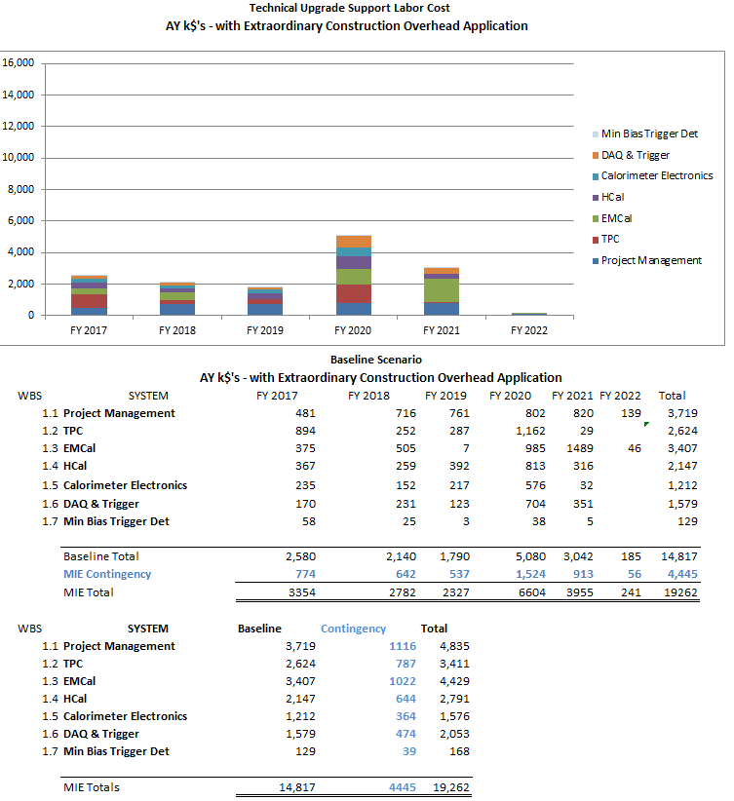
sPHENIX Upgrade Support Labor
30% Labor contingency included
In budget

Slide 30
Funding Split M&S and Labor
Capital Project Scope
RHIC Operations Scope
38.6 AY K$ w/Contingency
32 AY K$ w/ Contingency after descope
18.3 AY k$ w/Contingency

Slide 31
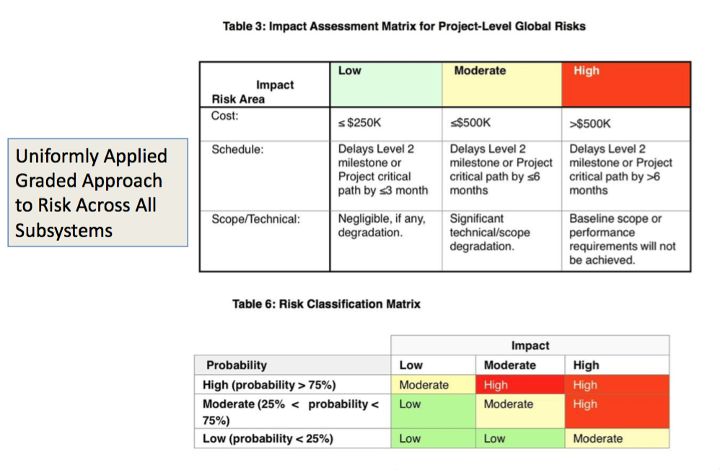
Risk Matrix

Slide 32
sPHENIX BOE Contingency Guidelines
Labor Bottom-Up Contingency - Uniformly Graded Approach to Risk Across All Subsystems
 | Type of Estimate | Contingency % | Description
L1 | Actual | 0% | Actual costs incurred on activities completed to date.
L2 | Level of Effort Tasks | 0%-20% | Support type activities that must be done to support other work activities or the entire project effort, where estimated effort is based on the duration of the activities it is supporting.
L3 | Advanced | 10%-25% | Based on experience with documented identical or nearly identical work. Development of activities, resource requirements, and schedule constraints are highly mature. Technical requirements are very straightforward to achieve.
L4 | Preliminary | 25%-40% | Based on direct experience with similar work. Development of activities, resource requirements, and schedule constraints are defined as preliminary (beyond conceptual) design level. Technical requirements are achievable and with some precedent.
L5 | Conceptual | 40%-60% | Based on expert judgment using some experience as a reference. Development of activities, resource requirements, and schedule constraints are defined at a conceptual level. Technical requirements are moderately challenging.
L6 | Pre-conceptual | 60%-80% | Based on expert judgment without similar experience. Development of activities, resource requirements, and schedule constraints are defined at a pre-conceptual level. Technical requirements are moderately challenging.
L7 | Rough Estimate | 80%-100% | Based on expert judgment without similar experience. Development of activities, resource requirements, and schedule constraints is largely incomplete. Technical requirements are challenging.
L8 | Beyond state of the art | > 100% | No experience available for reference. Activities, resource requirements, and schedule constraints are completely undeveloped. Technical requirements are beyond state of the art.

Slide 33
Technical Status
1.2 TPC: Mechanical design is advanced. In 1st round of prototyping but we’re building on ALICE, STAR and EIC R&D work. Full scale prototype with limited readout, ready fall 2017.
Two electronics boards needed FEE and DAM. Both based on existing boards.
1st prototype FEE produced & being tested in BNL Instrumentation. Similar to both ALICE & STAR boards.
DAM will be ATLAS FELIX board w/ new firmware. Testing in BNL Instrumentation has started with FELIX 1.5
1.3 EMCal: 2nd round of prototyping complete. Test beam analysis ongoing but initial results show that we are going to meet performance spec. Needs 1 more round of small prototype plus preproduction.
1.4 HCal: Advanced. 2ND round of prototyping complete. Meets performance specs. Detector design complete. Full size mech prototype for IHCal exists. Full size prototype for OHCal complete at vendor in 2 weeks. Working on installation plans.
1.5 Calorimeter Electronics: Advanced. Hamamatsu SiPM chosen. Preamp design done except for optimization of form factor(board size and shape). Digitizer board done. Working on back plane and crate controller. Nine months from ready to start production.
1.6 DAQ/Trigger: Costed upgrade commercial equipment for existing DAQ. Trigger simulations to identify rejection requirements.
1.7 Min Bias Detector: Reuse of existing PHENIX Detector.
1.8 Magnet: Exists. Former BaBar magnet passed cold low-field test. Full-field test Sept 2017. Conceptual design exists for cryo, PS, controls.
1.9 Infrastructure: Early planning stages.
1.10 Integration & Installation: Conceptual design exists for outer detector. Engineering work started for for inner detectors: TPC, INTT, MVTX, Min Bias Det.
1.11 Intermediate Tracker: First round of prototyping with Si strip ladder produced and being tested at BNL.

Slide 34
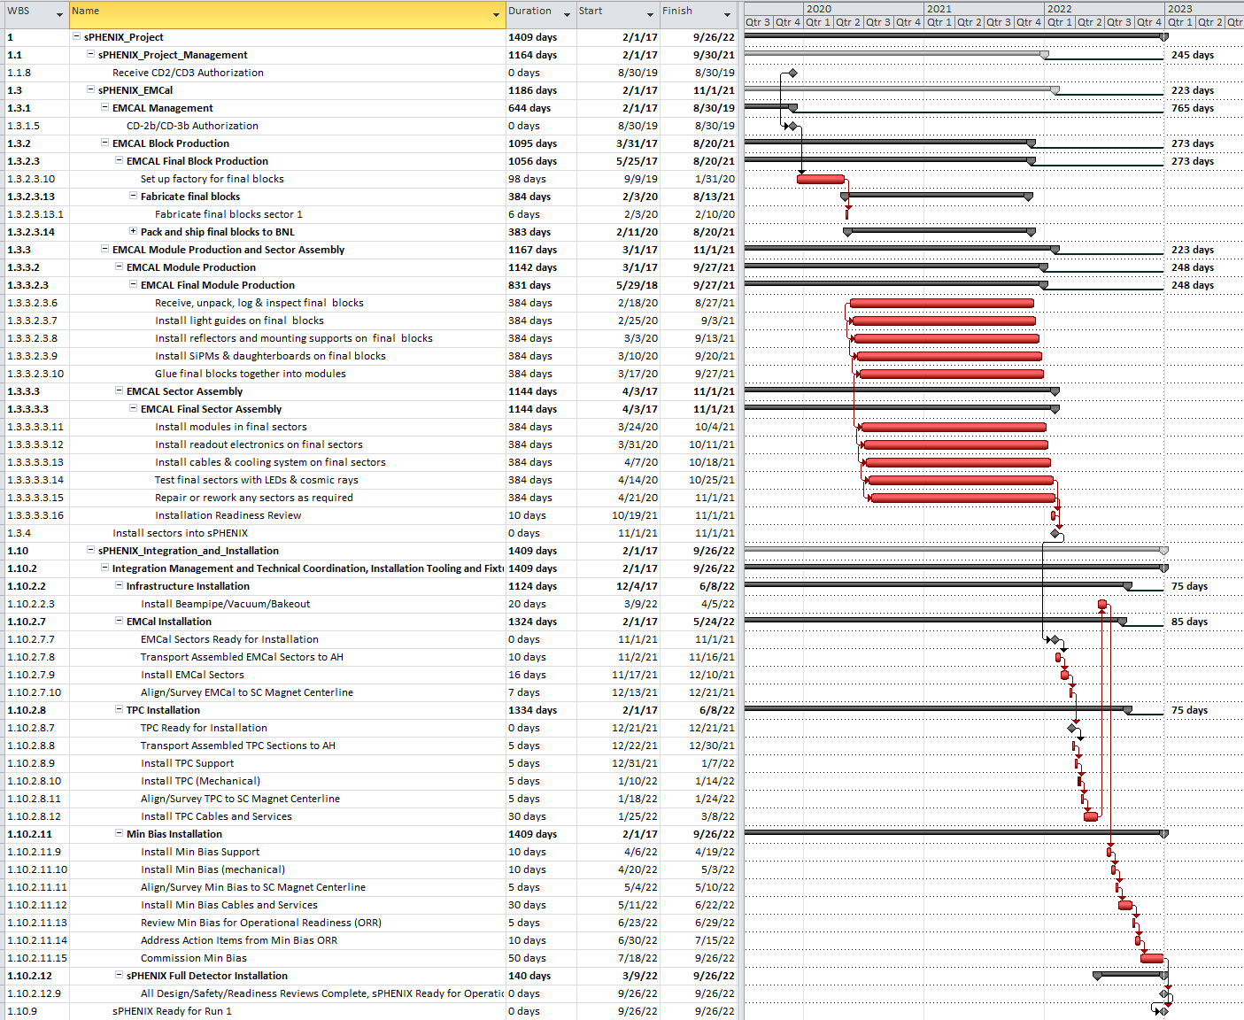
sPHENIX Critical Path EMCal through Installation

Slide 35
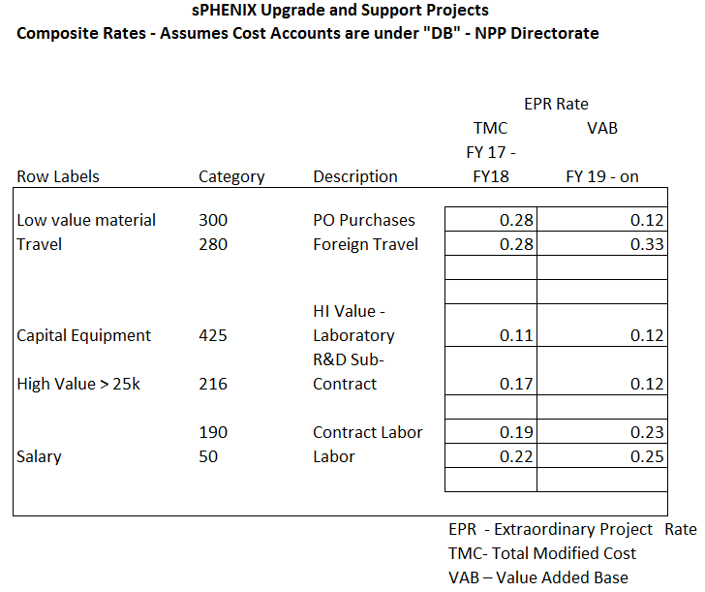
sPHENIX Extraordinary Project Rates

