Slide 1
sPHENIX Detector Overview
John Haggerty
Brookhaven National Laboratory

Slide 2
What is sPHENIX?
sPHENIX is a proposal for a major upgrade to the PHENIX detector capable of making high statistics measurements of:
  Jets with tracking and calorimetric reconstruction
  Jet correlations
  Upsilon states
A proposal in July 2012 led to the DOE reviews in July 2014 and May 2015 affirmed the science case which was subsequently included in the September 2015 NSAC Long Range Plan and led to a CD-0 approval September 2016
A new sPHENIX collaboration was formed in December 2015 which continues to grow to realize this detector and harvest its physics

Slide 3
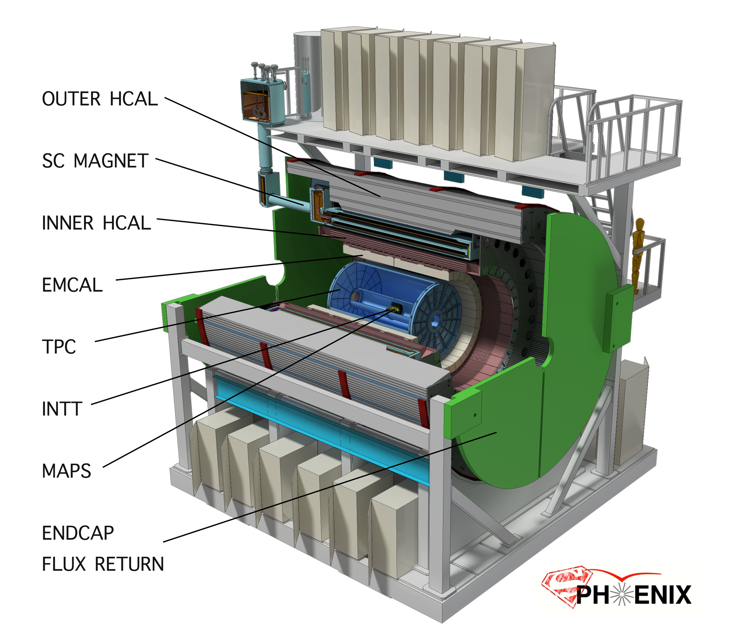
Notes:
Describe detector from outside in

Slide 4
The sPHENIX Detector—Calorimetry
Novel sampling hadronic and electromagnetic calorimetry
  “Tilted plate” HCAL populated with extruded scintillating tiles with light collected by embedded fiber
  Tungsten-scintillating fiber SPACAL with ~7 mm radiation length allows for compact design which can fit inside the solenoid
  In both calorimeters, light collected to SiPM’s which are
    Compact
    Don’t require high voltage
    Work in magnetic field
    Large signal that allows us easily to cable out analog signal
  Common electronics including low cost 60 MHz waveform digitizers

Slide 5
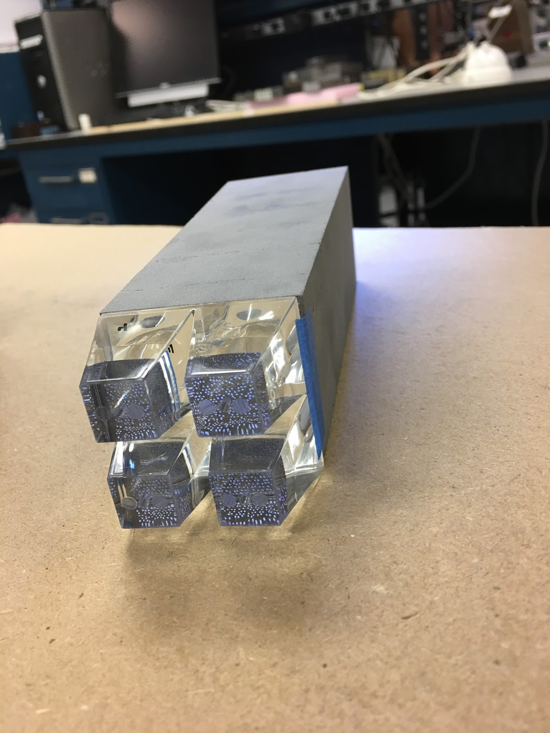
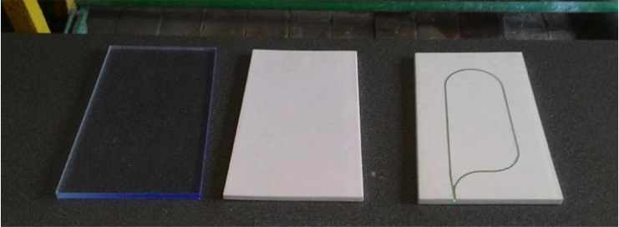
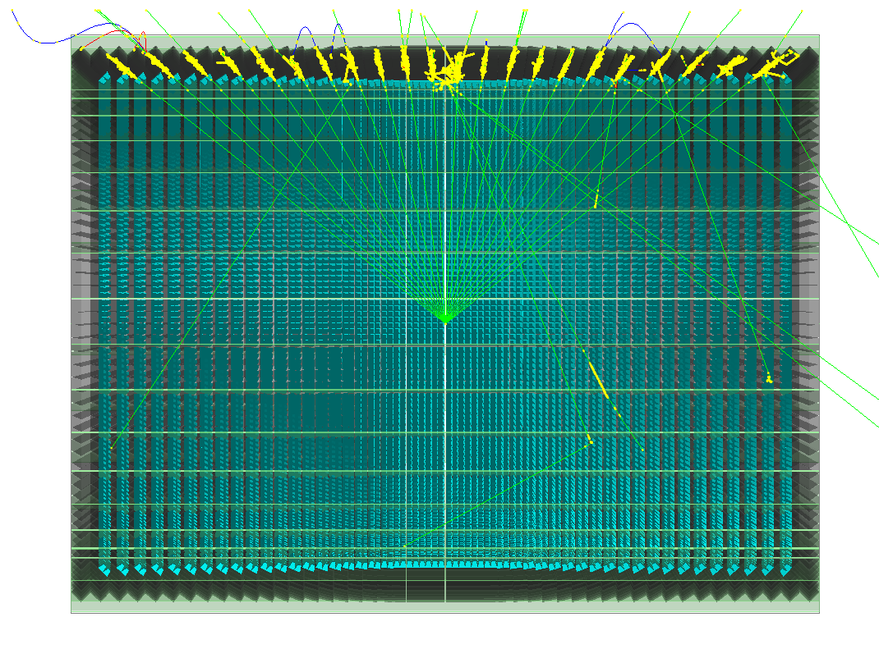
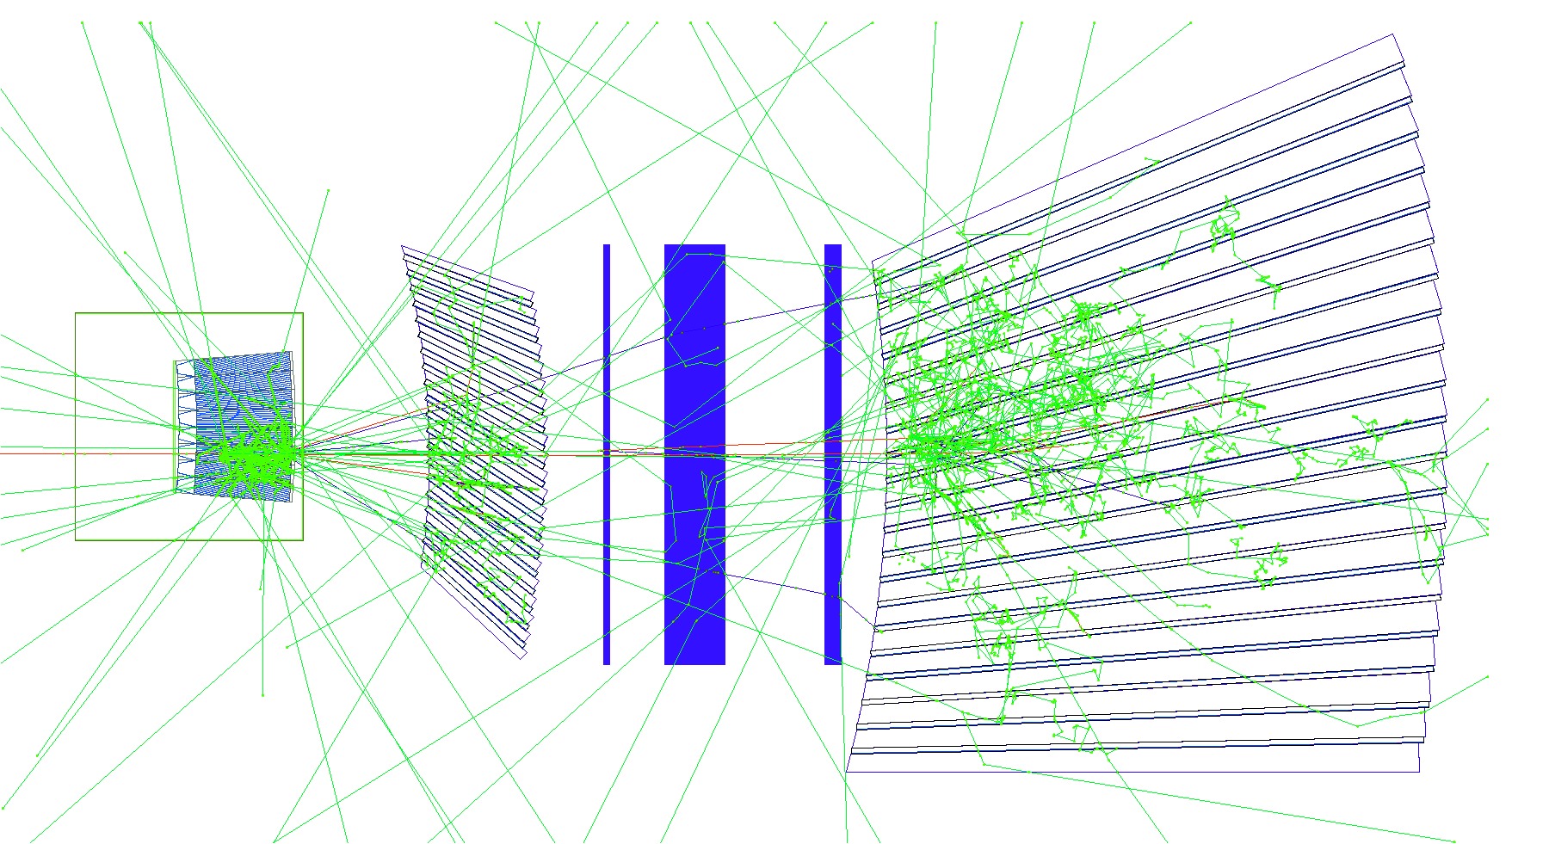
Calorimeters
HCAL tiles
EMCAL towers
GEANT4 simulation

Slide 6
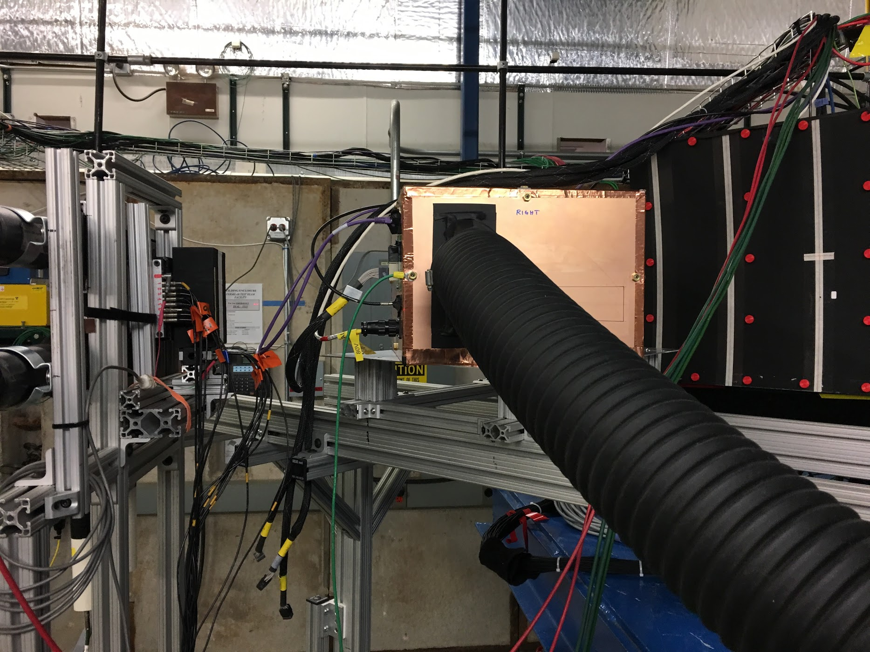
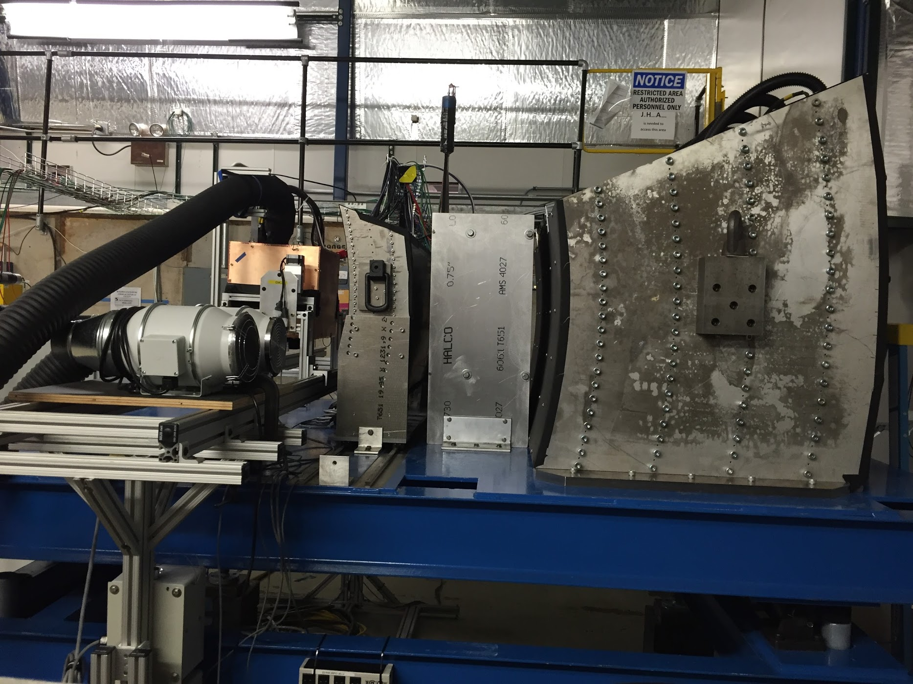
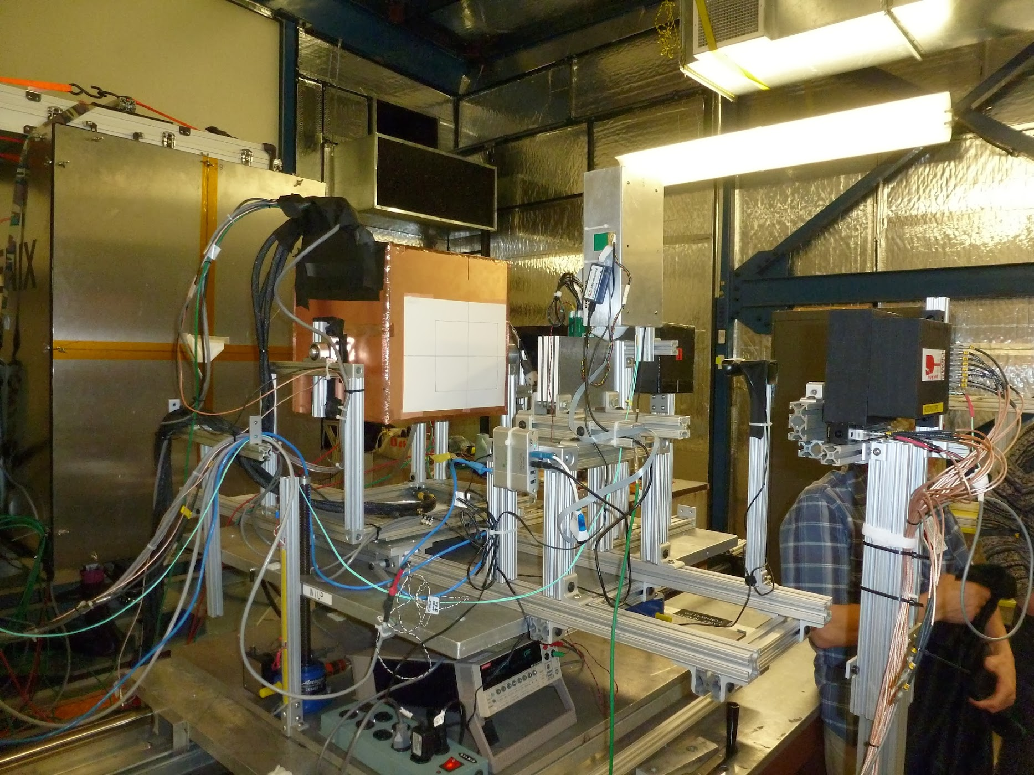
Calorimeter beam tests
February 2014
Proof of principle
February 2016
η~0
sPHENIX geometry
February 2017
η~0.9
https://arxiv.org/abs/1704.01461
(submitted to IEEE TNS)

Slide 7
EMCAL beam tests
Uniformity of tower response studied extensively in beam with electron showers led to better understanding of boundaries and how to minimize the degradation in resolution
Results consistent with simulation
Beam tests of η~0 (2016) and η~0.9 (2017) leading to a final η~0.9 test in 2018 that will meet requirements
Resolution at tower center

Slide 8
HCAL beam tests
Learned calibration techniques, energy response uniformity in tiles

Slide 9
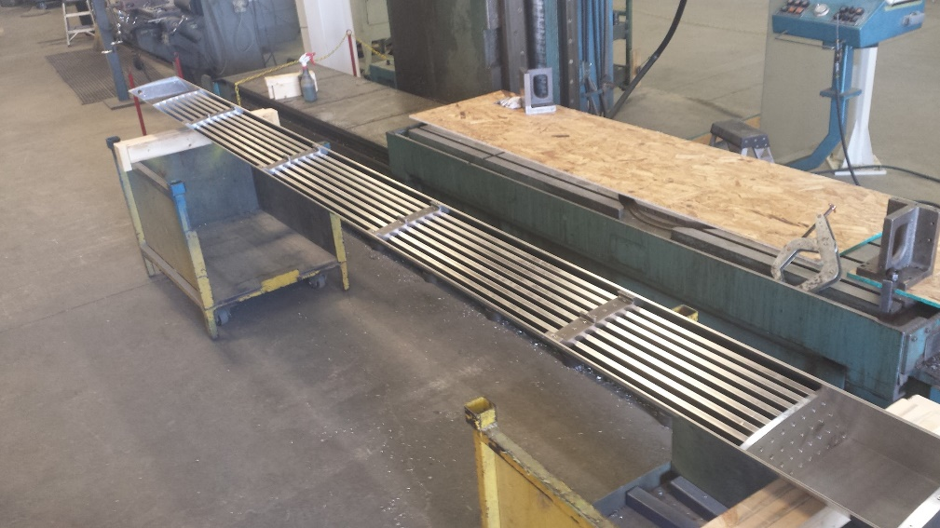
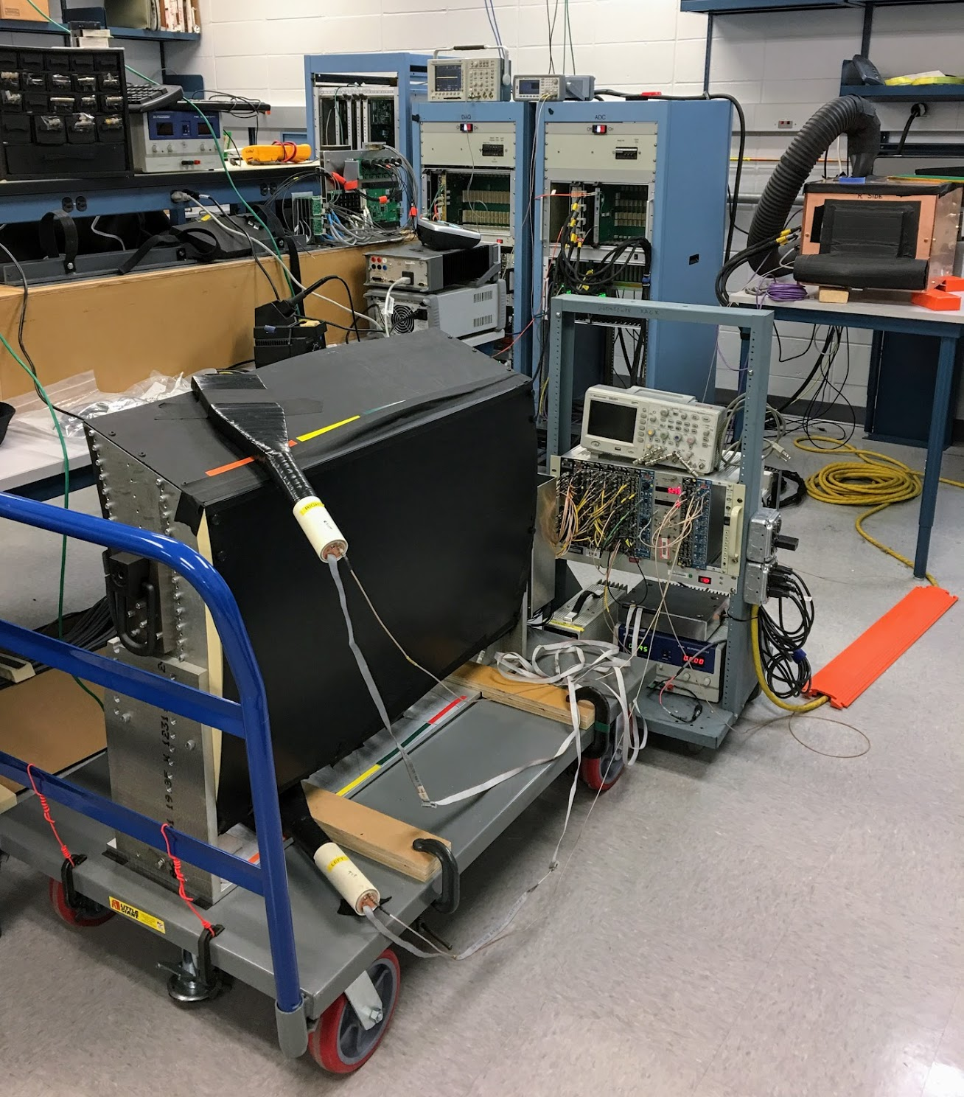
Next steps in calorimetry
“Module 0” prototypes of HCAL this year, half-sector of EMCAL next year
Back to test beam February 2018 with new “production” η~0.9 calorimeters, new “production” digitizers
By this time next year, we aim to have built and operated every piece of the EMCAL and HCAL

Slide 10
Calorimeter electronics
SiPM photodetector selected
Plans for purchase and characterization of SiPM’s being developed
Preamplifiers on the detector which drive differential analog signals out to racks about 10 m away
Waveform digitizers (60 MHz) packaged in VME which transmit data to DCM II’s in counting house
Low voltage, bias voltage, control, temperature compensation

Slide 11
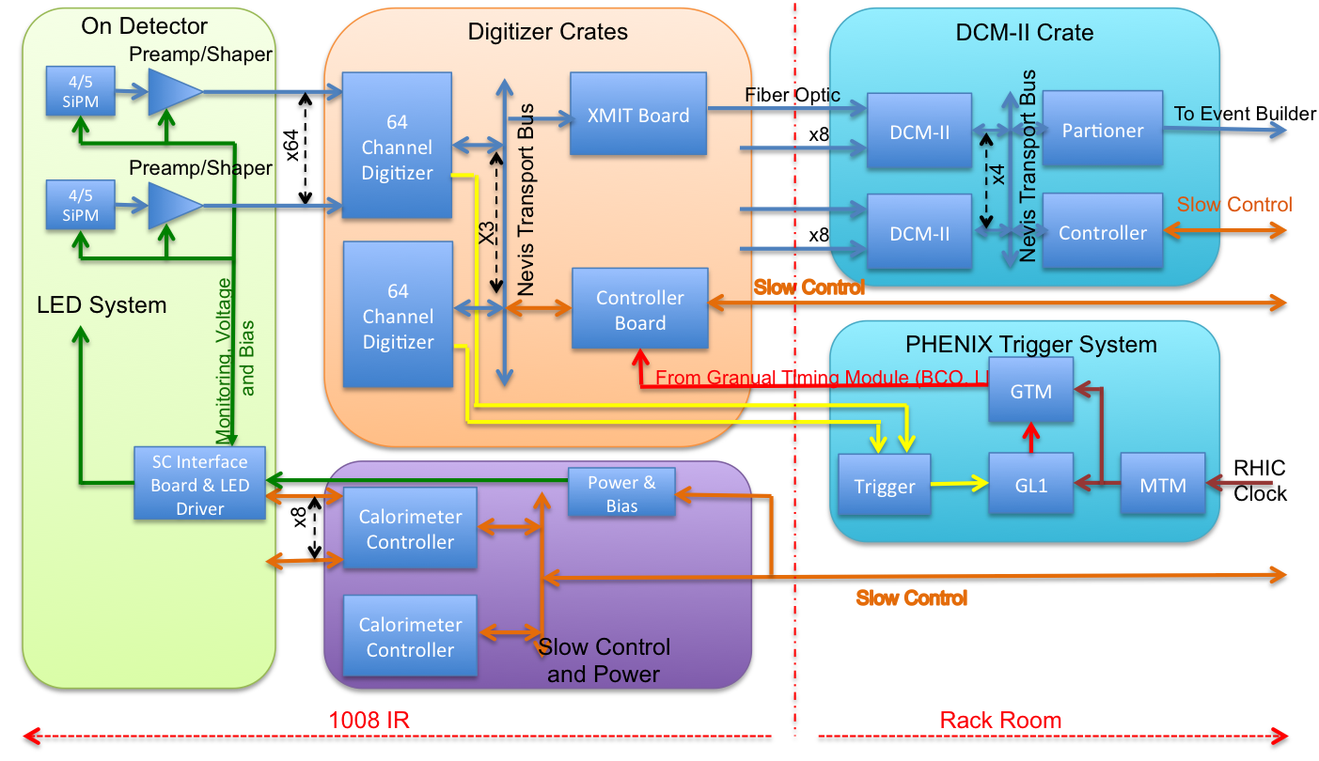
Calorimeter electronics

Slide 12
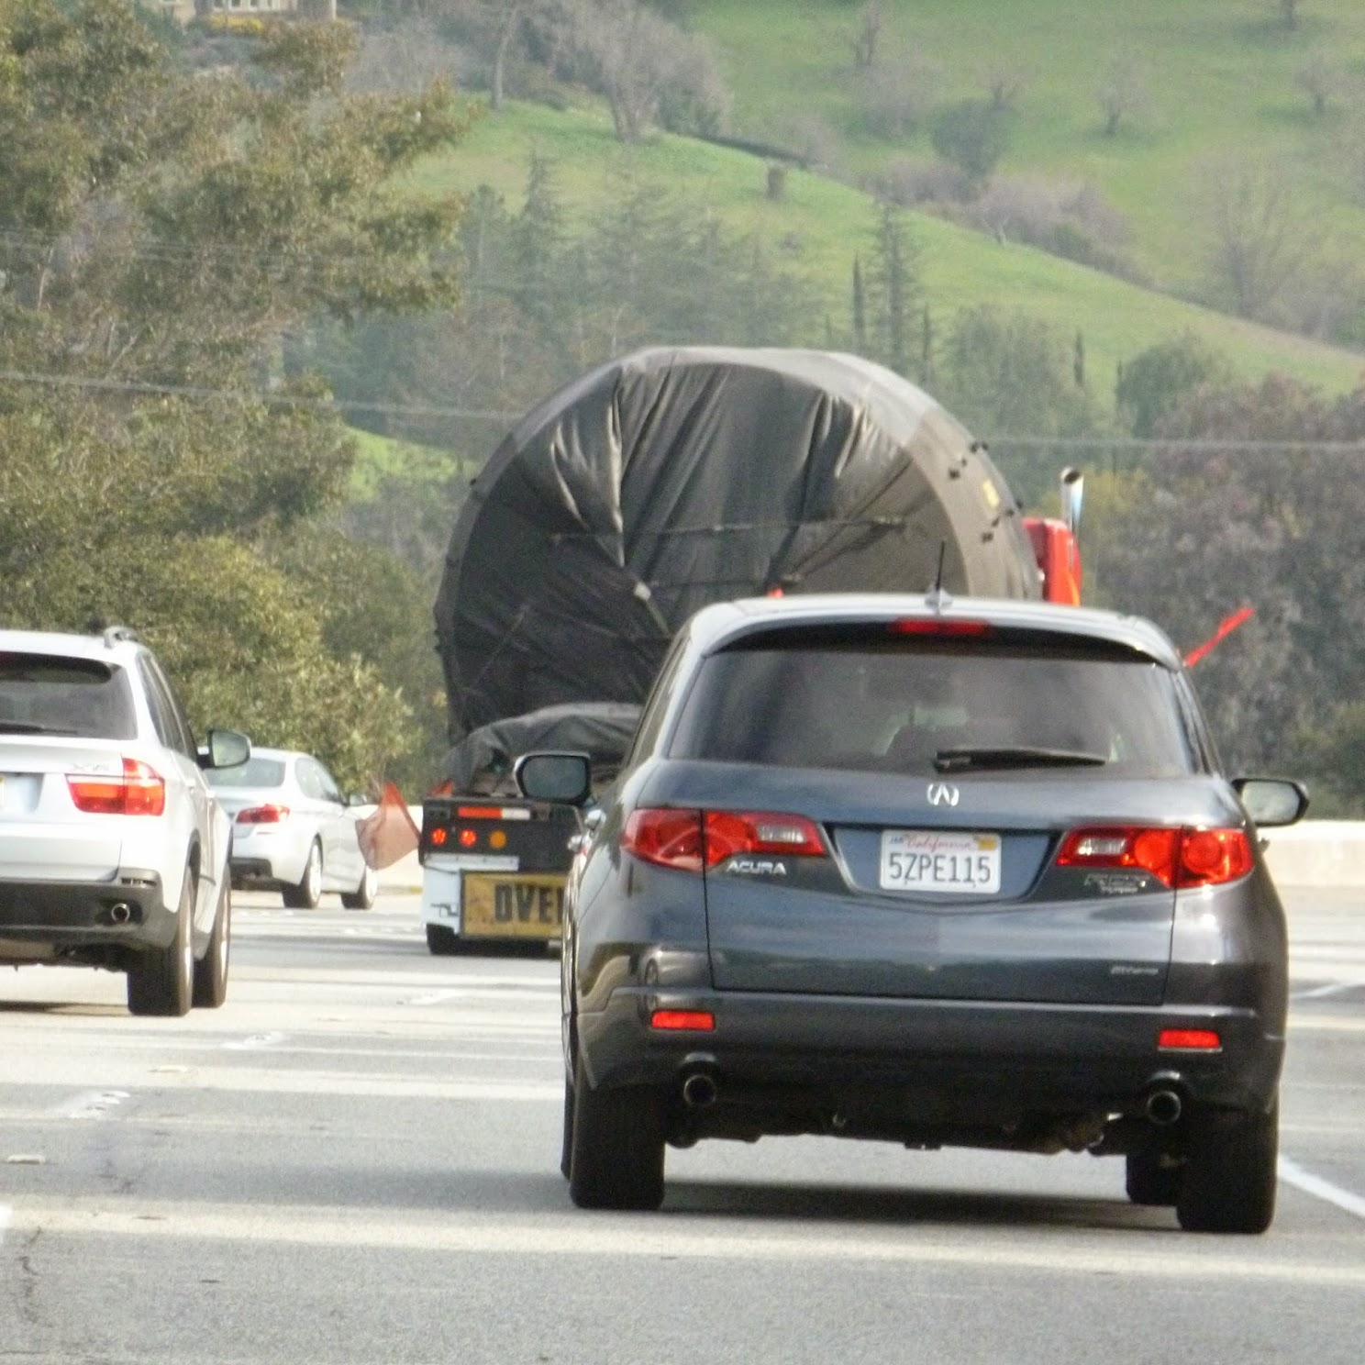
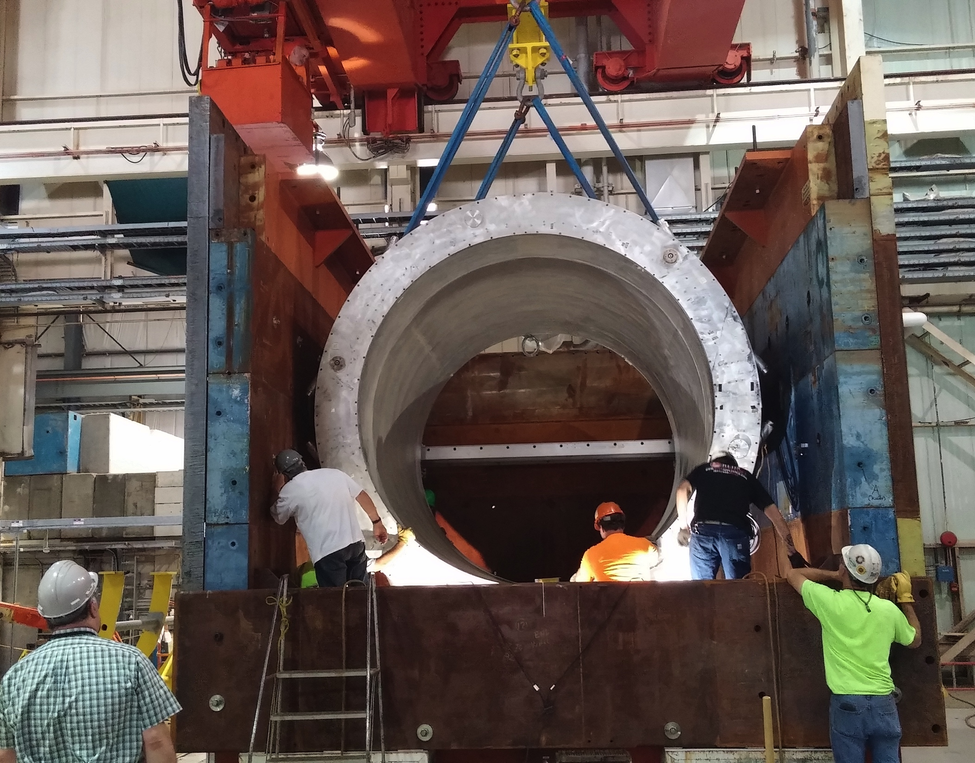
Solenoid magnet
High resolution tracking translates to high field
  1.5 T
  2.8 m bore
  3.8 m long
BaBar solenoid arrived at BNL in February 2015
  Low field test March 2016
  Preparing now for high field test September 2017
Cryo, power supply, and quench protection for 1008 under development
By this time next year, we aim to have tested the magnet at full field

Slide 13
TPC key features
Compact—outer radius 80 cm
3 (radial) x 12 (azimuthal) GEM chambers per end
FEE board being developed around SAMPA ASIC to be used by ALICE and STAR iTPC (no new ASIC development)
Fast gas low diffusion to achieve position resolution < 200 μ
Field distortions minimized by
  Minimize Ion Back Flow by judicious choice of electric field between GEM foils, pioneered by ALICE
  Gas choice (low mass, fast drift)
  High electric field
  Inner field cage 30→20 cm
Continuous readout

Slide 14
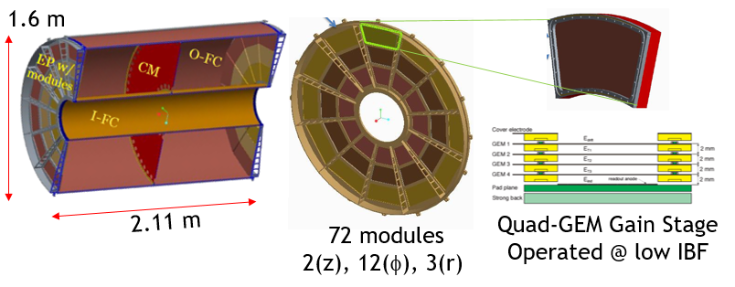
TPC detector overview

Slide 15
TPC Electronics Overview

Slide 16
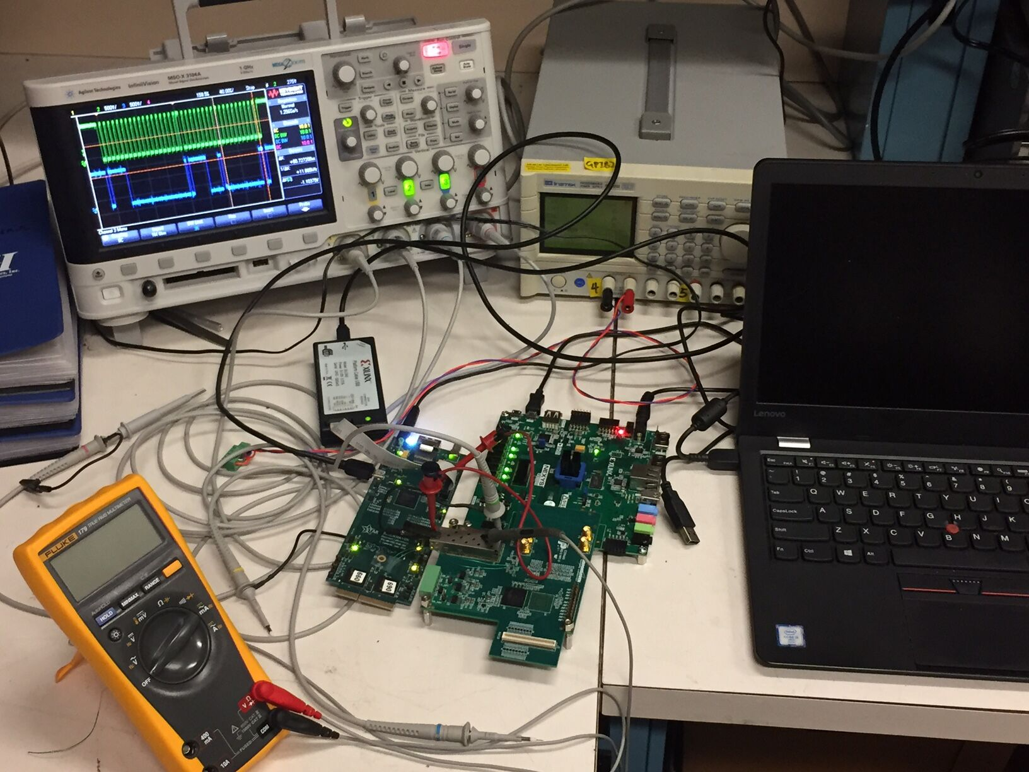
Next steps in TPC
Mechanical design and analysis very advanced
Full size prototype under construction at SBU
Up to 80 kV high voltage material tests
Attempt to optimize pad design
Complete and test prototype field cage
Prototype FEE card
Set up tests with FELIX board
Inner Region Integration Task Force
Simulations
Consider how we can do a truly comprehensive system test

Slide 17
Tracking simulation
Comprehensive tracking simulation and reconstruction is under way and aim to model realistic cluster size and two hit resolution
Material budget and incorporation of hits from INTT and MVTX to be included
Pattern recognition and fitting under intense scrutiny, mass resolution ~90 MeV

Slide 18
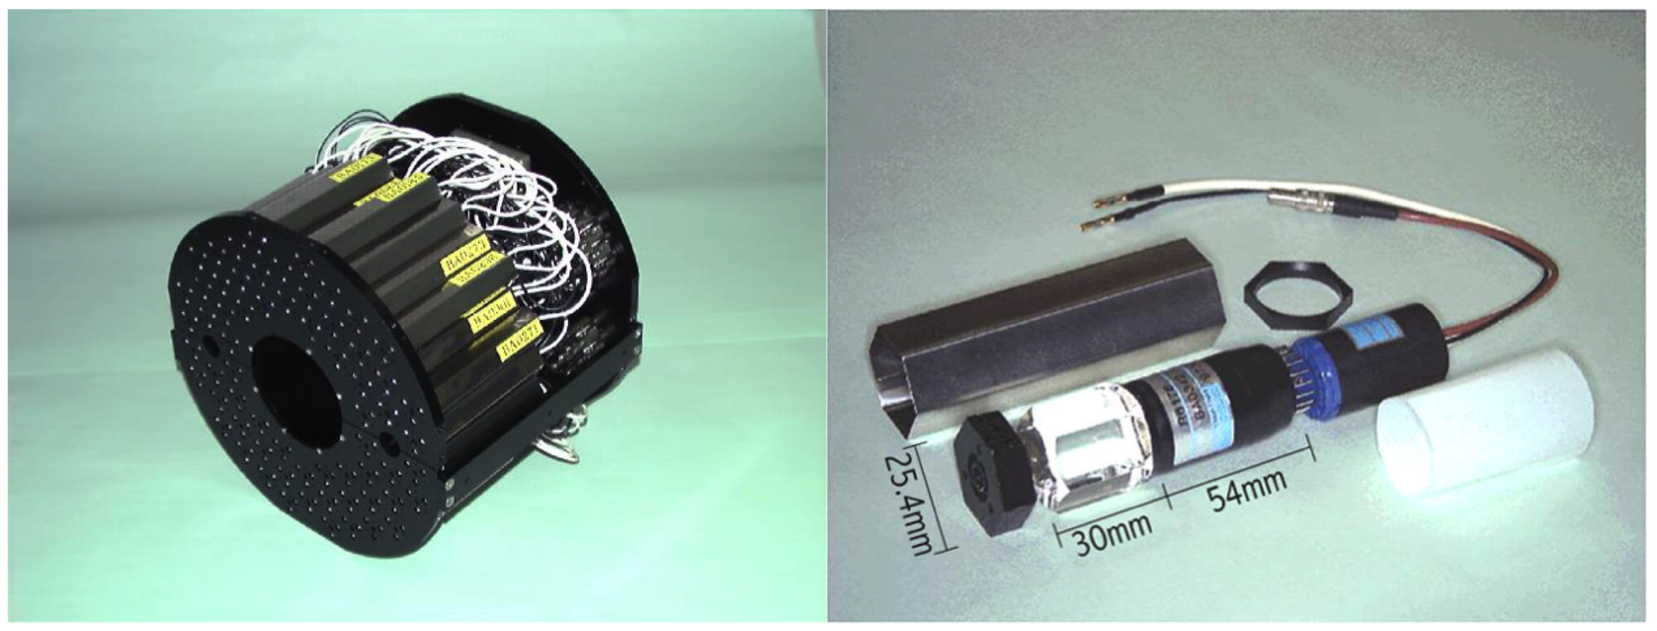
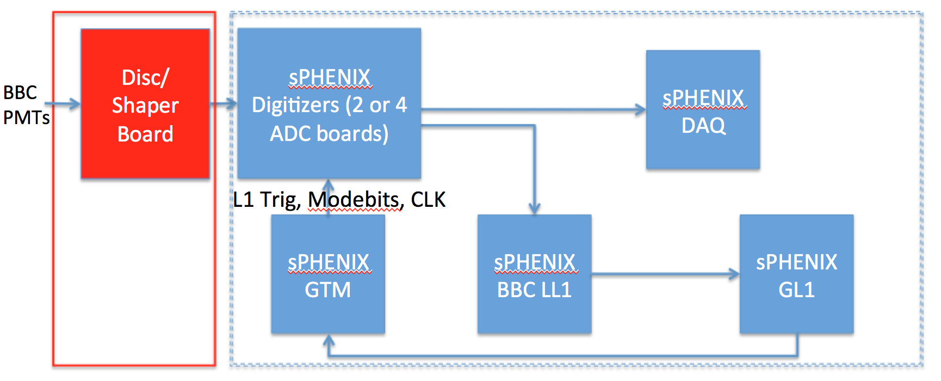
Minimum Bias Detector
This detector was the PHENIX BB counter and we expect to use it in sPHENIX
Existing electronics could be resurrected, but development of a relatively simple shaper board would allow us to use the new calorimeter electronics
PHENIX BB operated in a magnetic field, some testing and judicious choice of location is needed
Trigger based on technology being developed for calorimeter trigger

Slide 19
DAQ
Calorimeter readout uses a modest number of DCM II’s developed for PHENIX, as does INTT
Tests with DCM II achieved 15 kHz/90% live
Modest redesign of timing system and trigger manager (“GTM” and “GL1” in PHENIX parlance)
TPC readout is a significant challenge in data volume and rates, prototyping under way will allow
Data logging rate feasible today, likely to be even more feasible in five years

Slide 20
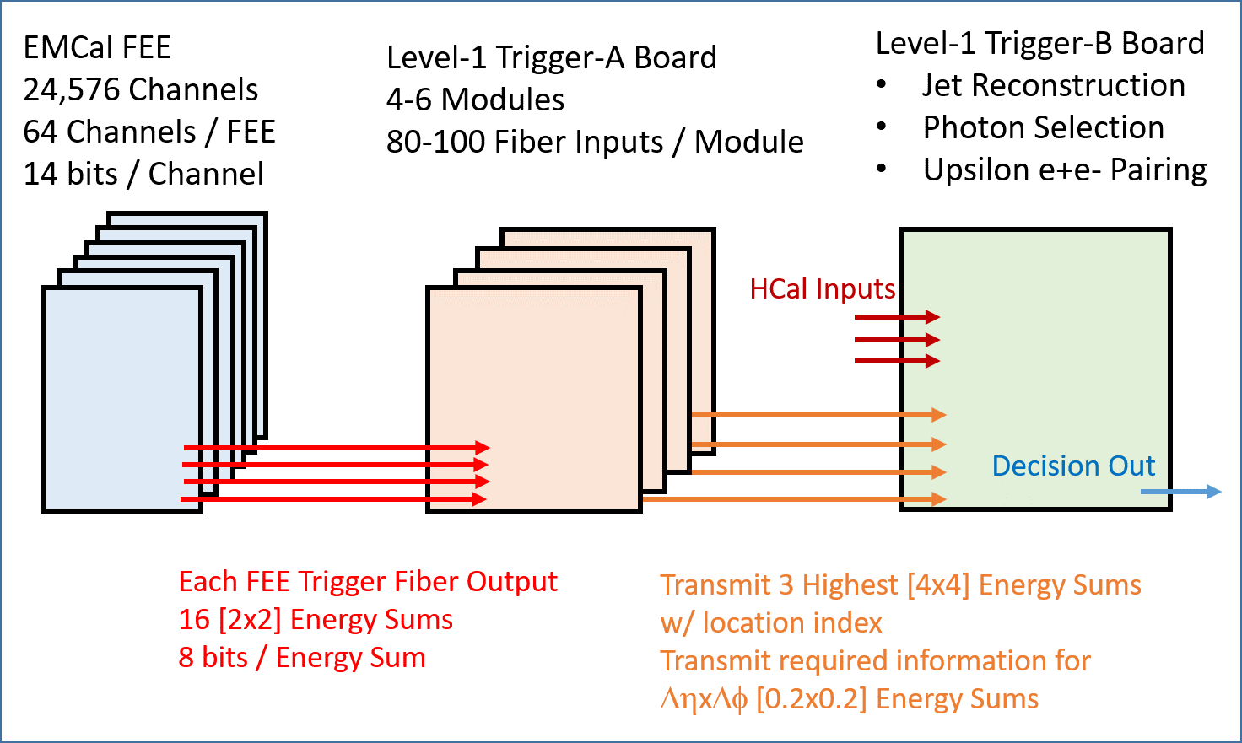
Trigger
Calorimeter electronics is designed to drive for trigger primitives on fiber at crossing rate
Trigger studies/simulation under way

Slide 21
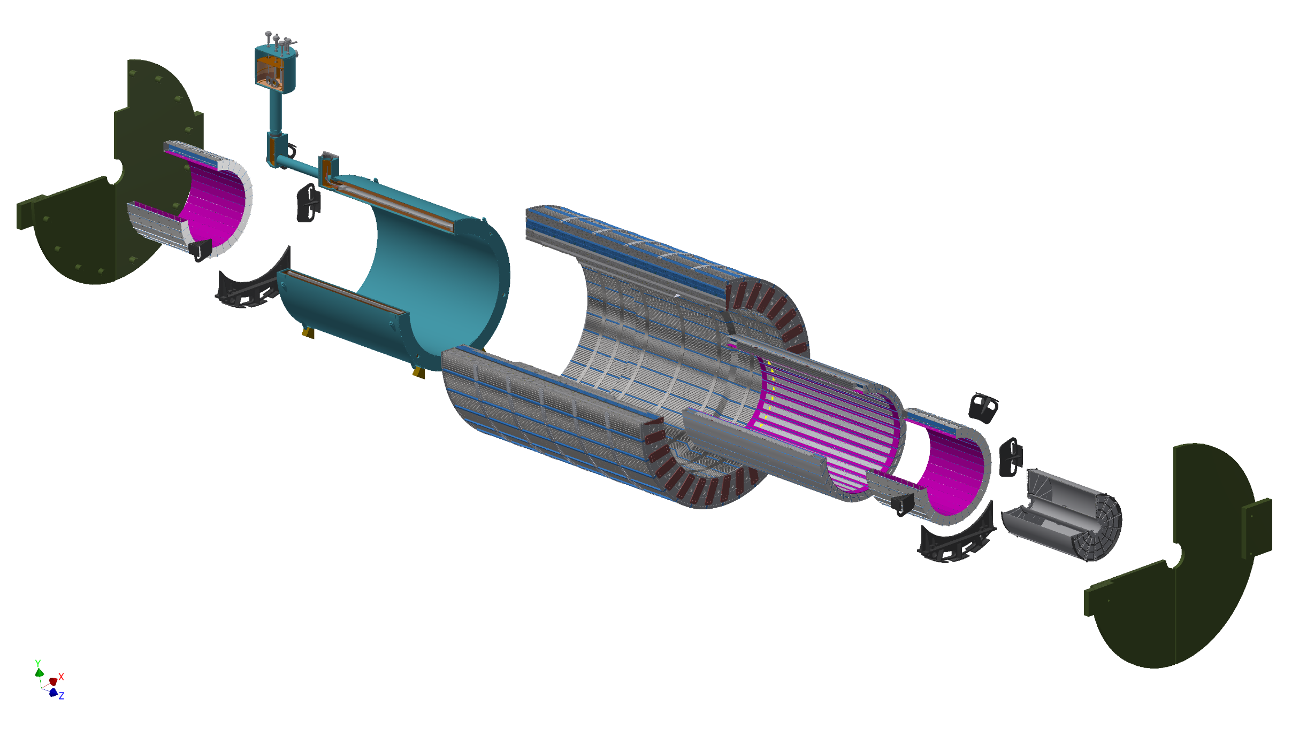
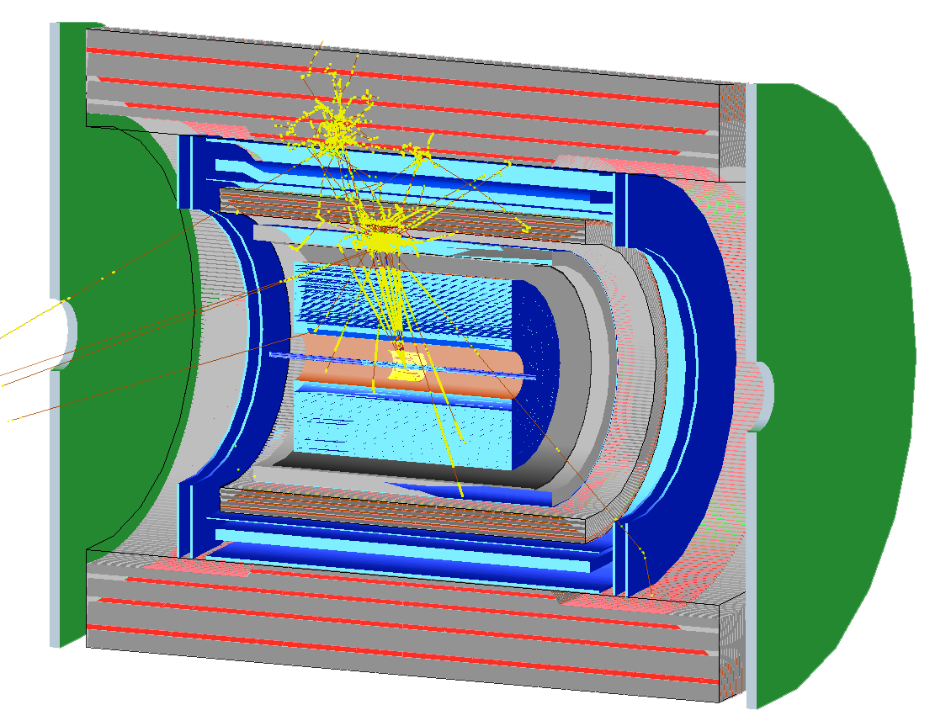
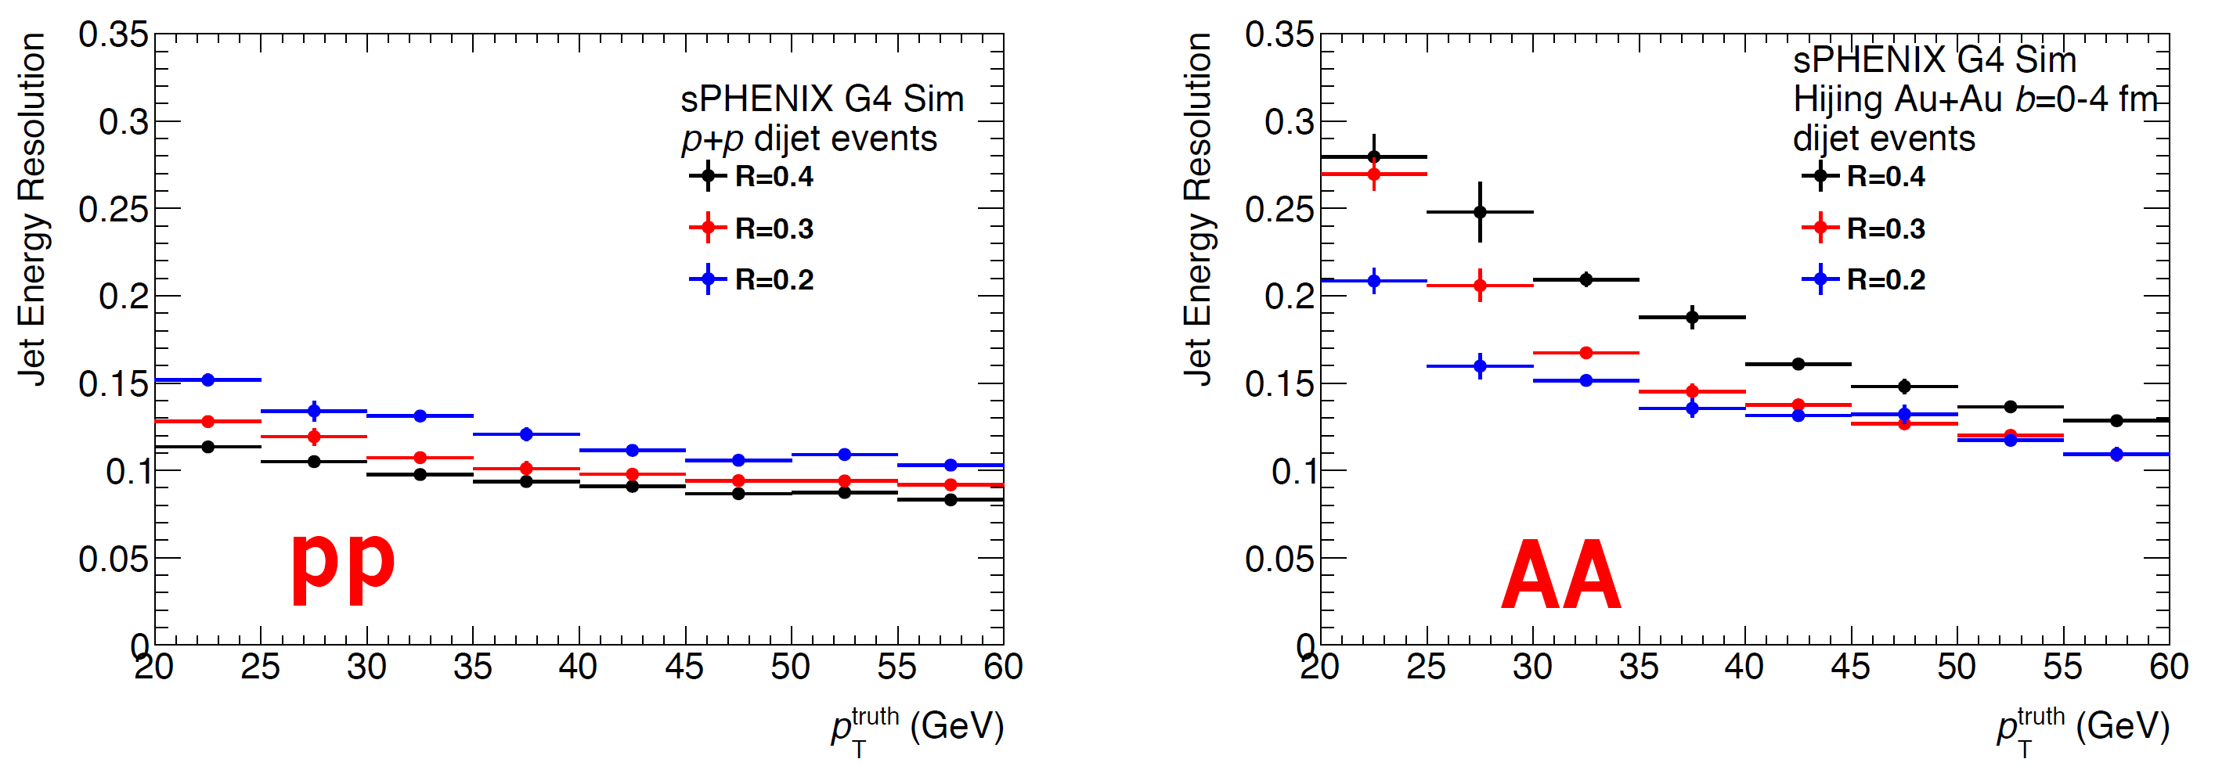
Design, prototype, simulation
Continued design, engineering, and analysis
Ever increasing fidelity to simulations
Another beam test 2/2018
Tests of other detector systems

Slide 22
Summary
We are building sPHENIX with a philosophy of prototype/test/simulate/review to limit surprises at first collisions
Calorimeter and calorimeter electronics very far along the development arc and have achieved required performance; could be ready for production next year, with experience of constructing and handling full size prototypes
The magnet will be tested at full field in the next few months
The TPC and the TPC electronics are deep into development, and rely on technology being developed for ALICE and STAR
The MBD detector exists and needs a modest amount of testing and development
DAQ and Trigger build on PHENIX experience, but need the first round of hardware to establish that the reference design is practical

