Slide 1
sPHENIX Director’s Review
August 2-4, 2017
BNL

Slide 2
CD-1 Documentation Status
James Mills
Brookhaven National Laboratory
mills@bnl.gov
631-344-4908

Slide 3
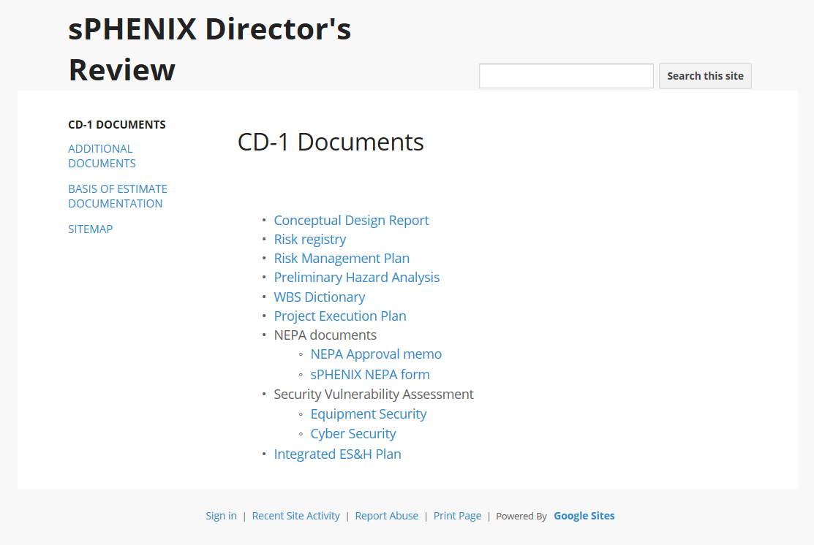
Access to CD-1 Documentation
Link:
https://sites.google.com/site/sphenixdirectorsreview/

Slide 4
The Continuous Flow and Updating of Information
Continuous Flow and Updating of Information

Slide 5
CD-1 Review Document Status
Integrated Project Team and Organization Chart - Complete
WBS (WBS Dictionary) - Updated
Basis of Estimate - Updated
Contingency Risk/Analysis - Updated
Resource Loaded Schedule
Activity List & Activity Attributes - Updated
Project Schedule – Updated
Critical Milestones – Updated
Proposed Funding Profile – Updated
Proposed Labor Profile - Updated
sPHENIX L2 Mangers, CAMs, Assigned Engineering and Design Staff
sPHENIX L2, CAMs, Project Office, and Engineers

Slide 6
CD-1 Review Document Status
Preliminary Hazard Analysis Report - Draft
NEPA Document - Complete
Integrated Safety Management Plan- Draft
Conceptual Design/Conceptual Design Report- Advanced Design/ Advanced Draft
Acquisition Strategy- In Development
Close all previous review recommendations - Ongoing
Preliminary Project Execution Plan - Draft
Preliminary Risk Management Plan - Initial Release for Use
Preliminary Risk Assessment and Risk Registry - Advanced Draft
Preliminary Security Vulnerability Assessment (Short security equipment protection & cyber security) - Complete
Alternate Analysis- For the PEP includes scientific alternatives - In Development
Integrated Safety, ESH
Risk Management

Slide 7
Additional Engineering Project Controls and Work Management Documents
sPHENIX Procedure Guidelines- Pending Release
sPHENIX Configuration Management- Pending Release
sPHENIX Document Control- Pending Release
sPHENIX Quality Assurance Plan- Pending Release
sPHENIX Work Planning- Pending Release
sPHENIX Awareness Training- Pending Release
sPHENIX Bottom’s-Up Contingency Guidelines- Released and Distributed
Interface Control Document/Interface Design Drawing – Draft Template/Released and Under Revision Control

Slide 8
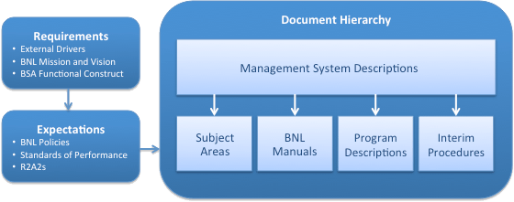
Standards Based Management (SBMS)
Brookhaven National Laboratory SBMS
The Standards-Based Management System (SBMS) provides Laboratory-wide procedures and guidelines for performing work safely and in compliance with requirements. All work at the Laboratory must comply with the minimum requirements specified in SBMS documents, including management system descriptions, subject areas, interim procedures, BNL manuals, and program descriptions.
sPHENIX Engineering Project Controls and Work Management Documents will meet all SBMS requirements but will be tailored to address complex multiple institutional and departmental collaborations.

Slide 9
Project Management (SBMS)
Management System: Project Management
Introduction
This subject area provides Laboratory-wide requirements and procedures for managing work at Brookhaven National Laboratory (BNL) that is subject to DOE’s Project Management system. Compliance with requirements of Appendix A of DOE Order 413.3B is required for all capital asset acquisitions with a total project cost (TPC) that is greater than or equal to $50 million.

Slide 10
Engineering Design (SBMS)
Subject Area: Engineering Design
Introduction
This subject area describes how to create, modify, distribute, and review engineering calculations, drawings and specifications, and establish configuration control (see the Configuration Management Program Description, or contact the Configuration Management Subject Matter Expert) for both equipment used for scientific purposes and facility construction. It provides for the verification and validation of design adequacy by Technical Authorities (i.e., competent individuals, approved by management, other than those who performed the work), before the approval and implementation of the design. It uses a process that fosters the use of sound engineering/scientific principles, risk management, and standards for design work.

Slide 11
Work Planning (SBMS)
Subject Area:
Work Planning and Control for Experiments and Operations
Introduction
This subject area uses the Integrated Safety Management core functions and guiding principles to establish a process for ensuring all work, operational and experimental, is properly planned and implemented to prevent accidents, injuries, and regulatory violations. It establishes requirements at Brookhaven National Laboratory (BNL) so that all work is properly managed by using a level of planning and control commensurate to the Environment, Safety, Security, and Health (ESSH) hazards, job complexities, and work coordination needs.
Line management is directly responsible for the protection of the public, the workers, and the environment.

Slide 12
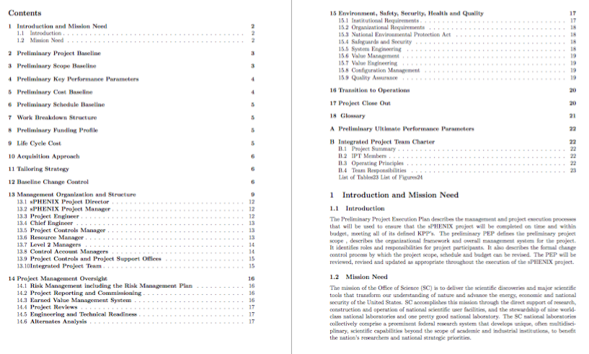
Project Execution Plan
Preliminary Key Performance Parameters
Organization Chart
Roles and Responsibilities
Preliminary Schedule
Preliminary WBS
Preliminary Cost Baseline and Funding Profile
Environmental, Safety, and Health
Project Management Oversight and Controls

Slide 13
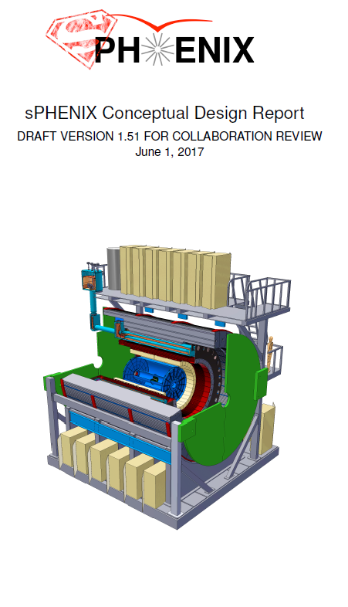
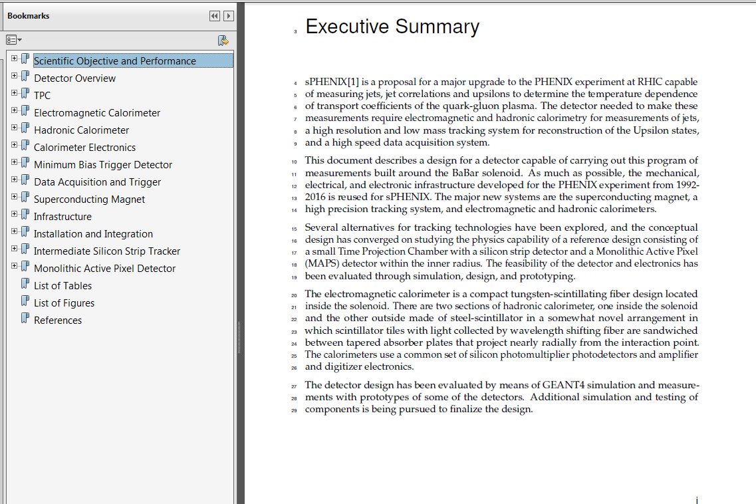
Conceptual Design Report

Slide 14
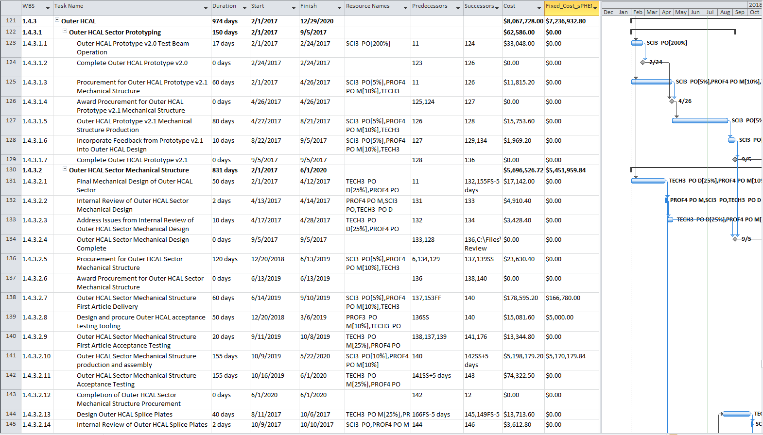
sPHENIX MS Resource Loaded Schedule
1850+ Tasks and Summary Tasks – Built from Bottom – Up
Fully Developed by L2 Managers and CAMs Integrated by L2 Managers, CAMs and Project Office
Tentative CD-1/CD-3a Authorization – 12/20/2018
Tentative CD-3b Authorization – 8/30/2019
Reconciled BOE to RLS Discrepancies – 7/7/2017
Schedule/Total Cost/Fixed Cost/Resources
Critical Path/Milestones

Slide 15
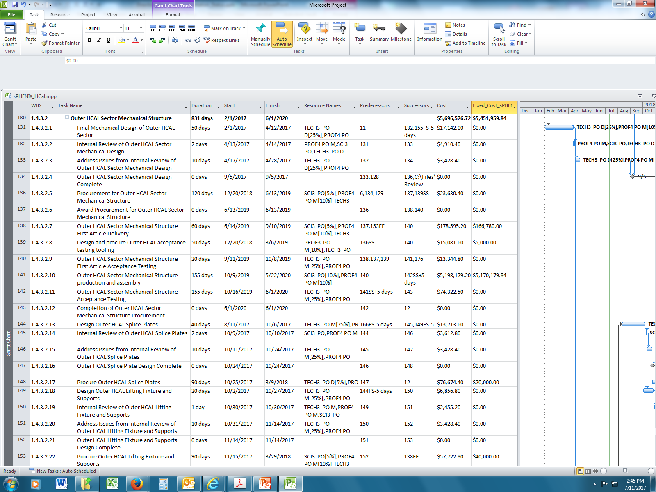
sPHENIX MS Project Plan

Slide 16
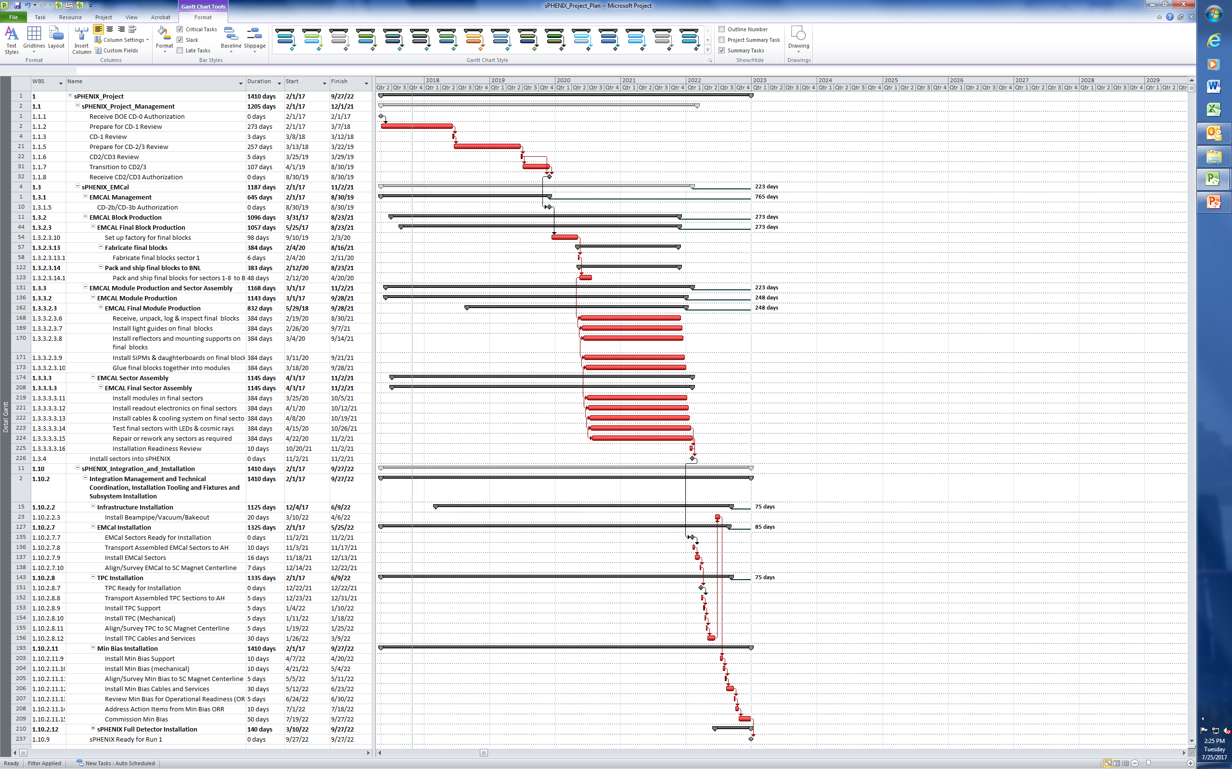
Critical Path Through EMCal Block and Module Production

Slide 17
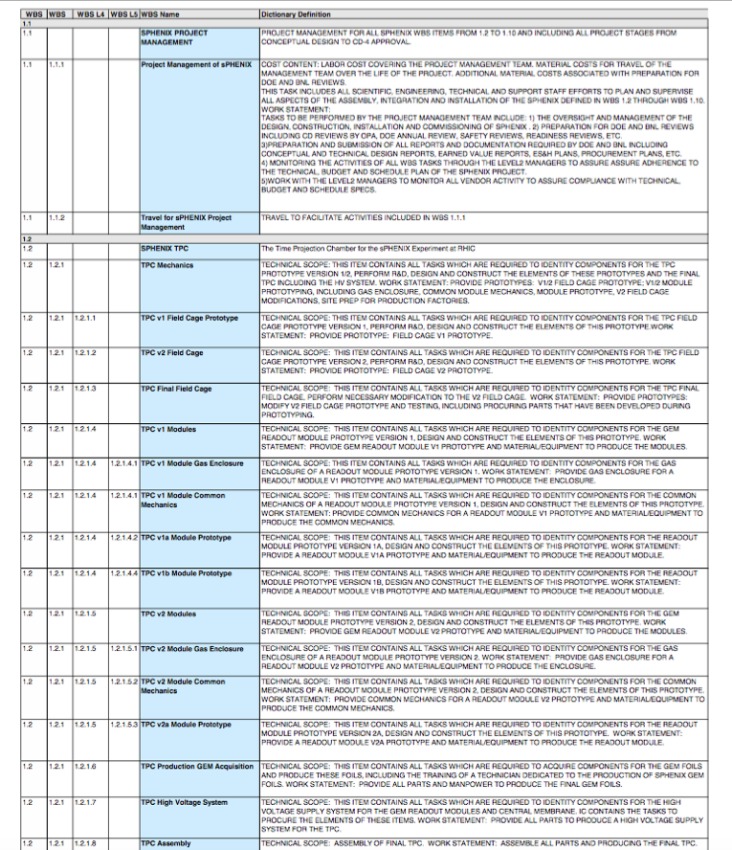
sPHENIX WBS Dictionary
Defined to
Work Package Level

Slide 18
sPHENIX WBS Dictionary – Examples
WBS Dictionary to Work Package Level (Deliverable)
1.2 1.2.1 1.2.1.1 TPC v1 Field Cage Prototype
TECHNICAL SCOPE: THIS ITEM CONTAINS ALL TASKS WHICH ARE REQUIRED TO IDENTITY COMPONENTS FOR THE TPC FIELD CAGE PROTOTYPE VERSION 1, PERFORM R&D, DESIGN AND CONSTRUCT THE ELEMENTS OF THIS PROTOTYPE.WORK STATEMENT: PROVIDE PROTOTYPE: FIELD CAGE V1 PROTOTYPE.
1.4 1.4.2 1.4.2.2 Outer HCAL Sector Mechanical Structure
TECHNICAL SCOPE: THIS ITEM CONTAINS ALL TASKS WHICH ARE REQUIRED TO IDENTITY COMPONENTS FOR THE OUTER HCAL MECHANICAL STRUCTURE, DESIGN AND CONSTRUCT THE MECHANICAL ELEMENTS OF THE OUTER HADRONIC CALORIMETER. WORK STATEMENT: PROVIDE OUTER HADRONIC CALORIMETER MECHANICAL STRUCTURE.

Slide 19
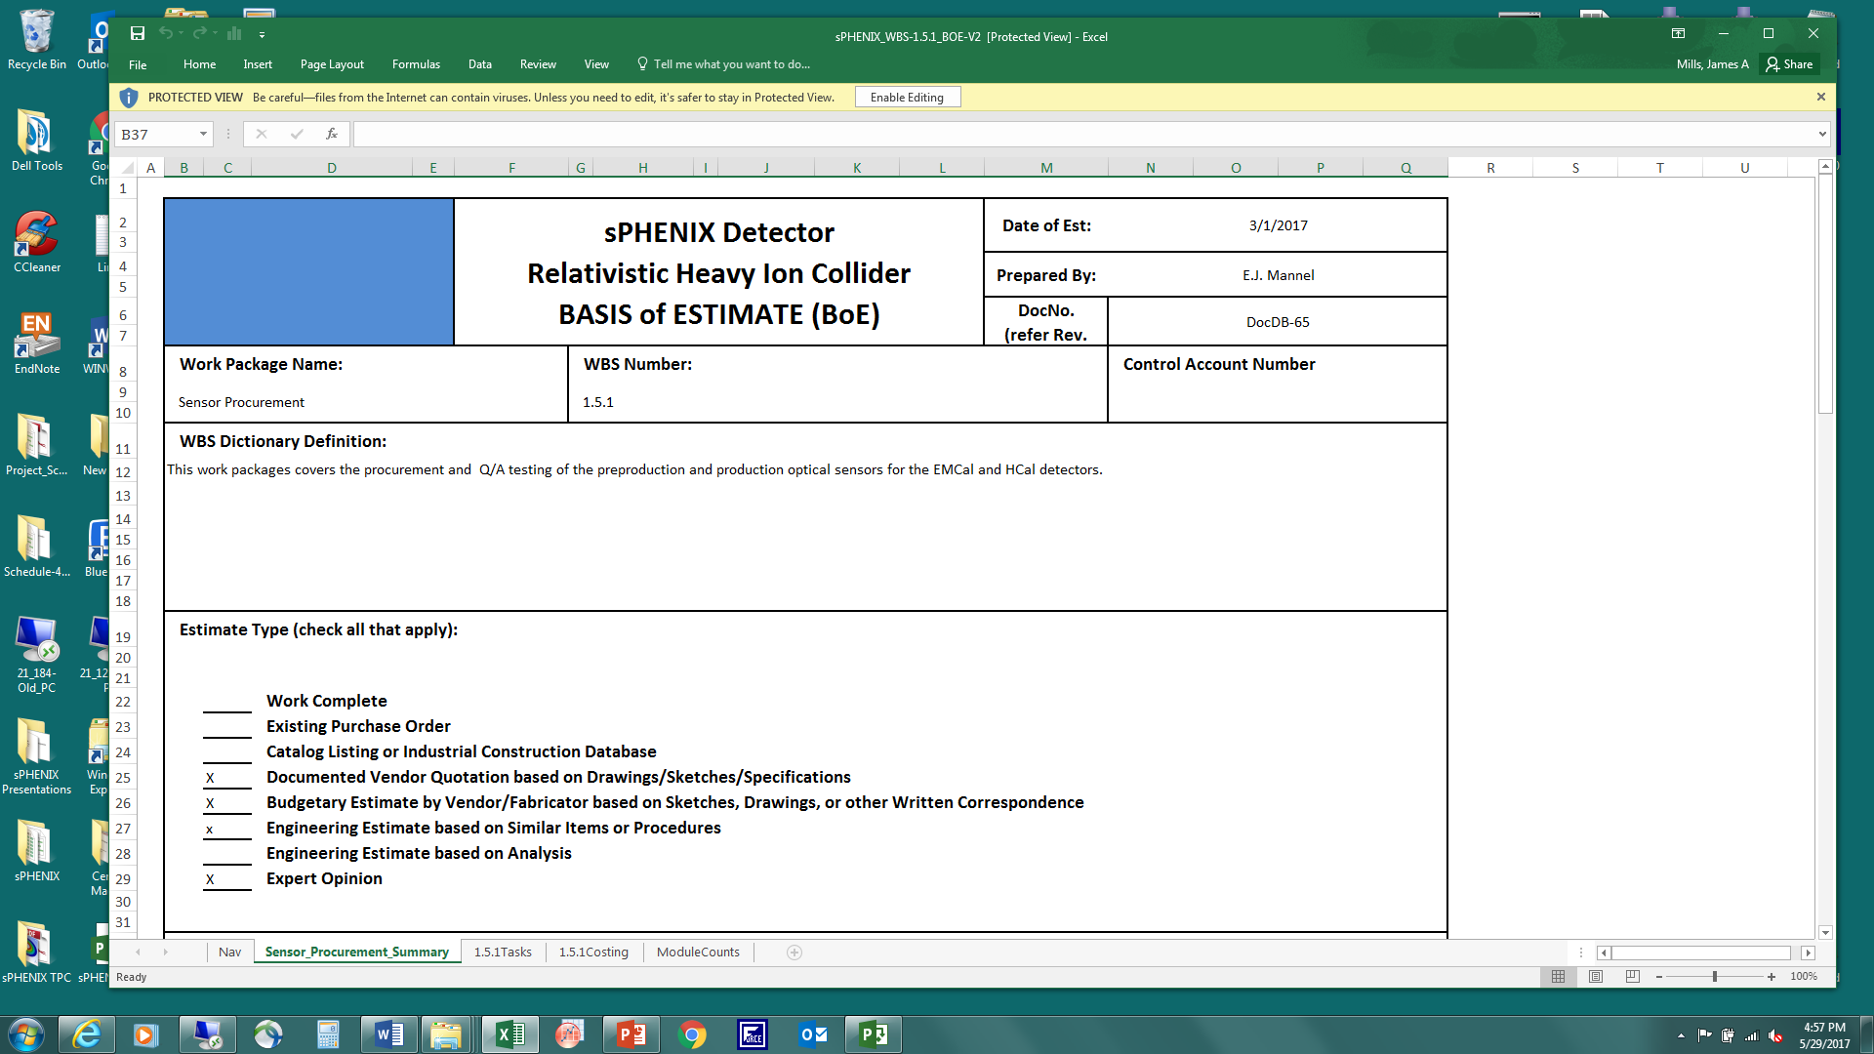
sPHENIX Basis of Estimate
See next slide

Slide 20
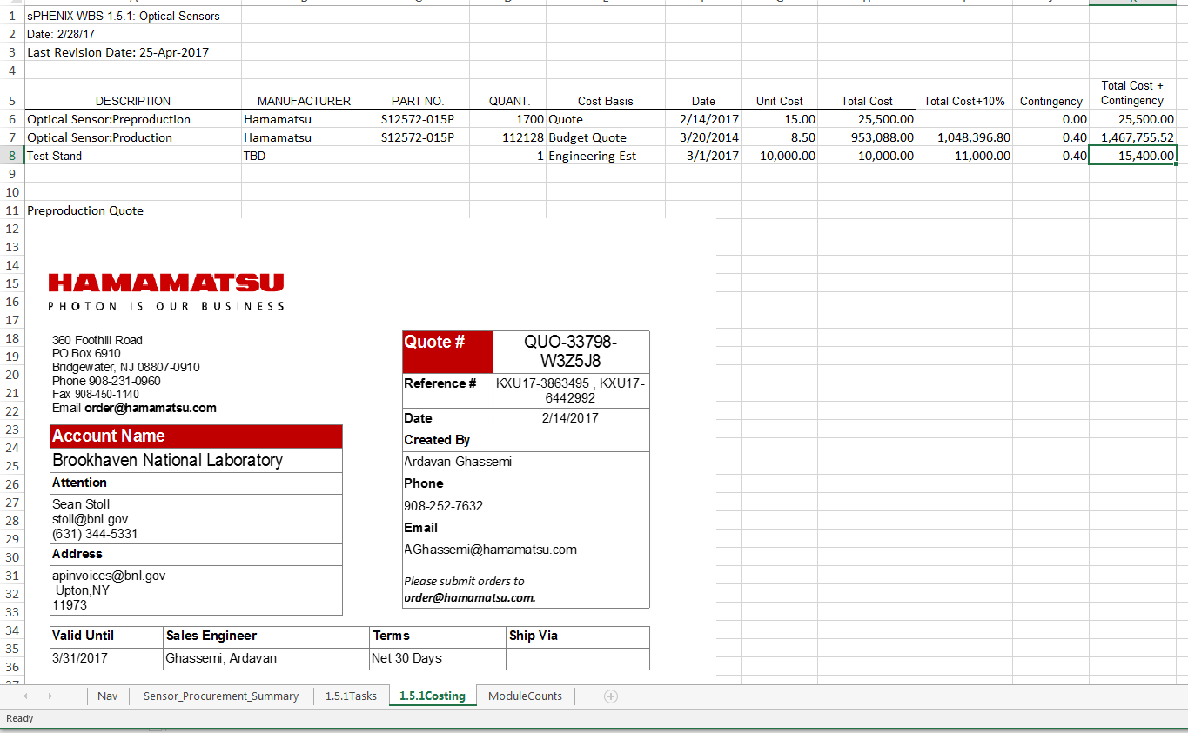
sPHENIX Basis of Estimate

Slide 21
sPHENIX BOE Contingency Guidelines
Labor Bottom-Up Contingency - Uniformly Graded Approach to Risk Across All Subsystems
 | Type of Estimate | Contingency % | Description
L1 | Actual | 0% | Actual costs incurred on activities completed to date.
L2 | Level of Effort Tasks | 0%-20% | Support type activities that must be done to support other work activities or the entire project effort, where estimated effort is based on the duration of the activities it is supporting.
L3 | Advanced | 10%-25% | Based on experience with documented identical or nearly identical work. Development of activities, resource requirements, and schedule constraints are highly mature. Technical requirements are very straightforward to achieve.
L4 | Preliminary | 25%-40% | Based on direct experience with similar work. Development of activities, resource requirements, and schedule constraints are defined as preliminary (beyond conceptual) design level. Technical requirements are achievable and with some precedent.
L5 | Conceptual | 40%-60% | Based on expert judgment using some experience as a reference. Development of activities, resource requirements, and schedule constraints are defined at a conceptual level. Technical requirements are moderately challenging.
L6 | Pre-conceptual | 60%-80% | Based on expert judgment without similar experience. Development of activities, resource requirements, and schedule constraints are defined at a pre-conceptual level. Technical requirements are moderately challenging.
L7 | Rough Estimate | 80%-100% | Based on expert judgment without similar experience. Development of activities, resource requirements, and schedule constraints is largely incomplete. Technical requirements are challenging.
L8 | Beyond state of the art | > 100% | No experience available for reference. Activities, resource requirements, and schedule constraints are completely undeveloped. Technical requirements are beyond state of the art.

Slide 22
sPHENIX BOE Contingency Guidelines
Materials Bottom-Up Contingency
Uniformly Graded Approach to Risk Across All Subsystems
Code | Type of Estimate | Contingency % | Description
M1 | Existing Purchase order | 0% | Items have been completed or obligated. (Note: Contact Change Orders are considered a Risk and should not be included )
M2 | Procurement for LOE/Oversight work | 0%-20% | M&S items such as travel, software purchases and upgrades, computers, etc. estimated to support LOE efforts and other work activities.
M3 | Advanced | 10%-25% | Items for which there is a catalog price or recent vendor quote based on a completed or nearly completed design or an existing design with little or no modifications and for which the costs are documented.
M4 | Preliminary | 25%-40% | Items that can be readily estimated from a reasonably detailed but not completed design; items adapted from existing designs but with moderate modifications, which have documented costs from past projects. A recent vendor survey (e.g., budgetary quote, vendor RFI response) based on a preliminary design belongs here.
M5 | Conceptual | 40%-60% | Items with a documented conceptual level of design; items adapted from existing designs but with extensive modifications, which have documented costs from past projects.
M6 | Pre-conceptual - Common work | 60%-80% | Items that do not have a documented conceptual design, but do have documented costs from past projects. Use of this estimate type indicates little confidence in the estimate. Its use should be minimized when completing the final estimate.
M7 | Pre-conceptual - Uncommon work | 80%-100% | Items that do not have a documented conceptual design, and have no documented costs from past projects. Its use should be minimized when completing the final estimate.
M8 | Beyond state of the art | > 100% | Items that do not have a documented conceptual design, and have no documented costs from past projects. Technical requirements are beyond the state of the art.

Slide 23
sPHENIX Risk Registry
 | sPHENIX Risk Registry
Owner | WBS | Risk Name | Risk trigger (if) | Consequences (then) | Timeframe | Probability | Impact | Rank | Mitigation Plan
E.O’Brien | 1.1 Management | Departure of Key Personnel | Someone critical to the Project informs of his intention to leave sPHENIX | Schedule delay occurs | all | 10% | Schedule: 3 months | Low | Closely work with sPHENIX collaboration to identify a potential replacement.
E.O’Brien | 1.1 Management | Safety incident | Safety incident resulting in injury | Schedule delay occurs | all | 5% | Schedule: 1 month | Low | Carefully plan all work in accordance with BNL SBMS. Include safety reviews and safety review recommendations implementation in sPHENIX resource loaded schedule.
E.O’Brien | 1.1 Management | Funding profile stretches | Funds not available on time | Cost increases because procurements need to be broken down into smaller units, or existing quotes expire, or new contracts need to be negotiated. | production | 50% | Schedule: 12-24 months Cost: $500K | High | Work closely with the funding agency so any funding profile changes can be evaluated as early as possible and sPHENIX Project schedule optimally adjusted to match the new funding profile.
E.O’Brien | 1.1 Management | Infrastructure support delayed | Infrastructure milestone is delayed | Project activities dependent on Infrastructure milestone are delayed | all | 5% | Schedule: 2 months | Low | Develop a detailed resource loaded schedule with key milestones for Infrastructure support and closely monitor this schedule for risk triggers.
T. Hemmick | 1.2 TPC | Procure v1a GEMs | Delivery date on v1-shapes GEMs leaves less than one month before magnet test. | The test will require that we use existing GEMs which will be 10x10cm^2. This will require a special module to adapt the smaller square GEMs to the standard opening. | R&D Phase | 20% | Cost $10k for square-GEM adapter parts | Low | In case the proper GEMs for the v1a prototype are not in hand, an adapter plate will be requires to fit an existing GEM-stack to allow the magnet test to proceed.
T. Hemmick | 1.2 TPC | Performance failure of v2 prototype | The v2 prototype fails in any performance criterion that requires more thasn trivial re-design. | If the v2 prototype fails, then there will need to be a v3 prototype added to the cycle. | R&D phase | 5% | Schedule: 2 months of float lost. Cost:$15k (only gain structure at risk…new GEMs) | Moderate | We will add a design cycle of a smaller device than the full sized field cage if the v1 prototype fails. We will proceed on v2 only after success of the small version.
T. Hemmick | 1.2 TPC | Failure or delay of CERN production | Factories wait upon GEM foil delivery and suffer schedule shifts. | The factory production of modules is critical path and will directly affect schedule. | production | 10% | Schedule: 3-5 months | Moderate | We will monitor carefully the success of CERN foil production and will hire a technician who will exclusively work on producing GEM foils for our project. If delays still occur, we will seek a second vendor.
T. Hemmick | 1.2 TPC | SAMPA Chip Failure | SAMPA chips fail to match performance specifications. | Affects delivery of the TPC since FEE must be applied before delivery. | production | 2% | Schedule: Unknown since mediation requires action from ALICE. | Moderate | ALICE and STAR shall be forced to mitigate the situation and if not, alternatives such as the sALTRO and DREAM chips must be considered.
S. Stoll | 1.3 EmCal | Loss of W powder supplier | Failure of the primary supplier of W powder (Tungsten Heavy Powder) to sign a contract and deliver the powder for the final block production at an affordable price. | Would need to obtain a quote and sign a contract with a different supplier for the powder. This will cause a delay in the schedule and possibly an increase in cost. In addition, powder from a different vendor could lead to poorer detector performance. | production | Low 20% | High. Cost: price increase > $500k. Schedule: 9 mo to rebid/negotiate contract/ place order. | Moderate | Find another source of W powder which can meet our specs. Some have already been investigated. Attempt to identify primary source of raw powder in China and identify new distributor. Accept degraded detector performance if new powder does not meeet specs.
S. Stoll | 1.3 EmCal | Loss of SciFi supplier | Failure of fiber vendor to sign a contract or deliver fiber on time. | Would cause a delay in the schedule and result in higher cost for the fiber | production | Moderate 30% | Moderate Cost: $1.4M higher cost for alternate supplier | Moderate | Two suppliers have been identified. We believe both can meet our specs, but one is roughly 2X high cost. If the lower priced supplier cannot deliver then we must use contingency to purchase from the other supplier.
S. Stoll | 1.3 EmCal | Loss of primary production site for blocks (University of Illinois Urbana Champaign) | UIUC decides to not fabricate the absorber blocks | Would cause a delay in schedule and a significant increase in labor resources required to build the blocks at BNL. | production | Low 10% | High Cost: Slight cost increase to relocate factory to BNL Schedule: Significant. At least 12 mo. Delay to set up new factory and begin production | High | Blocks would have to be built at BNL. However, we would also loose scientific oversight provided by UIUC, student labor, free use of facilities, space, etc.
S. Stoll | 1.3 EmCal | Cannot find a cost effective solution for making light guides | R&D studies and beam tests do not lead to improvements in the light collection uniformity from the modules | Will require position dependent correction for obtaining the desired energy resolution from the detector | R&D phase | High 75% | Low - Scope: Poorer detector energy resolution | Moderate | We will have optical quality injection molded light guides produced with what we believe will be the optimal shape given the space constraints of the detector. The resulting energy resolution will be measured in a beam test.
J. Lajoie | 1.4 HCal | Loss of scintillating tile provider (Uniplast) | Uniplast is unable to engage in or complete the production contract | Schedule delay in the procurement of the scintillating tiles, along with correspond delays in inner and outer HCAL assembly. | production | 10% | Schedule: 6-9 months | Moderate | Explore alternate scintillator vendors (FNAL, Elgin).
J. Lajoie | 1.4 HCal | Unable to produce inner HCAL in SS310 in a cost effective manner | Evaluation of inner HCAL prototype yields higher than anticipated production costs | Schedule delay in finalizing the design of the inner HCAL; re-engineering required. | production | 25% | Schedule: 6 months | Moderate | Investigate value-engineering designs and alternate materials (brass); will require re-engineering.
J. Lajoie | 1.4 HCal | Unable to identify suitable site(s) for inner HCAL assembly (scint. and electronics) | No participating University site can identify the space resources for assembly. | Schedule delay to set up assembly site at BNL | production | 5% | Schedule 3 months | Low | Investigate possibility of assembly (scintillator and electronics) at BNL.
E. Mannel | 1.5 Cal Electronics | Delay in SiPM Delivery | SiPM order not placed on schedule or vendor unable to meet production schedule | Delay in assembly of HCal and EmCal SiPM daughter boards. Potential delay in HCal and EMCal module assembly | Procurement | Moderate: 50% | Low: Schedule delay 2-3 months | Low | Closely monitor the procurement stage.
E. Mannel | 1.5 Cal Electronics | Delay in testing of SiPMs | SiPM Delivery not placed on schedule or vendor unable to meet prodcution schedule | Delay in assembly of HCal and EMCal SiPM daughter boards. Potential delay in HCal and EMCal module assembly | Production | Moderate: 50% | Low: Schedule delay 2-3 months | Low | Increase number of testing stations. Identify additional collaborators who can contribute to the testing program. Streamline testing program.
E. Mannel | 1.5 Cal Electronics | Delay in Assembly of HCal Daughter boards, Preamps, Interface boards, LED Drivers | Procurement of components, issuing of orders. | Potential delay in HCal module assembly and testing | Production | Moderate: 25% | Low: Schedule delay 2-3 months | Low | Staged partial deliveries of boards. Use multiple assembly houses
E. Mannel | 1.5 Cal Electronics | Delay in assembly of EMCal Daughter boards, Preamps or Interface boards | Procurement of components, issuing of orders. | Potential delay in EMCal module assembly and testing | Production | Moderate: 25% | Low: Schedule delay 2-3 months | Low | Staged partial deliveries of boards. Use multiple assembly houses
M. Purschke | 1.6 DAQ/Trigger | DAQ Prototype | Tests with the various prototype stages reveal problems | DAQ prototype throughput and performance is below specifications | All | Moderate: 25% | Cost, increase number of boards/PCs | Low | Acquire more expensive PCs / re-design parts of the architecture
M. Purschke | 1.6 DAQ/Trigger | Network switch | One of the currently identified vendors go out of business | Network switch more expensive than projected | Production | Low 20% | Cost due to lack of alternatives, Schedule (1Month) | Low | alternate vendors, different brands / getting acquainted with potentially new software interface
M. Purschke | 1.6 DAQ/Trigger | Global Lvl1 | Loss of engineering expertise due to employees leaving | adaptation of PHENIX GL1 runs into obstacles | Production | Low 20% | Schedule (2 months) | Low | select different card, identify a different engineer
M. Purschke | 1.6 DAQ/Trigger | Timing System | insufficient number of now-obsolete parts | Conversion/adaptation from GLINK problematic, or envisioned replacement board cannot be used | All | Low 10% | Schedule 3 months | Low | select different card, re-engineer fiber interface
M. Purschke | 1.6 DAQ/Trigger | Local LVL1 | Simulations reveal the failure of an envisiond algorithm | Performance of LLVL1 algorithms inadequate. Trigger latency too high. | Production | Moderate 30% | Schedule 3 months | Moderate | Prioritize Physics goals, procure more hardware
M. Purschke | 1.6 DAQ/Trigger | Storage | The TPC or other subsystem cannot meet the envisioned data reduction specifications | Data volume, especially from the TPC, too high | Production | Moderate 30% | cost ($100K) | Moderate | Invest in more local storage, change compression algorithms
M. Chiu | 1.7 MinBias | Magnetic field capability of BBC PMTs | Testing shows PMT gain drops below spec for B-field at preferred MBD location. | Must move MBD further away in z, losing some MB efficiency | All | 2% | Moderate: Cost: $0, Schedule: 0-6 months | Low | Testing mesh dynode PMTs to remove uncertainty in B-field performance. Worst case, move BBC to z=±300 cm
K. Yip | 1.8 SuperConducting Magnet | Magnet does not work; cannot achieve specified field | Failure of magnet to reach field. Possible causes, Internal electrical failure, vacuum leak failure, cryo system failure, Power supply failure | Detector System can't resolve data without adequate magnetic field. Rework of magnet to correct deficiency is necessary | All | Low 10% | High: Cost ~$100-500K schedule 6-12 mos | Moderate | Full field test at bldg 912 prior to transport to bldg 1008 to proe out magnet performance, cryo, power supply and quench detection systems. Electrical check (warm) at 1008 to check for faults induced in shipping. Final full field/mapping test in 1008 IR.
P. Giannotti | 1.9 Infrastructure | Engineering Resources not available | Engineering not available for timely design efforts | Cascading delays to production, assembly and installation | Design | Moderate: 30% | Moderate: Cost: $0, Schedule: 0-6 months | Moderate | Schedule relies on significant engineering resources not yet fully committed. Get early commitments from contributing groups for timely participation
P. Giannotti | 1.9 Infrastructure | Cradle Fabrication delayed | Fabrication delayed | Cradle not available on time to commence assembly and installation | Installation | low: 10% | Moderate: Cost: $0, Schedule: 0-6 months | Low | Reliable experienced fabricator(s), adequate schedule contingency
D. Lynch | 1.10 Integration and Installation | Subsystem not ready for installation | Subsystem not delivered in time for scheduled installation | Delays in construction/installation of sPHENIX | Installation | Moderate: 30% | Moderate: Cost: $0, Schedule: 0-6 months | Moderate | Build in adequate schedule contingency
D. Lynch | 1.10 Integration and Installation | Labor not available for installation | Labor not available for timely installation | Delays in construction/installation of sPHENIX | Installation | low: 10% | Moderate: Cost: 0-$20K, Schedule: 0-6 months | Low | Secure more labor support/ temporary hires
D. Lynch | 1.10 Integration and Installation | Pole Tips delayed | Fabrication delayed | Pole tips not available when scheduled for installation:delays move to IR for following installation. | Installation | low: 10% | Moderate: Cost: $0, Schedule: 0-6 months | Low | Reliable experienced fabricator(s), adequate schedule contingency (pole tips installation near end of installation schedule)

Slide 24
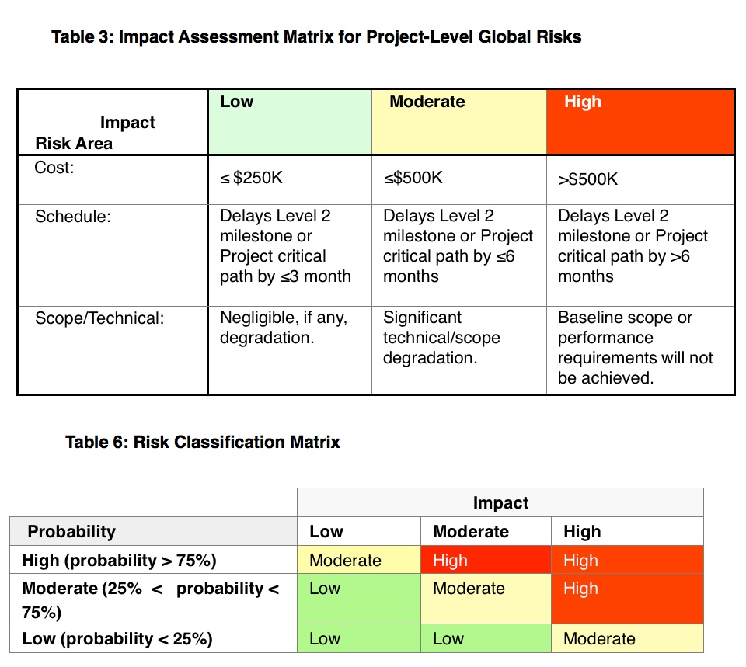
sPHENIX Risk Registry
Uniformly Applied Graded Approach to Risk Across All Subsystems

Slide 25
sPHENIX Risk Registry
 | sPHENIX Risk Registry
Owner | WBS | Risk Name | Risk trigger (if) | Consequences (then) | Timeframe | Probability | Impact | Rank | Mitigation Plan
E. Mannel | 1.5 Cal Electronics | Delay in SiPM Delivery | SiPM order not placed on schedule or vendor unable to meet prodcution schedule | Delay in assembly of Hcal and EMCal SiPM daughter boards. Potential delay in Hcal and EMCal module assembly | Procurement | Moderate: 50% | Low: Schedule delay 2-3 months | Low | Closely monitor the procurement stage.
E. Mannel | 1.5 Cal Electronics | Delay in testing of SiPMs | SiPM Delivery not placed on schedule or vendor unable to meet prodcution schedule | Delay in assembly of Hcal and EMCal SiPM daughter boards. Potential delay in Hcal and EMCal module assembly | Production | Moderate: 50% | Low: Schedule delay 2-3 months | Low | Increase number of testing stations. Identify additional collaborators who can contribute to the testing program. Streamline testing program.
E. Mannel | 1.5 Cal Electronics | Delay in Assembly of HCal Daughter boards, Preamps, Interface boards, LED Drivers | Procurement of components, issuing of orders. | Potential delay in HCal module assembly and testing | Production | Moderate: 25% | Low: Schedule delay 2-3 months | Low | Staged partial deliveries of boards. Use multiple assembly houses
E. Mannel | 1.5 Cal Electronics | Delay in assemblly of EMCal Daughter boards, Preamps or Interface boards | Procurement of components, issuing of orders. | Potential delay in EMCal module assembly and testing | Production | Moderate: 25% | Low: Schedule delay 2-3 months | Low | Staged partial deliveries of boards. Use multiple assembly houses

Slide 26
Summary
CD-1 sPHENIX Documents
Integrated Project Team
WBS (WBS Dictionary)
Basis of Estimate
Contingency Risk/Analysis
Activity List & Activity Attributes
Project Schedule
Critical Milestones
Proposed Funding Profile
Proposed Labor Profile
Preliminary Hazard Analysis Report
NEPA Document
Integrated Safety Management Plan
Conceptual Design/Conceptual Design Report
Acquisition Strategy
Close all previous review recommendations
Preliminary Project Execution Plan
Preliminary Risk Management Plan
Preliminary Risk Assessment and Risk Registry
Preliminary Security Vulnerability Assessment (Short security equipment protection & cyber security)
Alternate Analysis- For the PEP includes scientific alternatives
Interface Control Document and Interface Control Design Drawings
Over 20 Documents in Preparation for CD-1 Review
Continuous Improvement of Documentation, Estimates, Schedule, Scope
Level 2 Presentation: Scope, WBS Dictionary, Basis of Estimate, Schedule, Risk

Slide 27
Back Up

Slide 28
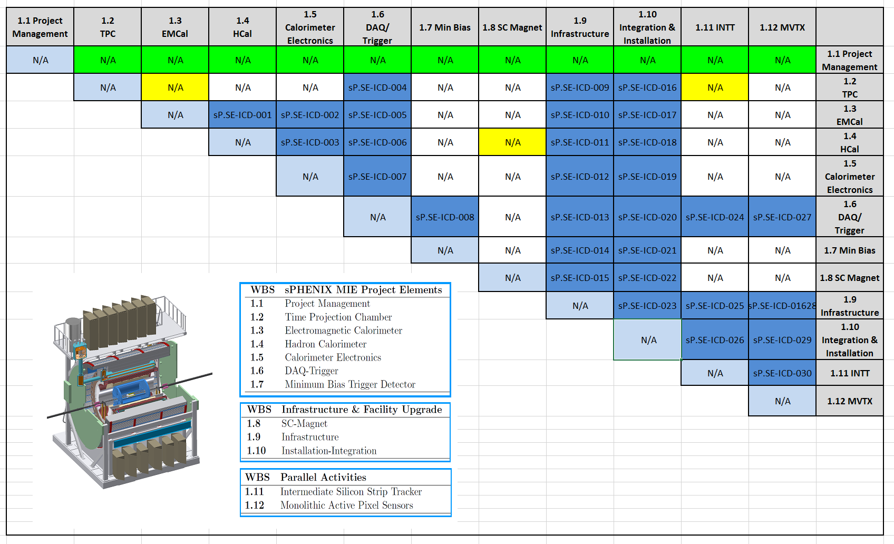
sPHENIX Interface Control Document (ICD)
sPHENIX ICD Matrix
ICD Links 2 and only 2 Subsystems
Documents which subsystems require a formal technical Interface to another subsystem. Total of 30 required for sPHENIX.

Slide 29
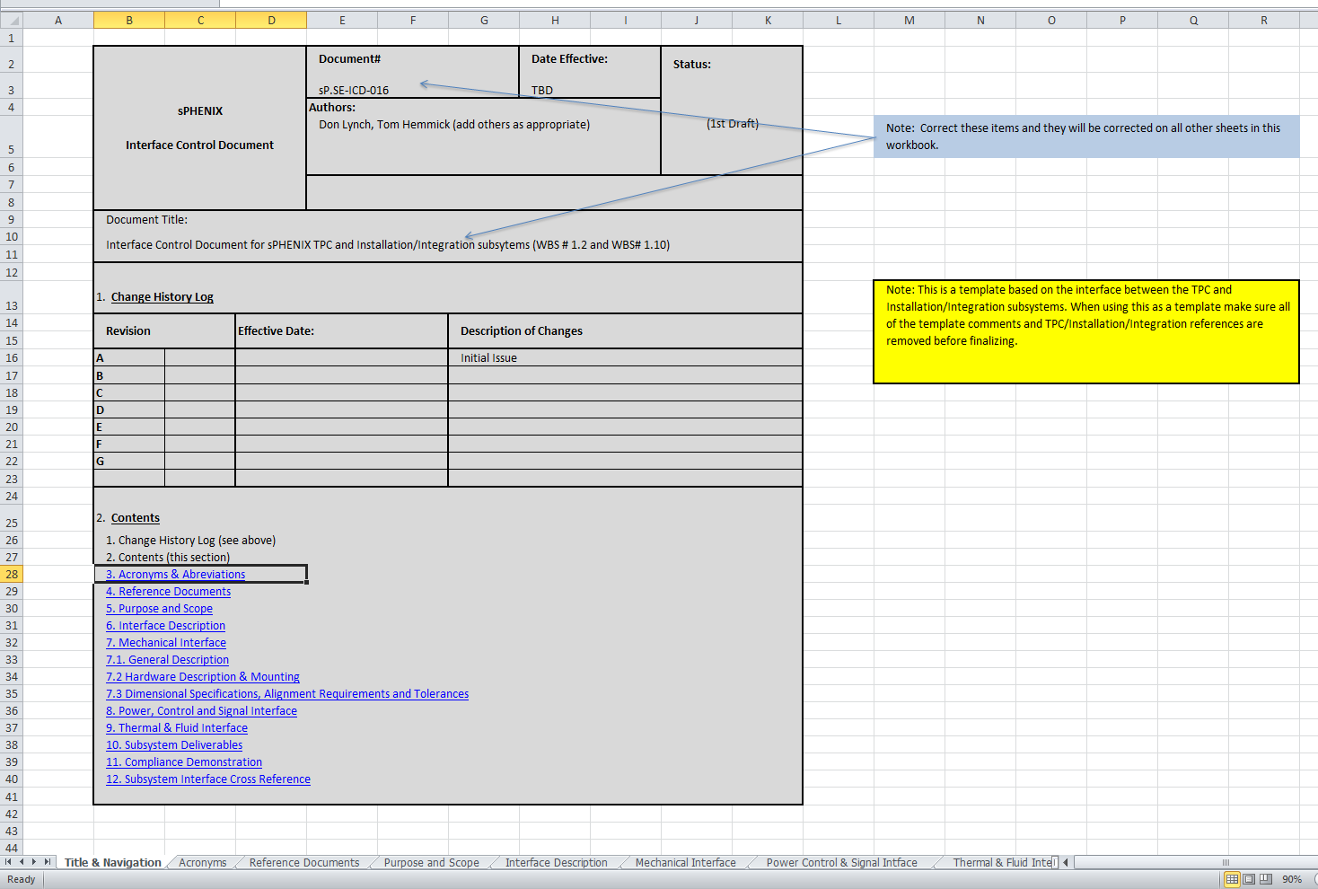
sPHENIX Interface Control Document (ICD)
Formal Handshake Between Subsystems
Describes Interface
Provides Technical Details of Interface
Specifies Deliverables between Subsystems and how to measure success
To be rolled out in draft form prior to Director’s Review

Slide 30
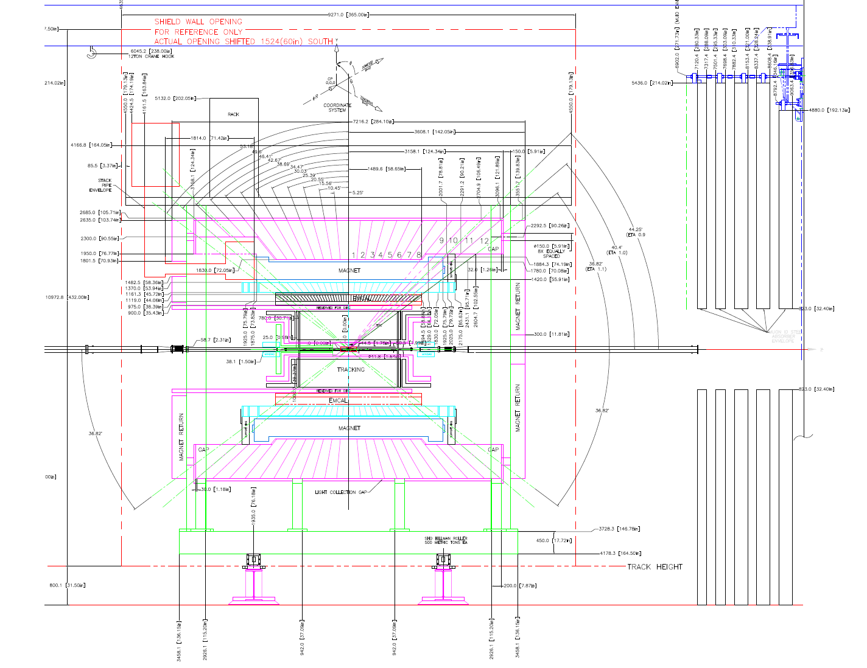
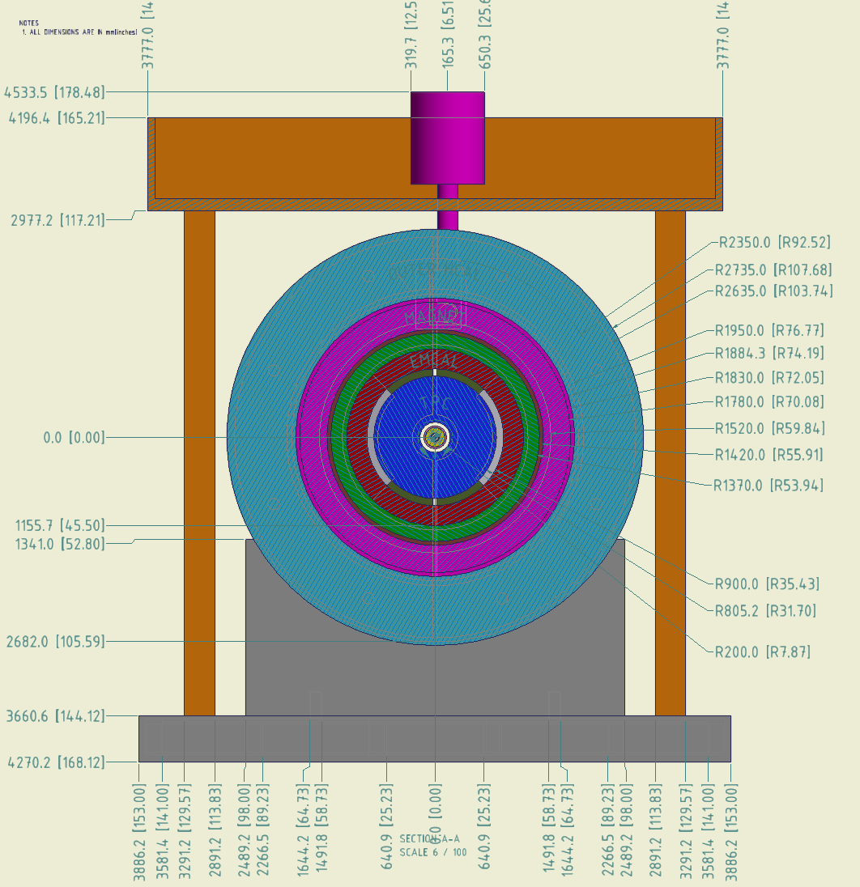
sPHENIX Interface Design Drawing (IDD)
Identifies Clearances and Stay Clear Zones.
Released and Available to L2 Managers.
Under Revision Control.
There will be individual IDD’s for each subsystem.
ICD will reference IDD.

