Slide 1
sPHENIX Director’s Review
EMCAL Subsystem
Craig Woody
BNL
August 2-4, 2017

Slide 2
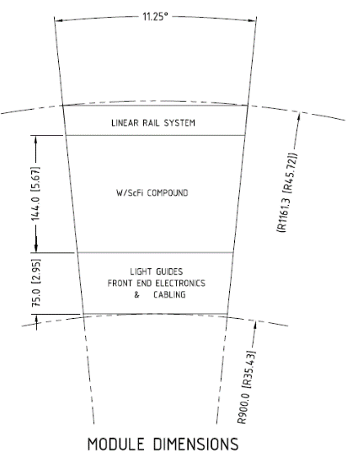
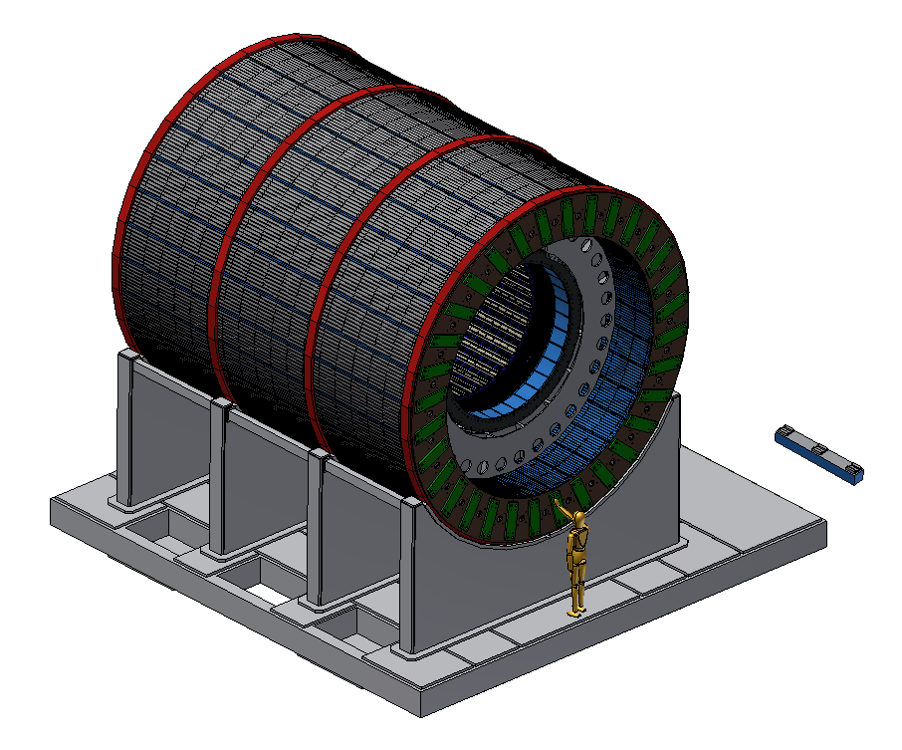
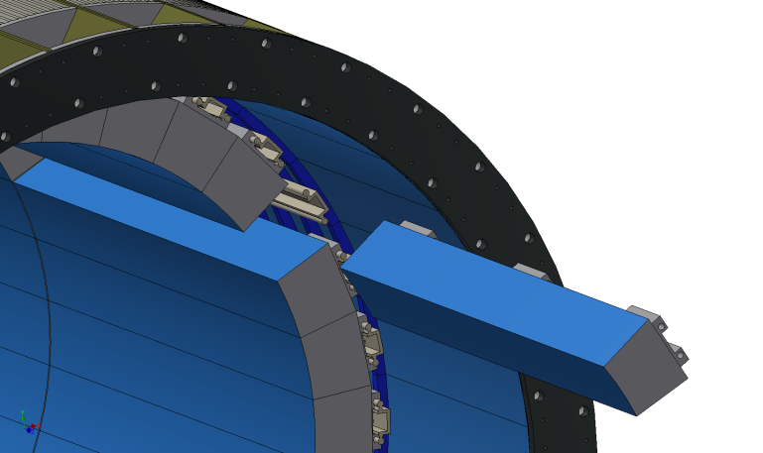
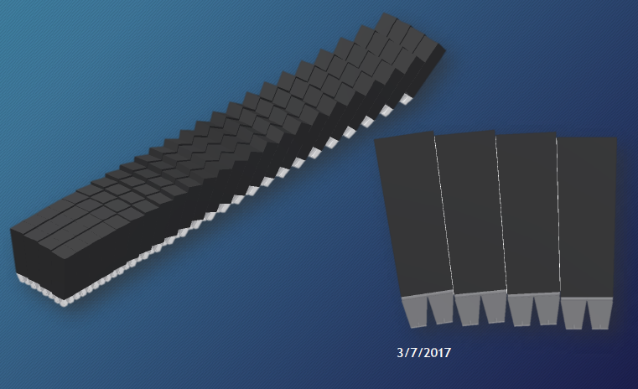
EMCAL Subsystem
2(±η) x 32 (φ) = 64 Sectors
~14 cm absorber (η=0)
7.5 cm readout
26 cm
26 cm total radial space
Designed to be compact to fit inside the BaBar magnet
EMCAL Sector
24 modules
2x8 towers each
Four 2x2 tower blocks = 1 module
1 Sector = 24 modules
= 96 Blocks
= 384 towers
Approximately projective back to vertex in η and φ

Slide 3
Design Specifications
EMCAL Design Specs:
Coverage: ± 1.1 in η, 2π in φ
Segmentation: Δη x Δφ ≈ 0.025 x 0.025
Readout channels: 96x256 = 24576 (towers)
Energy Resolution: σ_{E}/E < 15%/√E
Provide an e/h separation > 100:1
Approximately projective
Compact (in order to fit inside Babar solenoid)
Works inside a 1.5T magnetic field
Physics Contributions:
Jet measurements (EM component)
Photon measurements
Y measurement

Slide 4
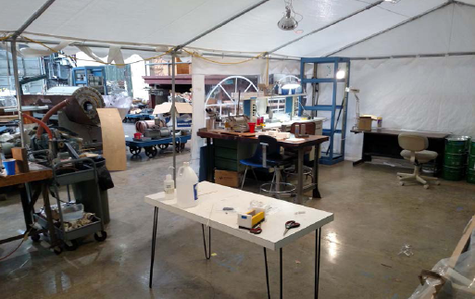
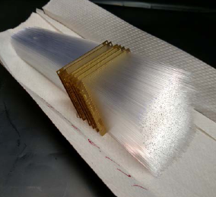
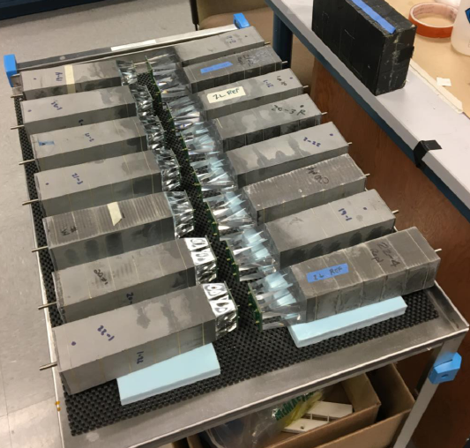
EMCAL Design
Design driver: Must be compact to fit inside Babar magnet & minimize cost of HCAL ⇒ W/SciFi SPACAL
Absorber
Matrix of tungsten powder and epoxy
with embedded scintillating fibers
Density ~ 9-10 g/cm³
X₀ ~ 7 mm (18 X₀ total), R_{M} ~ 2.3 cm
Scintillating fibers
Diameter: 0.47 mm, Spacing: 1 mm
Sampling Fraction ~ 2 %
Block fabrication area at UIUC
Modules are formed by pouring tungsten powder into a mold containing an array of scintillating fibers and infusing with epoxy
Fibers are held in position with metal meshes spaced along the module
W/SciFi blocks built at UIUC for large η prototype
Aug 2-4, 2017

Slide 5
Status of the EMCAL Design
The EMCAL subsystem is in an advanced conceptual design phase with detailed models and drawings of the absorber blocks, modules and sector assemblies.
We have tested two prototype calorimeters in the beam at Fermilab (η= 0 and η ~ 1) and have shown that the proposed design will meet the physics requirements of the experiment. A third and final prototype will be tested in the beam in early 2018.
Further work is needed on the design of the cooling system, cabling inside the sectors and support structure for the blocks. A full scale mechanical mockup is being constructed.
A full scale preproduction prototype of a complete EMCAL sector will be constructed in 2018 and tested in the lab at BNL with its calibration system and cosmic rays.

Slide 6
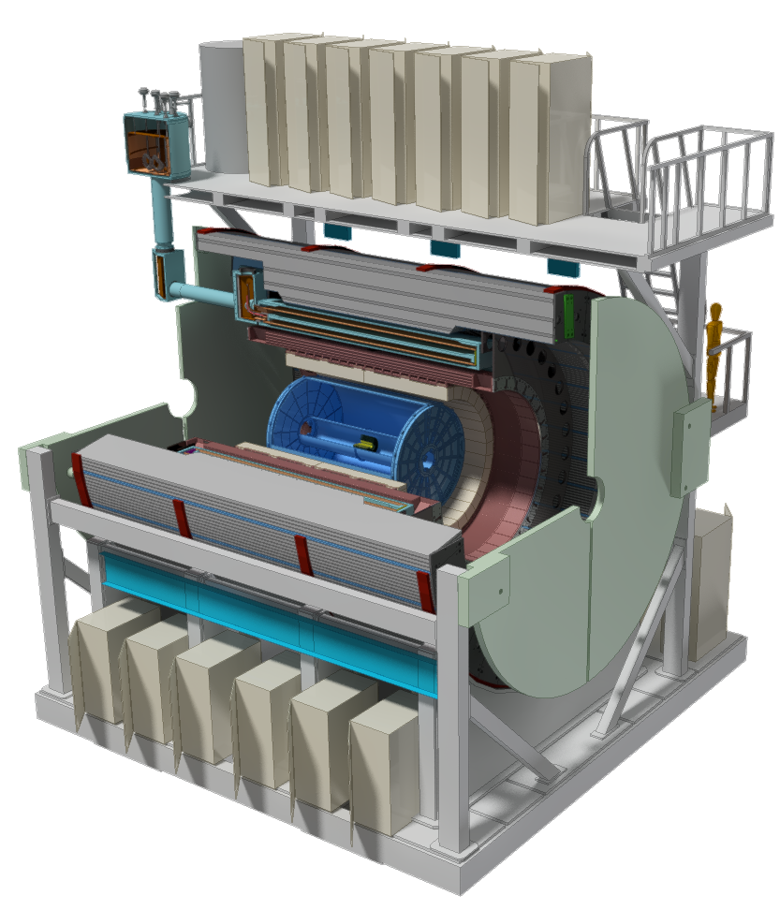
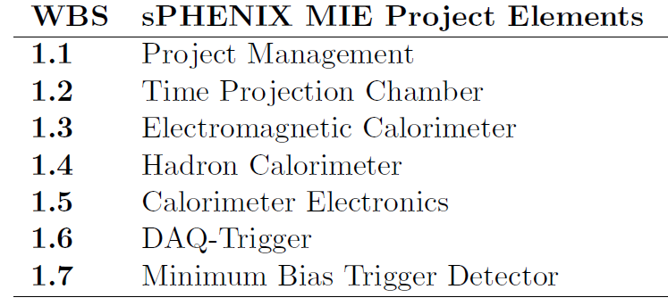
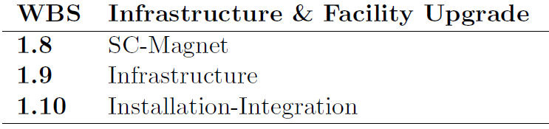
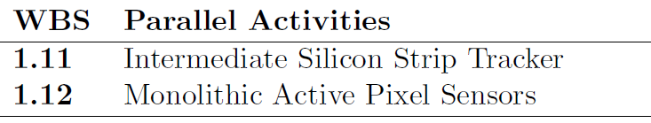
EMCAL Scope (WBS)
Inside the EMCAL Scope
Fabrication of absorber blocks and assembly into modules & sectors
Design, procurement and installation of light guides
Design, procurement and construction of mechanical structures for modules and sectors
Design, procurement and installation of cooling system
Installation of front end readout electronics
Not inside the EMCAL Scope
Design, procurement and fabrication of readout electronics (WBS 1.5)
Design, procurement and construction of external support structures (WBS 1.9,1.10)

Slide 7
Level 2/Level 3 Managers and CAMs
L2
Management
I. Sourikova
TPC T. Hemmick
EMCal C. Woody
HCal J. Lajoie
CalElectronics E. Mannel
DAQ & Trigger M. Purschke
MinBias M. Chiu
Mechanics K. Dehmelt
Blocks A. Sickles
Inner HCal J. Lajoie
CalEl Optical Sensors C. Aidala
DAQ E. Desmond
L3
GEM1 S. Milov
L3
Modules & Sectors S. Stoll
Outer HCal A. Gordeev
CalEl FEE S. Boose
Trigger J. Nagle
GEM2 V. Green
L 3 = Control Account Managers
CalEl Digitizers CY Chi
GL1 E. Desmond
Block Production – UIUC
Timing System M. Purschke
GEM3 V. Riabov
Module Production & Sector Assembly - BNL
TPC FEE T. Sakaguchi
L2 Manager
Craig Woody, Senior Physicist (BNL)
40+ years of detector experience (much of it with calorimetry)
L3 Managers
Anne Sickles, Assistant Prof. (UIUC)
Access to large construction facilities with experienced staff in
building large detectors
Sean Stoll, Physics Associate I (BNL)
25+ years in building and operating many kinds of detectors
(including the PHENIX EMCAL)
TPC DAM J. Huang
TPC Support R. Pisani

Slide 8
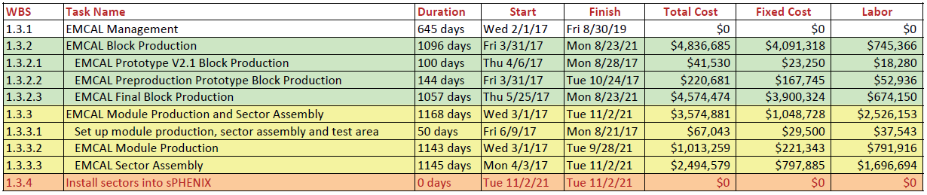
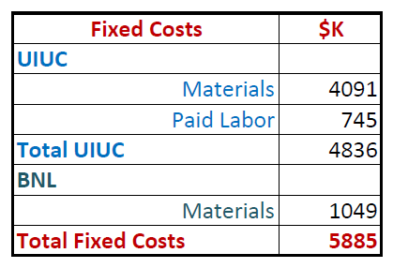
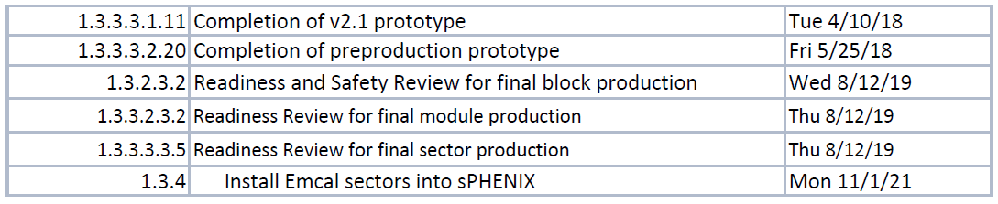
Resource Loaded Schedule (EMCAL Project File)
Main Schedule Driver:
Production of absorber blocks
at UIUC
Main Cost Drivers:
W-Powder: $2.225M
Scintillating Fiber: $1.28M
Key Milestones

Slide 9
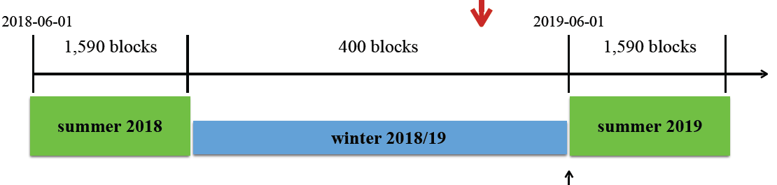
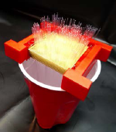
CD-3a Procurement
Schedule is being driven by the production of absorber blocks at UIUC.
This is in turn being driven by the filling of the fiber assemblies. This will be done by students that are mainly available during the summer academic break.
We must make use of the summer break period in 2019 to create a stockpile of fiber assemblies so that full scale production can begin in early February 2020.
This requires ordering sufficient fiber and screens (~ ½ the total order) in early 2019 such that they will be delivered by spring of 2019 and available for making fiber assemblies in the summer of 2019.
Fiber assembly schedule
Start of block production (2/3/20)
Filling fiber assemblies
summer 2019
winter 2019/2020
summer 2020
CD-3a Procurement (1/23/19)
½ fiber order - $640K
Screens - $176K
2.2 hrs/block
7 hrs/day, 5 days/week
10 students
10 weeks over summer
Total: $816K

Slide 10
EMCAL Staffing
FTE Profile by Category
FTE Profile by Fiscal Year
WBS Level | Org Sort | Group | FY 17 | FY 18 | FY 19 | FY 20 | FY 21 | FY 22
1.3 | BNL | Scientific | 0.03 | 0.90 | 0.00 | 0.10 | 0.23 | 0.02
 |  | Technical | 1.20 | 0.73 | 0.01 | 3.41 | 4.76 | 0.11
 |  | Professional | 0.71 | 1.34 | 0.02 | 1.28 | 2.07 | 0.08
 | BNL Sum |  | 1.94 | 2.98 | 0.03 | 4.79 | 7.05 | 0.22
 | Non-BNL | Student | 0.85 | 1.13 | 1.91 | 8.95 | 11.30 | 0.27
 |  | Technical | 0.32 | 0.06 | 0.09 | 1.37 | 1.67 | 0.00
 | Non-BNL Sum |  | 1.17 | 1.19 | 2.00 | 10.33 | 12.97 | 0.27
Grand Total |  |  | 3.11 | 4.17 | 2.03 | 15.12 | 20.02 | 0.49

Slide 11
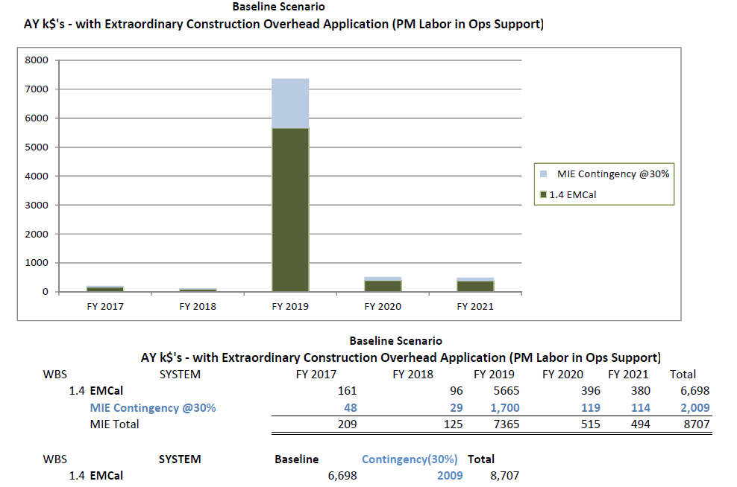
EMCAL Funding
Aug 2-4, 2017

Slide 12
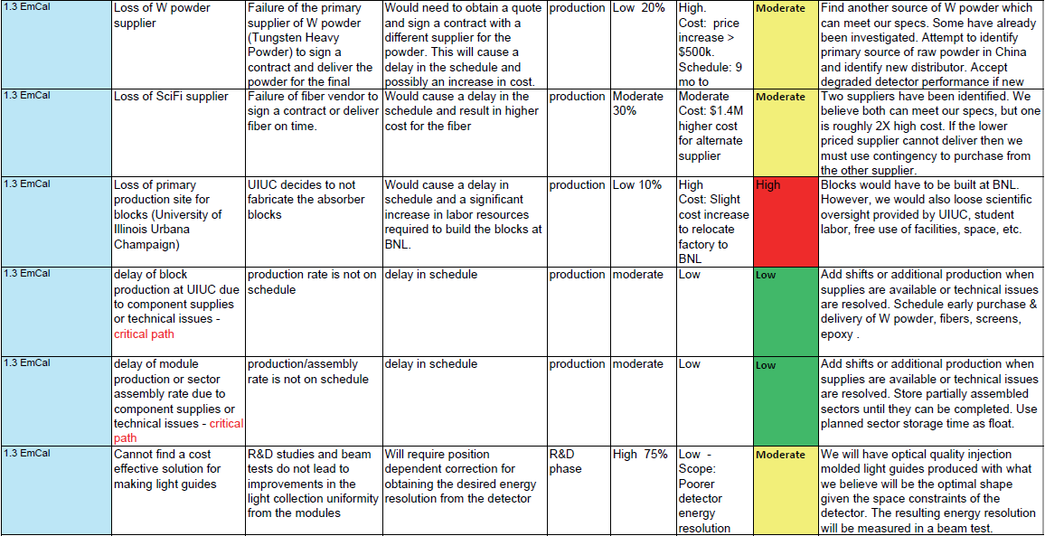
EMCAL Risk Registry

Slide 13
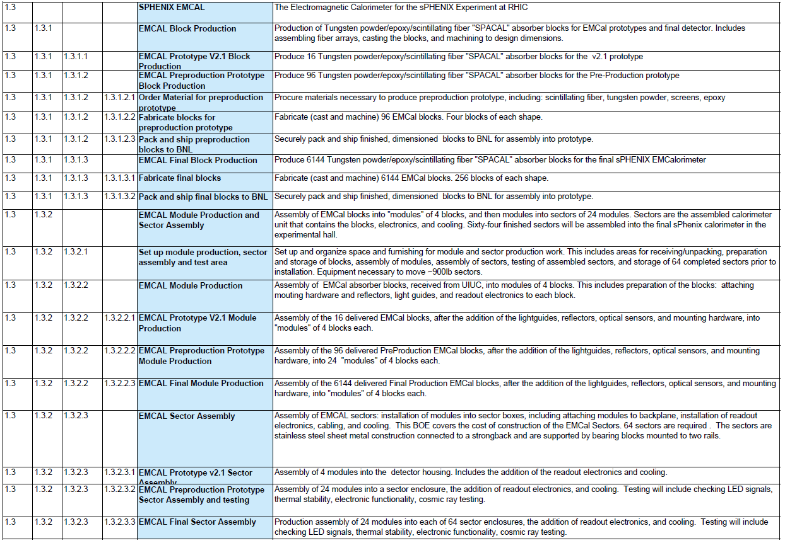
WBS Dictionary

Slide 14
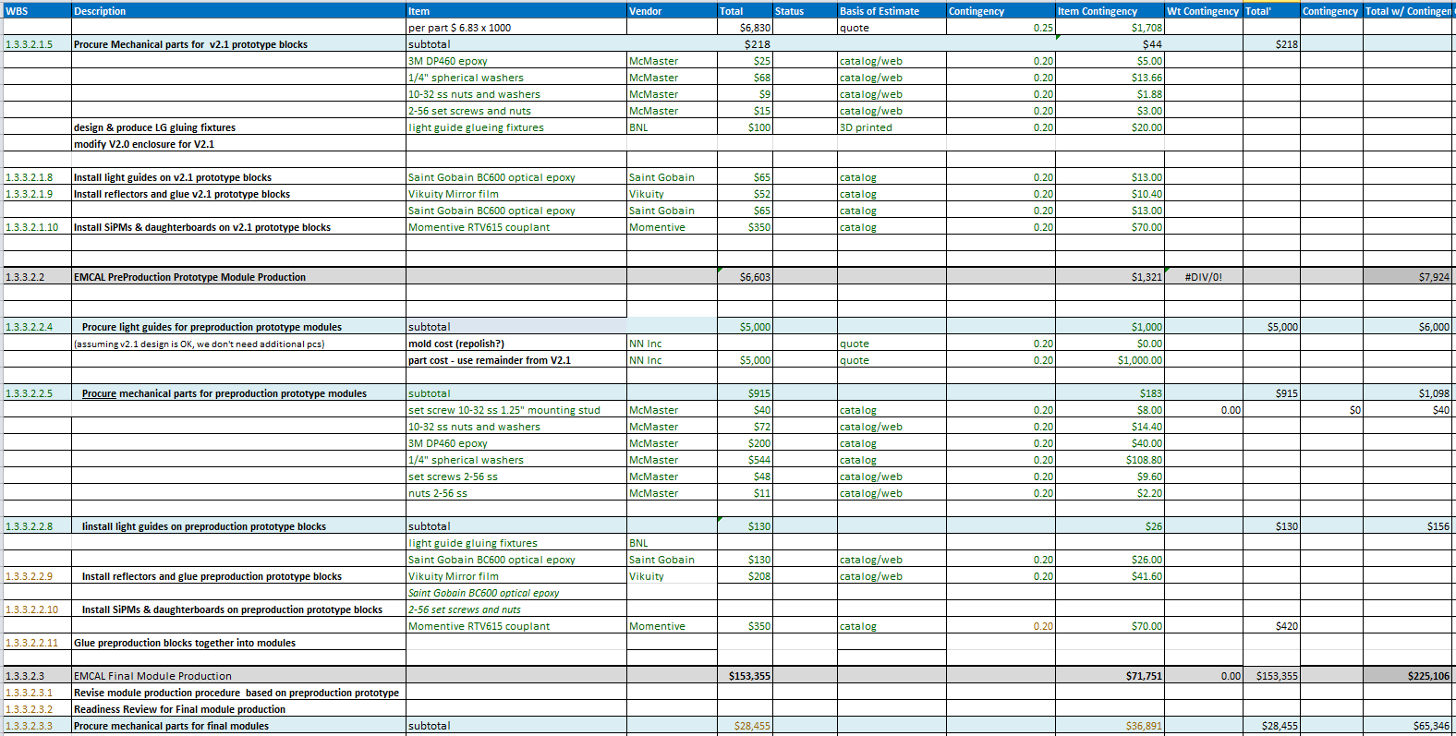
BOE Cost Breakdown
Example: EMCAL Module Production - Materials

Slide 15
Issues and Concerns
The EMCAL is on the critical path and therefore determines the entire installation schedule for sPHENIX.
We have only one production site for the absorber blocks (UIUC) and one site for module production and sector assembly (BNL). Both of these sites must keep up with a very aggressive schedule of producing one complete sector every 6 days and sustain this schedule without slippage for 1.5 years.
Possible funding shortfall could affect the amount of EMCAL coverage that could be constructed. If so, we would need to identify additional funds before the final design review (CD-3b) and before we begin final production in order to include the entire η coverage in the final sectors.
We need ~ $800K in CD-3a funds in early 2019 to order fibers and screens in order to start final block production in Feb 2020
We need ~ $5.0M in CD-3b funds in mid September 2019 to order the remaining materials necessary to begin full scale production of the final blocks, modules and sectors in Feb 2020.

Slide 16
Summary
We have been working on the EMCAL design for over 4 years and have brought it to a very advanced stage. Several prototypes have been built and tested and have been shown to meet the design requirements for sPHENIX.
We have developed a procedure for mass producing the large number of absorber blocks that will be required, and these blocks will be produced by our collaborating institution (UIUC) which has a great deal of experience and expertise in building and delivering large detector systems for nuclear and high energy physics.
We have assembled a competent team that is committed to designing, building, testing and delivering the EMCAL subsystem on time and within budget to the sPHENIX project.
Given the present schedule, we will expect to finish our remaining system development and testing and complete our engineering design before the CD-1 Review.

Slide 17
Back Up

