Slide 1
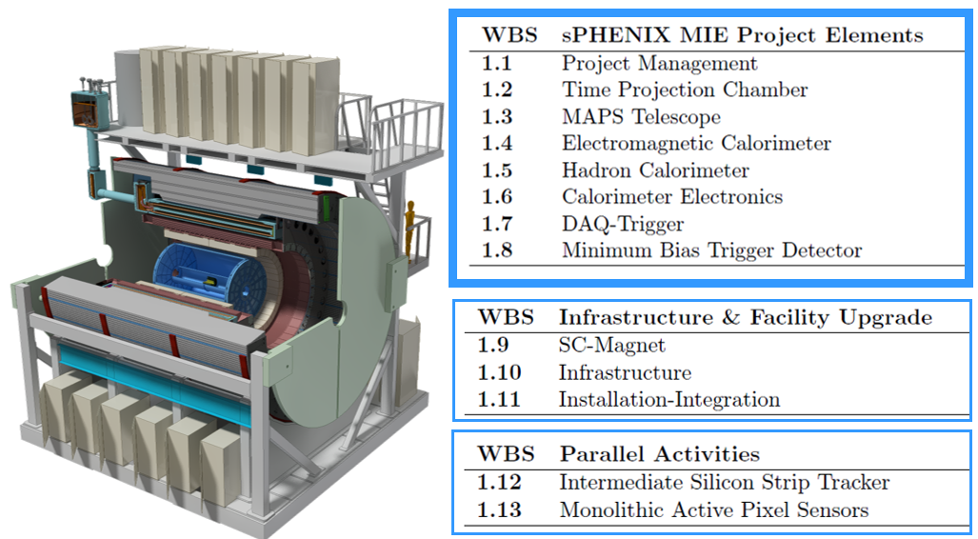
sPHENIX Director’s Review
Thomas K. Hemmick
Stony Brook University
L2 Manager, sPHENIX TPC

Slide 2
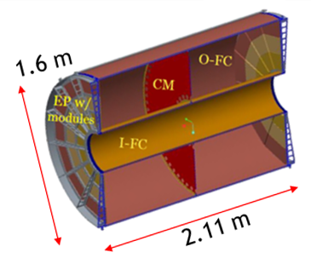
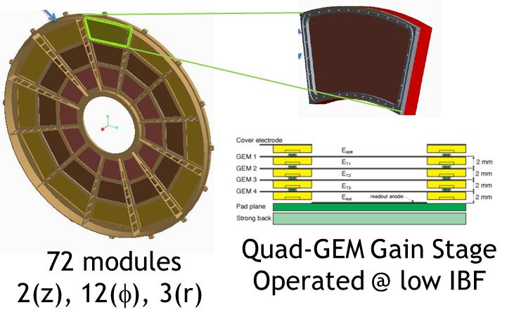
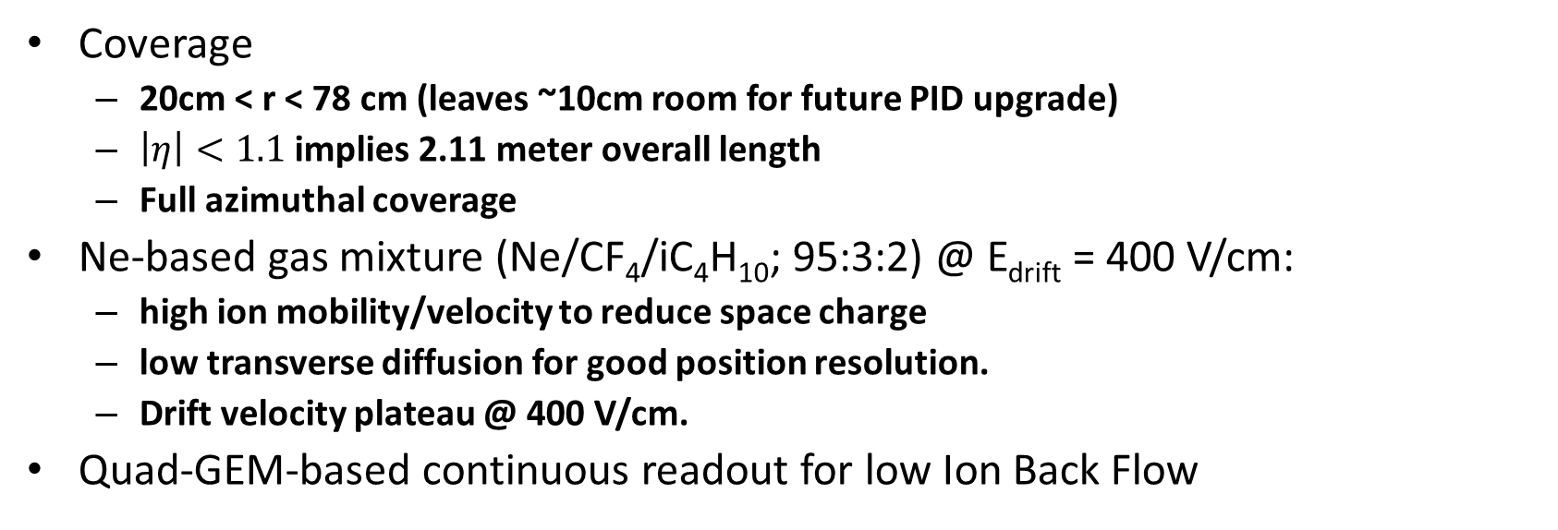
sPHENIX TPC Mechanical Description
Coverage
  20cm < r < 78 cm (leaves ~10cm room for future PID upgrade)
  $\left|η\right|<1.1$ implies 2.11 meter overall length
  Full azimuthal coverage
Ne-based gas mixture (Ne/CF₄/iC₄H₁₀; 95:3:2) @ E_{drift} = 400 V/cm:
  high ion mobility/velocity to reduce space charge
  low transverse diffusion for good position resolution.
  Drift velocity plateau @ 400 V/cm.
Quad-GEM-based continuous readout for low Ion Back Flow
A field cage similar to STAR/ILC holding a gas/avalanche similar to ALICE/T2K

Slide 3
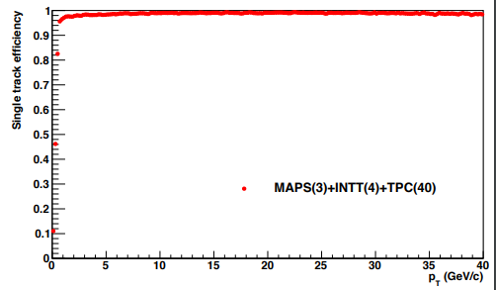
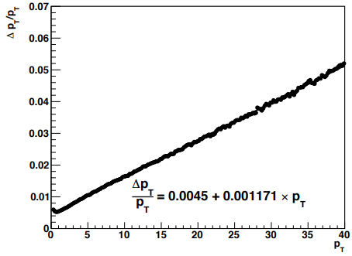
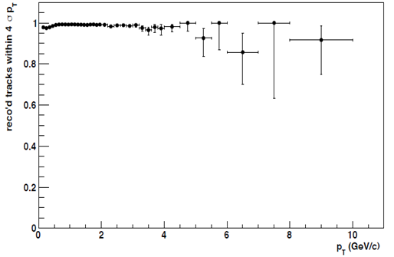
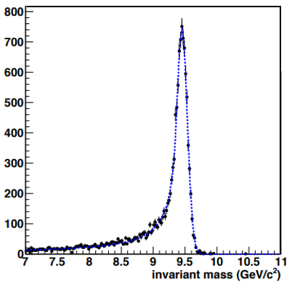

Performance Specifications
Principle Performance Requirements:
  Provide excellent pattern recognition.
  Separate the Upsilon States.
Hardware performance goals @ delivery:
  >90% of all channels fully functioning
  Drift field >350 V/cm
  eNoise(RMS) < 670 electrons.
  Gain > 2000
Physics performance goals:
  Tracking efficiency > 90%
  Purity > 95% below p_{T}= 10 GeV/c
  Single spatial point resolution < 250 μm
  Mass resolution(9 GeV/c²) < 100 MeV/c²
Simulation Studies of full tracking system
Efficiency
Momentum
resolution
$$σ=83±1.2 MeV$$
Purity
Mass
resolution
TPC has strict momentum resolution specs and no dE/dx resolution specs.

Slide 4
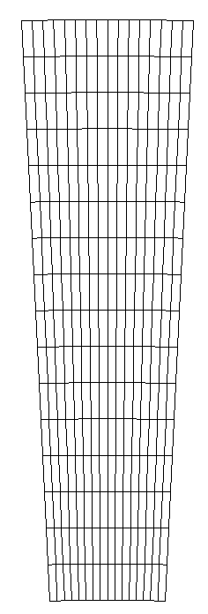
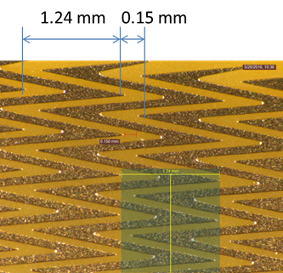
TPC On-Detector Electronics
“Wedge”
FEE
FEE card:
Uses ALICE “SAMPA” chip
SAMPA does zero suppression,
but readout is triggerless.
FPGA has minimal duty:
  Convert SAMPA to 8b10b
  Slow Controls.
Data “processed” at later stage.
Design minimizes onboard
power and complexity.
16 rows ~1.25 cm
FPGA
Optical
Optical
16 pads
~2mm
Module anodes segmented into 16x16 pad “wedges”.
Pads average 2mm x 1.25cm in size.
Individual pads segmented as Zig-Zag or Chevron.
Each FEE card supports a single wedge.
Similar (not identical) to STAR & ALICE SAMPA implementations

Slide 5
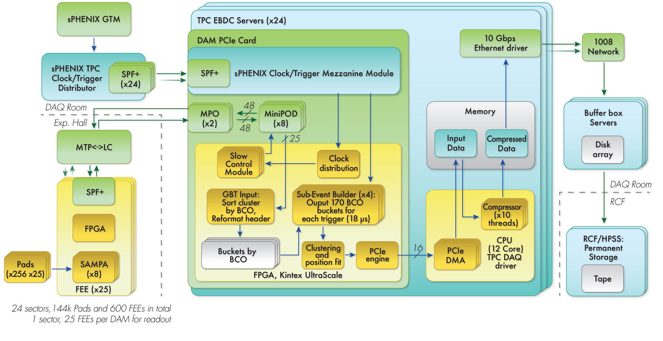
TPC Electronics Overview
FEE (sPHENIX Development)
  256 channel SAMPA→optical (no processing)
DAM (use e.g. BNL/ATLAS FELIX board)
  Data Aggregation Module.
  Aligns, Clusters, Compresses (Triggers?) Data.
EBDC (purchase commodity PC)
  Commodity PC, houses one sector of DAM cards.
TPC EBDC Server (x24)
RCF
DAM PCIe Cards
FEE (25/sector)
optical
On detector:
Custom sPHENIX
implementation
of SAMPA chip.
Counting House:
Combination of re-used boards for DAM and commodity PCs.

Slide 6
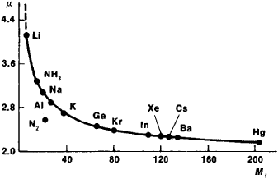
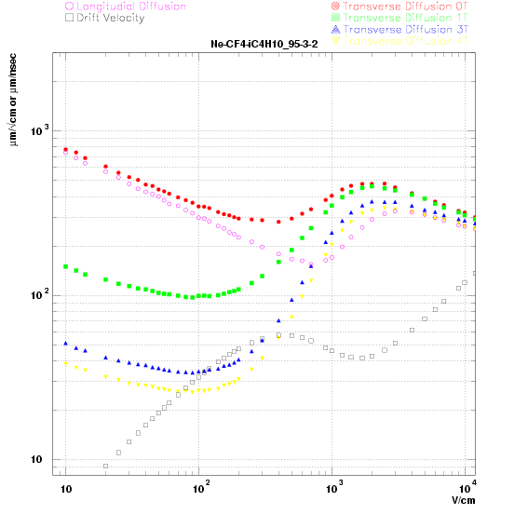
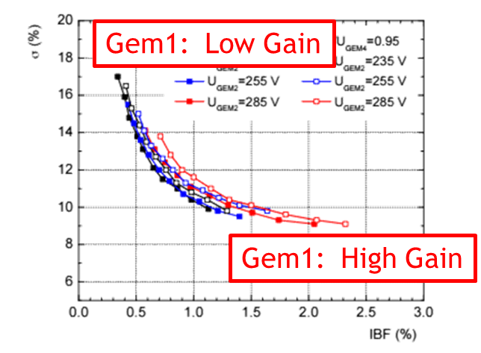
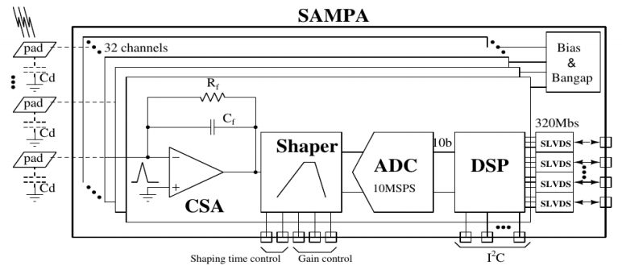
Design Drivers
Low Mass = High Mobility
Gas Choice
  The gas must be Neon-based to minimize space-charge distortions by maximizing the positive ion drift velocity.
  Use of a “cold” quench minimizes transverse diffusion and thereby improves the single point position resolution.
Drift field
  Ion drift velocity is directly proportional to E, indicating that the large electric fields are optimal (400 V/cm).
  Our candidate gas has a drift velocity plateau coincident with the desired drift field thereby minimizing environmental influence (T, P, E) on calibration.
Micro-Pattern Gas Detector for low Ion Back Flow
Simple FEE w/ continuous readout (SAMPA)
  Elimination of data processing “on-detector” minimizes complexity and power consumption of FEE card.
DAM adopt design from off-project development
  Digital programmable data processing is such a common need that both the ALICE-CRU and the ATLAS-FELIX boards appear more than capable of filling our needs.
Low Diffusion
Drift Velocity Plateau
400 V/cm

Slide 7
TPC Scope/Interface

Slide 8
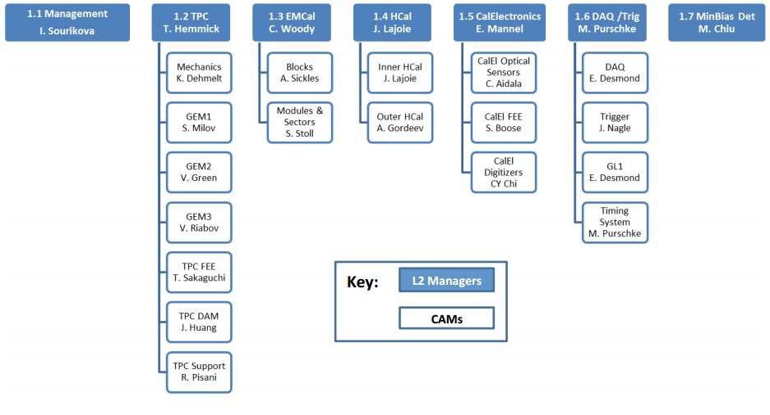
WBS Structure and Control Accounts
TPC DOE reporting level set at L3
WIS/Vanderbilt/PNPI are factories for the R1,R2, & R3 modules.
  Each institution builds & tests all modules/spares of a single size.
  Mapping of module size to institution is TBD.
Work packages and activities are located beneath each WBS L3.

Slide 9
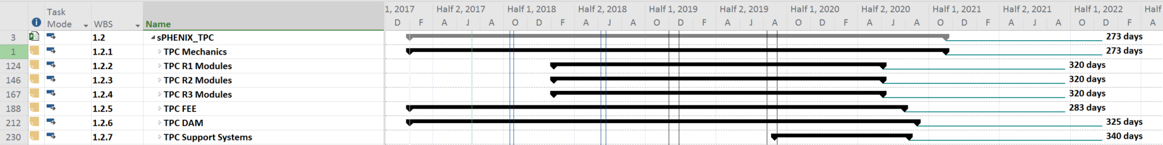
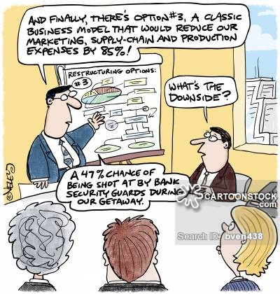
Schedules and Milestones from RLS
273 working days
~13 mos. calendar
These are the highest level milestones selected to minimize the complexity.
Lower level milestones include design reviews and production readiness reviews.
Overall schedule for TPC has 13 months float, which is longer than the sPHENIX float, meaning we are not on the critical path for sPHENIX completion.
COST PROFILE

Slide 10
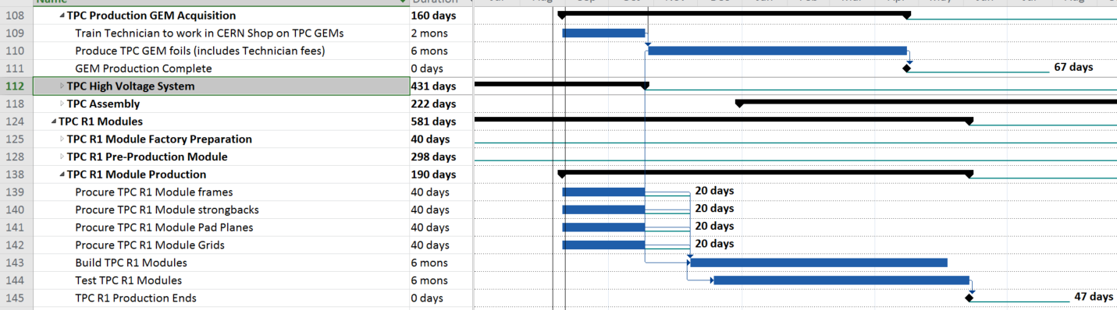
Schedule Driver: GEM Production
Factory production follows a Start-Start relationship to GEM production.
Module assembly takes less time than GEM production (PHENIX HBD experience).
GEM schedule drives module production schedule and TPC overall schedule.

Slide 11
Labor Profile
FTE Profile by Category
FTE Profile by Fiscal Year
Row Labels | FY 17 | FY 18 | FY 19 | FY 20 | FY 21 | FY 22
Cat B | 1.08 | 0.37 | 0.87 | 2.21 | 0.00 | 0.00
Engineering | 0.47 | 0.16 | 0.48 | 1.28 | 0.00 | 0.00
Scientific | 0.07 | 0.01 | 0.02 | 0.04 | 0.00 | 0.00
Technical | 0.54 | 0.20 | 0.37 | 0.89 | 0.00 | 0.00
Contributed | 1.51 | 1.65 | 3.78 | 18.92 | 0.79 | 0.00
Engineering | 0.00 | 0.27 | 0.36 | 0.00 | 0.00 | 0.00
Scientific | 0.59 | 0.39 | 1.09 | 2.63 | 0.08 | 0.00
Student | 0.92 | 0.99 | 2.33 | 13.56 | 0.70 | 0.00
Technical | 0.00 | 0.00 | 0.00 | 2.73 | 0.00 | 0.00
Grand Total | 2.59 | 2.02 | 4.65 | 21.12 | 0.79 | 0.00

Slide 12
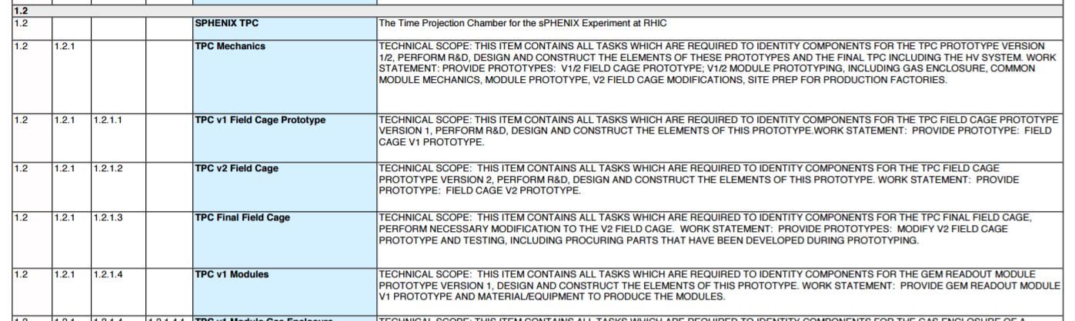
WBS Dictionary Example
All sPHENIX WBS Dictionary entries host their “master version” in WBS file.
  Extracted at will into pdf version for readability.
  Robust against numbering updates as the project files evolve.
Task descriptions all include:
  Technical Scope
  Work Statement
Present Status: 100% Complete and Up-to-date.
Example from the pdf Version

Slide 13
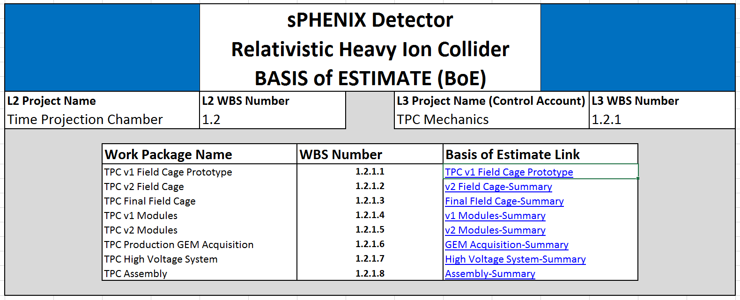
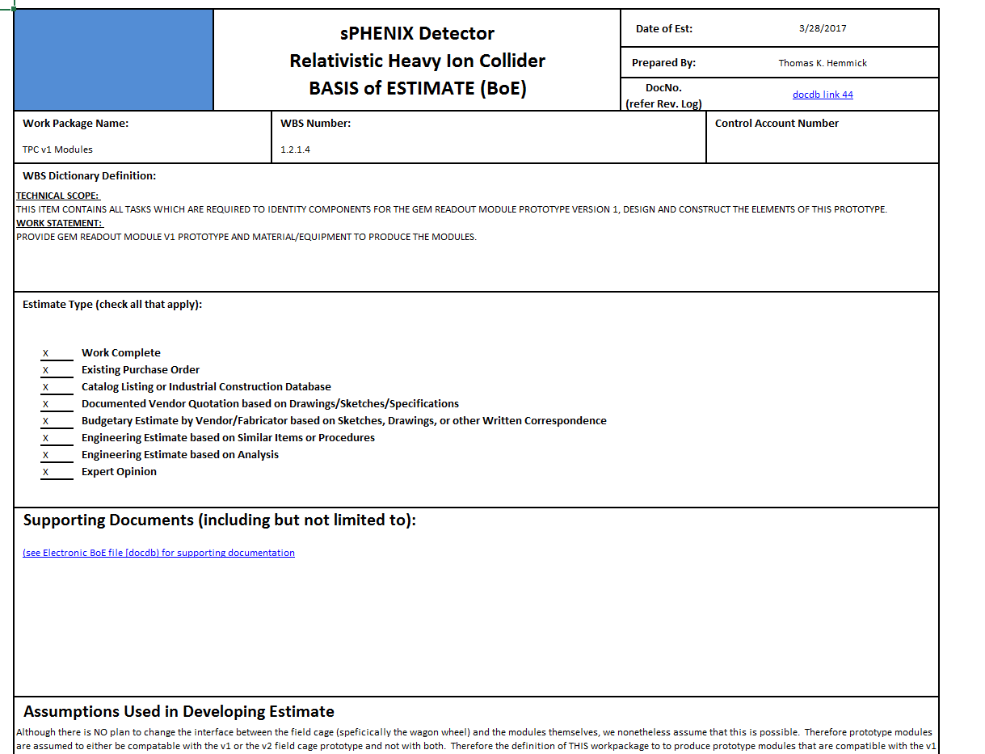
Basis of Cost Estimate (standard sPHENIX format)
Example: 1.2.1 TPC Mechanics
Title Page
Links to L4 Summary
One file for each L3 item (7 files for TPC):
  TPC Mechanics; R1; R2; R3; FEE; DAM; Services.
  The “Nav” page contains one link for each L4 item.
    L4 – Summary page.
    L4 – Details page.

Slide 14
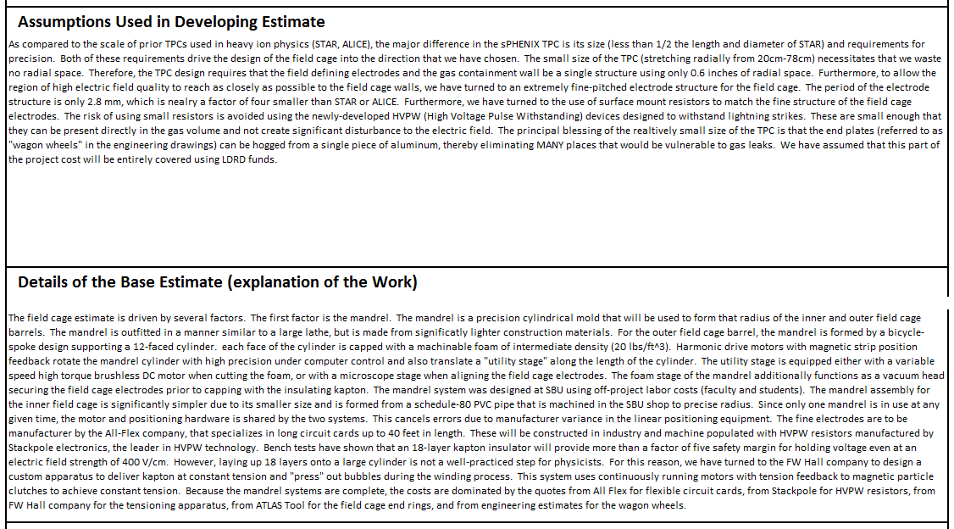

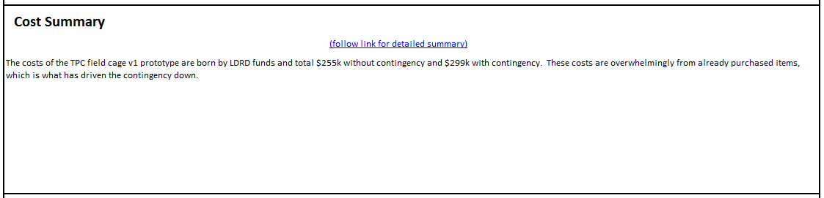
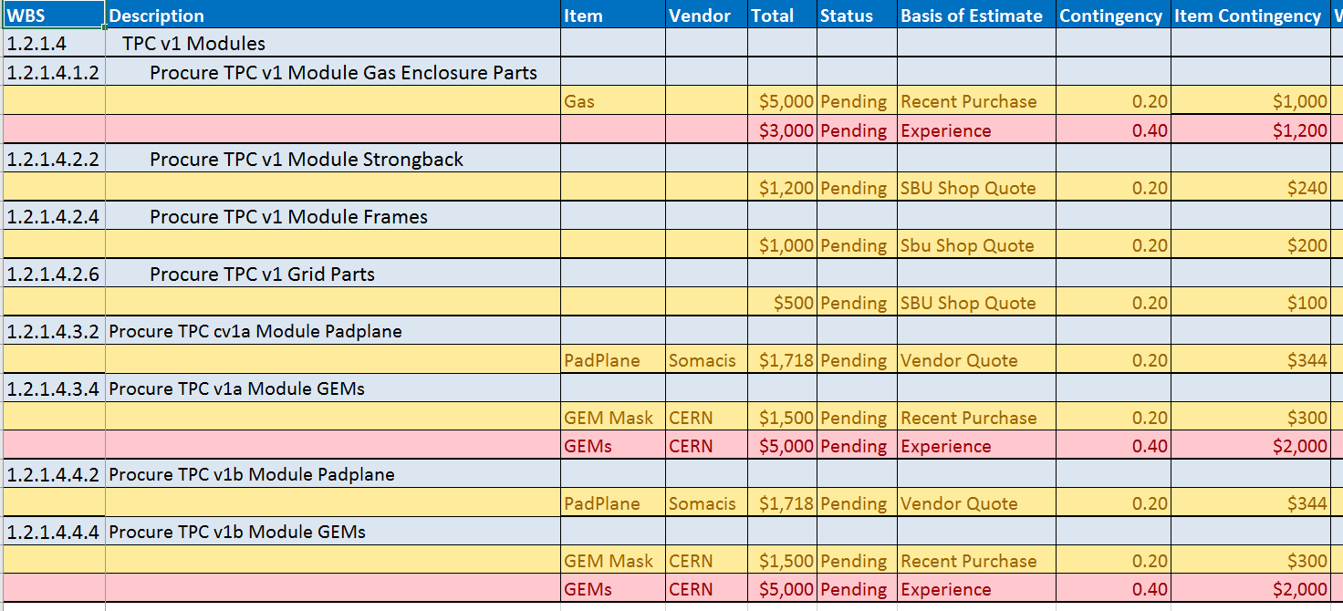
Summary Page Example
Level of Detail intended to be “standalone”
(don’t need CDR to read BoE)
Links to Details
Within each file 2 pages per L4 item:
  Summary page explains BoE Details and Assumptions.
  Intended to be readable without additional documents open and at the ready.
  Summary pages link to Details pages

Slide 15
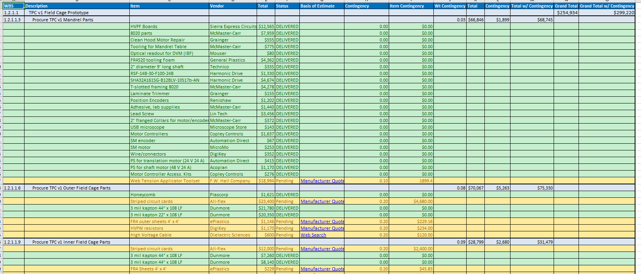
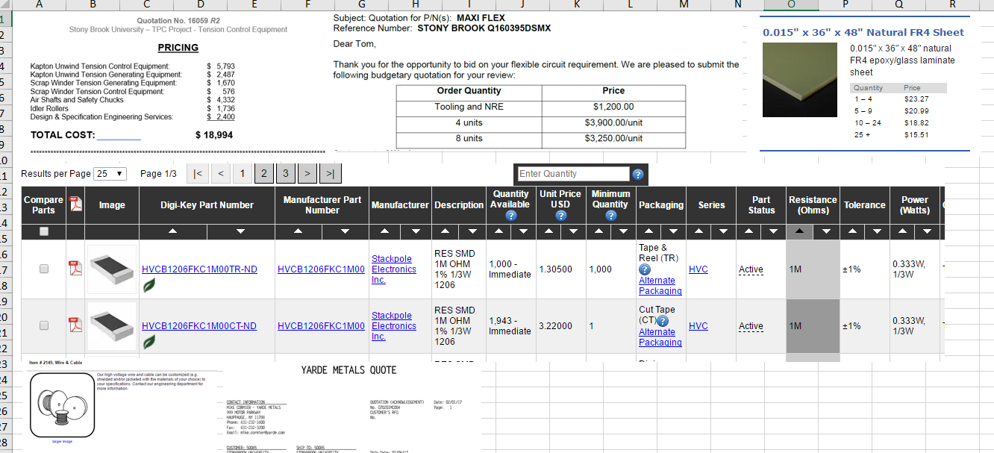
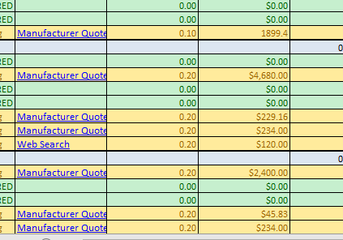
Details Page Example
NOTE: LDRD Captured in Project Files…Lots of green
Item-by-Item
Contingency
Details pages are purchase-by-purchase for each L5 WBS item.
Color code: Green=Delivered; Yellow=Quoted; Red=Estimate
Color code also indicates level of item-by-item contingency.
Links to Quotations

Slide 16
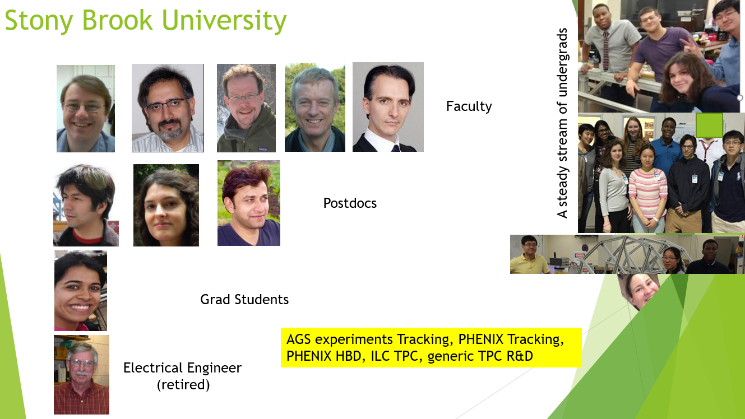
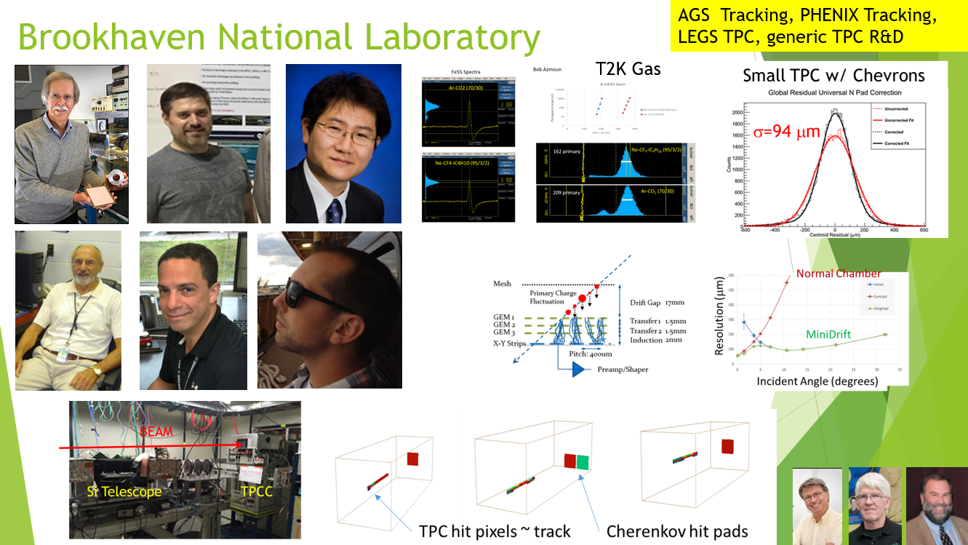
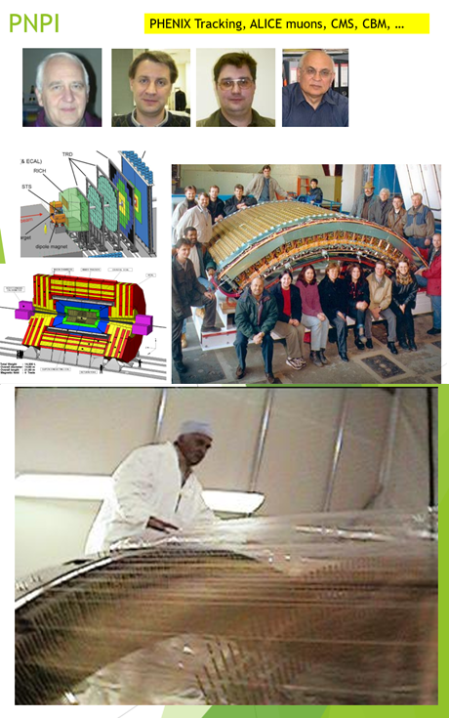
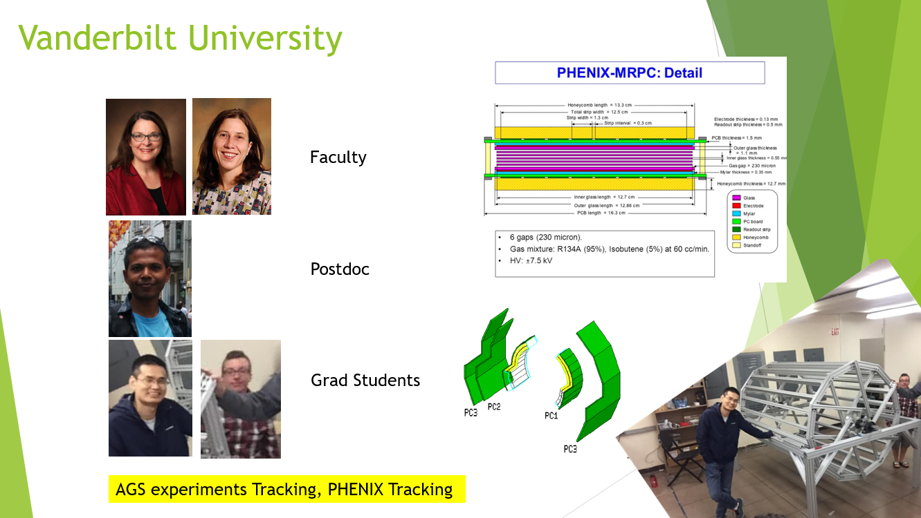
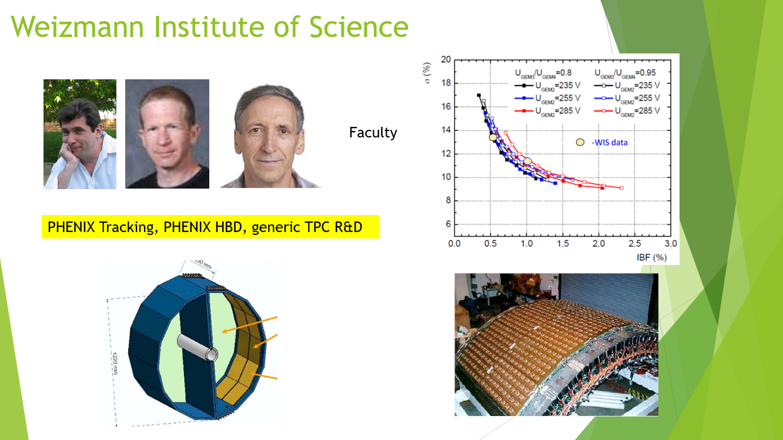
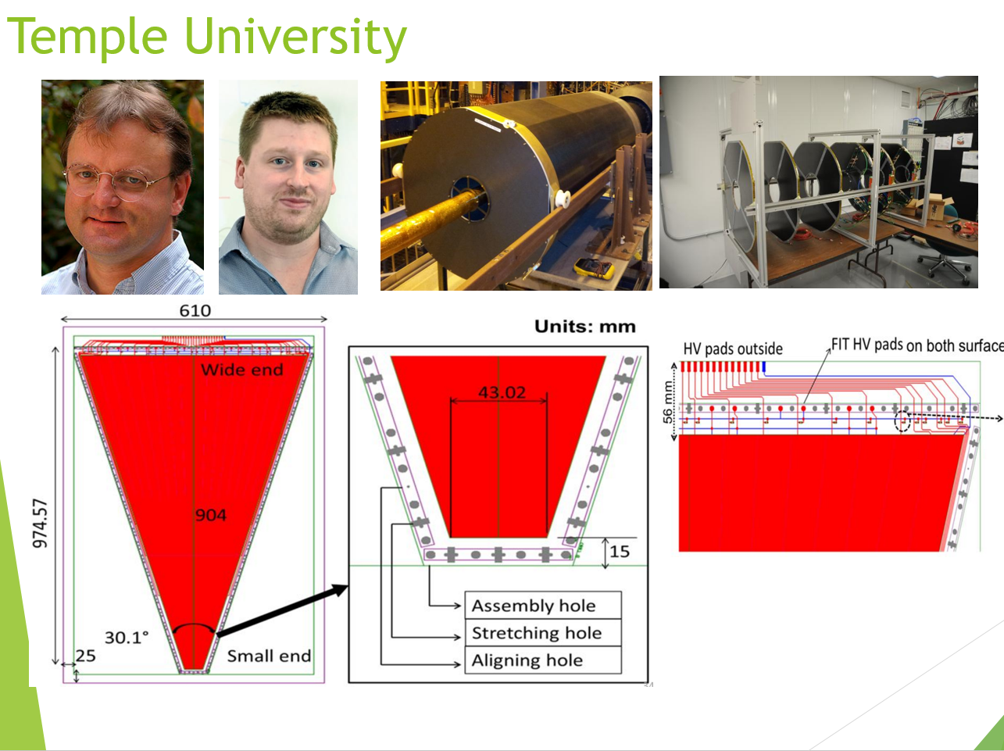
Collaborating Institutions and Technical Experience
Since 1988
Since 1996
Since 1988
Since 2001
Since 1992
Broad technical expertise in gas chambers and specifically with GEMS used in formulating the BOE for the sPHENIX TPC
NOTE: Yellow boxes indicate time period over which these institutions have worked closely with the sPHENIX TPC L2 Manager.

Slide 17
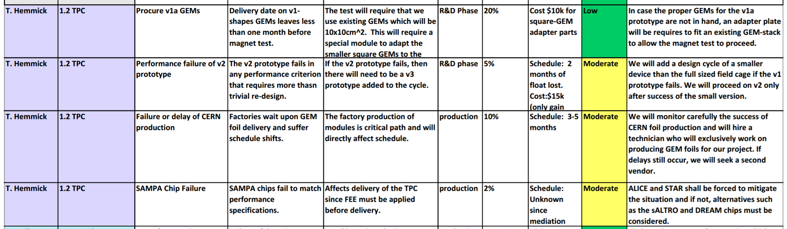
Risk Analysis
The table above is an excerpt from the sPHENIX risk registry.
Recent successes of bench tests of pre-production SAMPA chips have reduced the SAMPA chip risk from high to moderate.

Slide 18
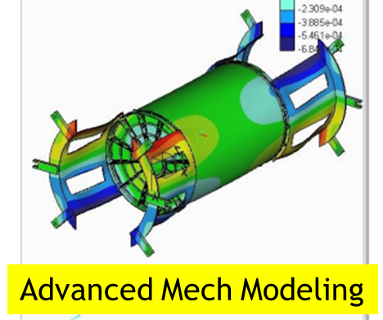
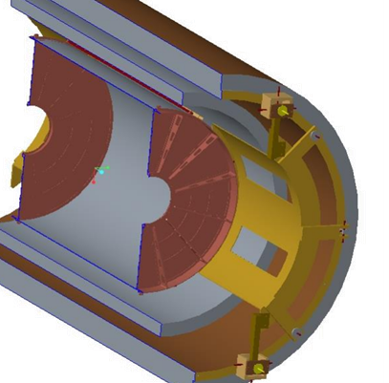
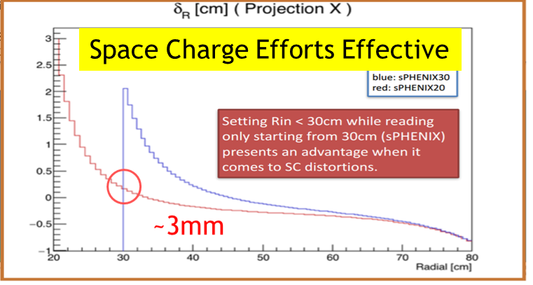
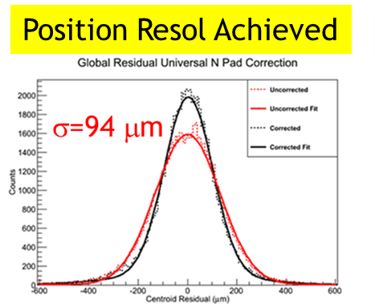
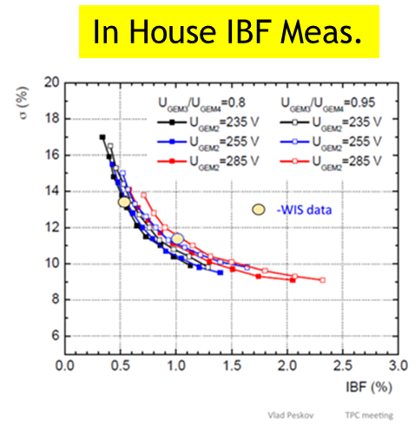
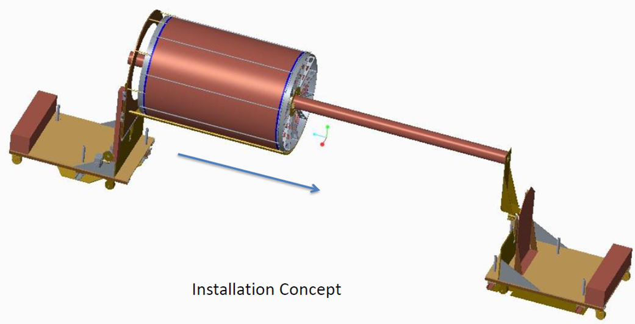
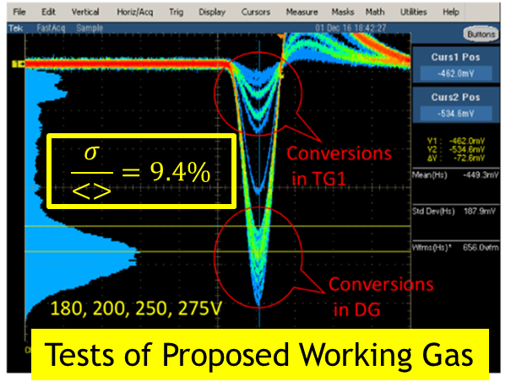
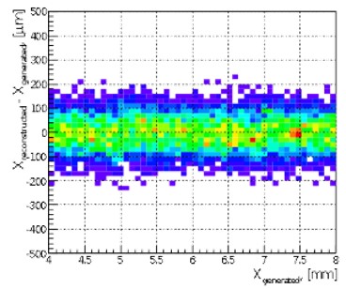
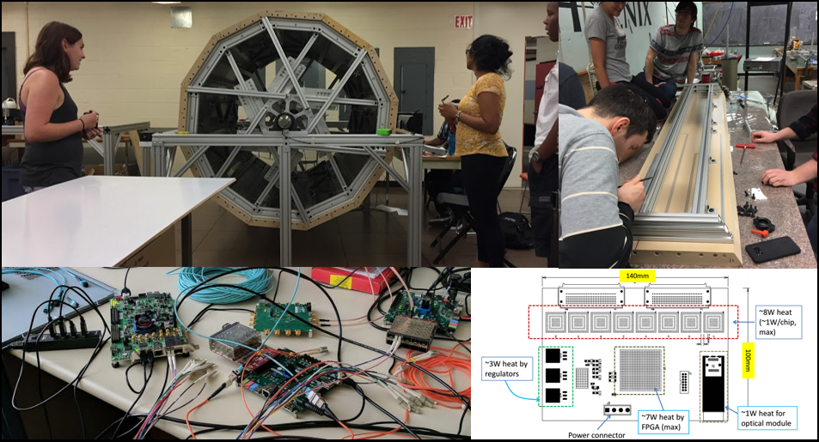
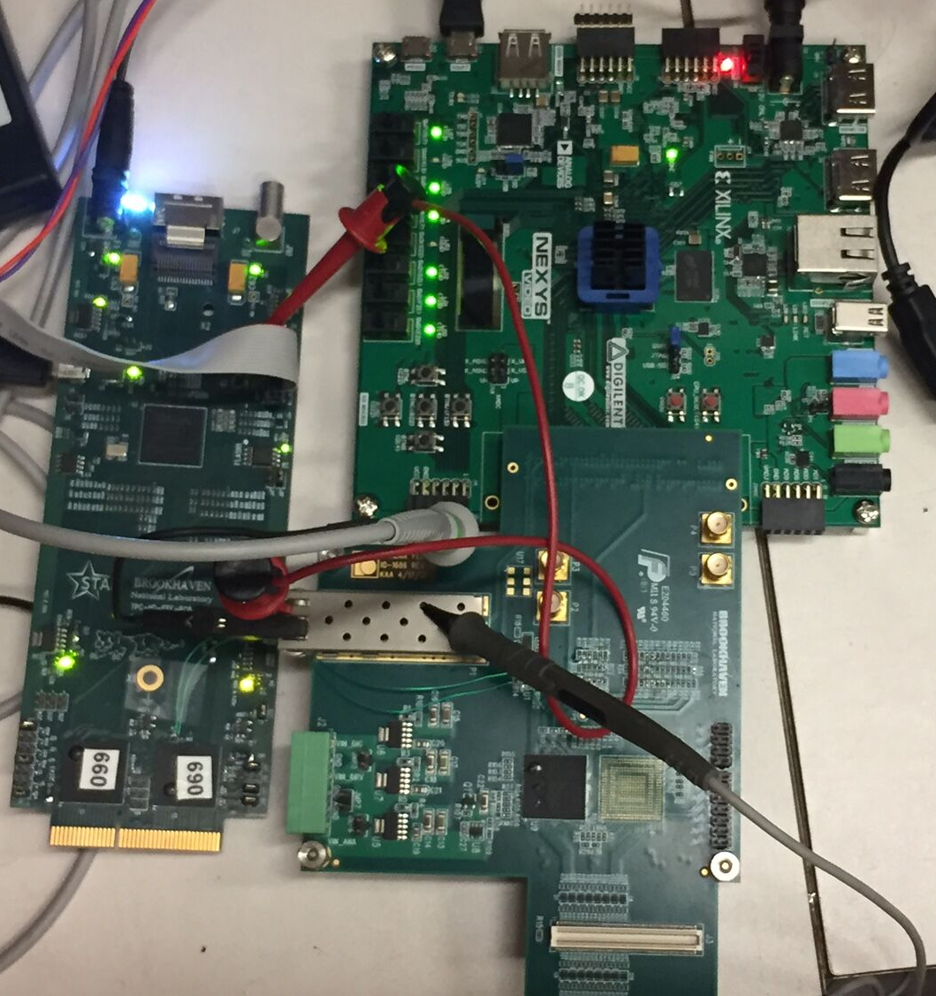
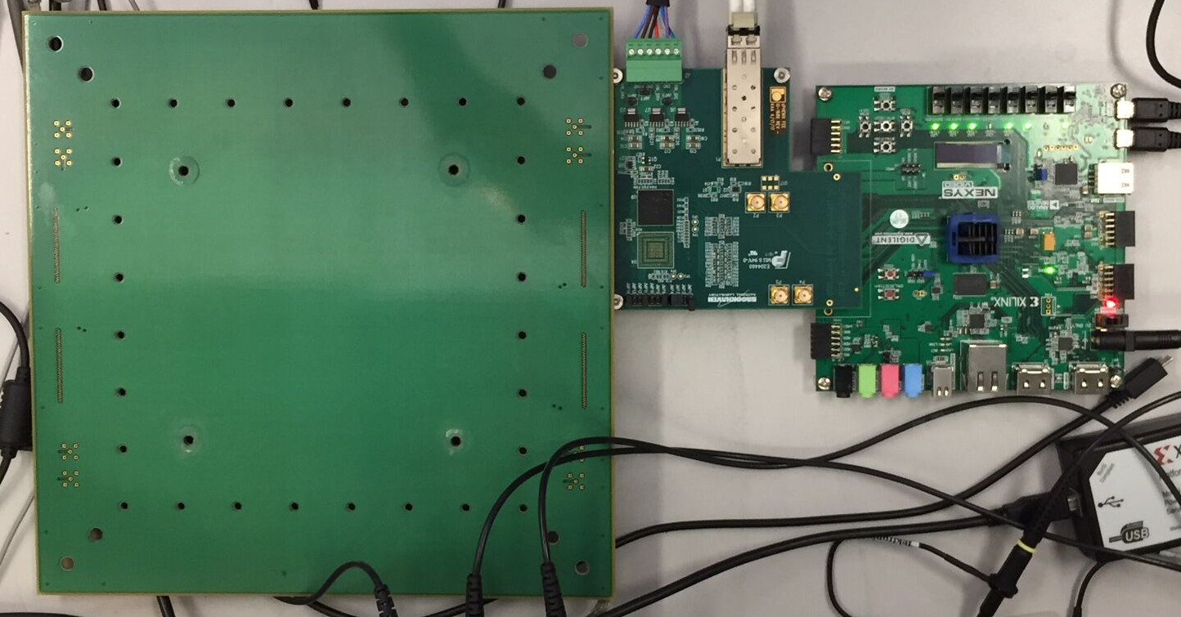
Status of design, generic R&D, OPC
Support Concept
Pad Shape Minimizing DNL
Installation Concept
(Theory)
FEE
Field Cage Prototyping
ADC Readout Success
FEE attached to GEM chamber
DAM Prototyping
FEE Prototyping

Slide 19
Issues & Concerns
GEM production is sole source at CERN
  TechEtch (former US vendor) would consider restarting production after receiving a purchase order.
  TechEtch previously demonstrated poor corporate memory on GEM foil production.
  Technical level contacts (Rui de Oliviera –CERN; Klaus Dehmelt – sPHENIX) indicate costs and schedule fit well within sPHENIX plans.
  Need to move to formal agreement with CERN quickly (discussion ongoing)
SAMPA Chip has passed bench tests, but production run does contain minor changes.
  Header trouble in triggered mode (not our concern)
  Noise a little higher than anticipated (~OK for our needs)…no affirmative changes to front end planned.
  Good News: iTPC (STAR using SAMPA) progress excellent, implemented.
  Becoming more likely that MPW3 (final run) will be good for sPHENIX.
Lowest IBF point for quad-GEM has stability issues @ ALICE.
  sPHENIX much finer HV segmentation; much shorter leads.
  R&D efforts show significant IBF performance improvement using field termination grid.
  Bench tests required for confirmation.

Slide 20
Back Up

Slide 21
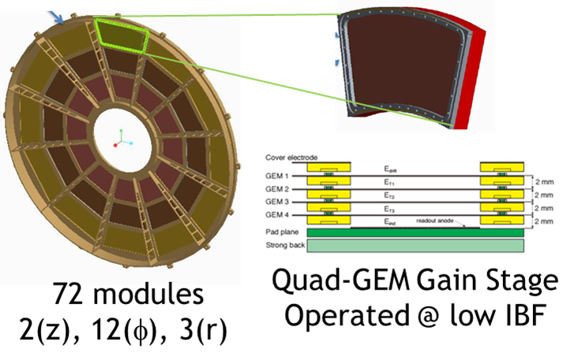

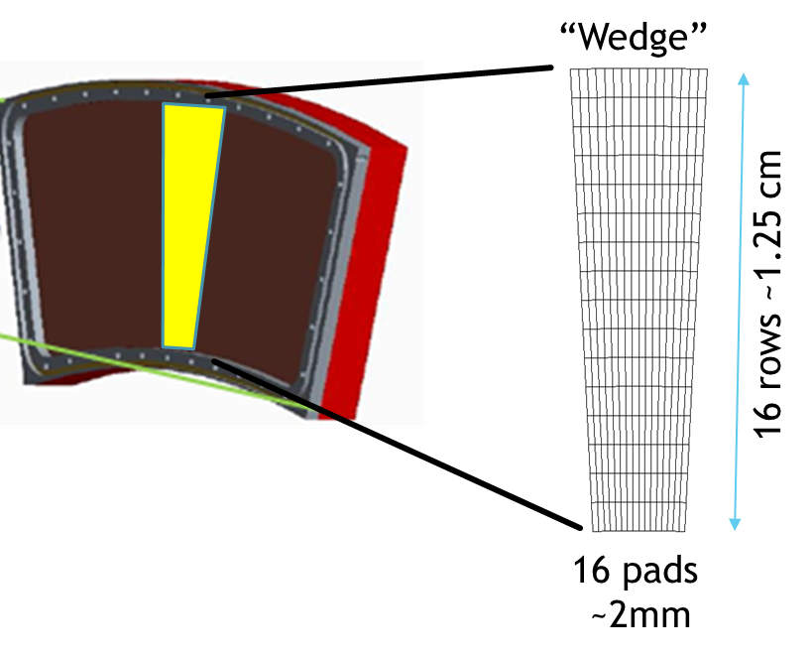
Numerology of the Subsystem
Item | Comment | Total
η coverage | Match magnet | +/- 1.1
φ coverage | Full aziumuth | 2π
Endcaps | 1 @ each end | 2
Sectors | 12 for each endcap | 24
Modules | 3 for each sector: R1, R2, R3 | 72
Wedges | R1: 5 wedges R2: 8 wedges R3: 12 wedges | 600
FEE | 1 @ each wedge | 600
DAM | CRU Option: 3/sector FELIX Option: 1/sector | 72 24
EDBC | 1 for each sector | 24
SAMPA | 8 for each FEE | 4800
Channels* | 32 for each SAMPA | 153,600
3 Modules:
R1, R2, R3

Slide 22
Safety and Design Reviews
Safety and Design Reviews are uniformly scheduled throughout the TPC project:
  These follow every final prototype completion
  (gather information on updates before executing pre-production)
  They also follow every pre-production step
  (demonstrating application of prior review advice).
Safety reviews always precede Design reviews to allow for possible of design changes due to safety concerns prior to any design review.

