Slide 1
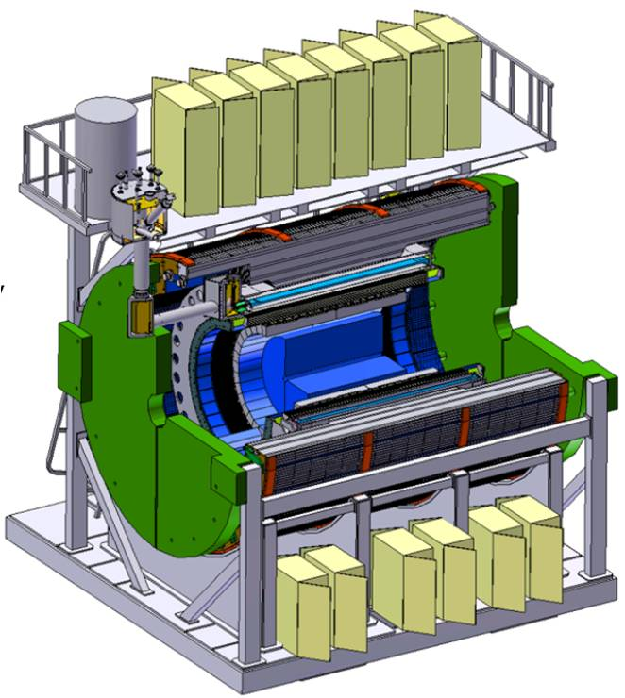
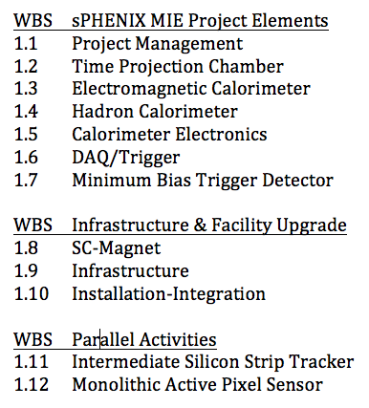
WBS 1.5 Calorimeter Electronics Dry Run
Eric J. Mannel
July 13-14, 2017
BNL

Slide 2
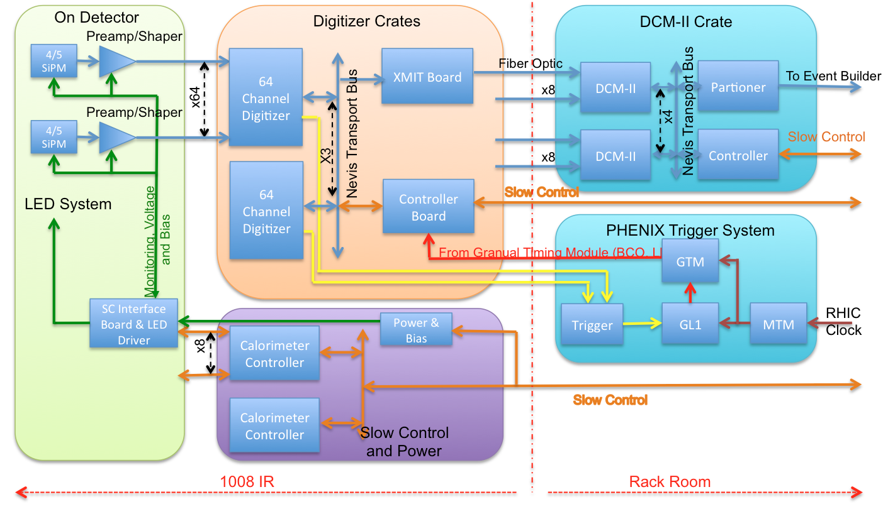
Electronics Overview-I
WBS 1.5
WBS 1.9
WBS 1.6

Slide 3
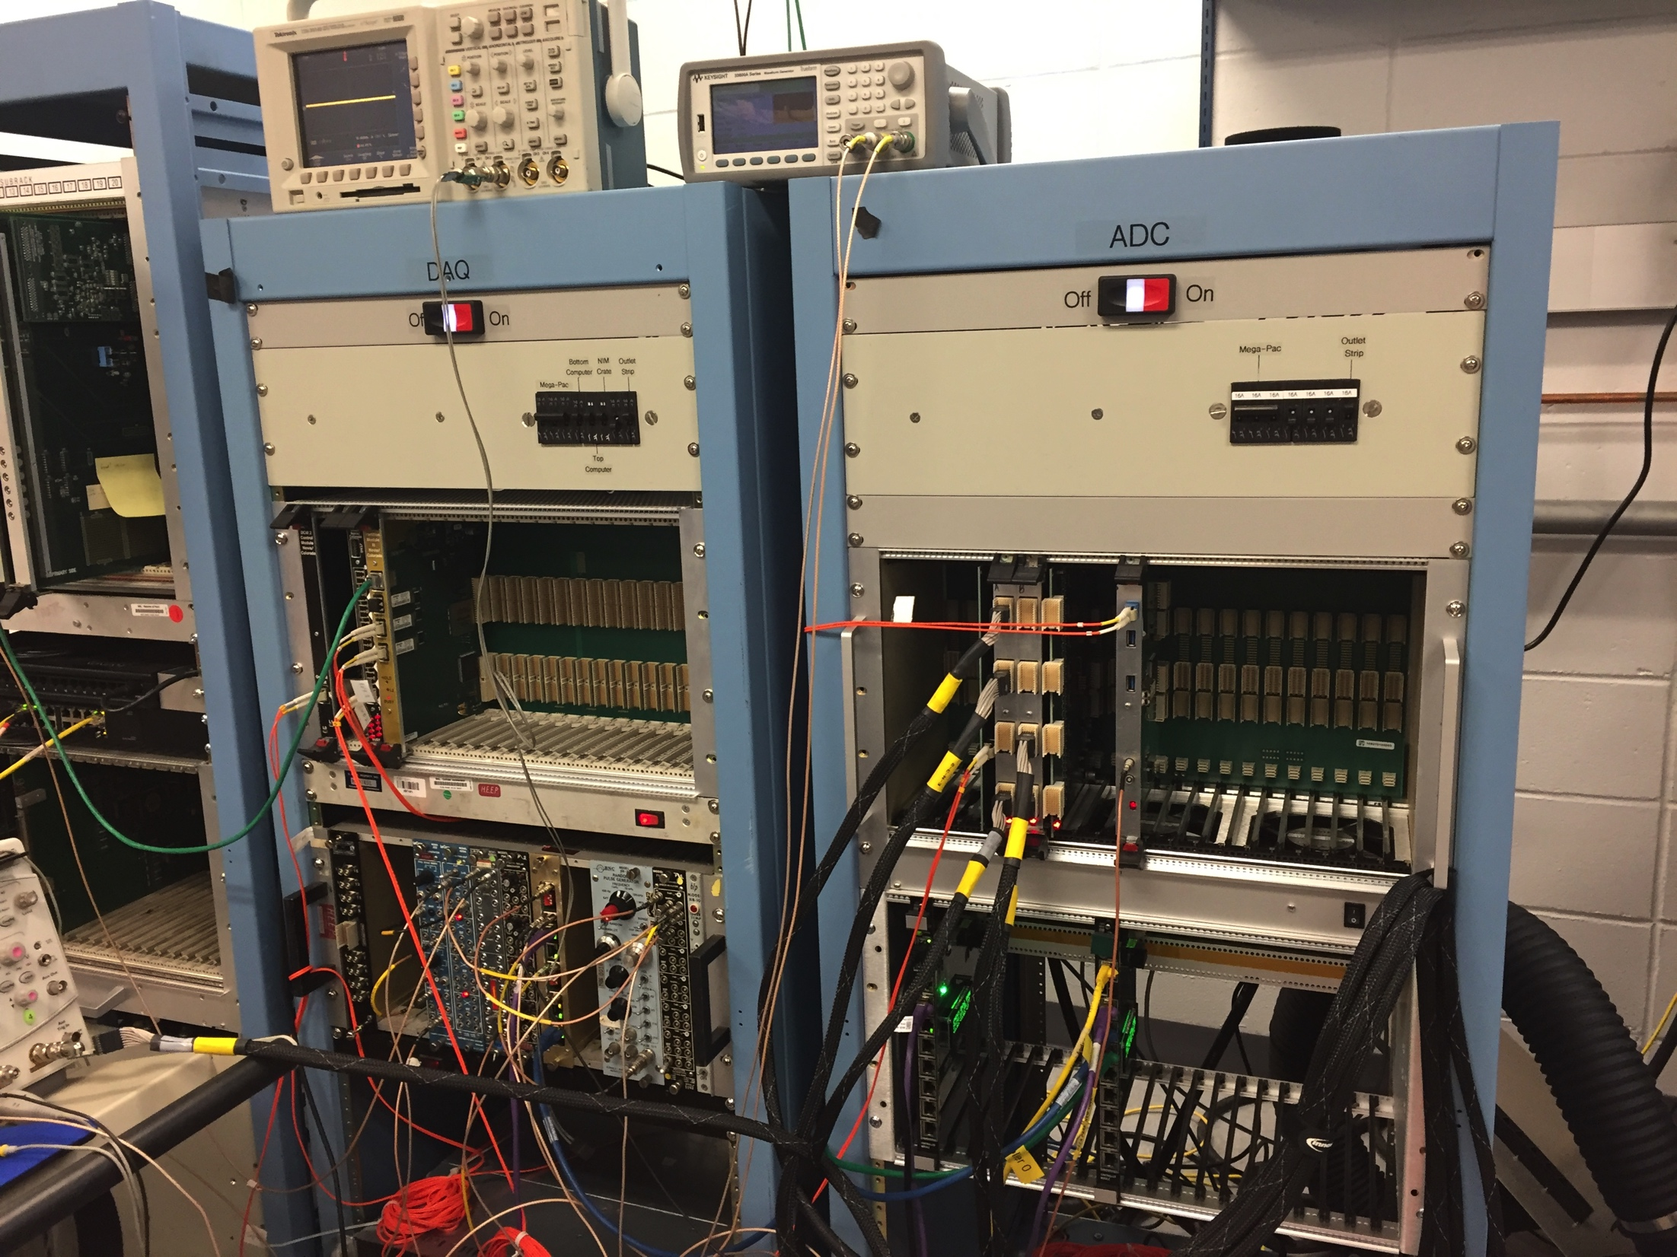
Electronics Overview-II
“Common” design for both EMCal and HCal
Optical Sensor: Silicon Photomultiplier (SiPM)
Font End Analog Section:
Amplification/Shaping
Gain adjustment
Different packaging for EMCal and HCal.
Digital Backend Section:
Continuous waveform digitization
Trigger primitives
Common Low Voltage and Bias Voltage Systems
Advance stage of design:
3 Stages of prototypes, beam test.
Use “Off the Shelf” components- No custom ASICS

Slide 4
WBS 1.5 Technical Overview
Silicon Photomultipliers:
Immune to magnetic fields
Susceptible to neutron damage: increased leakage current
15 x 15 μm²
Dynamic range: 10⁴
Gain: 10⁴
Analog Front End
Common design for EMCal/HCal with different packaging.
Located “on” detector.
Shaping time of 30 nSec
Switchable gain
normal gain
x 16 for calibration
Differential analog drivers
LED calibration/test system
Monitoring of voltages, current and temperature
Gain adjustment via bias voltage
Digitizer Back End
Identical for EMCal/HCal
Located “near” detector
14 Bit ADC (13 bit effective)
65 MHz maximum sampling frequency
40 BCO latency for triggering
Maximum of 32 samples/channel/event
5 Event buffering
Generate trigger primitives based on 2x2 towers

Slide 5
WBS 1.5 Scope
WBS 1.5.1 Optical Sensors:
EMCal: 98304 SiPMS
HCal: 13824 SiPMs
WBS 1.5.2 Front End Electronics:
EMCal: 24576 Channels
HCal: 3072 Channels
System consists of:
Analog preamplifier/Shaper/Driver Circuit
LED Test Pulse
Monitoring (e.g: Voltages, Temperatures, Current)
Bias and Low Voltage systems.
Internal signal and power cables
Crates for control modules
WBS 1.5.3: Digitzer System
Common for EMCal and HCal
27648 Total Channels
System consists of:
432 Digitizer Boards
144 XMIT Boards
432 Trigger primitive transmitters
36 Crates with controllers
Clock and Trigger distribution
Power supplies for 36 crates
624 Patch Fibers
Crate Power Systems

Slide 6
WBS 1.5 Boundaries
Inside the Scope
Optical sensors for EMCal/HCal: 1.5.1
Test and Sorted
Front end analog electronics assembled and tested: 1.5.2
SiPM Daughter boards
Preamplifier/Shaper boards
LED based calibration systems
Slow control and power systems
Internal signal and power cables
External Signal and Power cables to patch panels, digitizers and power supplies
EMCal/HCal digitizer system assembled and tested: 1.5.3
Digitizer/XMIT/Trigger Trans. Boards
Crates and Crate controllers
Optical fiber to patch panels
Power Systems for digitizer crates
Outside the scope
Detectors: 1.3 EMCal/1.4 HCal
Installation of electronics on detector: 1.3 EMCal/1.4 HCal
Post-installation testing: 1.3 EMCal/1.4 HCal/Commissioning
Racks, AC power and safety systems:1.9 Infrastructure
EMCal Cooling: 1.3 EMCal/1.9 Infrastructure
Optical Fibers between IR and Rack Room: 1.9 Infrastructure
DAQ System: 1.6 DAQ

Slide 7
WBS 1.5 Organization
WBS 1.5
Calorimeter Electronics
L2: E.J. Mannel (BNL)
WBS 1.5.1
Optical Sensors
L3: C. Aidala (UofM)
WBS 1.5.2
Front End Electronics
L3: S. Boose (BNL)
WBS 1.5.3
Digitizer System
L3: C-Y Chi (CU/Nevis)
Work Packages:
Optical Sensor Procurement
Work Packages
EMCal Preproduction
EMCal Production
HCal Preproduction
HCal Production
Work Packages:
Prototype Digitizers
Production Digitizers

Slide 8
WBS 1.5 Organization
Dr Eric Mannel (BNL)
HiRes Fly’s Eye Project (1995-2011): Oversaw production, testing and operations of the HiRes-II FADC based electronics
PHENIX VTX/FVTX Electronics Project Engineer (2011-2016)
sPHENIX Calorimeter Electronics oversight (2015-Present)
Prof. Christine Aidala (Univ. of Michigan)
PHENIX FVTX Electronics testing and assembly.
Long standing member of PHENIX and sPHENIX: Executive Council Member, Physics Convener
Steve Boose (BNL)
PHENIX Electrical Engineer for 20+ years
Analog front end systems
Slow control and Monitoring systems
Power systems.
Dr Cheng-Yi Chi (Columbia Univ./Nevis labs)
PHENIX Electronics Design & Fabrication: DCMs, HBD, MPC, RPC…
Neutrino Digitizer Electronics: Mico-Boone, Short-Baseline Near Detector
ATLAS electronics

Slide 9
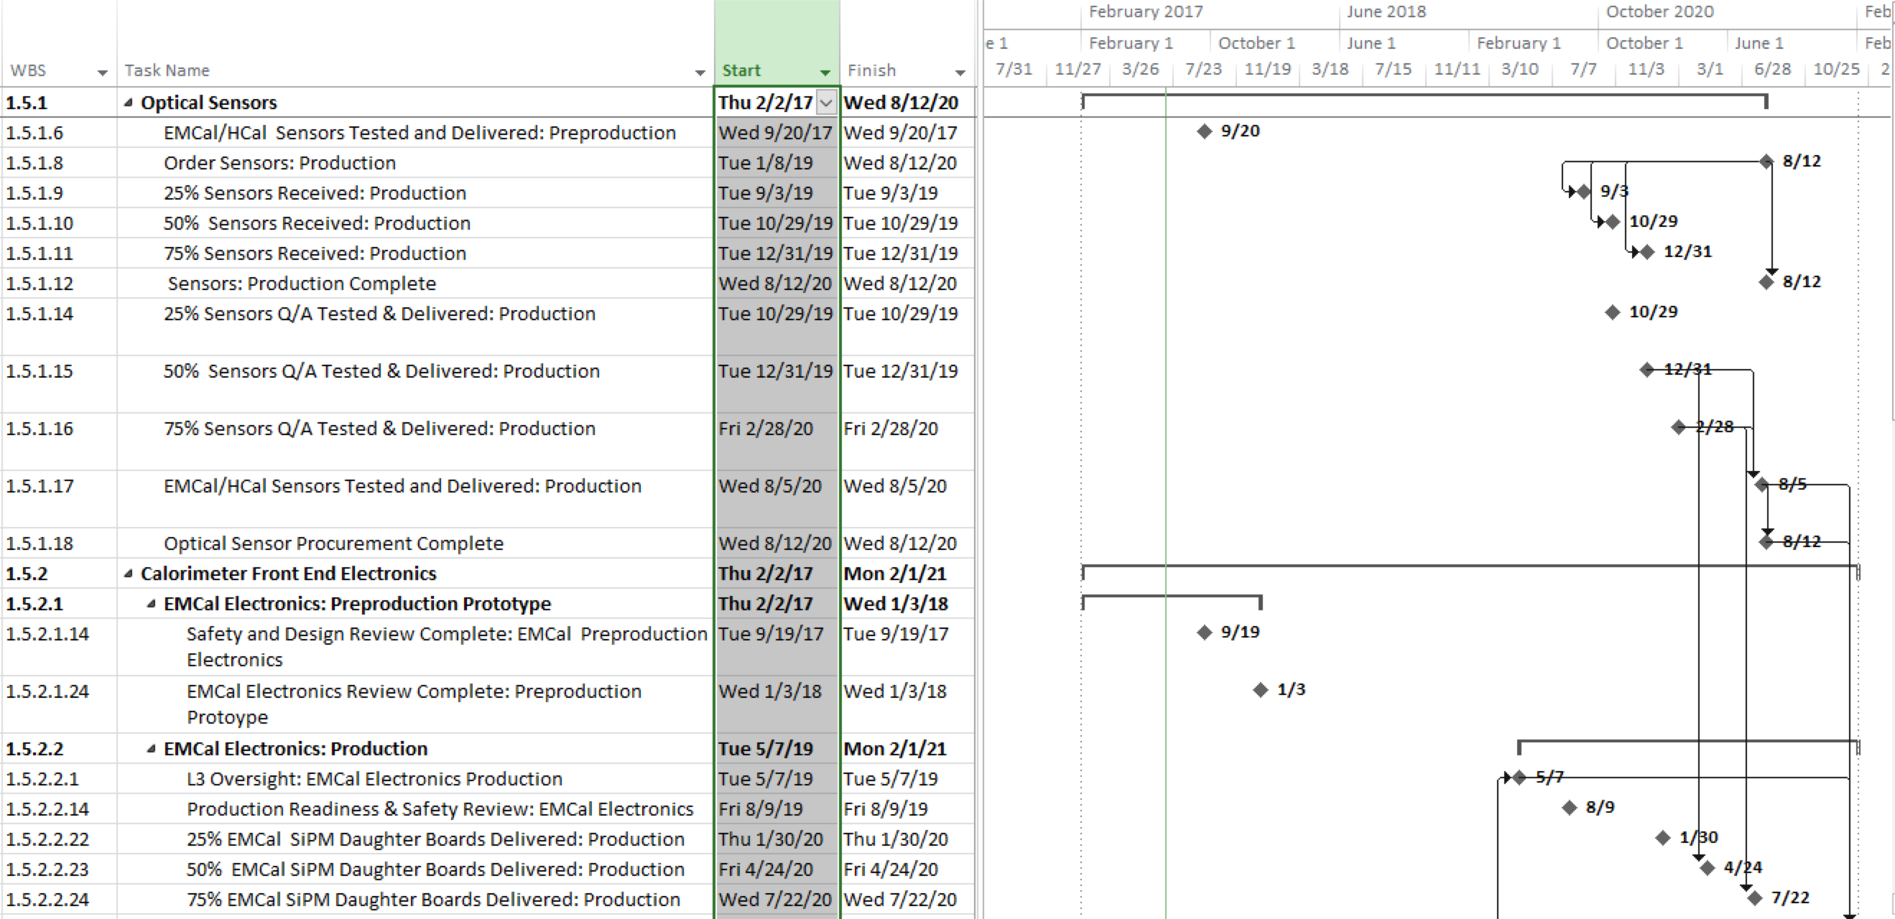
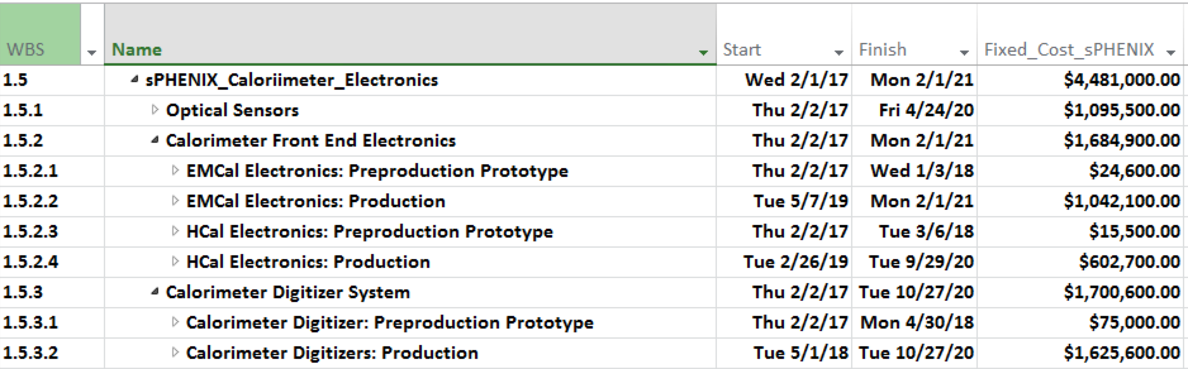
WBS 1.5 Schedule & Cost Drivers
Schedule Drivers:
SiPM Delivery
Cost Drivers:
SiPMS: CD-3A item $1.1M
EMCal Preamps: $0.4M
EMCal Cables: $0.4M
Digitizer Boards: $0.9M
Milestones:
Readiness & Safety reviews
Procurement start dates
Staged, scheduled deliveries
Task completion dates

Slide 10
WBS 1.5 CD-3A Items
Optical Sensors:
98K for EMCal
14K for HCal
Catalog item from single vendor Hamamatsu
Large Order, ~ $1M
Long lead time:
First delivery 3 months from AOR
10K Devices per months -> ∼1Year Delivery time
Requires post delivery assembly, testing and sorting, ∼2 months/10K devices
Required for assembly of HCal modules and EMCal sectors
~2 month float for first EMCal SiPMs daughter boards to be delivered for installation in modules

Slide 11
WBS 1.5 Labor Profile
FTE Profile by Category
FTE Profile by Fiscal Year
Row Labels | FY 17 | FY 18 | FY 19 | FY 20 | FY 21 | FY 22
Cat A | 0.05 | 0.03 | 0.16 | 3.09 | 0.22 | 0.00
Scientific | 0.04 | 0.03 | 0.05 | 0.13 | 0.00 | 0.00
Student | 0.01 | 0.00 | 0.12 | 2.96 | 0.22 | 0.00
Cat B | 1.18 | 0.50 | 0.99 | 2.99 | 0.22 | 0.00
Engineering | 0.66 | 0.22 | 0.45 | 0.76 | 0.04 | 0.00
Scientific | 0.18 | 0.01 | 0.18 | 0.91 | 0.13 | 0.00
Technical | 0.34 | 0.27 | 0.37 | 1.33 | 0.06 | 0.00
Grand Total | 1.23 | 0.53 | 1.16 | 6.08 | 0.44 | 0.00

Slide 12
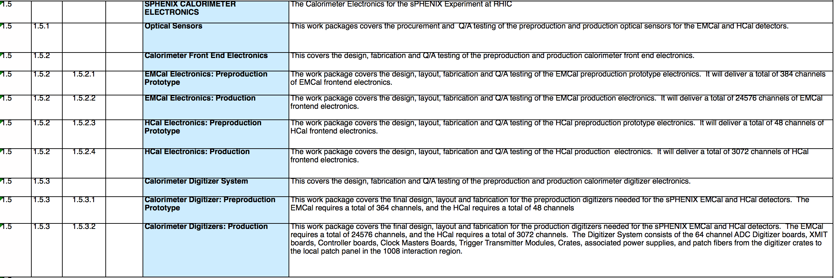
WBS 1.5 Dictionary

Slide 13
Basis for BOE and RLS
All components are standard off the shelf items.
2 long lead time item, SiPMs & SiPM Bias Supplies,
No custom ASICs
“Standard” PCB fabrication and assembly
Design work completed during R&D Phase
Use BOMs for component cost, scaled to larger orders
Use prototype fabrications costs, scaled to larger orders.
Working with some local vendors to “value engineer some assemblies.
Standard lead times for placing orders
Time to prepare order documentation- 1 month typical
2-6 months for PO to be issued based on expected order cost
Delivery times based on vendor estimates, engineering experience
Three CAM Accounts/BoE Files as of July 2017
WBS 1.5.1: Optical Sensors
WBS 1.5.2: Front End Electronics
WBS 1.5.3: Digitizers

Slide 14
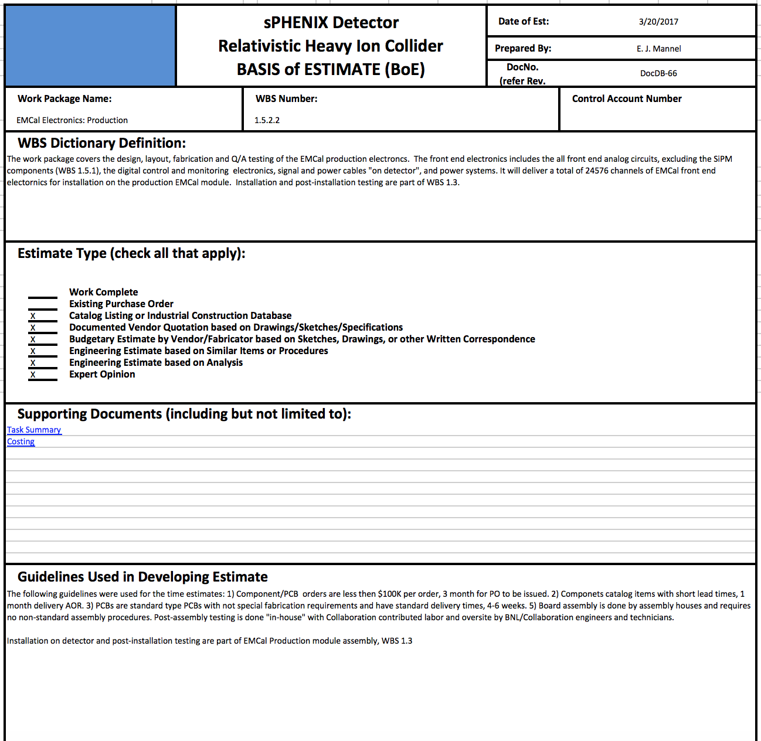
WBS 1.5 BoE Example: BoE Page 1
Have detailed BOE for each work package, 7 Total:
Identify what type of estimates were used in each work package
Guidelines used for estimates, both cost and time

Slide 15
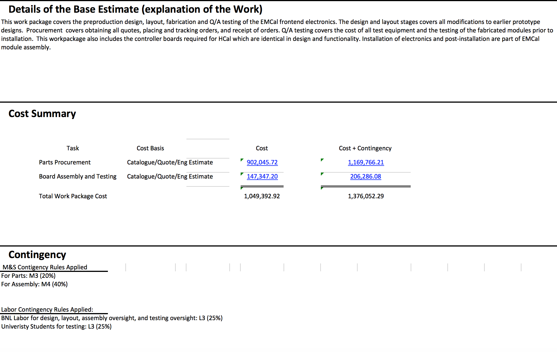
WBS 1.5 BoE Example: BoE Page 2
Identify what is included in the BOE,
What the total cost and cost + contingency
Explain how the contingency was determined and the levels used.

Slide 16
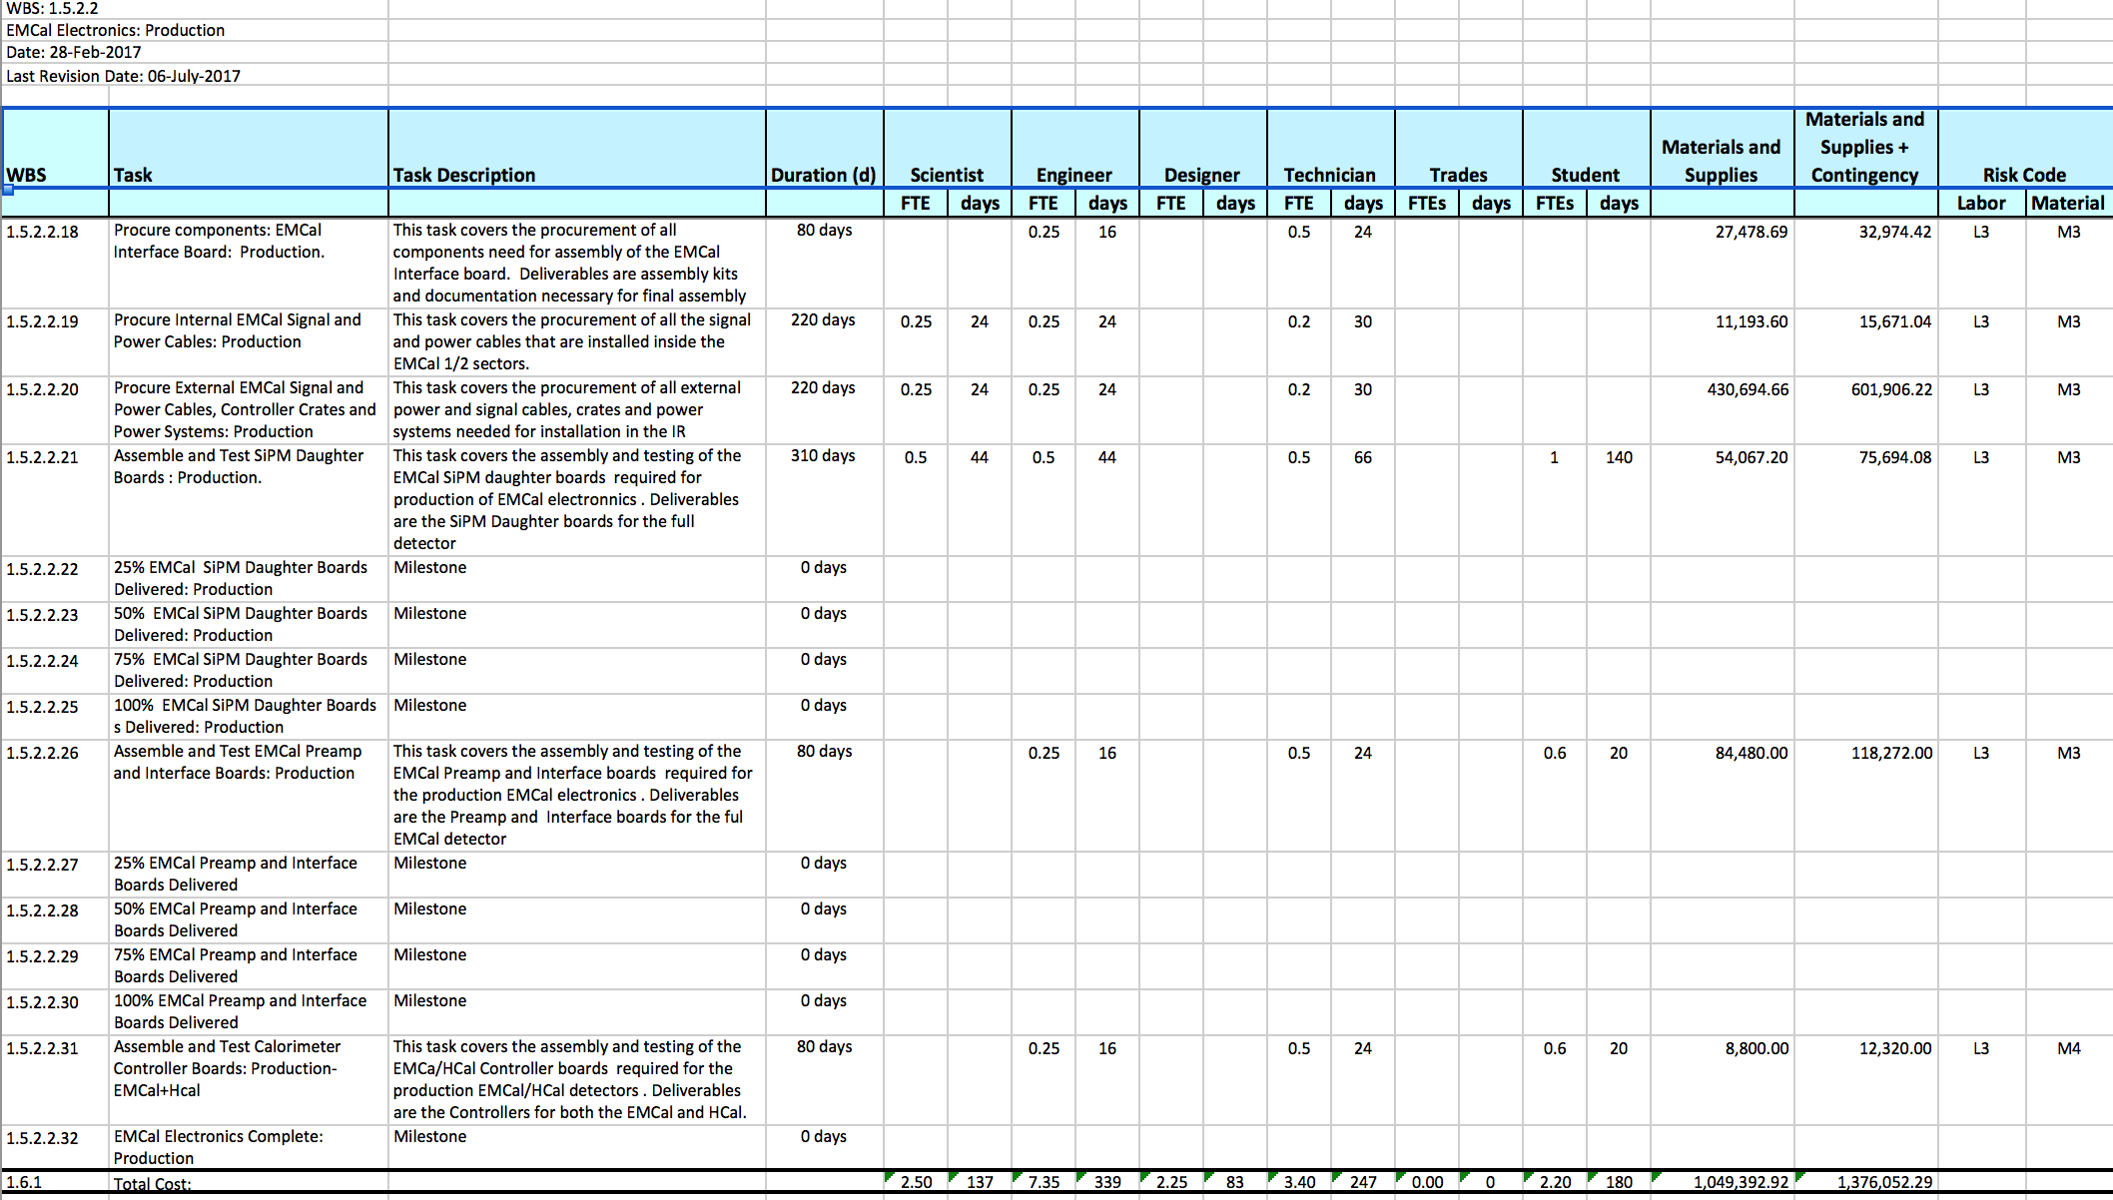
WBS 1.5 Task Summary Example
Used to:
Summarize cost at the task level
Estimate labor requirements

Slide 17
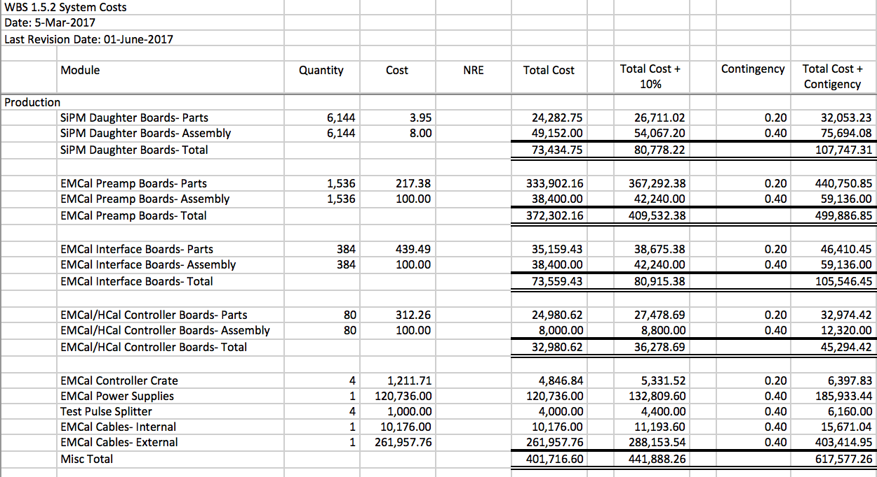
WBS 1.5 BoE Example: System Cost
Costs are estimated at the task level
Based on:
Number of modules required
BOMs for prototype boards
Includes 10% loss due to yield estimates

Slide 18
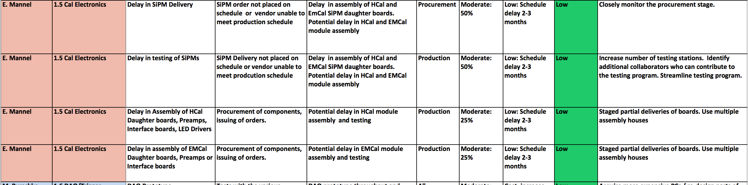
WBS 1.5 Risk Registry

Slide 19
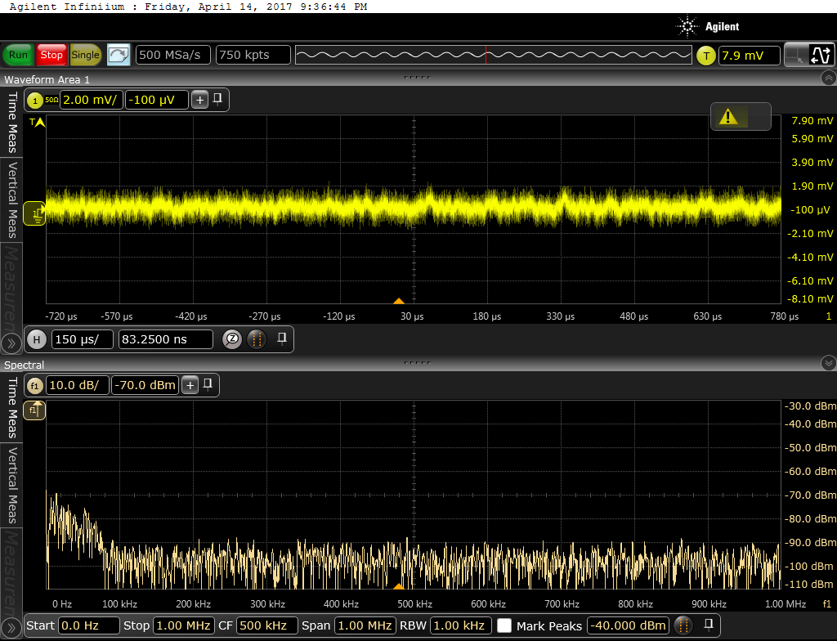
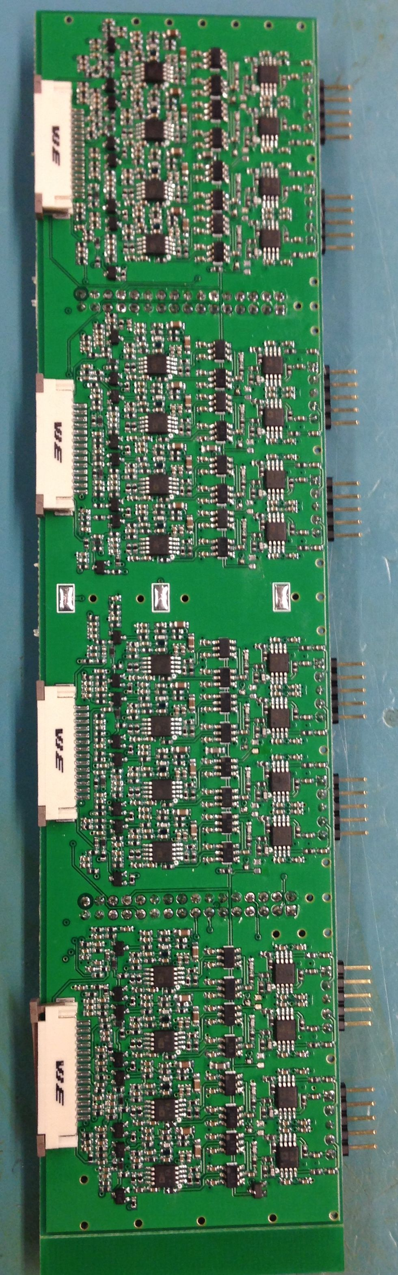
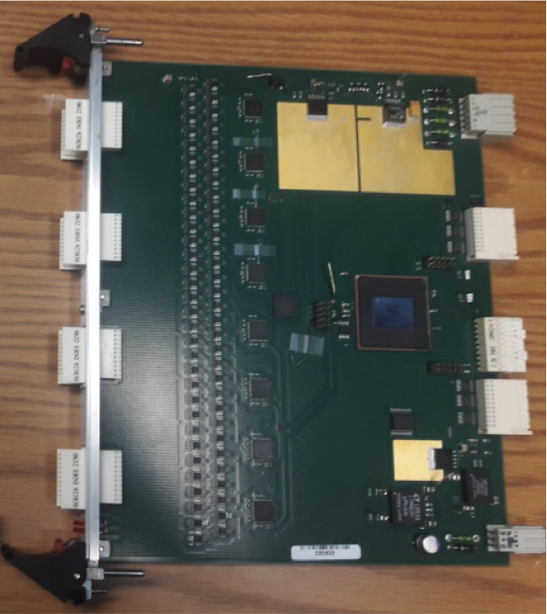
WBS 1.5 Prototypes
Most devices in advanced stage of development- Three prototype stages to date with beam tests
Cost estimates based on prototype designs
Analog modules used as part of T-1044
Low technical risk
Preamp Noise Measurement
Digitizer Module
2x8 EMCal Preamp Module

Slide 20
Issues and Concerns
SiPM Procurement:
Single vendor
Long lead time
Will need to monitor purchase process closely
SiPM Testing/Assembly
Critical for EMCal/HCal performance
Tied to SiPM delivery schedule
Monitor schedule closely, multiple test facilities
Value Engineer assembly process with potential assembly house(s)
Multiple testing sites
Front End Electronics Assembly & Testing
Needed for EMCal Sector/HCal assembly
Closely monitor schedule
Early design of test procedures, value engineering

Slide 21
Back Up

Slide 22
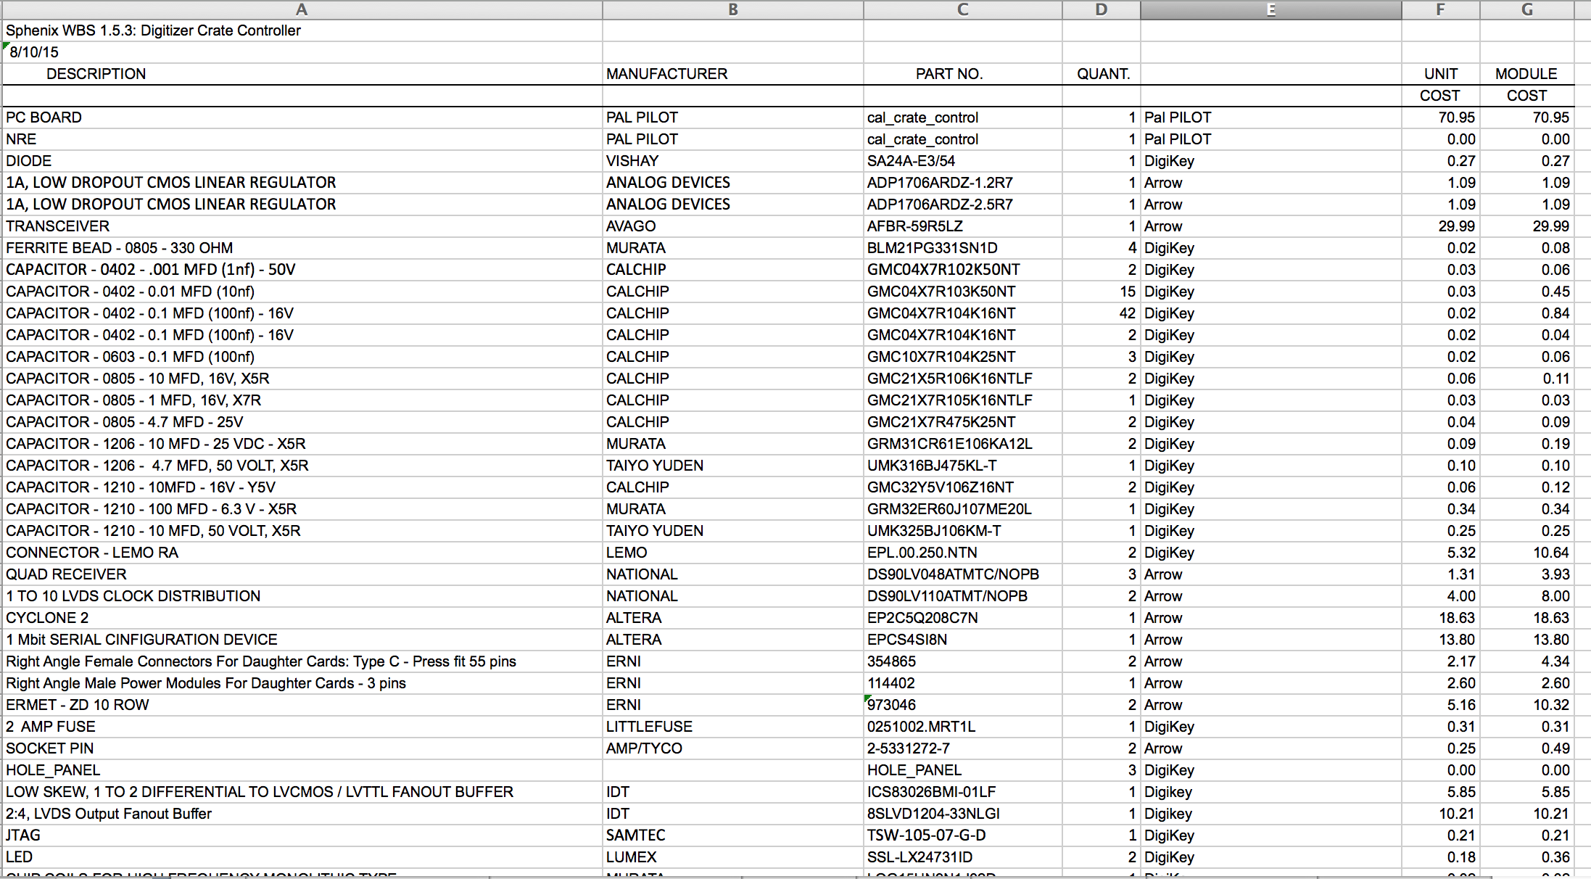
WBS 1.5: Detailed Cost Estimate
Used to estimate board costs
Based on prototype BOMs
Catalog pricing/Vendor budgetary quotes

