Slide 1
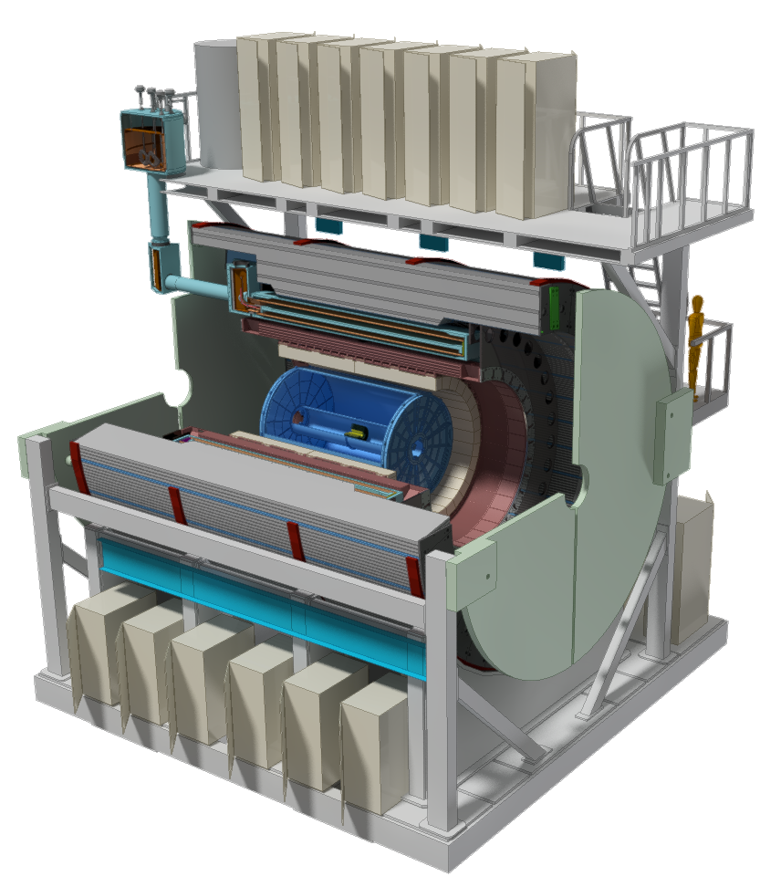
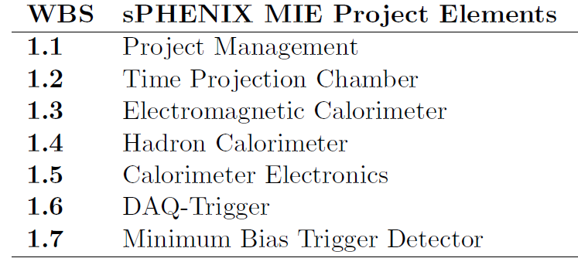
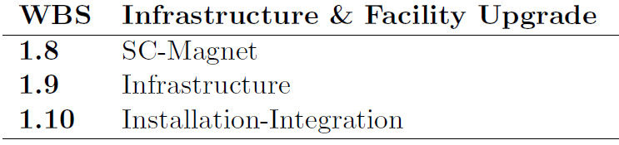
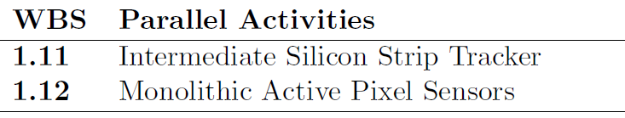

sPHENIX Director’s Review
John Lajoie
Iowa State University

Slide 2
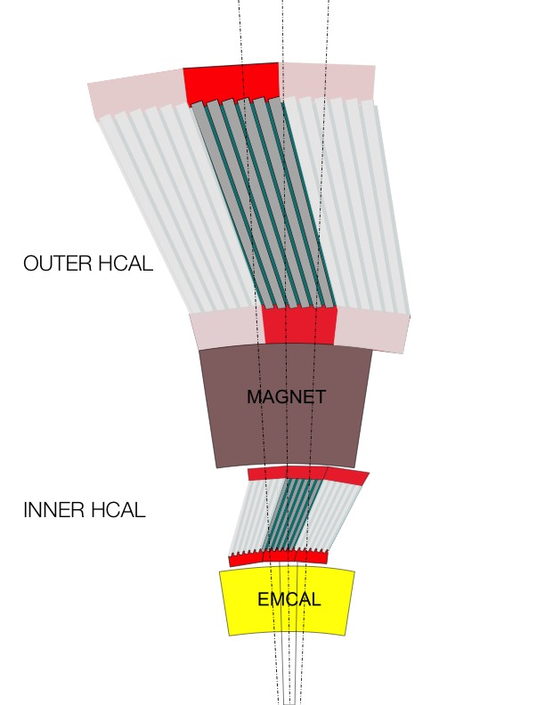
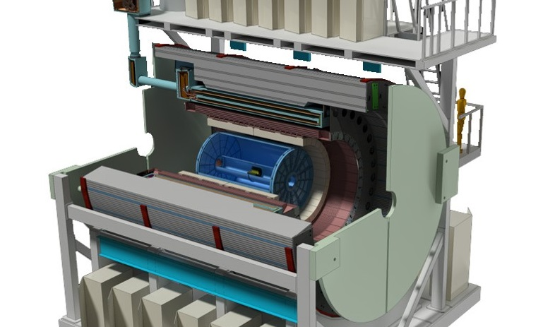
sPHENIX HCAL Description
HCAL steel and scintillating tiles with wavelength shifting fiber
  2 longitudinal segments.
  An Inner HCal inside the solenoid.
  An Outer HCal outside the solenoid.
  Δη x Δφ ≈ 0.1 x 0.1
  3,072 readout channels
  σ_{E}/E < 100%/√E (single particle)
SiPM Readout
Outer HCAL ≈3.5λ_{I}
Magnet ≈1.4X₀
Inner HCAL ≈1λ_{I}
EMCAL ≈18X₀≈1λ_{I}

Slide 3
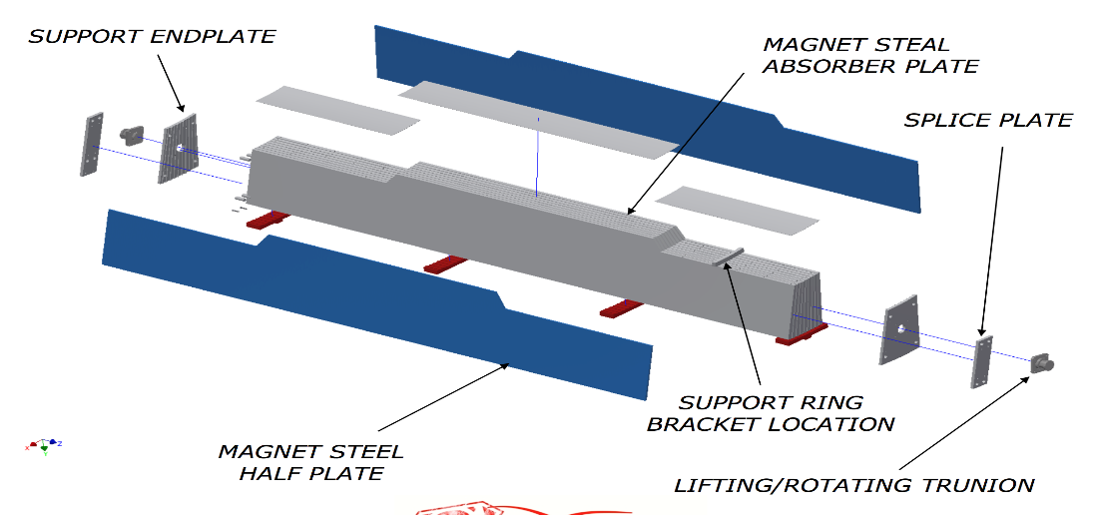
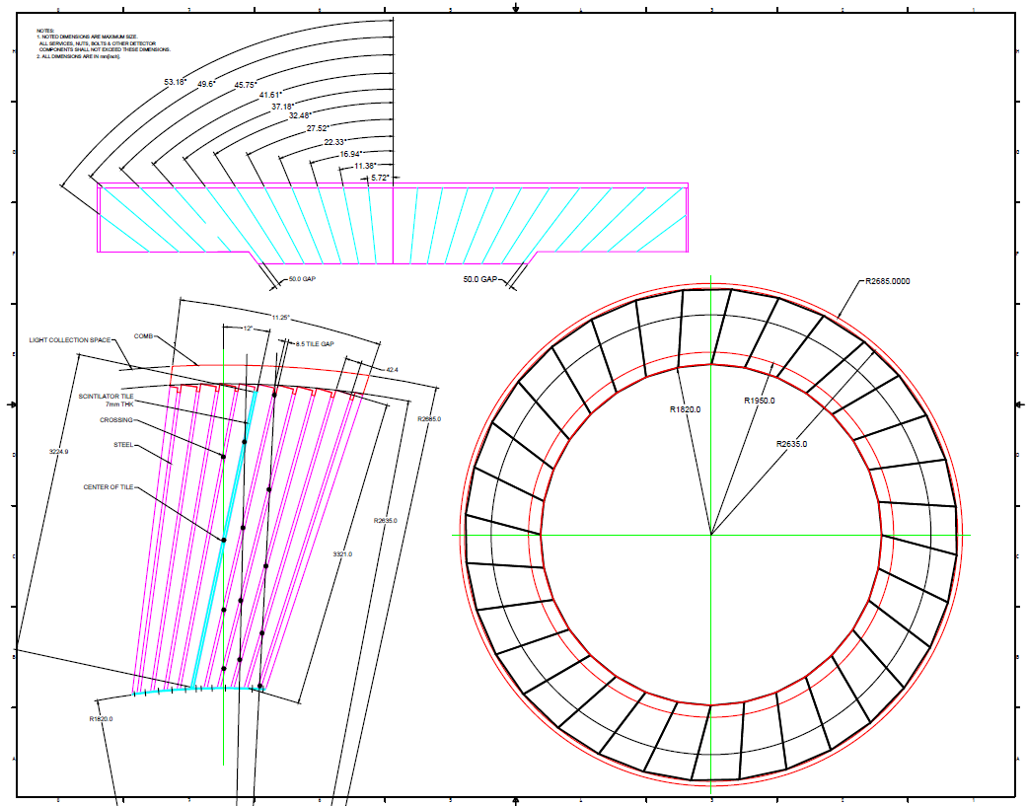
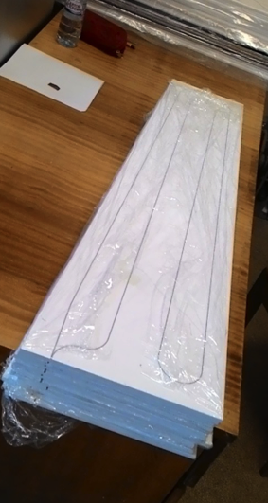
Outer HCAL Geometry
DELIVERABLE:
32 sectors - 1.9m inner radius, 2.6m outer radius
10 rows of 7mm scint. tiles (24 tiles per row), 12º tilt angle
Tapered 1020 steel plates ~26.1mm - ~42.4mm
Completed sector is 6.3m long, 13.5 tons
5 scintillators/tower
48 towers per module
32 modules; 1536 channels (7680 SiPMs)

Slide 4
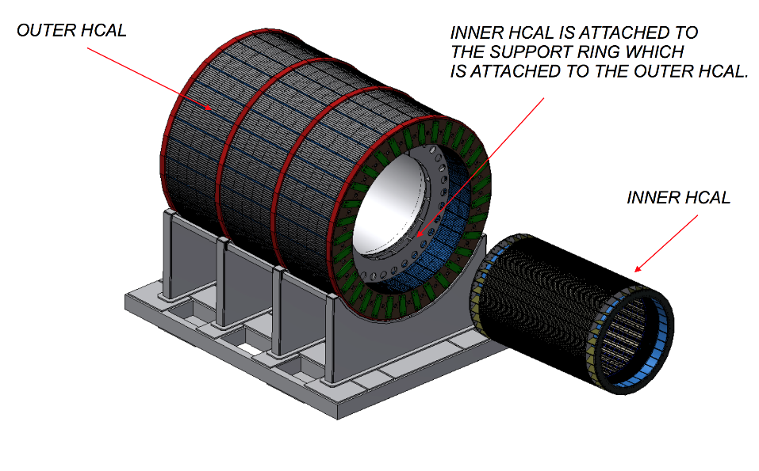
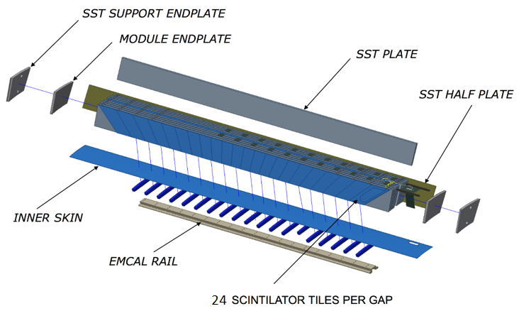
Inner HCAL Geometry
DELIVERABLE:
32 sectors - 1.16m inner radius, 1.37m outer radius
8 rows of 7mm scintillator tiles (24 tiles per row)
32º tilt angle, flat stainless steel plates ~10.2mm - ~14.7mm
Completed sector is 4.3m long, weighs ~ 1 ton
Flat SS310 steel plates
Half plates
on sides
4 scintillators/tower
48 towers per module
32 modules; 1536 channels
(6144 SiPMs)

Slide 5
HCAL Performance Specifications
HCAL performance driven by jet physics in HI collisions
Uniform fiducial acceptance -1<η<1 and 0<φ<2π
  Extended coverage -1.1<η<-1.1 to account for jet cone
Absorb >95% of energy from a 70 GeV jet
  Requires 5.5 nuclear interaction length depth
Hadronic energy resolution of combined calorimetry:
  with constant term <15%
  Gaussian response (limited tails)
  Performance optimized/demonstrated in three test beams
Hadronic calorimeter doubles as flux return
  Inner HCAL non-magnetic
  Outer HCAL magnetic (flux return)

Slide 6
Design Drivers
Why not a separate flux return?
  Simplified construction and support structures
Why an inner and outer HCAL segment?
  Size limitations set by existing interaction hall
  Set by radius of BaBar solenoid, the design of the mechanical support for the detector, and overall cost effectiveness
Why a tilted plate design?
  A tilted plate design can provide a uniform acceptance, adequate energy resolution and simplified construction
How are the tilt angles chosen?
  Chosen to avoid channeling (tails in resolution function)
Why Δη x Δφ ≈ 0.1 x 0.1?
  Driven by occupancy in Heavy Ion collisions
  Good match to scale of hadronic jets

Slide 7
Level-2 Managers and CAMs
TPC T. Hemmick
Mechanics K. Dehmelt
GEM1 S. Milov
GEM2 V. Green
GEM3 V. Riabov
TPC FEE T. Sakaguchi
TPC DAM J. Huang
TPC Support R. Pisani
EMCal C. Woody
HCal J. Lajoie
CalElectronics E. Mannel
DAQ & Trigger M. Purschke
MinBias M. Chiu
Management
I. Sourikova
Blocks
A. Sickles
Modules & Sectors S. Stoll
Inner HCal J. Lajoie
Outer HCal A. Gordeev
CalEl Optical Sensors C. Aidala
CalEl FEE S. Boose
CalEl Digitizers CY Chi
DAQ E. Desmond
Trigger J. Nagle
GL1 E. Desmond
Timing System M. Purschke
Participating Institutions:
BNL (all engineering, outer HCAL)
ISU (inner HCAL)
Colorado (tile testing)
GSU (tile testing,
outer HCAL)
WSU (inner HCAL)
ACU (inner HCAL)
In discussion with Russian institutions (MEPHI/IHEP/Kurchatov)
J. Lajoie – Professor, ISU
A. Gordeev – Engineer, BNL
ISU was responsible for the PHENIX LL1 trigger and MPC-EX.
WSU has a wide range of experience in building detectors.
ACU worked on the PHENIX MuTR chambers.

Slide 8
HCAL Scope/Interface

Slide 9
Resources/Cost Drivers
Steel is essentially a commodity material but precision machining is expensive
  Minimizing the volume of steel (HCAL radius) minimizes the cost
Scintillator tile production
  Surface flatness over long distances a key specification
    Wrapped tile thickness < 7.5mm, Uniplast can meet this spec.
  Uniplast (T2K, PHENIX),
    FNAL/Elgen also investigated, Uniplast most economical for complete tile assemblies
Module Assembly and QA
  Outer HCAL to be assembled at BNL
    Manpower, assembly location
  Assemble inner HCAL at multiple university sites
    Make use of university labor and facilities
    Deliver assembled, cosmics tested sectors to BNL

Slide 10
CD3a Request
The following CD-3a purchases are under WBS 1.4:
  Outer HCAL steel ($5.2M)
  Scintillating tiles (inner and outer HCAL, $2.1M)
  sPHENIX is/will be ready for this authorization:
    Outer HCAL design is complete; mech. prototype underway
    Outer HCAL performance measured to be within sPHENIX specifications in multiple test beams
    Tile designs complete; Uniplast ready for production after last prototype run (ongoing)
Impact of CD-3a request:
  Without the CD-3a funding authorization we will be unable to meet the sPHENIX schedule for first physics run in early 2023

Slide 11
Timeline of Major Tasks
  Sector Mechanical Prototypes: 3-9/2017
  Prototype v2.1 Test Beam: 2/2018 – 3/2018
  Outer HCAL Production: 6/2019 – 1/2021 (CD3a)
  Inner HCAL Production: 11/2019 – 7/2021 (CD3b)
24

Slide 12
HCAL Budget Profile

Slide 13
HCAL Staffing
FTE Profile by Category
FTE Profile by Fiscal Year
WBS Level | Org Sort | Group | FY 17 | FY 18 | FY 19 | FY 20 | FY 21 | FY 22
1.4 | BNL | Purchased Services | 0.00 | 0.00 | 0.18 | 0.46 | 0.12 | 0.00
 |  | Scientific | 0.60 | 0.36 | 0.16 | 0.37 | 0.00 | 0.00
 |  | Technical | 0.74 | 0.31 | 1.29 | 1.87 | 0.51 | 0.00
 |  | Professional | 0.38 | 0.47 | 0.23 | 0.91 | 0.75 | 0.00
 | BNL Sum |  | 1.71 | 1.13 | 1.87 | 3.61 | 1.38 | 0.00
 | Non-BNL | Student | 0.08 | 0.23 | 1.35 | 9.50 | 5.97 | 0.00
 |  | Technical | 0.00 | 0.00 | 0.38 | 1.27 | 1.76 | 0.00
 |  | Professional | 0.00 | 0.00 | 0.00 | 0.12 | 0.10 | 0.00
 |  | Postdoc | 0.00 | 0.00 | 0.82 | 1.46 | 1.61 | 0.00
 | Non-BNL Sum |  | 0.08 | 0.23 | 2.55 | 12.34 | 9.43 | 0.00
Grand Total |  |  | 1.79 | 1.36 | 4.42 | 15.95 | 10.81 | 0.00

Slide 14
BoE Summary Page (Example)
Developed from the ground up, using best estimates/quotes available at this time.
All cost items implemented in standard sPHENIX BoE form.
Detailed calculations separate out MIE and non-MIE labor, etc.

Slide 15
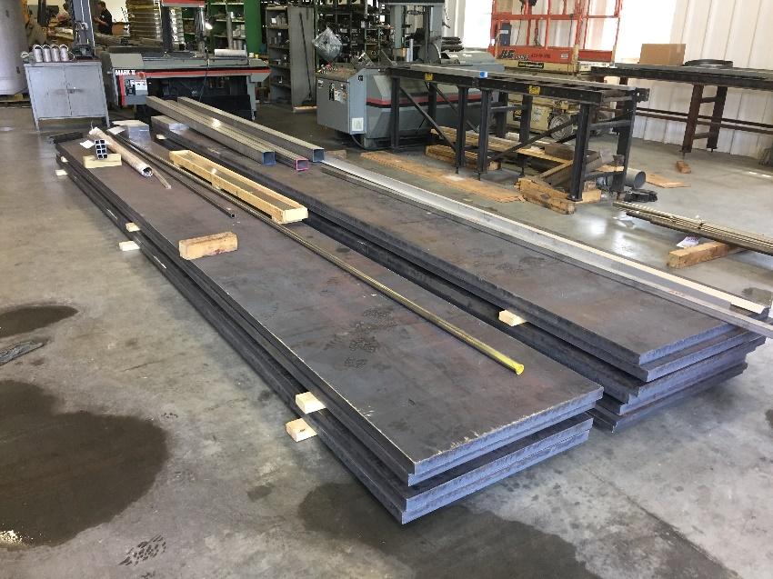
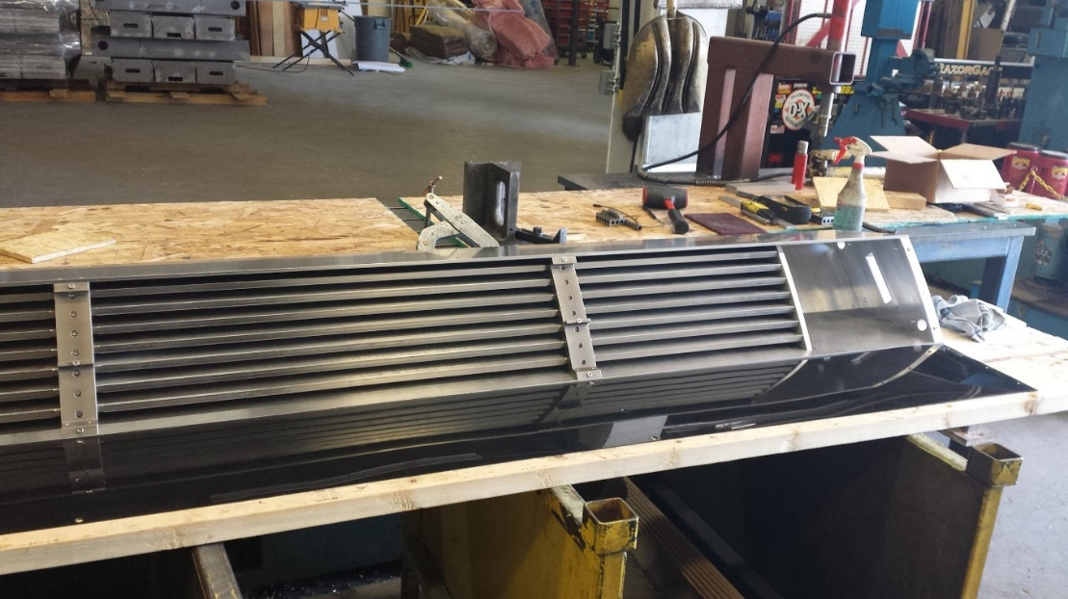
Sector Prototypes
Strecks visit – 5/2017
TSI/Ames visit 6/2017
(inner HCAL protoype funded by ISU)
Full sector prototypes underway – Will be used to identify key issues to optimize manufacturing and reduce machining time/effort. Mechanical deflections and tolerances measured as a function of temperature, to be compared with finite element analysis.

Slide 16
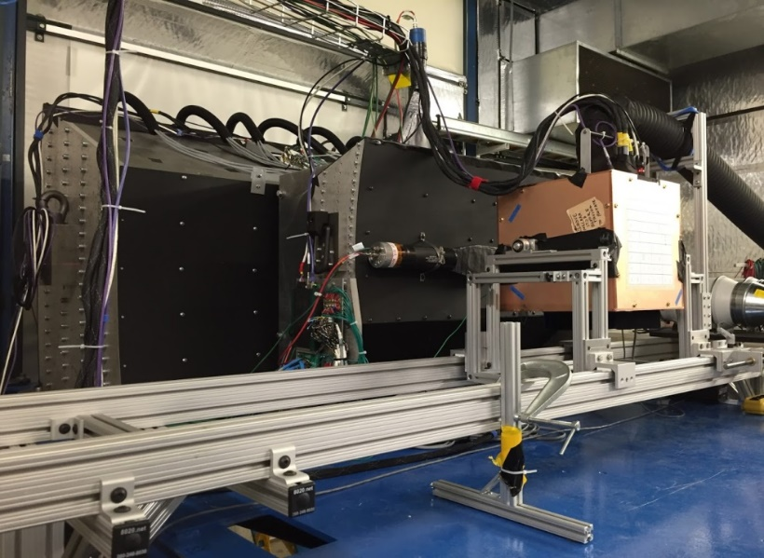
Performance
Simulated Magnet
Three test beams (2014/15/16):
EMCAL
IHCAL
Beam
OHCAL
In all cases, the combined system meets the sPHENIX spec!

Slide 17
Risk Registry/Issues and Concerns
Risk registry currently includes three major items, two of which are rated at moderate risk.

Slide 18
Back Up

Slide 19
RLS/BoE Guidelines
The Outer HCAL mechanical structures will be purchased fully assembled and delivered to BNL.
  Assembly at BNL will continue with BNL technicians and collaboration labor
    Populate with scintillator and electronics, test and provide initial cosmics calibration.
The Inner HCAL will be assembled at two (or more) University sites.
  ISU, WSU and ACU have expressed interest
  Sector assemblies provided by local vendors, populated with scintillator and electronics by University labor
  Shipped to BNL, tested after shipping and stored.
  IHEP Protovino investigating construction alternatives

Slide 20
Basis of Estimate Documents
Outer HCAL summary page is similar...

Slide 21
WBS Dictionary
Detailed WBS Dictionary available, based on MS Project file.

Slide 22
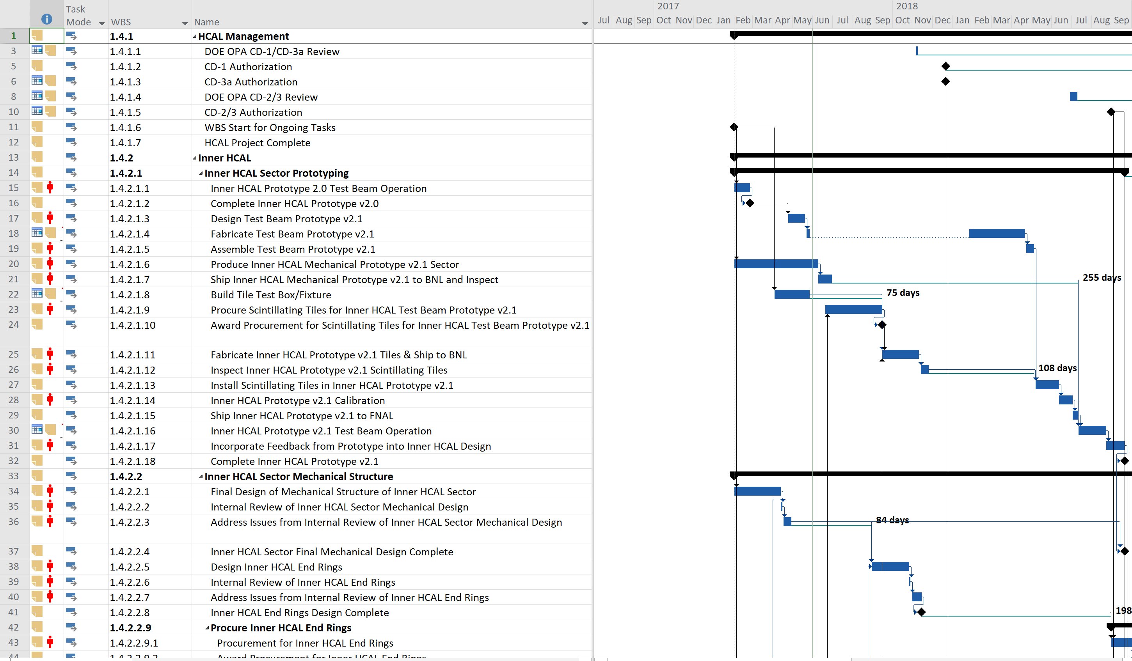
Resource Loaded Schedule
RLS includes fixed cost, paid labor and non-MIE labor, and University overheads.

Slide 23
Basis of Estimate (Detail)
Summary pages linked to detailed costs spreadsheet, identifying cost and contingency for every item (fixed, paid labor and non-MIE labor)
Deeper calculations separate out MIE and non-MIE labor, etc.

Slide 24
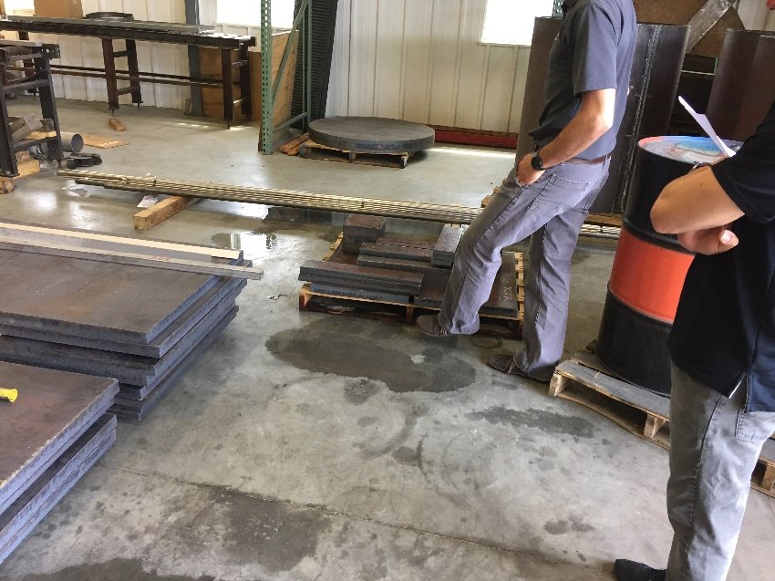
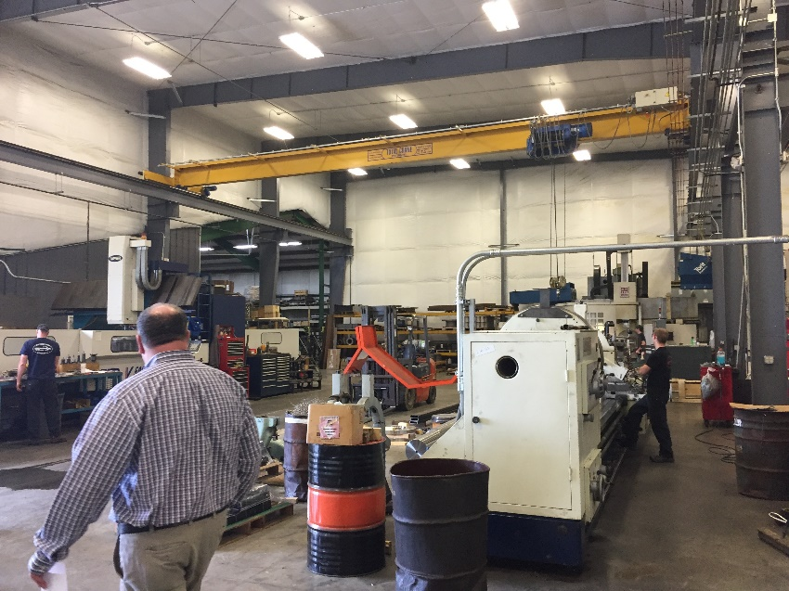
Engineering Strecks Visit (5/2017)
Outer HCAL Mechanical Prototype on track for delivery to BNL by end of summer.

Slide 25

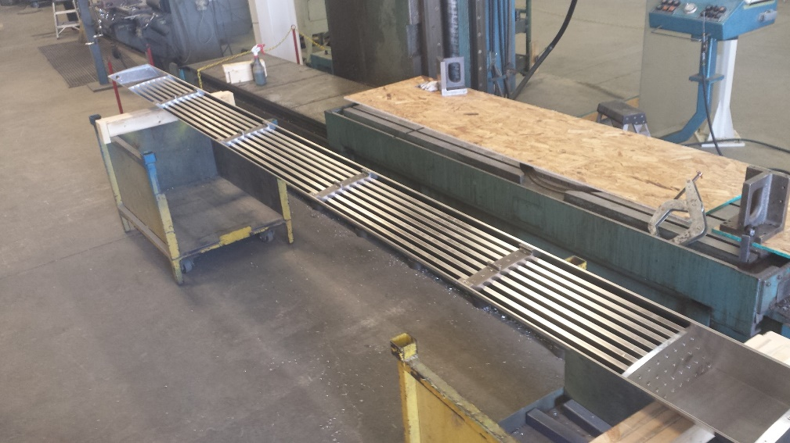
Inner HCAL Prototype (TSI Ames)
Full sector prototype completed – Engineering visit 6/26/2017. Identified key issues to optimize manufacturing and reduce machining time/effort. Mechanical deflections and tolerances measured as a function of temperature, to be compared with finite element analysis. (Prototype funded by ISU.)

