Slide 1
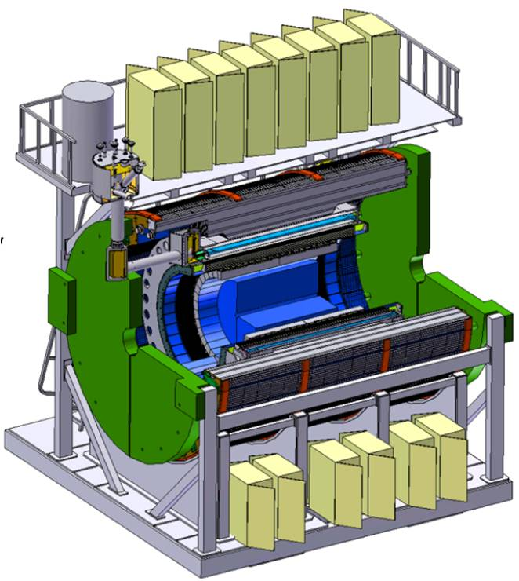
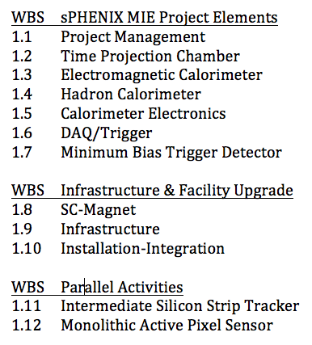
sPHENIX Director’s Review 1.6. DAQ/Trigger
L2 Manager: Martin L Purschke, BNL

Slide 2
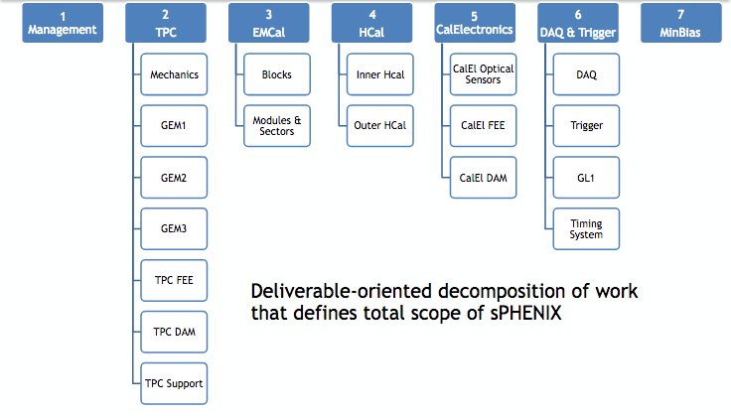
WBS 1.6 – DAQ-Trigger
Ed Desmond, BNL (DAQ)
Jamie Nagle and Dennis Perepelitsa, U Colorado (Trigger)
Martin Purschke, BNL (DAQ, Trigger, Timing)
Electronics Engineers (Firmware Development)

Slide 3
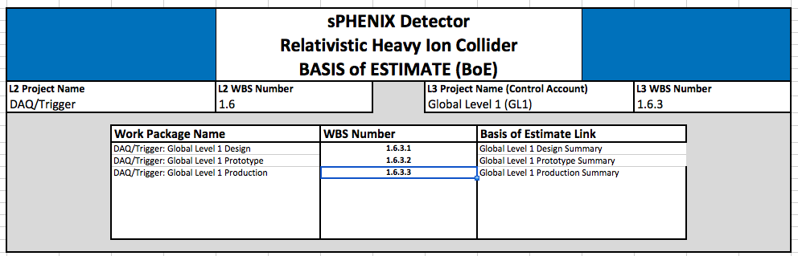
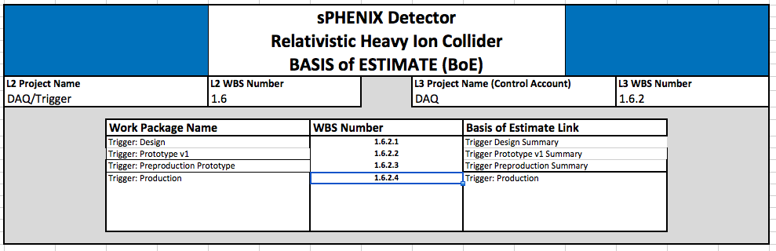
What 1.6 contains
The actual Data Acquisition 1.6.1
The Trigger System 1.6.2
The Global Level 1 1.6.3
The Timing System 1.6.4
You will find all information in the assorted work package documents

Slide 4
Package Walkthrough
Front-end module
Data Collection Module
Sub-Event Buffer
Network Switch
Assembly and Trigger Module
Buffer box
10+ Gigabit
Network
Switch
FEM
Buffer Box
FEM
DCM2
SEB
ATP
Many
(but not in scope here)
many
dozens
one
o(100)
o(10)

Slide 5
1.6.1 Data acquisition
Event Builder
FEM
10+ Gigabit
Crossbar
Switch
DCM
DCM2
Buffer Box
DCM
DCM
DCM
DCM
ATP
FEM
DCM
SEB
ATP
DCM
Buffer Box
DCM
DCM2
DCM
DCM
ATP
DCM
FEM
DCM
SEB
DCM
ATP
Buffer Box
DCM
To
HPSS
DCM
DCM2
ATP
DCM
SEB
DCM
DCM
ATP
Buffer Box
FEE
ATP
DCM
DCM
DAM
EBDC
ATP
DCM
Buffer Box
FEE
ATP
DCM
DCM
DAM
EBDC
ATP
Buffer Box
DCM
FEE
ATP
DCM
DAM
EBDC
DCM
ATP
Buffer Box
DCM
Interaction Region
Rack Room
Computing
Facility
Rack Room
Rack Room

Slide 6
1.6.1 Data acquisition
Not in 1.6 Scope
Event Builder
FEM
10+ Gigabit
Crossbar
Switch
DCM
DCM2
Buffer Box
DCM
DCM
DCM
DCM
ATP
FEM
DCM
SEB
ATP
DCM
Buffer Box
DCM
DCM2
DCM
DCM
ATP
DCM
FEM
DCM
SEB
DCM
ATP
Buffer Box
DCM
To
HPSS
DCM
DCM2
ATP
DCM
SEB
DCM
DCM
ATP
Buffer Box
FEE
ATP
DCM
DCM
DAM
EBDC
ATP
DCM
Buffer Box
FEE
ATP
DCM
DCM
DAM
EBDC
ATP
Buffer Box
DCM
FEE
ATP
DCM
DAM
EBDC
DCM
ATP
Buffer Box
DCM
Interaction Region
Rack Room
Computing
Facility
Rack Room
Rack Room

Slide 7
What does what?
Core DAQ System
Entire data flow and event building
Data logging and data transfer to tape storage system
Configuration (Slow Control)
Global Level 1 (GL1)
Decides for each RHIC beam crossing if the data should be taken
Receives and digests the Local Level 1 information
Keeps track of the DAQ busy
Local Level 1
Collect data from a given detector system to determine if a given collision is “valuable” – input to GL1
Timing System
Distributes the RHIC clock to the front-end modules
Sends the accepted L1 accepts to the FEMs
Manages multi-event buffering (how deep we have stacked events)

Slide 8
Data rates
The TPC dominates the data volume
Calorimeter values based on occupancy estimates
peak data rates (Gbit/s)
The ~100 Gbit/s peak rate would require 10 Buffer Boxes with 10Gbit/s interfaces
BufferBoxes’ role is to concentrate the data and level the output data flow from peak to to average values - provides some headroom

Slide 9
Description of major engineering tasks
Core DAQ System
Working implementation exists, many software enhancements and updates
Define and implement APIs and hand-off point with TPC-EBDC
Global Level 1 (GL1)
Porting existing firmware to a modern-day board
Enhancing and developing firmware
Local Level 1
Select FPGA board, implement physics algorithms in FPGA
Timing System
Select FPGA boards and right transceivers
Porting existing firmware
Enhancing and developing firmware

Slide 10
4 Stages for Local Level 1 - 1.6.2
Due to the anticipated complexity and dual nature (physics capabilities and technical implementation) of the LL1, we added one more prototype stage to this one.
Every other item has a standard design-prototype-production 3-stage cycle
1.6.2.1 Design
1.6.2.2 Prototype v1
1.6.2.3 Preproduction Prototype
1.6.2.4 Production

Slide 11
Risk Registry
DAQ Prototype |  | DAQ prototype throughput and performance is below specifications |  |  |  | Low
Network switch |  | Network switch more expensive than projected |  |  |  | Low
Global Lvl1 |  | adaptation of PHENIX GL1 runs into obstacles |  |  |  | Low
Timing System |  | Conversion/adaptation from GLINK problematic, or envisioned replacement board cannot be used |  |  |  | Low
Local LVL1 |  | Performance of LLVL1 algorithms inadequate. Trigger latency too high. |  |  |  | Moderate
Storage |  | Data volume, especially from the TPC, too high |  |  |  | Moderate
Local Lvl1 “Simulations reveal the failure of an envisioned algorithm”
Storage “The TPC or other subsystem exceeds the allotted bandwidth … additional compression strategies would need to be developed”

Slide 12
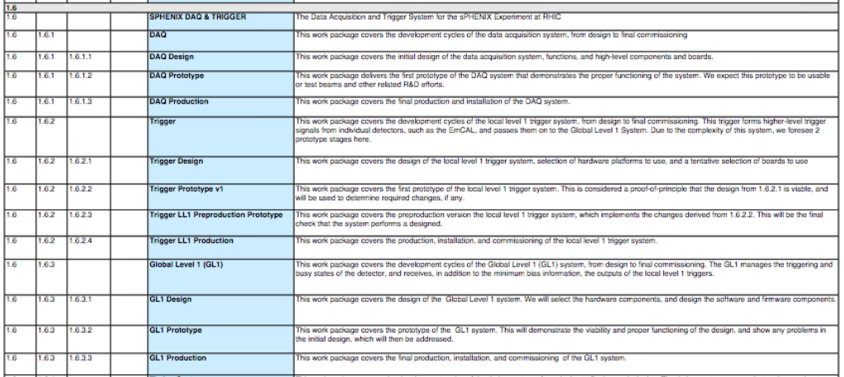
WBS Dictionary Example
Part of sPHENIX WBS Dictionary- Link
Defined down to the work package level
“This work package covers the development cycles of the Global Level 1 (GL1) system, from design to final commissioning. The GL1 manages the triggering and busy states of the detector, and receives, in addition to the minimum bias information, the outputs of the local level 1 triggers”

Slide 13
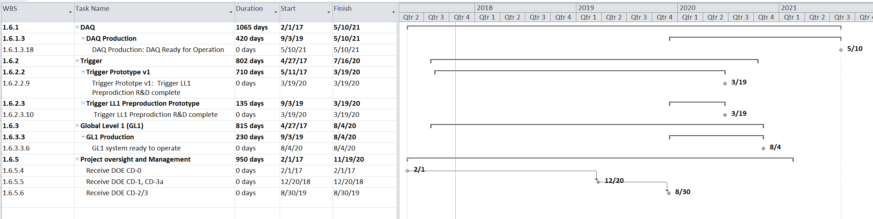
Schedule
Schedule Drivers:
COTS procurements as late as possible to take advantage of price decreases or next-gen hardware
DAQ infrastructure as early as needed to support detectors’ installation and commissioning cycle

Slide 14
Labor Profiles
FTE Profile by Category
FTE Profile by Fiscal Year
WBS Level | Org Sort | Group | FY 17 | FY 18 | FY 19 | FY 20 | FY 21 | FY 22
1.6 | BNL | Purchased Services | 0.00 | 0.00 | 0.00 | 0.02 | 0.00 | 0.00
 |  | Scientific | 0.33 | 0.50 | 0.23 | 1.17 | 0.70 | 0.00
 |  | Technical | 0.05 | 0.04 | 0.03 | 0.47 | 0.00 | 0.00
 |  | Professional | 0.36 | 0.40 | 0.22 | 1.07 | 0.55 | 0.00
 | BNL Sum |  | 0.73 | 0.93 | 0.47 | 2.73 | 1.25 | 0.00
 | Non-BNL | Scientific | 0.48 | 0.27 | 0.09 | 0.36 | 0.00 | 0.00
 |  | Student | 0.00 | 0.67 | 0.06 | 0.93 | 1.12 | 0.00
 |  | Professional | 0.15 | 0.23 | 0.10 | 0.59 | 0.00 | 0.00
 | Non-BNL Sum |  | 0.63 | 1.17 | 0.25 | 1.88 | 1.12 | 0.00
Grand Total |  |  | 1.36 | 2.10 | 0.72 | 4.61 | 2.37 | 0.00

Slide 15
Issues and Concerns
Concerns:
The Local Level 1 system needs work on more than one front (physics simulation, then implementation on the FPGA). Reflected in 2 prototype stages.
The TPC data volume might be higher than current estimates, leaving us with little headroom. This may require additional compression/reduction strategies (principally deeper buffering).
The good:
Already today, we take data with the near-final EmCal electronics. We will use this in the next test beam. There is no switch in readout hardware and APIs later.
Lots of experience in lossless online data compression - other experiments have copied our methods (TPC data will benefit most.)

Slide 16
Backup

Slide 17
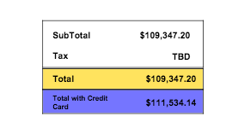
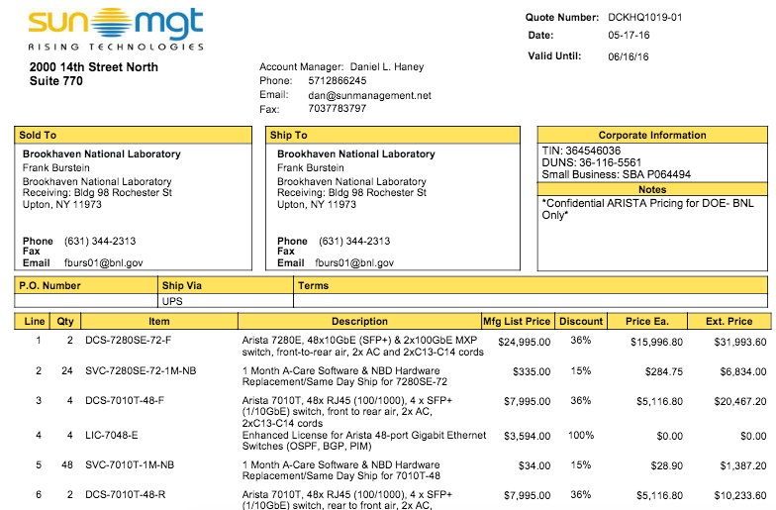
Individual high cost items
10+ Gigabit
Network
Switch
Candidate if he had to purchase today

Slide 18
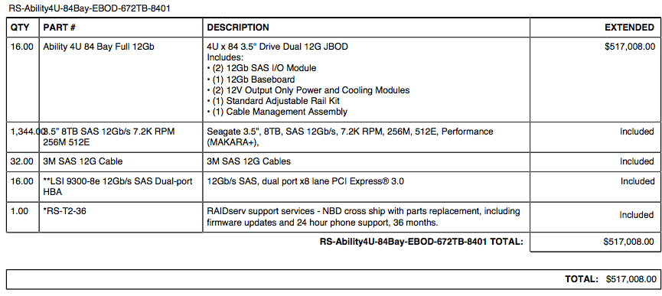
Individual high-cost items (2)
Buffer Box
Candidate if he had to purchase today
$517,000 / 16 * 6 = $195,000

Slide 19
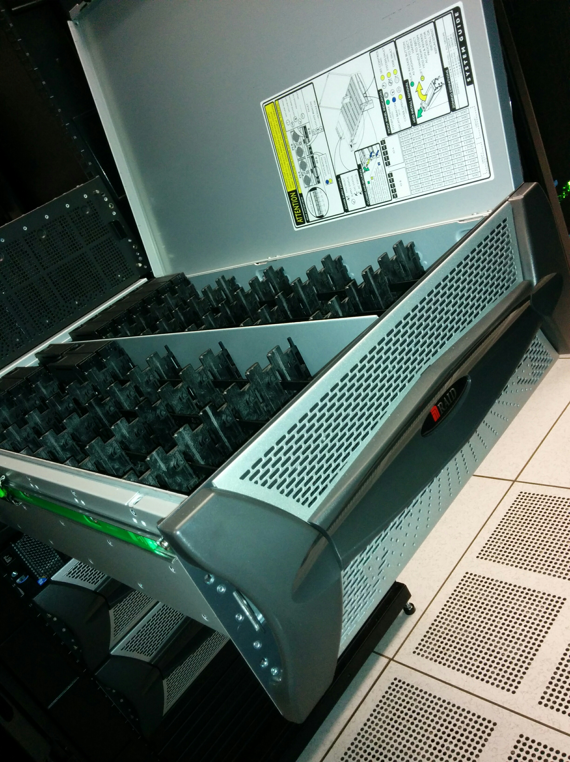
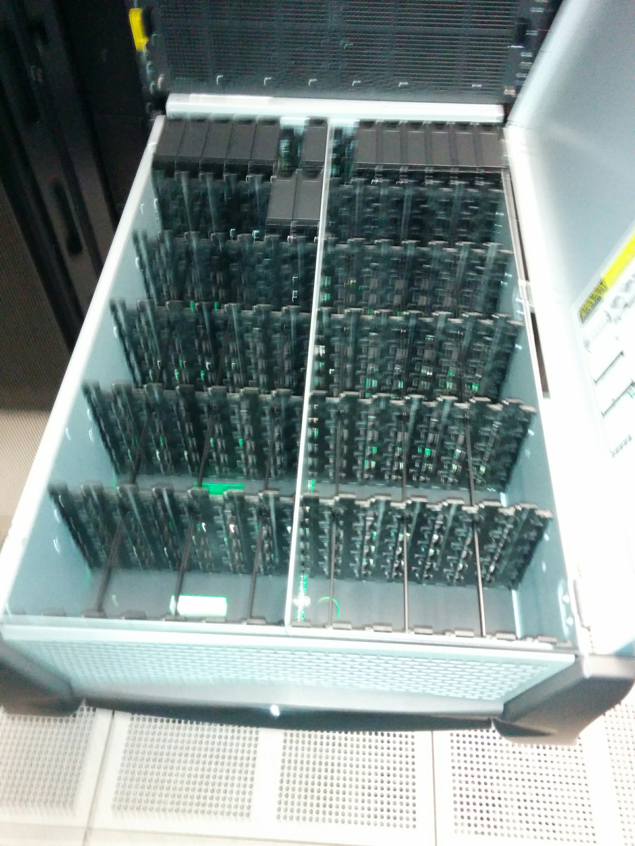
Individual high-cost items (2)
Buffer Box
Candidate if he had to purchase today
Machine in use in the RACF
(being set up)
$517,000 / 16 * 6 = $195,000

Slide 20
Individual $$$ items (2)
10+ Gigabit
Network
Switch
ATP
Buffer Box
$517,000 / 16 * 6 = $195,000

