Slide 1
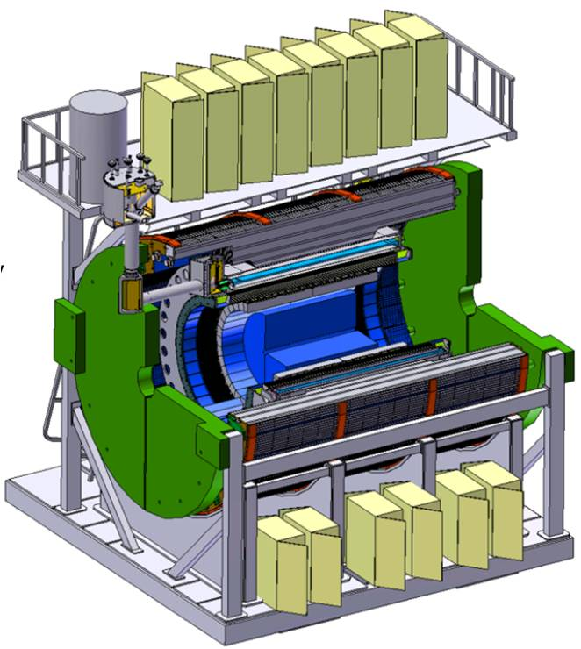
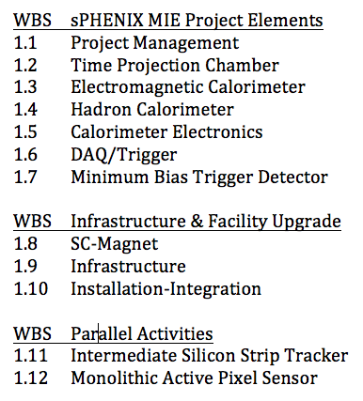
WBS 1.6 – DAQ-Trigger
L2 Manager: Martin L Purschke, BNL

Slide 2
Package Walkthrough
Front-end module
Data Collection Module
Sub-Event Buffer
Network Switch
Assembly and Trigger Module
Buffer box
10+ Gigabit
Network
Switch
FEM
Buffer Box
FEM
DCM2
SEB
ATP
many
many
dozens
one
o(100)
o(10)
FEM
Digitizer
A Calorimeter FEM from my perspective.. .
The FEM itself is not in DAQ purview
But some connections to it are.. .
Digitizer
XMIT
Digitizer

Slide 3
1.6.1 Data acquisition ( All together )
Event Builder
FEM
10+ Gigabit
Crossbar
Switch
DCM
DCM2
Buffer Box
DCM
DCM
DCM
DCM
ATP
FEM
DCM
SEB
ATP
DCM
Buffer Box
DCM
DCM2
DCM
DCM
ATP
DCM
FEM
DCM
SEB
DCM
ATP
Buffer Box
DCM
To
HPSS
DCM
DCM2
ATP
DCM
SEB
DCM
DCM
ATP
Buffer Box
FEE
ATP
DCM
DCM
DAM
EBDC
ATP
DCM
Buffer Box
FEE
ATP
DCM
DCM
DAM
EBDC
ATP
Buffer Box
DCM
FEE
ATP
DCM
DAM
EBDC
DCM
ATP
Buffer Box
DCM
Interaction Region
Rack Room
Computing
Facility
Rack Room
Rack Room

Slide 4
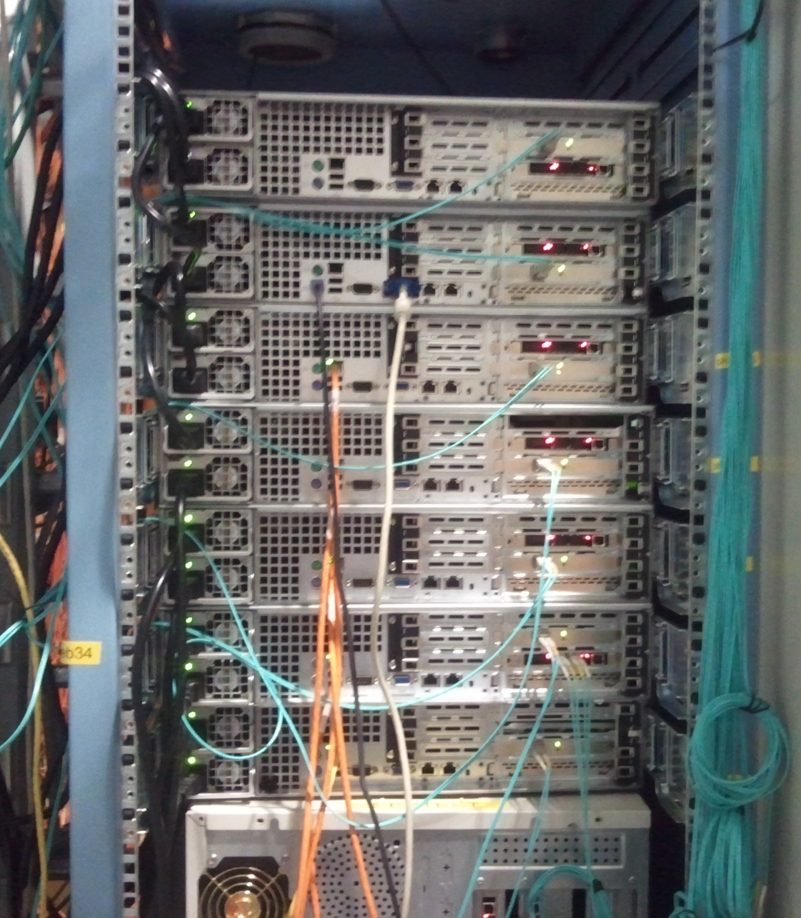
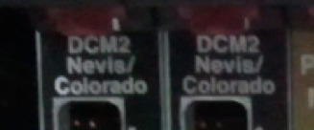
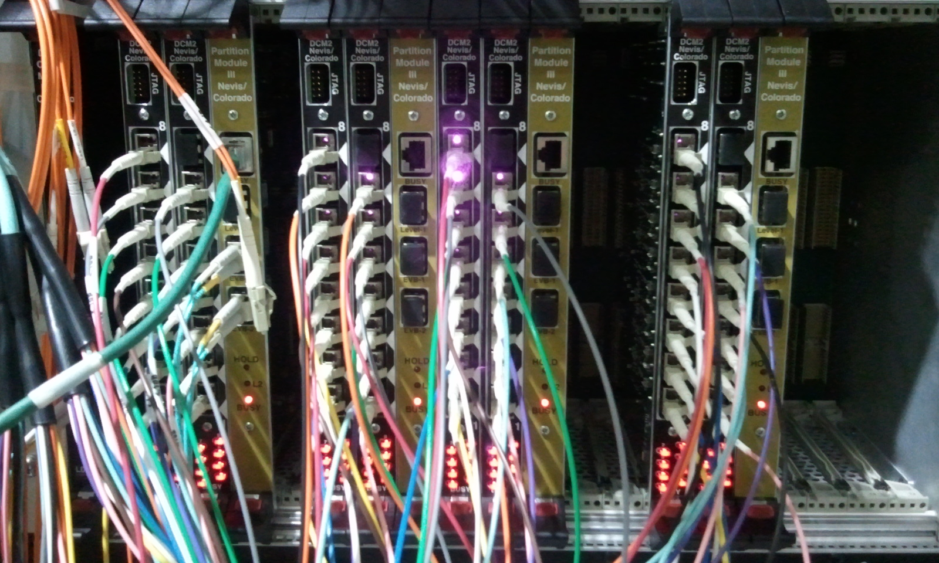
Pictures of existing Components
SEBs
2nd-generation DCM2s

Slide 5
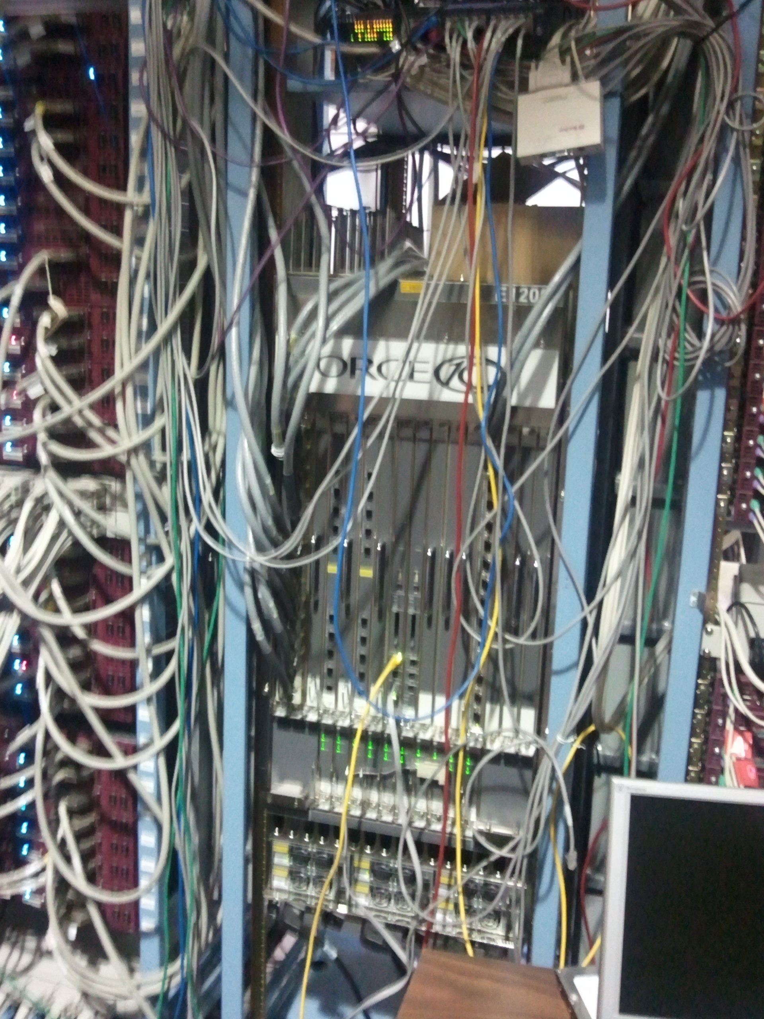
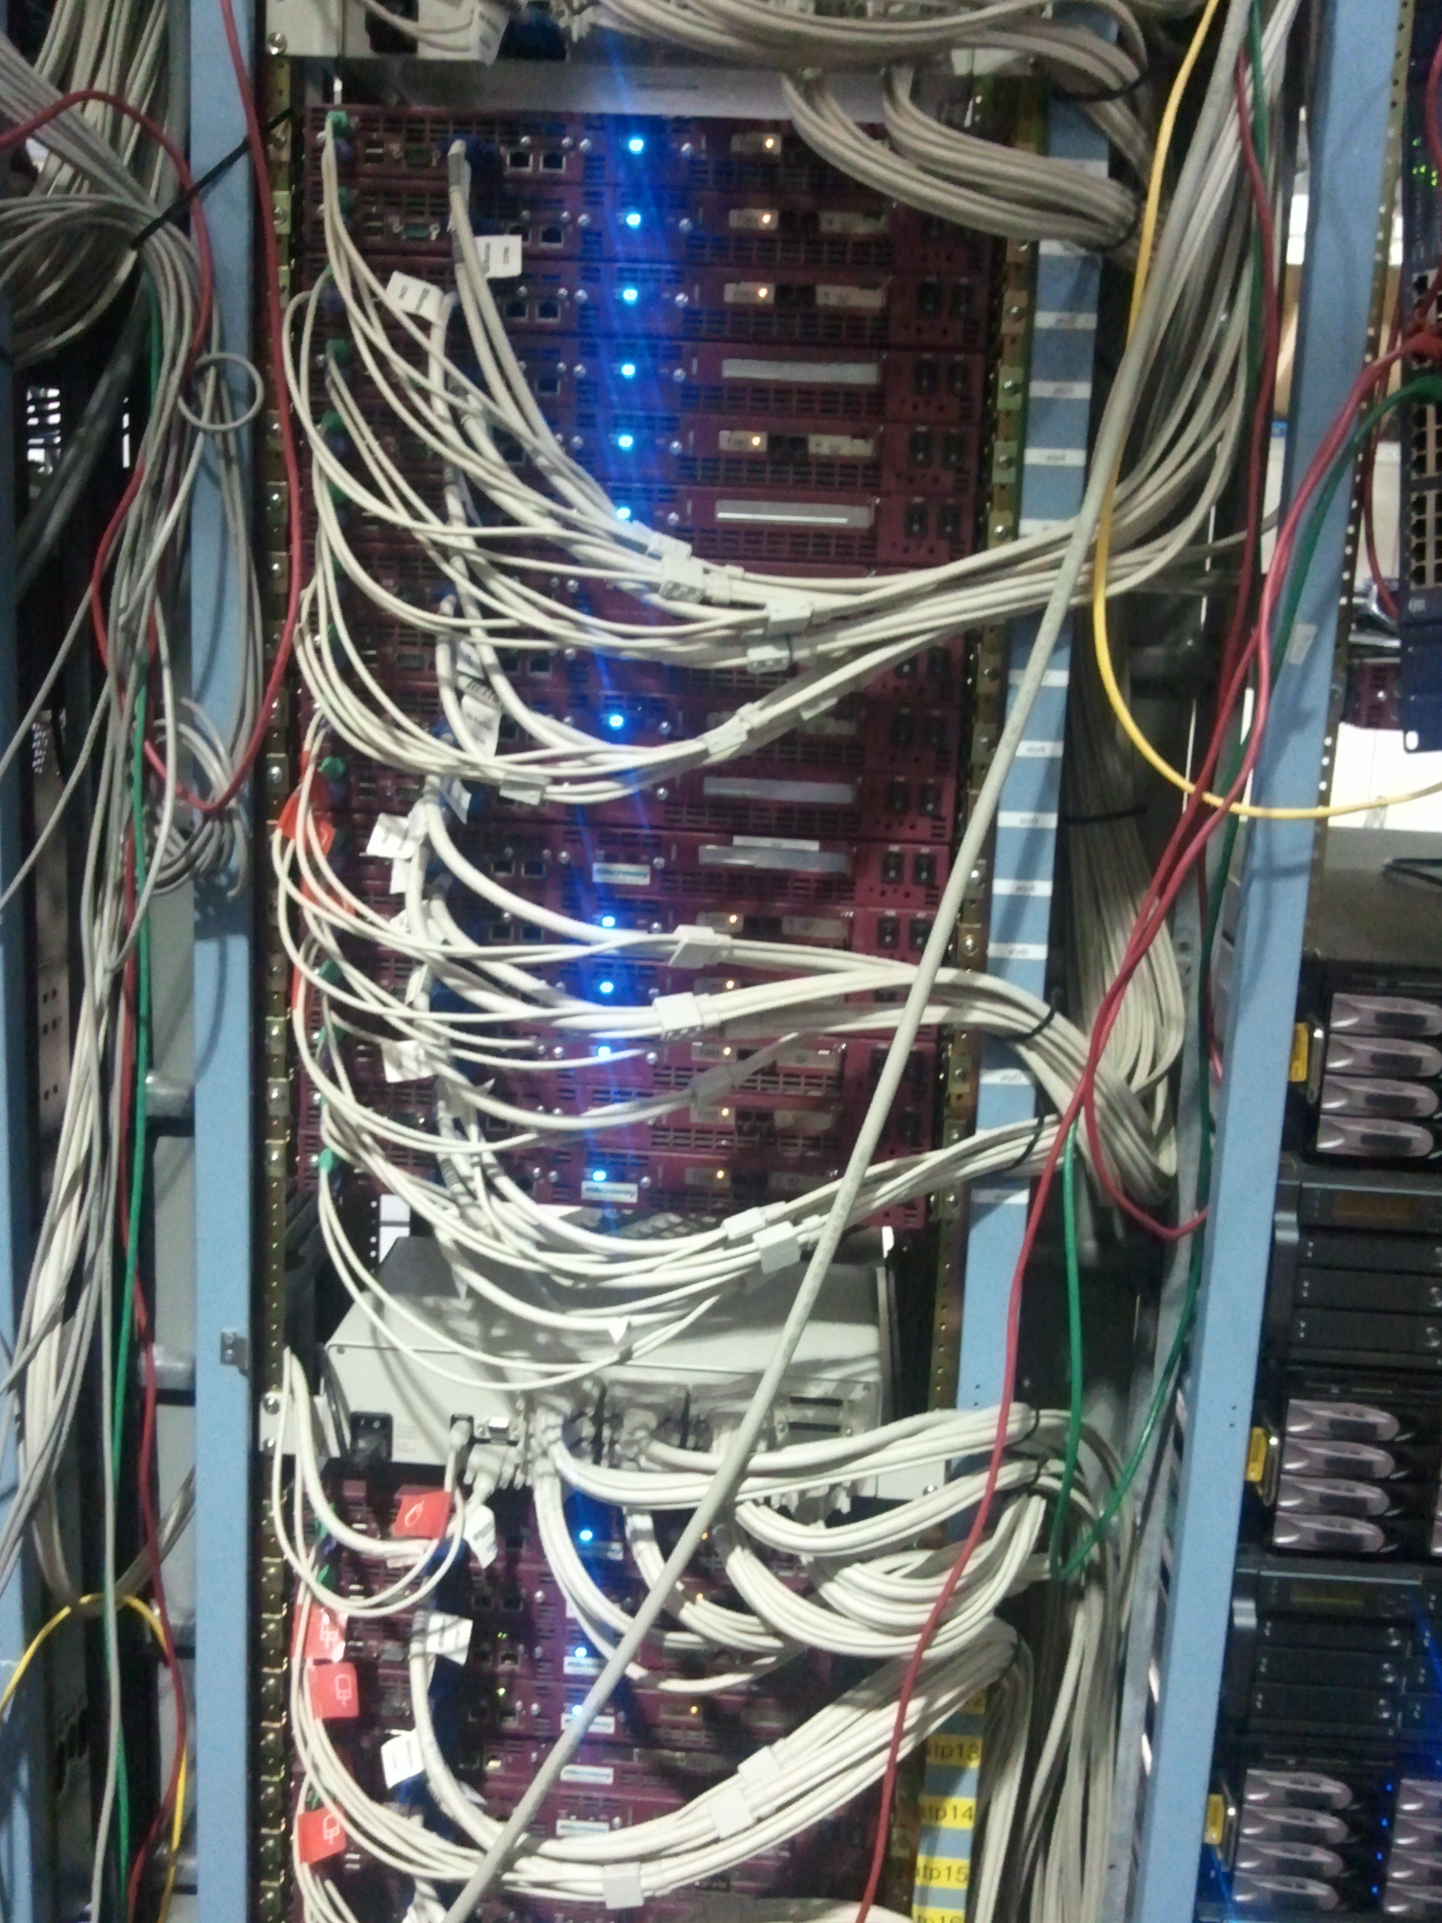
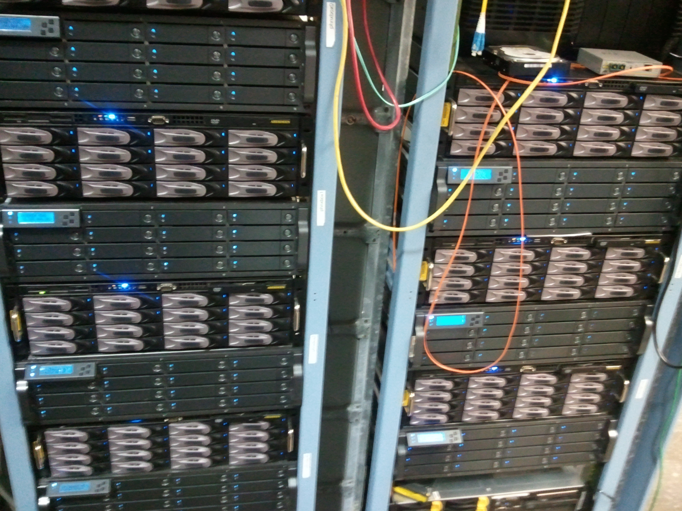
Pictures of existing Components
Network switch
(right after installation)
ATPs
Existing PHENIX Buffer Boxes

Slide 6
Emcal Local Level 1
10+ Gigabit
Network
Switch
FEM
DCM2
SEB
ATP
Buffer Box
Digitizer
Digitizer
Global Level 1
Digitizer
EMCAL Local Level 1
Digitizer
Digitizer
Digitizer
Digitizer
Digitizer
Digitizer
Each digitizer board supplies one fiber ( ~380 fibers total )
MBD Local Level 1
(Other Local Level 1)

Slide 7
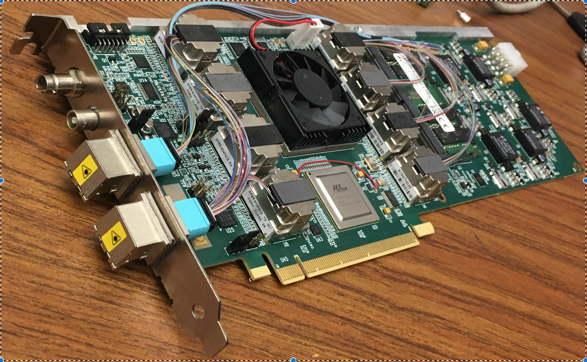
FELIX Card
FELIX v1.5 card
The FELIX card is a potential platform for other upgrade applications in sPHENIX (GL1, Timing, LL1)
Not that many generic cards on the market with 48 instrumented full-duplex high-speed transceivers.
Just one learning curve with just one card type
Same drivers/APIs (and same experts)
Economizing on spares with one card type
Work with the FELIX card for TPC development will allow preliminary engineering design to take place

Slide 8
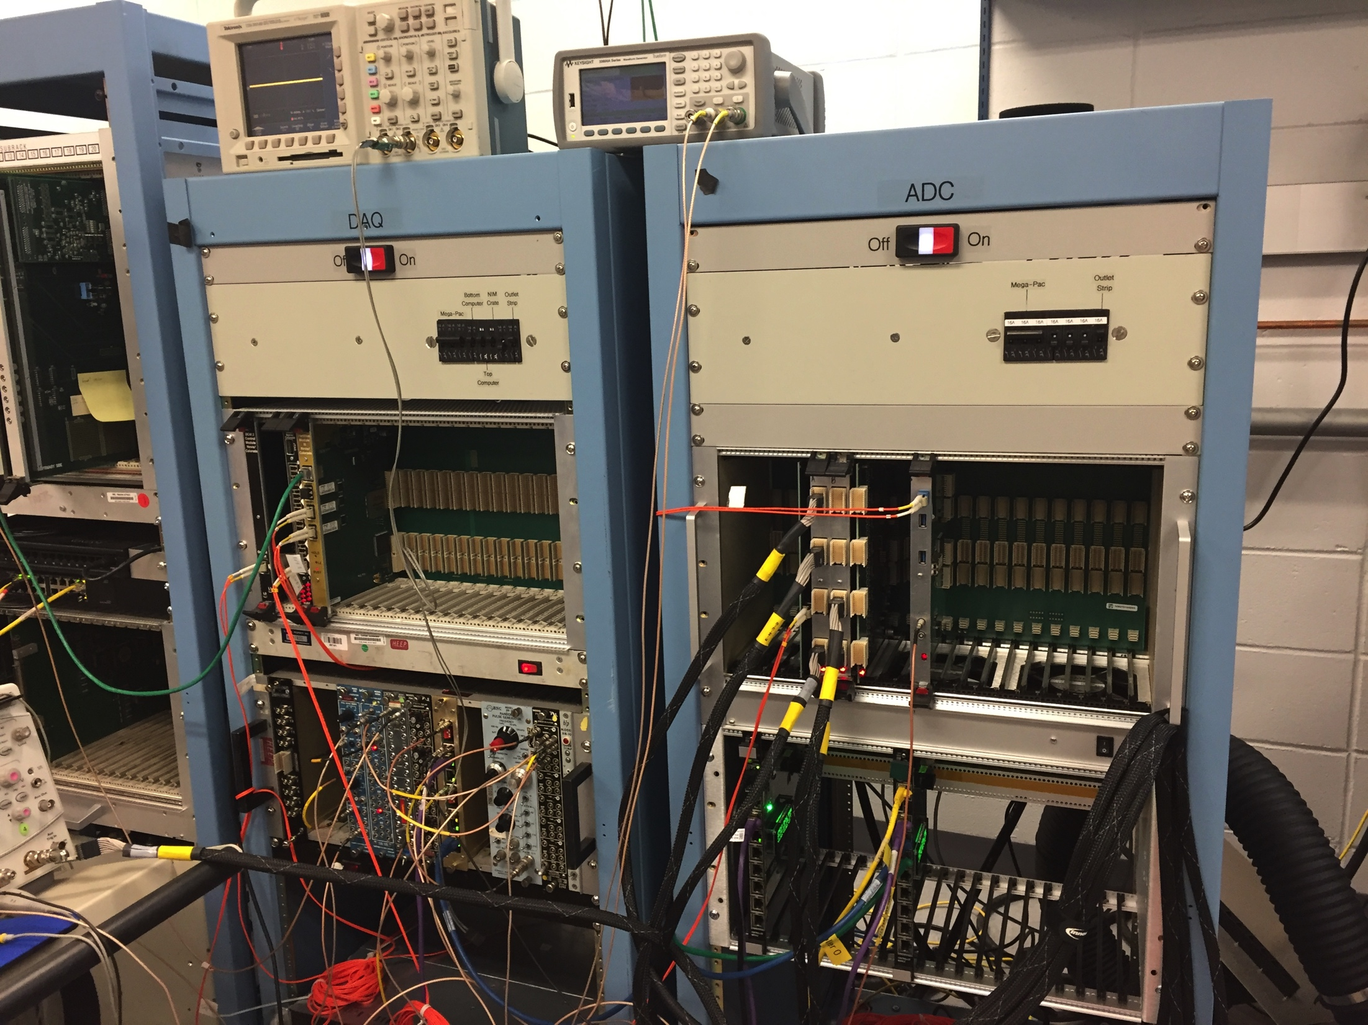
DCM2’s and assorted boards
The Data Collection Modules receive the full data set from the FEMs
They zero-suppress the data and package them
2nd-generation DCM2s
Test Stand in the Hcal Lab (cosmics tests, noise, pedestals, . . .) Already uses hardware and software components of the final DAQ front-end

Slide 9
Data Compression
After all data reduction techniques (zero-suppression, bit-packing, etc) are applied, you typically find that your raw data are still gzip-compressible to a significant amount
Compressed raw data format that supports a late-stage compression
This is what a file normally looks like
buffer
buffer
buffer
buffer
buffer
buffer
LZO
algorithm
Add new
buffer hdr
New buffer with the
compressed one as payload
This is what a file then looks like
On readback:
LZO
Unpack
Original uncompressed buffer restored
All this is handled completely in the I/O layer, the higher-level routines just receive a buffer as before.
Real-Time Conference
Real-Time Conference

Slide 10
Distributed Data Compression
No single computer can keep up with compressing a 100+Gbit/s data stream
The key is to distribute the compression workload
The ATPs are building buffers and compress them before sending them on
ATP
Buffer Box
This technology has been in routine use since 2003
ATP
Buffer Box
This is what a file normally looks like
ATP
ATP
Buffer Box
ATP
ATP
Buffer Box
ATP
Per-buffer compression ratio (in line with what other experiments see)
ATP
Buffer Box
ATP
ATP
Buffer Box
ATP
ATP
Buffer Box
record 0 length = 2385997 396 Or.length: 4266836 55.91% events: 19 from ATP 7
record 396 length = 2385997 415 Or.length: 4435180 56.50% events: 19 from ATP 15
record 811 length = 2279823 384 Or.length: 4294892 53.08% events: 22 from ATP 22
record 1195 length = 2210292 375 Or.length: 4274632 51.70% events: 24 from ATP 43
record 1570 length = 2434291 403 Or.length: 4332936 56.18% events: 20 from ATP 59
record 1973 length = 2471746 408 Or.length: 4312068 57.32% events: 18 from ATP 34
record 2381 length = 2463457 413 Or.length: 4591900 53.64% events: 23 from ATP 51
Real-Time Conference
Real-Time Conference

Slide 11
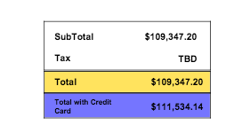
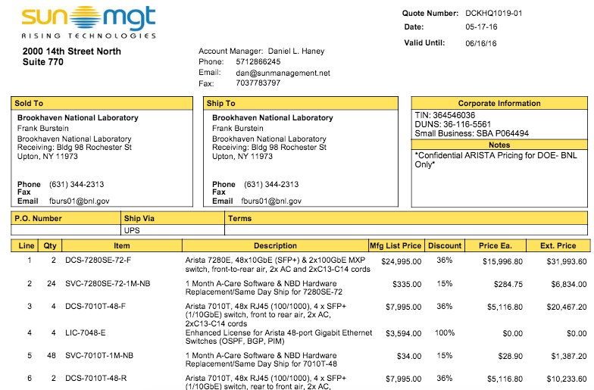
Individual High-Value items
10+ Gigabit
Network
Switch
ATP
Buffer Box

Slide 12
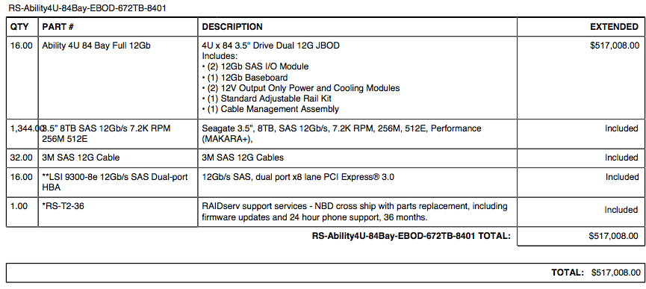
Individual High-Value items (2)
10+ Gigabit
Network
Switch
ATP
Buffer Box
$517,000 / 16 * 6 = $195,000

Slide 13
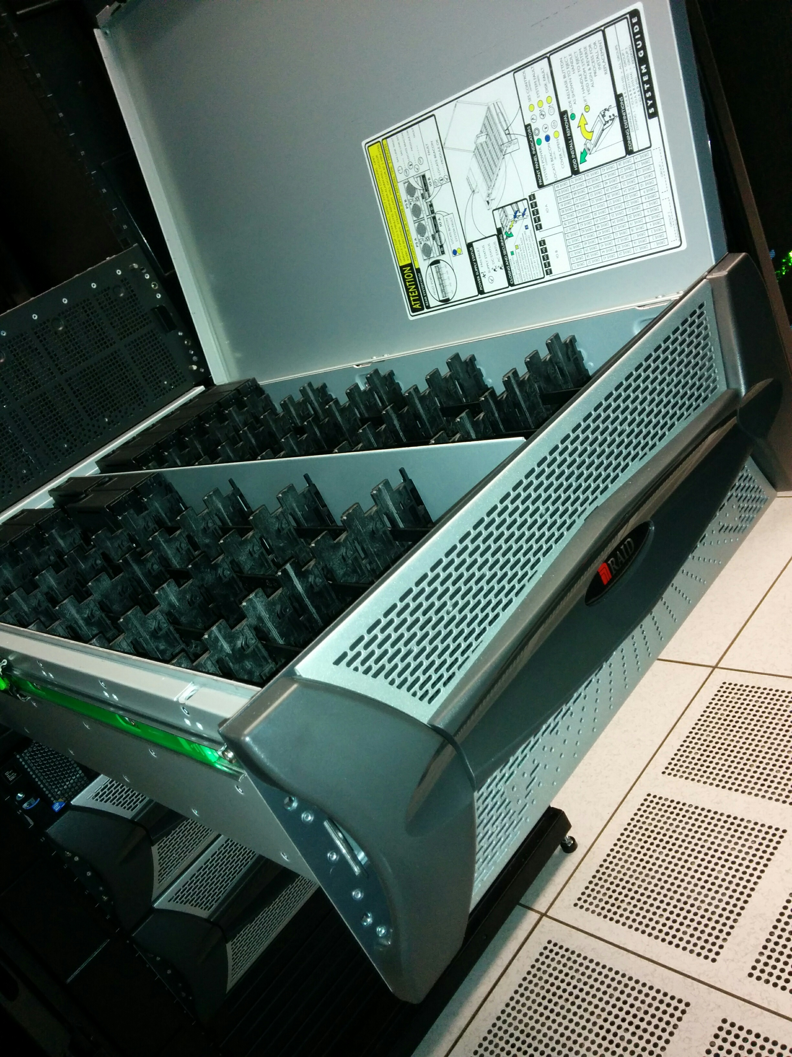
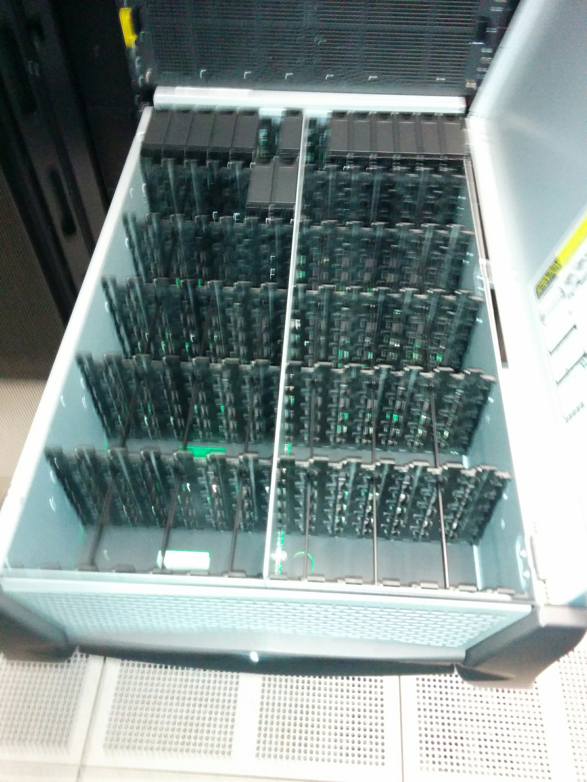
Individual High-Value items (2)
10+ Gigabit
Network
Switch
ATP
Buffer Box
Machine in the RACF
(being set up)
$517,000 / 16 * 6 = $195,000

Slide 14
Backup Slides

Slide 15
GL1 Cost
1.6.3.3 | GL1 Production |  |  |  |  |  |  |  | $0
1.6.3.3.1 | Procure final hardware | FPGA Boards | $11,400 | 10 | $114,000 | 10 | Atlas felix card w/48 fibers | 25% | $28,500
 |  | Server for Felix card | $1,805 | 5 | $9,025 | 5 |  | 20% | $1,805 | Price without additional cards
 |  | MTO <->MTP fiber couplers | $130 | 40 | $5,200 | 40 | 12 MTP - 12 MTO | 20% | $1,040
 |  | MTP <-> MPT fiber couplers | 225 | 10 | $2,250 | 10 | 48 -> 4x12 | 20% | $450
 |  | Fiber patch panel | $450 | 6 | $2,700 | 6 | 48 ports | 20% | $540
1.6.3.3.2 | Procure PCs and misc. materials | Server for Felix card | $1,805 | 5 | $9,025 | 5 |  | 20% | $1,805 | Price without additional cards
$142,200

Slide 16
LL1 Cost
Local Level 1
Prototype | $27,510.00
preproduction | $59,400.00
production | $152,350.00
Total | $239,260.00
1.6.2.4 | Trigger Production |  |  |  |  |  |  | $0
1.6.2.4.2 | Final updates to trigger crate requirements |  |  |  |  |  |  | $0
1.6.2.4.3 | Readiness Review |  |  |  |  |  |  | $0
1.6.2.4.4 | Procure Components | FPGA Boards | $11,400 | 5 | $57,000 | Atlas felix card w/48 fibers | 25% | $14,250
 |  | Server for Felix card | $1,805 | 5 | $9,025 |  | 20% | $1,805
 |  | MTO <->MTP fiber couplers | $130 | 40 | $5,200 | 12 MTP - 12 MTO | 20% | $1,040
 |  | MTP <-> MPT fiber couplers | 225 | 10 | $2,250 | 48 -> 4x12 | 20% | $450
 |  | Fiber patch panel | $450 | 6 | $2,700 | 48 ports | 20% | $540
 |  |  |  |  |  |  |  | $0

