Slide 1
sPHENIX Director’s Review WBS 1.8: Superconducting Magnet
Kin Yip
Collider-Accelerator Department
Aug 3, 2017
BNL

Slide 2
A little history …
The Superconducting Magnet was originally built ~1997-98 for the BaBar Experiment at SLAC and used until BaBar ended in Apr. 2008.
It was brought to BNL ~ Feb. 3 (near midnight), 2015.
LESHC (Laboratory Environment, Safety & Health Com.)/PCSS (Pressure Cryogenics Safety Sub-Com.) review (May 22, 2015) for the Cryo system
13 action items generated & all 13 already closed out
ASSRC/ESRC (Accel. Sys./Experimental Safety Review Committee) review (Dec. 8, 2015) for the low-field test
all action items closed out
Low-Field Test (100 A) was performed successfully on Mar. 22, 2016.
ASSRC/ESRC review (July 6, 2017) for the High-Field Test

Slide 3
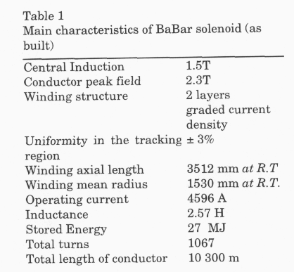
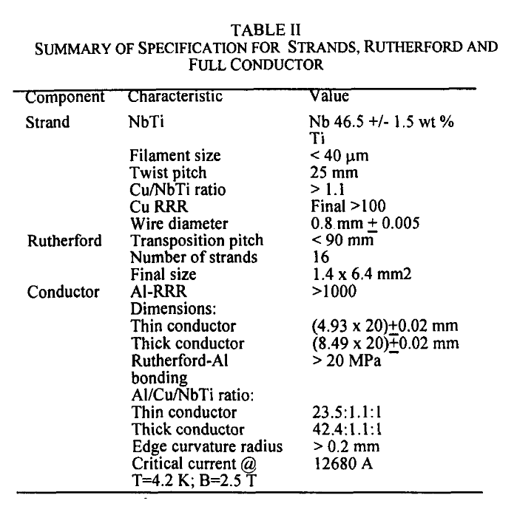
Original conductor/coil Specifications
~1.37 T in the High-Field Test
~1.4 T in sPHENIX
Heavily stabilized
~ 276% margin

Slide 4
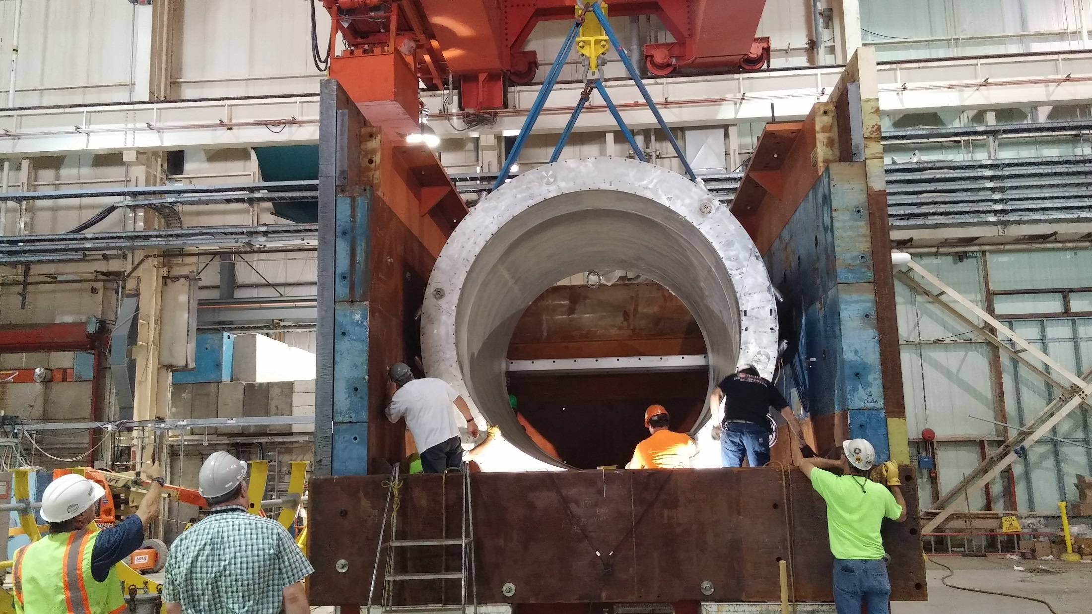
⇒ High-Field Test (BaBar operating current ~ 4596 A) is planned to be done in Sept./Oct. 2017 [ off-project ].

Slide 5
Status of the High-Field Test [off-project]
On June 30, 2017, the riggers have helped move/lift the Magnet Cryostat into the Flux Return steel box.
The Magnet Coil was initially slightly rotated (~0.5°) and we moved it up/rotated again ~July 7.
The Survey Group (C-AD) confirmed the alignment to be good ~July 11.
Superconducting Magnet Div. electrical/mechanical groups are installing the Extension starting July 12.
C-AD personnel are also responsible for assemblying/testing the front-end boards as well as the quench detection software. The software to transfer and store the data into the C-AD Control System is completed.
C-AD Power Supply should finish testing the Power Supply and send it to the test site by July 31.
Cryo group (C-AD) will connect the Magnet to the Cryo system in Bldg. 912 after Extension/Valvebox & platform are installed.

Slide 6
sPHENIX Project and WBS
WBS 1.8: Superconducting Magnet
1.8.1: Magnet Management & Technical Oversight (K. Yip)
1.8.2: Mechanical Disassembly, Transport & Reassembly (M. Anerella)
1.8.3: Cryogenic Systems (R. Than)
1.8.4: Power Supply & Quench Detection System (C. Schultheiss)
1.8.5: Magnet Field Measurement (A. Franz/J. Haggerty)

Slide 7
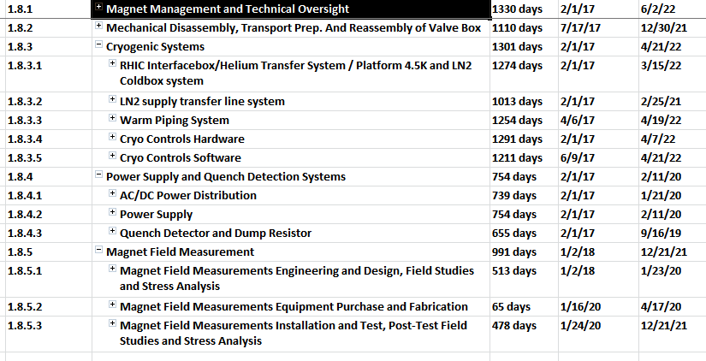
Documentation Made Available to the Committee
Basis of Estimate
https://docdb.sphenix.bnl.gov/cgi-bin/private/ShowDocument?docid=63
WBS Dictionary:
https://docdb.sphenix.bnl.gov/cgi-bin/private/ShowDocument?docid=83
Microsoft Project File:
https://docdb.sphenix.bnl.gov/cgi-bin/private/ShowDocument?docid=55

Slide 8
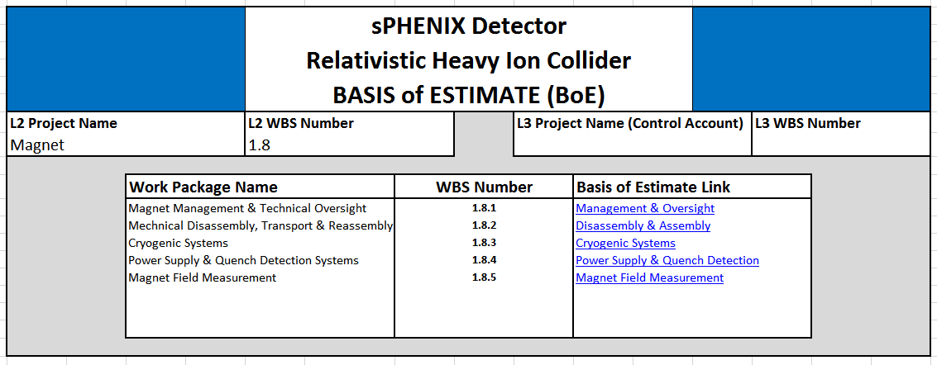
Magnet documentation status
The Basis of Estimate (BOE) for 1.8 is in sPHENIX docdb (docid=63).
An overview of the BOE looks like :

Slide 9
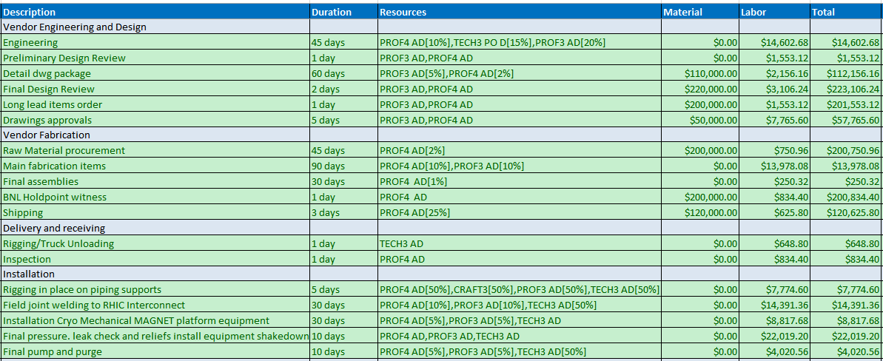
An example for the Basis of Estimate (Cryo)
“Cryogenic Systems” is our largest “spender” and here is a part of it :

Slide 10
An example of Purchase Order of similar nature

Slide 11
From the Basis of Estimate
Total and contingency estimates (FY17 $ Direct) :
 |  |  | Material | Labor |  | Total | Total with Contingency
1.8.1 | Management & Oversight |  | $0 | $819,963 |  | $819,963 | $874,437
1.8.2 | Disassembly & Assembly |  | $44,000 | $159,664 |  | $203,664 | $327,129
1.8.3 | Cryogenic Systems |  | $1,524,420 | $990,277 |  | $2,514,697 | $3,269,106
1.8.4 | PS & Quench Detection |  | $66,000 | $147,724 |  | $213,724 | $268,803
1.8.5 | Magnet Field Measurement |  | $7,000 | $126,773 |  | $133,773 | $160,528
1.8 |  |  | $1,641,420 | $2,244,401 |  | $3,885,821 | $4,900,003

Slide 12
Baseline Scenario - 1.8 S/C Magnet
AY k$'s - with Extraordinary Construction Overhead Application
 |  | Baseline Scenario
 |  | AY k$'s - with Extraordinary Construction Overhead Application
 |  | Resource |  | FY 2017 | FY 2018 | FY 2019 | FY 2020 | FY 2021 | FY 2022 | Total
 |  | Labor |  | 752 | 672 | 323 | 701 | 264 | 340 | 3,052
 |  | Non-Labor - Materials |  | 19 | 55 | 300 | 1,189 | 396 | 0 | 1,959
 |  | Baseline Total |  | 771 | 727 | 623 | 1,890 | 660 | 340 | 5,011
 |  | Contingency (30%) |  | 231 | 218 | 187 | 567 | 198 | 102 | 1,503
 |  | MIE Total |  | 1002 | 945 | 810 | 2457 | 858 | 442 | 6514
 |  | Resource |  | Baseline | Contingency | Total
 |  | Labor |  | 3,052 | 916 | 3,968
 |  | Non- Labor |  | 1,959 | 588 | 2,547
 |  | 1.8 S/C Magnet |  | 5,011 | 1503 | 6,514

Slide 13
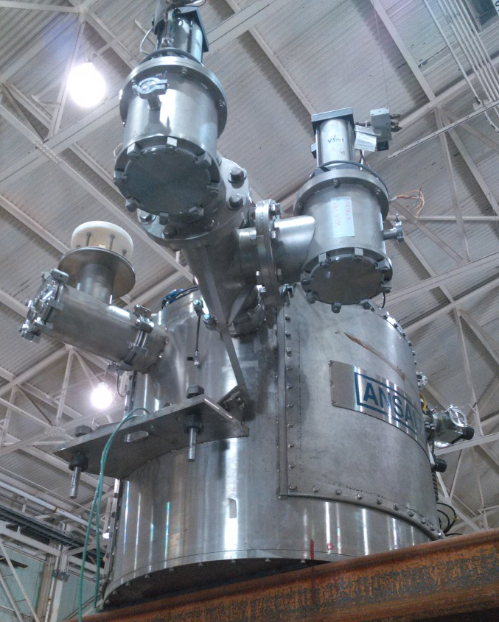
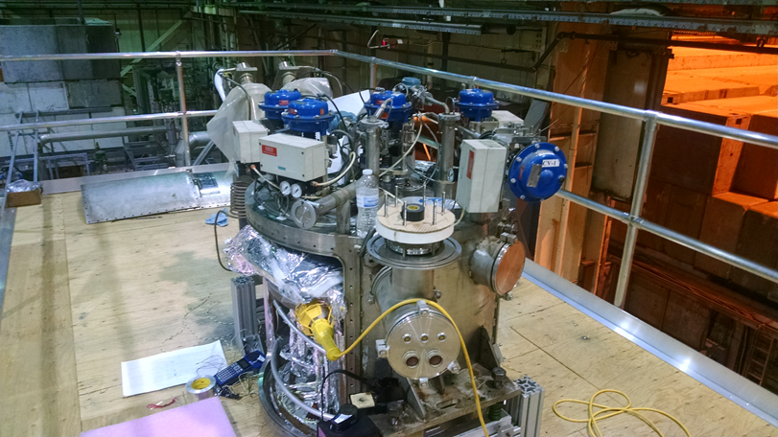
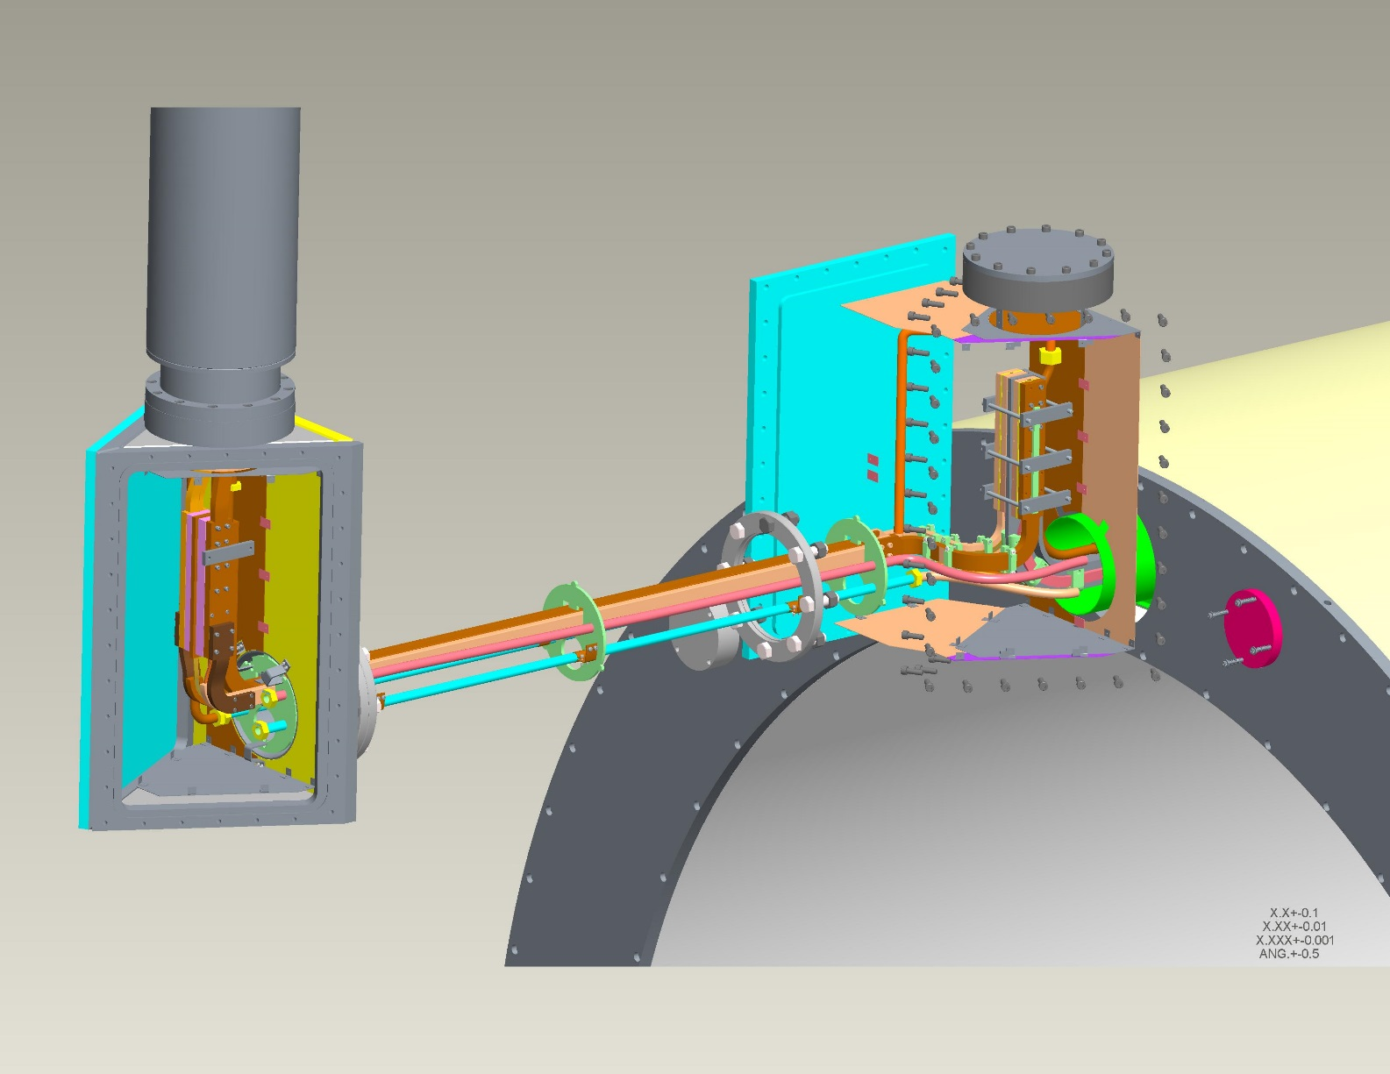
Valvebox
Extension

Slide 14
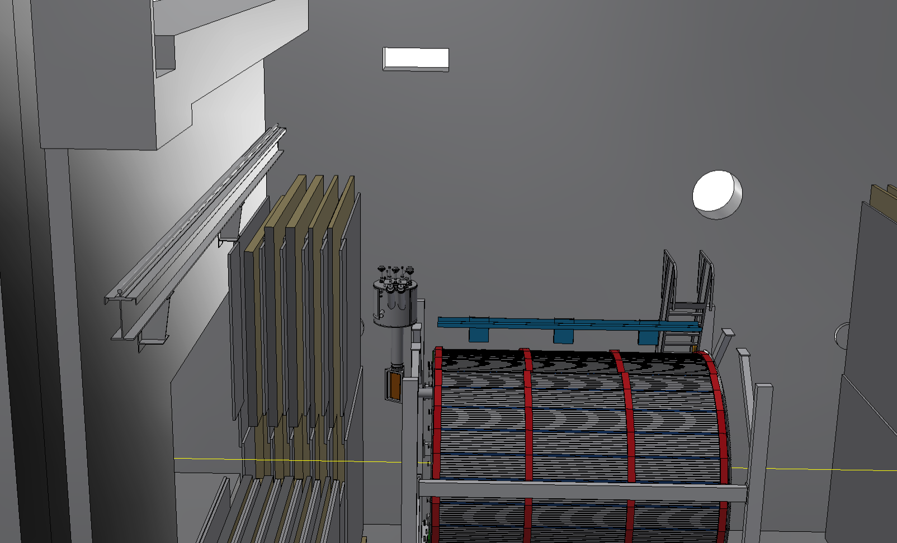
Depiction of sPHENIX Experimental Hall with Cryo/Electrical connection
Cryo/Electrical connections
Valvebox

Slide 15
Cryogenic System Diagram
External Portable LHE Dewar
New LN2 Cryo Line
LN2, 6 bar Storage
New Helium Cryo Line System
New Interface Valvebox
S: 4.7K, 3.5BAR
LN2 Cooler
H: 60K, 12BAR
U: 4.6K, 1.25BAR
RHIC Distribution
400L LHe
WR: 290K, 1.2 BAR
10 o’clock location
18 g/s Compressor
Current Leads
Solenoid Cryostat
SC SOLENOID
Solenoid Valvebox
THERMAL SHIELD

Slide 16
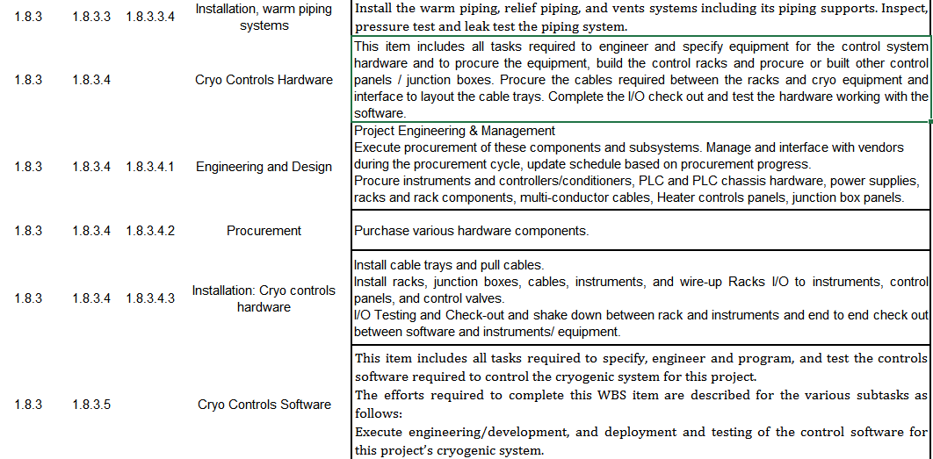
Example of WBS Dictionary

Slide 17
Schedule and Calendar
The High-Field Test [off-project] is expected to be performed in Sept. - Oct.
The Booster (RF) Cavity (for “Low Energy RHIC electron Cooling”) test may delay us from running even if we are all ready by September. We may need to negotiate with them. But this will not affect the sPHENIX project plan.
Milestones :
2018-6-15: Start ValveBox Disassembly
2018-7-31: Coil Ready to Ship
2020-1-23: Magnet (Field Measurement) Engineering & Design Complete
2021-12-30: Complete Mechanical Support
2022-3-15 : Installation (RHIC interface/He transfer system/Platform 4.5K/LN2 system) complete
2022-4-7 : Cryo Hardware installed
2022-6-2: Magnet is operational
The Magnet, quench detector etc. will be sitting in Bldg. 912 until Fall 2021.

Slide 18
Superconducting Magnet Staffing
FTE Profile by Category
FTE Profile by Fiscal Year
WBS Level | Org Sort | Group | FY 17 | FY 18 | FY 19 | FY 20 | FY 21 | FY 22
1.8 | BNL | Purchased Services | 0.05 | 0.00 | 0.07 | 0.13 | 0.02 | 0.00
 |  | Scientific | 0.38 | 0.71 | 0.61 | 0.62 | 0.42 | 0.12
 |  | Technical | 0.75 | 0.89 | 0.05 | 0.93 | 0.20 | 0.93
 |  | Professional | 2.49 | 1.51 | 0.53 | 1.30 | 0.36 | 0.44
 | BNL Sum |  | 3.67 | 3.11 | 1.25 | 2.98 | 1.01 | 1.49
Grand Total |  |  | 3.67 | 3.11 | 1.25 | 2.98 | 1.01 | 1.49

Slide 19
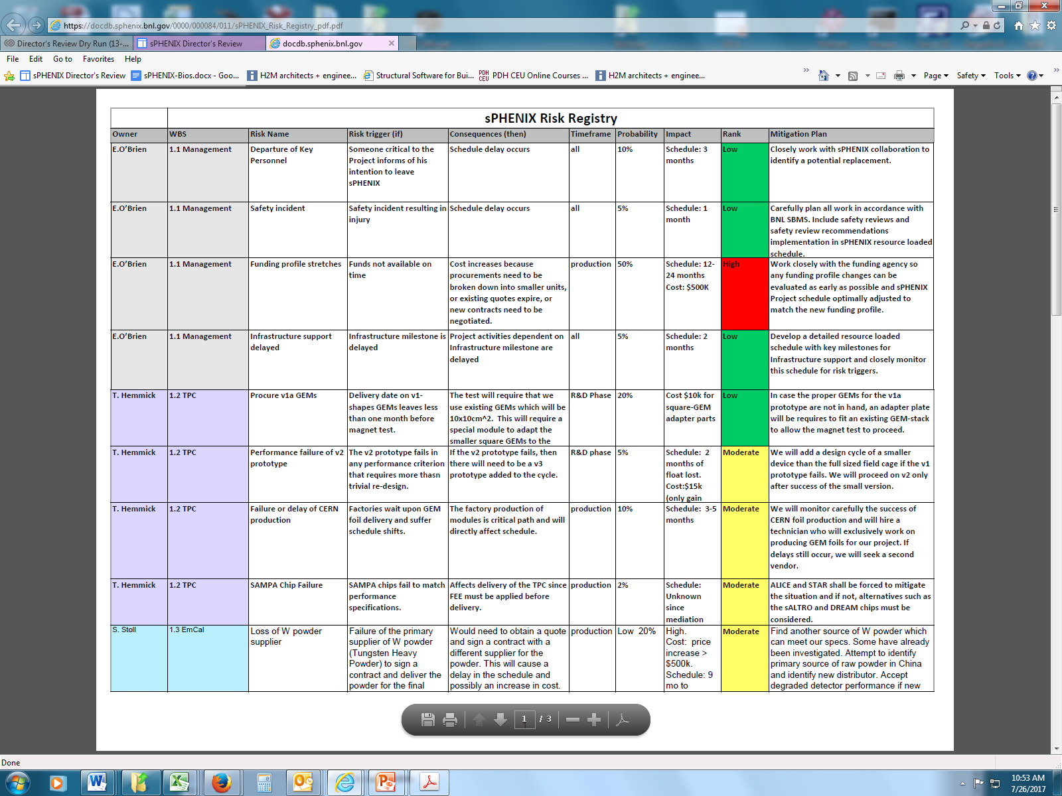
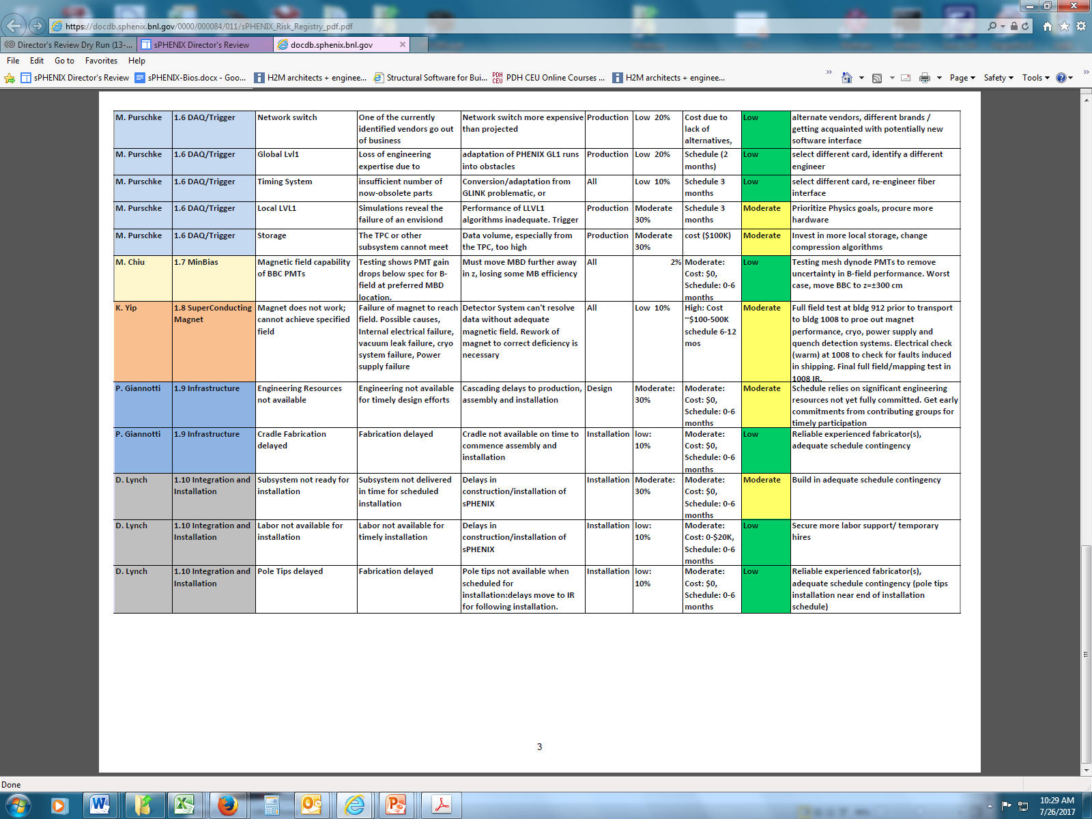
1.8 Magnet – Risk Registry
Extensive testing is being performed in order to remove risk.
We’ve completed 100 A test to show that it’s superconducting.
Available float (Fall 2017 to Fall 2021) provides adequate time for any repairs.

