Slide 1
sPHENIX Director’s Review
Dry Run
Superconducting Magnet including the High-Field Test
Kin Yip
Collider-Accelerator Department
July 14, 2017
BNL

Slide 2
A little history :
The Superconducting Magnet was originally built ~1997-98 for the BaBar Experiment at SLAC and used until BaBar ended in Apr. 2008.
It was brought to BNL ~ Feb. 3 (near midnight), 2015.
LESHC/PCSS review (May 22, 2015)
LESHC/PCSS 15-05 (13 action items) fulfilled
ASSRC/ESRC review (Dec. 8, 2015)
checkoff list items completed
Low-Field Test (100 A) was performed successfully on Mar. 22, 2016
ASSRC/ESRC review (July 6, 2017) for the High-Field Test

Slide 3
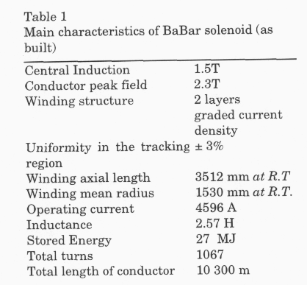
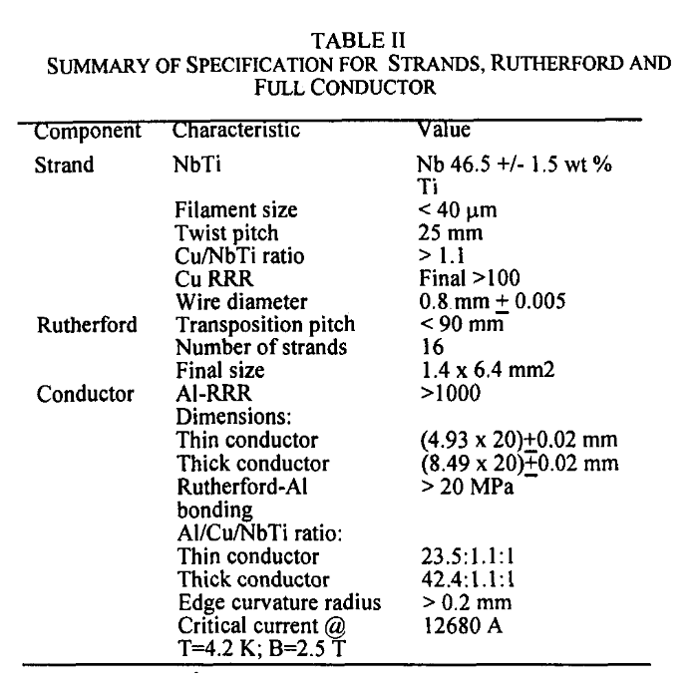
Original conductor/coil Specifications
~1.37 T in the High-Field Test
~1.4 T in sPHENIX
Heavily stabilized
~ 276% margin

Slide 4
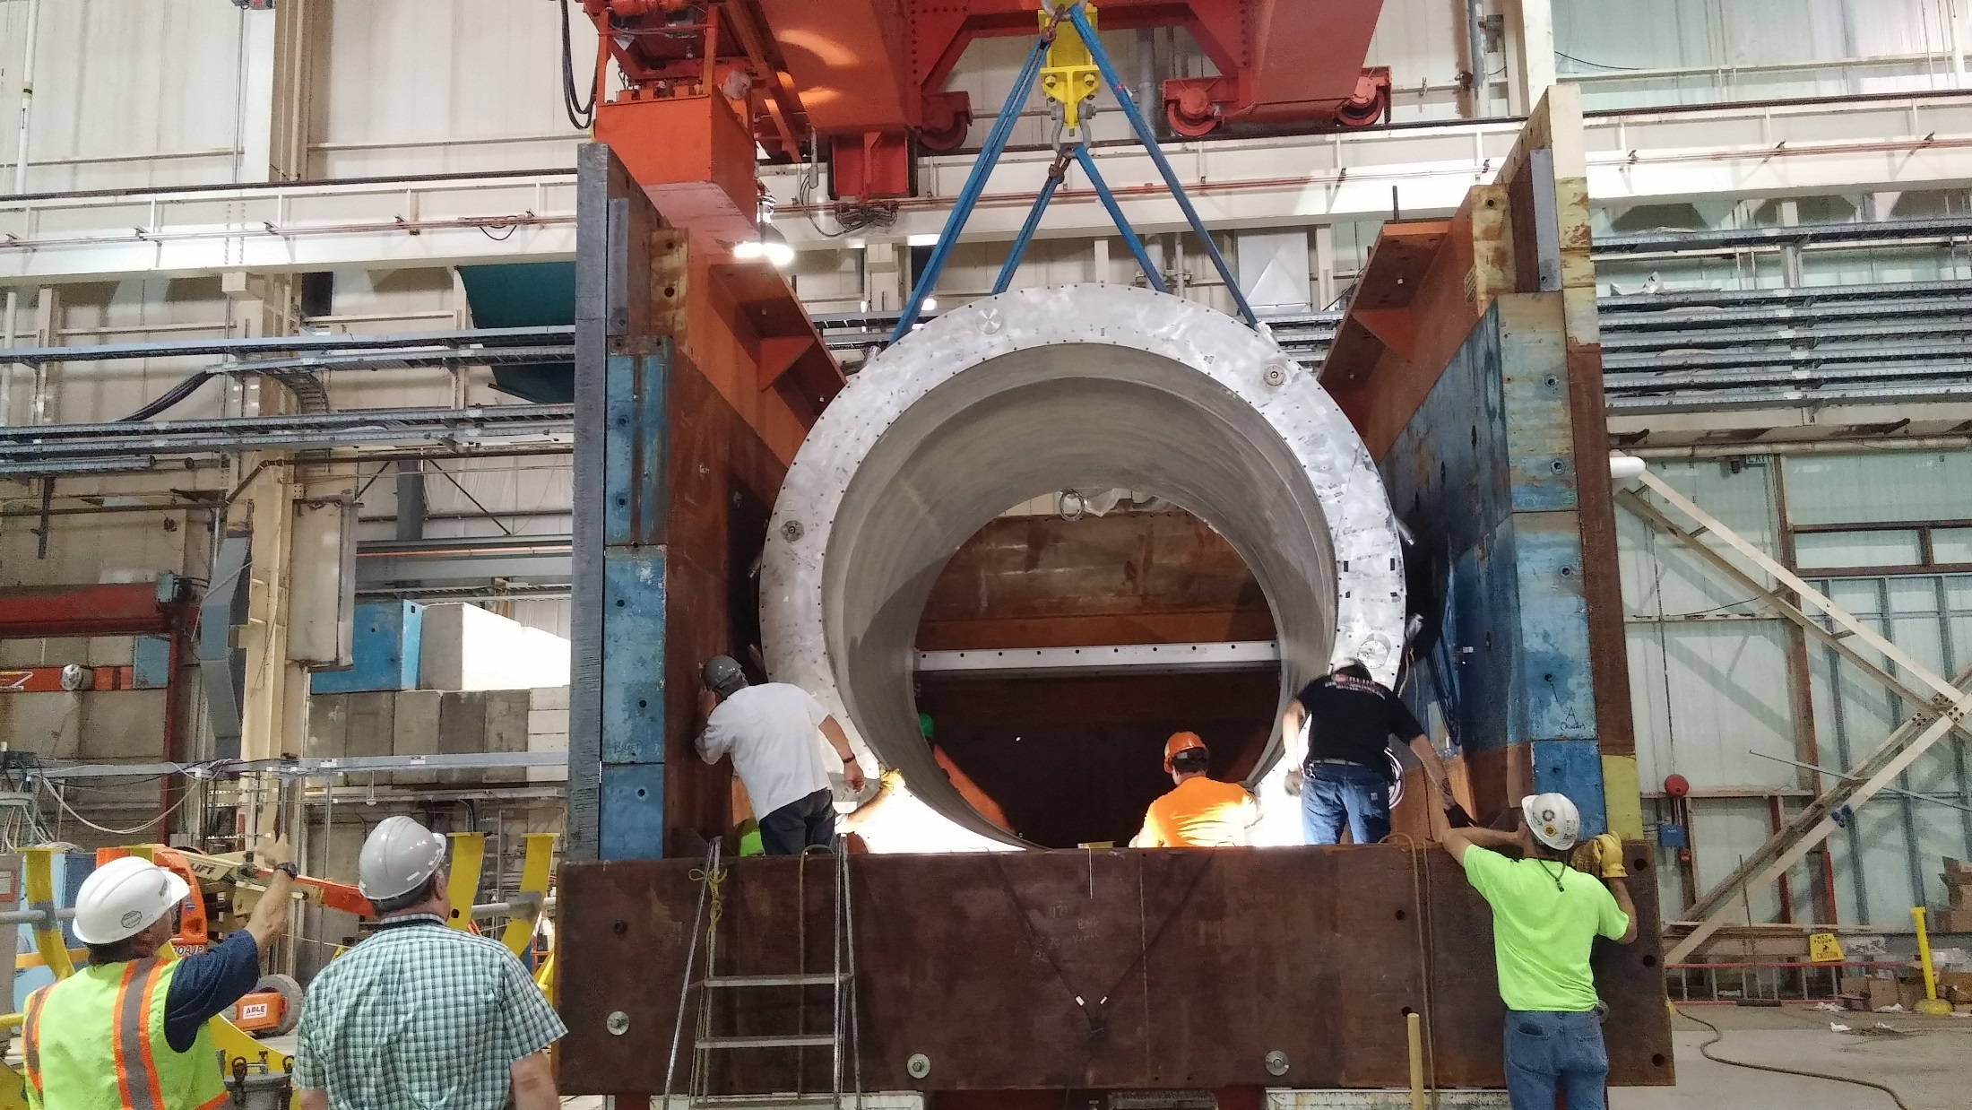
⇒ High-Field Test (BaBar operating current ~ 4596 A) is planned to be done in ~Sept. 2017 or so.

Slide 5
Status of the High-Field Test
On June 30, 2017, the riggers have helped move/lift the Magnet Cryostat into the Return Steel Box.
Jon Hock et. al. have determined that the Magnet was a bit rotated (~0.5°)/misplaced and we moved it up/rotated again ~July 7.
Survey confirmed the alignment to be good ~July 11
With the help of riggers, Ray Ceruti et. al. from Superconducting Magnet Div. are installing the Extension starting July 12.
In C-AD, C. Schultheiss is assemblying/testing the front-end boards; Z. Altinbas is taking of the quench detection software/W. Pekrul has finished the software (so that data will be transferred to the C-AD Control System and stored).
P. Rosas (C-AD) should finish testing the Power Supply and send it to the test site at the end of this month.
Cryo group (C-AD) will connect the Magnet to the Cryo system in Bldg. 912 after Extension/Valvebox & platform are installed.

Slide 6
sPHENIX Project and WBS
WBS 1.8: Superconducting Magnet
1.8.1: Magnet Management & Technical Oversight (K. Yip)
1.8.2: Mechanical Diassembly, Transport & Reassembly (M. Anerella)
1.8.3: Cryogenic Systems (R. Than)
1.8.4: Power Supply & Quench Detection System (C. Schultheiss)
1.8.5: Magnet Field Measurement (A. Franz/J. Haggerty)

Slide 7
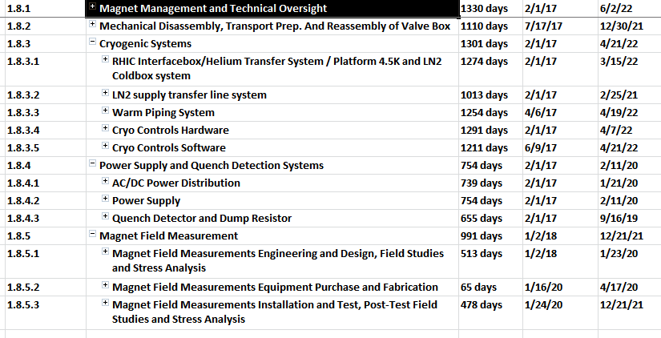
Documentation Made Available to the Committee
Basis of Estimate
https://docdb.sphenix.bnl.gov/cgi-bin/private/ShowDocument?docid=63
WBS Dictionary:
https://docdb.sphenix.bnl.gov/cgi-bin/private/ShowDocument?docid=83
Microsoft Project File:
https://docdb.sphenix.bnl.gov/cgi-bin/private/ShowDocument?docid=55

Slide 8
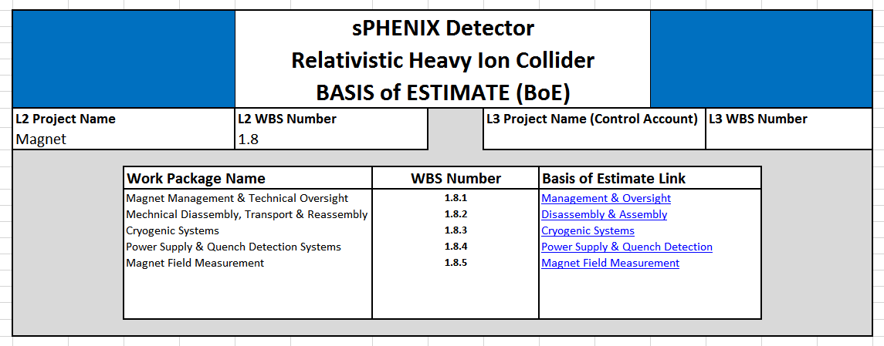
Magnet documentation status
The Basis of Estimate (BOE) for 1.8 is in sPHENIX docdb (docid=63).
An overview of the BOE looks like :

Slide 9
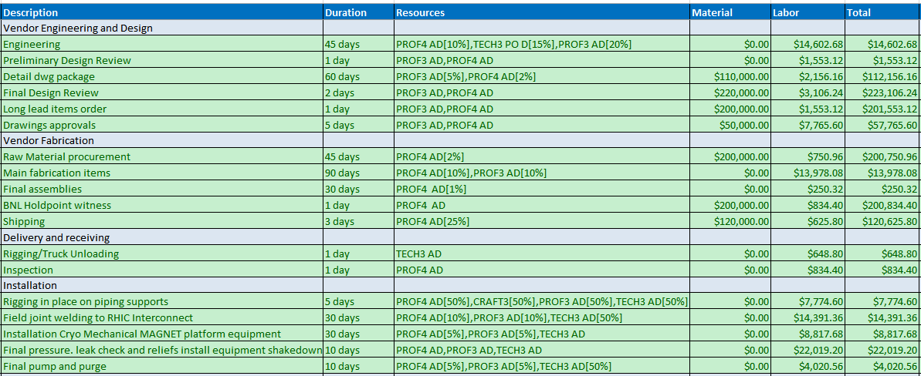
An example for the Basis of Estimate (Cryo)
“Cryogenic Systems” is our largest “spender” and here is a part of it :

Slide 10
From the BOE …
Total and contingency estimates :
 |  |  | Material | Labor |  | Total | Total with Contingency
1.8.1 | Management & Oversight |  | $0 | $819,963 |  | $819,963 | $874,437
1.8.2 | Disassembly & Assembly |  | $44,000 | $159,664 |  | $203,664 | $327,129
1.8.3 | Cryogenic Systems |  | $1,524,420 | $990,277 |  | $2,514,697 | $3,269,106
1.8.4 | PS & Quench Detection |  | $66,000 | $147,724 |  | $213,724 | $268,803
1.8.5 | Magnet Field Measurement |  | $7,000 | $126,773 |  | $133,773 | $160,528
1.8 |  |  | $1,641,420 | $2,244,401 |  | $3,885,821 | $4,900,003

Slide 11
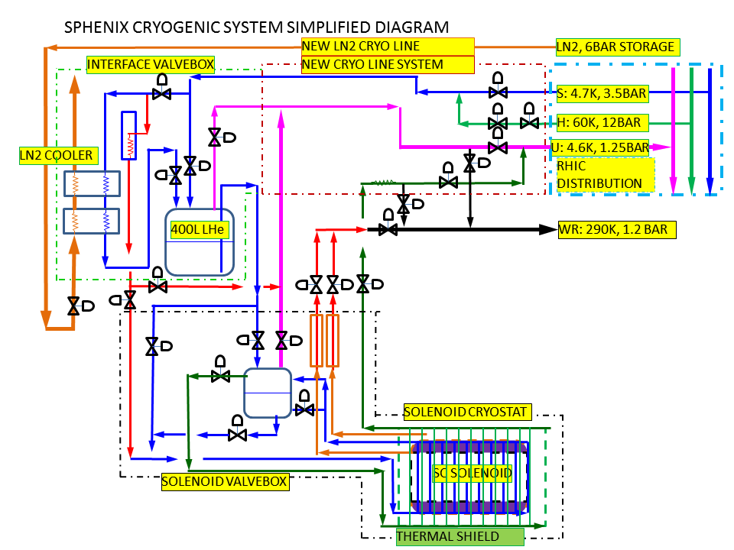

Slide 12
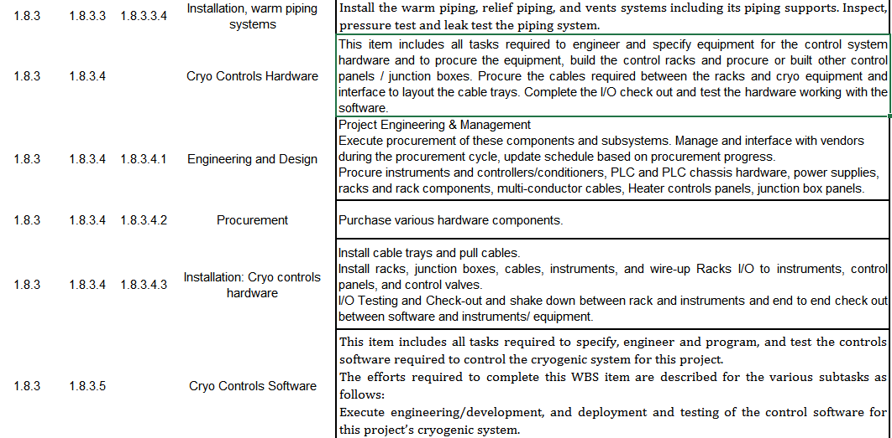
Example of WBS Dictionary

Slide 13
Issue & Concern
If you’re not careful, you can always make mistake or even drop dead.
But generally, I feel that if we can complete the High-Field Test for this superconducting magnet successfully, there is really no major risk.
M. Anerella/R. Ceruti @ Superconducting Magnet Division need to come up with some custom-made tools to do the assembly. They are very experienced and their performance in the couple years has given me confidence that they can do whatever is necessary.
We need to find a vendor to custom-make the piping connection from RHIC to sPHENIX but our Cryo group in C-AD has done similar things many times before and recently. And they’ve placed 30% in the contract contingency.

Slide 14
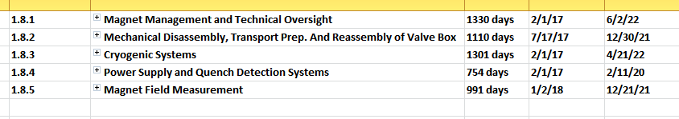
Schedule and Calendar
I hope the High-Field Test can be performed in September or October.
The Booster (RF) Cavity (for LEReC) test may delay us from running even if we are all ready by September. We may need to negotiate with them …
Microsoft Project file shows :
Apart from the Cryogenic systems, the Magnet, DAQ etc. are ready to be shipped and integrated in the 1008 environment after the High-Field Test, though they will be sitting in Bldg. 912 for some years.

Slide 15
Superconducting Magnet Staffing
FTE Profile by Category
FTE Profile by Fiscal Year
Row Labels | FY 17 | FY 18 | FY 19 | FY 20 | FY 21 | FY 22
Cat C | 3.58 | 3.02 | 1.19 | 2.68 | 1.01 | 1.49
Engineering | 2.40 | 1.42 | 0.46 | 1.04 | 0.36 | 0.44
Purchased Services | 0.05 | 0.00 | 0.07 | 0.13 | 0.02 | 0.00
Scientific | 0.38 | 0.71 | 0.61 | 0.62 | 0.42 | 0.12
Technical | 0.75 | 0.89 | 0.05 | 0.90 | 0.20 | 0.93
Grand Total | 3.58 | 3.02 | 1.19 | 2.68 | 1.01 | 1.49

