Slide 1
sPHENIX Director’s Review
August 2-4, 2017
BNL
Don Lynch

Slide 2
WBS Structure & Control Accounts
1.10: sPHENIX Installation and Integration
(Don Lynch)
1.10.1: Infrastructure Project Management and Oversight
1.10.2: Integration Documentation, Technical Coordination, Installation, Tooling, Fixtures and Subsystem Installation
1.10.2.1: Subsystem Interface & Integration Plan
1.10.2.2: Infrastructure Installation
1.10.2.3: Cradle Carriage Integration/Installation
1.10.2.4: sPHENIX SC Magnet Installation
1.10.2.5 : Outer HCal Integration/Installation
1.10.2.6: Inner HCal Integration/Installation
1.10.2.7 : EMCal Integration/Installation
1.10.2.8: TPC Integration/Installation
1.10.2.9: INTT Integration/Installation
1.10.2.10: MVTX Integration/Installation
1.10.2.11: Min Bias Integration/Installation
1.10.2.12: sPHENIX Full Detector Installation
See Backup for Key Personnel and WBS dictionary information)
2

Slide 3
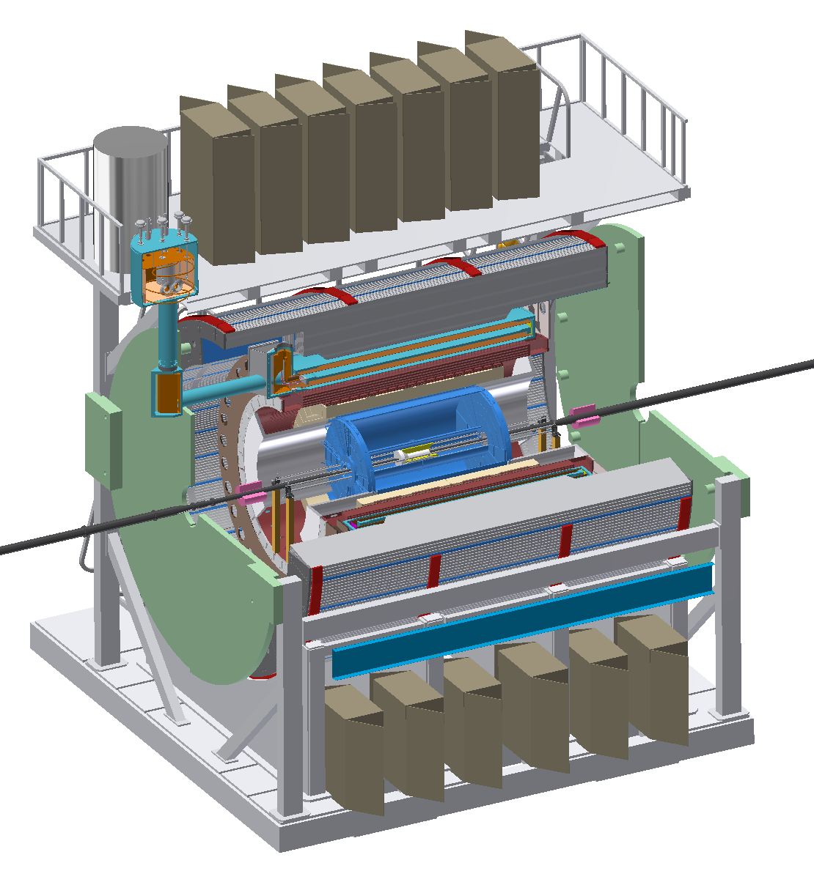
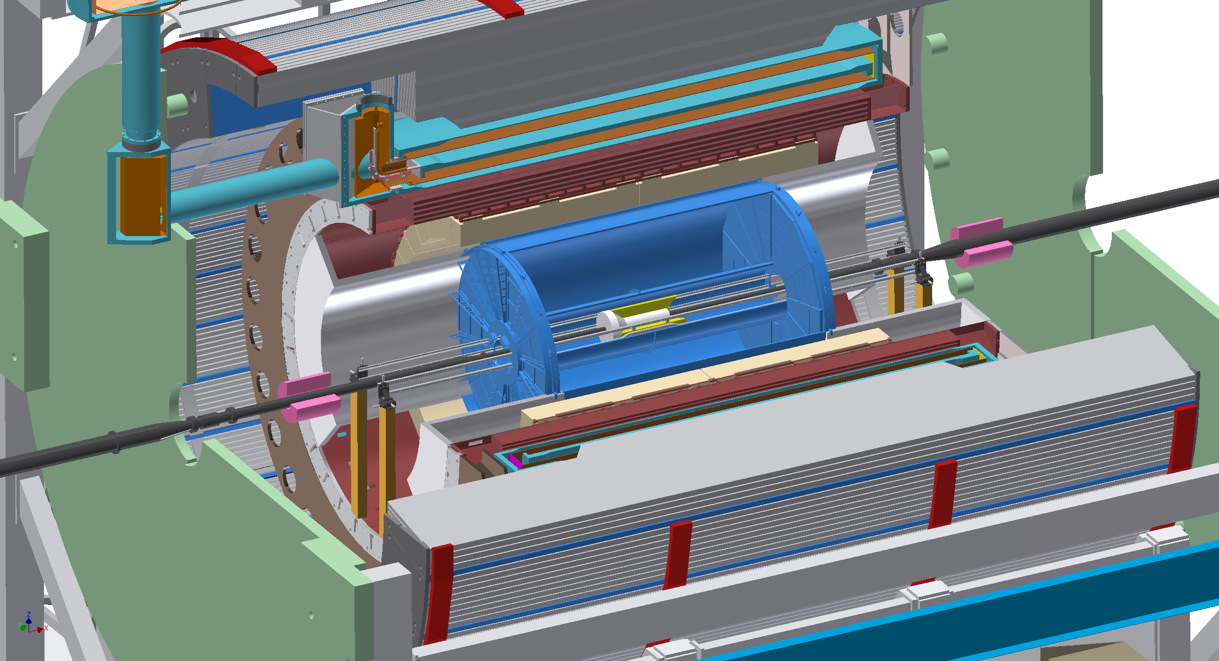
System Description
Installation Requirements
IR & AH Floor Loading Limits: 4000 psi, max
Installation to be accomplished in the Assembly Hall (40 ton and 5 ton overhead cranes) until TPC is installed then assembly is moved to IR for installation of BP (beampipe), INTT, MVTX and Min Bias
Overall size requirements The complete sPHENIX assembly, including magnet valve box stack and all electronics racks, must fit through the sPHENIX sill on the existing sPHENIX rail system
Infrastructure defines most interfaces (except installation tooling and fixtures interfaces)
Alignment precision: defined in ICD’s which link each subsystem with the Installation/Integration Effort
Commissioning of all subsystems separately and as a system (without beam)
Parallel Activities
INTT
MVTX
OUTER HCAL
INNER HCAL
EMCAL
TPC
MIN BIAS
BEAM PIPE
END CAP/FLUX RETURN
SC MAGNET
CRADLE CARRIAGE
sPHENIX MIE
See Backup for Installation sequence overview)
Infrastructure & Facility Upgrade

Slide 4
Scope
The Installation and Integration of the sPHENIX detectors into the full sPHENIX System Includes the following:
Defining the subsystem Interface and Integration plans, including installation procedures, work plans, integrated safety plans and all associated reviews.
Design and/or specification of all installation tooling, fixtures and access equipment.
Installation/upgrade of common Infrastructure including the cradle carriage, work platforms and access, services support structure, pole tips, beam pipe, HVAC, electronics cooling water, electronics racks, safety systems and upgrades to non-IR infrastructure from PHENIX to sPHENIX requirements.
Installation and alignment of all sPHENIX fully assembled, instrumented and tested subsystem components and installation of all associated services:
32 Outer HCal sectors
Superconducting sPHENIX Magnet (formerly BABAR Magnet) (Note: cryo and electrical services installation is part of the magnet subsystem scope.)
Inner (inside the Magnet) detector structural supports
32 Inner HCal sectors (Assembly of these sectors into the full detector prior to installation is included in this scope.)
64 EMCal sectors (installed onto rails mounted to the Inner HCal)-
Tracking detectors (TPC, INTT and MVTX)
Min Bias detector
QA testing of all detector components prior to and subsequent to installation
Commissioning of the fully assembled sPHENIX subsystem
(See Interface Control Documentation (ICD) slide in backup)
All detector components and detector services and services components (e.g. cables , fibers, piping, cooling equipment, etc) and all support structure components including the cradle carriage, inner detector support structure, other infrastructure items, etc.) are the responsibilities of the individual detector subsystems and/or the infrastructure subsystem. See these infrastructure and the individual detector subsystem scope definitions to see responsibility delineation for these subsystems.

Slide 5
sPHENIX Installation Status
Installation/Integration
Work Package Status Notes
Subsystem Interface & Integration Plan conceptual Detailed 3D model
Infrastructure Installation advanced conceptual Many repurposed components
Cradle Carriage Integration/Installation conceptual Detailed 3D model
sPHENIX SC Magnet Installation design Repurposed magnet feet, modifications in design
Outer HCal Integration/Installation design Lifting & handling fixtures in design
Inner HCal Integration/Installation advanced conceptual 3D model almost ready to begin design
EMCal Integration/Installation advanced conceptual final stages of modeling almost ready to design fixtures
TPC Integration/Installation pre-conceptual beginning to focus on installation and handling fixtures
INTT Integration/Installation pre-conceptual Still needs internal support structure analysis/design
MVTX Integration/Installation pre-conceptual Based on ALICE MAPS
Min Bias Integration/Installation Advanced conceptual Repurpose of BBC
sPHENIX Full Detector Installation conceptual 3D model and repurposed infrastructure almost ready for design
Status key:
pre-conceptual feasibility demonstrated, analyses in progress, options being considered
conceptual preferred model selected, model details in progress
advanced conceptual detailed model ready for engineering drawings
design engineering drawings in progress
final design drawings complete ready for review
design complete reviews complete ready for procurement
procurement procurement in progress
installation subsystem installation in progress
commissioning subsystem fully installed subsystem (non-beam) checkout in progress
operational commissioning complete, ready for beam and data taking
Detailed 3D models, layouts and design drawings in progress

Slide 6
Design Drivers/ Cost Drivers
Integration & Installation Design Drivers:
Safety
Subsystem design requirements
Existing infrastructure (shield wall opening, Crane coverage and limits, rail layout)
Minimum material in active areas
Access for repair, maintenance, upgrade
Subsystem assembly requirements
Subsystem support and alignment requirements
Integration & Installation Cost Drivers:
Installation labor dominates cost
Inner HCal Assembly Fixtures
Outer HCal Assembly and handling fixtures
EMCal Installation Fixtures
TPC Installation fixtures
Cradle/Carriage Assembly fixtures

Slide 7
BoE
Cost Summary
Contingency
Estimates for the labor and material described in this Control account are currently based on Engineering estimates and analyses of infrastructure concepts based on evolving design of the individual subsystems. Contingency is assigned to each detail in each work package. The overall material contingency for this control account is determined by a weight averaged summation ("bottoms up") of the contingencies for the individual work packages. Labor contingency for all labor is initially assumed at a constant 25%. As the work packages' labor content becomes more well defined the individual labor contingencies for each task is reevaluated and the composite contingency calculated as weight averaged in accordance with the total estimated (unburdened) labor cost for the task.
Bottom Up Composite Labor contingency for WBS #1.10.2: Integration Documentation, Technical Coordination, Installation Tooling and Fixtures and Subsystem Installation Control Account:
Labor Contingency: 25%
Material Contingency: 36%
WBS # Work Package Description Material Cost
1.10.2.1 Subsystem Interface & Integration Plan $0.00
1.10.2.2 Infrastructure Installation $5,000.00
1.10.2.3 Cradle Carriage Integration/Installation $52,500.00
1.10.2.4 sPHENIX SC Magnet Installation $43,500.00
1.10.2.5 Outer HCal Integration/Installation $63,500.00
1.10.2.6 Inner HCal Integration/Installation $84,500.00
1.10.2.7 EMCal Integration/Installation $32,500.00
1.10.2.8 TPC Integration/Installation $33,000.00
1.10.2.9 INTT Integration/Installation $33,000.00
1.10.2.10 MVTX Integration/Installation $33,000.00
1.10.2.11 Min Bias Integration/Installation $13,000.00
1.10.2.12 sPHENIX Full Detector Installation $2,000.00
Total Unburdened Material Cost for CA # 1.10.2 = $395,500.00
Resource Summary for Integration Documentation, Technical Coordination, Installation, Tooling, Fixtures and Subsystem Installation
in FTE’s by Resource Category
Administrators Scientists Engineers Designers Technicians Trades Students
0 1.7 4.8 2.1 7.0 2.4 6
BoE’s for Installation work packages can be found in here

Slide 8
Installation & Integration Staffing
FTE Profile by Category
FTE Profile by Fiscal Year
WBS Level | Org Sort | Group | FY 17 | FY 18 | FY 19 | FY 20 | FY 21 | FY 22
1.10 | BNL | Purchased Services | 0.00 | 0.18 | 0.00 | 0.41 | 0.23 | 1.47
 |  | Scientific | 0.07 | 0.01 | 0.00 | 0.00 | 0.00 | 1.50
 |  | Technical | 1.14 | 0.78 | 0.15 | 1.21 | 1.26 | 4.53
 |  | Professional | 1.32 | 0.74 | 0.66 | 1.14 | 0.42 | 0.95
 | BNL Sum |  | 2.54 | 1.71 | 0.81 | 2.76 | 1.90 | 8.45
 | Non-BNL | Scientific | 0.07 | 0.01 | 0.00 | 0.00 | 0.00 | 0.00
 |  | Student | 0.00 | 0.00 | 0.00 | 0.00 | 0.00 | 6.00
 | Non-BNL Sum |  | 0.07 | 0.01 | 0.00 | 0.00 | 0.00 | 6.00
Grand Total |  |  | 2.61 | 1.72 | 0.81 | 2.76 | 1.90 | 14.45

Slide 9
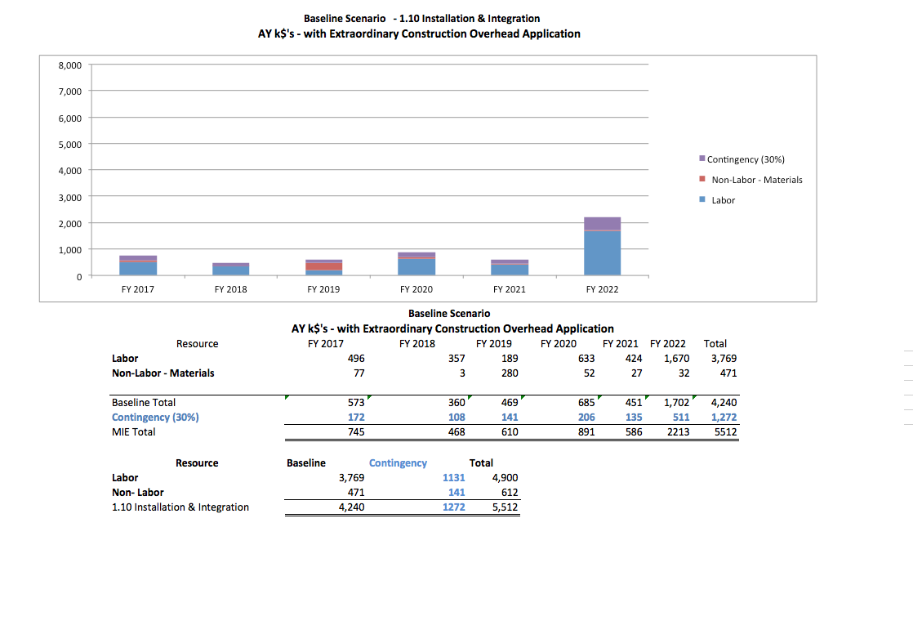
Cost Profile: Integration and Installation

Slide 10
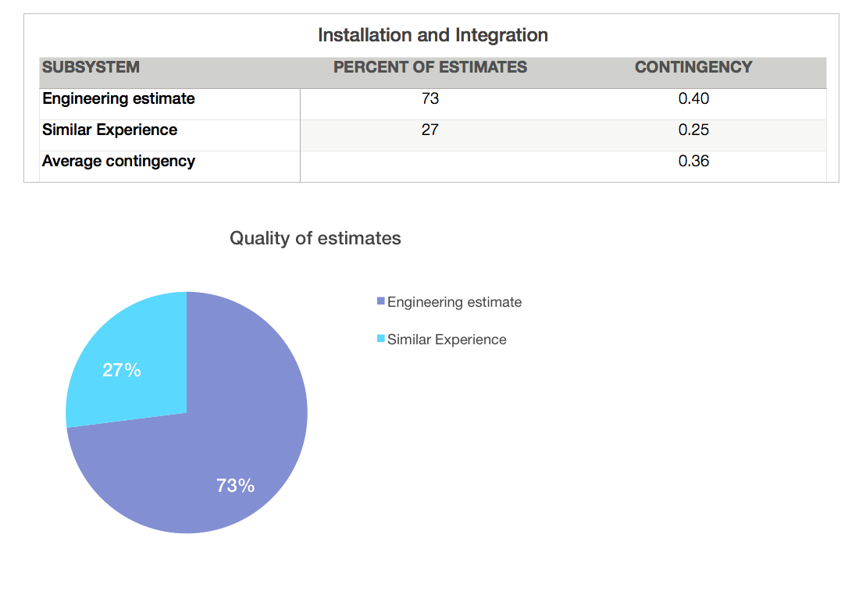
Basis of Estimate: Contingency

Slide 11
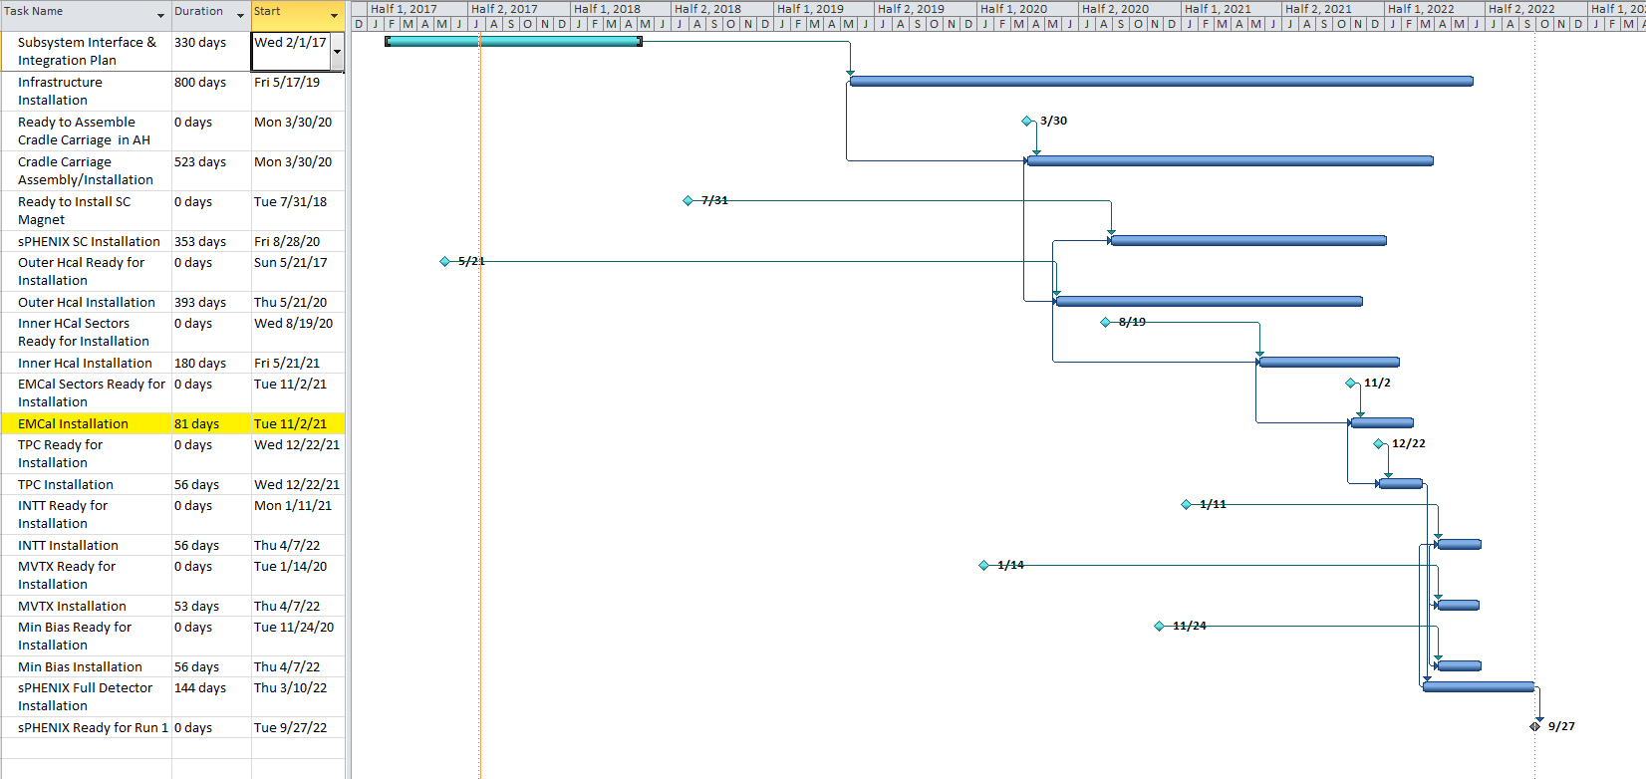
Schedule
Full sPHENIX Installation schedule can be found here

Slide 12
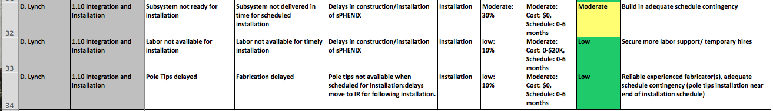
Risk Registry
The Registry section for Integration/Installation and other non-MIE subsystems is managed and monitored the same as for the MIE items. The Installation risk issues generally have to do with availability of labor and material in a timely fashion. These are mitigated by having a tight management structure and closely coordinated engineering for MIE and non-MIE subsystems.
Full sPHENIX Risk Registry can be found here

Slide 13
Summary
Installation and Integration Concepts are maturing
Outer detectors at design stage
Inner detectors still conceptual
Timely interface information from Inner Detectors (MVTX, INTT) (particularly for service routing)
Experienced personnel and a well-acquainted collaborator base
Experienced staff, outside experts
Challenge: Engineering and technical resources need to be augmented to meet requirements
Installation schedule depends on
delivery of subsystems on time
Availability of engineering resources for procedures, planning, tooling design (No significant technical challenges, just engineering and design resource allocation)
Key coordination efforts
Coordination with infrastructure design efforts
Pole tip design
Cradle carriage design
Inner detector support structures
Coordination with detector subsystems for commissioning during installation (delays in subsystem delivery may disrupt installation schedule)
Coordination with non-sPHENIX BNL groups (priority issues)
Coordination with non-BNL sPHENIX collaborators (CAD software issues)

Slide 14
Backup Slides

Slide 15
Installation L2/CAM/Key Personnel
Key Personnel:
Donald Lynch, P.E. Chief Engineer for sPHENIX
Relevant Experience
Five years as sPHENIX Chief Engineer. Thirteen years as PHENIX Chief Engineer (12 data taking runs, 9 new detector SUBSYSTEM projects, numerous overhaul/upgrades of existing subsystems, numerous facility and infrastructure projects) Thirteen years as Sr. Project Engineer at BNL/NSLS 15 years Non-BNL aerospace, thermal and mechanical engineering projects
Rob Pisani, Sr. Scientific Associate for sPHENIX
Relevant Experience
25 years particle detector support experience. SSC EmCal Prototype R&D(1993 Built/test), R&D PHENIX Rich Prototype, PHENIX HBD prototype, PHENIX TEC detector, PHENIX Gas System Coordinator (multiple systems), PHENIX VTX/FVTX Cooling System, Deputy Mgr of PHENIX Removal & Repurposing.
Paul Giannotti Principal Engineer and ES&H Coordinator, Electrical Engineer, Physics Department, BNL
Relevant Experience
Designer of PHENIX Control Room indication and alarm system, emergency shutdown safety system, and electrical power distribution. Operations and ES&H support for all PHENIX runs 2000-2016.
Steve Boose, Electronics Engineer for sPHENIX
Relevant Experience
25 years. Software / hardware design at BNL in support of the NASA SeaWiFS, DOE Ocean Margins Program and the PHENIX experiment at RHIC. 4 years Software / hardware design and technical support for the scientific laser industry. 10 years Electronics troubleshooting and repair in high vacuum, information systems and audio.
Rich Ruggiero, Sr. Design Engineer for sPHENIX
Relevant Experience
2012 - Present as sPHENIX Sr. Design Engineer. Responsible for all sPHENIX integration coordination and conceptual design. 1997-Present PHENIX Design Engineer responsible for all integration and cable routing, survey/installation, work access and detector upgrades. 1986 – 1997 BNL Designer for D0 Central Calorimeter, D0 EMCal and Coarse Hadronic sectors, Oasis proposal (predecessor to PHENIX), and various NSLS, AGS and ATLAS design projects.
Carter Biggs, Sr. Technical Associate for PHENIX and sPHENIX
Relevant Experience
2012-Present Technical Supervisor for the PHENIX and sPHENIX projects, responsible for the construction and maintenance of the PHENIX detector subsystems and their respective upgrades. Also supervised the construction and test set-ups for the H-Cal and EM-Cal prototypes for S-PHENIX. 1993-2012 Technical Associate responsible for the set-up of the PHENIX Time Expansion Chamber factory and the completion of those 2 meter x 4 meter wire chambers. Facility Space Manager for Bldg. 1008, coordination of the techs, engineers, scientists, and trades during the RHIC runs and shutdowns.
All have 25 + years Analyzing, Designing, Assembling and Installing Similar Detector subsystems at BNL

Slide 16
WBS Dictionary
WBS Dictionary entries for the 2 control accounts that comprise the Installation and Integration Subsystem
Technical Scope:
WBS 1.10.1 is the Control Account for Project Management costs associated with Integration and Installation.
Work Statement:
This Control Account encompasses the efforts of the Integration and Installation level 2 manager to manage this subsystem in accordance with the BNL and DOE requirements, including collecting and analyzing management performance data for this subsystem, reporting the data as appropriate and generally assuring that this subsystem meets cost and schedule estimates, and if the subsystem management performance strays from the baseline, implementing appropriate actions to restore performance to the baseline."
Technical Scope:
WBS 1.10.2 is the Control Account for all scientific, engineering and technical staff efforts to plan, execute and supervise all aspects of the assembly, integration and installation of the sPHENIX infrastructure components (defined by WBS 1.9), completed and tested detector subsystem modules and electronics for the sPHENIX MIE (defined by WBS 1.2 though 1.7), sPHENIX superconducting solenoid magnet (defined by WBS 1.8) and parallel detector projects to be installed in sPHENIX (defined by WBS 1.11 and 1.12).
Work Statement:
This Control Account encompasses the planning for and all of the actual installation and commissioning of these components will take place at the sPHENIX experiment complex at building 1008. There are 12 work packages included in this control account. Each work package has its own separate Basis of Estimate (BoE) document elsewhere in this workbook. These documents can be accessed from the Navigation page in this workbook."
WBS dictionary entries for installation work packages can be found in here

Slide 17
Installation Overview
2
Installation Sequence
Base and Cradle
Installation
1
Magnet
Installation
4
All detector installation performed in Assembly Hall
Lower Outer HCal
Installation
3
5
Upper Outer HCal
Installation
EMCal
Installation
7
6
(Next Slide)
Inner HCal
Installation
Notes:
Early stages of design for items not shown

Slide 18
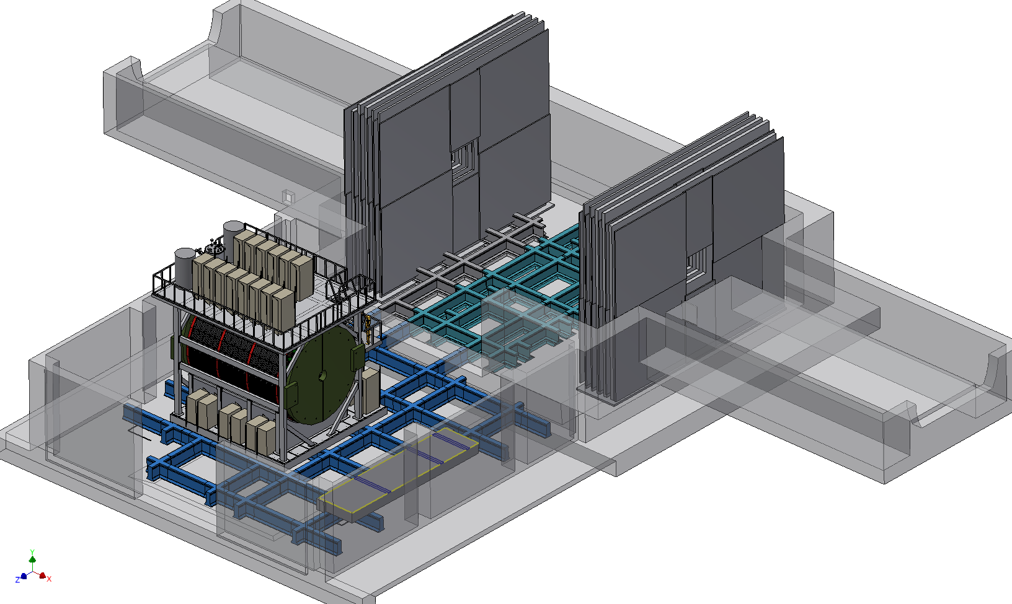
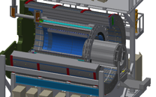
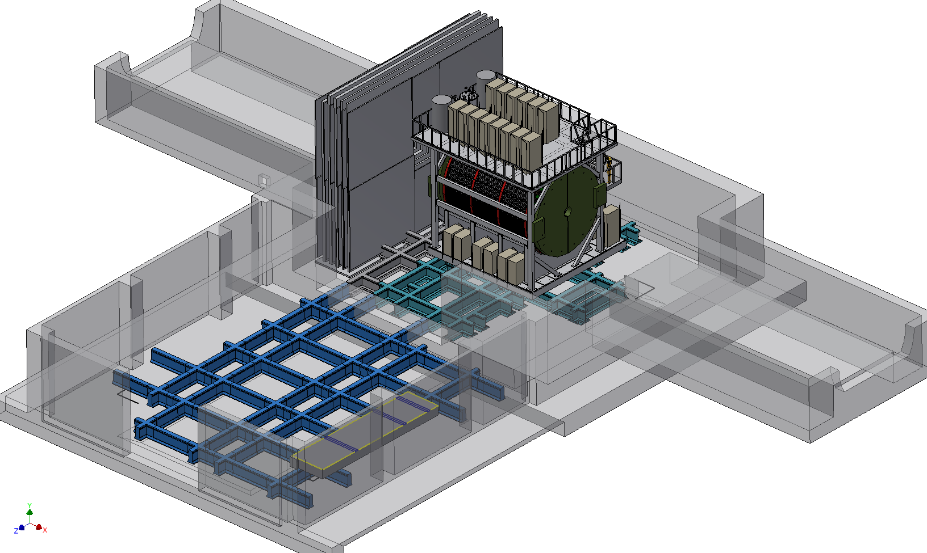
Installation Overview
8
9
TPC
Installation
Complete Cradle Carriage Assembly
(End cap/pole tips, platforms and access, racks, etc.)
(Previous Slide)
10
Move sPHENIX Assembly to IR
Install beampipe, INTT, MVTX and MinBias detectors and their supports and services
11
MVTX INTT beampipe
MinBias

Slide 19
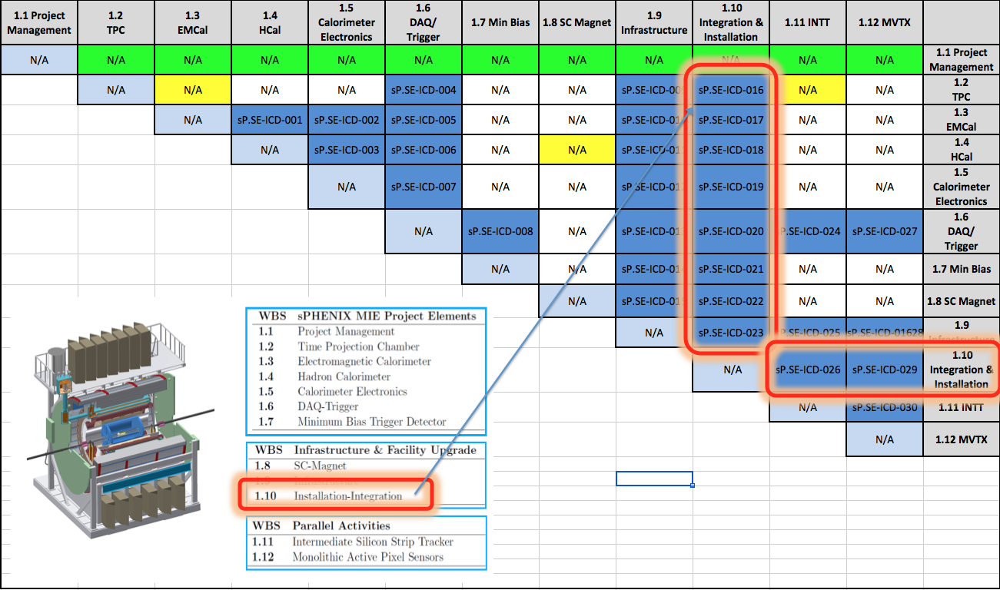
Installation Interfaces
Interface Control documents(ICD’s) define and quantify the interfaces between any 2 subsystems. Interfaces include mechanical, electrical, optical, cooling, gas media, etc. For the Installation and Integration effort there are 10 documents currently conceived. For purposes of the installation efforts, these generally refer to interfaces between the subsystems components and the tooling, fixtures, procedures and equipment required to accomplish the installation and alignment of these components.
The mechanical mounting, electrical, optical, cooling and gas connections that are made between adjacent detector subsystems and between detector subsystems and infrastructure/structural support components are defined in the ICD’s that are shared by each pairing of those subsystems.

