Slide 1
sPHENIX Director’s Review
August 2-4, 2017
BNL

Slide 2
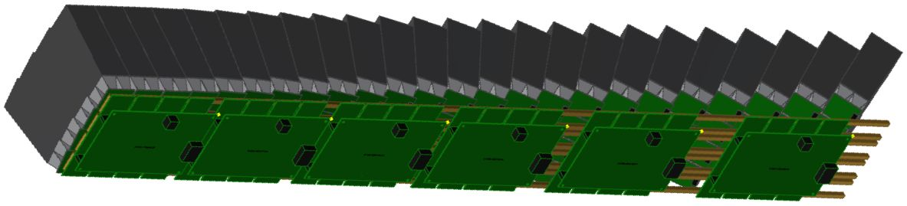
Calorimeter Electronics
(EmCal Sector Shown)
Preamp Board
Interface Board
SiPM Daughterboard
Physics Dynamic Range 30MeV (MIP) to 40GeV, additional high gain range for calibration.
Channel gain controls
  Stabilized against temperature variation.
  Compensated for radiation effects (increased SiPM current leakage).
  Adjustable to compensate for sensor variation.
Charge injection and LED test pulse sources for periodic channel testing.

Slide 3
Calorimeter Electronics Technical Overview
PhotoMultiplier (SiPM) sensor selected for reading out scintillator.
  Small size compatible with high density.
  Low cost -> ~$8 each.
  Magnetic field immunity.
SiPM parameter control.
  Gain vs temperature stabilization.
  Compensation for increased current leakage due to neutron damage.
  Channel gain trimming.
Preamplifier
  Shaping must be compatible with 60MHz ADC sampling and 106nS RHIC cycle time -> 30nS peaking and recovery to baseline within 106nS .
  High gain channel for resolving single microcell peaks during calibration.
Discrete COTS circuitry chosen for readout system.
  Low risk.
  Reuse of existing PHENIX readout technology.

Slide 4
Scope
EmCal
256 channels in Φ by 96 in Z = 24576 total.
HCal
128 channels in Φ by 24 in Z = 3072 total.

Slide 5
Subsystem Collaborators
Steve Boose - Electronics Engineer
  Electronics and software design.
Sal Polizzo - Technician
  PC Board layout, prototype assembly and testing.
Martin Purschke - Physicist
  Test stand programming.
  Collaborators are being recruited for much of the production assembly. Potential institutions include University of Michigan, University of Augustana, Debrecen and Georgia State etc.

Slide 6
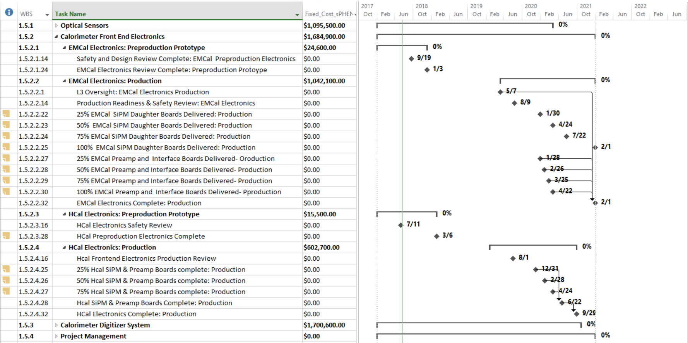
Schedule Drivers
EmCal Preamps and Interface boards.
EmCal internal cables.
Completion of electronics reviews.
Float for EmCal Preamp delivery ~6 weeks. 1st delivery 1/30/2020, required for EmCal module assembly 3/10/2020.
Float for EmCal Interface boards: 1/28/2020, required for EmCal module assembly 3/10/2020.
Float for cables, ~4 weeks.

Slide 7
Cost Drivers
EmCal Preamps: $400k
EmCal/HCal Signal Cables: $500k

Slide 8
Basis of Estimate and Resource-Loaded Schedule

Slide 9
Status and Highlights
EmCal:
Latest preamp revision is ready for Pre-Production Prototype production and assembly phase following system test.
New prototype 3M signal cabling system design is underway. We need to build a single prototype of this design and test before committing to a Pre-Production run of cables.
The Interface board design is ready for final system functional testing before Pre-Production Prototype phase but the communication connector should be retrofitted to save approx 3.8mm of height.
An End Cap design concept exists but must be finalized.
HCal:
Latest revision of preamp board with added channel switching must be system tested prior to Pre-Production order.
The Interface board design is working well but would benefit from a few minor signal re-routes to make it fully compatible with the same firmware as EmCal.
New 500uM LED fiber source has been designed and a prototype is being built for testing with tiles.
Slow Control:
New cleaned-up revision of the Controller board is set to go into the layout phase.

Slide 10
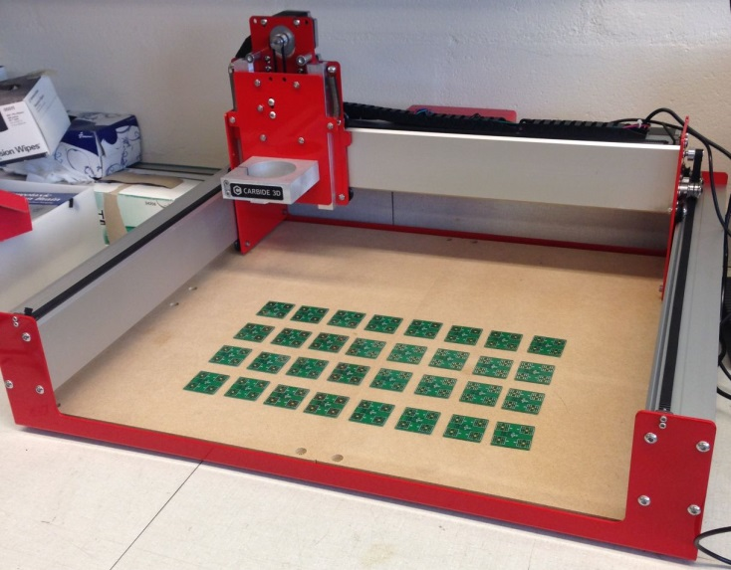
Test Stands
The Preamp Tester hardware design is near completion. The motherboard must be produced, assembled, programmed and tested.
The EmCal Daughterboard Tester
  XYZ table has been acquired and controller exercised via software.
  Motherboard concept is in place, design to follow.
HCal Tile Tester
  Based on CAEN DAQ module.
  GSU is making progress on two stands, one for tile factory and one for final test.
EmCal Daughterboard Test Table

Slide 11
Summary
Space (board height in r) has been a concern for EmCal. The current estimate indicates that the electronics package may exceed the allotted height by approx. 5mm. However changing the Interface communication connector will reduce height by 3.8mm and possibly 5mm more can be gained by switching from Meritec cabling to the new 3M concept.
Some challenges remain in the EmCal assembly process especially since liquid cooling was added. A detailed assembly procedure is in progress.
Overall we are confident that the Pre-Production Prototype electronics package will remain on schedule.
There have been 3 successful test beam runs with prototype electronics. Design changes have all been minor, with most of them being to accommodate mechanical design changes in the EMCal and HCal.

Slide 12
Back Up

Slide 13
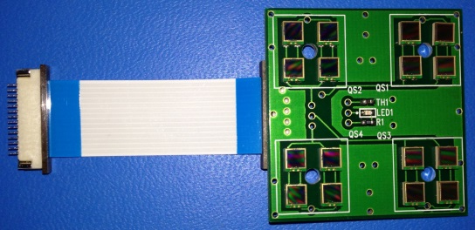
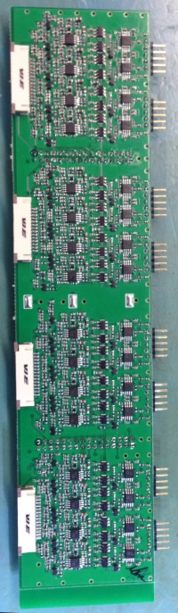
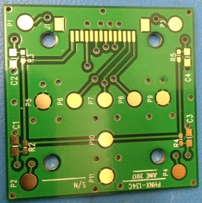
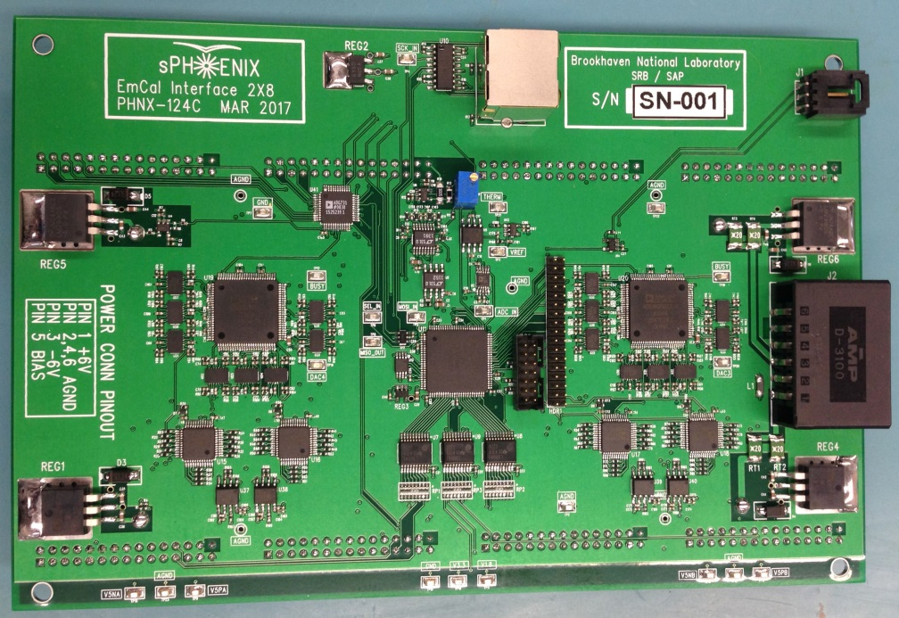
EmCal System Boards
Preamp
(2X8) Channel
Daughterboard (bottom)
Daughterboard
Pogo pads for testing
Interface Board
Comm Connector
Test Pulse Connector
Power Connector

Slide 14
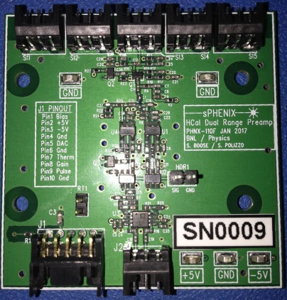
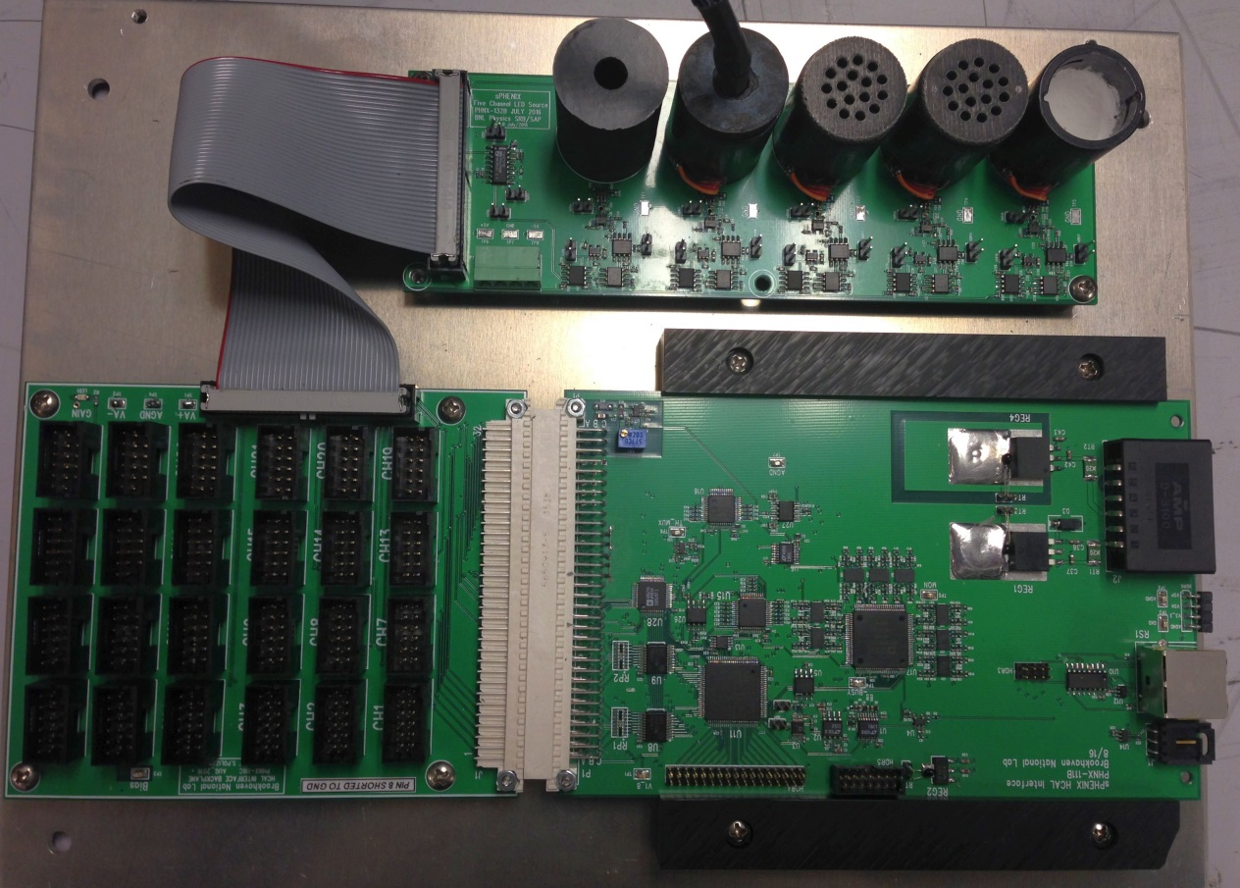
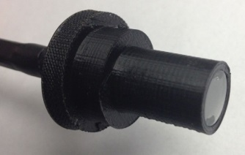
HCal System Components
Dual Gain Preamp
LED Driver Board
Backplane Board
24 Fiber Light
Source Plug
Interface Board

Slide 15
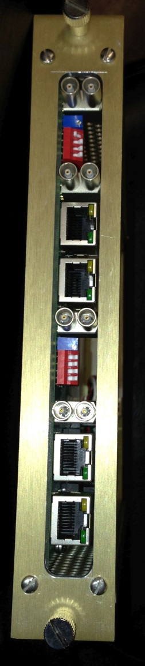
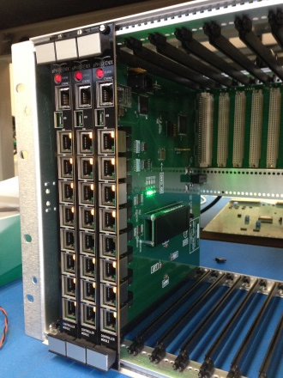
Slow Controls Boards
sPHENIX Calorimeter Controller
Test Pulse Fanout Module

Slide 16
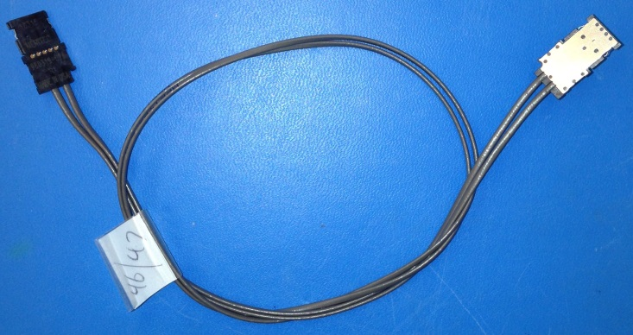
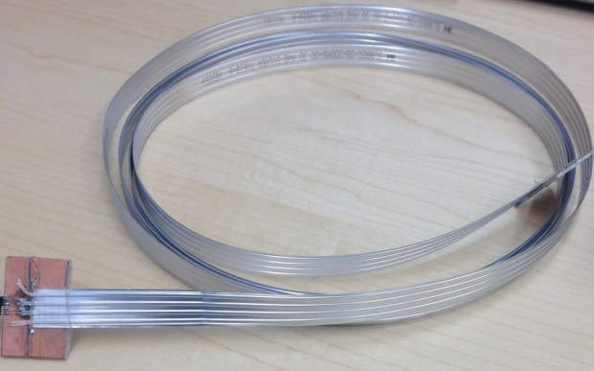
Signal Cables for One Sector
Meritec Method
Buy 96 144” cables with Meritec connectors on each end.
Cut each one into two cables and add preamp connectors for 384 channels total.
96 Cables X $164 = $15744.
Add cost of parts and labor for preamp connectors.
Total approx $16K.
3M SL8802 Method
Buy SL8802 cables custom cut to length and preformed at ends - $1900.
Make transition boards for each end - approx $600.
Preamp connectors - $135.
Z-Pack connectors - $310.
East End Assemblies Labor quote - $1008.
Total $3593.

Slide 17
SL8802 Twinax Application
Preamp Connector M22-6541042R
3M SL8802/08 100 Ω Twinax
2mm Hardmetric Connector
Amp 106012-1
0.031” Preamp Paddle board
Add beads of glue here
EmCal Endcap plate is here
0.062” Endcap Paddle board
SL8802 4 lane Twinax cable is purchased in custom lengths with leads gull-winged either up or down.
Cable leads are tack welded to pads on paddle boards - 30um gold over 50um nickel.
4 Twinax cables, 2 on top and 2 on bottom to each HardMetric connector. Must be glued to paddle boards.
4 HardMetric connectors per paddle board = 64 chan.
6 Endcap boards per sector.

Slide 18
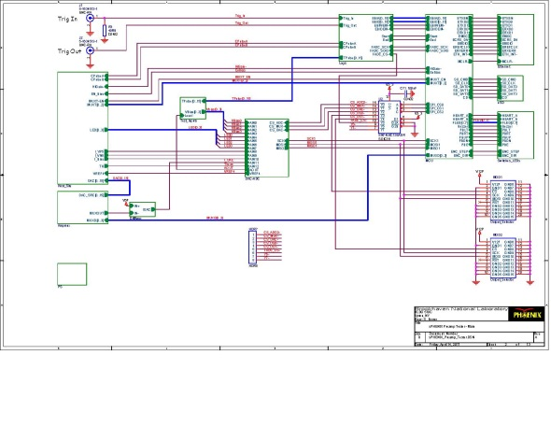
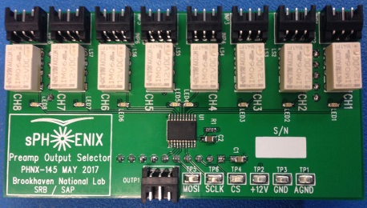
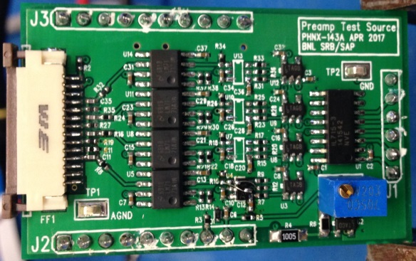
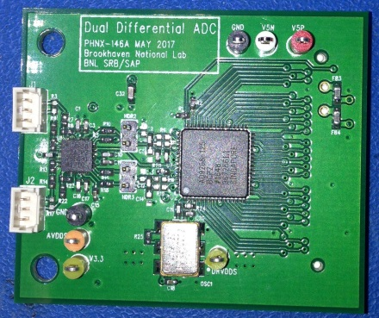
Preamp Tester
Will consist of a main board with three plug-in modules, Test Source, Output Selector and ADC module. Main board layout will commence once plug-ins have been successfully prototyped.
Test Source and Output Selector modules have been built but not yet tested.
An ADC Module is in process of being assembled.
Sal and Bill are working on an adapter for HCal preamps.
Test Source
Output Selector
ADC

Slide 19
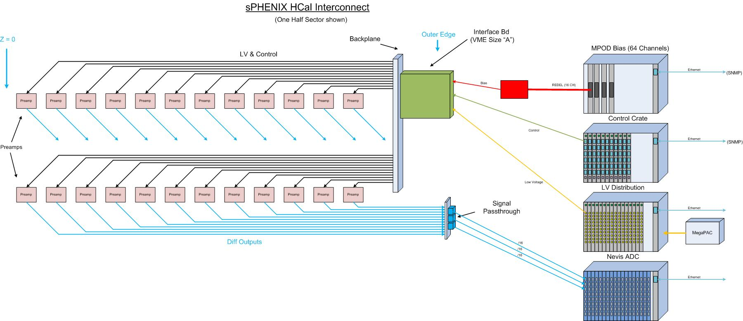

System Layout and Interconnect

