Slide 1
sPHENIX Director’s Review
Calorimeters and Calorimeter Electronics: Silicon Photomultipliers
Christine Aidala
University of Michigan
August 2-4, 2017
BNL

Slide 2
The Subsystem
Silicon photomultipliers (SiPMs) – choice of optical sensors for both the EMCal and HCal
Capable of detecting single photons
Advantages compared to photomultiplier tubes
  Insensitive to magnetic fields – critical for calorimetry inside solenoid
  Significantly lower operating voltages (< 100 V rather than > 1000 V)
Disadvantages
  Temperature sensitive: temperature must be monitored
  Susceptible to neutron damage: increased leakage current

Slide 3
The Subsystem Technical Overview
Hamamatsu S12572-015P SiPM
  Catalog item
  15 x 15 μm² pixel size
  40,000 μ-cells
  Dynamic range: 10⁴
  Gain: 2x10⁵

Slide 4
Scope
WBS 1.5.1 Optical Sensors:
  EMCal: 98304 SiPMS
  HCal: 13824 SiPMs
SiPM procurement, testing, and sorting
  Test gain as a function of operating voltage for all ~120k SiPMs required for the EMCal and HCal
  Sort SiPMs into sets with operating voltage matched for shipment to assembly warehouse
    For final detector, operating voltage will be controlled for individual calorimeter towers, i.e. groups of 4 SiPMs

Slide 5
Subsystem Collaborators
University of Michigan
  Christine Aidala – L3 Manager, Associate Professor
  Postdoc – currently Michael Skoby
  Graduate student – currently Nicole Lewis
  Undergraduates
Augustana University
  Nathan Grau – Associate Professor
  Undergraduates
Debrecen University – building the testing devices and possible testing site
  Balazs Ujvary – Associate Professor
  Jozsef Imrek – FPGA expert
  Graduate students - Tamas Majoros, Zhandong Sun
  Undergraduates - electrical engineering as well as physics students

Slide 6
Schedule Drivers
Delivery by Hamamatsu of 10,000 SiPMs every 4 weeks starting September 2019
Delivery by Debrecen of first testing device 2018
Availability starting September 2019 of 3 working SiPM testing devices capable of testing at least 64 SiPMs each in a period of 4 hours or less
Means of recovering schedule slippage
  Continue testing during weekends
  Test 4 rather than 3 batches per day at each site by working at night
  Use spare testing device
If one site is no longer able to perform testing, 2 testing devices can be operated at a single site

Slide 7
Cost Drivers
SiPM procurement: Final cost negotiated with Hamamatsu for SiPMs and any testing performed by Hamamatsu
Hours of labor needed for SiPM testing
  Current estimates assume each device completes testing of 64 SiPMs in 4 hours, with 3 devices + 1 spare distributed at 3 sites
  Current estimates assume 8 hours of labor per day needed to test 3 batches each of 64 SiPMs at each site, i.e. continuous supervision of testing device for two batches per day and no supervision for third batch

Slide 8
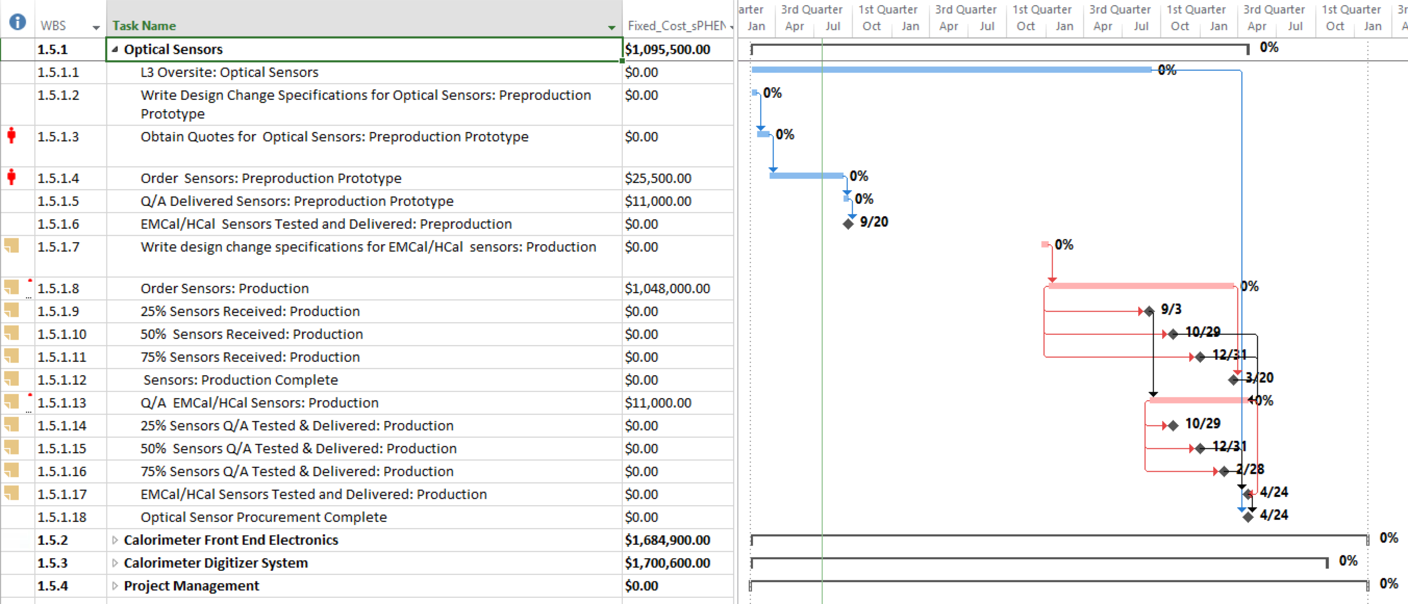
Basis of Estimate and Resource-Loaded Schedule
SiPM cost and schedule based on quotes from Hamamatsu
SiPM testing device expected specifications and cost based on information provided by Debrecen. Prototype testing device has already been produced.

Slide 9
Status and Highlights
1 prototype testing device, produced by Debrecen, currently at University of Michigan
  Lab space of C. Aidala, 867 sq. ft. (~81 sq. m) available
Capable of testing 3 SiPMs at a time.
Device self-contained including LED and power supplies, requiring only dedicated computer with Ethernet and virtual machine
Set up to allow remote operation from Debrecen or elsewhere (SiPMs must be changed locally)
Measurements
  Current as a function of bias voltage, allowing determination of breakdown voltage
  Integrated charge at 11 operating voltages, showing 1-, 2-, 3-photon peaks, etc. Allows calculation of gain in order to determine operating voltage within 0.02 V

Slide 10
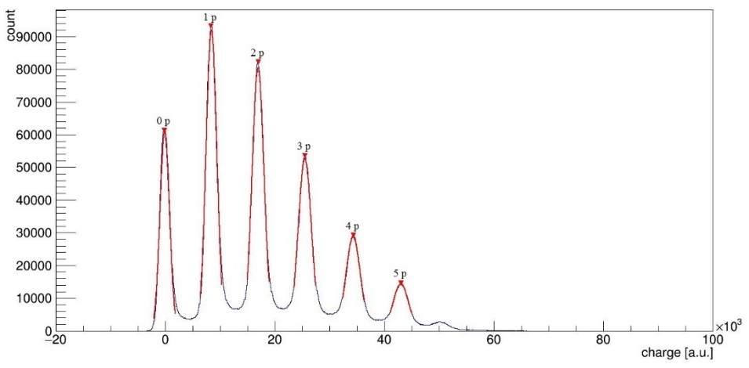
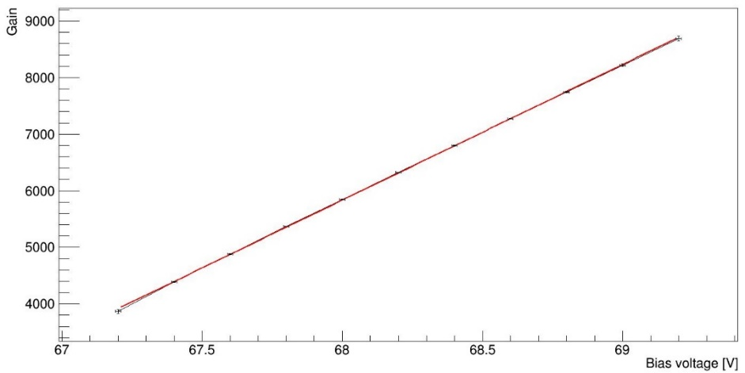
Status and Highlights
Debrecen taking lead in developing testing hardware
  Have produced prototype capable of testing 4 SiPMs at a time
  Device self-contained including LED and power supplies, requiring only dedicated computer with Ethernet and virtual machine
Michigan leading the testing efforts
  Lab space of C. Aidala, 867 sq. ft. (~81 sq. m) available
  Prototype testing device currently at Michigan, set up to allow remote operation from Debrecen or elsewhere
Measurements
  Current as a function of bias voltage, allowing determination of breakdown voltage
  Integrated charge at 11 operating voltages, showing 1-, 2-, 3-photon peaks, etc. Allows calculation of gain in order to determine operating voltage within 0.02 V
1p
2p
counts
0p
Gain
3p
4p
5p
charge
Bias voltage (V)

Slide 11
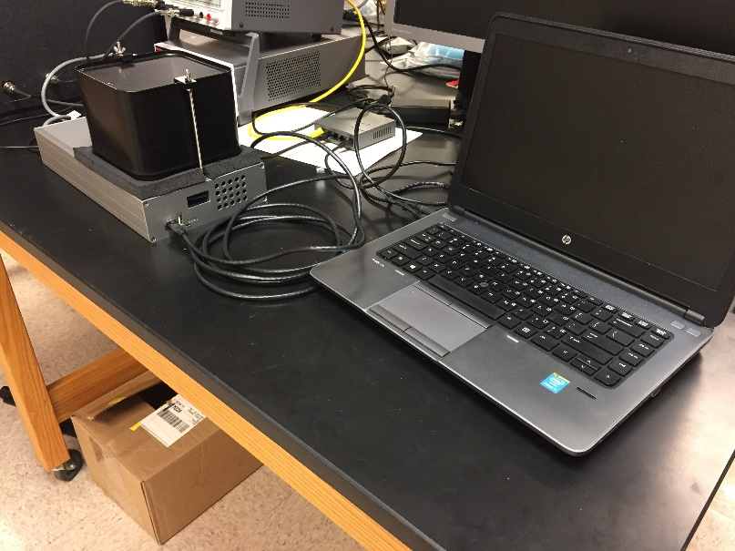
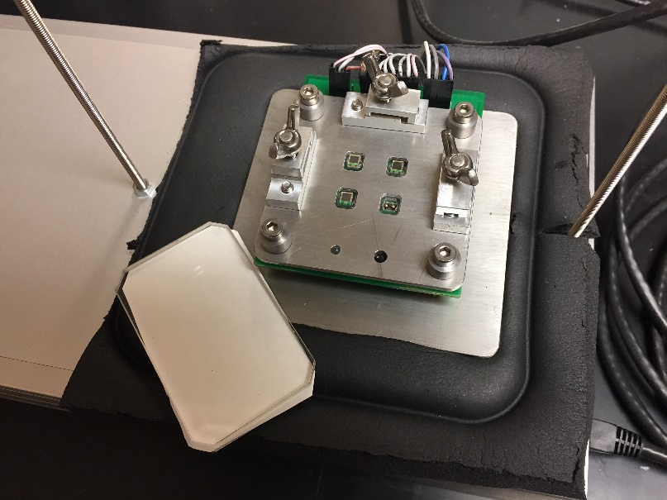
Status and Highlights
Prototype testing device will be brought to BNL September 1, 2017 for modifications by the Debrecen group that will improve the testing rate, and for subsequent testing of the 1500 SiPMs needed for final prototype calorimeter in preparation for FNAL beam test in 2018
SiPM testing for final prototype calorimeter will be performed at BNL by personnel from Debrecen and Michigan
Experience gained during this larger-scale testing will serve to finalize the design of the large (64 channel) SiPM testing devices to be built by Debrecen
Prototype testing device at Michigan

Slide 12
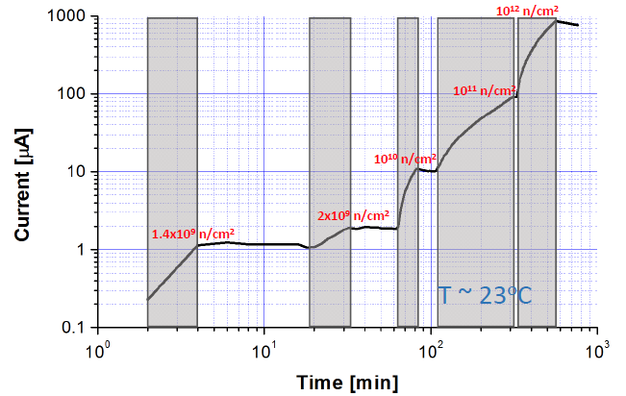
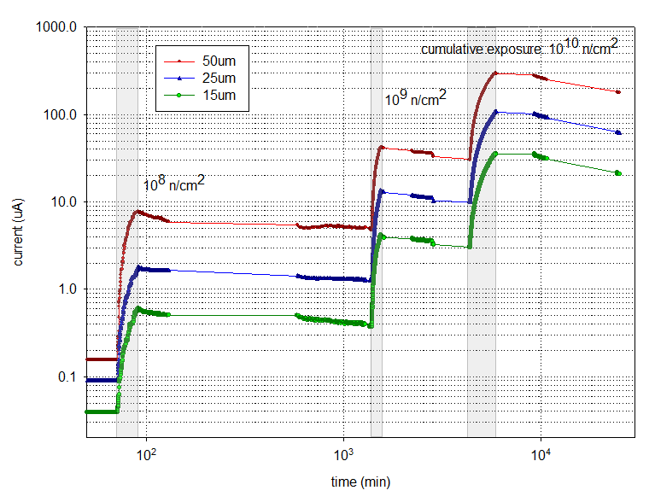
Issues and Concerns
Effects of neutron radiation damage to SiPMs over time still need to be considered in detail
Initial irradiation studies performed at ATOMKI and BNL
ATOMKI
BNL
Current [μA]
Time [min]

Slide 13
Back Up

Slide 14
Testing Plan
SiPMs to be tested in parallel at Michigan, Augustana, and 1 other institution, requiring 3 testing devices + 1 spare, about $8,000 each (TBC).
Starting in September 2018, Hamamatsu will ship about 10k SiPMs every 4 weeks, requiring about 500 devices to be tested each day (5 days a week). The SiPMs will be shipped on 13x13 trays, therefore, each institution will receive about 60 trays every 4 weeks.
The SiPMs will have an accompanying traveler sheet that lists the SiPMs by tray position and serial number. Hamamatsu will also provide the operating voltage and gain for 3% (TBD) of the devices. Before testing begins on an individual tray, the traveler sheet will be scanned and its information uploaded into an Excel database. This database will be part of the testing device software and is being developed by Debrecen and Michigan collaborators.
Next, each SiPM will be placed in the 8x8 testing array and the SiPM array position will be recorded in the database. The handling of the SiPMs will only require common tweezers. Once the SiPMs are in place, the testing device will measure the gain at a series of supply voltage settings, determine the operating voltage (breakdown voltage + 4V) for each SiPM, measure the corresponding temperature, and automatically record this information into the database (TBD). The testing device will require about 4 hours (TBD) to complete measurements for all 64 SiPMs.
The SiPMs will then be sorted by operating voltage before placing the next set of 64 SiPMs into the testing device. Because the SiPMs need to be matched within 0.02 V (TBC) and Hamamatsu has indicated that all SiPM operating voltages will be within +/- 1 V, the devices will be sorted into 100 0.02-V bins. The voltage bin and tray position of each SiPM will be recorded in the database. This sorting procedure will take about 20 minutes for each set of 64 SiPMs. Loading the next set of 64 SiPMs into the testing device will take less than a few minutes.
Testing and sorting of sets of 64 SiPMs will done up to 3 times per day for each institution (3 sets x 64 SiPMs x 3 testing devices = 576 SiPMs/day).
Schedule for shipping SiPMs from institutions to the assembly warehouse TBD.

Slide 15
Test Capability at Debrecen
In addition to physics, also a strong program in electrical engineering
  About 300 BSc/MSc/PhD students combined
SiPM experts not just in the department, but also in the neighboring institutes
  ATOMKI, Department of Nuclear Medicine, also a long-time collaboration with National Instruments, which has their European center at Debrecen
Dedicated lab for SiPM development (and testing) from September 2017
2 PhD students and 1-2 experts can manage the test, 5-10 students can be involved easily

Slide 16
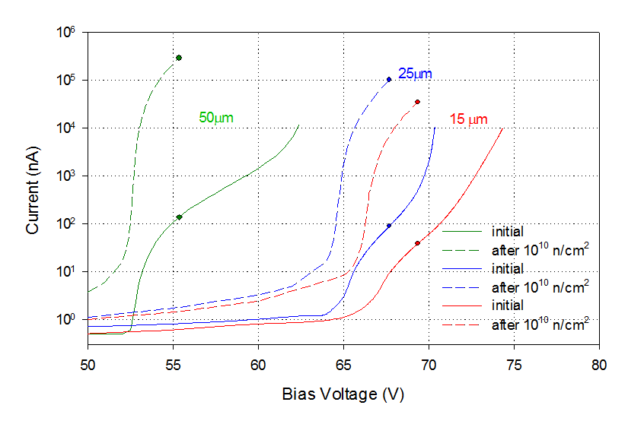
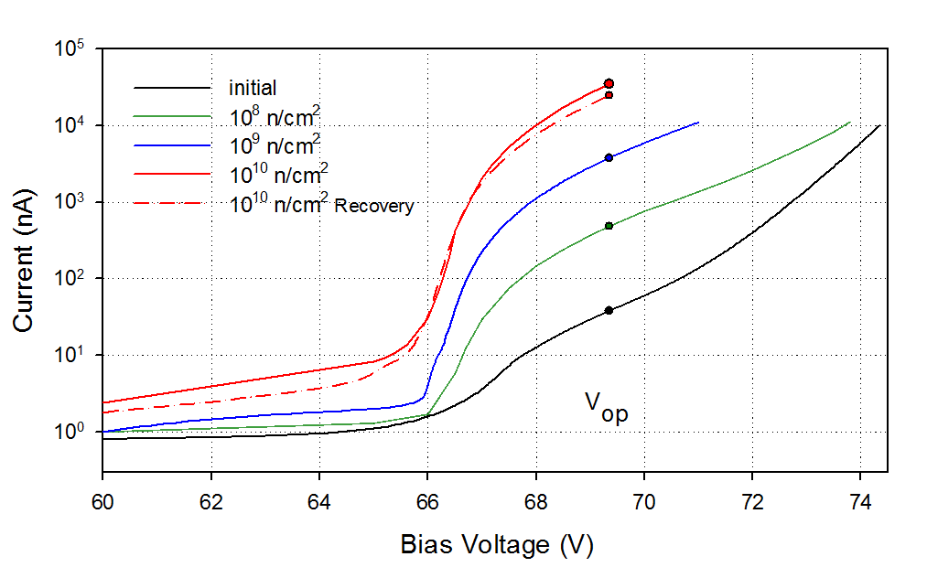
Neutron Irradiation
SiPMs irradiated with 14 MeV neutrons up to 10¹⁰ n/cm²
(BNL)
15 μm pixel device irradiated in steps
Hamamatsu S12572-015P
Pixel I_{int} at V_{op} I_{final} at V_{op} Factor
Size (nA) (μA) Increase
15 μm 38 36 937
25 μm 96 104 1085
50 μm 137 290 2116
Steady increase in current with dose
Small initial recovery followed by slow long term recovery at RT
Small increase in current below V_{op}
Large increase at V_{op}
Smaller pixel sizes show less damage

