Slide 1
sPHENIX Director’s Review
1.2.6 TPC Data Aggregator Module (DAM)
Jin Huang (BNL)
August 2-4, 2017
BNL

Slide 2
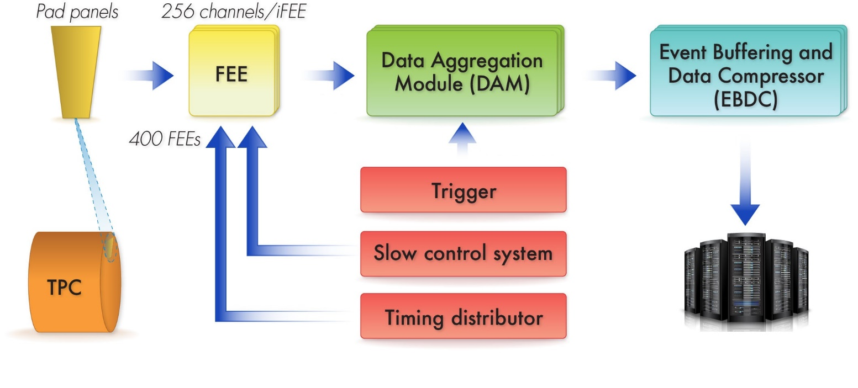
The Subsystem
Input data stream:
600 4-10-Gbps bidirectional fibers links
Max continuous: 2 Gbps / fiber
Average continuous: 1.6 Gbps x 600 fibers
Clock/Trigger input:
Optical links
Clock = 9.4 MHz
Trigger Rate = 15 kHz
Output data stream to buffer box:
24 x 10 Gbps Ethernet via fiber
FPGA based triggering and clustering
Total continuous output: 80 Gbps
TPC DAM L3 Scope, 1.2.6
150k chan
600 FEEs
24 sectors
Continuous
readout
Transfer to RCF
continuously
Buffer box
Structure/
GEM L3 Scopes
WBS 1.2.1-4
FEE L3 Scope
1.2.5
DAQ L2 Scope
WBS 1.6

Slide 3
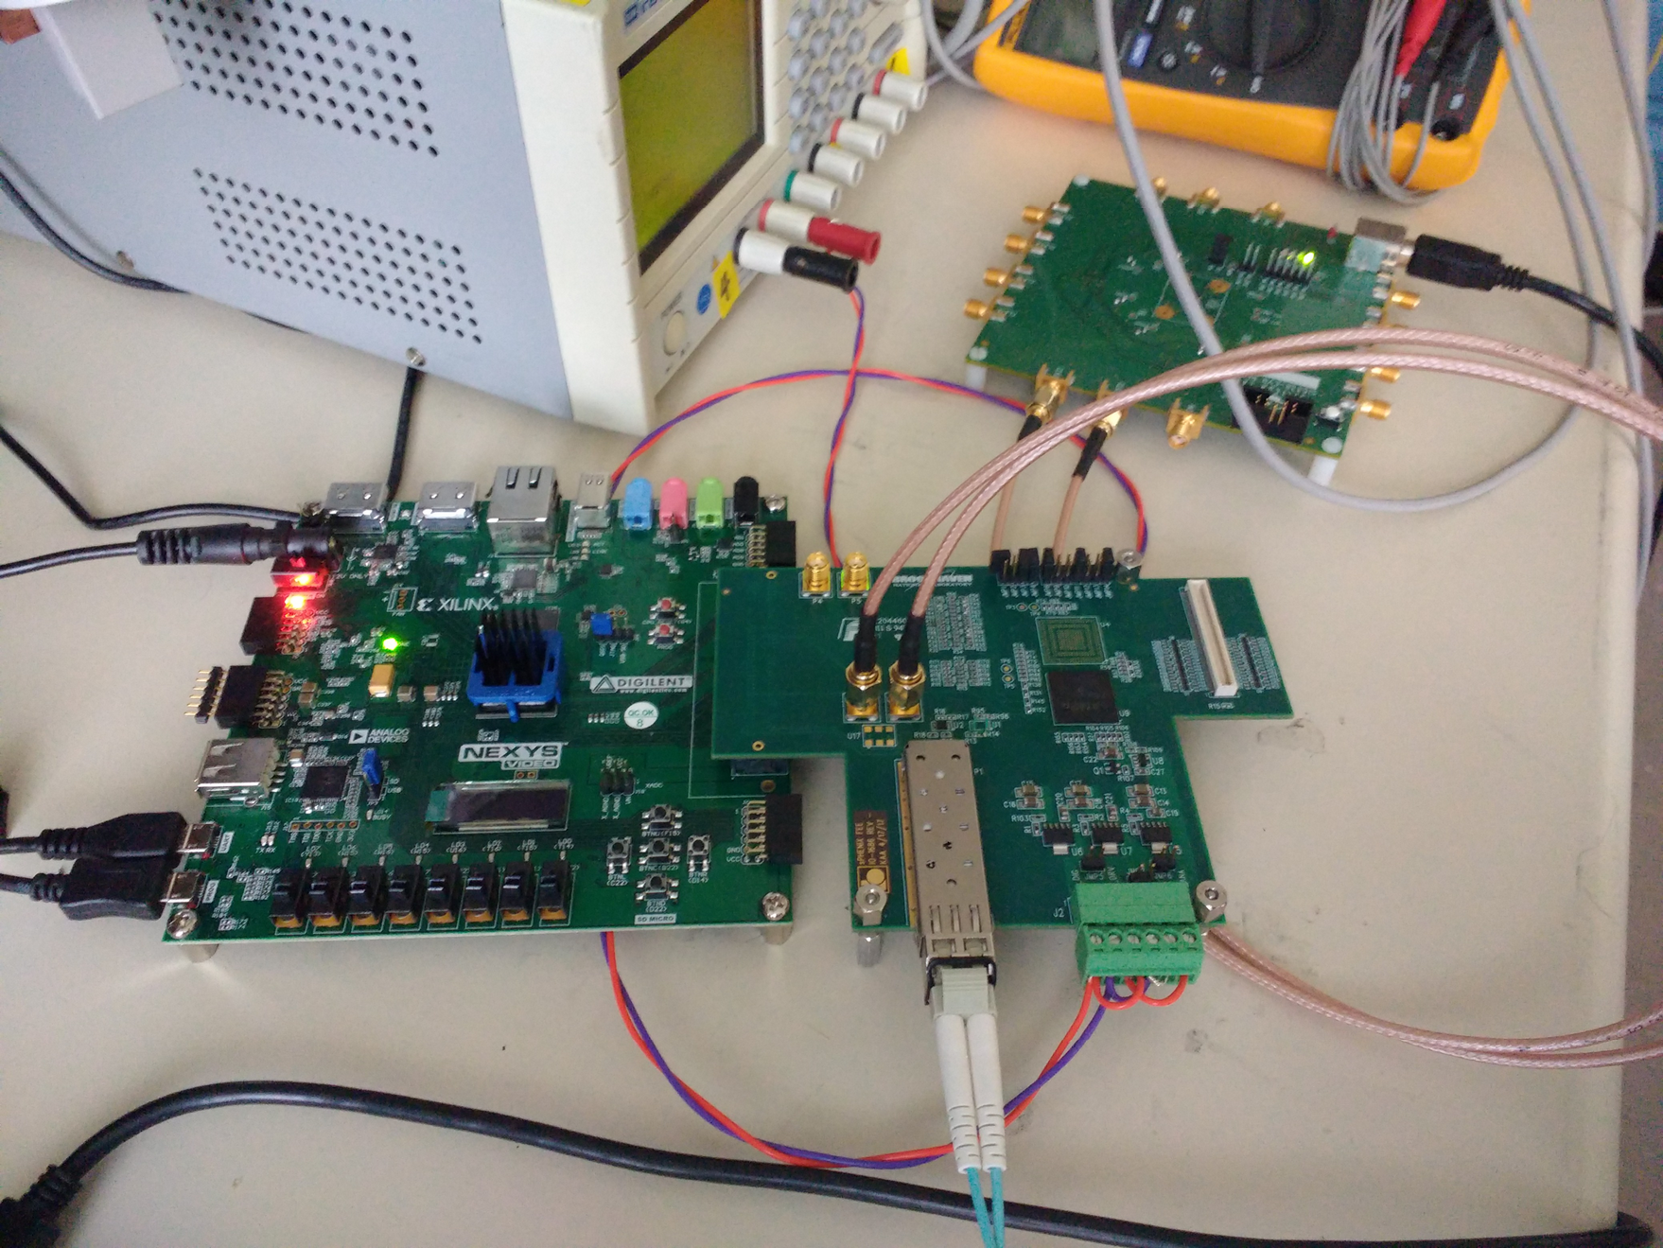
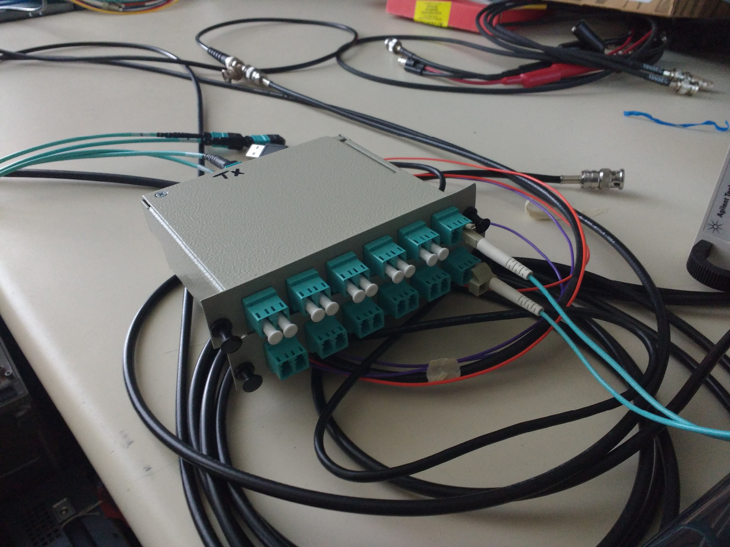
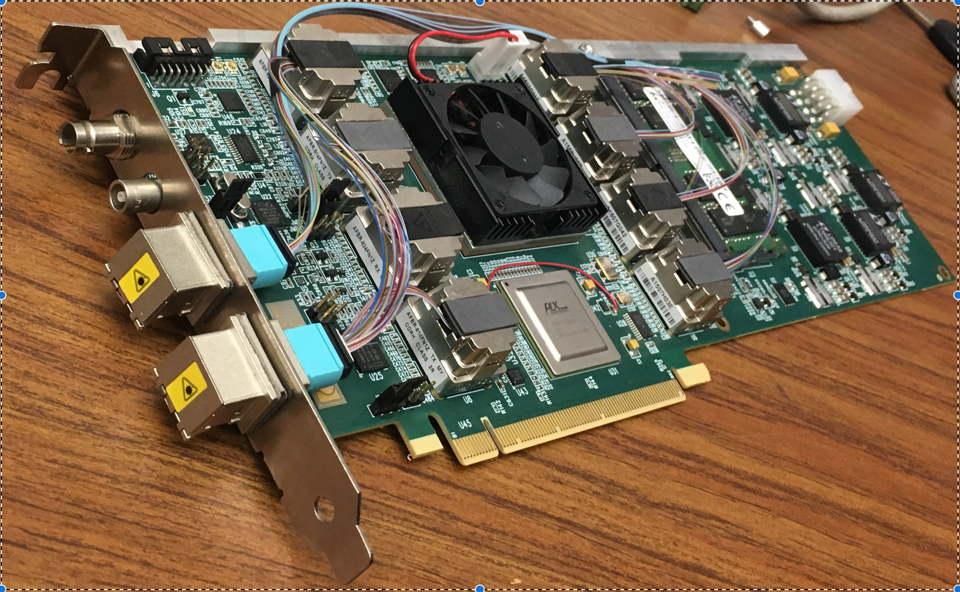
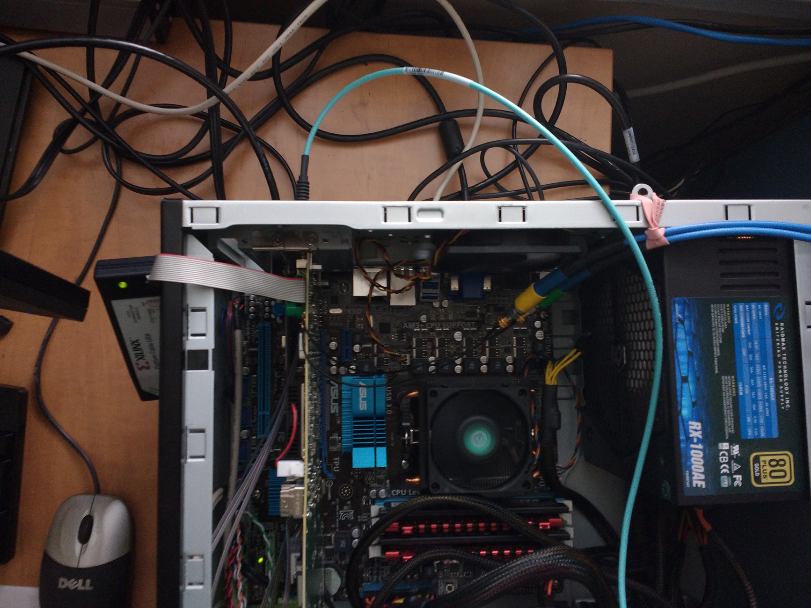
The Subsystem Technical Overview
Collect data from 600 bi-directional 4+ Gbps fiber links to FEEs at rate of 940 Gbps
Reducing data via triggering, clustering and compression to reduce data to 80 Gbps
Driven to use large-FPGA based data acquisition cards with multi-10Gbps input and PCIe Gen3 output, hosted on commodity servers.
  Similar architecture adopted for ATLAS, LHCb, ALICE upgrade for 2020+
Default implementation taking advantage of BNL-developed FELIX PCIe card
  48-bidirectional 10 Gbps optical link
  Large Xlinx Ultrascale FPGA (XCKU115), optimizing cost/link
  PCIe Gen3 x16 link to server, demonstrated to 101 Gbps
  FELIX Prototype v1.5 card used in TPC test stand already
FEE Prototype
Server
MTP <-> LC Breakout
FELIX v1.5 card
FELIX in server

Slide 4
Scope
Data Aggregation Modules (DAM) + Event Buffering and Data Compressor (EBDC) servers
Timing trigger distribution on DAM/EBDC server rack in DAQ room
Interfaces detailed as following:
Include fibers to FEEs
Not include transceivers on FEEs
→1.2.5
Include DAQ software modules
interfacing to the event builder
Not include network cabling→1.6
Include clock/trigger
distribution on rack
TPC DAM L3 Scope, 1.2.6
Transfer to RCF
continuously
Buffer box
Structure/
GEM L3 Scopes
FEE L3 Scope
1.2.5
DAQ L2 Scope 1.6

Slide 5
Subsystem Collaborators
Jin Huang (BNL/Physics) CAM
  Associate Physicist, heavy-flavor topical group co-convener
  Past projects highlight: commissioned DAQ for PHENIX forward silicon tracker, a successful upgrade @ RHIC featuring 2-Tbps continuous readout
John Kuczewski (BNL/Instrumentation Division)
  Experienced digital developer
  Expert of development for electronics, FPGA and drivers
  Past projects highlight: LSST CCD readout electronics
Joe Mead (BNL/Instrumentation Division)
  Senior engineer
  25 years experience in designing high speed electronic circuitry, embedded systems, and DAQ systems for high-energy/nuclear physics and neutron/photon applications
  Past projects highlight: designer of timing system for the PHENIX experiment; ATLAS LAr Calor. Readout; Neutron Detector DAQ
Joint development with TPC FEE (WBS 1.2.5) and DAQ (WBS 1.6)

Slide 6
Synergistic collaboration
In close collaboration with BNL Physics Omega group:
  Developed the BNL-711 PCIe card, which is chosen for ATLAS FELIX project, and used in ATLAS phase I upgrade and forward
  Leading the finalization of FELIX PCIe card design
Sharing resource in FELIX development:
  Lend us a FELIX v1.5 card for prototyping
  Sharing firmware blocks and PCIe driver software
  Consultation
Feedback on FELIX v2.0 timing
mezzanine design
FELIX v1.5 card
FELIX v1.5 internal diagrams

Slide 7
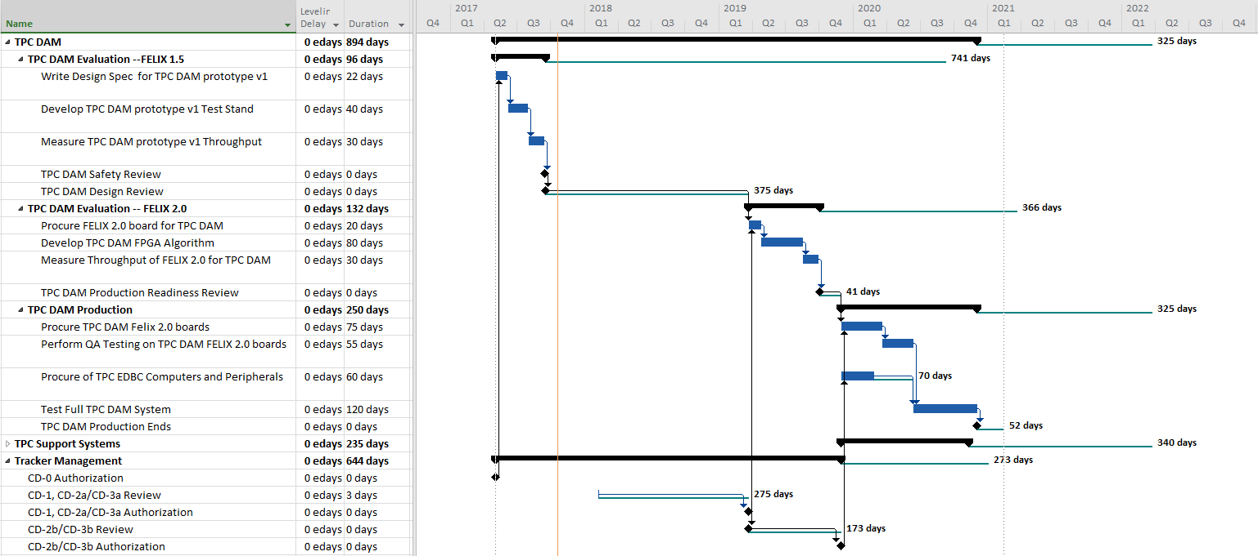
Schedule Drivers
Q3 FY19: Complete DAM implementation & Test: DAM production readiness review: Q4 FY19
Q4 FY19 – Q4 FY20 : Procurement & Test
320-day schedule float: NOT on critical path
Scheduling risk for FELIX card production is low:
  Already received v1.5 prototype card for the prototyping stage, 1.2.6.1
  After the planned installation of ATLAS Phase-I upgrade (planned delivery @ end 2018, one year prior our procurement)
  In the very unlikely case that ATLAS FELIX project were to be significantly delayed, we would use the existing FELIX v1.5 design for TPC DAM production
Scheduling risk for EBDC server production is low:
  Commodity computing
  Procurement scheduled at the latest stage of the production to take advantage of commercial computing development

Slide 8
Cost Drivers
FELIX PCIe card: 230k$ + 25% contingency
  24 cards + 20% spare @ 8k / card
  Driven by FPGA cost
Commodity server: 187k$ + 40% contingency
  2U 24-core server supporting full size PCIe Gen3 x16 + SMBus
  24 servers + 20% spare @ 6.5k / server
  40% Contingency assigned due to the uncertainty of number of CPU cores required for data compression.
  Contingency band will reduce as prototyping, algorithm development and test with simulated FELIX output data.
Next leading cost - data fibers based on quote: 76k$ + 20% cont.

Slide 9
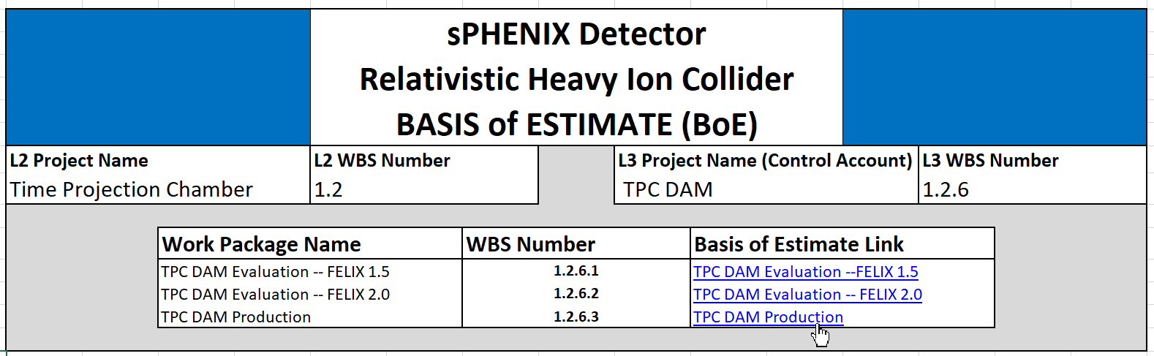
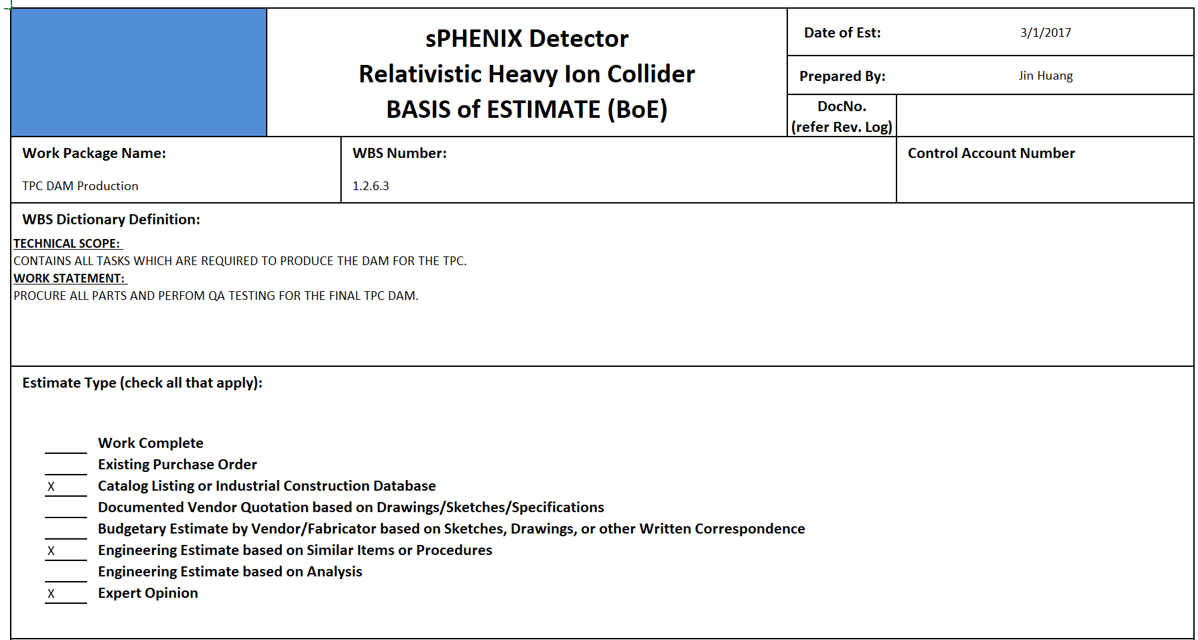
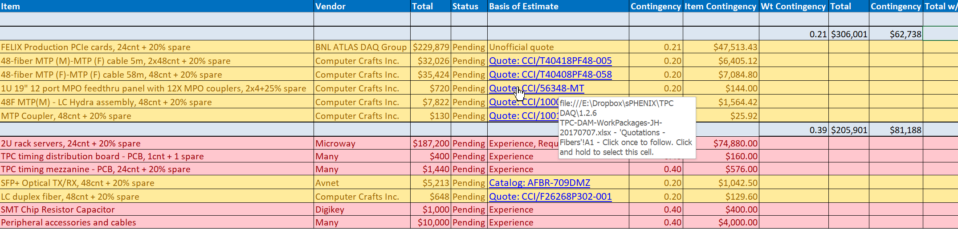
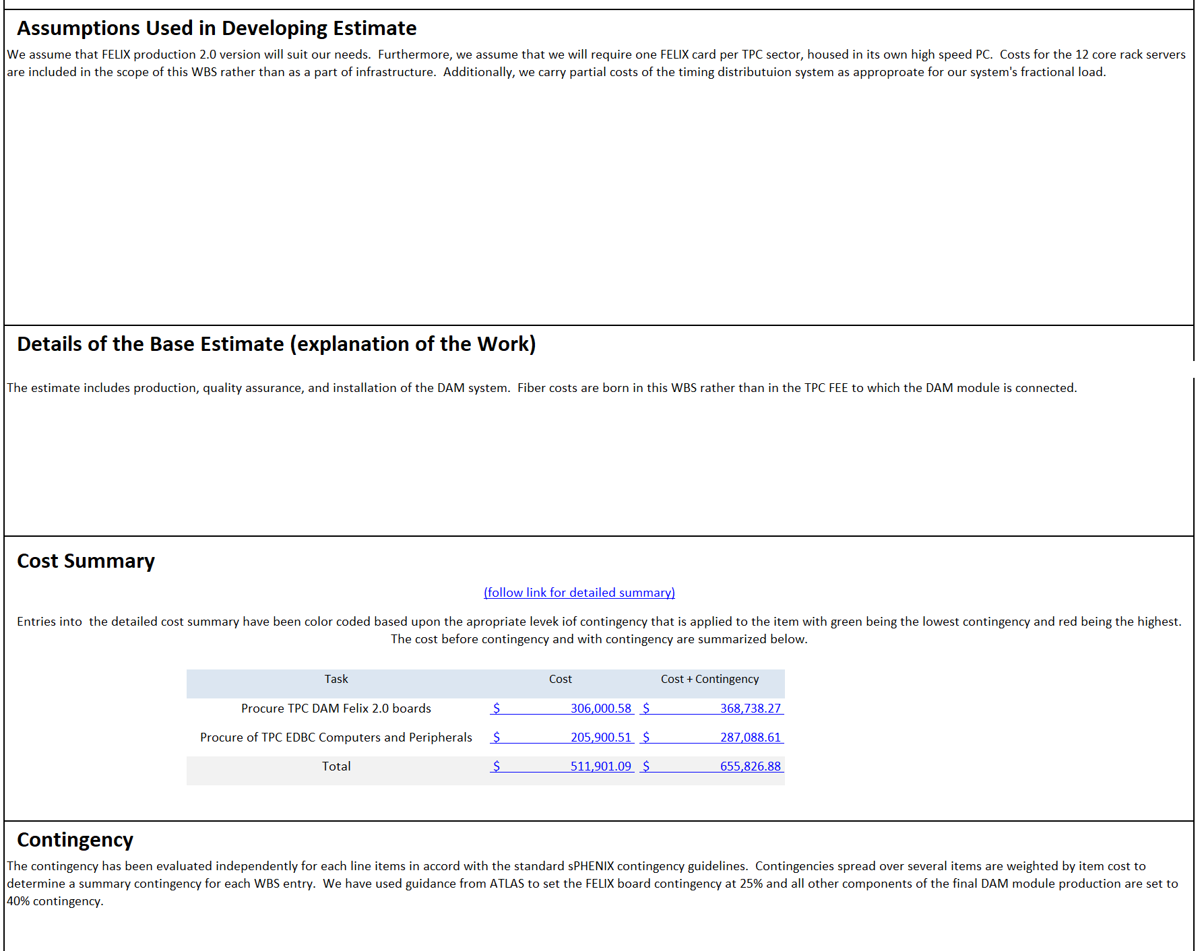
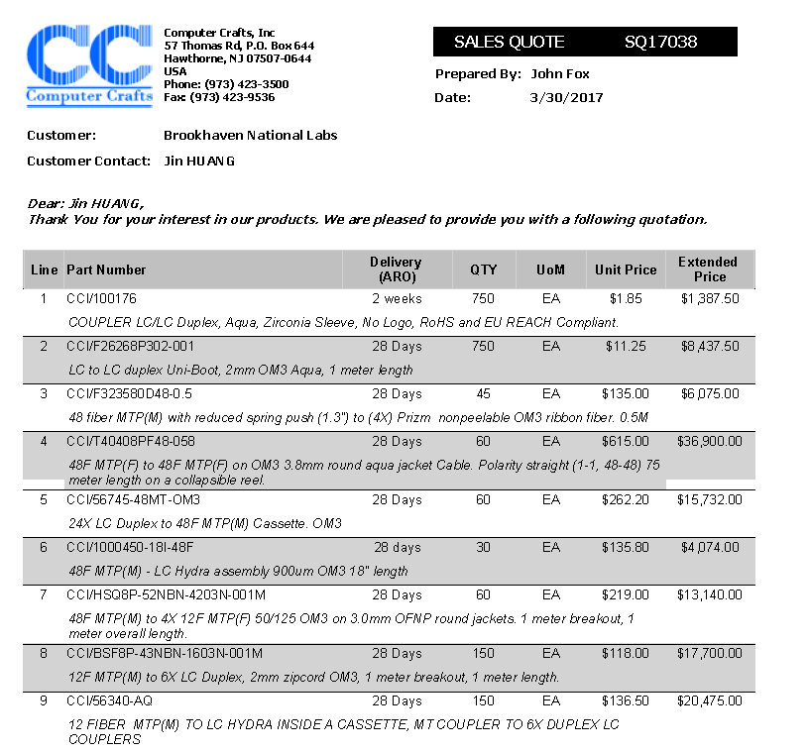
Navigate through BOE 1.2.6

Slide 10
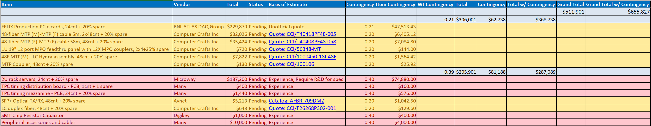
Basis of Estimate and Resource-Loaded Schedule
FELIX PCIe card: 230k$ + 25% contingency
  Assume final FELIX production card production is ready at our schedule
    Well into final prototyping stage, producing pre-production card as speaking
    Planned for production of ATLAS Phase-I upgrade (delivery end 2018)
Commodity server: 187k$ + 40% contingency
  6.5k / server based on online catalog quote @ DELL and expert’s experience with procurement of scientific computing
Next leading cost - data fibers based on quote: 76k$ + 20% cont.
  Fiber distribution designed:
    48-fiber trunk + patch panels from DAQ room to exp. Hall
    48 MTP-> LC duplex breakout on TPC
  Quoted each part from Computer Crafts, Inc.
BOE WBS 1.2.6 TPC DAM, sheet Production -- Details

Slide 11
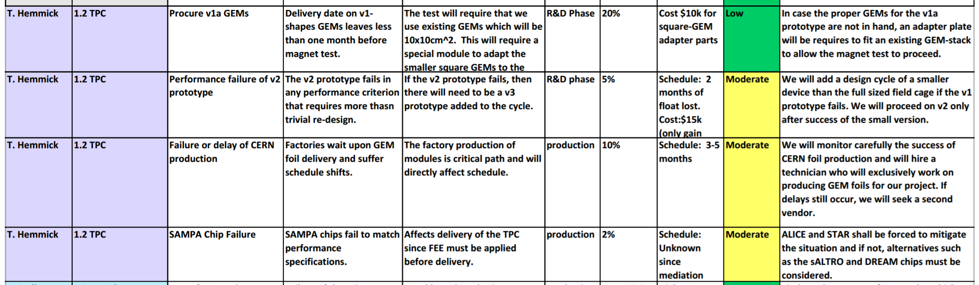
Risk Registry
No item in TPC DAM 1.2.6 is considered risky.
Relates to moderate risk to the downstream DAQ storage risk (WBS 1.6)
Risk registry, TPC WBS 1.2
Risk registry, DAQ WBS 1.6. See talk DAQ/Trigger by Dr. Martin Purschke
Storage |  | Data volume, especially from the TPC, too high |  |  |  | Moderate
Storage “The TPC or other subsystem cannot meet the envisioned data reduction specifications”

Slide 12
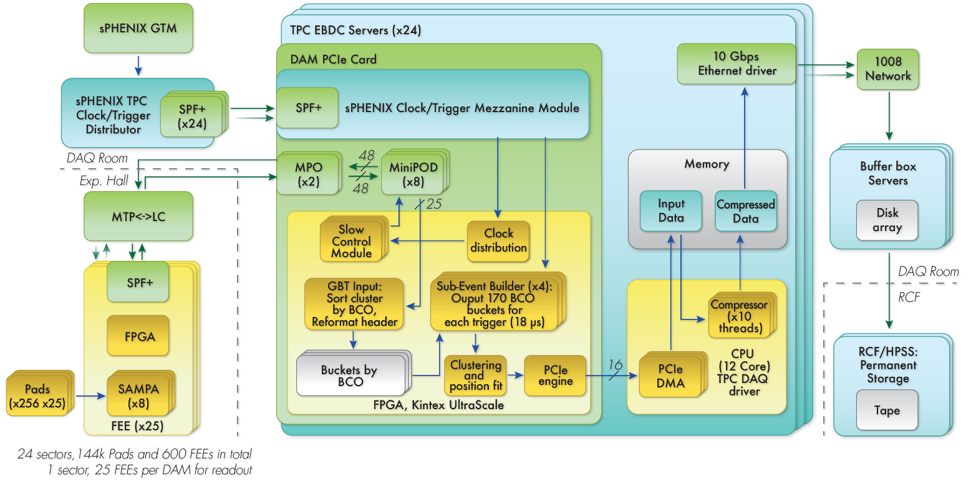
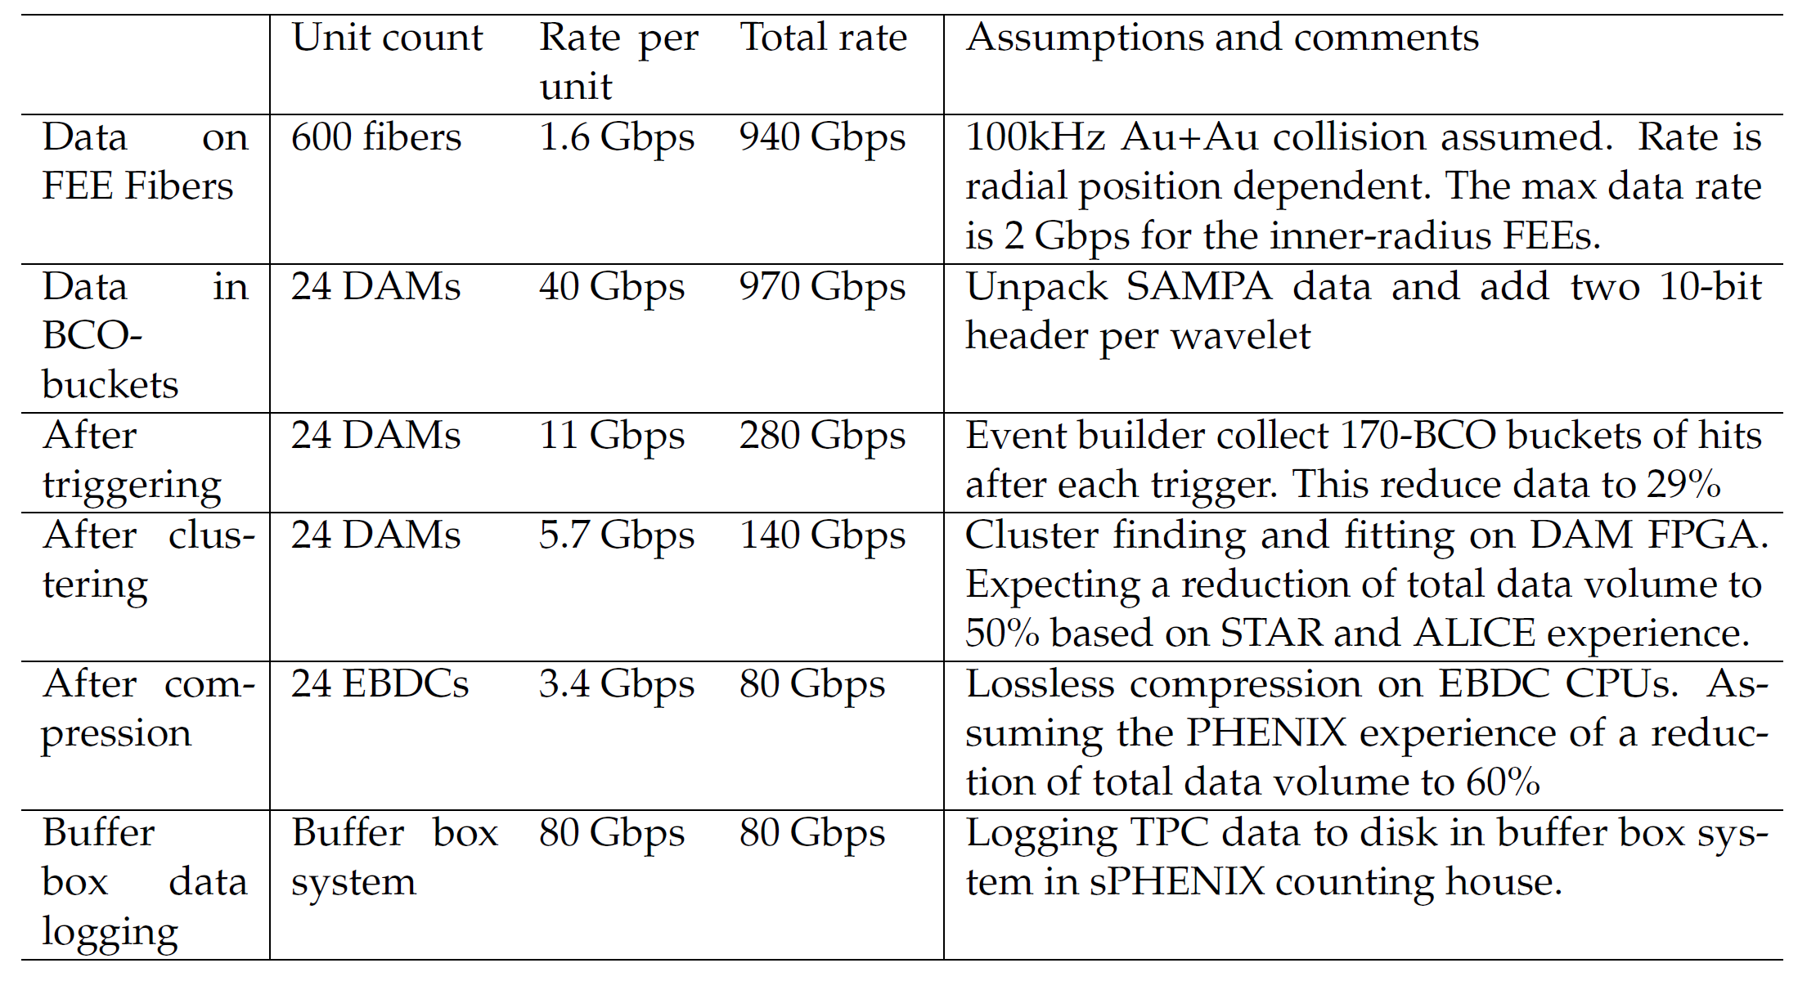
Status and Highlights: Design
For each one of the 24 TPC Sectors,
25 FEEs with 1 SPF+/FEE
12 LC duplex <-> 48F MTP on TPC cage
2x 48F MTP connect TPC cage <-> DAM
Readout by 1 FELIX PCIe Card
Hosted on 1 server
Implementing the design in DAQ test stand

Slide 13
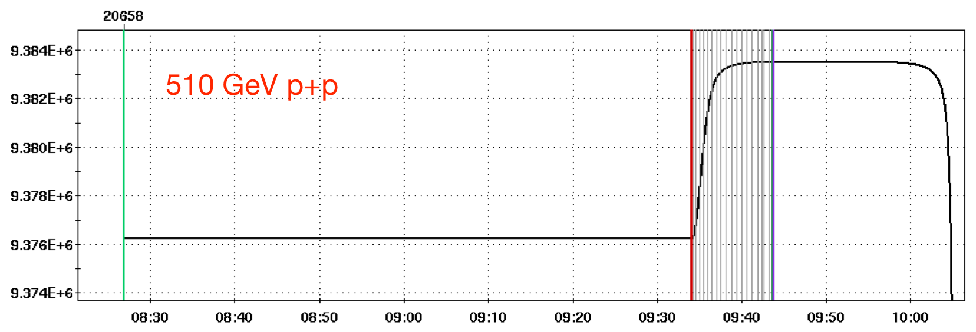
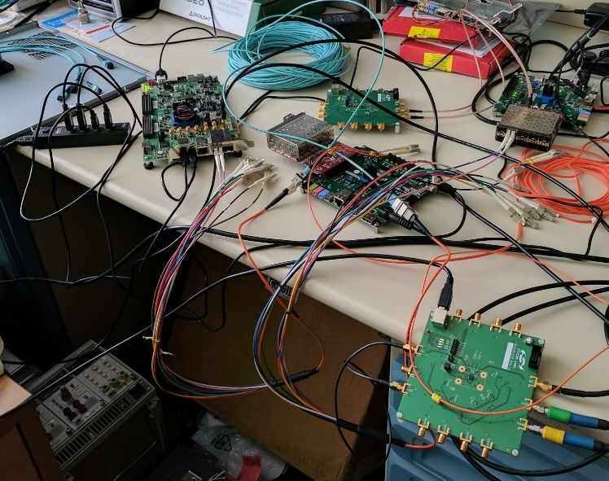
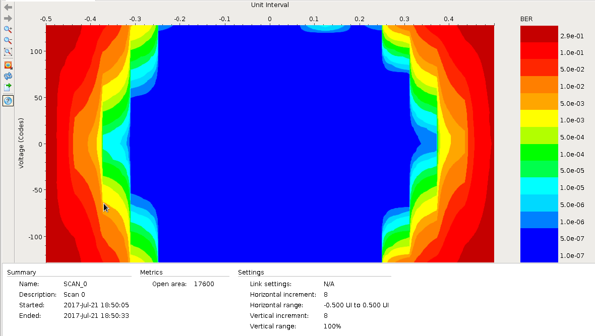
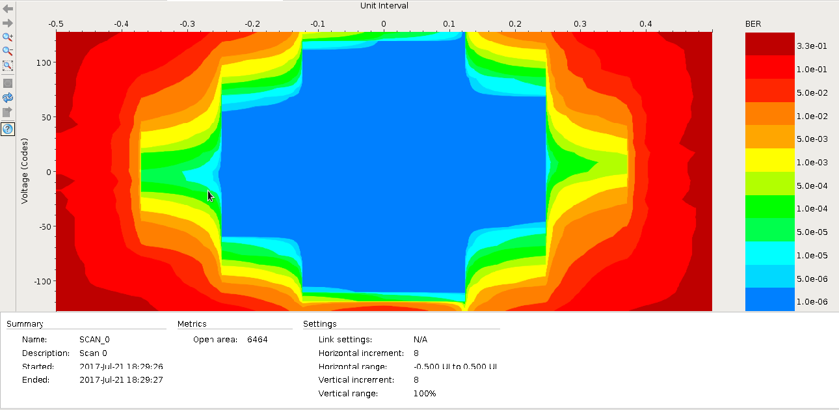
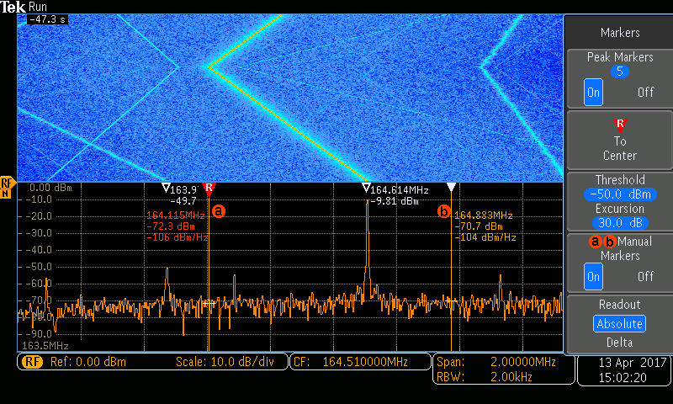
Status and Highlights: Test Stand
RHIC frequency spread (due to ramp) is large, 9.362 MHz ±22 kHz
Function generator mimic repeated RHIC clock ramping (triangle pattern)
DAM/FELIX
Kintex-7 Ultrascale
Downlink: 4.8 Gb/s
Multiples of RHIC clock (9.4 MHz)
Recover clock from 8b/10b
Optical Links
FEE
Atrix-7
Uplink: 4.8 Gb/s, fixed clock
Uplink iBERT @ DAM: 1.46e-13
Downlink iBERT @ FEE: 1. 023e-13
Test recovered “RHIC” clock
Kintex 7 (eval board for now) -> Atrix 7 (eval board)

Slide 14
Summary
Low risk in DAM hardware design: taking advantage of FELIX PCIe card, a DAQ development for ATLAS upgrade at BNL, and commodity computing
Produced the cost and schedule for the TPC DAM (WBS 1.2.6) by bottom-up estimate
Prototype test progress well
Challenges:
  Reach the targeted data reduction factor, including implementing a reliable clustering algorithm in FELIX FPGA
  Integration and system test with TPC FEEs and with sPHENIX DAQ prior to beam

Slide 15
Back Up

Slide 16
Labor profile, TPC 1.2
FTE Profile by Category
FTE Profile by Fiscal Year
Row Labels | FY 17 | FY 18 | FY 19 | FY 20 | FY 21 | FY 22
Cat B | 1.08 | 0.37 | 0.87 | 2.21 | 0.00 | 0.00
Engineering | 0.47 | 0.16 | 0.48 | 1.28 | 0.00 | 0.00
Scientific | 0.07 | 0.01 | 0.02 | 0.04 | 0.00 | 0.00
Technical | 0.54 | 0.20 | 0.37 | 0.89 | 0.00 | 0.00
Contributed | 1.51 | 1.65 | 3.78 | 18.92 | 0.79 | 0.00
Engineering | 0.00 | 0.27 | 0.36 | 0.00 | 0.00 | 0.00
Scientific | 0.59 | 0.39 | 1.09 | 2.63 | 0.08 | 0.00
Student | 0.92 | 0.99 | 2.33 | 13.56 | 0.70 | 0.00
Technical | 0.00 | 0.00 | 0.00 | 2.73 | 0.00 | 0.00
Grand Total | 2.59 | 2.02 | 4.65 | 21.12 | 0.79 | 0.00
This is sum manpower for all TPC 1.2 scopes.

Slide 17
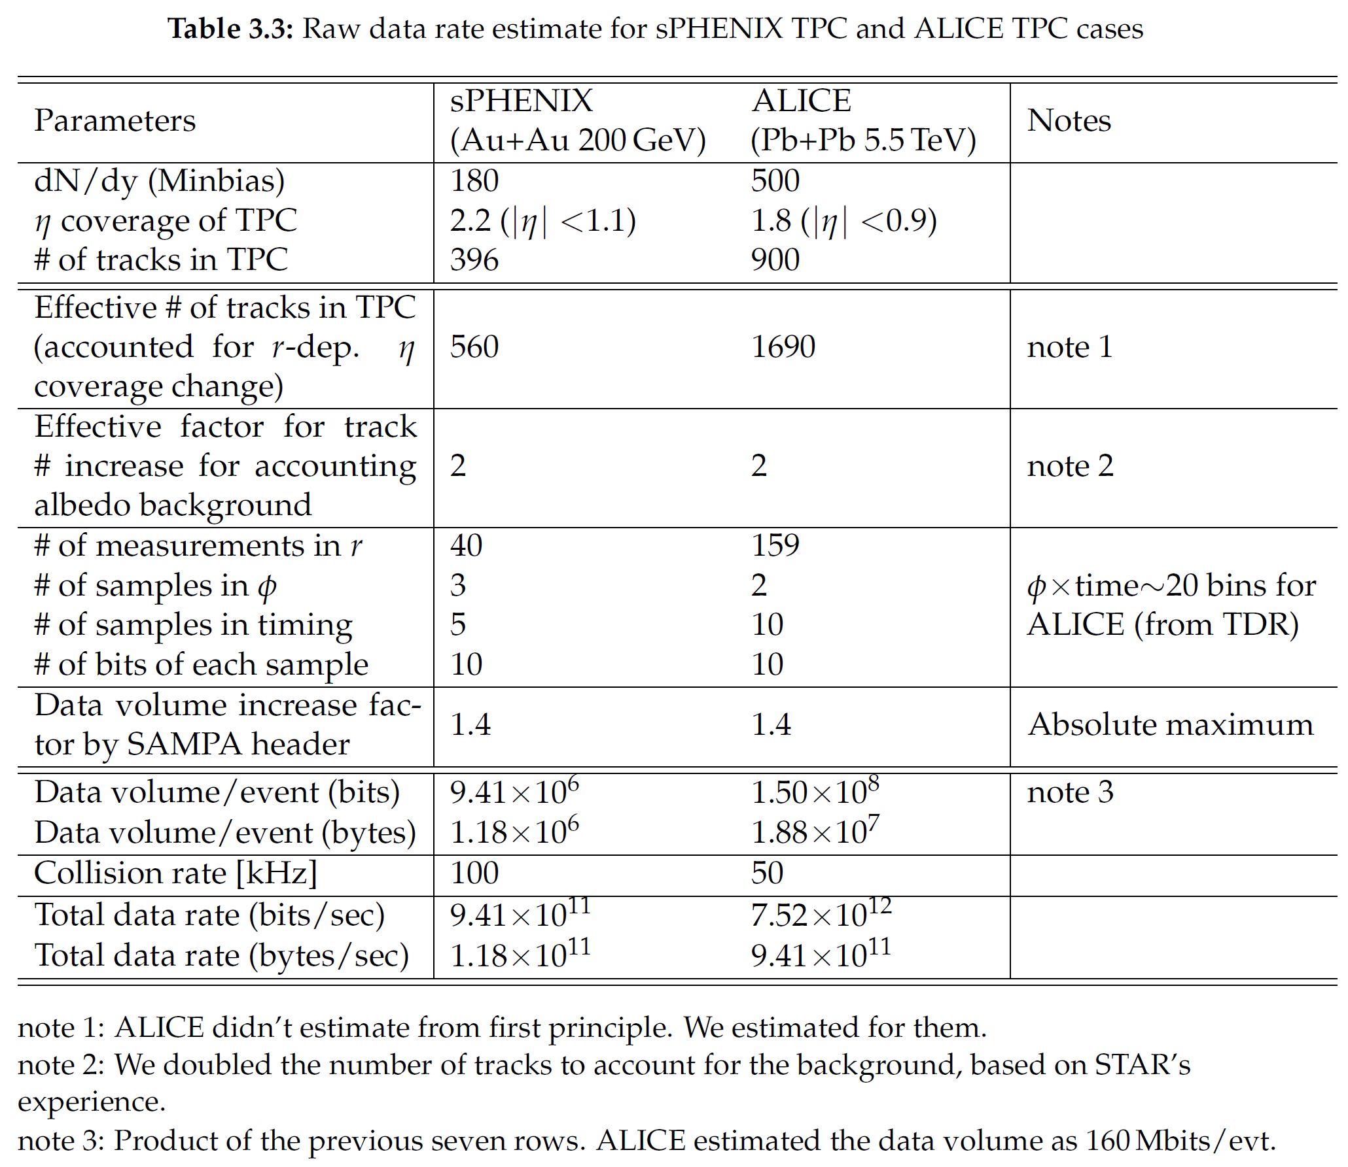
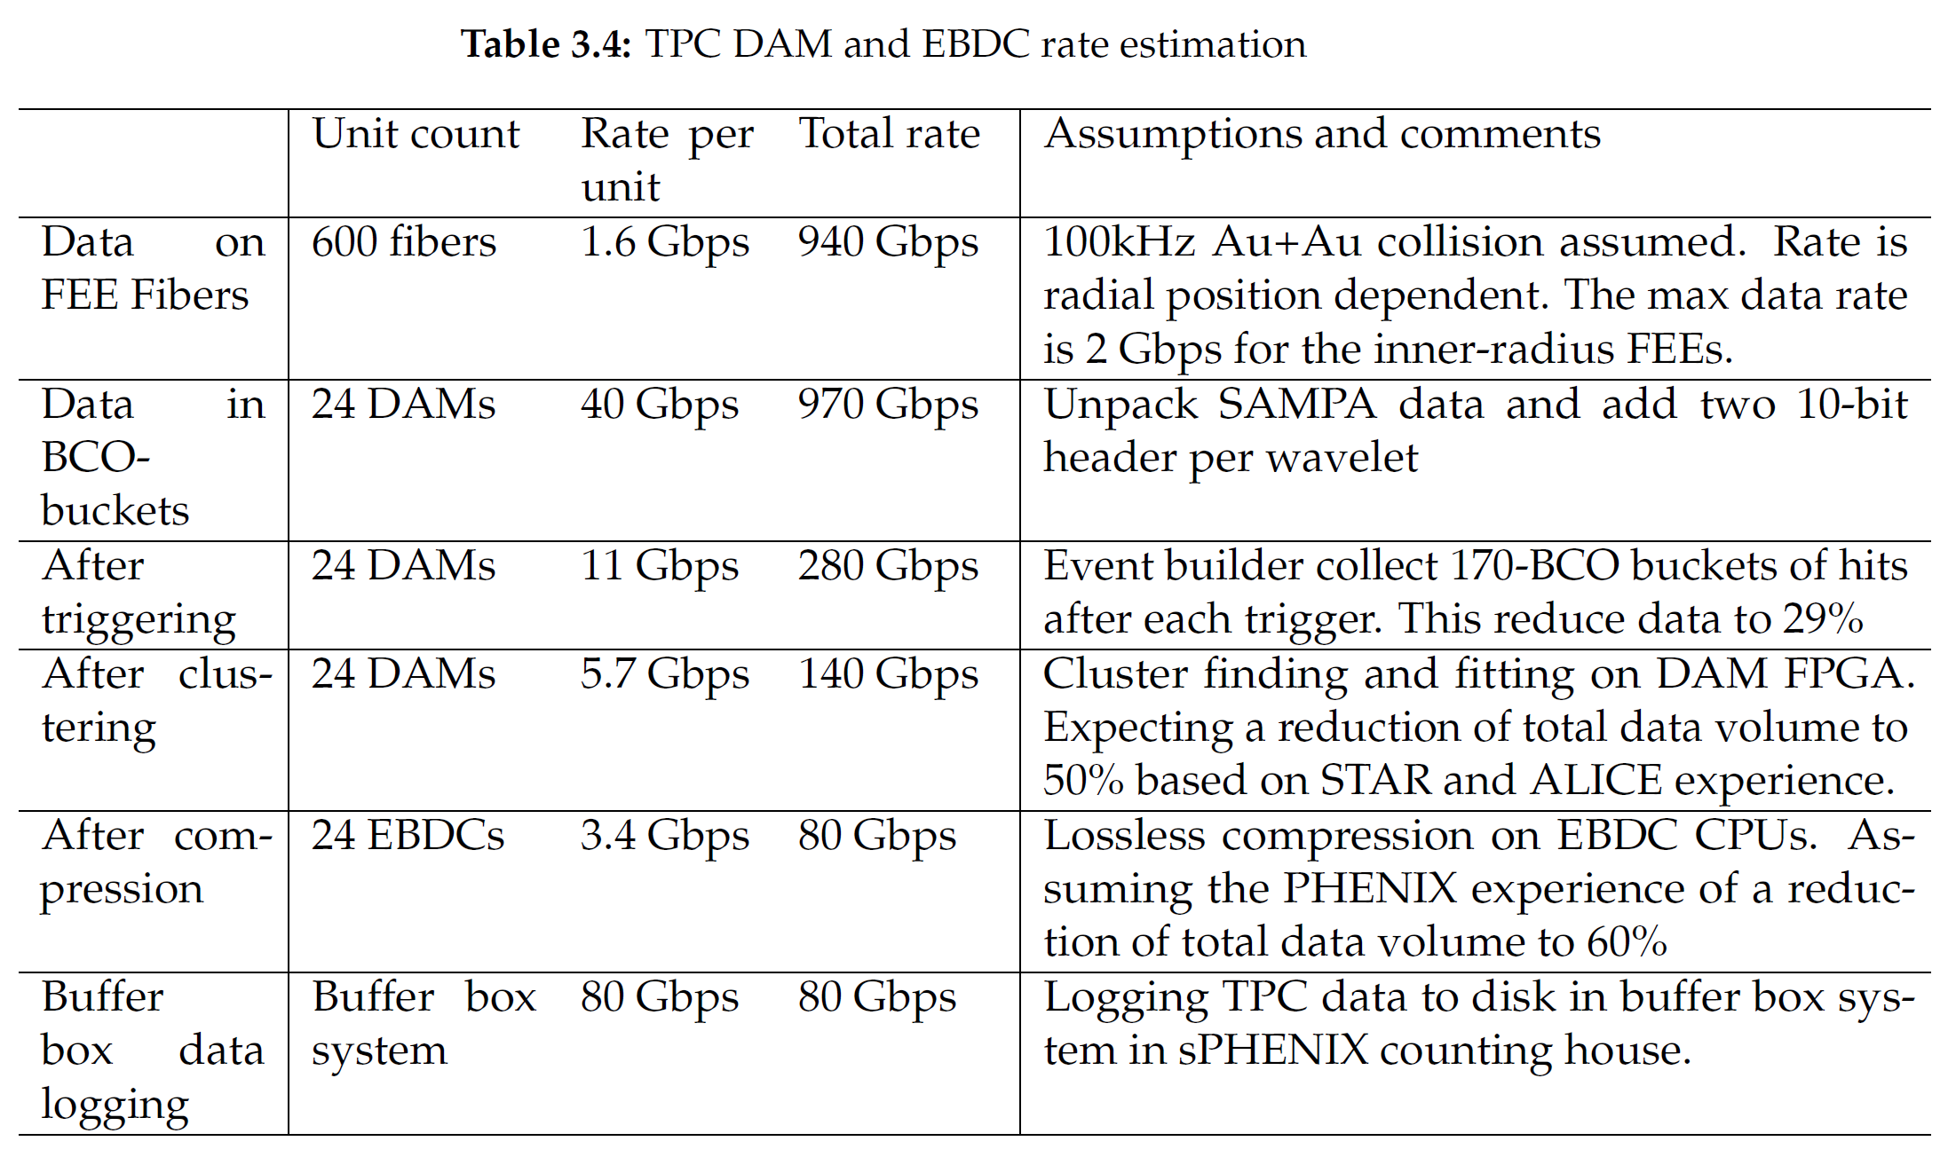
Rate estimation

Slide 18
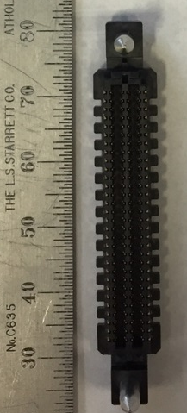
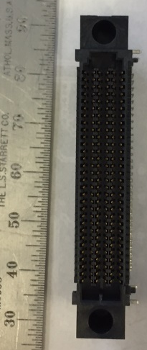
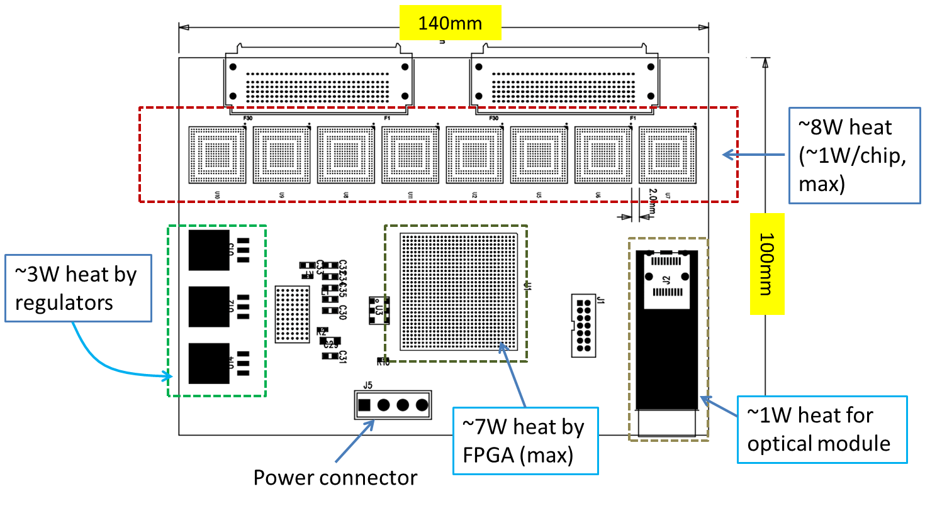
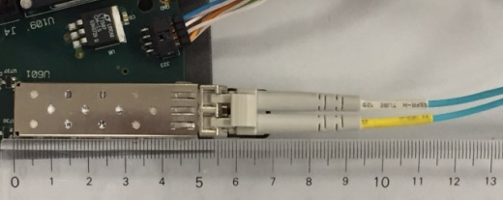
Status and Highlights (II)
Design of full-scale prototype is in progress.
Full-scale prototype design will be passed to board routing as soon as we finished evaluating basic features of SAMPA with small-scale prototype
Selecting of peripheral parts are almost done.
Signal connectors
Padplane side
FEE side

Slide 19
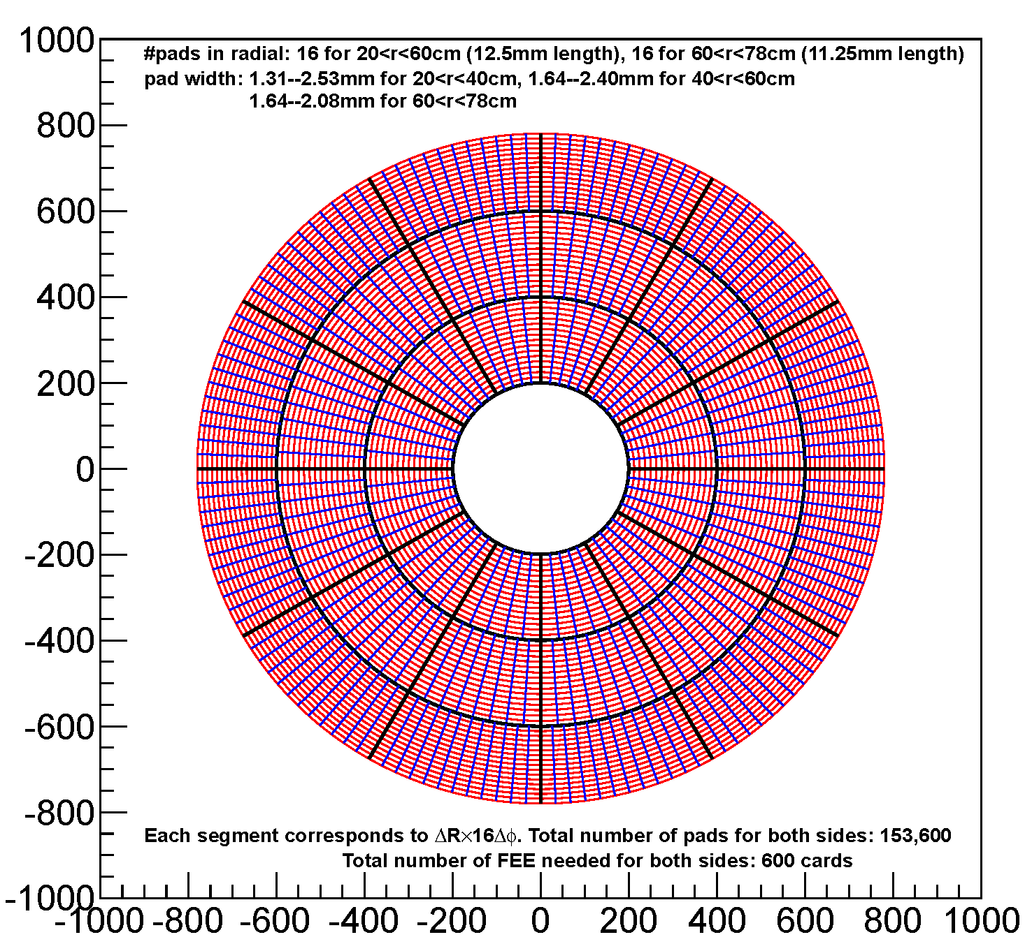
Padplane layout
New pad layout (30<r<78cm)
  Three segments in radial direction, each divided into 16 (8 for 30<r<40cm)
  12 segments in phi direction, each divided into multiple of 16
  Matching to number of input to a FEE
  Each cell in the right figure corresponds to 16 pads in phi
Variable pad size as a function of radial position
Total 153,600 pads for both side
  600 FEE cards
Data Rate (no header included)
  1.42Gbps/board for 30<r<40cm
  1.45Gbps/board for 40<r<60cm
  0.77Gbps/board for 60<r<80cm
  → 28Gbps/(1/12 full azimuth)
5 FEEs for 30<r<40cm, 8 for 40<r<60cm, 12 for 60<r<78cm, for each 1/12 of full azimuth
Each cell = 16pads in phi

Slide 20
Data rate calculation
Raw data (100% duty factor is assumed)
  Sampling rate in z-direction: 10MHz (= 100nsec)
  Pulse peaking time is 160nsec (fixed from SAMPA’s specification), which leads to ~350nsec for whole pulse shape.
    More than 4 samples in timing (z) direction is necessary. We decided on taking 5 samples including pre-signal
  One cluster will be spread over 3 pads in r-φ plane
    Coming from the characteristics of the Ne2K (Ne - CF₄ - iC₄H₁₀: 95% - 3% - 2%) gas
  We measure 40 clusters for one track
  Each sample is 10 bits: 40 clusters * 15 * 10 bits = 6 Kbits/track
  800 tracks per event: 6Kbits/track * 800 = 4.8 Mbits/event
    This number doesn’t take eta-dependent acceptance change of TPC into account
  At 100 KHz: 4.8 Mbits/event * 100 KHz = 480 Gbits/s
With header of SAMPA (40% increase at maximum): 670Gbits/s
  With eta-dependent acceptance change: 940Gbits/s

Slide 21
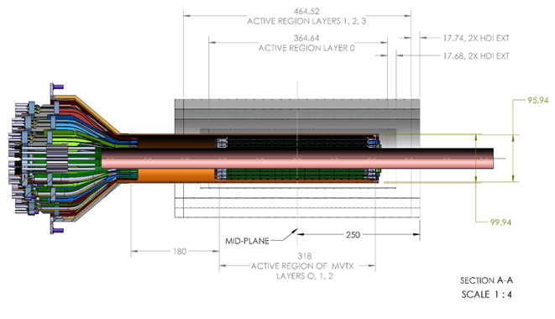
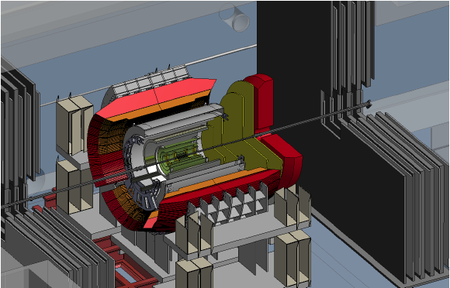
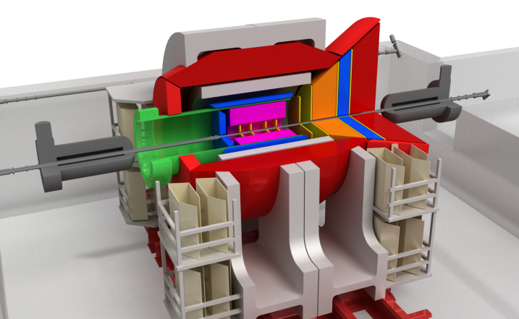
Advanced DAQ for RHIC and eRHIC
MAPS upgrade (proposed)
sPHENIX
Forward upgrade (LOI)
eRHIC detectors (ePHENIX, BeAST, ...)
Deliver to FEEs:
Timing with
10-500 MHz
beam clock,
Slow control,
O(1000) links
Data downlinks:
O(100k) ADC channels
@ 10-100 MHz
O(100M) Pixels channels
O(100 Tbps) from FEE
before reduction
O(100 Gbps) to disk
after FPGA+CPU reduction
Advanced DAQ for RHIC and eRHIC
Trigger-less, O(1000) 10-Gbps bi-directional links, FPGA-based data reduction, Connect customized FEE to commodity computing
RHIC/eRHIC Timing
Online Farm
Data Storage

Slide 22
ATLAS/FELIX BNL-711 PCIe Card
Credit: Kai Chen (BNL), https://indico.bnl.gov/conferenceDisplay.py?confId=2653
BNL-711 Board chosen for ATLAS FELIX project, and used in ATLAS phase I upgrade, which is projected to complete before sPHENIX.
Readout for ATLAS Phase-I sub-system of Liquid Argon Calorimeter, Level-1 calorimeter trigger, New small wheel of the muon spectrometer

Slide 23
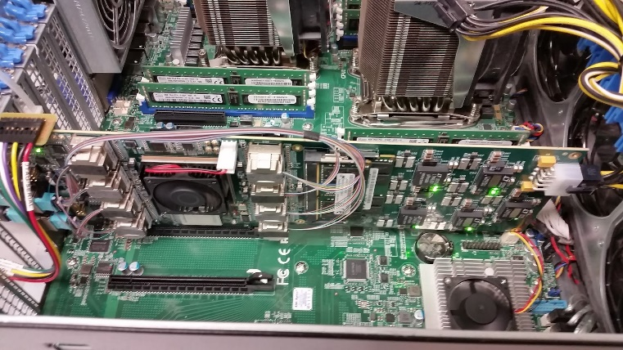
ATLAS/FELIX Card for sPHENIX?
Credit: Kai Chen (BNL), https://indico.bnl.gov/conferenceDisplay.py?confId=2653
Main features for FELIX PCIe Card
  Design: BNL/Omega group, Layout: BNL/Instrumentation, Goal: multiple users.
  A large Kintex Ultrascale FPGA, 1.5 M Logical Cells
  ( 24x Logical Cells of FVTX FEM card )
  48 bi-directional GBT link via two 48-F MTP connectors
  PCIex16 Gen3, 101 Gbps demonstrated
  2x DDR4 memory slots (v1.0, v1.5), removed v2.0
  TTC-timing input (v1.0, v1.5), timing mezzanine card (v2.0)
Timeline and availability:
  Current version: v1.5 prototype, can be ordered now
  Next version: v2.0 pre-production, design completed, layout on-going, expect available Oct 2017
  FELIX production system delivery expected end 2018 for ATLAS Phase-I upgrade. ATLAS needing 100+ card with various flavor of firmware depending on subsystem configurations.
BNL/Omega group, Local expert expressed willing for help us to adapt FELIX in sPHENIX
  Boards for initial evaluation test
  Support firmware software development, timing mezzanine card design
  The team is also help in possible use of FELIX card in proto-Dune.
  The FELIX team is open for inputs in guiding the design to be more generic to various users.
FELIX v1.5 Card in test stand

Slide 24
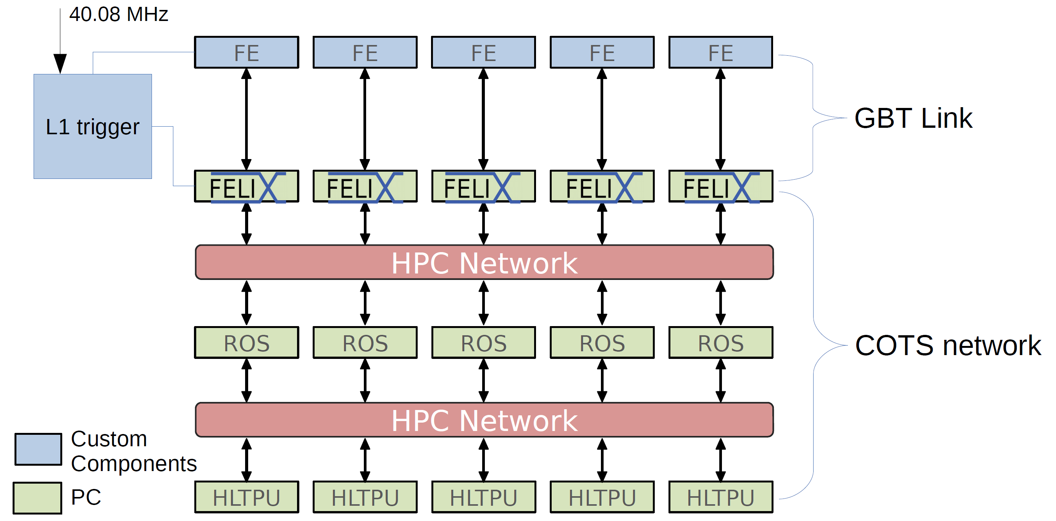
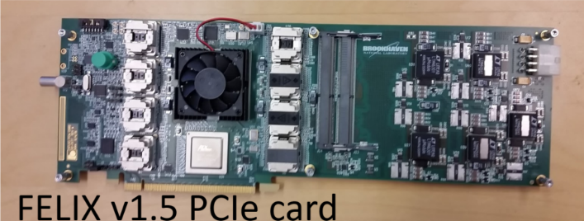
FELIX
ATLAS DAQ structure for mid-2020s:
Front-End Link eXchange (FELIX)
BNL/ATLAS group is finalizing FELIX PCIe card for ATLAS DAQ upgrades for 2020s. Significant DAQ hardware R&D @ HEP..
Using high performance large-FPGA optical link card
to bridge custom FEE and commodity computing
Besides ATLAS, similar architecture also proposed
for ALICE and LHCb upgrades

Slide 25
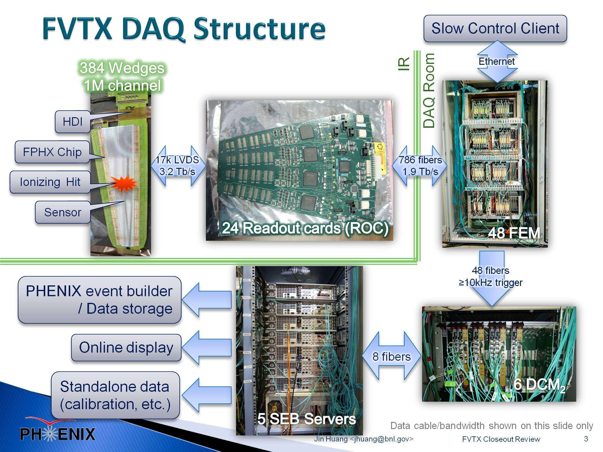

Comparing to current RHIC trigger-less DAQ
2020s
2x (FELIX Card on commodity server)
FVTX detector @ PHENIX carries one of most advanced DAQ @ RHIC, successful upgrade in 2012, continuous readout & triggering capability
FELIX would reduce the five crates of custom DAQ electronics to just two FELIX PCIe cards in terms of FPGA resource and data process rate

Slide 26
Schedule
Not on the critical path for TPC (1.2)
Prior to CD-2:
Schedule driven by FPGA and DAQ firmware software development
Scheduling risk for FELIX card production is low:
  Already received v1.5 prototype card for the prototyping stage, 1.2.6.1
  Well into final prototyping stage, producing pre-production card as speaking
  Planned for production of ATLAS Phase-I upgrade (delivery end 2018)
Scheduling risk for EBDC server production is low:
  Commodity computing
  Procurement scheduled at the latest stage of the production to take advantage of commercial computing development

Slide 27
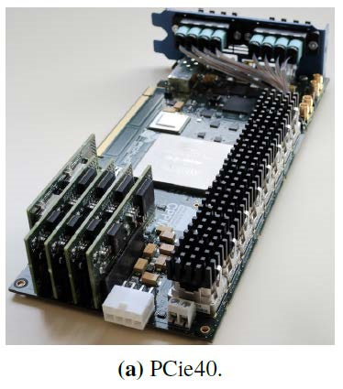
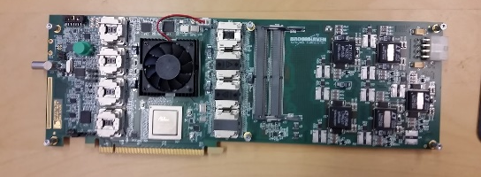
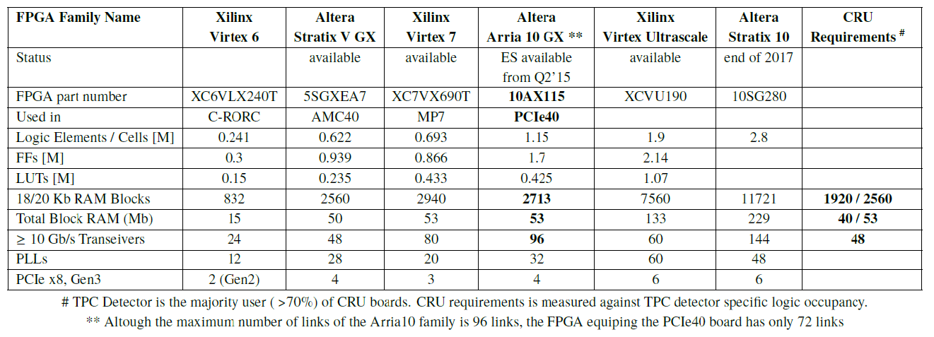
FPGA Choices
CRU/
PCIe40
FELIX
Xlinux Kintex Ultrascale
Available
XCKU115
BNL 711, FELIX v1.5 prototype
1.451
1.3
0.66
4320
75.9
(48 input + 48 output fiber links in FELIX)
48
6
ATLAS group estimated 48x GBP unpacking
and PCIe output use ~20% FELIX Resource

Slide 28
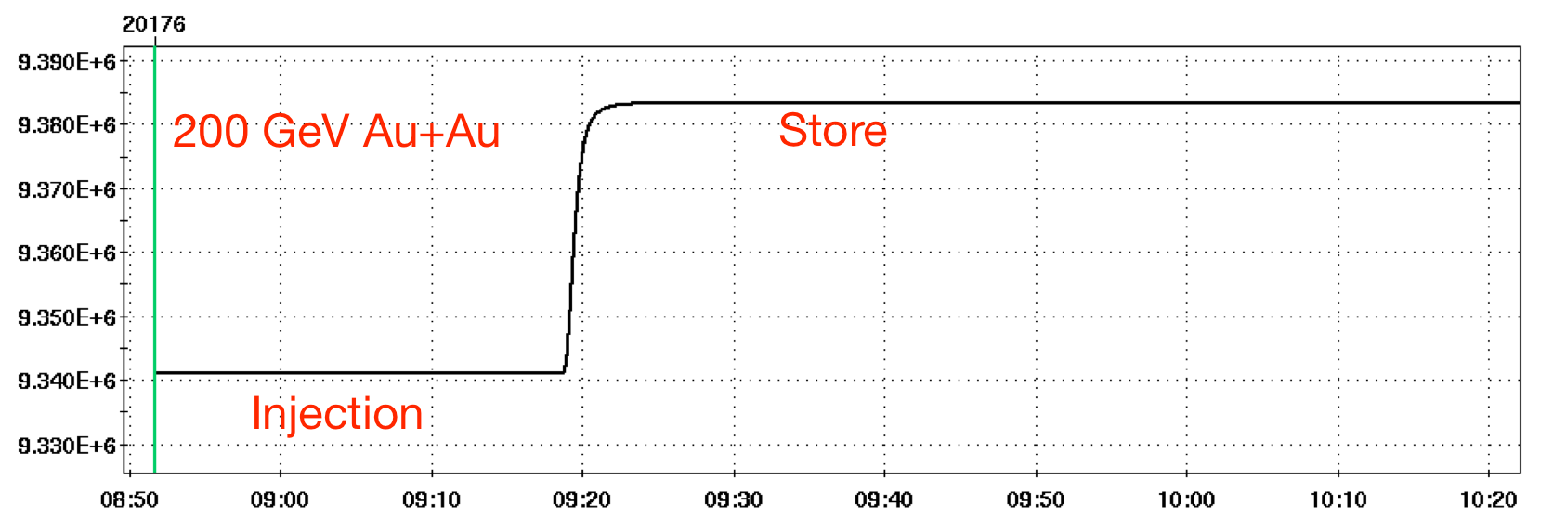
Kintex -> Atrix SFP+ fiber links with RHIC clock delivery
One of the feature of the design is to use FELIX distribution slow control and RHIC clock to 25x FEE.
Use RHIC clock (~9.4 MHz) as base frequency. Multiply x14 as fiber clock + slow control data in via 8b/10b encoder
Recover RHIC clock on FEE, and slow control data via 8b/10b decoder
John Kuczewski (BNL, instrumentation): tested with expected RHIC clock frequency spread (due to ramp). Excellent error rate
Special requirement: RHIC frequency spread due to ramp, 9.362 MHz ±22 kHz
DAM/FELIX
Kintex
Downlink: ~3.2 Gb/s
Multiple of RHIC clock
Recover clock from 8b/10b
FEE
Atrix
Optical Links
Uplink: fixed 3.2 Gb/s

Slide 29
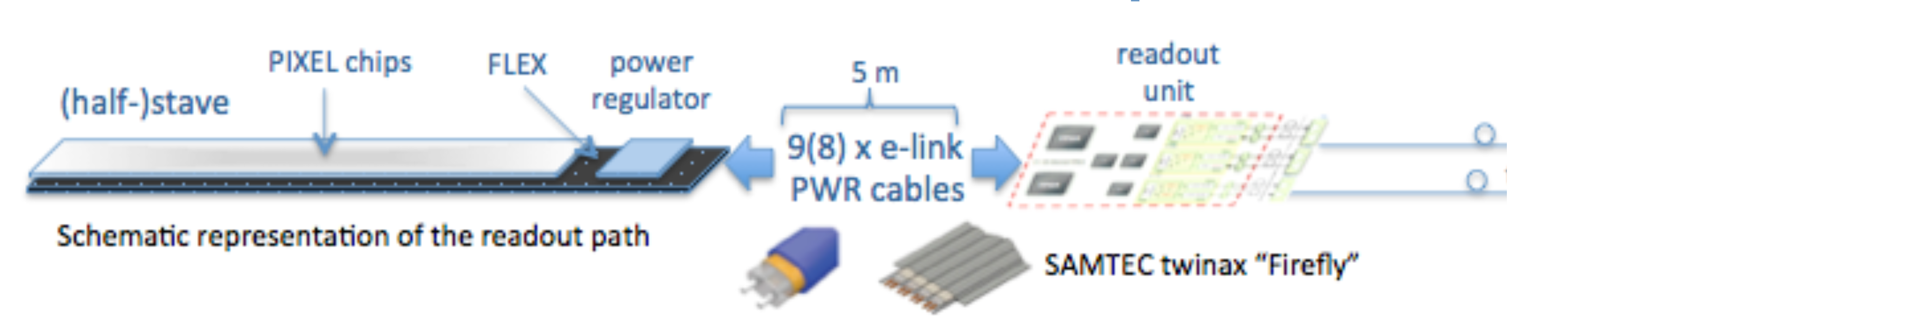
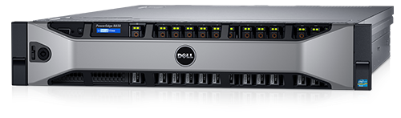
TPC Outlook and possible use in MAPS
The TPC group acquired v1.5 FELIX PCIe card to setup a test stand and evaluate DAQ feasibility. Plan to switch to pre-production cards end 2017. Meanwhile, we would also want to learn to CRU, prior to final decision on the readout cards.
After Ming’s request, a v1.5 FELIX PCIe card has been manufactured for MVTX.
It makes sense to try pursuing the same system for MAPS+TPC readout, and share production batch, DAQ expertise and effort in timing distribution, card/server pool, event-building software development
GBT Data link
Trigger/Clock

