Slide 1
SiPM Characterization
Henry Bilton

Slide 2
Summary
Expose the SiPM to 0-8 photons and measure the output voltage. Putting the voltages on a histogram yields several spikes for integer photons
By fitting the curve with exponentially modified normal distributions, we can determine the single photon response.
By doing this for for several input voltages, we can fully characterize the SiPM

Slide 3
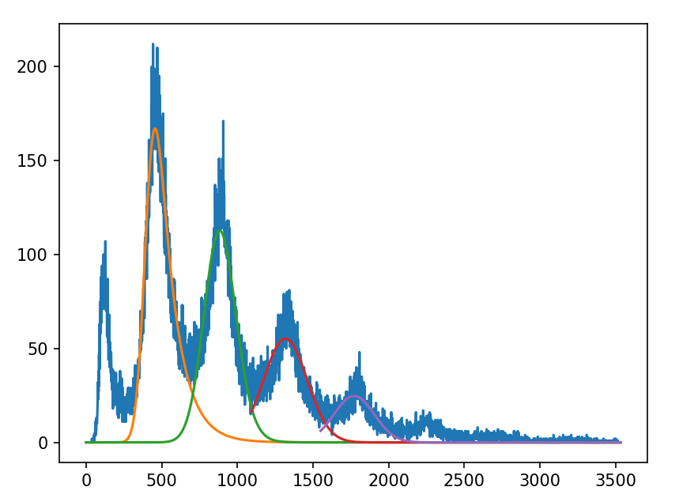
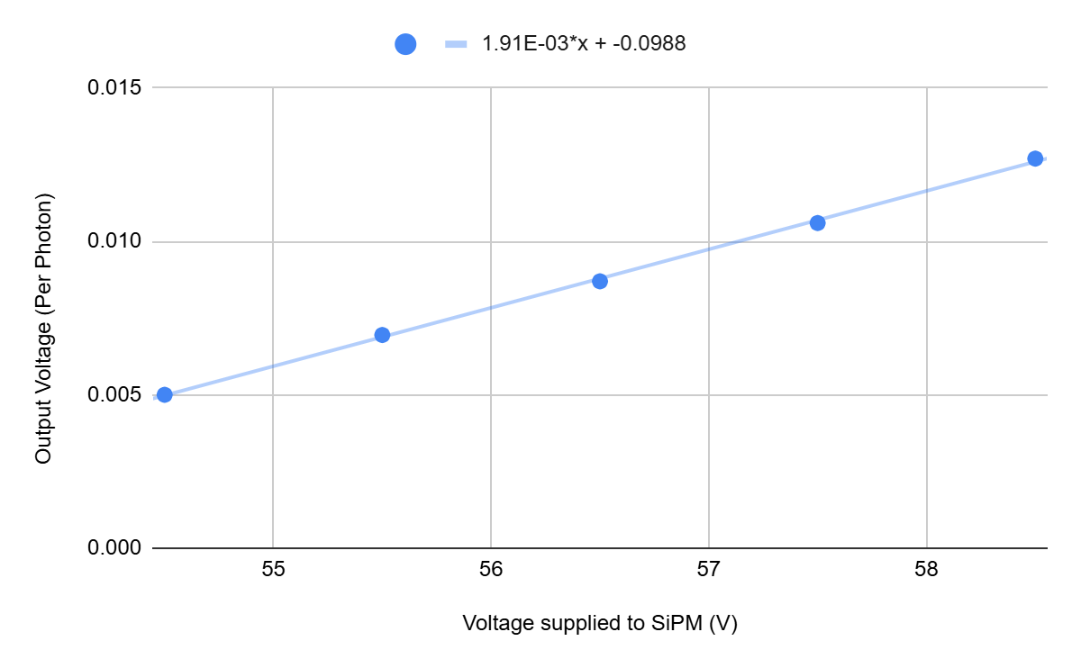
540 SiPM
From above we can determine the breakdown voltage is 51.9V
Curve fitting for 540 SiPM at 55.5 volts

Slide 4
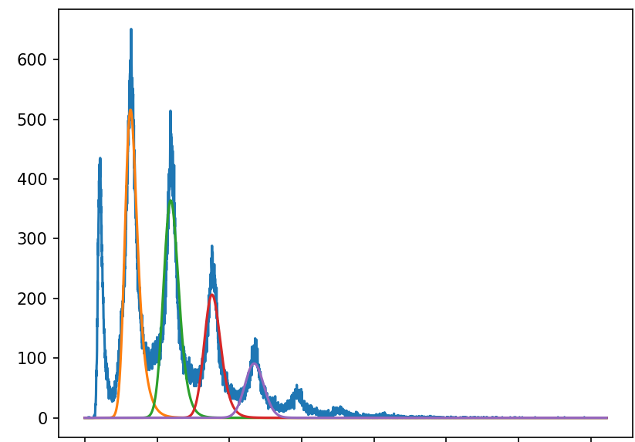
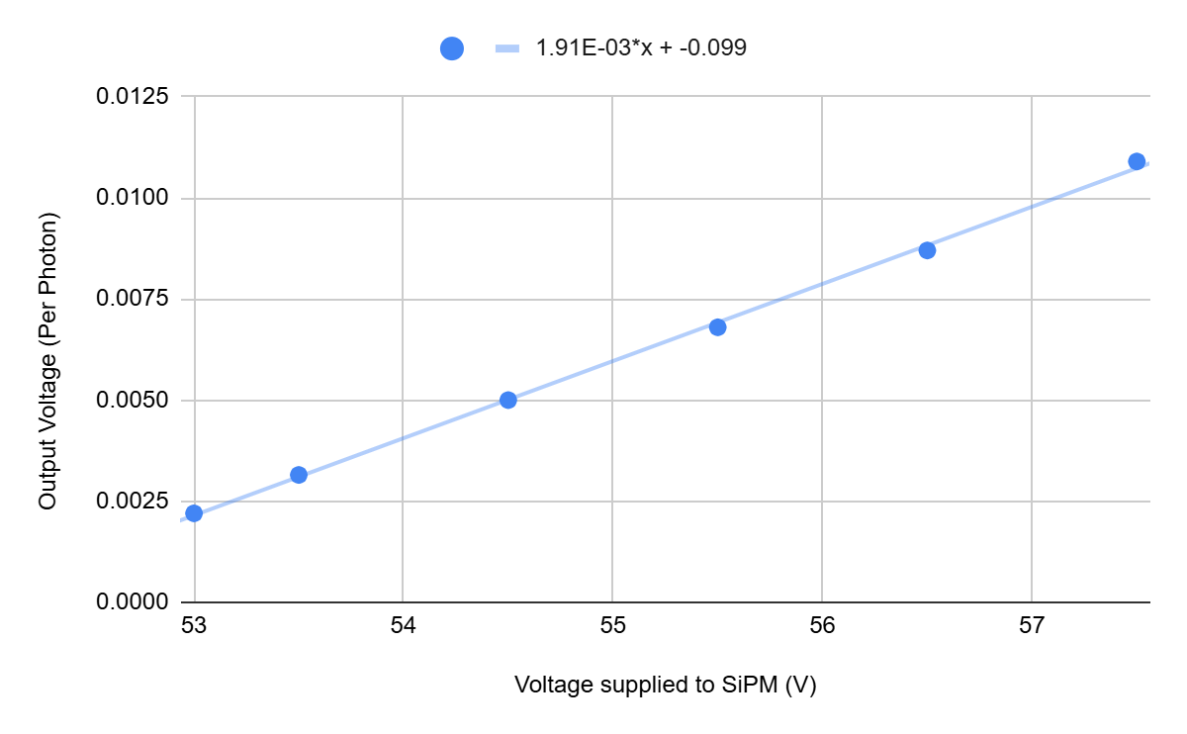
541 SiPM
The breakdown voltage for this one is also 51.9 V
Curve fitting for 541 at 55.5 V

Slide 5
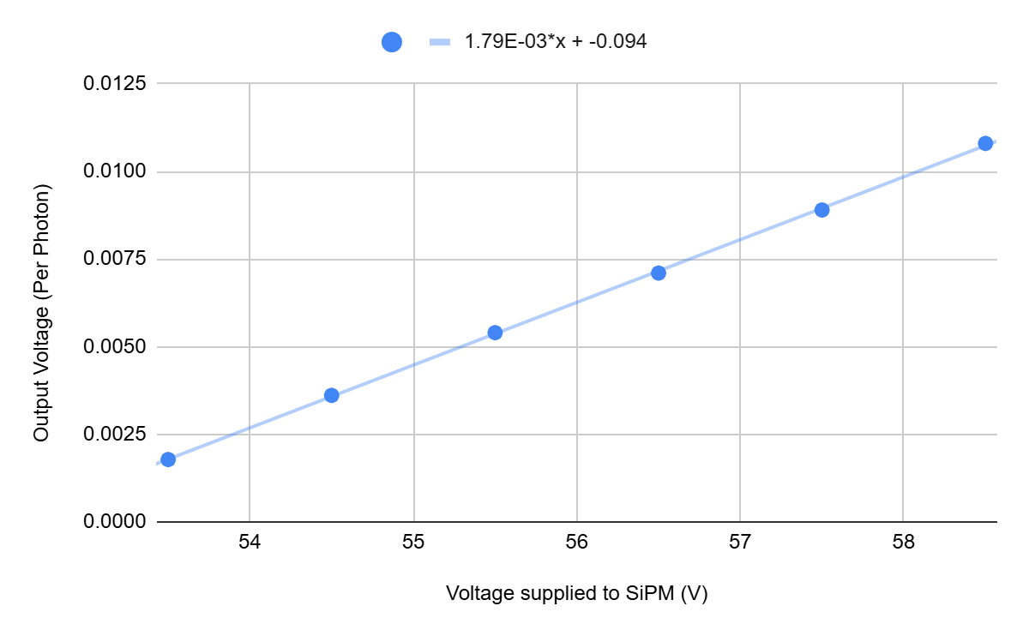
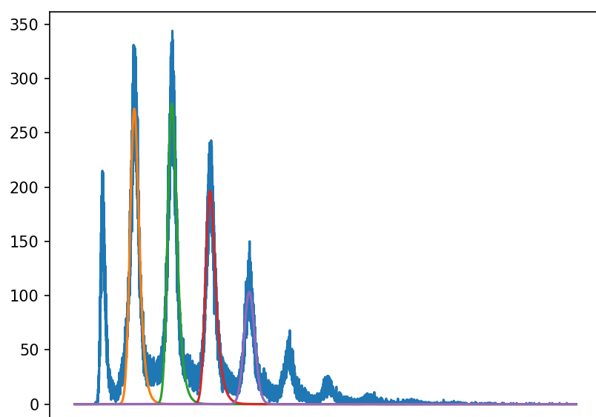
546 SiPM
The breakdown voltage for this one is significantly higher at 52.5 V
Curve Fitting for 546 at 55.5 V

Slide 6
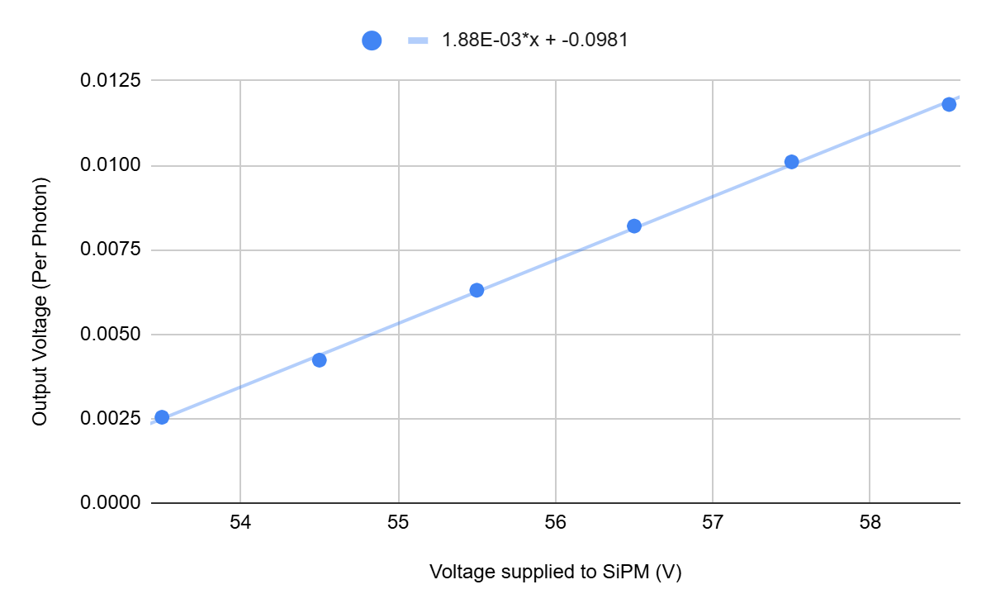
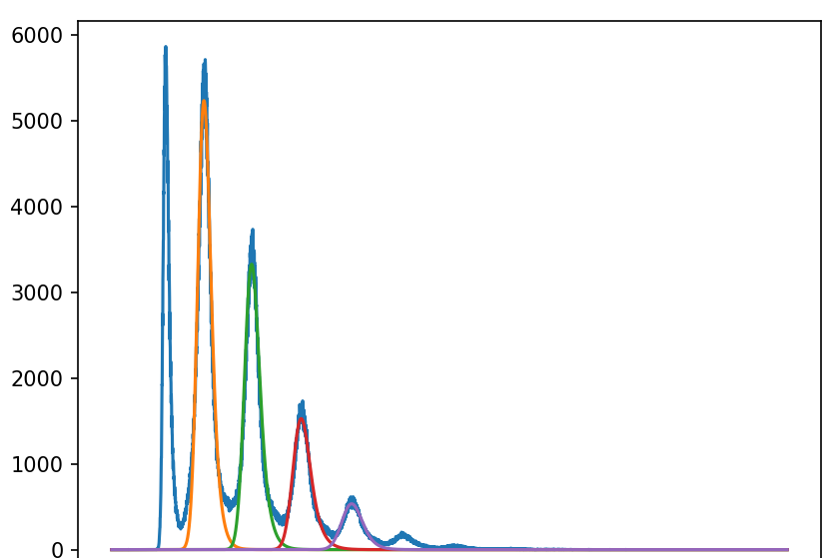
547 SiPM
The breakdown voltage for this one is in between at 52.2 volts
Curve Fitting for 547 at 55.5 V

Slide 7
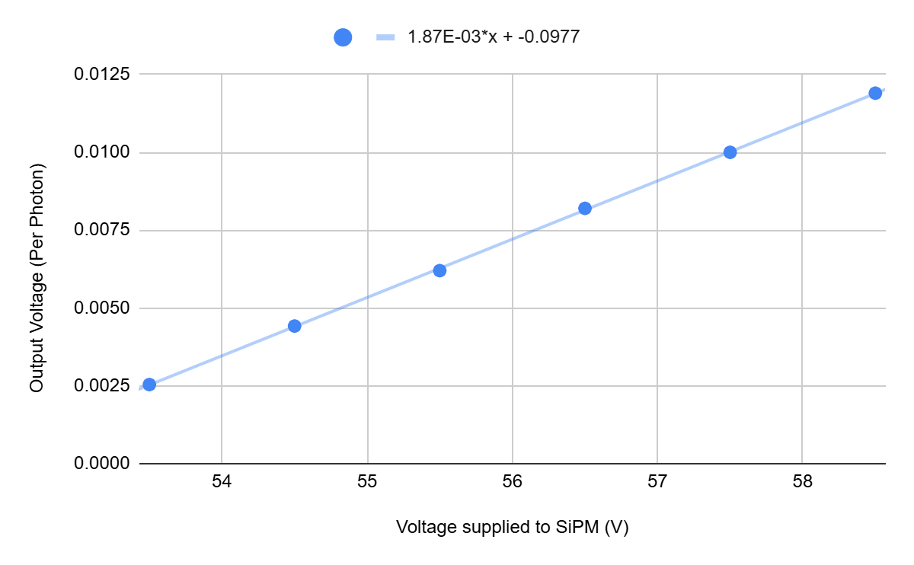
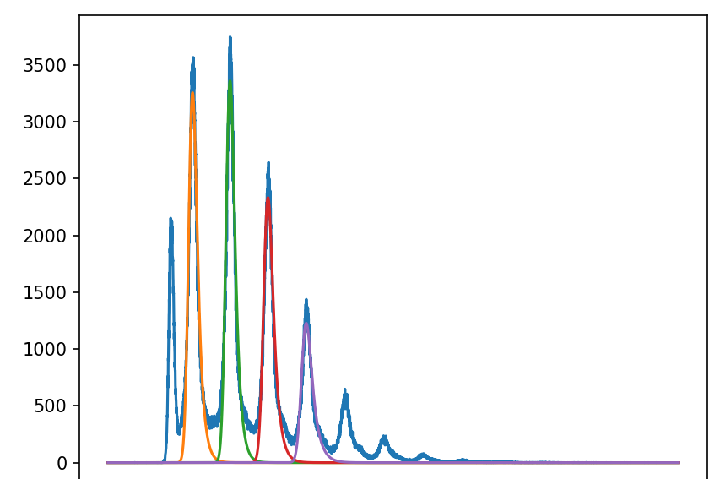
548 SiPM
The breakdown voltage for this one is in between at 52.2 volts
Curve Fitting for 546 at 55.5 V

Slide 8
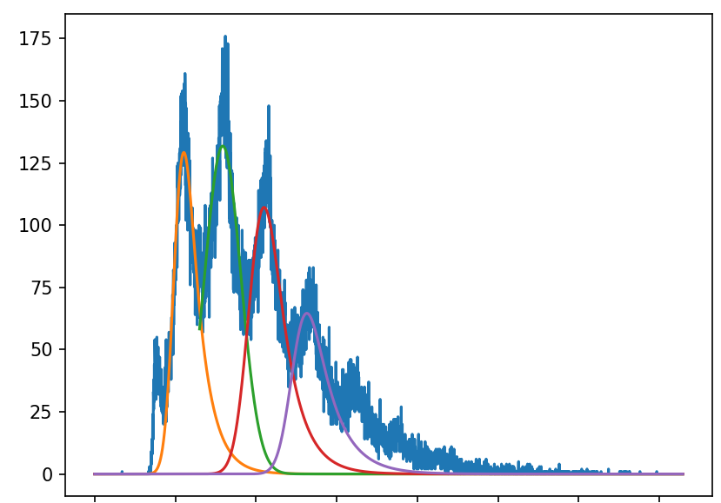
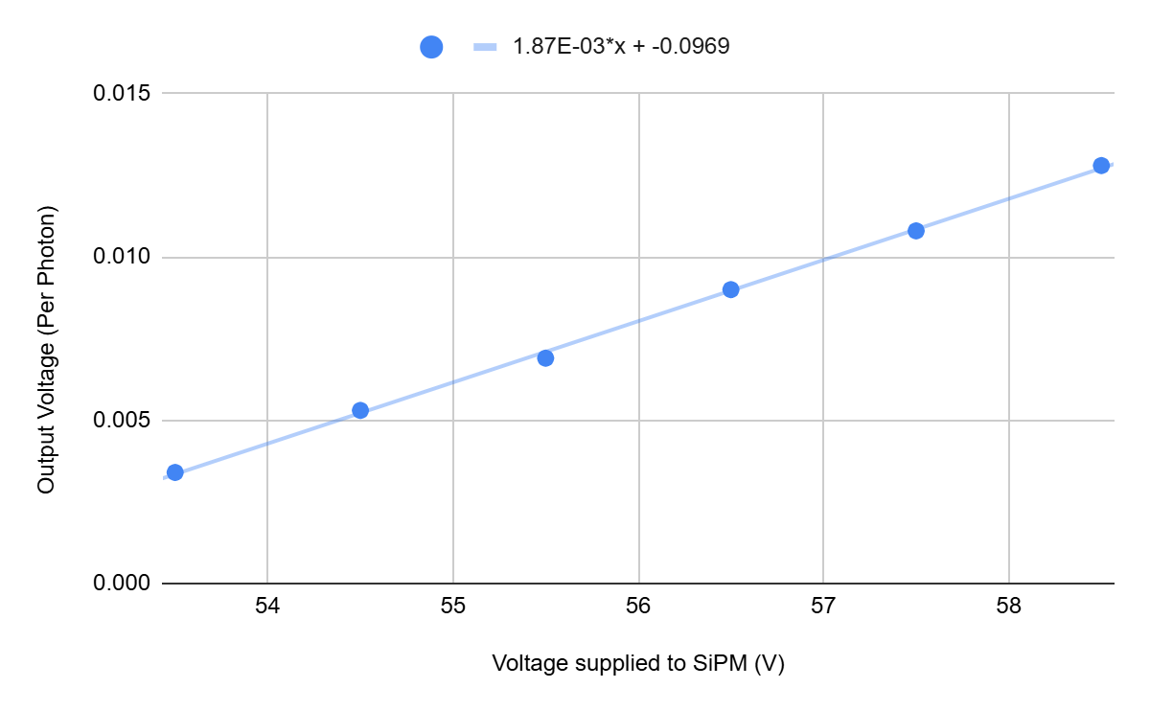
535 SiPM
The 535 has a breakdown voltage of 51.7 volts
This SiPM is much noisier than all previous SiPMs

Slide 9
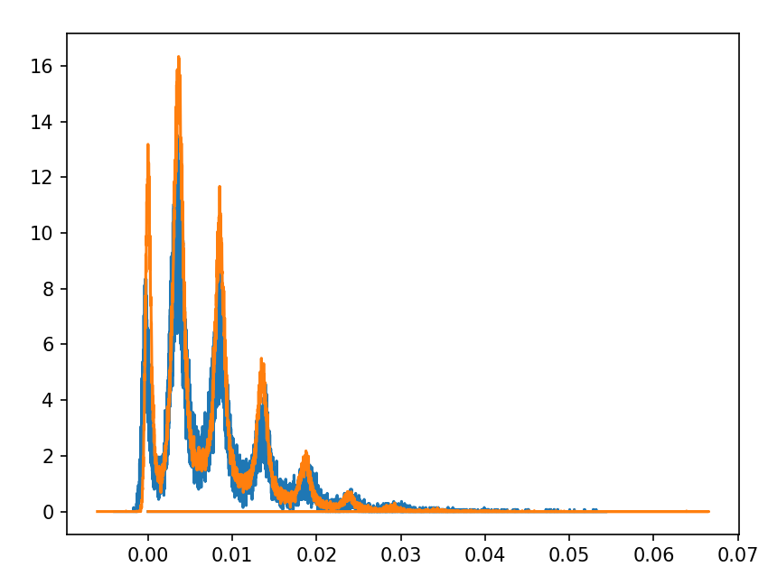
Comparing 540 and 541 SiPMs
541 has slightly tighter peaks, indicating less noise and better resolution
Other SiPMs cannot be directly compared since they have different gains.
Orange: 541, Blue: 540

Slide 10
Conclusion
Best: 546, 547, 548
Adequate: 540, 541
Subpar: 535, 536

Slide 11
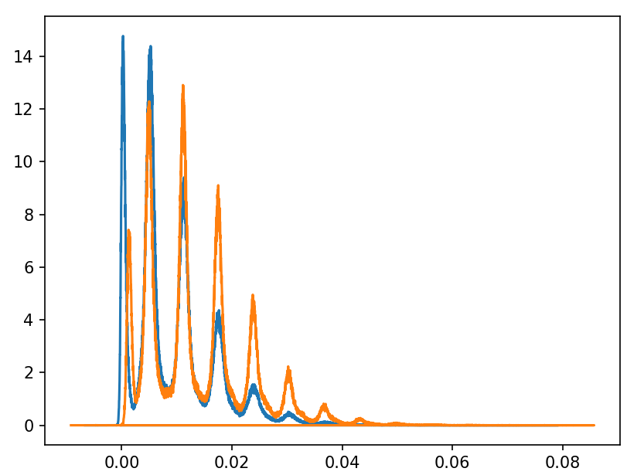
Comparing 547 and 548 SiPMs
Both curves have similar resolution and steepness.
The differences are likely due to differences in setup geometry.
Orange: 548, Blue: 547

