Slide 1


NMSU Collaboration Membership Application
David Ruth
Burcu Duran
Michael Paolone
ePIC Collaboration Council Meeting
5/29/2026

Slide 2
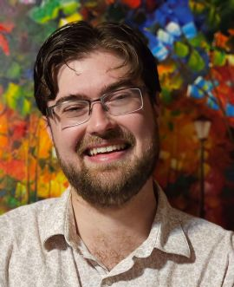
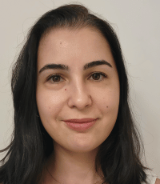
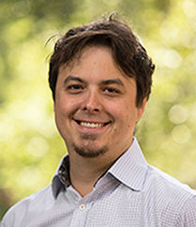

New Mexico State University Experimental Nuclear Physics Group
3 Tenure-Track Faculty
8 Graduate Students
1 Postdoctoral Associate
David Ruth
Assistant Professor
Burcu Duran
Assistant Professor
Michael Paolone
Associate Professor
Current Focus: Medium Energy Nuclear Physics at
Departmental Theory Support from 3 Theory Faculty (R. Sufian,
M. Sievert, M. Engelhardt)
D. Ruth has some past and current ePIC involvement (Barrel HCal WG,
Far Forward WG)

Slide 3
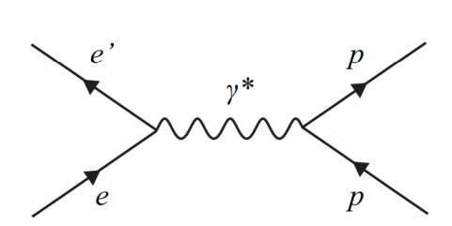
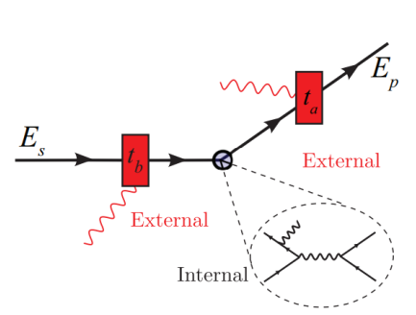
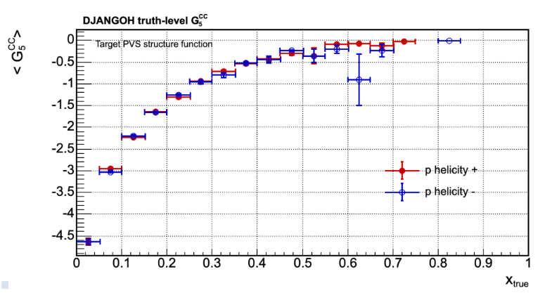
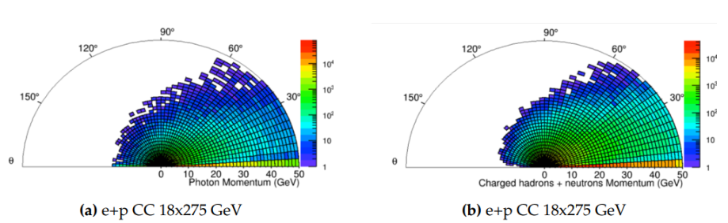
Spin Structure Function Studies with ePIC
Internal/external Born Level radiative corrections
D. Ruth primary interest: spin-dependent structure of nucleons (g₁ and g₂ SSF at Jlab)
Want to work with Inclusive DIS WG to extend to EIC!
Systematics study and radiative corrections
Parity violating structure functions g₃, g₄, g₅: Never measured, available in EIC w/ Charged Current DIS
Need impact study on g_{3,4,5} in anticipation of a world first measurement!!
Unique potential for quark flavor separation
Impact study underway (C. Paudel, D. Ruth)
Churamani Paudel – NMSU Postdoc
Preliminary
EIC Yellow Report

Slide 4
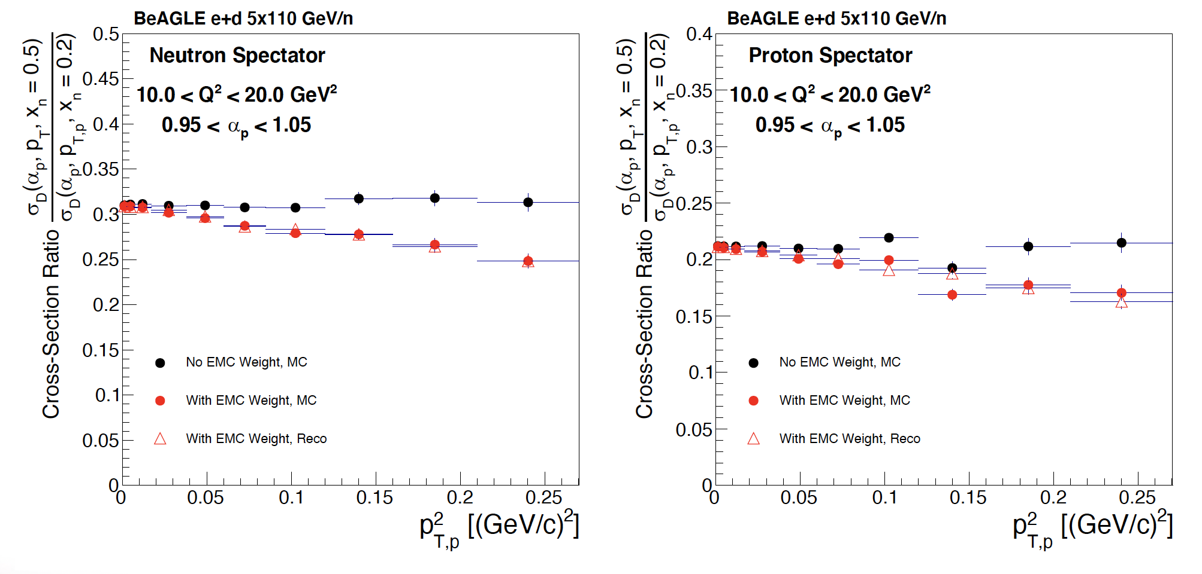
The EMC Effect at the EIC via Tagged DIS
Measure deuteron reduced cross section inside and outside the EMC effect region
Ratio allows direct comparison of the xsec with and without the EMC effect
Establish the required luminosity
Needs to be redone with the updated simulation framework
FSIs expected to dominate at these kinematics – important to separate them from initial
modifications!
Study done by Alex Jentsch et al
(https://indico.cern.ch/event/1199314/contributions/5216823/attachments/2620644/4531026/tagged_dis_EIC_DIS_2023_v2.pdf)

Slide 5
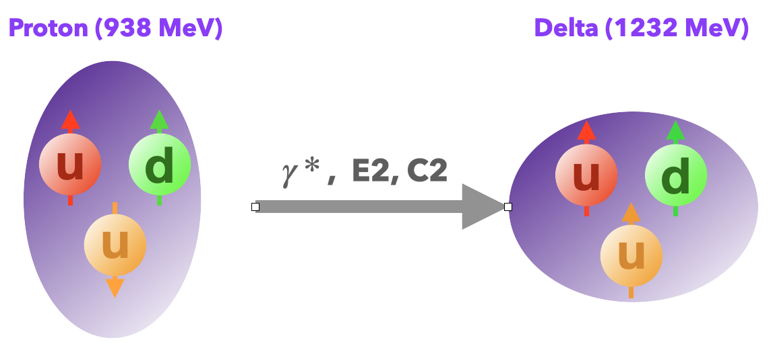
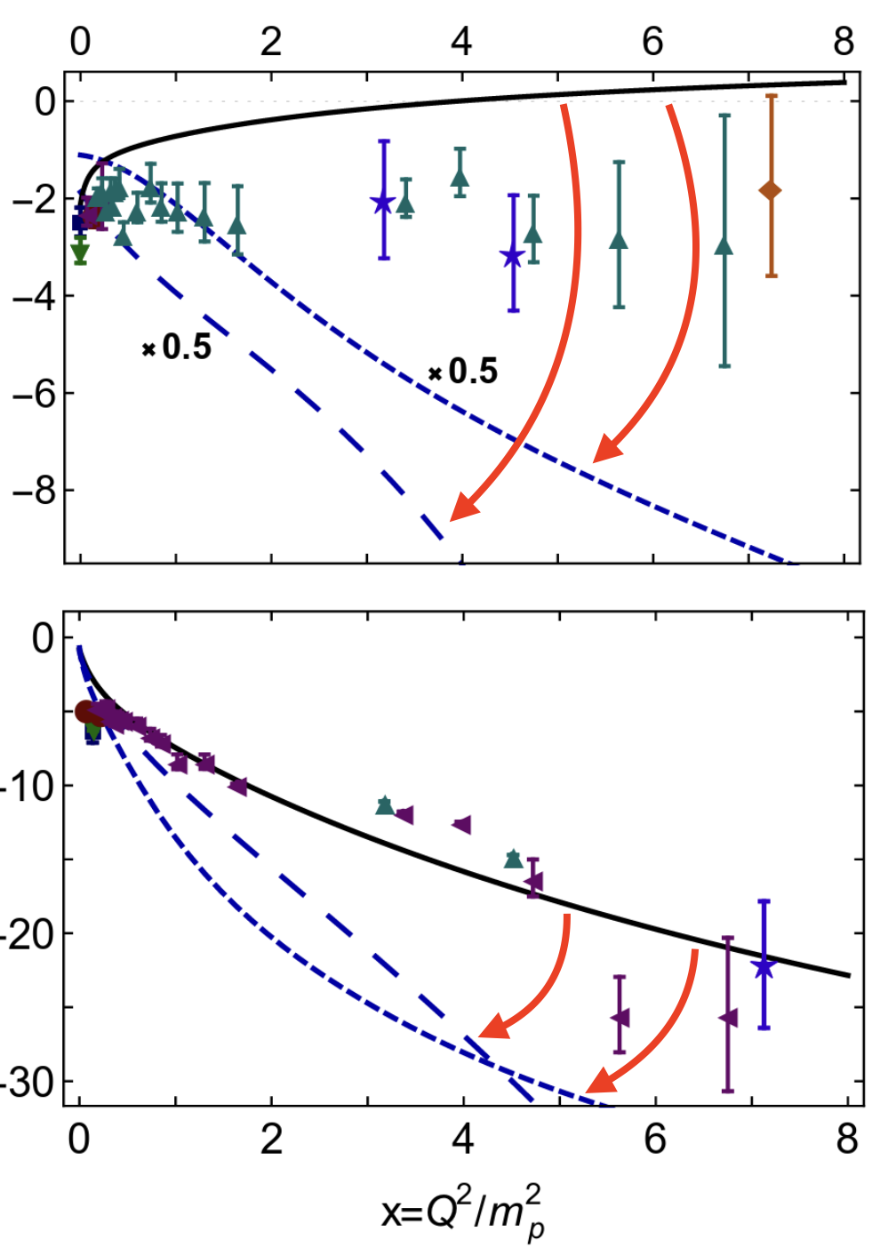
N-Delta Transition
The ratio of the electric/coulomb-quadrupole to magnetic-dipole transition amplitudes define the N-to-Delta transition form factors (EMR and CMR TFFs).
At low-Q2, pion cloud dynamics dominate. At high-Q2, TFFs are extremely sensitive to higher order partial waves. TFFs should also converge to perturbative predictions.
Models have shown significant sensitivity to truncation of higher-order partial wave contributions to the TFFs. The effect grows with Q2.
Calculations from Lu. et. al. Phys. Rev. D (2019)
EMR
CMR
The EIC provides a unique opportunity to study TFFs at large Q2!

Slide 6
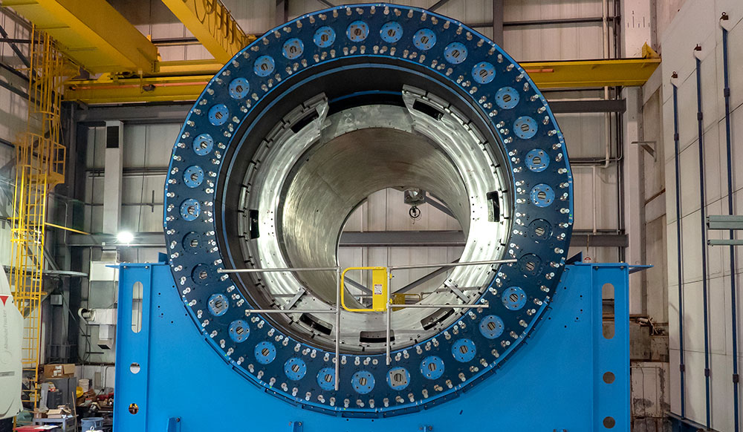
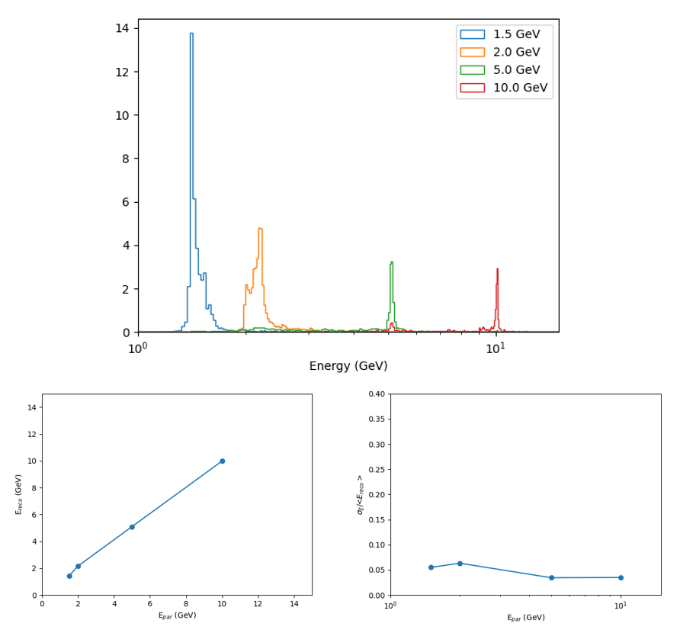
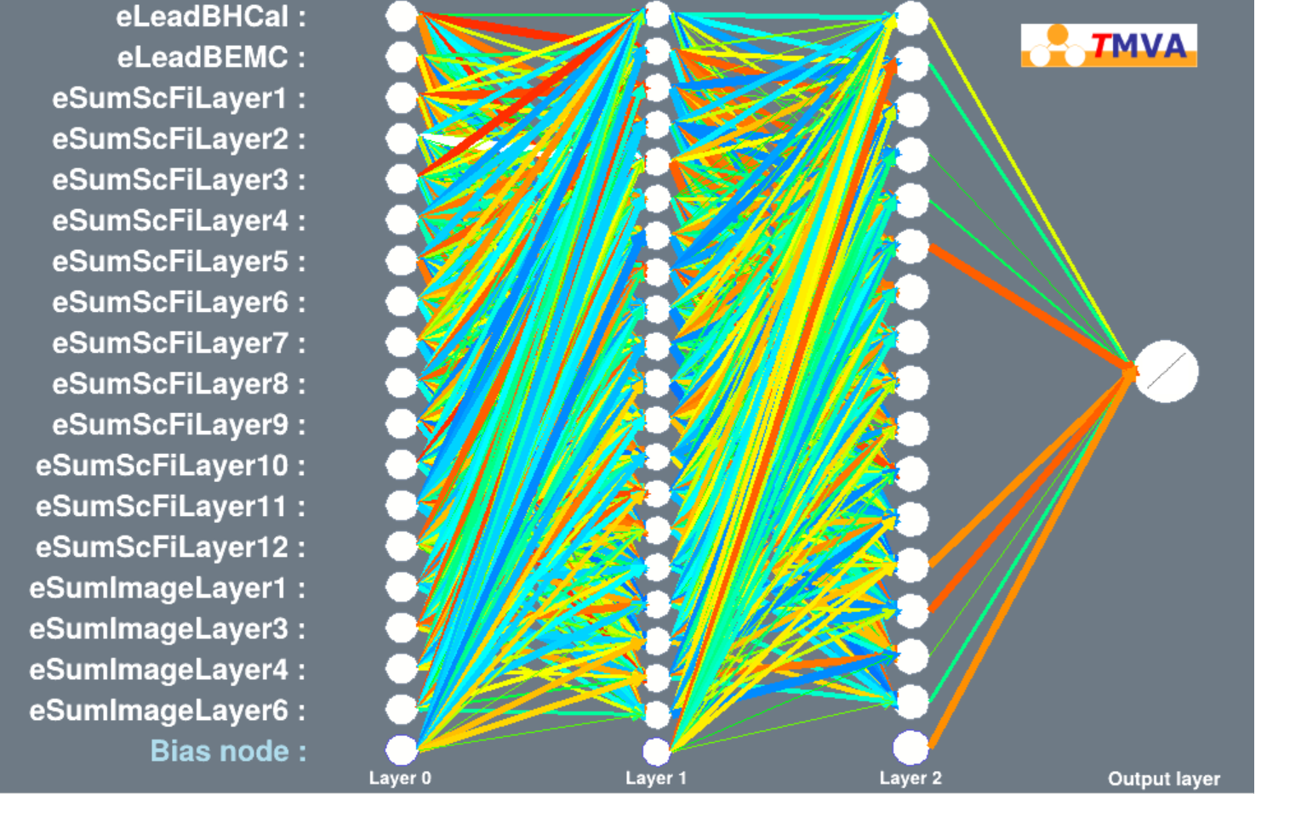
Barrel HCal Machine Learning Energy Calibration
Barrel Hadron Calorimeter – Good Energy Resolution needed for desired physics!
In Progress: Neural Network (MLP) based calibration!
Overfitting with single particle training data, but promising potential
Working on changing to continuous energy spectra training data

Slide 7
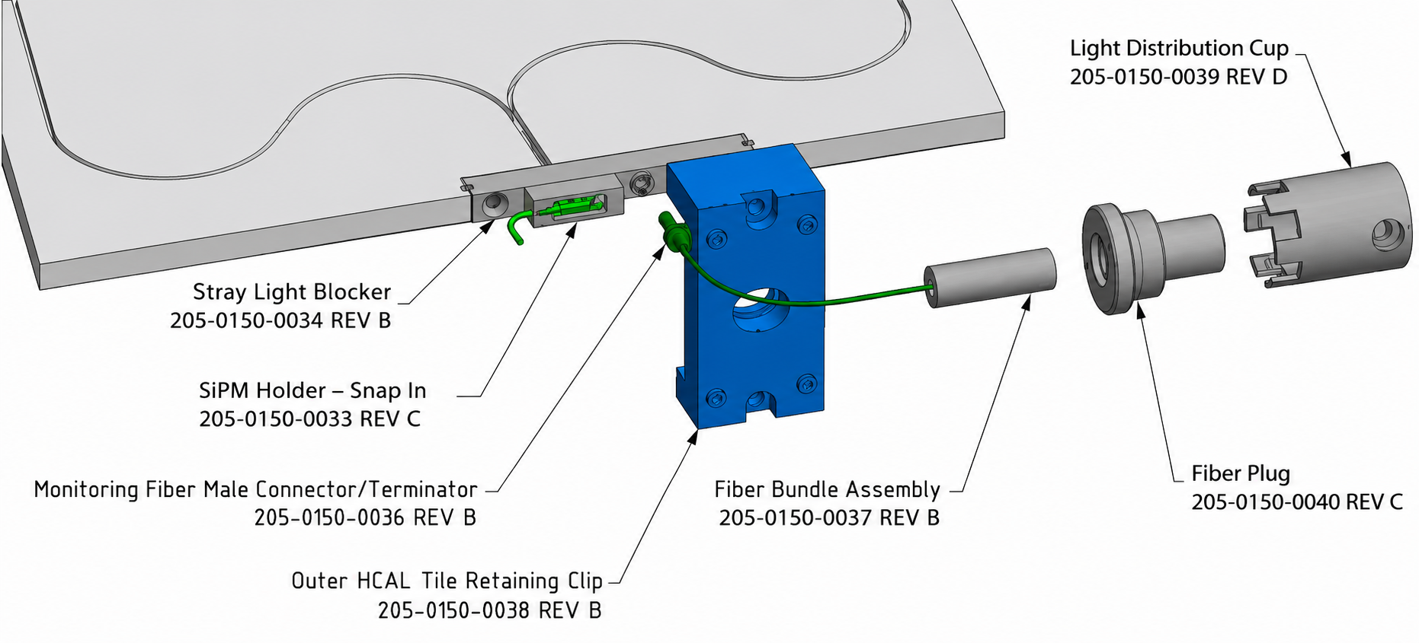
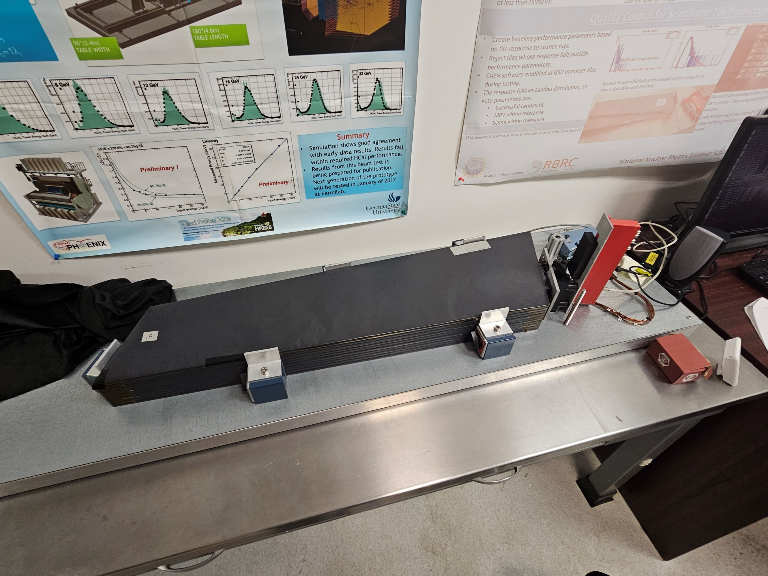
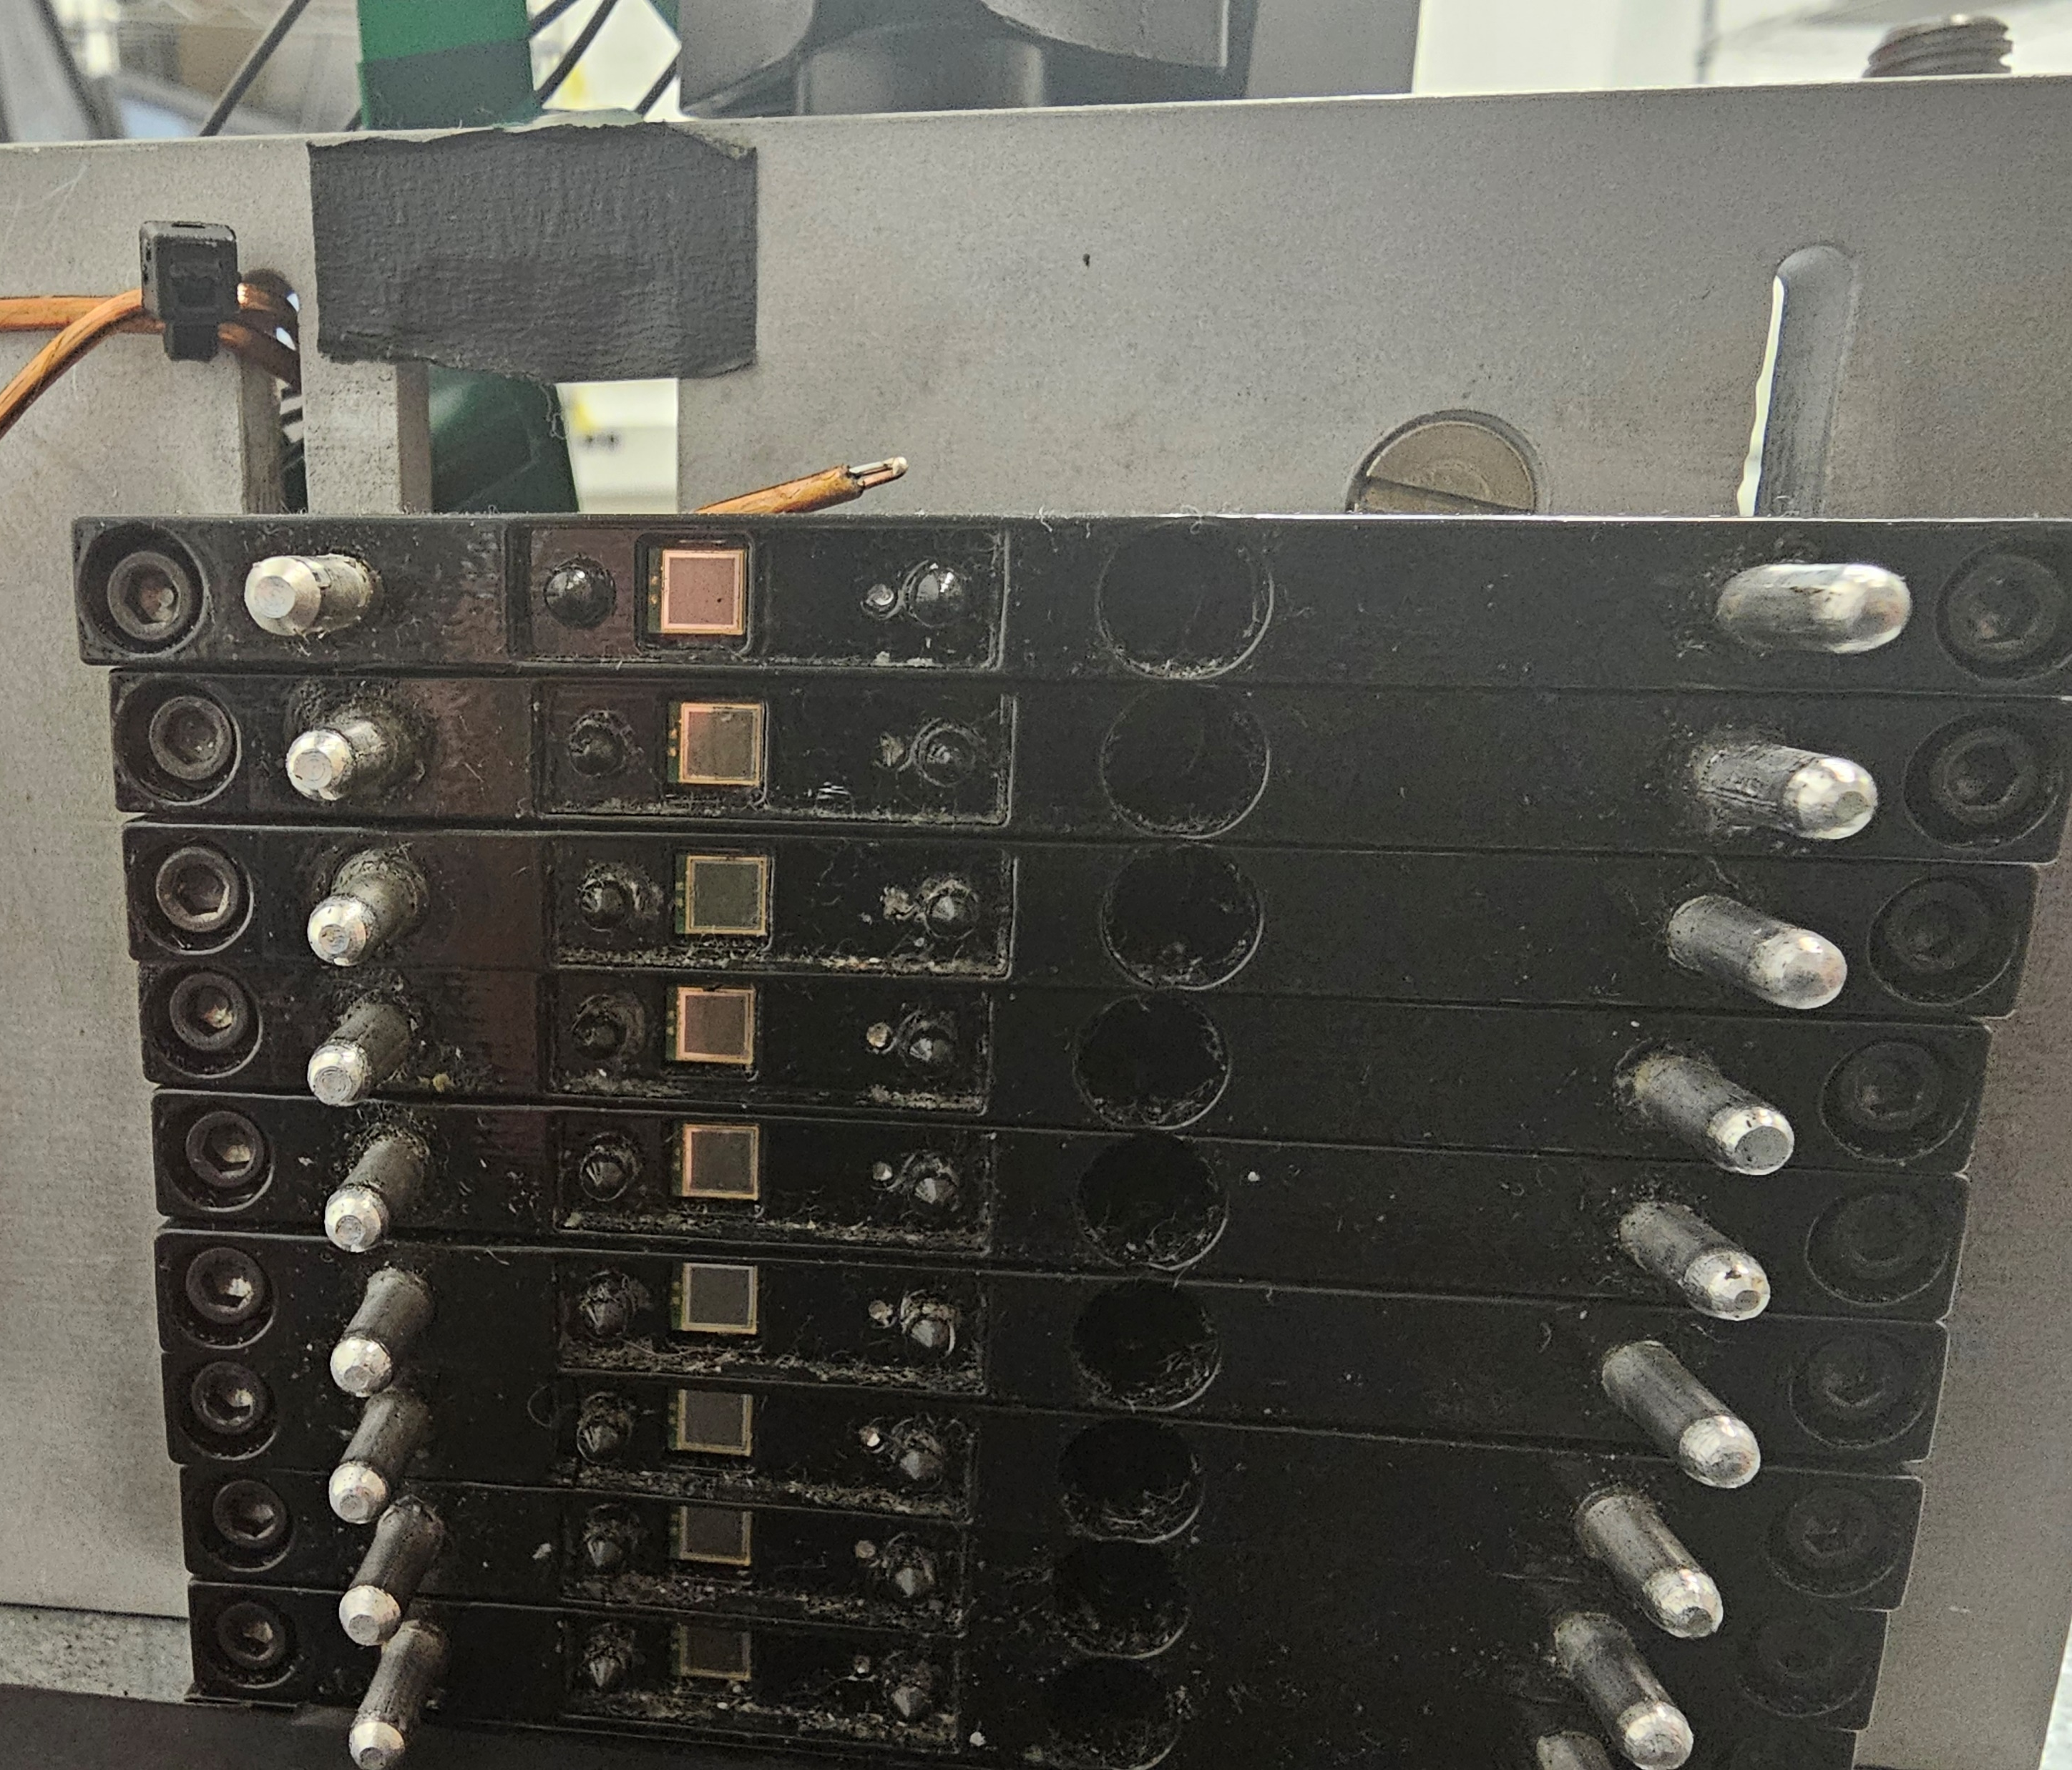
BHCal LED System
sPHENIX LED Design
sPHENIX oHCal System – for monitoring of tile & SiPM stability and performance
ePIC system – also for calibration
ePIC reads out every tile independently instead of using towers of 5 tiles
R&D on LED system design and logistics needed – prototype will be constructed at NMSU
GSU Tile Testing Stand (M. Connors Lab)

Slide 8
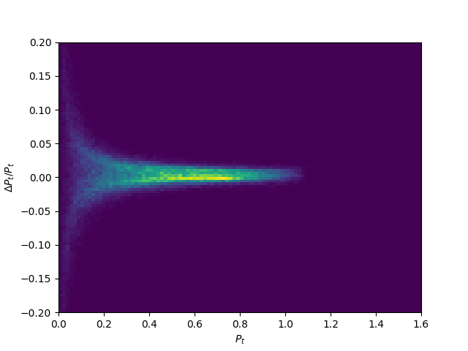
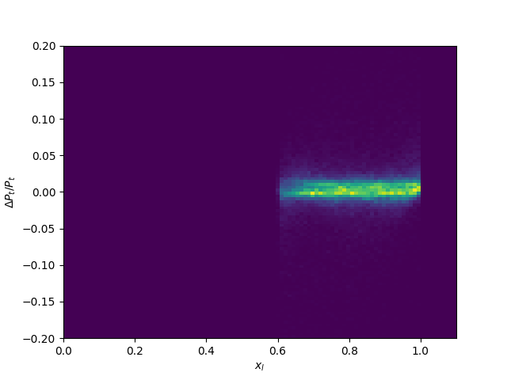
Far Forward Regime – Momentum Reconstruction & ZDC
Worked with A. Jentsch on a machine learning solution to momentum reconstruction for ePIC Far Forward Region Roman Pots
Needs to be integrated into EICRecon and extended to Off-Momentum Detectors
More Recent: ZDC Involvement
NMSU is helping to keep the ZDC effort moving forward in the wake of Miguel Arratia’s departure
D. Ruth working to help organize ZDC meeting and general efforts
B. Duran and D. Ruth will learn from UCR (Sean Preins, Ken Barish) and participate in tile testing and simulation
We will also develop and test an LED calibration system for the ZDC!

Slide 9
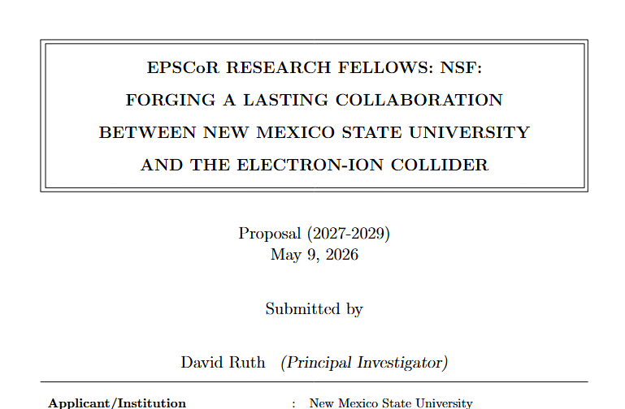
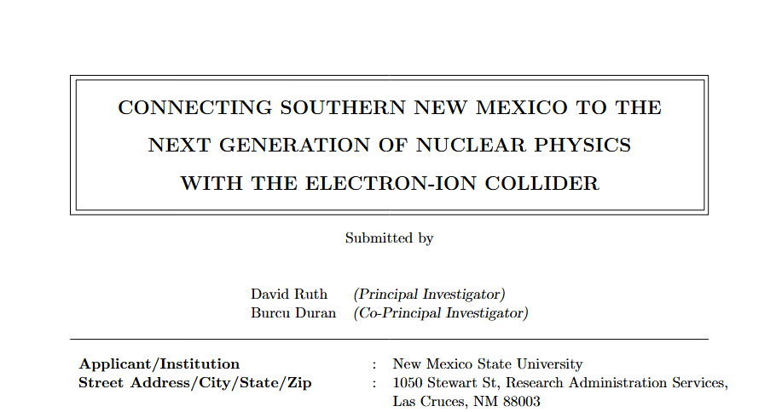
Work Allocation Plans
Recently submitted two EPSCoR grant proposals to try and get funding to participate in ePIC:
  DE-FOA-0003615 (4yrs support for 1 Postdoc, 2 Grad Students, D. Ruth, B. Duran)
  NSF 24-528 (4 months at BNL for D. Ruth and 1 Student to help commissioning of BHCal)
Working Groups:
Barrel HCal WG
Far Forward WG
Inclusive WG

Slide 10


Conclusion
NMSU has a strong and energetic Exp. Nucl Physics group interested in extending from JLab work into helping with ePIC!
Lots of expertise on nucleon structure analysis and simulation
Clear plan for WG involvement, hardware and software work, and impact studies
Please allow us to officially join ePIC: we are ready to get to work!

