Slide 1
Proposal for Joining the ePIC Experiment at the EIC
Mriganka Mouli Mondal
International Center of High Energy Physics and Applications (ICHEPA)
Lovely Professional University (LPU)
Phagwara, Punjab, India

Slide 2
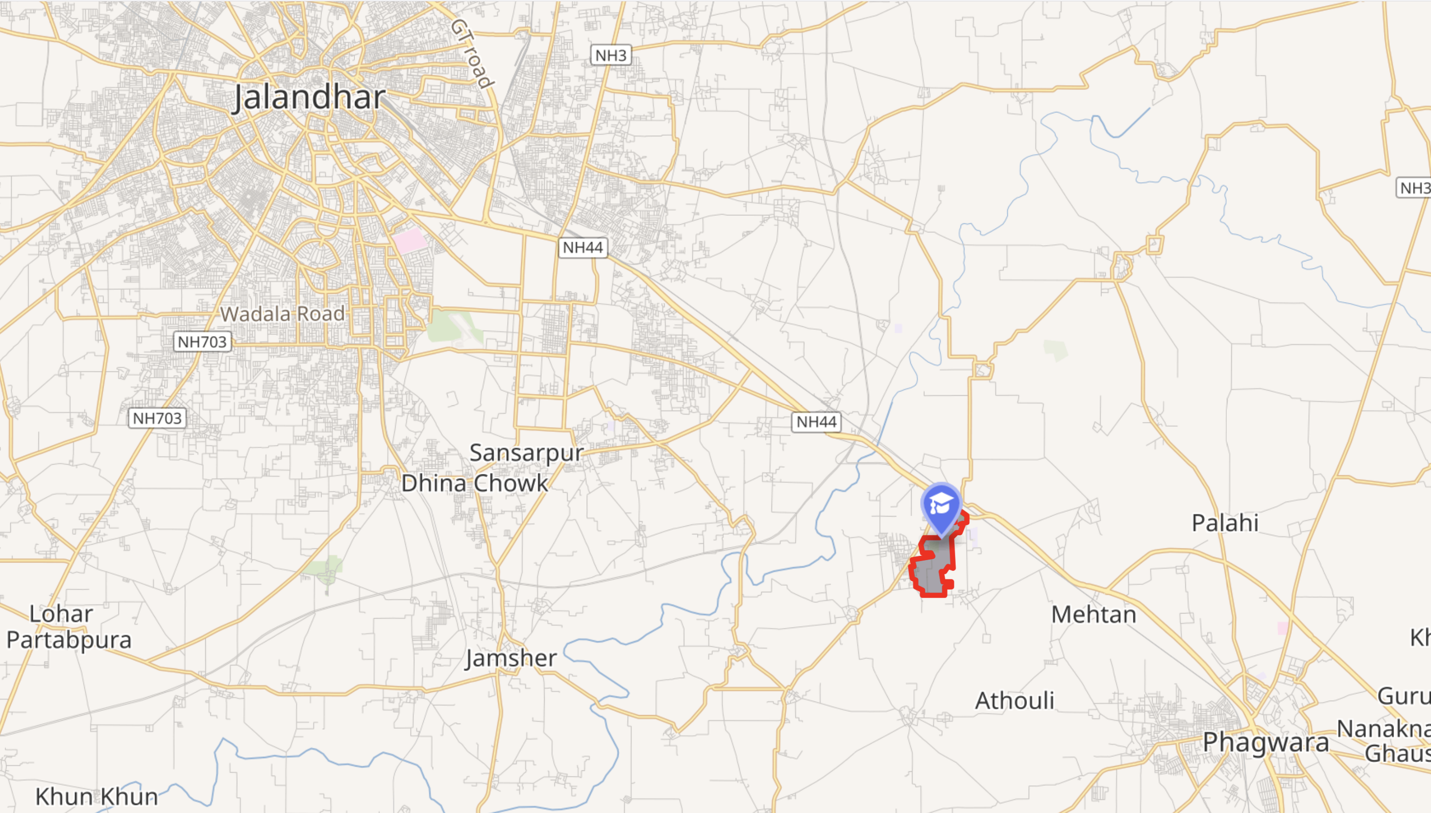
Punjab, India
Nearest Airport : Amritsar 110 km
Chandigarh 130 km
https://www.lpu.in/
35000+ students
3000+ International students
150+ Programmes offered
200+ Industry Collaborations
LPU
~800 Acers of Land
One of India’s largest and most prestigious private universities
901-950 range by the QS World University Rankings
NAAC grade of ‘A++’

Slide 3
People in ICHEPA
People of HEP-experiment
  Dr. Mriganka Mouli Mondal, Associate Professor, Head of ICHEPA (Physics analysis, detector simulations, detector integrations)
  Dr. Tapan Nayak (Honorary Adjunct Professor)
  Dr. Triloki (hardware expert)
Current Status: project students from bachelor’s and master’s are working DIS simulations using Pythia. Would get in ePIC simulations. We are also part of STAR experiment in forward data analysis for TSSA
Diverse Area: Few Faculties from Physics(Plasma theory), Bio-Engineering(QDs) and Computer divisions (AI/ML) are working with the center in contributing DRD-5/RDq and other multidisciplinary areas.

Slide 4
Expertise – Mriganka Mouli Mondal
Experience: ALICE-CERN, STAR-BNL, PHENIX-BNL, CREX-Jlab, H1-DESY (Currently LPU is in STAR experiment)
Detector
  Photon Multiplicity Detector (PMD) at ALICE and STAR: R&D, CERN-PS, SPS beamline test, Installations, Operations (2005-2009)
  Forward Meson Spectrometer (FMS) at STAR: Installation, Calibration, Operation, simulations, data analysis (2011-2016)
  A spaghetti calorimeter (SPACAL): testing and data analysis in Fermilab (sPHENIX/ePIC) (2014)
  ALICE Forward Calorimeter (FoCal): simulations for LOI, physics performance and TDR. (2018-2025), in PS-T10 beamline test for FoCal (2024)
Simulations
  ATHENA proposal and fast simulations for flavor correlations within jets.
  Event generates PYTHIA, HERWIG, HIJING, BeAGLE
Analysis
  - Jet, dihedron correlations, direct photons, TSSA in in STAR, TSSA for neutrons at PHENIX, jet substructure at H1, CGC-ALICE/STAR.

Slide 5
Expertise – Triloki Triloki
Involved in various Collaborations : COMPASS RICH, ALICE-ITS, RD51 R&D for MPGDs, ND Photocathode R&D (INFN), [NA58, ePIC-EIC, ALICE-CERN]
Expertise (UHV technology, gas detector, thin-film photocathode, QDs, UV monochromator)
Developed a UHV facility at INFN Bari for the outgassing study of the IRIS detector R&D for ALICE3.
Testing and characterization of the MAPS sensors for the ITS3 upgrade of the ALICE experiment.
Bending, gluing, and air cooling of dummy Si sensors for ALICE-ITS3 and ePIC experiments.
R&D on VUV-sensitive thin film photocathode (CsI, KBr, ND, and hydrogenated ND)
R&D on an MPGD-based single-photon ThGEM detector coupled to a nanodiamond (ND) photocathode
Installation, operation, and alignment of VUV & VUVAS 1000 monochromator (McPherson, USA) for the photoemission and optical properties analysis of thin film photocathodes.
Mass-scale fabrication of resistive plate chamber (RPC) at SPRING-8, Japan.
Optoelectronics and electroluminescent device fabrication using quantum dots.

Slide 6
Infrastructure and Funding at LPU
LPU provides infrastructure for basic Lab setup. For the newly formed center, ICHEPA, faculties students for for HEP.
LPU support: Mechanical and Electronics engineering
EIC-India DPR proposal: funding options from DAE/DST (Indian Government Funding Agency).
Arranging equipment and forming collaborations with other institutes/universities (MoUs).

Slide 7
Research Plan and discussions
Simulations
  TDR effort in PID dRICH, Jets, kinematics reconstruction, Exclusive/Diffraction/Tagging,
  Currently, students are trained aiming for:
      H1 DIS data analysis
      ePIC simulations
  ePIC simulations and software development to be carried out as bachelor and master projects
Hardware
  Planning to get engaged primarily in dRICH
      Refractive index measurement for RICH radiator gas
      Contamination study of RHIC radiator gas
  Possibility to contribute at Forward calorimeter
Preliminary discussions were held with Marco Contalbrigo. We are making a preliminary plan for the interferometer setup and arranging options for C₂F₆ gas

Slide 8
Thank you

