Slide 1
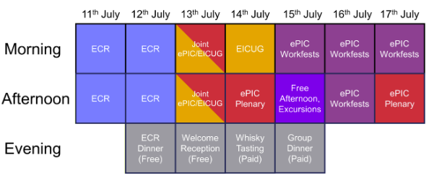
Electronics and DAQ WG Meeting (6/18/26)
Coming up…
WG Mtgs: 6/25, 7/2, 7/9
7/11-7/17 – EICUG - collab meeting
  3 workfest sessions:
    Wed Morning – Joint Electronics & DAQ + SRO (opposite physics)
    Thurs Morning – Joint Electronics & DAQ + SRO (opposite AI #1)
    Thurs Afternoon – (tracking / AC-LGAD & ASICs)
    Fri Morning – (AI #2 / TOF mechanics)
Sept 15-18 DOE IPR of EIC project status
  Page turns week of July 27th
  Dry Runs Week of August 10th
Collaboration meeting workfests:
Call for contributions?
Who is attending?
Status Updates aimed towards informing collaboration of status from Electronics & DAQ (About 2 hours)
  Summary of the ASIC reviews
  GTU status
  FLX status
  Generic RDO status
Status and discussion from the SRO WG (including echelon 1/ echelon-X) discussions (About 6 hours)
  Orchestration workflows (Panda/Rucio)
  AI integration
  Streaming Reconstruction
  Echelon 1-2 definitions, requirements & resources, ESNET / distributed network discussions
  Calibration workflows

Slide 2
Past Activities to wrap up:
Space Allocations
  South Platform
  Extend forward / backward “platforms”
Data Rates & Limits Summary
  At the detailed level, we never will complete needing to pay attention to data rates as new information comes in, however:
  For preTDR / TIC effort:
    Counts of components, and rate/data limits are “complete” - with many caveats
      The summary table is provided and filled in wrt Electronics/DAQ contribuitions
      Expected rates / background rates are for the detector groups to organize
    Need to update the pre-tdr data rate section to reflect this
    Probably I/we need to help some of the detector groups fill in the rest of the table. Several groups have presented results at TIC but not filled in the table.
  Generally, there is a lot of uncertainty in the rates the detectors will see
    E.g. tracking has an output data rate to tape of about 370 Gb/s
      The rate capabilities through the DAM board can handle these rates
      We probably need to worry about handling rate to tape:
        Need better understanding of data volumes during low luminosity running and ramp-up
        Increase 100 Gb/s request to echelon 1
        Evaluate more convential trigger system in DAQ software

Slide 3
Electronics and DAQ WG Meeting (6/18/26)
ASIC internal reviews are complete
  Fernando / I will producing a summary report
MPGD RDO baseline
  Met with MPGD group last month. The costs are roughly similar so:
    Endcap MPGDs will send data directly to FLX
    For Cymbal / Outer Barrel MPGD group will decide (decision needs to be finalized)
Priorities moving forward:
Final Design Review Targeted for early 2027
What priorities, needs should we target?

Slide 4
Electronics and DAQ WG Meeting (6/18/26)
Priorities moving forward (to become ready for FDR --- Jeff):
Slow Controls Test Stand
  Evaluate more closely PS etc requested
  Evaluate enclosures
  Specify granularity of power control and evaluate consistency with enclosure / PS choices
Version Control Repos
  Software
  Firmware
  Some exist, some don’t. Need to collect, document and have a organized scheme for where code is located
DAM boards
  Develop details of aggregation along MAPS scheme
  Extend this to other potential applications (e.g. Astropix)
  Code to run FLX-155 / FLX-712 relatively transparently
  Person/people to be the FLX expert that can cover these tasks and integrate with detector groups
  GTU – DAM - RDO protocol (Downlink and uplink)
Fiber Distribution Details
  FLX boards use the multi-fiber connectors orgininating from different RDOs
  Multiple Generic RDOs will be on single PCB Board
  Fiber distribution from detector based VTRX+ uses incomplete portion of MTP fibers
    Fiber connections are not trivial
    Whether we use static patch panels or sPHENIX-like active fiber routing hardware, this needs to be designed

Slide 5
Electronics and DAQ WG Meeting (6/18/26)
Priorities moving forward (to become ready for FDR --- Jeff):
DC/DC - LV distribution
Power Trees / Chassis
RDO
Grounding – move towards implementation plan for generic plan
Status of VTRX+ / lpGBT acquisition
--- Keep eye on update 400Gb ethernet version FLX ---
Resource:
  Mosaix mock-up board developed by Jo, for lpGBT front end board

