Slide 1
Auxiliary Det. Preliminary Design Review (part 2)
Sometime in October.
  Focus is RP, OMD, and B0.
  Emphasis on engineering designs and IR constraints.
  Need to demonstrate 60-70% design readiness.
Charge questions:
Are the technical performance requirements appropriately defined and complete for this stage of the project?
Are the plans for the various sub-systems appropriately documented and complete for this stage of the project?
Are the current plans for the detector likely to achieve the technical performance requirements, with a low risk for cost increases, schedule delays, and technical problems?
Are the schedule assumptions for the fabrication of the various sub-systems and assembly plans reasonable and consistent with the overall detector schedule?
Have ESH and QA considerations been adequately incorporated into the plans at their present stage?
Have the recommendations from previous reviews been adequately addressed?

Slide 2
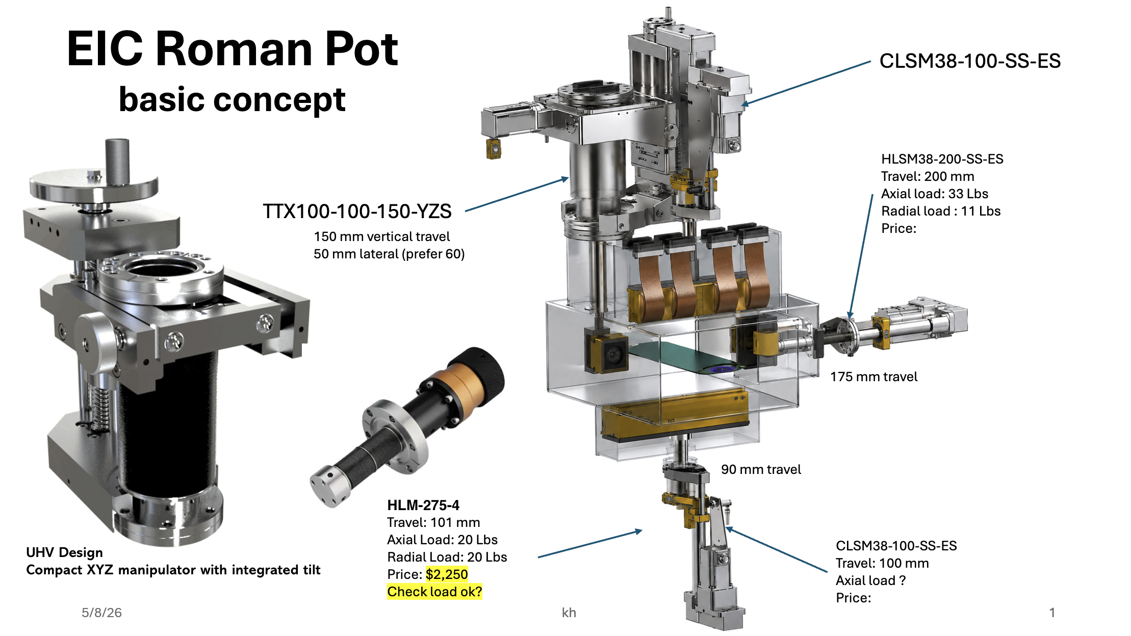
Roman pots/OMD mechanical design
Karim Hamdi (BNL)

Slide 3
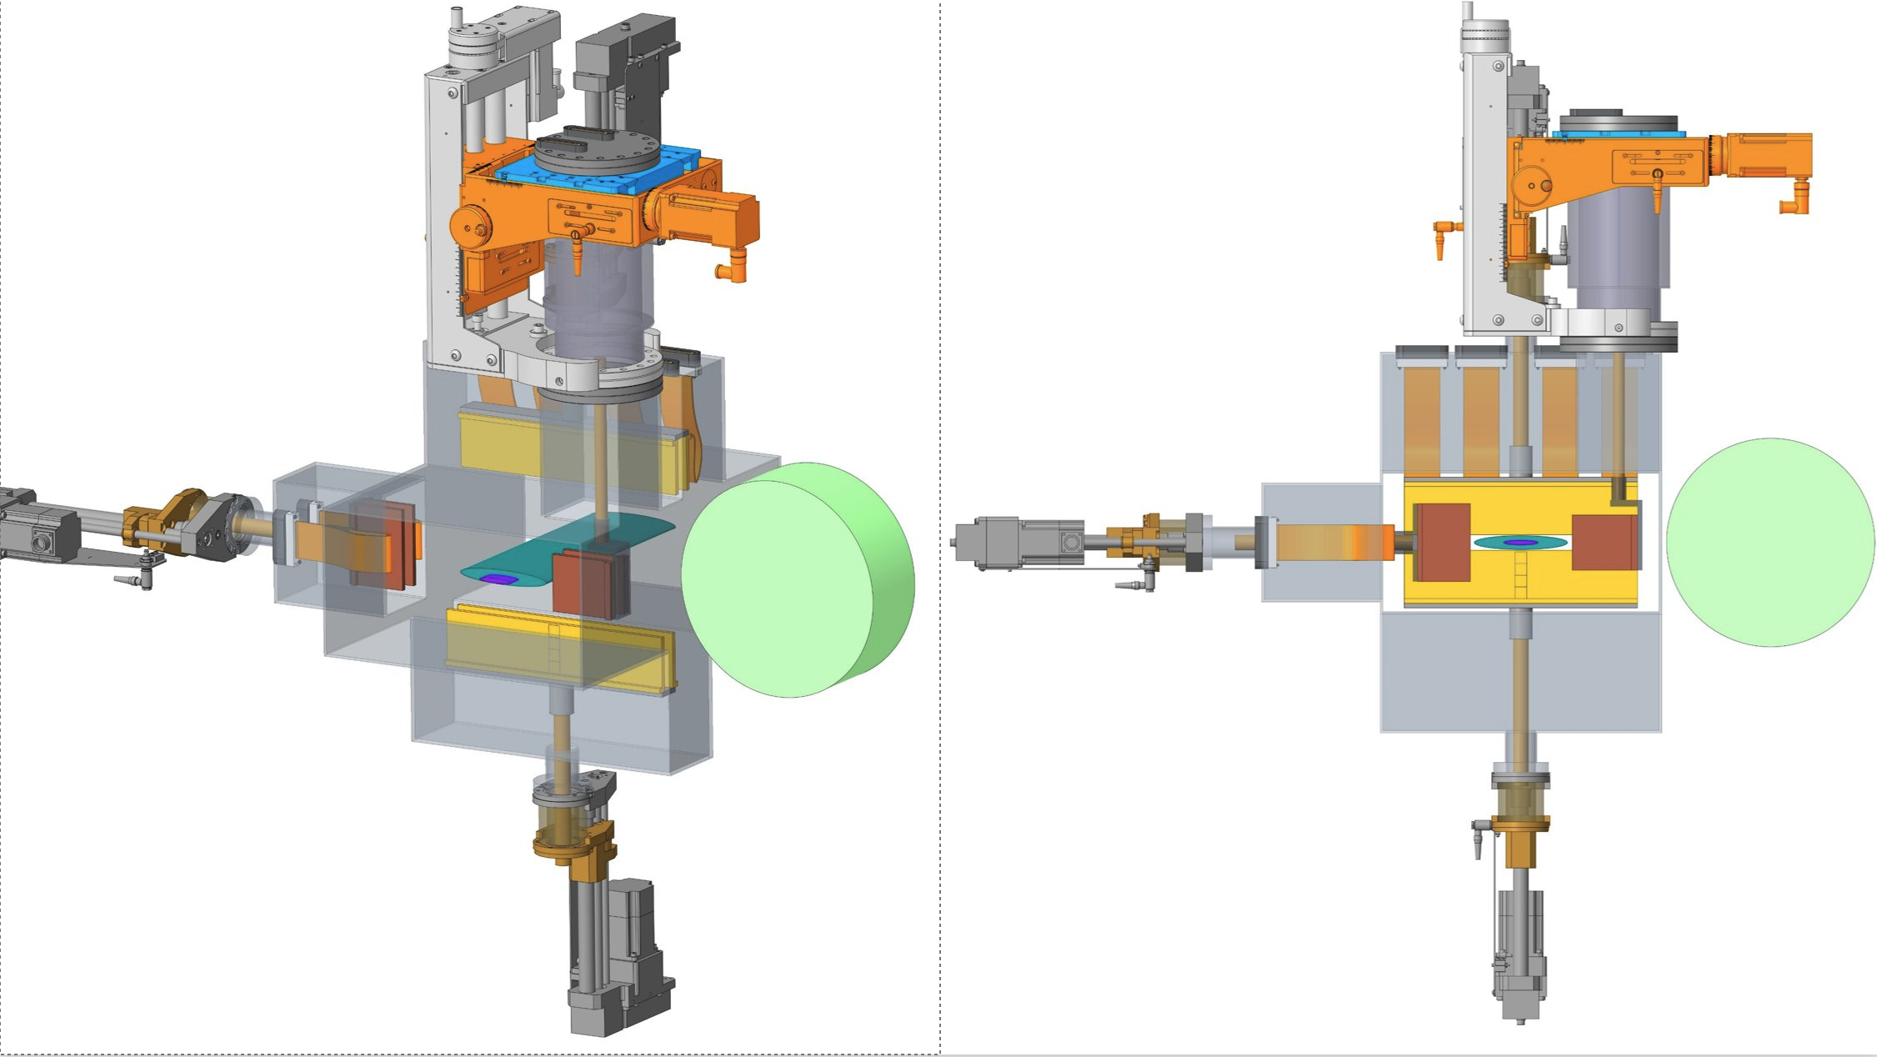
Roman pots/OMD mechanical design
Karim Hamdi (BNL)

Slide 4
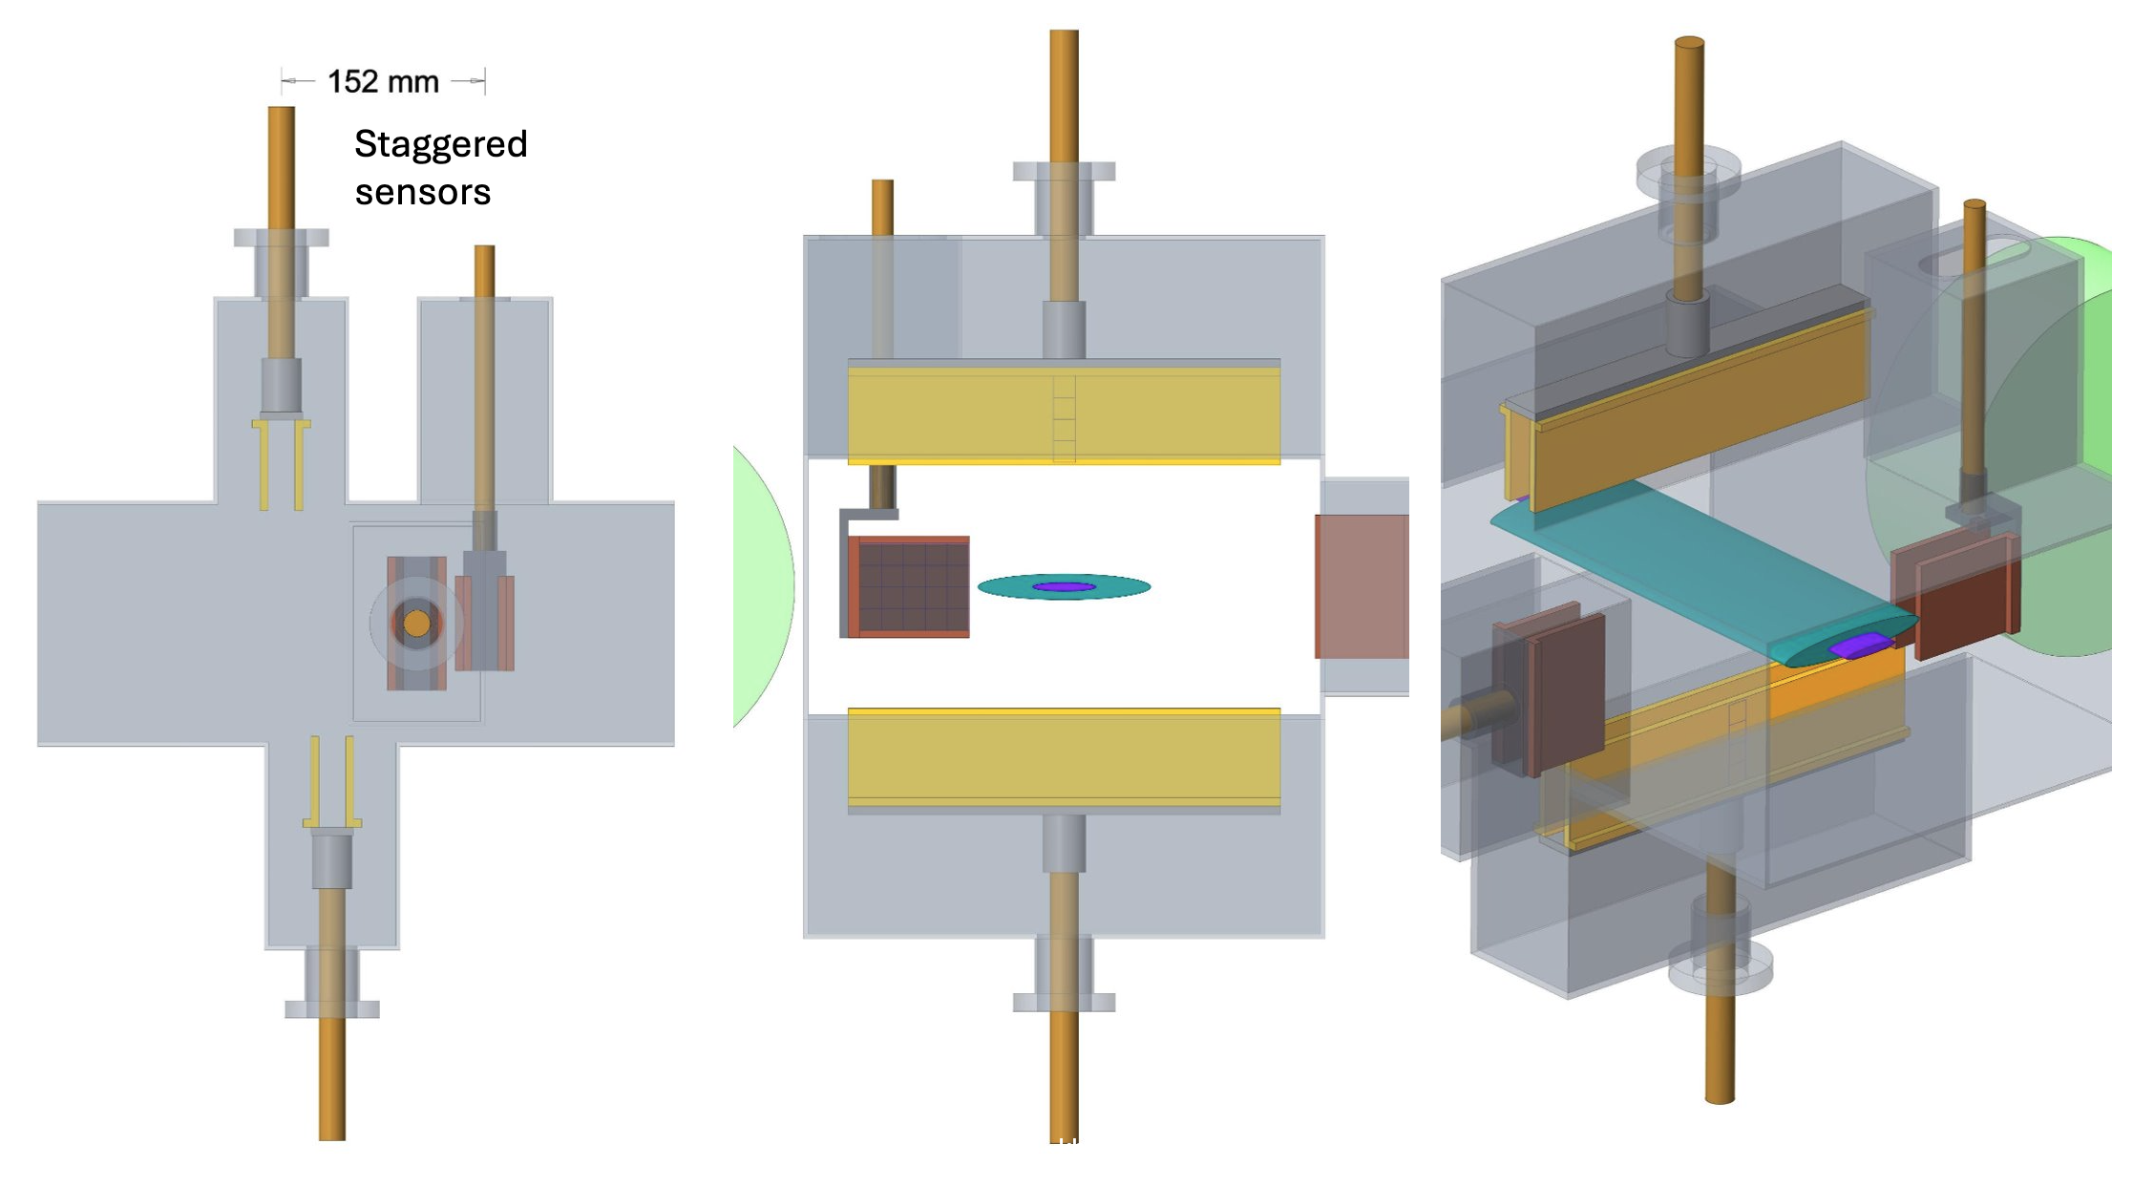
Roman pots/OMD mechanical design
Karim Hamdi (BNL)

Slide 5
Roman Pot module board/stave development
Roman pot detector will be used in UHV -- compatible build types
  Ceramic PCB (LTCC) with adhesiveless Polyimide Flex (expensive)
  Only use adhesiveless Polyimide Flex (Kapton) with backing plate not as expensive but can add complications
Build a stepping stone test article using standard FR4 rigid flex that will have 3 sensors
It will be used for verifying wire-bonding to the substrate
Will be backward compatible with existing readout boards RBV1 and ZCU106
Readout 3 ASICs using RBV1 and/or KCU105
  needs a new adapter board and the RVB1 can deliver power to the ASICs
Test signal integrity, power delivery and grounding over flex cable
Jack Fried (BNL)

Slide 6
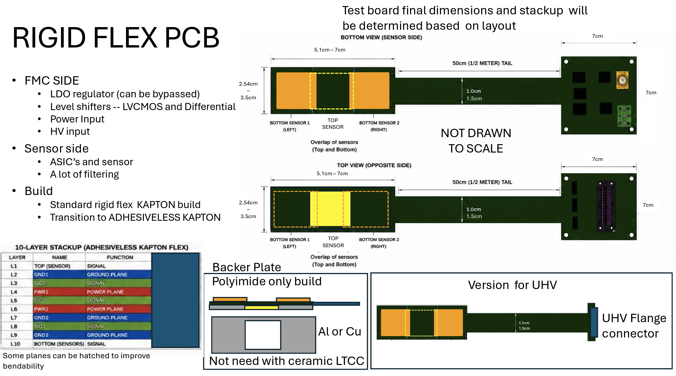
Rigid Flex PCB
Jack Fried (BNL)

Slide 7
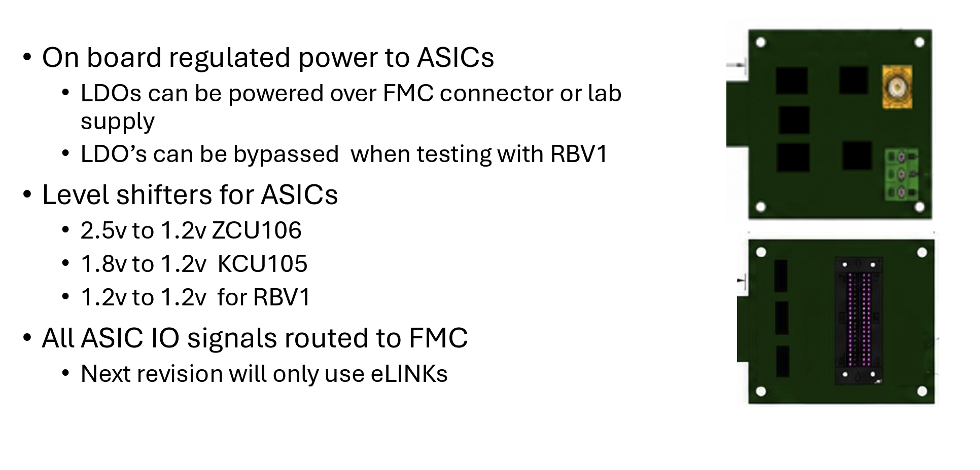
Rigid Flex PCB
Jack Fried (BNL)

Slide 8
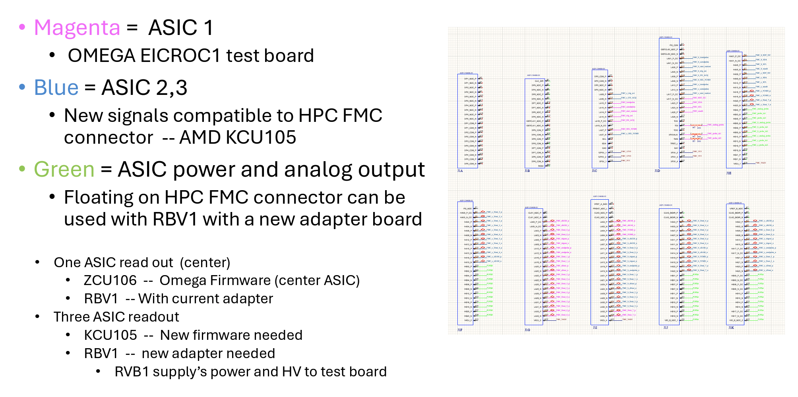
Rigid Flex PCB: pinout
Jack Fried (BNL)

Slide 9
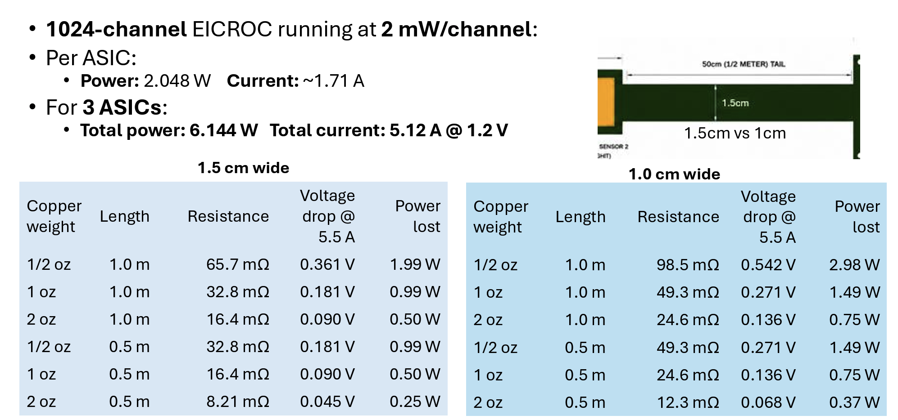
Rigid Flex PCB: power
Jack Fried (BNL)

Slide 10
July Collaboration Meeting
AC-LGAD workfest, Thursday July 16th from 1:30pm to 5:00pm (local Glasgow time)
1:30pm - 1:35pm - quick introduction of the work fest (Satoshi?)
1:35pm - 2:05pm - Pixel AC-LGADs, status, testing plans, next production, QA and EICROC testing at BNL (Alex Jentsch)
  I will also get some input from UIC, UCSC, U. Hawaii, ORNL on the QA, testing, etc. plans for the talk, like we did for the review, but for the broader attendees to see. I think we can also easily include the QA/testing plans for the strip AC-LGADs in this discussion, since there will be overlap in this testing among the institutions.
2:05pm - 2:25pm - EICROC testing status from IJCLab (IJCLab)
2:25pm - 2:45pm - EICROC1 and EICROC2 status and plans from Omega (Christophe de la Taille)
2:45pm - 3:05pm - discussion of testing plans for pixel AC-LGADs and future EICROC versions (follow-up from previous discussions) —> this can be used to fill in missing technical​ details for the QA process for the sensors and ASICs (maybe Jenni Ott can lead this discussion and give a talk since she put in a PED request for this? If Jenni will not be there, maybe Simone or Mathieu?)
3:05pm to 3:20pm - coffee break + further discussion
3:20pm to 3:40pm - Strip AC-LGADs, status, plans, production, etc. (Satoshi Yano)
3:40pm to 4:00pm - Strip AC-LGADs QA, plans, etc. (Simone? Or combine with previous talk and add more time?)
4:40pm to 4:20pm - FCFD, status, plans, next steps, etc. (Artur?)
4:20pm to 4:45pm - Discussion of FCFD variant for Cherenkov detectors (Who will give this talk?)
4:45pm to 5:00pm - final discussions

Slide 11
AC-LGAD + EICROC testing @ BNL
Alex Jentsch (BNL) on behalf of the BNL team
Alessandro Tricoli, Gabriele Giacomini, Ashik Ikbal (Kent), Souvik Paul (Stony Brook), Maya Mancini (Brandeis), Prashanth Shanmuganathan, Prithwish Tribedy, Rachel Kovach-Fuentes (Rice)
EICROC meeting
June 23rd, 2026

Slide 12
Overview of BNL work (EICROC + ACLGAD)
Analog testing:
  Jitter from AC-LGAD+EICROC via analog output of EICROC.
  Jitter from AC-LGAD+FNAL board.
  Working on order of UCSC testboards for usage with large pixel sensors (in-progress).
Digital testing:
  New firmware setup on ZU706 and ZCU106 boards for testing (Jan. 2026).
    Tested preamp output with charge injection to ensure the charge makes it into the circuit.
    Have not been able to produce reasonable ADC/TDC distributions with charge injection.
    Likely an issue with the configuration files we have.
    Will work with IJCLab to solve issues → expect results in the next week or two.
  Once above is solved, focus on data collection with Sr-90 and TCT.
    Spatial and timing resolution.
    Integration with borrowed telescope from BNL colleagues to begin testing system with external trigger in preparation for test beams

Slide 13
Overview of BNL work (EICROC + ACLGAD)
Analog testing:
  Jitter from AC-LGAD+EICROC via analog output of EICROC.
  Jitter from AC-LGAD+FNAL board.
  Working on order of UCSC testboards for usage with large pixel sensors (final assembly in progress).
Digital testing:
  New firmware setup on ZU706 and ZCU106 boards for testing (Jan. 2026).
    Tested preamp output with charge injection to ensure the charge makes it into the circuit.
    Trigger window issue resolved, and I2C communication issues resolved.
    Testing working okay with ZU706 board.
    Measure calibration (threshold) offsets.
  Once above is complete, focus on data collection with Sr-90 and TCT.
    Internal trigger to reproduce IJCLab results and measure charge sharing.
    Setup with DC-LGAD trigger to work on full-chain testing.
  EICROC1 testboard received at BNL, work beginning on integration with RBv1.
  Stave/module board for far-forward detectors under design – expect physical board by end of Summer.

Slide 14
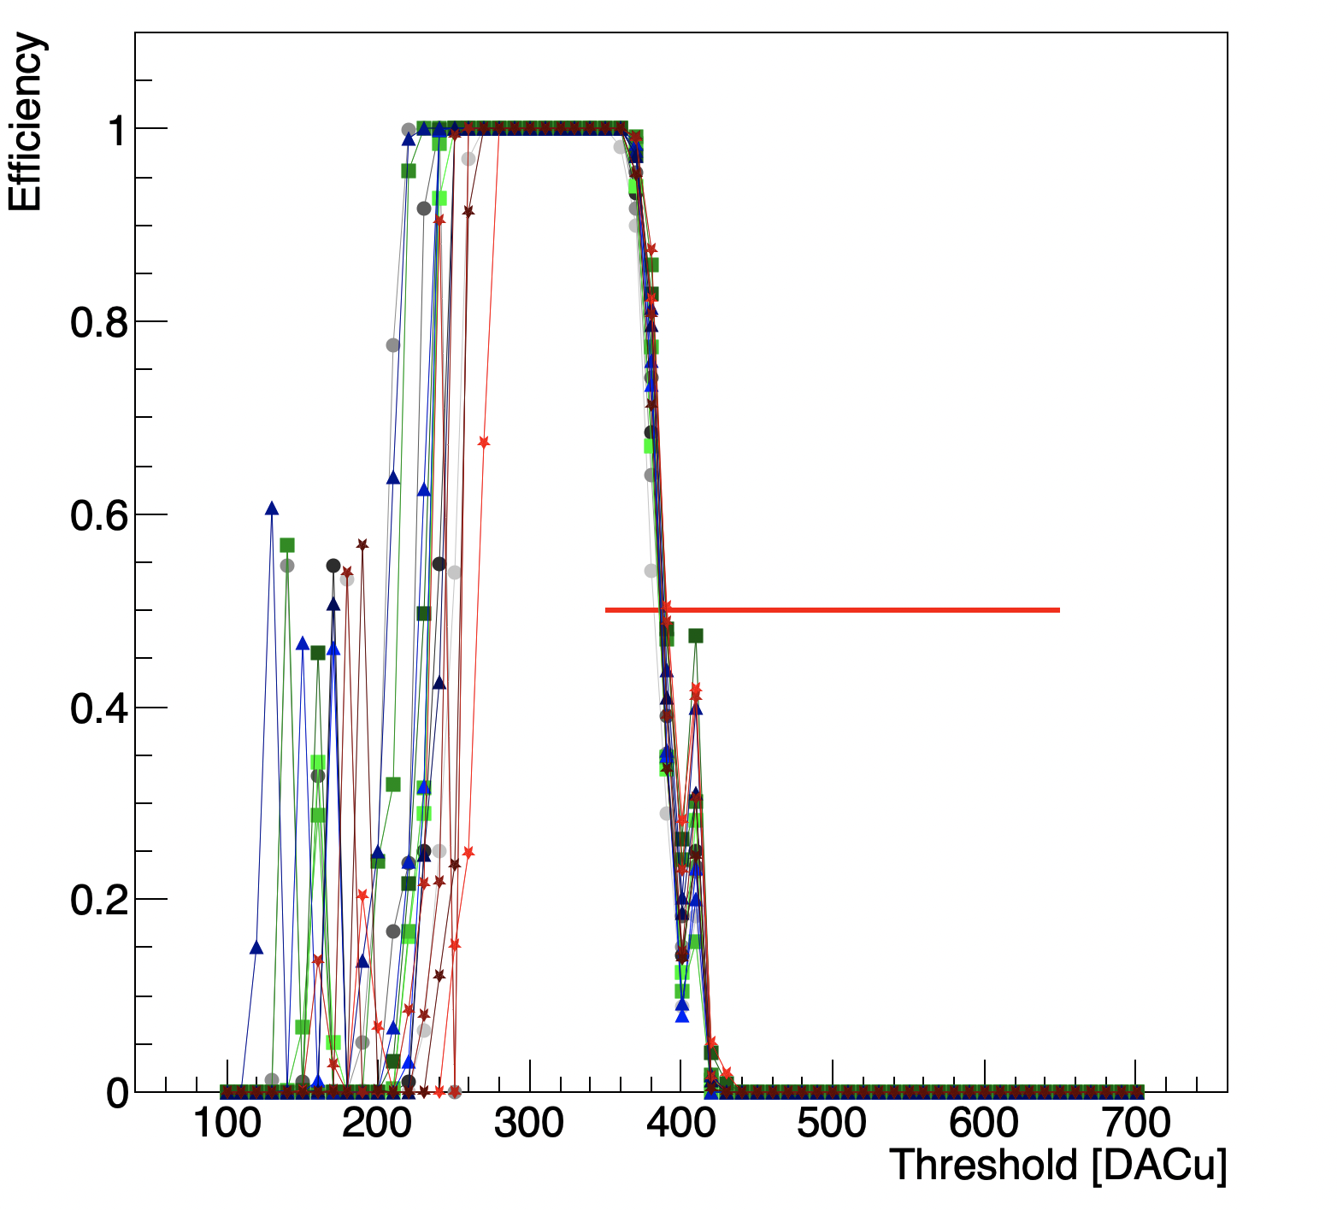
EICROC0 testing @ BNL
Using bump-bonded (30um gain layer) sensor to EICROC0 @ -170V.
Q = 45 DACu
Calibration performed successfully.
Focus is now on Sr-90 measurements.

Slide 15
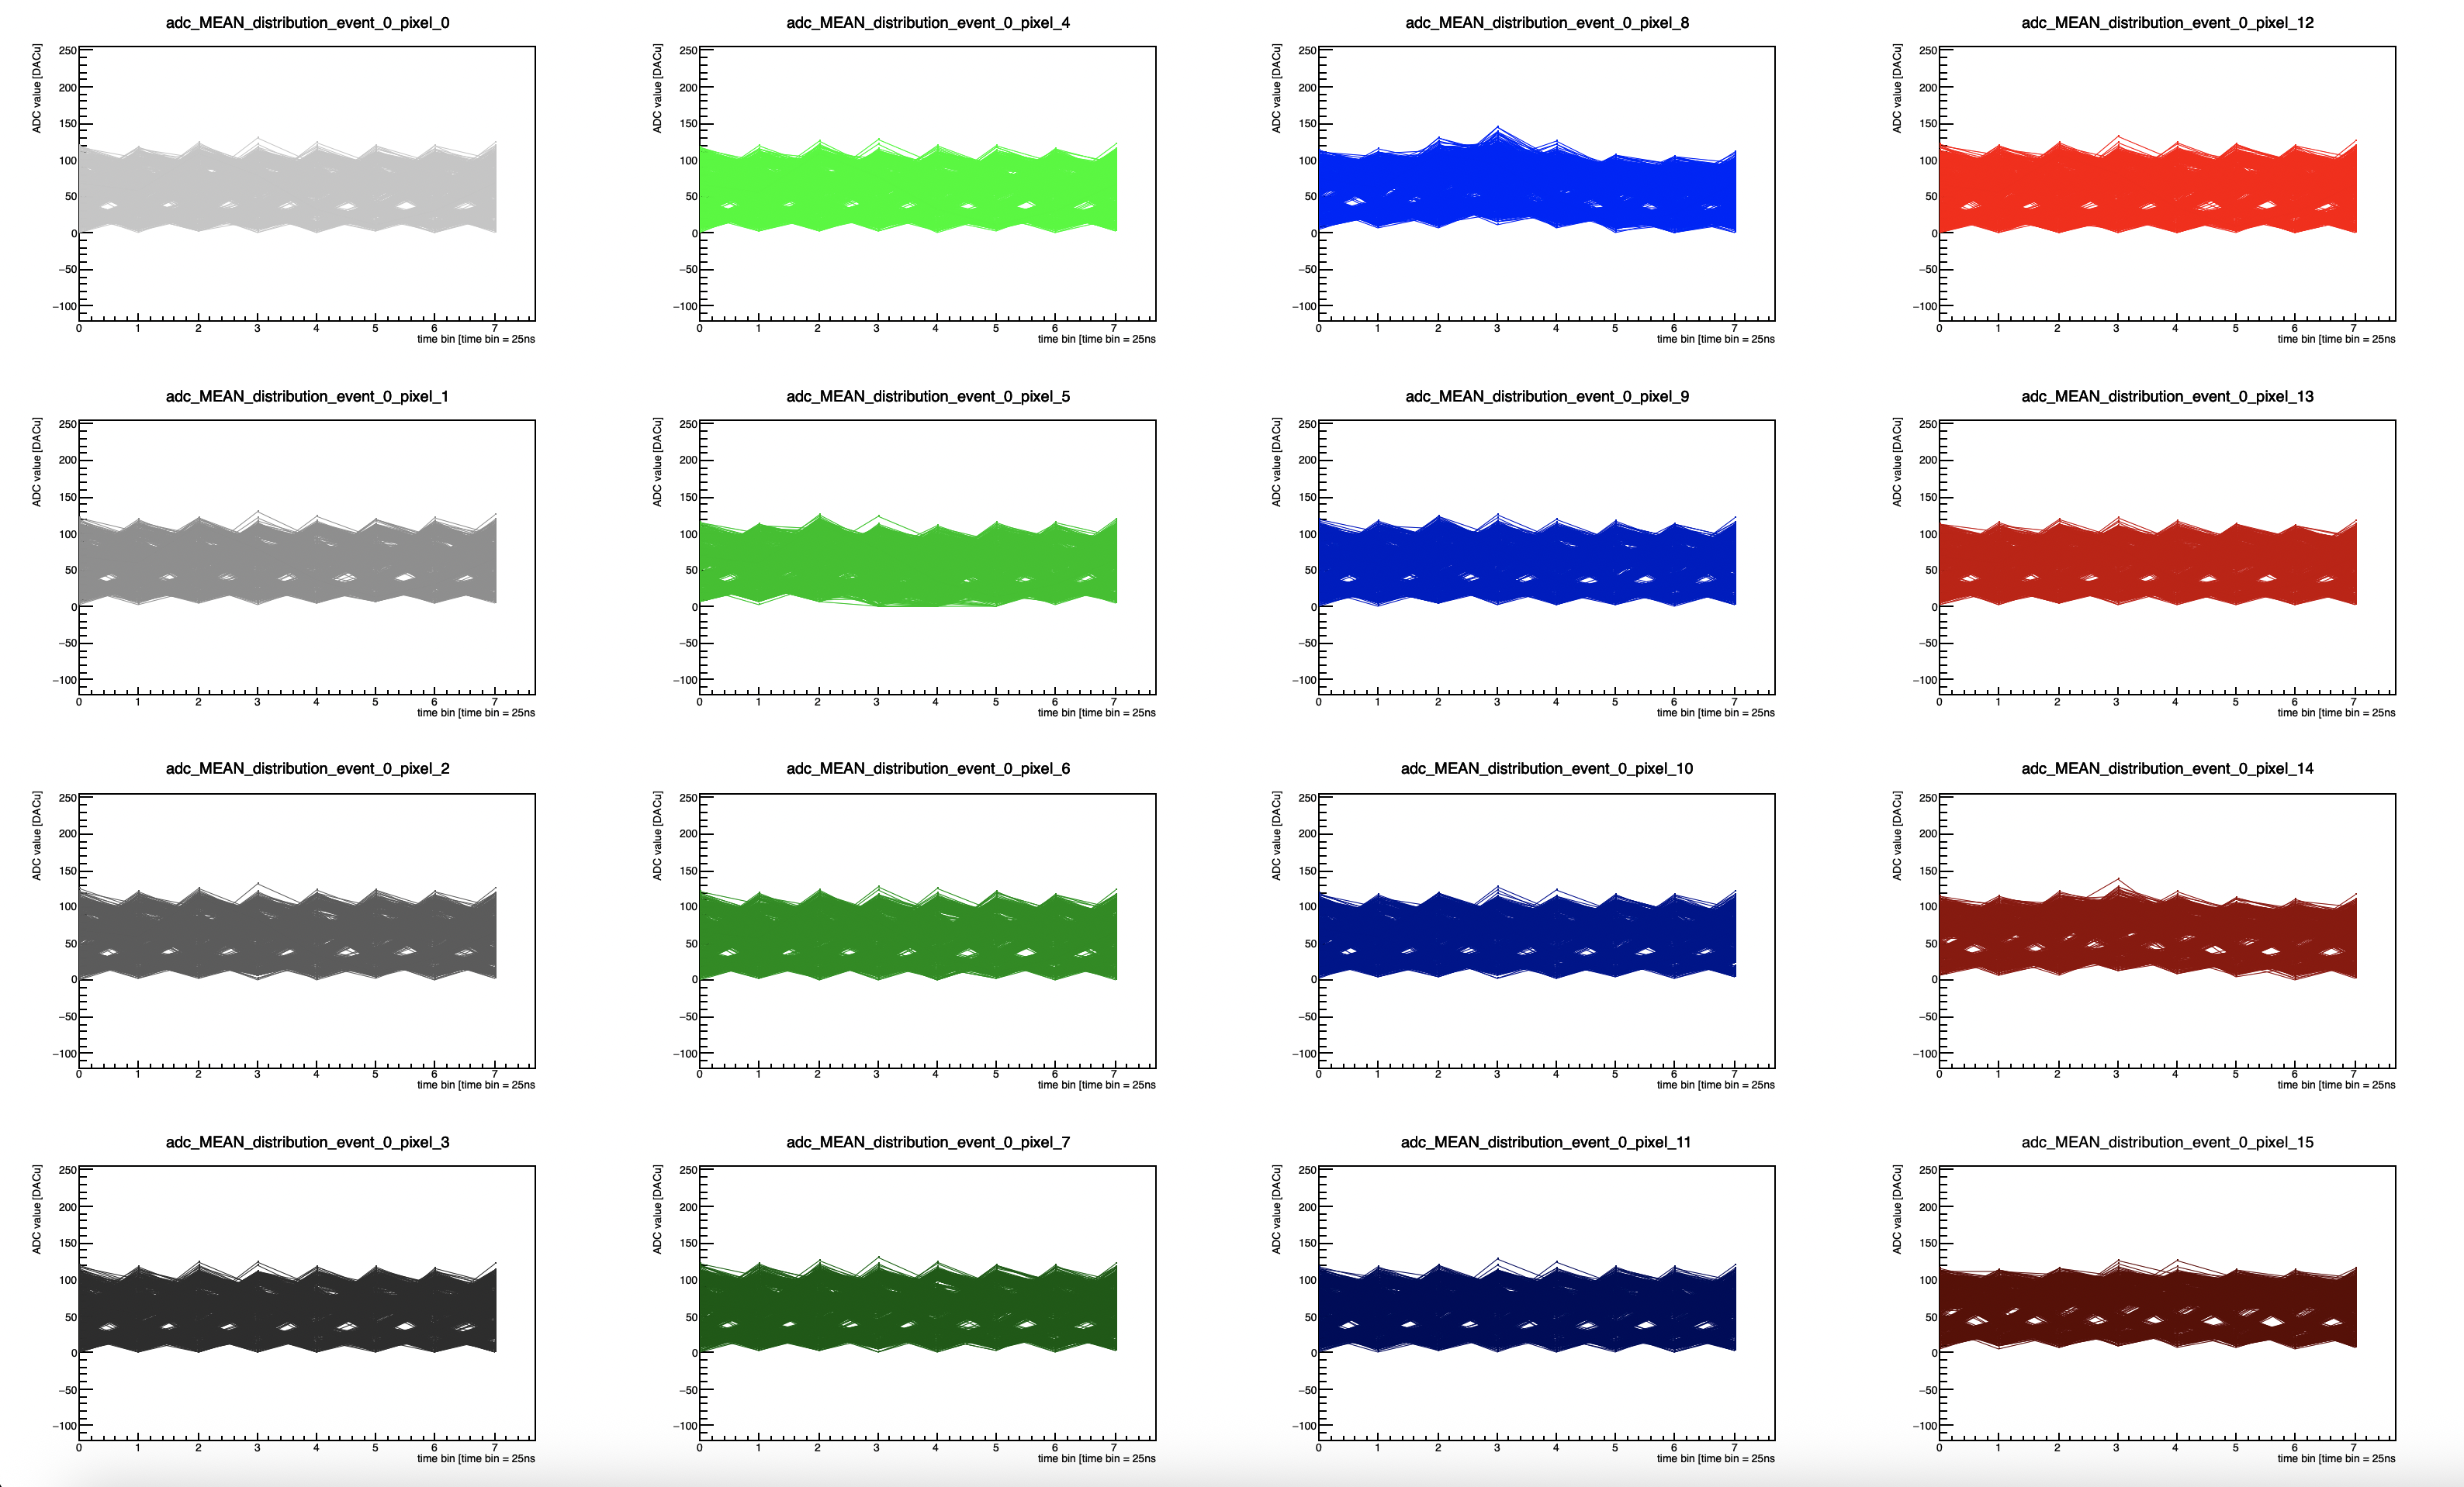
EICROC0 testing @ BNL: Sr-90 source
”trigger” pixel = 5
Running in mode where ACQ window is always “open”, closes only when TRGOUT received from any pixel.
Offline, only look at events where pixel five is over threshold, ONLY
NO pedestal subtraction

Slide 16
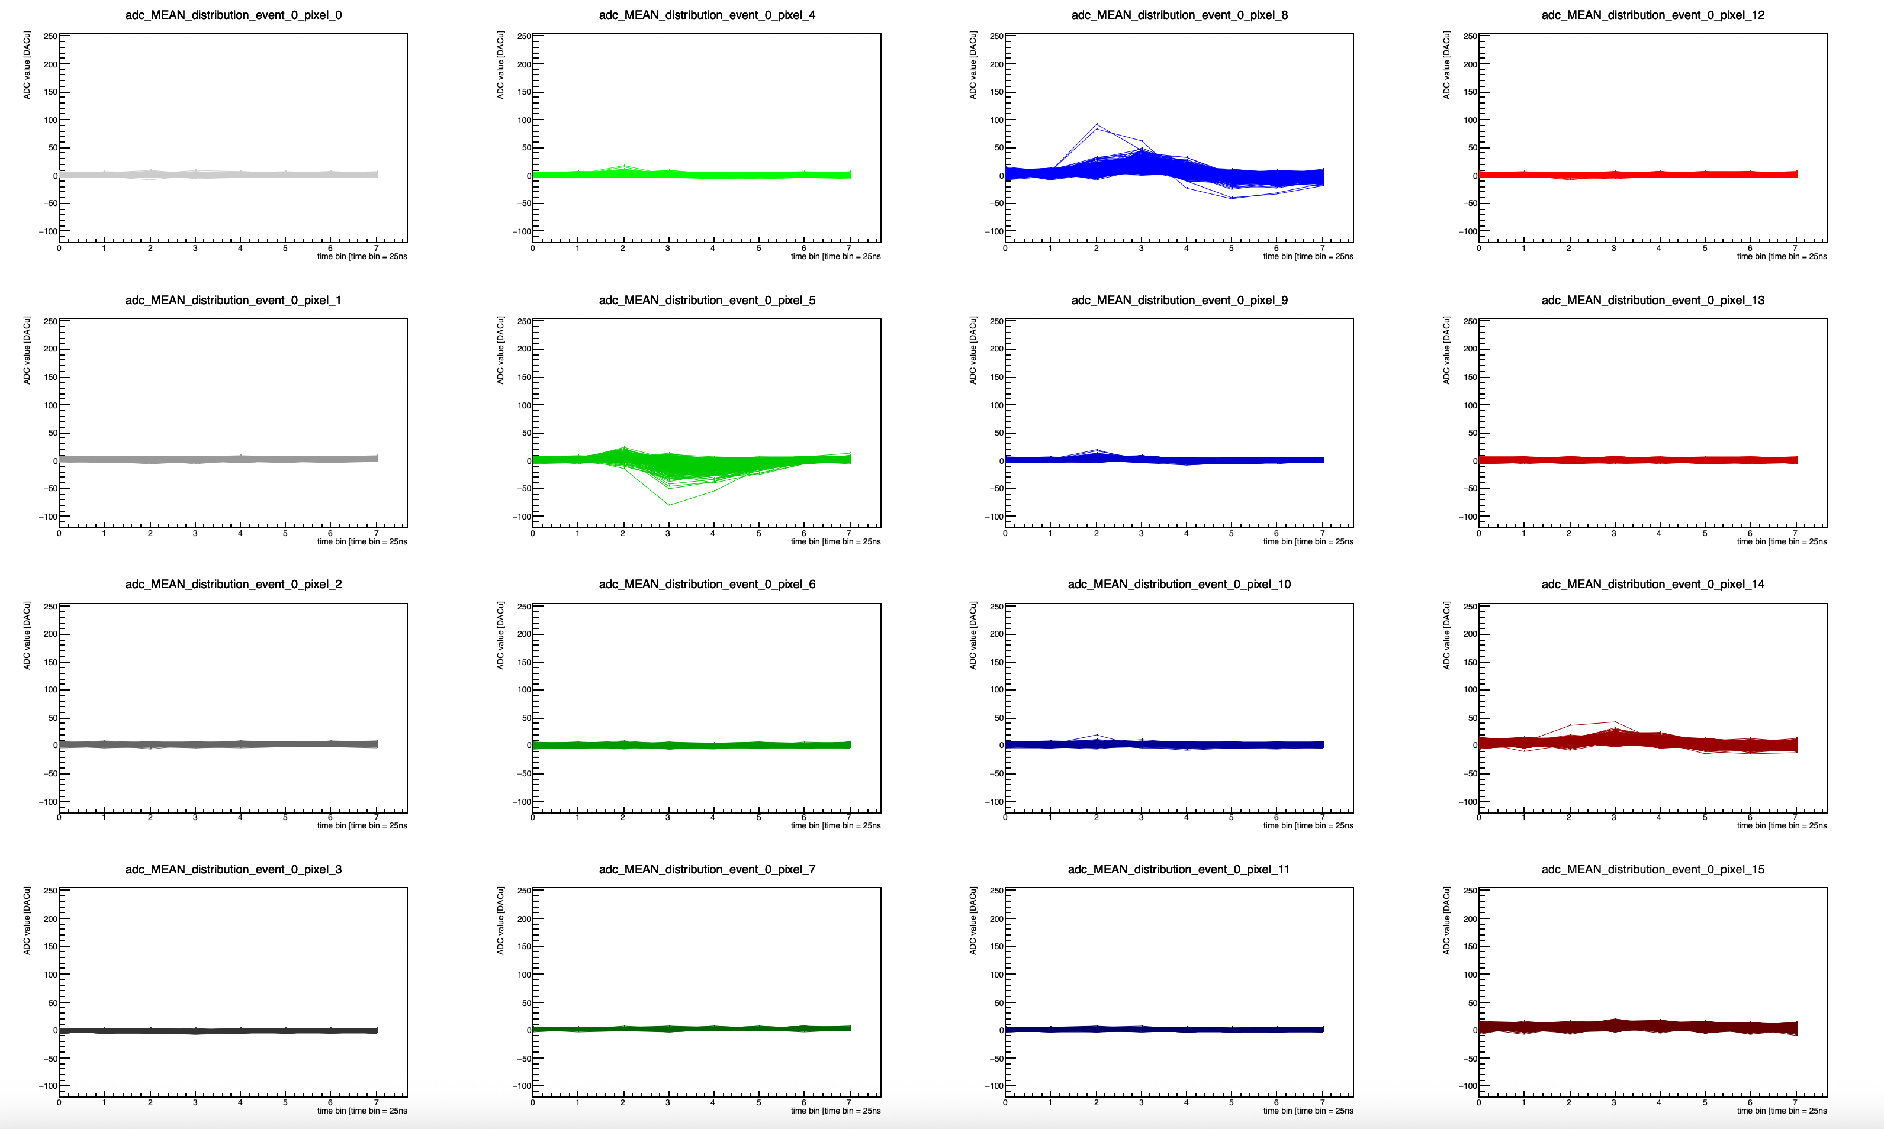
EICROC0 testing @ BNL: Sr-90 source
Using bump-bonded (30um gain layer) sensor to EICROC0 @ -170V.
  Internal trigger
”trigger” pixel = 5
Running in mode where ACQ window is always “open”, closes only when TRGOUT received from any pixel.
Offline, only look at events where pixel five is over threshold, ONLY
Pedestal is average of far pixels (far pixel 15 is very noisy).

Slide 17
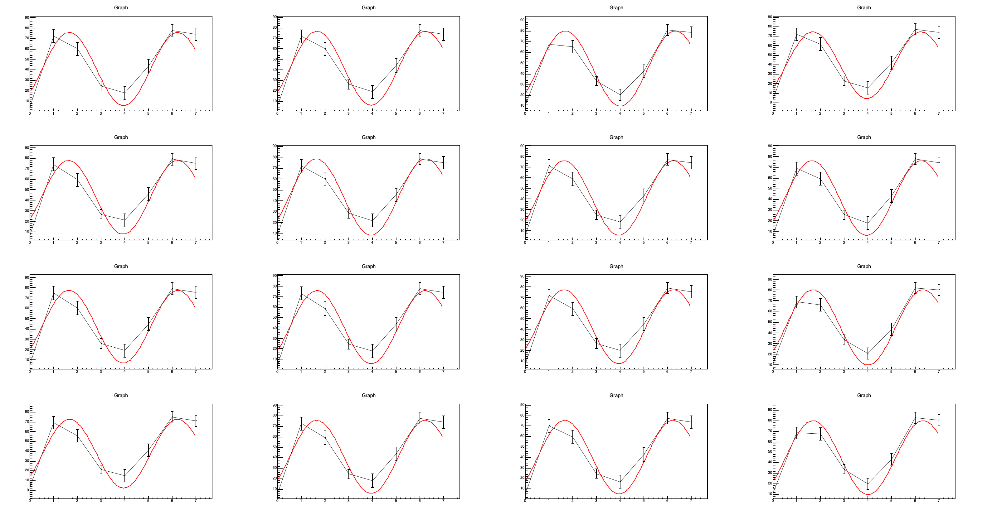
EICROC0 testing @ BNL: pedestal behavior
Using bump-bonded (30um gain layer) sensor to EICROC0 @ -170V.
  Internal trigger
Measure of pedestals (no source).
Delays set to have defined time window (causes pedestals to stay “in-phase”).
Large ADC waveforms from pedestal.
  Have found we can “subtract” these pedestal runs from Sr-90 data IF we match the pedestal phase to the data collected with the source.

Slide 18
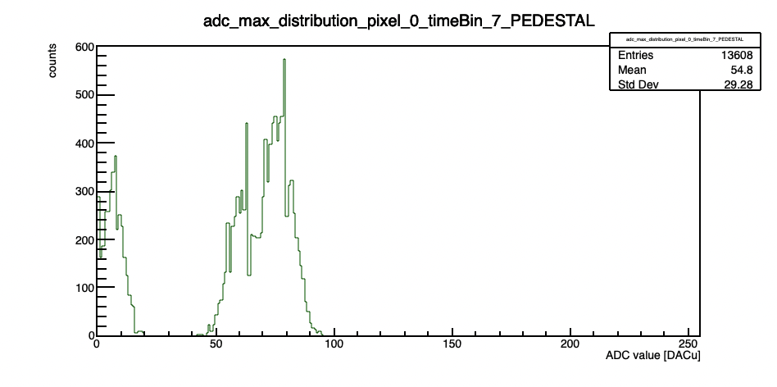
EICROC0 testing @ BNL: ADC issue
Using bump-bonded (30um gain layer) sensor to EICROC0 @ -170V.
  Internal trigger
Multimodal ADC distribution.
  Seemed “fixed” when we used “ceic.reset_before_acq(1)”
  What does this actually do?

Slide 19
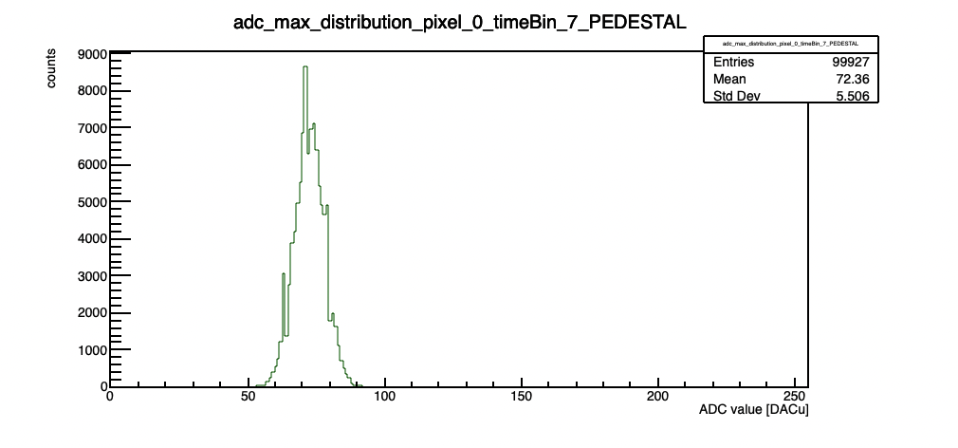
EICROC0 testing @ BNL: ADC issue
Using bump-bonded (30um gain layer) sensor to EICROC0 @ -170V.
  Internal trigger
  Seemed “fixed” when we used “ceic.reset_before_acq(1)”
  What does this actually do?

Slide 20
AC-LGAD + EICROC testing @ BNL (previous results)

Slide 21
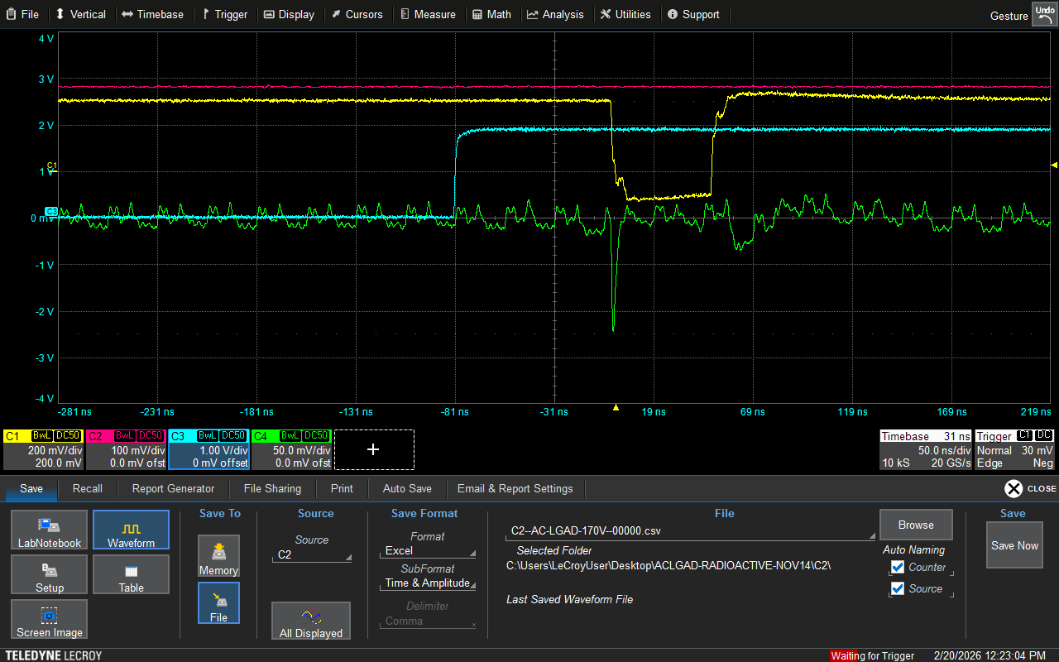
Trigger Issue
Using the ZU706
  Delays set incorrectly in script to interact with firmware.
  Blue: J67 output from FPGA board (start and stop ACQ?)
  Green: analog output from preamp.
  Yellow: command pulse output from testboard.
  Magenta: TRG_OUT from test board.
When scope looks like this, events do not look like they should (the blue output pulse exceeds the 200ns window expected for a shaped event?)
  What actually happens? Does it overwrite ADC/TDC values?

Slide 22
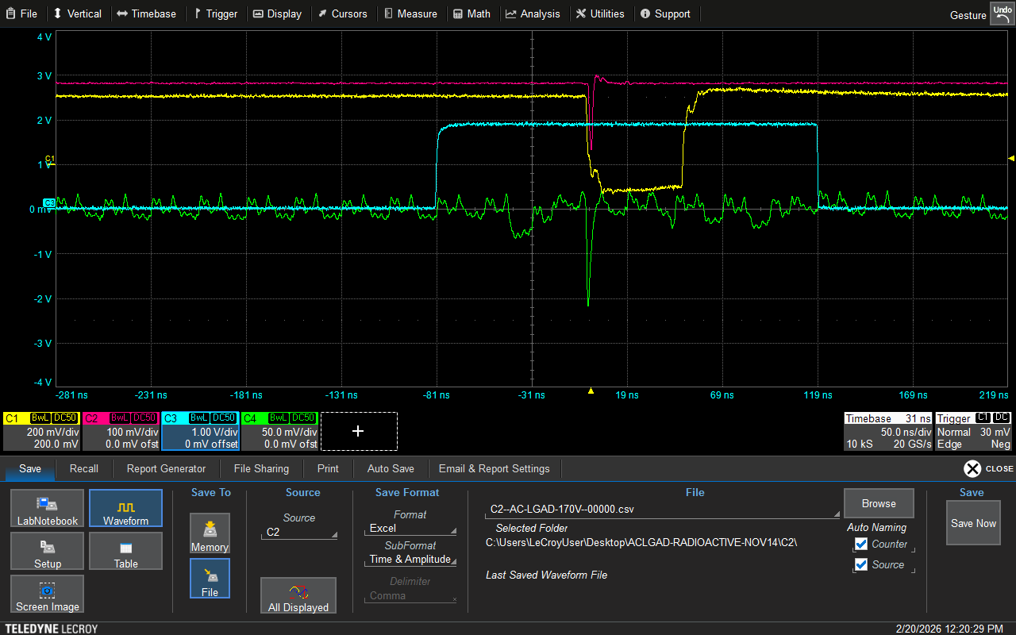
Trigger Issue
Using the ZU706
  Delays set incorrectly in script to interact with firmware.
  Blue: J67 output from FPGA board (start and stop ACQ?)
  Green: analog output from preamp.
  Yellow: command pulse output from testboard.
  Magenta: TRG_OUT from test board.
“guessed” that the blue trigger window established by the FPGA needed to be the same width as a shaped “event” (200ns; 8 time samples).
  Adjusted delays until this was true, then tried taking data.

Slide 23
Trigger Issue – shift to reduce noise
Using the ZU706
  Delays set incorrectly in script to interact with firmware.
  Blue: J67 output from FPGA board (start and stop ACQ?)
  Green: analog output from preamp.
  Yellow: command pulse output from testboard.
  Magenta: TRG_OUT from test board.
“guessed” that the blue trigger window established by the FPGA needed to be the same width as a shaped “event” (200ns; 8 time samples).
  Adjusted delays until this was true, then tried taking data.
1 time bin

Slide 24
ADC distributions

Slide 25
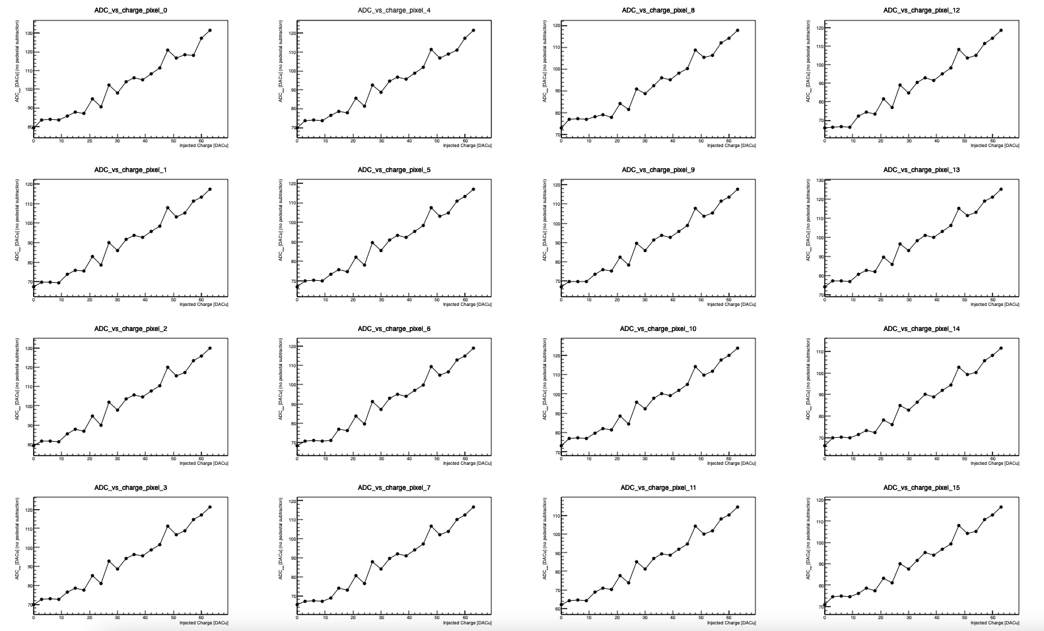
Snapshot of results after fixing trigger issue
All pixels show linear ADC response with increasing charge.
  Distributions are noisy due to combination of unbiased sensor, and potentially the location of the pulse within the trigger window (will adjust and re-take data).
Threshold = 350 DACu
(bump-bonded) Sensor unbiased
520227547096 | 0 | 39 | 0 | 0 | 89 | 0 | 562 | 142 | 0 | 0 | 100 | 0 | 0 | 60 | 1 | 0 | 55 | 0 | 0 | 67 | 0 | 0 | 78 | 0

Slide 26
Snapshot of results after fixing trigger issue
All pixels show linear ADC response with increasing charge.
  Distributions are noisy due to combination of unbiased sensor, and potentially the location of the pulse within the trigger window (will adjust and re-take data).
Threshold = 350 DACu
(bump-bonded) Sensor unbiased
520227547096 | 0 | 39 | 0 | 0 | 89 | 0 | 562 | 142 | 0 | 0 | 100 | 0 | 0 | 60 | 1 | 0 | 55 | 0 | 0 | 67 | 0 | 0 | 78 | 0
TDC ADC H

Slide 27
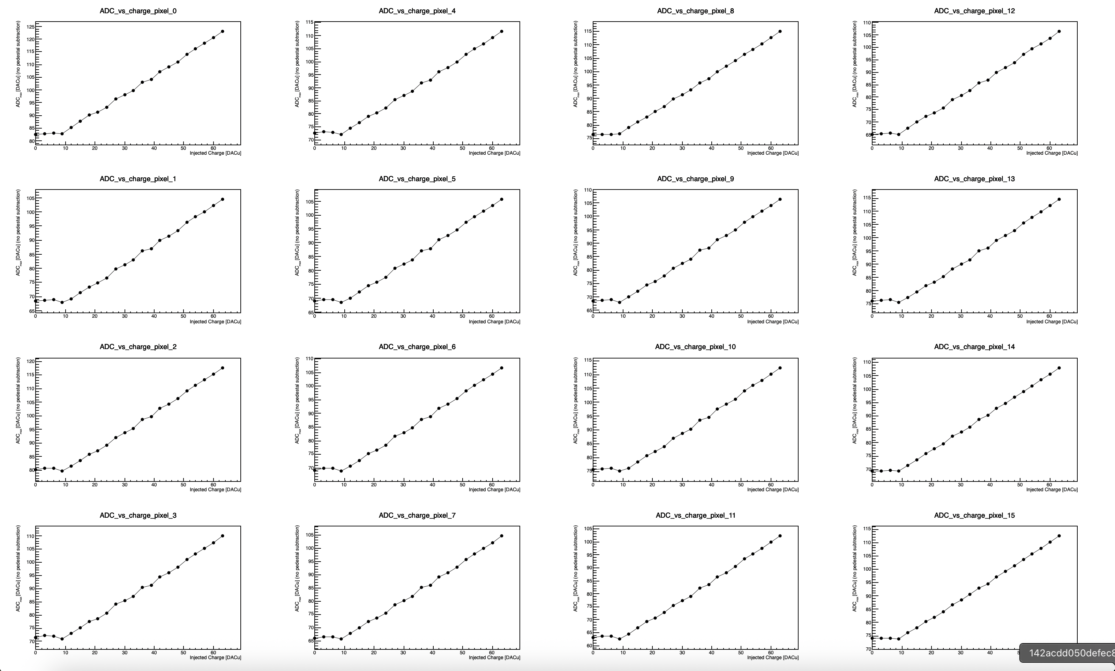
Snapshot of results after fixing trigger issue
All pixels show linear ADC response with increasing charge.
  Adjusted trigger window → shift pulse to center of acquisition window.
Threshold = 350 DACu
(bump-bonded) Sensor unbiased
520227547096 | 0 | 39 | 0 | 0 | 89 | 0 | 562 | 142 | 0 | 0 | 100 | 0 | 0 | 60 | 1 | 0 | 55 | 0 | 0 | 67 | 0 | 0 | 78 | 0
TDC ADC H

Slide 28
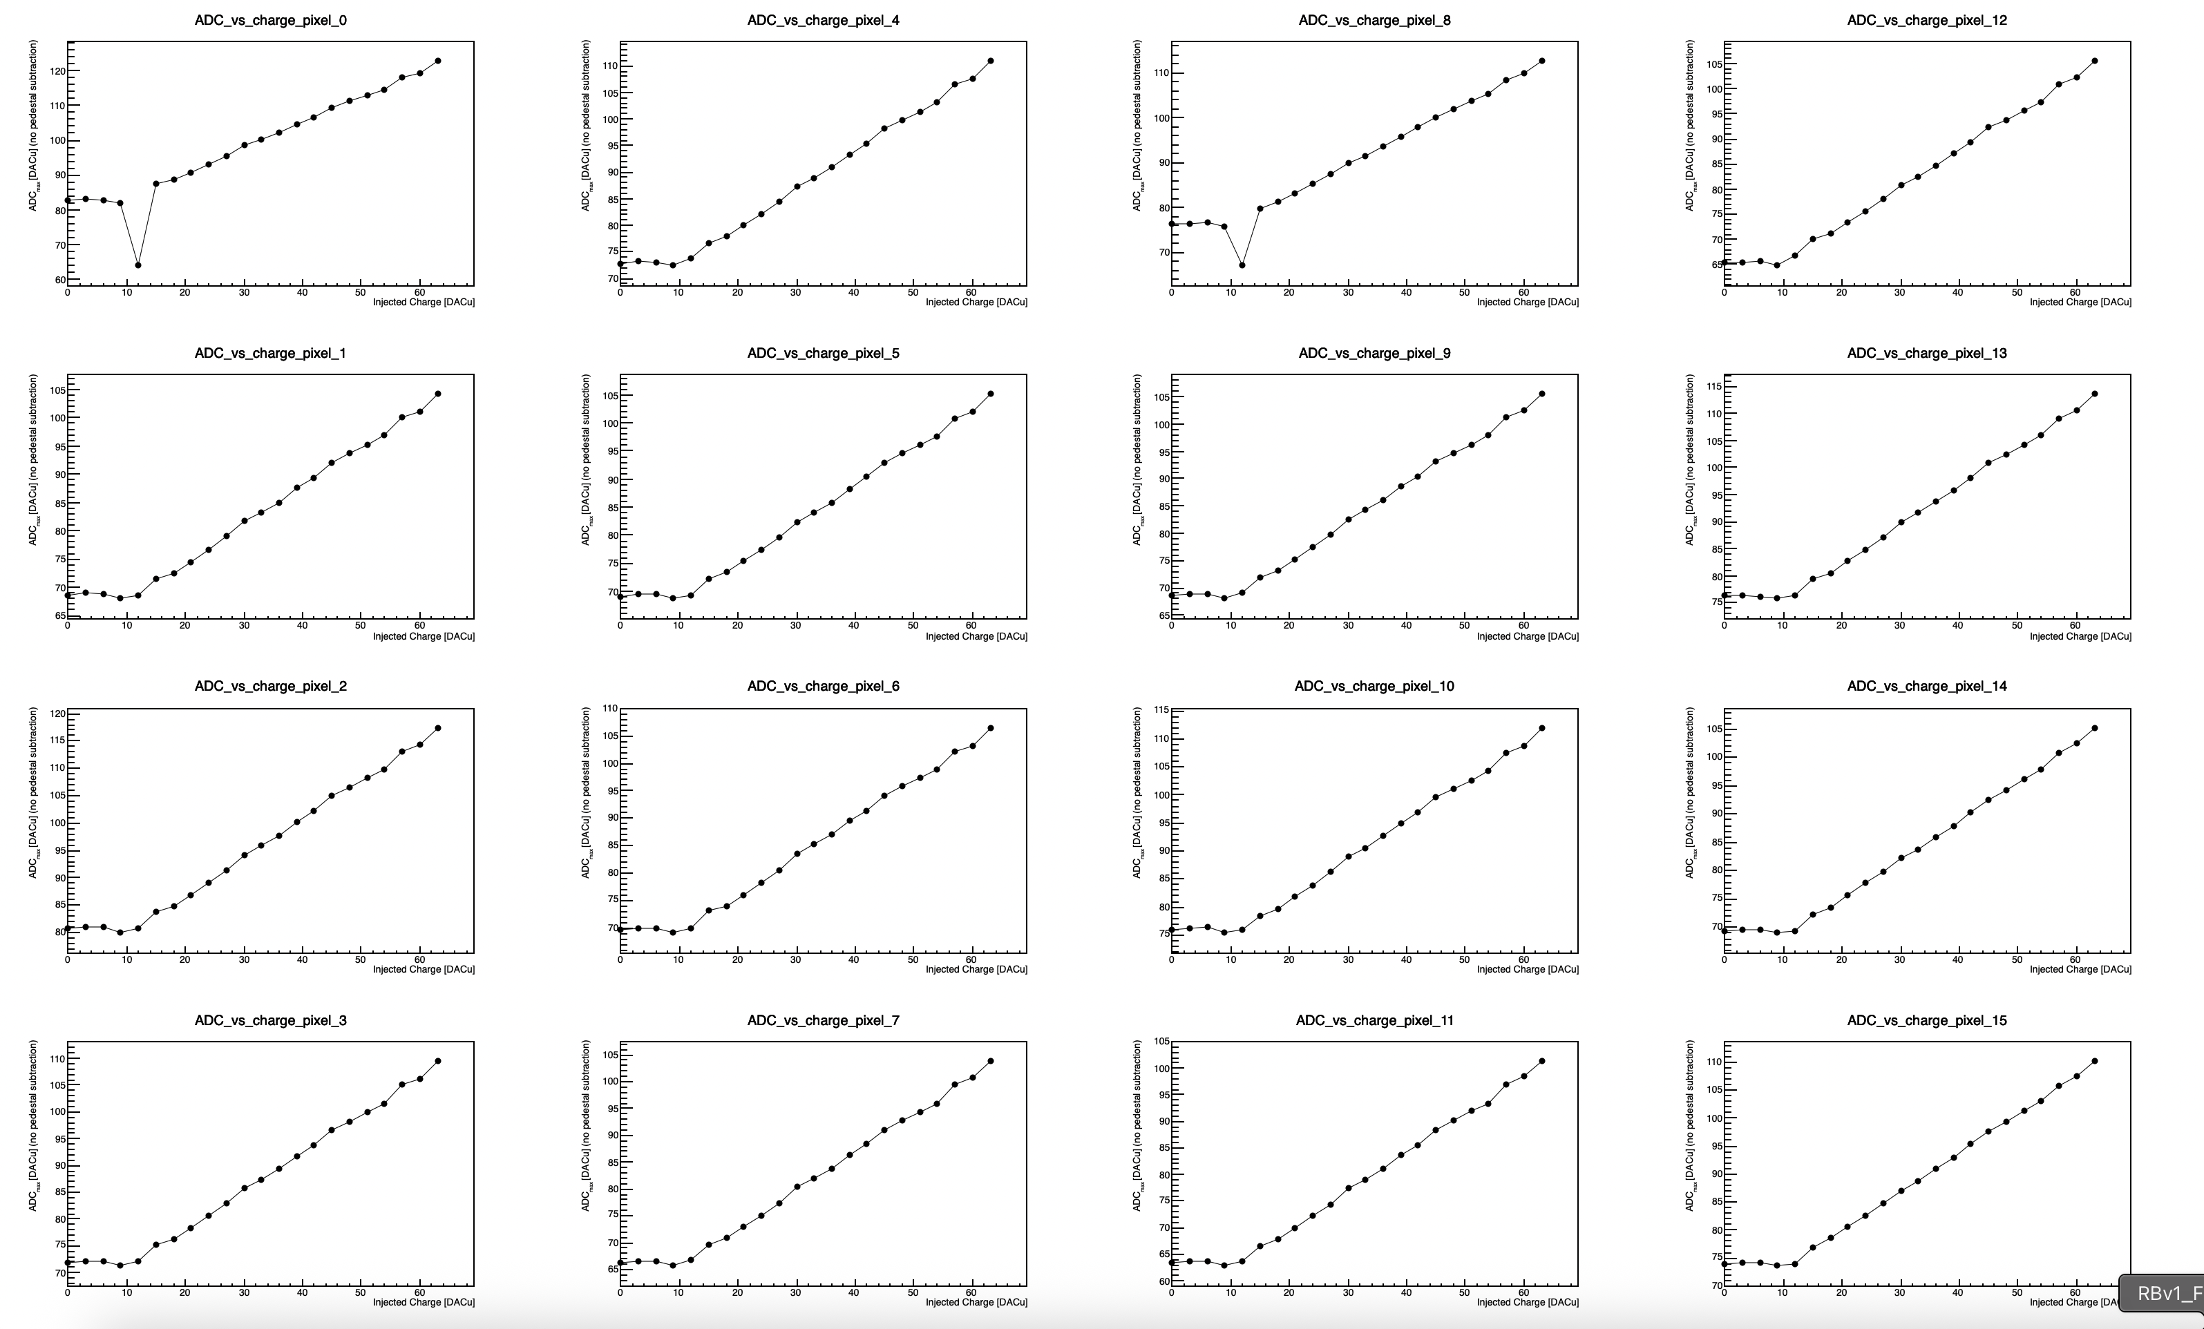
Snapshot of results after fixing trigger issue
All pixels show linear ADC response with increasing charge.
  Adjusted trigger window → shift pulse to center of acquisition window.
Threshold = 350 DACu
(bump-bonded) Sensor BIASED
520227547096 | 0 | 39 | 0 | 0 | 89 | 0 | 562 | 142 | 0 | 0 | 100 | 0 | 0 | 60 | 1 | 0 | 55 | 0 | 0 | 67 | 0 | 0 | 78 | 0
TDC ADC H

Slide 29
TDC distributions – first trigger window, unbiased sensor

Slide 30
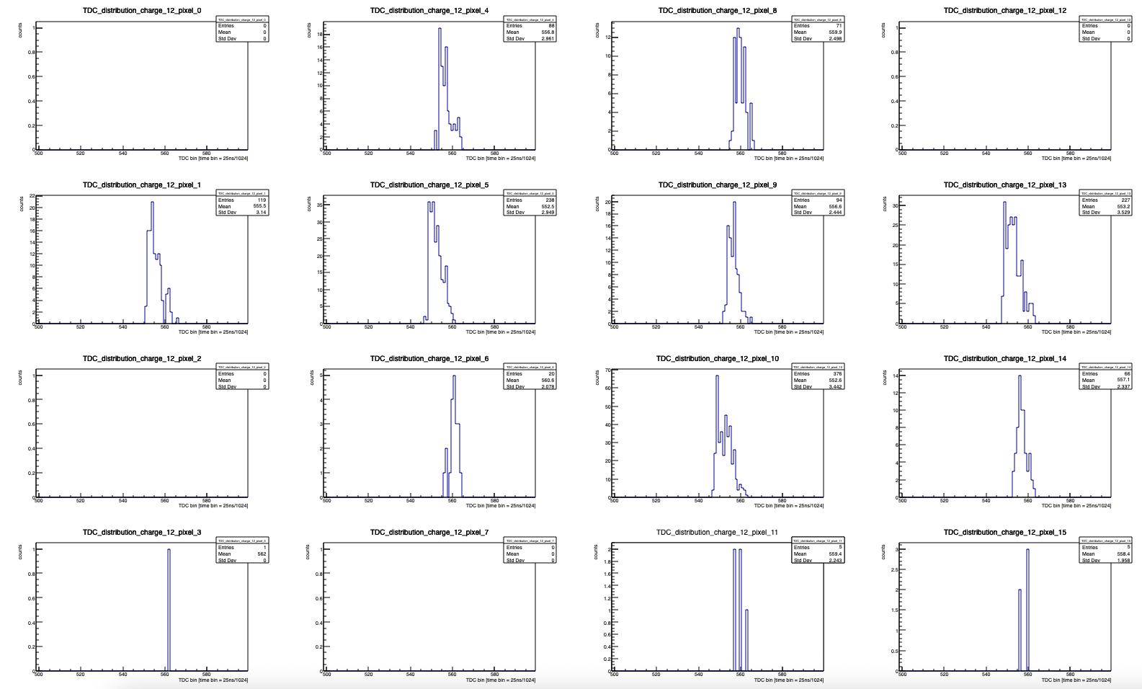
Snapshot of results after fixing trigger issue
TDC distributions for low (Q = 12 DACu ~ 5.3 fC) charge.
  Higher threshold causes come channels to never record TDC → this is what the offsets correct for.
Threshold = 350 DACu
(bump-bonded) Sensor unbiased
520227547096 | 0 | 39 | 0 | 0 | 89 | 0 | 562 | 142 | 0 | 0 | 100 | 0 | 0 | 60 | 1 | 0 | 55 | 0 | 0 | 67 | 0 | 0 | 78 | 0
TDC ADC H

Slide 31
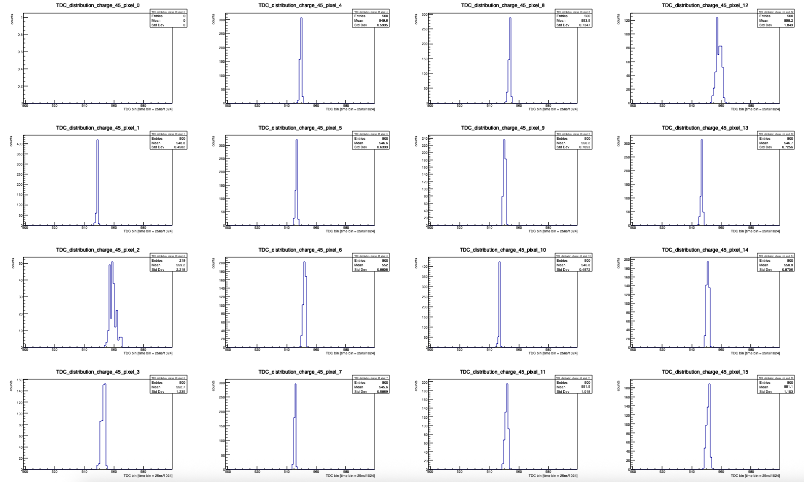
Snapshot of results after fixing trigger issue
TDC distributions for high (Q = 45 DACu ~18.4 fC) charge.
  Sharper TDC distribution (smaller sigma); channel 0 has an issue with its TDC.
Threshold = 350 DACu
(bump-bonded) Sensor unbiased
520227547096 | 0 | 39 | 0 | 0 | 89 | 0 | 562 | 142 | 0 | 0 | 100 | 0 | 0 | 60 | 1 | 0 | 55 | 0 | 0 | 67 | 0 | 0 | 78 | 0
TDC ADC H

Slide 32
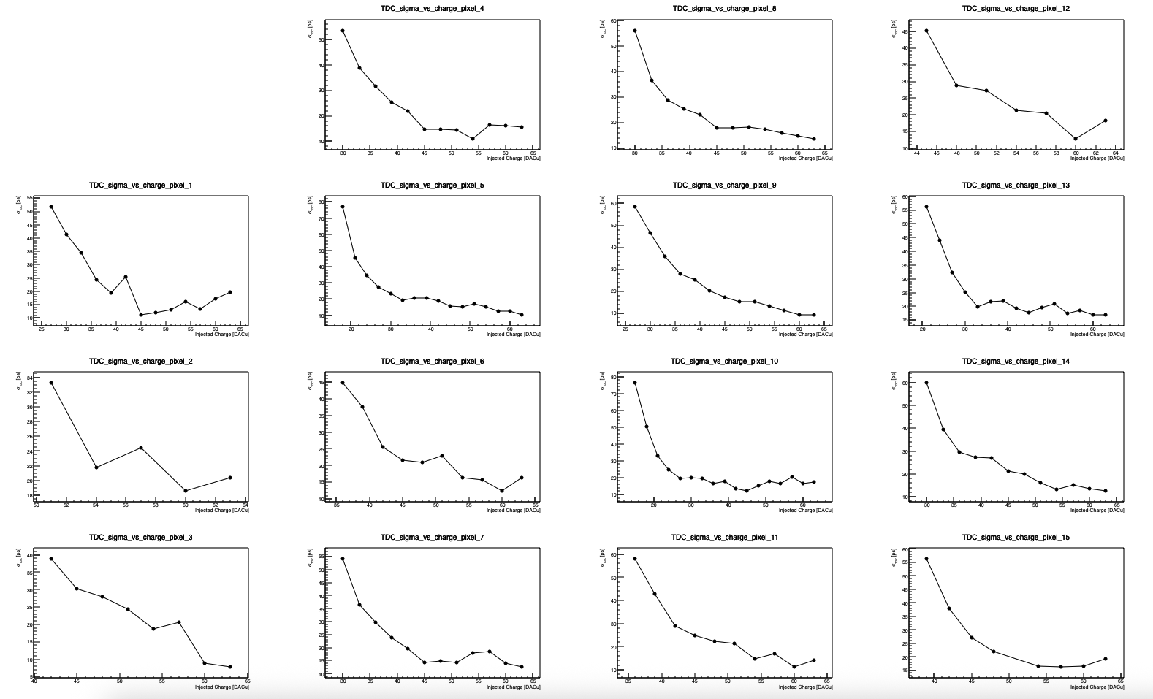
Snapshot of results after fixing trigger issue
TDC jitter distributions
Threshold = 350 DACu
(bump-bonded) Sensor unbiased
520227547096 | 0 | 39 | 0 | 0 | 89 | 0 | 562 | 142 | 0 | 0 | 100 | 0 | 0 | 60 | 1 | 0 | 55 | 0 | 0 | 67 | 0 | 0 | 78 | 0
TDC ADC H

Slide 33
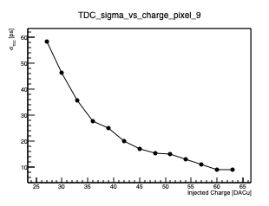
Snapshot of results after fixing trigger issue
TDC jitter distributions
Threshold = 350 DACu
(bump-bonded) Sensor unbiased
520227547096 | 0 | 39 | 0 | 0 | 89 | 0 | 562 | 142 | 0 | 0 | 100 | 0 | 0 | 60 | 1 | 0 | 55 | 0 | 0 | 67 | 0 | 0 | 78 | 0
TDC ADC H

Slide 34
TDC distributions – shifted trigger window, unbiased sensor

Slide 35
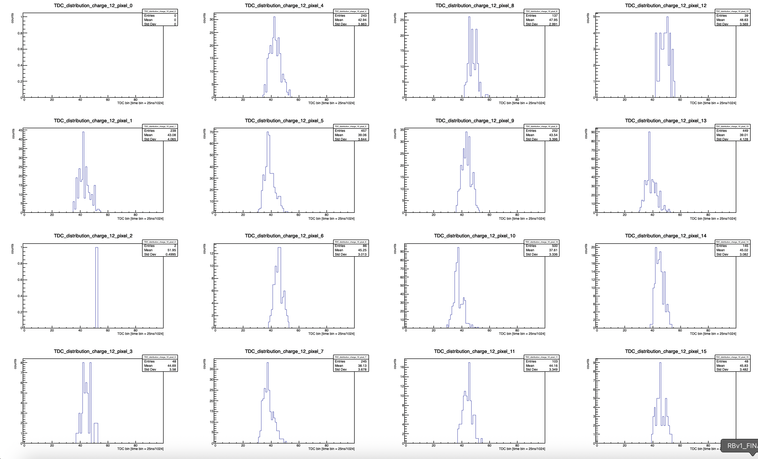
Snapshot of results after fixing trigger issue
TDC distributions for low (Q = 12 DACu ~ 5.3 fC) charge.
  Higher threshold causes come channels to never record TDC → this is what the offsets correct for.
Threshold = 350 DACu
(bump-bonded) Sensor unbiased
520227547096 | 0 | 39 | 0 | 0 | 89 | 0 | 562 | 142 | 0 | 0 | 100 | 0 | 0 | 60 | 1 | 0 | 55 | 0 | 0 | 67 | 0 | 0 | 78 | 0
TDC ADC H

Slide 36
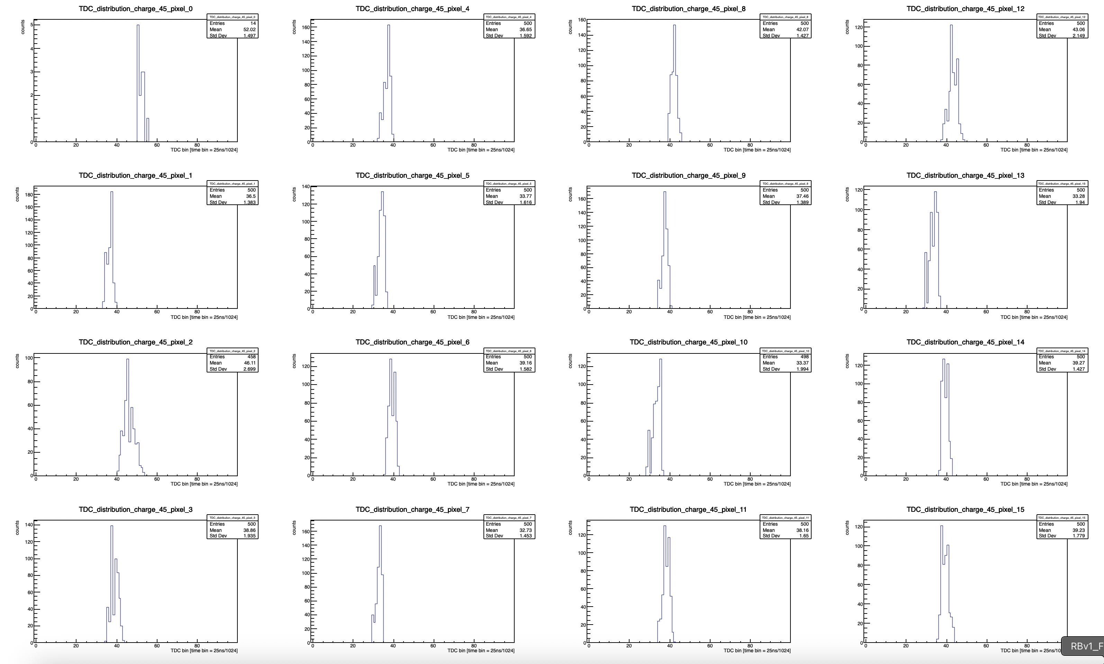
Snapshot of results after fixing trigger issue
TDC distributions for high (Q = 45 DACu ~18.4 fC) charge.
  Sharper TDC distribution (smaller sigma); channel 0 has an issue with its TDC.
Threshold = 350 DACu
(bump-bonded) Sensor unbiased
520227547096 | 0 | 39 | 0 | 0 | 89 | 0 | 562 | 142 | 0 | 0 | 100 | 0 | 0 | 60 | 1 | 0 | 55 | 0 | 0 | 67 | 0 | 0 | 78 | 0
TDC ADC H

Slide 37
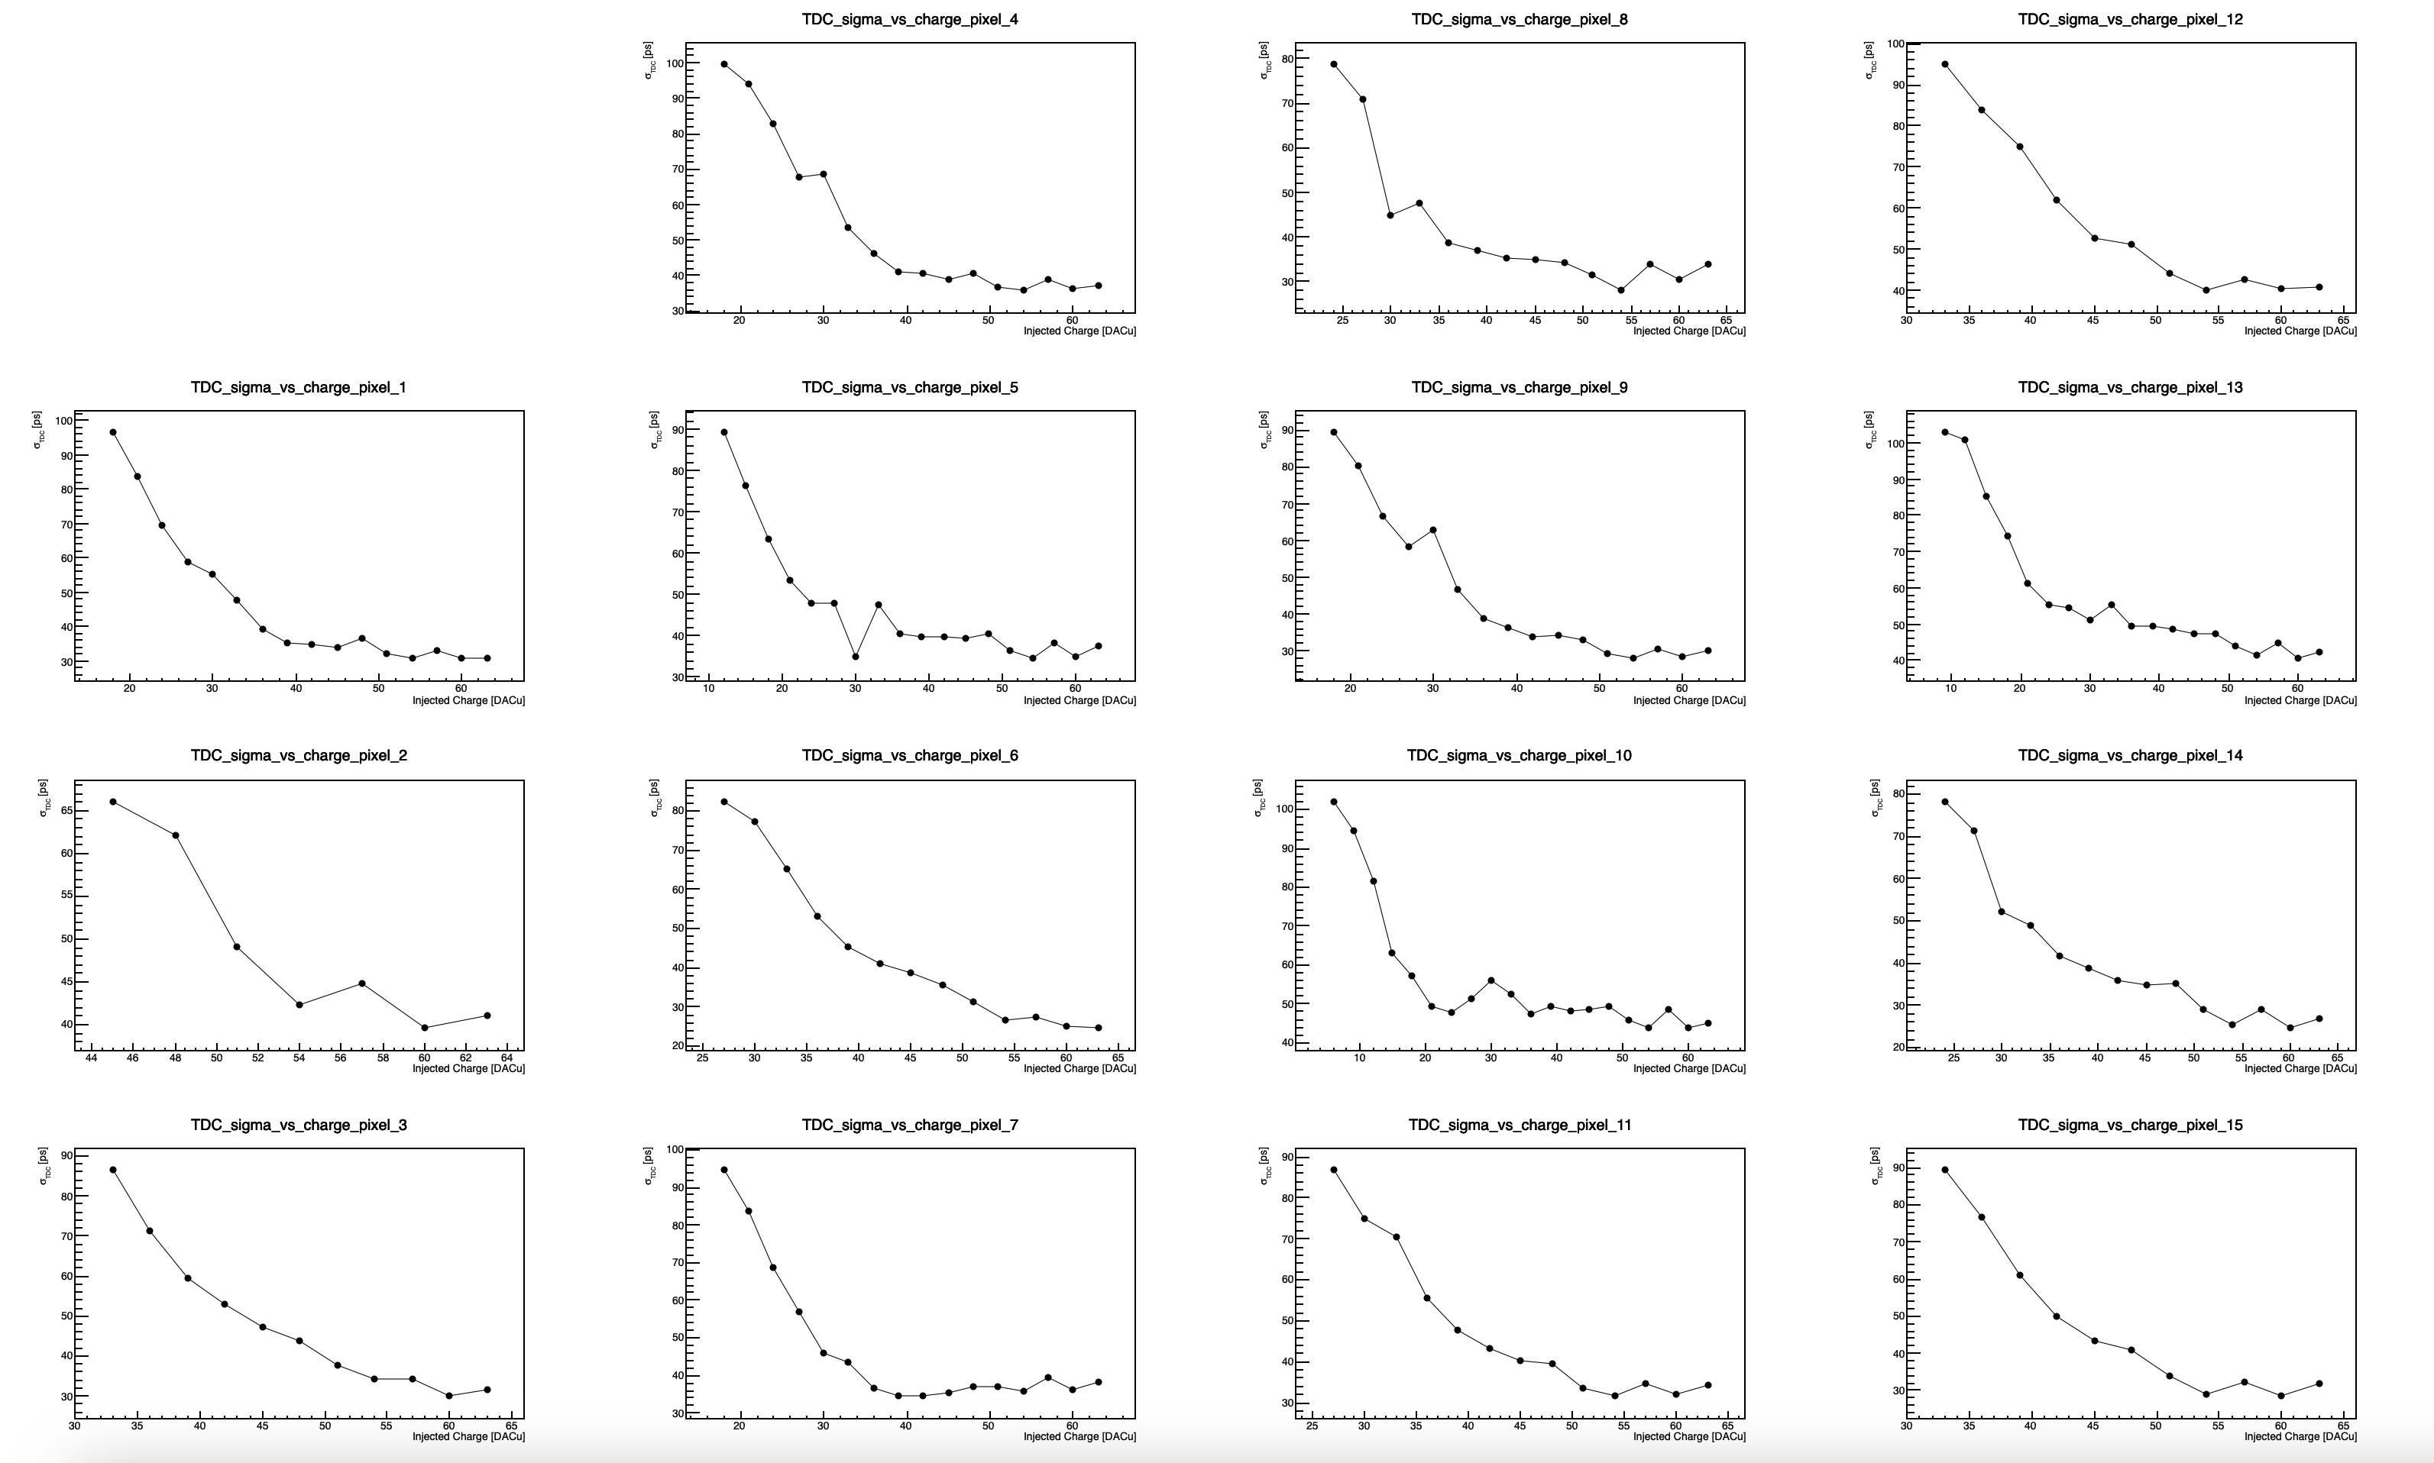
Snapshot of results after fixing trigger issue
TDC jitter distributions
Threshold = 350 DACu
(bump-bonded) Sensor unbiased
520227547096 | 0 | 39 | 0 | 0 | 89 | 0 | 562 | 142 | 0 | 0 | 100 | 0 | 0 | 60 | 1 | 0 | 55 | 0 | 0 | 67 | 0 | 0 | 78 | 0
TDC ADC H

Slide 38
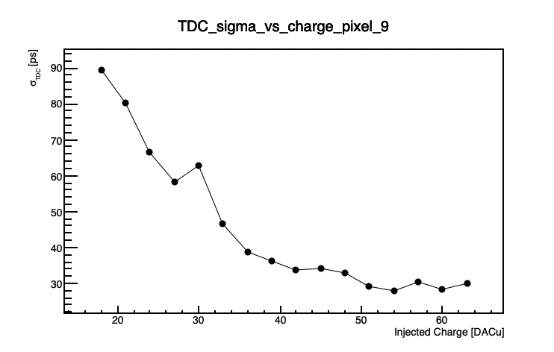
Snapshot of results after fixing trigger issue
TDC jitter distributions
  Worse overall jitter with shifted pulse in ACQ window
Threshold = 350 DACu
(bump-bonded) Sensor unbiased
520227547096 | 0 | 39 | 0 | 0 | 89 | 0 | 562 | 142 | 0 | 0 | 100 | 0 | 0 | 60 | 1 | 0 | 55 | 0 | 0 | 67 | 0 | 0 | 78 | 0
TDC ADC H

Slide 39
TDC distributions – shifted trigger window, biased sensor

Slide 40
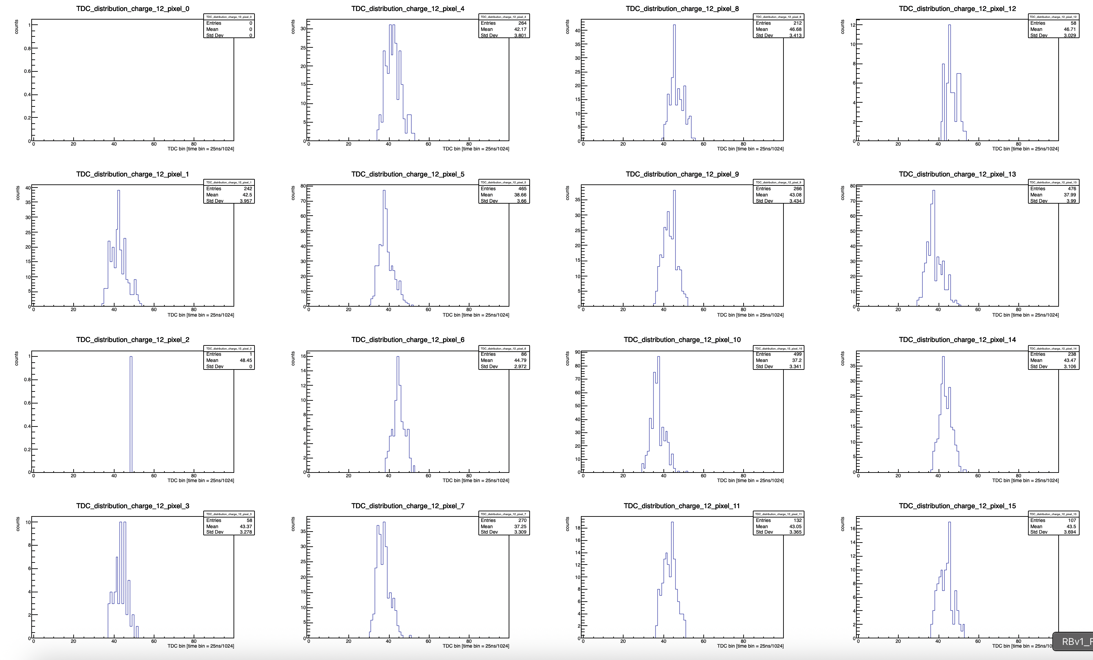
Snapshot of results after fixing trigger issue
TDC distributions for low (Q = 12 DACu ~ 5.3 fC) charge.
  Higher threshold causes come channels to never record TDC → this is what the offsets correct for.
Threshold = 350 DACu
(bump-bonded) Sensor BIASED
520227547096 | 0 | 39 | 0 | 0 | 89 | 0 | 562 | 142 | 0 | 0 | 100 | 0 | 0 | 60 | 1 | 0 | 55 | 0 | 0 | 67 | 0 | 0 | 78 | 0
TDC ADC H

Slide 41
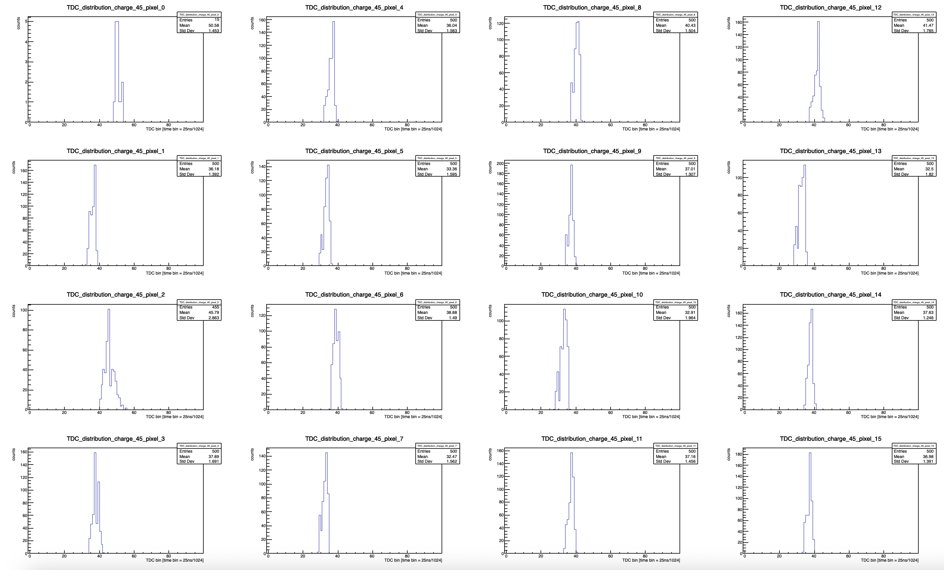
Snapshot of results after fixing trigger issue
TDC distributions for high (Q = 45 DACu ~18.4 fC) charge.
  Sharper TDC distribution (smaller sigma); channel 0 has an issue with its TDC.
Threshold = 350 DACu
(bump-bonded) Sensor BIASED
520227547096 | 0 | 39 | 0 | 0 | 89 | 0 | 562 | 142 | 0 | 0 | 100 | 0 | 0 | 60 | 1 | 0 | 55 | 0 | 0 | 67 | 0 | 0 | 78 | 0
TDC ADC H

Slide 42
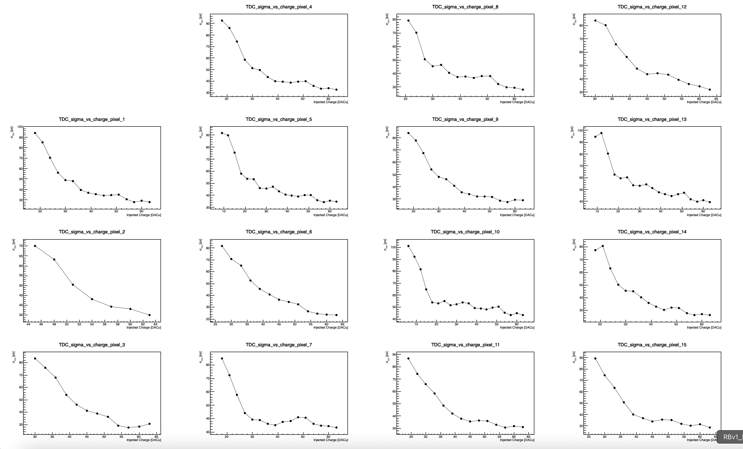
Snapshot of results after fixing trigger issue
TDC jitter distributions
Threshold = 350 DACu
(bump-bonded) Sensor BIASED
520227547096 | 0 | 39 | 0 | 0 | 89 | 0 | 562 | 142 | 0 | 0 | 100 | 0 | 0 | 60 | 1 | 0 | 55 | 0 | 0 | 67 | 0 | 0 | 78 | 0
TDC ADC H

Slide 43
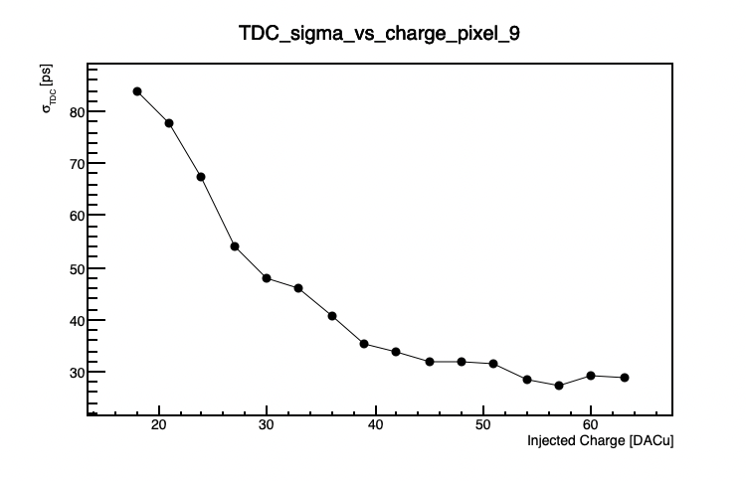
Snapshot of results after fixing trigger issue
TDC jitter distributions
  Worse overall jitter with shifted pulse in ACQ window
Threshold = 350 DACu
(bump-bonded) Sensor BIASED
520227547096 | 0 | 39 | 0 | 0 | 89 | 0 | 562 | 142 | 0 | 0 | 100 | 0 | 0 | 60 | 1 | 0 | 55 | 0 | 0 | 67 | 0 | 0 | 78 | 0
TDC ADC H

Slide 44
Summary and outlook
Major trigger window issues + I2C issues ironed-out for now (thanks to Dominique et al for some firmware updates which fixed the I2C issues).
Should have initial calibrations done in a few days, and will start setting up the Sr-90 data-taking with internal trigger.
  External trigger testing will follow soon after.
Order is ready for the analog preamp boards for large sensors (just need some boiler plate text added to drawings for export control).
  Ordering 25, but the company is local, so we can order more if needed down the road.
Stave/module board design for FF detectors in-progress, first version expected in 1-2 weeks (fabrication of v0 soon after).

Slide 45
Backup

Slide 46
Trigger Issue
Using the ZU706
  Delays set incorrectly in script to interact with firmware.
  Blue: J67 output from FPGA board (start and stop ACQ?)
  Green: analog output from preamp.
  Yellow: command pulse output from testboard.
  Magenta: TRG_OUT from test board.
When scope looks like this, events do not look like they should (the blue output pulse exceeds the 200ns window expected for a shaped event?)
  What actually happens? Does it overwrite ADC/TDC values?

Slide 47
Trigger Issue
Using the ZU706
  Delays set incorrectly in script to interact with firmware.
  Blue: J67 output from FPGA board (start and stop ACQ?)
  Green: analog output from preamp.
  Yellow: command pulse output from testboard.
  Magenta: TRG_OUT from test board.
“guessed” that the blue trigger window established by the FPGA needed to be the same width as a shaped “event” (200ns; 8 time samples).
  Adjusted delays until this was true, then tried taking data.

Slide 48
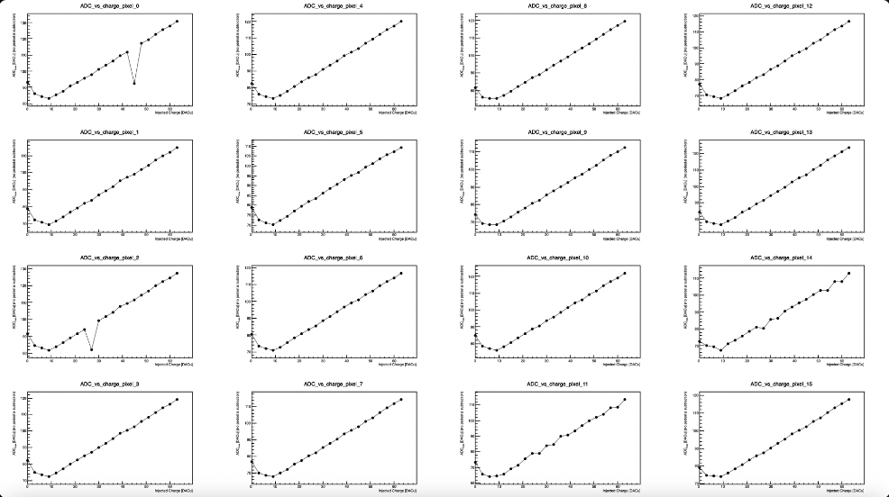
Trigger Issue
After this tinkering, finally got some results with charged injection that were not complete nonsense.
  ADC vs. injected charge.
TDC ADC H
520227547096 | 0 | 39 | 0 | 0 | 89 | 0 | 562 | 142 | 0 | 0 | 100 | 0 | 0 | 60 | 1 | 0 | 55 | 0 | 0 | 67 | 0 | 0 | 78 | 0

Slide 49
Trigger Issue
After this tinkering, finally got some results with charged injection that were not complete nonsense.
  ADC vs. injected charge.
For each charge, average ADC values in each time-bin, and then extract the maximum from the averaged waveforms.
  The maximum is plotted for each charge, per pixel.
TDC ADC H
520227547096 | 0 | 39 | 0 | 0 | 89 | 0 | 562 | 142 | 0 | 0 | 100 | 0 | 0 | 60 | 1 | 0 | 55 | 0 | 0 | 67 | 0 | 0 | 78 | 0

Slide 50
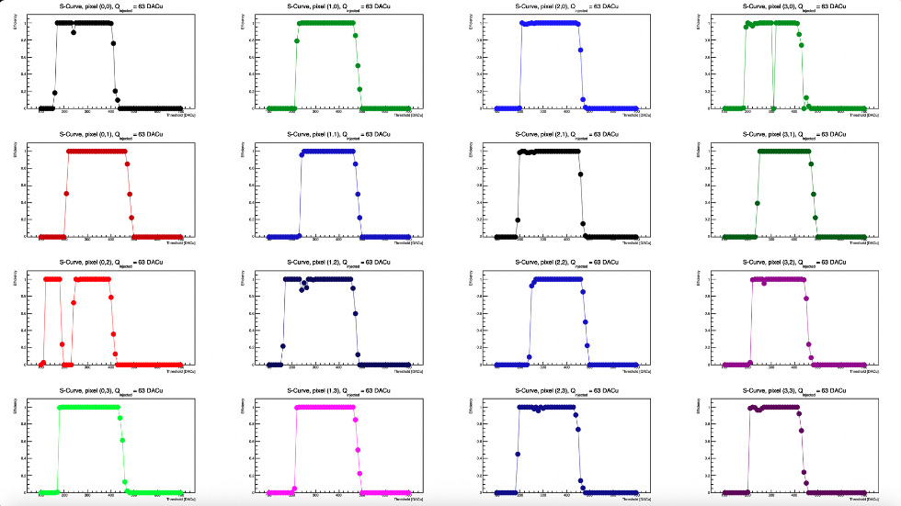
Trigger Issue
After this tinkering, finally got some results with charged injection that were not complete nonsense.
  S-curves.
TDC ADC H
520227547096 | 0 | 39 | 0 | 0 | 89 | 0 | 562 | 142 | 0 | 0 | 100 | 0 | 0 | 60 | 1 | 0 | 55 | 0 | 0 | 67 | 0 | 0 | 78 | 0

Slide 51
Trigger Issue
After this tinkering, finally got some results with charged injection that were not complete nonsense.
  S-curves.
Look for “good” events with one hitbit == 1 (only crossed threshold once).
  Should also have one TDC value, after hitbit == 1
TDC ADC H
520227547096 | 0 | 39 | 0 | 0 | 89 | 0 | 562 | 142 | 0 | 0 | 100 | 0 | 0 | 60 | 1 | 0 | 55 | 0 | 0 | 67 | 0 | 0 | 78 | 0

Slide 52
Open Issues
When we try to extract s-curves from lower injected charged (needed to calibrate the thresholds) – data look incoherent.
  Meaning, our events do not have the behavior they should.
  Still do not know if the trigger delays we are using are even correct → ”seems” correct doesn’t mean much – we need documentation on the meaning of the various variables so we can be sure.
Cannot replicate reasonable behavior with the newer Xilinx (ZCU106).
We have contacted IJCLab/OMEGA and will work to solve the issues so we can calibrate the thresholds and Vref, and start taking data with the Sr-90 source.

Slide 53
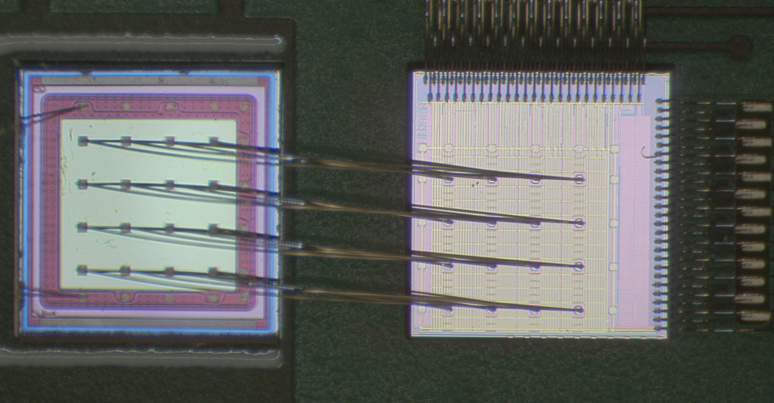
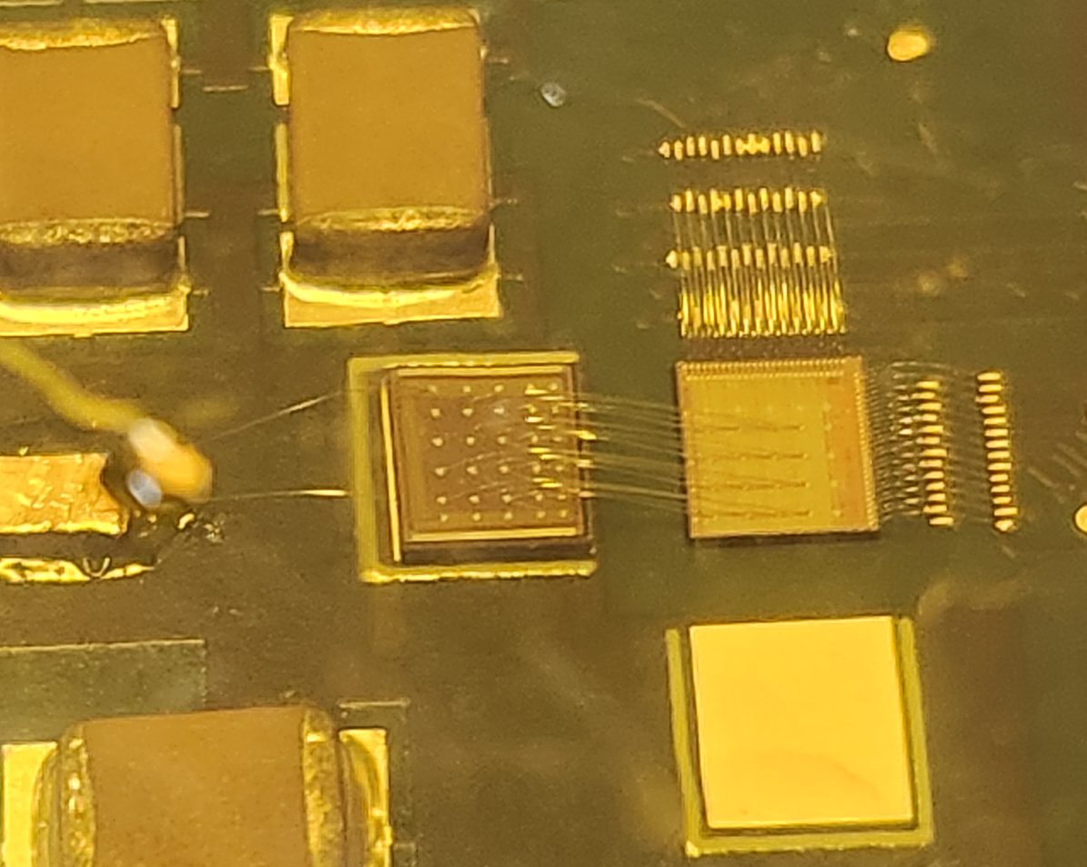
Implementation of AC-LGADs for FF Tracking
AC-LGAD
EICROC0
BNL AC-LGAD:
500x500 um² pixel pitch
100x100 um² metal electrode
30um active thickness
EICROC ASIC proposed for pixilated AC-LGADs.
  Uses infrastructure from ALTIROC (used for DC-LGADs in ATLAS) and HGCROC (I2C)
  Currently only 4x4 channel version exists, 32x32 (full channel count) in production (to arrive in Feb./March 2026).
  Also used in FTOF (or any pixilated AC-LGAD detector).

Slide 54
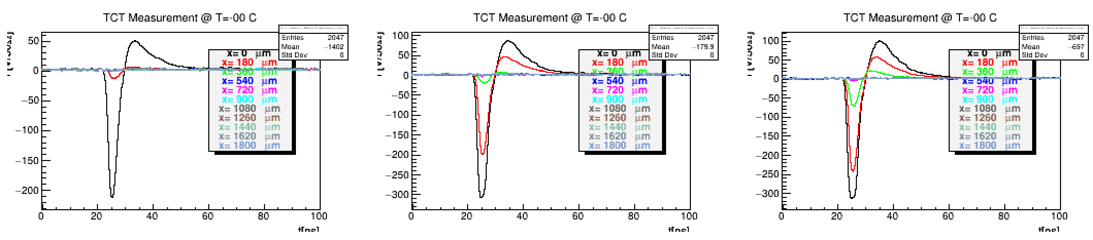
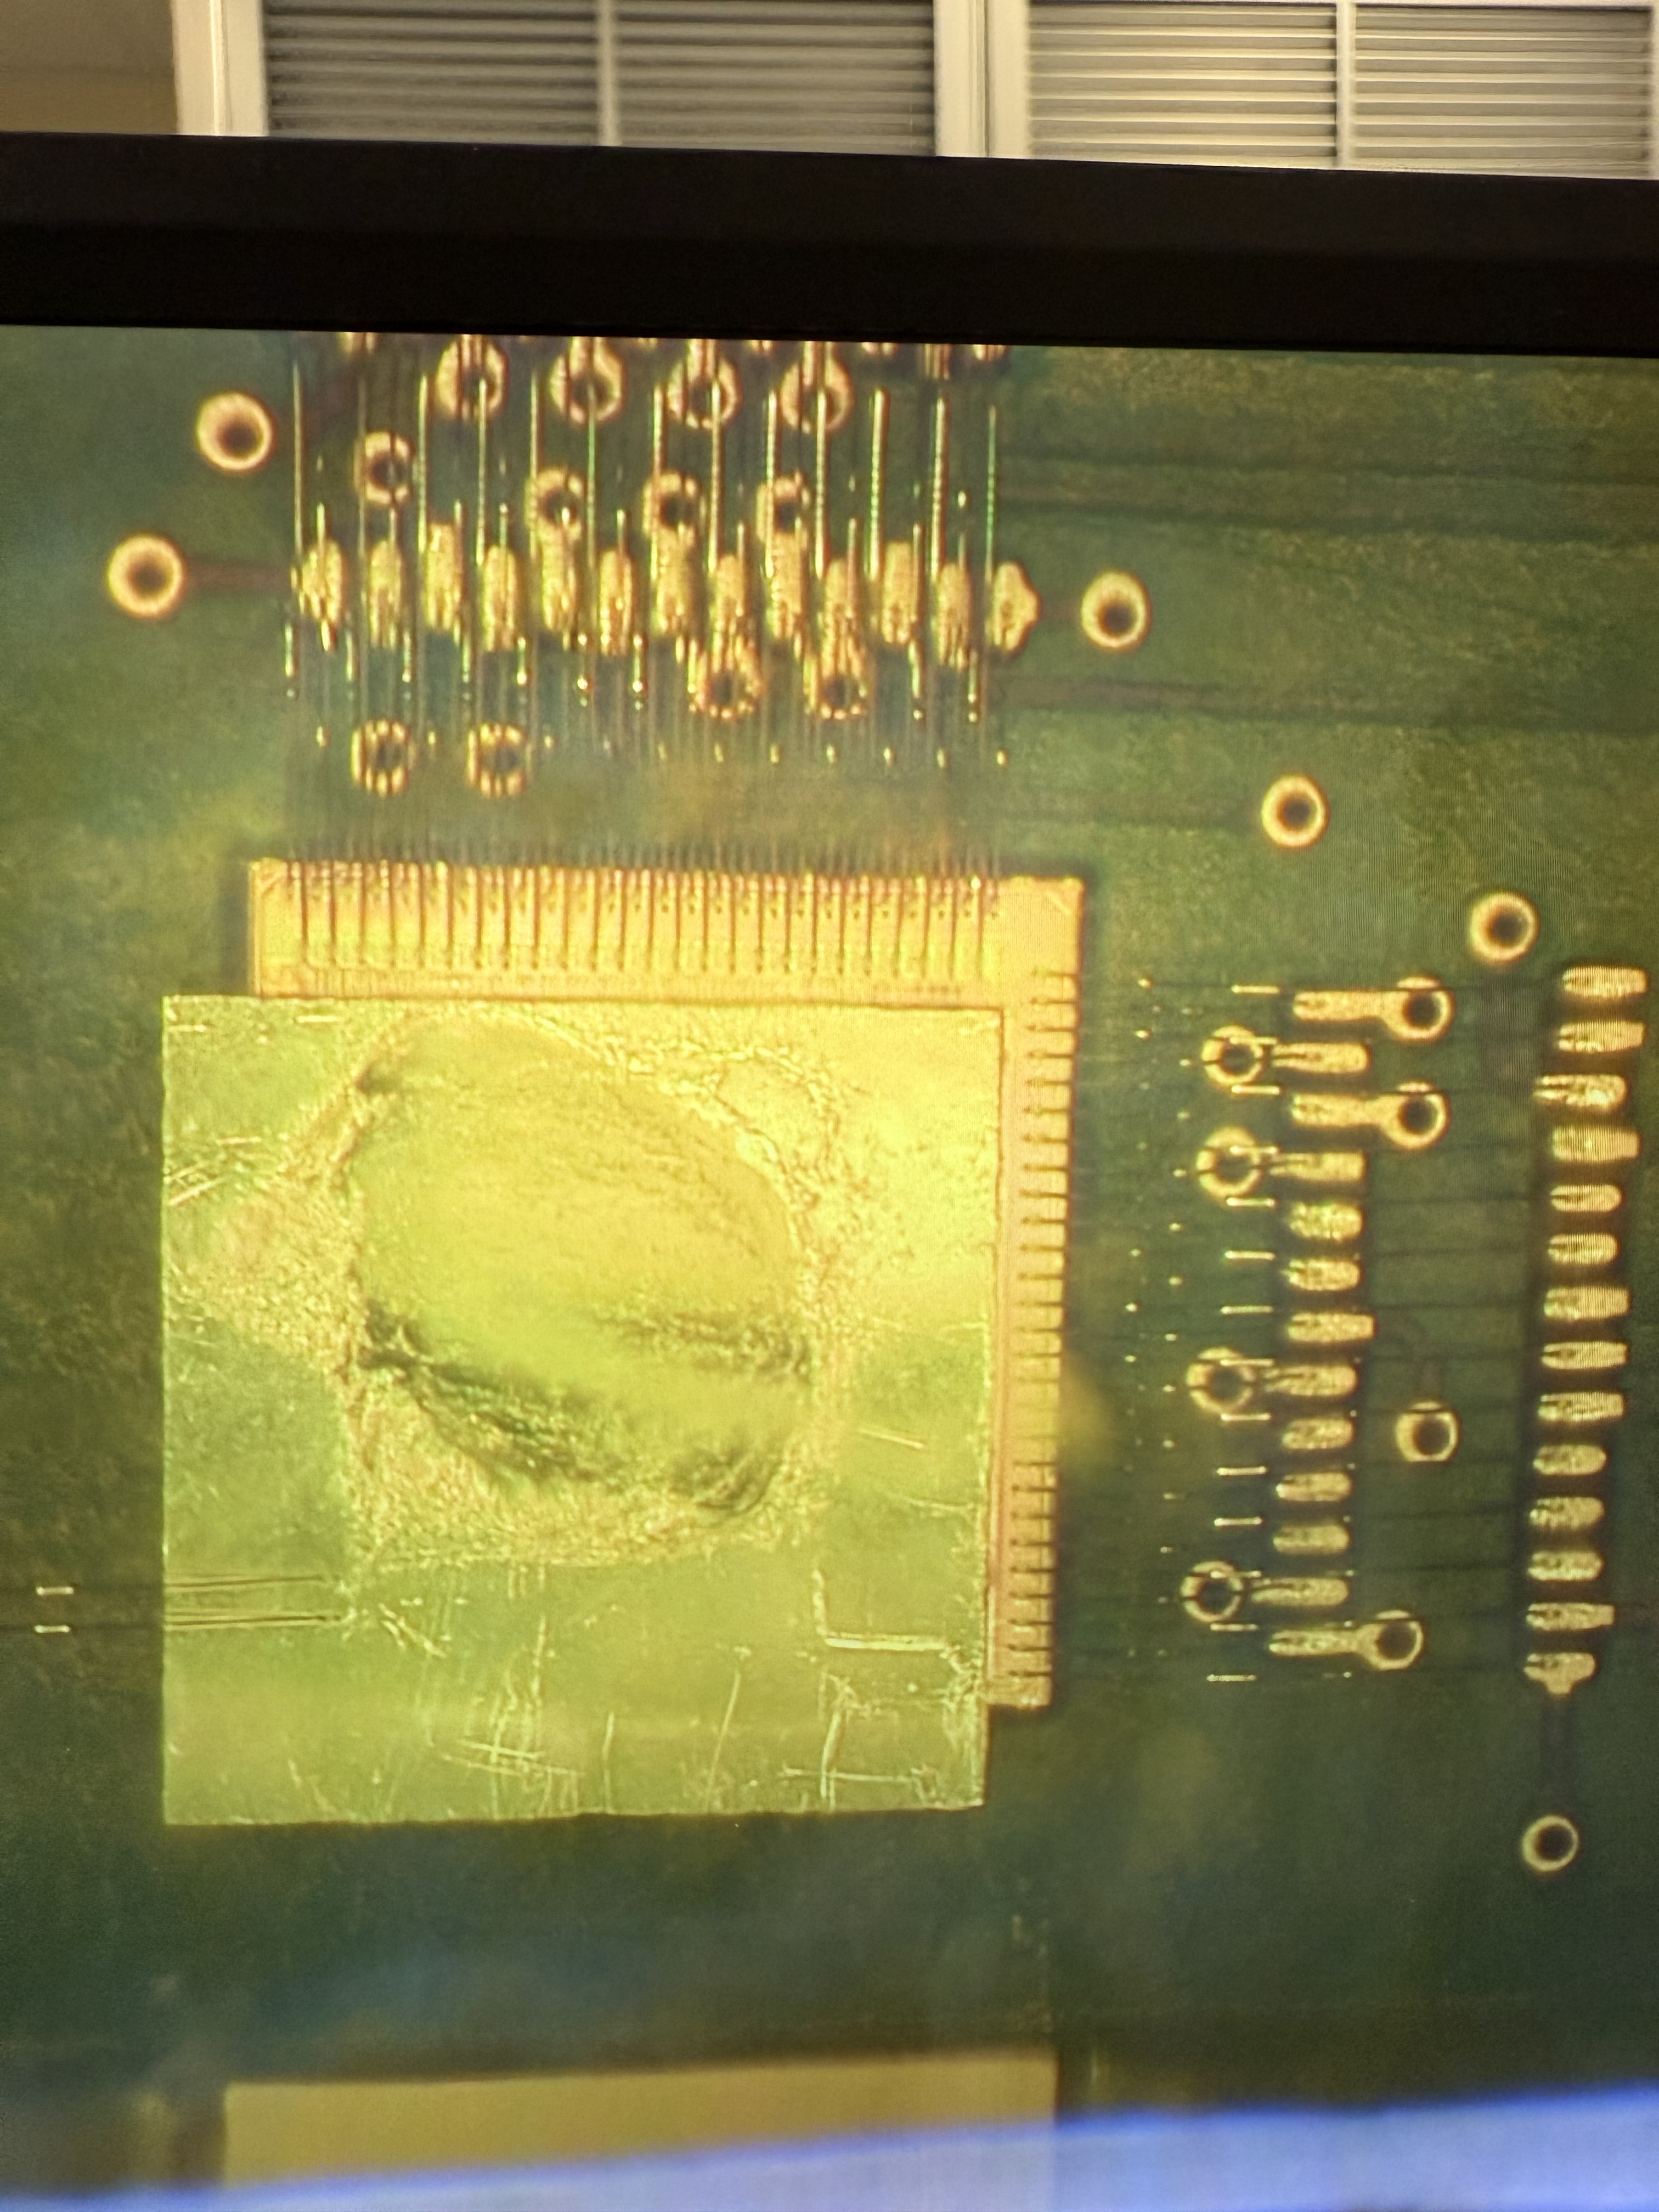
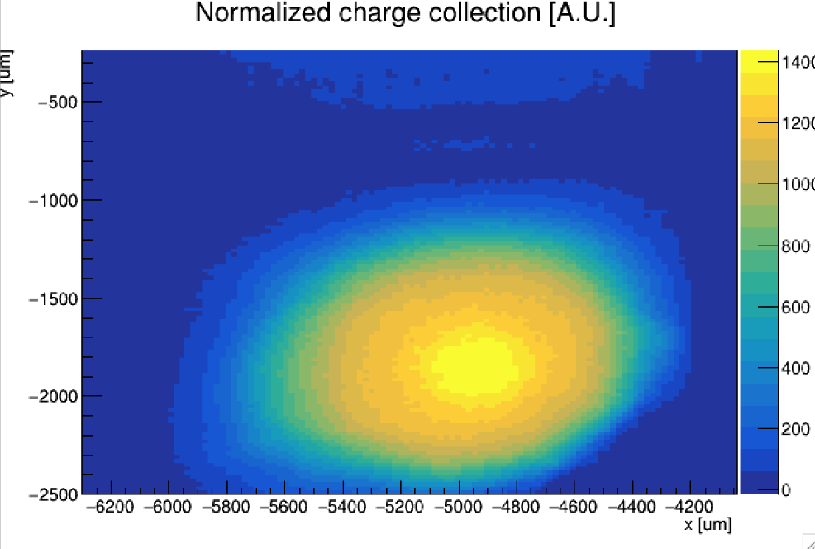
AC-LGAD Testing → AC-LGAD + EICROC0
V [mV]
V [mV]
V [mV]
t[ns]
t[ns]
t[ns]
AC-LGAD (HPK) “etched” to remove portions of the backplane which normally block incident TCT IR light from the laser in a bump-bonded assembly.
  Etching by Simone Mazza from UCSC.
TCT is useful for doing position dependent measurements (e.g for spatial resolution), and for probing uniformity of charge collection and gain.
Etched, bump-bonded assembly.

Slide 55
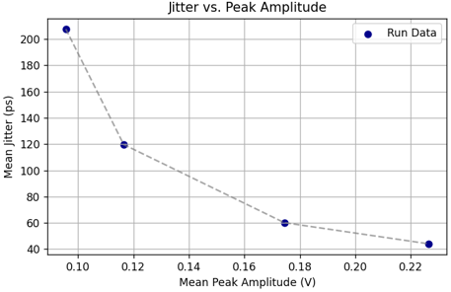
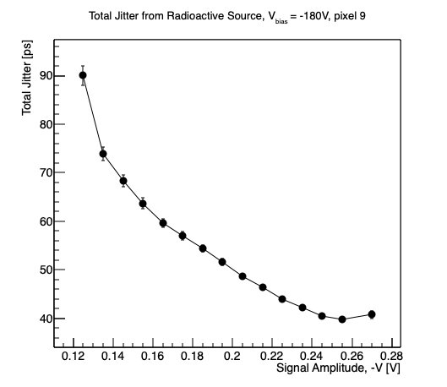
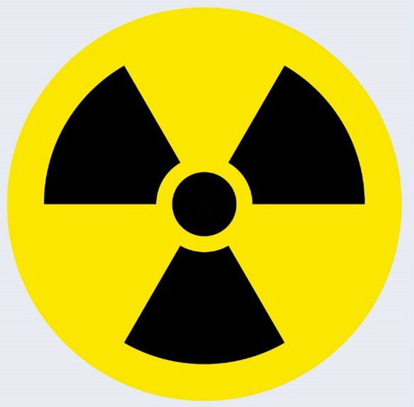
AC-LGAD Testing → AC-LGAD + EICROC0
Laser measurements (variable laser power)
Sr-90 radioactive source
Jitter measured using full bump-bonded sensor + ASIC (readout with commercial Xilinx FPGA board).
  Jitter of sensor ~ 10ps; EICROC (TDC) via charge injection ~ 10-15ps.
Total jitter (via analog output of EICROC test board) ~ 40ps – why?
  Likely from hybridization and/or non-optimal analog readout → under study.

Slide 56
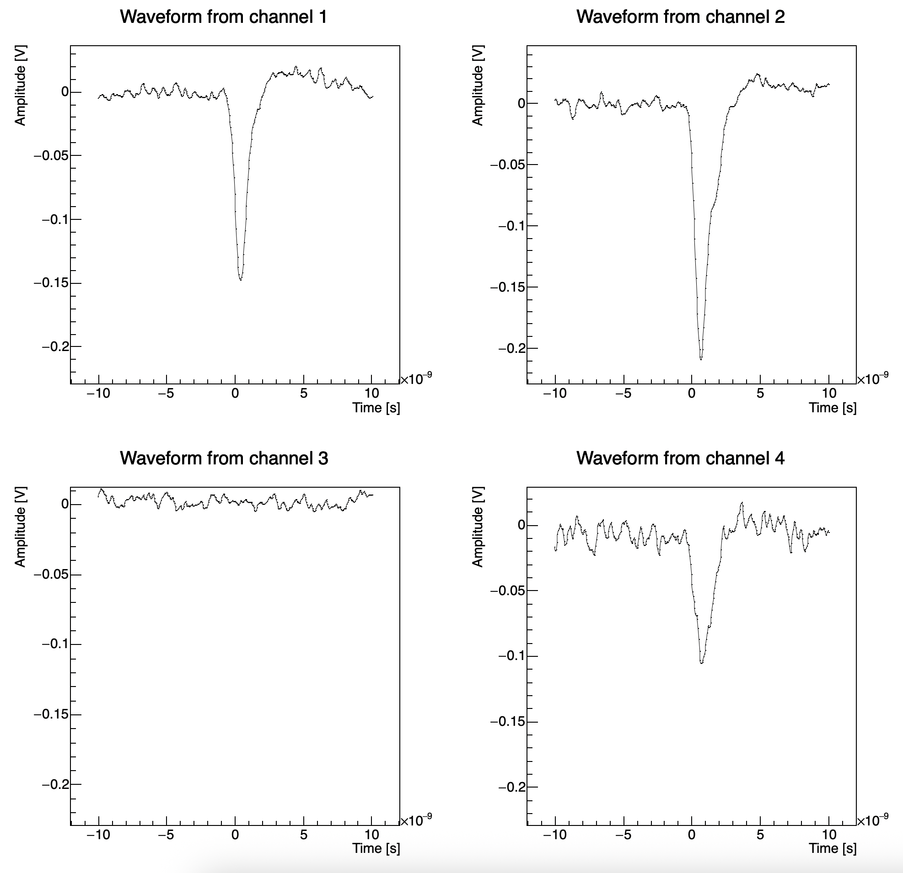
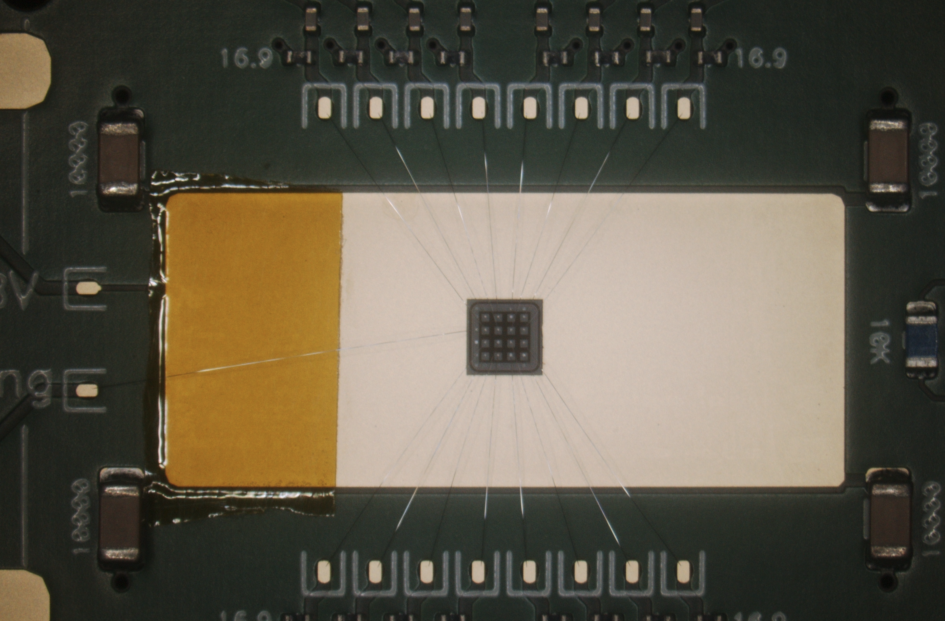
AC-LGAD Testing → AC-LGAD + Fermilab Board
AC-LGAD wire-bonded to Fermilab test board with low noise preamplifiers.
Sensor assembly placed under Sr-90 source and 4 channels readout at once.
  4 pixels in center of sensor.
Teledyne LeCroy 4-channel oscilloscope used to readout analog output from board.
  Channel 1 used as trigger with low threshold.
Goal was to measure the jitter from the pixel with maximum amplitude in each event.
56

Slide 57
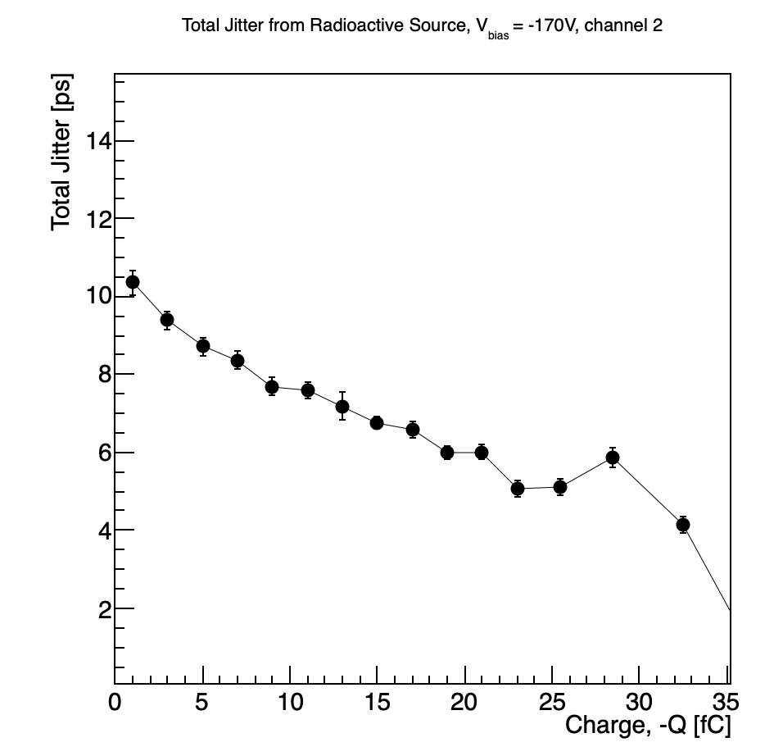
AC-LGAD Testing → AC-LGAD + Fermilab Board
Results with a single pixel taken as a baseline.
Analog signal amplitude converted to charge by integrating waveform over time over the signal region.
  Integral then divided by preamp gain (100) and preamp impedance (50 Ohms) to convert to fC.
Jitter of sensor found to be consistent with previous measurements of similar AC-LGADs.
57

Slide 58
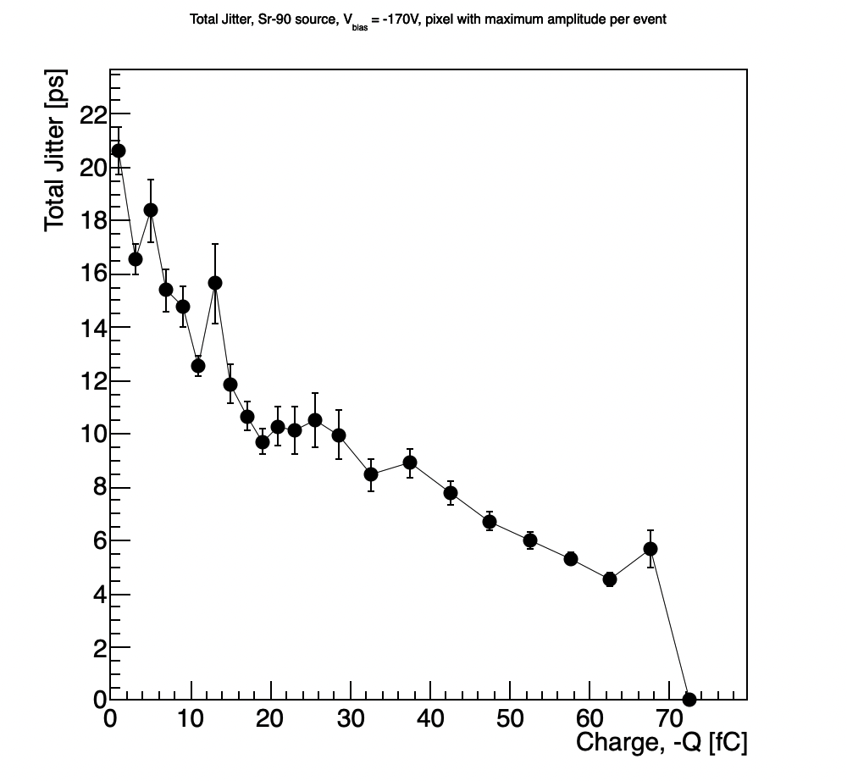
AC-LGAD Testing → AC-LGAD + Fermilab Board
Jitter calculated using multiple pixels, with a focus on the pixel with maximum amplitude from each event.
  Results also found to be consistent with previous measurements.
Jitter measured here using a 30um HPK sensor (same as the other tests) wire-bonded to a Fermilab test board with fast, low-noise preamps.
  Much lower jitter observed.
Jitter measured here by reading out 4 pixels, with one serving as a trigger with a very low threshold, and taking the pixel with the maximum amplitude in each event – those were then used to calculate jitter as a function of charge.
  Waveform time-integrated, and then divided by preamp gain (100) and impedance (50 Ohms)
58

Slide 59
Overall testing plans for AC-LGADs @ BNL
Sensor and ASIC testing between TOF/auxiliary subsystems leverages workforce from all groups.
  Example (currently happening):
    HPK sensors characterized (IV curves) at UCSC (and potentially UIC),
    shipped to BNL for testing with EICROC + laser/sources,
    RBv1 developed by Rice, then sent to BNL (arrived in Dec. 2025),
    sensor/ASIC integration tested at BNL with FPGA; Rbv1 setup tested in parallel (in-progress; see discussion by Tonko),
    when EICROC1 received (Feb./March 2026), integration with RBv1 tested,
    all groups use results for e.g. test beam planning at SPS.
QA needs for sensors/modules for pixilated systems understood (for common items).
  Sensors, ASICs, readout, hybridization, etc.

Slide 60
Some comments on needs for testbeam(s)
Current testbeam setups use sensors + analog boards w/ preamps, which are then read out by external digitizers.
Work needs to be done to test large pixel sensors to assess performance (some may be done in March testbeam, but need to solidify goals).
We have put in a request for SPS test beam → closer to real-life EIC beams (hadrons at high energy).
  Primary goal is to test AC-LGADs w/ ASICs to assess current full-chain performance (for example, EICROC1 + 32x32 HPK AC-LGADs + RBv1 FEB).
  This is ambitious to say the least → sensor performance goals still not met from other campaigns can still be achieved with this testbeam.
    Testing with 4x4 sensors + EICROC0?
  What other goals should we aim to achieve here?
Future (~ 2 weeks) AC-LGAD cross-cutting meeting will discuss goals, needed resources, institutional support, etc. to assure a successful SPS campaign (assuming SPS approves the beam time; still waiting to hear from them).

Slide 61
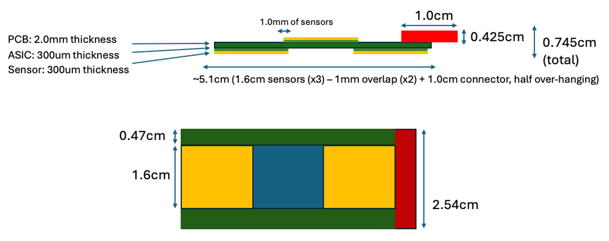
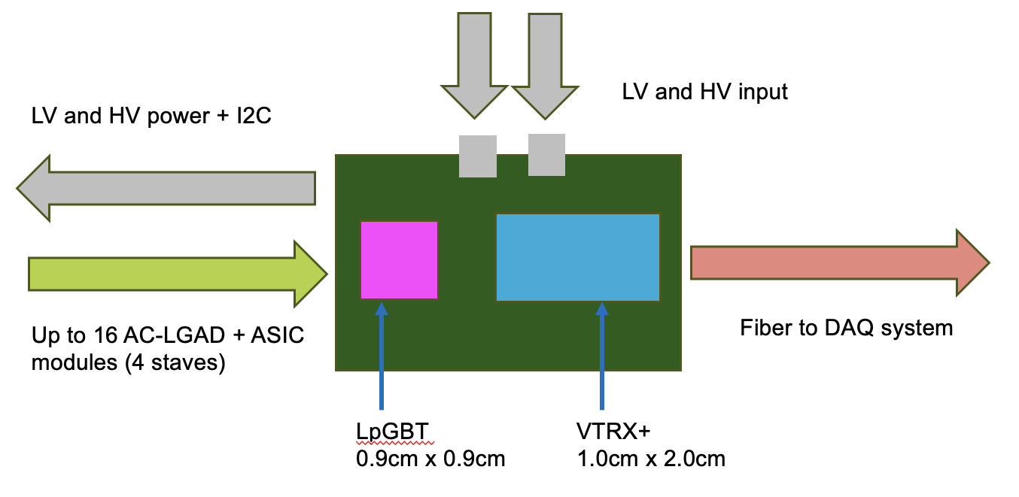
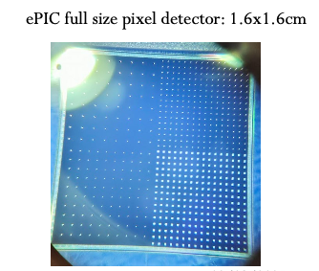
Implementation of AC-LGADs for FF Tracking
Readout needs to be separated from sensor/ASIC board to obey physical constraints for far-forward subsystems.
*Stave dimensions will be updated once EICROC1 schematic is in-hand.
Far-forward sensor “staves”
  (3) 1.6cm x 1.6cm AC-LGADs with 500um pixel pitch
  bump-bonded to EICROC1/2 ASICs
  staggered on a two-sided PCB to provide full active-area coverage.
  These sensors have 32x32 channels, matching the EICROC1/2.
    Currently have 32x32 channel sensors from HPK which are under test.

Slide 62
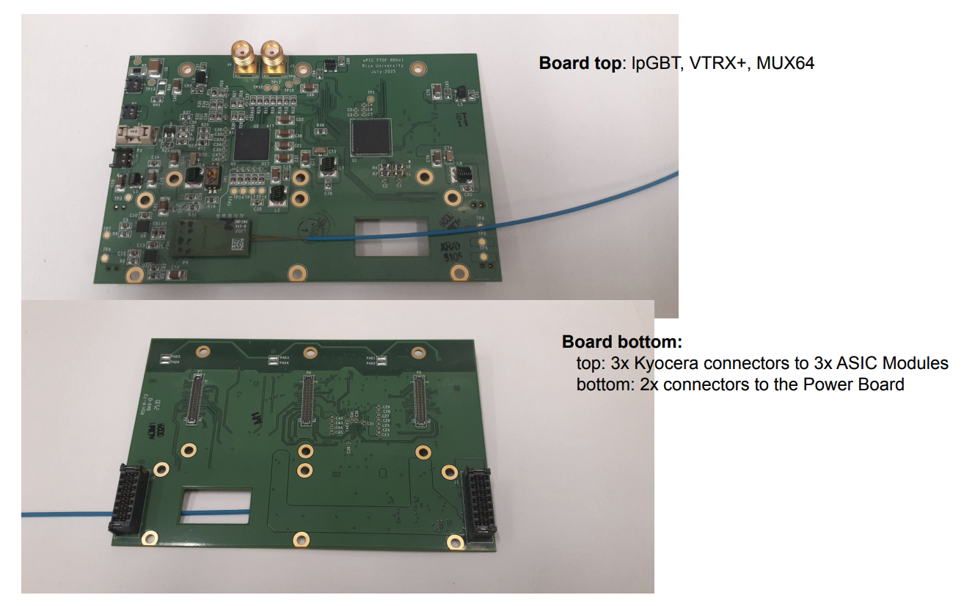
Implementation of AC-LGADs for FF Tracking
Tonko Ljubicic (Rice Univ.)
*Stave dimensions will be updated once EICROC1 schematic is in-hand.
Far-forward sensor “staves”
  (3) 1.6cm x 1.6cm AC-LGADs with 500um pixel pitch
  bump-bonded to EICROC1/2 ASICs
  staggered on a two-sided PCB to provide full active-area coverage.
  These sensors have 32x32 channels, matching the EICROC1/2.
    Currently have 32x32 channel sensors from HPK which are under test.
Strong synergy with TOF: front-end + power board will be the same as FTOF.
  Only difference is sensor stave/module, and the separation of the FEB for flexibility for FF detector needs.
Presently optimizing choice of readout board “flavor” which works best for auxiliary detector needs.

Slide 63
Broad timeline of AC-LGAD activities (non-exhaustive)
Action Item | Current Status | Dates (expected completion) | Notes
4x4 BNL and HPK sensors tested at Fermilab | Complete | 2020 to Summer 2022 | Established timing resolution ~ 20ps and spatial resolution ~ 20um (7x better than normal for pixel pitch due to charge sharing)
EICROC0 testing with charge injection | Mostly complete (jitter still under study) | Summer 2023 to now (Feb. 2026) | Tested analog and digital output, measured jitter, tested linearity of ADC Firmware does not support external trigger; will be updated to enable this with EICROC1
4x4 sensor testing with EICROC0 | Mostly complete (jitter still under study) | Summer 2023 to now (Feb. 2026) | Testing has been done with AC-LGADs wirebonded to EICROC0 – noise unacceptably high. Now using bump-bonded assemblies. Tested with TCT and Sr-90 source. Jitter from individual components small (10-15ps) – total jitter from analog output of EICROC0 testboard with AC-LGADs bump-bonded high – under study now.
Testing of full-size 32x32 channel HPK sensors | In-progress | Summer 2025 to now (Summer 2026) | IV curves measured and breakdown voltages identified; production yield > 90%; first test beam @ DESY in December 2025; hope for test beam @ SPS in Summer 2026; Lab testing underway (laser, source)
RBv1 setup and initial tests | In-progress | Summer 2025 to now (Spring 2026) | Work done to validate setup at Rice; setup being established at BNL to test EICROC1 with two different readouts after receipt of ASIC
Testing of EICROC1 | Not started | March 2026 to Fall 2026 | Will test with FPGA setup as done with EICROC0; aim is to test with RBv1 (lpGBT-based readout) as soon as EICROC1 is received.
Full-chain tests (32x32 sensor with EICROC1 and RBv1) | Not started | Late Spring 2026 – TBD (end of 2026) | Goal is to have initial full chain testing done by Summer if EICROC1 testing + RBv1 setup is successful.

